Slide 1


Remote and Rural Health & Wellbeing …and beyond Meeting with Ms Jenni Minto MSP
Dr Linda Shore
Research Fellow – Rural Lab
GSA Highlands and Islands
The Glasgow School of Art

Slide 2
Meeting at Holyrood between Ms. Jenni Minto MSP and Dr Linda Shore, Rural Lab, Glasgow School of Art
29.02.2024 @ 09:45-10:30am
Draft Agenda
09:45 - 09:50am Introductions and research background and common interests
09:50 - 10:05am Overview of The future of healthcare is NOT in clinical settings (Public Health)
GP Practice & Experiences reimagined in Moray
Breathe, Eat, Sleep, Move & GROW! – a kinetic chain approach to healthcare futures and self-management of life - including case study re Moray Leisure Centre
Design Your Menopause Life – a case study exemplifying holistic health management introduction and rationale
10:05 - 10:20am Design Your Menopause Life (DYML) (women’s health)
concept of a) Physical Immersive Event and b) Developing a Digital Holistic Health Tool
10:20 - 10:30am Wrap up discussion and next steps

Slide 3
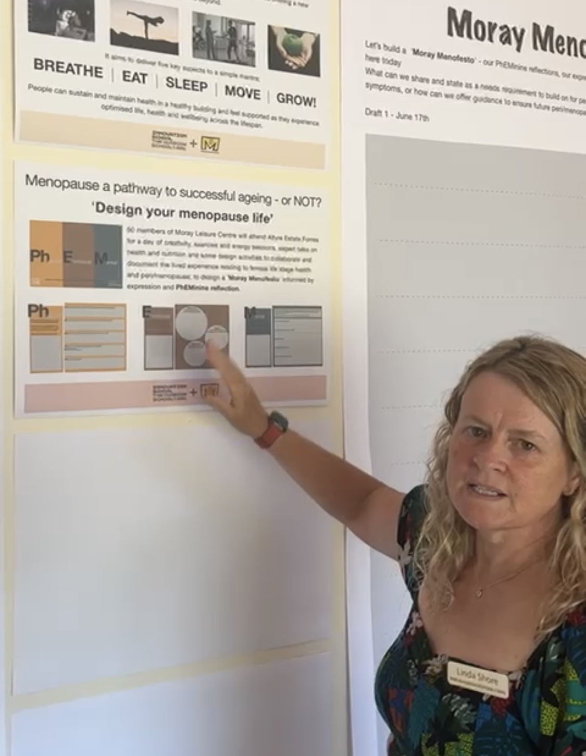
Dr Linda Shore is a UX (User eXperience) designer/researcher, specialising in methodologies and approaches in research, lifespan and health design, design tools to optimise the lived experience and interactions with emerging technologies and speculative/futures design.
She has published and disseminated her research, nationally and internationally.
Notes:
5 mins

Slide 4

Healthcare, Education & Economy
“Globally, there are inequalities in levels of physical activity between women and men, girls and boys, old and young, and the socio-economically advantaged and disadvantaged – this is unfair and unjust”
WHO, 2022
*Nearly half of new **NCD cases (47%) will result from hypertension
43% will result from depression
*Physical inactivity costs health systems US$ 27 billion a year and by 2030, US$ 300 billion.
– if we do nothing
WHO, 2022
*Global stats
**Noncommunicable diseases (NCDs) – heart disease, cancer, chronic respiratory disease, diabetes
Notes:
heart disease, cancer, chronic respiratory disease, and diabetes

Slide 5
Notes:
15 minutes

Slide 6
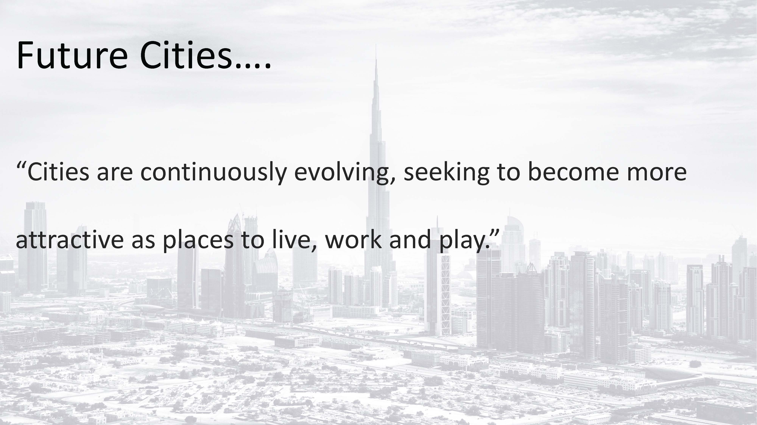

Slide 7

GP Practice & experiences reimagined in Moray
GPs and Primary Care in Moray through Moray Health & Social Care partnership and GP vision/groups (clinical and medicalised setting).
Currently planning some research and innovation work funded by Moray Health & Social Care Partnership as we reimagine GP primary care & user experience (UX) in a remote/rural setting.

Slide 9
Notes:
15 minutes

Slide 10
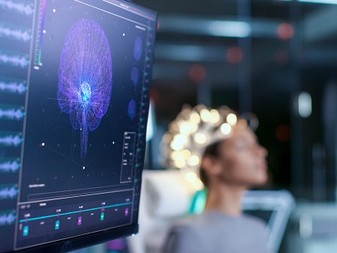

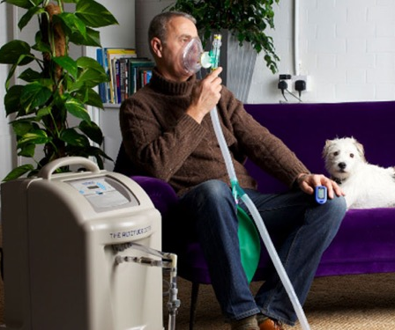
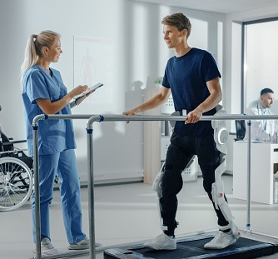
The future of healthcare is NOT in clinical settings
This programme of research is generated from the Glasgow School of Art’s Rural Lab, which is located at the Altyre Estate in Forres, Moray. The aim of this research is to ensure that quality of life and day to day life within Moray can offer optimised health and wellbeing experiences.
The ambition is that by demonstrating this successfully, it can be exemplified Nationally and Internationally.
Notes:
15 minutes

Slide 11
The future of healthcare is NOT in clinical settings
A future of healthcare beyond clinical settings conceptualises –
Breathe, Eat, Sleep, Move & GROW!
that becomes a kinetic chain of health experienced in a region at intuitive touchpoints we encounter throughout our daily life, e.g., supermarket, library, Post Office, bus stop workplace, and leisure centre.
Notes:
15 minutes

Slide 12
The future of healthcare is NOT in clinical settings
We know that none of these elements, work without the other e.g., if we don’t breathe; we die, if we don’t eat; we die...etc., hence the kinetic chain of health becomes a public health approach similar to the body and its own biomechanics and kinetic chain.
We need a whole systems innovation to optimise health management & care.

Slide 13
The future of healthcare is NOT in clinical settings
The Moray Leisure Centre is currently a traditional 20th Century Leisure Centre (MLC), I have been working with them as we future focus and envision a hub that provides more than a traditional leisure centre message.
The redeveloped MLC would incorporate the Breathe, Eat, Sleep, Move, GROW! kinetic chain approach to healthcare in the form of Labs within the footprint space.

Slide 14
The future of healthcare is NOT in clinical settings
Breathe - provision of an Altitude Lab,
Eat - inclusion of a Nutrition Lab,
Sleep - a Sleep Lab,
Move a Gait Lab.

Slide 15
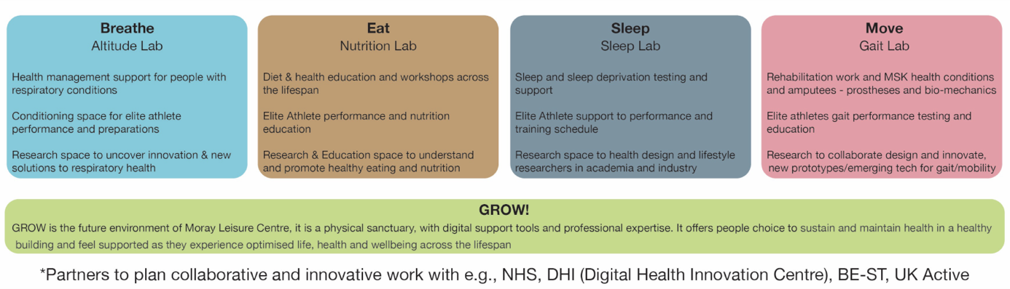
The future of healthcare is NOT in clinical settings
Citizens and people requiring health management support,
Elite athletes to prepare and train for competition
Research and knowledge exchange opportunity with industry and academic, health collaborative potential.
Leisure Centres and other spaces that cannot offer the Labs, can still hold true to the mantra and message of Breathe, Eat, Sleep, Move & GROW! through the provision of activities, events or literature and digital supports.

Slide 16
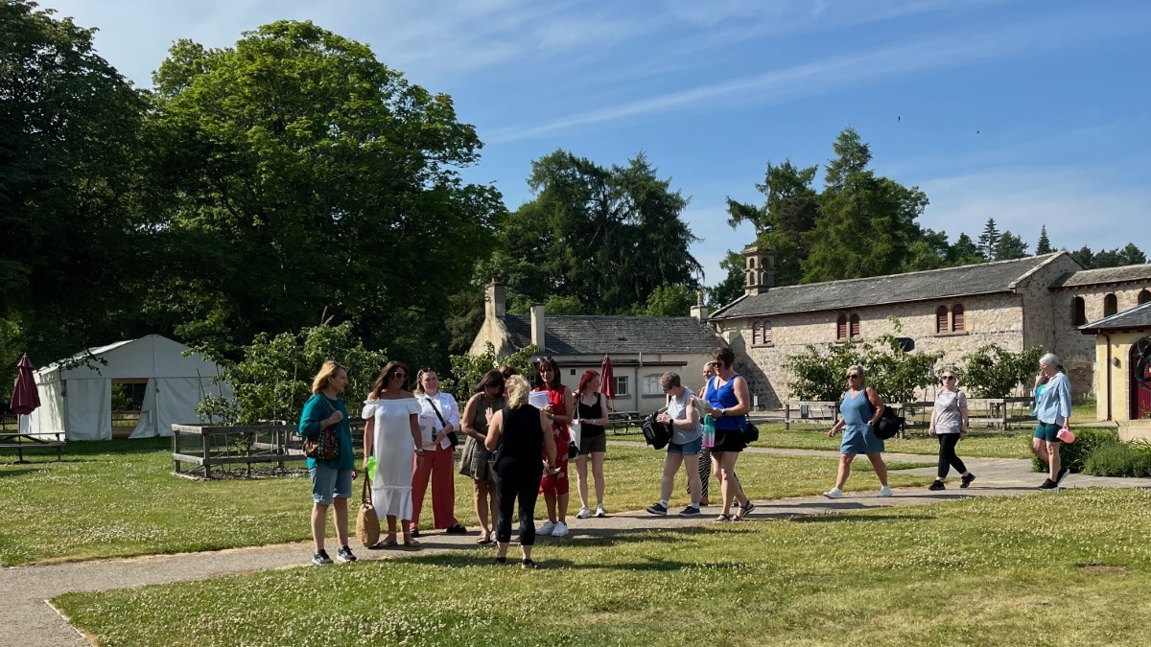
Design Your Menopause Life!
This research focusses on a time in a typical female’s lifespan whereby they are managing life, career or family responsibilities while experiencing symptoms of peri-menopause and menopause. It is well documented how exercise and health awareness can optimise and affect our health and wellbeing - our Physical, Emotional and Mental (PhEM) health can be supported through activity, exercise, social engagement, and education. The ‘Design your Menopause life’ (DYML) solution is envisioned as a digital and physical solution that empowers women as they experience peri and menopause symptoms.

Slide 17
Design Your Menopause Life!
Menopause is a life stage of uncertainty and can potentially be a challenge to successful ageing, whereby hormonal changes can impact and affect self-esteem, energy levels and motivation to exercise. As we age, exercise and training e.g., strength and weights can support muscoskeletal and physical changes – in turn helping with emotional and mental outlook and wellbeing. However, if menopause symptoms affect us emotionally, physically and mentally we may stop and become more sedentary, physically inactive which in turn impacts on our ageing experience..

Slide 18
Notes:
15 minutes

Slide 19
Design Your Menopause Life!
Design Your Menopause Life – an exemplar case study service – we know that GP practice and care has witnessed increased demand of 400% for menopause support. This research exemplifies how we can design solution that can offset some of this demand by encouraging curiosity and self-awareness as part of a journey rather than a waiting list. It is conceptualised as
1) an immersive event to attend (in person or online) for employees and or citizen groupings.
2) as a Digital Holistic Health Tool that is provided through GP Practice and engaged with by the person.

Slide 20
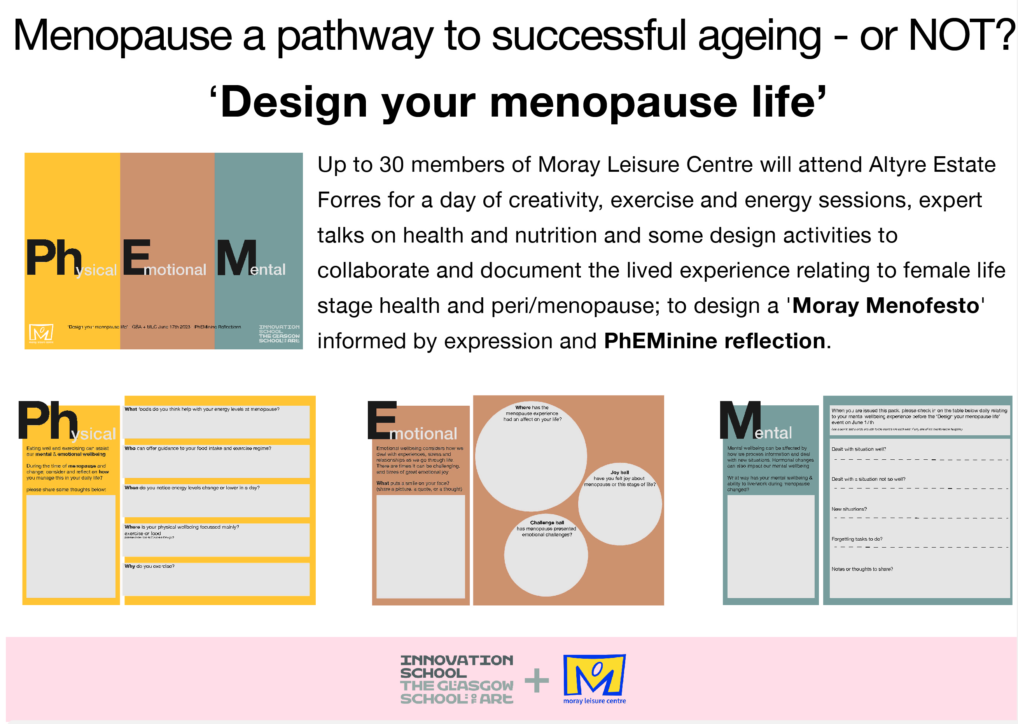
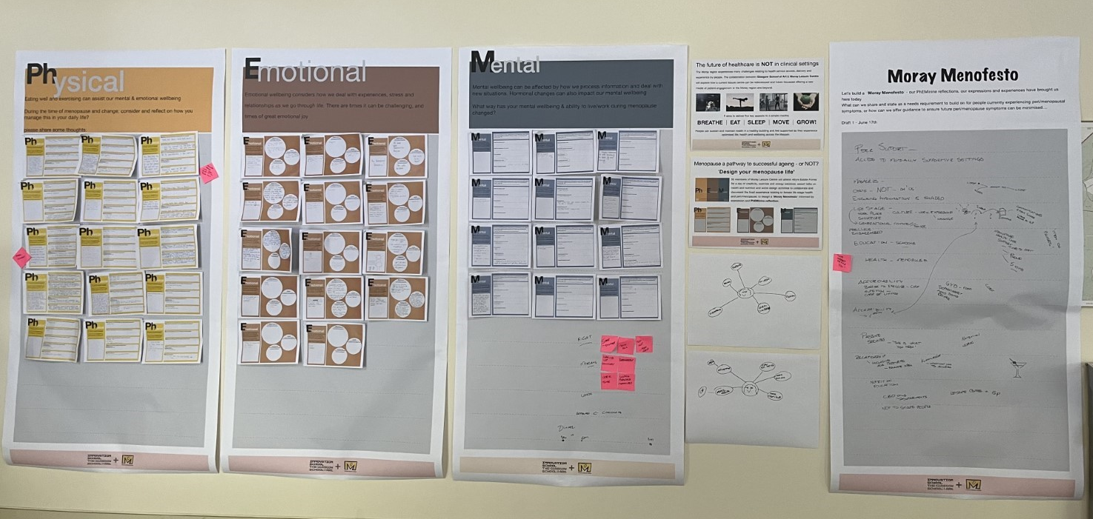
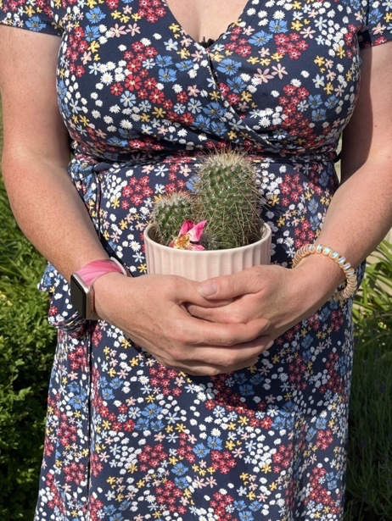
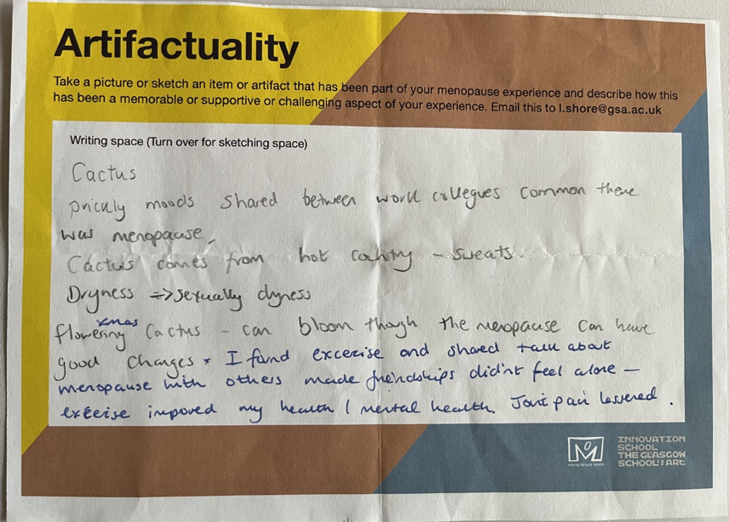
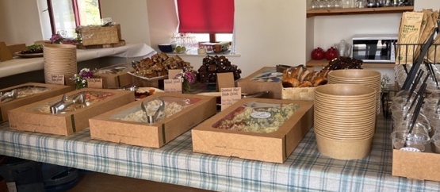

Slide 21
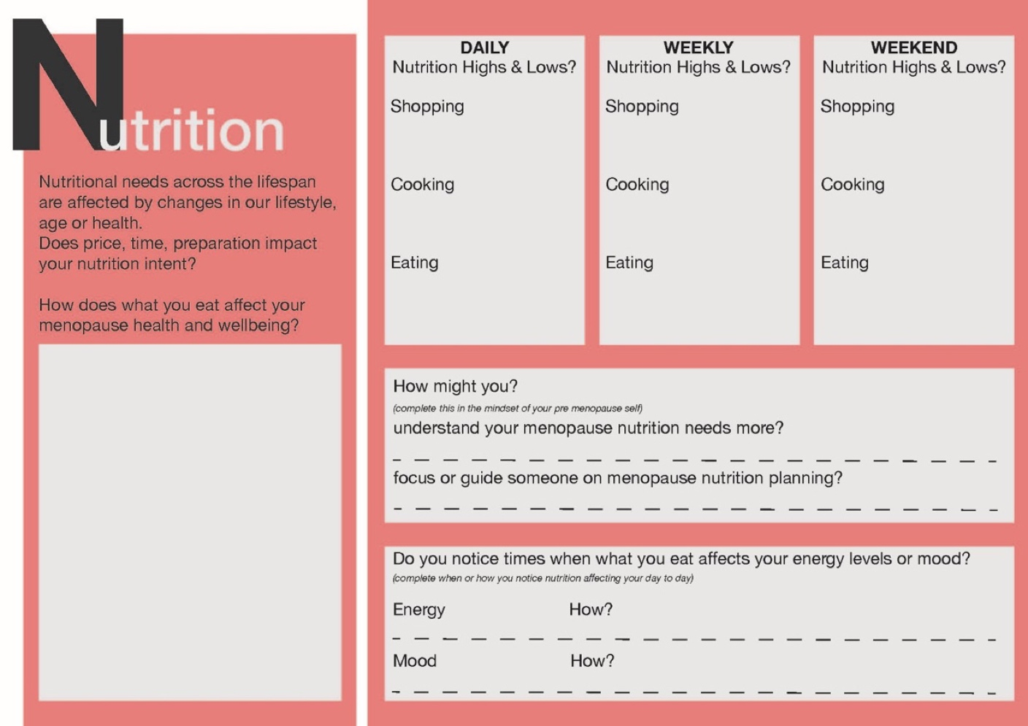
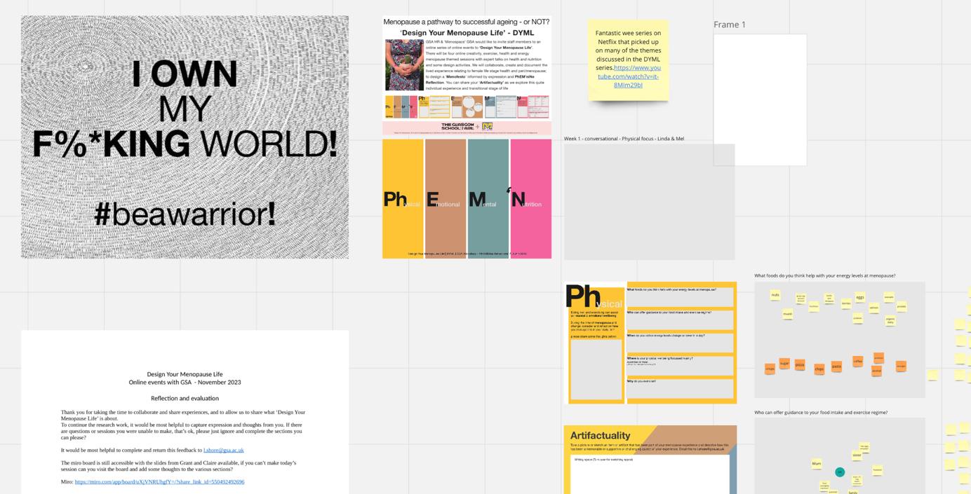

Slide 22
Design Your Menopause Life!
The Digital Holistic Health Tool once adopted can be utilised to self-diarise but also receive information as a part of the journey. It would document the story of the person and identify through AI recurring themes that once the person does attend an appointment with the menopause specialist in the practice there is a clear view of an individual’s menopause experience and provision to probe or enquire to tailoring solutions that assist e.g., HRT or lifestyle changes/planning. It identifies this through ‘PhEMiniNe Reflections’ (Ph – Physical Wellbeing, E – Emotional Wellbeing, M – Mental wellbeing, N – Nutrition wellbeing)

Slide 23
Innovation Opportunity – Digital Holistic Health Tool
This Digital Holistic Health Tool could be adapted to include other conditions that do not always require to be medicalised and can often be supported as part of a person’s healthspan and journey, e.g., low level mental health, pregnancy, pre-diabetes, post-stroke recovery, endometriosis.
By understanding over a period, how someone experiences symptoms, motivations challenges etc, we may more efficiently support recovery or direction to autonomous health management that can be supported.

Slide 24
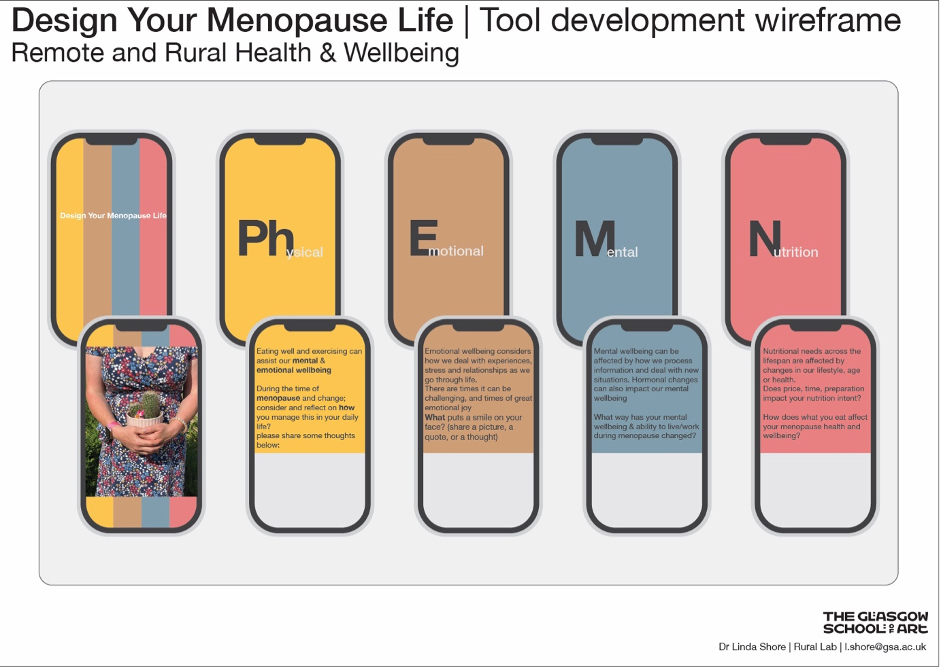

Slide 25
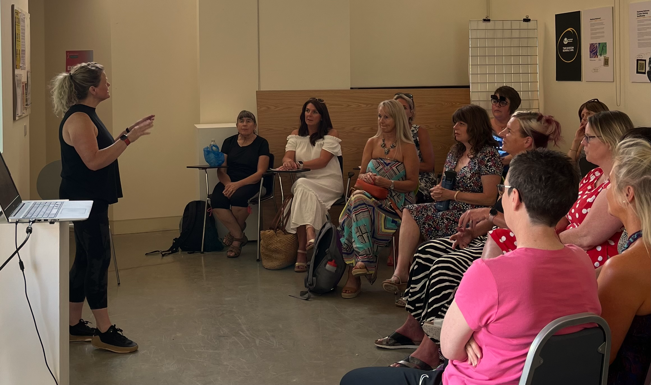
Menopause - a pathway to successful ageing (or not) Menopause is a life stage of uncertainty and can potentially be a challenge to successful ageing, whereby hormonal changes can impact and affect self-esteem, energy levels and motivation to exercise As we age, exercise and training e.g., strength and weights can support muscoskeletal and physical changes – in turn helping with emotional and mental outlook and wellbeing. However, if menopause symptoms affect us emotionally, physically and mentally we may stop and become more sedentary, physically inactive which in turn impacts on our ageing experience. “I was delighted to hear about this initiative in Moray and surprised it is not used anywhere else. I have taken elements of this to introduce to my fitness to improve fitness and wellbeing; Can we see more of this in other areas of Scotland?” [online event attendee]

Slide 26
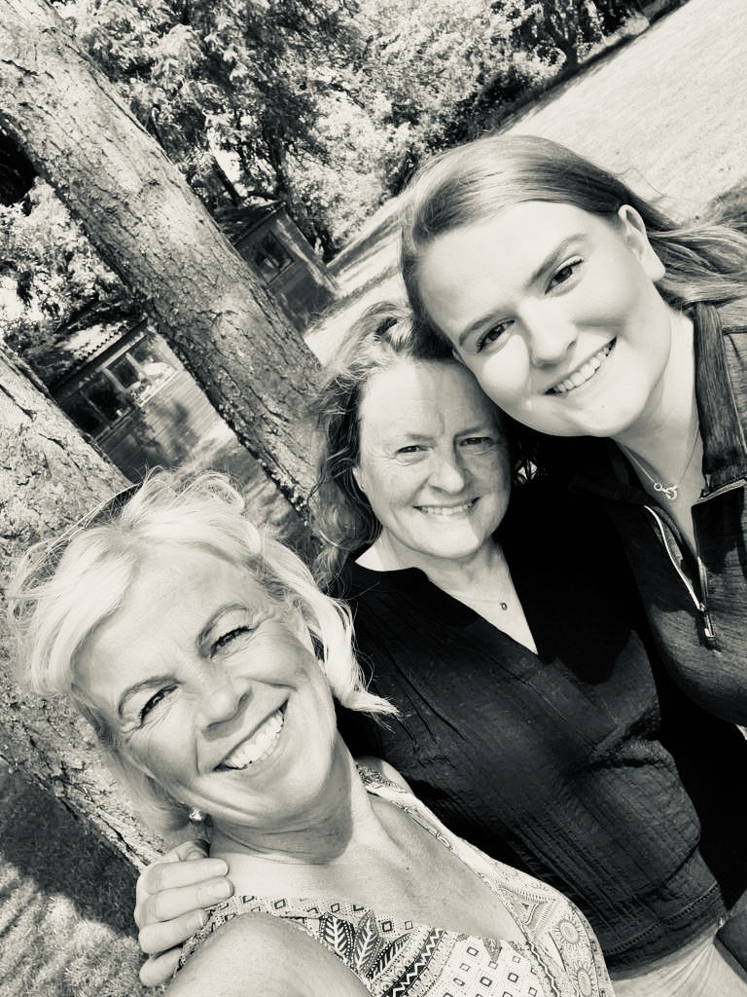
Thank You
Upcoming publications:
'Design Your Menopause Life' as a Pathway to Successful Ageing (due to be presented at DRS 24 in Boston, USA)
Breathe, Eat, Sleep, Move & GROW! – a kinetic chain approach to designing for healthcare futures.
Dr Linda Shore
Research Fellow – Rural Lab
GSA Highlands and Islands
The Glasgow School of Art
Notes:
5 mins

