Slide 1

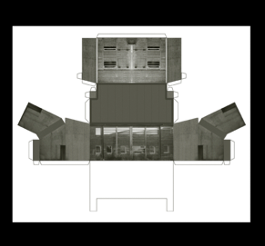
Pollphail
A short documentary film made about my practice and involvement with Pollphail, a derelict village in Argyll, Scotland.
Submitted by Mick McGraw
Output No. 3

Slide 2
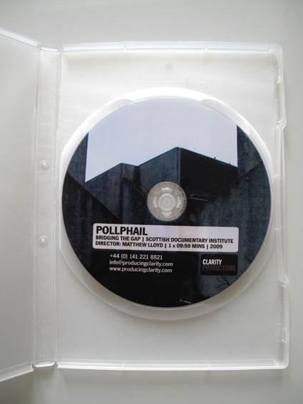
Image one POLLPHAIL, 10 minute long documentary film, this is the main part of Submission No.3 (DVD included in box file for viewing).

Slide 3

Pollphail
The output in evidence here is primarily a short documentary film and the dissemination will focus mainly on the film screenings, both nationally and internationally. The documentary film would not exist without the research and artworks which led up to the making of the film so I feel it is important to reference this work and how it led to the film being made. The project has been ongoing in various guises for 20 years and throughout this presentation I will reference a number of key works (both my own and by other influential practitioners) which have shaped the methodology of how I perceive, develop and construct my ideas.
Pollphail Village is a derelict (soon to be demolished) development on the shore of Loch Fyne in Scotland. It was built in the mid-1970’s to house workers at a newly built concrete oil platform fabrication yard at Portavadie. With the boom in North Sea oil at the time, the government wanted to transfer some of the money to the West coast to boost job numbers and bring down unemployment. Unfortunately the construction yard never received any orders and the village never housed a single worker, being left to return to nature over the past 35 years.
I have made and exhibited a body of work over the years based on this site with the most recent works being shown at Glasgow Print Studio. I was approached by film-maker Matt Lloyd in 2009 after he discovered I was involved with making work about the site. Matt directed the short film (Submission NO.3) based on my work and my views on the future of the place alongside, or in opposition to, the intentions of the site’s owner, a property developer.
I feel I should point out that I work across a range of media and projects at any given time. As a consequence the works may not look linked or even similar in appearance and I am aware this may confuse your viewing and evaluation. I apologise if this makes the research and methodology appear disjointed. I should assure you that this is not the case and is completely intentional with the works taking on the appearance of the most relevant method of production at that particular time. I hope this may explain the relevance of the following images and their importance to the evolution of this submission.
No.3
Mick McGraw

Slide 4
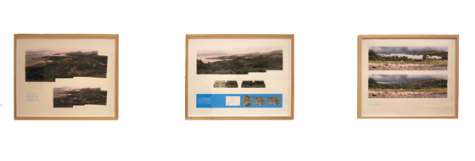
Image two Three lithographs of work based on the Pollphail site, shown as background support for the main output.

Slide 5

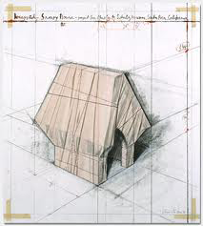
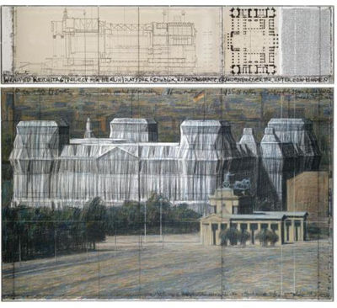
Much of my work explores our relationship to land use and its infrastructure; how history has and continues to shape and inform our understanding and evolution of land use, from ancient roads and routes, industry, agriculture, engineering, technology, ecology and warfare.
My research aims to question the decisions made around land development in rural areas and investigate the implications this has on those who interact with these places, both permanently or transiently.
I first came across this site on the shores of Loch Fyne in Argyll in 1993 when I was studying for my Masters degree. I was completely intrigued to find what looked like a typical 1970’s local authority housing scheme in a completely isolated rural location. The sharp contrast between the environment and the starkness of the concrete whitewashed and wood clad buildings led me to return to begin a documentation process where I was developing a number of ideas based around the sense of loss, isolation and longing. I was, and continue to be very much influenced by a range of other artists whose work looks at site specificity and interventions within the landscape, such as image one, Christo’s proposal drawings of wrapped buildings and structures.
Image three Christo’s drawings for proposed works, shown as a main influence to my own practice.

Slide 6
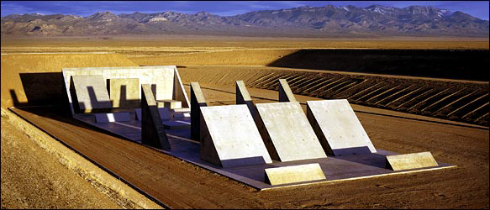
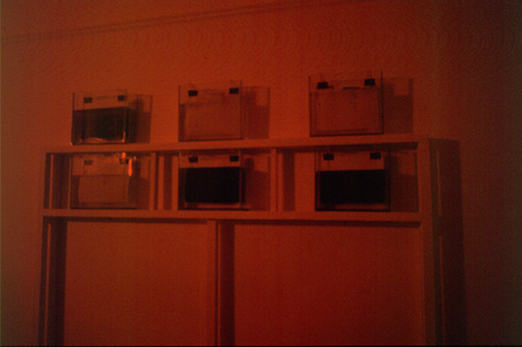
This idea of intervention in the landscape has been informed through my extensive research into Land Art. Michael Heizer’s Complex City (image two) makes an enormous bunker-like structure in the desert of Nevada. What is most interesting about this work is that it cannot be seen from the surrounding landscape, it is built in an excavated depression to protect its identity. I had this notion that Pollphail Village was the same. It was a white elephant, built at enormous financial cost but a bit of an a embarrassment. The owners always hoped someone would do something with it but no-one ever came forward due to its isolated location and poor single-track infrastructure. One of the earliest works I made with this idea in mind was a photographic installation (situated in a darkroom) where images of the buildings were developed live in front of the viewer over a 24 hour period. If you saw then early in the morning there would be very little trace of image but if you returned later in the day, the image would be much more visible. On the next day of the exhibition, the previous day’s photographs were “un-developed”, they were placed in tanks of bleach solution which dissolved the previous days images. The idea was that there would be no record of the place after the second day, it continued to emerge then disappear over the duration of the exhibition, (image five).
Image four Michael Heizer’s Complex City, Nevada.
Image five Sample, by Mick McGraw. Time based installation of developing and dissolving images, 1993.

Slide 7
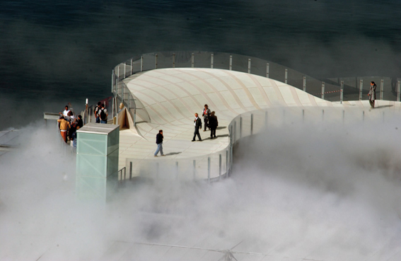
The body of work which has led to the output Pollphail encompasses many elements, from prints, photographs, architectural models and drawings. This interest in the architecture of the site led me to investigate small space architecture and temporary buildings. The spaces for living in Pollphail were small single bedrooms with built in plywood furniture, very reminiscent of prison cells or oil rig accommodation. I became interested initially in the writings of NY architects Diller & Scofidio but then became inspired by such temporary structures such as the Blur Building (image six), a structure built on the surface of a lake where the architecture was a cloud generated by atomising water droplets to make steam. This ephemeral space struck a real chord with me in relation to the temporality of Pollphail, its days have always been numbered ever since it was completed. These ideas led me to research cutting edge, almost sci-fi developments in technology through organisations like DARPA (Defense Advanced Research Projects Agency), a US government think tank who develop the most incredulous advancements in worldwide technology, usually for weaponry and defence projects (they invented the very first internet- ARPANET for the US military in the 1960’s).
Image six The Blur Building, by Diller & Scofidio
Lake Neuchatel, Switzerland, 2002.

Slide 8

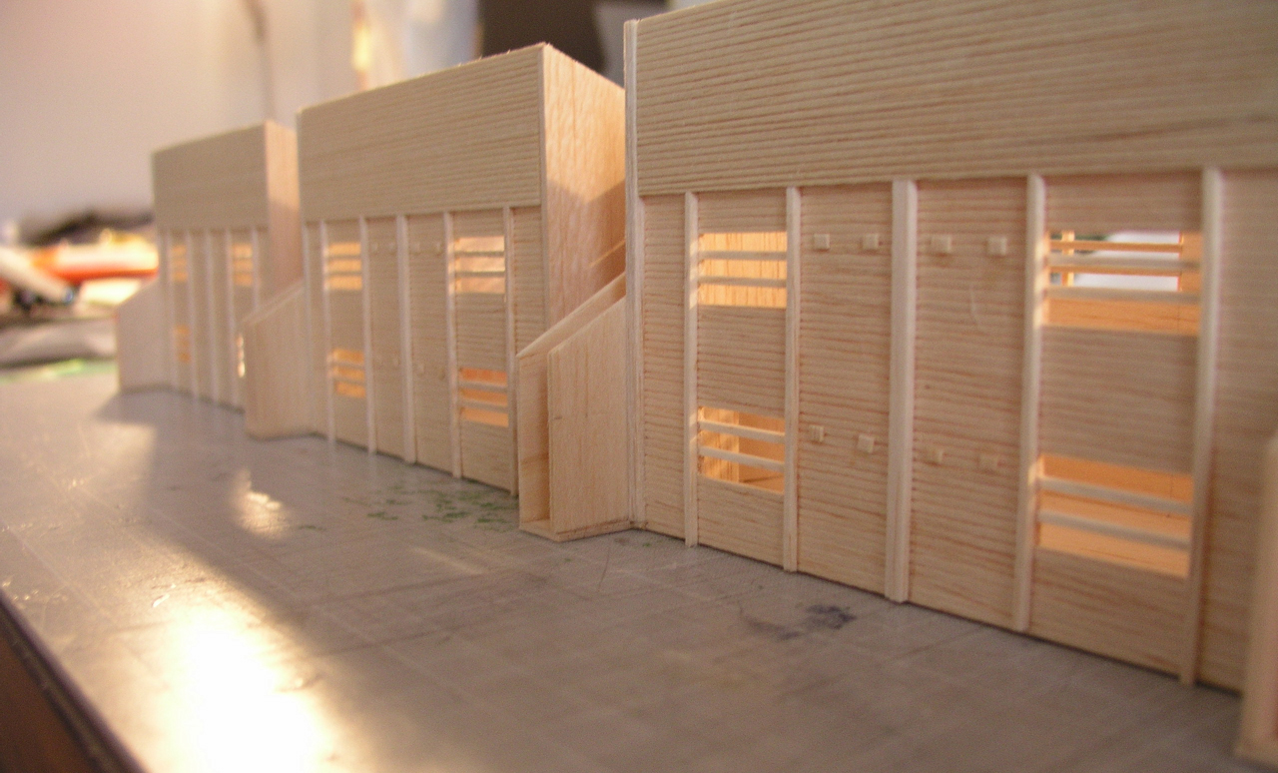
As it has transpired over time, I have visited the village of Pollphail at least once a year to continue to document the decay of the site. With the eventual disappearance of the site in mind, I embarked on making a scale model in balsa wood of the entire site as there were no records of such a model in existence at the time. (The last owner of the site subsequently had one made as his plans were to demolish the site and build a holiday resort). This required surveying the site extensively and taking many measurements and photographs to be able to construct the piece with accuracy.
As I was still pre-occupied with the preservation of the site (selfishly perhaps?), the owner put it up for sale as he could not gain permission for his plans. Demolition was started but halted after they found asbestos which meant the costs began to spiral so the demolition is now in stasis. I was still looking at the employment of technology in other works and came across some interesting research on the DARPA site. They employ “performers” from all disciplines to help them with their research projects, even consulting science fiction writers to come up with the most “out-there” ideas, DARPA then attempting to see if they can make these ideas manifest.
Image seven Pollphail architectural balsa model in the making, Mick McGraw.

Slide 9
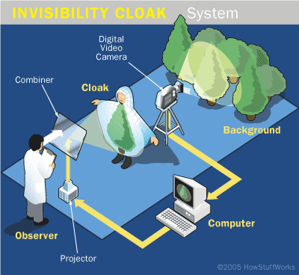
“The Defense Advanced Research Projects Agency (DARPA) was established in 1958 to prevent strategic surprise from negatively impacting U.S. national security and create strategic surprise for U.S. adversaries by maintaining the technological superiority of the U.S. military.” DARPA website
I stumbled across a defence project where they have been developing technology whereby they are making soldiers and their hardware invisible to the eye through the deployment of meta-materials linked to video capture and re-projection. This is known as an Invisibility Shield (akin to Harry Potter’s Cloak, sounded ridiculous, didn’t it?) but by wrapping surfaces in nano-technology meta-materials they take on the live image projection of what exists behind them thus rendering them invisible (see image eight). This technology has already been used to “hide” tanks in battle situations and recent developments have seen the materials allow light to bend around surfaces (what one would need to disguise a moving figure).
Image eight Invisibility cloak technology, developed by DARPA and University of St. Andrews

Slide 10
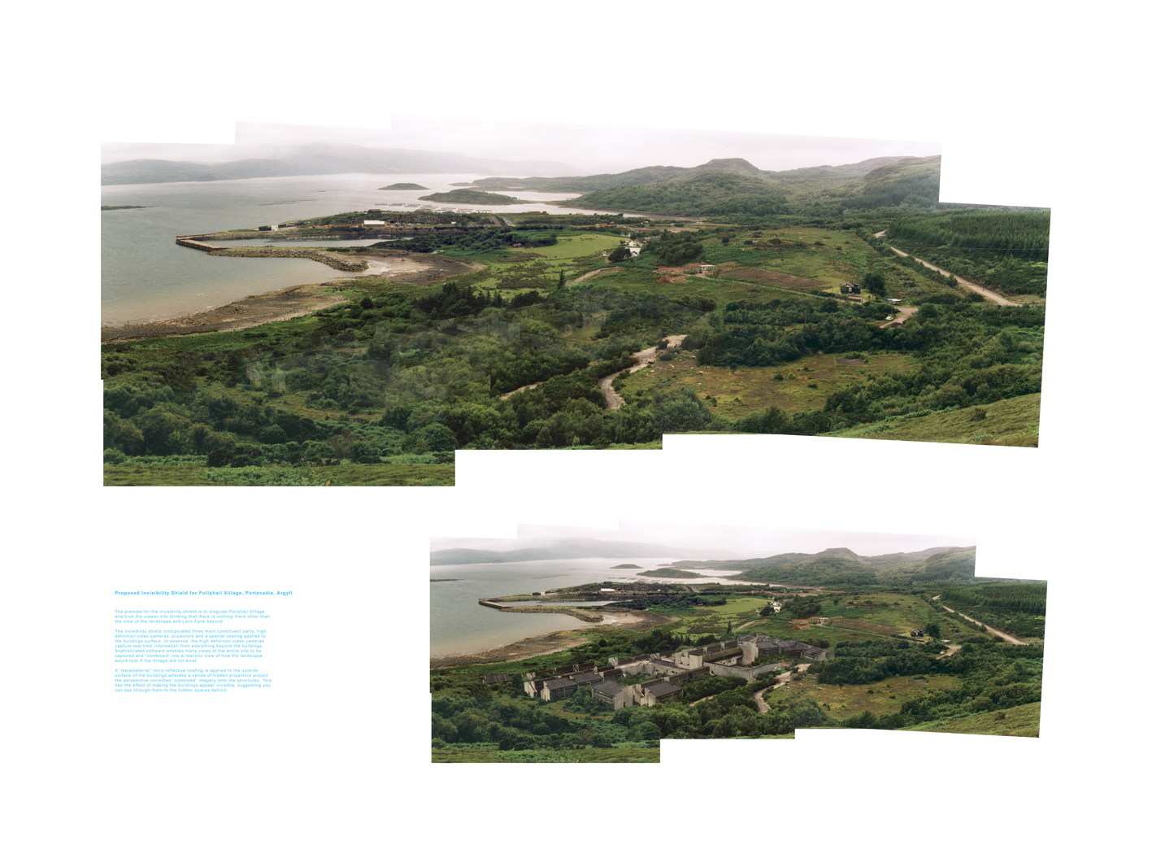
With the ideas around invisibility shields at the forefront of my research, I decided to try and see if I could emulate this technology. I experimented with Scotchlite fabric (this works in a similar type of way to the top-secret meta-material by reflecting back to the human eye the light source which is directed towards it).
The idea for the newest pieces was to design a hypothetical “proposed” work (I have another body of work addressed in another output which investigates proposals for simple alterations to how we interact with the land) but this work is quite different (as explained earlier in the submission). It suggests the employment of incredibly high-tech means to allow it to happen.
The initial stages were to take the primary source material site photographs. The stages afterwards saw the need to re-visit the site again to photograph what existed behind the structures I was trying to hide. It seems obvious now but I was constantly in a problem solving and re-negotiation of ideas scenario, where I really had no idea what the research and investigation was going to throw up next. This was a real challenge but hugely rewarding experience where I felt I really had broken some new interesting ground as far as my practice was concerned.
Image nine Proposed Invisibility Shield for Pollphail Village I, Mick McGraw

Slide 11
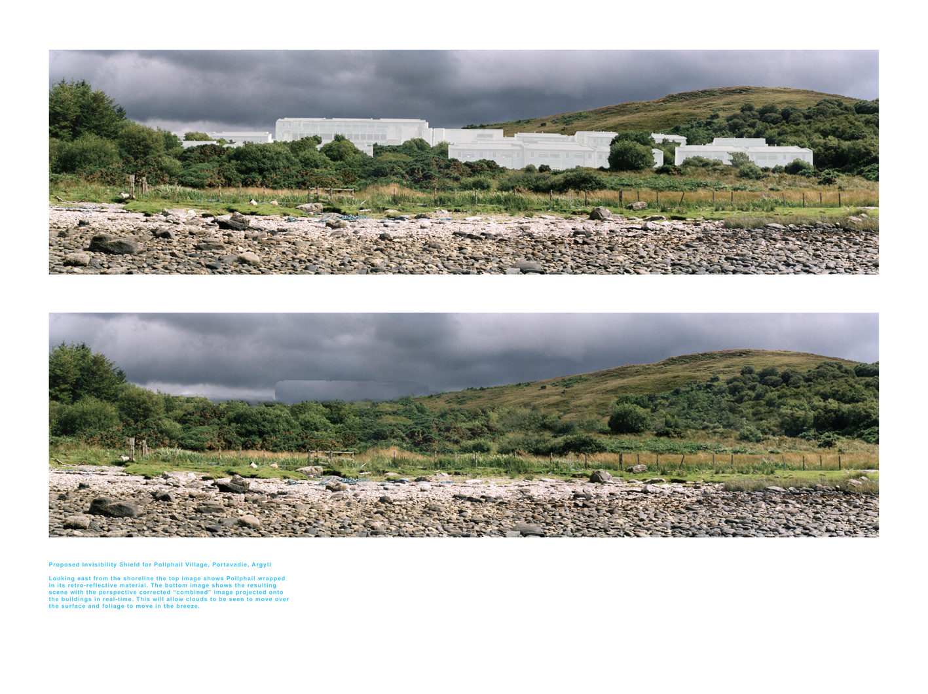
Images nine, ten and eleven show the final prints which were made from this series. They are difficult to experience if not seen in real life but they attempt to show the before and after of the Village. Image ten attempts to show the buildings visible form the shoreline, wrapped in their meta-material fabric (the semi translucent grey wrap). The image beneath in image ten might suggest the invisibility shield in action. This relied on me having to go behind the buildings, attempt to work out the possible angles of viewpoint at given locations and photograph the scene from behind the structure. For example, I had to photograph the scenes from the shoreline, then go up the hill behind the buildings and photograph the sky in the distance. This image of the sky was then superimposed on top of the corresponding image to give the suggestion the sky was in front of the structure.
The resulting printed works have a short piece of text outlining the process and intention behind the works, to obscure the buildings from the outside viewer, to hide them so they remain protected.
Image ten Proposed Invisibility Shield for Pollphail Village II, Mick McGraw

Slide 12
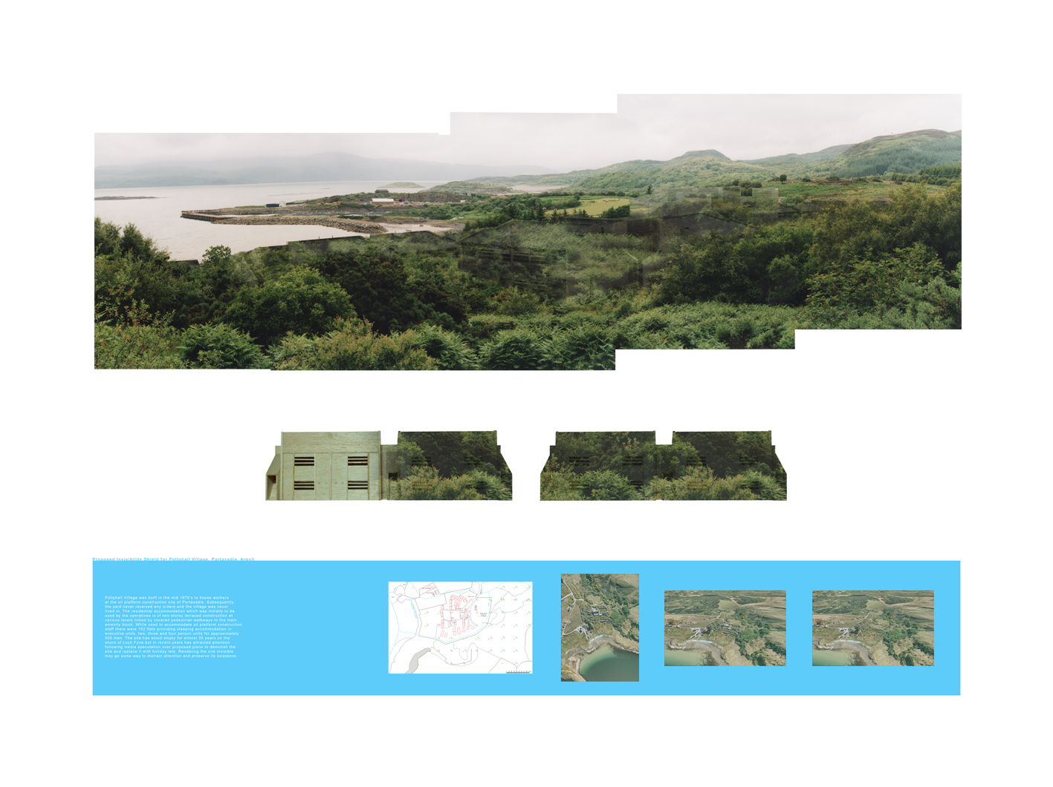
In 2009 I was approached by Matt Lloyd, an independent filmmaker who had been told about my practice and interest in this site. After meeting with Matt and discussing the project, he managed to secure some funding to be able to make a short 10 minute documentary film about Pollphail and my involvement with it. The film documents my work (the architectural model and printed matter) with an interview with myself and the site’s then owner, Alan Bradley. It is intertwined with news footage from the projects inception in the 1970’s and the opposing dialogue between myself and my intentions for the site and the owners desire to demolish and build holiday homes.
The film was supported by Scottish Screen and Clarity Productions and has been shown extensively across the UK, Europe, USA and the Far East.
Image eleven Proposed Invisibility Shield for Pollphail Village III, Mick McGraw

Slide 13

The works which lead up to this output submission have been exhibited in the following exhibitions-
Scottish Contemporary Landscape,
Glasgow Print Studio, February 2011
4 person Group Exhibition
Place, Identity and Memory
Gracefield Arts Centre, Dumfries,
May to October 2009
Edinburgh Printmakers,
INKUBATOR ll, Group Exhibition.
2009
University of Leeds,
11th Contemporary Artist Book Fair
2008
Glasgow School of Art,
MARKING THE TERRAIN,
Group Exhibition 2008

Slide 14
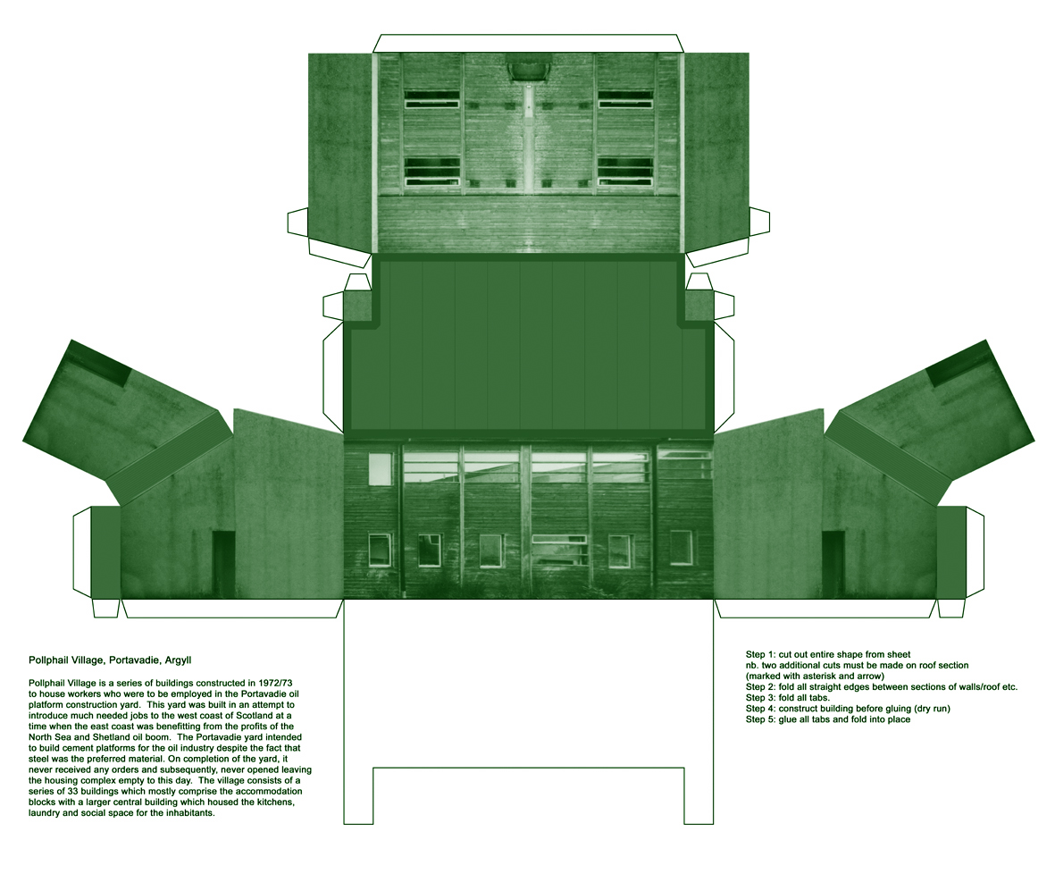
Image twelve Pollphail Village II, by Mick McGraw.
Cut out and build print as featured in the POLLPHAIL Documentary film.

Slide 15
The dissemination of POLLPHAIL has been incredibly widespread and well received across the world. The film is available to public viewing via Scottish Screens archive, Clarity Productions and many online sites. It has been exhibited widely both nationally and internationally at the following screenings and film festivals-
The Flatpack Festival, Birmingham, POLLPHAIL film screening 2010
SXSW Festival, Austin Texas, USA, POLLPHAIL film screening 2009.
London International Documentary Film Festival, POLLPHAIL film screening 2010.
Alchemy Film and Moving Image Festival, Hawick, POLLPHAIL film screening 2010.
The Times BFI 53rd London Film Festival
POLLPHAIL film screening 2009
7th World Film Festival, Bangkok,
POLLPHAIL film screening 2009.
7th Inverness Film Festival, Inverness, Scotland,
POLLPHAIL film screening 2009
Edinburgh International Film Festival
POLLPHAIL film screening 2009.
Jihlava International Documentary Film Festival, Czech Republic
POLLPHAIL film screening 2009.
CPH:DOX, Denmark,
POLLPHAIL film screening 2009.
http://www.scottishdocinstitute.com/films/pollphail/
http://vimeo.com/20068135
http://www.ckdgalbraith.co.uk/scotlands-ghost-village-set-for-new-future
http://www.dokument-festival.com/database/movie/6830%7CPollphail
http://www.producingclarity.com/productions/i52/pollphail
Image one & a description of what we are looking at in the context of the project.

Slide 16
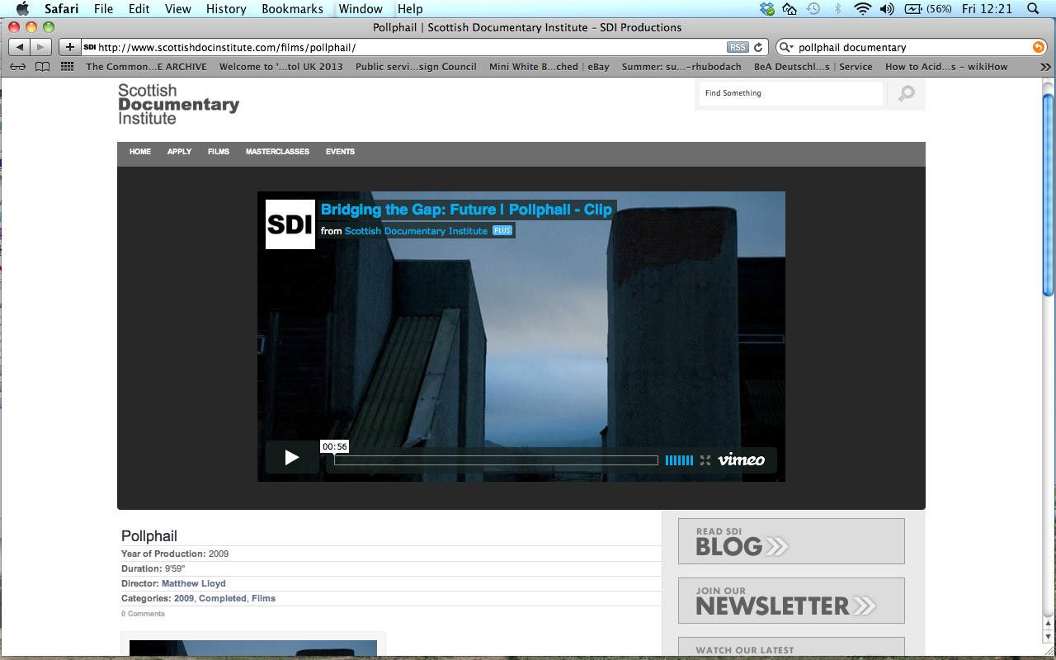

Slide 17
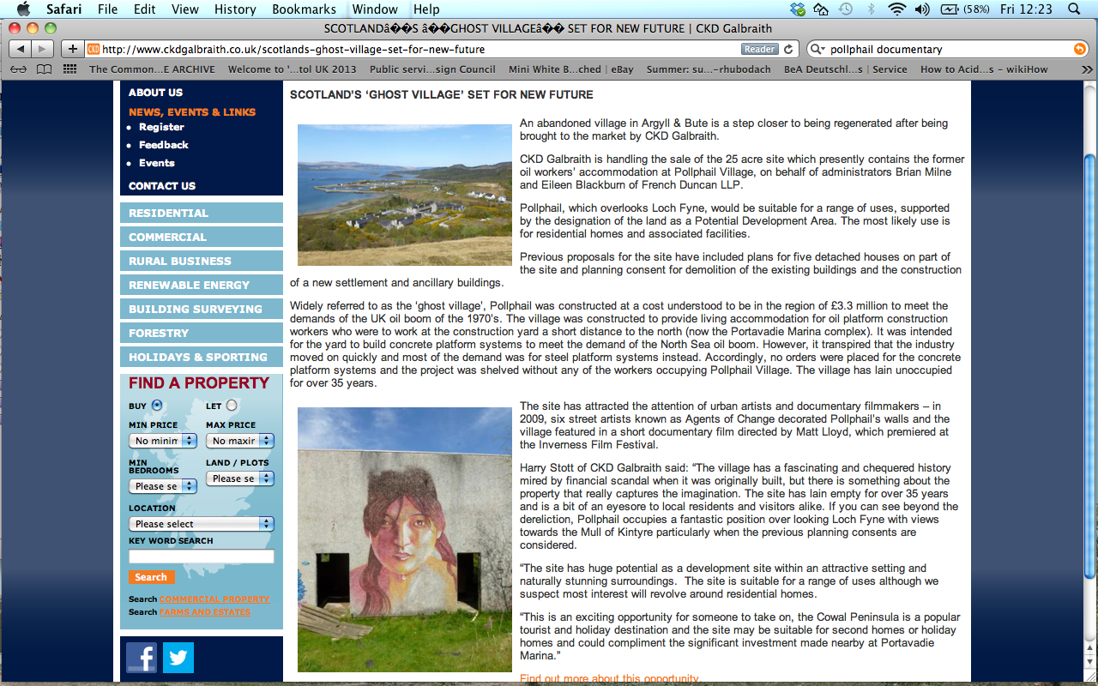

Slide 18
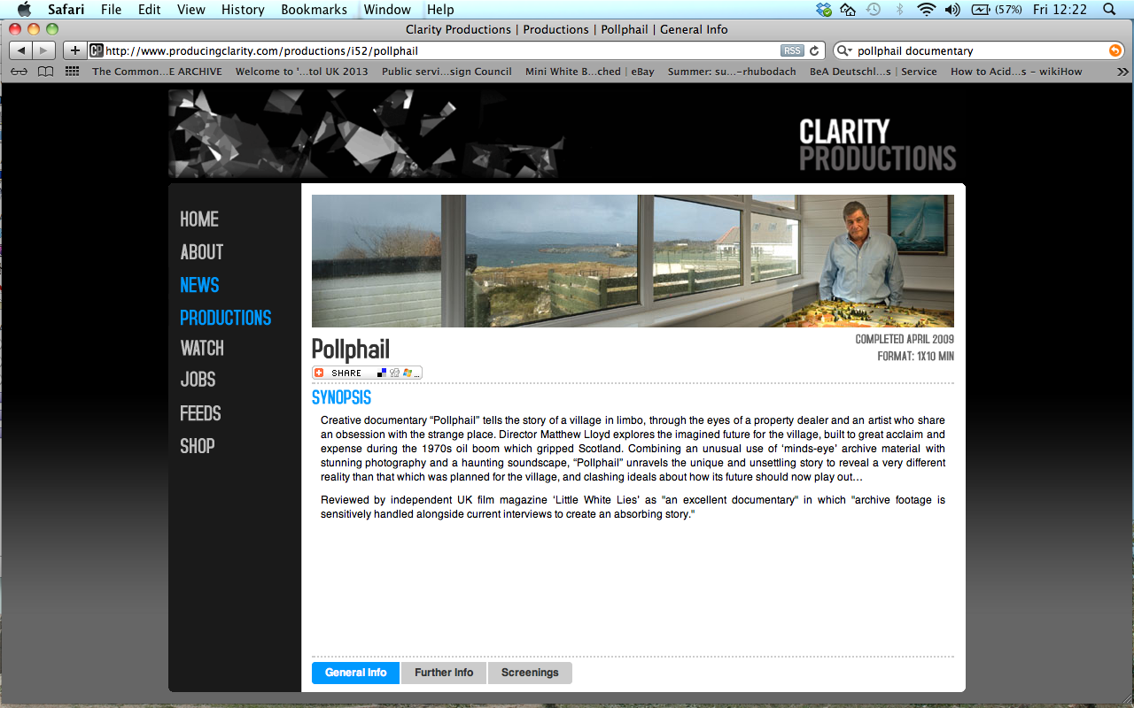

Slide 19

With thanks to filmmaker Matt Lloyd and producer Carina Willson of Clarity Productions

