Slide 1
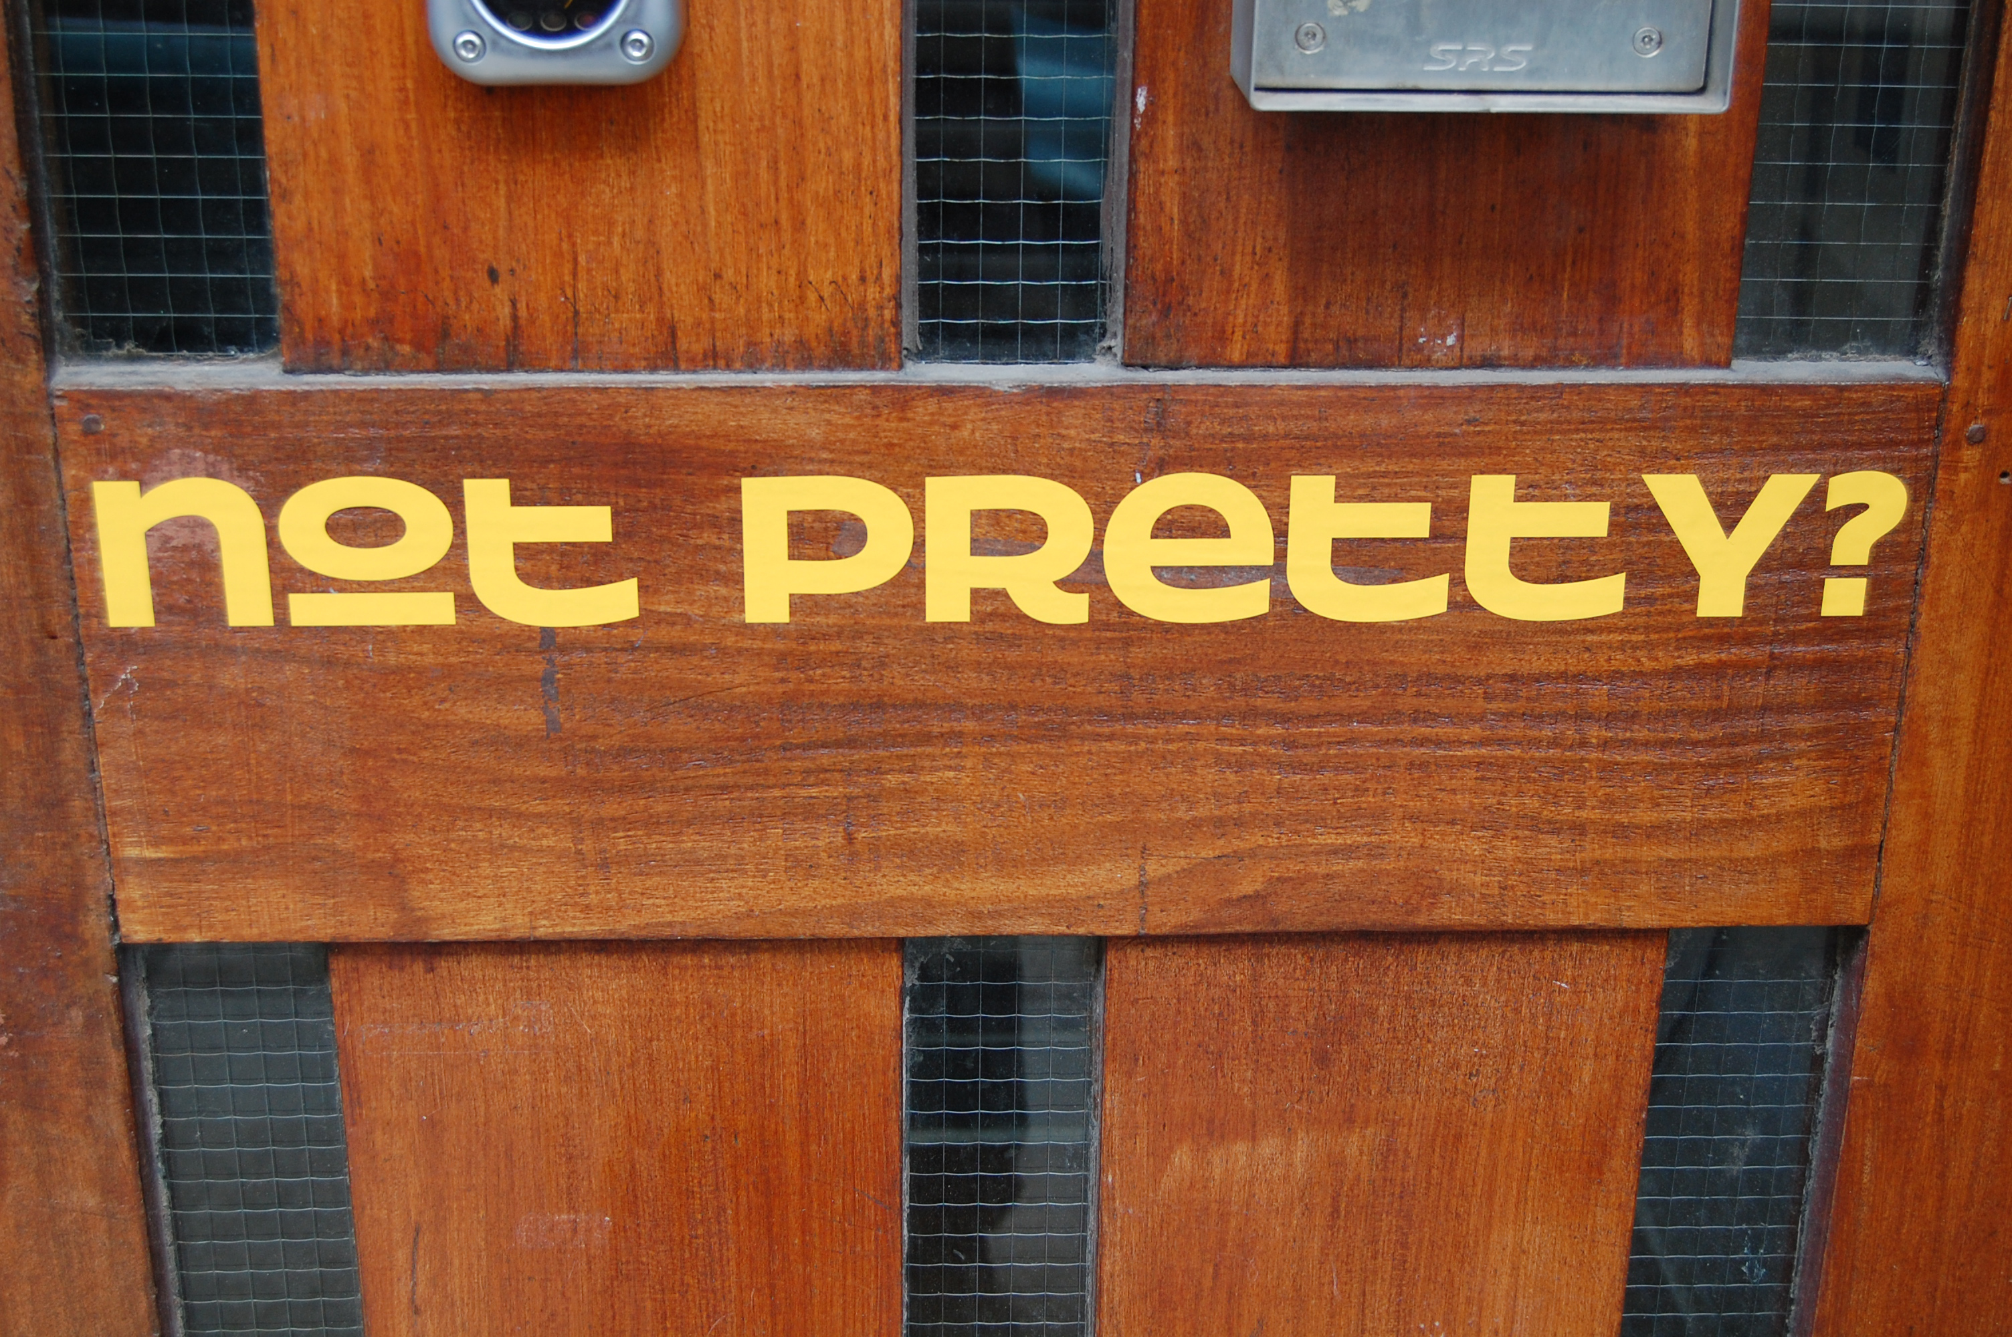

Slide 2
a snapshot of contemporary jewellery practice by male designer/makers from Scotland and Australia.
Glasgow- Atrium Gallery, April 2011
Edinburgh- SH Jewellery Gallery, July 2011
Sydney- metalab, August 2011

Slide 3
Rationale for development of exhibition taken from the press release.
This exhibition of jewellery brings together a diversity of practice, experience and cultural influences from 2 countries; a unifying element is that all the makers are male.
Scotland is represented by Jonathan Boyd, David Goodwin, Andrew Lamb and Grant McCaig, Australia by Nicholas Bastin, Cesar Cueva, Christian Hall and Mark Vaarwerk with curator Michael Pell finding himself somewhere in the middle.
Historically the wearing of jewellery could be considered a reasonably straight forward activity- an expression of personality, a statement of status or wealth through the acquisition and wearing of intrinsically valuable jewellery and gemstones, or perhaps a declaration of sentimentality with the romantic or decorative pieces which blossomed in the Victorian era. In the 1950’s art jewellery began appearing and things started to change. Parallel to the traditional ‘status jewellery’ market a subculture of jewellery slowly developed, losing the traditional hierarchy of precious materials and moving towards the art driven interest and integrity of considered intelligent design. Contemporary art jewellery had arrived. No longer did jewellery simply rely on being pretty or created from intrinsically expensive materials- the appeal or ‘value’ of this new work was equally in the ideas and execution of the making, together with the choice of appropriate materials.
In developing this exhibition Michael Pell has selected a variety of makers whose work he considers aesthetically intriguing or challenging. A parameter he set for this exhibition was gender, this first show focusing on males. He defined a further parameter of geography- as a Sydney born Australian living in Scotland for the last 6 years he chose makers from cultures he knows. The viewer is offered the opportunity to consider, interpret and enjoy this small selection of makers and interrogate the work from their own aesthetic viewpoint. This combination of artists offers a focused snapshot of contemporary male jewellers’ practice from 2 sides of the globe. This exhibition is intended as the first in a broader series of exhibitions pairing groups of artists from a variety of countries to further explore the relationships between makers of various ethnicity, gender and artistic jewellery practice.

Slide 4
Rationale for development of exhibition taken from the press release (cont.)
Questions Pell asked himself in developing this exhibition included- Does the gender of a maker influence the aesthetic quality of their work? Do collections of jewellery have an intrinsic cultural identity? Can jewellery have or acquire a masculine/feminine quality? Is this evident in a body of work created by male jewellers? Can I look at a piece of work and say ‘a boy made that’?
As contemporary jewellery practitioners the 9 artists exhibited each have a very individual approach to their practice. This exhibition invites you to consider and investigate the presence, or otherwise, of a ‘maleness’ in the work shown, and to view the work in terms of its public potential – who might wear it?
In bringing together these makers Pell considered his own approach to designing and making jewellery- he has always strived to create jewellery with equal appeal to both women and men. His interest in male adornment and the question of what might be considered ‘appropriate’ for men to wear has always intrigued him. In designing and making Pell relies on the rigour and discipline of clear thinking, using robust materials, often precious, imposing a limited palate of colour and material combinations to create his jewellery. He strives to minimise and reduce what he considers unnecessary decorative detail to create fresh, austere pieces. Usually simple forms, his work might suggest historical jewellery pieces or architectural details.
Many of the pieces presented have an intangible quality of being, or relating to, something beyond themselves, though this ‘something’ is not always apparent. By imposing a familiarity of form or referencing recognisable objects or images, the designers draw the audience into speculating about what the pieces might represent, though they represent nothing more than that which the viewer has decided it could or should.
This work is open to interpretation, though does not insist on it.

Slide 5
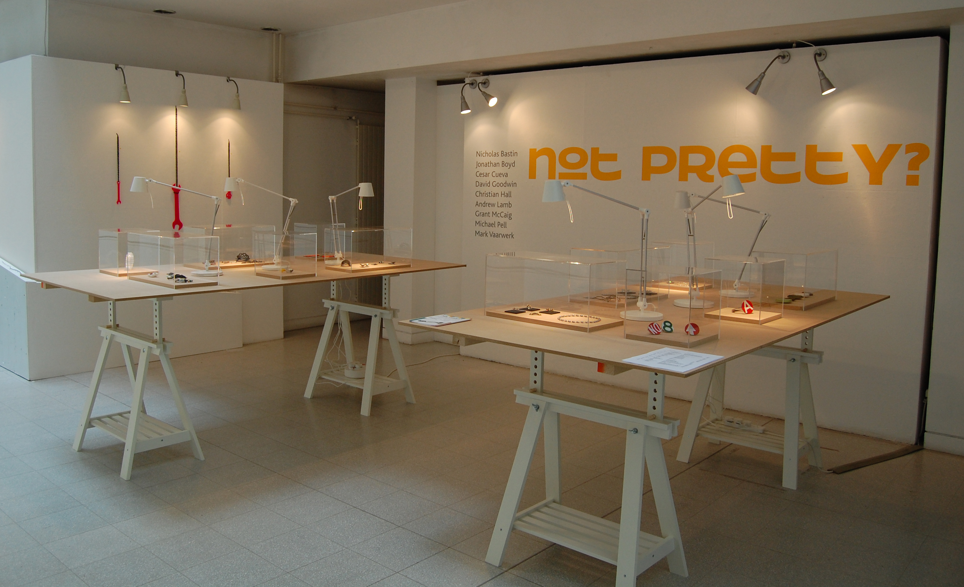
Installation view, Atrium Gallery, The Glasgow School of Art

Slide 6
Nicholas Bastin
Educated Sydney and Melbourne, lives Melbourne
Education
Currently enrolled PhD, School of Art, RMIT University
Master of Arts, Fine Arts, RMIT University, 2004
Bachelor of Arts, Fine Arts (Honours), Gold and Silversmithing, RMIT University 1993
Bachelor of Arts, Fine Arts, Gold and Silversmithing, RMIT, 1989
Solo Exhibitions
2007 Dangerous Shell, Glitzern, Melbourne
2006 Asakusa Window, Object Gallery, Sydney.
2002 Battle of the Drones, Mezzanine Gallery, Ivy Hopes, Melbourne.
1997 A Group of Juicy Green Protrusions (with Sally Marsland), Craft Victoria, Melbourne.
Group Exhibitions
2010 By Example, Australian Contemporary Jewellery, The Museum of Arts & Crafts Itami, Itami, Japan
2010 Treasure Room: Australia: Schatzkammer – Australien, Galerie Handwerk, Munich, Germany
2009 Four Jewellers, Melbourne Australie, Espace Solidor, Cagnes Sur Mer, France and Galerie Biró, Munich, Germany
2009 Jewellery Topos, Gallery Marzee, Nijmegen, The Netherlands
2009 Melbourne Hollow Ware, Gallery Marzee, Nijmegen, The Netherlands
2008 Innovative Contemporary Jewellery, SOFA Chicago Art Fair, represented by Charon Kransen Arts, New York
2008 It’s Got Legs: RMIT University Gold and Silversmithing Postgraduate and Alumni Award Exhibition, School of Art Gallery, RMIT University, Melbourne
2008 Fuse, JamFactory, Adelaide
2007 Moving Parts, e.g.etal, Melbourne
2007 It’s Got Legs: RMIT University Gold and Silversmithing Postgraduate and Alumni Award Exhibition, School of Art Gallery, RMIT University, Melbourne
2007 SOFA New York Art Fair, represented by Charon Kransen Arts, New York
2007 Beyond Metal: Contemporary Australian Jewellery and Hollowware, RMIT Gallery, Melbourne; touring exhibition India, Singapore, Malaysia, Australia

Slide 7
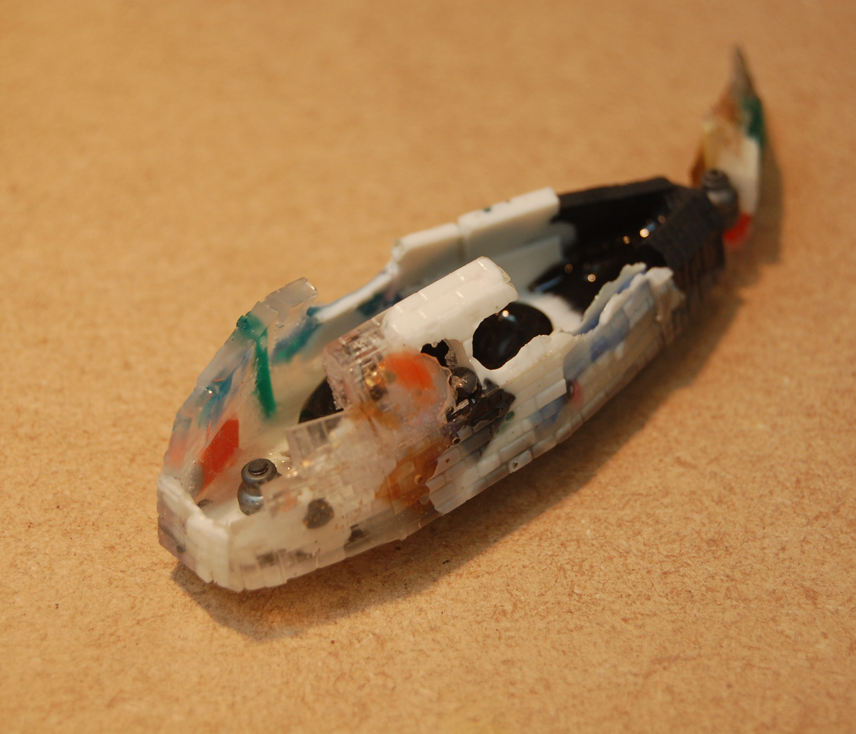
Nicholas Bastin
Educated Sydney and Melbourne, lives Melbourne

Slide 8
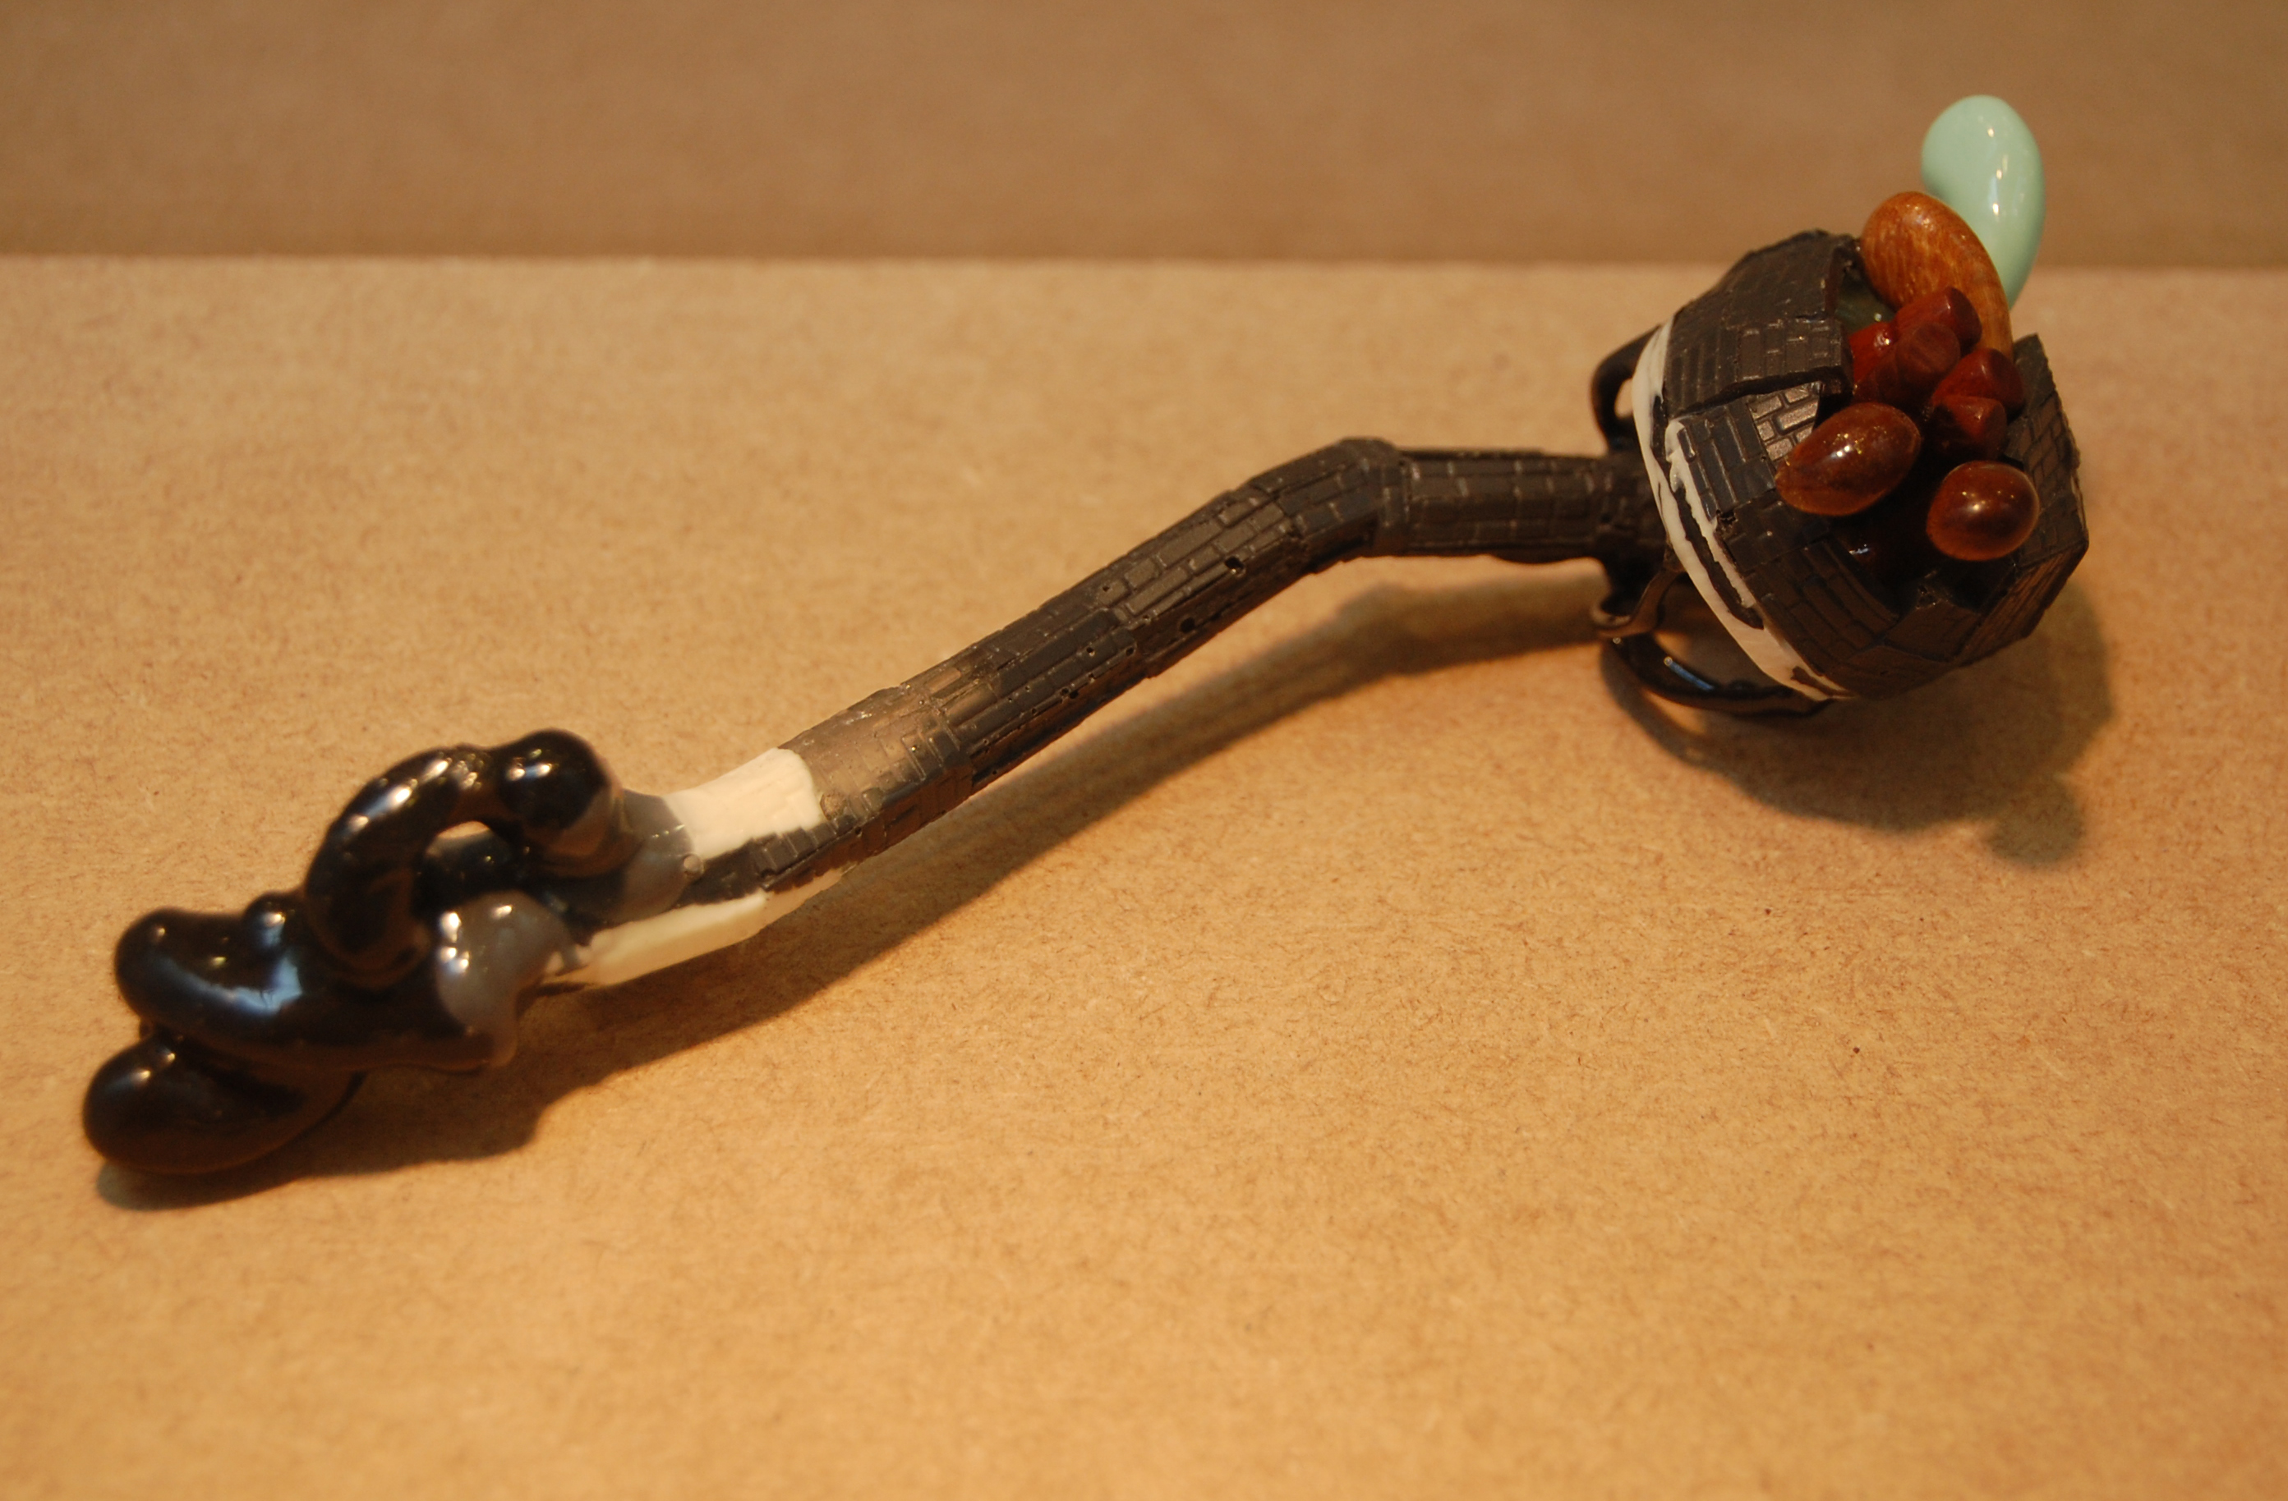
Nicholas Bastin
Educated Sydney and Melbourne, lives Melbourne

Slide 9
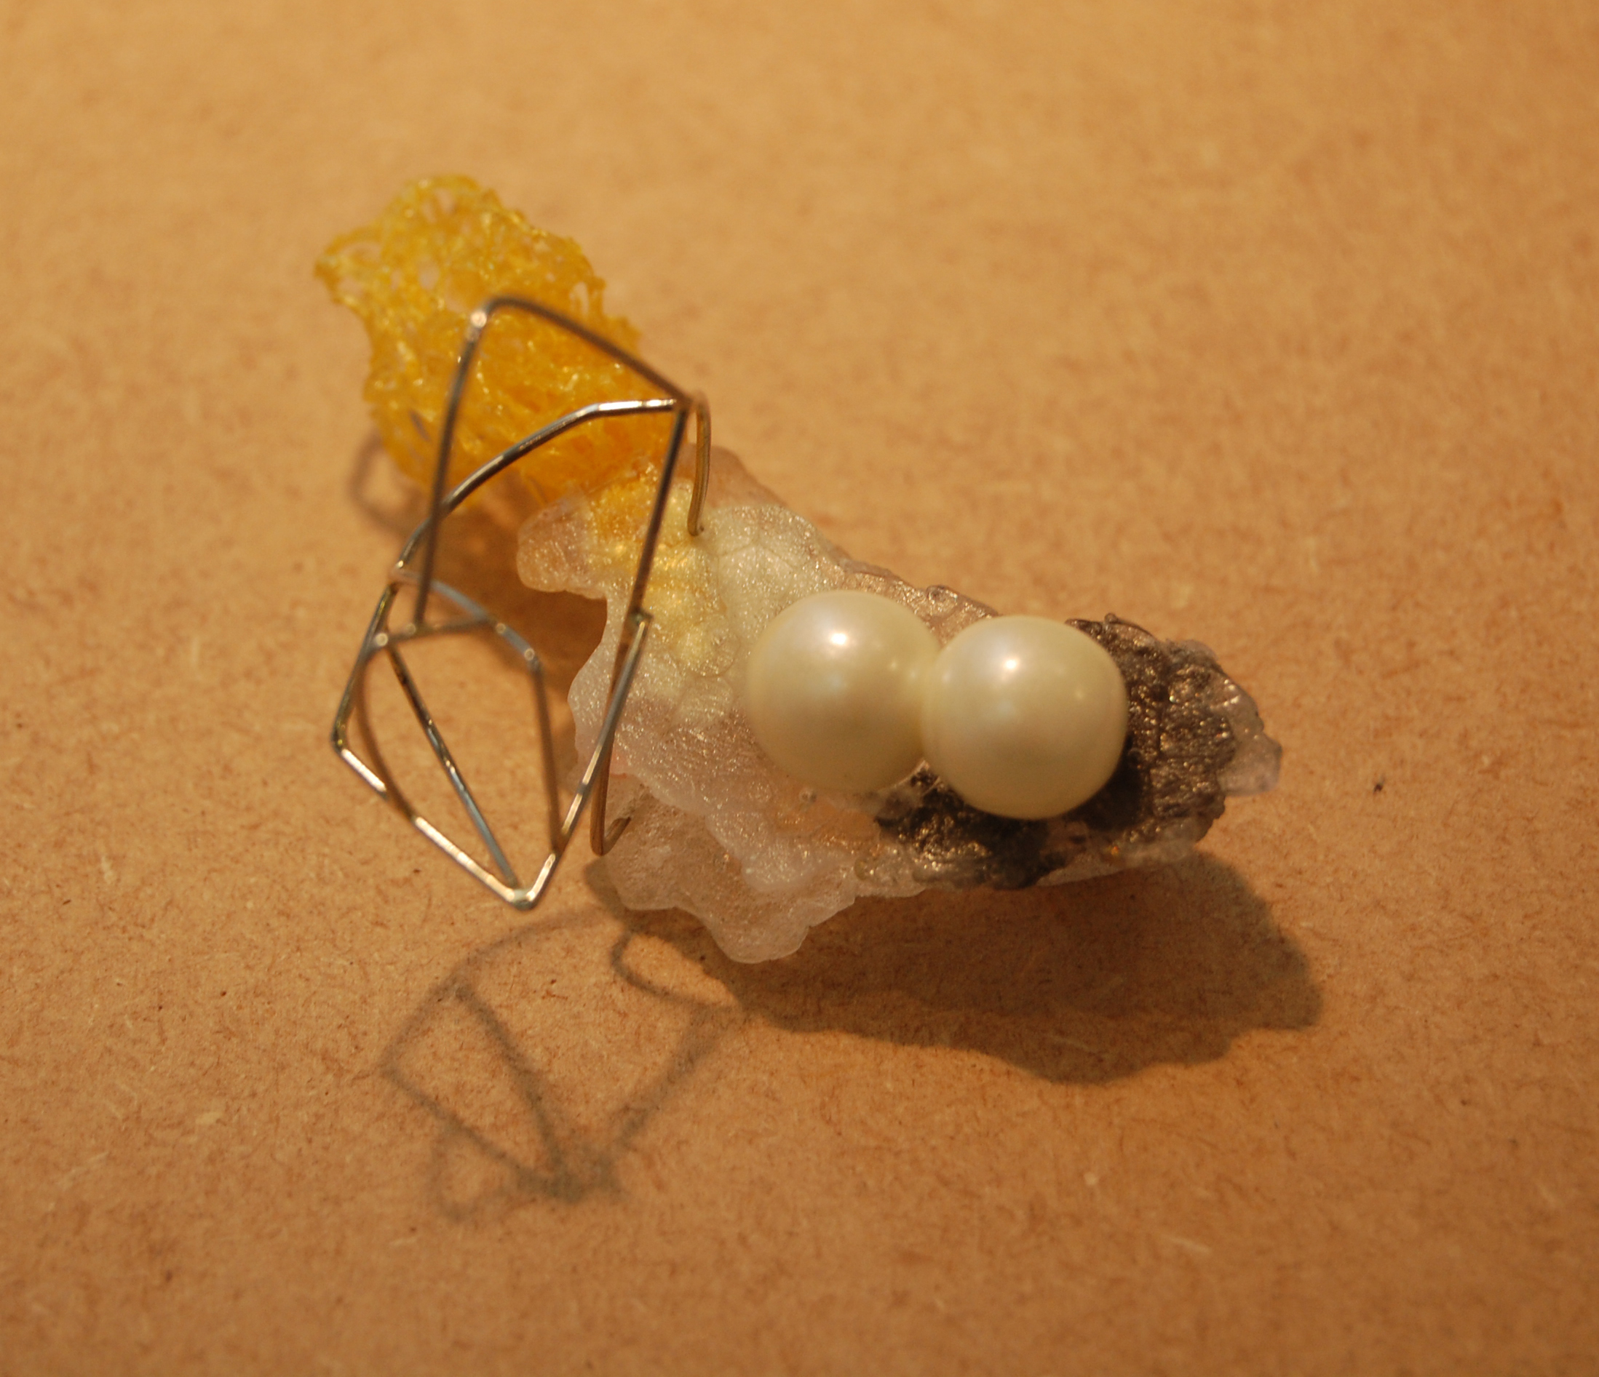
Nicholas Bastin
Educated Sydney and Melbourne, lives Melbourne

Slide 10
Jonathan Boyd
Educated Glasgow and London, lives Glasgow
Education
2007-09 MA Goldsmithing Silversmithing, Metalwork and Jewellery, Royal College of Art
2006 BA (Hons) Silversmithing and Jewellery (First Class), Glasgow School of Art.
Awards
2010 Best New Design Goldsmiths Hall
2010 Scottish Arts Council Development Grant
2010 Goldsmiths Fair Bursary 2010
2009 Galerie Marzee International Student Award
2009 Theo Fennel Overall Excellence RCA Graduate Show 2009
2009 Conran Award Shortlisted
2008 Individual winner, Royal Mint commemorative coin project
2008 Sloane Square Award 2009
2007-09 Donald Dewar Award for exceptional Scottish talent, Scottish Executive
2008 Commended, Waddesdon Manor, Applied Arts Competition
2007 New Designer of the Year (runner up), British Design Council
2007 Richard A Hubbard Memorial prize, Glasgow School of Art
2006 Precious Metal Bursary, Goldsmiths Hall
2005 Goldsmiths Course Prize, Worshipful Company of Pewterers

Slide 11
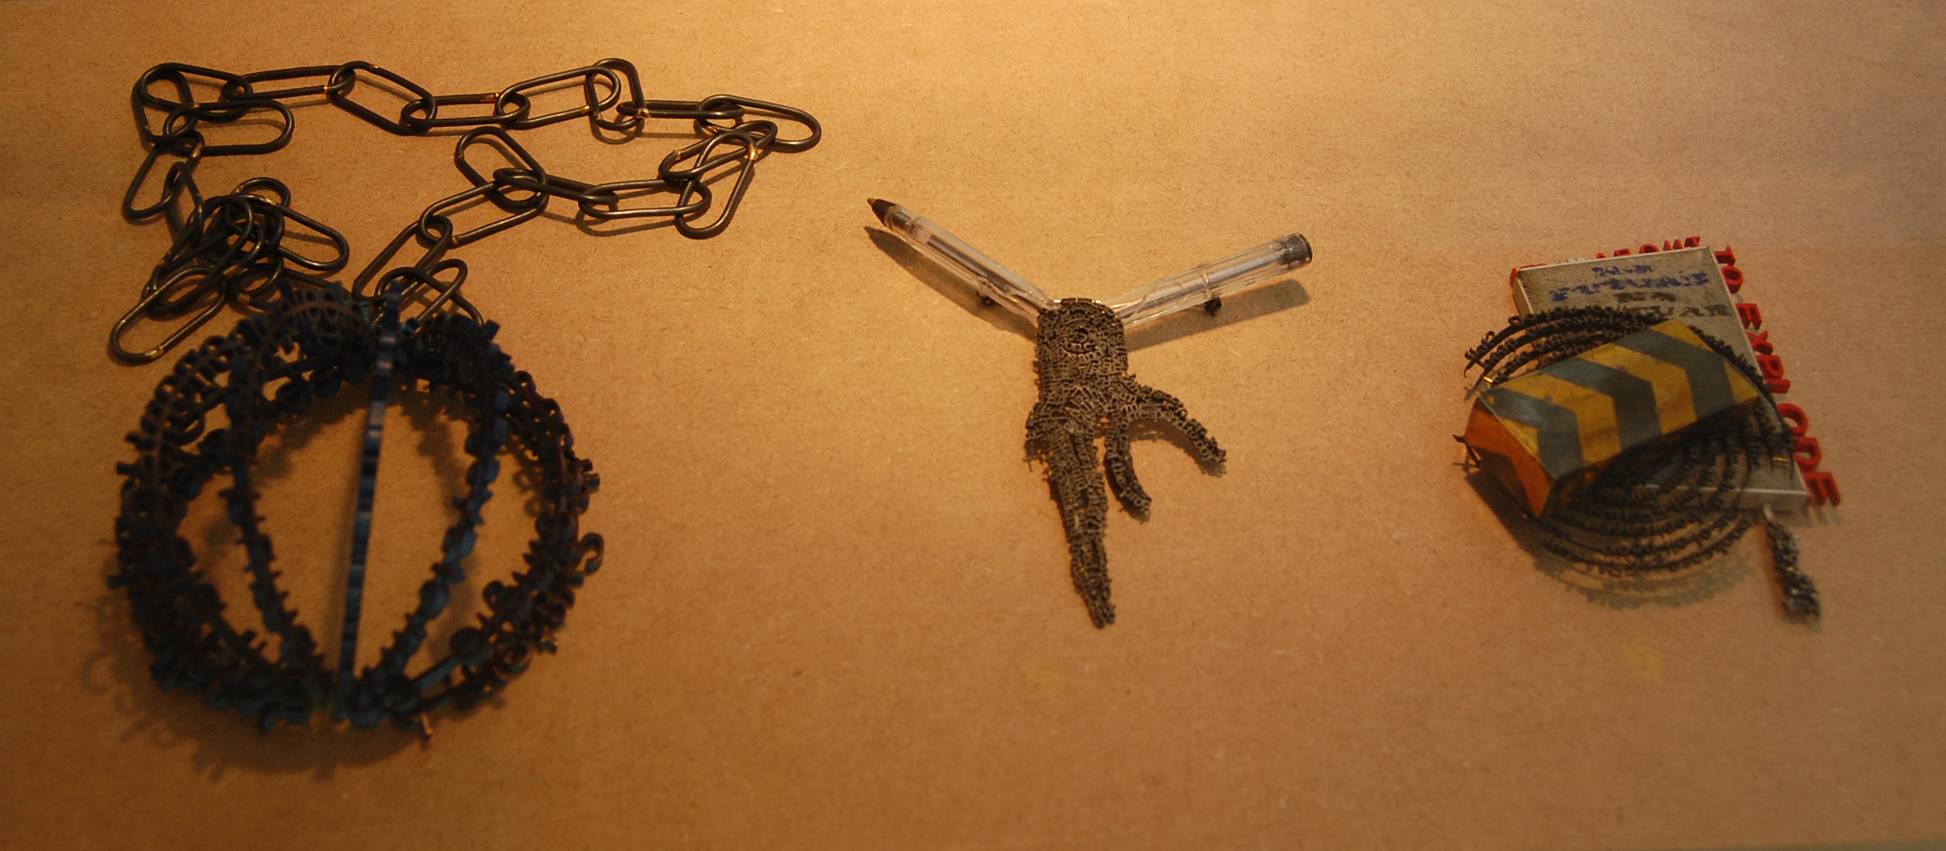
Jonathan Boyd
Educated Glasgow and London, lives Glasgow

Slide 12
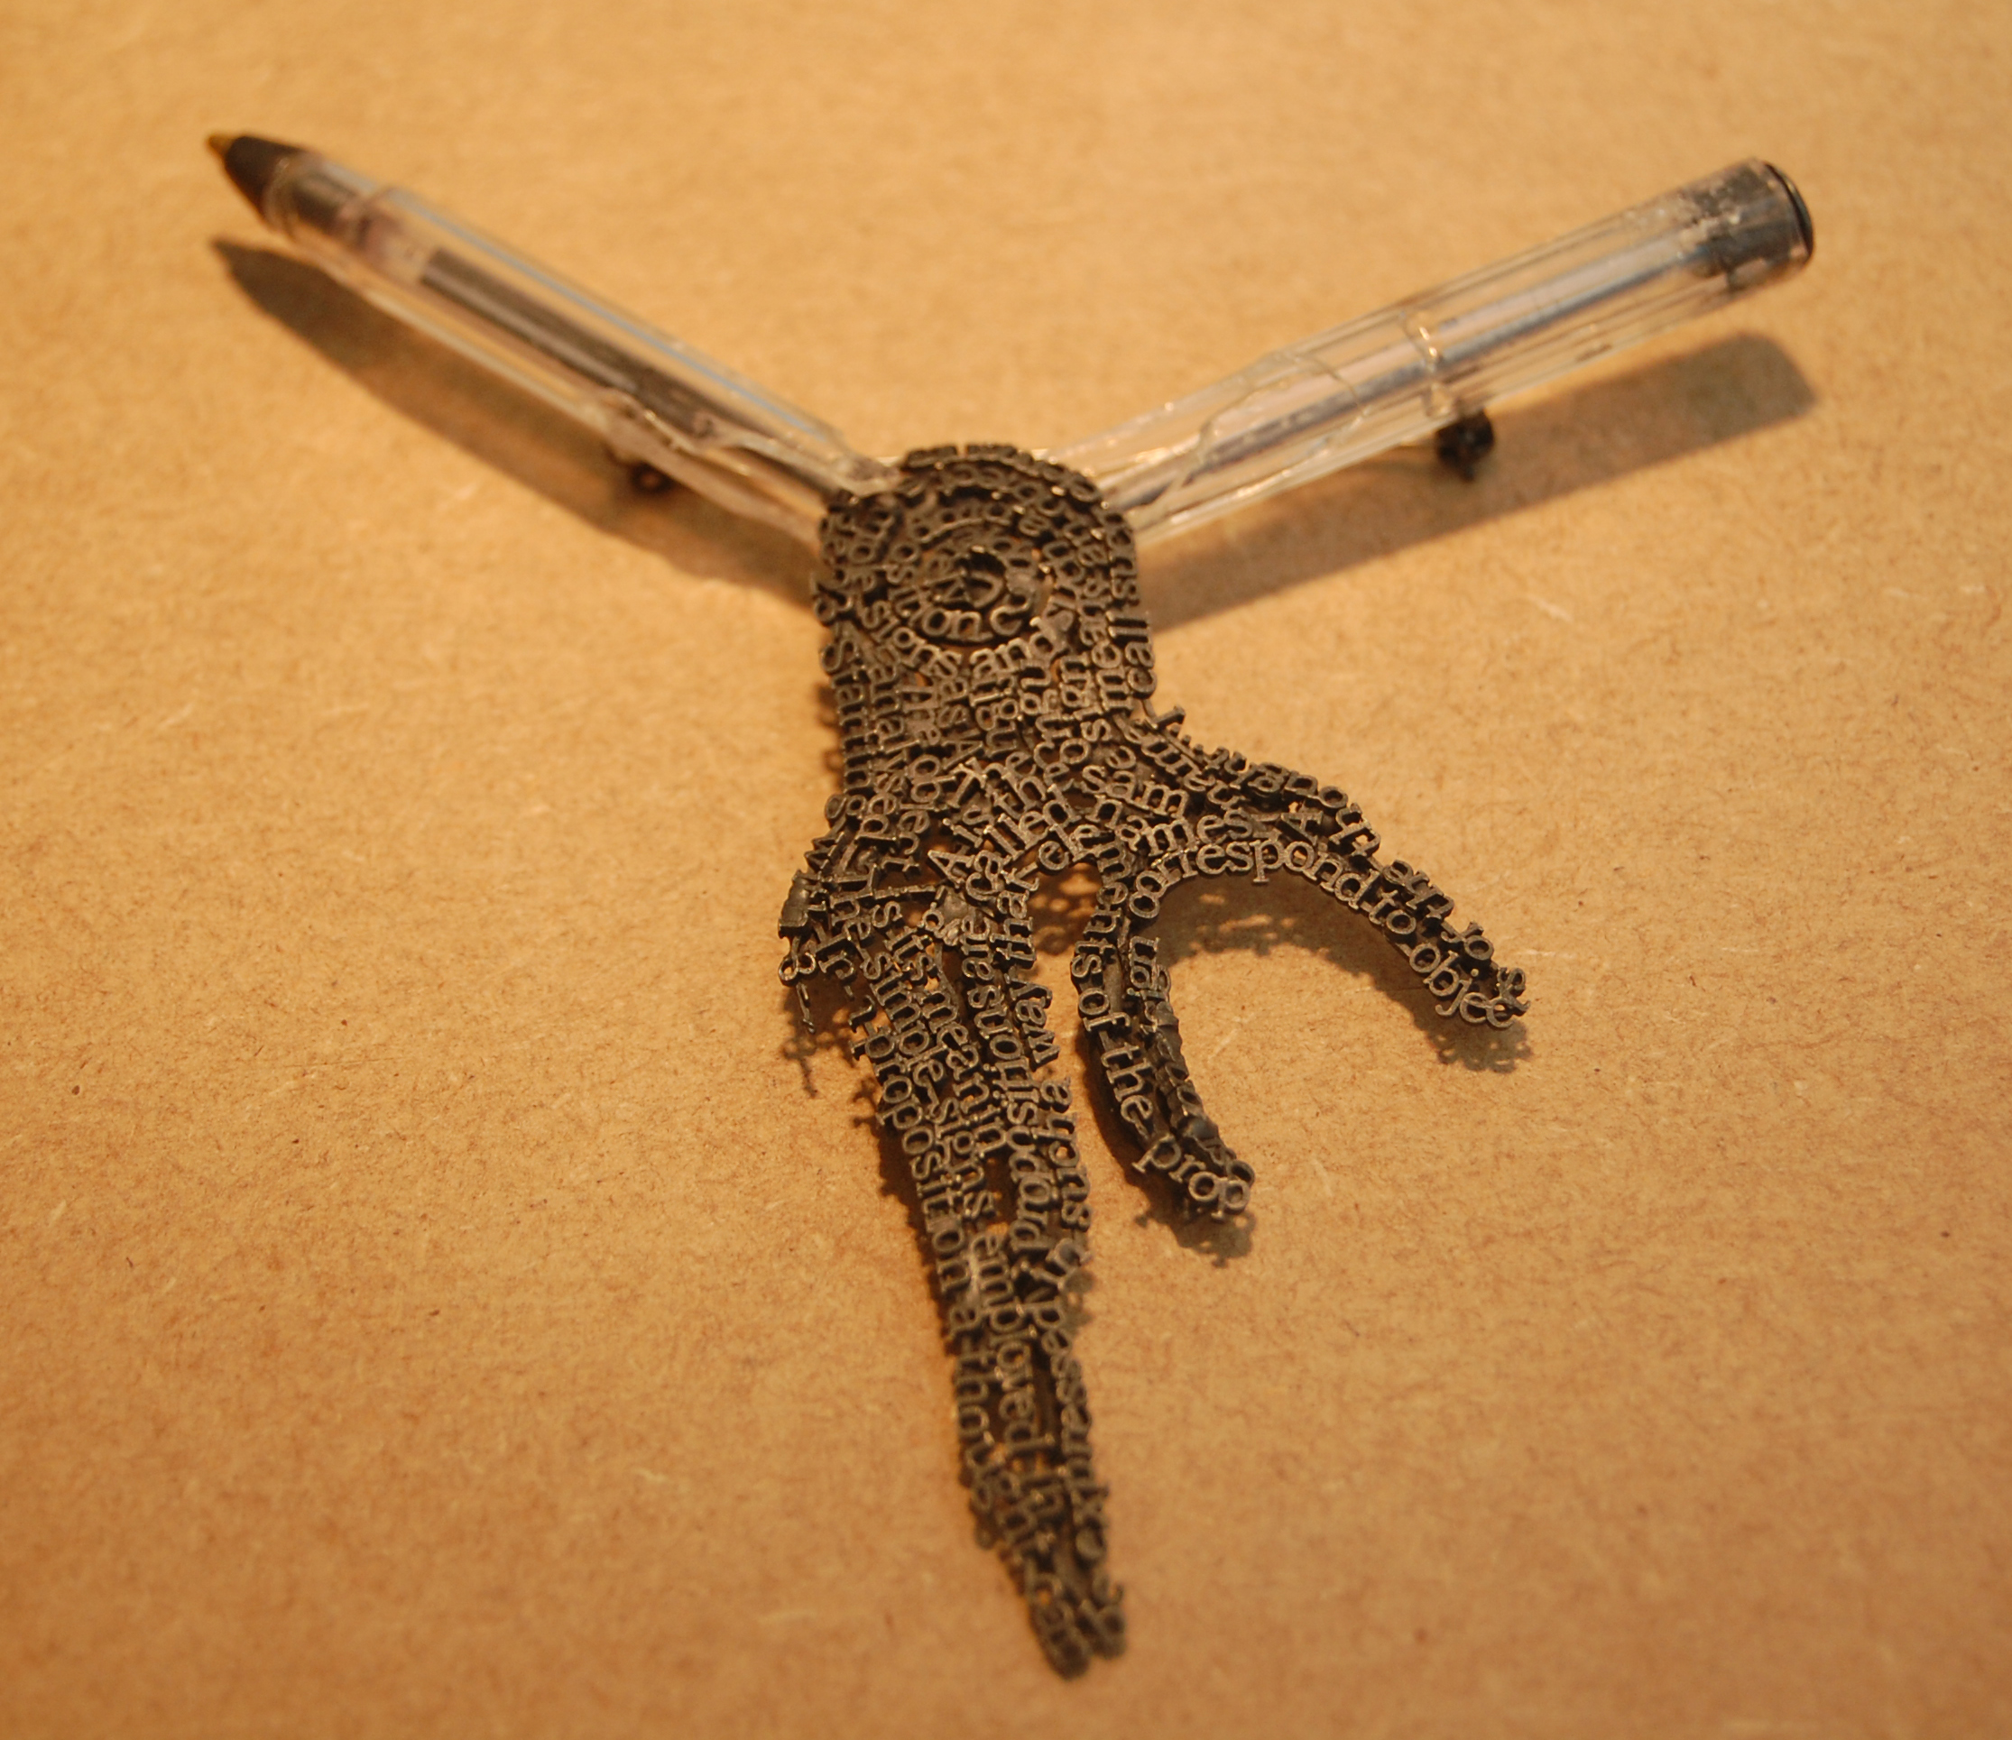
Jonathan Boyd
Educated Glasgow and London, lives Glasgow

Slide 13
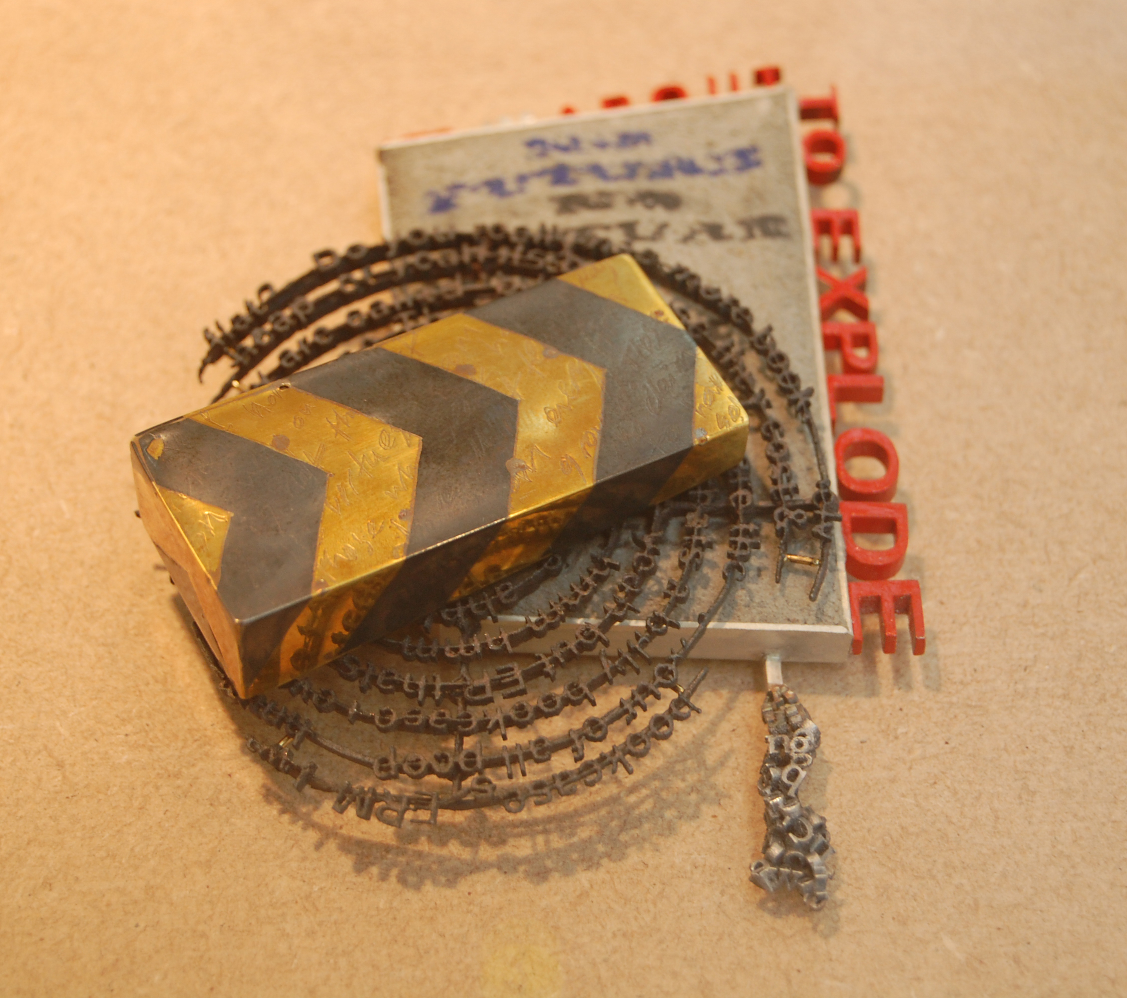
Jonathan Boyd
Educated Glasgow and London, lives Glasgow

Slide 14
Cesar Cueva
Educated Sydney, lives Sydney
Education
2005 Certificate in Small Business Management NEIS program
2004 Bachelor of Visual Arts (Honours)
National Institute of the Arts, Australian National University, Canberra
1999 Bachelor of Design (Industrial Design)
University of Western Sydney, Nepean
Diploma in Jewellery + Object Design
Sydney Institute of Technology, Enmore Design Centre
1996 Diploma in Applied Science (Architectural Technology), Sydney Institute of Technology, Ultimo
Selected Exhibitions
SMH Young Designer of the Year Powerhouse Museum, Sydney
Candela ‘05 Metalab, Sydney
Candela - New Works in Lighting Workshop Bilk, Queanbeyan, NSW
Metalab Collective 2005 - 2010 Metalab, Sydney
Catch-on II - Contemporary Australian Jewellery Seoul, Korea
Cracker Metalab, Sydney
Fashionstate - Direction in Detail Metalab, Sydney
Zu presents - Presents at Zu Zu design, Adelaide

Slide 15
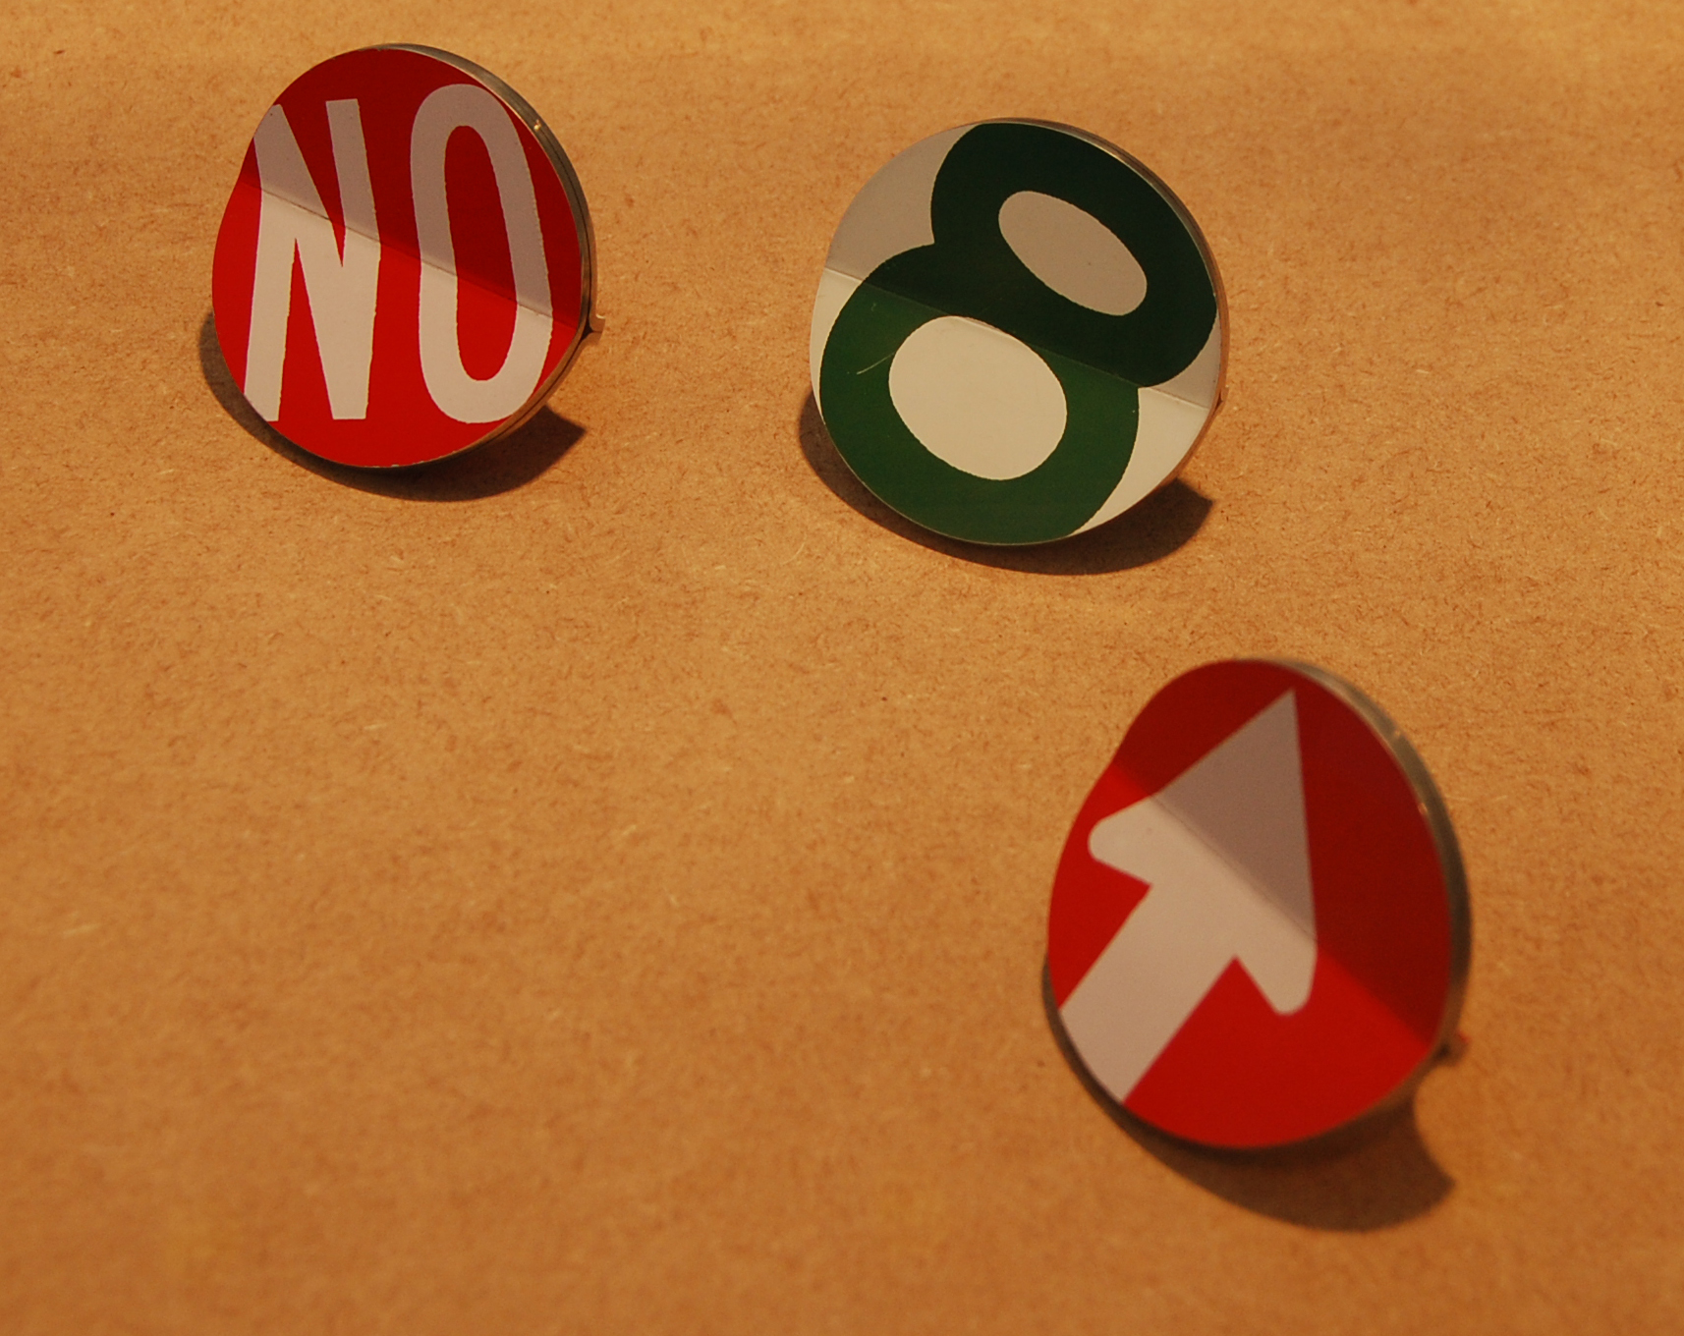
Cesar Cueva
Educated Sydney, lives Sydney

Slide 16
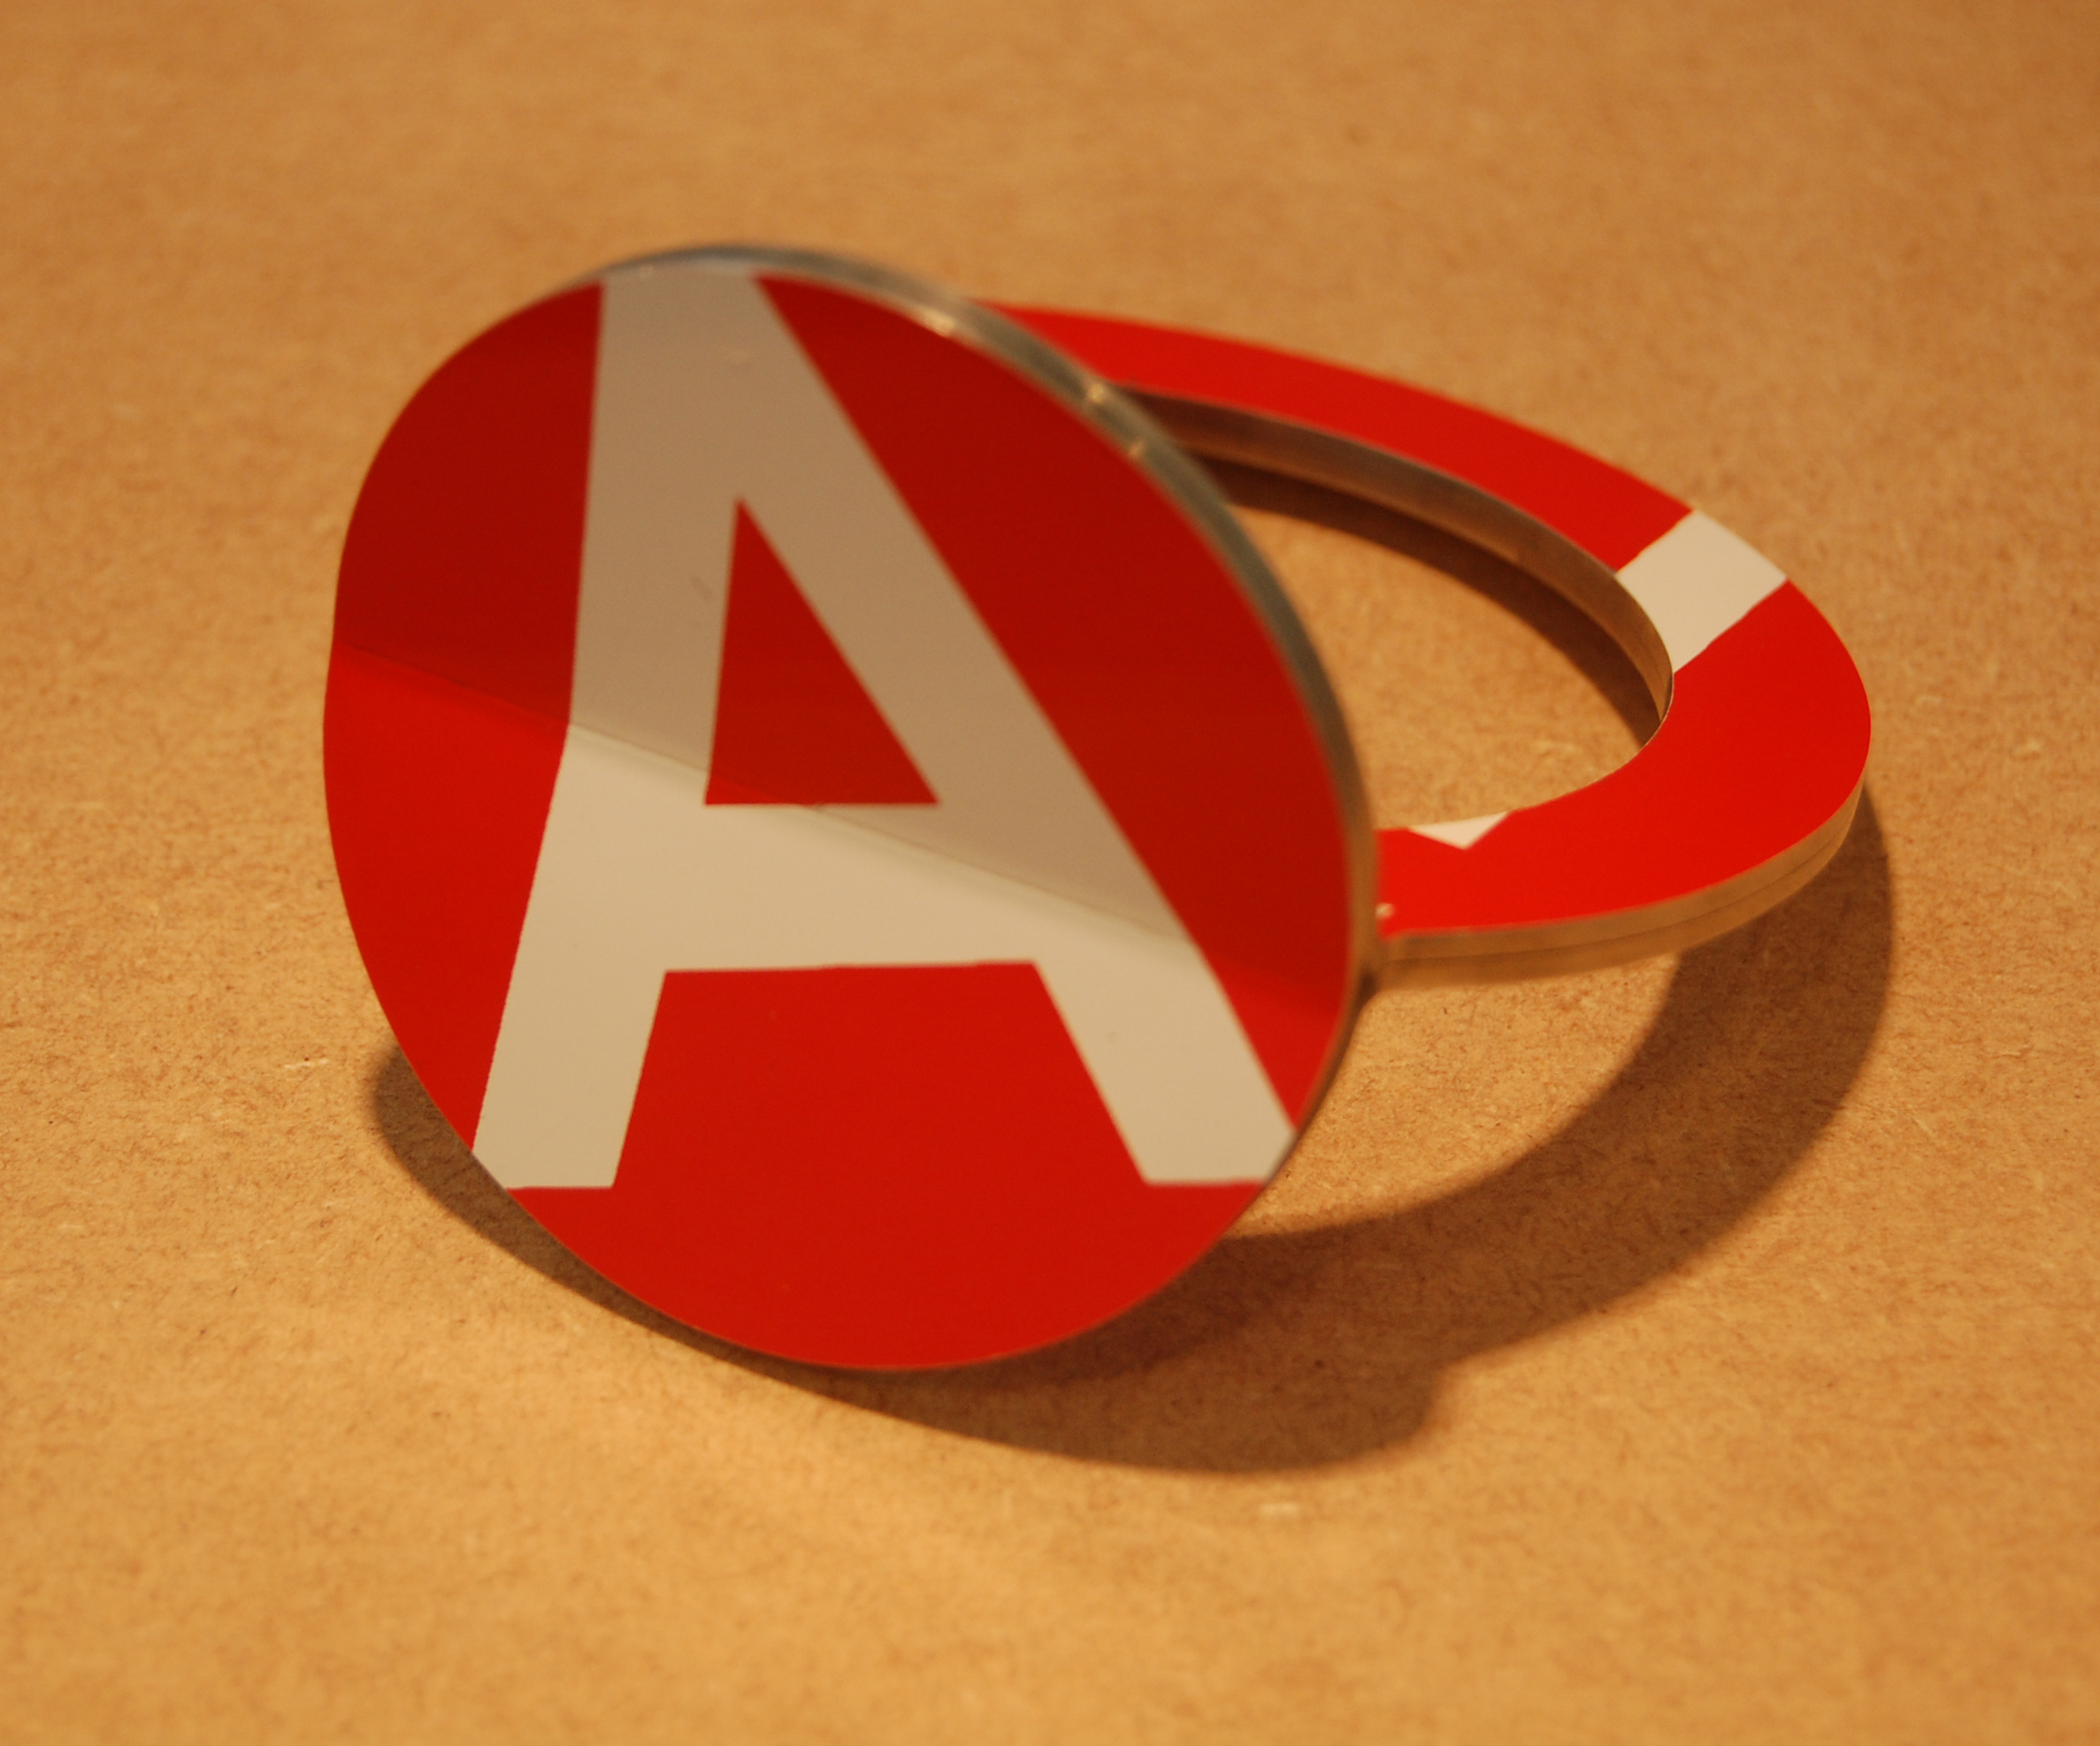
Cesar Cueva
Educated Sydney, lives Sydney

Slide 17
David Goodwin
Educated Glasgow and London, lives London
Education
2002-4 Masters, Goldsmithing Silversmithing Metalwork and Jewellery. Royal College of Art
2001-2 Postgraduate Training, Bishopland Workshops, Reading
1997-01 BA Hons. Silversmithing and Jewellery – Glasgow School of Art
1996-7 Preparation Course, Visual Arts Studios, glasgow
Professional Practice
Senior Lecturer in Jewellery, The Sir John Cass School of Art, Media and Design
London Metropolitan University
Awards
2004 New Designer of the Year, BDC
Harley Foundation Award, Harley Foundation
The Grima Award, World gold Council

Slide 18
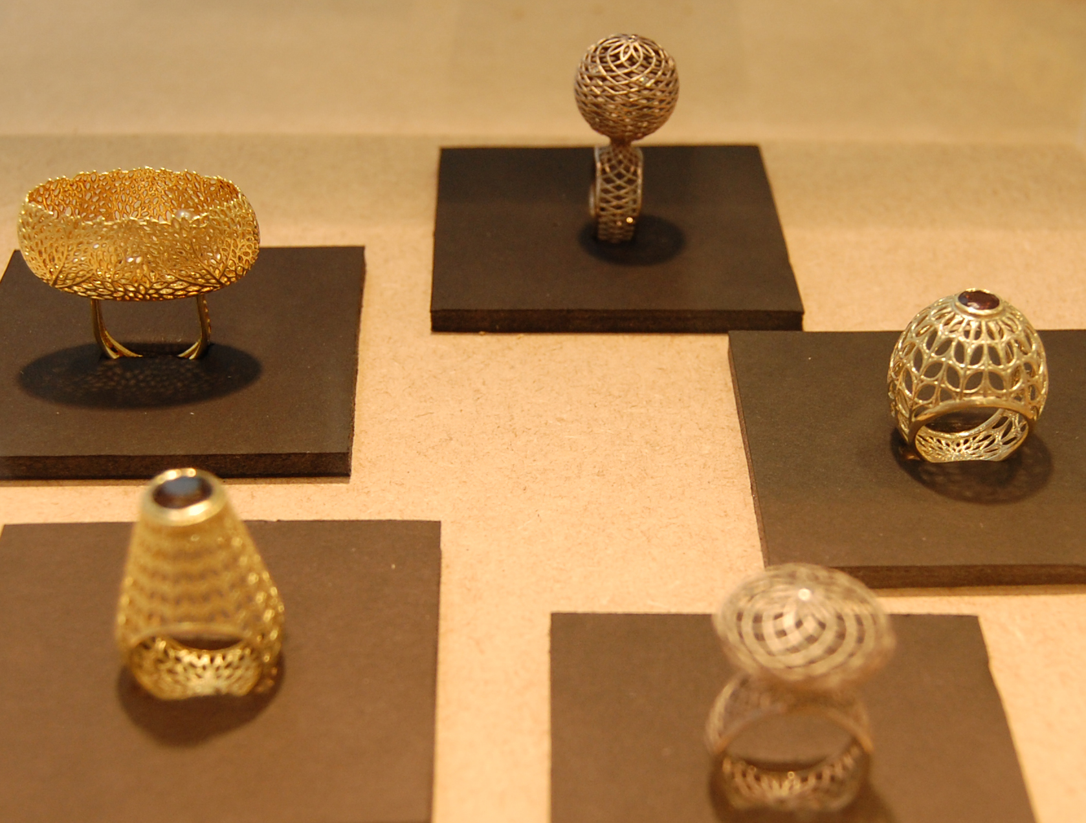
David Goodwin
Educated Glasgow and London, lives London

Slide 19
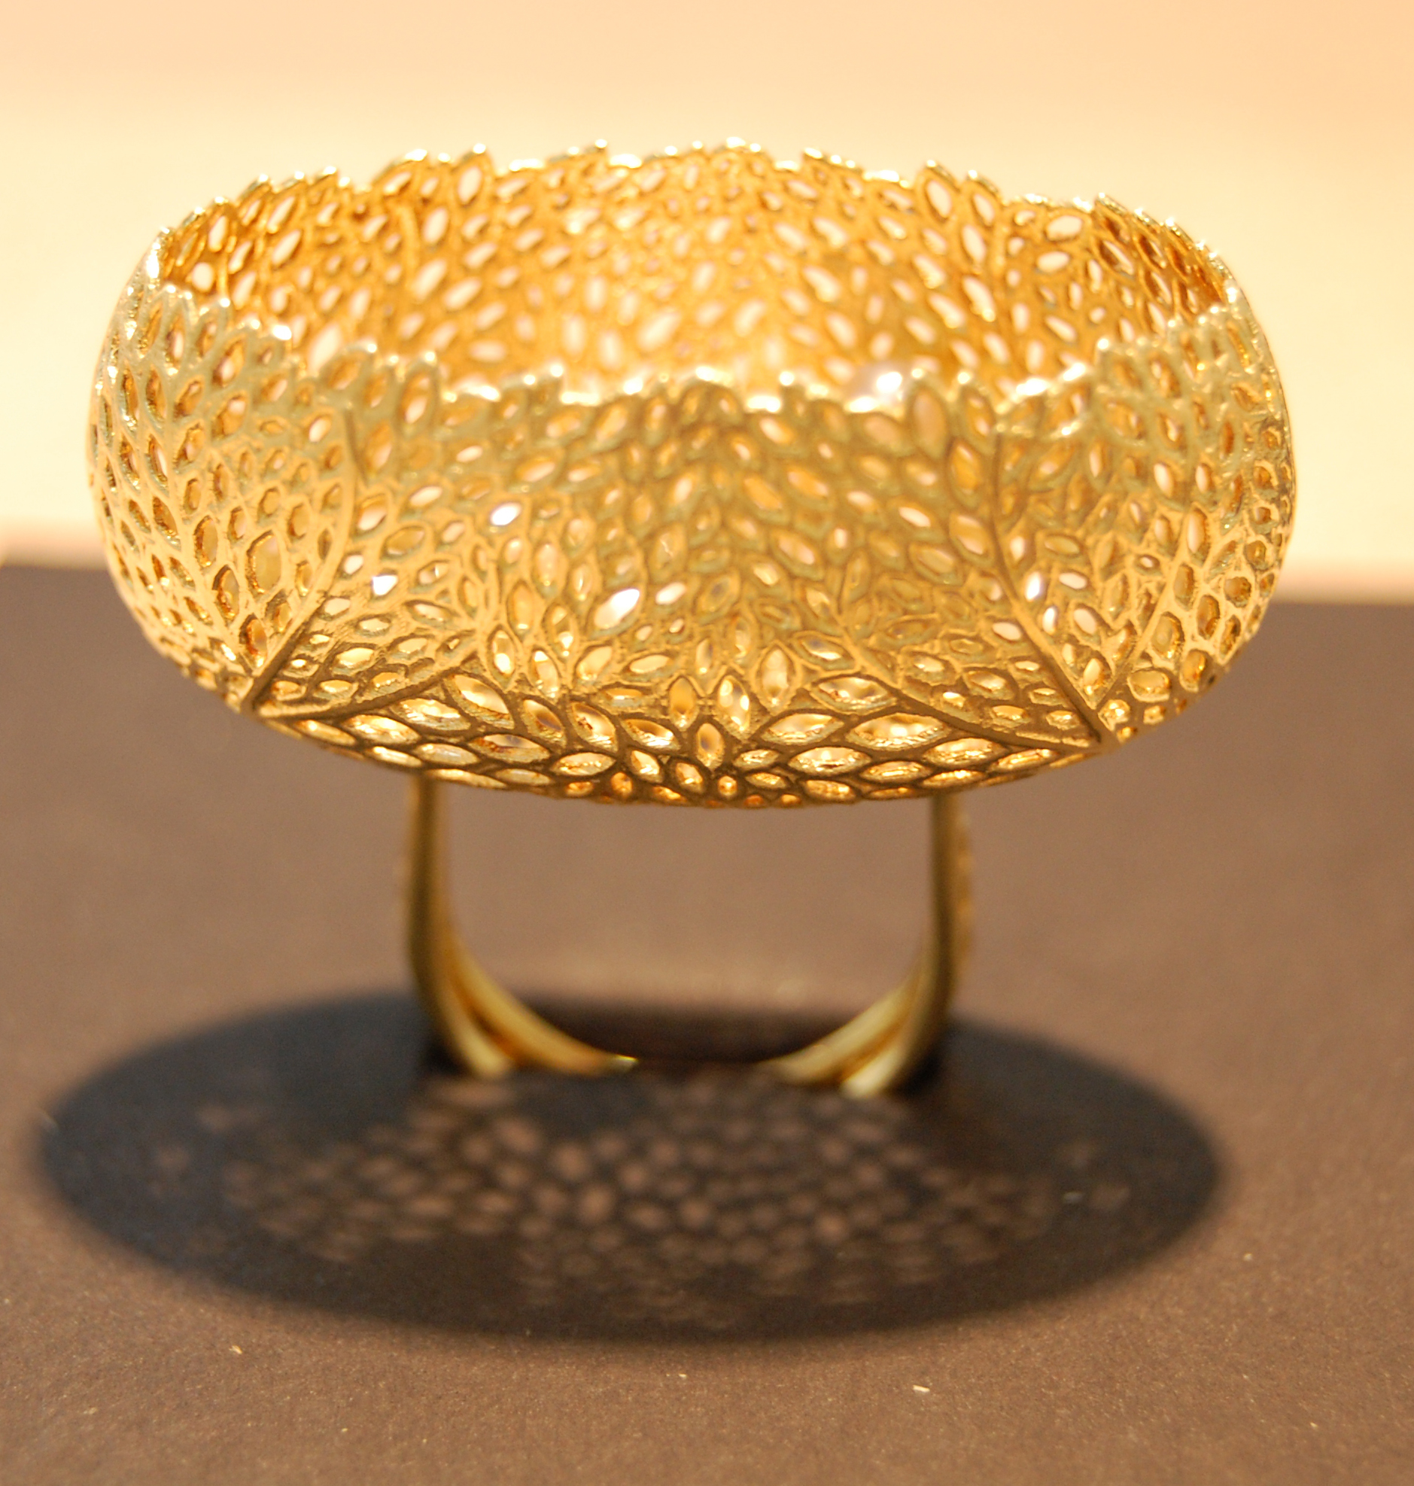
David Goodwin
Educated Glasgow and London, lives London

Slide 20
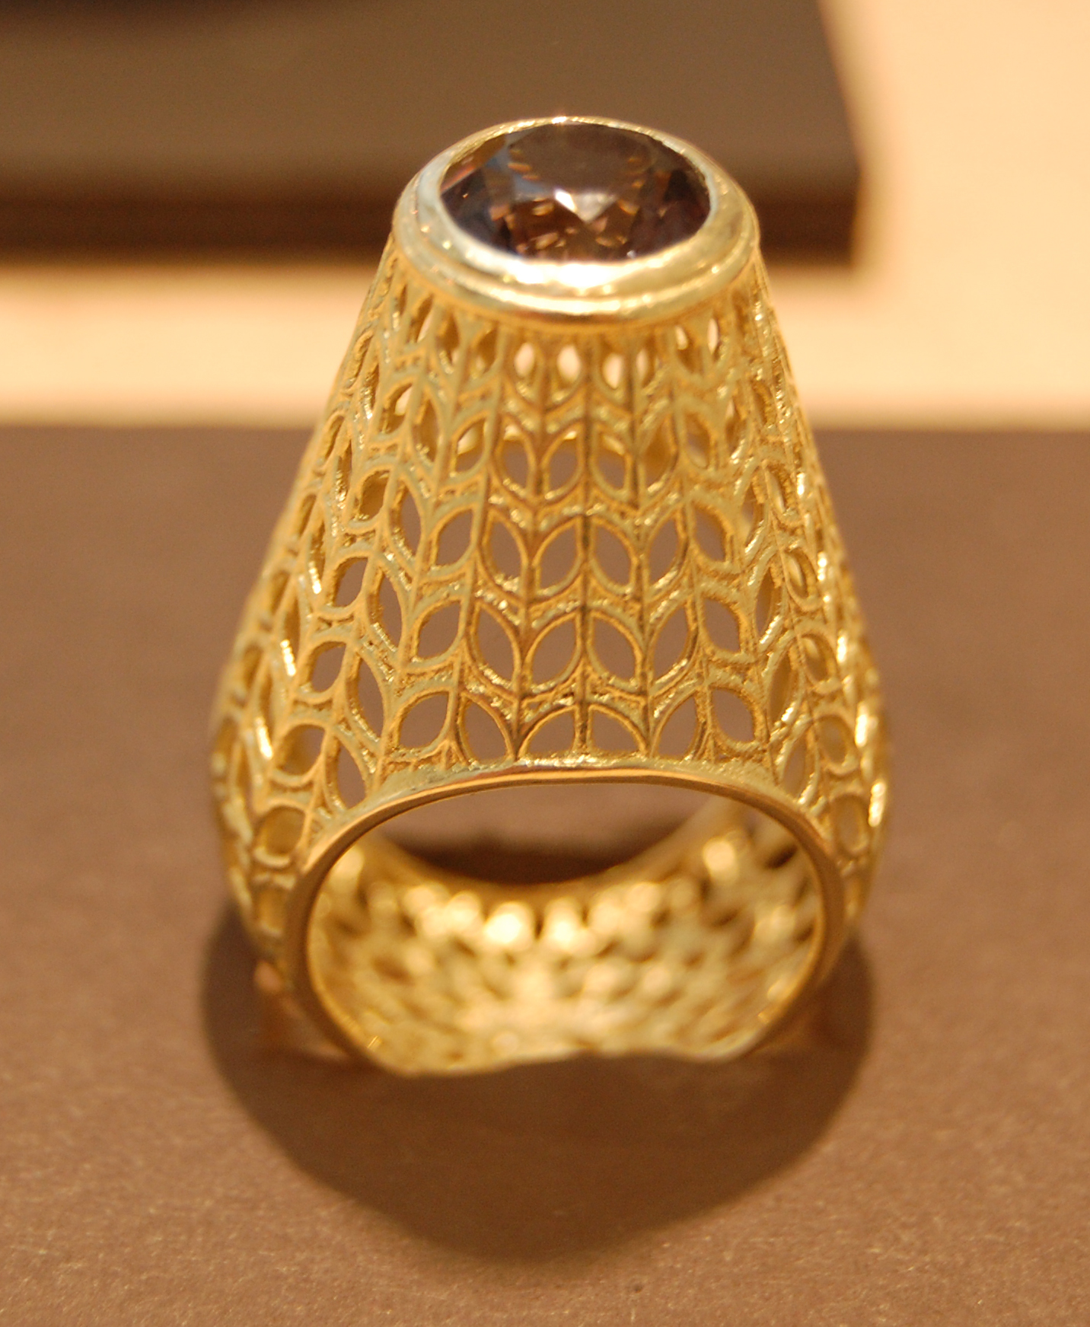
David Goodwin
Educated Glasgow and London, lives London

Slide 21
Christian Hall
Educated Sydney, lives Adelaide
Education
2003 Master of Visual Arts, Sydney College of the Arts, University of Sydney
1998 Bachelor of Visual Arts, First Class Honours, Jewellery and Object Design, Sydney College of the Arts, University of Sydney
Solo Exhibitions
2010 AirCraft, JamFactory, Centre for Craft and Design, Studioworks Retail Gallery, Adelaide
2007 Transmission, JamFactory, Centre for Craft and Design, Galley Two, Adelaide
2006 Aerial Manoeuvres, JamFactory, Centre for Craft and Design, Purple Space, Adelaide
2005 Domestic Departure, Object: Australian Centre for Craft & Design, Project Space, Sydney
2003 MVA Exhibition, Sydney College of the Arts Gallery, Sydney

Slide 22
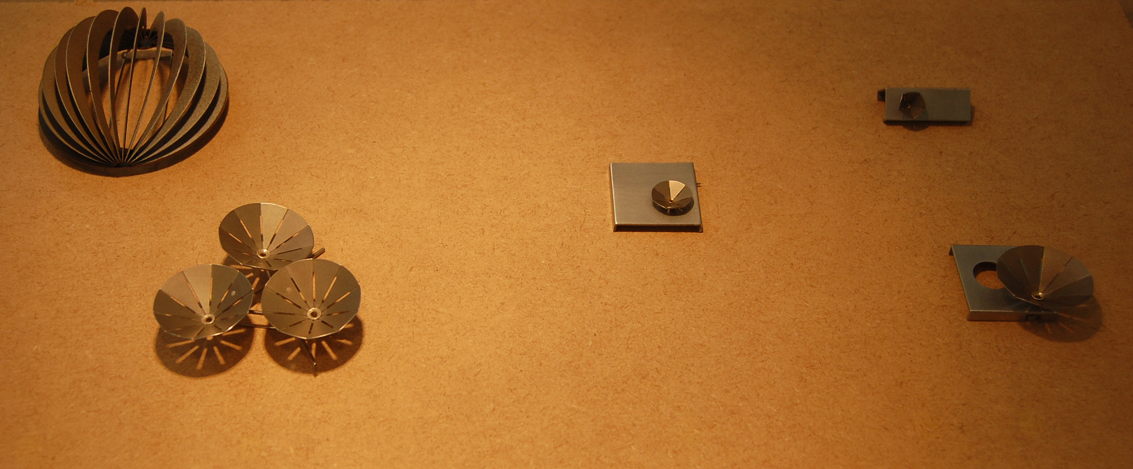
Christian Hall
Educated Sydney, lives Adelaide

Slide 23
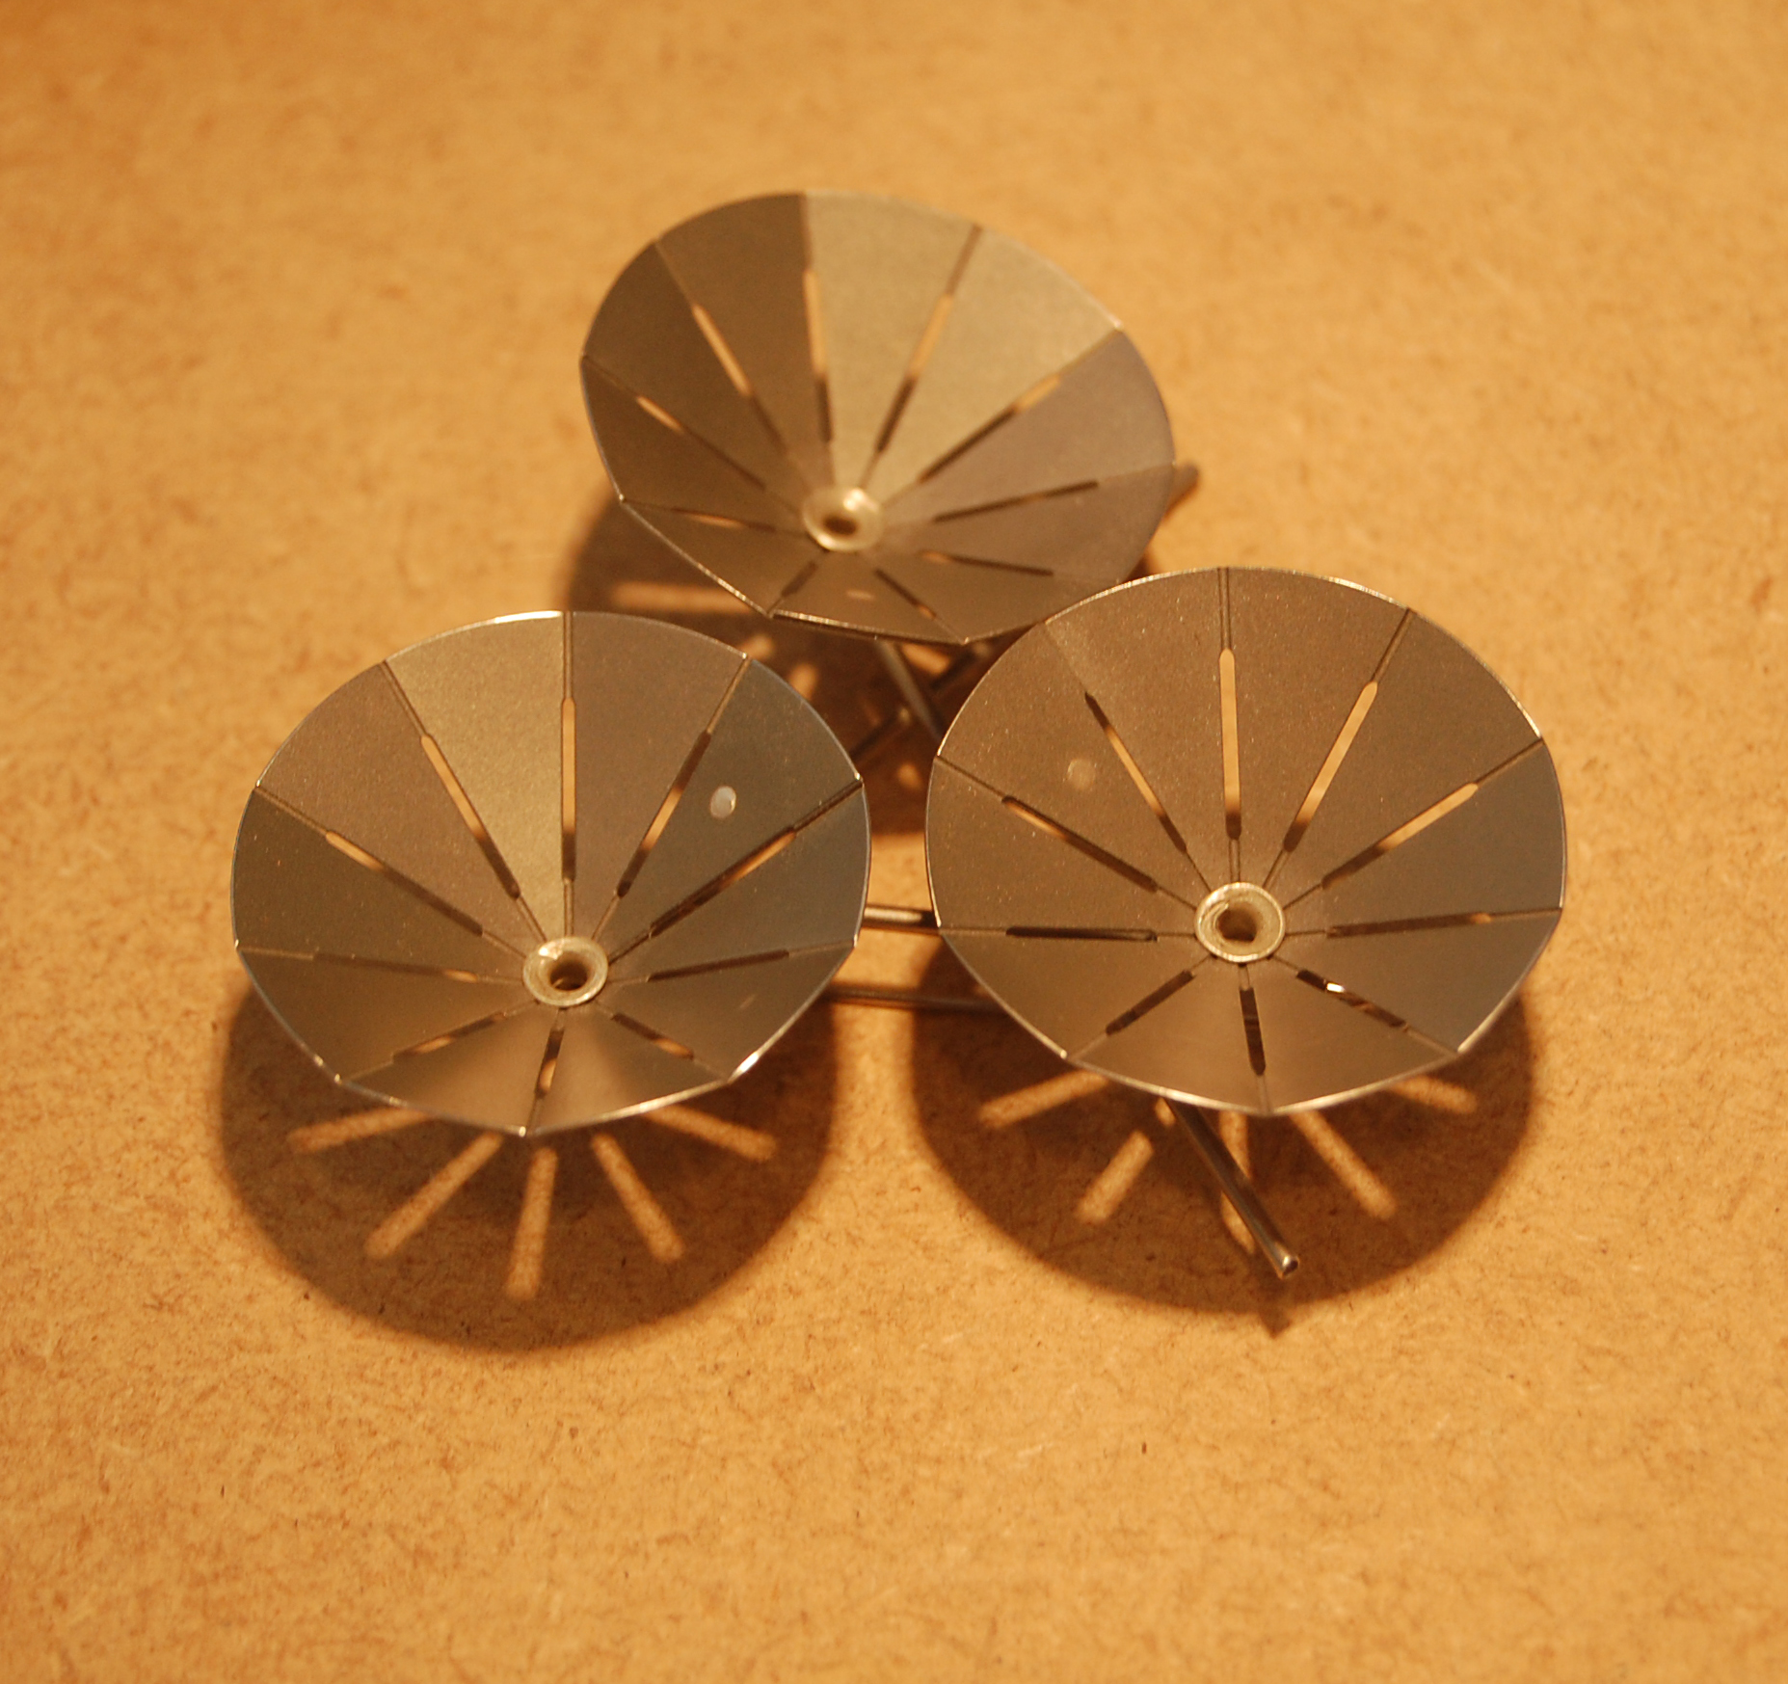
Christian Hall
Educated Sydney, lives Adelaide

Slide 24
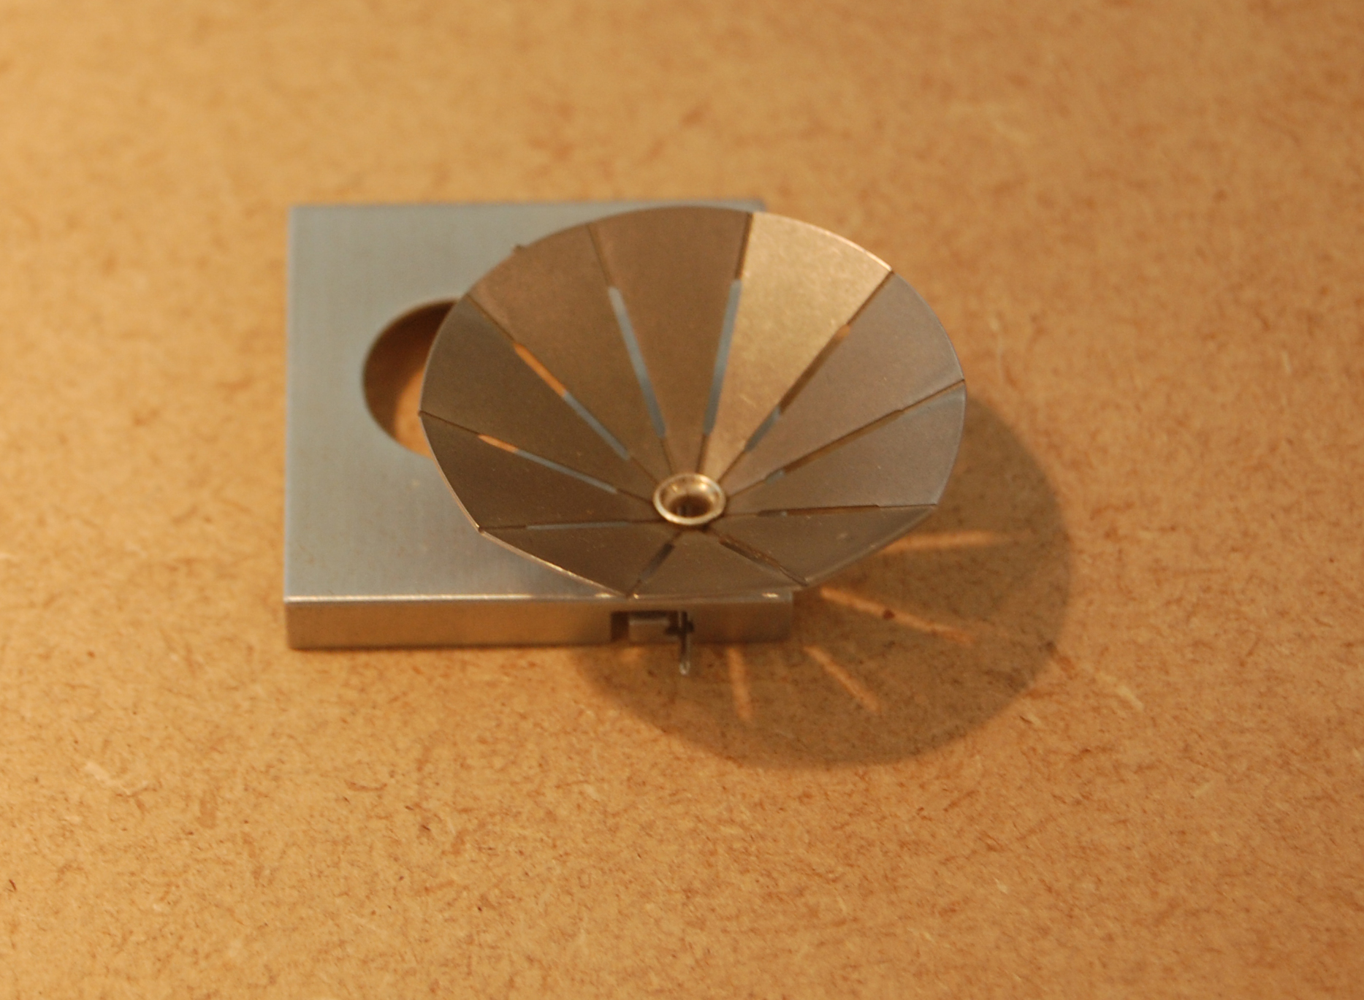
Christian Hall
Educated Sydney, lives Adelaide

Slide 25
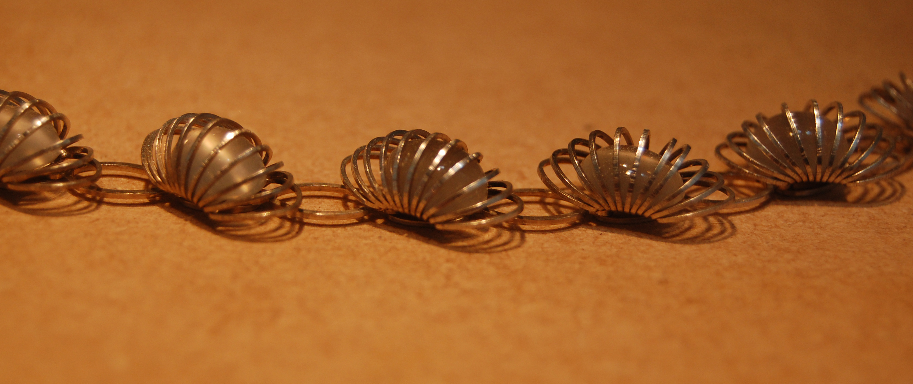
Andrew Lamb
Educated Edinburgh and London, lives Edinburgh

Slide 26
Andrew Lamb
Educated Edinburgh and London, lives Edinburgh
Education
2002-4 Masters, Goldsmithing Silversmithing Metalwork and Jewellery. Royal College of Art
2000 BA Hons. Design and Applied Arts – Edinburgh College of Art
Professional Practice
Present Glasgow School of Art, Part time Lecturer, Silversmithing and Jewellery (since October 2009)
2009 Goldsmiths' Hall, Creation II Day of Knowledge - two lectures for Coutts London Jewellery Week.
University of Hertfordshire, Visiting Lecturer
2008 Victoria and Albert Museum, Workshop with Dorothy Hogg for the opening of the Sackler Centre
2007-9 Royal College of Art, Part Time Jewellery Technical Instructor
2007 Royal University for Women, Bahrain, Visiting Lecturer
2006 Wire Weekend, Short Course, Clerkenwell Green, London
2005 Association for Contemporary Jewellery, member of judging panel, ACJ Prize at New Designers
Applied Arts Scotland, Edinburgh College of Art, Visiting Lecturer
Kent Institute of Art and Design, Visiting Lecturer
Richmond Adult community College, Visiting Lecturer
2001-2 Edinburgh College of Art, Artist in Residence
2000-1 Bishopsland Workshops, Post-graduate Training course / residency
2001 Surrey Institute of Art and Design, Visiting Lecturer

Slide 27
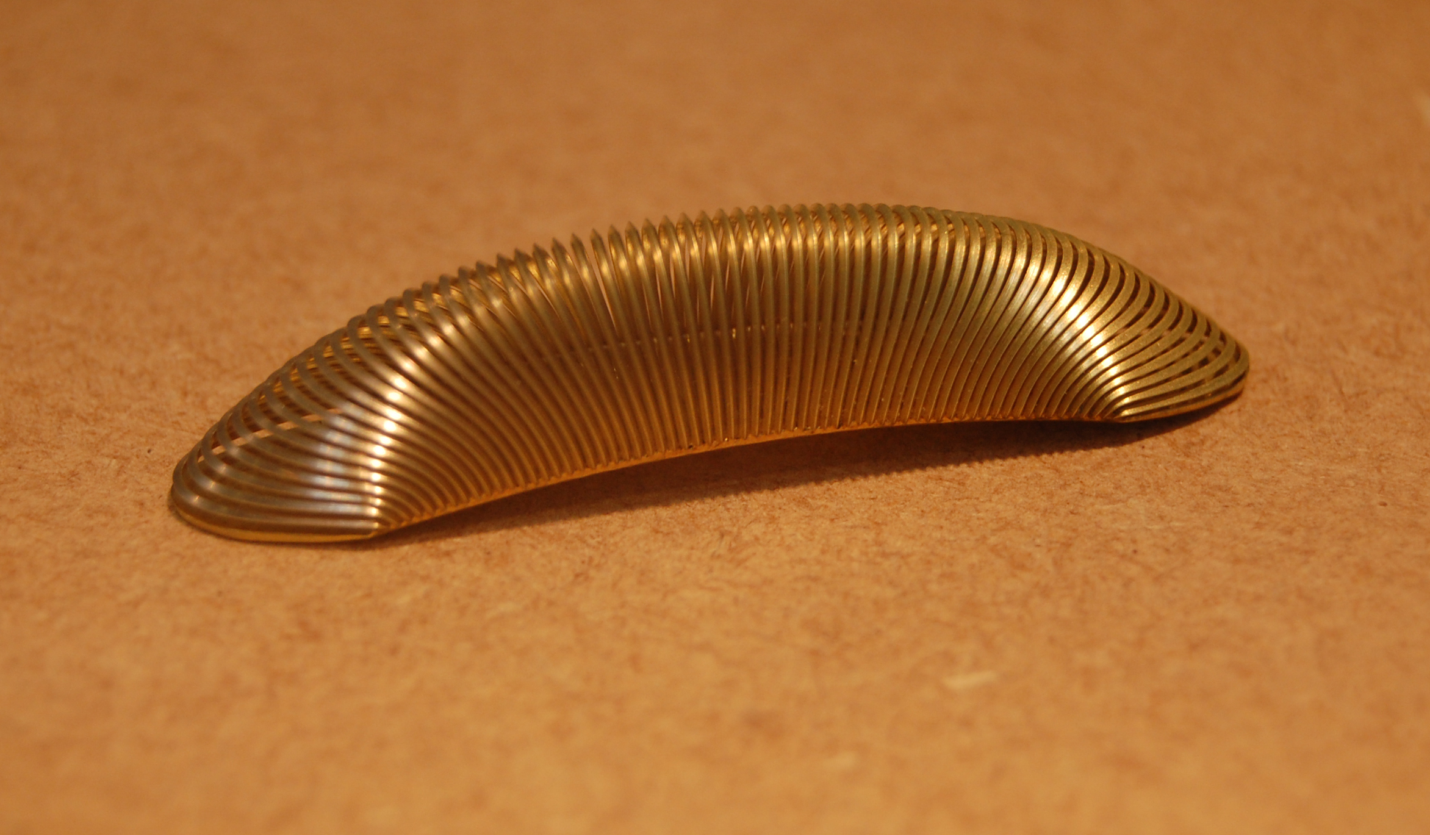
Andrew Lamb
Educated Edinburgh and London, lives Edinburgh

Slide 28
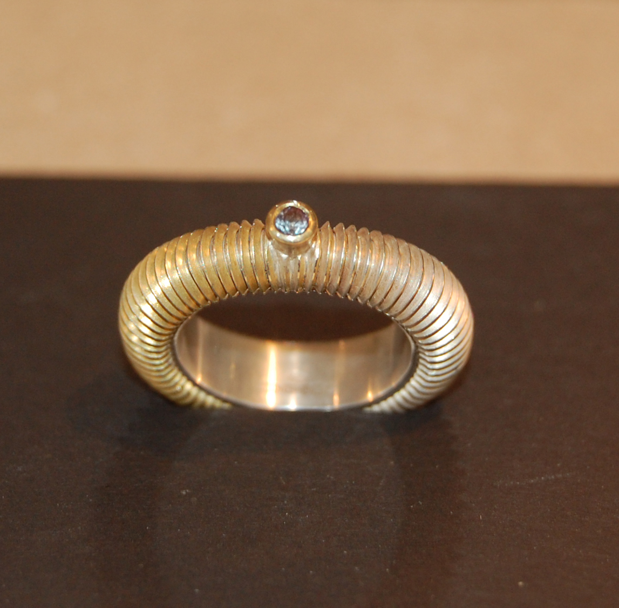
Andrew Lamb
Educated Edinburgh and London, lives Edinburgh

Slide 29
Grant McCaig
Educated Glasgow and London, lives London
Education
2009-11 Masters, Goldsmithing Silversmithing Metalwork and Jewellery. Royal College of Art
1998 Golsmiths Hall Business Schoool
1994-8 BA Hons. Silversmithing and Jewellery – Glasgow School of Art
1997 Exchange student to Maine college of Art, USA
Professional Practice
1998- Part time Lecturer in Jewellery and Silversmithing,
Present Edinburgh college of Art
Awards
2004 British Jewellers Assoc. Silver Award, Chealsea Craft Fair Runner Up
1998 Richard Hubbard Arrol Memorial Prize
Goldsmiths’ Craft Council Designer Silversmith (junior) First Place
1997 Goldsmiths’ Hall Precious Metals Bursary
1996 Dimple Whisky International Design Competition Runner Up
1995 Glasgow Art Club Drawing Competition Second Place

Slide 30
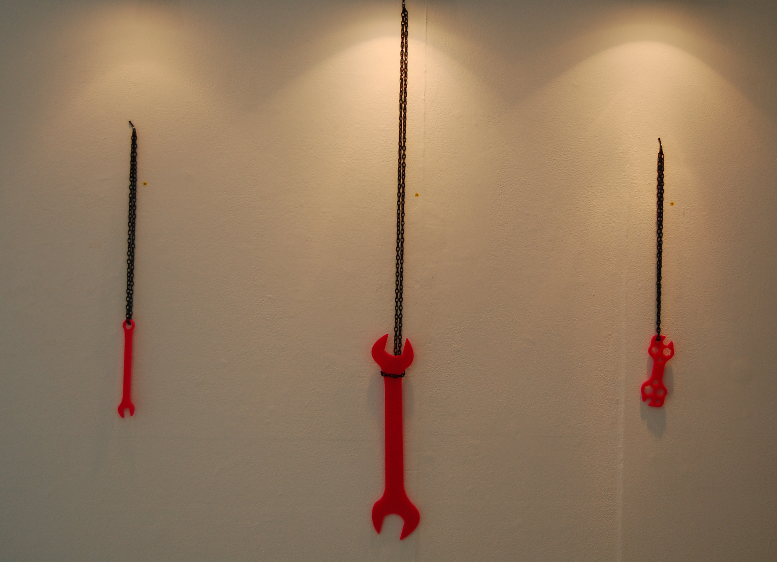
Grant McCaig
Educated Glasgow and London, lives London

Slide 31
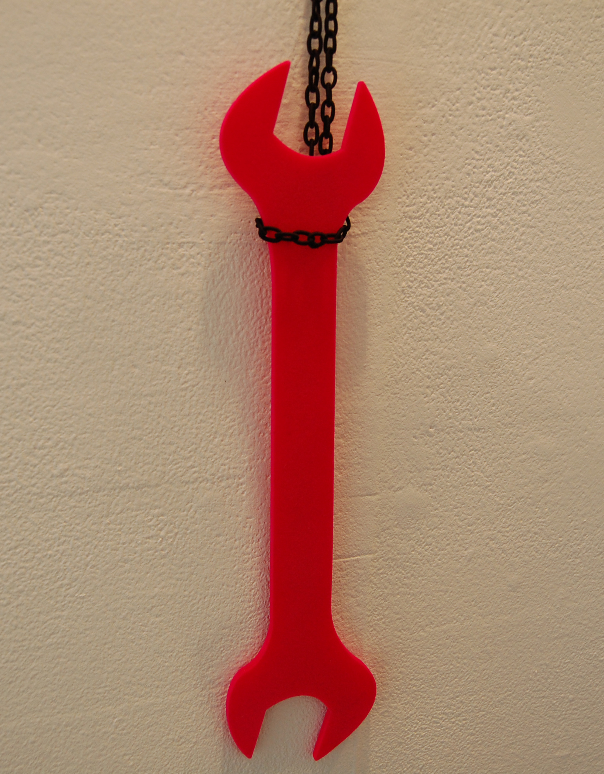
Grant McCaig
Educated Glasgow and London, lives London

Slide 32
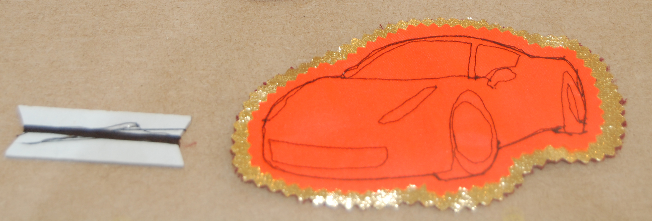
Grant McCaig
Educated Glasgow and London, lives London

Slide 33
Michael Pell
Educated Sydney and London, lives Glasgow
Education
2006 Post Graduate Cert. in Learning & Teaching in Art, Design & Communication
University of the Arts, London
2000 Certificate IV in Craft and Visual Arts Practice – Business Management
Eastern Suburbs Business Education Centre, Sydney
1999 Advanced Diploma in Arts, Jewellery and Object Design
Sydney Institute of Technology Design Centre, Enmore, Australia
1998 Associate Diploma in Arts, Jewellery Design
Sydney Institute of Technology Design Centre, Enmore, Australia
Professional Practice
2011 Curator- ‘not pretty?’ Touring Exhibition, Scotland and Australia
Curator- ‘Forty Years in the tower’ Glasgow School of Art
2005-present Permanent Lecturer, School of Design, Glasgow School of Art, Scotland
2005 Visiting Lecturer, S&J, Glasgow School of Art, Scotland
Artist in Residence, Silversmithing & Jewellery, Edinburgh College of Art, Scotland
1999 Established ‘gallery onefivesix- contemporary jewellery and objects’
156 Commonwealth Street, Surry Hills, Sydney, Australia
Co-founded ‘MANK’ jewellery and silversmithing studio
Batman Lane, Surry Hills, Sydney, Australia

Slide 34
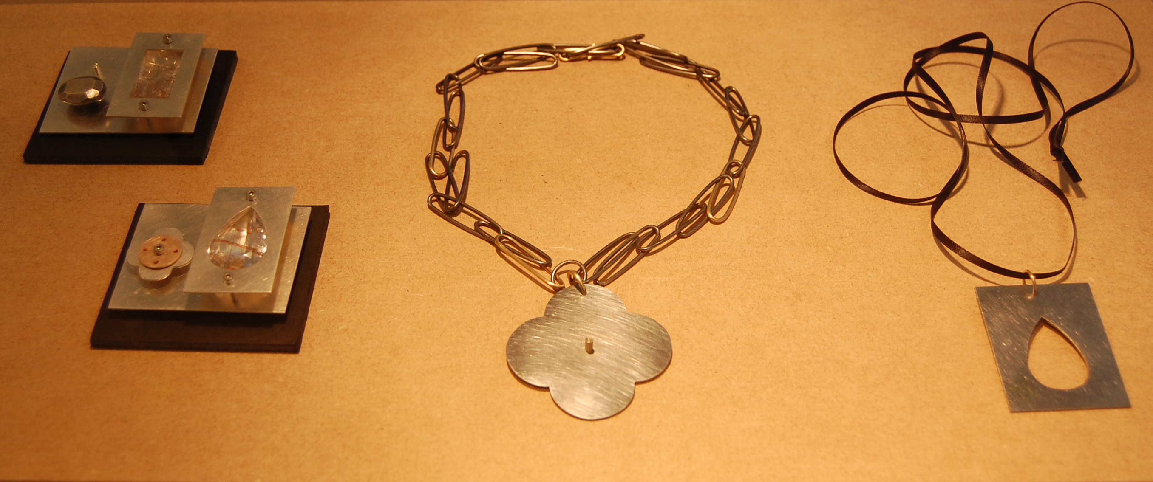
Michael Pell
Educated Sydney and London, lives Glasgow

Slide 35
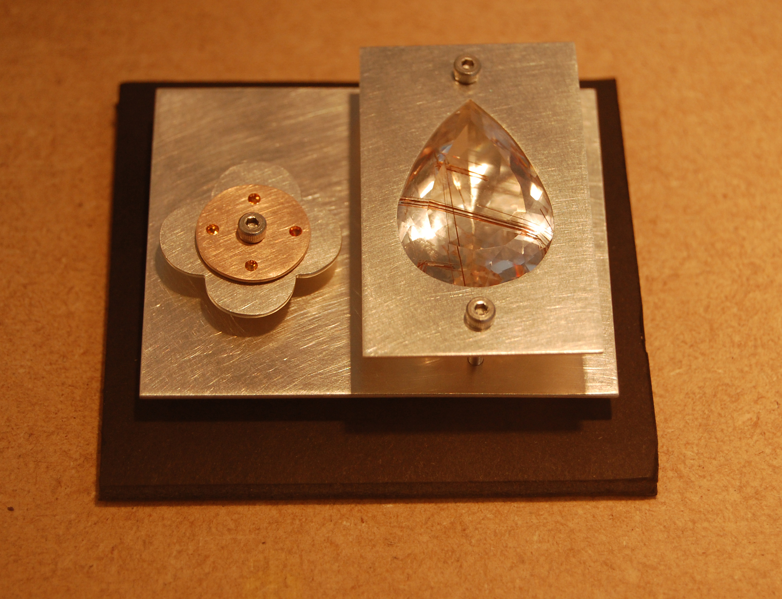
Michael Pell
Educated Sydney and London, lives Glasgow

Slide 36
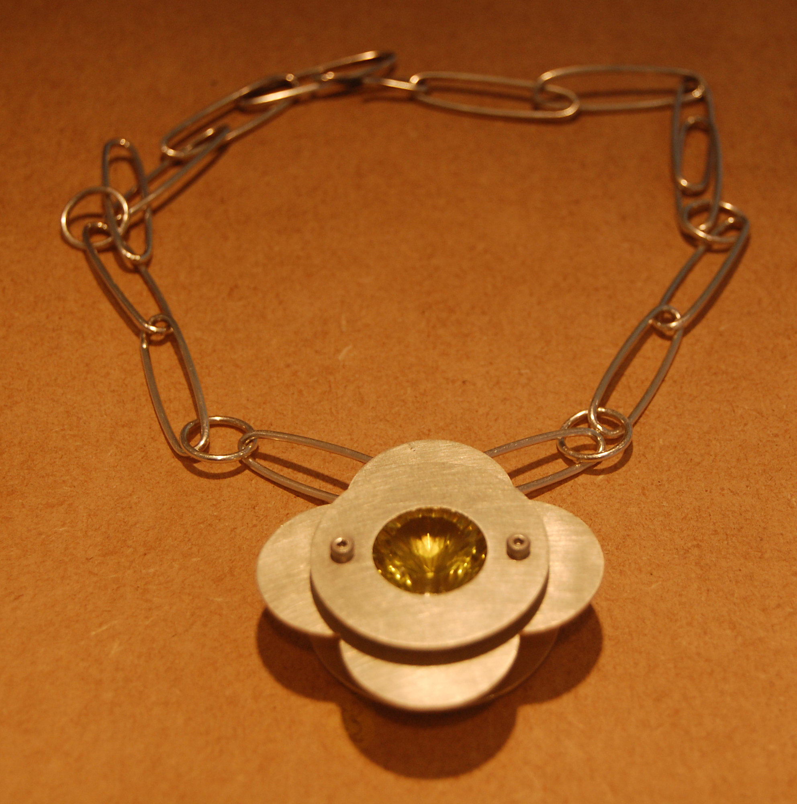
Michael Pell
Educated Sydney and London, lives Glasgow

Slide 37
Mark Vaarwerk
Educated and lives in Sydney
Education
1996-1997 Associate Diploma in Arts (Jewellery Design). Sydney Institute of Technology, Enmore.
Residencies
2007 April, May, June. Australia Council London Studio.
2004 February and March. The Hub Centre for Contemporary Craft, design and making, Sleaford, U.K.
2003 January to April. The Pearoom, Heckington, U.K., HAT Australia Jewellers exchange program.
1999 August to November. Mentorship grant awarded by Craft Queensland, funded by Australia Council.
Mentor and host Tracey Clement, Sydney.
Workshop Teaching
2008 “transforming throwaway plastics: some simple techniques”
Queensland College of Arts, Brisbane 10, 11 May, 15, 16 March
2007 University of South Australia, Adelaide, 1,2,3 September, 29, 30, 31 January
Australian National University, Canberra, 1-4 January

Slide 38
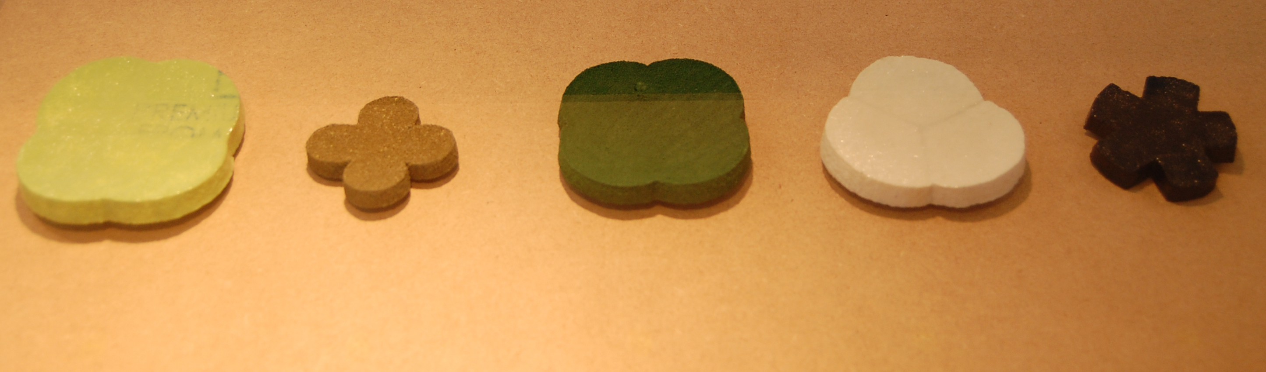
Mark Vaarwerk
Educated and lives in Sydney

Slide 39
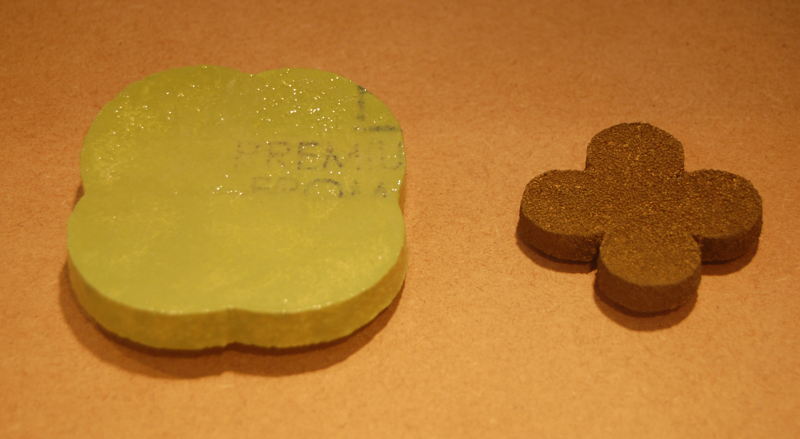
Mark Vaarwerk
Educated and lives in Sydney

