Slide 1
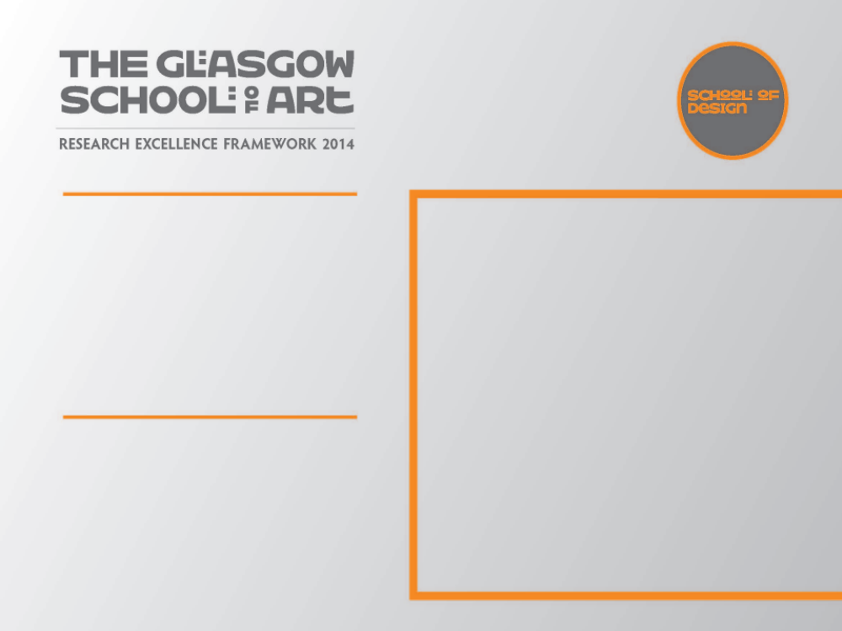
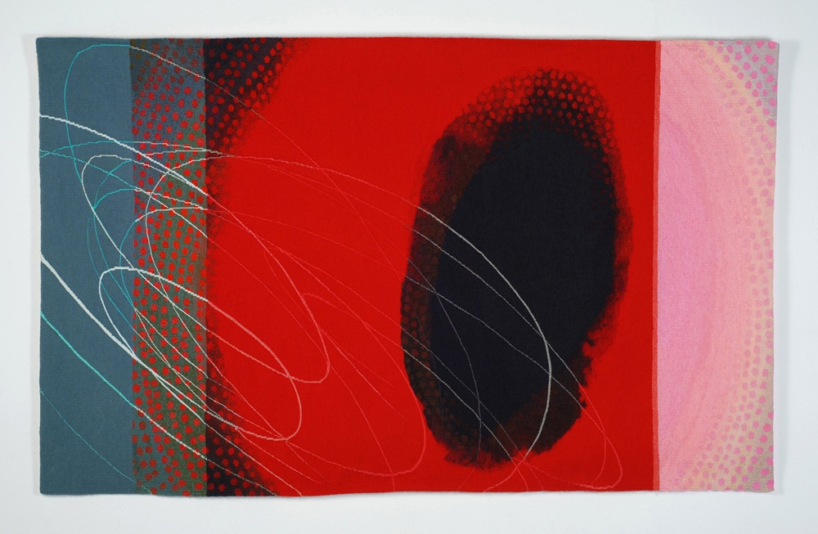
Jo Barker – Tapestries
Solo Exhibition
Hand-woven tapestries exploring translation from drawing, painting & digital manipulation, into yarn. Investigations focus on colour intensity; capturing spontaneity of drawn and painted marks and fleeting qualities of light.
Tapestry – ‘Resonance’ 2009
172 x 104cm
Submitted by Jo Barker
Output No. 1

Slide 2

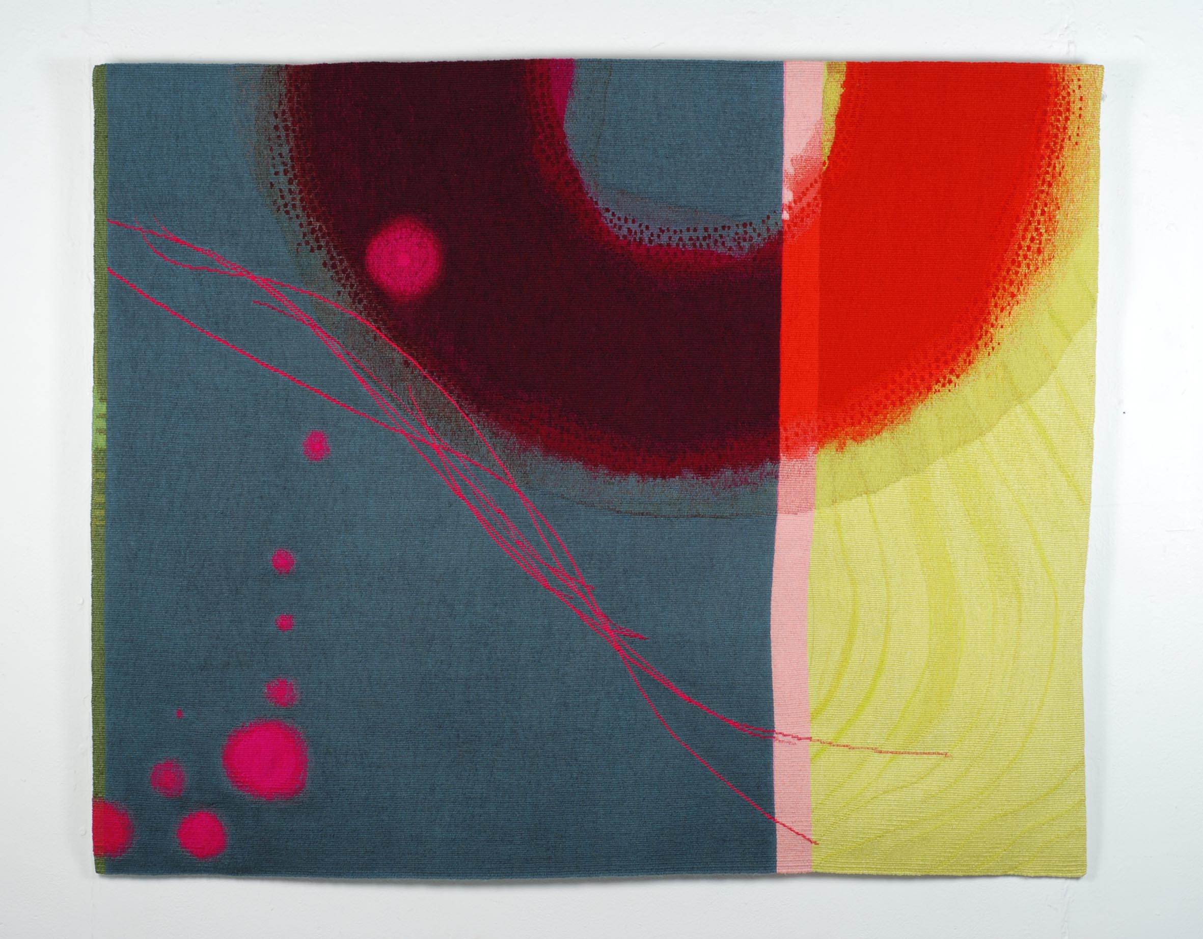
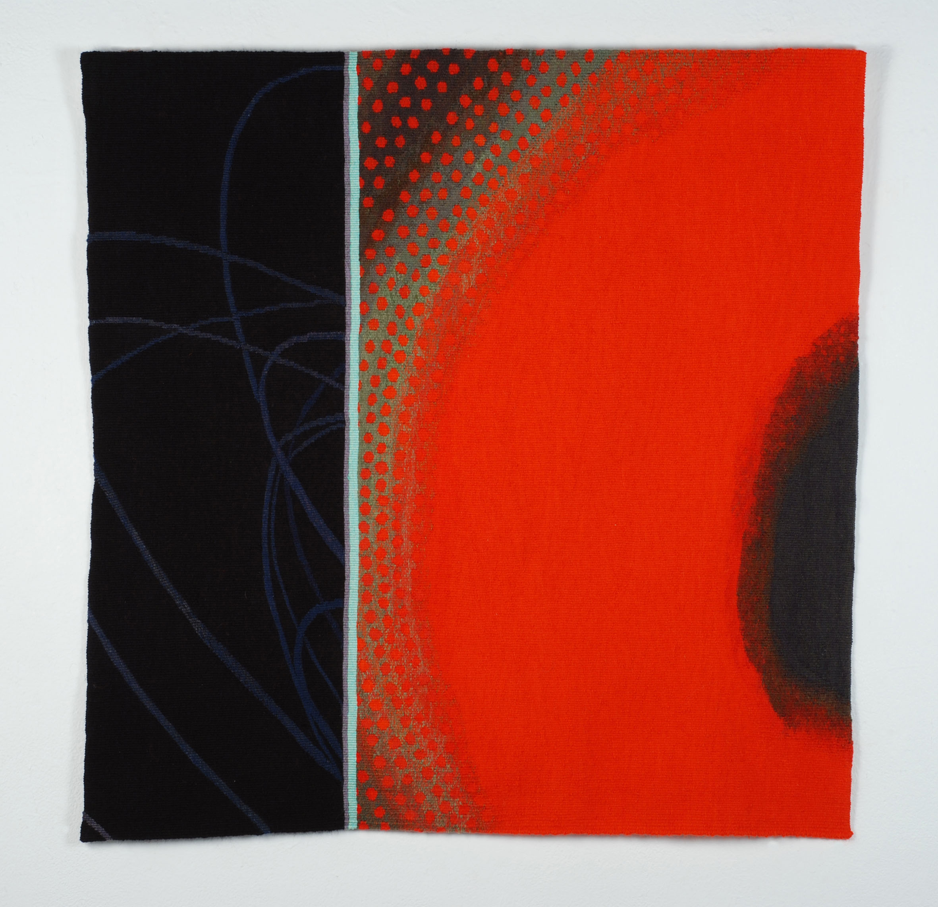
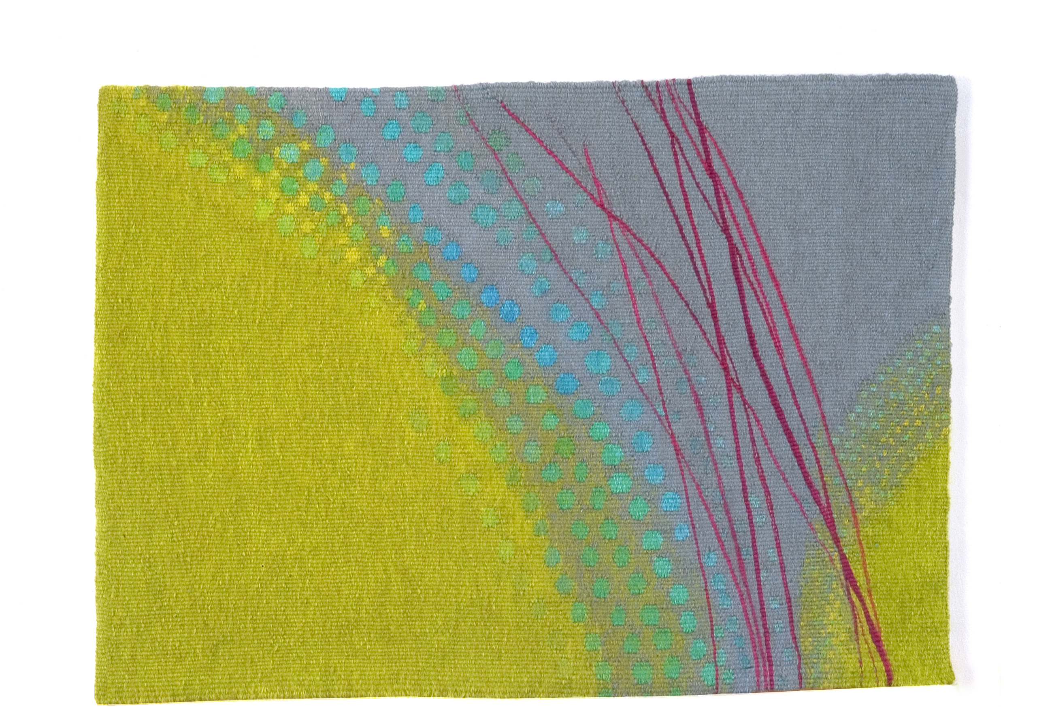
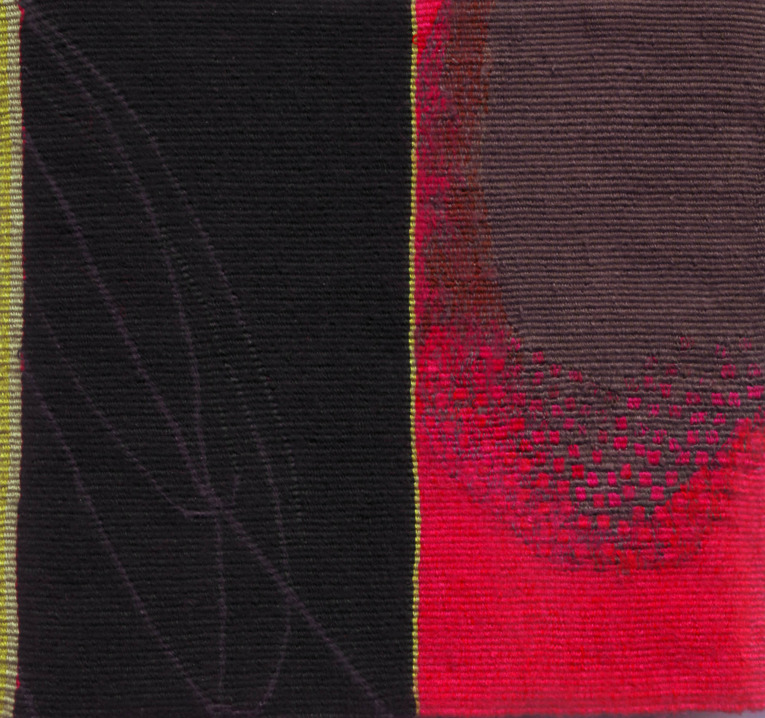
Jo Barker – Tapestries
Solo Exhibition
This output comprises:
New body of work and production of exhibition catalogue as a result of receiving funding awards from Scottish Arts Council, Theo Moorman Trust for Weavers and Inches Carr Trust
Invitation from Scottish Gallery, Edinburgh for solo exhibition
Subsequent showings: exhibitions in 8 galleries in UK & USA
3 peer review articles
2 book sections
5 catalogues
Research for this exhibition involved:
Study trip to Cairo to observe Coptic tapestries in Coptic Museum, plus traditional weaving workshop, Harrania, Egypt
Learning & application of photoshop skills to assist design of tapestries
Research questions asked:
How does the use of digital tools at the design stage
of the working process translate into the hand woven
making stage?
Is it possible to capture the spontaneity of a graphic
drawn line & layered painted marks in the slow,
traditional construction technique of Gobelin tapestry
weaving?
180
Jo Barker
2.
3.
1.
4.
5.
Work created for solo exhibition ‘Jo Barker – Tapestries’ , Scottish Gallery, Edinburgh 2009
1. Resonance – 104x171cm 4. New Green – 38x52cm
2. Drift – 103.125cm 5. Rose Haze – 18x19cm
3. Vermilion Glow – 82x80cm

Slide 3

Resonance – 104x171cm

Slide 4
New Green – 38x52cm
Drift – 103x125cm

Slide 5
Rose Haze – 18x19cm
Vermilion Glow – 82x80cm

Slide 6
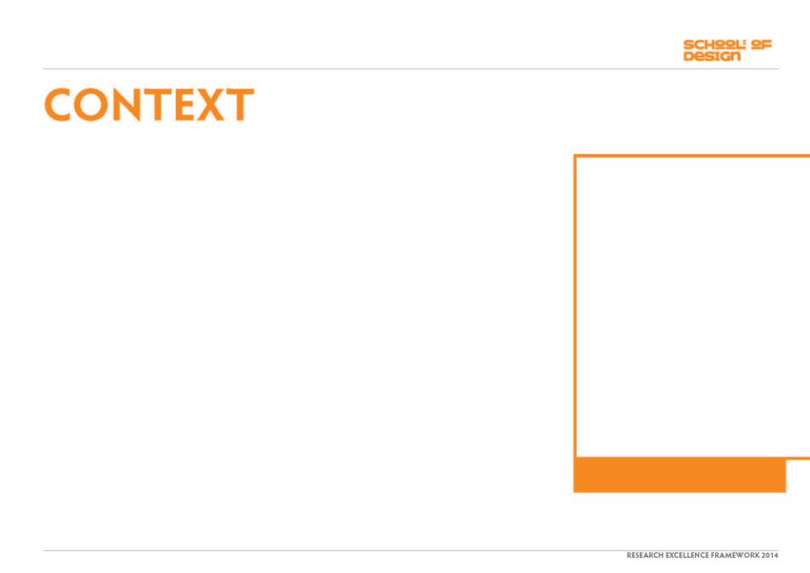
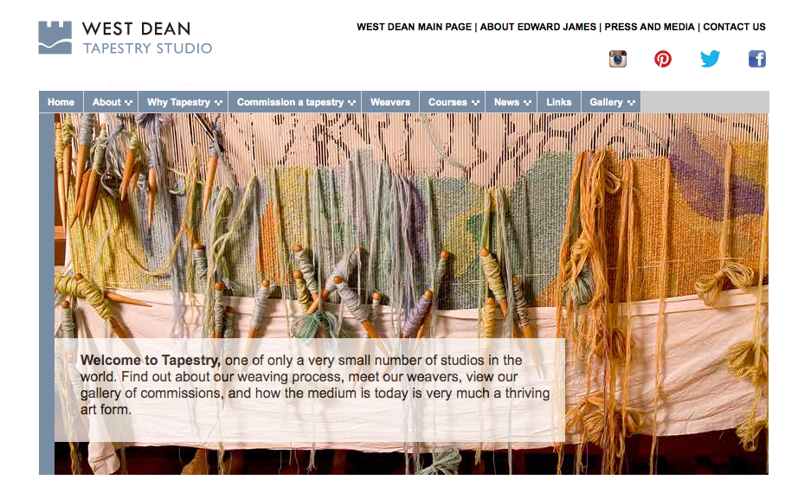
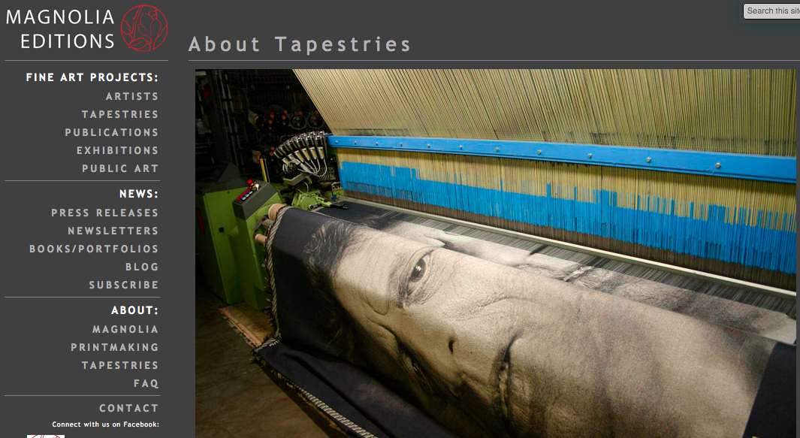
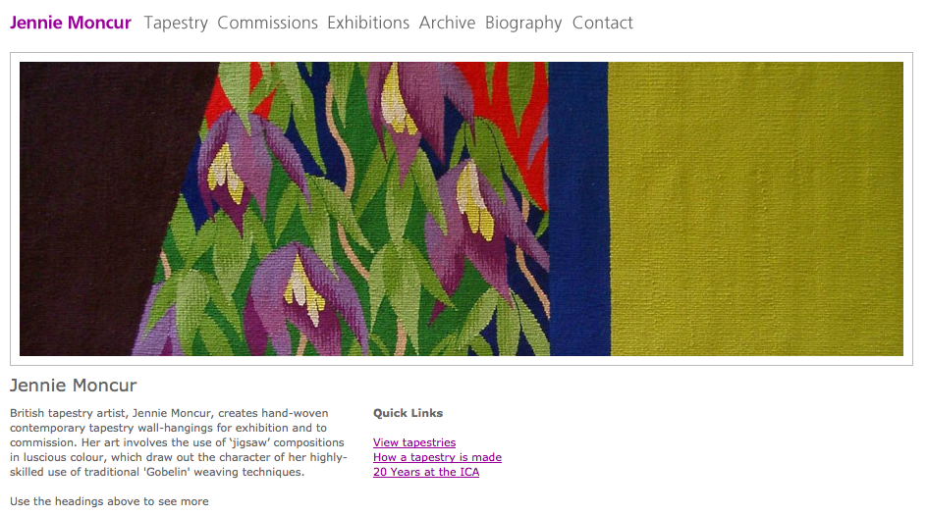
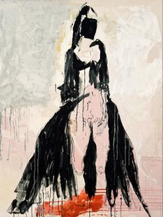
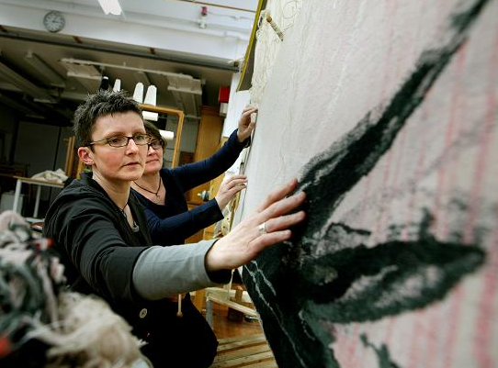
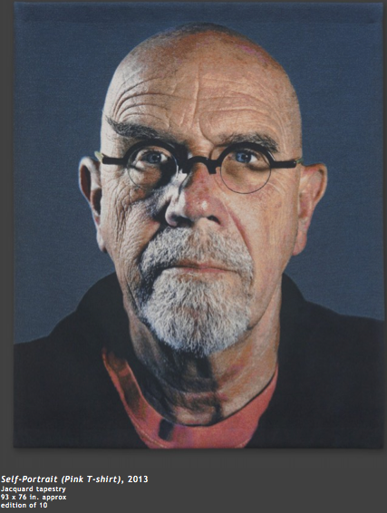
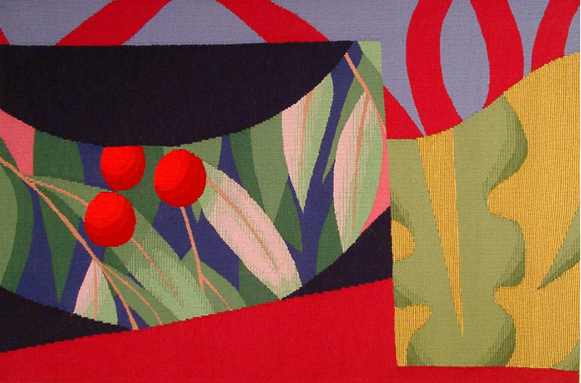
Current practice in the field of tapestry weaving finds itself falling into one of three major methods of design & manufacture.
1. Studio weaving
Skilled craftspeople handweaving artists designs eg Tracey Emin at West Dean Studio, UK
http://www.westdean.org.uk/Tapestry/Showcase/Tracey%20Emin%20Four%20Tapestries.aspx
2. Machine manufacture
Digital jacquard looms producing artitsts editions eg Chuck Close at Magnolia Editions, USA
http://www.magnoliaeditions.com/artists/chuck-close/?filter=Tapestry
3. Individual artist weavers
Artists working from their own studios producing one-off hand woven tapestries from their designs.
http://www.jenniemoncur.com/

Slide 7
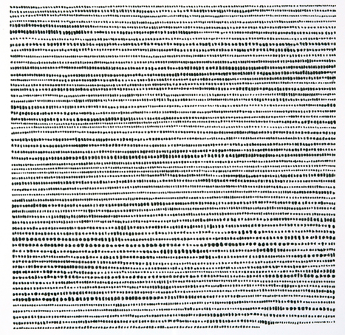
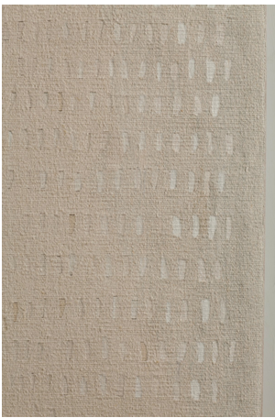
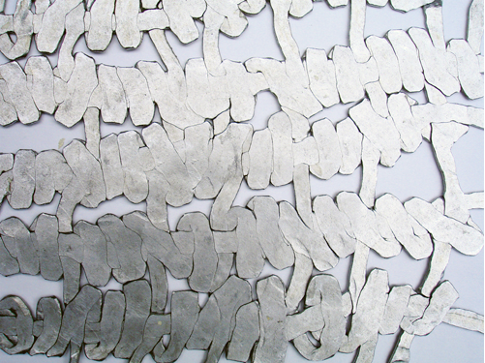
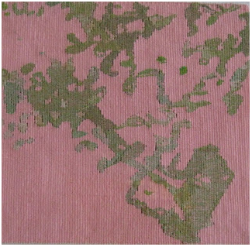
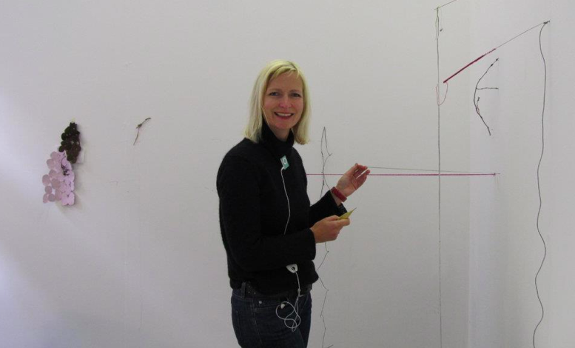
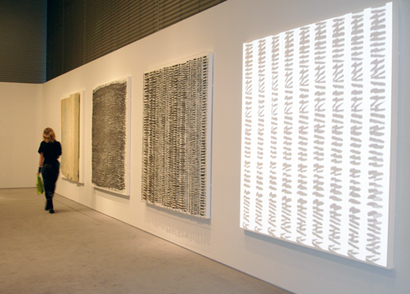
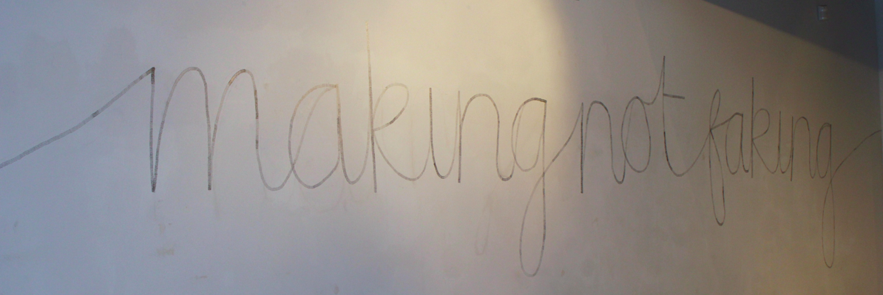
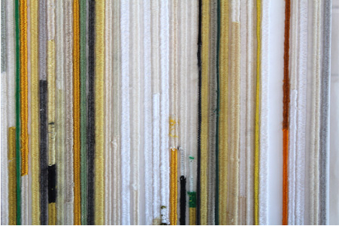
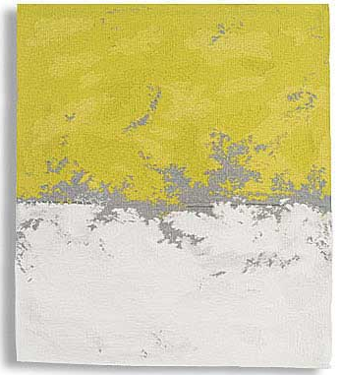

My work falls into category 3 (previous page).
It is important to me that the work is designed and made by the artist; for the work to have creative integrity. It is also important to exhibit alongside contemporaries whose professional practice aligns with my own and whose creative philosophy contain the intellectual rigour that I respect. For example, within the field of tapestry weaving:
Sara Brennan. The work is minimalist referencing artists such as Barnett Newman and Rothko. Often producing series of works which nudge subtle colour palettes of dark and light tonal areas, creating tensions between notional sections of land, sky and horizon of a consciously non specific landscape.
Susan Mowatt currently focuses particularly on the process of weaving itself. the importance of making, connectivity to materials and experiencing the ‘flow’. Working with fragments and lines of weaving she re-assembles them and creates large and small scale installations.
Sue Lawty explores the links between contemporary use of unconventional materials and traditional practice. Constructed pieces - tapestries, assemblages, and drawings in two and three dimensions - are abstract and minimal. They explore repetition and interval; investigating territories of expression in raphia, hemp, linen, lead, tiny stones or shadow.
Sue Lawty

Slide 8
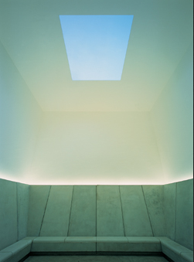
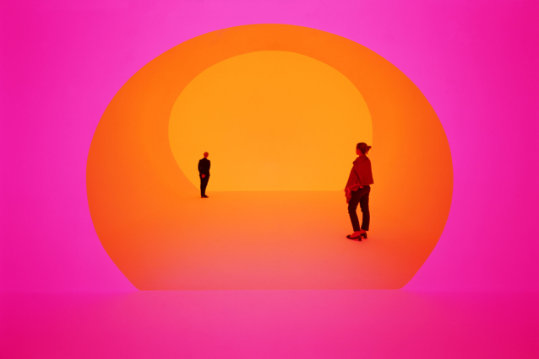
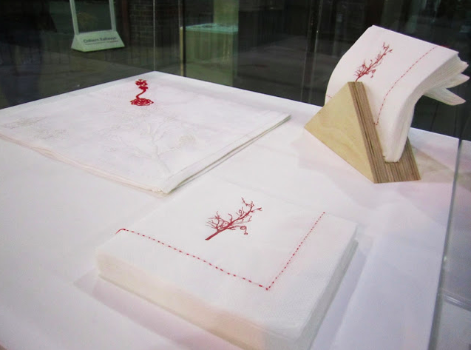
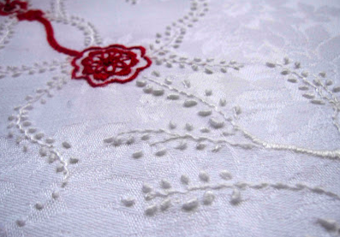
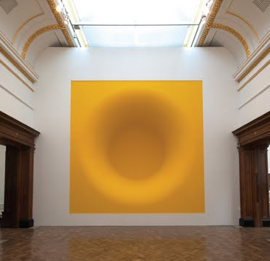
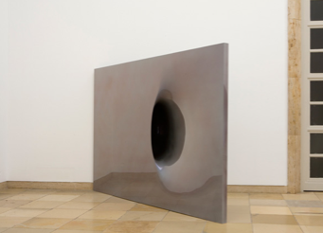
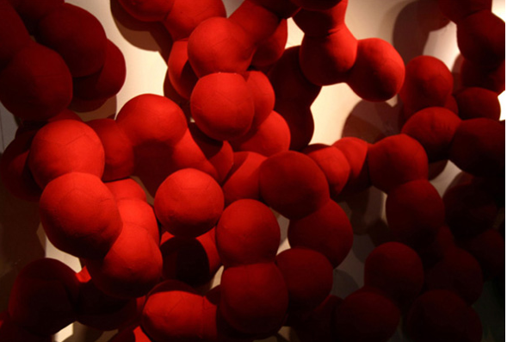
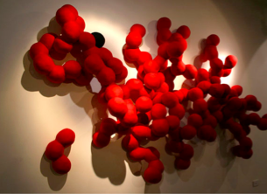
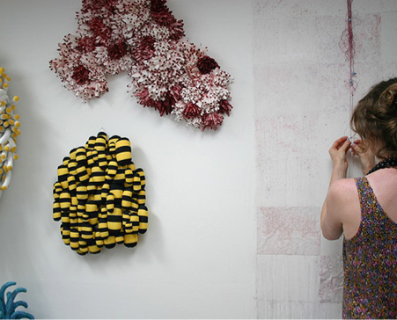
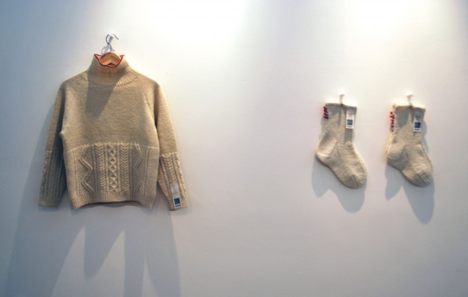
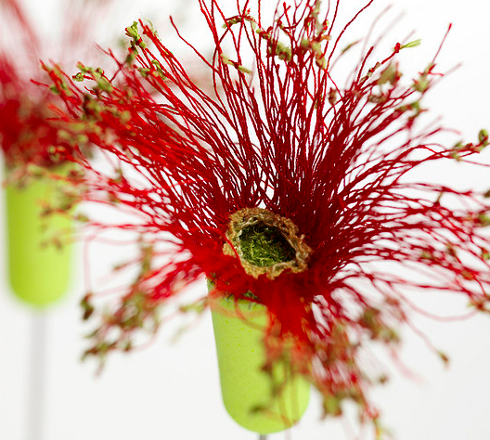
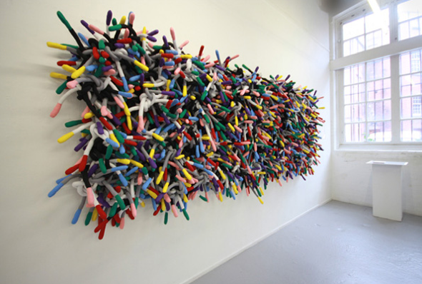
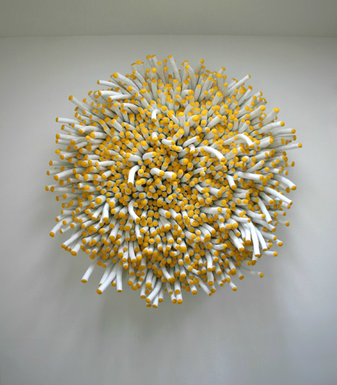
Whilst my work remains 2 dimensional, textile artist colleagues whose work I respect, working in 3 dimensions, have also been co-exhibitors.
Anna Ray has a multidisciplinary textile approach, embracing traditional methods of making employing embroidery and drawing techniques in a wide range of materials whilst also using digital technology. Her work explores psychological and physical experiences.
Deirdre Nelson . Research, humour and a wide
range of ‘craft’ techniques – including
knitting, embroidery, lacemaking – contribute
to projects dealing with social and environmental
issues, whilst also engaging communities in
the process.
James Turrell
Anish Kapoor
Inspiration from sculptors working with
perceptions & illusions of space & light

Slide 9
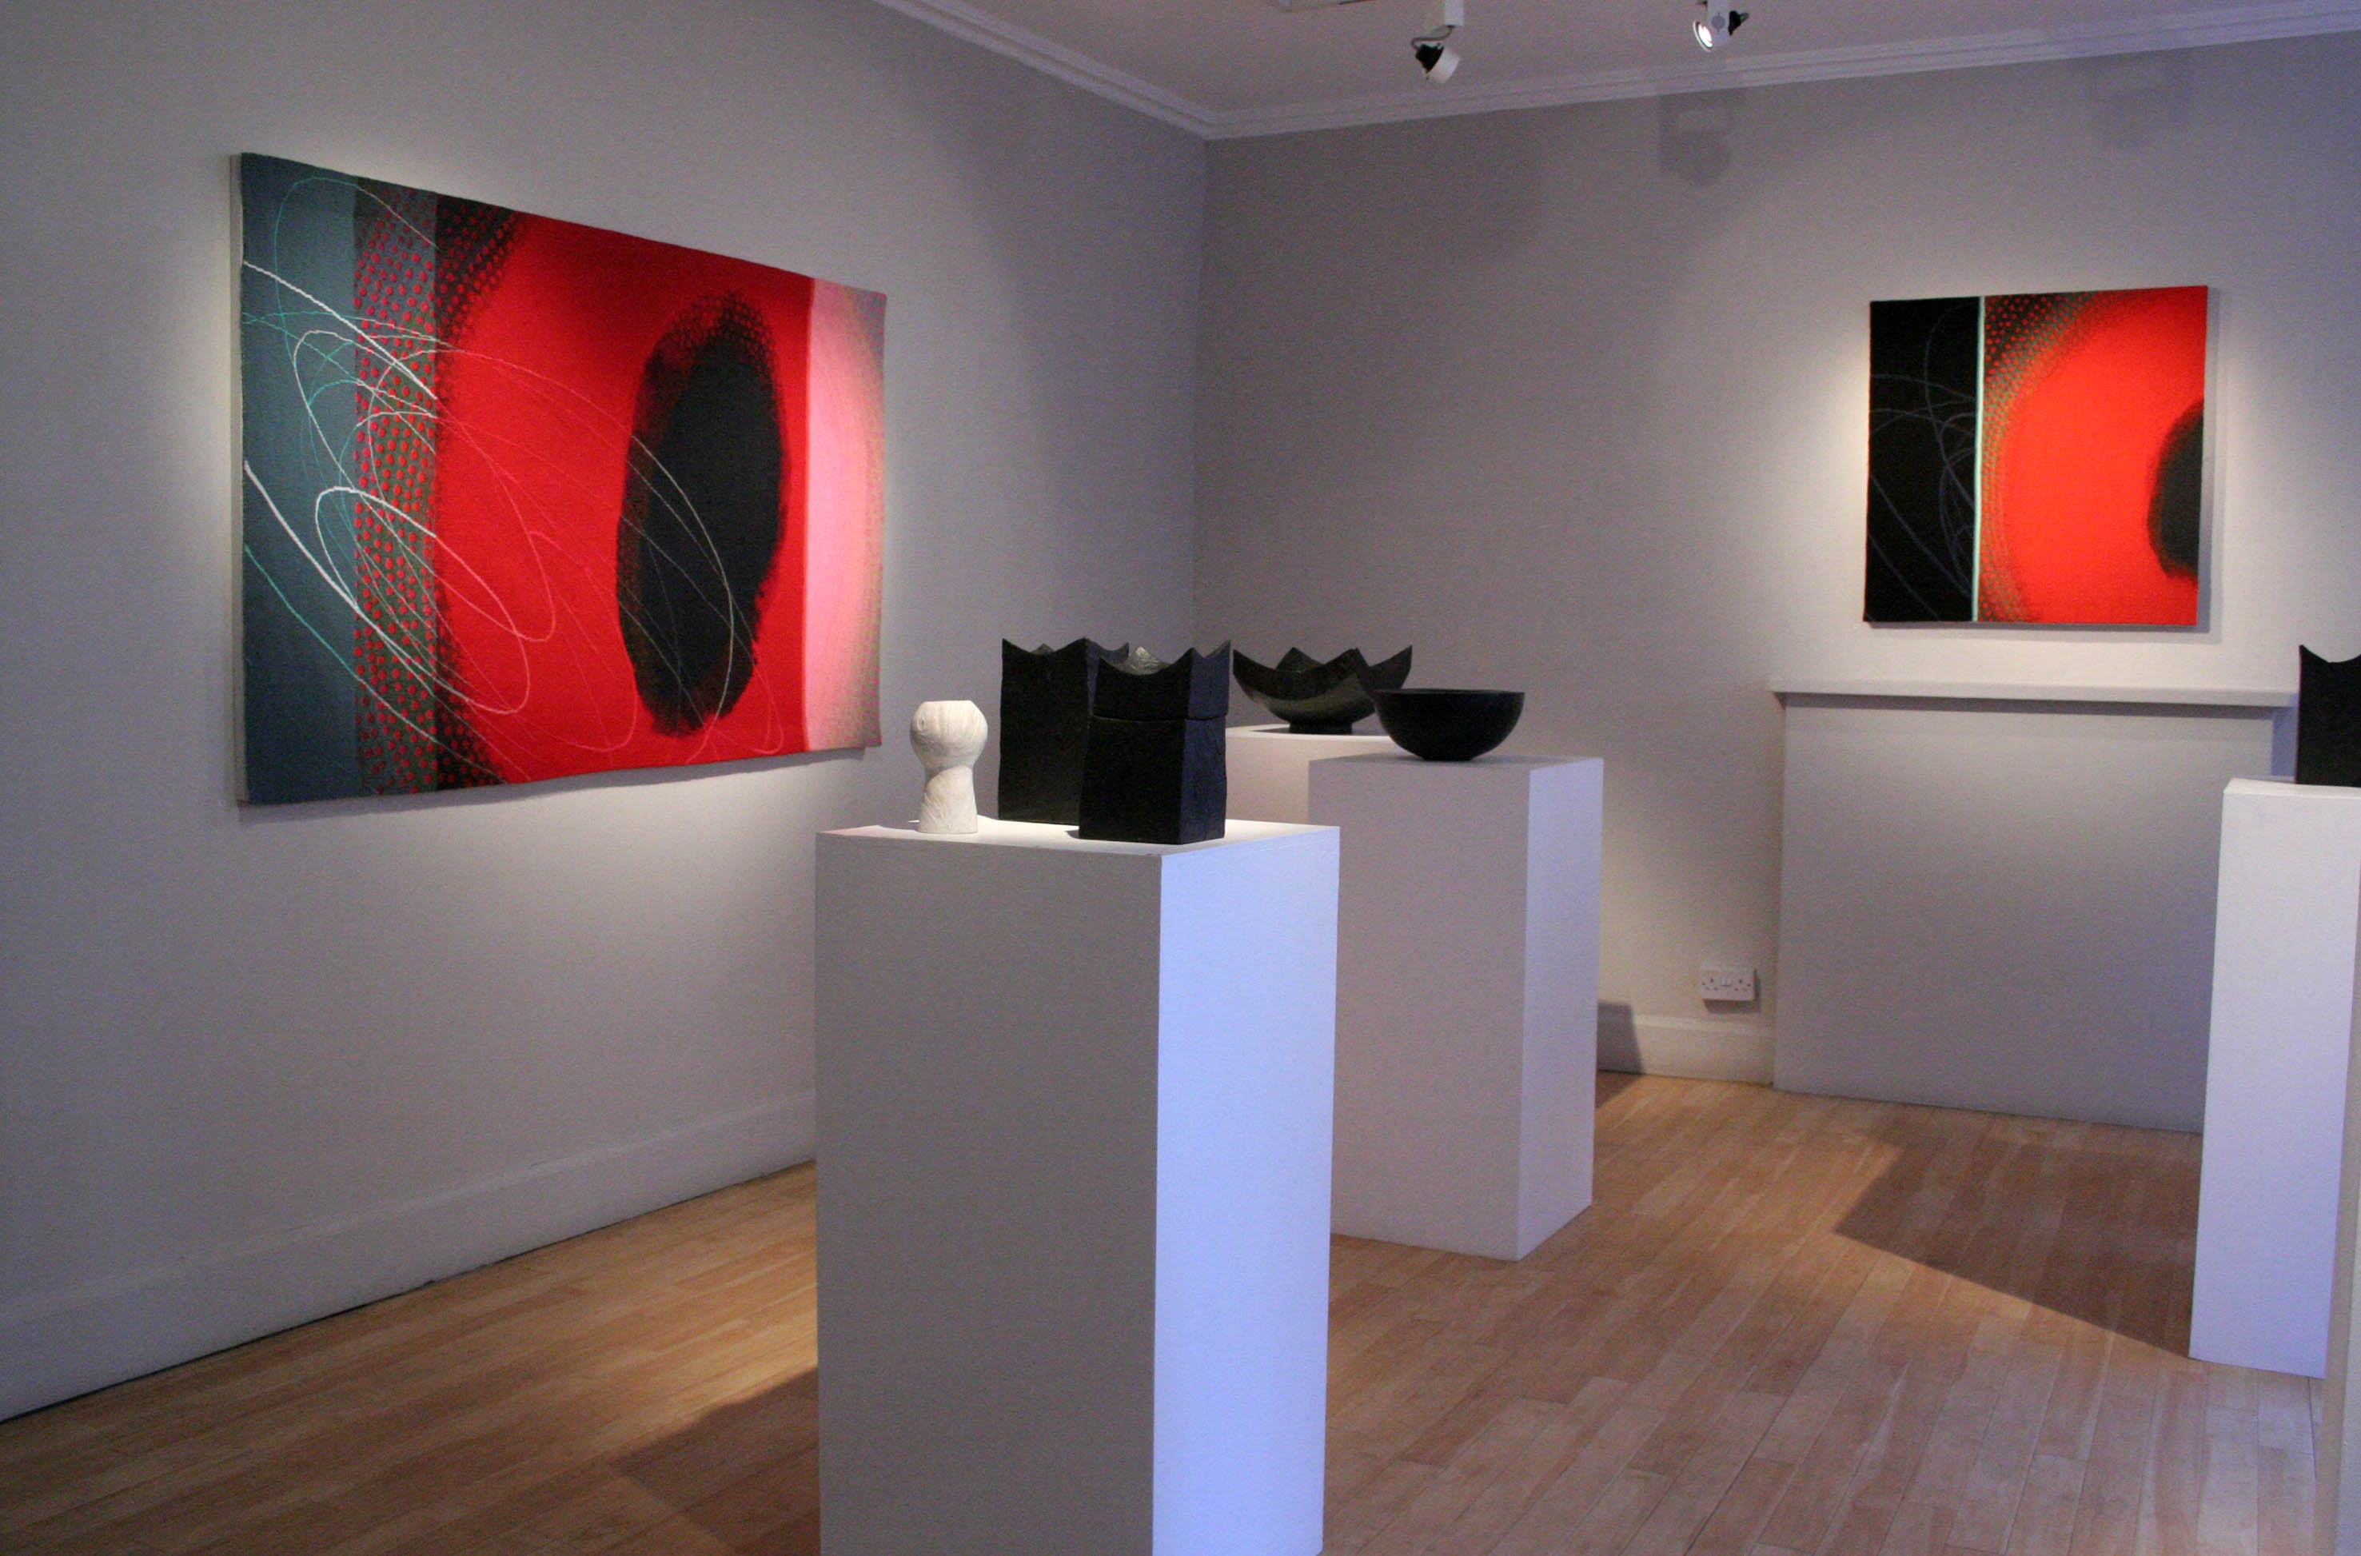
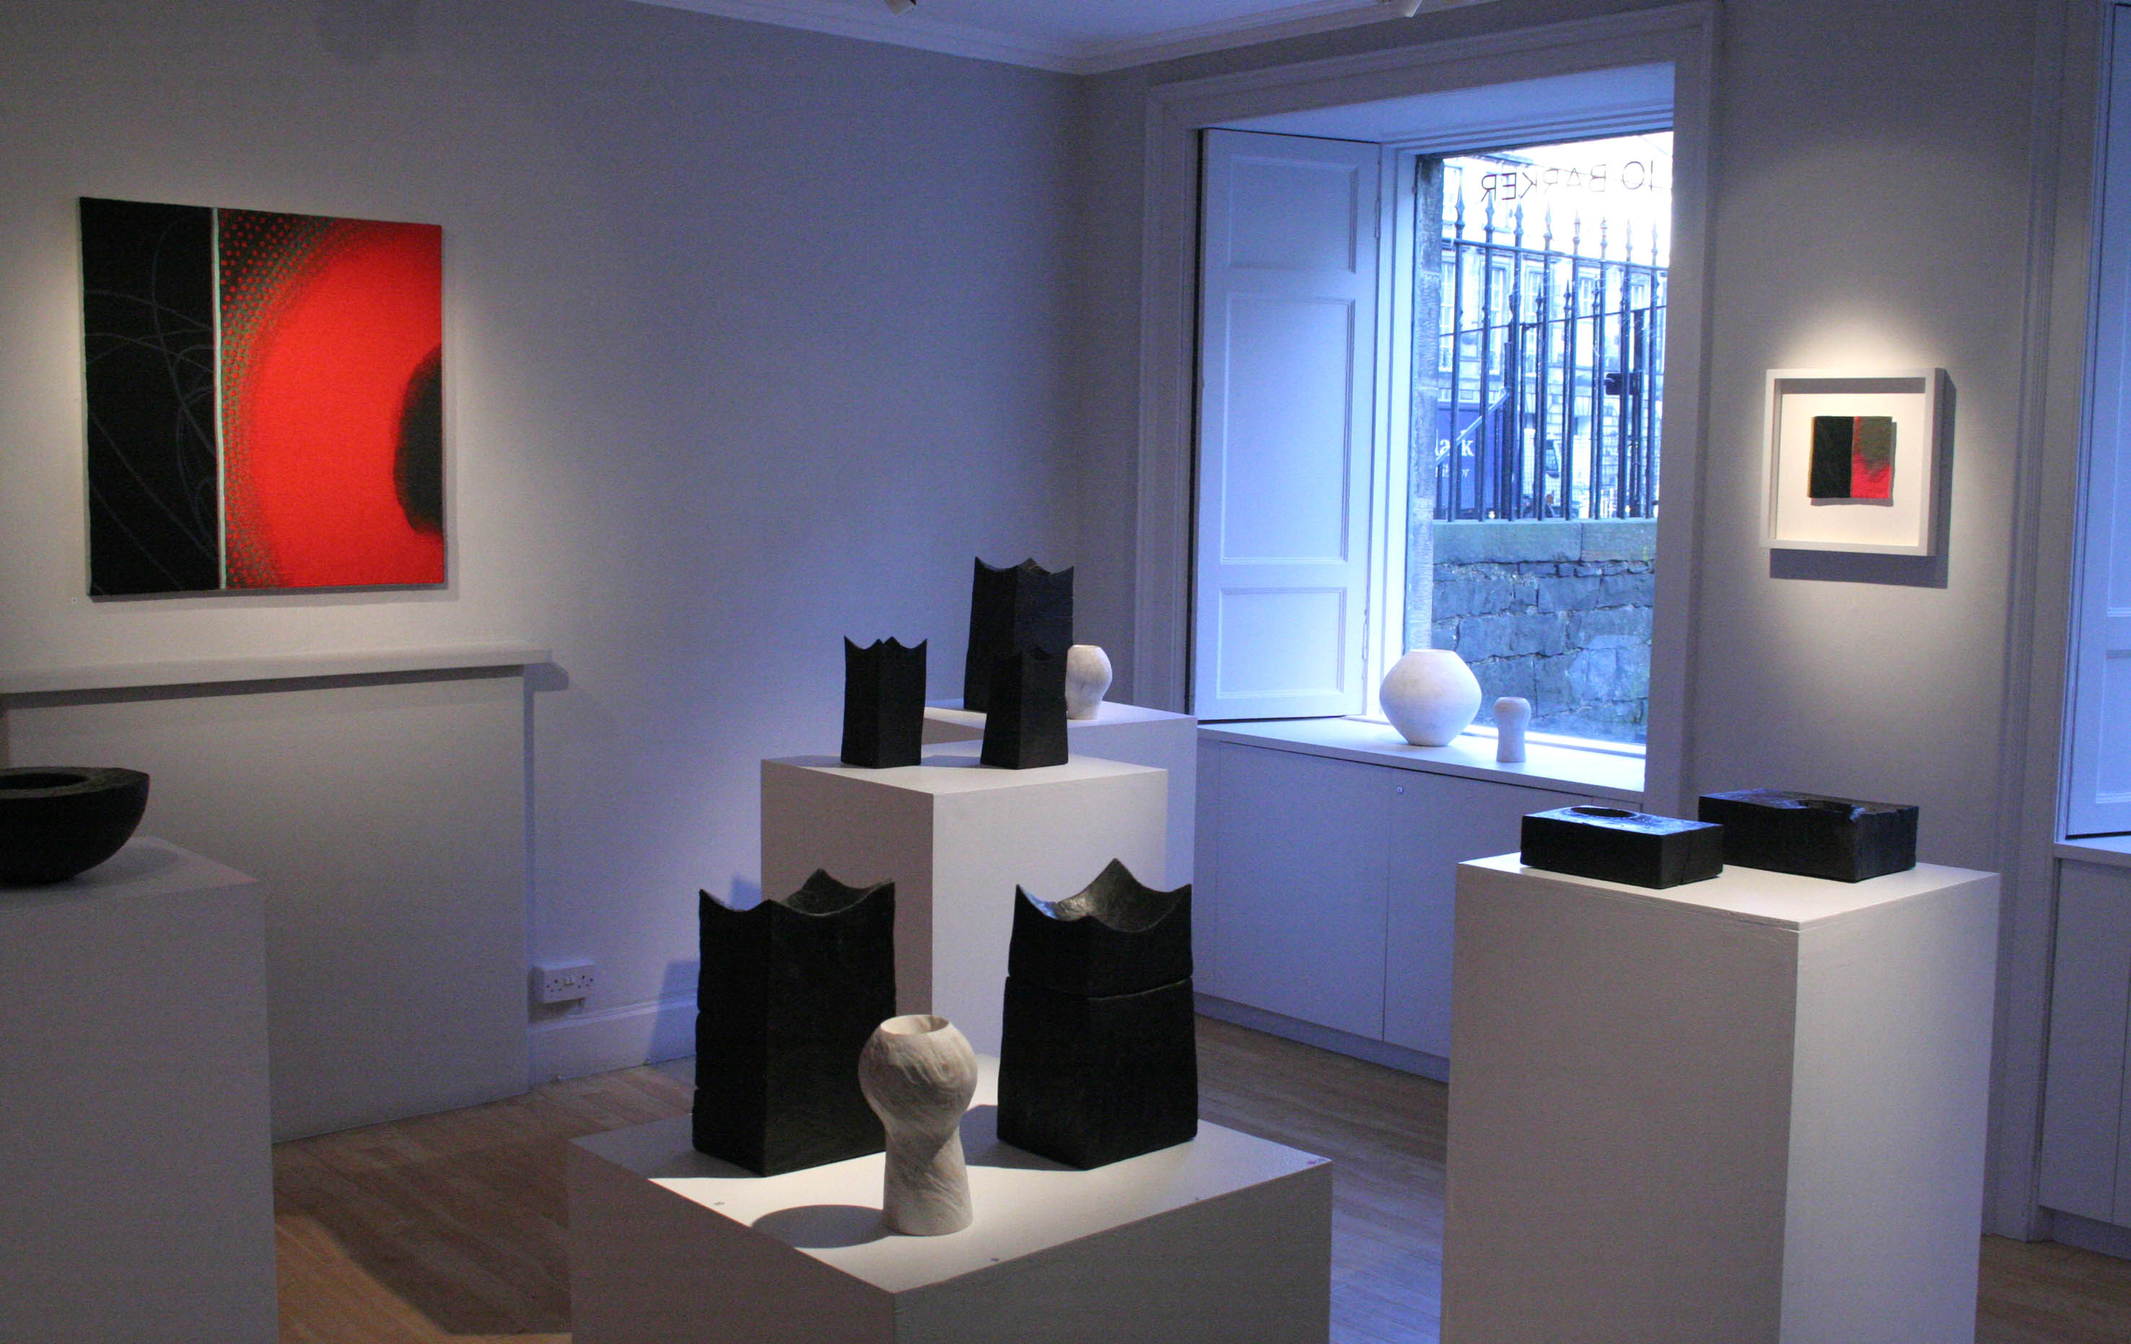
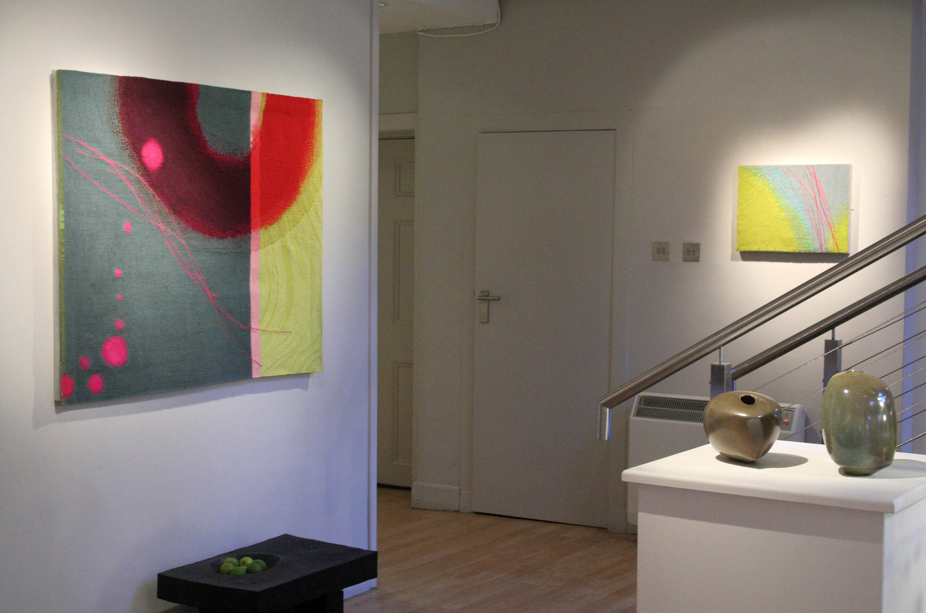
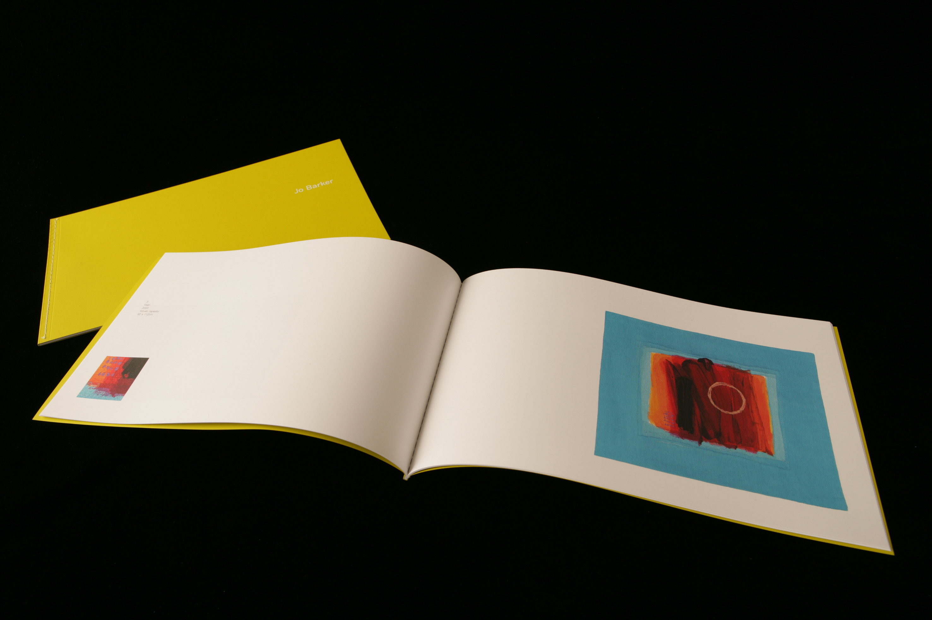
Traditionally, tapestry designs have taken the form of drawings, paintings or photogrpahs which are translated into woven images.
I was interested to incorporate digital skills into this stage of the process – an area under-explored at this time in the field – and further, to explore the potential of capturing the vibrancy of digital-screen colour luminosity in the subsequent translation into weaving with yarns.
The funding awards (p1) resulted in the body of work created for the solo exhibition “Jo Barker - Tapestries” at the Scottish Gallery Edinburgh in 2009, plus the production of a full colour catalogue.
Scottish Gallery installation views of solo exhibiton. Tapestries displayed on walls.
Exhibition catalogue “Jo Barker – Tapestries”
http://issu.com/michaeldancer/docs/jobarker_14
ISBN-13: 978-0956109903

Slide 10
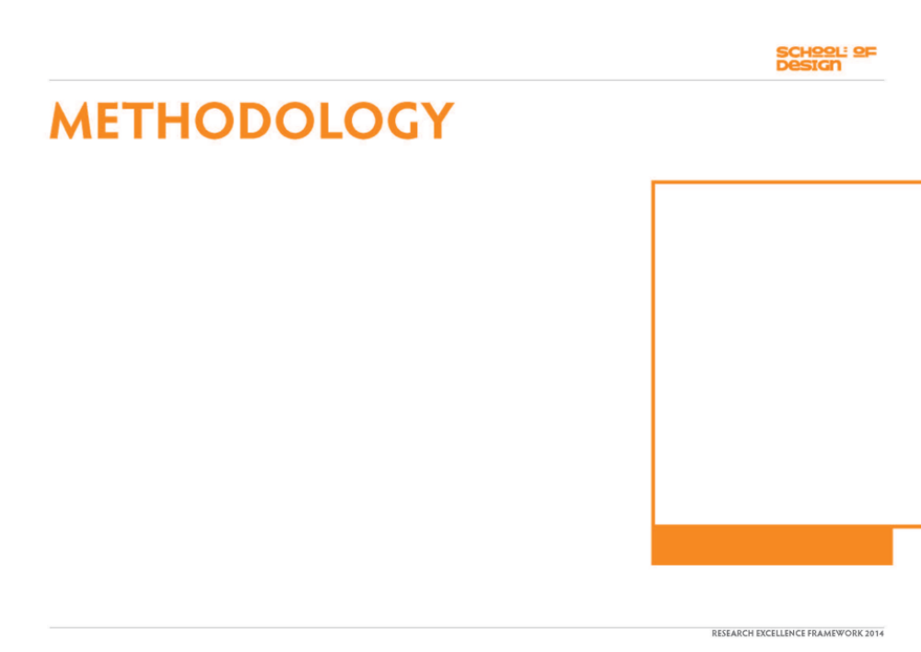
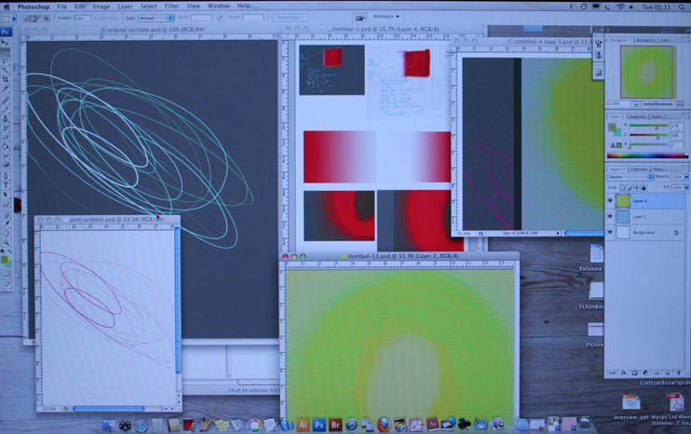
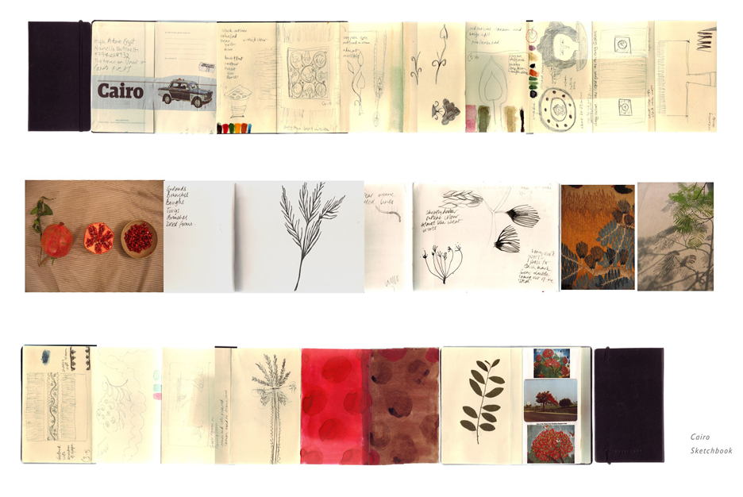
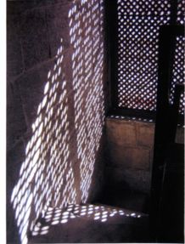
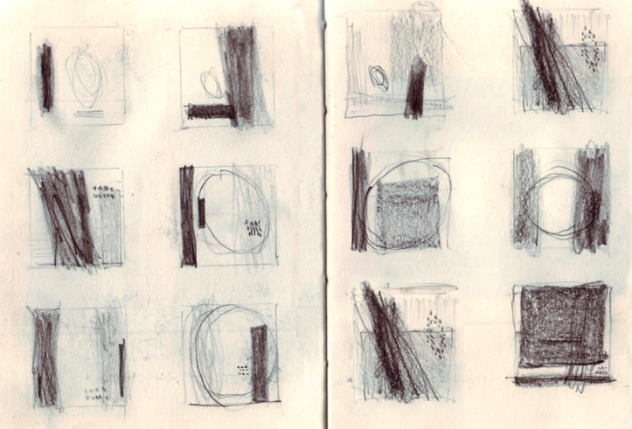
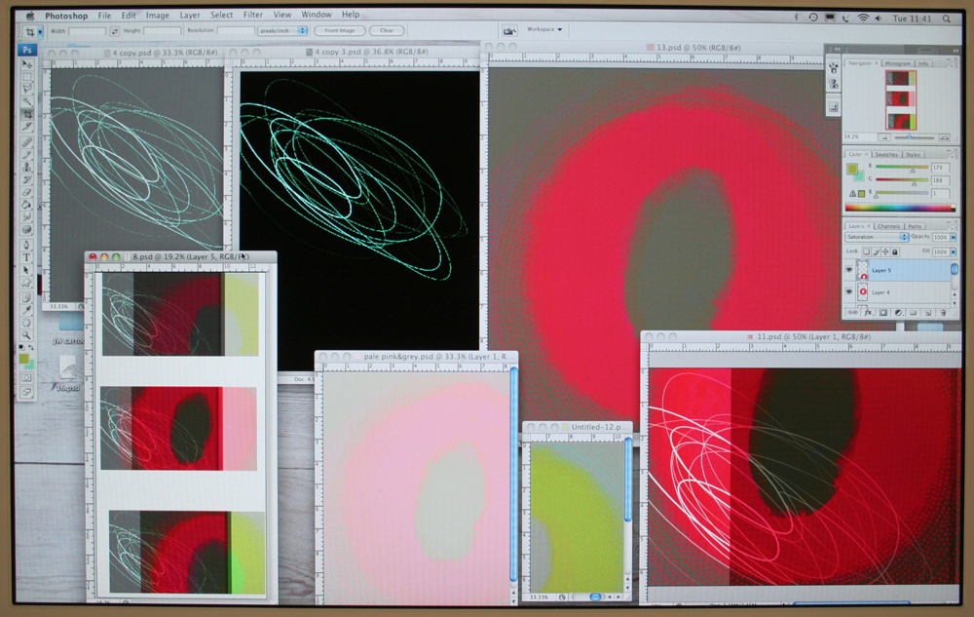
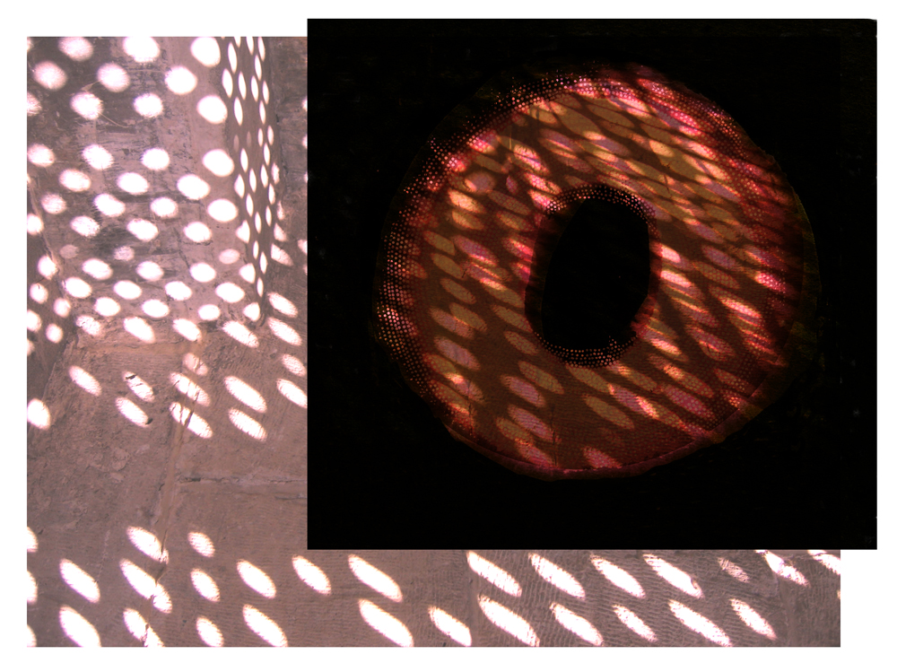
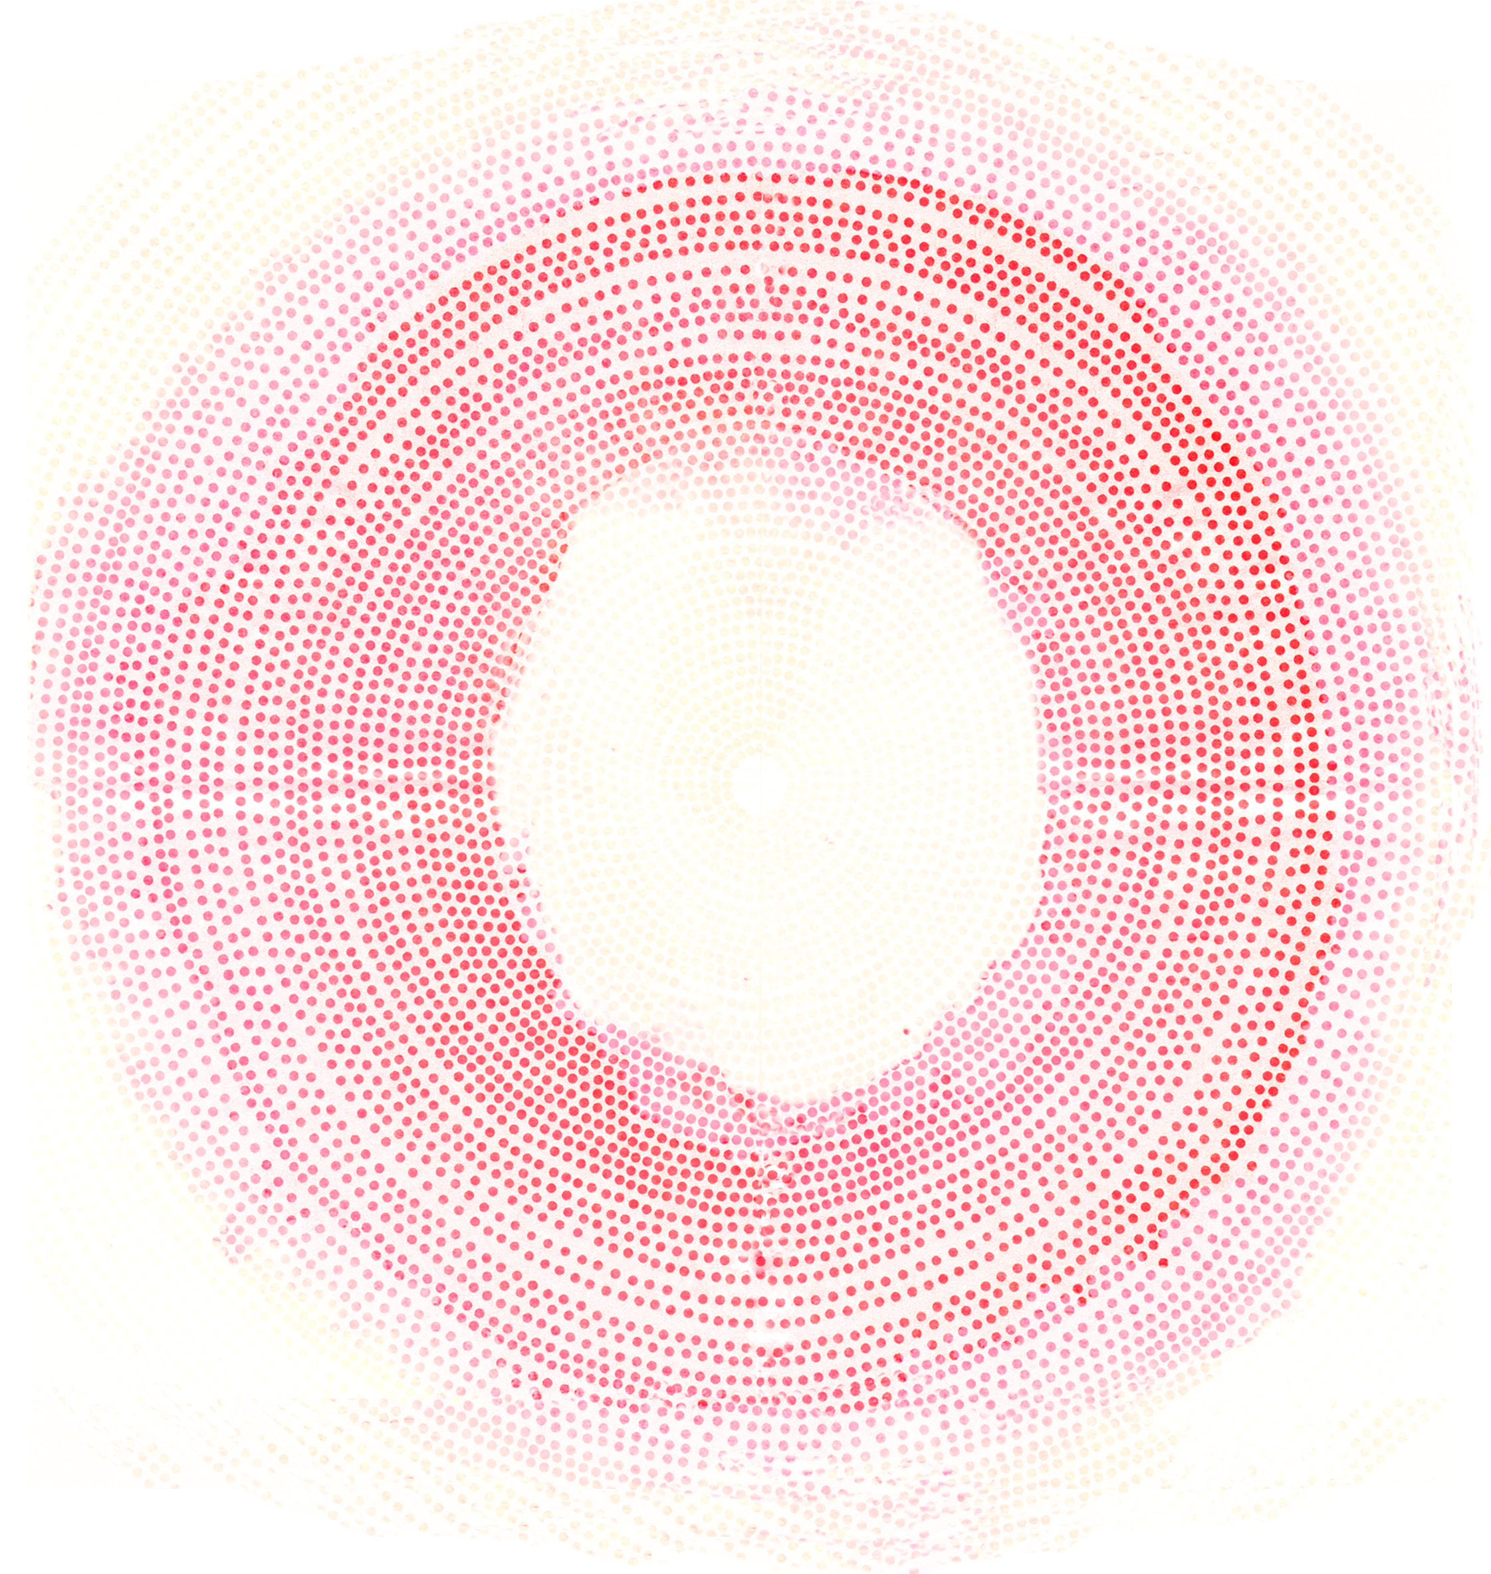
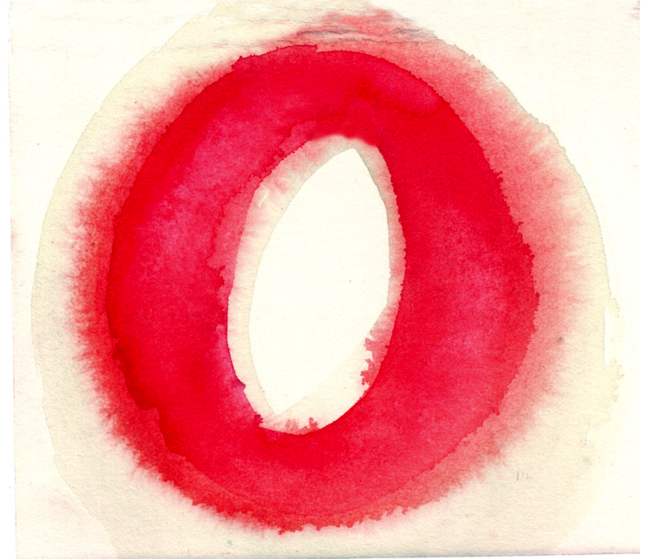
Drawings, collages, paintings and photographs were developed from selected primary research which were manipulated & further refined in Photoshop.
In this case the starting point was a study visit to Cairo, in particular qualities of fleeting light filtered through wooden Mashrabiya screens. These were combined with gestural drawn marks; pools & hazes of watercolour paint.
All images: designs in progress, from sketchbooks, photos, paintings to digital manipulations.
An intuitive response is employed at each stage of development until a suitable conclusion is reached.
Above: Photoshop development work
.

Slide 11
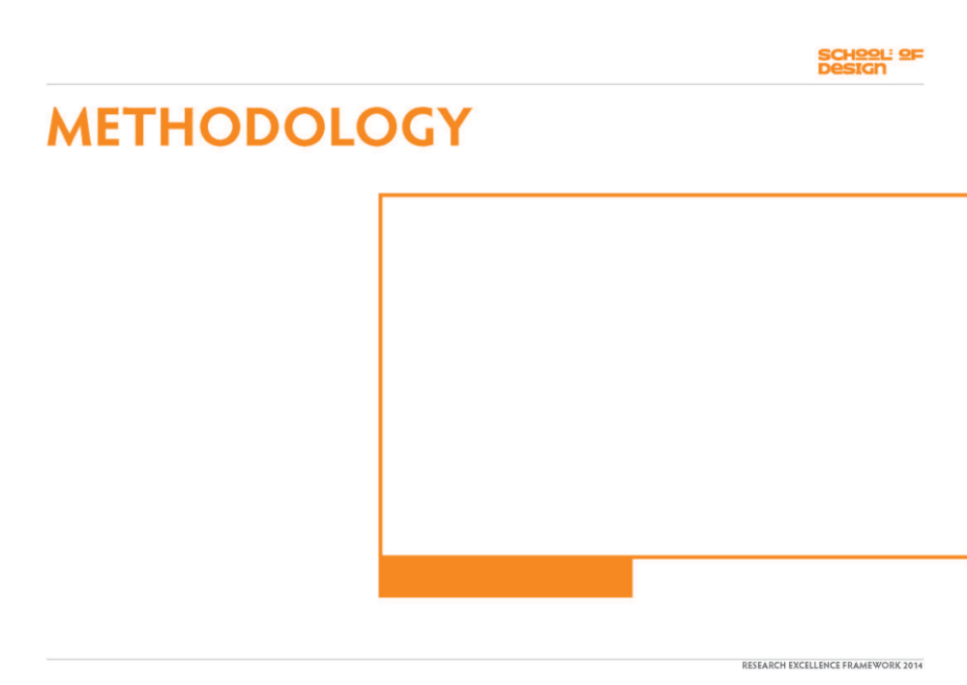







Designs were scaled up to larger dimensions to suit a gallery setting and translated into woven tapestries using wool, cotton, linen and silk yarns.
In particular the method of weaving employs the use of fine gauge yarns to mix subtle combinations of tones & blends of colours in order to create the illusion of layers of painted or drawn marks.
This process is slow. Larger works take 8 -12 weeks to complete.
“ …there is increasing awareness and appreciation
that time spent on thinking through making creates
something of particular value & quality in our
contemporary world. “
Amanda Game
Curator: “Follow A Thread”
ISBN: 978-1-905865-20-8
Left: Work in progress & materials. Right: – ‘Resonance’ on loom showing translation process

Slide 12




: FURTHER SHOWINGS OF WORK
2009
10th Wave III: Art Textiles & Fiber Sculpture
Browngrotta Gallery, Connecticut, USA
Invited exhibitor
1 of 7 representing UK. Total 72 international exhibitors.
A comprehensive examination of contemporary international art textiles.
“The 10th Wave III will offer a comprehensive view of this medium, through the work of a large group of accomplished artists, at a time when the movement has achieved critical and popular acclaim.”
Tom Brown, Curator
Catalogue ISBN – 1-930230-380-9
Work exhibited: ‘Drift’
Exhibition catalogue

Slide 13




: FURTHER SHOWINGS OF WORK
2009
COLLECT – International Art Fair for Contemporary Objects
Saatchi Gallery, London
Represented by The Scottish Gallery, Edinburgh
“Collect “ is the UK’s annual Art Fair for the Applied Arts,
a partnership exhibition with the Crafts Council, London
and attracts leading galleries from around the world
exhibiting the work of international level makers.
Work exhibited: ‘Resonance’
COLLECT – exhibition information & publicity

Slide 14




: FURTHER SHOWINGS OF WORK
2009
‘Follow A Thread – Six contemporary responses to the art of tapestry’
Ruthin Gallery, Wales
Touring to Harley Gallery, Welbeck &
Dovecot Studios, Edinburgh
1 of 6 artists working within the field of tapestry.
Catalogue ISBN 978-1-905865-20-8
Work exhibited: ‘
Resonance’, ‘Vermilion Glow’, ‘Rose Haze
Top: Ruthin Gallery, Wales
Bottom left: Gallery installation view. Right: Catalogue

Slide 15




: FURTHER SHOWINGS OF WORK
2010
Stroud International Textiles Exhibition
‘Visions into Colour’
Museum in the Park, Stroud
Exhibition opened by Sir Christopher Frayling
Invited as 1 of 11 exhibitors
Catalogue
Artists talk
Work exhibited:
‘Resonance’, ‘Vermilion Glow’,
‘Cobalt Haze’, ‘New Green’, ‘Rose Haze’
Left: Exhibition website publicity
Right: Catalogue

Slide 16






: FURTHER SHOWINGS OF WORK
2011
That was Then: This is Now
City Art Centre, Edinburgh
Retrospective exhibition
A survey of Scottish Tapestry spanning 50 years
including works from the City Art Centre’s
tapestry collection
1 of 16 exhibitors
Work exhibited: ‘Resonance’, ‘Blush’
Left: Exhibition poster
Top right: Catalogue Bottom right: Gallery installation
Work featured on Gallery banner

Slide 17



: FURTHER SHOWINGS OF WORK
2012
Retro-Prospective: 25 years of Art Textiles & Sculpture
Browngrotta Gallery, Connecticut, USA
Invited exhibitor.
1 of 8 representing UK. Total 63 international exhibitors
"The works included in "Retro/Prospective: 25+ Years of Art Textiles and Sculpture" will reflect the origins of the contemporary textile art and sculpture movement," says Tom Grotta, founder and co-curator at browngrotta arts. "There will also be current work by established and emerging artists, to explain where the movement is now and to predict what's ahead.”
Catalogue – ISBN 1-930230-41-9
Work exhibited: ‘Resonance’
Images: Catalogue, installation views & publicity

Slide 18







Embroidery Magazine
Dr Jessica Hemmings. Mar/Apr 2009, p54
: PEER REVIEW
Crafts Magazine
Dr Jessica Hemmings. Jan/Feb 2010, p60
Modern Carpets & Textiles for Interiors
Dr Jessica Hemmings. Spring 2009, p13
2.“..these works withstand & deserve considerable
scrutiny. Close inspection revealed the quality &
density of weaving, the painstaking combinations of
threads & wools that in combination create Barker’s
bold and spontaneous gestures”.
Images: Peer review magazine articles
1. “Five tapestries are on display, each providing a
sense of spontaneity and looseness of mark that belies
the realities of their construction”.
3. “…colour seems as though it seeps across
the surface”.

Slide 19





: BOOK SECTION
2011
Tapestry Weaving – Design & Technique
Author: Joanne Soroka
Crowood Press
ISBN 978-1-847972-80-4
“Tapestries were among the most prestigious of art forms,
created for the mightiest in the land and valued for
centuries.
Despite its illustrious history, tapestry weaving
is actually a simple technique that requires little equip-
ment or expenditure, and can be done anywhere.
Written by a prominent tapestry weaver, this lavishly
illustrated book gently leads you through the whole
process with detailed diagrams and exciting work by
contemporary weavers.
It will be useful to the absolute beginner, but
experienced weavers will also find new ideas and
techniques to tempt and inspire them.”
Book : Tapestry Weaving – Design & Technique
Cover (above) & pages ages featuring work

Slide 20


: BOOK SECTION
2012
Textiles: The Art of Mankind
Author: Mary Schoeser
Publisher: Thames & Hudson
ISBN: 978050516454
Work featured: Vermilion Glow
Book : Textiles – The Art of Mankind
Work features on p49 – ‘Vermilion Glow’

Slide 21
2009
Included in English GCSE Syllabus, Art
& Design
(CAN’T FIND ANY EVIDENCE
DON’T INCLUDE ?)

