Slide 1
Anne Bjerge Hansen
Displaced Landscapes
REF output

Slide 2


Slide 3
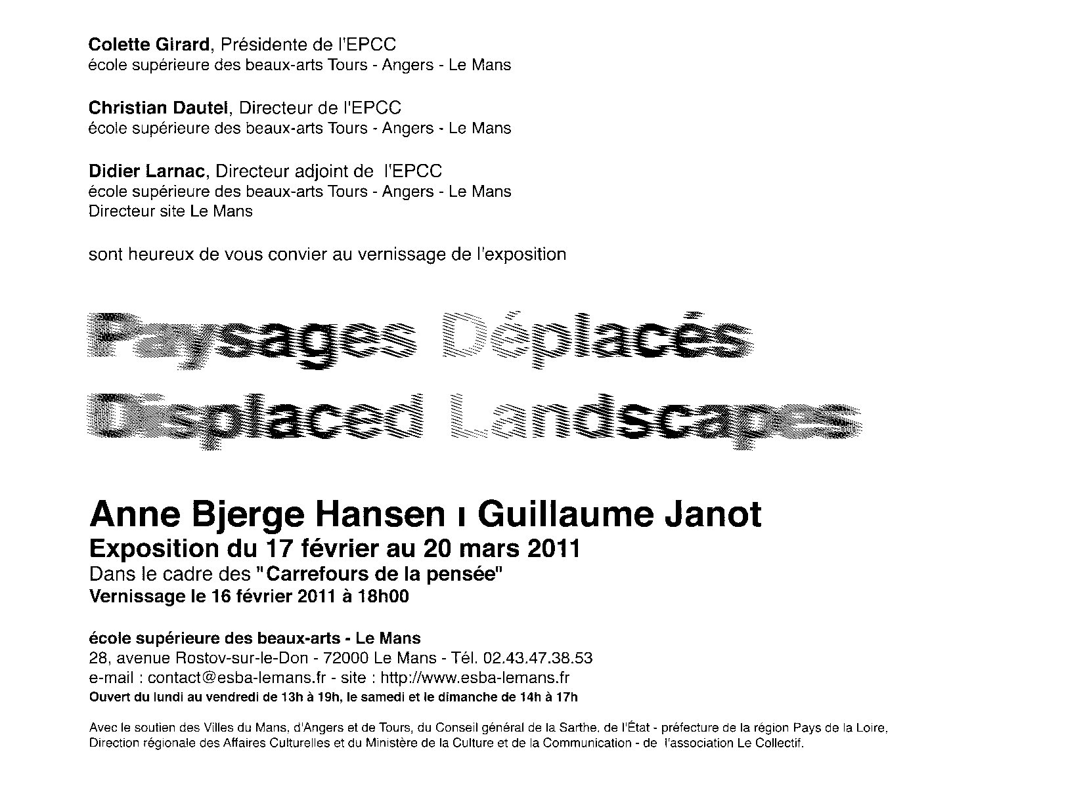

Slide 4
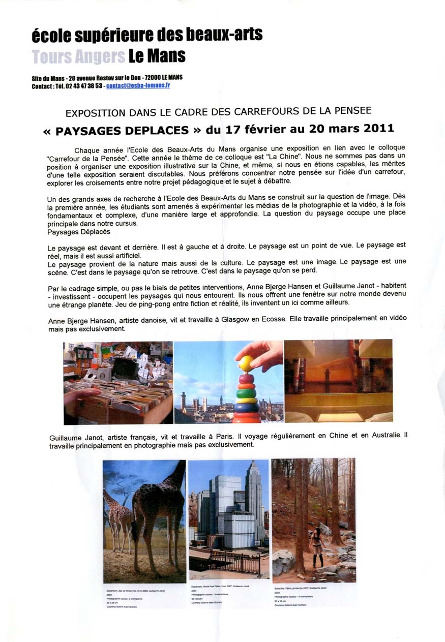

Slide 5
stills and installation documentation from Displaced Landscapes

Slide 6
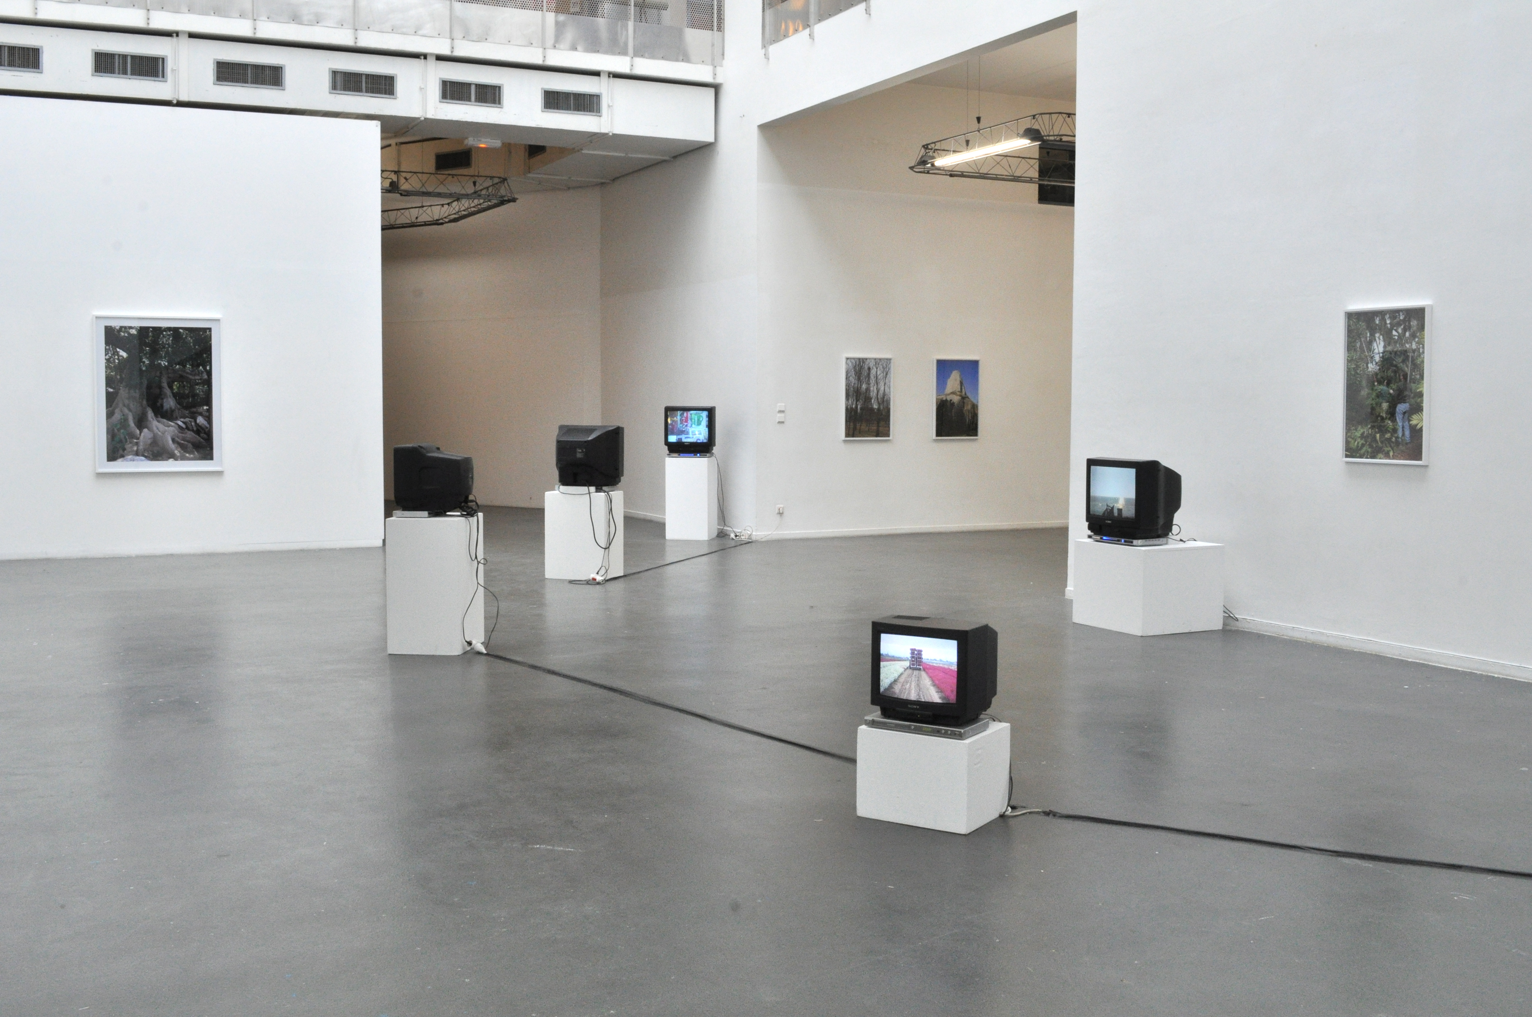

Slide 7
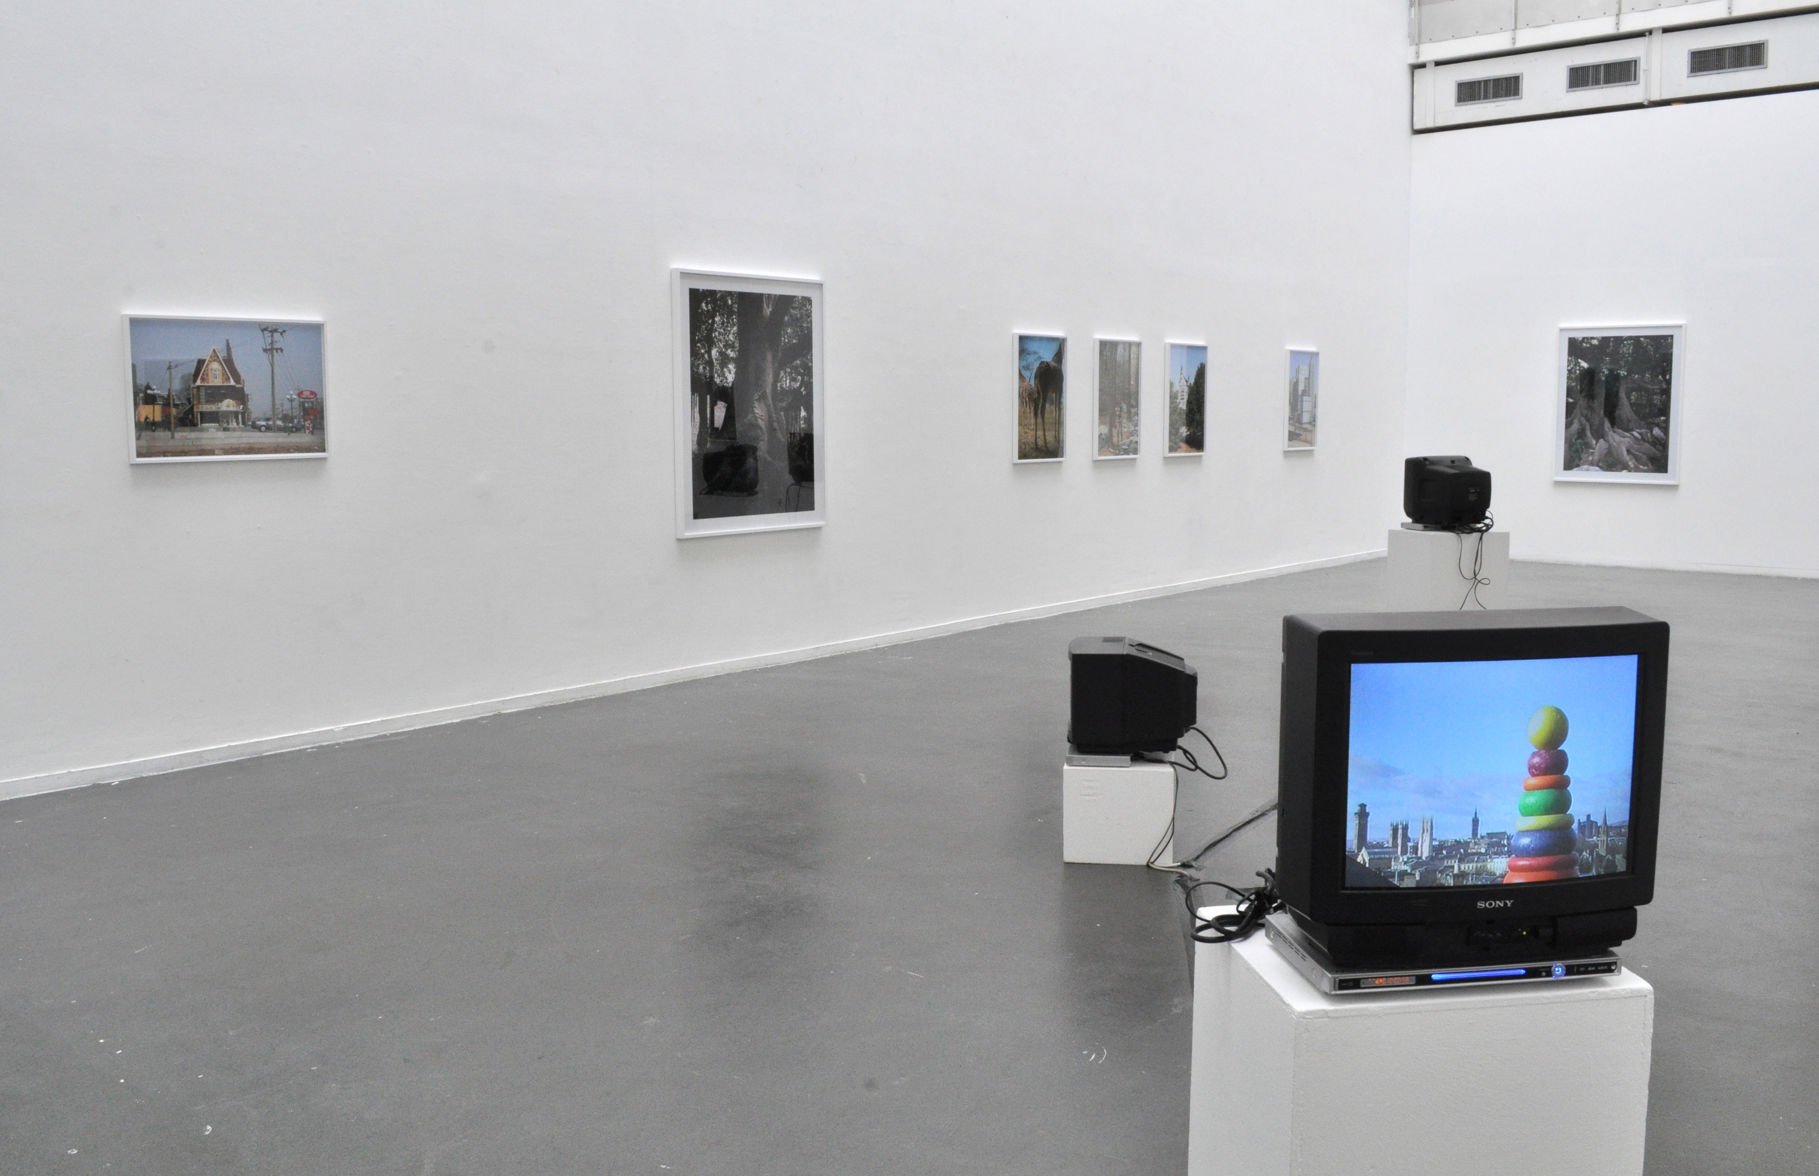

Slide 8
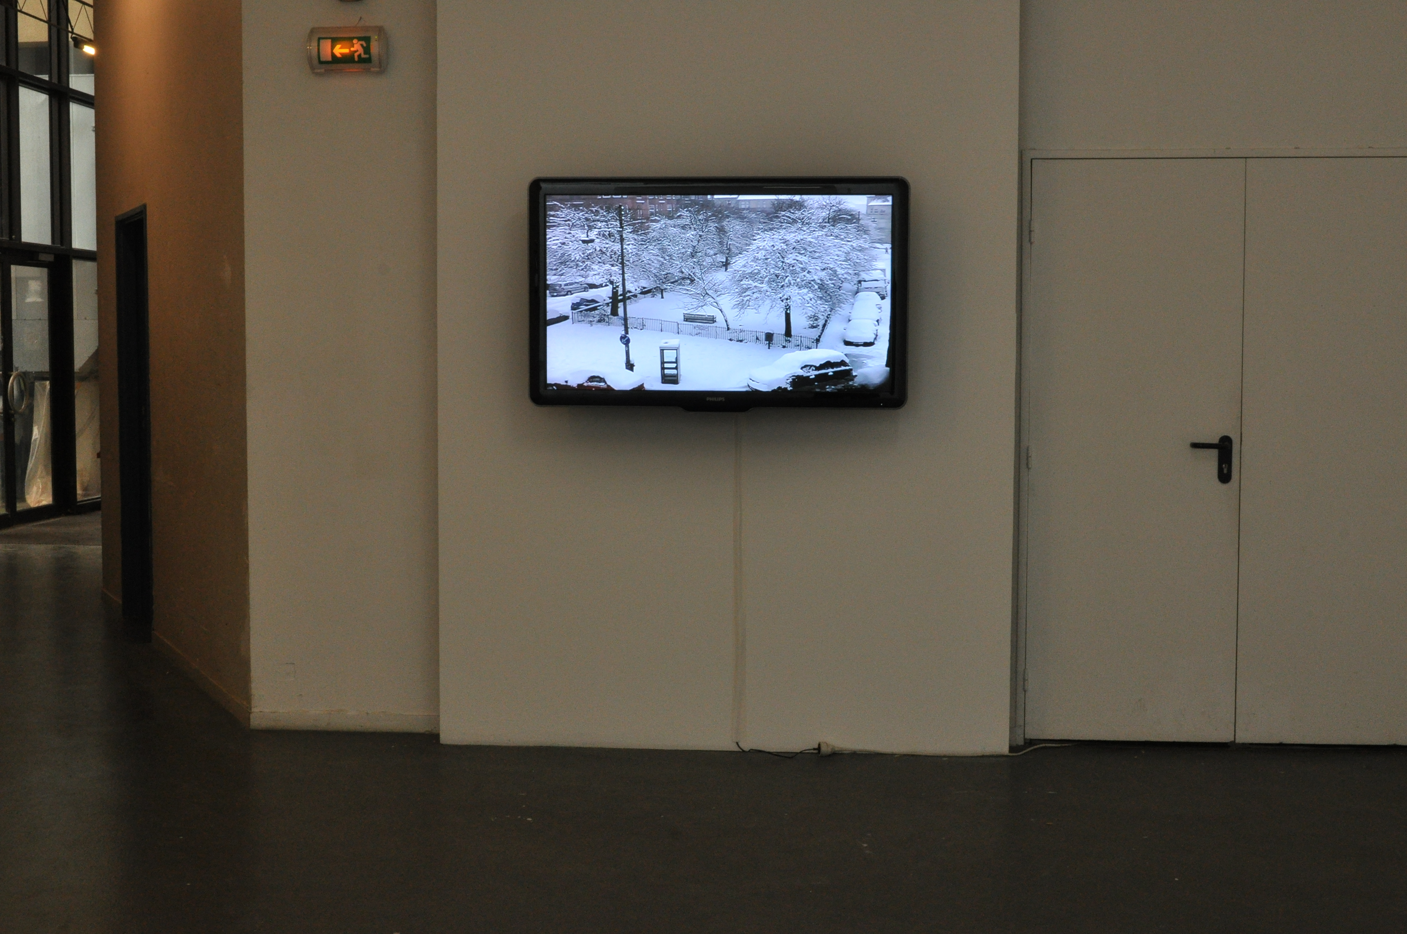

Slide 9
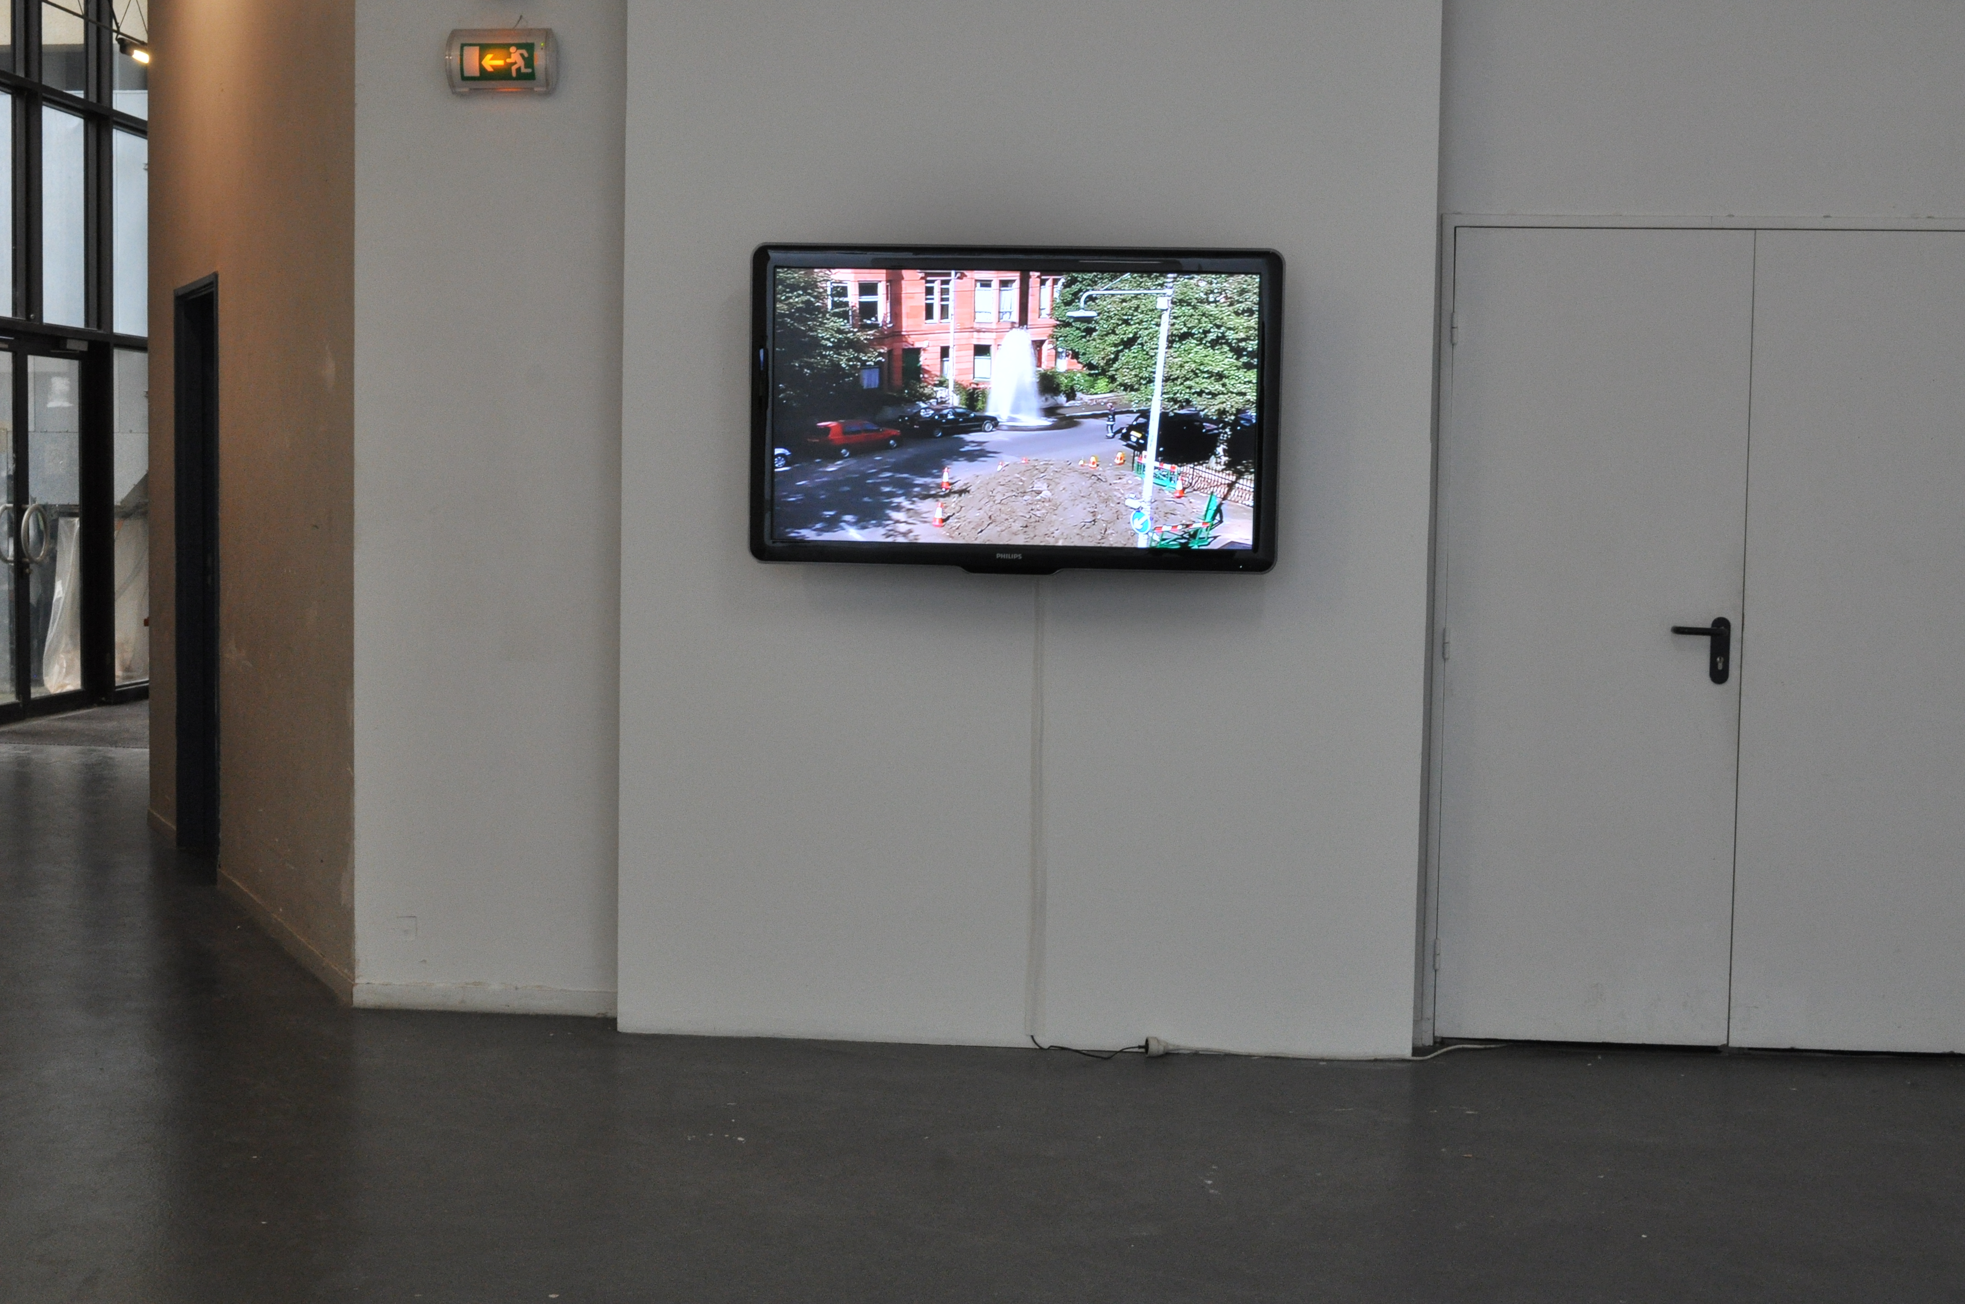

Slide 10
