Slide 1
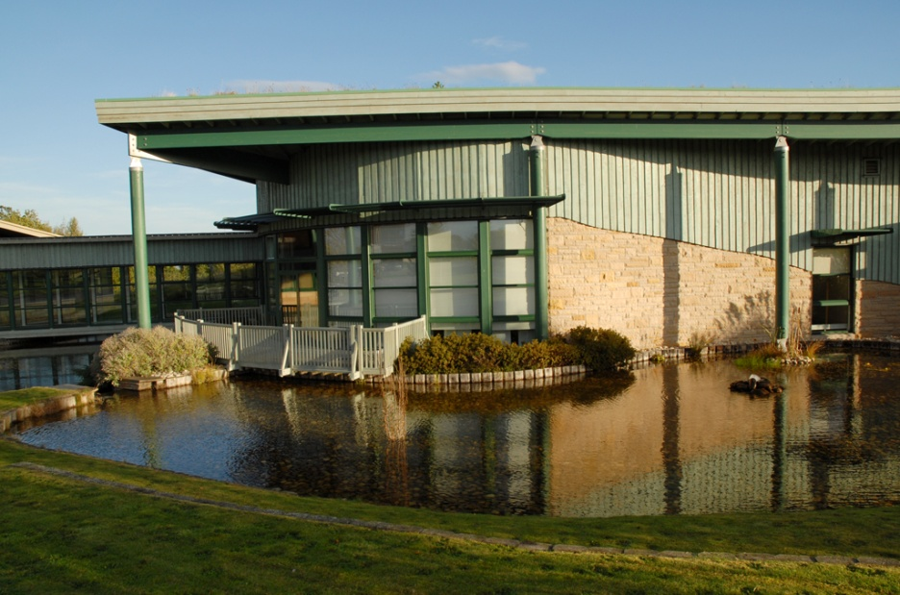
Practically Learning
Richard Wilson
The Centre For Design Innovation
Horizon Scotland
The Enterprise Park
Forres
Moray
IV36 2AB
UK
Notes:
Practically Learning
Richard Wilson – Researcher ( The Centre for Design Innovation )

Slide 2
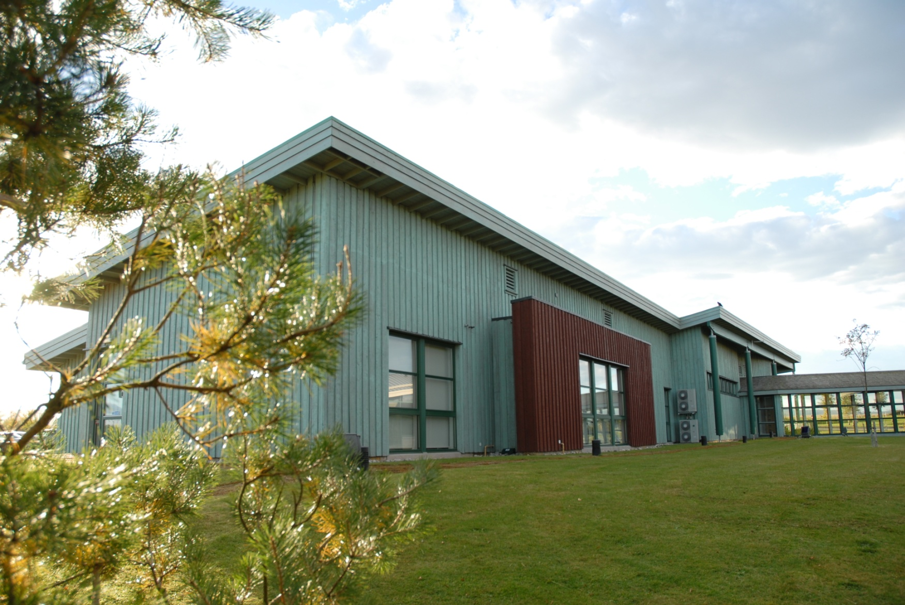
Horizon Scotland
CENTRE FOR DESIGN INNOVATION

Slide 3
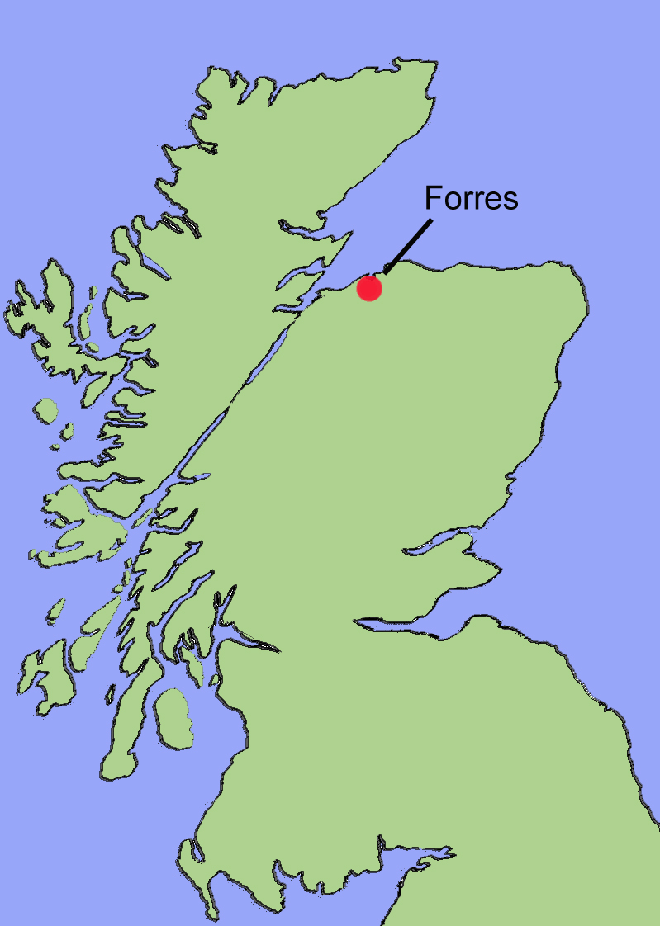


Where is the CDI
Notes:
CDI is based in Forres, on the north coast of

Slide 4
Disconnected?
?
EDUCATION
EMPLOYMENT
Notes:
Education is currently disconnected to industry and the world of work, many of the workshops and work experience young people I have worked with don't seem to understand or relate the work they are doing in their school with work in the real world.

Slide 5
Why is this?
Does the curriculum get in the way ?
Never had to make anything ?
No sense of pride of ownership ?
Off the shelf ?

Slide 6
We don't “Make” anymore
Complexity?
Is making a lost art?
Making?
Curriculula?
Money?

Slide 7
Schools have their arms tied
MONEY
BUDGET CUTS
CURRICULUM
Notes:
MONEY, CUTS, CURRICULUM

Slide 8



My Workshops
Funding

Slide 9
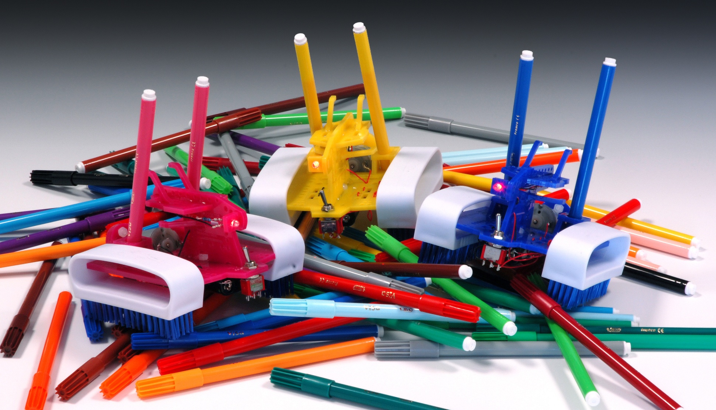
Artful Dodgems

Slide 10
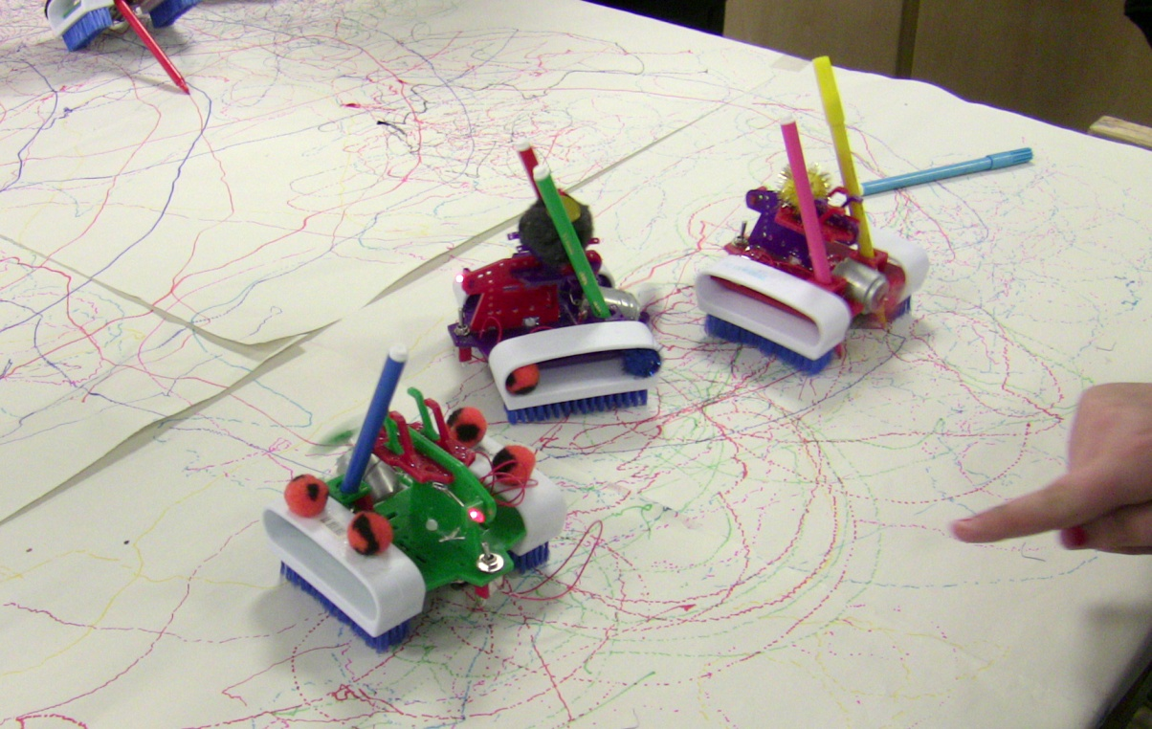
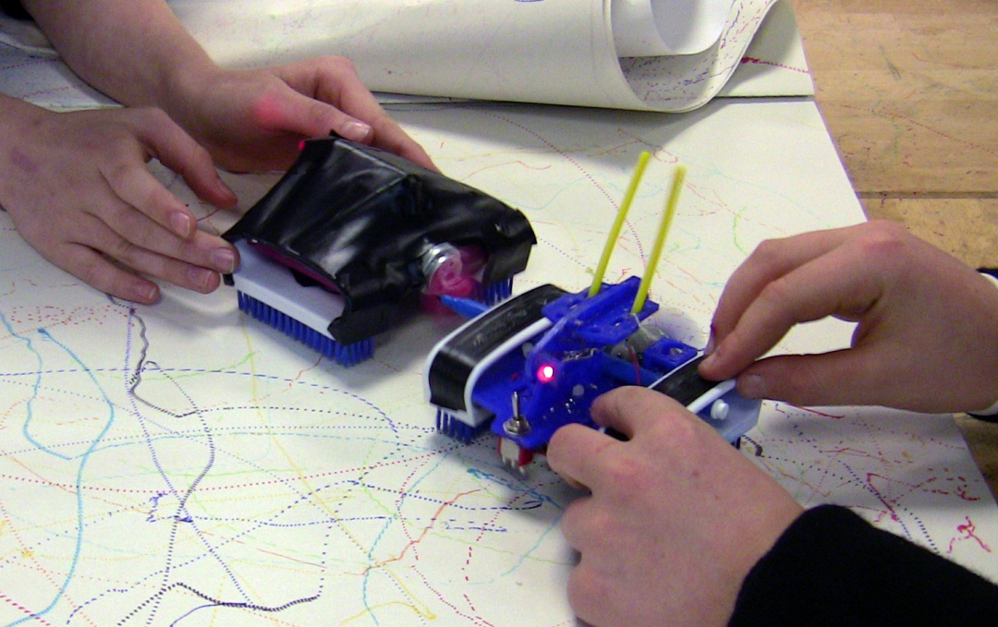
Artful Dodgems - Version 2
Kit based workshop with the option to customise the look and function.
Design & Construction
Basic Electronics
Maths & Physics
Practical Skills
Listening

Slide 11
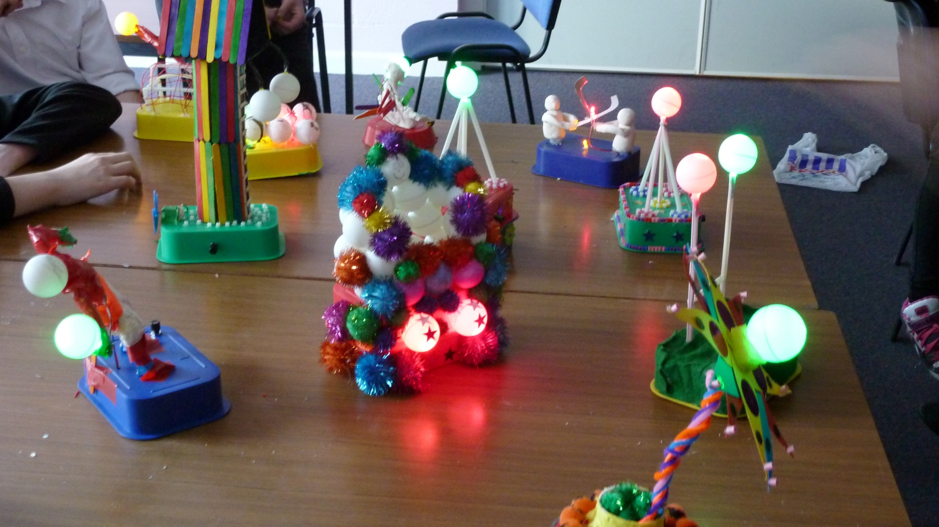
Inventor Box

Slide 12
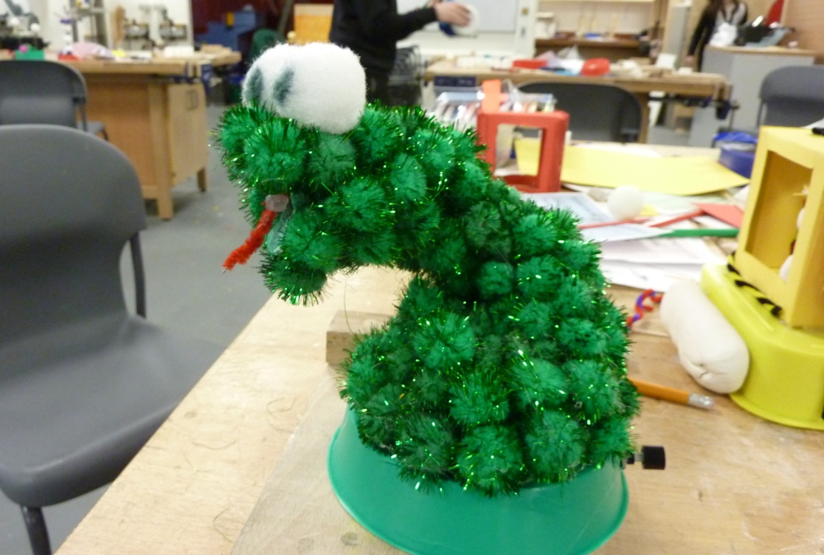
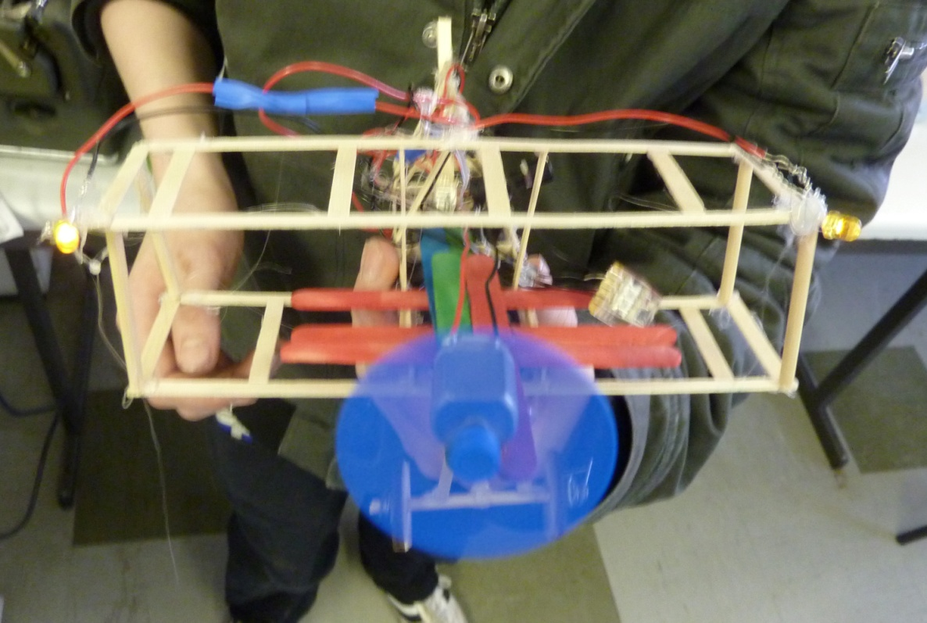
Inventor Box
Materials based workshop that allowed for free design thinking.
Anything goes using the materials provided.
Design & Construction
Basic Electronics
Maths & Physics
Practical Skills
Listening
Materials

Slide 13
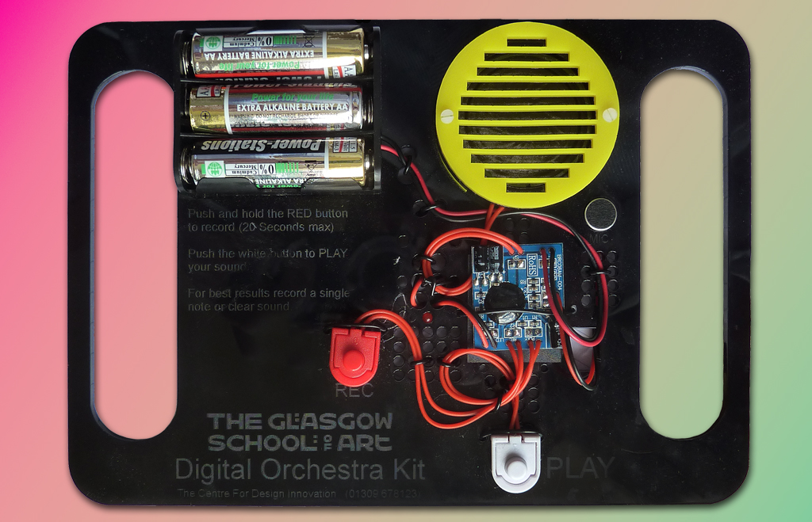
Digital Orchestra

Slide 14
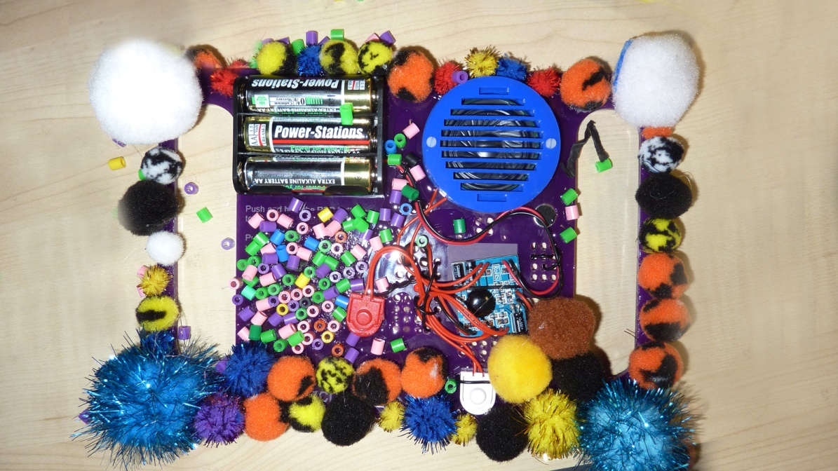
Digital Orchestra
Build the kit, in stages.
Binary Numbers.
Learn about digital recording.
Create a performance.
Customise the design.
The grand performance

Slide 15
How can we fix this issue?
Also
I think its important not to swing completely the other way.
The pressure is on the schools to save money and they are cutting back on the practical skills like woodwork and metalwork. This is something beyond their control. Don't shoot the messenger.
Computing is strong in schools, but its not like the 1980’s. Programming and being good with computers became un-cool.

Slide 16

Thank You
Richard Wilson
Researcher Digital Media & Technology
The Centre For Design Innovation
Horizon Scotland
The Enterprise Park
Forres
Moray
IV36 2AB
Tel: +44 (0)1309 678123
Email: ri.wilson@gsa.ac.uk

