Slide 1

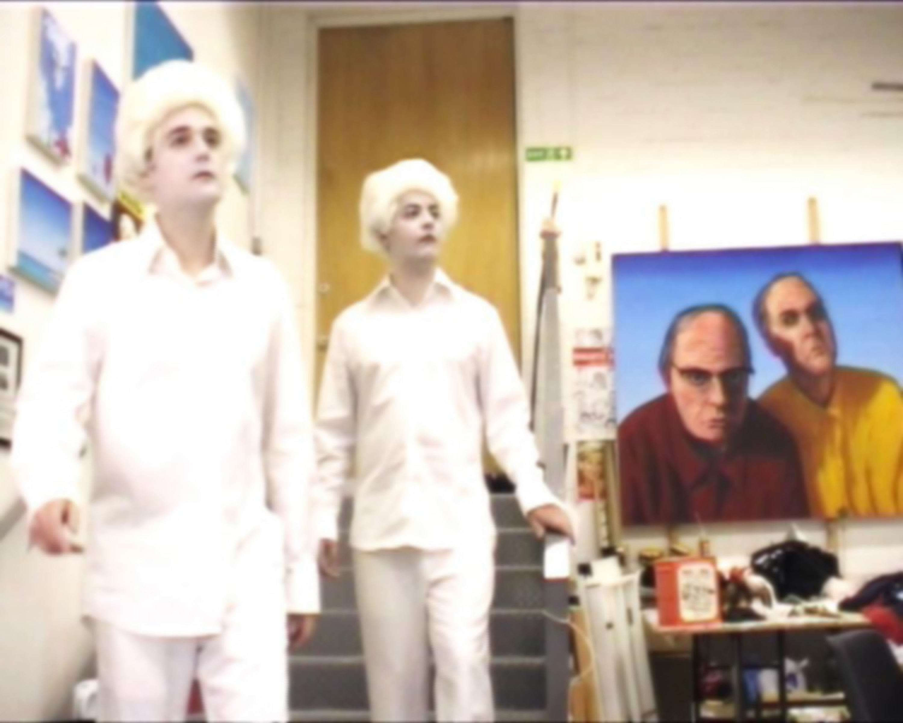
Cock and Bull
A retrospective exhibition of collaborative video works made with John Beagles between 1996 - 2009 at the Margaret Lawrence Gallery, Victoria College of the Arts, Melbourne. This project also included a commission to make a new video work.
Submitted by Graham Ramsay

Slide 2

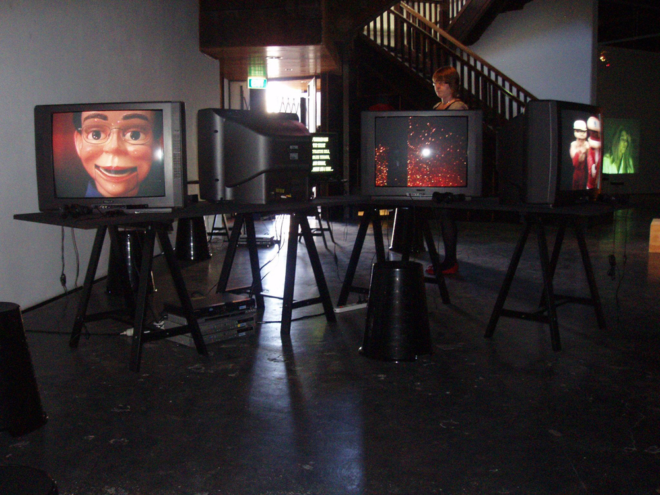
Cock and Bull
I showed a retrospective selection of collaborative video works made with John Beagles between 1996 - 2009 at the Margaret Lawrence Gallery, Victoria College of the Arts Melbourne as part of the group exhibition 'Cock and Bull'. This involved showing 14 individual video works made between 1996 and 2009, which represented a unique opportunity for a significant overview within an exhibition context of this key element within my collaborative practice. This exhibition aimed to examine the structures of contemporary society through humour, irony and melodrama. Works in the show encompassed a number of approaches such as the satirical narratives and the invented biography, which clearly connect with some of my longstanding research interests. In particular this means an exploration of approaches to art practice that draw upon a playful approach to narrative form, humour and absurdity as a means to engage with socio-political concerns. As such this exhibition provided a very productive context within which to consider my practice.
This exhibition also included a commission by the gallery for a new piece of work. This work continued existing themes relating to self portraiture, while expanding the practice to include elements of historical narrative.
2275
Graham Ramsay and John Beagles
Installation view ‘Cock and Bull’ Margaret Lawrence Gallery, VCA, Melbourne 2009

Slide 3
Installation view ‘Cock and Bull’
Margaret Lawrence Gallery, VCA, Melbourne 2009

Slide 4

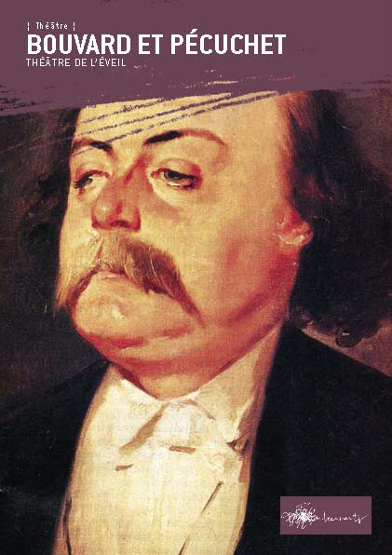
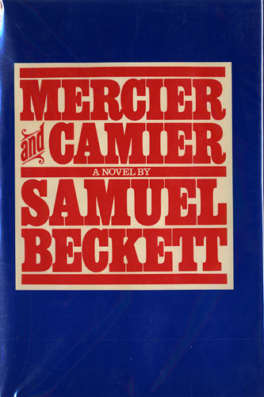
In ‘Two Fine Examples Of British Dentistry’ (2009), our fop doppelgangers work on a series of paintings and sculptures in a large studio. The narration outlines the development of this joint enterprise and the pleasures, pitfalls and postures encountered as part the creative process. The script development for this work made reference to the unfinished satirical work ‘Bouvard et Pécuchet’ by Gustave Flaubert, and Samuel Beckett’s ‘Mercier and Camier’.
Art historically we drew upon self-representations of male artists in their studios, including iconic examples such as Velazquez, Courbet and Picasso.
Key literary references – Flaubert and Beckett

Slide 5

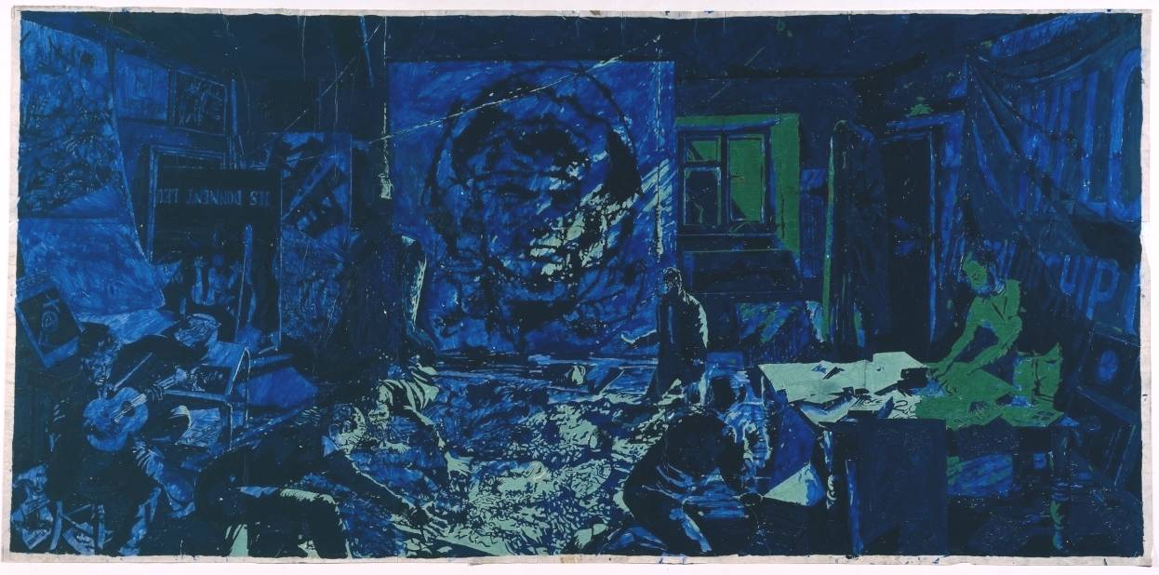
In our collaborative practice we have always had an interest in the allegorical and critical potential of humorously playing with habitual ideas central to the mythology of art, specifically those relating to notions of authenticity, originality and political agency. This connects with an investigation into the sketchbook as locus of creativity and the studio as site of alienated production. This was made most explicit in ‘Dub’l introoder’ (Transmission Gallery, Glasgow 2001) where we presented a fiction of our studio, and also in ‘Unrealised Dreams’ (Scottish Pavilion, Venice Biennale & Stills Gallery both 2003) where ‘failed’ projects and satirical sketchbook ‘fantasies’ became the subject of the work. At its core this self-reflexive examination of the processes involved in art production comes out of an engagement with several key art historical and theoretical examples. The most prominent of these reference points are Rene Magritte’s 1948 ‘Periode Vache’ paintings , Art and Language’s ‘Studio paintings’ of the 1980’s, and T.J Clark’s notion of practices of negation (T.J Clark ‘Clement Greenberg’s Theory of Art’ in ‘Pollock and After’ edited by Francis Frascina, 1985).
Art & Language ‘Index: The Studio at 3 Wesley Place, in the Dark (IV), and Illuminated by an Explosion nearby (VI)’ 1982

Slide 6
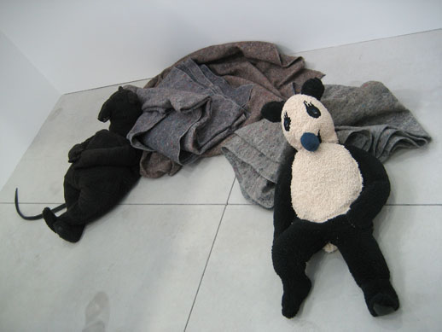
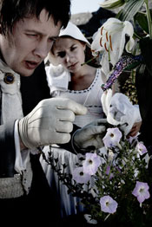
Fischli &Weiss ‘Rat and Bear’ 2004
John Bock ‘The Dandy’ 2007
CONTEXT - contemporary art
Several of the artists we showed alongside in the survey exhibition ‘When Humour Becomes Painful’ (2005) at the Migros Museum fur
Gegenwartskunst, Zurich offered valuable points of reference and common threads of research run through their work and ours.
Specifically this includes an artist such as John Bock, for instance his video ‘Dandy’ (2007), with Bock playing the tormented
genius, an inventor attempting to achieve perfection in every creative aspect of his life. The use of humour evident in the practices of
Fischli and Weiss or Martin Kippenberger, particularly those works that make direct or oblique references to the mythologies of the creative
process or the studio as a problematic space of production, were also of great importance. In the case of Fischli &Weiss this would be both
sculptural and video works from the ‘Rat and Bear’ series (1980 – 2004), and for Kippenberger works such as the ‘Pictures Awarded Prizes’ (1987)
or his ‘Museum of Modern Art, Syros’ (1993 – 1996).
Our work is also clearly related to that of Paul McCarthy in his use of costumes, theatrical sets, and fractured narrative structure.
Works such as ‘Painter’ (1995) or ‘Bossy Burger’ (1991) are two clearly relevant examples.

Slide 7

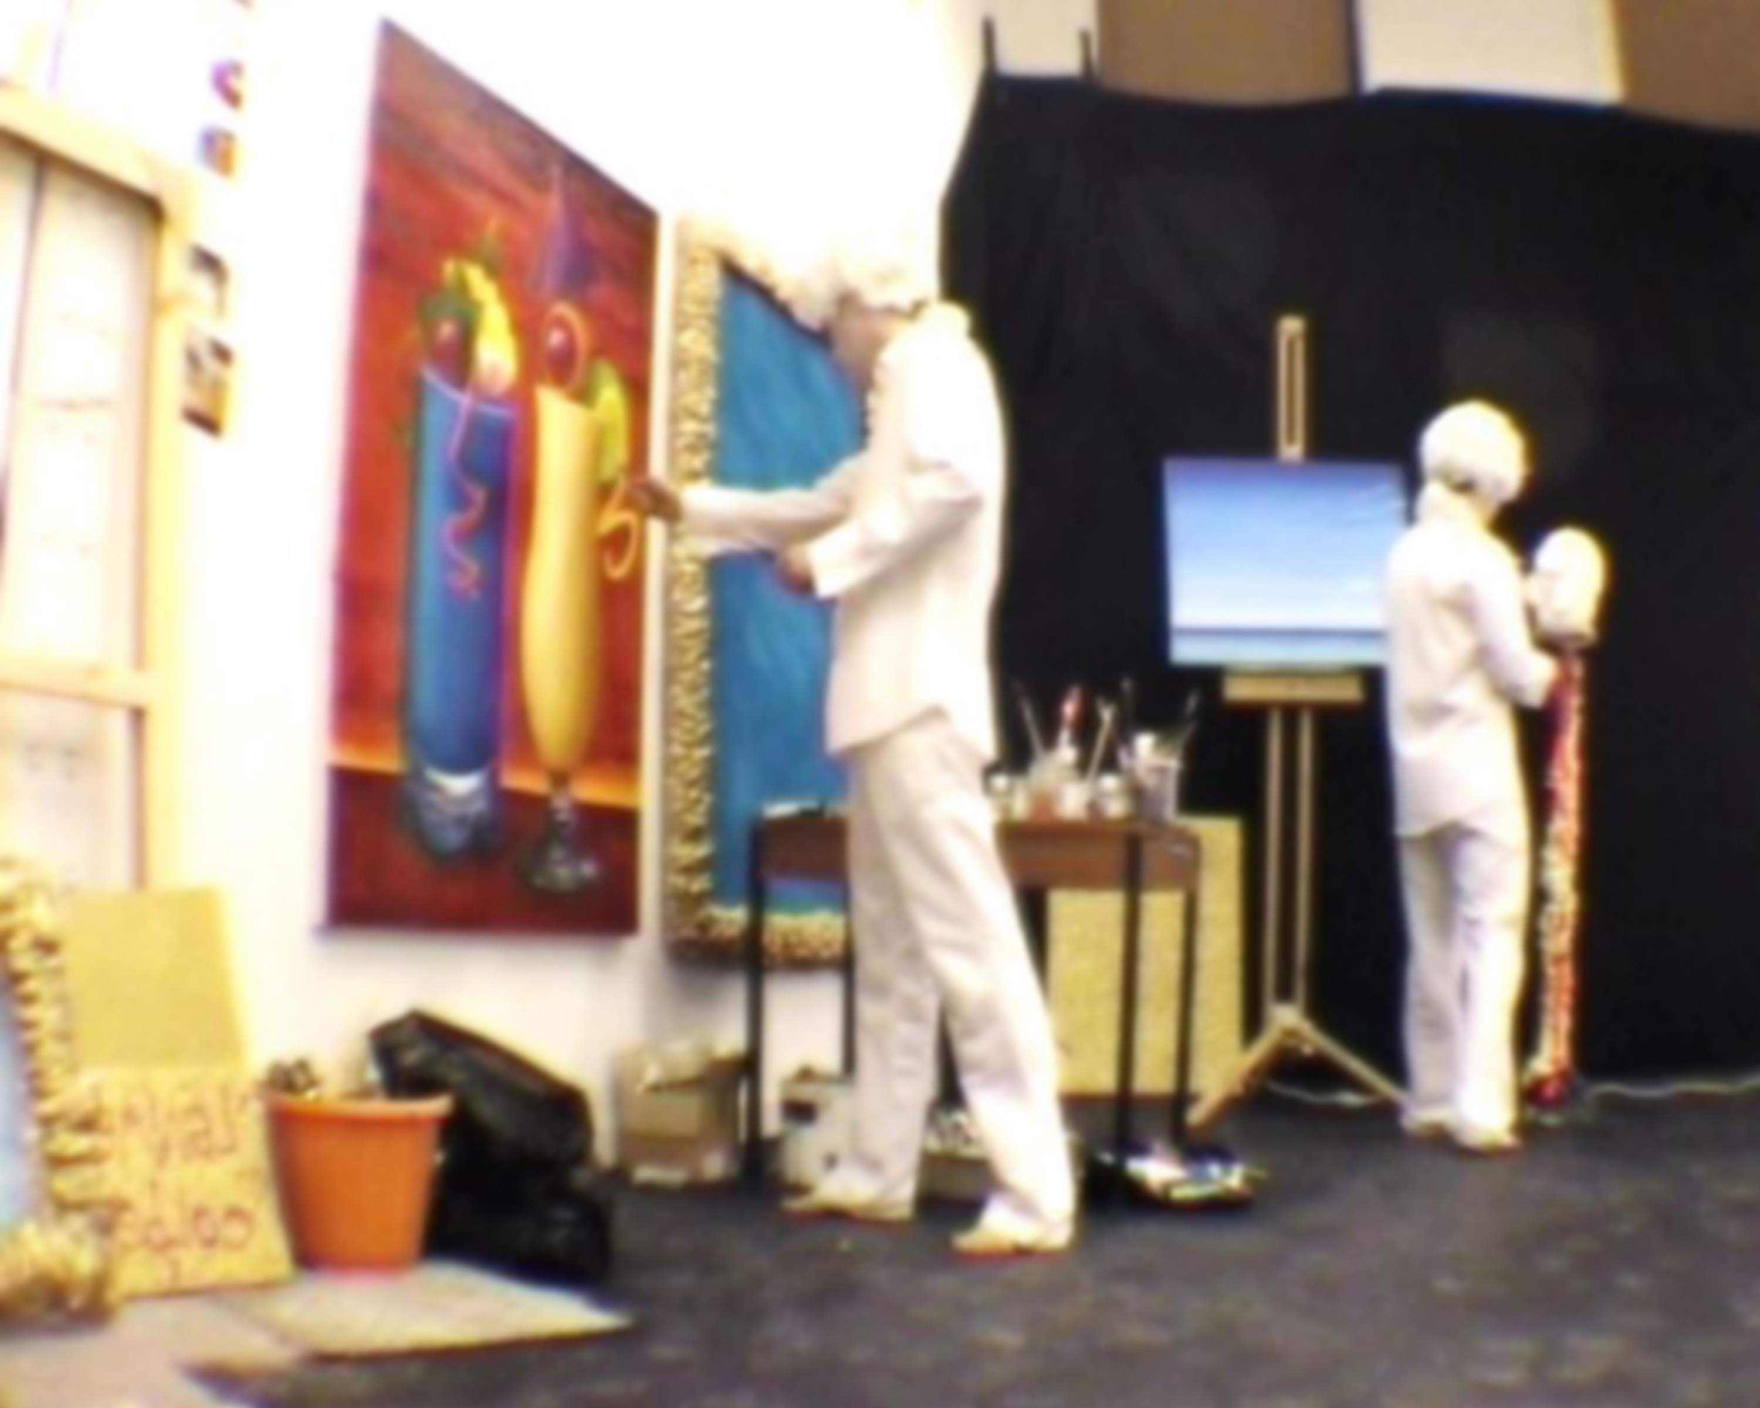
The exhibition was specifically developed with the artists in mind, by curators Dr. Kate Daw (Head of Painting, VCA, University of Melbourne) and Vikki McInnes head curator, VCA Margaret Lawrence Gallery. Prior to the exhibition Dr Kate Daw travelled to Glasgow for a studio visit in 2008, when the formal commission for new work and the residency were offered. The other artists involved in the project, were chosen because of their mutual interest in how art works can be used to explore the structures of contemporary society through the use of humour, irony and melodrama.
Image one & a description of what we are looking at in the context of the project.

Slide 8

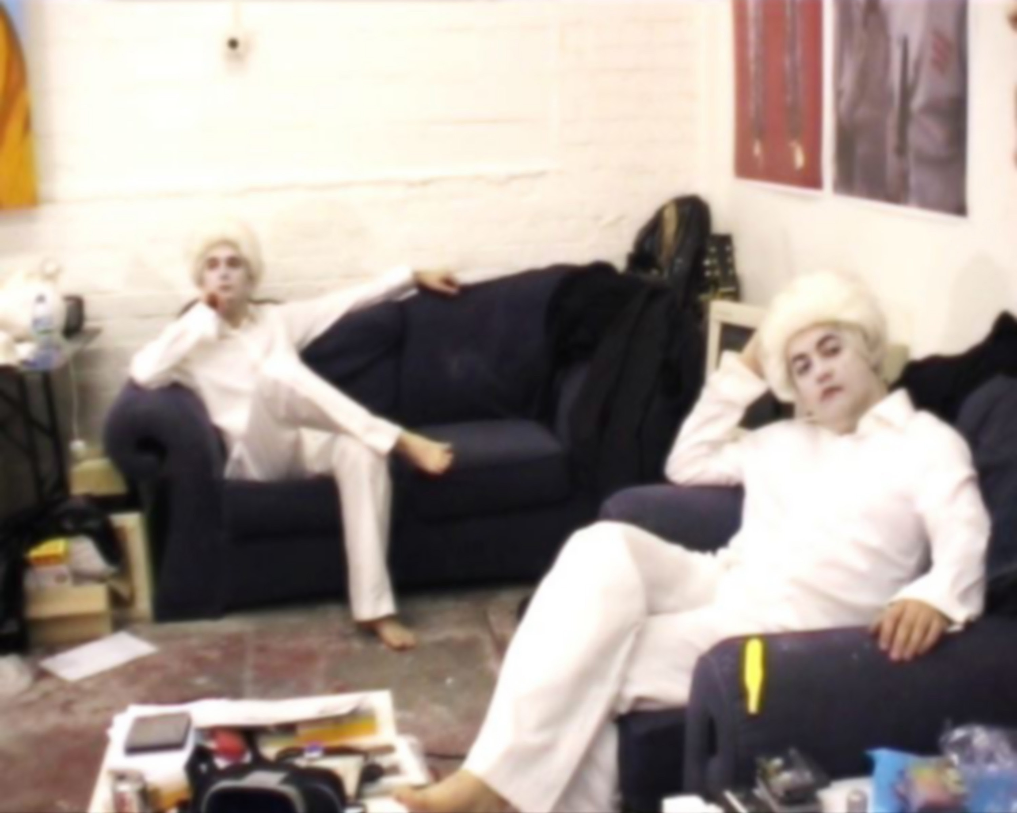
For the commission I produced a new twenty minute film – ‘Two Fine Examples of British Dentistry’.
The script development and use of an actor to narrate the text, as well as the lengthy shooting and editing process occurred over
a six month period between late 2008 and early 2009.
The film was shot in a large studio set up with furniture, artworks and other relevant props.
A soft focus effect was added in post production.
Image one & a description of what we are looking at in the context of the project.

Slide 9

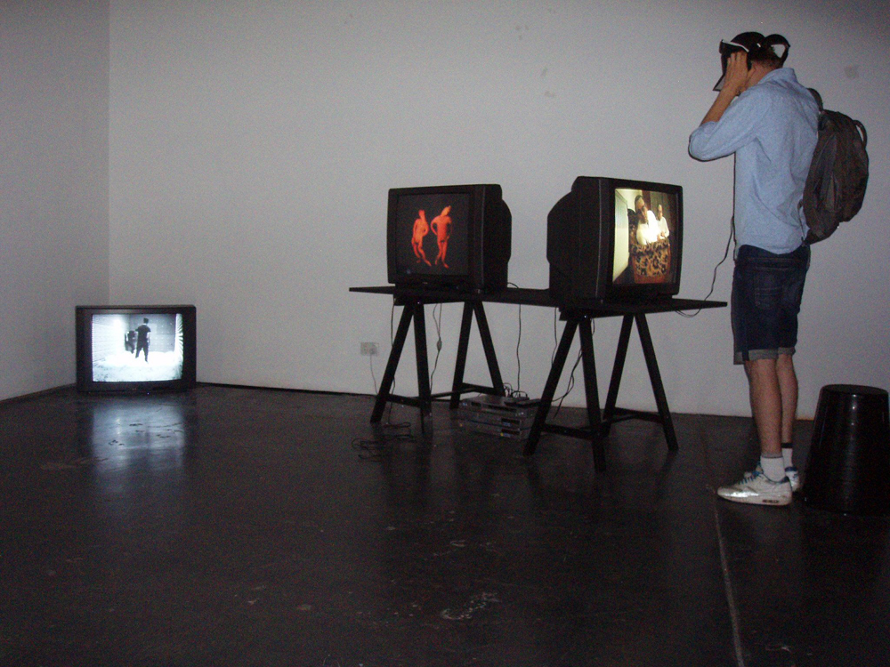
This project’s initial public showing was at the Margaret Lawrence Gallery, Victoria College of the Arts Melbourne as part of the group exhibition 'Cock and Bull'. The other artists included in the exhibition were Jon Campbell, Tony Garifalakis, and Matthew Griffin, all based in Australia. Curated by Dr Kate Daw and Vikki McInnes. This show was open from March 19th to April 18th 2009 and a catalogue was published with essays by numerous authors. I gave a lecture at VCA to staff and students and was also involved in a live performance event at VCA.
The exhibition was reviewed by Robert Nelson in The Age national newspaper March 18, 2009
http://www.theage.com.au/news/entertainment/arts/arts-reviews/bloody-good-or-simply-silly-
Installation view ‘Cock and Bull’
Margaret Lawrence Gallery, VCA, Melbourne 2009

Slide 10

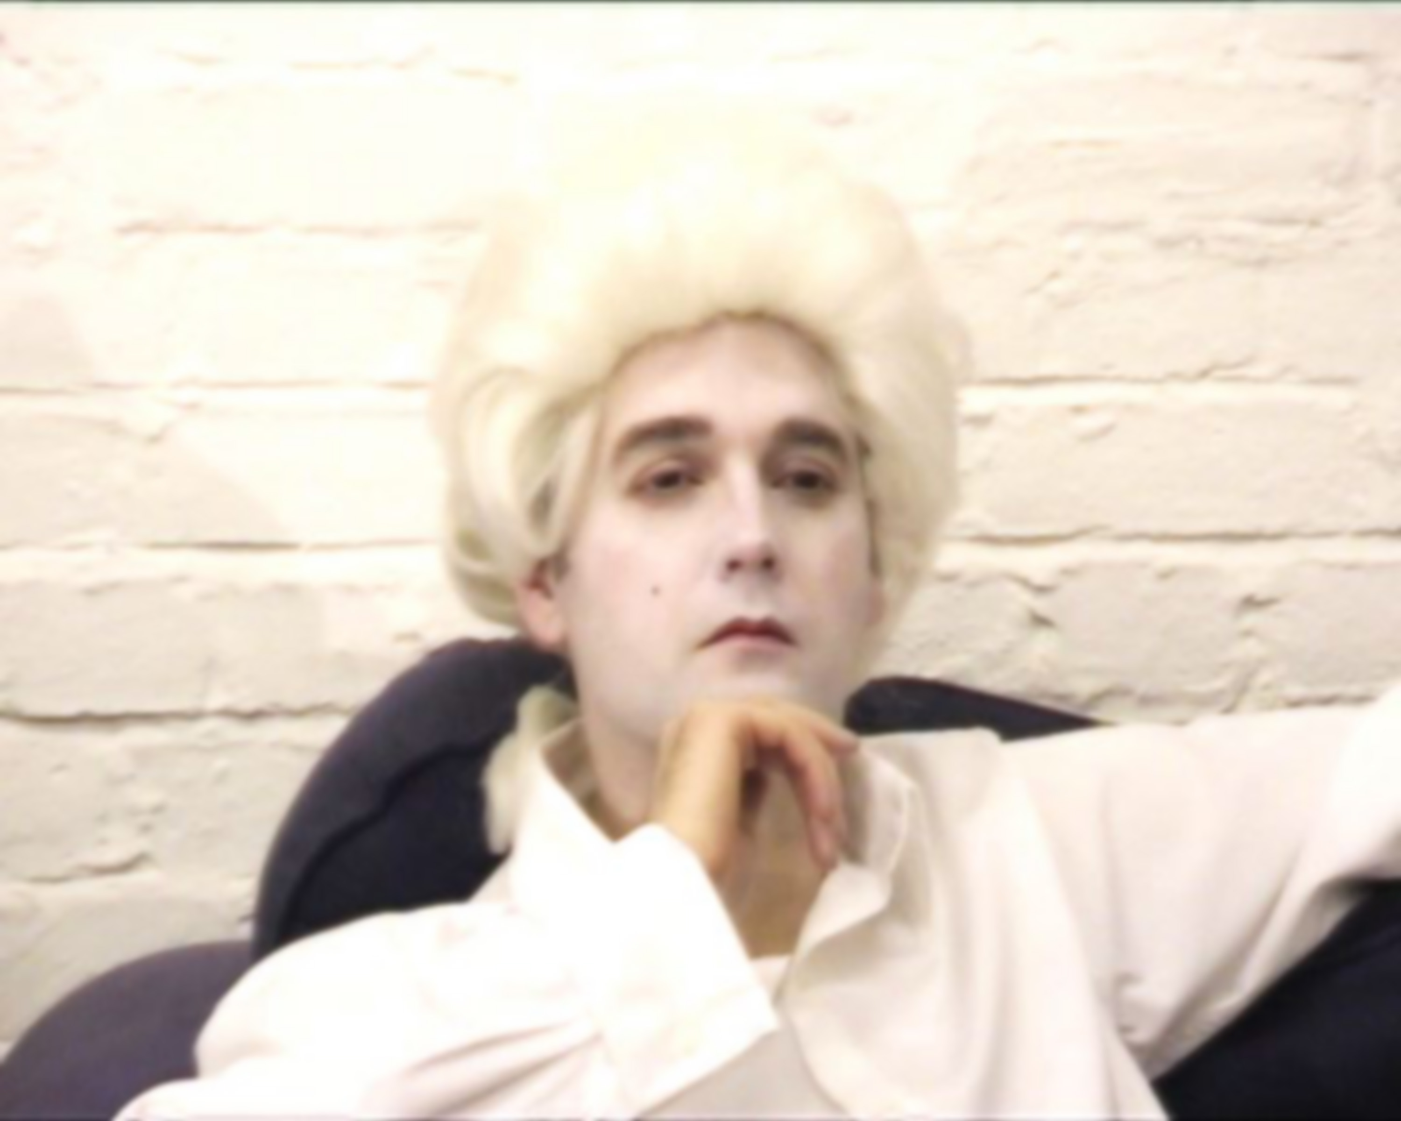
Two Fine Examples of British Dentistry’
has subsequently been exhibited in other group and survey shows, most notably as part of ‘Running Time -Artists film in Scotland 1960-present’ at the Dean Gallery, Gallery of Modern Art, Edinburgh in 2009. A survey exhibition, dedicated to Scottish artist films, featuring selection of over one hundred film and video works by over sixty artists, including Douglas Gordon, Margaret Tait, Boyle Family, Eduardo Paolozzi, David Shrigley and Luke Fowler. Three of my collaborative video works were included in this exhibition that took place at the Dean Gallery, Scottish National Gallery of Modern Art, Edinburgh. Exhibition dates 17th October − 22nd November 2009
Image one & a description of what we are looking at in the context of the project.

