Slide 1

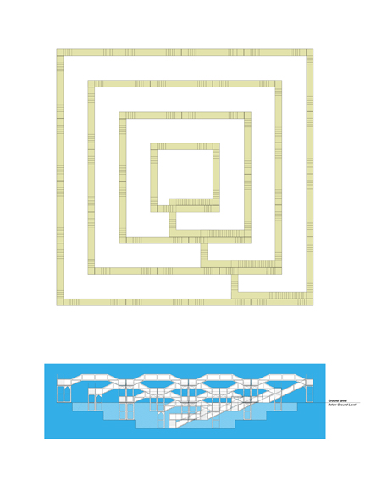
Prints Tokyo 2012, International Print Exhibition
Select group exhibition of International artists working in print media at Tokyo Metropolitan Art Museum Ueno, organised by Japan Print Association, October 2012.
Submitted by Mick McGraw
Output No. 2

Slide 2

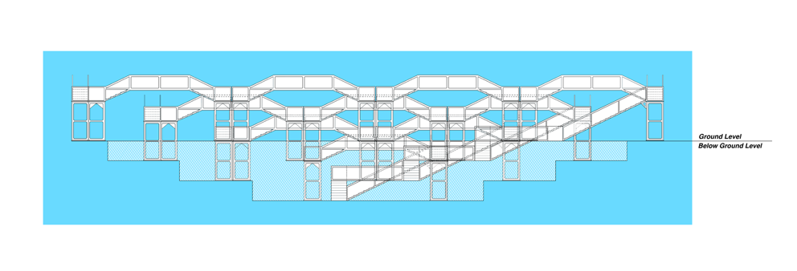
Prints Tokyo
This output examines my ongoing research into a series of works which take the form of hypothetical proposals. The print included in the Prints Tokyo exhibition is a colour lithograph, printed from offset lithographic plates. The ideas behind this ongoing series of proposed works emerge out of the intention to encourage individuals to experience acts of true simplicity, such as being able to watch desert sands shift beneath a purpose designed portable shelter, to this work, which allows the participant to embark on a journey over a series of linked staircases both above and below ground with no other function other than to be able to walk over different levels and observe the landscape/ urban-scape from different heights without any un-necessary distractions. This is a self contained walk, ie. it is uninterrupted and has only one entry and exit point.
The exhibition in Tokyo has been selected by the members of the Japan Print Association of international artists who have influenced their own work.
No.2
Mick McGraw
Image one Walking for the Purpose of Walking (detail) by Mick McGraw. Indication of digital drawing.

Slide 3
Image two. Walking for the Purpose of Walking, offset lithograph. This is the main featured work in the Prints Tokyo Exhibition (Submission NO.3)

Slide 4
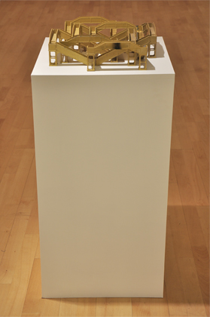
Image three. Walking for the Purpose of Walking 1, sculpture using train set models, this work formed the basis for the drawings in the final work.

Slide 5

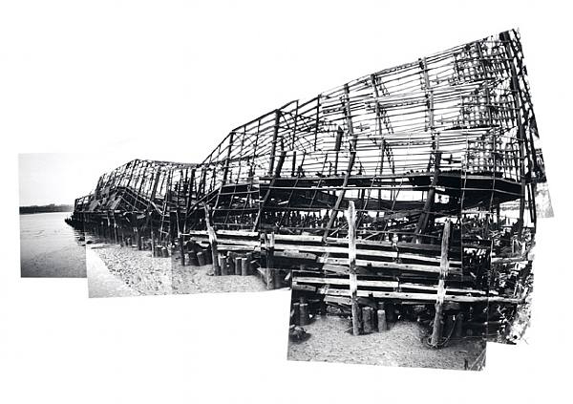
In order to introduce the relevance and rigour behind the research for the print included in the Prints Tokyo exhibition (submission No.3), it is important to be able to track the evolution of this piece. This work has emerged as a direct result of a body of work begun around 17 years ago when my work migrated to using the latest digital technology at the time. As a foil to the advances in technology, I felt compelled to continue to make drawings and out of this emerged the first work in this ongoing series, Proposal for Viewing Desert Environment (Image six). The background for this piece emerged when I was looking to buy a new tent! I scoured magazines and brochures looking for the right product but more interestingly I became fascinated in the diagrams which depicted the sizes and layouts (plans and elevations and isometric views). At the same time I came across the work of Mary Miss (image four and five) and Alice Aycock (image six). Both of these artists used photo-collage techniques with drawings to attempt to realise hypothetical sculptures and scenarios (some of which have been built). To date none of mine have been realised but they are designed to scale with all measurements being actual scale sizes and weights. It is not necessary for them to be realised as the idea exists within the print and the dissemination that this offers.
Image four. Mary Miss, Untitled (Collapsed Pier) Inspiration and background research.

Slide 6
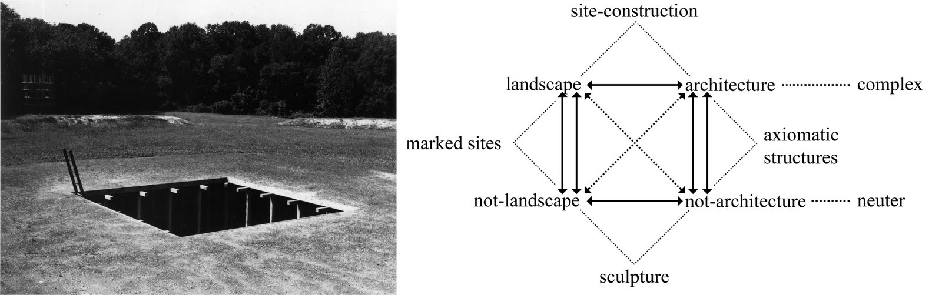
Jennifer Shields, in her blog Collage and Architecture, a manuscript writes of Miss-
Mary Miss’s attitude toward public structure focusing around human engagement directly influences Miss’s need for photo/drawings. Photo/drawings for Miss are essential in conveying the spatiotemporal experience of places, whether existing or constructed by herself. It can be said that Miss’s photo/drawings are a collage of photographs each depicting a separate reality in order to form a “new experience” that could not be conveyed in a single drawing or photograph.
This idea of the “new experience” is intrinsically linked to my own ideas and a number of these pieces have developed through a similar intention to visualise an idea. My notion of drawing in these works comes from a lifelong interest in technical drawing and the language this uses to depict and represent shape, surfaces and hidden features through the use of broken lines in combination with plan, front and end elevations. These supposed simplistic interventions I am proposing are, ironically, incredibly complex in their fabrication (continues on next page)
Image five. Mary Miss, Perimeter/Pavilion/Decoys (1978) Inspiration and background research.

Slide 7
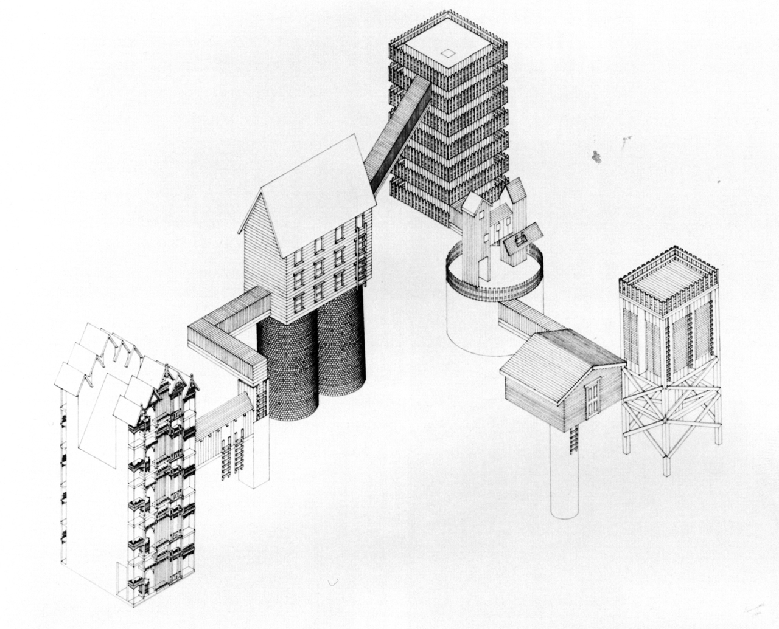
..as trying to visualise accurately how something exists when it is not tangible is incredibly time-consuming but hugely rewarding when it appears to “work”.
What is interesting to me is that this body of research works hand in hand with other much more technological processes and ideas. Another side to my research investigates advances in superior technology by organisations such as the US government funded DARPA (Defense Advanced Research Projects Agency) which heavily influences some of my other projects. As mentioned earlier, the series of “proposed” works appear to be almost too simplistic, spiritual or cathartic by nature and could in some ways be my mechanism for backing away from the speed of our current lives (from the writings of French linguist and philosopher Paul Virilio). Some of these proposals are based in a somewhat rural environment whilst others are intended to offer breathing space in the centre of a city.
Image six. Alice Aycock, I Have Tried to Imagine the Kind of City.... Inspiration and background research.

Slide 8
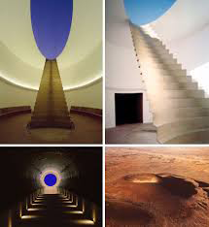
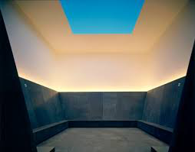
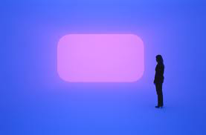
Walking for the Purpose of Walking as exhibited in Tokyo is conceived as a potentially urban work whereby the stairs (based on drawings of vintage Hornby Dublo railway model footbridges) are linked together with elevated walkways and connecting sections designed in an almost maze-like pattern. This work is intended to offer an experience for the viewer/participant which acts as a release from the everyday experiences of modern living. The idea is to be able to embark upon a walk which changes levels and offers differing viewpoints to the view from which one might be accustomed to (by seeing it from different heights, angles, perspectives, eye levels).
Another influence on this body of work has been the works of James Turrell (image seven). Turrell’s works are primarily involved in examining notions of light and space. His Skyspaces offer apertures on the sky where one can look at the changing colour of the sky (often only opened at dusk throughout the autumn and winter) with the sole intention of watching live, the hue of the colour of sky change towards darkness. I am interested in this idea of the “live” experience which incorporates our whole array of senses throughout the duration.
Image seven. James Turrell, various light-works and lightspaces, inspiration and background research.

Slide 9
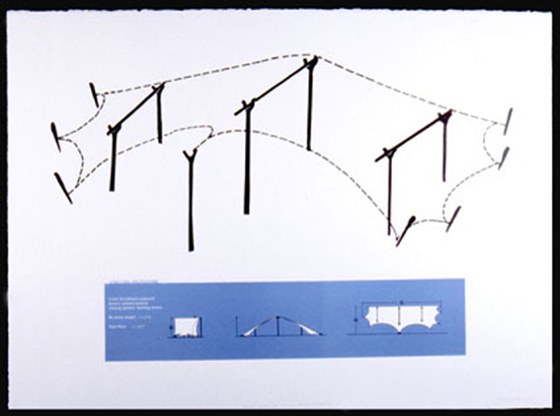
Other works in this “Proposed Series” include Proposal for Viewing Deep Water Section (image nine, a balsa wood scale model), Suspension Reflection, (image ten), Avon Displacements,(also image ten), and Proposed Sound Projection for an Urban Complex (image eleven), amongst others. Each of these works is based on research, both site specific and theoretical, to investigate or instigate an action to provoke a response of some description, whether this be curiosity, enlightenment or suspicion, for example. These works explore notions of proposed live sound projections across an urban network, a movable floating pontoon which can be walked upon on the surface of open water to observe the changing colour and characteristics of the waves, or in Suspension Reflection, to re-appraise some of our incredible feats of engineering mastery by proposing to place large scale site specific mirrors which allow one to see the reflection of the civil engineering of the structure they may be standing upon (the Clifton Suspension bridge in this case).
Image eight. Proposed Structure for Viewing Desert Environment, Mick McGraw, Offset Lithograph.

Slide 10

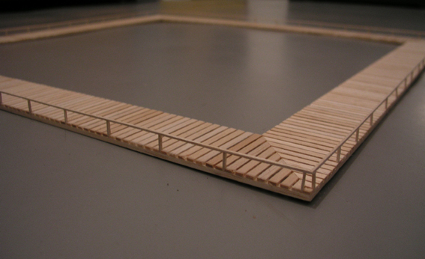
The methodology employed in the majority of these works, and more specifically in Walking for the Purpose of Walking often results in the work being made through a printmaking process, normally offset lithography.
Often the work starts as a sketch or a photo-collage as a result of either being in a specific location or responding to an idea which has been thrown up by researching a subject. In Proposal for Viewing Deep Water Section (image seven) the starting point was seeing a floating pontoon for mooring boats on. This led to an investigation through materials of making scale models in the first instance. This repetitive process, although banal and time consuming, offers much reflective time for developing ideas through the process of making and using ones hands. This in turn often sparks further activity through freehand drawing before taking in to the rather un-conventional method of drawing via the computer. Once the drawings are completed, they are printed off as separations (single acetates denoting each colour to be printed), transferred photographically to printing plates and the subsequent prints made in coloured layers.
Image nine. Proposal for Viewing Deep Water Section, Mick McGraw, scale model, research for drawing.

Slide 11
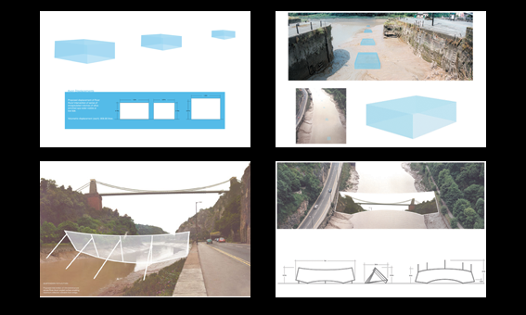
As these works are conceived and exhibited as “working plans or blueprints for production” they are always made to scale. In order to do this I need to utilise existing plans or maps, surveying equipment or altimeters to gain exact height changes in accurate increments. This can see me surveying a site with an altimeter, plotting spot heights in relation to a map where I draw or write down exact co-ordinates, sometimes in conjunction with a GPS unit where the exact location is important (I have individually documented the last remaining Scots Pine Trees in an ancient remnant woodland in partnership with Scottish Natural Heritage) where the precise location of live and dead trees was of the utmost importance. The background to Suspension Reflection (image ten) relied on using scale plans of the Avon gorge in conjunction with scale models to be able to visualise the resultant proposal to be able to see the reflection of the Clifton Suspension Bridge whilst standing on the bridge looking downwards to where the proposed mirror needed to be situated.
Image ten. Four prints from the series Suspension Reflection and Avon Displacements, Mick McGraw.

Slide 12
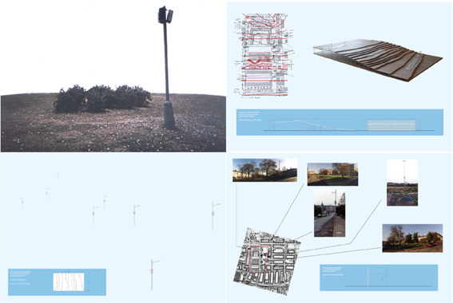
Image eleven shows the four prints made for the Proposed Sound Projection for Urban Complex project. These were made from initial site visits plotting accurate spot heights which were transferred to maps. Once done a scale model was made in plywood showing the topography of the proposed network of speakers to facilitate the sound work.
The working methodology of this series of works, although printed, had its roots in visiting the site on multiple occasions to be able to gather as much relevant information as was needed to be able to convincingly represent the concept of the work (as it was not going to be made, certainly not at that point in time). The use of the 3 dimensional model was essential in being able to work out the “on the ground” facts as the work needed to exist hypothetically but realistically also.
Image eleven. Proposed Sound Projection for Urban Complex, Mick McGraw, Digital Lambda Prints.

Slide 13

In the work for Prints Tokyo, the methodology behind the work had been honed and developed through a number of works which had been made over a much longer period. The methods of production and testing in the lead up to the final incarnation of the piece were investigated thoroughly. As the work is made to scale, I had made many scale models beforehand to become absolutely familiar with attempting to visualise the “experience” of embarking on the circuitous walk without actually ever having done so (in that exact configuration).
By conceiving the piece with the train set models (image three), I was able to “scale myself” down conceptually to be able to re-enact the walk. This in turn led to being able to accurately represent the surfaces and planes of the drawing, albeit represented by the methods of technical drawing (unseen surfaces and features being represented by broken lines).
The research in these works is quite complex to identify but it centres on the suggestion of a re-appraisal of our preconceptions of what progress actually means. I am attempting to highlight a greater awareness of what has gone before, particularly in terms of how we use land and infrastructure but also of how we need to slow down and consider the speed at which we are living our lives, perhaps by introducing some means to, ever so slightly, amend how we look at and interact with our familiar surroundings. I am aiming to re-introduce the notion of not just “art for art’s sake” but” experience for experience sake”. We need to be willing to let go of the everyday experience to try things deemed unconventional, to steal back that time for reflection and contemplation.

Slide 14

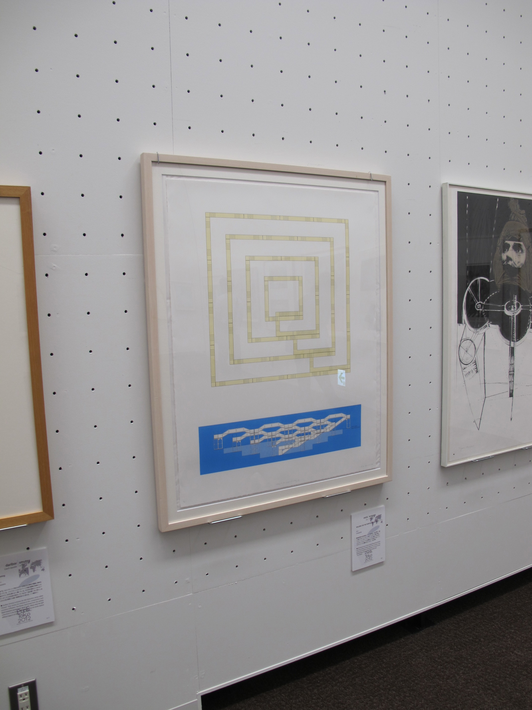
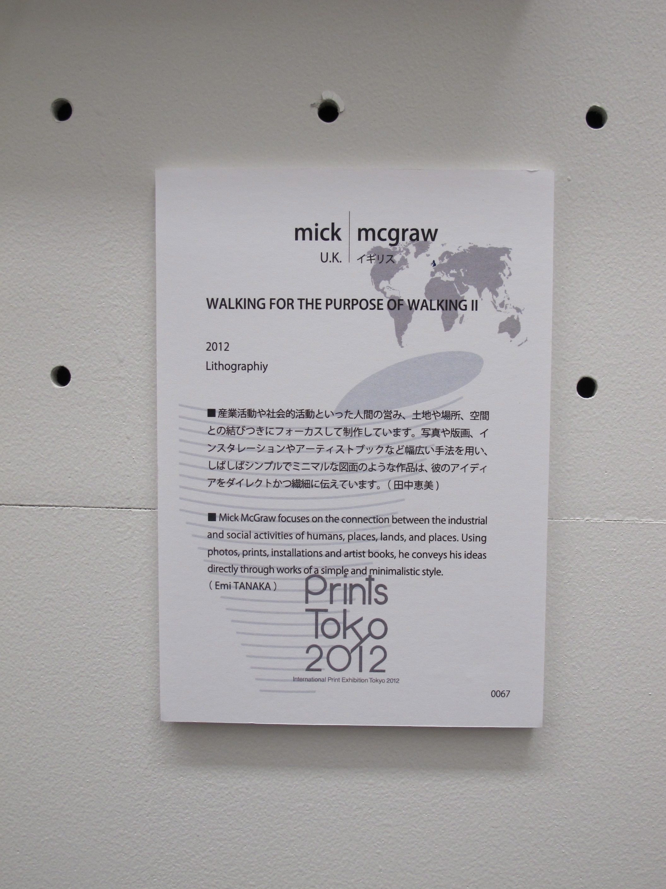
This work was exhibited alongside another 117 pieces selected from all over the world outside of Japan, including UK, USA, China, India, Canada to name a few. Other artists represented in the exhibition from the UK include David Faithfull, Rebecca Salter and Bronwen Sleigh amongst others. This exhibition will display a large cross section of prints being made today from across the world. The accompanying symposium had a Keynote lecture by LIAO Shiou Ping, President of the Taiwan Art Academy, Prof. of the National Taiwan Normal University, Tadayoshi NAKABAYASHI, Director of Japan Print Association and Noriko YANAGISAWA, Member of Japan Print Association, based upon “After 1960, Deployment of the Japan Print Association and Trends in International Printmaking”.
Exhibition Catalogue published by Japan Print Association, October 5th 2012
168 pages long with one page for each artist.
(available to see in physical form in the box file) or at-
http://www.printstokyo.info/
Image twelve Walking for the Purpose of Walking installed at Tokyo Metropolitan Art Museum, Japan.

Slide 15
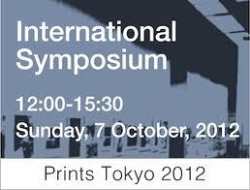
This international selection of works by Japanese associate members is intended to show the range of work happening across the world in Printmaking.
"The Japan Print Association has continued to promote print arts as well as inspire and educate young artists these past 80 years in Japan, the country of prints. Our activities also reached out internationally. The association has also been encouraging members to join international programs as trainees and by such international connections we hope to hold exhibitions full of new and fresh perspectives. This year the 80th annual exhibit “Prints Tokyo 2012” continues the quest for further internationalization. It is a special exhibition that takes on the latest developments in the art of printmaking but it is also a bridge to building international relationships, thus fulfilling one of the main objectives set out at the establishment of the association."
Image twelve Walking for the Purpose of Walking installed at Tokyo Metropolitan Art Museum, Japan.

Slide 16
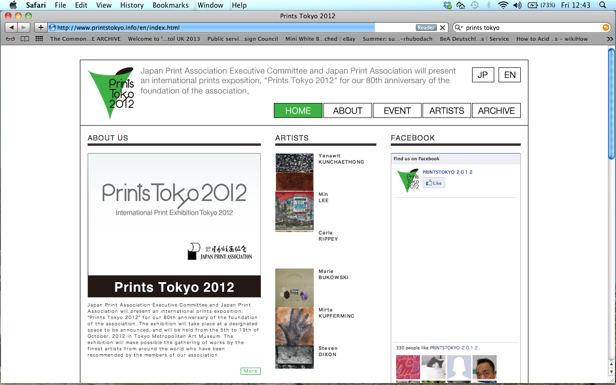

Slide 17
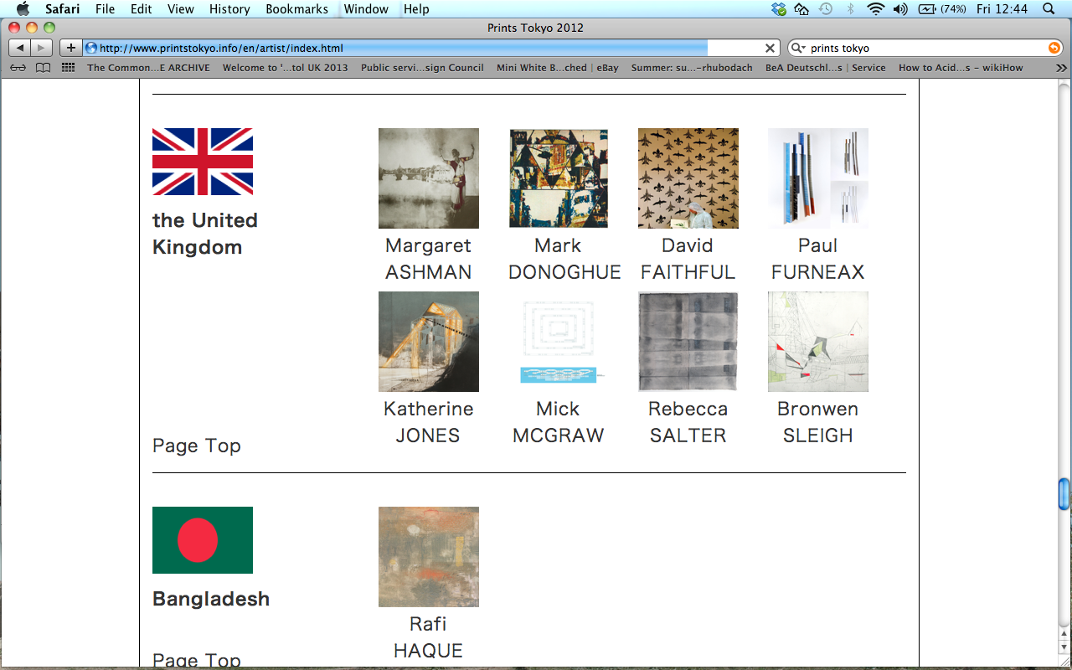
http://printstokyo.info/artist/0067.html

Slide 18

Acknowledgements to the Japan Print Association and also to the nominator (who invited me to be part of this exhibition),
Miss Emi Tanaka.

