Slide 1

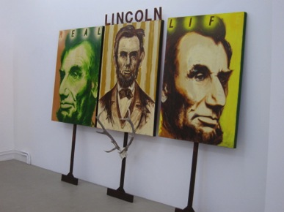
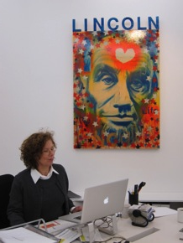
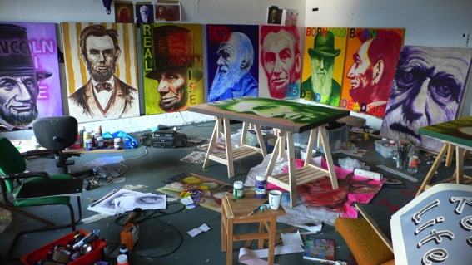
Ross Sinclair – Real Civic life
(Lincoln, Darwin and The Monarch of the Glen in a Real Life Civic Portrait Painting Protest show, made in Scotland on the occasion of the 201st anniversary of the birth of Darwin and Lincoln and the 251st anniversary of the birth of Robert Burns.)
Angelika Knapper Gallery, Stockholm, Sweden
1Feb – 7 March 2010
My second solo exhibition in Angelika Knapper Gallery in Stockholm, Sweden which represented the culmination of 18 months studio research/production.
Submitted by Ross Sinclair
Output No. 1

Slide 2

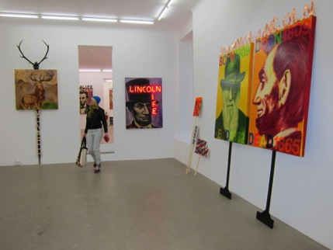
Ross Sinclair – Real Civic life
This was a solo exhibition at a gallery in Stockholm. "For Scottish artist Sinclair’s second show with Angelika Knapper he explores his/our contemporary relationship with the USA through the idea of the Civic portrait, long fallen from favour but here re-born as the materials for a protest, a demonstration. Located in the gallery but ready at a moments notice to be taken to the streets to help articulate the formless fury of a life with no God. The project was inspired by the seemingly arbitrary fact that Abraham Lincoln and Charles Darwin were born on the same day, 12 February 1809 while Robert Burns remained Lincolns' favourite poet.”
The exhibition physically consisted of over 30 discrete hybrid painting/assemblage/neon works. This exhibition sought to investigate the relationship of the gallery viewer to contemporary issues of civic, national and international identity in the 21st century, through reflection of multiple art works that utilise unusual combinations of materials in painting, neon and sculptural installation and was formed by a process of studio research and development from previous exhibitions.
1
Ross Sinclair
Ross Sinclair, Real Civic Life, Angelika Knapper Gallery, Stockholm, 2010

Slide 3
Ross Sinclair
Real Civic Life
(Lincoln, Darwin and The Monarch of the Glen in a Real Life Civic Portrait Painting Protest show, made in Scotland and exhibited in Sweden on the occasion of the 201st anniversary of the birth of Darwin and Lincoln and the 251st anniversary of the birth of Robert Burns.)
Angelika Knapper Gallery
Stockholm
1Feb – 7 March 2010

Slide 4
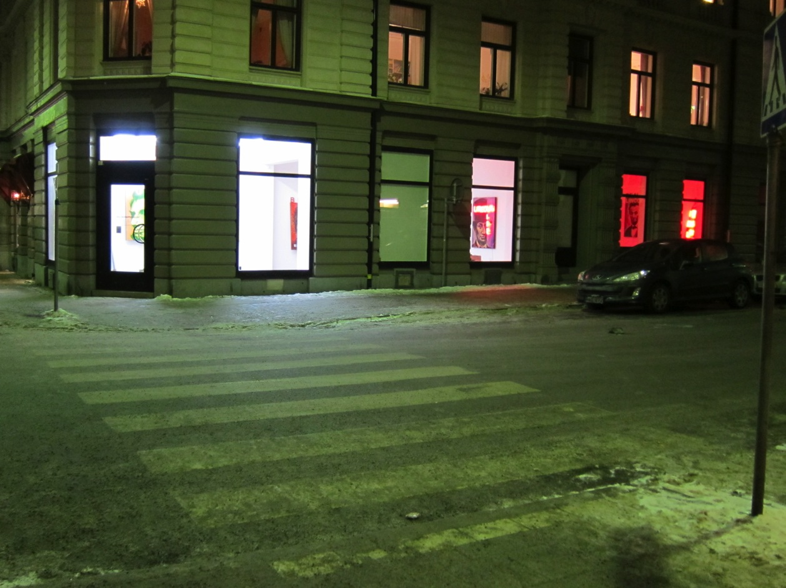

Slide 5
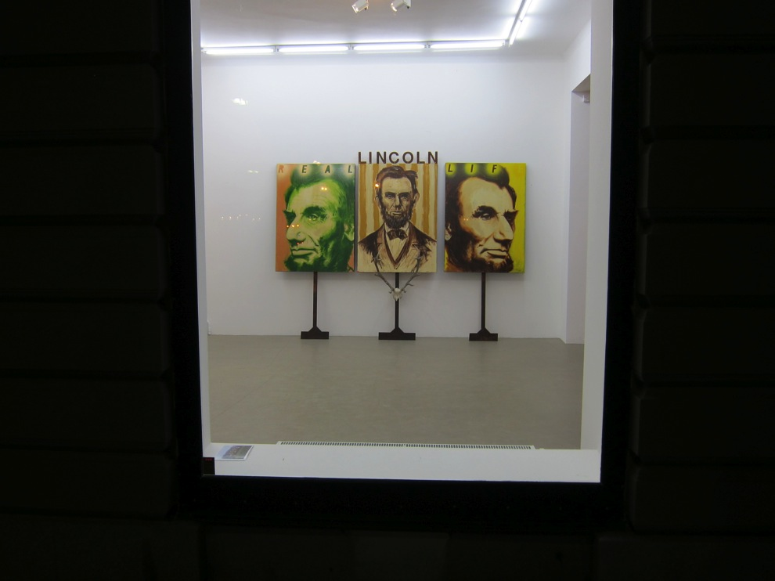

Slide 6
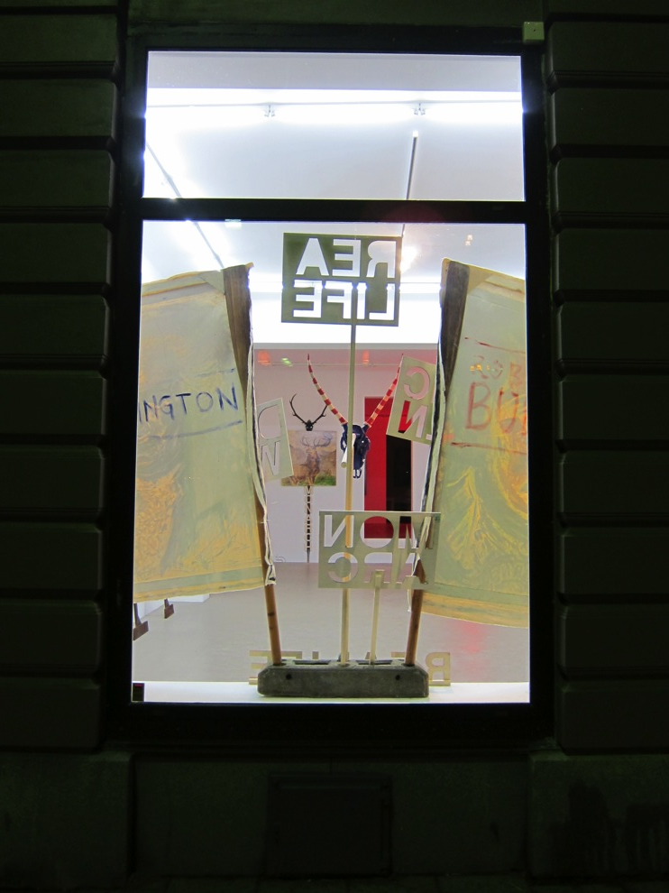

Slide 7
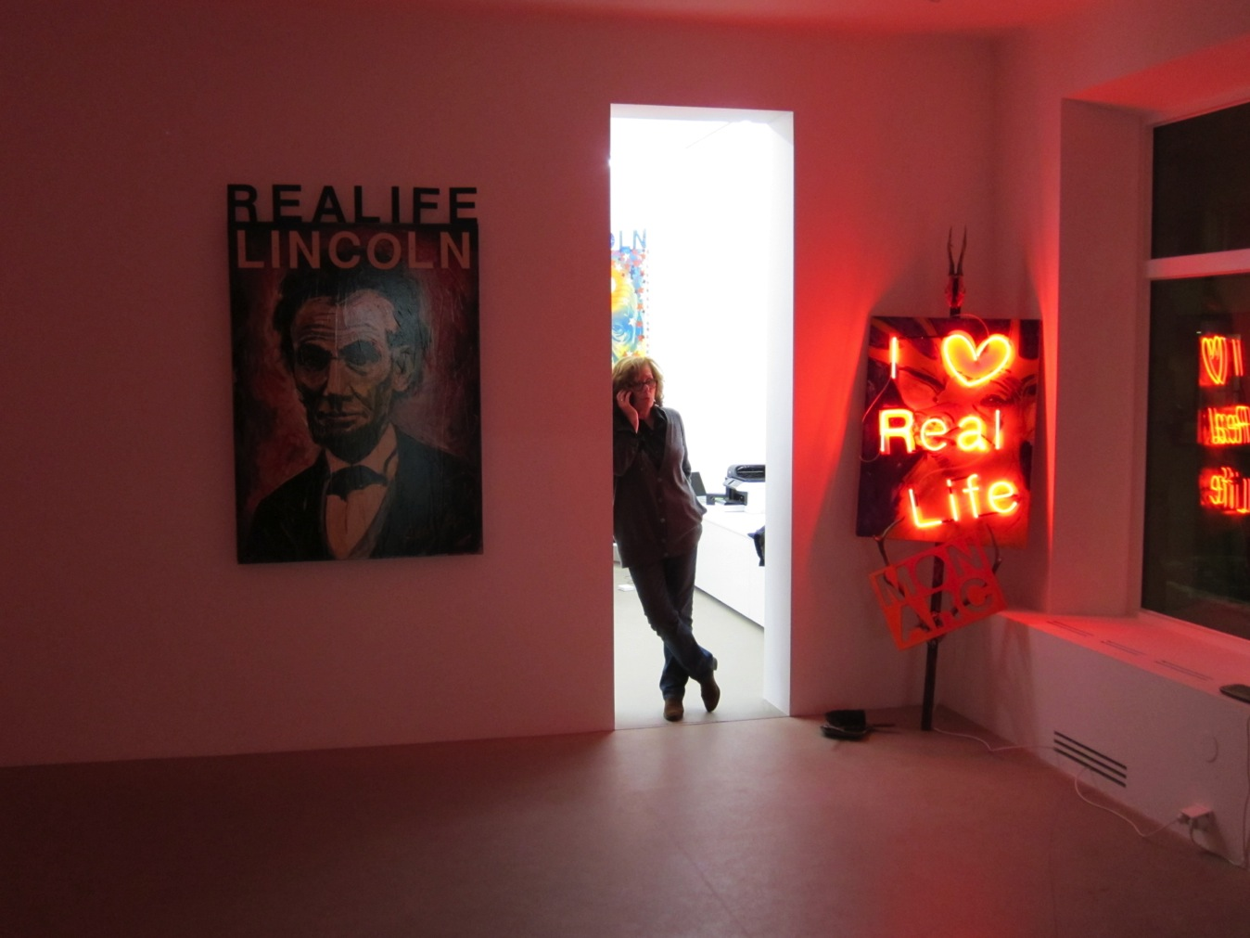

Slide 8
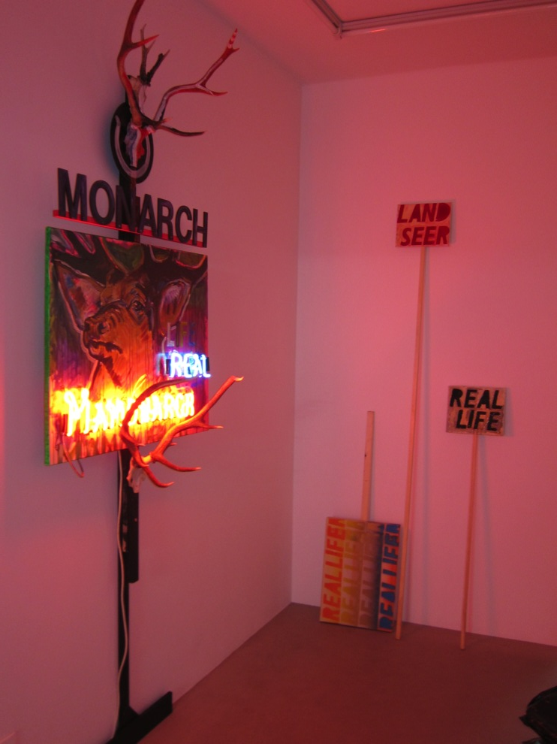

Slide 9
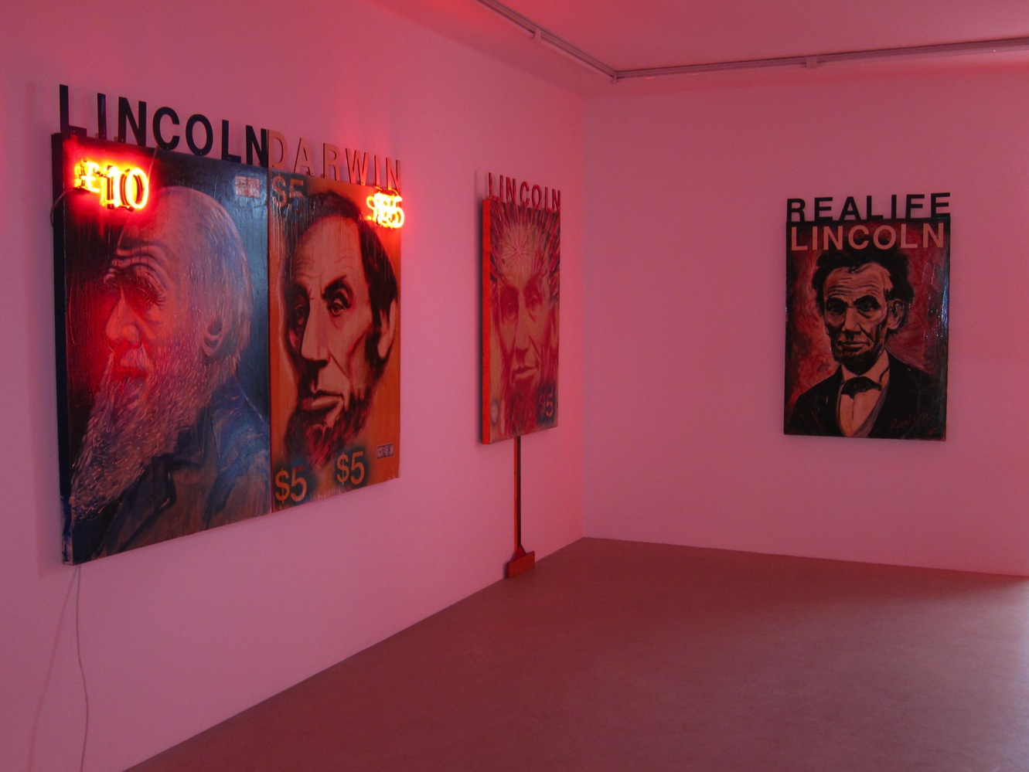

Slide 10
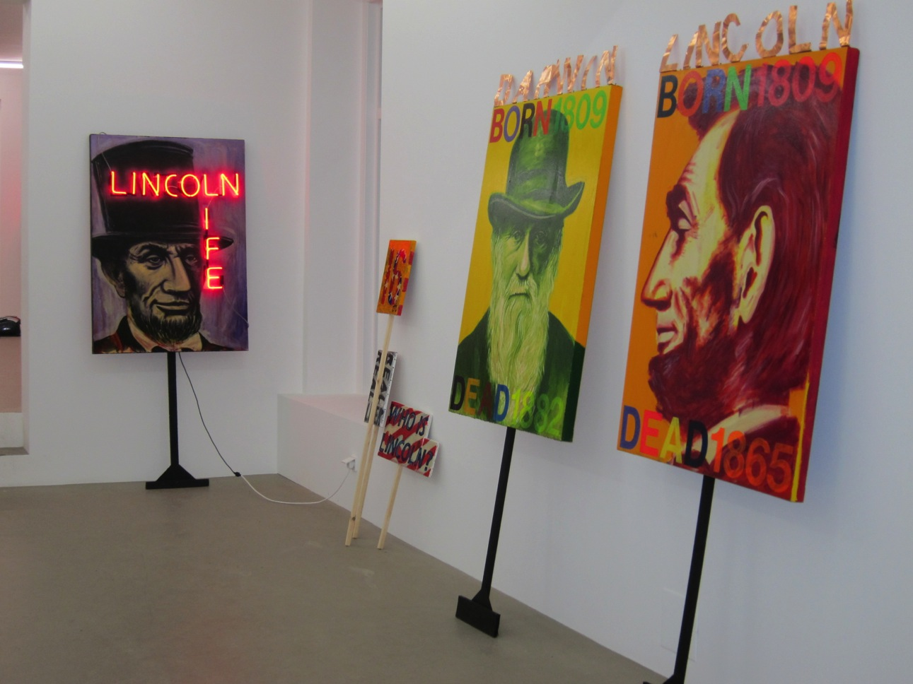

Slide 11
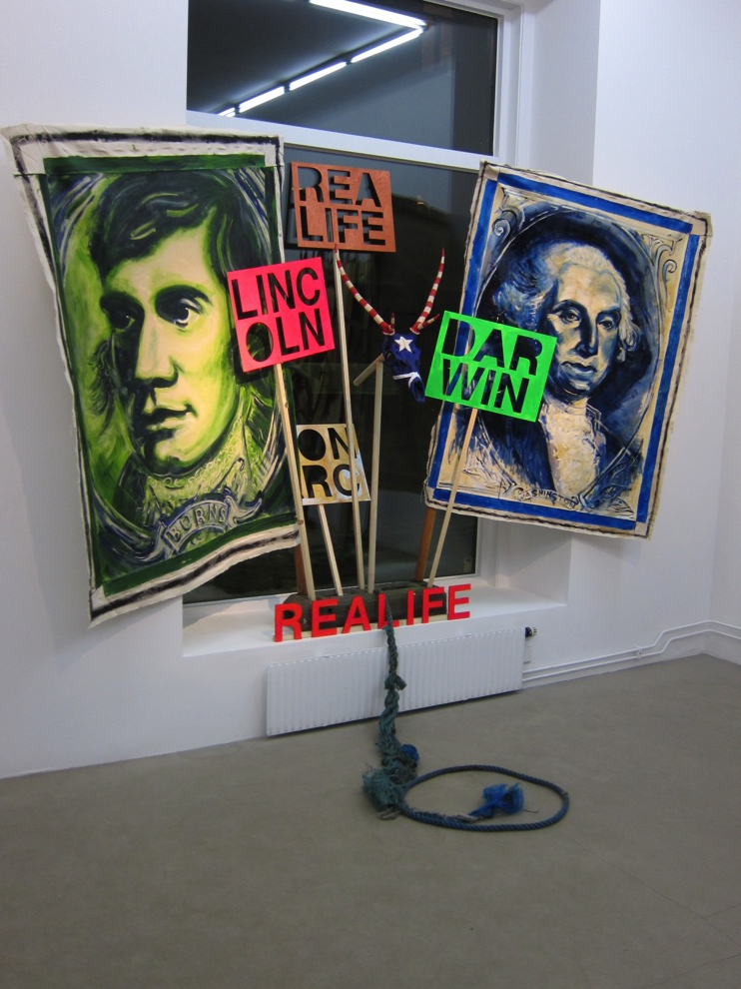

Slide 12
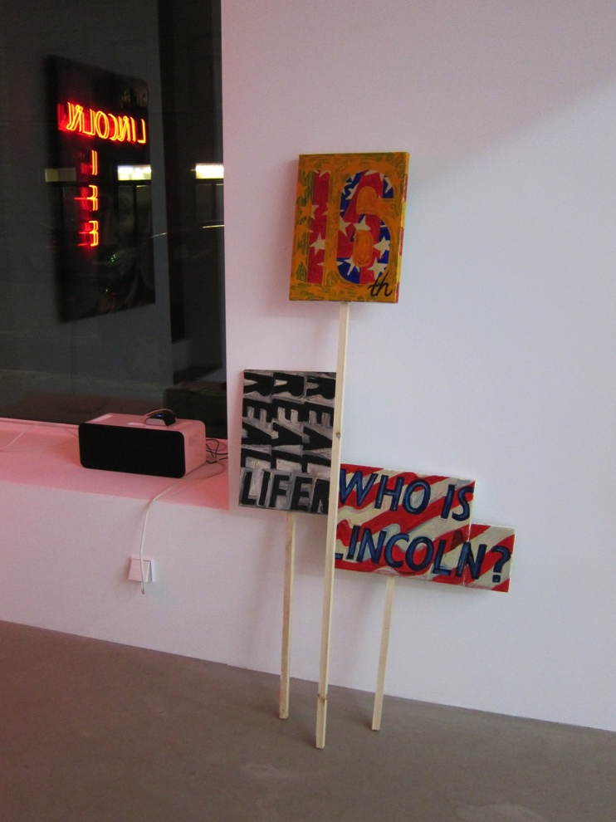

Slide 13
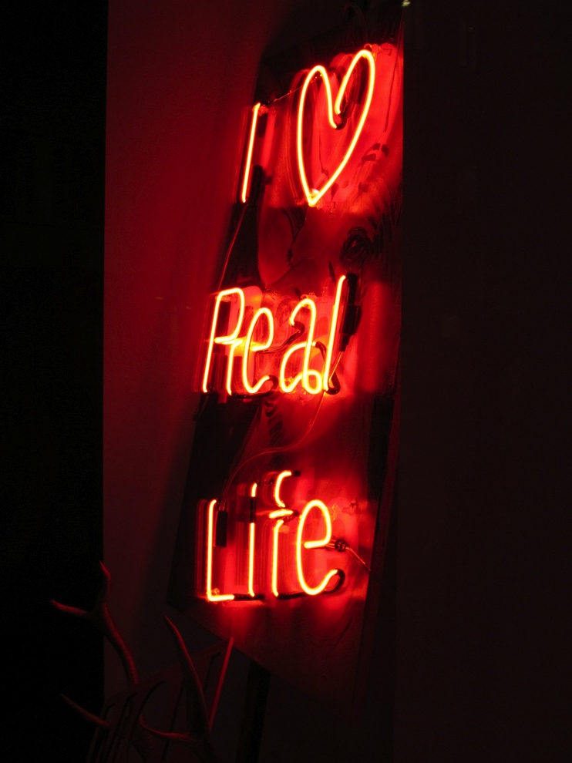

Slide 14
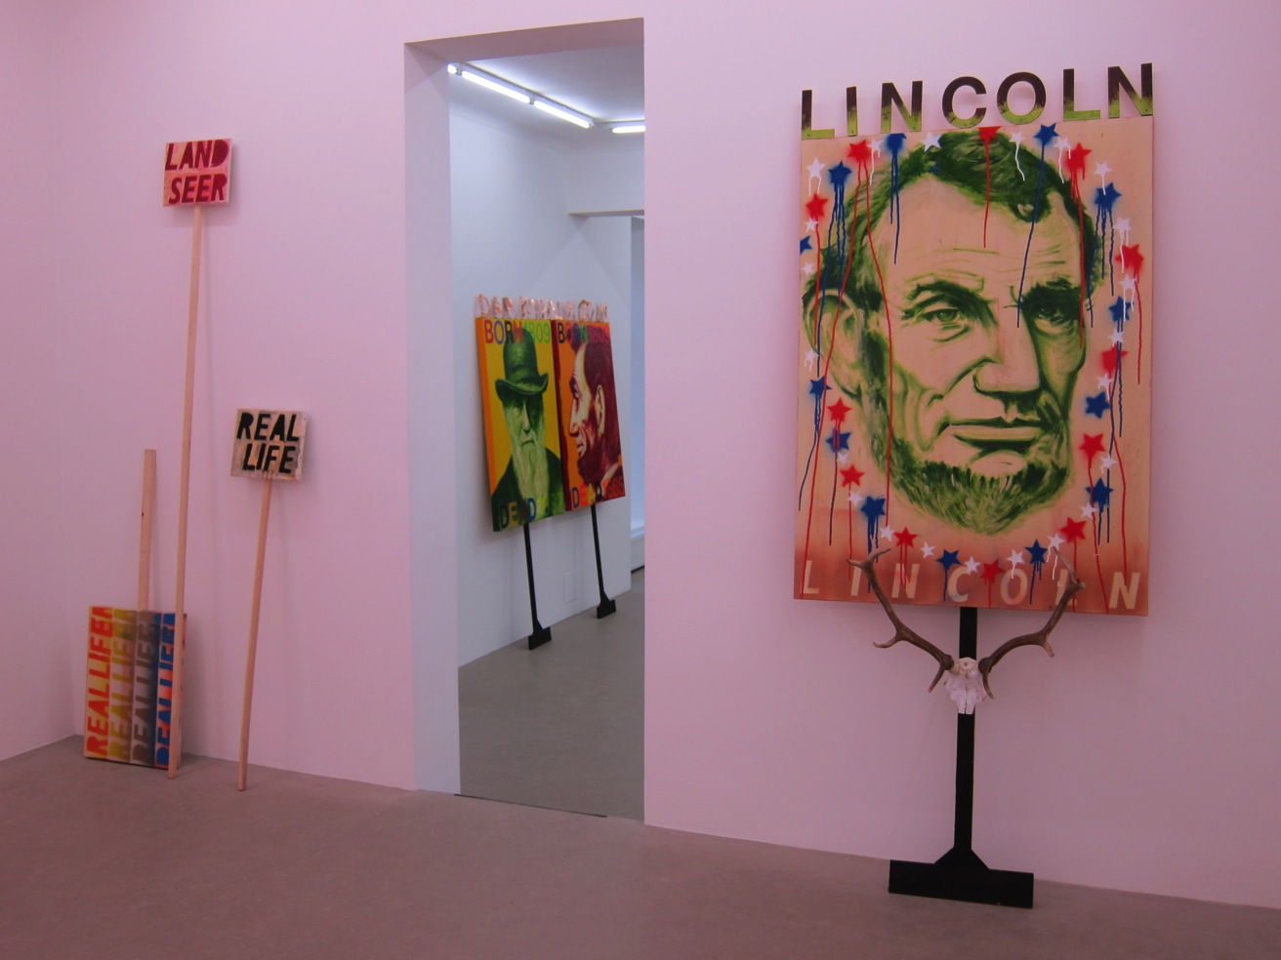

Slide 15
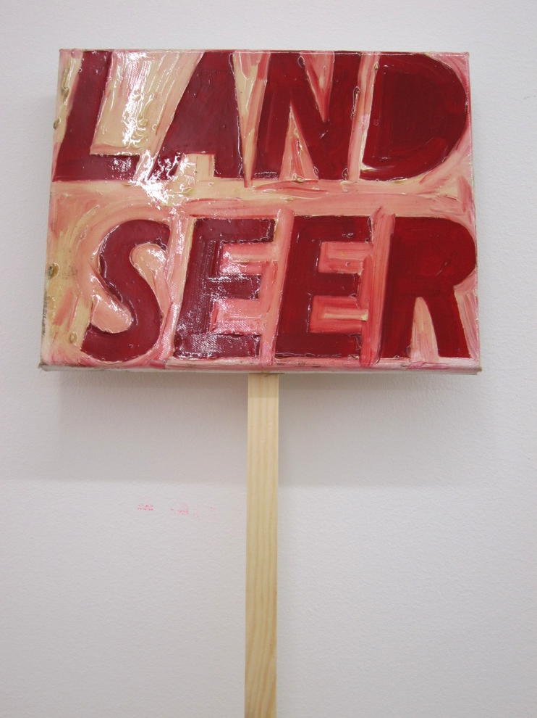

Slide 16
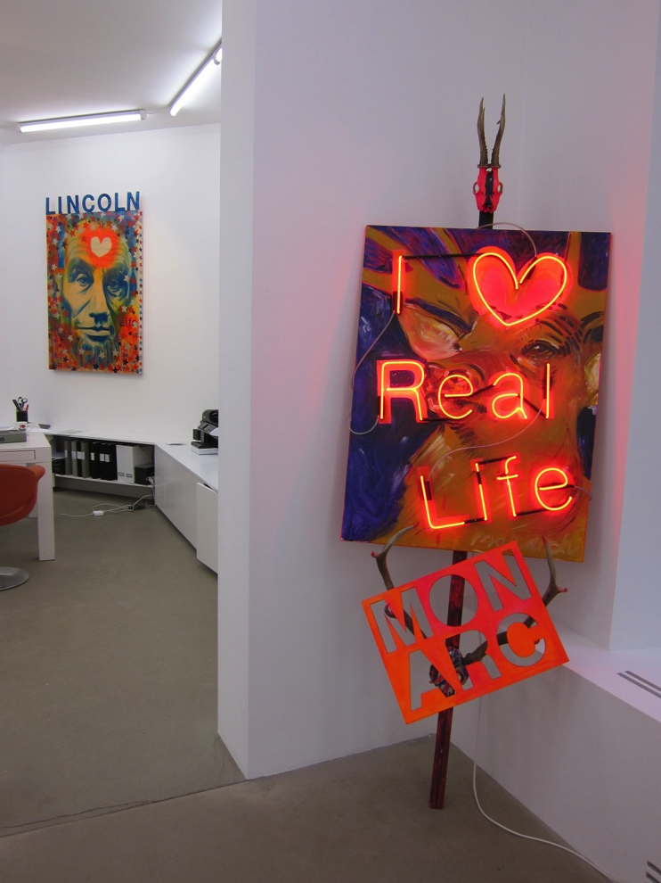

Slide 17


Slide 18
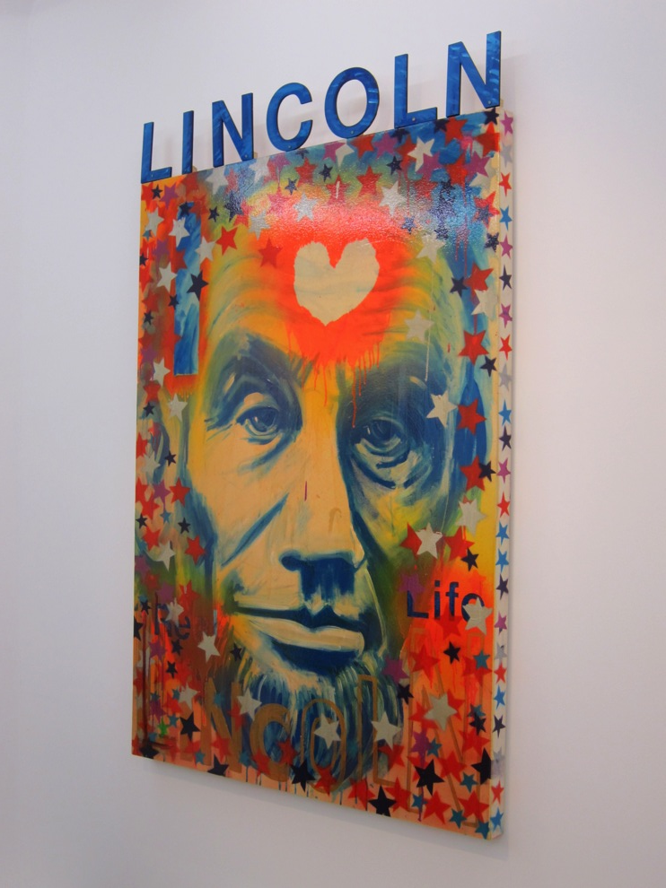

Slide 19
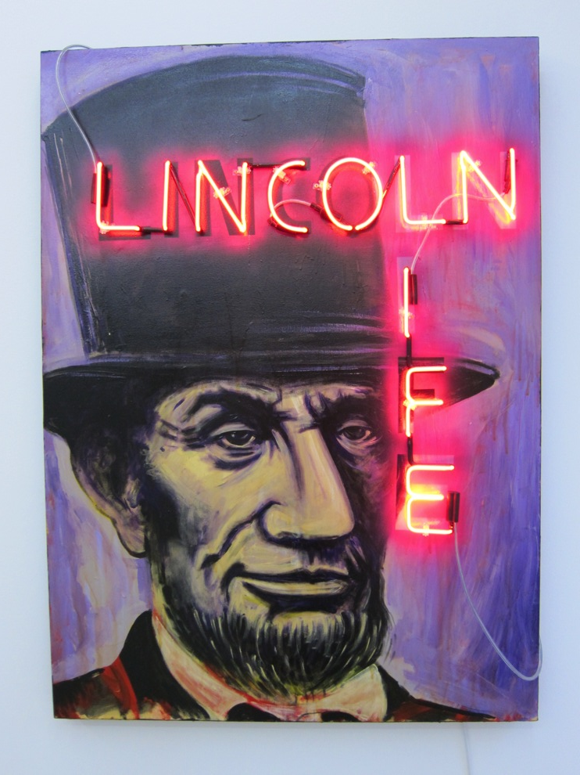
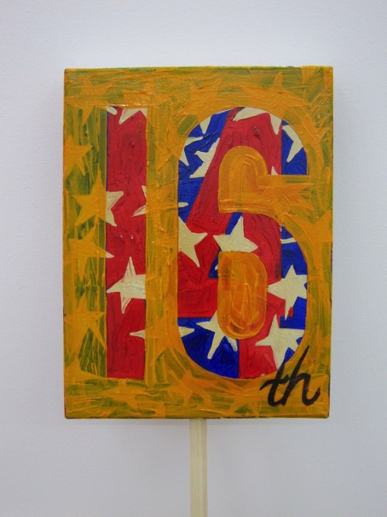

Slide 20
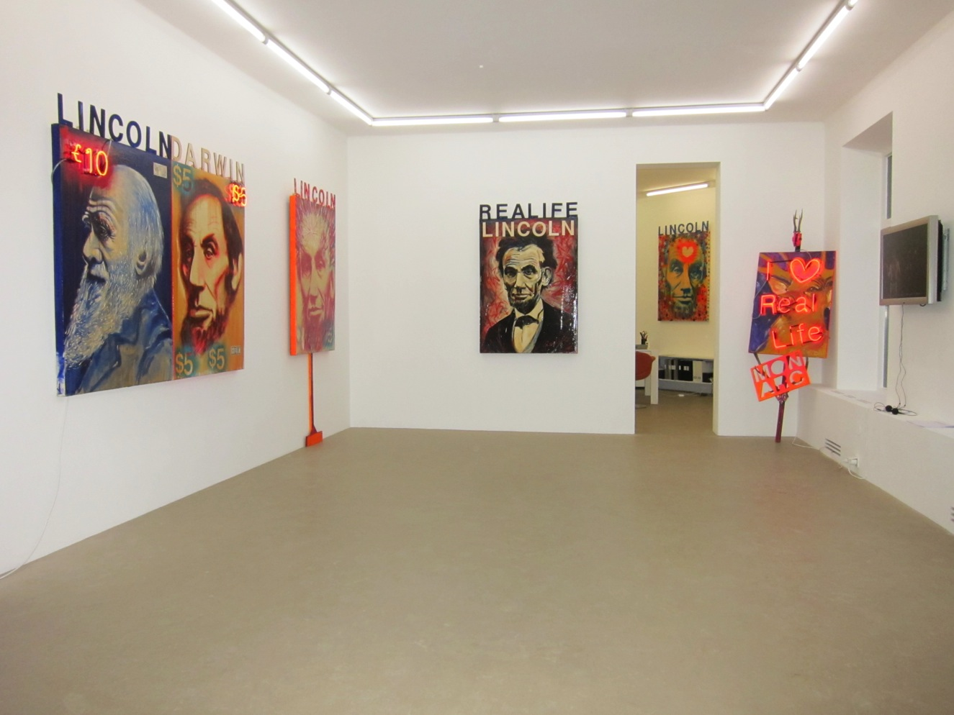

Slide 21
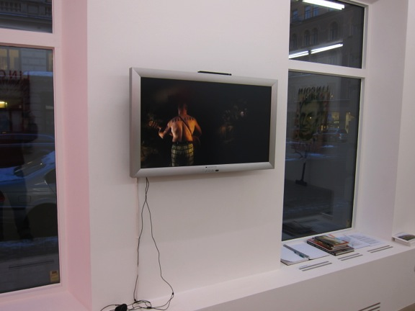
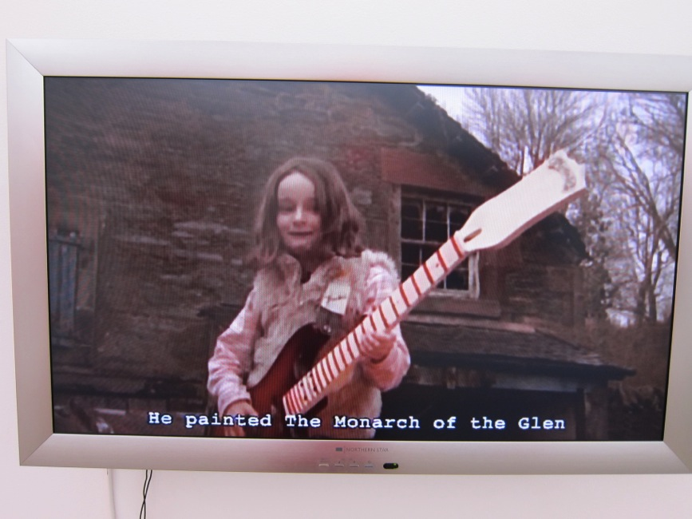

Slide 22
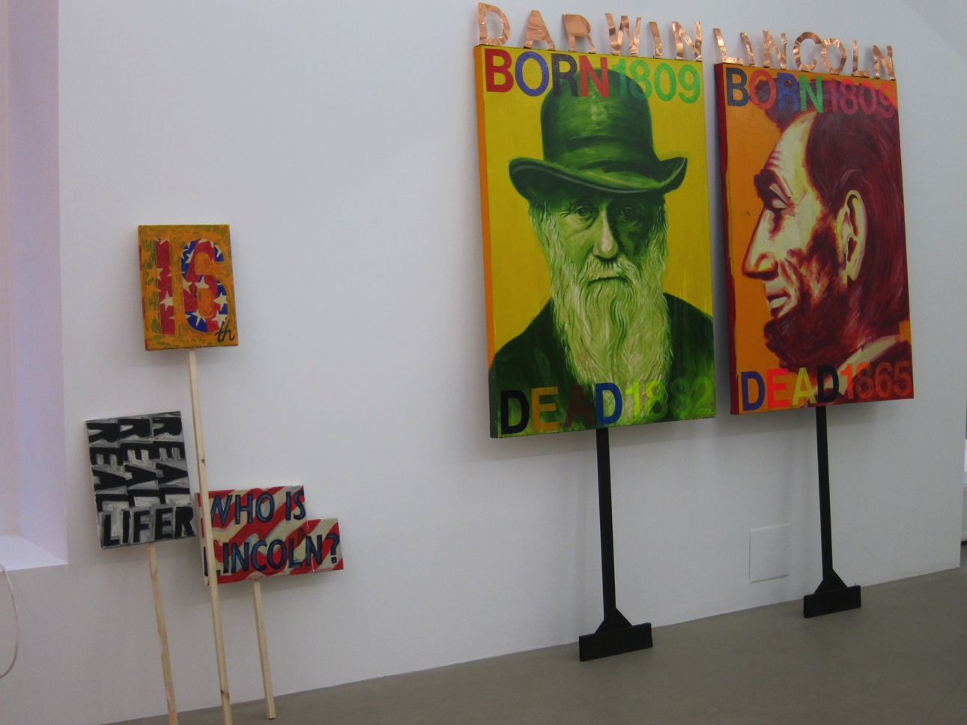

Slide 23
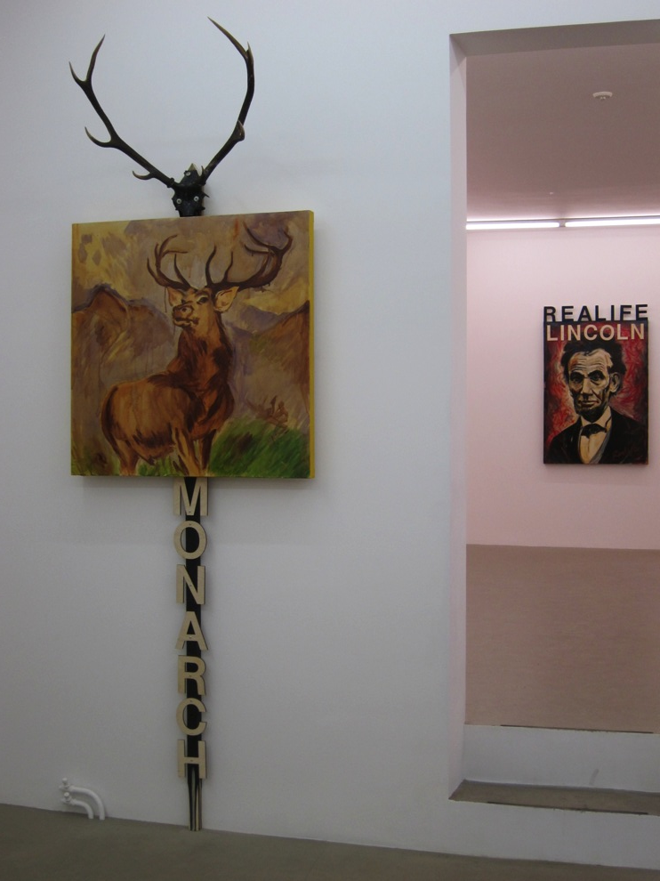

Slide 24
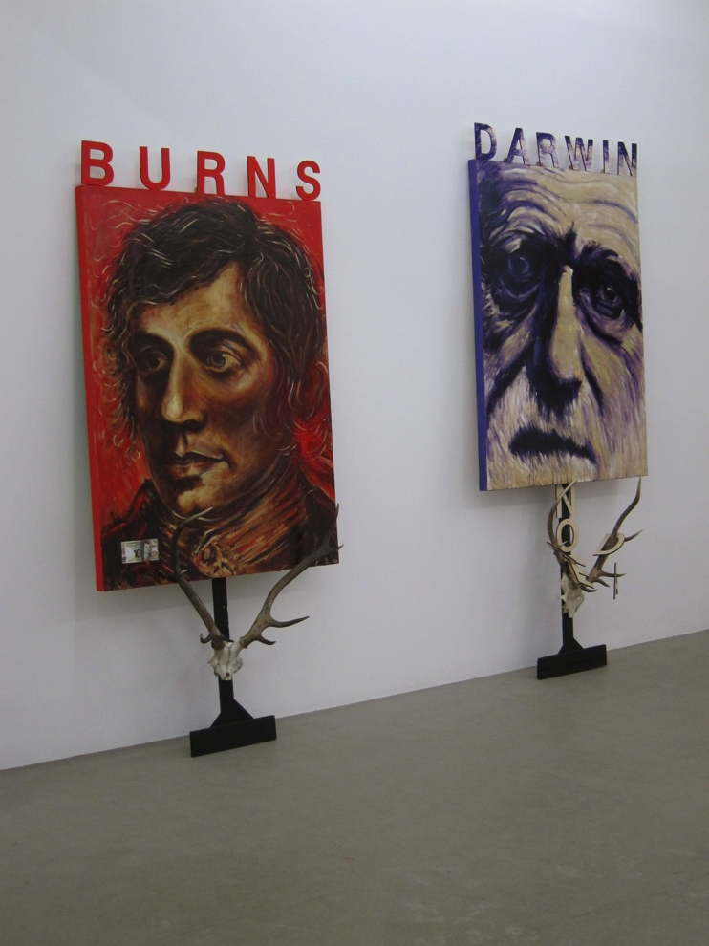

Slide 25


Slide 26
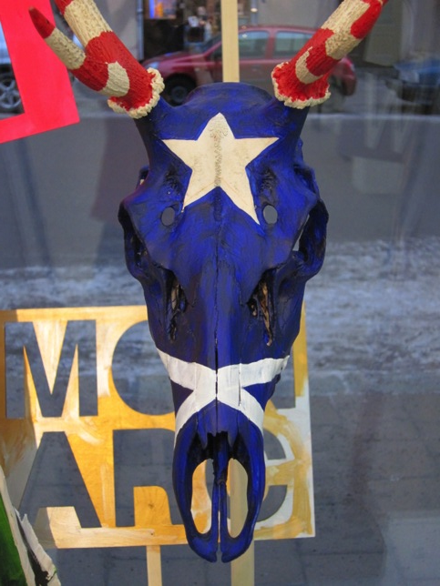
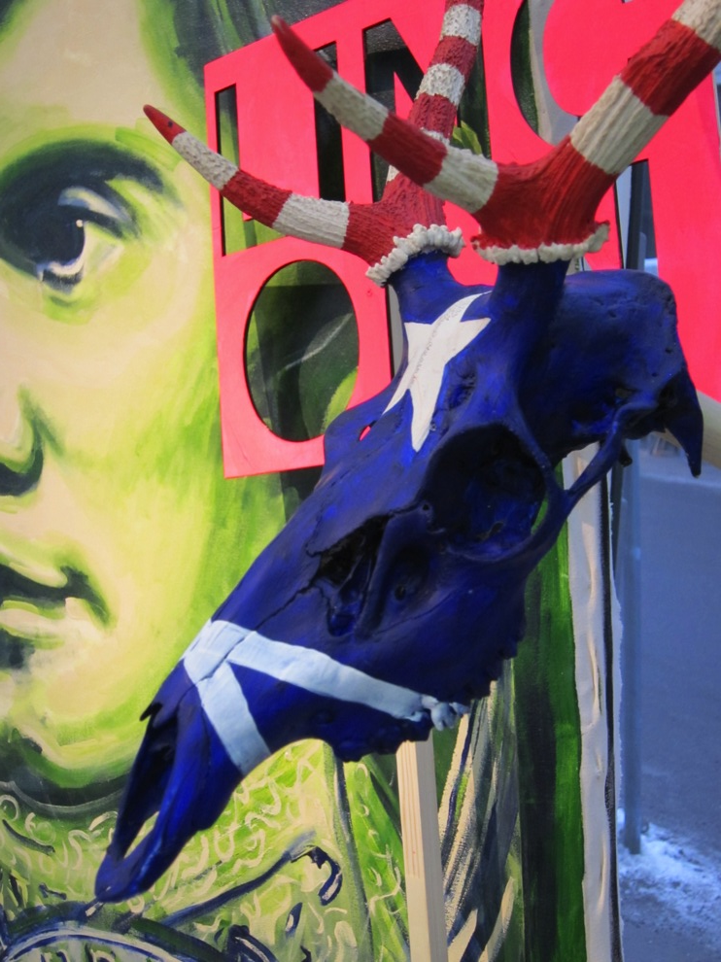

Slide 27


Slide 28
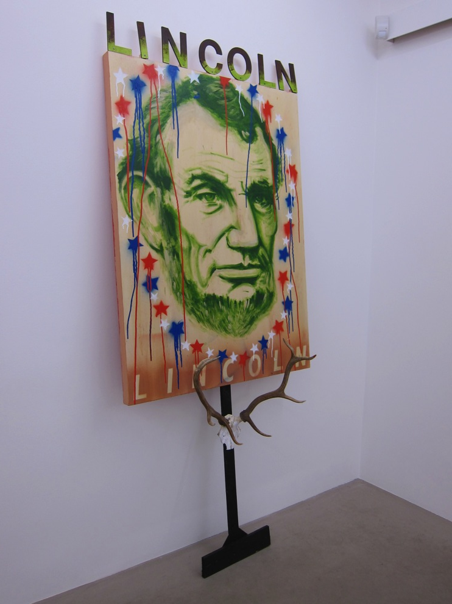

Slide 29
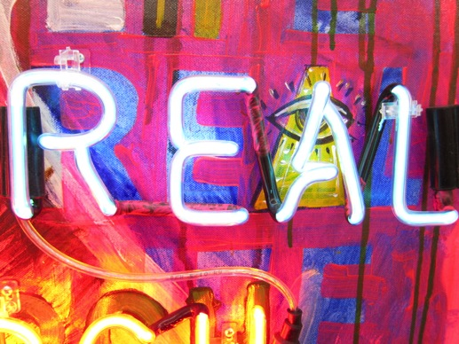
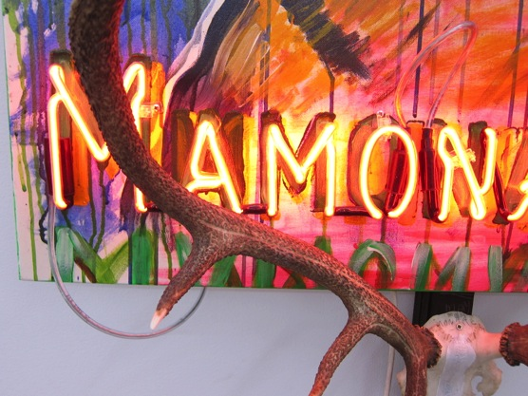
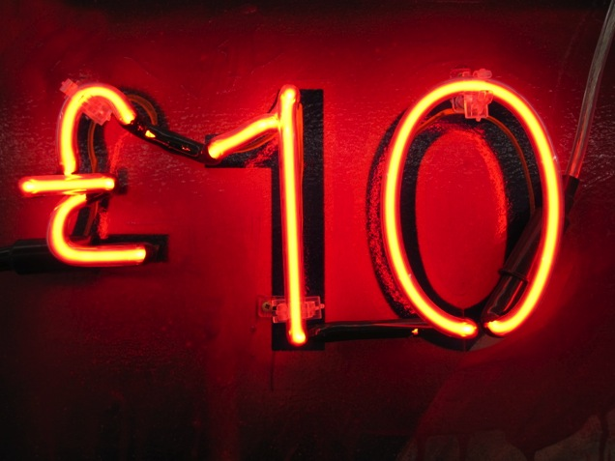
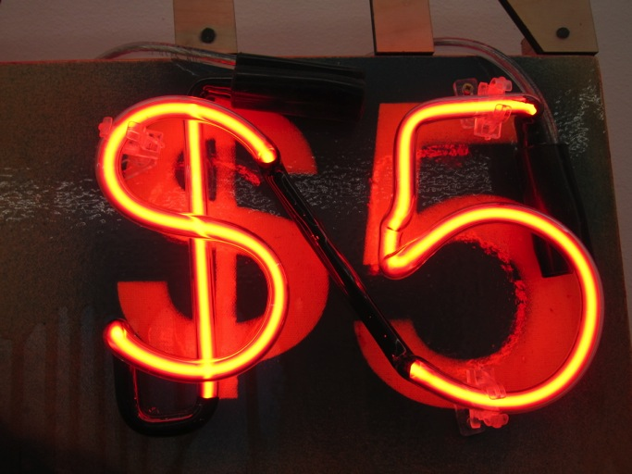

Slide 30

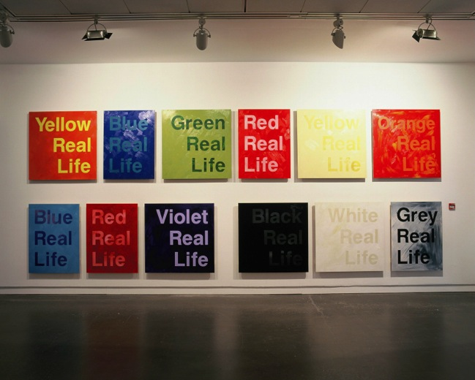
This project forms part of a momentum of practice that has been evolving for the past 25 years. The archaeology of this particular project starts with my Real Life Painting Show at CCA Glasgow in 2006, with accompanying symposium/interviews etc. links (http://www.artandresearch.org.uk/v1n1/sinclair.html)
http://www.artandresearch.org.uk/v1n1/painting.html
I also made a selected version of this Real Life Painting Show in a previous exhibition with Angelika Knapper Gallery in Stockholm, also in 2006. With that project I specifically sought to explore and test, through the large-scale production and exhibition of works, the possibilities of painting as a contemporary conceptual tool through the use of colour, scale, text and form, in relation to audience producing over 160 paintings for the project.
http://www.scotsman.com/lifestyle/visual-arts/primary-colours-1-489348
The following 2 pages of context outline the basic premis for this Painting Show which was the developmental precurser of the output submision
Detail from Ross Sinclair Real Life Painting Show, CCA Glasgow 2006

Slide 31
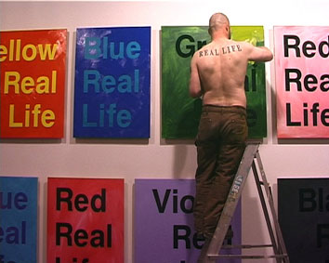
Ross Sinclair is better known for his large-scale installations than for his painting. He would be the first to admit that he is not attempting to create a masterpiece in oils in the old tradition. However, he is determined in this exhibition to investigate the possibilities of how paint can be used by a contemporary artist who may use many materials at different times, rather than follow a long apprenticeship to just one medium. The Real Life Painting Show is characterised on every level by a sense of experiment. One starting point for the work lies in the frustration that many successful artists experience today: working on large installations or exhibitions with little time, issues arise that can only be dealt with quickly before moving on. Sinclair, for instance, felt that when working on his installations he would face choices in terms of combining colours, often on a large scale. The implications of these colour combinations, though, was always something that there was never enough time to address. The Real Life Painting Show is a deliberate attempt to examine those issues and explore their consequences. Describing this process in his own words he says, ‘I'm taking a few steps back, holding a mirror up to my practice, pulling it apart, asking what the building blocks of it are, the pieces of the jigsaw, what are the essential elements?’
Detail from Ross Sinclair Real Life Painting Show, CCA Glasgow 2006

Slide 32
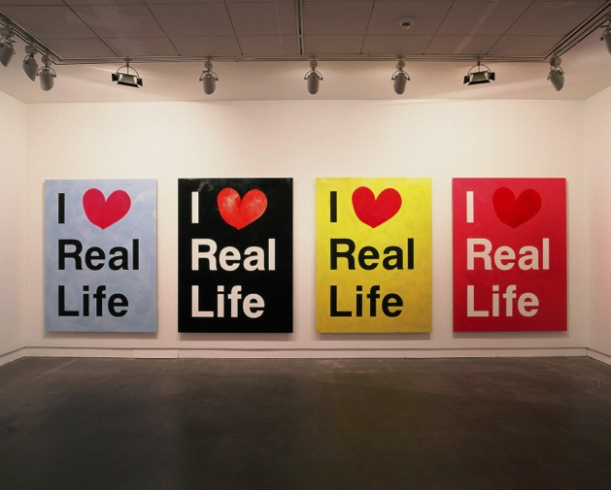
Allied to this exploration of the basic elements of his practice, Sinclair found himself rethinking the role of the studio in his work. Like many contemporary artists, he found the traditional studio unnecessary for long periods of his career. While developing the Real Life Painting Show he began to discover the benefits a studio can bring. Setting up a large space first in Kilcreggan at Cove Park and later converting the CCA galleries into a vast studio, Sinclair created a hybrid between a factory and a laboratory, producing over 100 paintings. The physical space of the studio allowed for a more exploratory way of working. Even in the final days of the exhibition installation, the studio gave him the possibility of creating new paintings and taking the series in new directions. Assessing his approach to this body of work, Sinclair explains that he needs to discover the power of the medium he is using through the process of making. In Real Life Painting Show that meant reconsidering the potential today to tap into the modernist tradition and its bold uses of colour: ‘The only way for me to try to investigate the power is to crawl inside and try to come out from the inside. To see if one could ever regain that confidence and certainty. What happened to that at the end of modernism, when everything went off into a million different avenues of investigation? Is there something that can jump from there to now?’
Detail from Ross Sinclair Real Life Painting Show, CCA Glasgow 2006

Slide 33
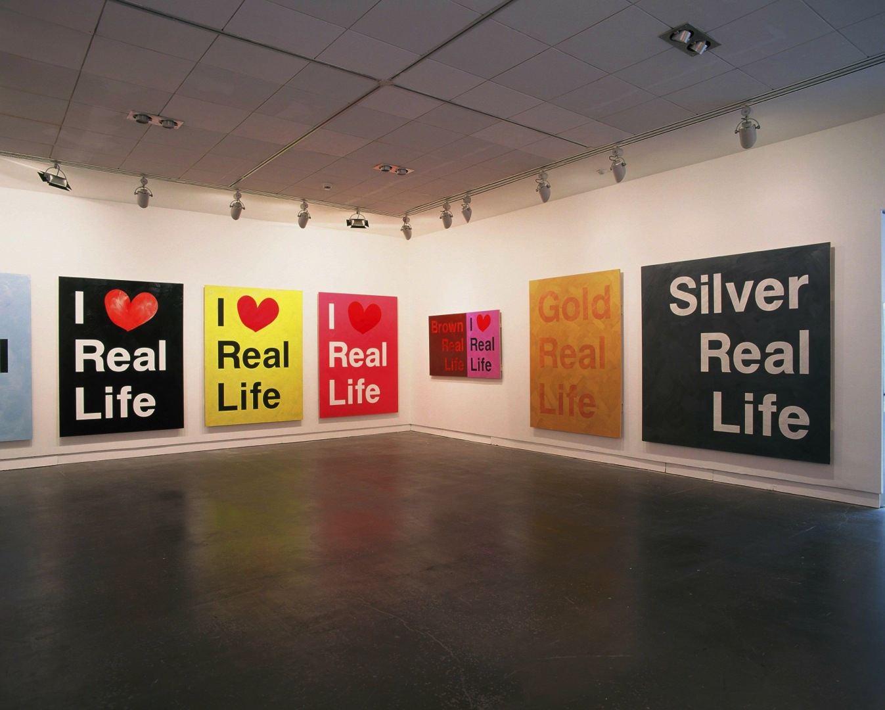

Slide 34
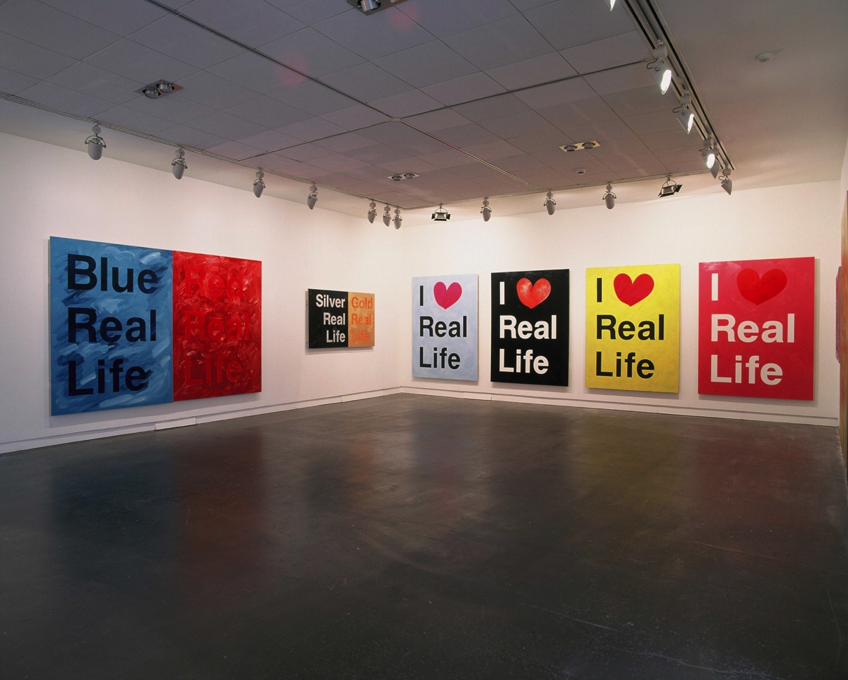

Slide 35
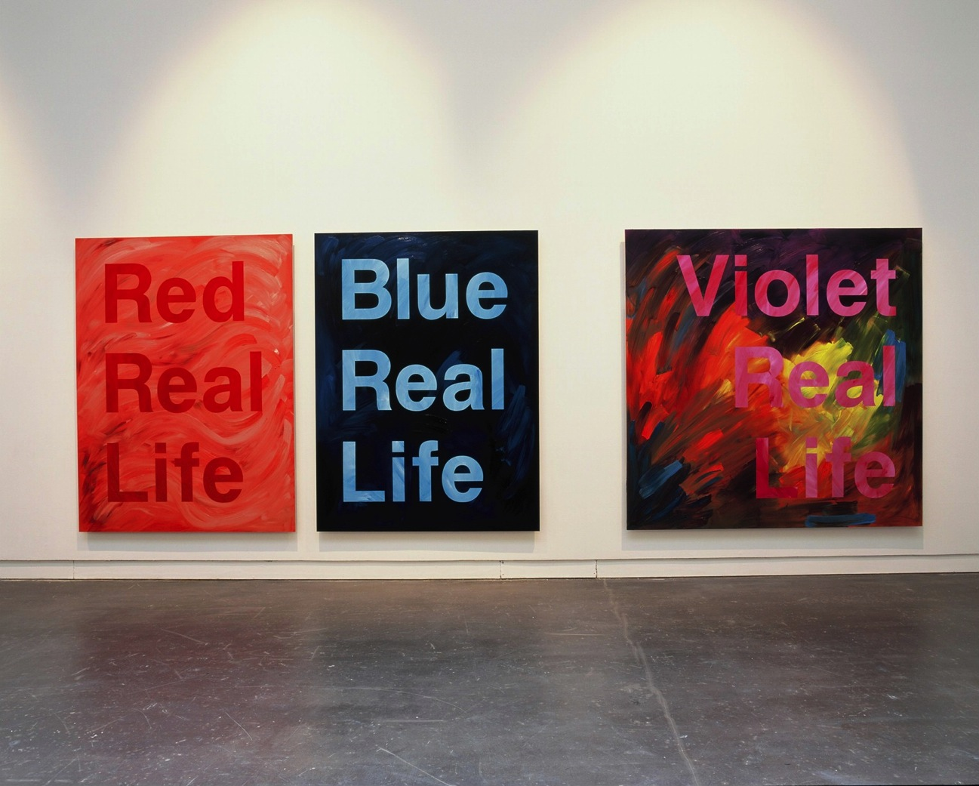

Slide 36
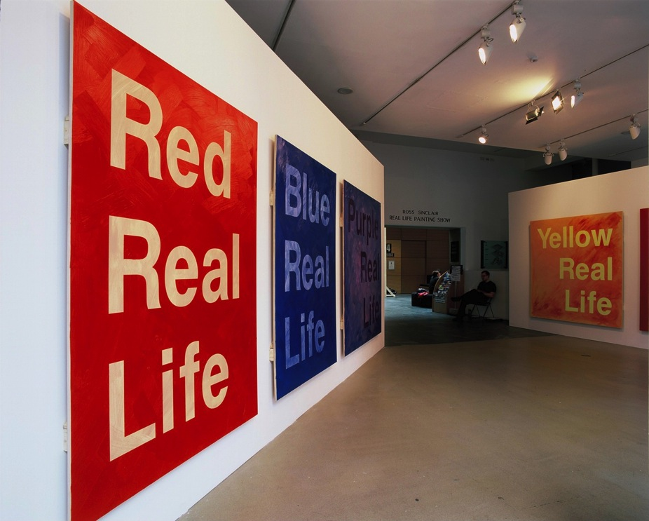

Slide 37

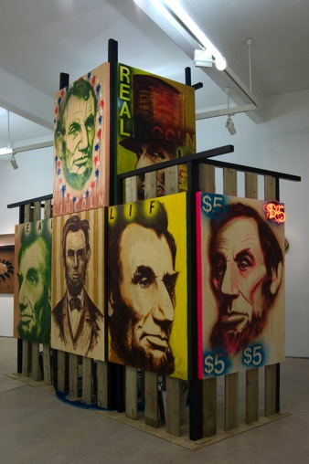
Continuing the developmental precurser of this output, In 2007 I made a project called
Sinclair vs. Landseer, in Aberdeen Art Gallery. This was an ARHC funded projects (Craig Richardson, Oxford Brookes, speculative research route) where I researched, developed and produced a contextual, site specific installation in direct response to the works and legacy of Sir Edwin Landseer in a public civic museum, in the company of Ramsay, Raeburn, Wilkie, and some of the best civic portraiture of the 18th/19^{th.} My work was sited in direct proximity to the Landseer work, Flood in the Highlands (1860)’ This dynamic juxtaposition of my work in a figurative context informed the development of the Real Civic Life show. Landseer painted Monarch of the Glen in 1851 and it has become one of the most iconic images of Scotland. I would carry an appropriation of this image forward into the Real Civic Life exhibition in Stockholm.
I continued to develop this research and moved toward the use of the painting combined with installation in the work “Anglo American Love Song” in Freedom Centre, Hales Gallery, London 10 Oct-15 Nov 2008.
http://www.halesgallery.com/exhibitions/_18/
The output “Real Civic Life” in Stockholm, develops that research further exploring the possibilities of the painted portrait to address the complexity of national identity and cultural relationships in relation to an international audience in a contemporary context. In turn this project has subsequently informed the development of my practice in relation to the Deveron arts “We Love Real Life Scotland”, residency/book project in an exploration of art in social context.
“Anglo American Love Song” in Freedom Centre, Hales Gallery, London 10 Oct-15 Nov 2008.

Slide 38
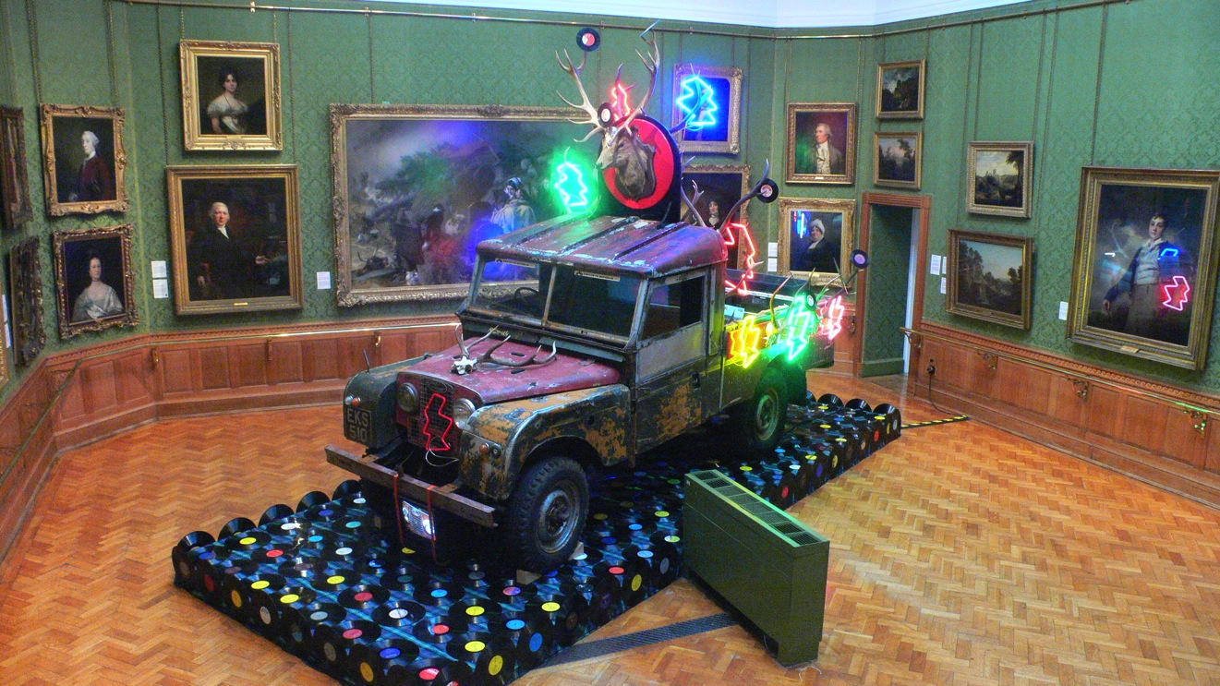
Ross Sinclair
Sinclair vs. Landseer, in Aberdeen Art Gallery 2007.

Slide 39
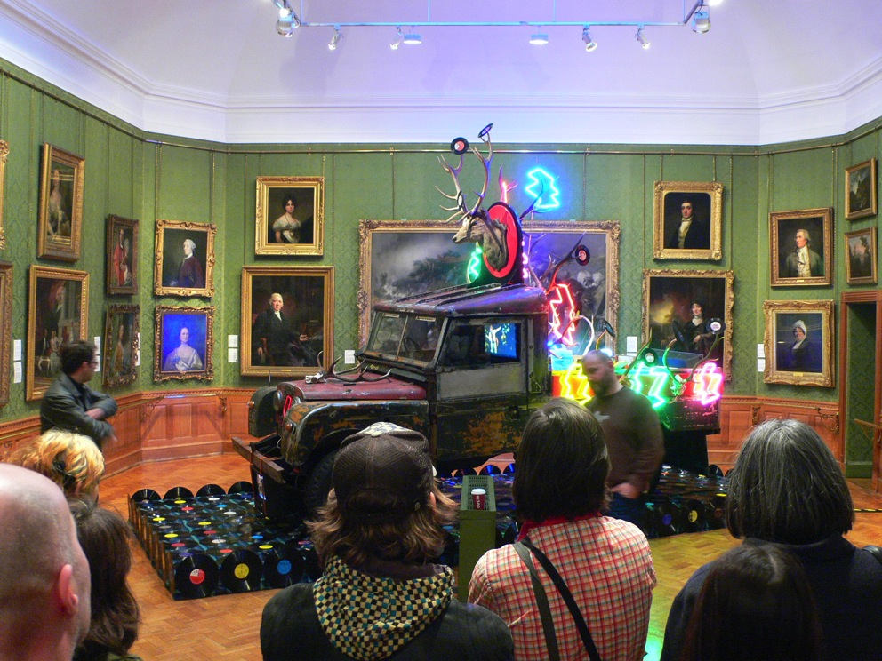
Artists talk, with curator, Craig Richardson

Slide 40
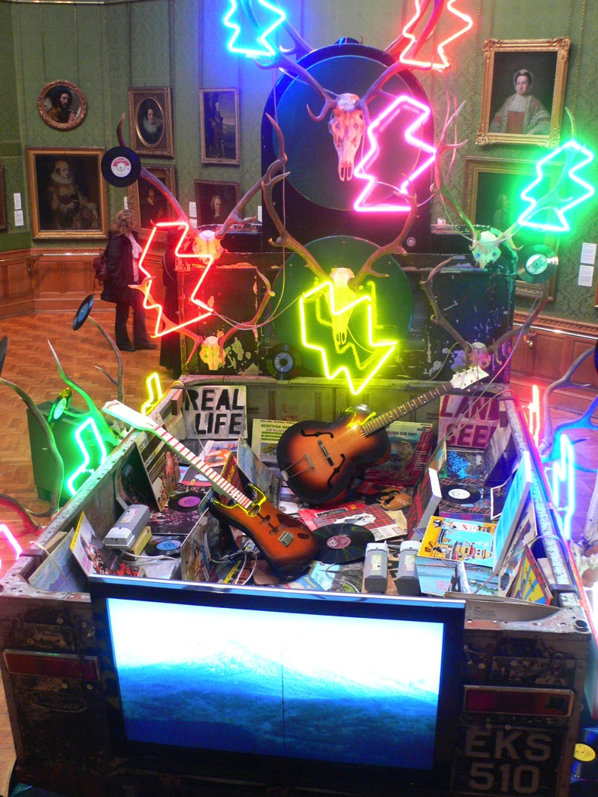

Slide 41
Ross Sinclair
“Anglo American Love Song” in Freedom Centre, Hales Gallery, London 10 Oct-15 Nov 2008.

Slide 42

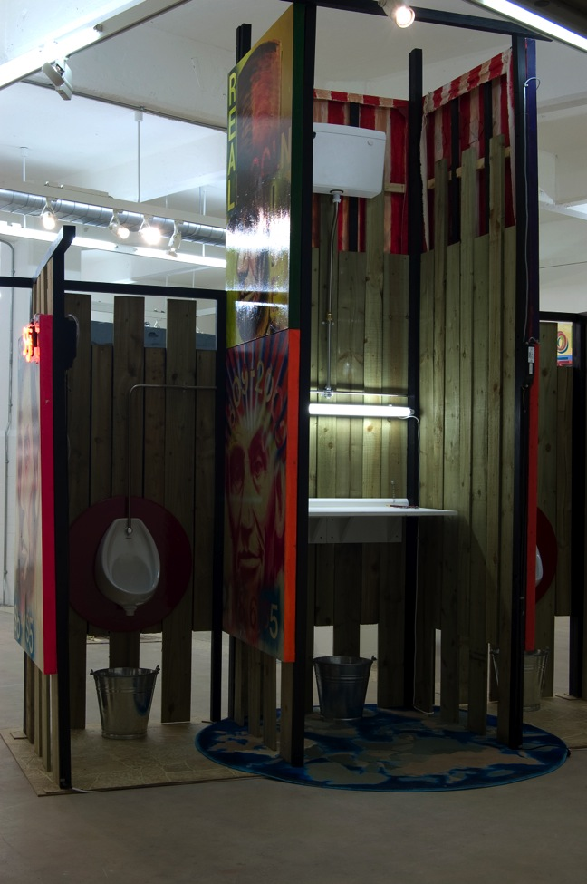

Slide 43
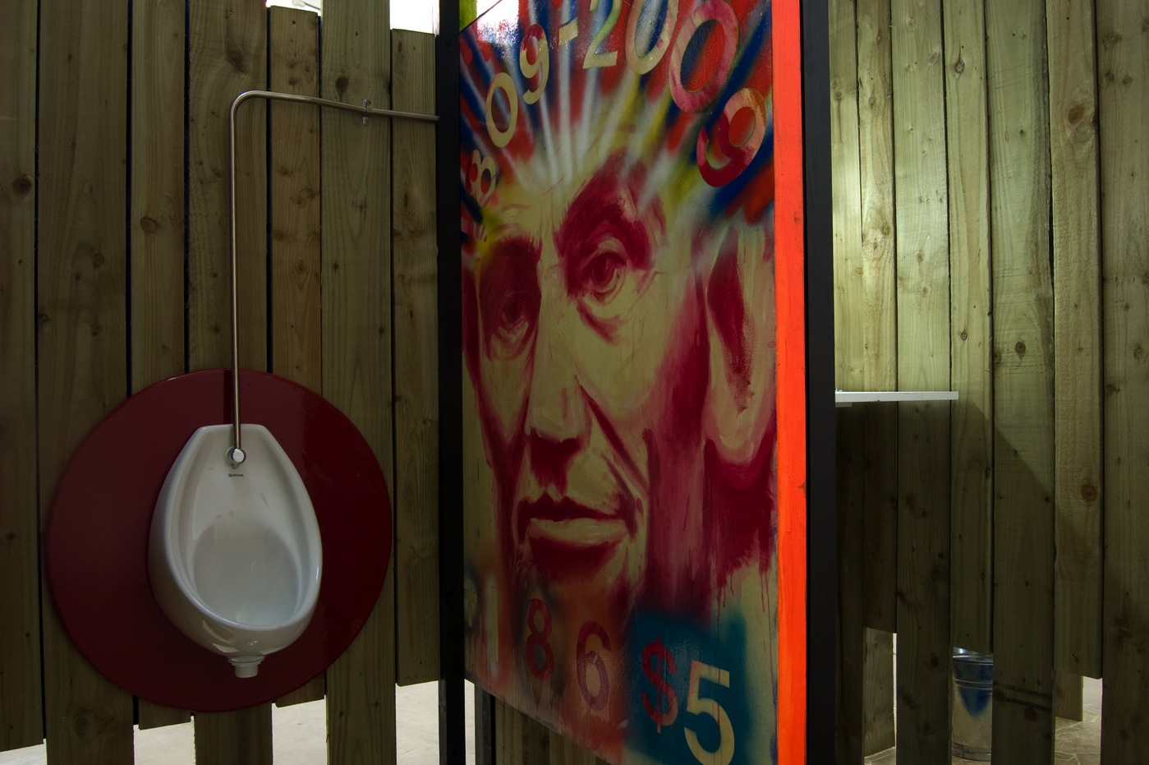

Slide 44

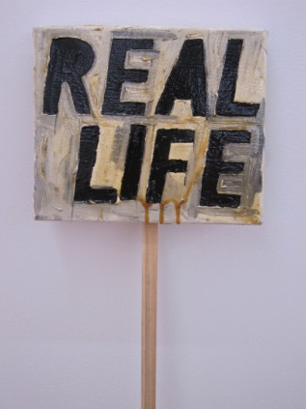
From a text handout written for the Real Civic Life…On February 12 1809, two baby boys were born within a few hours of each other on either side of the Atlantic. One entered life in a comfortable family home called The Mount, that still stands in the leafy English countryside of Shrewsbury, Shropshire, the other opened his eyes for the first time in a nameless, long-lost cabin in the Kentucky woods…they never met, but their great parallel lives would transform society and mankind’s understanding of itself.
Adam Gopnick, Angels and Ages – A short book about Darwin, Lincoln and Modern Life, Quercus 2009
The opening of this exhibition Real Civic Life, falls on the 201st anniversary of the birth of Abraham Lincoln and Charles Darwin. Darwin’s theory of Evolution opened up a dramatic new era of discovery while Lincoln unleashed a great tide of blood to uphold the union of the USA and bring about the emancipation of America’s slaves, developing a connection between freedom and sacrifice that exists to this day. Lincoln’s favourite writer was Scotland’s national poet, Robert Burns, in whom he saw mirrored a love and respect for mankind, a desire that all people should have the right to live in freedom and equality. The most recognisable iconic image of Sinclair’s birthplace, Scotland is “The Monarch of the Glen”, the noble stag painted by an Englishman, Sir Edwin Landseer in 1851.
.
This is a defining image of a country that never really existed in the first place – and still barely does - whose national identity was born from the pages of fiction and the brush of Landseer - a Victorian tourist-artist. “The Monarch of the Glen”, was completed when Lincoln and Darwin were 42 years old, the same age as the artist Ross Sinclair when this project began. For Scottish artist Sinclair’s second show with Angelika Knapper he explores his/our contemporary relationship with the USA through the idea of the Civic portrait, long fallen from favour but here re-born as the materials for a protest, a demonstration. Located in the gallery but ready at a moments notice to be taken to the streets to help articulate the formless fury of a life with no God. These works interrogate the reality our Godforsaken world in the 21st century when the very idea of re-inventing the conservative civic portraits of two 19th century icons born two hundred years ago appears like a necessary radical step. Re-imagining portraits of Lincoln and Darwin, as well as Robert Burns and The Monarch of the Glen, Sinclair attempts to visualise a tenuous new landscape of relationships between these cultural, political and scientific torch bearers in order to illuminate a path out of our contemporary darkness.In this project Sinclair examines familiar themes in his work of identity and geography, the paradigm of Real Life, set in the context of a turbulent international situation
Ross Sinclair, Real Civic Life, Angelika Knapper Gallery, Stockholm(detail).

Slide 45
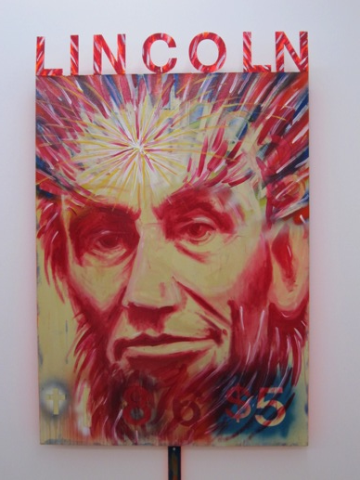
On a more practical level as I mentioned before, these complex questions were explored via the development, construction and presentation of more than 30 discrete hybrid painting/assemblage/neon works aiming to investigate the contemporary utility of the (civic) portrait. The subjects of these were chosen in order to explore specific inter (national) identities, in this case the my home identity in Scotland and that of the USA set in the Swedish context. It is important for this project to affirm that I was exploring the idea of research as a body of work, developed
over a period of time, formally, conceptually, empathetically succeeding, failing, starting again – Building from the foundations up…
…Researching.
This was the foundation for this project. Having explored ideas of the veracity of painting as a credible conceptual tool in the previous projects discussed above I discovered this was not going to be a quick fix project and consequently I spent a lot of studio time exploring the various possibilities/limitations of my own abilities
The project explored the question of why the construction of a series of portraits of two 19th century icons born two hundred years ago could today appear like a necessary radical step. Re-imagining portraits of Lincoln and Darwin, as well as Robert Burns and The Monarch of the Glen, this body of work attempts to visualise a tenuous new landscape of relationships between these cultural, political and scientific torch bearers in order to “illuminate a path out of our contemporary darkness”, from Scotland to Stockholm via the cultural/political influence of the USA. This project sought to examine familiar themes in my work of identity and geography, the paradigm of Real Life (which I have been investigating since I had the words tattooed on my back in 1994), and set in the context of a turbulent international situation
The images that follow are an honest reflection of the journey from the studio to the show to the eye of the viewer…
Ross Sinclair, Real Civic Life, Angelika Knapper Gallery, Stockholm(detail).

Slide 46
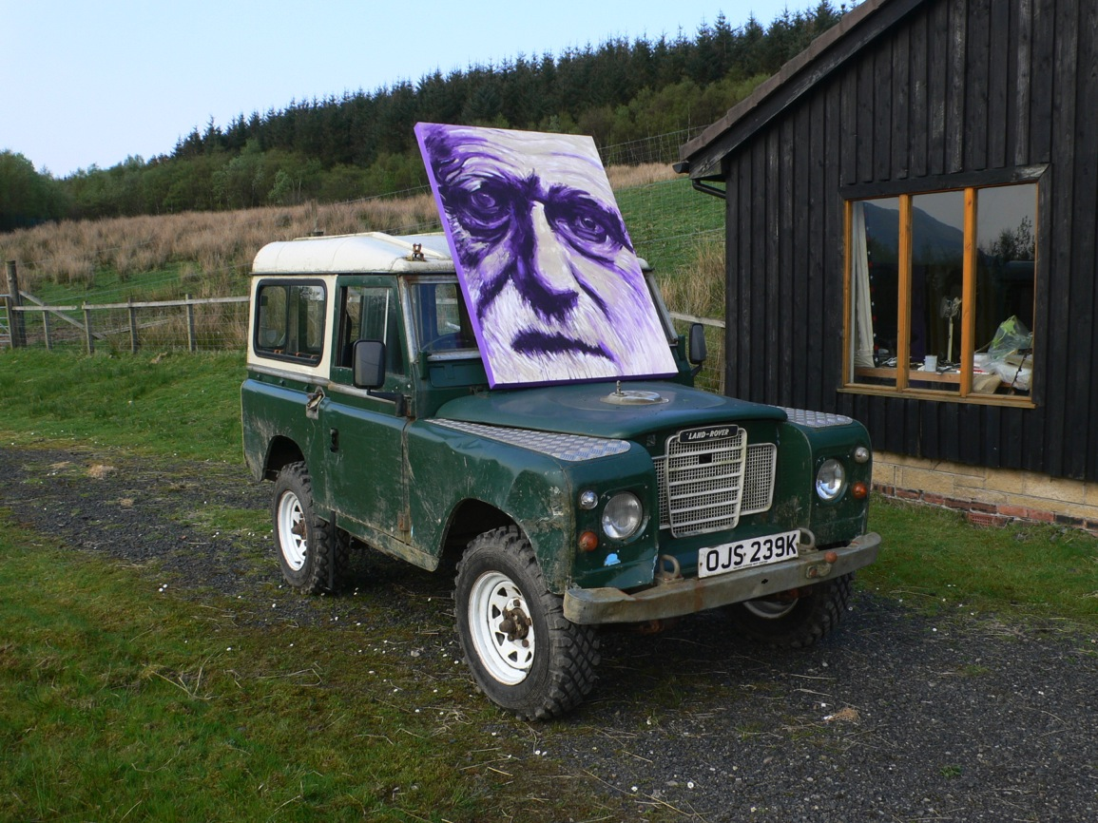

Slide 47
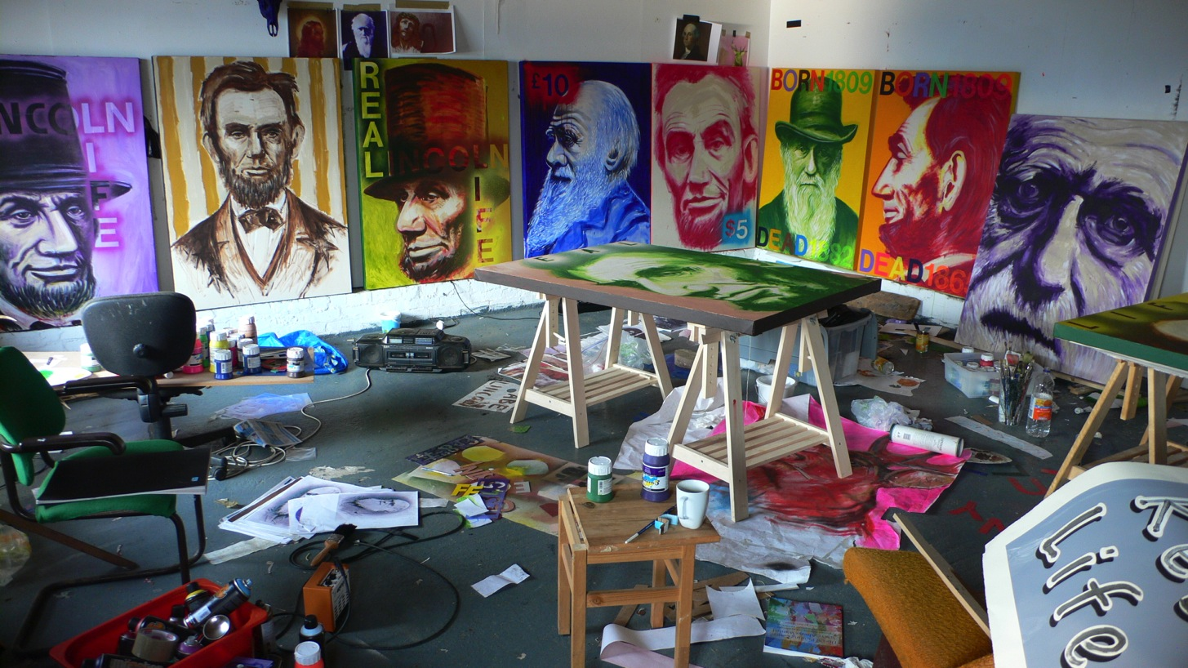

Slide 48


Slide 49




Slide 50


Slide 51





Slide 52



Slide 53




Slide 54






Slide 55


Slide 56


The exhibition Real Civic Life was open in the Angelika Knapper Gallery in Stockholm between 1 Feb – 7 March 2010.
A couple of pieces were bought by private collectors.
Subsequent Exhibitions -
This project in turn informed my output -
Ross Sinclair : We love Real Life Scotland Art, History and Place, A Reader exploring the heritage of Huntly’s Gordons and other Scottish Incidences in the work of Ross Sinclair
http://www.angelikaknappergallery.com/RossSinclair2010.htm
http://www.angelikaknappergallery.com/RossSinclair.htm
http://www.angelikaknappergallery.com/RossSinclair2006.htm
Ross Sinclair, Real Civic Life, Angelika Knapper Gallery, Stockholm, 2010

Slide 57


Slide 58


