Slide 1

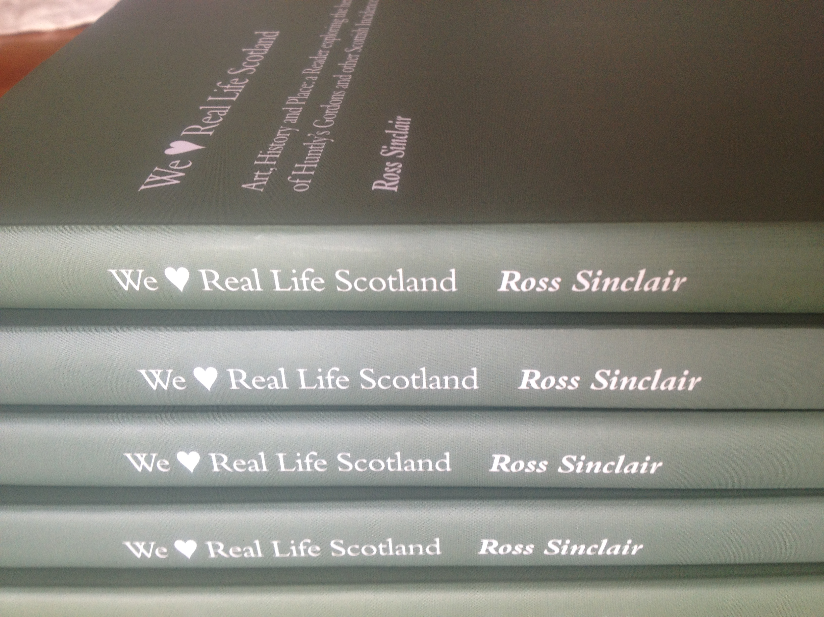
Ross Sinclair : We Love Real Life Scotland Art, History and Place, A Reader exploring the heritage of Huntly’s Gordons and other Scottish Incidences in the work of Ross Sinclair
A book which reflects on a 3 month residency with 13 commissioned texts, including one by myself, discussing this project and many others of mine concerning ideas of contemporary national identity
Ross Sinclair - We Love Real Life Scotland ; Art, History and Place, Deveron Arts, Huntly. 184pp ISBN 978-1-907115-09-7 – published 2012
Submitted by Ross Sinclair
Output No. 3

Slide 2

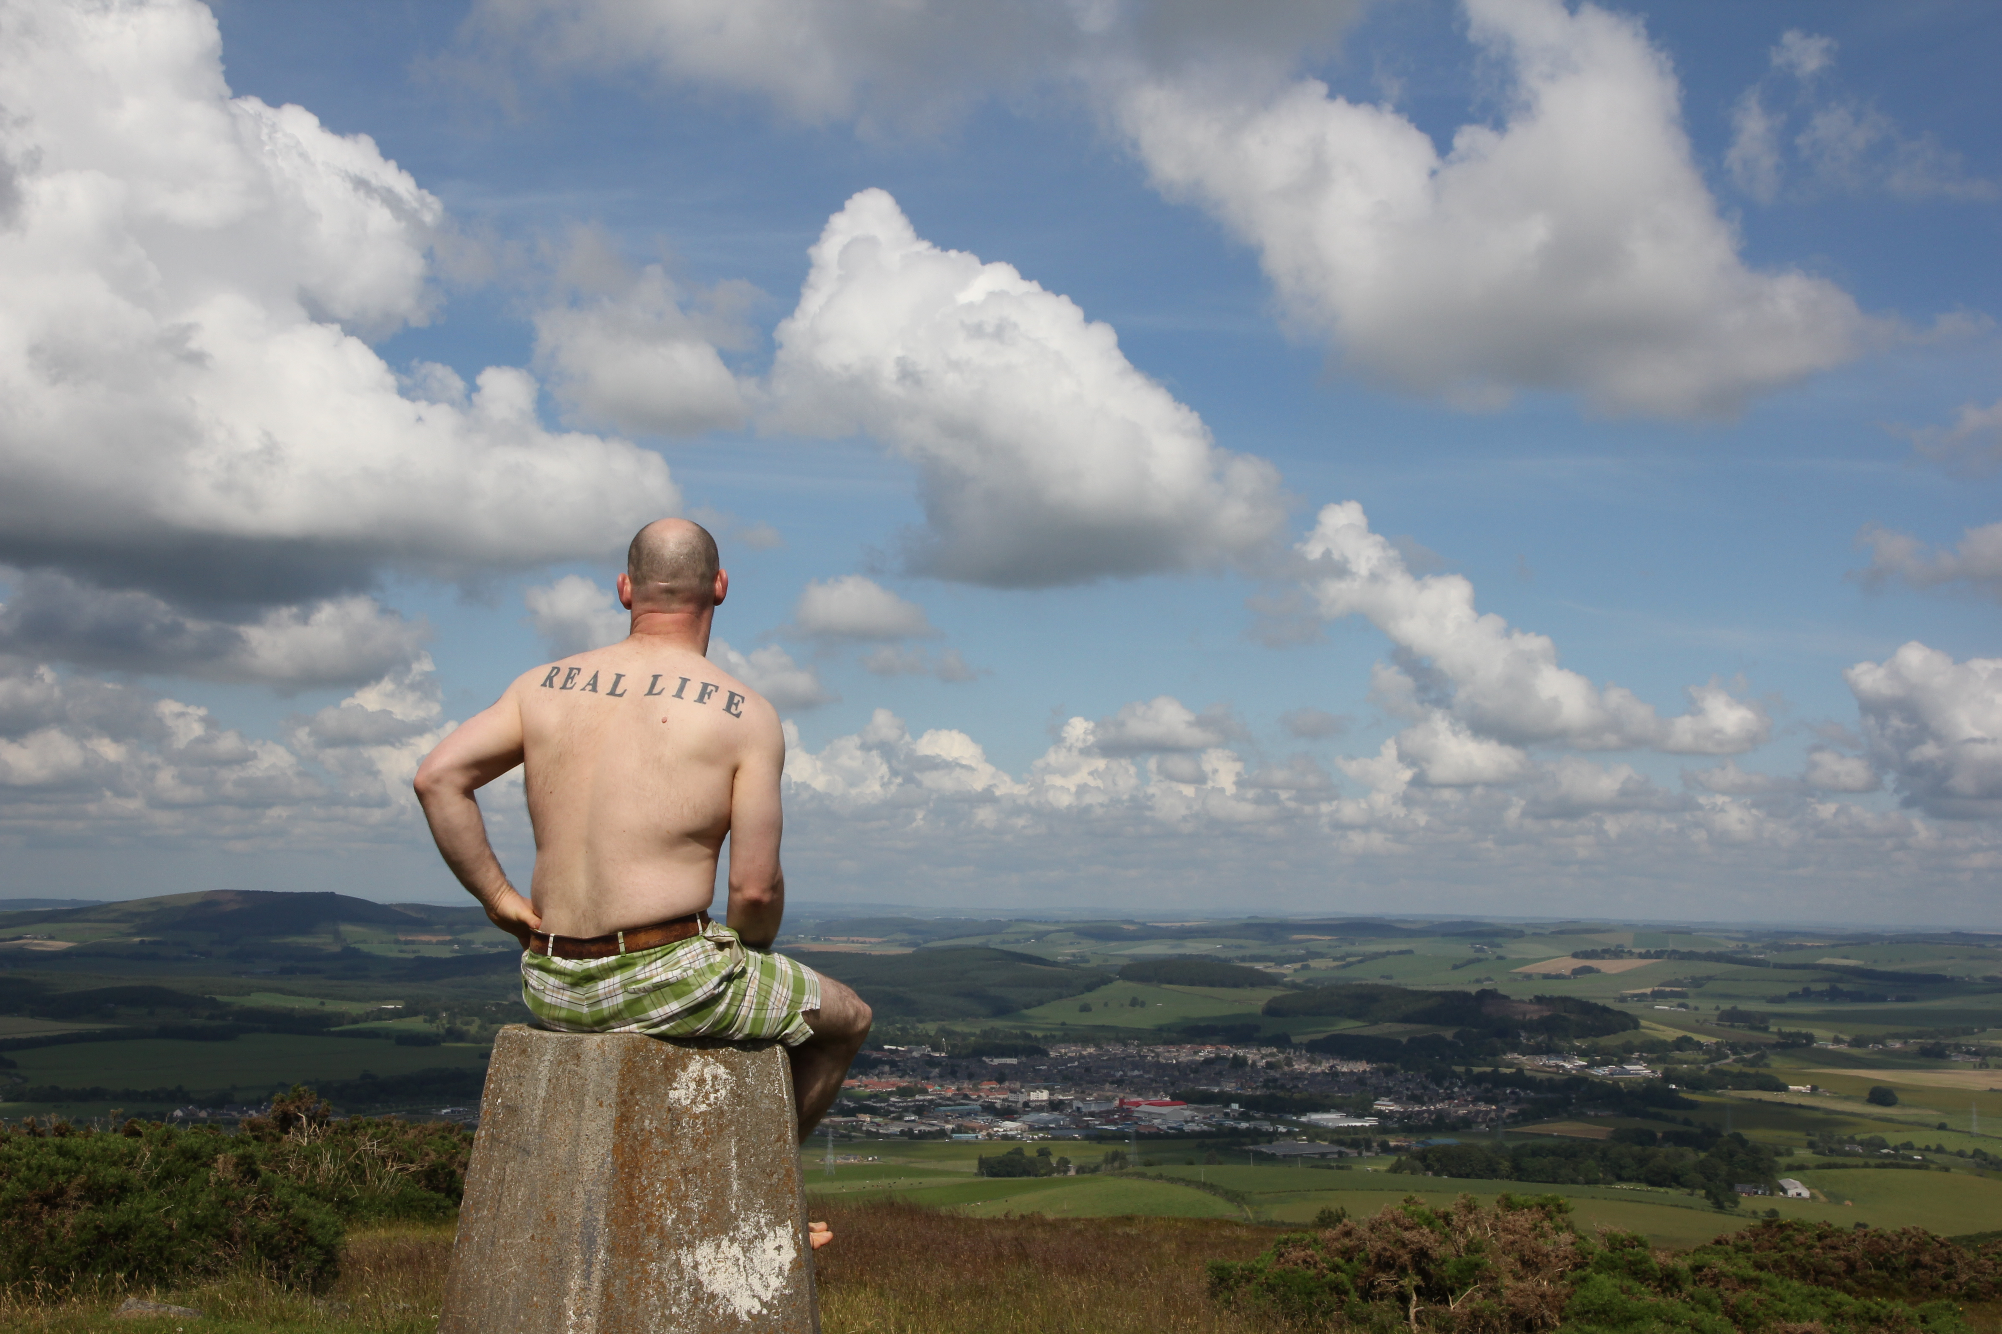
Ross Sinclair : We love Real Life Scotland Art, History and Place, A Reader exploring the heritage of Huntly’s Gordons and other Scottish Incidences in the work of Ross Sinclair
I have submitted this as an 'artist monograph' book, but it Im not sure if this is the most appropriate category. The book documents the work from a 3 month residency with Deveron Arts in Huntly, Scotland in summer 2011, where I made multiple site-specific artworks exploring the models of art in social context including performance, talks, tours and events. The book is co-edited with the director of Deveron Arts and we have commissioned more that a dozen texts, from writers local, national and international, which discuss my own work, the context of the project and the longer history of works I have made which reflect of discussions around national identity, history and geography.
The texts are contributed by
Sinclair, Ross
Forbes, Anne
Gordon, Kim William
Zeiske, Claudia
Scott, Pat
Mullholland, Neil
Buchanan, Roddy
MCCrone, David
Richardson, Craig
McCaughey, Peter
Relyea, Lane B.
McKee, Francis
Scott, Patrick
3
Ross Sinclair
Real Life Huntly, The view from the Clashmach

Slide 3

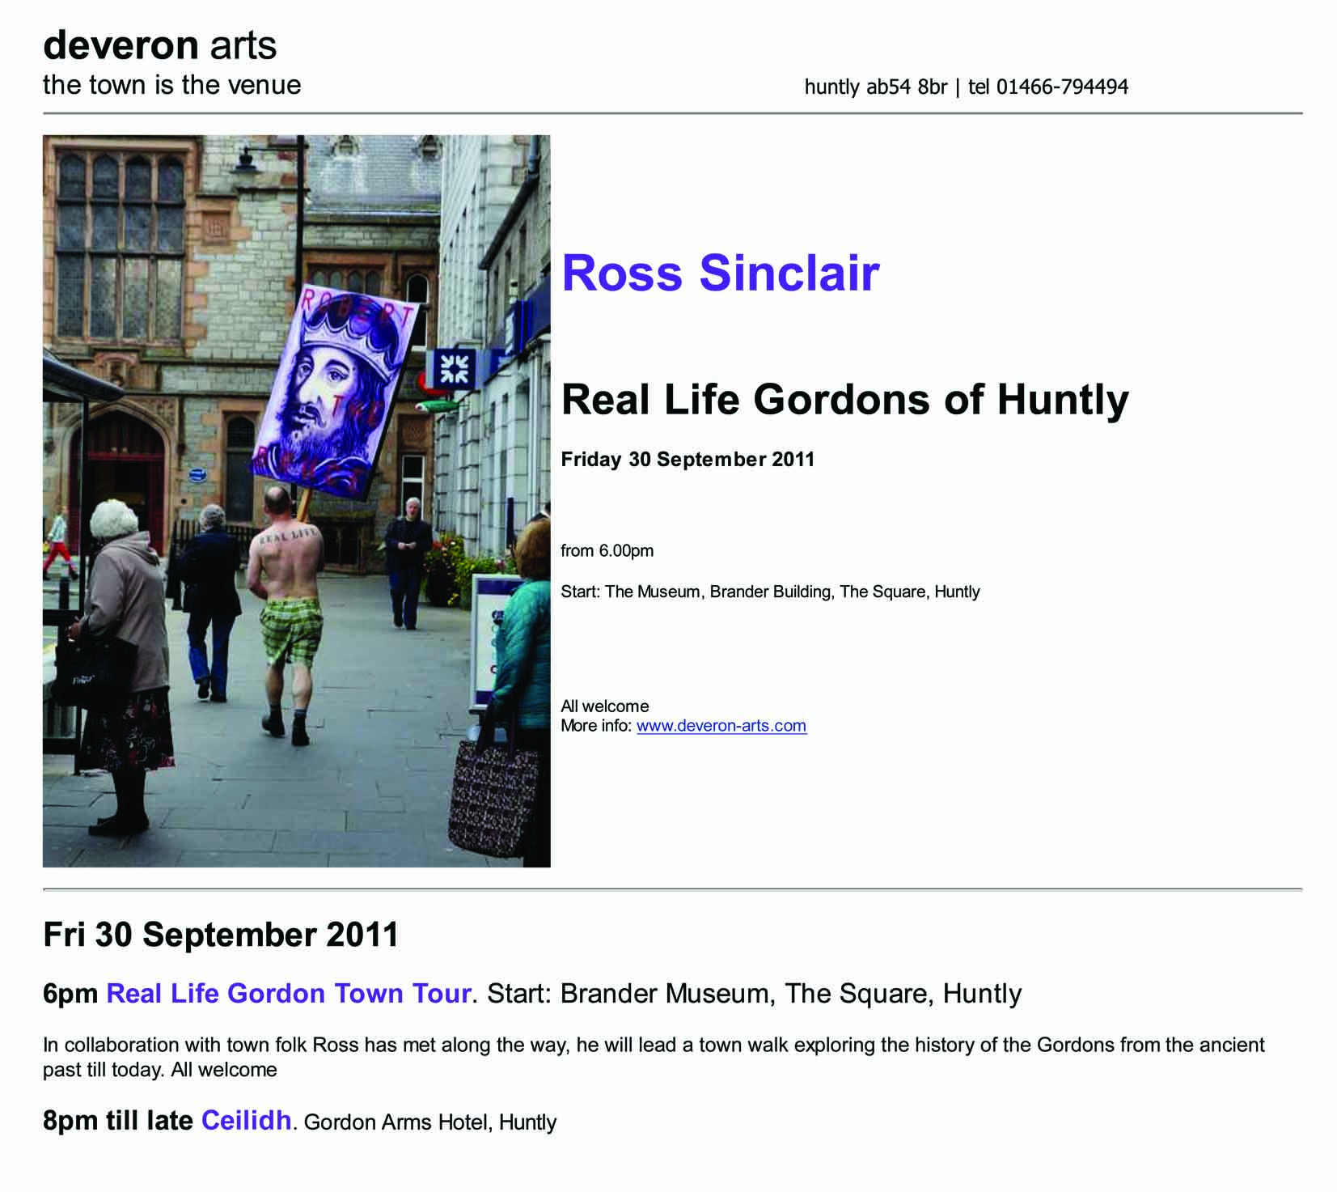
This aim of this book is to discuss over the pages of a substantial publication,184 pages, a three month residency I undertook in summer 2011 This seeks to ask some questions about how artists address context and audience through the construction and dissemination of artworks, particularly in a social context, a place without an institutional cultural infrastructure.
One of the research questions concerns the role of the contemporary artist in residence when embedded in a contemporary ‘non art’ community. How can art and artists address the context of history, through contemporary practice. How can the publication reflect this process and promote this enquiry, engaging and dialogic in the mind of the reader.
Announcement for one of the events which punctuated the 3 month residency

Slide 4

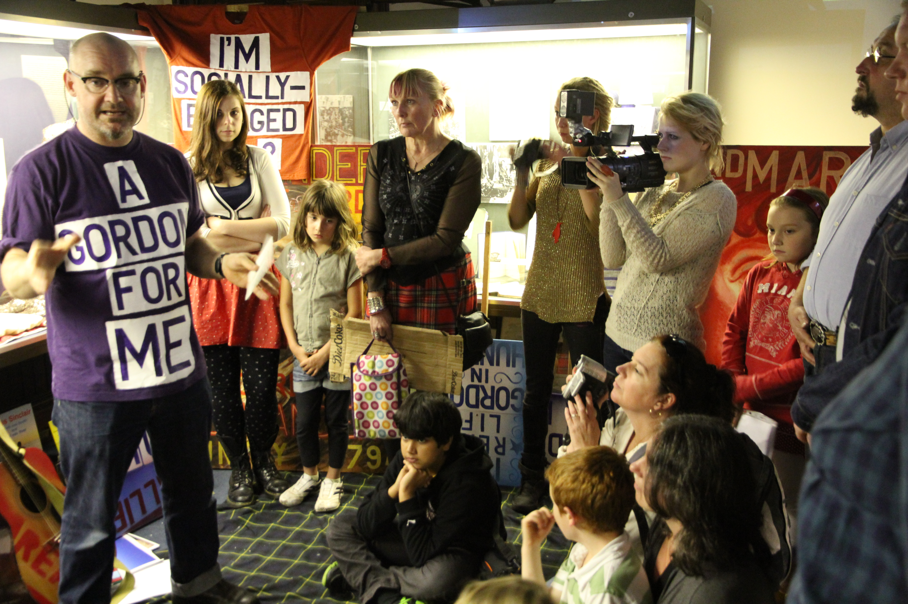
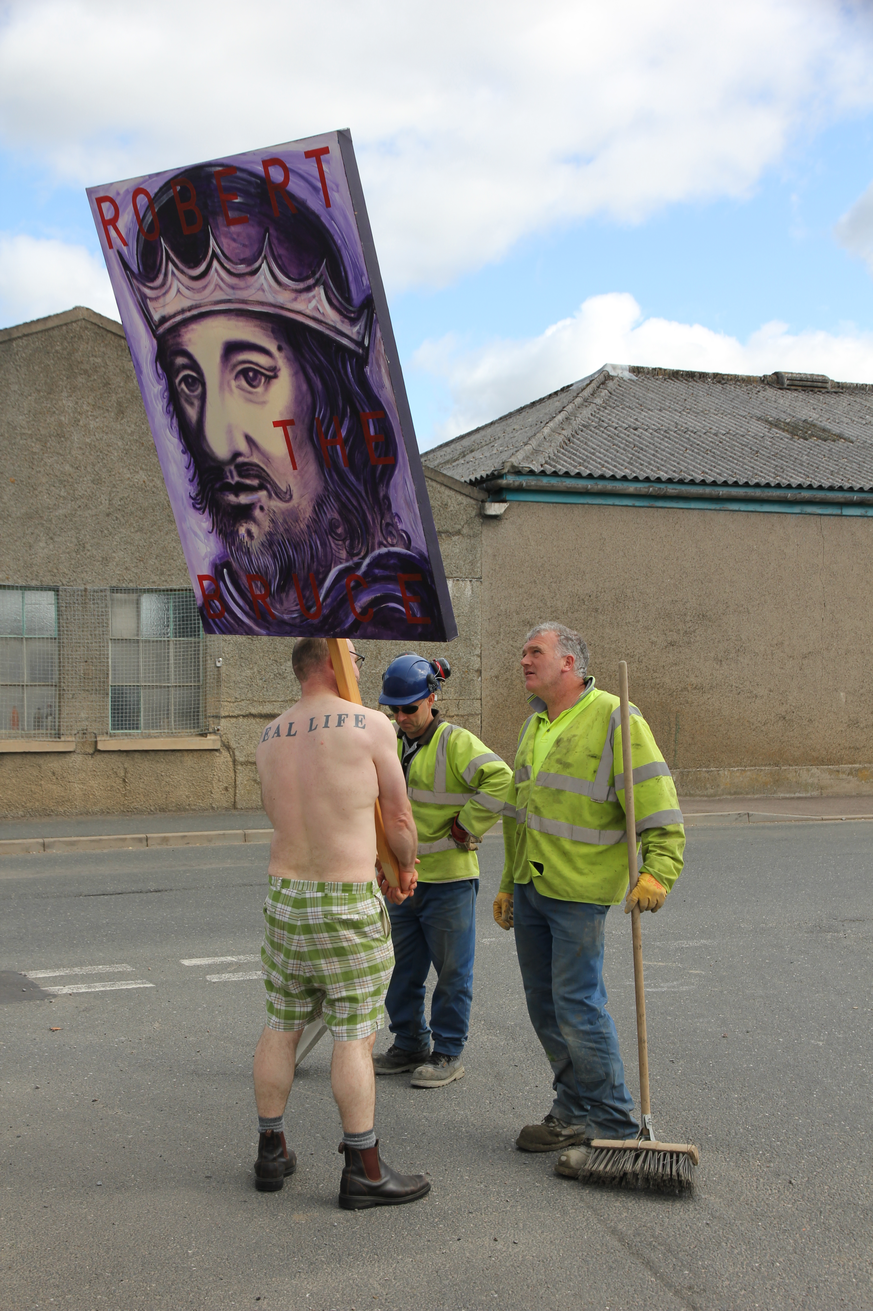
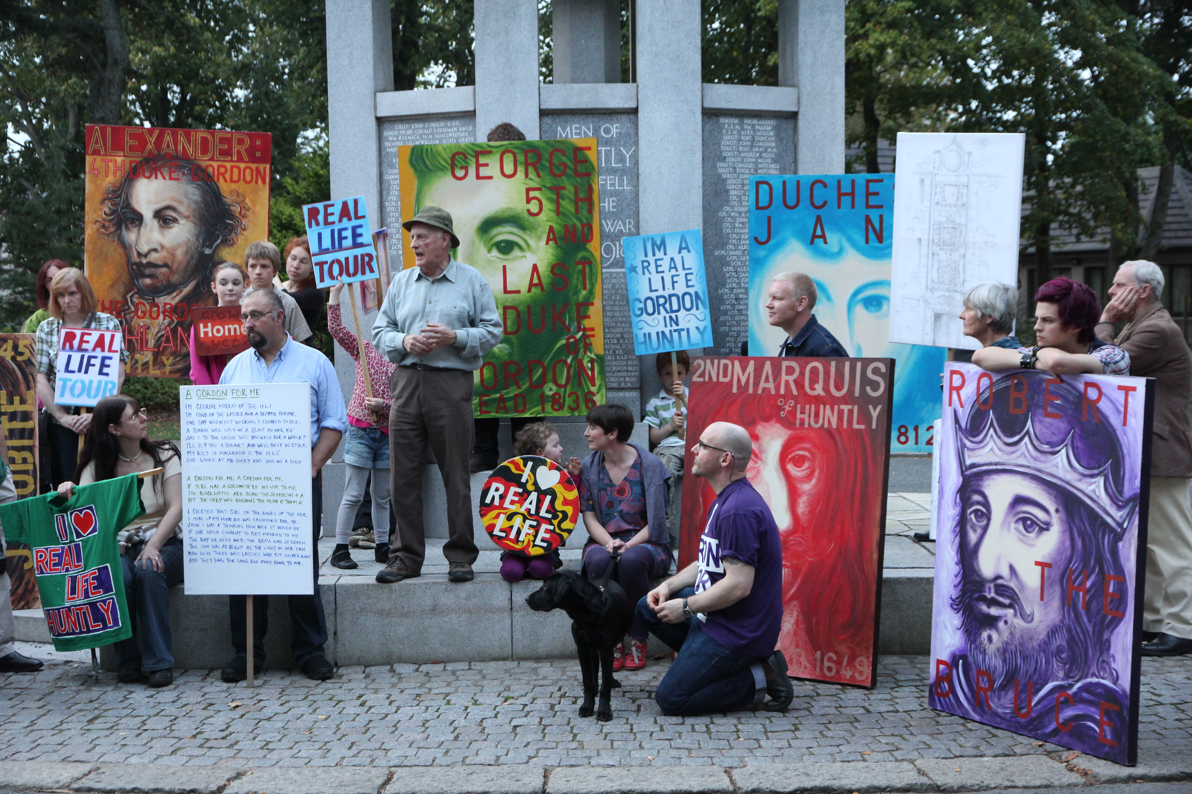
The material for the publication, and the ideas for it, were gathered during a three month ‘artist in residence’ where I explored and documented many ideas of context and engagement, history and geography through the construction and dissemination of artworks including, paintings, performance, music, ‘events’ lectures, artist talks, film screenings, visits to museum, tours, interview, and discussion, all made specifically in relation to the population of the town of Huntly, Aberdeenshire, Scotland. The book aims to discuss and describe the process of this residency and forms part of a contemporary debate about the role of the artist and artwork in relation to new audiences within the paradigm of ‘Relational Aesthetics”. It contains 13 commissioned texts from writers local, national and international, including one written by myself interrogating the process on the various aspects of context in relation to my project and my own practice.
Ive included it here to give a fuller picture of the research questions but please refer to the book itself for the full story.
Images from a few of the many events which took place over the 3 month residency, discussed in the book

Slide 5
Ross Sinclair : WHERE ARE WE?
A Reflection on a Journey with The Real Life Gordon’s of Huntly
Summer 2011, Huntly
The Real Life Artist in residence is currently residing in the Old Road house, working in the empty shop in Bogie St. and will soon move to the closed down museum of this very particular town of Huntly, embedded in this northern community working with the very particular organisation Deveron Arts.
But how did I get here - and what could that mean? A couple of years ago, Claudia Zeiske asks if I would like to come to Huntly to do a residency. I know about Deveron Arts, I am interested in context, passionately interested in the audience, in what ART looks like when you add people. I had worked with Claudia years before, on the Glenfiddich residency. So, I say yes. Some time later she says there is a summer slot coming up the following year, which suits me with my other work/family commitments. But she says because of the way the money supports the residency there has to be a theme.
Stop - A theme I think, a theme, I’ve never been given a theme, I don’t need a theme. My autonomy and individuality as an artist is surely my theme, my particular and unique voice which is constructed from my experience of the world and the history of art and culture and then feeds back into it the world, offering insight and dialogue and humanity : that’s my theme. My 25 years of art practice, hundreds of exhibitions - catalogues, Real Life monographs, (Real Life Mono-logues maybe) But these are my themes. They are mine - Aren’t they?
But now my theme, for 3 months if I choose to accept it, is the story of the Clan/Family/ House of Gordon in Huntly, or maybe in History, or in the imagination, or in collective memory perhaps, or in Scotland – or in the world - that’s up to me. My job is the Gordons in Huntly. However I want to cut it, any which way I want to look at it…mmm ok lets think about it.
So I spend some time before I come to Huntly working up and proposing a couple of defined projects specifically in relation to the context. They are politely but firmly rebuffed by Deveron Arts. This was an unusual experience for me, particularly as I thought they were good projects. Usually, as an artist, the organisations/institutions who invite you to work with them want to try to utilise what you propose, develop your project, realise your vision. But D/A wanted me to think about how ‘my vision’ would be refracted and re-focussed through the collective lens of the people of Huntly. Interesting.
Can I make this residency work? It seems so random at first, the theme, this place, this story - is it real? But the more I think about it the more I believe this story could weave in and through lots of works I’ve made in the past which reflect on notions and history and politics and people of a small damp northern European nation. Capital of Culture/Culture of Capital, We Love Real Life Scotland, Real Life Rocky Mountain, A Dream of the Hamnavoe Free State, Journey to the Edge of the World – The New Republic of St Kilda, The Real Life Rock Opera, Sinclair vs. Landseer, and many more peppered throughout 20 years of work. Maybe that’s an angle.
By now I’m thinking, well, why shouldn’t I have a theme – it’s a new challenge, new ways of thinking, quick on your feet, get on with it. A fresh start - no gallery, no baggage, no infrastructure, just the audience, the people – the conversation, the dialogue. A simple contract. Can I make it mine? This is the first time ever I have ever been approached to work with a theme, how will this work? But all the time the idea is growing - how this plugs into an idea of the specifics of History and Geography explored through my practice. For me, the story of this family in this one discrete location itself is almost literally incredible, particularly in how it weaves through the history of Scotland itself. From the beginnings through the Norman Conquest, this Family Gordon’s wending their way North ending up in The Borders, guarding the English border for Bruce and before for Wallace, being then granted the lucrative lands up here in Huntly by Robert the Bruce after they supported him at the Battle of Bannockburn, while the previous Lord changed sides to the English at the last minute, shifting allegiances .

Slide 6
What a story. You couldn’t make it up. Or could you?
But how can this story turn into art? I’m interested in the attempt to engage an audience - to start to unravel or explore what it means to be somebody – anybody - an individual who lives in a small country like Scotland, or a place like Huntly in the heart of this small damp northern country. Some of the related projects I’ve made before have not always been exclusively Scotland-identified, but have been more about the identity of a small country which has been politically and economically overshadowed by a more powerful neighbor and has perhaps had long spells of being an autonomous national state, but subsequently from a socio economic international point of view has been subsumed by a greater nation state. Are you with me? A Gordon for me? You could be from anywhere but if you’re here now then you’re a Scot as far as I can see, a component part —but then again this could be true of any place or ‘no-place’(utopia). Look at anywhere in central Europe, Scandinavia - Scotland is just one of many examples, but it retains its own unique story. Maybe that’s true for the Gordons too, as it was in the past, you changed your name and pledged allegiance to the Earls for a “Bow o’ Meal”. In the story of the Gordons of Huntly we have the whole complicated and contradictory paradigm of Scottish History mirrored in glorious microcosm.
At its core, Scotland is endlessly interesting because the accumulated image of Scotland, which has slowly come into focus over the past 300 years, is essentially fictional. Of course it’s made up of a large part of Walter Scott, from Queen Victoria coming back to Scotland (with Edwin Landseer doing the visuals), Ossian, the fashionably fictional poet of Scots folklore which of course was exposed as a beautiful scam “translated” by James Macphearson. And yes, all these things are related to historical facts, but this re-imagining of the culture, the mythology, the identity if you like - becomes reified after the last political force of the nation has faded, made impotent after Culloden - Bonnie Prince Charlie and the Stewart line disappear back to Europe and by then it’s all over. So the tartans and Clans are proscribed, then in 1822 Walter Scott stage-manages George the Fourth’s trip to Edinburgh where he supposedly invents the short kilt etc. And it all kicks off again. Then Victoria follows twenty years after that, along with her Balmorality - or should that be Balamory-Ality? Next stop Harry Lauder and Brigadoon. But it’s all a fiction – isn’t it? Is it? Then why do we love it so much? Uniquely in the world, the given image of Scotland comes from art, poetry, and literature, and because we’re still at the moment part of the United Kingdom we have a latitude to make it whatever we want as it doesn’t really exist in the first place. That’s got to be exciting. Maybe that’s really the biggest issue surrounding Scottish Independence – to advance towards this goal intellectually perhaps we have to find a way to knock our famously mythologized history out of focus – in order to ultimately make this country a Real Life Proposition? Maybe we can’t have our cake and eat it?
So I spend a few weeks making portrait paintings of the historic lineage of the Gordon’s in Huntly, from the Lords to the Earls through to the Marquis’ to the Dukes etc, etc. thinking about the history, devouring the books, the dates, the names, the honours, the hierarchy. It seems like a good way to start a dialogue. I’m working in the empty shop on Bogie St. people pop in and visit. Later I move to the closed down museum. Making objects, tools, something to get the conversation started – a way to engage folk. I put some paintings on a pole and carry the pictures up the Clashmach on sunny summer days – to give the old nobility a great view of the town they so carefully laid out and modernised two-hundred years previously. I walk round the town with them. The Square, the Shortbread factory, the town, the country – talk to the people – everyone is interested - what do they think art could be?
But DEVERON ARTS says - The Town is the Venue
So now I’m in living in Huntly working with Deveron Arts who are committed to a socially engaged art practice. But when I’m out and about making my socially engaged art the citizens of Huntly still say to me, “What’s this for then?” And I can reel off the aspirations for the project, ‘what I’m trying to do with it’, but at the same time I sometimes wonder. But I’m also imagining a place where Art didn’t exist. Perhaps observing a place where art doesn’t exist, at least not in the way we usually discuss it. That’s why this is fertile ground. Where’s the gap that exists in the market of our imaginations today that necessitates something called art to fill it?

Slide 7
And what If ART had never been invented? How would you punt it on Dragons den as a new idea? What would be the USP of an art invented in the 21stcentury? – No cave paintings – no high church – no renaissance – no patronage – no modernism – no post-modernism and certainly no situation we’ve become accustomed to in the recent decades at the end of this vertical, hierarchical, linear history when post-historical art has been flooding out sideways from the plundered corpse of modernism – all of culture floating around like little islands on non conformity on ever expanding oceans of uncertainty.
So what then are the aims and objectives of the artist today? What does he or she think about in the studio? Who are the audience in the imagination of the artist? In the minds eye? Maybe there isn’t one – maybe there shouldn’t be one - Is it art for arts sake? A dialogue with itself, a feedback loop, a specialist interest, like stamp collecting or bird watching. Autonomous. A thing of rare beauty. An evocation of the sublime? It makes me despair about all the things we say about art, “asking the viewer to think about things in a different way” – “holding up a mirror to society “ – “creating a window to see a view of something, not as it is but as it could be”, etc. What do these words mean to people in the everyday? What could they mean when you’re walking down the street, and you come across me parading round the square outside the Museum in Huntly with a painting of Robert the Bruce, (who gifted Huntly to the Gordons in 1318) attached to a pole, strutting around as if I were protesting about something. Dressed only in shorts with a tattoo that reads ‘Real Life’ indelibly inked on my back(serving you, the public, since 1994) But protesting against what? - Whaddya Got? Maybe that’s part of what I’ve been trying to find out – what do the people of Huntly think their history is – what could art fit into this? So I try to talk to them, tell them about the project, undermine their scepticism - usually it works – a bit of human connection… Think of it as Field-work.
Then I begin to wonder. Are the citizens of Huntly socially engaging with my socially engaged art practice? That’s quite a complex exchange.
But the audience, the public, the participants, the citizens of Huntly in this case -what do they get from this exchange? Entertainment? Distraction? Affirmation of what they thought already - are we simply singing to the choir – preaching to the converted? Or is a simple provocation enough? An exhortation to think again, to reconsider one’s preconceptions about ones attitude to life? The old art talk. Or can we hold up a new paradigm of relational aesthetics where the audience truly are part of the artwork. They make it. They realise it. They ARE it. Could that be where art is hiding today?
But who are this audience? Who are this Scottish public? And what about now, after the event? Are you, the reader, now the audience of this work, a few steps removed- another layer of participants in the process?
DEVERON ARTS told me they want participants, not audience.
2 examples of the works in Huntly -
OK so I wanted to explore the situation of the Gordons in Huntly today - 600 years of Gordon History, all those generations. What does it mean now, today? We hosted an event down by Huntly Castle where we looked up the Huntly phone book and found all the Gordons listed. We called them up and invited them to have lunch together at Huntly Castle, their ancestral seat. I set up a carnival style tableau facade constructed from the portraits I’d made of the old Nobility, that I’d been previously carrying around town, and up local Hills, one of which, the Clashmach is owned (as part of their farm) by one of the Gordon families attending. We invited them all to come, cajoled and encouraged, asking them to bring mementos and memories of their Gordon heritage/lineage to share and discuss. As an art event, it turned out to be a really unusual and unique day. It was a meeting (possible the only one ever) of the remaining Huntly ‘clan’ - whose individuals mostly did not know each another before that day. We had a home made lunch and chatted. I made a performance of a song I made that charts 12,000 years of Huntly History. I wrote and used this song in various forms over the residency and recorded it as “The Huntly History Song” with “A Gordon for Me” and “Cock o’ the North” blended in for good measure. After lunch and the ‘entertainment’ from me we made photo portraits of all the present day Gordons in Huntly with the tableaux of their illustrious forebears in the background and the glorious castle as the backdrop, as individual family groups and as a whole, all together. Trying to make sense of it. Later we made a poster of the group with the song lyrics on it and sent it around.

Slide 8
In one way this was a very simple, straightforward way to document the Gordon Family in Huntly in 2011 at the castle bearing their family name. But there’s the artist in residence framing it as an artwork with Deveron Arts hosting it most generously and bringing it all together. Looking back at its core this work begins with a simple human moment of a really elemental exchange – an invitation – a warm reception, and sitting down across the table and talking, talking with a constituency of people that really had little interest in Art per say. But then we document the process, the contemporary Gordons together with the old Gordons. A strange moment. A rich and dynamic moment. A moment of participation, of engagement, no doubt. Through the work one can reflect on questions of identity, what’s in a name, what’s family, where do we come from and where might we be going? How can we understand and engage with these big issues of Identity/geography/history/time/class/ownership. Maybe in a small way by infusing with a kindness. But on another level “the work” is about the whole story of the event itself, constructing it, making it happen, adding another layer to The History. Making up this unusual event from nothing – a strange day, probably like no other for the Gordons. People wore their Sunday best, but it was Saturday.
On the poster we see pictured “All the Real Life Gordons in Huntly”- again we ask - are they participants or audience – or are you the audience for this work, suddenly now, at this moment, holding this book in your hands? This moment exists in the memory of these Gordons. Does it now exist in an art dialogue – relationally? And how does this square with House of Gordon USA’s Kim William Gordon’s relation to Huntly, to Scotland to his Gordon ancestry, 10 generations removed in the USA? Which is more real, more authentic?
No 2
Real Life Artist in Residence (made with a great deal of assistance from Gayle Meikle) was sited in the livestock mart on the Huntly Hairst weekend, . During this yearly event (a sort of Hybrid Halloween) Huntly hosts its yearly celebration of all things local and fresh - farmers’ market on Saturday in the town square and then on the Sunday at the local livestock mart all of Huntly life is represented in each of the metal pens of the sprawling market. It’s a kind of Gala Day, with the bouncy castle and the tractor show, rare breeds, sheep shearing and rabbit skinning amongst the crafts, and photos, clubs and associations represented - politics and wooly jumpers together and all sorts of other things inbetween. And so, in the middle of the livestock mart, we constructed our artist in residence. I brought all the stuff I had been working from the “studio” in the museum - into our pen, and I sat there all day painting away(with the help of Ross H. Frew) and making music with my back to the audience, singing the Gordon Songs old and new - Real Life tattoo to the fore. After a few hours I really did feel like I was just one of the other exotic ‘rare breed’ animals in the show. On one level this was surreal and bizarre. Gayle sat at the front of the stall and spent the day talking to the visitors, trying to frame the project for each one, patiently explaining who we were and perhaps what we were trying to do. Of course this was a double-edge sword. One was a straightforward presentation of the studio, the ‘creative moment’ albeit symbolically recreated through my Real Life Paradigm and completely out of context – but this led to a broader question – what are we doing here - what is the job of art in this place?
Can culture and art can be just another aspect of what goes on in this town, with this community? This project sought to address the question of what really goes on in the studio – and how does that translate out here in the world? What’s my job? What’s my role? Of course in Huntly in plain view of the people, in an animal market surrounded by all aspects of vibrant rural life, this question is considerably more complex, challenging and engaging than it might be in a city gallery. What is an artist – what do they do, what are they for? Can they ever be a constituent part of the community like the farmers/rare breeds/sheep shearing/rabbit skinning/knitting etc we see displayed at this event? We show what we do. Are we just the same, can we make a contribution – be another part of the Jigsaw that makes up the big picture? It’s a messy business – there are no real answers - only more questions, but good questions, valuable questions.
That’s been the really interesting part of the residency - to assemble this jigsaw puzzle with all these different parts or versions of History in the present that don’t really fit together very coherently, but are all just as believable as the next version through the sincerity and veracity of the convictions held by all the people I met who told me about the part that was important for them. They might not be the voices normally heard together in the choir of History, those of regular citizens who happen to share the name Gordon, private soldiers who served in The Gordon Highlanders, informal historians, community workers, artists, singers, archaeologists, teachers, dancers, speakers, listeners and participants. But they can be in THIS Choir of History.

Slide 9
I think, of course, the responsibility of the artist in this context is to make sure the projects that develop are, on balance, first and foremost artworks that involve mixed audiences/participants rather than simply entertainment or diversion, especially in the often robust shadow of funding imperatives and a bums on seats demands/mentality of post project reports and review. However I think that’s why the project above with the “All the Gordon’s in Huntly 2011” worked because there was a clear premise for their invitation, i.e. simply their name in relation to 600 years of history I was working with but they were a completely diverse demographic right across the social spectrum. In a sense the family name here is completely arbitrary, but defined and critical at the same time in relation the notion of this event as an artwork - so everyone was in it together, equal, perhaps unsure what they were part of at first, then slowly coalescing into some kind of definable group in relation to and through the artwork, the event. That was a stimulating journey through that day – a new community proposed – a reflection of a sense of place – a belonging - created in the moment that didn’t exist at the start of that day and thereafter exists only as a memory, a feeling, an idea one can build into one’s Real Life. An image, an idea that can be carried with you always - forever. To assist in locating where we are in Huntly, in Scotland, right now, locally, nationally and internationally.
A Museum Tour.
On the last weekend I was in Huntly on my residence I made the ‘Real Life Gordons of Huntly Portable Museum Tour’ with a group made up of the various people I met and worked with during my stay in Huntly, and the invited public. I had experienced many different histories of The Gordons in Huntly with the many fascinating people I had met during my residency and I wanted to make an project which brought some of these people together along with the work that I had made, so that we could experience together many different ideas and impressions of this History, the academic, the lived, the remembered, the forgotten which may even appear paradoxical or contradictory. A different story. A celebration. And this would present a dialogue, in which we invited the people who come on the tour to join. Perhaps we could bask together in the warm glow of the sometimes ambiguous grasp on a factual history of The Gordons in Huntly, in Scotland, in Europe etc, and begin to reconstruct it in a more common, enquiring manner.
So the public were duly invited and a group of around 40 (just the right amount!) met in the old Huntly Museum where I’d been working in the Brander building, on the town square, under the Library, surrounded by the remaining artefacts from the Huntly collection not already returned to the Aberdeenshire council vaults. This now appeared as a strange space, a mix of studio-museum-history-contemporary. I introduced the whole notion of my residency to the assembled visitors and we kicked off the tour with a skype conversation with Kim William Gordon. He lives in St Louis, Missouri, USA and I first played the visitors part of an interview with him I made at the start of my residency, when I met him in Huntly, where he had passionately articulated his relationship with his Gordon heritage, Huntly and Scotland, as Head of the House of Gordon USA. He wished us luck for the tour and set us off in good spirits.
I had prepared all the works I had made over my residency and everybody grabbed something from my ‘Museum’, there were large paintings, t-shirts, small paintings, signs, sing along song lyrics, posters, ‘Real Life Tour’ signs etc which made for a bright and lively looking tour group. Everyone had something to carry along and I reckon the age range was about 5 yrs to 80 something. It gave us a common identity. We were on a journey together. My modest contribution to the dialogues of Huntly history. 3 months from 600 years. I was interested in how the group would look to the general citizens of Huntly who would see us as we perambulated awkwardly round the different stations on our tour. Not immediately identifiable I hoped, diverse puzzling. We exited into the summer evening, making some art.
We first went round to the town square and enjoyed an introduction to the history of Huntly by Patrick Scott, town historian and author of the timeless, “A History of Strathbogie”. We crowded round as he jumped up on one of the benches in front of the library and gave us the story of the square. We then processed along to the war memorial where he informed us about the history of the memorial and the town’s long and intimate relation to the military, imploring inclusion on the memorial for recent casualties for Afghanistan. Then it was along to the Gordon Highlanders Memorial (sculpted by David Annand in 1994 to commemorate the regiments 200th year) where I ‘interviewed’ Private Darren Sharp, whom I had got to know over the previous weeks and Major Mike Taitt, both of The Gordon Highlanders Regiment. I had made a ‘surprise’ painting of Darren which he was carrying wrapped in paper - a symbolic painted image of a regular soldier, in contrast to the many paintings of commanding and high ranking officers we had seen on a visit to the Gordon Highlanders Museum, some weeks earlier.

Slide 10
We unveiled and presented Darren with the painting (It now hangs in his mothers hall) He seemed happy with the picture and I think it sat well alongside the other many images clustered around the memorial at that moment, carried from the studio/museum, including one of the 4th Duke of Gordon, who founded the regiment in 1794. We posed for photos. From there we made our way to the Gordon Schools Arch where we had the pleasure of seeing two students from the Brenda Gordon School of Dance entertain us with some Highland dancing for which I supplied some live music, the traditional bagpipe tune ‘Cock of the North’, played awkwardly on guitar. This tune was named in Honour of the 4th Duke of Gordon. We tripped through the arch and traveled down the grand avenue in a novel procession of portraits and colour.
We continued down to Huntly Castle where we were treated to a succinct though comprehensive introduction to the Gordons and the Castle by Anne Forbes based on her forthcoming book on the rise of the Gordons. She stood and spoke on the upper level of the castle grounds flanked by myself, Anna and Gordon who held up her annotations as required – it was quite a spectacle. As the light began to fade we then retraced our steps up the avenue where we were accosted by a dark stranger who sang a Broadside Ballad to the throng concerning the dastardly deeds of the 4th Duke of Gordon – in contrast to his shining public image, alluded to above. These ballads were sung in Huntly and in town squares across the country during the time of the improvement (circa 1800/industrial revolution) and the printed words sold to interested listeners for a small coin. Our stranger handed us our song-sheets free, gratis. (The stranger was none other than esteemed local archaeologist Colin Shepherd). This intervention added a welcome note of disquiet, that things are not necessarily all they seem. From this encounter we went into the Gordon Primary Schools where we had a presentation from Norma Hunter and Sarah Rumis who discussed the projects they had made with the schoolchildren in relation to my project and displayed some of the results on the windows around the entrance. I had visited the primary and secondary schools on a few occasions to help out. Then with the help of Mina (P5) and her friend Hanna we tried to teach the assembled crowd ‘A Gordon for Me’ which I had been rehearsing with the primary school choir for use on my Huntly History Song I had been making at a local recording studio. The adults were hopeless - the kids were much better students of song. After a couple of verses and a wobbly key change we hurried through the gloaming up to Gordon affiliated St Margaret’s Chapel, the first church built in Scotland since the reformation with a spire and bell. This institution was built with support from the so-called Sherry Gordons, who moved to Spain from Aberdeenshire and started the successful Gonzalez-Bayez sherry empire. They later sent an impressive suite of paintings to decorate the Chapel and tell the story of important scenes from the bible. We took all my paintings in there too and they mingled awkwardly with the sacred art. It was an intriguing contrast. We were treated to a fascinating history of the building from Ann Dean, who had written on history of the chapel and after a short Q and A we retired to the hall next door for a well earned drink (of Spanish Gordon sherry) and tasty tapas supplied by Daisy Williamson.
From then we carried all the paintings and signs and t-shirts and posters and songs etc round to the Gordon Arms to display then around the hall, where the Gordon Family Ceilidh, organised by Norma, was already in full swing. A great night was had by all.
The next day Norma D. Hunter hosted a Gay Gordon’s world record attempt in the Stewarts Hall. We took the portraits etc along to flank the hall for this ambitious challenge, while films of The Gordon Highlanders played in the background . Again Mina and Hanna helped me galvanise the dancers with a round of A Gordon for Me and we were then piped along in the Gay Gordons by the Huntly and District Pipe Band . I’m sorry to report that the plucky dancers were narrowly defeated in this world record attempt . However what the dancers lacked in numbers was more than made up for in enthusiasm, engagement and spirit.
And this was the same spirit that had flowed generously through all the people I met and all the works we made during the story of my residency in Huntly
January 2011, Kilcreggan
Ross Sinclair
Particular thanks to Amy Fung for help in crystalising some of these thoughts during interviews and discussions in Huntly, Claudia Zeiske, Anna Vermheren, Gayle Meikle, Blaine Johnson, Anne Forbes, Kim William Gordon and Janet, Patrick Scott, Keith NAME, Steve Brown, Darren Sharp all the writers and also to Murdo MacDonald and Alec Finlay.for formative early discussions about this book.

Slide 11

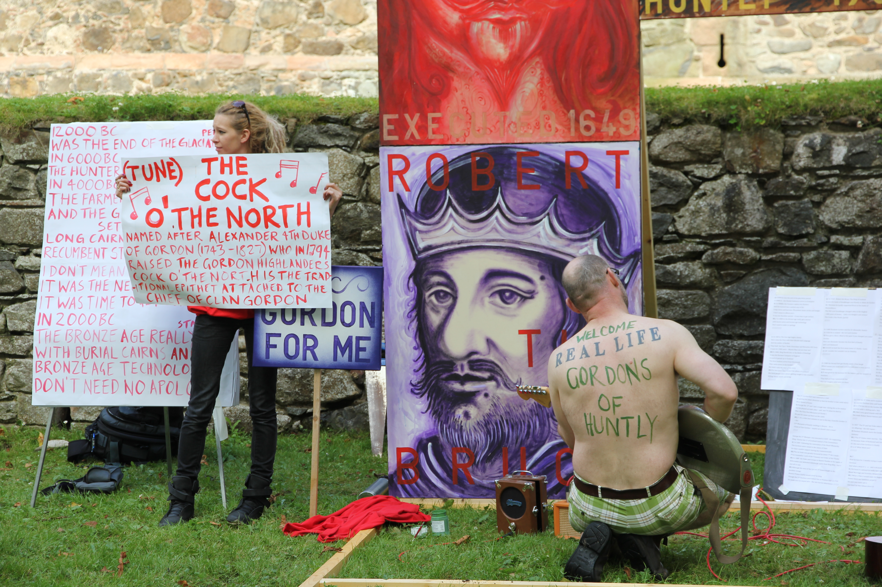
The book contains many images and texts analysing audience/artworks/research/methodologies from the period of this residency exploring relational or socially engaged art practice. This was achieved through the development of a specific project which reflected multiple histories of the different audiences. Deveron Arts are an organisation based in the small Aberdeenshire town of Huntly which for many years have run an international programme of artist residencies which the aim of inviting artists to make challenging site specific work where the motto is “The Town is the Venue.” A further aspect of the book is to explore a strand of my practice that has addressed, over the past 20 years, the complex issue of Scottish identity through the exhibition and dissemination of a number of artworks exhibited in various locations which are discussed here.
This has a strong relationship with my role as a lecturer in SEA at GSA, and the long history of EA where we actively encourage the students to explore ideas of site, context and audience in a yearly public art project.
Detail of performance at Huntly Castle

Slide 12

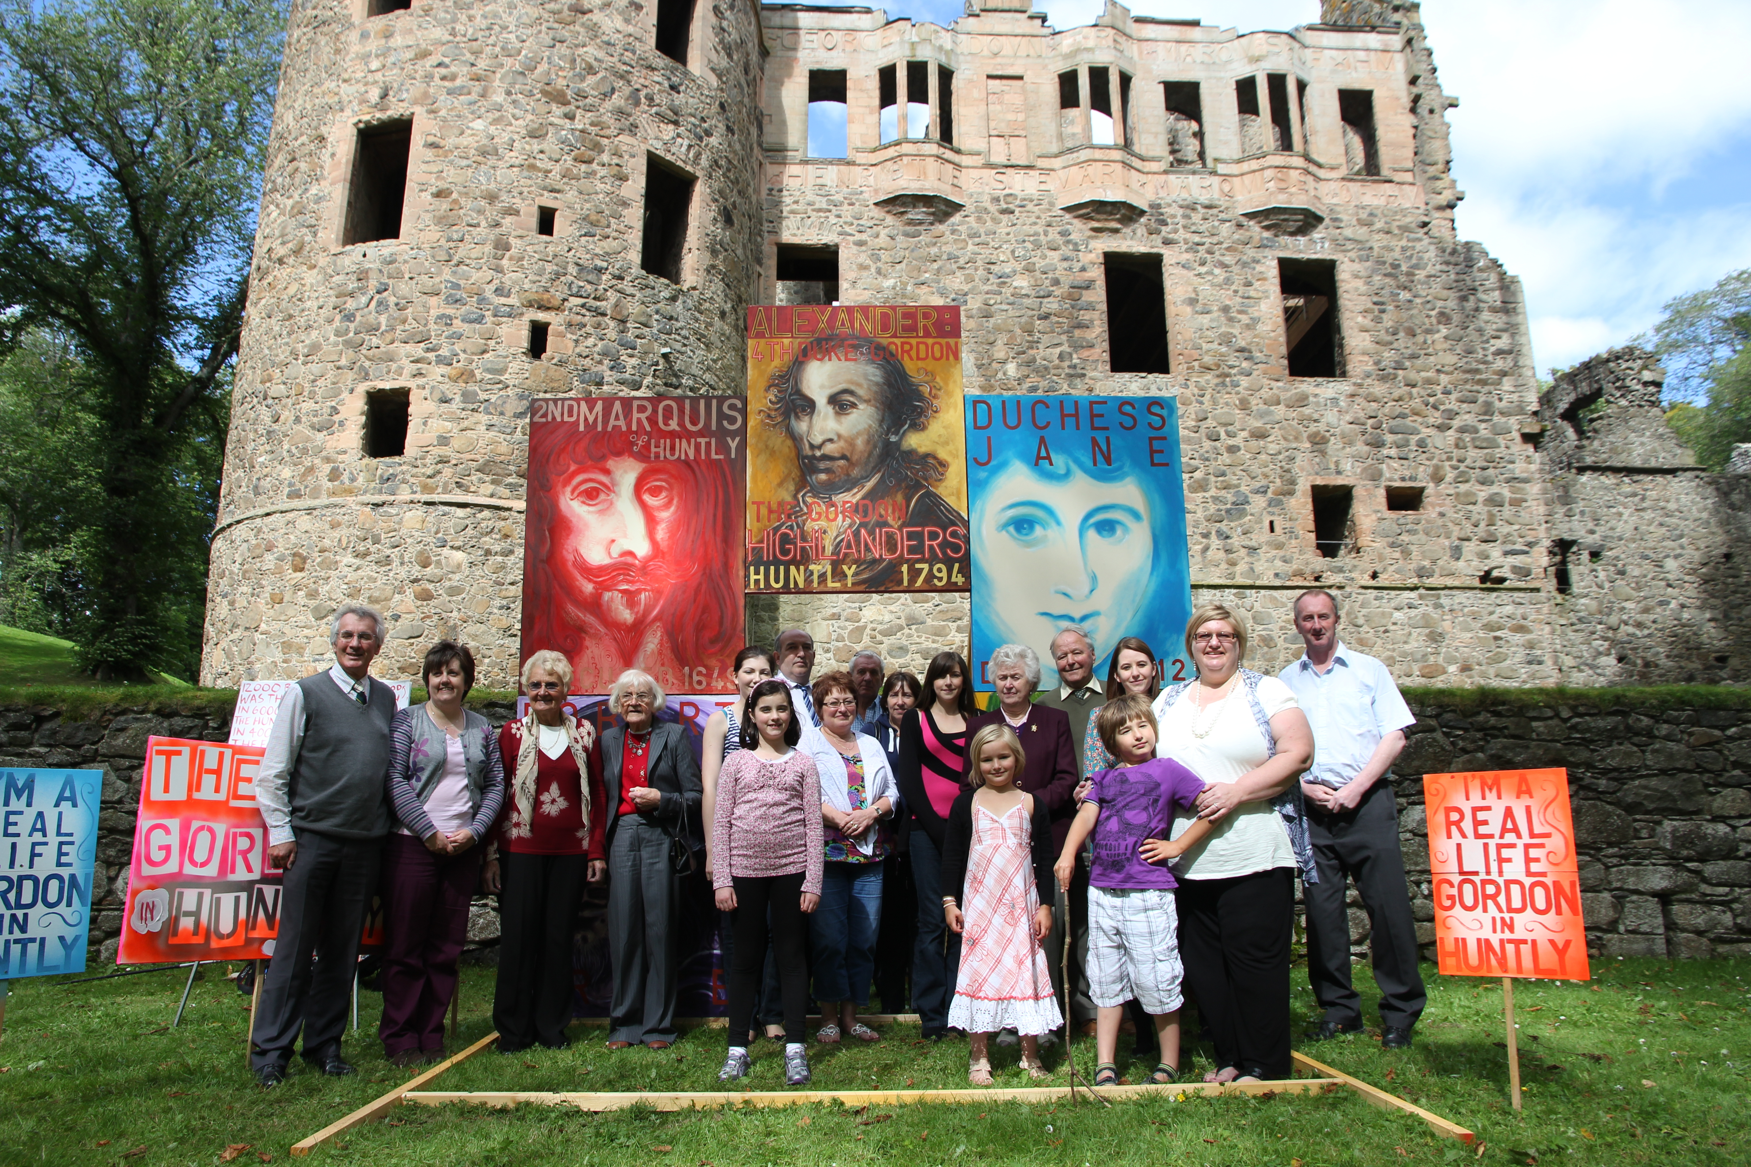
The book was launched at a public event at the Royal Scottish Academy in Edinburgh (http://www.royalscottishacademy.org/) at the launch of the Edinburgh Art festival 2010
http://www.edinburghartfestival.com/events/2012-08-02
This 2 hour event included a performance by myself involving music as well as introductions from Claudia Zeiske from Deveron Arts, a presentation/performance from myself discussing the development of the project and subsequently the construction of the book. There were further papers from Craig Richardson, Professor of Fine Art at University of Northumbria, who contributed an essay on my work to the book and also Murdo Macdonald, Professor of the History of Scottish Art at University of Dundee who made a presentation called 'Ross as Bard'. There was an audience of around 70/80 and afterwards a question and answer session. The event was adverstised and publicised widely through the RSA/Edinburgh Art festival 2012.
The Real Life Gordons of Huntly, every Gordon in the Huntly phonebook invited.

Slide 13

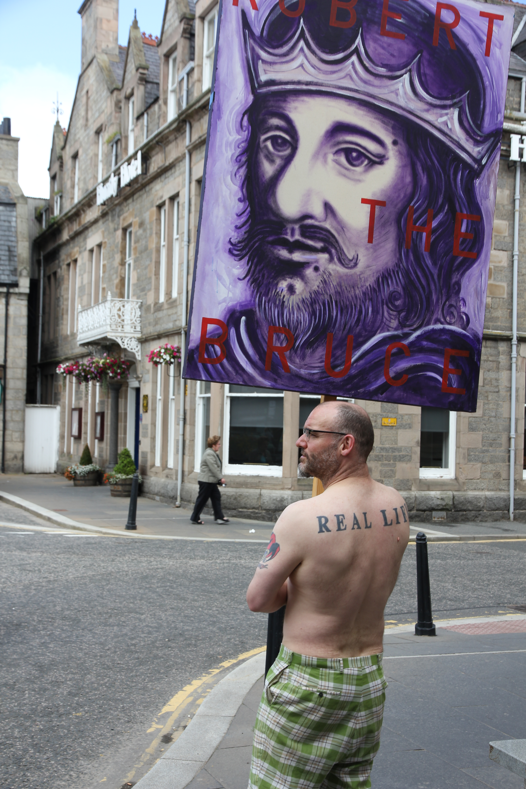
The book continues to be distributed by Deveron Arts.
I delivered a paper on the project and book at State of Play: Art and Culture in Scotland Today organised by AHM at Dundee Contemporary Arts on Sat 1st October 2011
http://www.dca.org.uk/whats-on/talks-and-events/state-of-play-art-and-culture-in-scotland-today.html
In response to this the organisation Public Art Scotland worked with me to develop a 36 minute set of 4 videos which form an extended monologue/voiceover on the project developed from my essay in the book.
http://archive.publicartscotland.com/blogs/28-The-Editorial-Perspectives-on-Participation/articles/510-Ross-Sinclair-s-Video-Reflections
Please click though to ‘you tube channel’
http://archive.publicartscotland.com/search/?cx=005169466167014530546%3Abtqtzi152g4&cof=FORID%3A11&q=ross+sinclair&sa=Search&siteurl=archive.publicartscotland.com%2F&ref=www.publicartscotland.com%2F&ss=1881j317859j13
http://archive.publicartscotland.com/
Image of ongoing performance wher I walked arounf the town discussing art with the townsfolk

