Slide 1

IN BLACK AND WHITE
Funded by the AHRC, Beyond Text program, In Black and White are a series of drawings produced as a result of a 6 month long multi-disciplinary project looking at the bond between memory and place. The project culminated in an exhibition, performance and symposium in the Institute of Arab and Islamic Studies at the University of Exeter, England.
IN BLACK AND WHITE, Rafah, page 19, The Guardian, 19.01.09
by Shauna McMullan for the exhibition De-Placing Future Memory
Submitted by Shauna McMullan
Output No. 1

Slide 2

IN BLACK AND WHITE
IN BLACK AND WHITE are a series of 4 drawings made using permanent ink on newsprint. Two identical pages of two different newspaper images portray the aftermath of the Israeli strikes on Palestine during the 2009 conflict. On one page all of the white spaces have been blacked out leaving a totally black image. On an identical page all of the black has been silvered out leaving a completely white page. Using drawing, this was done twice, using a fine nib pen, once with an image of Rafah from page 19, The Guardian, 19.01.09, and secondly with an image of Gaza, pg. 2 & 3, The Guardian, 07.01.09.
These artworks were produced as a result of an international, multi-disciplinary, collaborative, research project called De-Placing Future Memory, which comprised of two workshops followed by an exhibition at the gallery in the Institute of Arab and Islamic Studies at the University of Exeter.
Workshop 1: 21 – 22 May 2009, Kay Labs, University of Exeter
Workshop 2: 24 - 25 Sept. 2009, Institute of Arab and Islamic Studies, Univ. of Exeter
Exhibition: 23 Sept. – 17th Oct. 09, Inst. of Arab and Islamic Studies, Univ. of Exeter
1
Shauna McMullan,
Detail of IN WHITE, Rafah,
page 19, The Guardian, 19.01.09

Slide 3
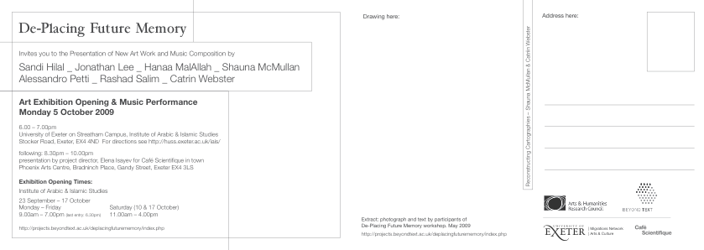
Exhibition invitation postcard, back

Slide 4
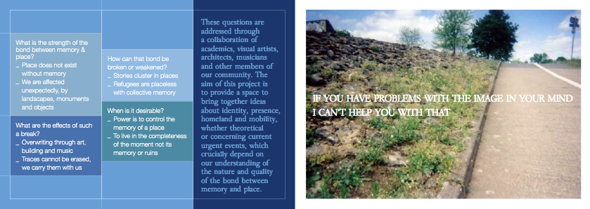
Exhibition invitation postcard, front

Slide 5

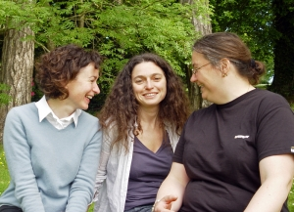
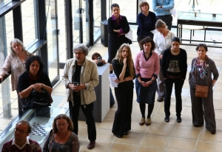
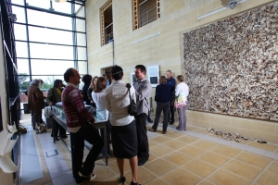
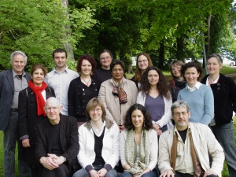
Based on our shared interests in mapping, drawing, place and memory, Dr. Elena Isayev, Senior Lecturer in the Dept. of Classics and Ancient History, University of Exeter, commissioned Catrin Webster and myself to be key artists in this project. Our role was twofold, firstly to develop and run 2 drawing workshops with international specialists from the fields of archaeology, history, geography, anthropology and politics, taking the themes of the project as our focus – mapping, place and memory. Our second role was to develop a new body of work as a result of the knowledge exchanged during the workshops, which was exhibited in a group exhibition of international artists sharing ideas on the core themes.
Using drawing as a shared methodology, the workshops as places of exchange, and the exhibition as a point of synthesis, the aims of the project were to support a multidisciplinary community of scholars and practitioners to explore the ways in which communication is articulated, transmitted, received and controlled. The focus was to provide a unique space where current ideas about identity, presence, homeland and mobility could be shared, challenged and expanded upon.
De Placing Future Memory Workshop participants and exhibition opening

Slide 6

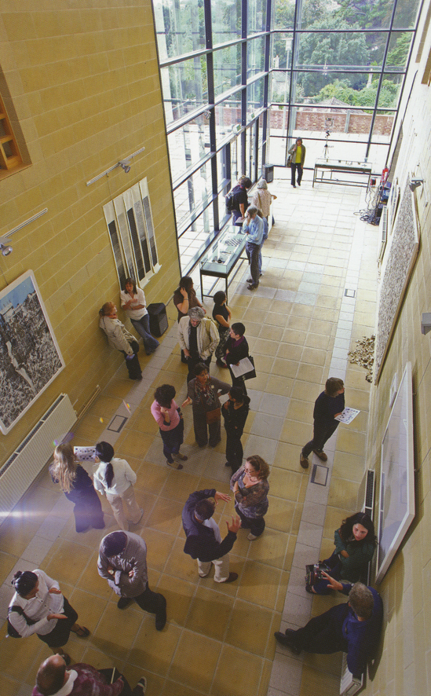
De Placing Future Memory took place at a time of heightened conflict in Palestine and Israel and this provided another background to the project and to many of the workshop presentations for e.g. Prof. of Politics, Michael Dumper, discussed his ongoing research project Conflict in Cities and the Contested State with an emphasis on comparative perspectives on the Palestinian refugee issue. Prof. of History, Ilan Pappe, gave a paper called Memory as the Land of Fear, which focused on the history of Israel and Palestine. These two presentations and in particular subsequent conversations with the cultural geographer John Whylie and Michael Dumper informed my own choice of subject and materials in the production of the artworks IN BLACK & WHITE.
IN BLACK AND WHITE, sought to explore issues of ‘positionality and situated knowledge’ by producing two different and opposing interpretations of the exact same image. My aim was to create artworks that developed from ideas surrounding modern Western thinking about place and its relationality geography, as discussed in workshops, and to synthesize these complex ideas into a series of simple black and white images.
De Placing Future Memory, aimed to explore the permeability of the bond between memory and place. It was interested in the role of the physical world, and the extent to which lessons from the exploration of materiality, and in particular art, can expose the impact of subliminal pasts, beyond what may be articulated through text.
Key questions asked during the two artist led workshops and development of the artworks IN BLACK AND WHITE for the exhibition were:
What causes a shift or break in the memory of a place?
Can a better understanding of the physical world help us understand the bonds between memory, place and belonging?
Can an artwork show us that our perceptions and identities are continually shifting, unstable and contingent?
These strands of inquiry are currently, crucially significant in what is perceived as a rapidly shrinking world, with high levels of human mobility and ongoing tensions in the Middle East.
It is rare that the impact of the physical world, and in particular art, and its role is brought into consideration of these questions. Informed by these themes IN BLACK AND WHITE was my attempt to address them.
De-Placing Future Memory exhibition view in the gallery of the Inst. Of Arab & Islamic Studies

Slide 7
IN BLACK, Rafah,
page 19, The Guardian, 19.01.09

Slide 8
IN WHITE, Rafah,
page 19, The Guardian, 19.01.09

Slide 9

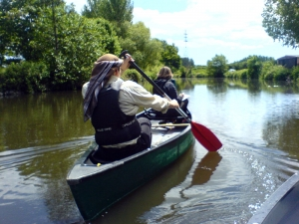
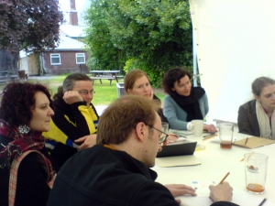
De-Placing future Memory centred around two workshops, incorporating art practice initiatives led by key project artists, Catrin Webster and myself, alongside panel presentations of connected ideas by the other participants.
The first workshop began with a series of artist led journey’s asking participants to make their way to the same location but through a variety of different methods, using drawing as a research method, and testing knowledge in relation to experience. It was essential that individuals were generous in exploring their own positions from a different perspective, and also being open minded in testing unfamiliar approaches.
These included:
Travelling by foot, asking passers by for directions and collecting hand drawn maps en route
Canadian canoeing by the canals, one person rowing whilst the other drew what they saw
Being taken on a tour by a local taxi driver who selected the route based on his unique memories of the city.
On completion of these journey’s, each participant shared their drawings and unravelled the experience of the journey from the perspective of his or her individual discipline.
These experiences were contextualised further on day two by a series of presentations by artists and academics.
The aim of this first workshop was to create an opportunity to share distinct ideas and methodologies and to draw on each other’s work. This introductory workshop initiated ongoing discussions and relationships throughout the intervening period, resulting in an in-depth debate and discourse addressing the project’s main questions in the final workshop and a new body of related artworks for the exhibition.
Continuing to use drawing as a research method, IN BLACK AND WHITE, developed out of my attempt to process and understand ideas discussed through the workshops. In particular 3 core ideas: How could an everyday, throw away material of such relatively little value as a newspaper page be elevated to something of significance and value? Was it possible for an image of devastation and destruction to be changed into a unique thing of beauty and how would this affect our memory of the original? And finally was it possible for the same image to have two different realities? This was my first time to work with such overtly political imagery and was only possible because of the knowledge gained through the project.
Workshop 1. group discussions, sharing practice, in Exeter University and artist led journey in canoe.

Slide 10
IN BLACK AND WHITE, Gaza,
Page 2 & 3, The Guardian, 07.01.09

Slide 11

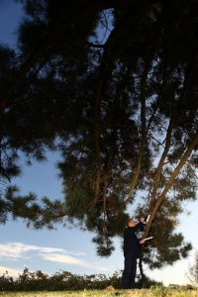
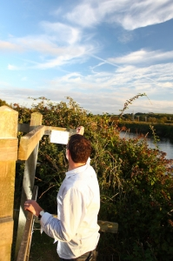
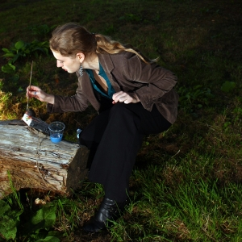
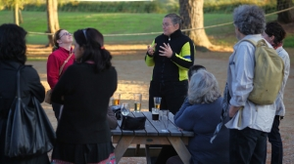
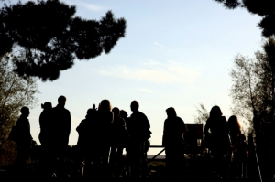
Participants were asked to reflect on the impact of the material world on memory, not only through a verbal/textual medium, but through the expression of that agency via the artist led journeys. These reflections were drawn together and presented in the second workshop which took place four months after the first and which coincided with the opening of the exhibition. The second workshop involved a series of academic presentations following on from the ideas raised in the first, as well as a group discussion in the gallery about the artworks response to the overarching themes. The second w/shop also coincided with the Univ. of Exeter Schools Conference, 23rd Sept. 09, and key artists (Catrin & myself) led interactive art journeys for local secondary students.
“The experiment of approaching the theme of place and memory through a collaboration between art/music practitioners and academic researchers surpassed all expectations. In part because of the mutual interest in the theme and many crossovers in the nature of inquiry that built on each other.” Elena Isayev, final AHRC report.
Artist led journey with workshop participants, using drawing, organised by Webster & McMullan

Slide 12
IN BLACK, Gaza,
Page 2 & 3, The Guardian, 07.01.09

Slide 13
IN WHITE, Gaza,
Page 2 & 3, The Guardian, 07.01.09

Slide 14

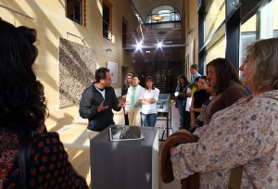
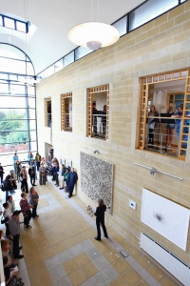
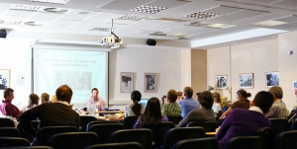
All of the commissioned artworks addressed the theme of memory and place resulting in an exhibition called De Placing Future Memory, which ran from mid September to mid October 2009 at the gallery in the Institute of Arab and Islamic Studies at the University of Exeter. There was also a presentation at Café Scientifique Phoenix Arts Centre in Exeter.
The Institute of Arab and Islamic Studies is one of the foremost academic institutions in the UK offering research and taught degree programmes within the field of Arab, Middle Eastern, and Islamic Studies. It’s gallery is a unique and important international art-space which commissions and exhibits contemporary and historical art projects with an interest in the history, politics, economies, societies, anthropology and art of Middle East.
Because of the nature of the outcomes, which combined scholarly discussion and art works it was possible to bring the ideas to a much wider audience in a very immediate way. During the period of the workshops the project directly engaged some 1000 people, of whom at least half were members of the public.
Public presentations in Kay labs Lecture Theatre & Gallery of Arab & Islamic Studies, Univ. of Exeter

Slide 15
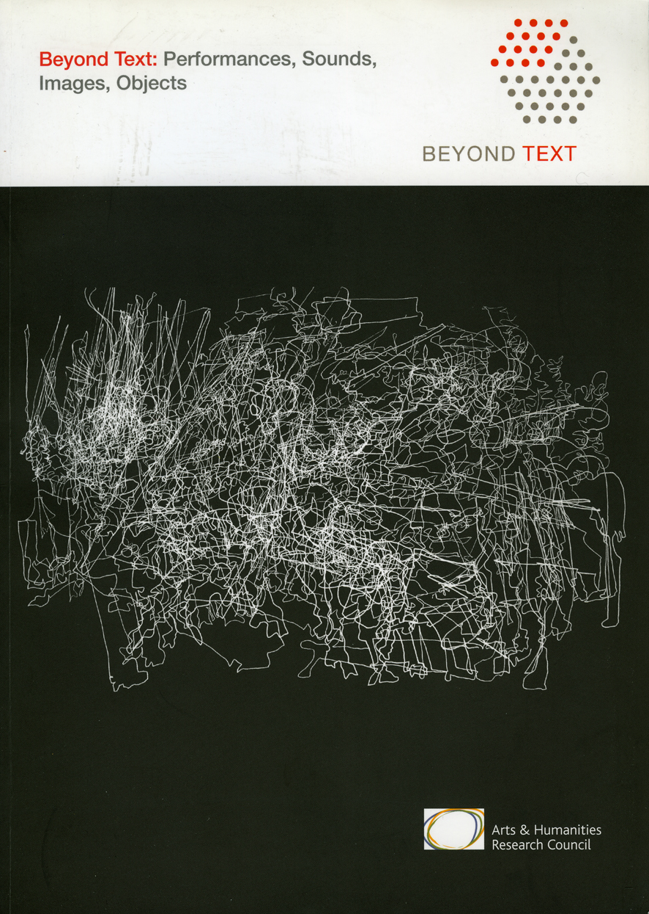
Each workshop had 27 key participants (artists & academics) brought together from around the world including America, Palestine, India, The Netherlands, England, Iraq and Ireland making the international reach of the project significant. Each workshop was attended by some 60 people and this included research students from within and outside Exeter Univ. as well as artists, curators and members of the public.
The key academic findings, artistic works as well as music compositions specifically created for the project were presented in a number of public events: collaborative symposia, an art exhibition, a music performance, student and school children workshops, and a presentation at the Phoenix arts Centre in Exeter. All the details and results from the project are also available on the De-Placing Future Memory web sites:
http://projects.exeter.ac.uk/futurememory/
https://collections.exeter.ac.uk/repository/handle/10472/5258
The AHRC, Beyond Text programme, which funded the project publised and contextualises the outcomes from De Placing Future Memory on its website and related book:http://projects.beyondtext.ac.uk/deplacingfuturememory/index.php
http://projects.beyondtext.ac.uk/deplacingfuturememory/project_team.php?i=14&p=De-Placing%20Future%20Memory
As a consequence of my involvement in De-Placing Future Memory, Political Scientist Professor Michael Dumper invited me to give a presentation at the Conflict in Cities & The Contested State, annual project workshop at the University of Exeter, 16th – 19th September 2009. This is an ESRC funded project that is looking at everyday life and the possibilities for transformation in Belfast, Jerusalem and other divided cities.
http://www.conflictincities.org/aboutus.html
The work made for De-Placing Future Memory has subsequently been shown in the exhibition STUDIO 58, Women Artists in Glasgow since World War II, in the Mackintosh Gallery, Glasgow School of Art. Studio 58 was an exhibition that focused on the work of 53 women artists who either studied / or taught at GSA from 1939 until the present day. The exhibition was curated by Dr. Sarah Lowndes in cooperation with Jenny Brownrigg, Director of Exhibitions at GSA. ISBN 978-0-9567646-1-4
http://www.flickr.com/photos/glasgowschoolart/7596017474/in/photostream/
Exhibition view, - gallery in the Institute of Arab & Islamic Studies, Univ. of Exeter

