Slide 1
Ross Sinclair. Anglo American Love Song 1809-2009,2008. Acrylic varnishes on canvas, wood, neon and various mixed media 330 x 350 x 170 cm part of
THE FREEDOM CENTRE 'THIS SHOW WILL CHANGE YOUR LIFE!’
10 OCT - 15 NOV 2008
Hales Gallery, London
Group show curated by
Paul Hedge and Bob and Roberta Smith.
With research development of projects from 2006

Slide 2
THE FREEDOM CENTRE 'THIS SHOW WILL CHANGE YOUR LIFE!'10 OCT - 15 NOV 2008Group show curated by Paul Hedge and Bob and Roberta Smith. Hales gallery is pleased to present The Freedom Centre, a group show that is bound to change your life! The ideas for this show were developed from conversations between Paul Hedge, the gallery director and the great libertarian artist/s Bob and Roberta Smith, centring around a text based work that the artist/s had made in 2007 entitled The Apathy Workshop, 2003. The mock diary page featured in the work describes how the artist/s set up an apathy workshop as a response to the hopelessness they felt when participating in government art programmes set up to do good in areas of mental health and prison inmate reform. The premise arrived at from these exchanges was that art is paradoxically a powerful tool in the fight for freedom because at its heart it is useless. Discussions followed, with all sorts of artists, many of whom are the artists now participating in this show and it seemed that this sense of hopelessness was widespread, yet the response from the artists was to stoically continue to make art in the face of powerlessness. 'Freedom', has been used as a tag line for many organizations from both the Right and the Left of the political spectrum, by groups both religious and secular, to the psychedelic and peculiar.The show attempts to create an environment where Freedom is promoted in all of its contradictory forms. The Freedom Centre celebrates the empty rhetoric and unrealistic nature of its aims. Artists included in the show: Trevor Appleson, Adam Dant, Ian Davis, Katy Dove, Peter Joslyn, Richard Klein, Hew Locke, Laura Oldfield Ford, Tom Price, Ross Sinclair, Bob and Roberta Smith, Tomoko Takahashi, Jim Torok, Julie Verhoeven, Jane Wilbraham, Martin Wilner.

Slide 3
This work was developed from an ongoing body of research about the concept of identity, local, civic, political, national, international, and in particular the construction of identity inherent in the relationship between the United States of America and Europe. This later developed further into the project Real Civic Life, at Angelika Knapper Gallery in Stockholm. The exhibition was presented at exactly the same time that the US Election was happening when Barack Obama was elected the 44th president of the United States.(not known when the work was made/installed). This contextual signifier is critical to the understanding of the work. Site, specific, context related, time sensitive. On one level The work appears as a monument, or tribute to Abraham Lincoln, the 16th and perhaps most esteemed president of the USA and embodiment of the very idea of America. On closer inspection the reverse of this construction appears as some kind of voting booth, dimly lit with a backwoods feel, perhaps a nod to the famous story of Lincoln being born and raised in a log cabin – celebrating the humble beginnings from whence he travelled upwards to assume the greatest role in the free world. This is an articulation and celebration that anything is possible in the free world within a republic of democracy and freedom. However on each side of this voting booth instead of a place to register ones vote there are 2 urinals, indicating a different kind of booth where one could make perhaps make a different kind of contribution to the democratic debate .
As is often the case in my work the viewer was free to construct the physical experience of this work themselves, starting with their own engagement, experience, interests - formally, politically, intellectually and then to physically explore and construct the work from the front, back, inside outside.

Slide 4
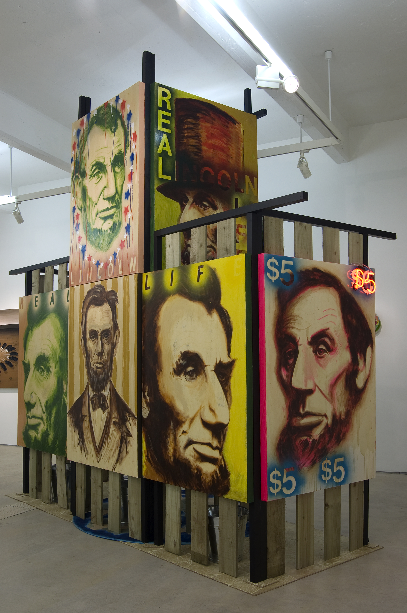

Slide 5
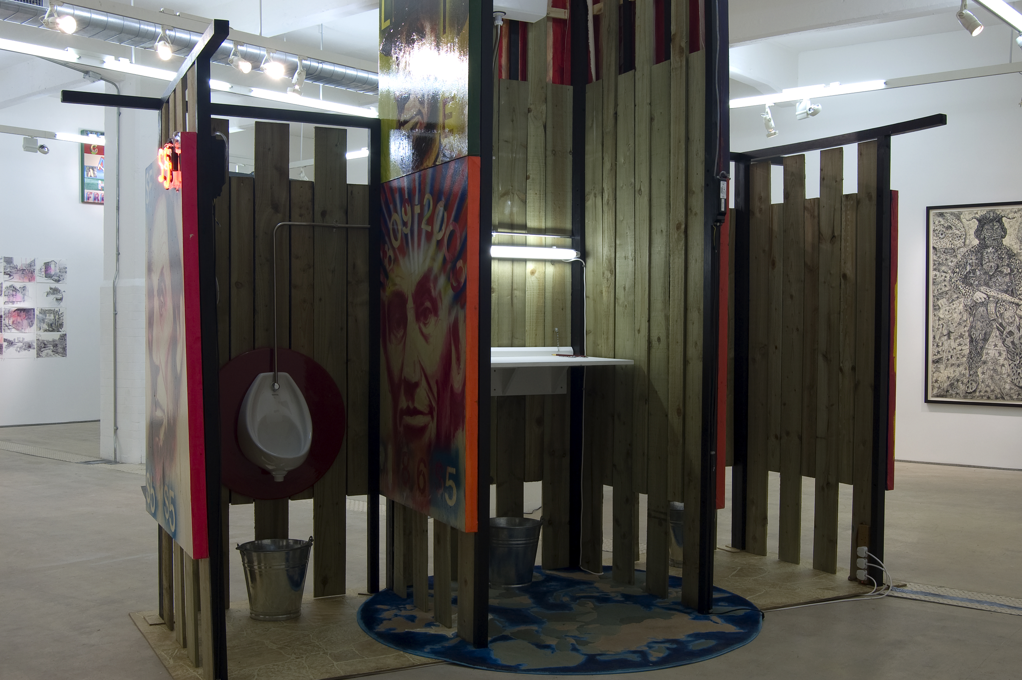

Slide 6
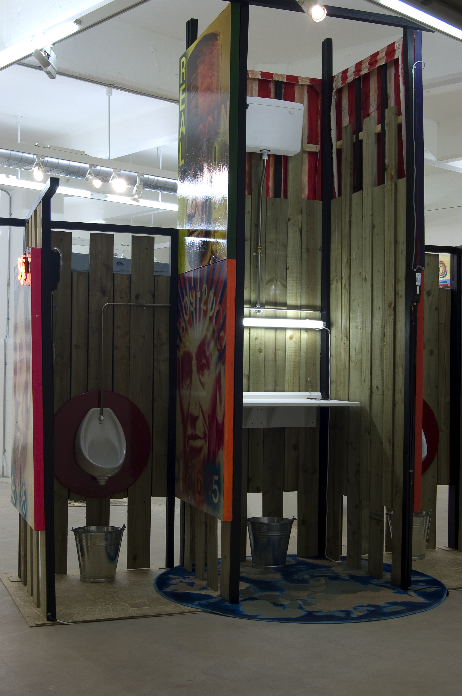

Slide 7
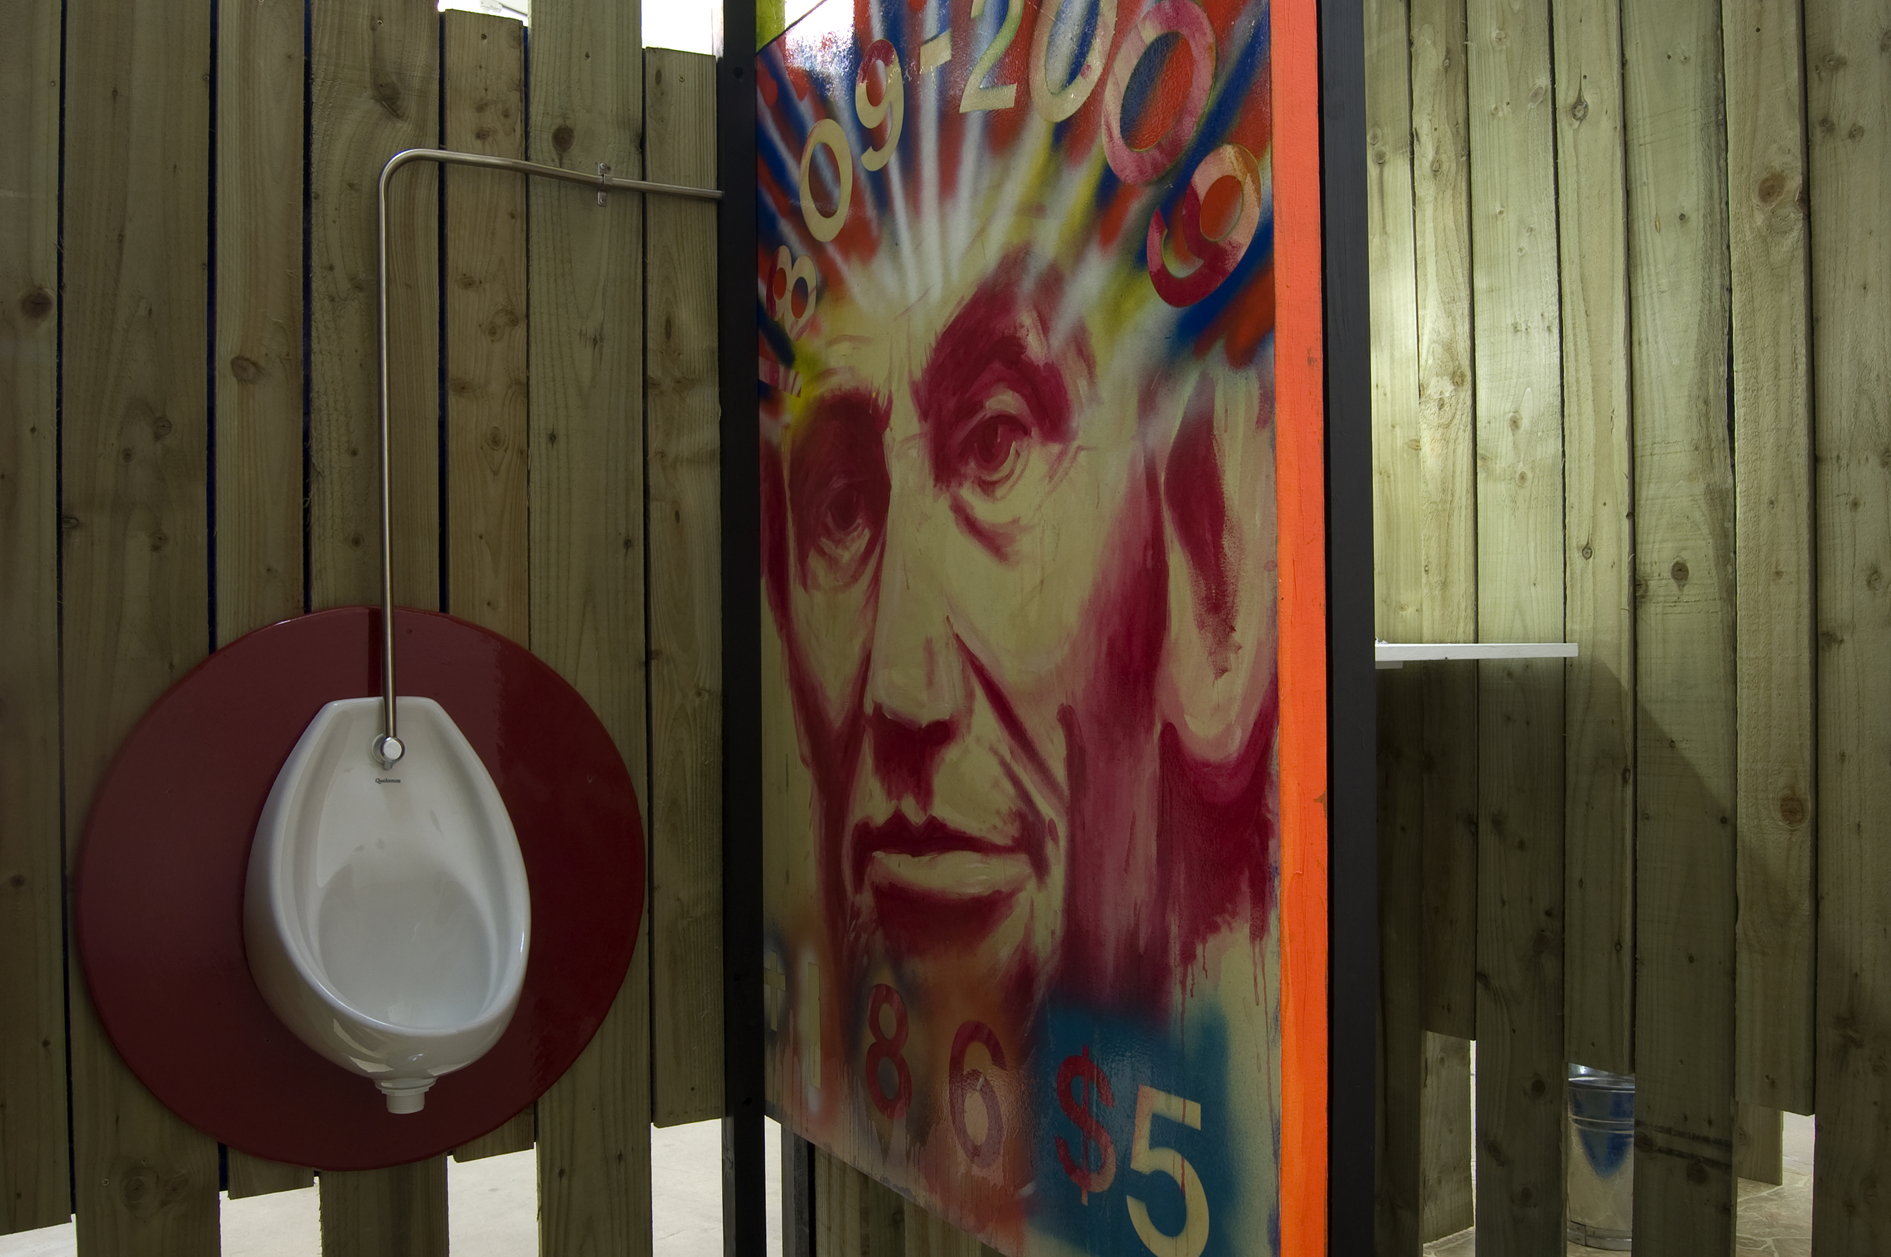

Slide 8
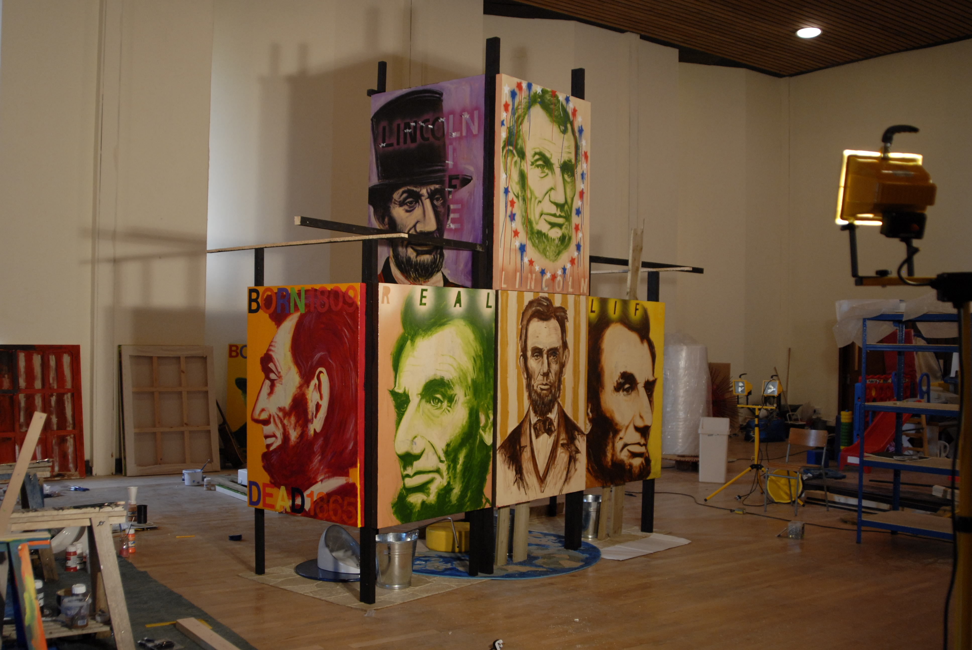

Slide 9
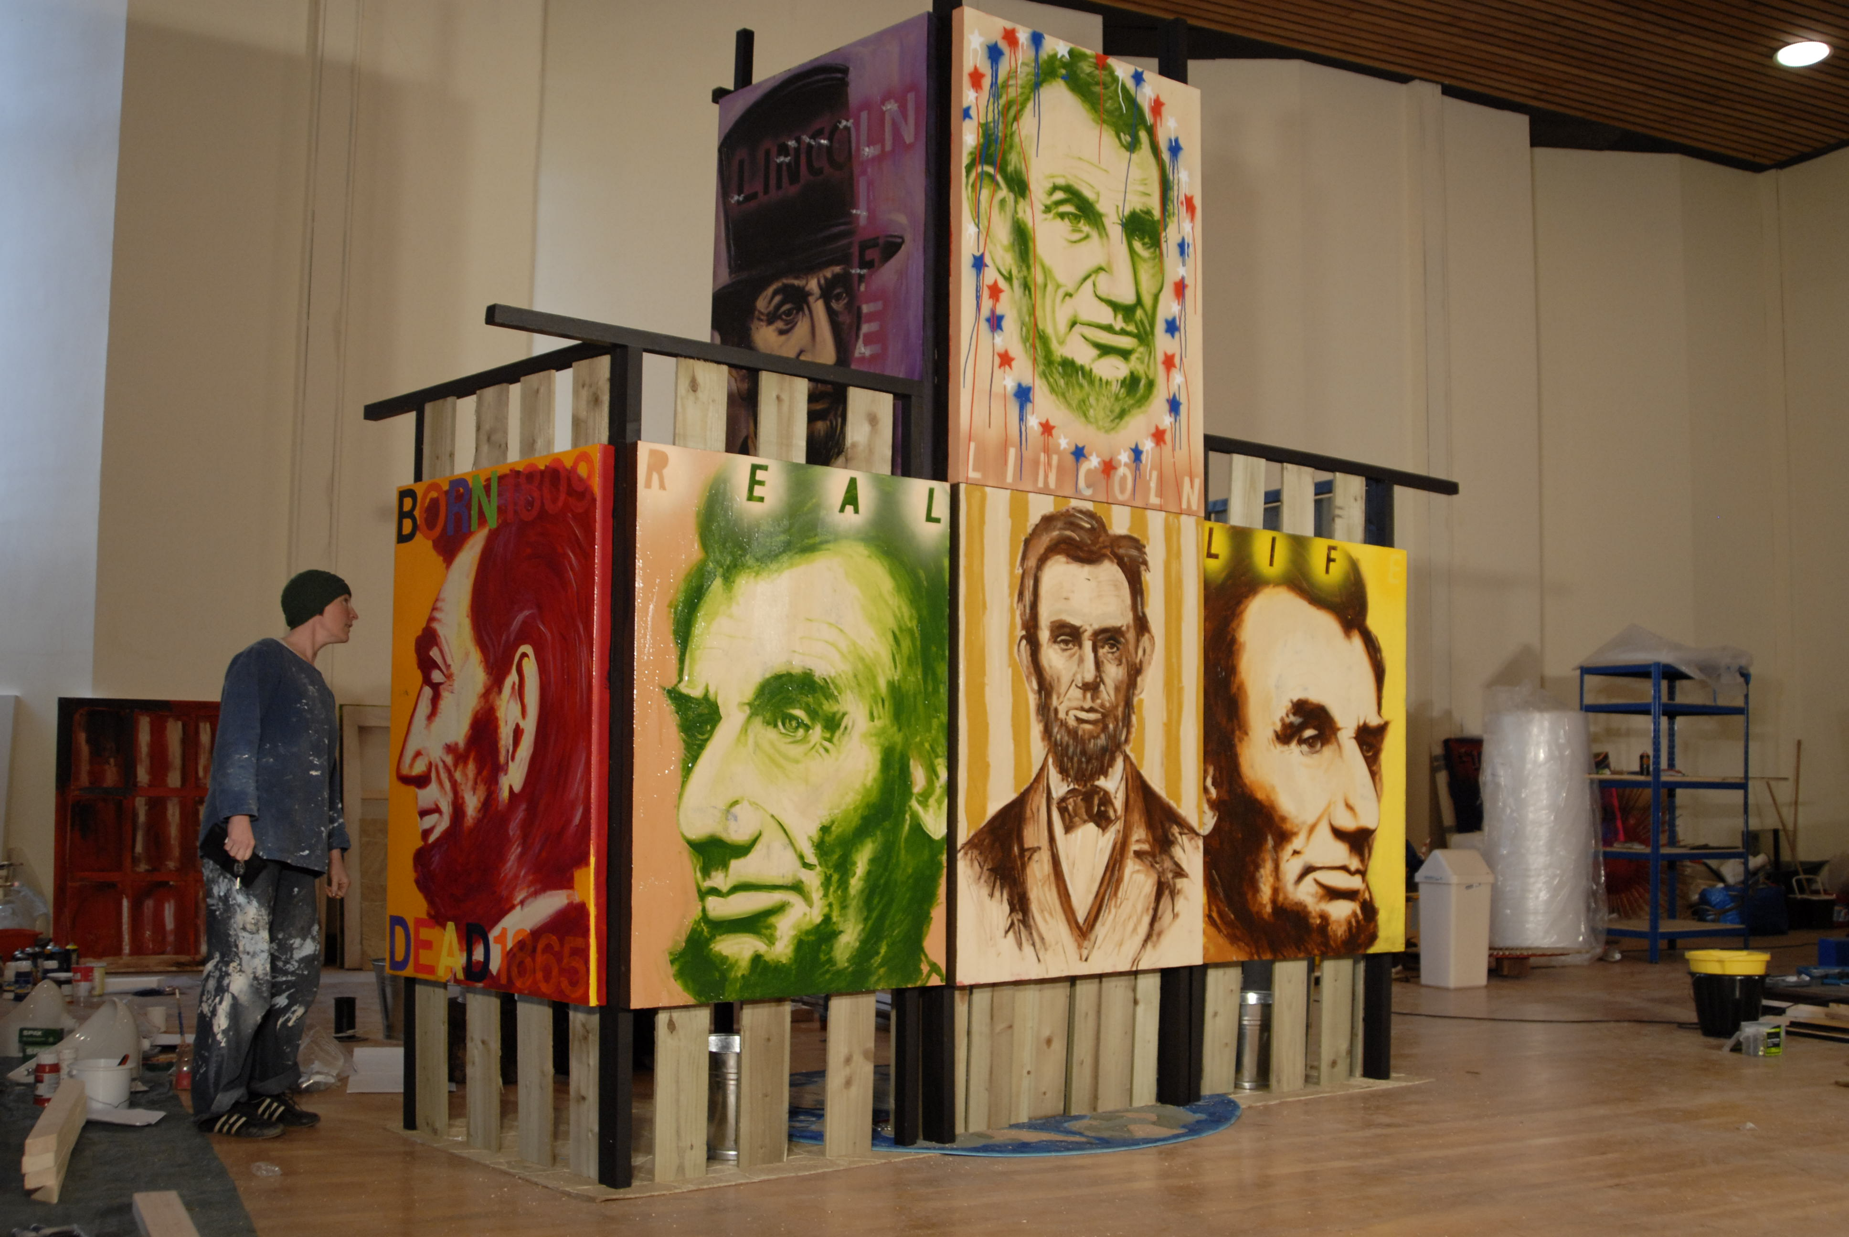

Slide 11
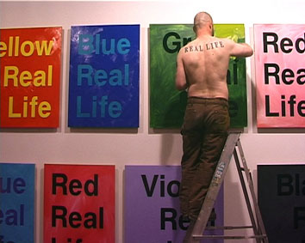
Antecedents/Research and development of project from ‘painting investigations’ in Real Life Painting Show, CCA Glasgow 2006

Slide 12
Rationale for investigation of Painting as conceptual tool
Ross Sinclair: Real Life Painting Show CCA Glasgow 2005
Ross Sinclair is better known for his large-scale installations than for his painting. He would be the first to admit that he is not attempting to create a masterpiece in oils in the old tradition. However, he is determined in this exhibition to investigate the possibilities of how paint can be used by a contemporary artist who may use many materials at different times, rather than follow a long apprenticeship to just one medium.
The Real Life Painting Show is characterised on every level by a sense of experiment. One starting point for the work lies in the frustration that many successful artists experience today: working on large installations or exhibitions with little time, issues arise that can only be dealt with quickly before moving on. Sinclair, for instance, felt that when working on his installations he would face choices in terms of combining colours, often on a large scale. The implications of these colour combinations, though, was always something that there was never enough time to address. The Real Life Painting Show is a deliberate attempt to examine those issues and explore their consequences. Describing this process in his own words he says, ‘I'm taking a few steps back, holding a mirror up to my practice, pulling it apart, asking what the building blocks of it are, the pieces of the jigsaw, what are the essential elements?’
Allied to this exploration of the basic elements of his practice, Sinclair found himself rethinking the role of the studio in his work. Like many contemporary artists, he found the traditional studio unnecessary for long periods of his career. While developing the Real Life Painting Show he began to discover the benefits a studio can bring. Setting up a large space first in Kilcreggan at Cove Park and later converting the CCA galleries into a vast studio, Sinclair created a hybrid between a factory and a laboratory, producing over 100 paintings. The physical space of the studio allowed for a more exploratory way of working. Everything was in continual flux and there was time to reconsider, change or extend the reach of the work. Even in the final days of the exhibition installation, the studio gave him the possibility of creating new paintings and taking the series in new directions.
Assessing his approach to this body of work, Sinclair explains that he needs to discover the power of the medium he is using through the process of making. In Real Life Painting Show that meant reconsidering the potential today to tap into the modernist tradition and its bold uses of colour: ‘The only way for me to try to investigate the power is to crawl inside and try to come out from the inside. To see if one could ever regain that confidence and certainty. What happened to that at the end of modernism, when everything went off into a million different avenues of investigation? Is there something that can jump from there to now?’
He and his wife, the artist Christine Borland, have three daughters, Grace, seven, Agnes, who is nearly two, and baby Jean. "I think a bit of it is responding to their growing up, mark-making, doing paintings, using colour, it's responding to that very unlearned, pre-cognitive reasoning. 'I want red, I want yellow, wow, there's orange in the middle'. It's totally brainless in a way!"
But they also articulate a series of questions about painting itself. Sinclair's monotones nod towards the modernism of the 1950s and 1960s. "There is something attractive there, the confidence and the certainty. Ad Reinhardt doing all black, Robert Ryman all white, the absolute certainty of these poles. From the beginning of the 1970s everything squelched sideways in interesting and important ways."
"Without sounding too ridiculous about it, perhaps [it's about] the transformative power of art, perhaps a reaffirmation of the importance of a single brush stroke, the joy and humanness of that action, this sense that you can still express some things, can still make this creative image to talk to people, to have a dialogue. I love the idea of just one mark, that joy of being creative, like kids, that unbridled imagination, when anything is possible."
CCA would like to thank Cove Park, where Ross Sinclair was generously allowed to prepare the work for this exhibition. Quotations cited above are taken from ‘Primary colours’, an interview with Susan Mansfield in the Scotsman, 8th April, 2006.
Ross Sinclair
Ross Sinclair is a Glasgow based artist currently exhibiting as part of Glasgow International at CCA. Ross trained at the Glasgow School of Art and attended the California Institute of Arts in 1992. He is now a part time researcher and lecturer at the Glasgow School Art in the department of Sculpture and Environmental Art. His recent practice has included a variety of materials including neon, sound, deer antlers, photographs and room sized installations. The current exhibition at CCA demonstrates Ross’ determination to investigate the possibilities of how paint can be used by a contemporary artist who may use many other materials at different times, rather than follow a long apprenticeship to just one medium.

Slide 13
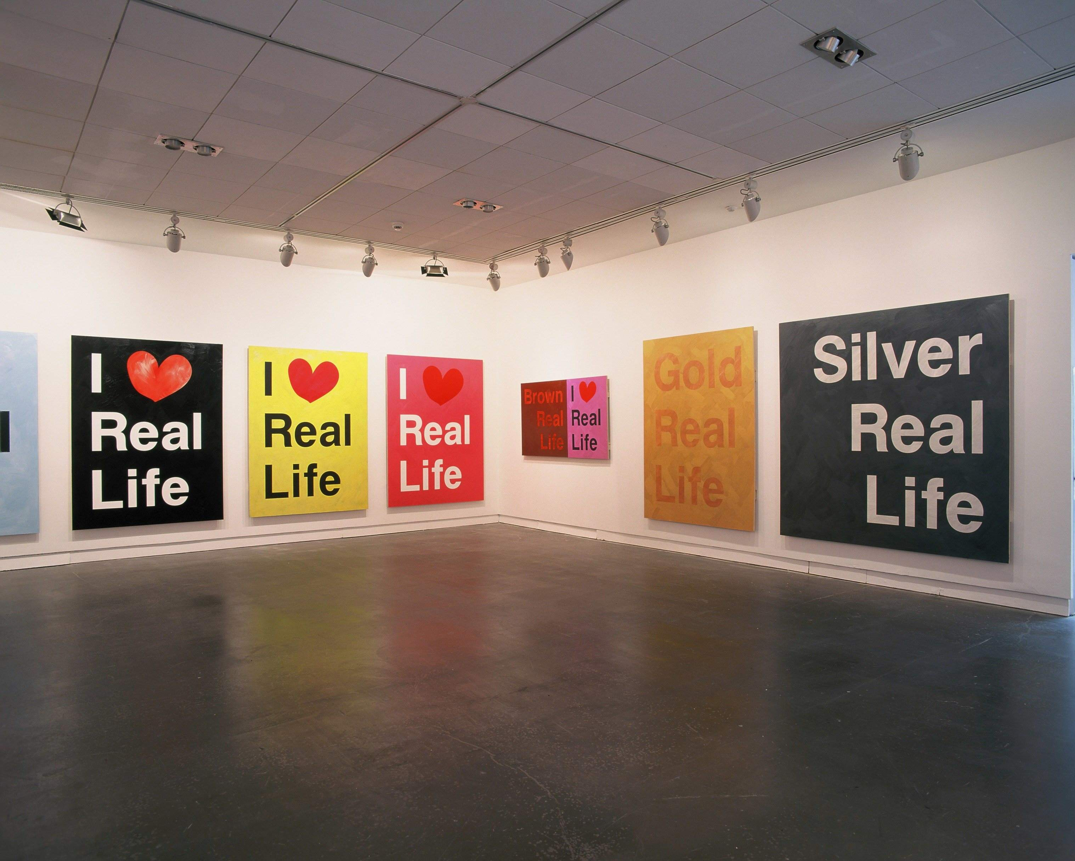

Slide 14
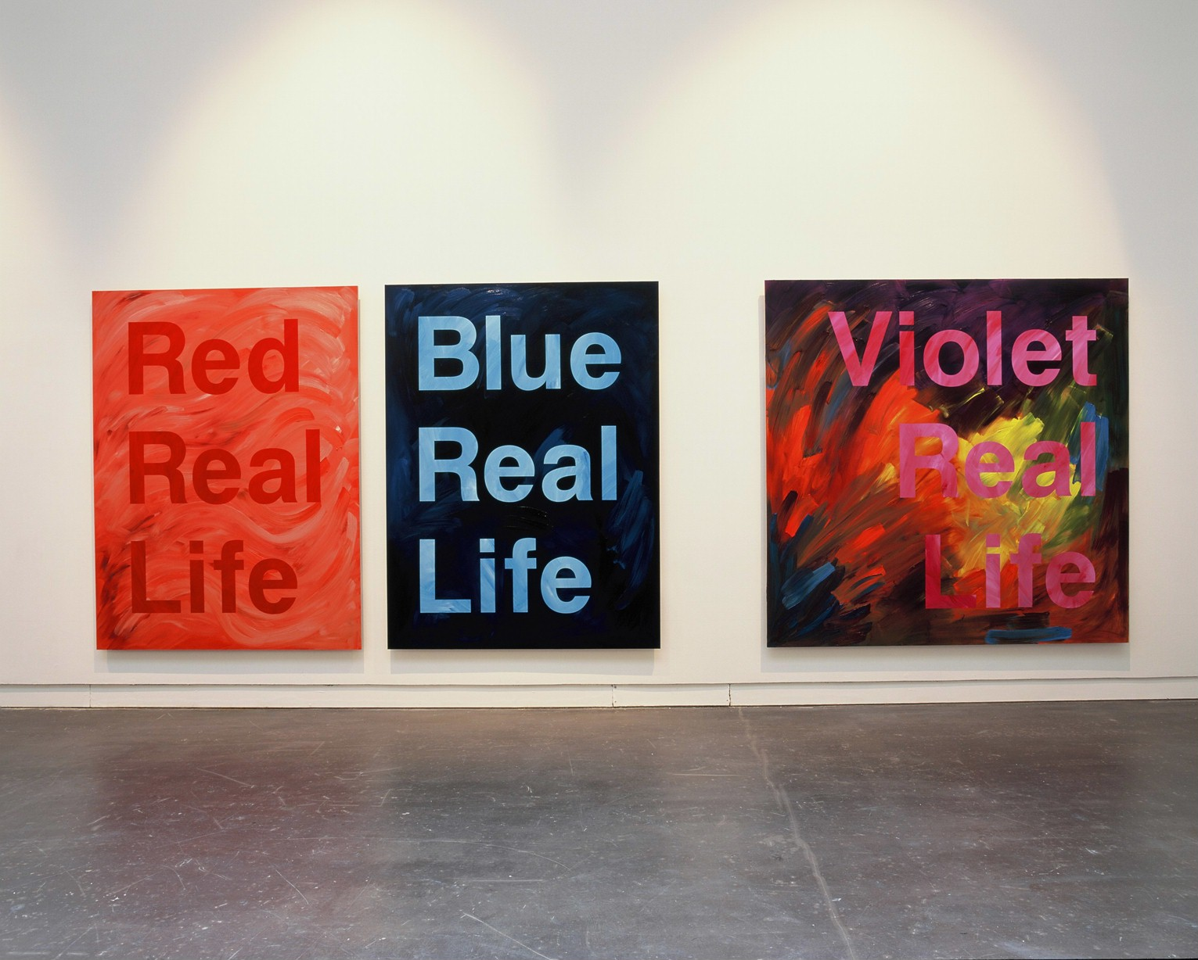

Slide 15
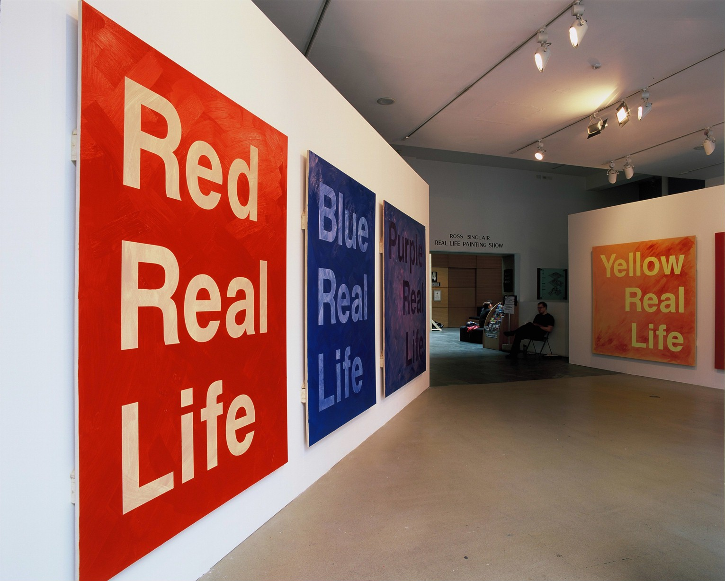

Slide 16
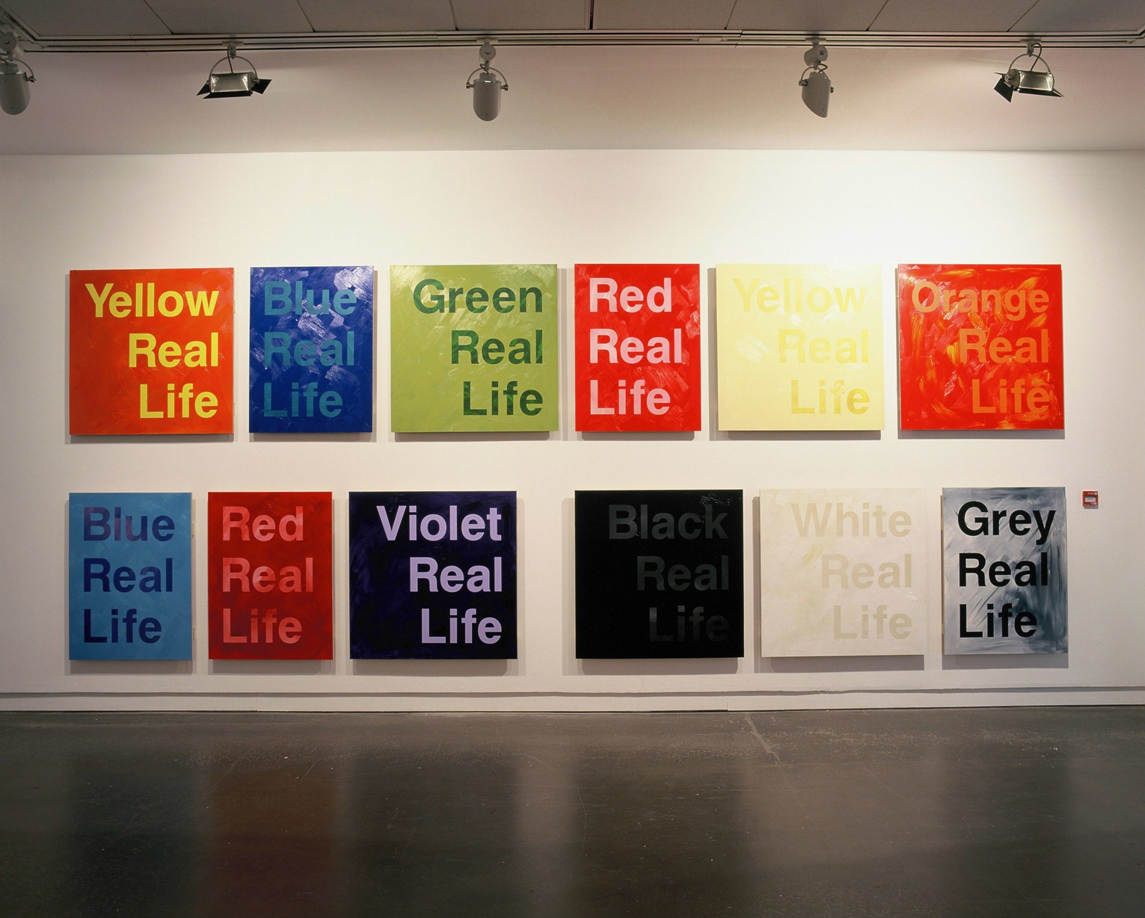

Slide 17
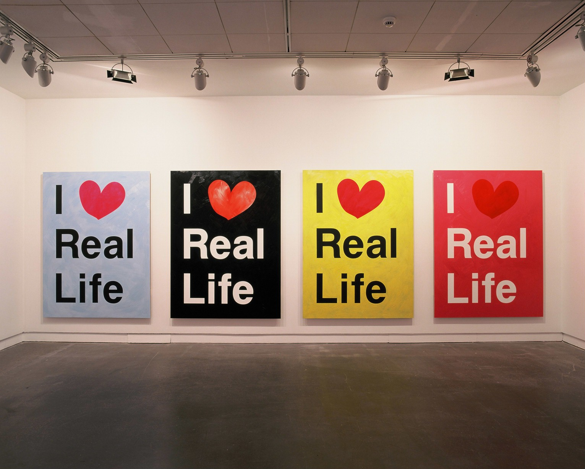

Slide 18
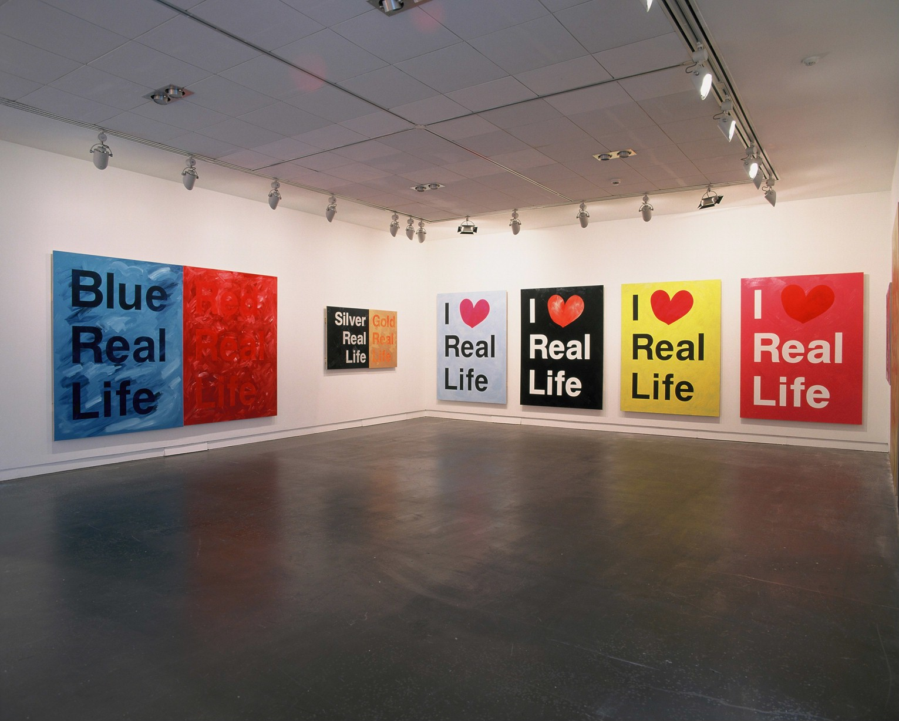

Slide 19
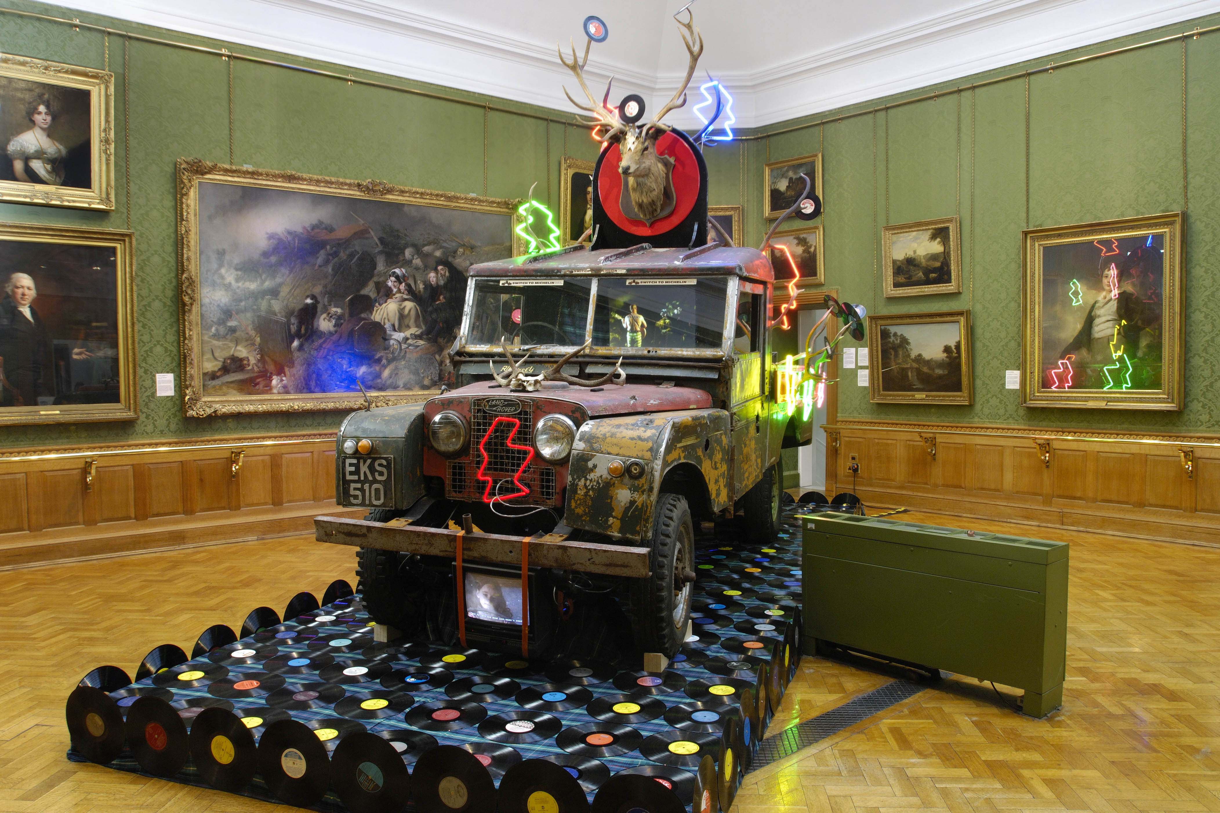
Sinclair vs. Landseer, Aberdeen Art Gallery 2007, site specific installation in 19th Century gallery in response to Landseer painting. AHRC funded project(speculative research route) Research into paintings/portraits by Raeburn, Ramsay, Wilkie etc

Slide 20
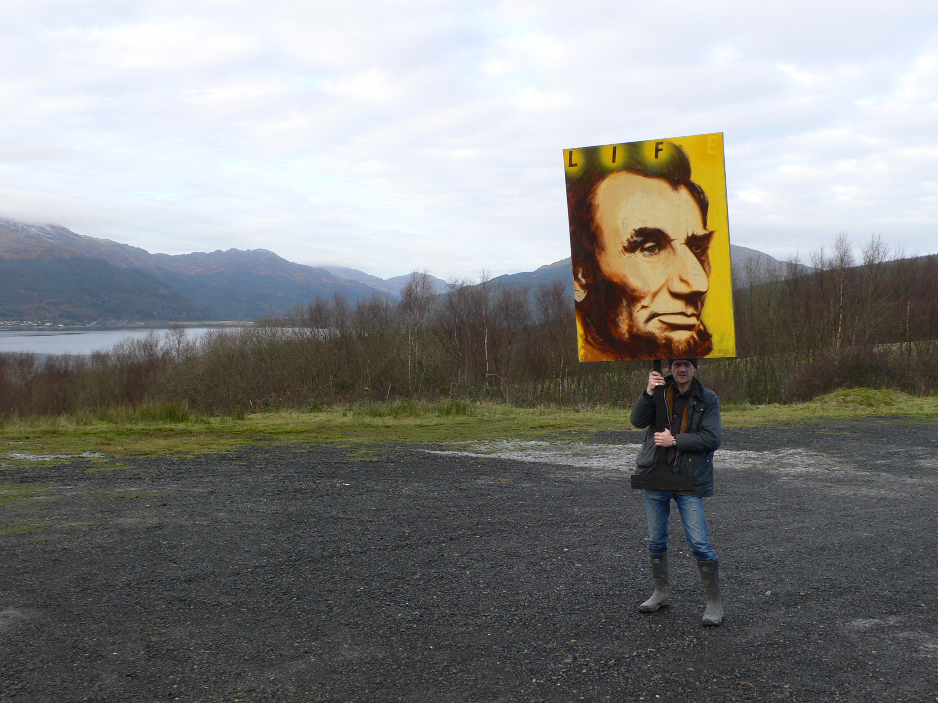
Research/production at Cove Park Studio 2008

Slide 21
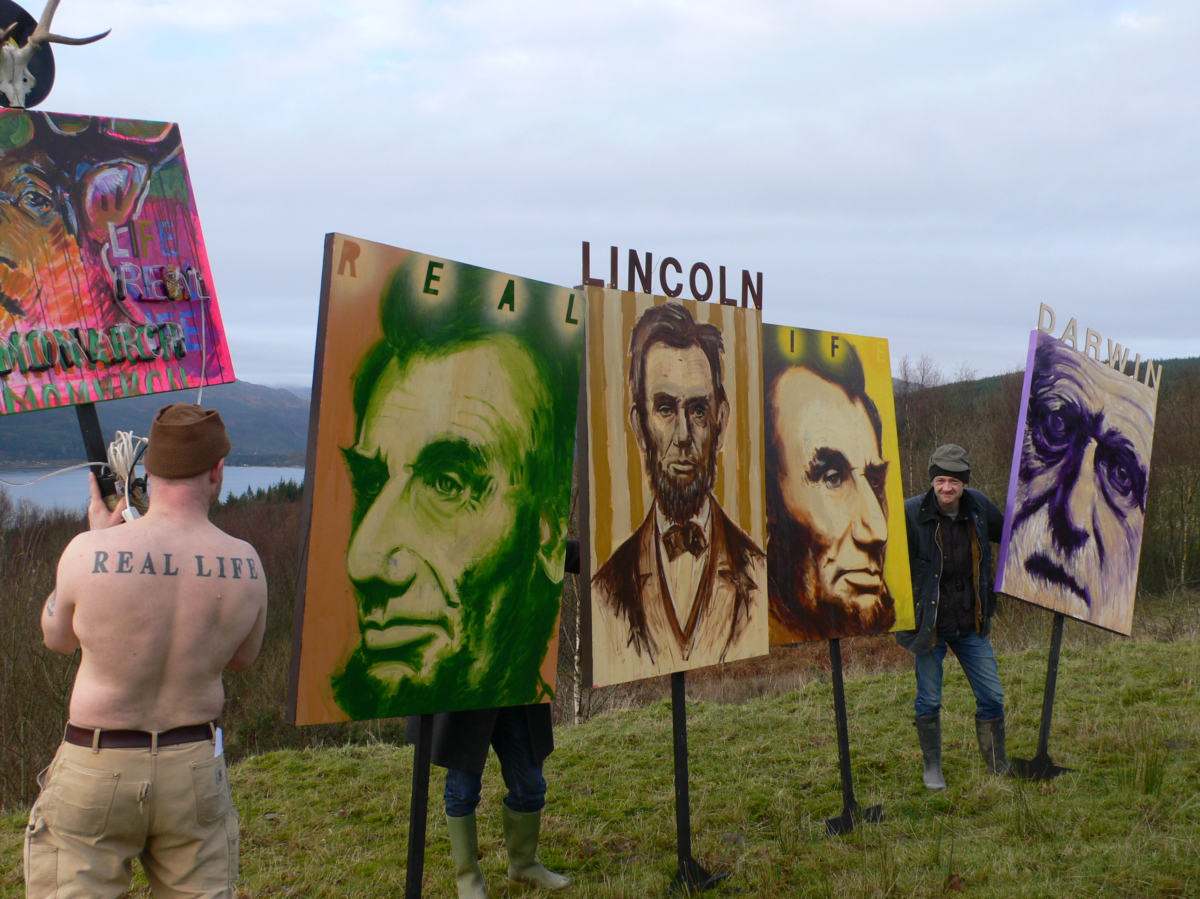

Slide 22
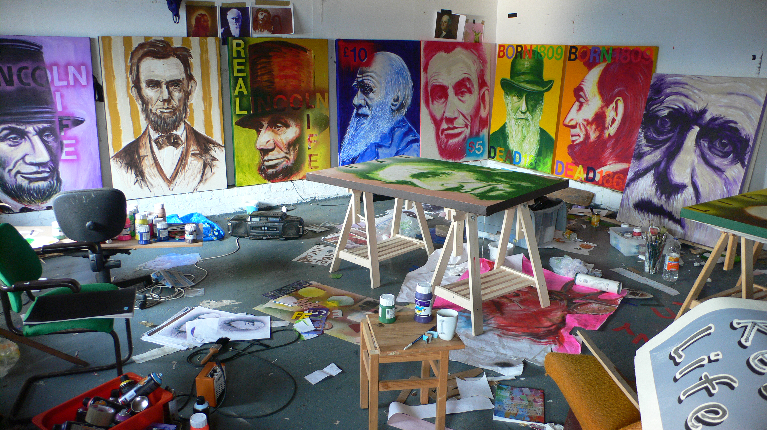
Research/studio/production, cove park 2008

Slide 23
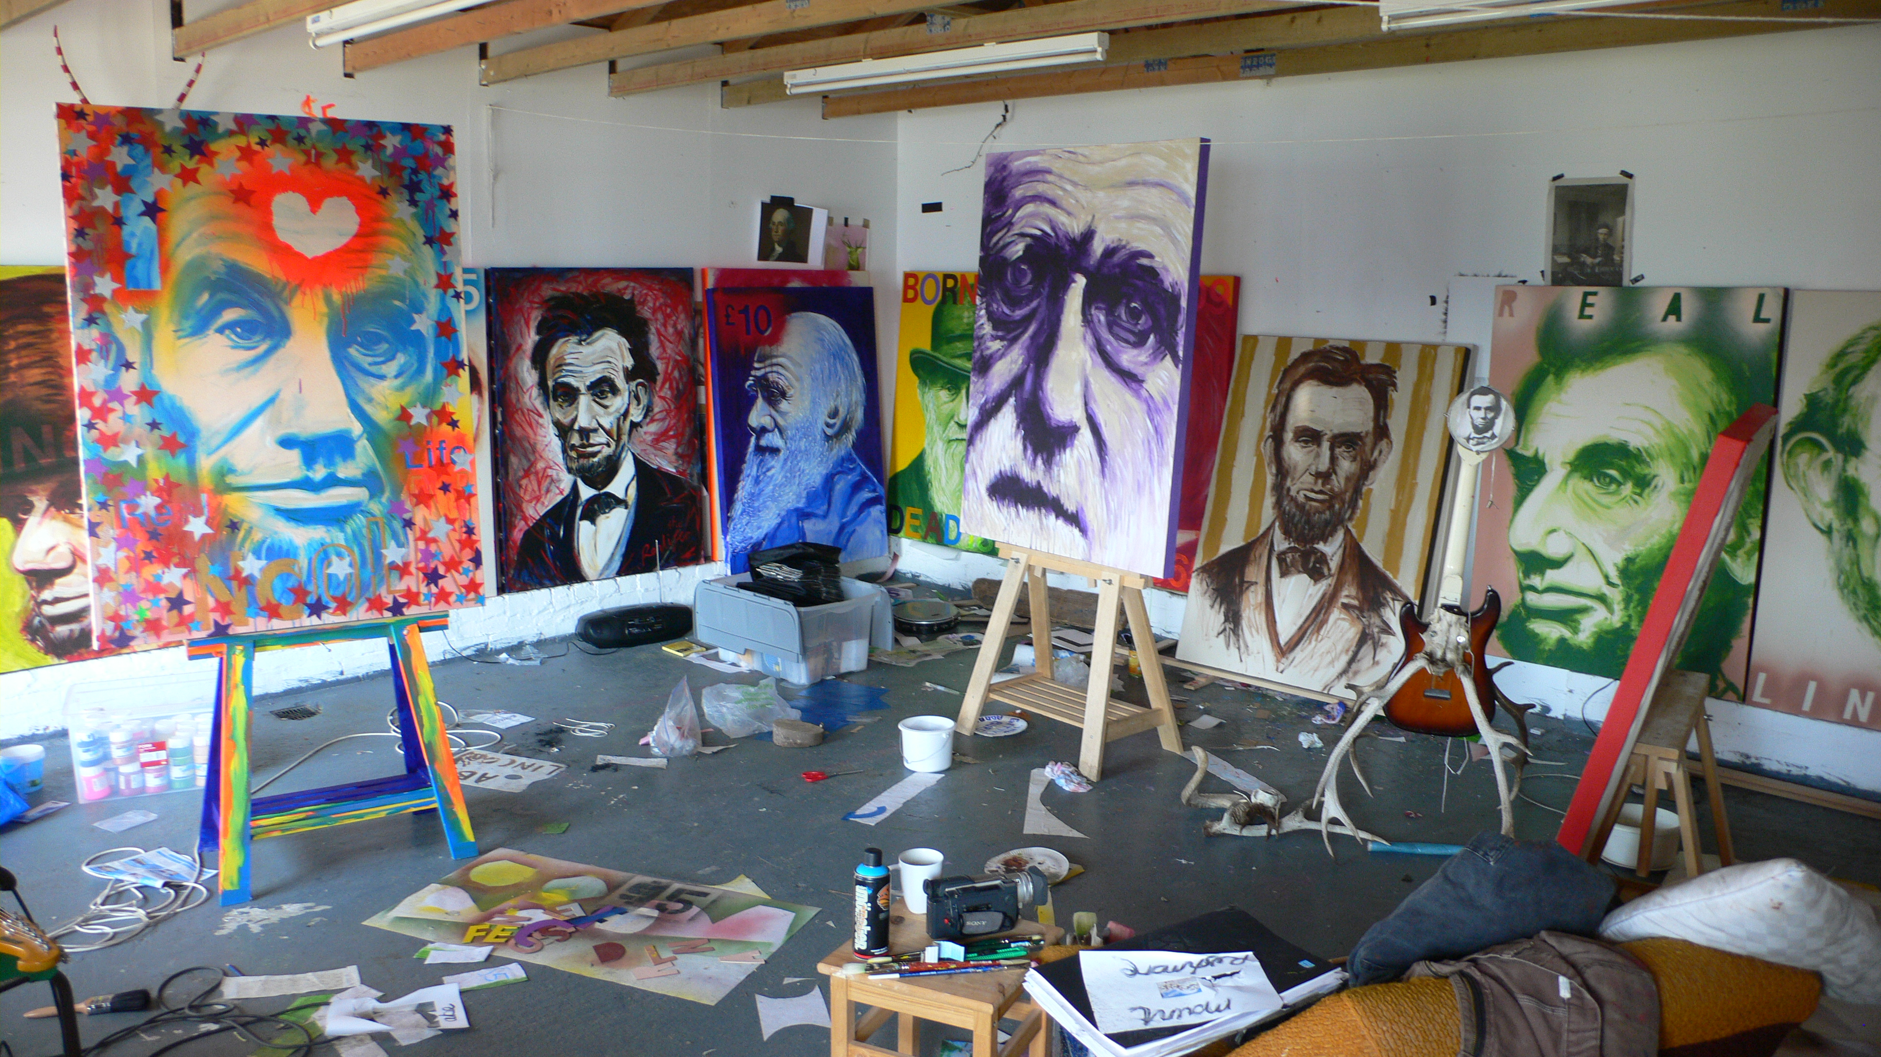

Slide 24
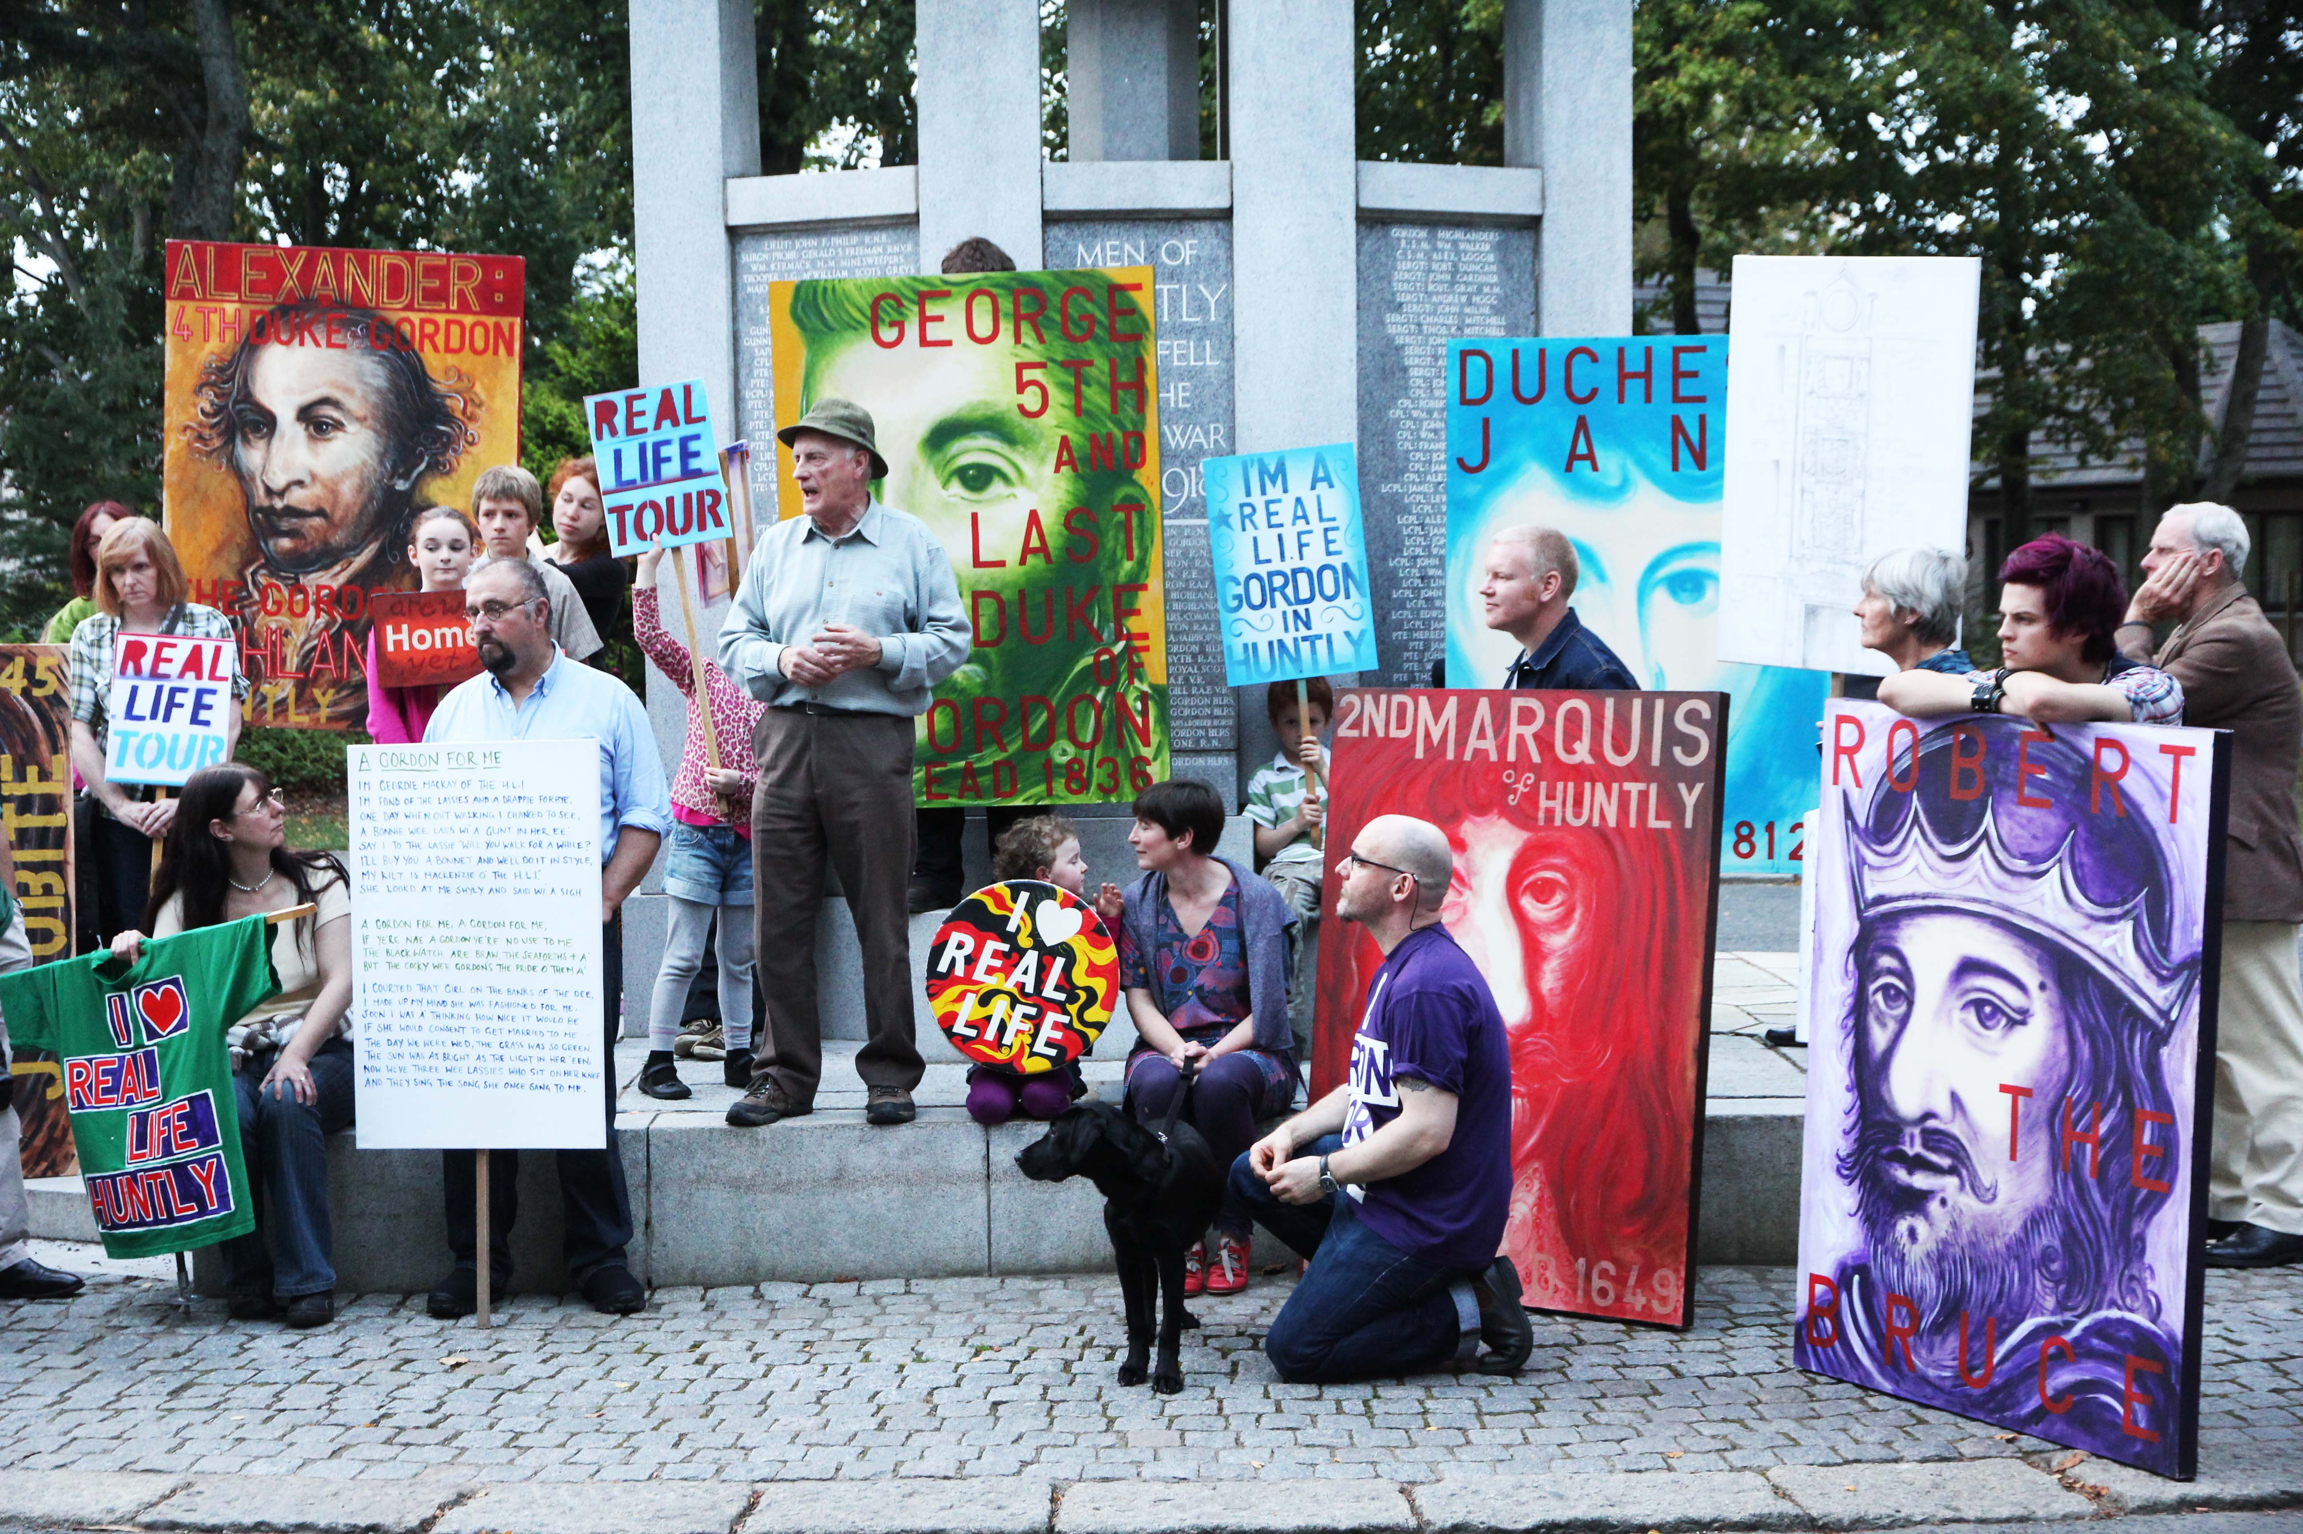
Continued development of project in 2011 as part of We Love Real Life Scotland project

