Slide 1

Artlink Artist Commission: 2006 - 2008
Artist commission by Artlink to create new scent work for adults with profound developmental and multi sensory disabilities. The aim of the brief was: To explore the individuals understanding of their immediate environment through their olfactory senses and create an environment which stimulates a positive sense of well being for that individual.
Submitted by Clara Ursitti
Output No. 1

Slide 2

Artlink Artist Commission, 2006 - 2008
An Artlink commission to create two new works for two clients with profound learning and multi sensory disabilities, in two separate settings. Working with a team as lead artist, the aim of the brief was: To explore the individuals understanding of their immediate environment through their olfactory senses and create an environment which stimulates a positive sense of well being for that individual.
The biggest challenge was that both clients had limited verbal skills and therefore much of what we had to do as a team was read their non-verbal language. The result was a set of scented bubble baths and a machine for the bath that would cause waves for Marshall . The second result was a set of scented body creams for the other client, Bruce. ( Note, these are not the actual names of the clients/audience to respect their privacy)
.
1
Ideas Team: Olfactory Specialist/Lead artist, Clara Ursitti, parents of clients , Rosemary Kerr ( careworker ), Alison Stirling ( Artlink ) Bob Walley ( Clinical Psychologist, Consultant Clinical Psychologist
Department of Psychology, Edenhall Hospital,Musselburgh,
East Lothian)
Image one & a description of what we are looking at in the context of the project.

Slide 3

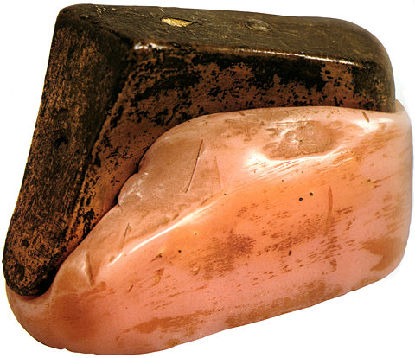
Art Context:
Context specific art has a well documented and debated history internationally and within the Scottish context. It raises issues surrounding who art is for, what its role is and can be in society, who it excludes, as well as questioning judgment and taste. See: Claire Bishop, Claire Docherty, Nicolas Bourriard and Grant Kester , David Harding and the Artist Placement Group.
The work was context specific, and for a very small audience, designed specifically for two clients, and their care workers. As such, it raises issues surrounding who art is for, as well as issues surrounding how to judge socially engaged art work, of which Claire Bishop has written eloquently. So, for example, do we judge the success of such art works by their effect on the community, or by aesthetic criteria? These debates are ongoing. Furthermore, the collaborative nature of the work adds to the discourse surrounding the intersection of art in other fields , such as healthcare.
In addition to this, the idea of an audience for a piece of work being a specific person, or a very select group of people, adds to the discourse begun by artists in the past, such as Marcel Duchamp ( eg: 11 Rue Larrey 1927, and Female Fig Leaf - Marcel Duchamp, 1950-61, and Wedge of Chastity 1954, made for his wife, Teeny Matisse ) and Abramovich/Ulay ( see: Communist Body/Fascist Body , a work for an audience of 11 guests ).
Wedge of Chastity, 1954 Marcel Duchamp,

Slide 4

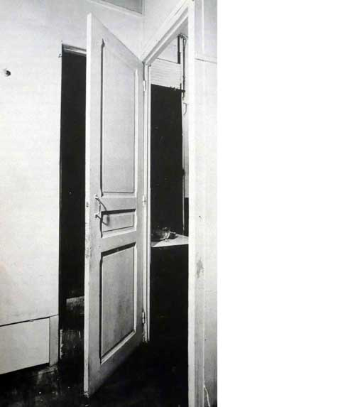
In terms of my own research interests, the commission allowed me an opportunity to further my exploration in non-verbal communication through the clients in consultation with James Hogg ( Director, White Top Research Group ) and Bob Walley, a psychologist interested in autism who worked with the clients. It also tied in with my interest in the non-visual senses, specifically smell.
Social Context:
The two individuals who live in residential housing had:
Long periods of ‘non involvement’ as a result of their disability
Needed high levels of ‘comfort’ in order to feel safe within environments
Challenging behaviour in relation to inability or reluctance to get involved
There was a need for creative responses to encourage greater interaction with the immediate and external environments. To illustrate this further, in such situations, the flutter of an eyelid, the rocking movement of a body, a gesture of the hand combined with a howl or a laugh, can all have communicative
significance that needs to be interpreted. It can also be misinterpreted, with dramatic consequences for someone lacking verbal communication in care.
Paying close attention to what someone who cannot speak might be trying to communicate was necessarily paramount.
I consulted James Hogg, director of the White Top Research Group, Department of Sociology at University of Dundee, where research is focused on learning disability with a special interest in profound and multiple disability. Both he, and Bob Walley, a psychologist on the Ideas Team, cited that work with scent and disability was practically non-existent and were excited about the project and its future potential for further research in their respective fields.
11 Rue Larrey, 1927, Marcel Duchamp

Slide 5

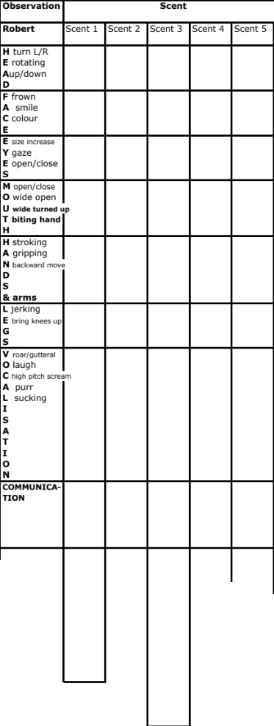
As both clients had limited language, methods used in sociology to interpret non-verbal communication were used to develop the artwork. James Hogg advised on the ethics and method of this. The aim was to find a consensus from the staff/family in the interpretation of the non-verbal response to the scents tested. A questionnaire and a method were developed especially for this task with the advice of the client’s psychologist Bob Walley and James Hogg, and in consultation with the staff. These were used with the fragrances that were tested over a year and a half period. The fragrances chosen for testing were based on observations of the clients daily life and interviews with the client’s families to find out more about their personal history, in order to imagine what scents they might have encountered in their past. ( eg: vinyl, saddle, popcorn, horses stable, frankincense etc…) . So, an of olfactory diary or history was made for each client, in order to start the process of which fragrances to test. Client M, for example, although blind, autistic, confined to a chair with limited hearing and movement,
was active and enjoyed swimming in addition to high risk activities such as horseback riding and bungee jumping. These activities, as well as his everyday life within the residential home, were all considered when trying to imagine odours to test for a reaction.
It was also brought to my attention form the psychologists that the aim should not just be to “pacify” the clients, but to challenge them as well, as long as they had a choice in the matter. As such, rather than testing the fragrances in the room where they could not get away because of limited mobility, the fragrances were tested on scent strips, allowing them to be sniffed and removed should they be disturbing, and then repeated in case the disturbance was stimulating rather than negative
Fig.5 Questionnaire used weekly over a period of a year and a half to test smell preferences reading non-verbal communication of audience/clients

Slide 6

The scent strips were numbered, so that I knew what they contained, but the care staff did not. This meant that there was less of a chance of staff preferences colouring their interpretation of the non-verbal reaction to the scent. They were repeated in different order, different times of the weak, until we narrowed down which four fragrances we would work with. The decision was made in consultation with the care staff and Bob Walley, over several meetings of the Ideas Team.
Numbered scent strips for testing

Slide 7
Alison Stirling ( Artlink ) has been invited to talk about the commission at various conferences around the world as exemplary and innovative.
Video documentation of one such conference, Connected and Consequential: A Conference for Artists, Activists, Academics and Civic Leaders
June 10-12, 2011, Boston, MA, can be found on the Artists in Context website, considered a key resource for discourse around context specific practice:
http://www.artistsincontext.org/index.php/component/content/article/74-about/193-greater-boston-videos.html
( do I need to add the time that she mentions my work?? )
More information on the confrence:
http://www.artistsincontext.org/index.php/connected-a-consequential/greater-boston.html
There is publications of the ideas team projects. I’ve also given a seminar on the commission to MRes students at Glasgow School of Art, 2010.
10:35 – 11:35 a.m. Case Study: Ideas Team with Artistic Director of Artlink, Edinburgh, Alison Stirling, and artists Kelly Dobson, Steve Hollingsworth and Wendy Jacob
How can people with profound developmental disabilities inform an artistic process? How do you bring people together to further inform and realise these ideas? In February, a group of artists, engineers, arts administrators and care workers met in Edinburgh to discuss the creation of a center -- part ideas laboratory, part university and part day center -- where individuals from across a range of abilities and disciplines could collaborate on creative projects that challenge normative ways of communication and being in the world. The aim of the center is to use the most cutting edge ideas for the most disadvantaged people.
Excerpt from the Connected and Consequential confernece, Boston on the Art and Context website. Alison Stirling discusses the Ideas Team project, including my commission. See video link.

Slide 8

Artlink publication image??
As Artlink consider the result and method of this commission to be exemplary, they have invited me to act as a consultant for other artists who have been commissioned to work with people with limited or no verbal communication. As a result, most recently I have been helping artist Wendy Jacobs, Research Fellow at MIT and founder of the Autism Studio, advising her on methodologies for developing new work. I have shared my research with her, including the form on the past page ( fig.5?) which she is going to adapt using touch rather than smell, for a project using vibration. She will use the same method I developed to try and analyse the non-verbal communication of the clients in collaboration with the care staff with a view to making work specifically for the clients.
Maybe something about exhibition for Artlink AGM presentation – work exhibited and also did a talk
Image one & a description of what we are looking at in the context of the project.

Slide 9

A smell??
Artlink publication for conferences, with the work from ideas Team
Any conference material
The form from Fig 5??

