Slide 1

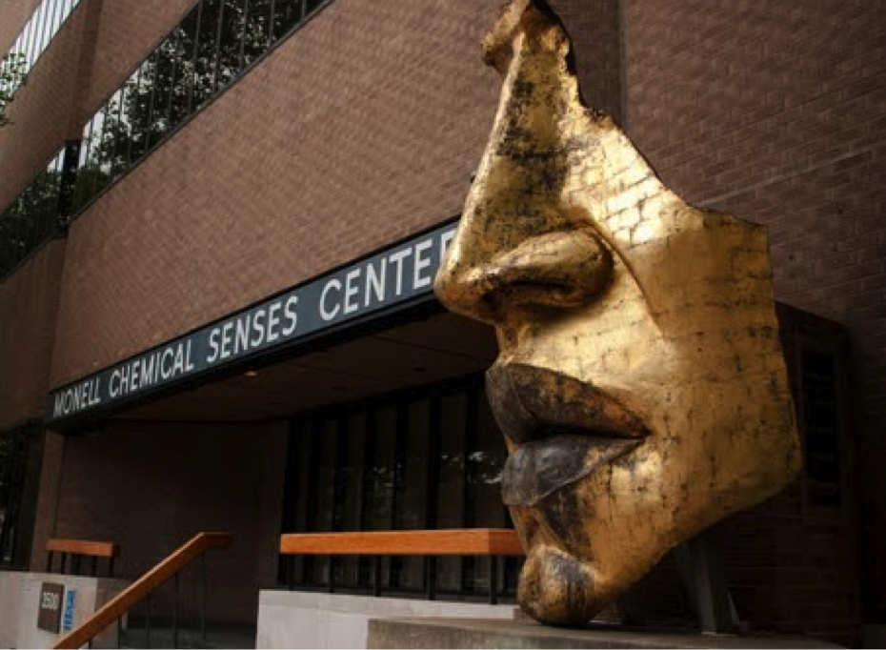
The Scent of Grinding Bones: a body of work for exhibitions over 2013 - 2014 and an experiment in the Dalton Lab, Monell Chemical Senses Centre, Philadelphia
A two year research and production period at Monell Chemical Senses Centre and NextFab, Philadelphia through a Canada Council Artist Award, Long Term Grant, 2012 - 2014, as artist in residence. The award is for the research, creation and exhibition of a a new body of work for public presentation. The research is being conducted at the Monell Chemical Senses Centre, Philadelphia, a multi-disciplinary and world leading centre for the study of taste and smell.
Clara Ursitti
Output No. 1

Slide 2

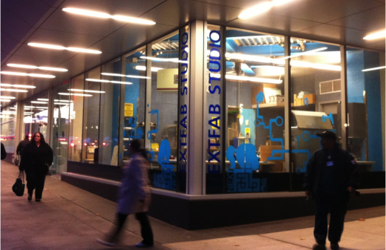
A new body of work researched and developed at Monell Chemical Senses Centre, Philadelphia, Penn University.
A new body of work researched and developed at Monell Chemical Senses Centre, Philadelphia, Penn University for different exhibitions from 2012 – 2014.
The Monell Chemical Senses Centre in Philadelphia is a world leading interdisciplinary non-profit organisation with scientific expertise in the area of smell and taste. In addition to using Monell to develop the work, I am using Bread Board/NextFab Studios within the University City Science Center, a studio complex that facilitates cross-disciplinary art exhibits with a focus on the creative application of new generation fabrication technology.
Key Work so far:
Self Portrait in Scent Sketch no. 6
Solo exhibition of new work created in the lab in Philadelphia at EKG Gallery, Philadelphia, November – December 2013
Poison Ladies, new performance/intervention for event at Nite Flights, The Old Hairdressers Gallery, Glasgow ( February 6, 2013 ).
Whisper Game, Rotor Galleri, Gothenburg, Sweden, ( August 2012)
Jeux de Peau, in exhibition Intersections, Weizmann Institute, Tel Aviv, Israel, through the Contemporary Art Society, London
Pist Protta Tit ünd fire (limited edition publication, Autumn 2012 )
.
3
Clara Ursitti
Breadboard/Next Fab Studios, where I am producing the work, a “gymnasium for innovators”

Slide 3

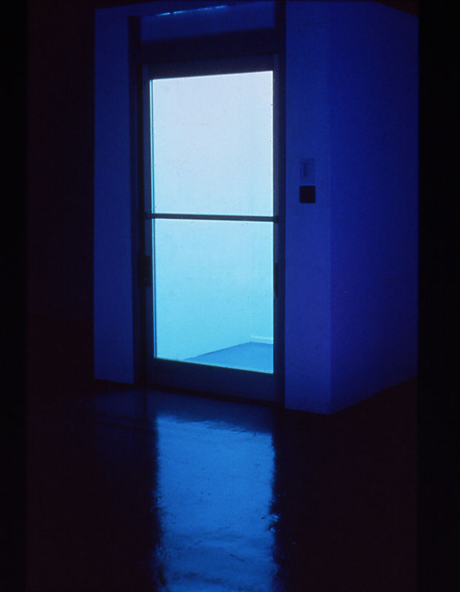
I have been working with fragrance since the early 1990s creating, to quote Jim Drobnick, “ pungent installations that delve into the social and psychological aspects of scent.” In my earlier scent installations, such as Bill (1998) and Self Portrait in Scent Sketch no. 1 (1994) there is often nothing to look at apart from the architectural space and a title. The scent haunts the viewer, and with this earlier work, as with my present work, I am interested in non-verbal (chemical) communication, things that are difficult to articulate in words, speculative fiction and memory. My practice is experimental and eclectic, often performative and non-object based, and references issues relating to gender. It sits somewhere between sculpture and performance.
I have focused on the non-visual senses. My practice has evolved from being exclusively scent based, where there was very little visual element to the work, to experimenting with having sculptural/installation elements, performance and video. This has been a natural process, but also necessary due the tremendous amount of time and resources required to develop the formulas where I need to collaborate for the chemical analysis and use specialist state of the art equipment that is difficult and expensive to access.
Self Portrait in Scent Sketch no 1 (1994 ), Centre for Contemporary Art (CCA) Glasgow.

Slide 4

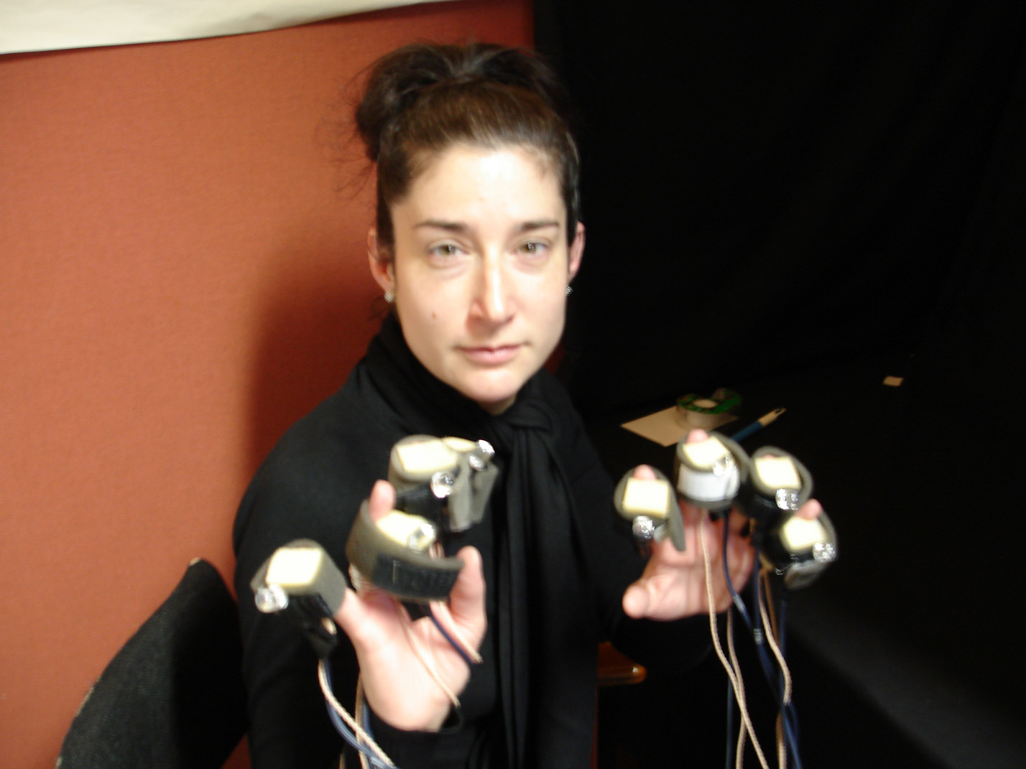
Furthermore, I have been invited to speak on a panel on a new area that is being labeled as “ Olfactory Art” ( CAA, New York, 2013 ). I am skeptical of this category, and it is for this reason that when I was invited, I decided to submit an abstract, to test my ideas around this. I think I find the label limiting and am more interested in how the senses intermingle through the crossmodal, with a focus on scent and the non-visual senses. This was something that I started to think about whilst based in the Crossmodal Laboratory at Oxford University, as Helen Chadwick Fellow, 2006. The conference was a good way to test some of my thinking and making, not that the two are mutually exclusive. It was also an opportunity to learn more about what other people are researching in the area, and meet some faces that I had corresponded with, read their writing, or that had written about my work in the past.
While at the CAA panel in New York, a member of the audience who was one of the founders of the American Synesthesia Association, invited me to talk at their annual conference, as she found my talk focusing on the crossmodal within my practice of interest.
To develop my longstanding interest in scent and the non-visual senses, I am working at the Monell Chemical Senses Center, Philadelphia, a multidisciplinary centre with a team of experts in smell and taste. This is a unique opportunity that would have been impossible without the Canada Council Grant award, enabling me to build a new body of work.
When I first began working with scent in the early 90s, information on the subject was a desert. There was no writing on artists working this way, and very little in terms of cultural studies or science. It was new area. Although I have moved on to experiment with performance and video, much of my early scent work is now being recognised as significant in contemporary art practice, and has been written about in various conferences, books and journals. I have built a reputation in the area of scent in art (see photocopied articles) a new area that is now being taken more seriously, with a lineage that some say goes as far back as Duchamp’s Belle Haine and Giacomo Balla’s, Arte degli Odore (Caro Verbeek), and others site DaVinci ( Jim Drobnick).
l
Participating in a touch/sound experiment in the Crossmodal Laboratory, University of Oxford, 2006

Slide 5
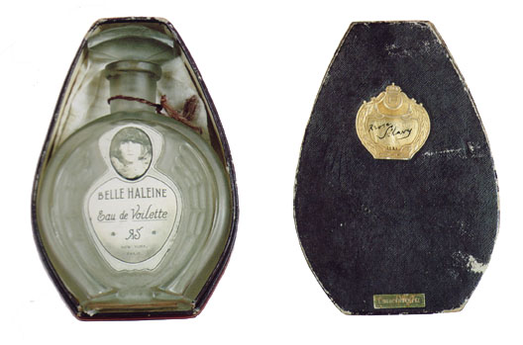
In terms of the new category “Olfactory Art” three main interests emerge:
The perfume industry, who want to have
perfumers and perfumes considered art. ( see Chandler Burr and Koan Jeff Bayasa )
2) Writers, curators, social anthropologists and historians interested in the non-visual senses from a post colonial perspective, with the intention of destablising western aesthetics which they view as occularcentric. ( See Jim Drobnick, David Howes and the Sensory Formations series, Berg Publishers )
3) Feminist scholars interested in destablising visual dominance in art and film which they see as patriarchal ( See the feminist journal Tessera ( The Senses Issue: Summer 2002 ), which focuses on the Senses, Constance Classen, Jennifer Fisher, Helen Molesworth )
Belle Haleine, 1921, Marcel Duchamp

Slide 6
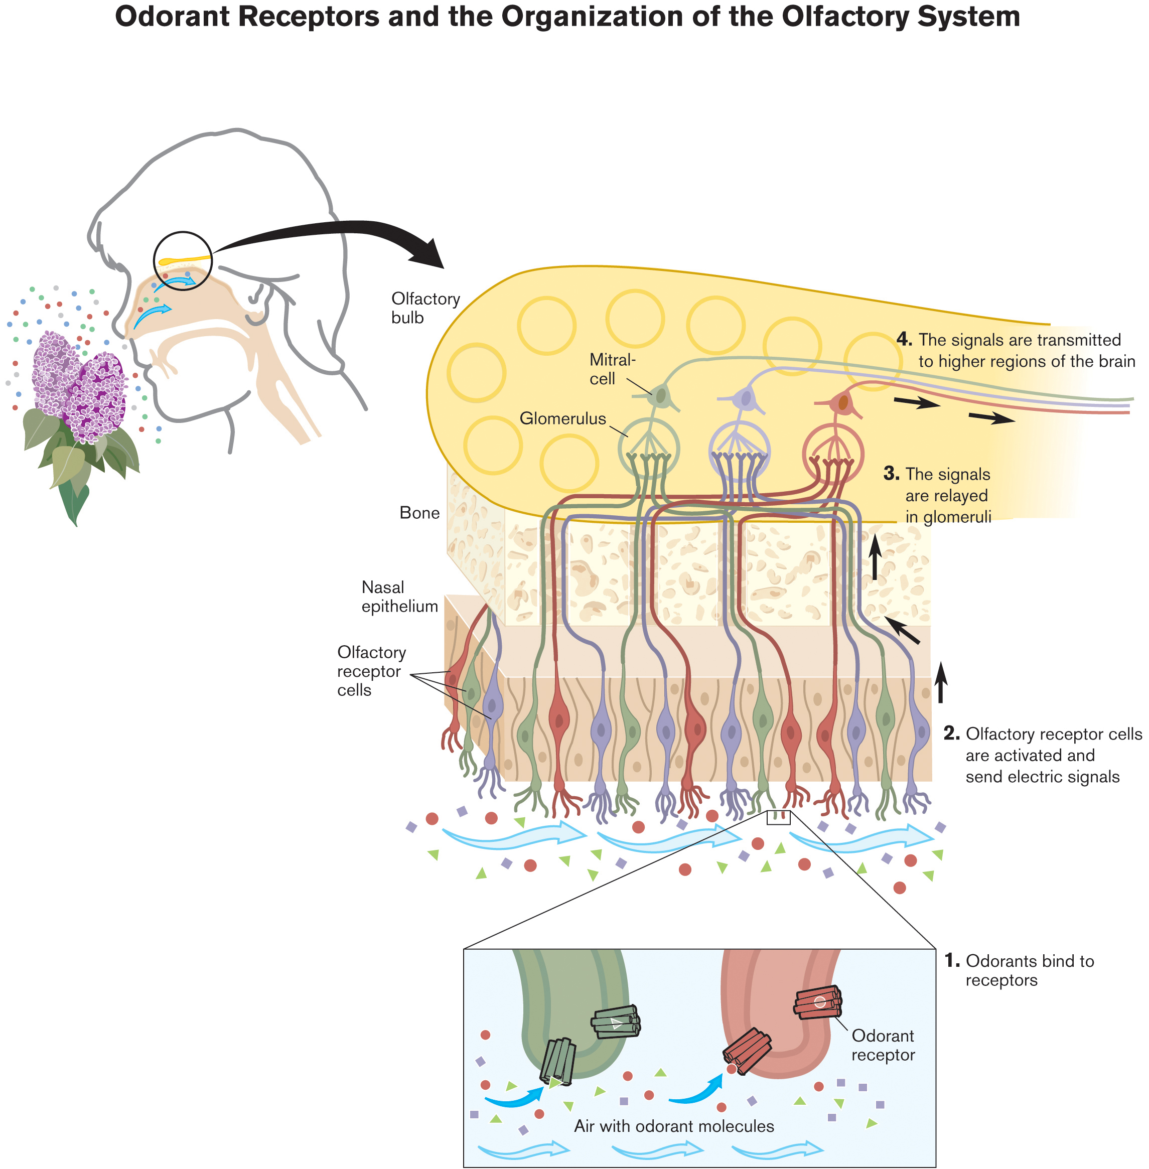
2006
The Smell Cultural Reader is published, ed. Jim Drobnick, Berg Press. An anthology from different disciplines on the much neglected sense of smell. It includes my work.
2005
Empire of the Senses: The Sensual Culture Reader , is published by Berg Press. Ed. David Howes.
” Its aim is to enhance our understanding of the role of the senses in history and across cultures by overturning the hegemony of vision in contemporary theory and demonstrating that all senses play a role in mediating cultural experience. It asks provocative questions that most of us take for granted. Are there, for example, only five senses, or is this assumption a Western construct?”
2004
Richard Axel and Linda B. Buck receive the Nobel Prize in Physiology or Medicine for their discoveries of "odorant receptors and the organization of the olfactory system”. Unlike other sensory systems, we still have very little understanding of how the sense of smell works and their discovery is a crucial first step towards decoding this.
Key Context changes since the early 90s:
2013
College Art Association Annual Conference (CAA) , New York New York, included an Olfactory Art Panel in the four day international conference. I was one of two artists invited to present a paper, alongside a curator, and art historian of the senses and an architect.
2012
Museum of Art and Design ( MAAD ), New York appoints a Curator Of Olfactory Art, Chandler Burr.
A new Institute for Art and Olfaction opens in Los Angeles.
Museo de los Aromas, Santa Cruz de la Salceda, Burgos, Spain opens in 2012
2008
Critic, curator and writer Jim Drobnick, curates Odour Limits, an exhibition of artists using scent, which I am included in.
Robert Blackson curates If ever there was, an exhibition of impossible scents from artists and perfumers.
Diagram from Nobel Prize website explaining Axel and Buck’s research on olfaction, 2004.

Slide 7

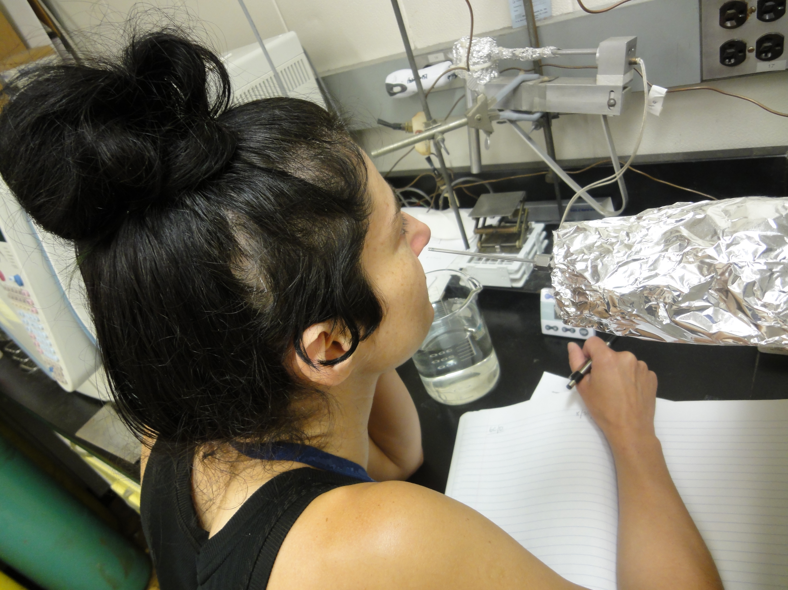
Between 2012 – 2014, I am based at the Monell Centre as artist in residence for an intense research and development period, to be inspired by the scientific investigation at Monell. This work was and is being developed alongside a new scent self portrait, building on my past work through using their analytical equipment and expertise. They are one of the only places in the world analysing human body odour. Furthermore, they are the first and oldest research centre for the study of the chemical senses, a rapidly growing field of enquiry.
My methodology consists of:
Observing the observers. I interviewed scientists in different labs to find out more about their research, and also work out which labs would be more appropriate or of interest for me to work with and vice versa. This also allowed me to learn more about their very specialised methods, which could potentially be useful for me in the studio.
I participated in many of their experiments, in order to better understand
their methods, and the experiments themselves from both their point of view, but also from the point of view of the volunteers. From this initial “ recce “ , I decided that Pamela Dalton’s lab, focused on the cognitive psychology behind smell, would be
a good match. Her interest in the emotion elicitation capabilities of odours is useful for me as an artist, and I felt like we looked at things in a similar way, although from different disciplines and with different outcomes.
The second lab that I decided would be useful to be based in was that of George Preti’s lab, a world expert on human body odour where the focus is on the chemistry of odorants. Preti has looked at a plethora of areas in relation to the molecules that compose our body odour, from odour printing, pheromones, to non-invasive diagnostic possibilities of diseases such as ovarian cancer and Fish Odour Syndrome.
The unique structure of Monell, where leading scientists from different disciplines are in one building, focused on one common area: smell and taste, means that their research is shared as questions often cannot be answered in one discipline. Consequently, if there is something
In the Preti lab, spending and intense 40 minutes smelling and recording a human sample to try and break down its molecular structure.

Slide 8

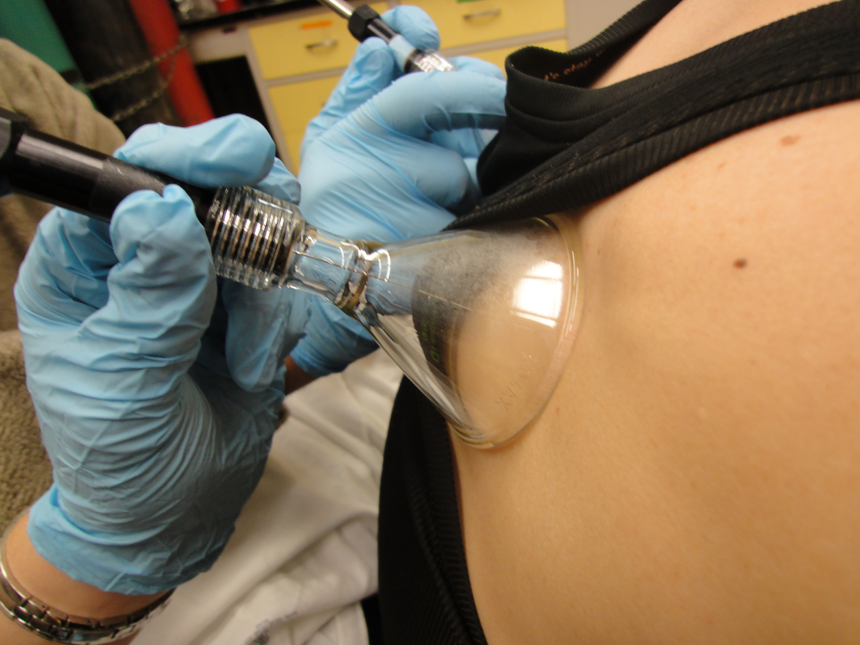
that Pam or George’s lab cannot help me with, they can often point me to another lab in the building for an answer.
The ongoing conversation and contact has been invaluable, and also mutually beneficial. For example, having the time to observe and participate what they do in the labs has meant that I have been able to offer some suggestions or ideas. So, in one instance, I am developing a
new work for a lift as part of the exhibition at Esther Klein, while at the same time, from conversations about this, Pamela will be conducting an experiment in a lift, and I will be helping. This experiment is basically the result of a conversations I had with her, asking if they always use the lab for dispersing smells, which seemed artificial to me. I mentioned the lift as the subjects use it to get to the lab, and it seemed a logical and more natural place to experiment with odours, with the subject being unaware. Our ongoing conversations will continue beyond the scope of my time at Monell, and have been invaluable.
Getting my sweat sampled for analysis at Monell.

Slide 9
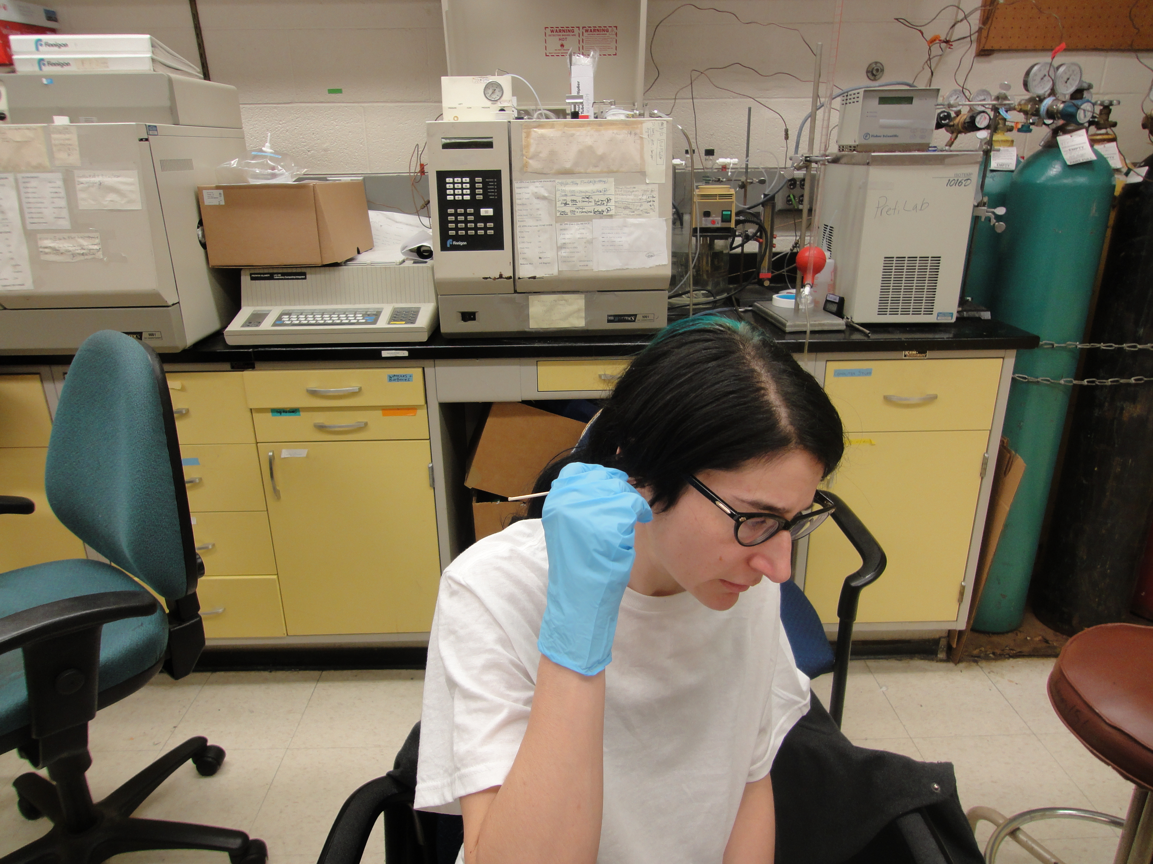
Literally across the street from Monell, I am working with NextFab/Breadboard Studios to design and build new scent dispersal systems for installations. The studios a hybrid program at the University City Science Center that facilitates cross-disciplinary art exhibits with a focus on the creative application of new generation fabrication technology. They are dubbed as a “ gymnasium for innovators”.
Finally, much of my method revolves around “ following my nose” and intuition. So, for example, a conversation in the lab might lead to me making an appointment with a contact in the fragrance industry, or in trying to obtain a rare molecule for a new work, attempting to make a sculpture that induces hunger. This is always exciting as there are always surprises.
In the Preti lab, participating in an experiment looking for chemicals that might co-relate ear wax and strength of body odour with fertility levels and ovarian cancer.

Slide 10

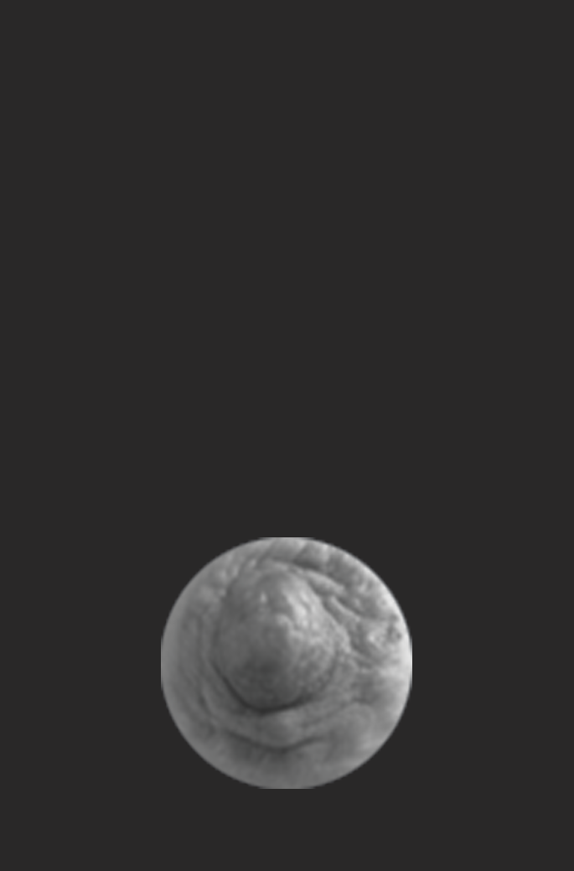
Solo exhibition of new work created in the lab in Philadelphia at EKG Gallery, Philadelphia, November 8 2013 – January 26 2014
Poison Ladies, new performance/intervention for event at Nite Flights, The Old Hairdressers Gallery, Glasgow ( February 6, 2013 ).
Whisper Game, Rotor Galleri, Gothenburg, Sweden, new scent installation ( August 2012) for group exhibition and catalogue/publication
Jeux de Peau, in exhibition Intersections, Weizmann Institute, Tel Aviv, Israel, through the Contemporary Art Society, London ( with publication )
Pist Protta Tit ünd fire – new work for Danish publication with my first scratch and sniff, limited edition of 700.
Olfactory Art Panel, CAA ( College Art Association ) Annual Conference, New York, New York, February 2013 ( presented some of the new work above )
American Synesthesia Association AGM, June 2013, Toronto, Canada.( presented a paper on my work and research , including Poison Ladies, above )
Pist Protta Tit ünd fire – new work for Danish publication with my first scratch and sniff, limited edition of 700. A recreation of the scent of a volcano is released when scratched.

