Slide 1

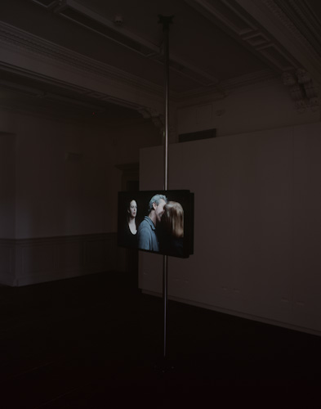
What have we done? 2011
A solo exhibition double colour video installation with sound. Two monitors show different views of the same act. Six individuals kiss one another in a seemingly endless cycle.
Submitted by Eddie Stewart
SMITH/STEWART
Output No. 2

Slide 2

What have we done?
Output 2. Solo Exhibition
2011
What have we done?
SMITH/STEWART
The Changing Room, Stirling, Scotland
2
SMITH/STEWART
Image one & a description of what we are looking at in the context of the project.

Slide 3

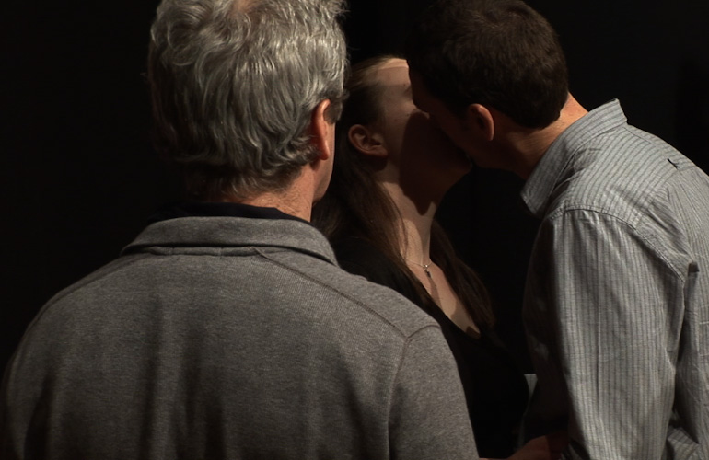
Question/s:
Will invited participants follow a specified instruction/s for a performance-to-camera? - Even if this plays with breaking conventions of social behaviour?
Collaboration:
Our work is predominantly about relationships, starting with our own. We have worked collaboratively (& been together as partners) for just over 20 years. Our roles within our collaboration are indistinguishable - we are in effect one artist, SMITH/STEWART. We both have equal input at all stages of the work, from its conception, research, fabrication, (often as performers in the work itself), installation, dissemination. We haven't made work separately since the mid-nineties and our practice continues to be solely in collaboration with each another though in more recent works we are reaching out to the audience &/or invited participants to extend this collaboration further, ie: in works such as ‘What have we done?’.
Image one & a description of what we are looking at in the context of the project.

Slide 4

Our own practice continually pushes the possibilities of collaboration: fundamental concerns revolve around human relations and what people are capable of doing to one another, physically and psychologically. We want to engage the viewer with ideas about the nature of the relationships we have with one another (intimate, familial, social, political). Central to this exploration is the body and its context and different media are used to explore ideas of separation, unity and ultimately, mortality.
Recent works have employed mechanised structures and objects; architectural interventions; and performances utilising constructed situations with specific groups of people (as in this case).
Mechanics of personal inter-relations drive our work and we aim to set up space to create a performative situation which forces the viewer to make a decision - a decision which will have implications affecting their experience of the piece and the consequences of participating - or not - in what we’ve constructed.
Either way, this decision becomes the work.
Where previously we worked within the closed system of our relationship, we're now keen to devise situations beyond our complete control, inviting groups to take part in performances where: Each subject is a participant. Each viewer is a subject. Each subject is a viewer.
Situations structured in such a way that whatever happens becomes the work. We can't predict the outcome.
For an overview of selected works from 1993 to present, visit our website www.smithstewart.co.uk
Image one & a description of what we are looking at in the context of the project.

Slide 5

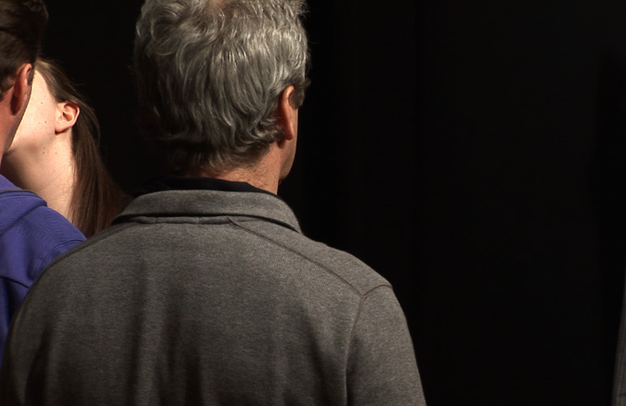
A performance-to-camera double monitor video installation, colour, with sound, What have we done? is part of an ongoing series of instructional performances, where our interaction with others forms the basis of the work. A provocative situation invites the participant/s to make a decision; and the consequences of participating - or not - in what we’ve constructed has implications beyond their and our control.
In this piece, through giving specific instructions and working with a particular group of auditioned unknown actors, we aim to explore the boundaries of collaboration, power, intimacy, acting and reality. We constructed a situation to video a live action and, in the resulting footage, a kiss is endlessly passed round a circle of six participants - male and female, of various ages - in an anticlockwise direction in a seemingly endless loop.
With deliberately no contextualising information as to who these people are and what their relationships might be, the work becomes a metaphor for all our histories of intimacy.
Image one & a description of what we are looking at in the context of the project.

Slide 6

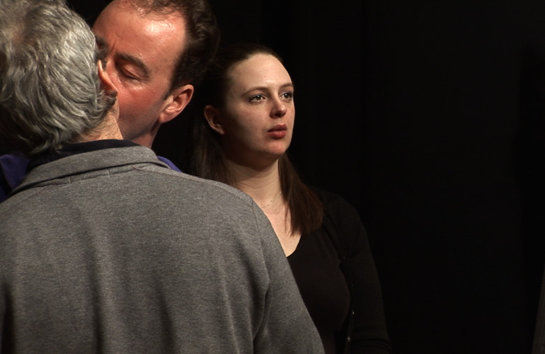
Image one & a description of what we are looking at in the context of the project.

Slide 7

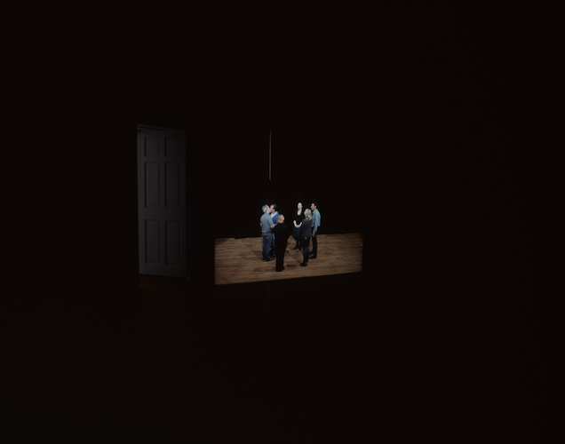
Review: Laura Edbrook, The Fruit of Their Actions, MAP 25, (Excerpt:)
"We learn that this is not theatre; subjects do not know their manners in advance. Solicited out-with their inhibitions, it is their reaction to the experiment, and consequences, that is documented. The subjects are 'revealed' as they engage in their activity. The results present a loaded circumstance; a concentrated ceremonial presentation of the dynamics of social relations, attitudes and beliefs, of the widespread collectivity of social intimacy.
Necessitating subjects in a work has potential social implications. The contributing strangers have now left a mark on each other's internal history. Bidding their goodbyes and resuming their previous disassociation with one another they will remain bound by this event, mutually sustaining their juncture of shared history.
Why goodbye?
Because there is no love without goodbye."
Image one & a description of what we are looking at in the context of the project.

Slide 8
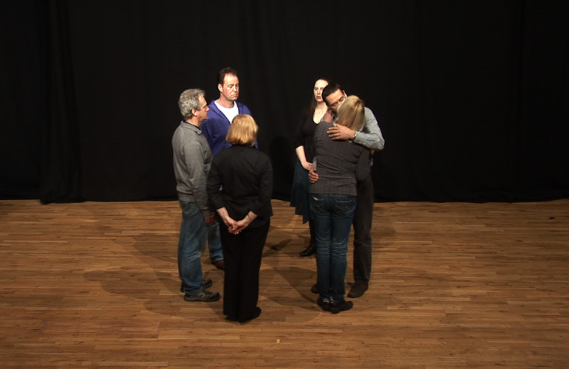
- Artists’ gallery talk: 26 March 2011
- Trajectories:
A proposal to develop this work as a more ambitious piece, ‘X’, was shortlisted from over 1000 applications (to approximately ten) for the Artangel Open in June 2013.
Unfortunately, we were unsuccessful in receiving one of the two commissions but our proposal is accessible on’ Artangel The Open 100’ list:
http://www.artangel.org.uk/open_100/the_open_100_list_of_artists
http://www.artangel.org.uk/open_100/smith_stewart
[For general info about Open:
http://www.artangel.org.uk/open_100/about_open ]
Image one & a description of what we are looking at in the context of the project.

Slide 9

