Slide 1

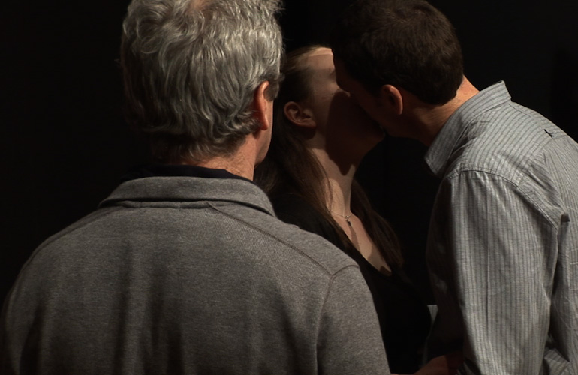
What have we done? 2011
+ performative works (related)
A solo exhibition double colour video installation with sound. Two monitors show different views of the same act. Six individuals kiss one another in a seemingly endless cycle. Developed from related cited works exploring the kiss / breath / participation, through constructed situations and performance.
Submitted by
SMITH/STEWART
Output No. 2

Slide 2

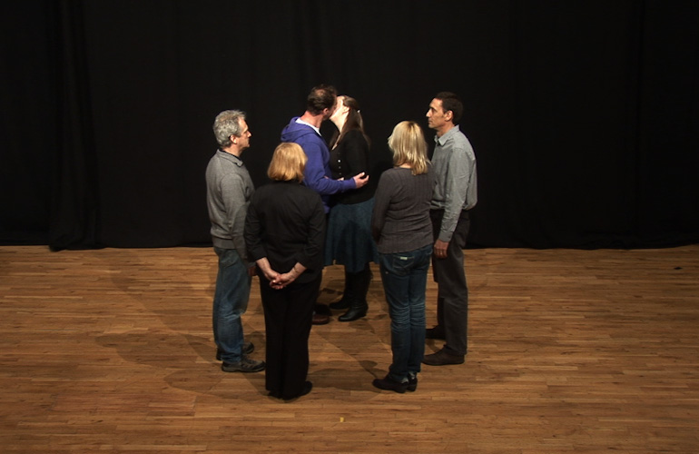
What have we done?
Output 2. Solo Exhibition
2011 What have we done?
SMITH/STEWART, The Changing Room, Stirling, Scotland
(including preparatory work Audition, 2011)
+
2010
solo SMITH/STEWART performance commission
Commissioned by Arika for KYTN (Kill Your Timid Notion festival)
Dundee Contemporary Arts, Dundee
Friday 26 February 2010
+
2009/10
International group exhibition
Emporte Moi / Sweep me off my feet
Musee d'Art Contemporain du Val-de-Marne, Qubec, Canada (24 September - 13 December 2009) & MAC/VAL, Vitry-sur-Seine, Paris, France (7 May - 5 September 2010)
Catalogue ISBN: 978-2-916324-50-0
2
SMITH/STEWART
Stephanie Smith
Eddie Stewart
Image one & a description of what we are looking at in the context of the project.

Slide 3

Collaboration:
Our work is predominantly about relationships, starting with our own. We have worked collaboratively (& been together as partners) for just over 20 years. Our roles within our collaboration are indistinguishable - we are in effect one artist, SMITH/STEWART. We both have equal input at all stages of the work, from its conception, research, fabrication, (often as performers in the work itself), installation, dissemination. We haven't made work separately since the mid-nineties and our practice continues to be solely in collaboration with each another though in more recent works we are reaching out to the audience &/or invited participants to extend this collaboration further, ie: in works such as, What have we done?
Mechanics of personal inter-relations drive our work and we aim to set up space to create a performative situation which forces the viewer to make a decision - a decision which will have implications affecting their experience of the piece and the consequences of participating - or not - in what we’ve constructed. Either way, this decision becomes the work.
Image one & a description of what we are looking at in the context of the project.

Slide 4

Other artists included:
Marina Abramovic & Ulay, Bas Jan Ader, Fiona Banner, Sophie Calle, Lygia Clark, Tracey Emin, Felix Gonzalez-Torres, Douglas Gordon, Carsten Holler, Pipilotti Rist, Sam Taylor Wood, Andy Warhol, Cerith Wyn Evans].
Where previously we worked within the closed system of our relationship, we're now keen to devise situations beyond our complete control, inviting groups to take part in performances where: Each subject is a participant. Each viewer is a subject. Each subject is a viewer.
Performances utilising constructed situations with specific groups of people (as in Pronounce DEAD & What have we done?)
Situations structured in such a way that whatever happens becomes the work. We can't predict the outcome.
For an overview of selected works from 1993 to present, visit our website www.smithstewart.co.uk
Our own practice continually pushes the possibilities of collaboration: fundamental concerns revolve around human relations and what people are capable of doing to one another, physically and psychologically. We want to engage the viewer with ideas about the nature of the relationships we have with one another (intimate, familial, social, political). Central to this exploration is the body and its context and different media are used to explore ideas of separation, unity and ultimately, mortality.
We have always stated that we make ‘sculpture’ whilst simultaneously challenging notions of what sculptural practice involves. Early pieces - predominantly performance-to-camera video installations - involved the dual interaction of a man and woman (ourselves) often in extreme situations requiring mutual complicity and trust – particularly evident in the performance-to- camera video installation ‘Mouth to Mouth’ [also cited here in the context of Emporte Moi, an international group exhibition exploring Love in Contemporary Art.
Image one & a description of what we are looking at in the context of the project.

Slide 5

Question/s:
How can/does a collaborative artistic intimate relationship explore extremes of love, interdependence & trust?
Will an audience follow a specified instruction/s as participants in a live performance? A simple request for a simple truth.
Will invited participants follow a specified instruction/s for a performance-to-camera? - Even if this plays with breaking conventions of social behaviour?
Can you make a new chain between a disparate set of individuals which could bind them together forever conceptually / physically / mentally?
What’s the difference between making a choice and a decision?
Image one & a description of what we are looking at in the context of the project.

Slide 6
A performance-to-camera double monitor video installation, colour, with sound, What have we done? is part of an ongoing series of instructional performances, where our interaction with others forms the basis of the work. A provocative situation invites the participant/s to make a decision; and the consequences of participating - or not - in what we’ve constructed has implications beyond their and our control.
In this piece, through giving specific instructions and working with a particular group of auditioned unknown actors, we aim to explore the boundaries of collaboration, power, intimacy, acting and reality. We constructed a situation to video a live action and, in the resulting footage, a kiss is endlessly passed round a circle of six participants - male and female, of various ages - in an anticlockwise direction in a seemingly endless loop.
With deliberately no contextualising information as to who these people are and what their relationships might be, the work becomes a metaphor for all our histories of intimacy.
Image one & a description of what we are looking at in the context of the project.

Slide 7
Images of What have we done?

Slide 8
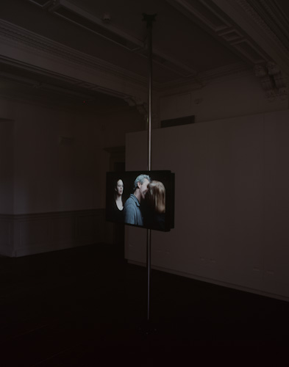

Slide 10
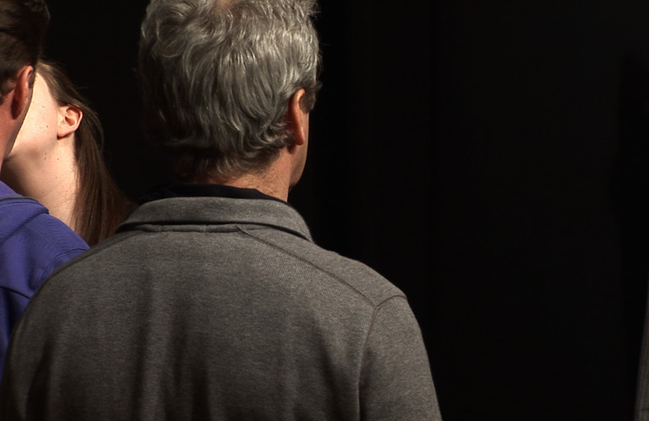

Slide 11
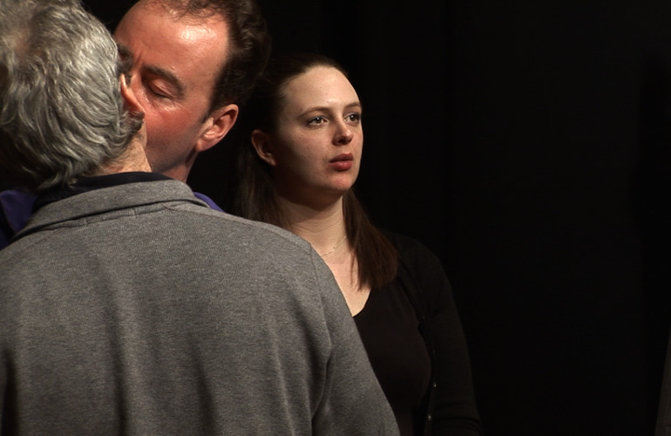

Slide 12
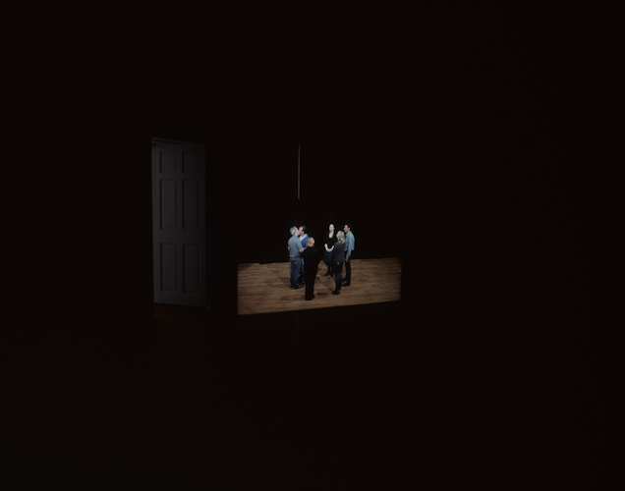

Slide 13
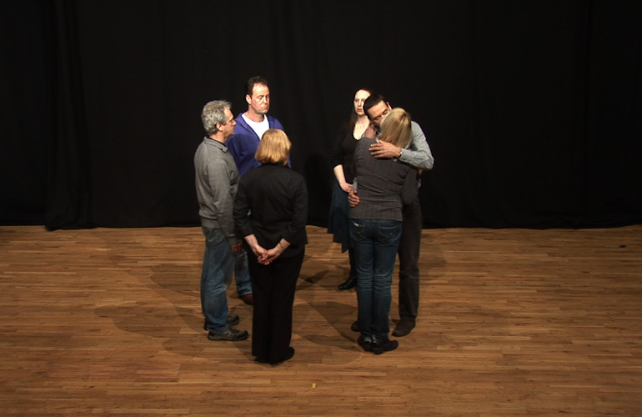

Slide 14
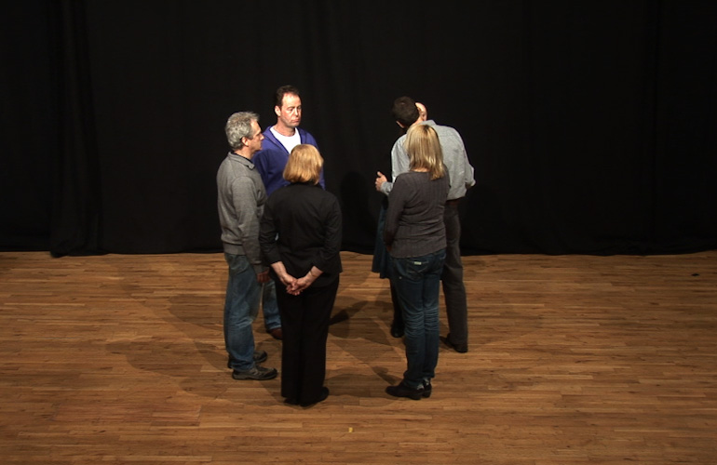

Slide 16
‘Audition’ 2011, was a work (made just prior to What have we done?) for all who attended an “audition for an artists’ film” Through the process, the invited participants actually also became the only audience, thus creating loops of performers/audience, associations and time.
This indeed developed from our first live performance with other people (extending out from our collaboration to actually involve the audience), Pronounce DEAD.
A performance made for one night, Pronounce DEAD was a piece where each participant was asked to carry out an identical specific instruction, which was only fully revealed on looking directly into a video camera. Their reaction became the work.
"Smith/Stewart’s terse, neat proposals, always tested via performance, lead to provocative outcomes, and unpredictable ones at that; an exponential function of the situation they instigate and the people involved."
(Arika)
Image one & a description of what we are looking at in the context of the project.

Slide 17
In this case the participants were the festival audience. In a strictly choreographed way they were asked to queue up on the stairs leading to one of the small galleries of DCA and were individually directed into the room and given instructions to, once inside the space, look directly at the camera, say their name followed by a pause and then the word they saw when looking at the lens. The word on the autocue was’ DEAD’.
This word ‘DEAD’ is loaded with potential significance, yet at the same time just a word.
The simple request we ask of our participants actually asks an awful lot from them. It is at once intense and straightforward, complex and banal. "Dead" is just a word after all. But to link this word directly to your own name has implications.
In the adjoining large gallery space, a live feed was projected onto a screen. As each participant moved through to this main space they became aware that they had been viewed. They then saw the next person's action. So, the first person saw everyone (except themselves) and the last person saw no one.
Image one & a description of what we are looking at in the context of the project.

Slide 18
Images of Pronounce DEAD

Slide 19
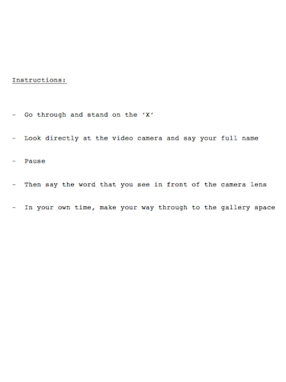

Slide 20
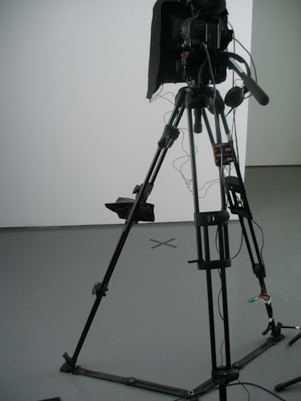

Slide 21
Through all these outlined related research concerns and outputs - made manifest through different modes of performance - we aim to interrogate the complexities of what is is to be alive and the impact one’s choices and decisions can make.
Mortality, isolation and relations with others also form the subject of an early seminal performance-to-camera piece, Mouth to Mouth, which has been successively shown since its making in 1995. It has been cited in major video art texts and is in the Tate and Arts Council of England collections. This work was recently shown in the context of a major show exploring Love in Contemporary Art, Emporte Moi/ Sweep me off my feet.
Shot with a black & white security camera & shown on a CCTV type monitor, Mouth to Mouth, 1995, explores themes of interdependency and trust.
Image one & a description of what we are looking at in the context of the project.

Slide 22
The static, voyeuristic viewpoint shows the artists (ourselves) in a bathroom, involved in an intimate 'closed-circuit' of actions. Stewart lies fully clothed submerged underwater whilst Smith kneels at the side of the bath, waiting for his exhalations; the cue for her to go down and give him air mouth to mouth.
The piece is a tense, endless cycle which, "exposes our dependency on others and therefore our vulnerability. As Stewart lies underwater in the bath, he is reliant on Smith to provide him with air to breathe. She, in turn, is bound to this relentless act of giving - the idea of leaving him helpless is inconceivable.”
(Kathryn Stout, 'Self Evident', Tate Britain)
"The video Mouth to Mouth shows a looped image of a repeated action: Smith, is leaning over the bathtub in which Stewart, is lying underwater. When he runs out of air she submerges her head to supply it mouth-to-mouth.
Image one & a description of what we are looking at in the context of the project.

Slide 23
Watching the images, shown on a CCTV video, waiting with anticipation for the amplified sound of breathing, viewers involuntarily become involved in the couple's relationship. This kind of forced voyeurism enables the artists to question the authority of society and its powers to determine norms in amorous and sexual relations. [...]
By revisiting the myth of Narcissus, who was mortally enamoured of his reflection, the two artists show the relationship of a couple to be a permanent reprieve that will inevitably end with one of them becoming exhausted or asphyxiated."
(Lucile Hamon, Emporte Moi exhibition catalogue).
Image one & a description of what we are looking at in the context of the project.

Slide 24
Images of Mouth to Mouth

Slide 25
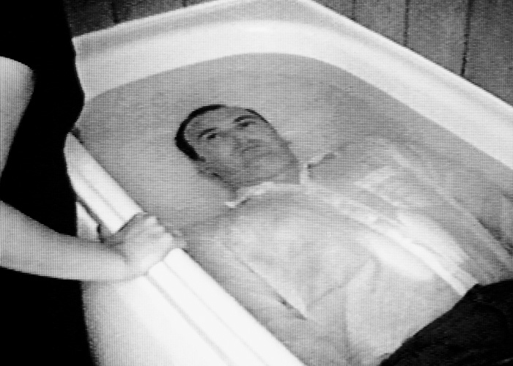

Slide 26
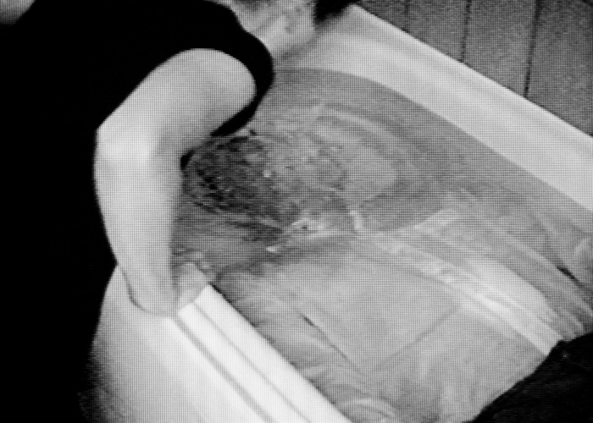

Slide 27
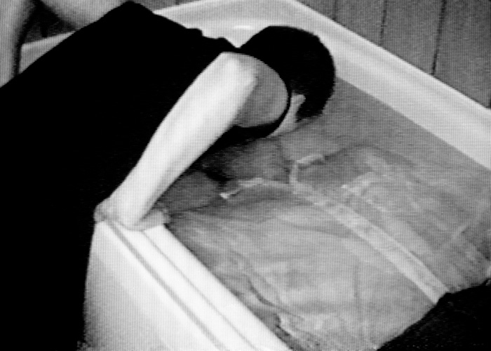

Slide 28
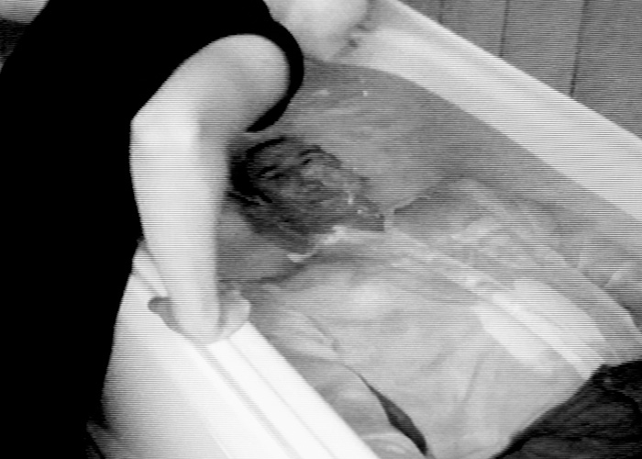

Slide 29

What have we done?:
"We learn that this is not theatre; subjects do not know their manners in advance. Solicited out-with their inhibitions, it is their reaction to the experiment, and consequences, that is documented. The subjects are 'revealed' as they engage in their activity. The results present a loaded circumstance; a concentrated ceremonial presentation of the dynamics of social relations, attitudes and beliefs, of the widespread collectivity of social intimacy.
Necessitating subjects in a work has potential social implications. The contributing strangers have now left a mark on each other's internal history. Bidding their goodbyes and resuming their previous disassociation with one another they will remain bound by this event, mutually sustaining their juncture of shared history.
Why goodbye?
Because there is no love without goodbye."
(Review: Laura Edbrook, The Fruit of Their Actions, MAP 25)
Image one & a description of what we are looking at in the context of the project.

Slide 30

What have we done? contd.:
- Artists’ gallery talk: 26 March 2011, The Changing Room, Stirling
- Trajectories:
A proposal to develop this work as a more ambitious piece, ‘X’, was shortlisted from over 1000 applications (to approximately ten) for the Artangel Open in June 2013.
Our proposal is accessible on ‘Artangel The Open 100’ list:
http://www.artangel.org.uk/open_100/the_open_100_list_of_artists
http://www.artangel.org.uk/open_100/smith_stewart
Pronounce DEAD:
- A collaborative experience shared by the participants in the event.
http://arika.org.uk/kytn/2010/
http://arika.org.uk/kytn/2010/performances/smith_stewart
Image one & a description of what we are looking at in the context of the project.

Slide 31
Emporte Moi (Mouth to Mouth):
An illustrated catalogue including essays by curators Frank Lamy & Nathalie de Blois
ISBN: 978-2-916324-50-0
Weblinks re. show (in French):
http://www.macval.fr/francais/expositions-temporaires/expositions-passees/emporte-moi/article/le-mot-des-commissaires-de-l
http://www.macval.fr/francais/expositions-temporaires/expositions-passees/emporte-moi/article/presentation-4441
http://www.macval.fr/francais/expositions-temporaires/expositions-passees/emporte-moi/oeuvres-96/
http://www.macval.fr/francais/expositions-temporaires/expositions-passees/emporte-moi/article/les-artistes
Image one & a description of what we are looking at in the context of the project.

Slide 32
Emporte Moi (Mouth to Mouth) contd.:
Mouth to Mouth is in the Tate Collection
http://www.tate.org.uk/art/artworks/smith-mouth-to-mouth-t07581
& The Arts Council Collection, London.
It has also been shown in numerous international group exhibitions and is cited in key texts on video art, eg:
Video Art, Michael Rush. Thames & Hudson. London (ill.) ISBN 9780500284872
http://www.thamesandhudson.com/Video_Art/9780500284872
Video Art, A Guided Tour, Catherine Elwes. I. B. Tauris, London (ill.) ISBN-10: 1850435464 / ISBN-13: 978-1850435464
A key essay outlining this & other works:
‘The Medium as Metaphor’ by Ulrich Loock,
in’ Smith/Stewart Videoarbeiten’, ISBN:
3-267-00128-5
Image one & a description of what we are looking at in the context of the project.

