Slide 1

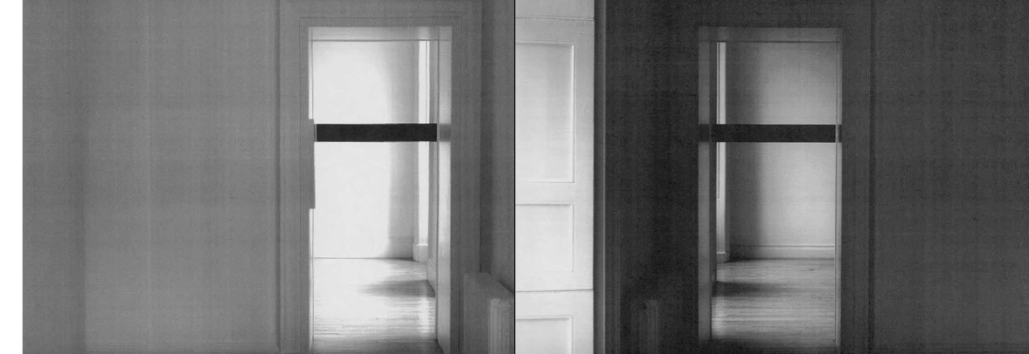
Enter Love and Enter Death
Solo SMITH/STEWART Exhibition Publication,
2009
Enter Love and Enter Death, Inverleith House, Royal Botanic Garden, Edinburgh (ill.)
ISBN: 978-1-906129-24-8
Submitted by Stephanie Smith SMITH/STEWART
Output No. 1

Slide 2
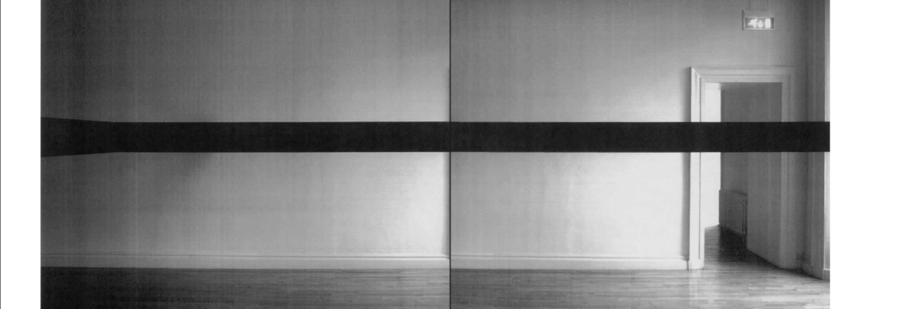

Slide 3

Enter Love and Enter Death
1
SMITH/STEWART
Output 1.
Solo SMITH/STEWART Exhibition Publication:
2009 Enter Love and Enter Death,
Inverleith House, Royal Botanic Garden, Edinburgh (ill.)
ISBN: 978-1-906129-24-8

Slide 4


Slide 5

Question:
Can a publication - through specifically treated documentation and a deliberately unconventional layout structure - in any way 'replicate' the viewer's real experience of sculptural work in the installation space?
Can the publication act as a work in itself?
Collaboration
Our work is predominantly about relationships, starting with our own. We have worked collaboratively (& been together as partners) for just over 20 years. Our roles within our collaboration are indistinguishable - we are in effect one artist, SMITH/STEWART. We both have equal input at all stages of the work, from its conception, research, fabrication (often as performers in the work itself), installation, dissemination. We haven't made work separately since the mid-nineties and our practice continues to be solely in collaboration with each another (though in more recent works we are reaching out to the audience &/or invited participants to extend this collaboration further).
Image one & a description of what we are looking at in the context of the project.

Slide 6


Slide 7

We have always stated that we make ‘sculpture’ whilst simultaneously challenging notions of what sculptural practice involves. Early pieces - predominantly performance-to-camera video installations - involved the dual interaction of a man and woman (ourselves) often in extreme situations requiring mutual complicity and trust. Recent works have employed mechanised structures and objects; architectural interventions (as in the exhibition Enter Love and Enter Death); and performances utilising constructed situations with specific groups of people.
Our own practice continually pushes the possibilities of collaboration: fundamental concerns revolve around human relations and what people are capable of doing to one another, physically and psychologically. We want to engage the viewer with ideas about the nature of the relationships we have with one another (intimate, familial, social, political). Central to this exploration is the body and its context and different media are used to explore ideas of separation, unity and ultimately, mortality.
Current work places the viewer in the middle of stark sculptural installations, so that their actual physical experience of the work makes it function and have meaning.
Mechanics of personal inter-relations drive our work and we aim to set up space to create a performative situation which forces the viewer to make a decision - a decision which will have implications affecting their experience of the piece and the consequences of participating - or not - in what we’ve constructed. Either way, this decision becomes the work.
NB: The publication Enter Love and Enter Death is being cited as the output but this is obviously the publication of the exhibition of the same name which took place at Inverleith House, Royal Botanic Garden, Edinburgh, Scotland late 2007/early 2008.
For an overview of selected works from 1993 to present, visit our website <www.smithstewart.co.uk>
Image one & a description of what we are looking at in the context of the project.

Slide 9

which is only comprehensible in the mind’s eye or in our imagination.
These ideas were transposed into print on paper in a large-scale publication which attempted to be an extension of the work as well as its particular document.
We used black & white photocopies of our documentation to give a sense of the work's simple, direct presence and deliberately utilised white borders and breaks from this reproduction process as part of the structure of the book's layout.
This was then scanned, designed and printed in a limited edition, working with renowned book designer Robert Dalrymple, Edinburgh.
Enter Love and Enter Death was our solo exhibition made for the seven rooms of Inverleith House, the Georgian mansion in Edinburgh’s Royal Botanic Garden.
In a pared-back and confrontational installation throughout the building, handmade sculptural constructions divide the space and the bodies of those populating it. The fabricated structures marked out the space (and its imagined potential functions). These divisions, determined to some extent by the fabric of the architecture, suggest feelings of somehow being categorised; split up into oppositional camps or simply surrounded.
Through minimal means, the viewer's vision is obstructed and their movement frustrated: They are implicated within the work and forced to experience it. Once inside, the proximity and position of the framework compound the impossibility of being able to see the entire structure
Image one & a description of what we are looking at in the context of the project.

Slide 10
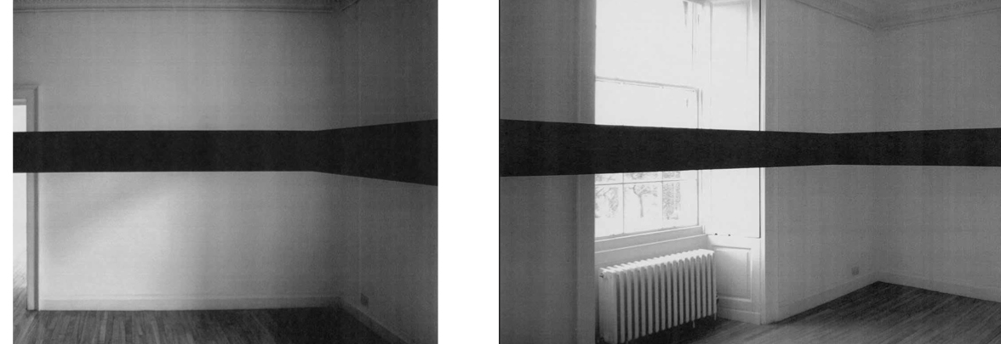

Slide 11

The resulting artists' book is an invaluable vehicle for the dissemination of a new body of work in the public domain; vitally making it available, in another format, in another way, to a wider audience who may not have had a chance to see the actual exhibition.
Exhibition links:
http://www.rbge.org.uk/the-gardens/edinburgh/inverleith-house/archive-exhibitions/inverleith-house-archive-main-programme/2007/smith-stewart
Exhibition Reviews:
Art Monthly, Dec-Jan 07-08, No. 312
http://www.exacteditions.com/browse/334/351/3191/3/29/0/27/312
Scotland on Sunday, January 13 2008
http://www.rbge.org.uk/assets/files/Gardens/edinburgh/Smith_Stewart_Scotland_on_Sunday.pdf
The Skinny, January 08
http://www.theskinny.co.uk/art/features/41390-smithstewart_enter_love_enter_death
Image one & a description of what we are looking at in the context of the project.

Slide 12
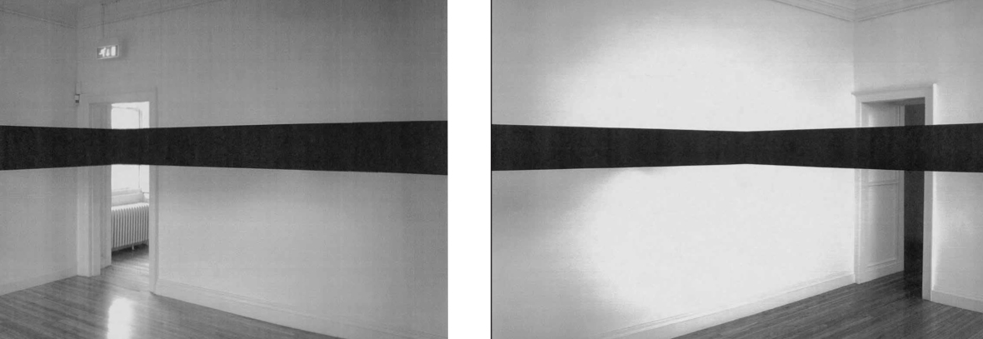

Slide 13
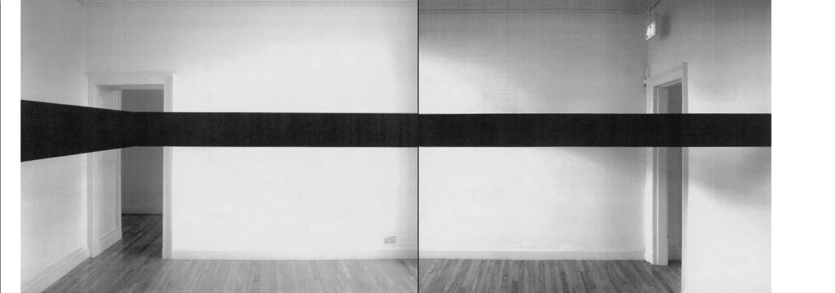

Slide 14
