Slide 1

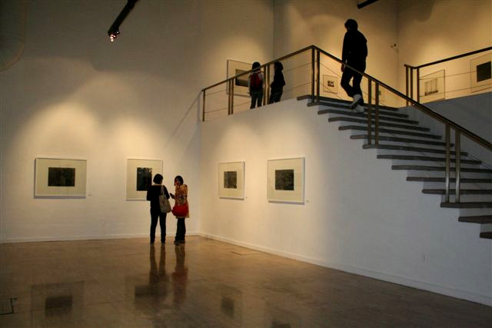
DARKDAYLIGHT
Solo exhibition entitled DarkDayLight, at the Instituto Veracruzano De Cultura, in Veracruz Mexico (17 June – 03 July 2008).
The output is supported by an exhinition of the same work at La Galerria del Sur, Universidad Autonoma Unidad Xochimilco in Mexico City ( 06 August – 31st August 2008).
.
Submitted byC.McBride
Output No. 1

Slide 2

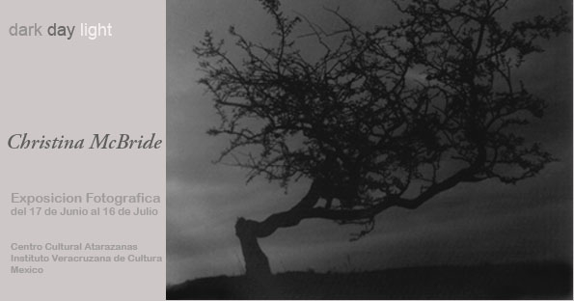
Title of submission, Adobe Caslon Pro Bold Italic, 10 pt
The exhibition comprised of 26 framed black and white silver gelatin prints. The scale of the images ranged in size from 1m x 1.5m to some square format works which were 1m x 1m.
The images were made over a period of two years and some of the central concerns included:
The silence of the photographic space and its specific relationship to the properties of analogue.
What kind of encounter is generated by contemporary artworks that employ outdated and increasingly obsolete technology? What are the arguments for the preservation and promotion of analogue formats?
How might contemporary representations of landscape by a woman artist interrupt the male-dominated history of landscape photography?
Adobe Caslon Pro Bold Italic, 10 pt
Adobe Caslon Pro Bold Italic, 10 pt
Exhibition invitation for 16 June 2008

Slide 3

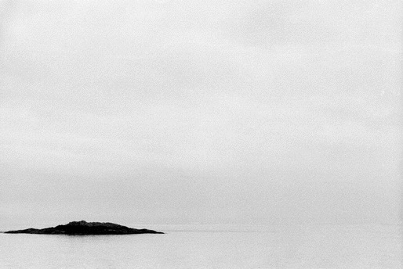
Photography is the medium of time and has been described by photographer and theorist Allan Sekula (1951-2013) as occupying a floating, rather indeterminate zone between painting, literature and cinema. It developed as a way of seeing and recording the world around us – but it was limited by its inability to hear it. Unlike cinema, which evolved by linking image with sound, photography has remained mute, continuing to view the world in a very still and very silent way. But this silence, rather than being a limitation of the medium, is proving to be one of its greatest strengths; it is both in, and through this silence that both maker and viewer can access a particular space, a space in which to reflect on the transient nature of time and notions of place and history. In his essay ‘Metaphors of Silence’ (1974) Ihab Hassan concludes that:
“At a certain limit of contemporary vision, language moves towards silence. Criticism must learn this to acknowledge this metaphor.” Similarly, in her essay ‘Aesthetics of Silence’ (1982), Susan Sontag refers to the metaphoric potential of silence as a:
“cleansed, non-interfering vision, in which one might envisage the making of art-works that are unresponsive before being seen, inviolable in their essential integrity by human scrutiny.”
from Darkdaylight 2008, Silver gelatine print 1.5m x 1m

Slide 4

The analogue medium is now under intense pressure, as materials, equipment and resources are discontinuing, closing down or becoming obsolete to be replaced by digital ‘alternatives.’ Whilst digital technology has opened up immense possibilities for the making and resolution of lens-based images, it is quite distinct from analogue. Film has a latitude and resolution that is specific to the medium and is fundamentally different to other lens-based processes available today.
There are two main areas of research within this work ; a) a questioning and testing of the place and future of analogue in this digital age and b) an interrupting of the male-dominated representation of landscape through the photographic medium.
Research is informed by a number of secondary sources most notably the writing of Jean Baudrilliard who in ‘La Photographie ou l'Ecriture de la Lumiere: Litteralite de l'Image’ (2000), describes the raw phenomenology of the photographic image as being a bit like ‘negative theology’. He refers tothe ‘apophatic’ practice of proving God’s existence by focusing on what he was not,
rather than what he was and links this to photography’s potential to reveal our knowledge of the world through emptiness and simplicity, rather than direct drama and confrontation. He also asserts that it is the writing of light which acts as the medium for the elision of meaning , contrasting this with theoretical wring where it is language which acts as the symbolic filter.
Tacita Deans work ‘Film’ commissioned for the Turbine Hall of Tate Modern 2011, acted as ‘a call to arm’ of artists, filmakers and writers to challenge the decline of the analogue medium. In response, a number of high profile people have responded to this call including Jeff Wall, Roni Horn, Marina Warner and Thomas Demand, all reinforcing the importance of preserving this medium.
We are at a critical moment in the history of analogue and it is imperative that we preserve the specifics and sensibilities of the vocabulary of this medium. I consider my work to be a contribution to the argument for the survival, support and place for the analogue medium in contemporary and future art practices.
from Darkdaylight 2008, Silver gelatine print 1m x 1m

Slide 5
Landscape is not the ideologically neutral subject many people imagine it to be. Rather, it is a physical, historical and social organism which can be interrogated as a record of the material facts of our time and what we have chosen to make of them.
It has a long history within photography - from the early pioneers venturing into the wild to capture the virgin nature, to the more contemporary saturation of images as travellers and tourists provide proof of having ‘been and seen’
Through my research and practice I question the cultural meaning of landscape in order to understand and confront interests, ambitions and intentions which lie beyond the formally aesthetic or personally expressive. I am interested in responding to and reflecting on the arbitrary tracks left by nature for us to contemplate. It is often in and through the irregularities, imperfections and random flaws I encounter, that discoveries can be made - things can become clear.
But what is the place of landscape photography in contemporary art practices? Why has this genre been so dominated and defined by the male perspective and framed by mythologies of man conquering nature?
And why do so few women make work in and of the land?
John Stathatos’ essay ‘A conditional Presence: Women and Landcape Photography’ first published in Shifting Horizons: Women's Landscape Photography Now, 2000 asserted that a significant shift was taking place within the history of landscape photography as a result of the increased participation of women, who, he believed: “have begun a process which it would not be excessive to describe as a reclamation of landscape.” He argues that is through the application of a number of sensibilities and strategies which include:
“…the apprehension of connections between vision and the other senses and an embracing of viewpoints suppressed or insufficiently acknowledged in contemporary culture”
that women are impacting real change.
from Darkdaylight 2008, Silver gelatine print 1.5m x 1m

Slide 6

This body of research began with a series of images I made whilst undertaking a residency at the Banff Centre for the Arts, Canada at the end of 2006. It was the first body of photographic works I had made for a very long time as prior to this I spent many years working within the context of public art. I undertook this residency in order to focus on the shifts taking place within my practice, where photography was beginning to assert a much more central role.
Situated within the Banff National Park and surrounded by the magnitude of the Rocky mountains, this context was crucial in triggering a process of engagement and enquiry about the relationship between landscape and the photographic medium. I spent many long days travelling through the landscape with my outdated cameras, either hiking or travelling by car. .After returning from Banff I expanded this work, travelling to a number of locations in the north of Scotland in 2007 and the west coast of Ireland in 2008.
I have had a long interest in the practice of Japanese Ink Wash (Sumie) painting,
particularly the early work from artists such as Sesshu and Hassegawa Tohaku. Their concern to not simply reproduce the appearance of a subject, but to capture its ’soul’, using the most concise of lines and mark making resonates with my work. For me there are very strong connections between the ambitions of these artists and how they work with the visual language and concerns I have with my own photographic practice.
I choose to work with cameras (5x4 pinhole, plastic holgas etc.) which disrupt the conventional components of the photographic image – the exposure, the focus, the depth of field, the detail. etc I am not concerned with specifics or detail but rather in working with the language of photography to subvert representations and expectations. I am also interested in questioning the assumptions about nature and culture, which photography has traditionally been used to serve/reinforce.
Because of the scale of the images all the photographs need to be printed on rolls of paper and developed in large troughs of chemistry. It is a very long and time consuming process, with
from Darkdaylight 2008, Silver gelatine print 1 m x 1m

Slide 7

a typical working day being between 10 – 12 hours. However the duration of this process and time spent alone in this dark space is an essential aspect of my working practice and a crucial place to think and make decisions.
Following a number of studio visits I had whilst I was in Banff, I was invited to have a solo exhibiton at the Instituto Veracruzano De Cultura, Mexico. This exhibition offered me the opportunity of consolidating this body of research and extending my work to an international audience. It also allowed me to bring to a level of conclusions much of the research i had undertaken in the various different contexts.
In 2009 I used this body of work as the basis for an application for a highly competitive Artist Award of £15,000.00 to the Scottish Arts Council. I was one of four artist who received the award that year.
from Darkdaylight 2008, Silver gelatine print 1.5m x 1m

Slide 8

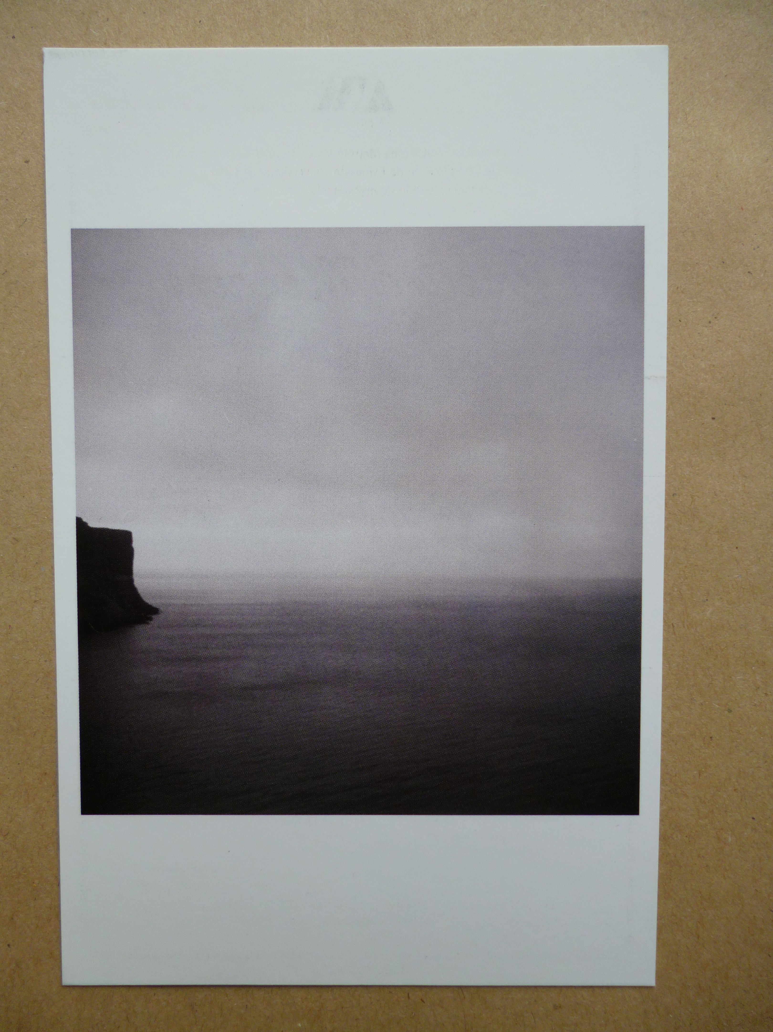
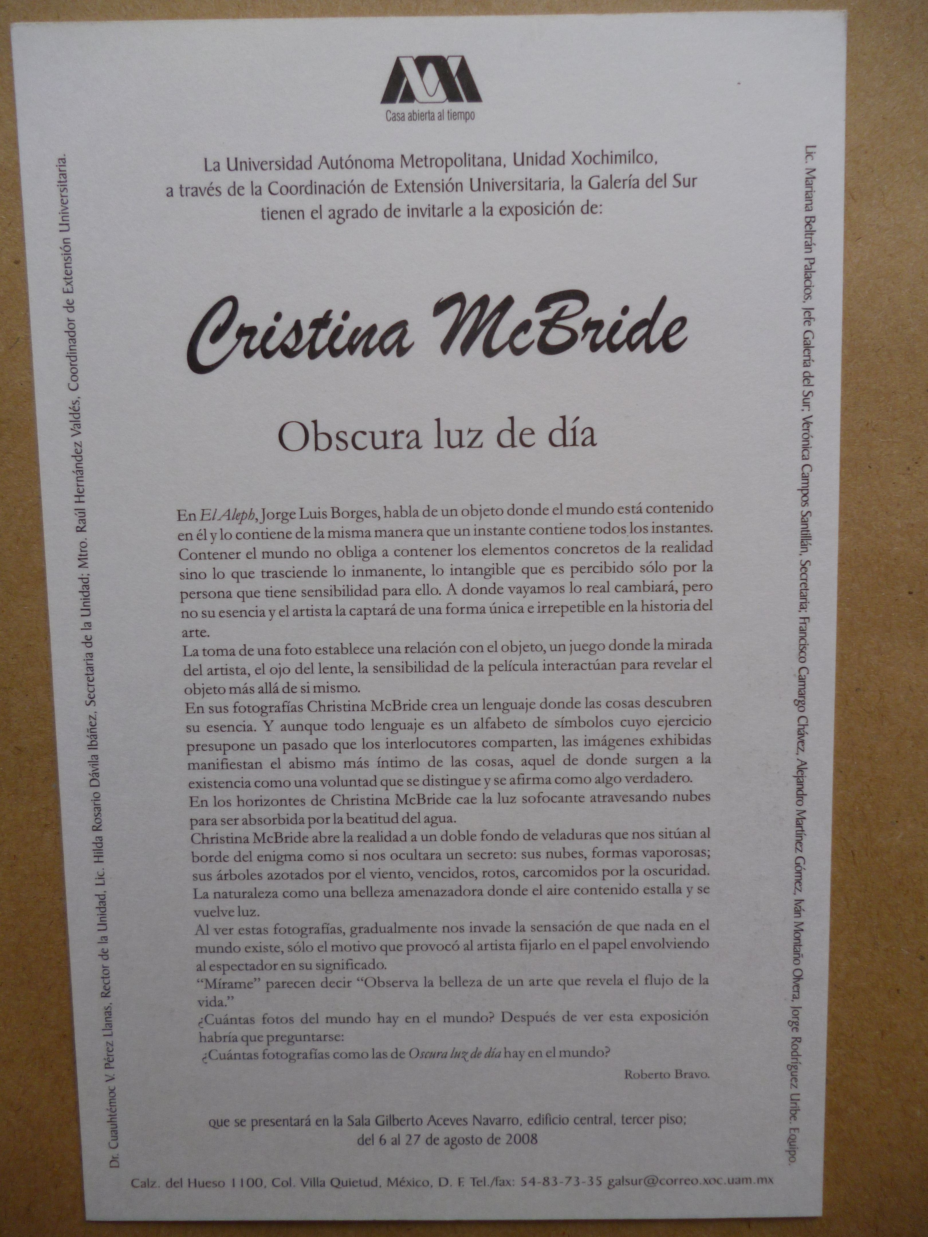
The work undertaken as part of this research has been disseminated through a number of public sources which include:
Dark Day Light, Instituto Veracruzano De Cultura, Veracruz, Mexico ( 17 June – 03 July 2008),
A solo exhibition of 26 silver gelatine photographs.
La Galerria del Sur, Universidad Autonoma Unidad Xochimilco in Mexico City ( 06 august – 31st August 2008)
The exhibition was promoted through a number of websites and periodicals, including:
http://metrolatinousa.com/2008/06/16/inaugurara-la-fotografa-escocesa-christina-mcbride-una-muestra-la-exposicion-se-llama-dark-day-light-3/
http://xalapa.tipz.mx/centro-cultural-atarazanas/
Invite ( front/back) for La Galerria del Sur, Universidad Autonoma Unidad Xochimilco in Mexico City .

Slide 9

Creative and Professional Development Grant, Scottish Arts Council.
Scottish Arts Council Artist Award
Hope Scott Trust
Glasgow City Council Visual Art Grant

