Slide 1

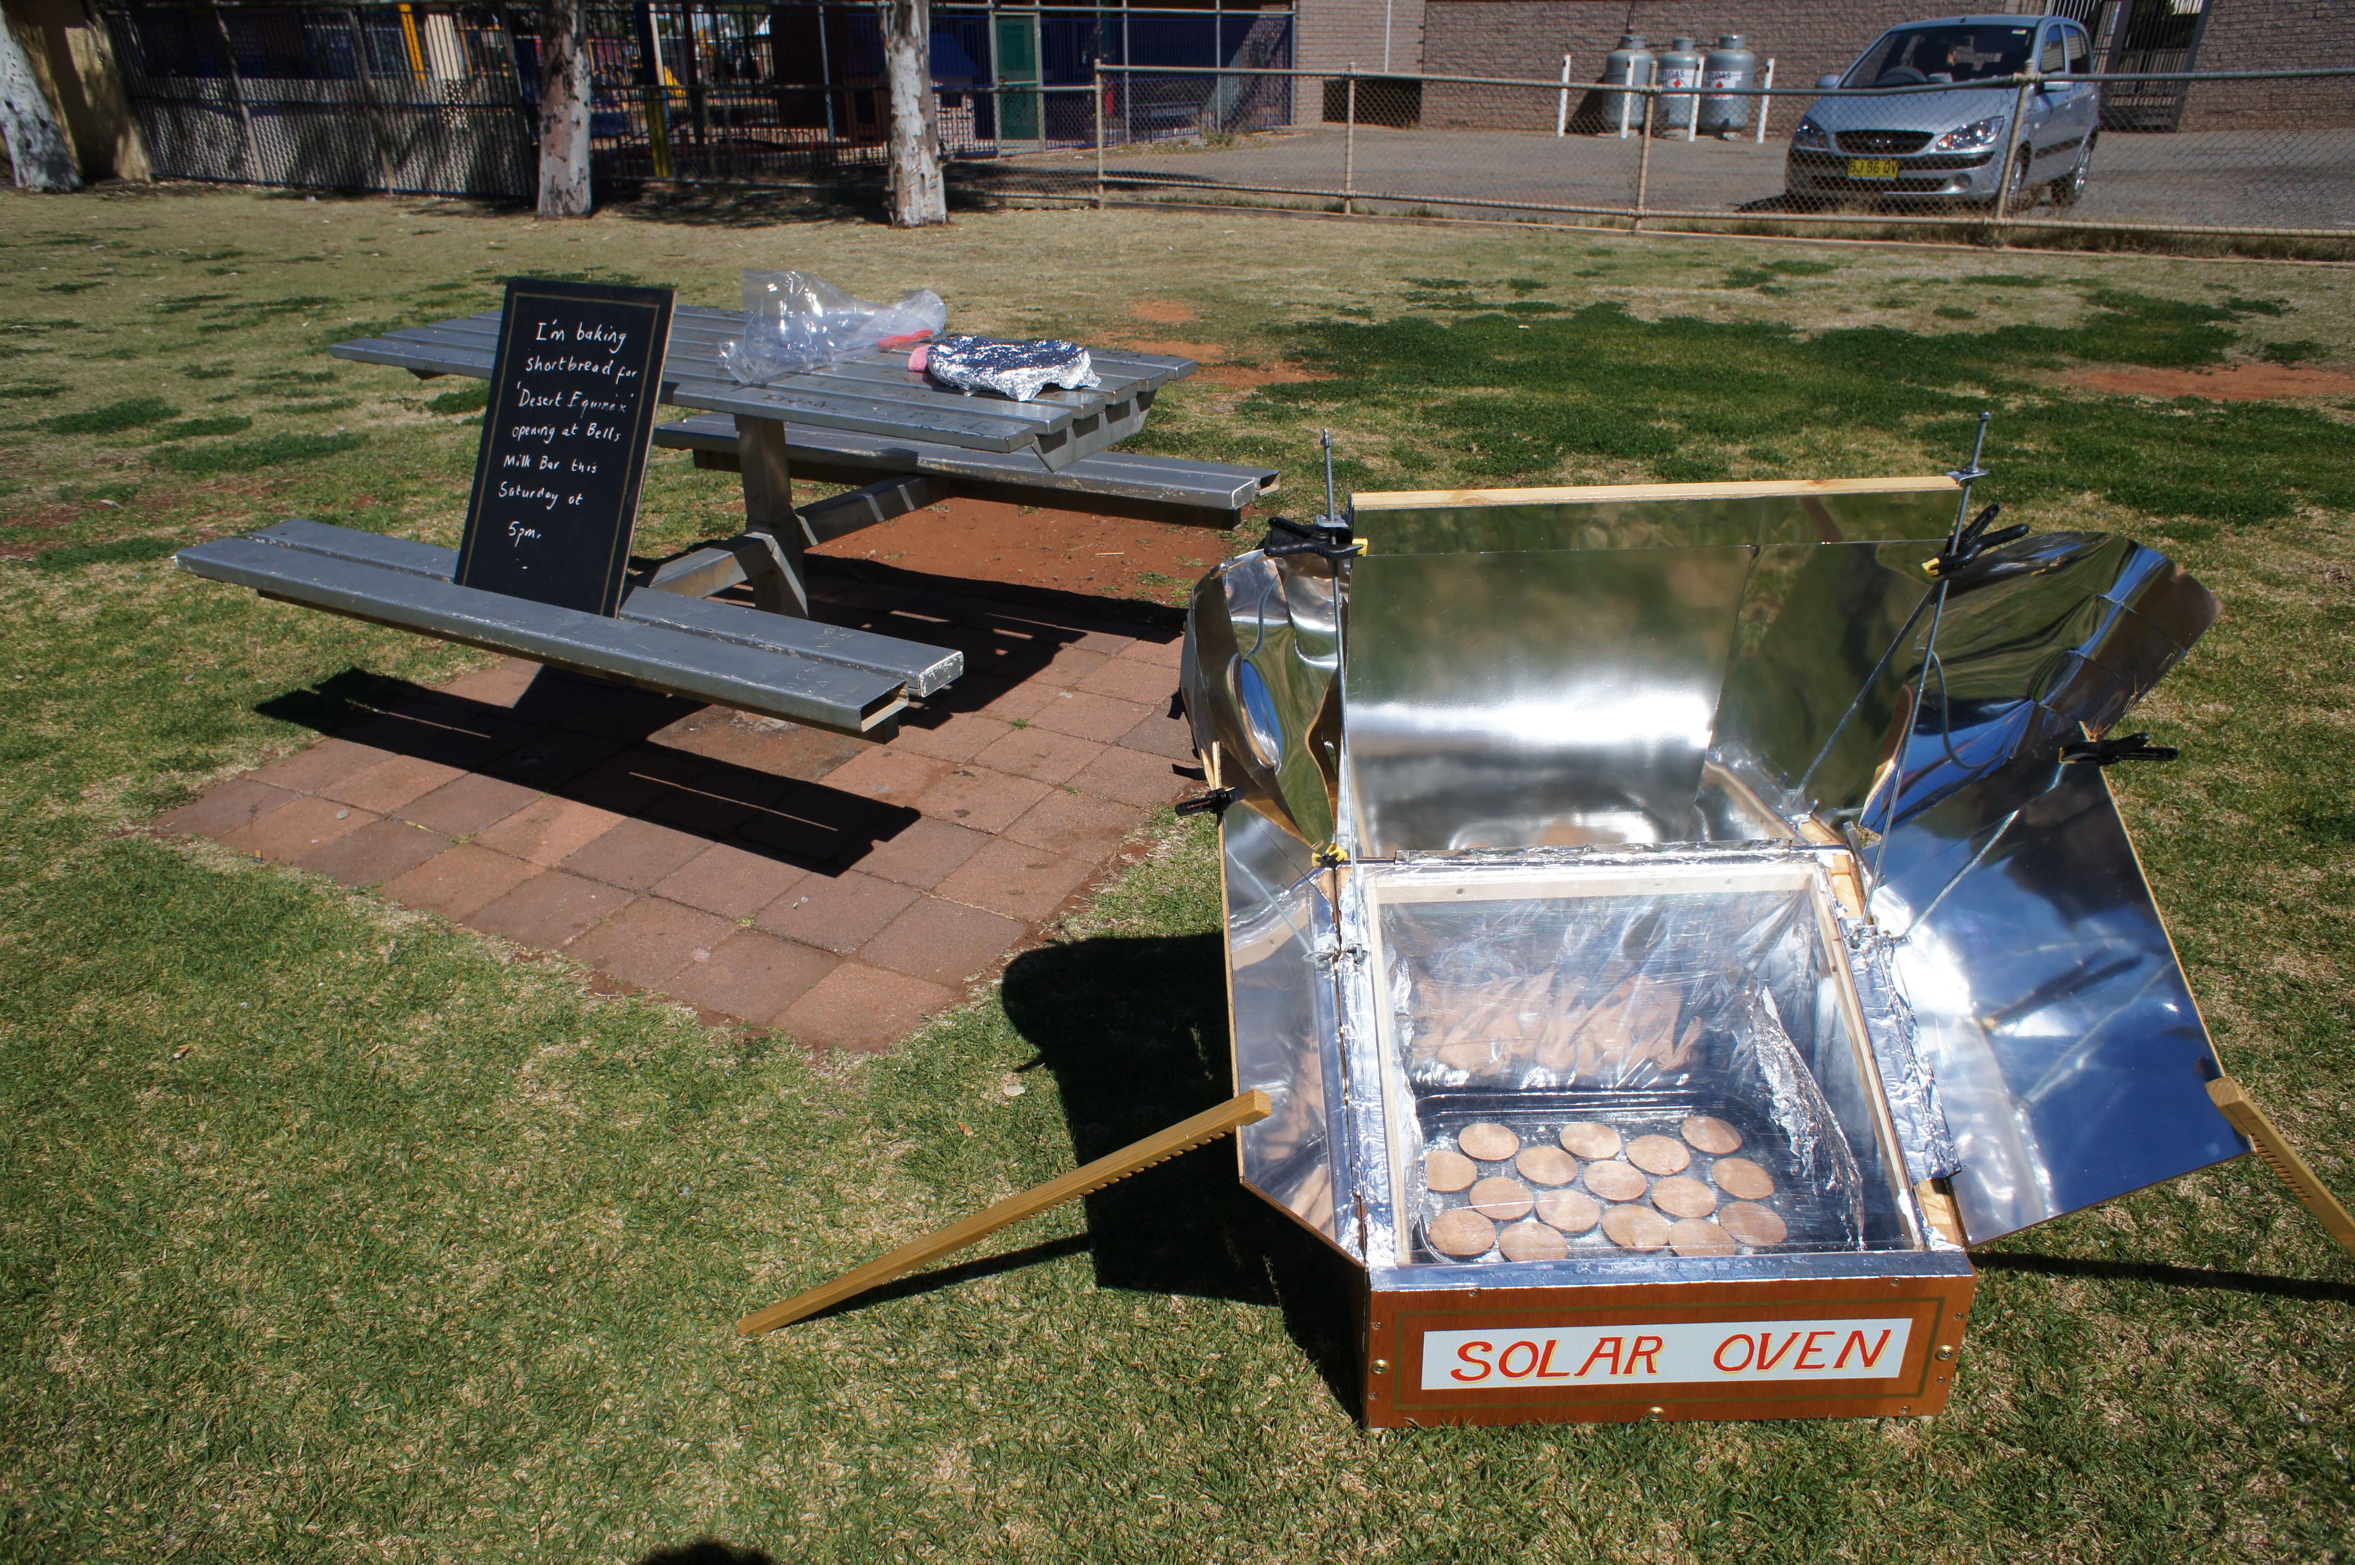
Solar Oven
Flat-pack sculpture for off-grid communal cooking
Submitted by Justin Carter

Slide 2

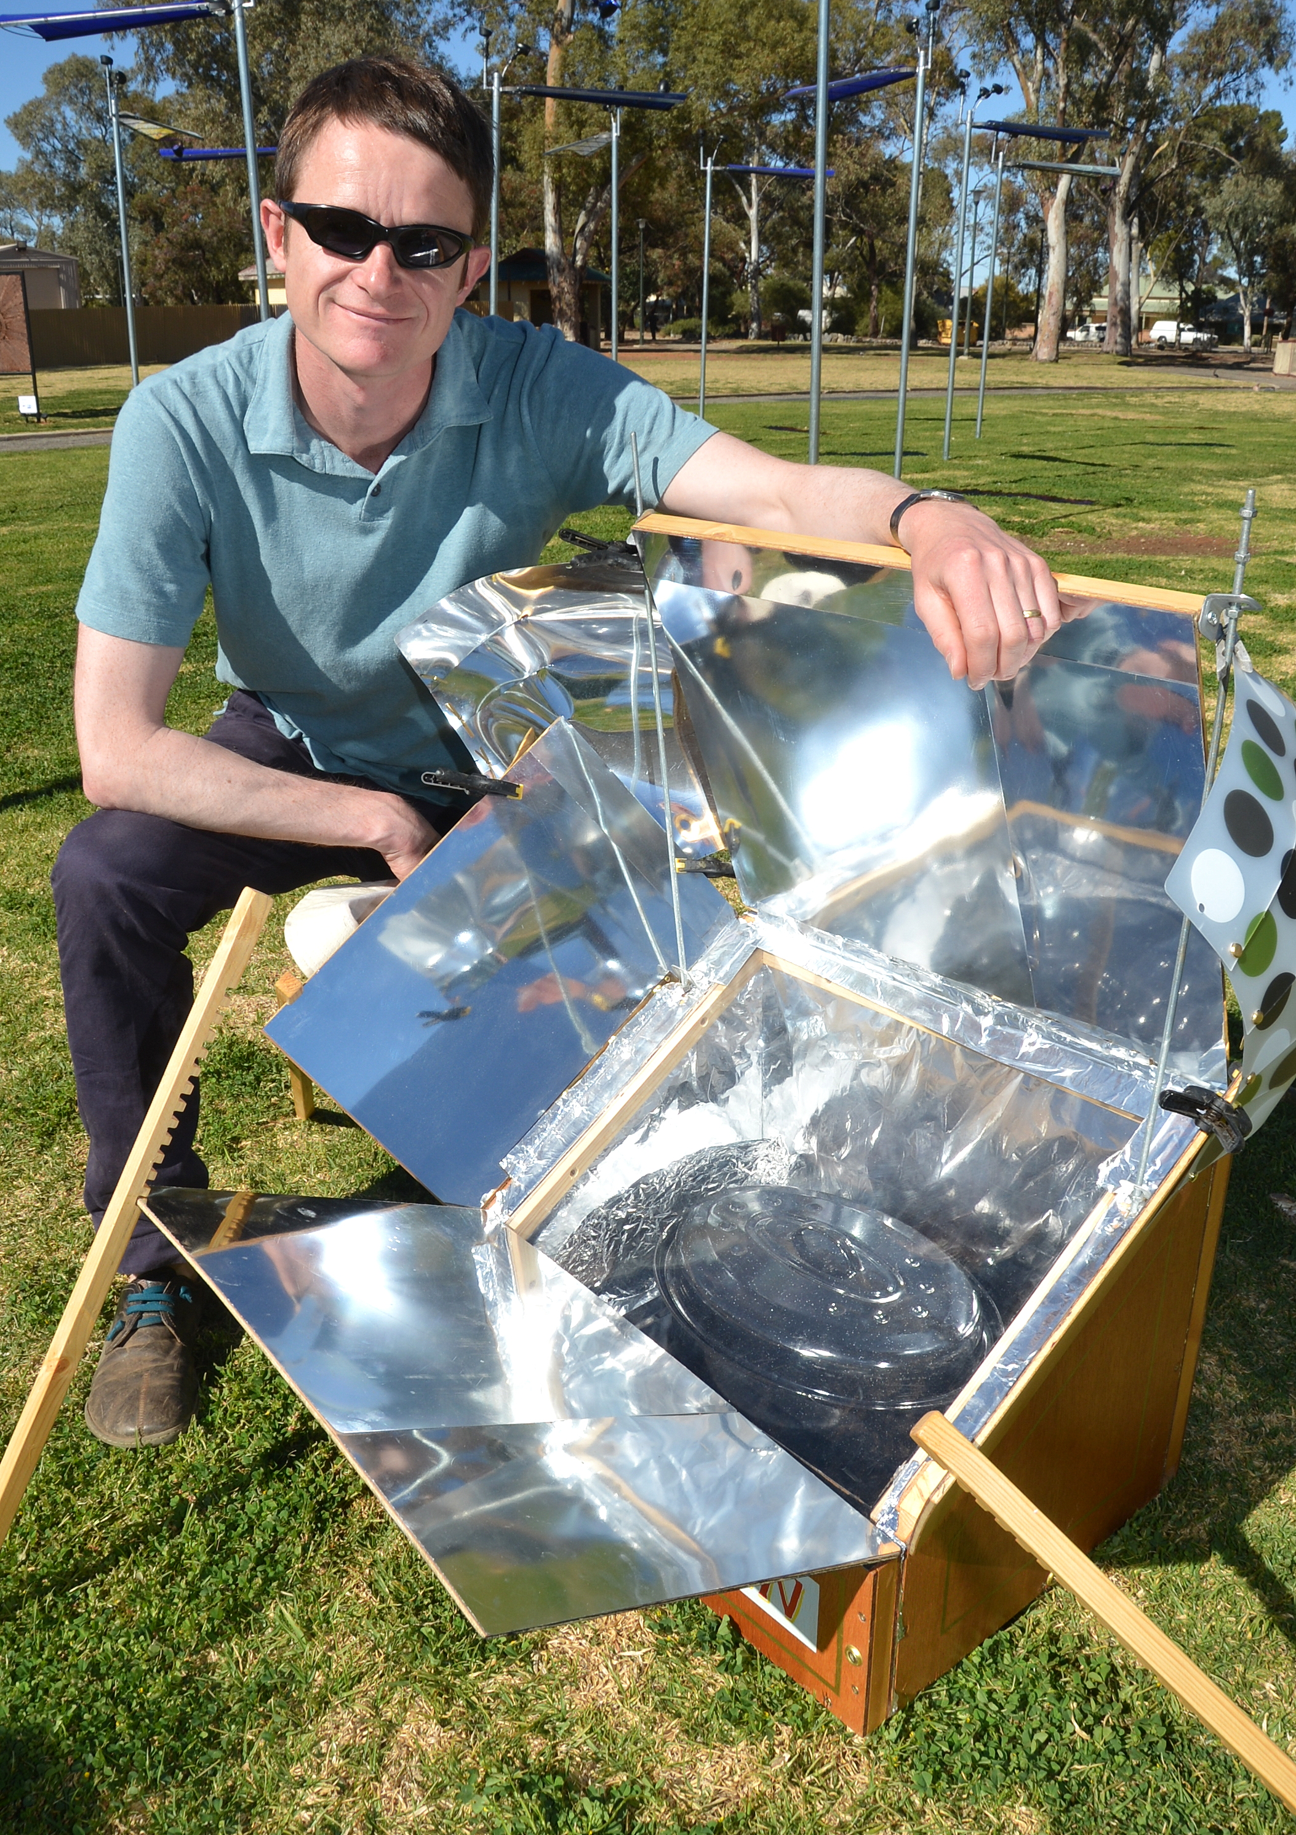
Solar Oven
Output Title – Solar Oven
Output Type – Artefact
Publisher – ‘Desert Equinox’, Broken Hill Australia and ‘Machine Wilderness’ Downtown Block Party, Albuquerque, NM (ISEA 2012) exhibitions/performances
What does it mean to return a technology intended for the so-called ‘Developing World’ back to the so-called ‘Developed World’? The Solar Oven provided a movable ‘stepping-stone’ to many of the other exhibits in the off-site group exhibition Desert Equinox in Broken Hill. It gently advocates a more ecological use of solar energy in one of the most suitable contexts on the planet.
4
Justin Carter
Images of Solar Oven used for public cooking and distribution of food.

Slide 3

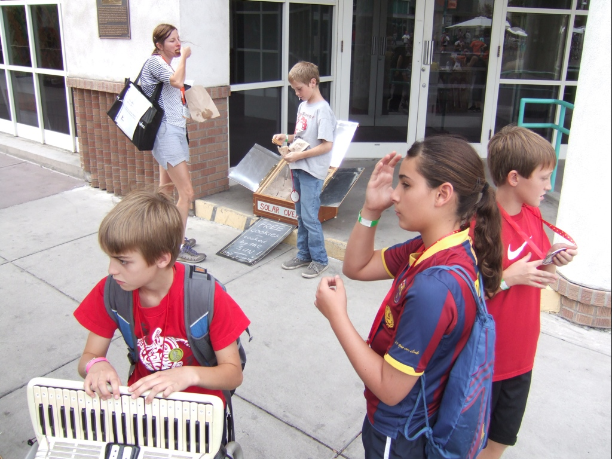
My specific concept developed out of the need (identified by the curator) for work to engage audiences directly. Whilst much of the work in the exhibition was hi-tech, I was keen to introduce more basic technologies that might remove some of the mystique regarding solar power. In this instance a solar oven was fabricated and used to prepare food which was gifted to local people. This approach advocated a more sustainable approach to food preparation which is fuel-free and carbon neutral. It also tapped into the outdoor culture of BBQ’s for which Australia (and the USA) is renown.
Compared to the diesel-fuelled generators often used for outdoor catering, the Solar Oven was a safe and clean alternative, provoking discussion around alternative, appropriate technology. The Solar Oven provided a mobile ‘stepping-stone’ to many of the other more fixed exhibits in the off-site exhibition Desert Equinox. This methodology developed further the approach I took with ‘Sustainable Indulgence’ – a Solar Powered ice cream stall, commissioned for the Whitstable Biennale 2008.
The Solar Oven in Public use in New Mexico at ISEA ‘Downtown Block Party’.

Slide 4

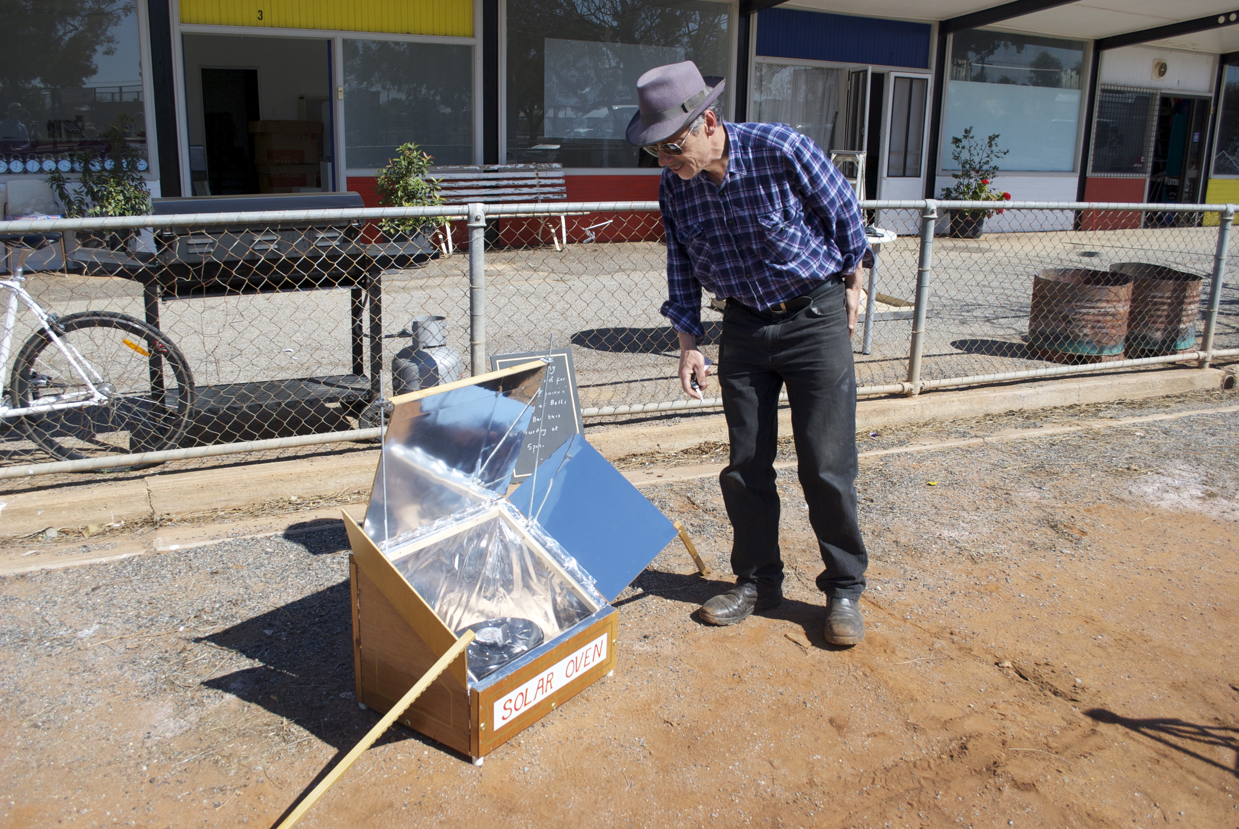
The work is conversational in tone whilst retaining a critical awareness regarding engagement with people and place. The writings of Grant Kester and Claire Bishop are significant in this respect. Key artistic influences include Agnes Denes (Wheatfield – A confrontation) Bonnie Sherk (The Farm) and Nancy Holt (Sun Tunnels). The ‘social’ aspect to this research is in the spirit of Krzysztof Wodiczko, Michael Rakovitz and Marjetika Potrc, all of whom create art/design hybrids.
The approach taken was also influenced by Victor Papaneks book ‘Design for the Real World’ and more obliquely, the writings of Villem Flusser.
Image of Solar Oven in operation outside the Art Exchange (a project partner)

Slide 5

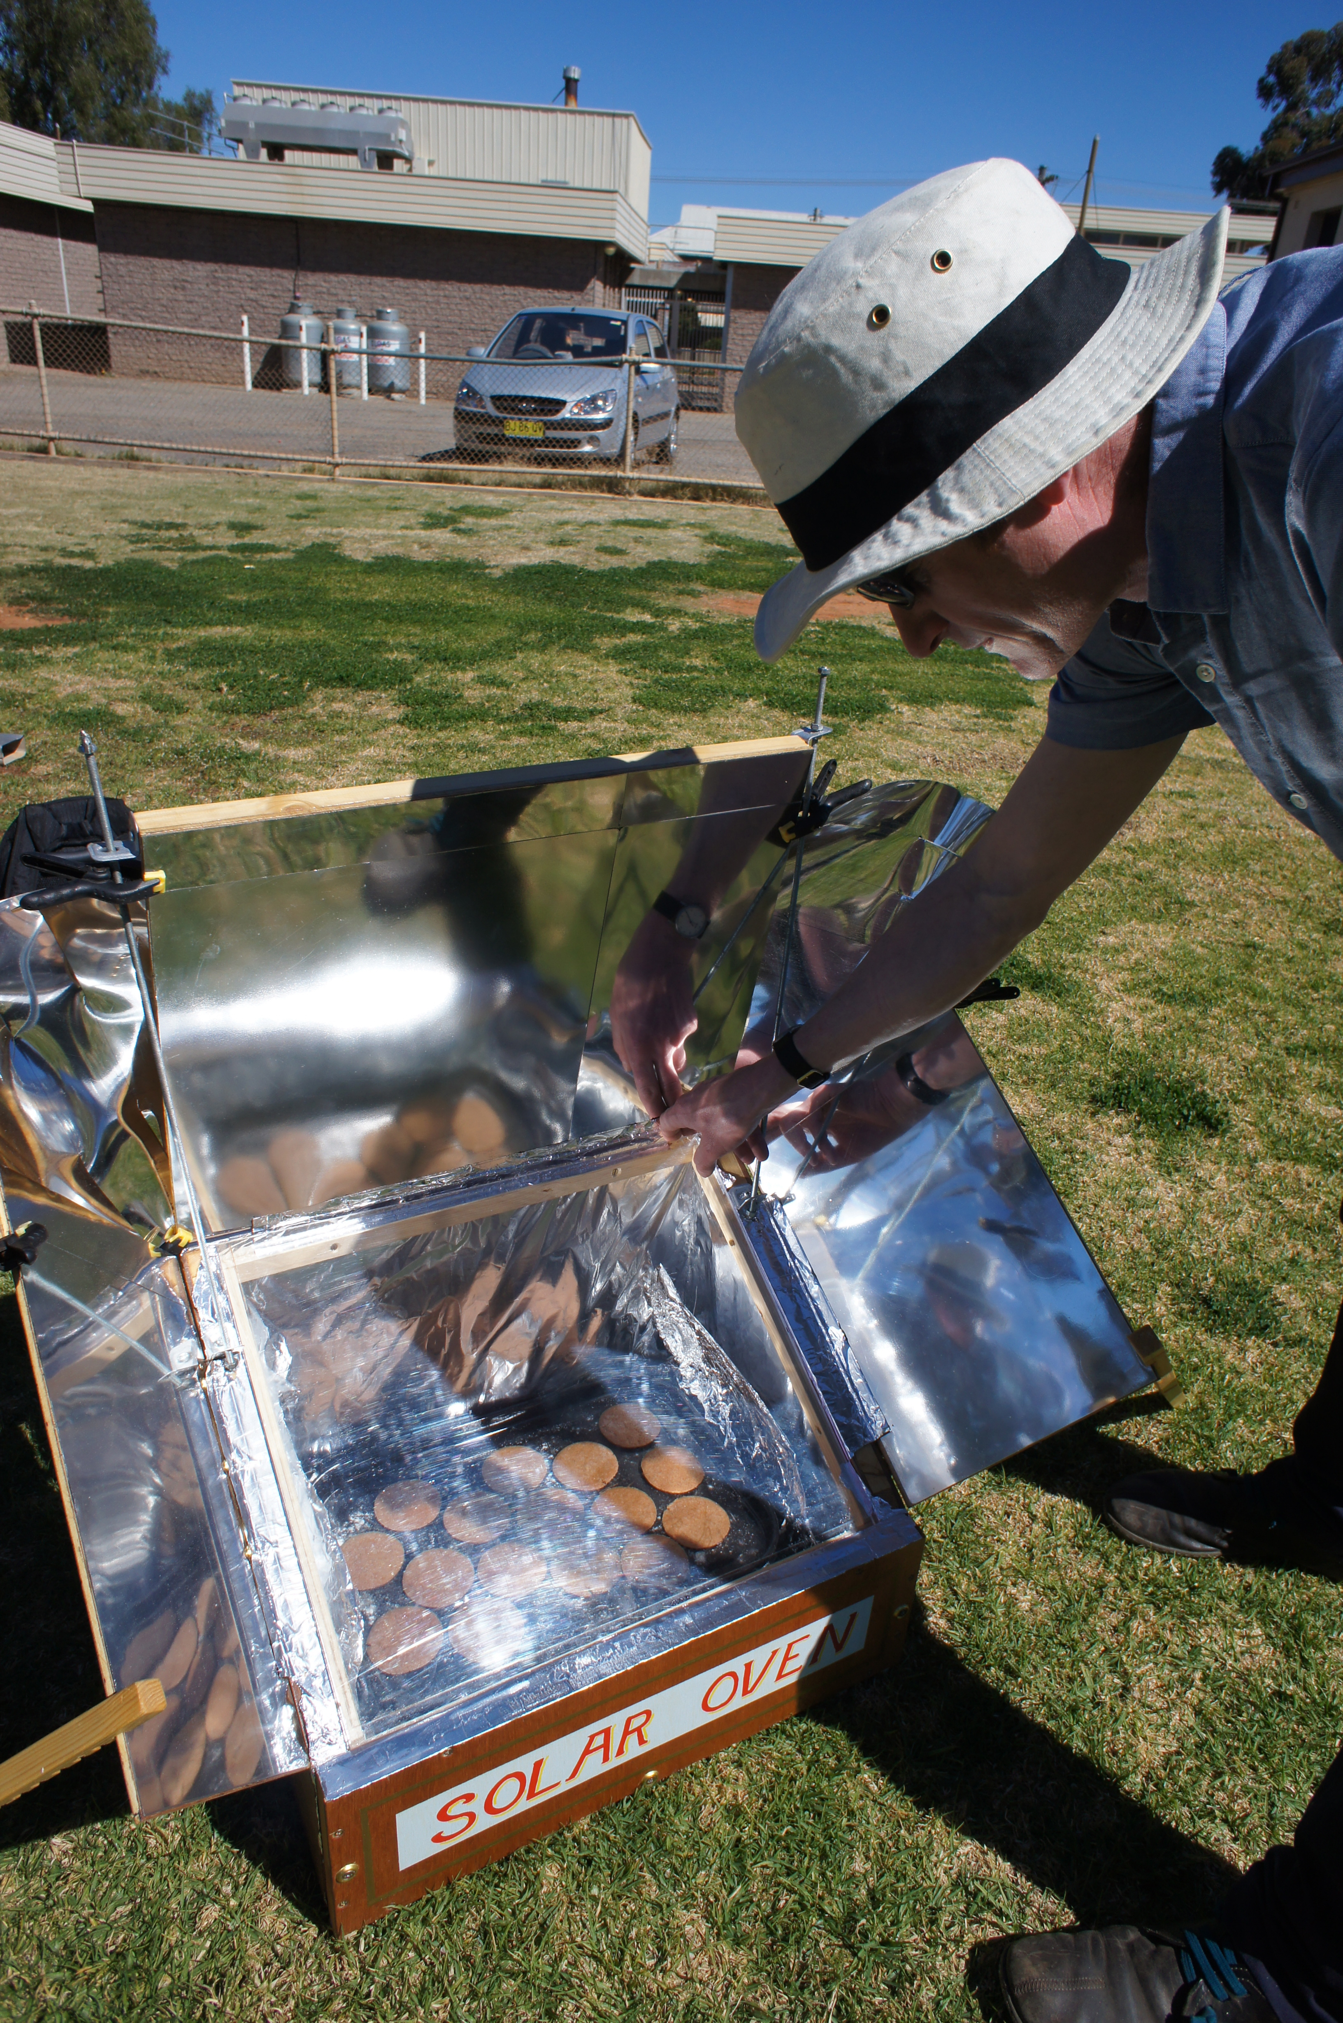
Audience participation and awareness of contemporary art were identified as key challenges within the context of the ‘Desert Equinox’ project. How can a contraption function both as a ‘sculptural object’ and as an ‘everyday’ device, capable of functioning off-grid? How can a meaningful dialogue be developed between people and place, through technology?
My specific concept developed out of the perceived need to engage audiences directly. Whilst much of the work in the exhibition was hi-tech, I was keen to introduce more basic technologies that would remove some of the mystique regarding solar power. Could this approach encourage a DIY attitude among the public?
“Desert Equinox is very much about balance: the timing of the exhibition will coincide with the spring equinox (opening on the 1st Sept and running until the 23rd). This has been done for both practical and poetic reasons. Weather at that time of the year is not too hot, but the sun is in the sky for a good amount of the day. It is dark early, as summer time has not yet commenced which makes it easy to show light works in the evening. Broken Hill was once a thriving mining town and its landscape has been largely influenced by man’s activities in the area. Now that this industry is declining the town is seeking to utilise its other attributes to revitalise the area”.
(Allan Giddy, Director IREA and curator of Desert Equinox)
Solar Oven being used to cook biscuits in Patton Park, Broken Hill, Australia.

Slide 6

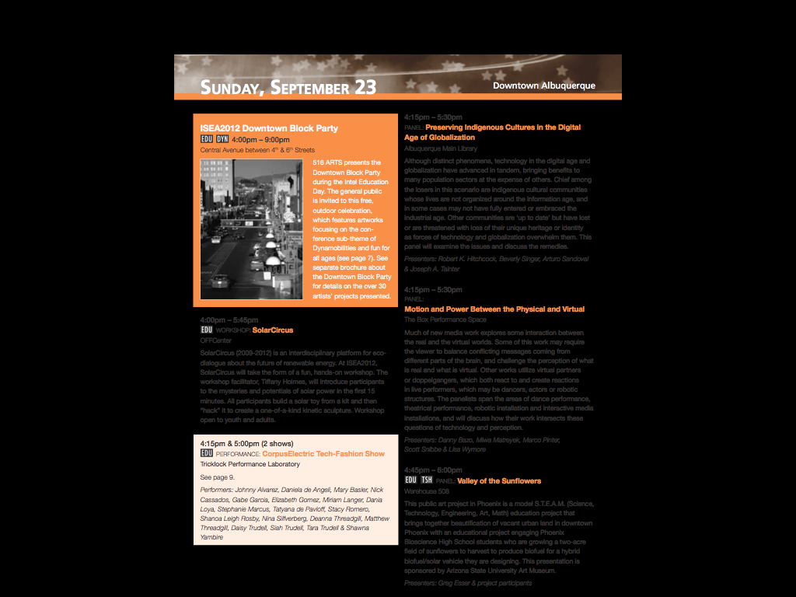
“Desert Equinox offers an international group of selected artists the opportunity to explore issues surrounding climate change and sustainability. Artworks created will use solar power, offering autonomy and independence from the national grid. While the works themselves will not be wholly rhetorical, the theme of solar technology should awaken public interest in sustainability, whilst also expanding the field in relation to sculpture. The various projects will not be located in and around a gallery space, but instead infused within different communities to make positive relations between people and place. A key aim of the project is also about encouraging artists and researchers to work closely together, sharing resources, skills and ideas”.
(Allan Giddy, Director ERIA)
Programme of events for Downtown Block Party at ISEA in Albuquerque.

Slide 7
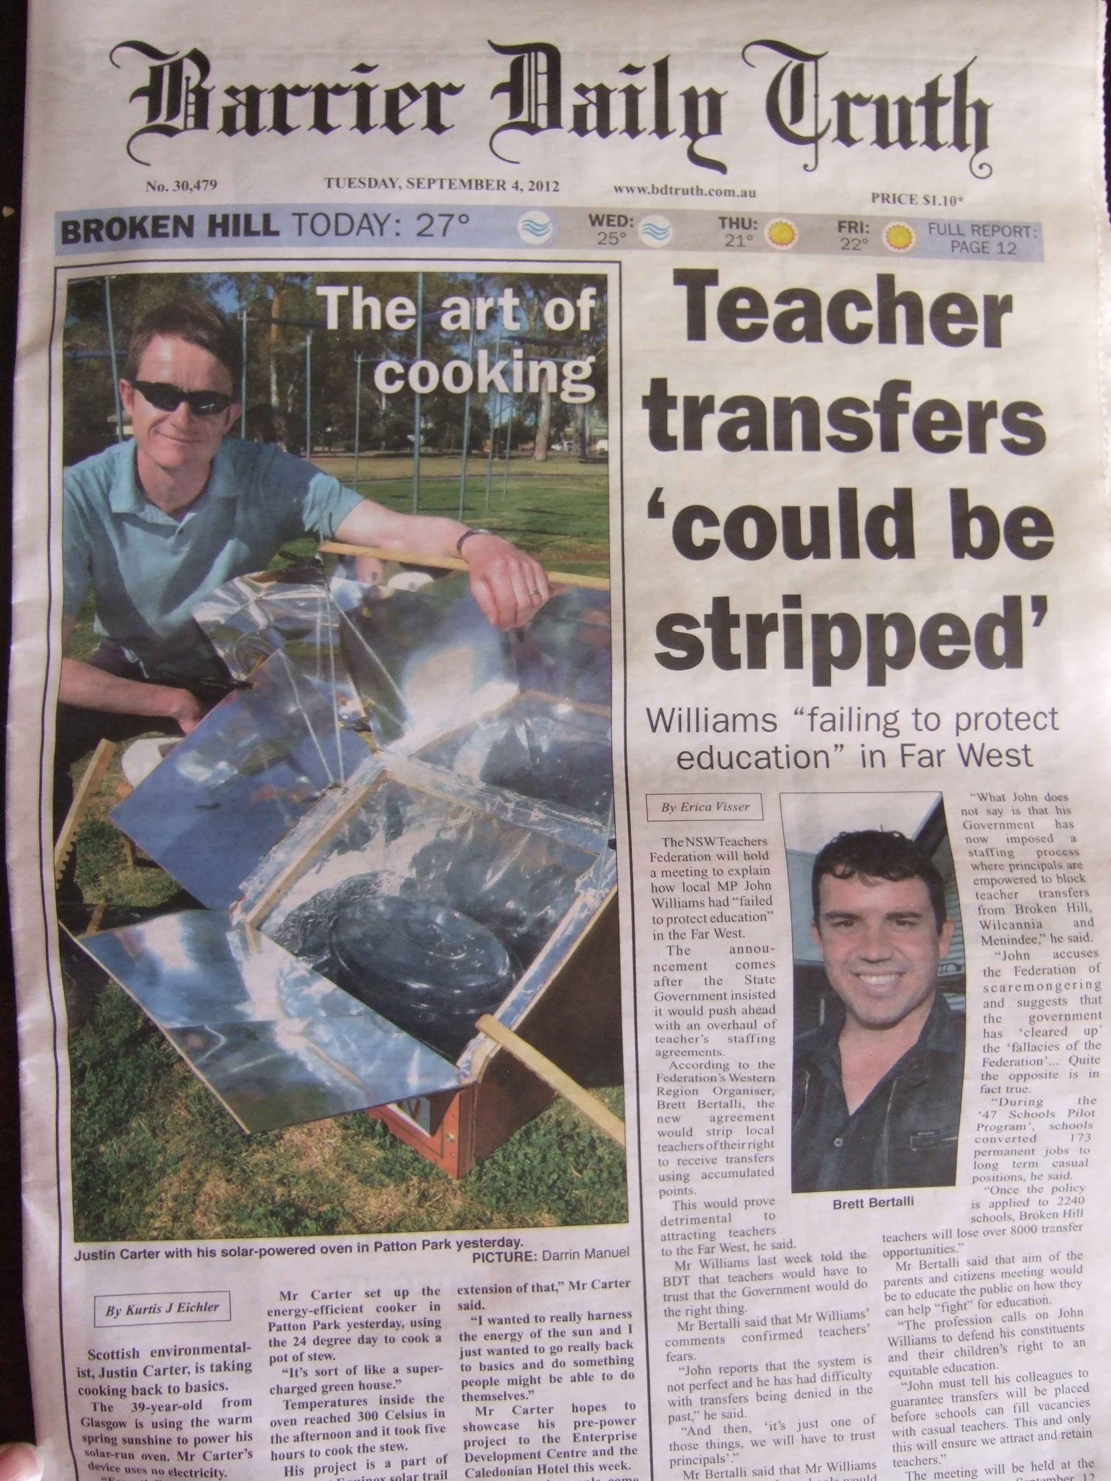
Solar Oven was presented as part of the group exhibition Desert Equinox in Broken Hill, Australia - September 1st-16th. Desert Equinox has a dedicated website and publication. In Australia the work (and Desert Equinox on the whole) managed to get good media coverage on the radio and in the press, including ABCs programme ‘Country Hour’ and the front cover of the regions local paper, ‘The Daily Truth’. The nature of this coverage suggests that the work went beyond the specific art audience and entered into more general debates about food production and energy use. A video document for ‘Desert Equinox’ is also undergoing final edit.
In Broken Hill, Art Exchange (a regional gallery and cultural centre) commissioned a community outreach programme through D/Lux. Local children were introduced to the technical and scientific concepts behind some of the artworks in order to develop ‘scientific literacy’.
Front page of the regional newspaper in Broken Hill, Australia.

Slide 8

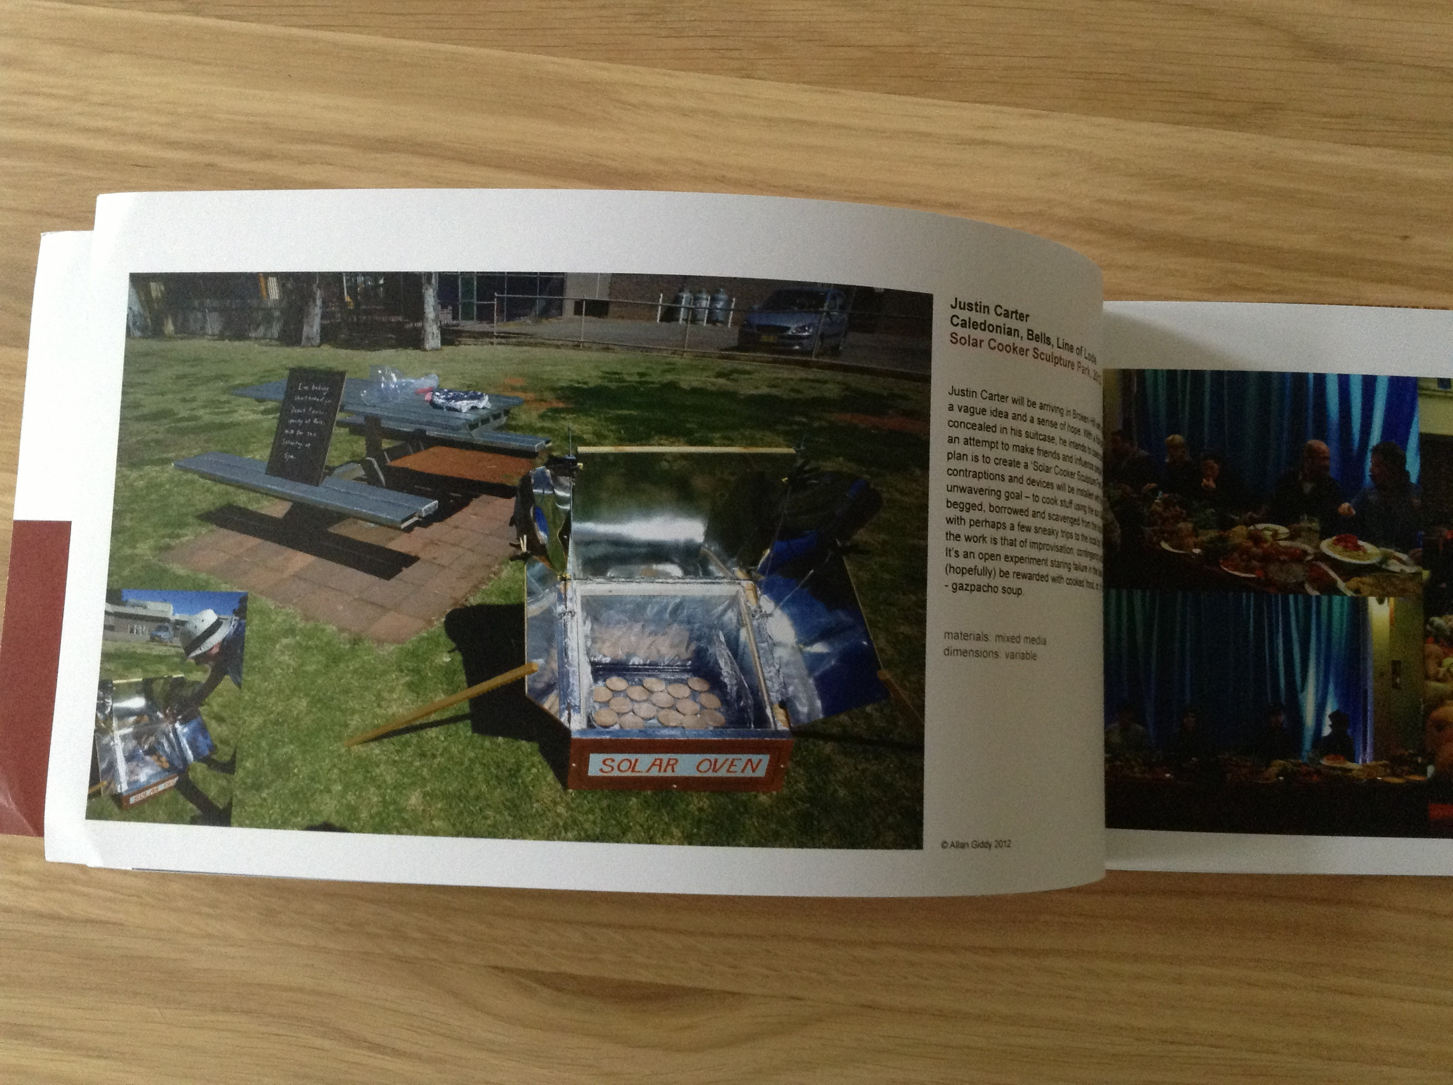
The Solar Oven was also selected for Machine Wilderness Downtown Block Party, part of International Symposium on Electronic Art (ISEA2012) in Albuquerque, New Mexico.
Albuquerque, NM (ISEA 2012) September 23rd 2012.
See links to work:
http://desertequinox.squarespace.com/
http://www.cofa.unsw.edu.au/events/archive/580
http://www.abc.net.au/local/stories/2012/08/31/3580559.htm
http://www.brokenhillartexchange.com/justin-carter.php
http://www.abc.net.au/rural/sa/content/2012/09/s3583475.htm
https://www.facebook.com/dluxmediaarts/timeline?filter=1
Image and text relating to the work in the Desert Equinox catalogue.

Slide 9

Thanks to GSA for supporting this project through the allocation of funding and research leave, to Glasgow City Council for awarding a Visual Arts Award to make it all possible, to Allan Giddy and to all of the other artists involved in Desert Equinox.

