Slide 1
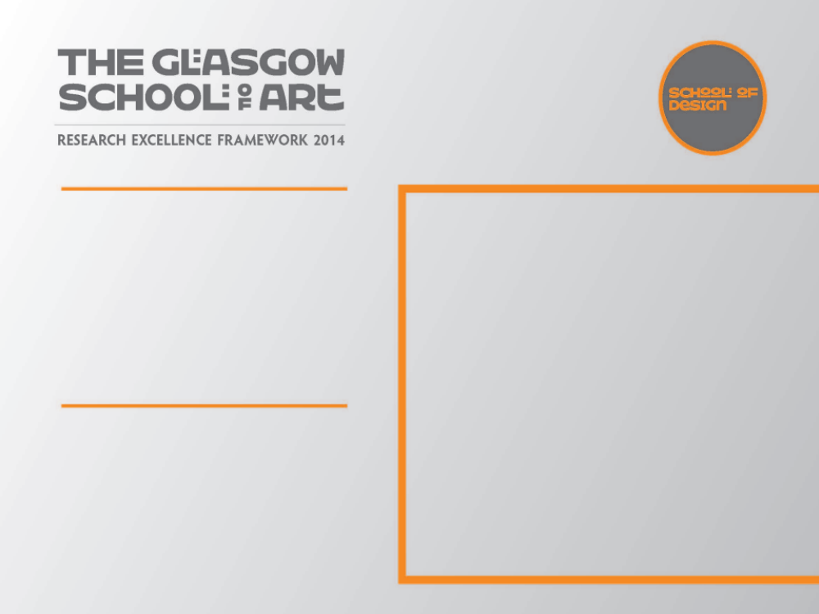
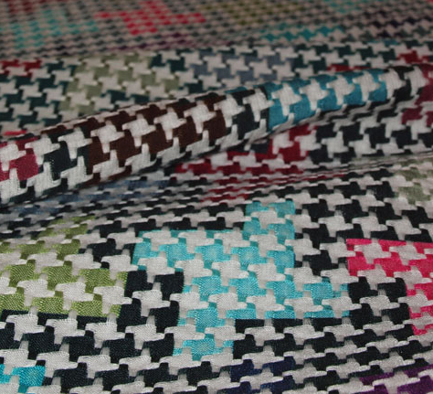
The Fusion of Digital Inkjet Printing with Bespoke Woven Textiles.
How will the woven structure of the fabric and the yarn type ‘enhance’ or ‘interfere’ with the digitally printed pattern?
Submitted by Elaine Bremner
Output No. 1

Slide 2

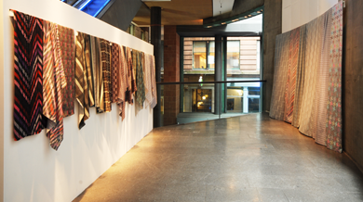
The Fusion of Digital Inkjet Printing with Bespoke Woven Textiles
1
Elaine Bremner
The result of this project was a collection of textile samples that integrated the qualities of specially woven fabrics, using different yarn combinations, with the visual qualities of digital inket printing to create unique textile samples. These samples were shown in a solo exhibition at The Lighthouse, Glasgow, 1 March – 1 June 2008
Review Gallery, The Lighthouse

Slide 3
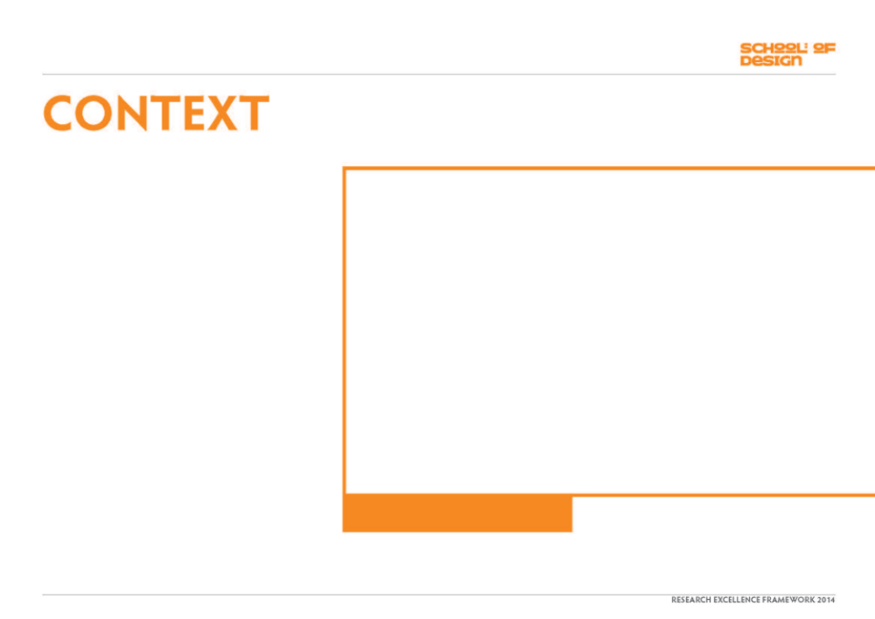
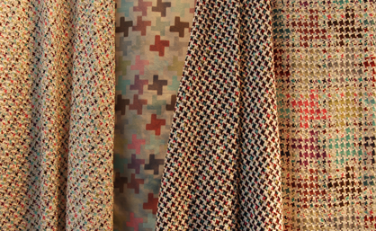
Typically for optimal colour retention digital inkjet printing requires the base fabric to be of fibre types that all belong to one dye class i.e. cellulosic fibres would be printed with reactive dyes. In almost all cases substrates would be 100% silk, 100% cotton etc.
Printing the same image onto a variety of base cloths where a mix of yarns were used in the construction produced interesting results.
Variety of woven substrates with printed image at different scales.

Slide 4
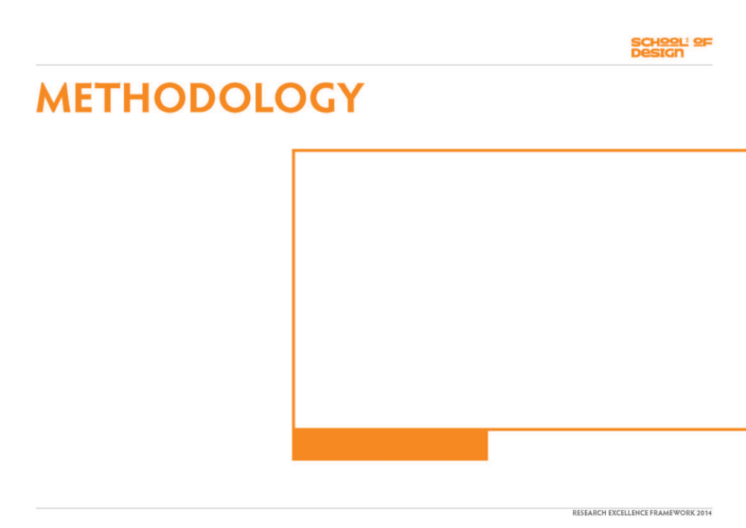
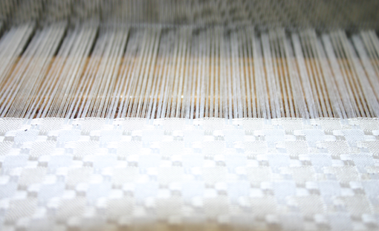
Bespoke woven fabrics allow decisions to be made about the exact quantities and proportions of yarns which make up a cloth. These decisions will affect the resulting print as certain yarns accept the ink whilst others resist.
Designing both the woven structure and the printed image/pattern allows complete control over the outcome producing a unique effect. Printing onto a specifically woven fabric also allows the weight and handle of cloth to be chosen, not imposed.
Looms were set up with warps containing a mix of yarns including silk, wool, polyester and cotton yarn. The combination of silk and polyester produced the most interesting results.
Fabric being woven on the loom, 50% silk /50% polyester.

Slide 5
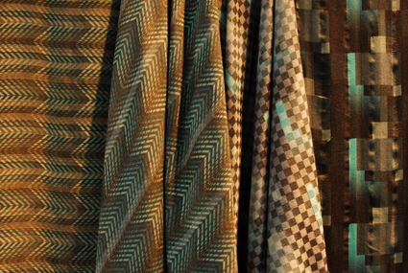
A range of patterns were designed on Photoshop and each individual pattern was printed at different scales and in different colour-ways onto the woven base cloths and the results were compared to assess how the different structures interacted with the image.
The combination of structures and yarns exaggerated and intensified or diffused and distorted the digital print and so create unique and innovative textiles. .
Two printed images on two different base cloths.

Slide 6
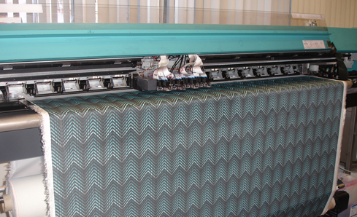
Fabric was pre-treated then digitally printed.
Fabric being digitally printed

Slide 7
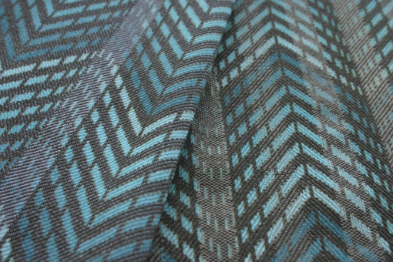
On washing the fabric the dye will be retained by some of the yarns and not by others. The combination of yarns in the warp and weft that will retain the dye adds to the complexity of the printed image.
Image printed on a fabric made from a mix of silk and polyester yarns.

Slide 8
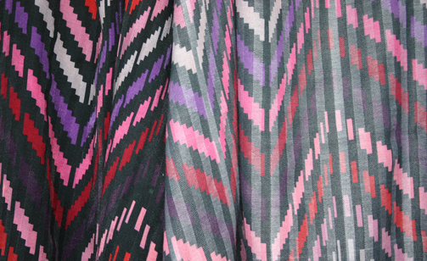
Different colour-ways were tested to test what effect this had on the resulting ‘image’ of the woven ground and the print.
Image printed onto 2 different base fabrics; the left 100% silk and right silk/polyester mix.

Slide 9
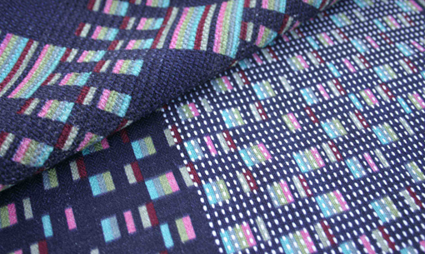
In some instances the threads that rejected the dye appeared to float on top of the cloth and be quite separate from the print.
Fabric with polyester warp threads in sections.

Slide 10
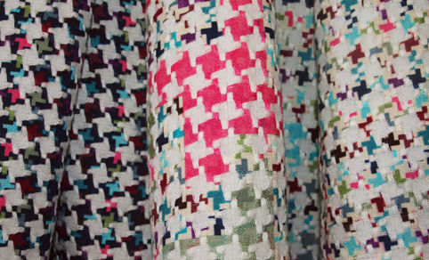
In other cases, particularly the dogtooth print and weave combination, the un-dyed threads looked to be an integral part of the printed image.
Fabric made from 50% silk and 50% polyester.

Slide 11
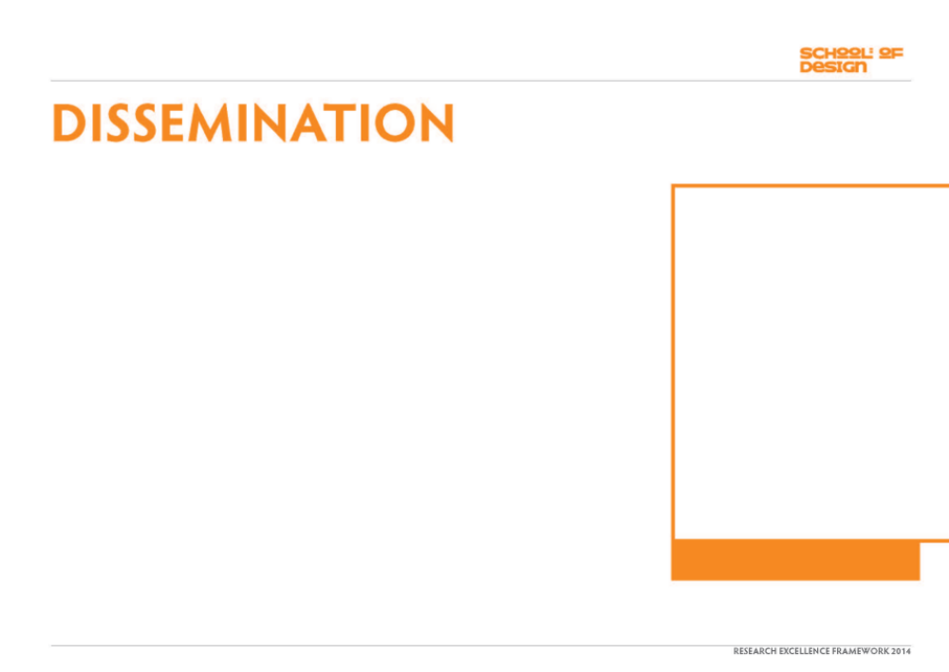
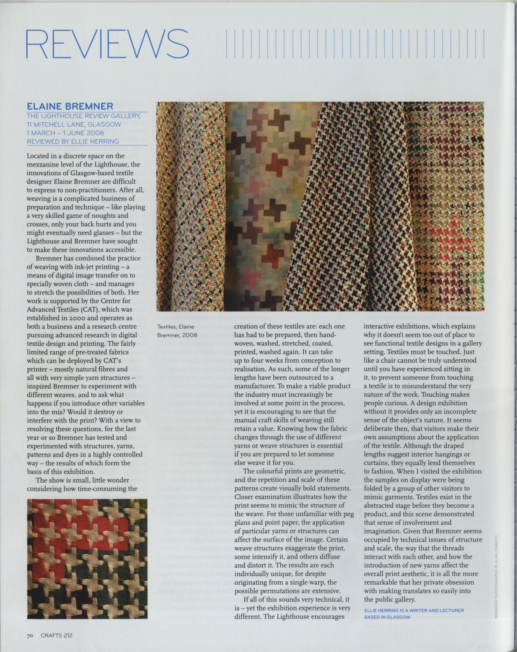
Exhibition Review in Crafts Magazine (May/June 2008)
Exhibition Review in Crafts Magazine

Slide 12
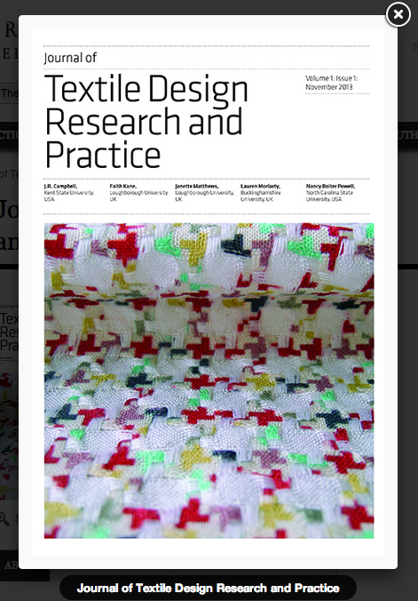
An image of one of the fabrics produced as part of this project was used on the front cover of Textile Design Research and Practice (2013)
file://localhost/Users/e.bremner/Desktop/Bloomsbury%20-%20Journal%20of%20Textile%20Design%20Research%20and%20Practice.html
Image one & a description of what we are looking at in the context of the project.

Slide 13
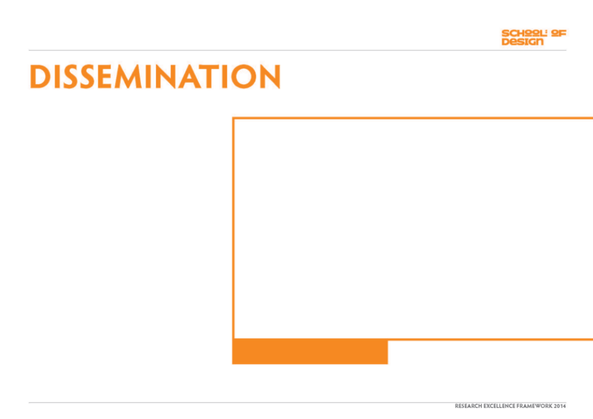
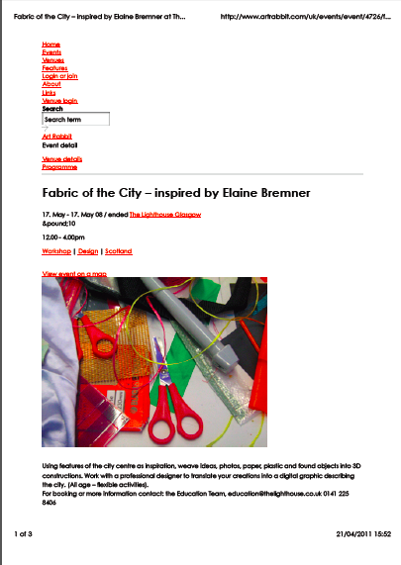
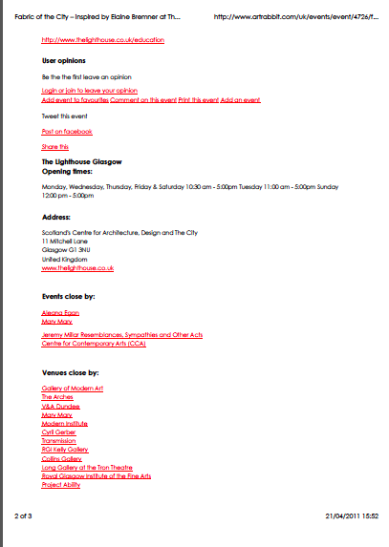
Saturday workshops led by Elaine Bremner in the Lighthouse and attended by children and adults. The aim of the workshops was to introduce people to the practical process of weaving and the design process behind the work in the exhibition.
http://www.artrabbit.com/uk/events/event/4726/f...
Image one & a description of what we are looking at in the context of the project.

Slide 14

???
???

