Slide 1

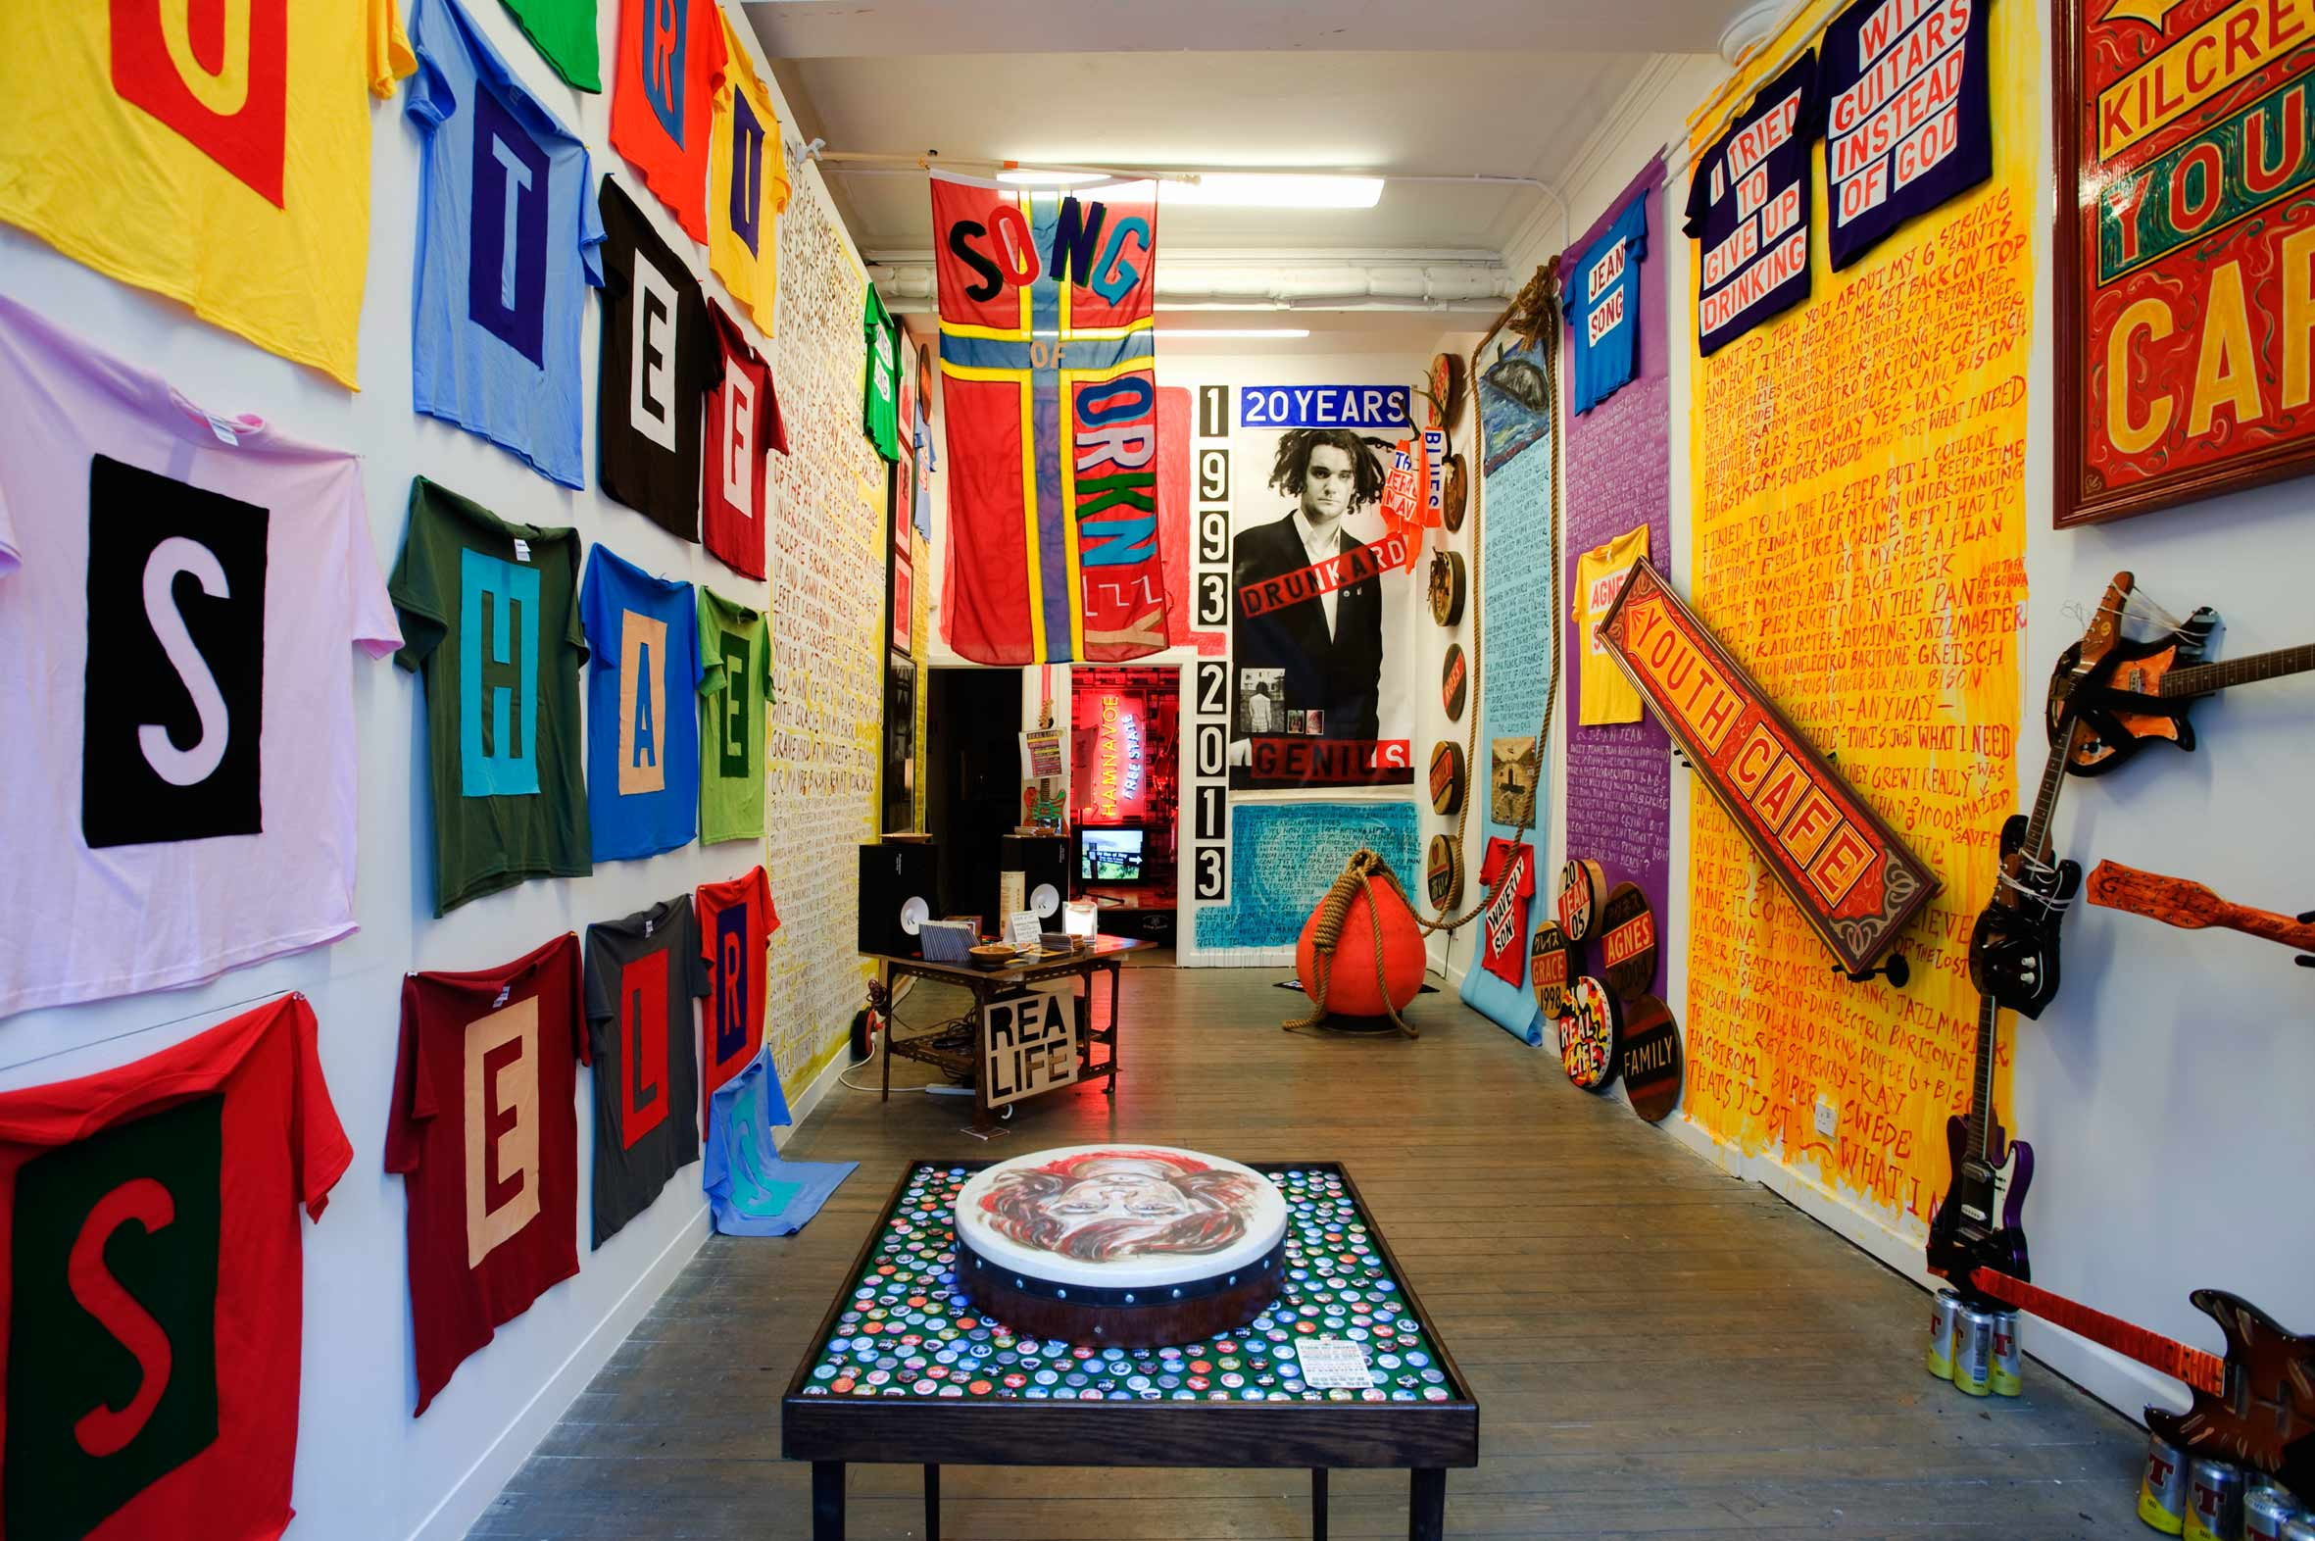
Ross Sinclair : I Tried to Give up Drinking with Guitars instead of God - A show about an Album
A solo exhibition at 'The Duchy' gallery in Glasgow in March/April 2013 (http://theduchygallery.com)
The show is part of ‘Objective’, a city-wide project organised by the Gallery of Modern Art in March/April 2013. It also included a performance event at The Poetry Club, Glasgow
In the project I aim to reflect on the relationship between art and music and in conjunction with the exhibition I release a new album of music I have been developing over the last few years. This is distributed widely in an edition of 2000.
Submitted by Ross Sinclair
Output No. 4

Slide 2

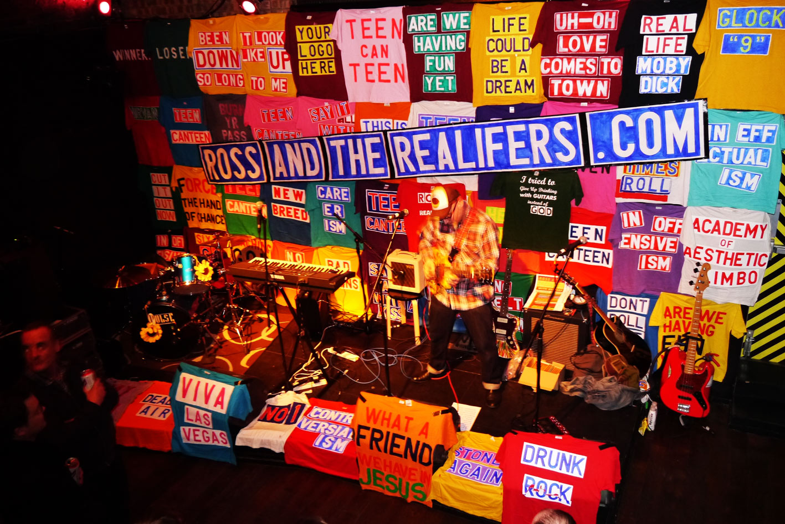
Ross Sinclair I Tried to Give up Drinking with Guitars instead of God - A show about an Album
I’ve been working for 25 years as a visual artist showing widely, sometimes writing and teaching and in the last couple of decades since I had the Real Life tattoo inked on my back, I have often utilised music/song as part of large scale solo installations, (Fortress Real Life, South London Gallery 2001, Selected Real Life, Badischer Kunstverein, Karlsruhe, 2002, Sinclair vs. Landseer, Aberdeen Art Gallery 2007 etc.)
In I Tried to Give Up Drinking with Guitars Instead of God (March/April2013) music itself was the starting point. I produced a full scale CD album of 12 original songs (2000 copies), written and recorded in my home studio. These were collected together as the basis for an exhibition where I activate each of their themes : geography – history - kids – getting old – failure – stopping drinking etc. forming a melodic visual reverie.
I explore with great joy the intuitive and abstract ways that music/song can focus the development of artworks in contrast to a more cerebral frontal lobe approach I otherwise employ when I am developing an ART EXHIBITION in my usual manner where I am sometimes unable to shake off a more formalised relationship with the day job of CULTURE. In this project I allow myself to have more fun, I think this mindset extends to the audience too.
4
Ross Sinclair
Live performance in support of the project at The Poetry Club, Glasgow, Sat 6 April 2013

Slide 3

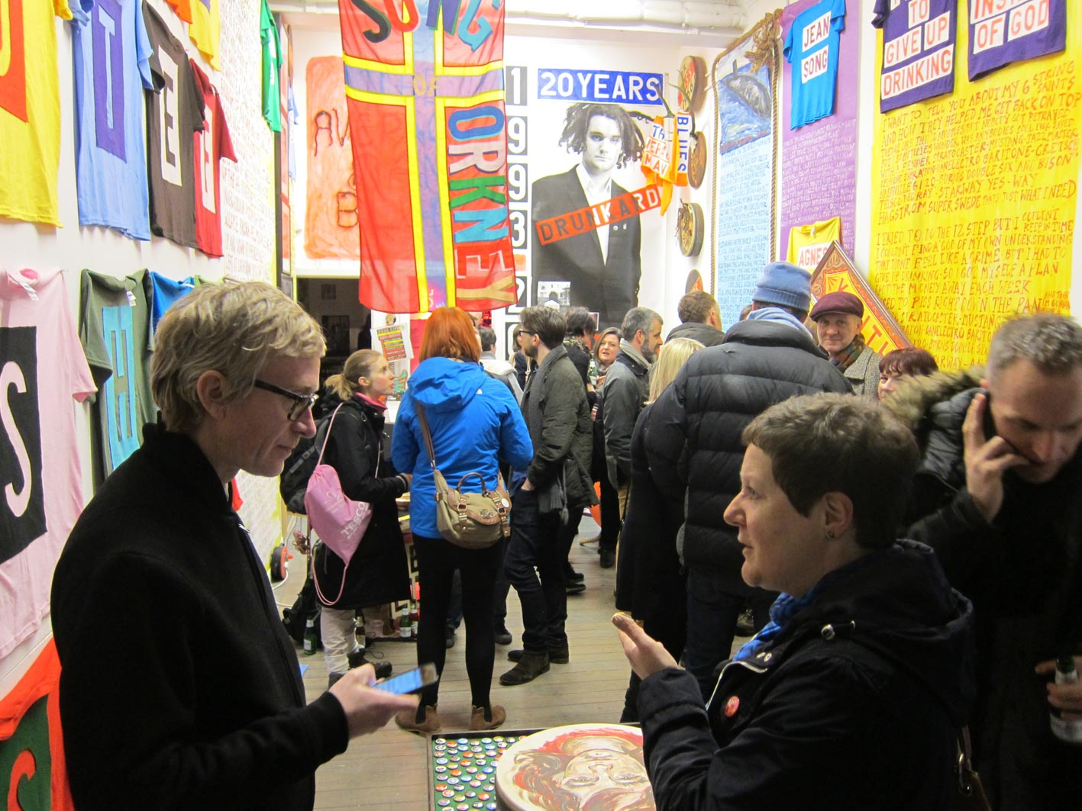
"Although I’ve been pretty busy making art for the last 20 years I’ve never stopped making music. I guess I feel like Art has been my main job so that always generates a lot of frontal lobe activity, worrying, getting it right, thinking of the consequences, considering the contexts, talking to students about it later on my teaching gig at the art school. This is often exciting and dynamic but it always starts with thinking. Starting with music allows me to indulge my intuitive sense, to creep up on things from a more peripheral route, an elliptical meander. Beginning with abstract noodling, unformed chords and la la la words and a ‘waiting to see what happens’ attitude takes you to a different place, by another route. For better or worse I never allow myself to do this in Art. So I’m always recording, messing about, putting songs together for one thing or another”
Image from the opening of the exhibition

Slide 4
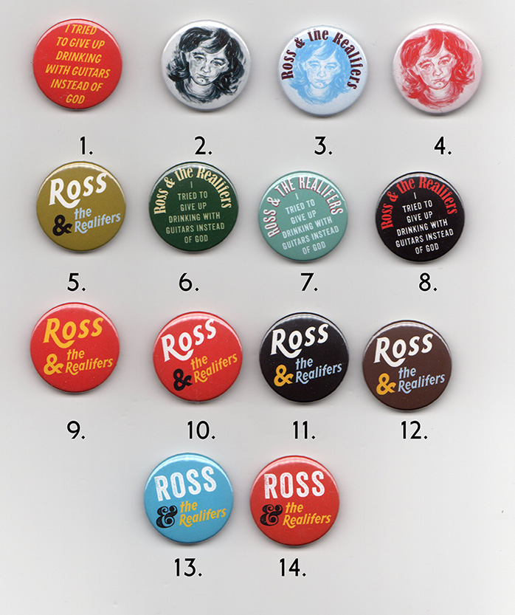

Slide 5
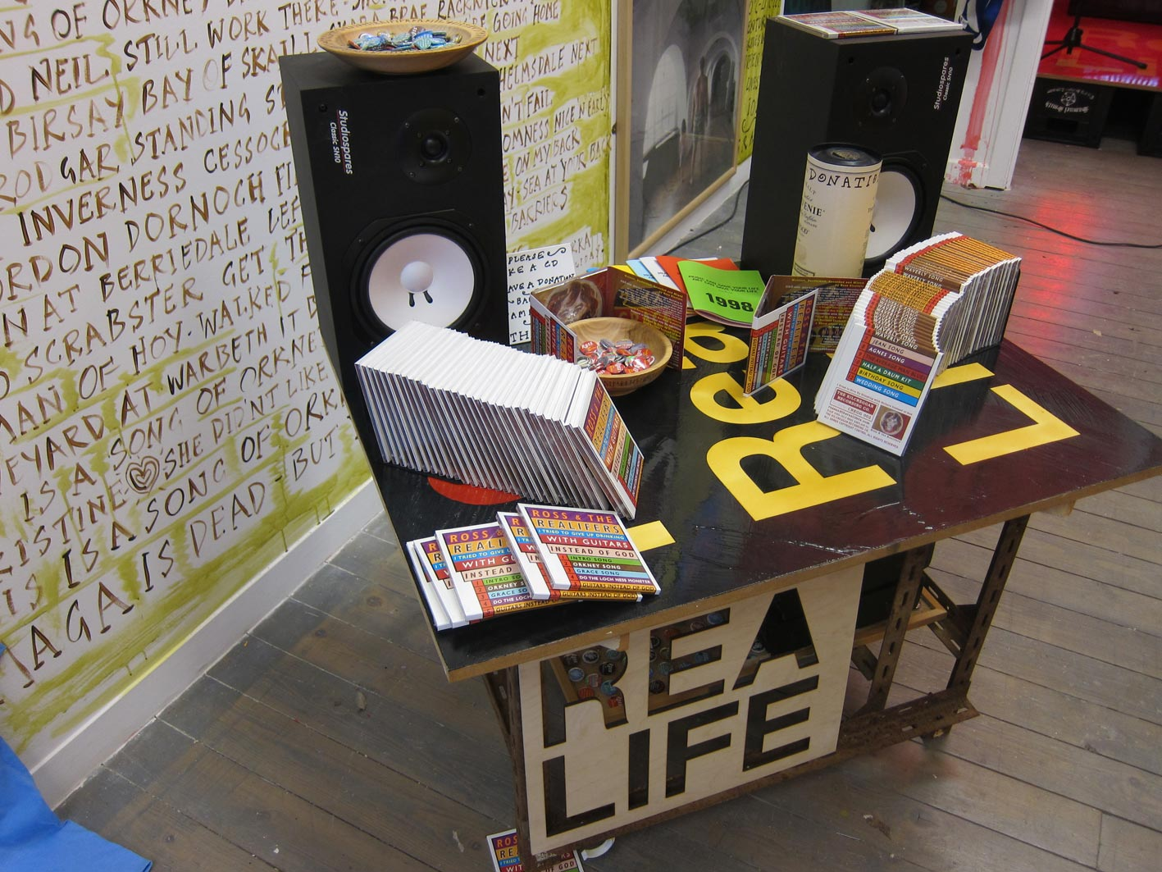

Slide 6
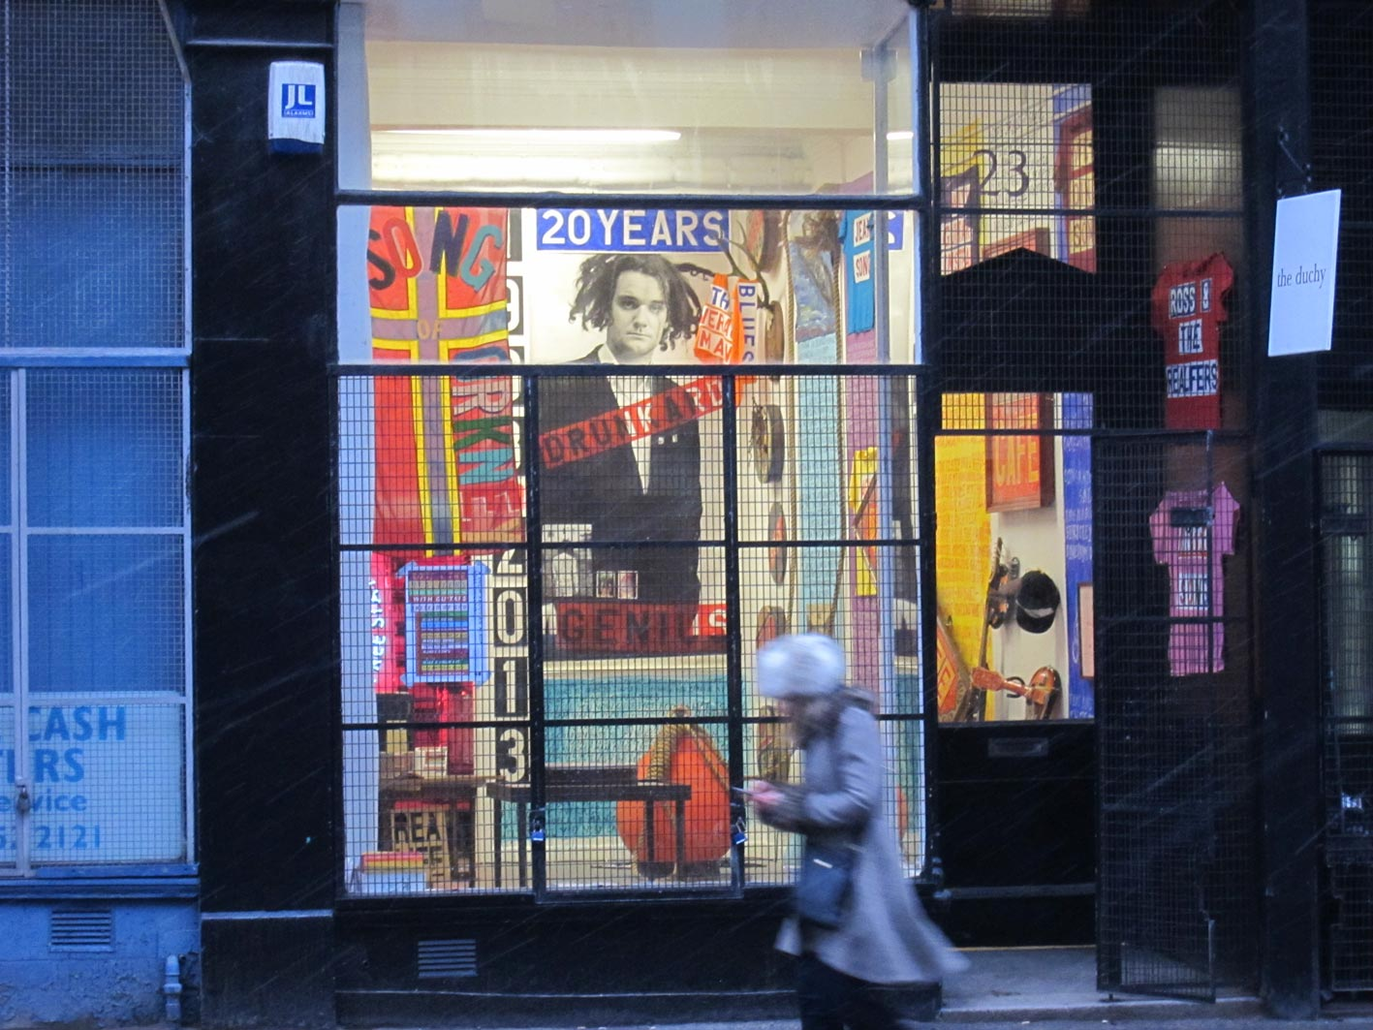

Slide 7
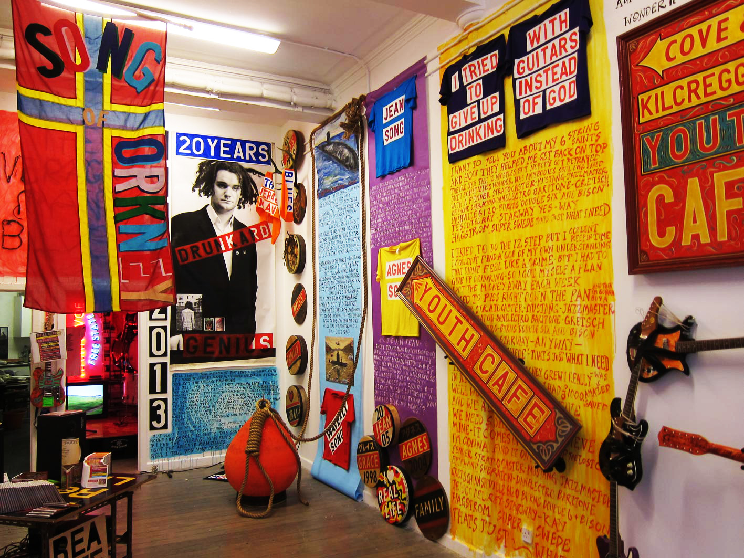

Slide 8
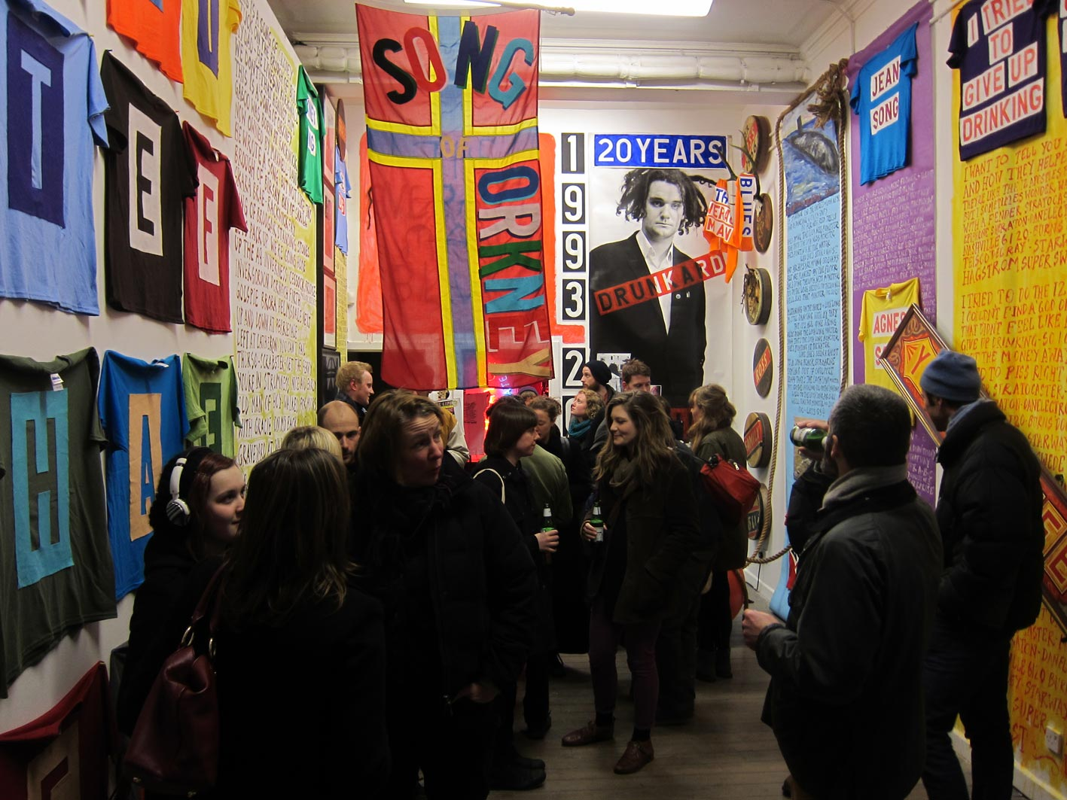

Slide 9
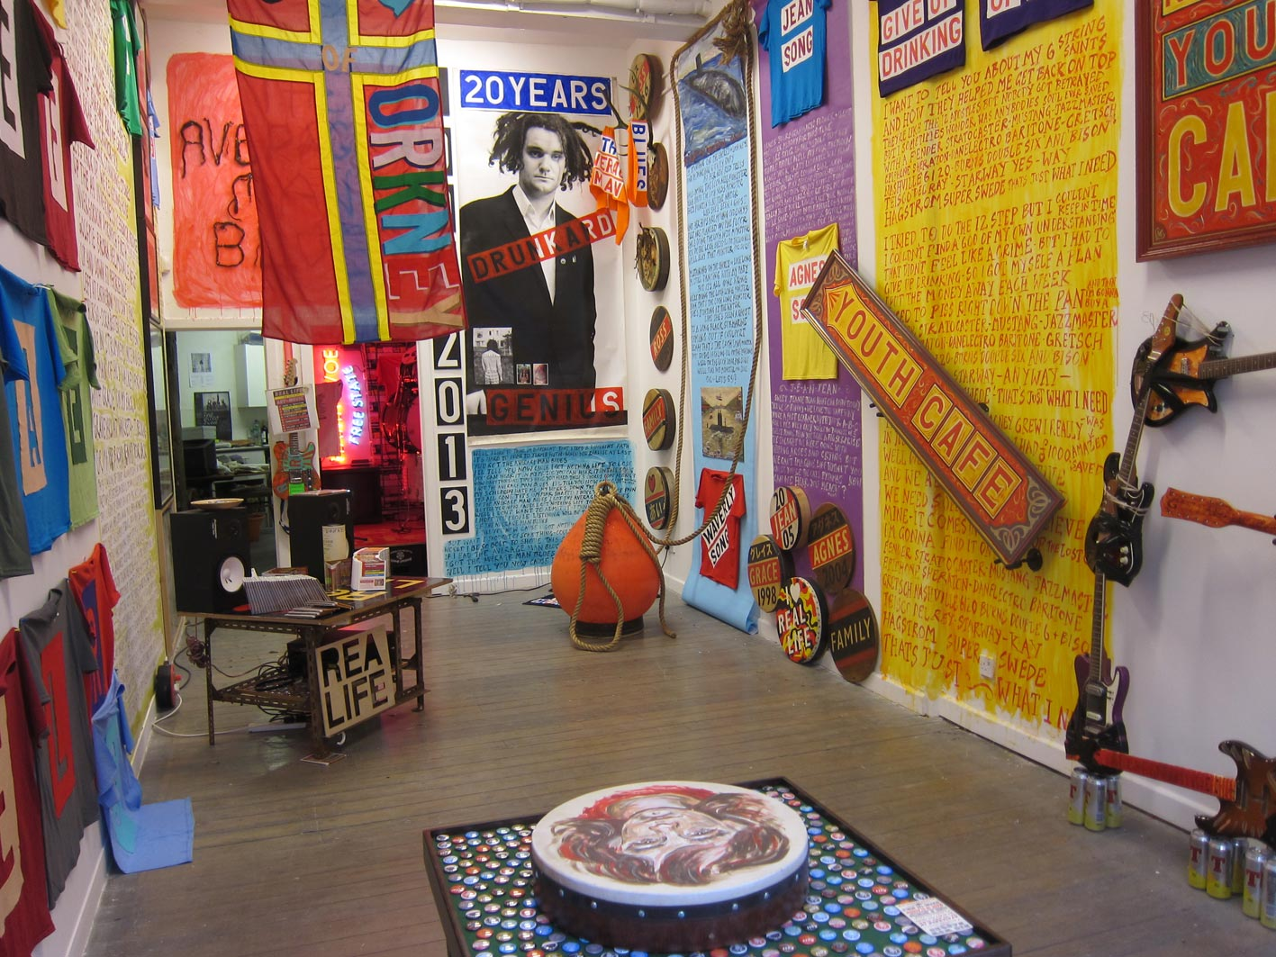

Slide 10

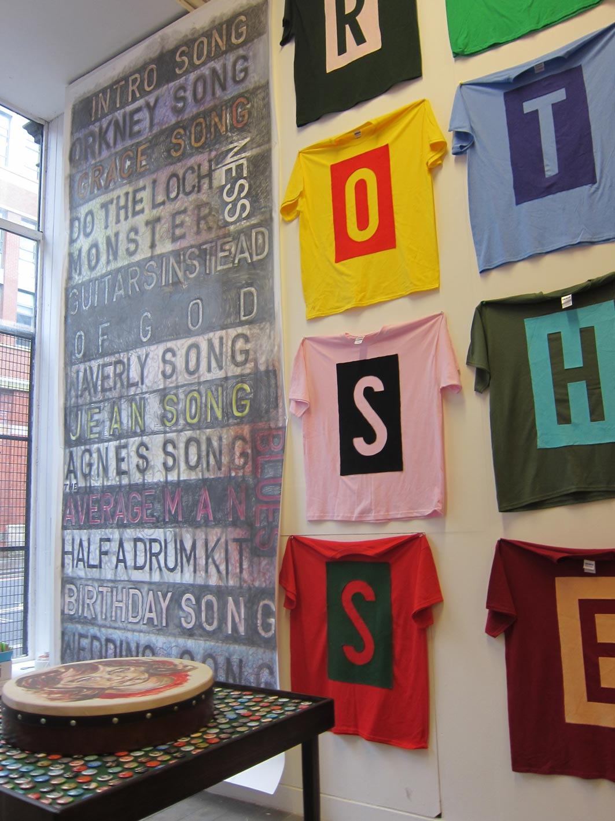
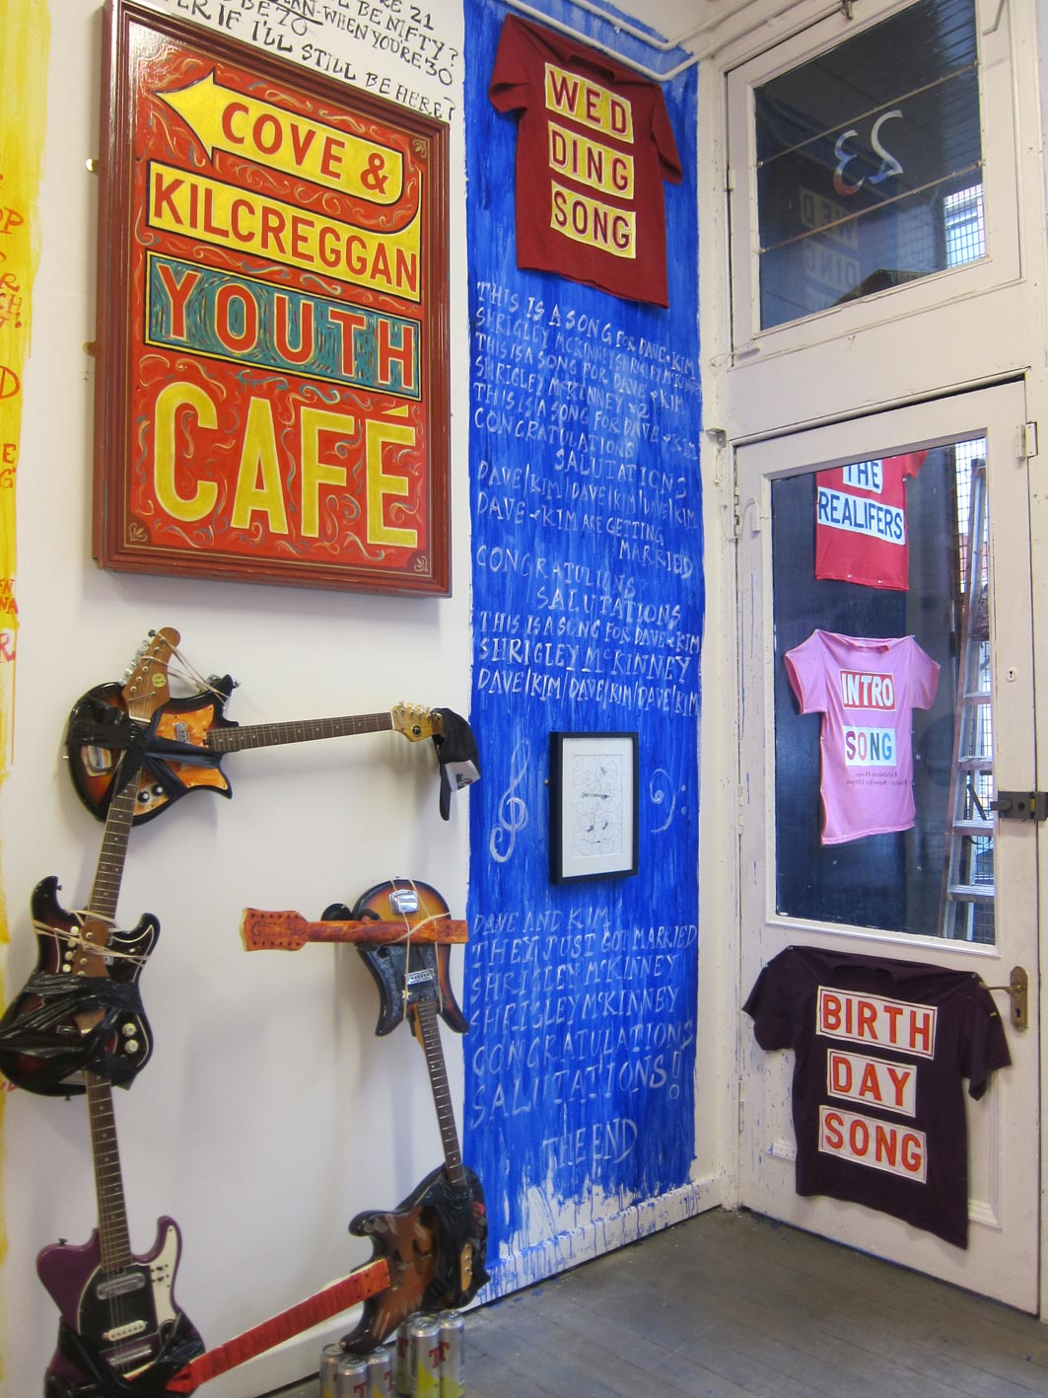
At the beginning of 2013 Ainslie and Lauren, Directors at The Duchy asked me to do a show. It was kind of short notice and this was good, no messing about, no time for fifty different ideas - so I thought it would be a good time to put a few of these songs I’d been recording together, make a current selection and to build a show around it, activating the songs with a visual dynamic in the exhibition and to make the album a physical thing and to launch it at the show. The website I constructed reflects that journey into “I Tried to Give Up Drinking With Guitars Instead of God”. Thanks to my friend Dave Dunbar for helping me sonically along the way and to Kenny Macleod for mastering it from a diverse bunch of audio mixes and to Eileen Daily for editing the Orkney Song video for me."
Details of exhibition

Slide 11
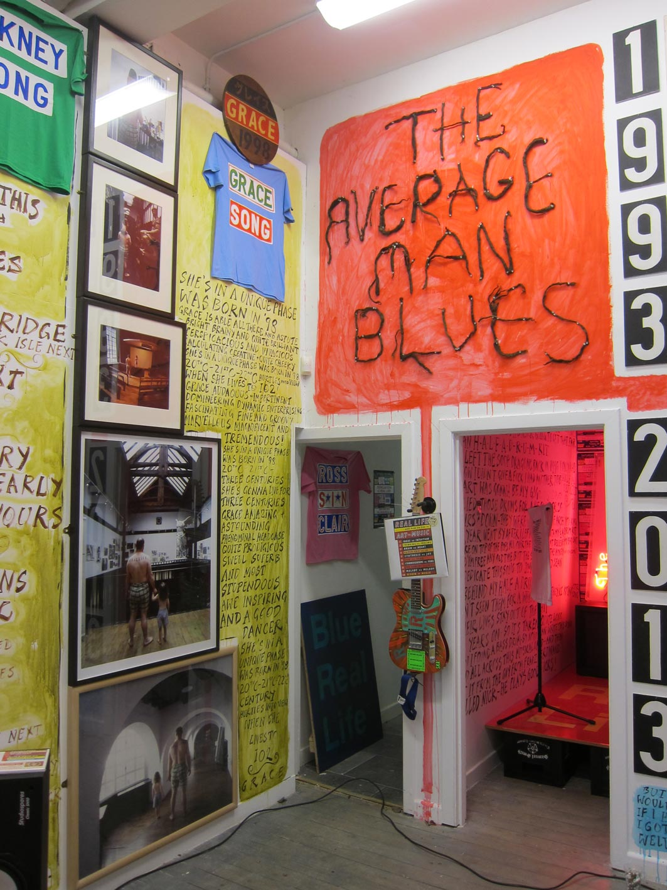
A Press Release
Ross Sinclair’s first band was called Gods for all Occasions, circa ‘84/85, whose main claim to fame was that it featured his pal Neil Menzies and Raymond McGinlay, later of Teenage Fanclub; otherwise there wasn’t much to write home about. They really weren’t so hot, and Sinclair was writing many of the songs and singing them – go figure. While that band was still going Sinclair joined a fledgling incarnation of The Soup Dragons. He played drums and stayed for 5 years performing on dozens of records and playing hundreds of gigs from the very first, supporting Primal Scream at the legendary ‘Splash One’ club in Glasgow to one of his last supporting Jesus and Mary Chain at the Brixton Academy (maybe not such a big journey right enough) There were many gigs and various performances in-between at such venues as Glastonbury (1987) and numerous euro tours, festivals and tours of the toilet circuit and beyond.
In the end he got tired of arguing with Sean the singer(don’t worry they made up) over drum machines and the new ‘dance’ direction and left in early 1990, to complete his studies at Glasgow School of Art. He left with the gear he happened to have at home – It was only Half a Drum Kit. This was the inspiration for one of the songs on the record. A couple of months later the band recorded a cover version of the Rolling Stones, “I’m Free” and were on Top of the Pops.
They went on to sell half a million albums in the States. Oops. Since 1990 Sinclair has worked as an artist, showing all over the world working in various galleries and museums, making hundreds of exhibitions at home and abroad. He has been the recipient of a Paul Hamlyn Award, The Arendt Oetker Atelier Stipendium, and the Baloise “Statements” prize at the Basel Art Fair as well as numerous awards from the Scottish Arts Council. His work is in various public and private collections.
Imge from the exhibition

Slide 12

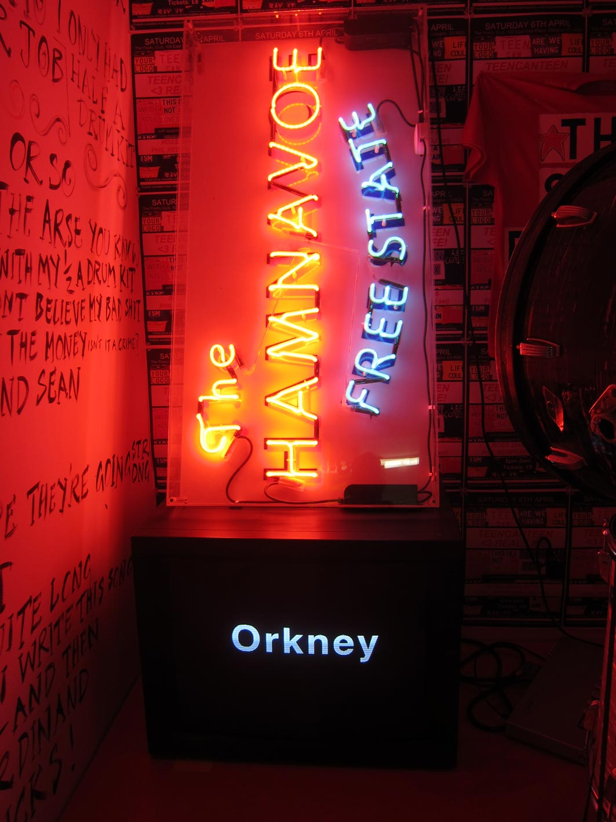
Now Sinclair has made a new record, I Tried to Give Up Drinking with Guitars instead of God, his first proper album, since ‘This is our Art’, the first Soup Dragons album in 1988 and the first where he has written, performed and recorded all the material himself.This could be a contender for two records – the longest span of time between albums (25 years) and the oldest geezer to have a debut solo album (46 years)
While most artist’s debut albums are concerned with chasing girls and getting high, Sinclair’s’ is focussed on the pressing concerns of being an old parent, nuclear bombs in submarines near his home on the Clyde, the ever present spectre of alcoholism, falling out of artistic vogue, worrying that you might be only average after all, and deciding whether or not to get married to your long term partner…and other such critical concerns.I guess that’s what floats to the surface when you make your debut solo album at 46.
Image from the exhinition
Poster for live performance

Slide 13

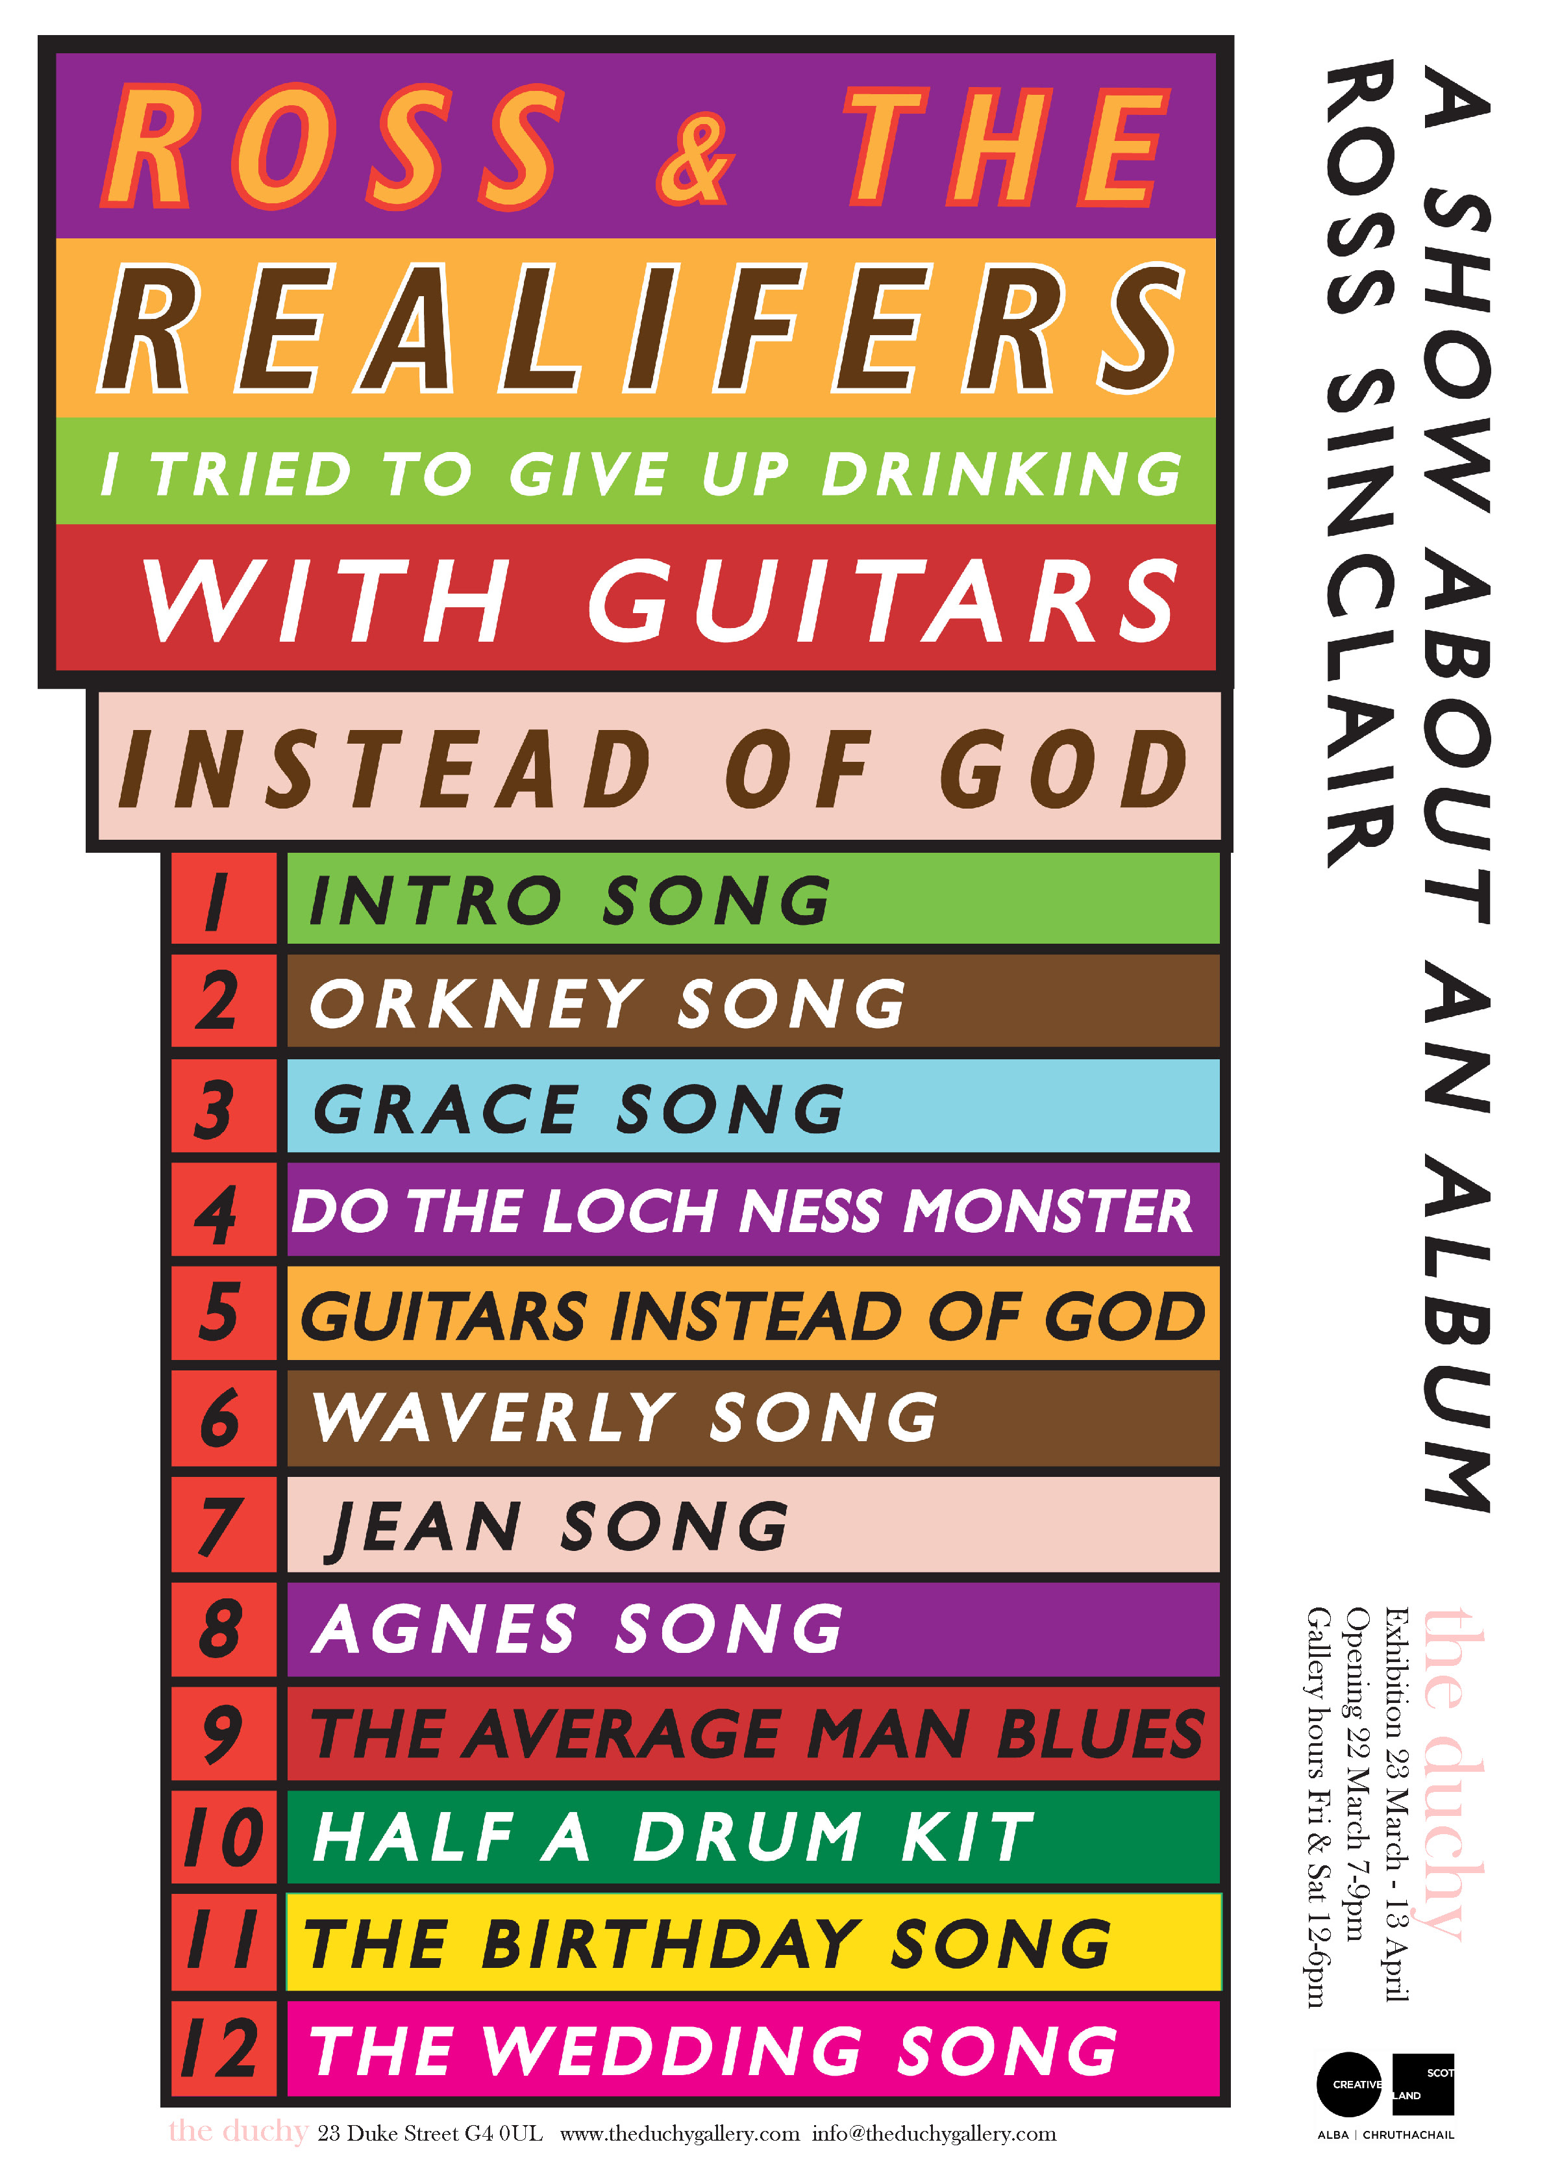
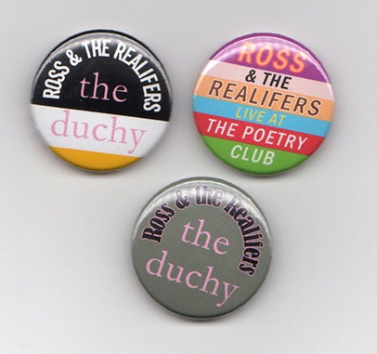
I approached the development of the project almost like an residency. I had a long install period of about a month where I used the gallery like a studio and developed the various works in response to each of the songs. I utilised various forms to articulate the themes and ideas which grew from the project including video, text, painting, sculpture. The music was present in the space throughout the show and the cd album was freely available in the space. (there was a donations jar) There were badges and t-shirts which helped to emphasise the mobile, fluid aspect of the project.
Some of the songs discussed ideas of history and geography so these were visually reflected.
Badges and poster for the show

Slide 14

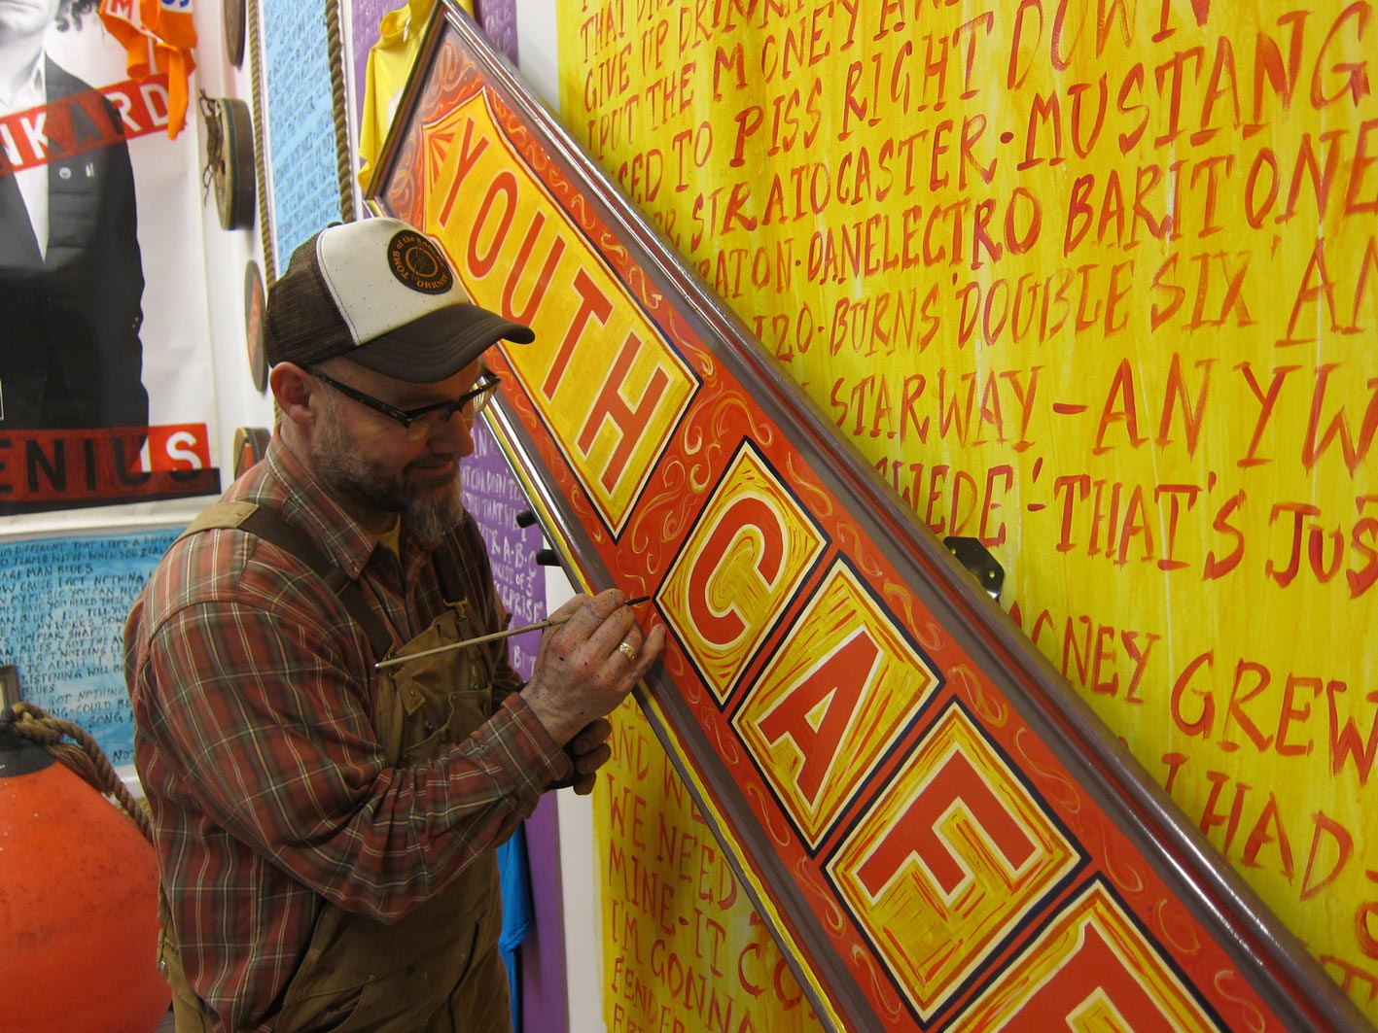
I have taken part in numerous exhibitions over the years concerning art and music for example Everything Flows, Patricia Fleming Projects, Glasgow, 2012 'Record Store', at Monorail Records, Glasgow and Avalanche Records 2012/13, Nothing in the World But Youth, Turner Contemporary, Margate 2011, Among the Living, Skateboard Project ICA, London, Mima, Middlesburgh,2007, On Stage, Hannover Kunstverein/Villa Merkel Esslingen, Germany 2003, Air Guitar, Milton Keynes Gallery 2002 etc but this time I wanted the space and time to develop a project that didn’t have to fit in with some curators idea of what the relationship between art and music could be. To this end I have also written a number of texts on the subject, most noteably
Music can Save your Life : Art can Save your Life in Make it Funky, Strategies between Pop and Avant-Garde in Music and Visual Arts in 20th Century Ed. Markus Muller/Ulrike Groos, Oktagon, Cologne – 2000
I reprinted this latter text in a booklet that was given away at the show in order to extend the discussion further.
Work in progress in the development of the exhibition.

Slide 15

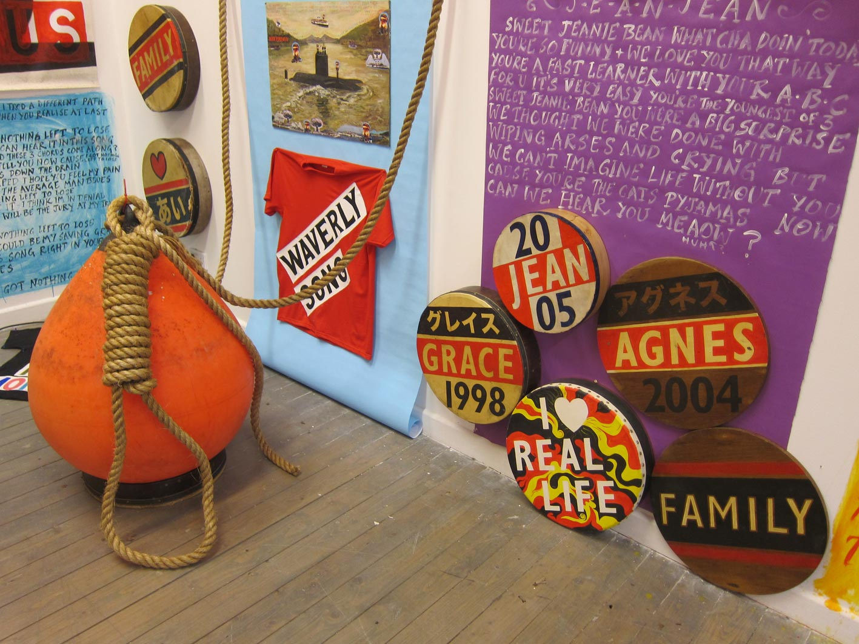
I constructed a website especially to document this project which is still developing. It documents the exhibition itself and features videos/lyrics/music/pictures live details in a user friendly enjoyable experience. It is an integral component of the project.
www.rossandtherealifers.com
I distributed the album during international Record Store Day 2013 in Glasgows better record shops.
Glasgow Museums, Gallery of Modern Art
Objective Project which the show was part of. Map info etc:
http://www.glasgowlife.org.uk/museums/our-museums/goma/whats-on/exhibitions/Objective/Pages/default.aspx
I took part in a Public discussion responding to the themes of the “Objective’ project in Tramway on Sat 16 March 2013 with the artists Danny Holcroft and Nick Evans organised by the Gallery of Modern Art, Glasgow
Art/Music Essay
Detail of exhibition

Slide 16
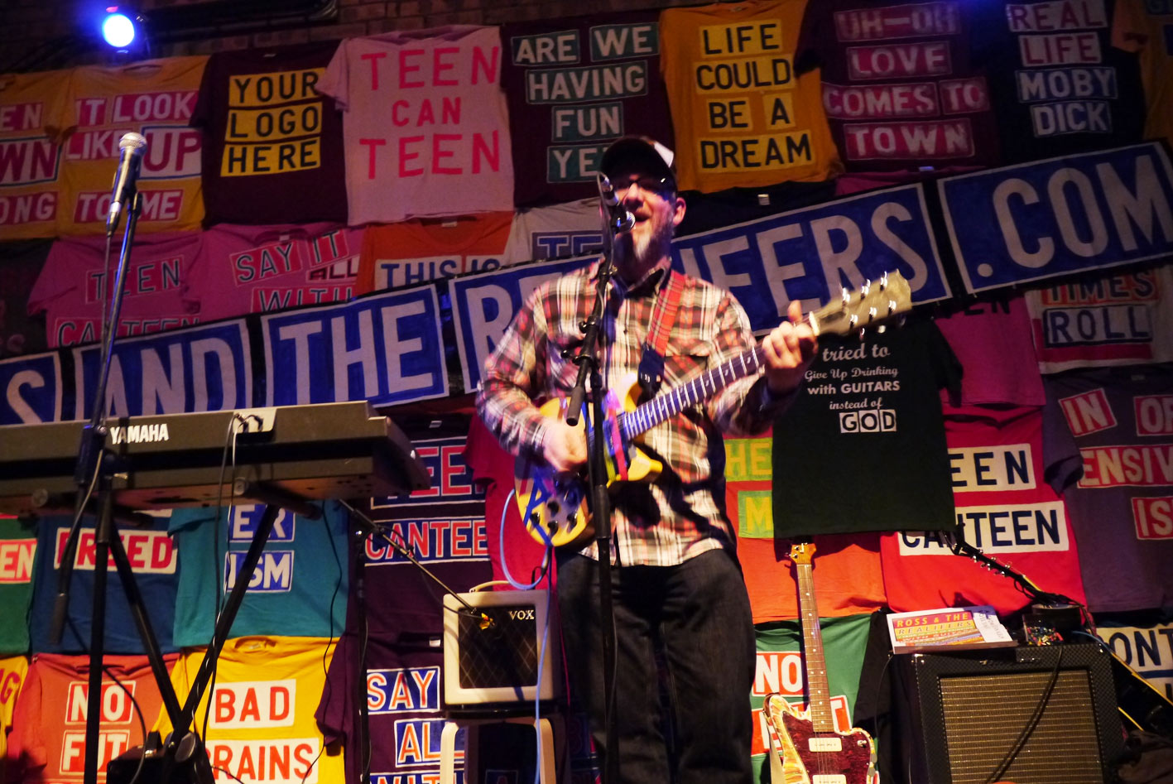
As a direct result of this exhibition I was invited to make a commission for the Edinburgh International Art festival 2013. This will be a major public commission where my works will be shown on Billboards, posters,postcards, signs, bags, beermats, banners, badges and well as a limited edition vinyl record (in red vinyl)
The project will generate over 43000 discrete art works.
http://www.edinburghartfestival.com/commissions
Performance at The Poetry Club as part of show, 6 April 2013

