Slide 1
PRACTICE-LED PHD’S

Slide 2
WHAT IT IS NOT
EXTENDED PRACTICE
Students from art and design make assumptions regarding relevance of research methods and qualitative and quantitative practice.

Slide 3
WHAT IT IS
  RESEARCH
  CONTEXTUALISED PRACTICE
  A DEFENCE OF A PREPOSITION
  A QUESTION/s
  A PROOF AS A BODY OF EVIDENCE
  An EVIDENCED RESEARCH JOURNEY
  RESEARCH also FOR RESEARCHERS
  A CONTRIBUTION TO KNOWLEDGE

Slide 4
FORMING A METHODOLOGY
WHAT, WHY and HOW?
  DEFINE SCOPE CONTEXT SIGNIFICANCE AND PROCEES/ METHOD
WHO CARES?
  Audience CONSUMER END USERS
SO WHAT?
  CONTRIBUTION

Slide 5
AN ESSENTIAL BEGINNING
    PRE TRANSFER M.Phil / PHD
      THIS MUST BE ACHIEVED …
    Establish the following
      WORKING TITLE
      RESEARCH QUESTION/S
      METHODOLOGY
      EPISTEMOLOGY VISUAL TEXTUAL

Slide 6
HOW DOES THE PRACTICE BASED METHODOLOGY DIFFER ?

Slide 7
EMPHASIS ON A VISUAL CONTEXT
SET QUESTIONS TO BE ANSWERED THROUGH THE PRACTICE
LIMIT SCOPE OF SECONDARY SOURCES TO RETAIN FOCUS ON PRACTICE
ACTION RESEARCH GROUNDED THEORY PHENOMENOLOGY AND MIXED METHODOLOGY

Slide 8
WHAT SHOULD WE BE LOOKING FOR?
TITLE
  Leads to questions and contribution
QUESTIONS
  Contains the scope and Viva questions, possible examiners
EPISTEMOLOGY
  Leads to appropriate scope and focus in textual and visual contexts
Consolidation of prior knowledge in relation to established fields of inquiry (i.e Philosophy) providing additional rigour for practice-

Slide 9
DEMANDS INCREASED FREQUENCY OF SUPERVISION IN VISUAL CONTEXT
SEQUENCE
EPISTEMOLOGY (VISUAL TEXTUAL )
METHODOLOGY
CONTIBUTION
RESEARCH QUESTIONS
TITLE

Slide 10
EXAMPLES OF DOCTORAL QUESTIONS and

Slide 11
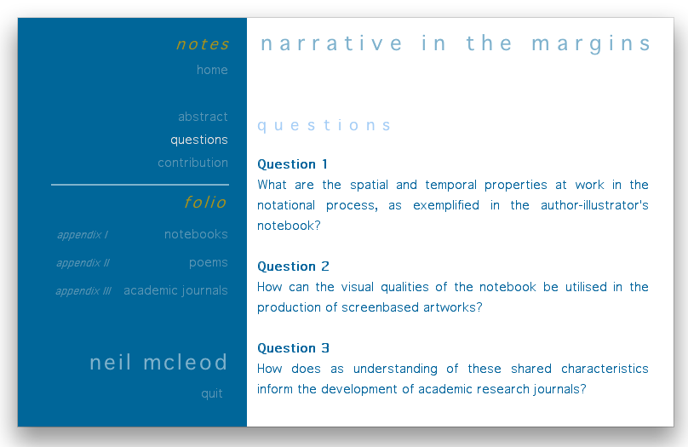

Slide 12
THANKS
Dankie

