Slide 1
REF PORTFOLIO
Helen Marriott

Slide 2
As a designer maker a deep understanding of my chosen materials, techniques and engagement with new technologies is essential in the development of ideas and working practice

Slide 3
sequence of designing & making three artifacts
A bumper crop of acorns on my oak tree in 2008 provided me with a new source material for my work. I was fascinated by the acorns, collected them at all stages of growth and cast them in silver.
I was also inspired by the designer craftsmen I work alongside who employ cutting edge technology; computer aided design, laser cutting, rapid prototyping and casting. I wanted to incorporate some of these techniques alongside the traditional skills that were so familiar to me.

Slide 4
In 2009 I was invited to participate in an exhibition with the Contemporary British Silversmiths titled SidexSide Edge-Edge the silver for which was sponsored by a Finnish bullion company. It provided a collaboration with our Finnish counterparts to be held in Hame Castle Finland.
When considering this project I was keen to include the produce from my oak tree in developing a new direction for my work.
The silver acorns were fascinating but limited, the leaves had more potential. It was interesting that after the leaves fell from the tree they did not curl like most other leaves but remained flat, I gathered a selection and drew them. I used the shapes to create an outline which I developed to fit together and by placing them side x side and edge to edge ideas for bowls emerged.

Slide 5
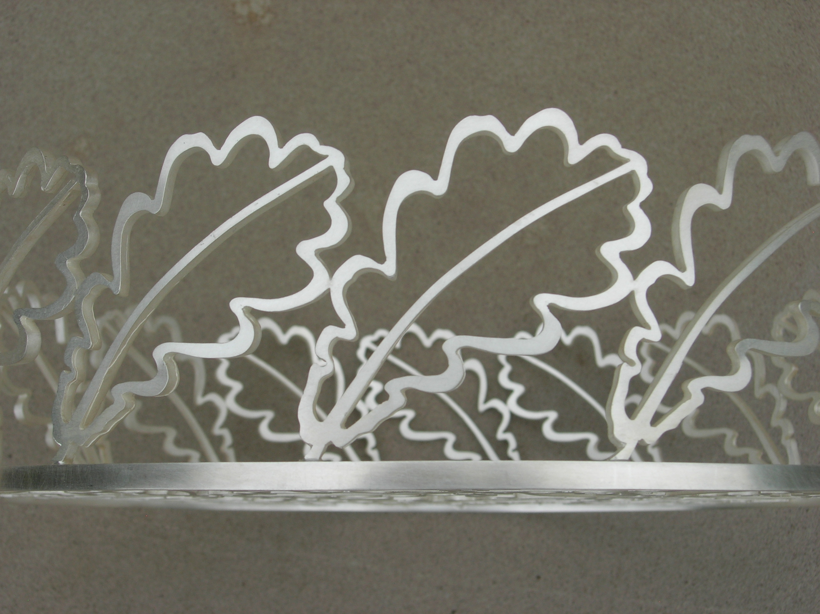
side x side

Slide 6
Placing the leaves together in different ways produced a number of outcomes, the resulting design was in part dictated by the amount of silver the bullion dealer was providing.
The bread basket evolved and was made by casting in silver separate units and soldering them together. This is the most exciting part of designing, making it work.

Slide 7
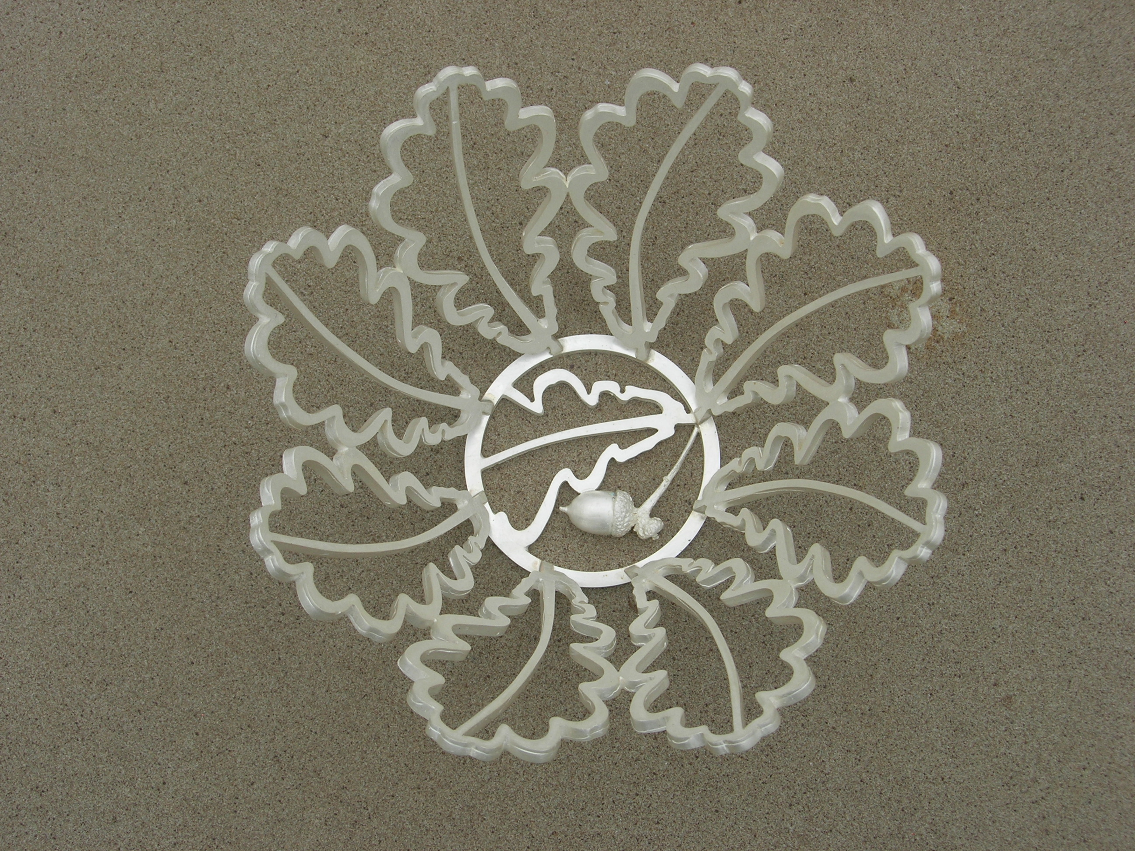
Development sample

Slide 8
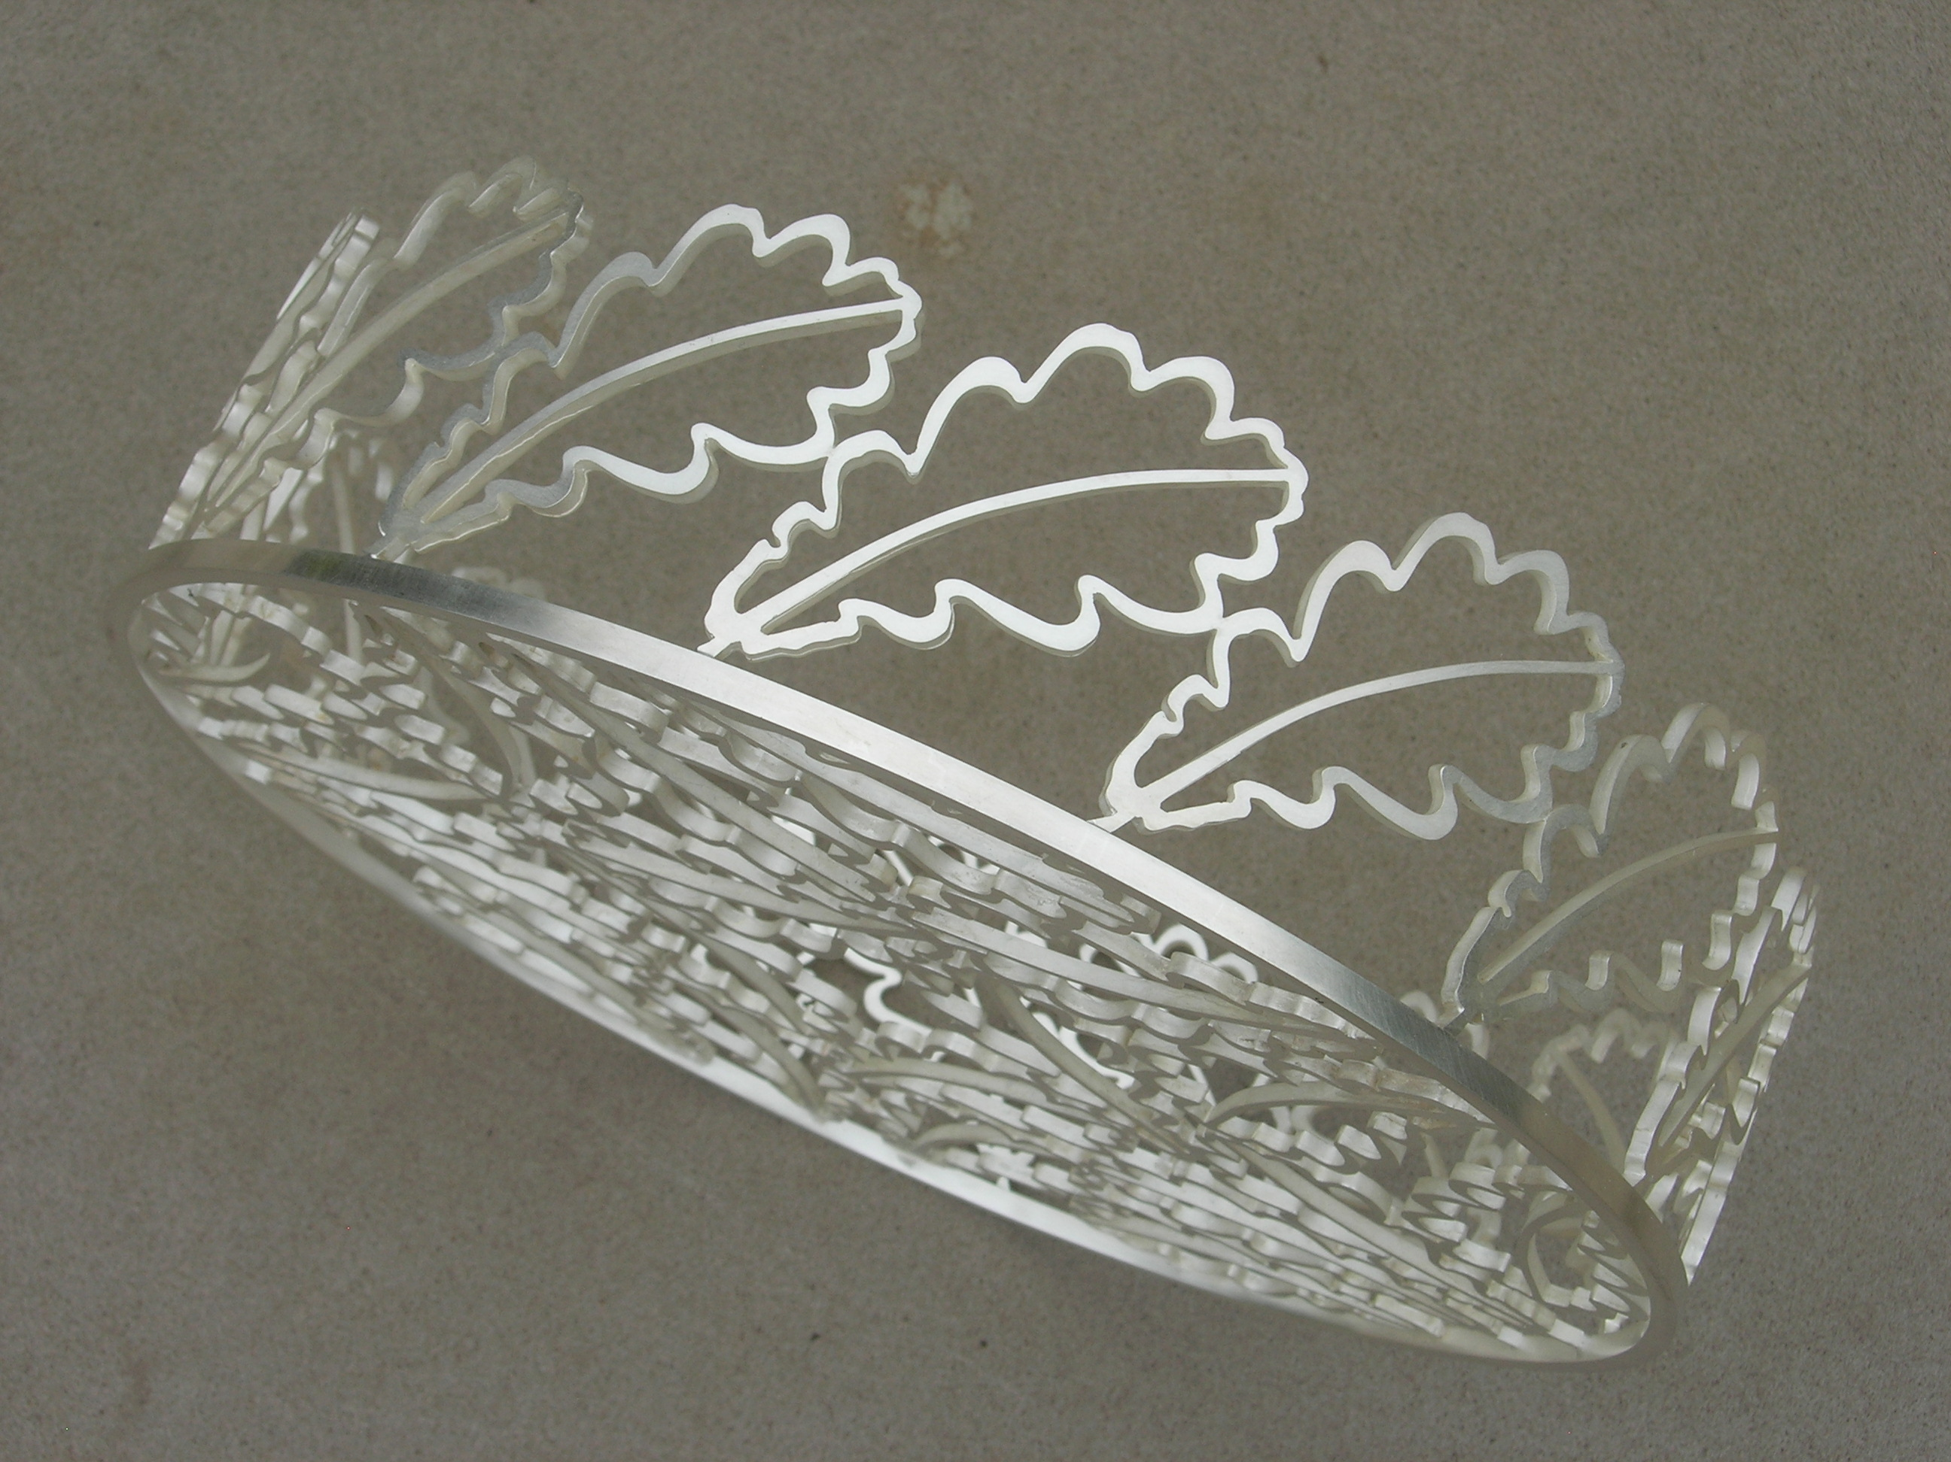
bread basket

Slide 9
The exhibition was opened in Finland and then taken to Royal Cornwall Museum September 2010 and The Capstone, Liverpool Hope University May 2011 a catalogue accompanied it.
The development of the technique used changed the direction of my work from mainly flat and hollow ware using traditional techniques to three dimensional objects made from identical elements joined together, I was increasingly interested in the different forms I could achieve.

Slide 10
An approach from a client wishing to commission large brassware for a church in memory of a member allowed me to take this idea into a scale that I had never previously worked. I developed designs for a floor standing flower pedestal and candlestick both nearly one metre high
The scale required of this commission, constraints in my workshop and transportation of the work made the technique I had developed ideal. Instead of joining repeat outlines side x side I looked at them radiating out from a central ring, creating a circular form.

Slide 11
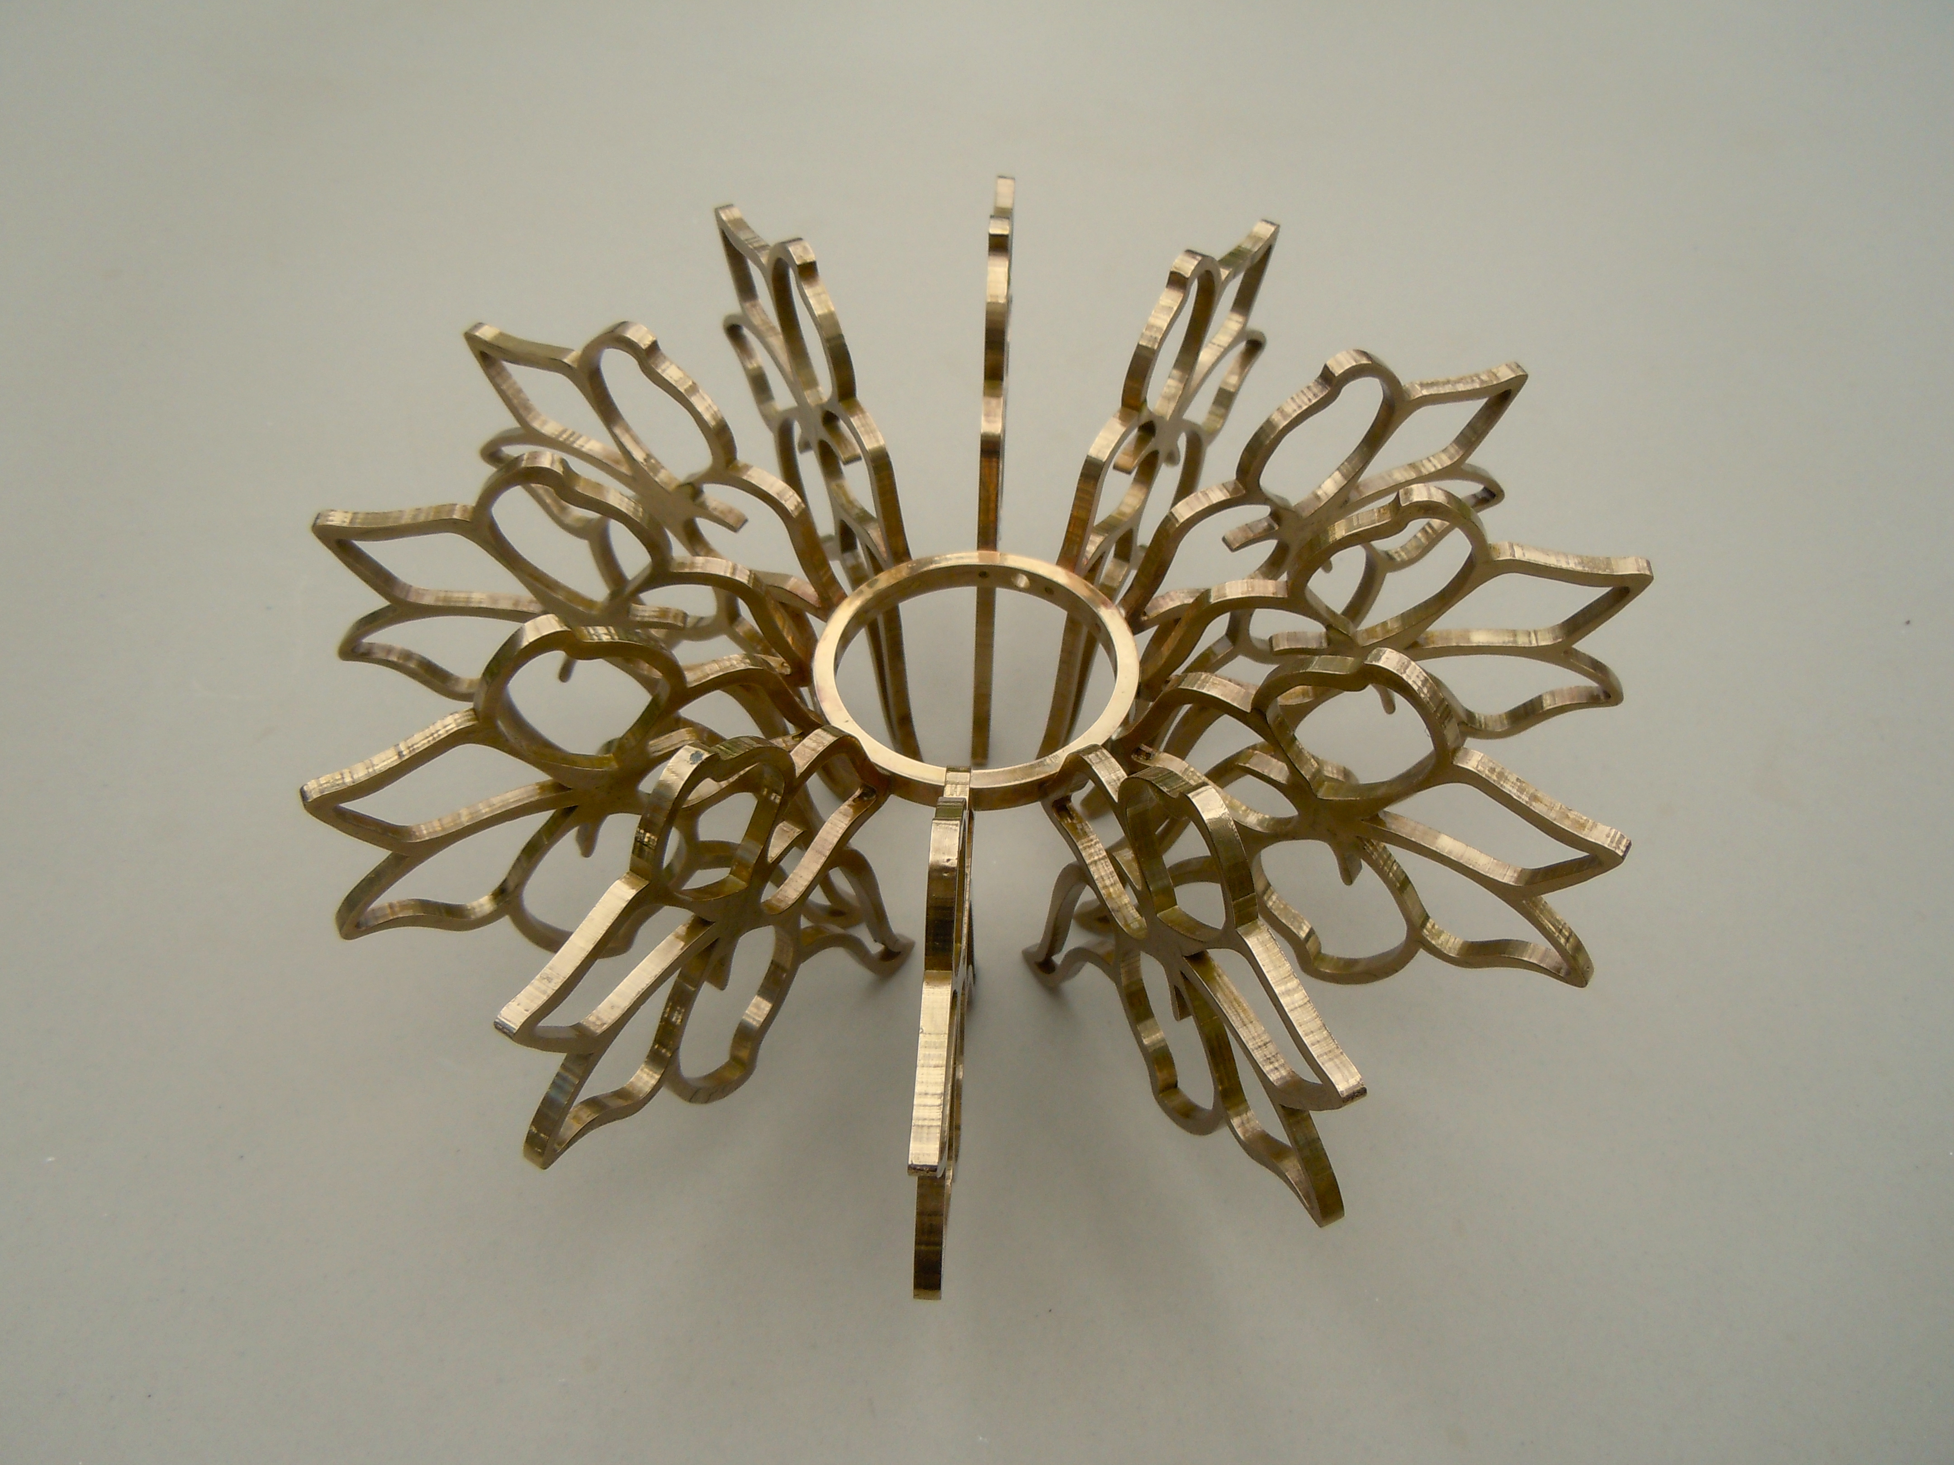

Slide 12
The design of these outline shapes came from delphinium flowers which I drew extensively as they were relevant to the client.
The traditional method used to produce multiples of an element is to make the object in metal, make a rubber mold, inject hot wax into it thus generating identical waxes for casting. This was the method I had used to produce the leaves for the bread basket. When considering the manufacture of the delphinium outlines which were too large to produce using a rubber mold I decided to scan the drawing on to a computer and laser cut the shapes in acrylic. The acrylic shapes were then mounted in the traditional way onto a wax sprue, invested in plaster and cast in bronze.

Slide 13
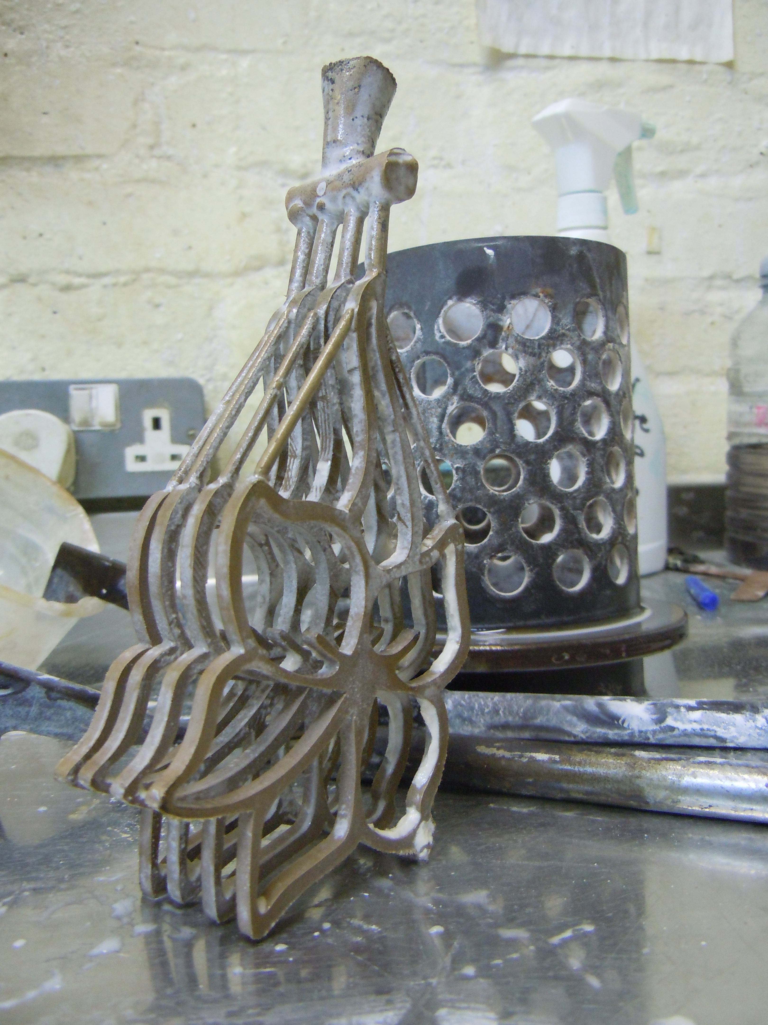
process

Slide 14
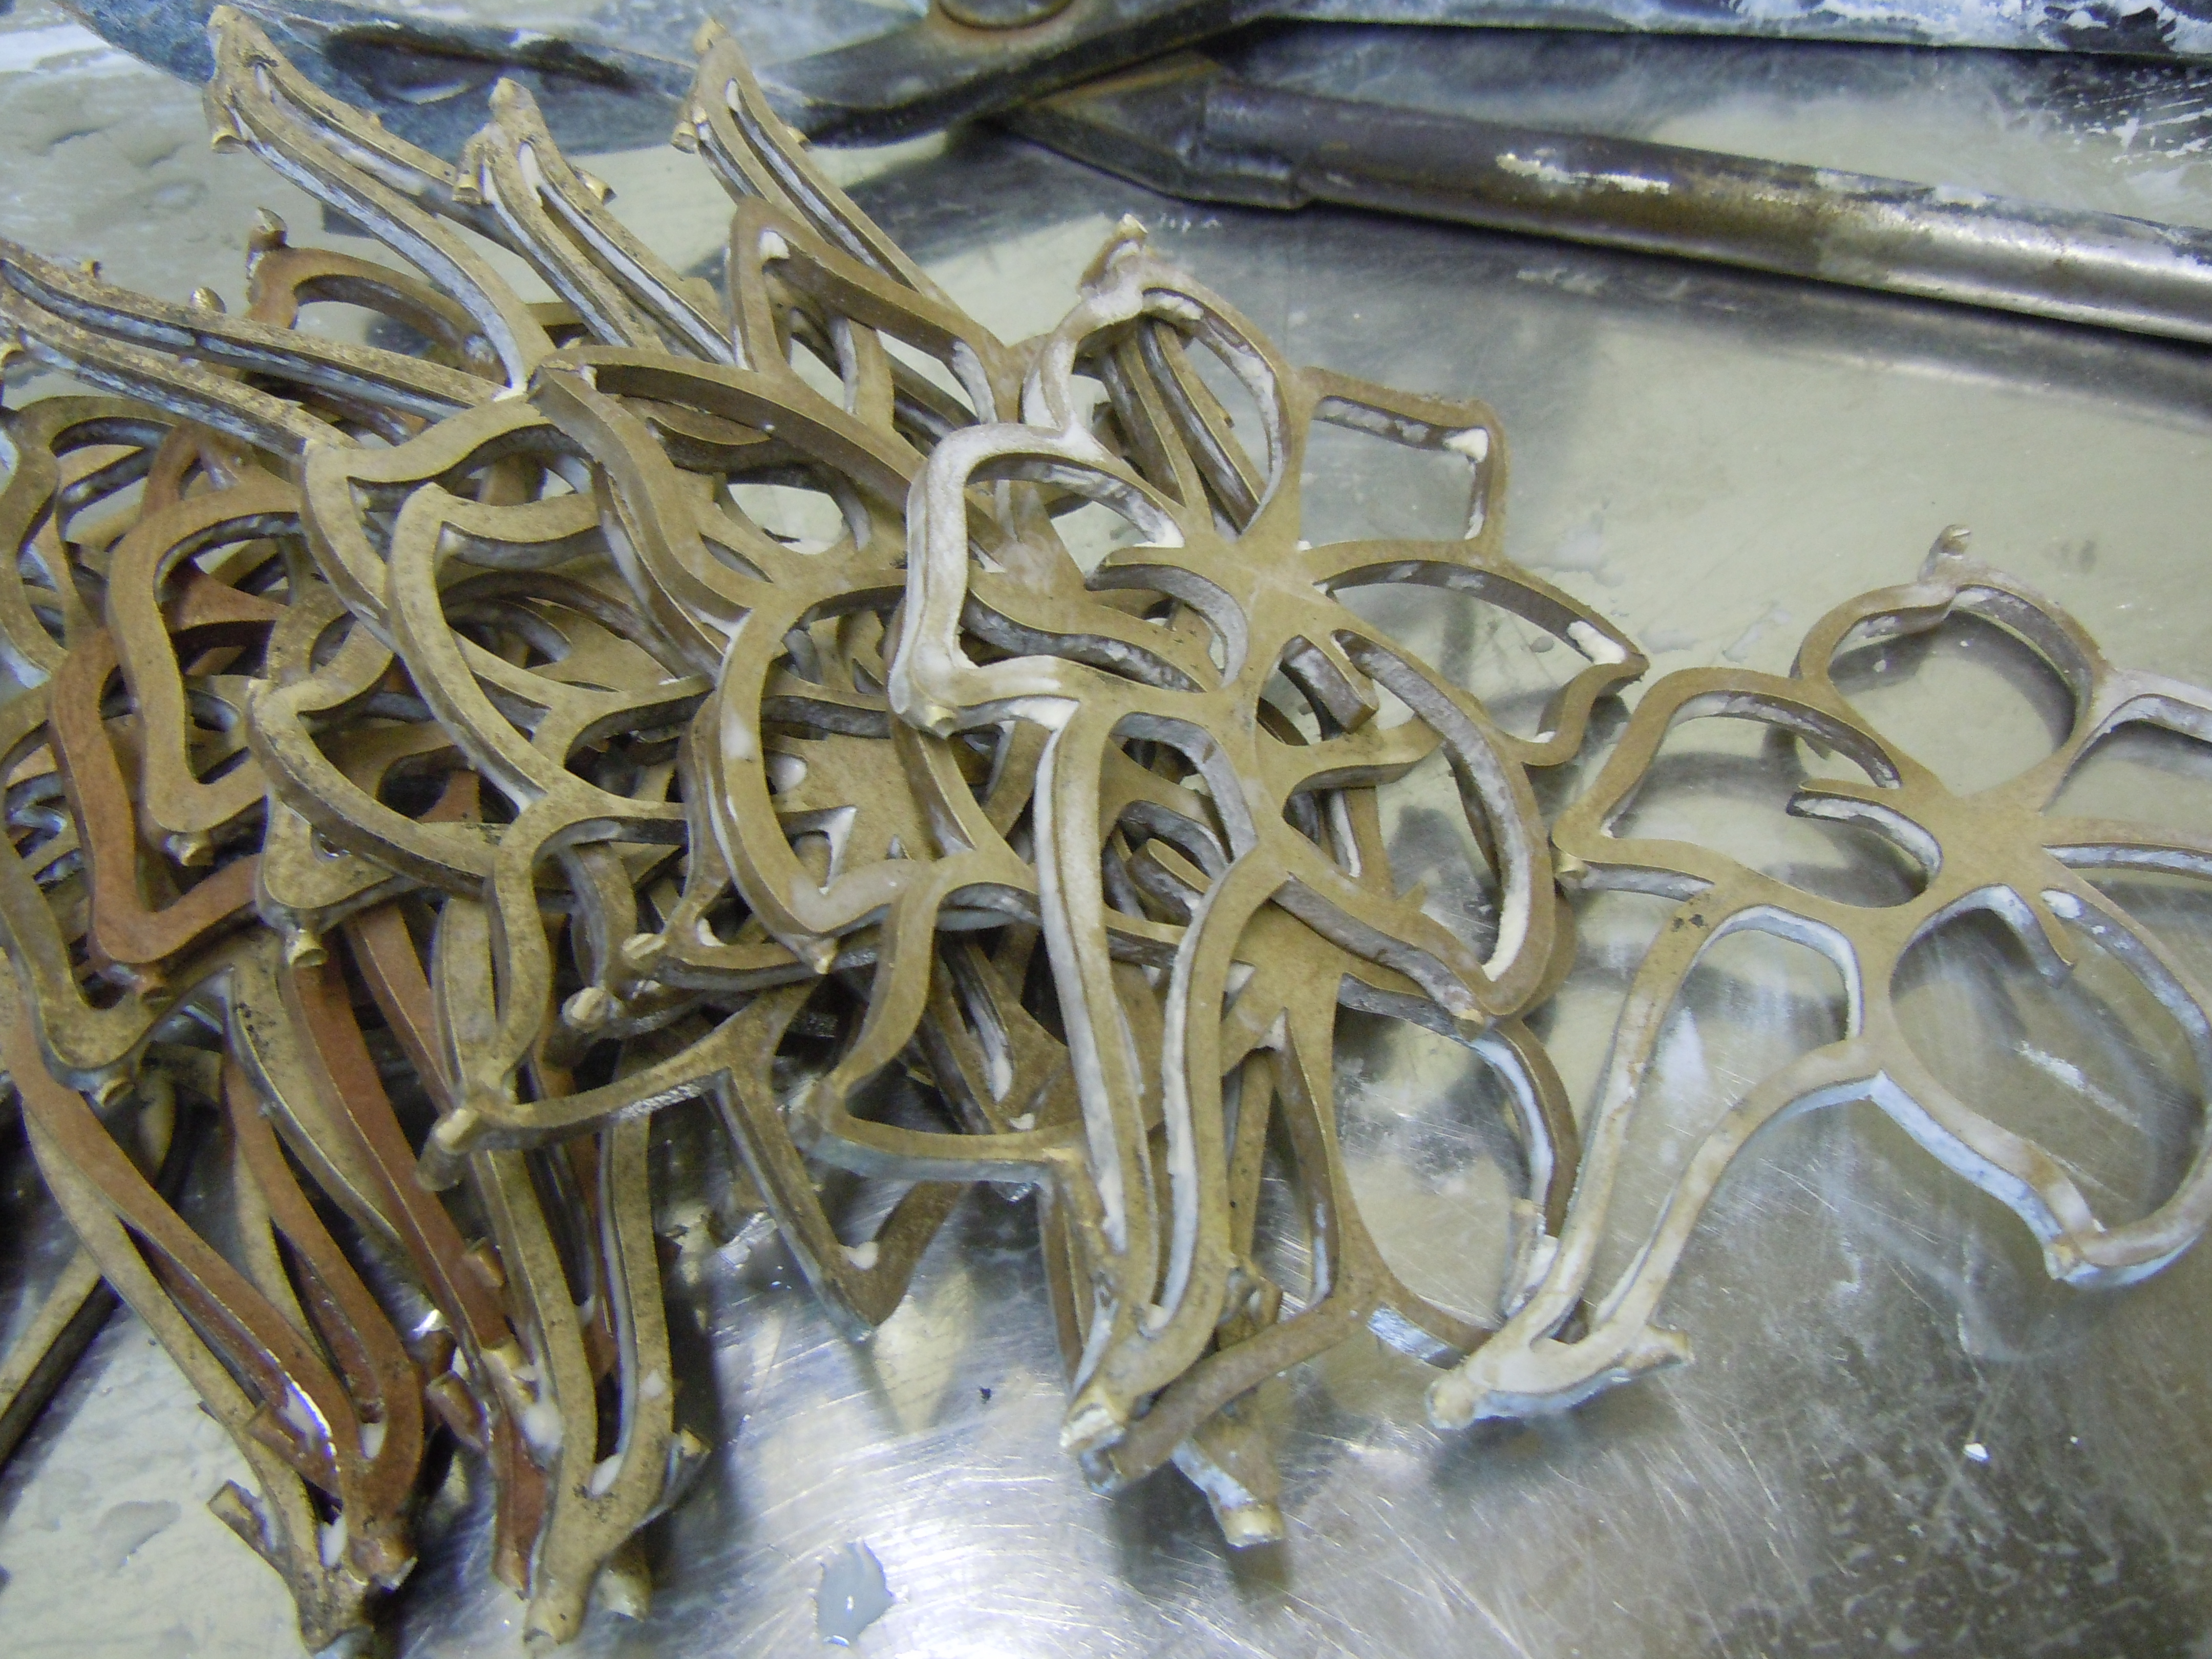
castings

Slide 15
When soldered together the three dimensional shapes created were more interesting than I had imagined, I was really excited by the outcome. These forms introduced a delicacy to very large brass objects.

Slide 16
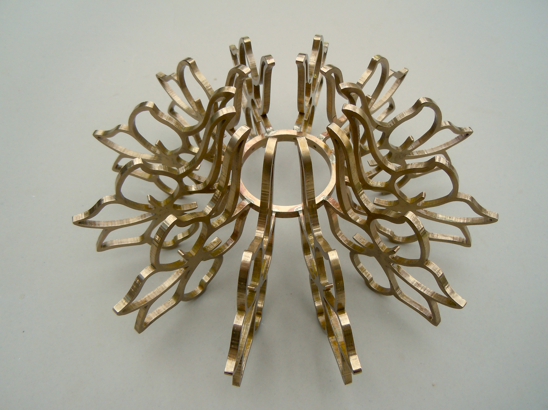

Slide 17
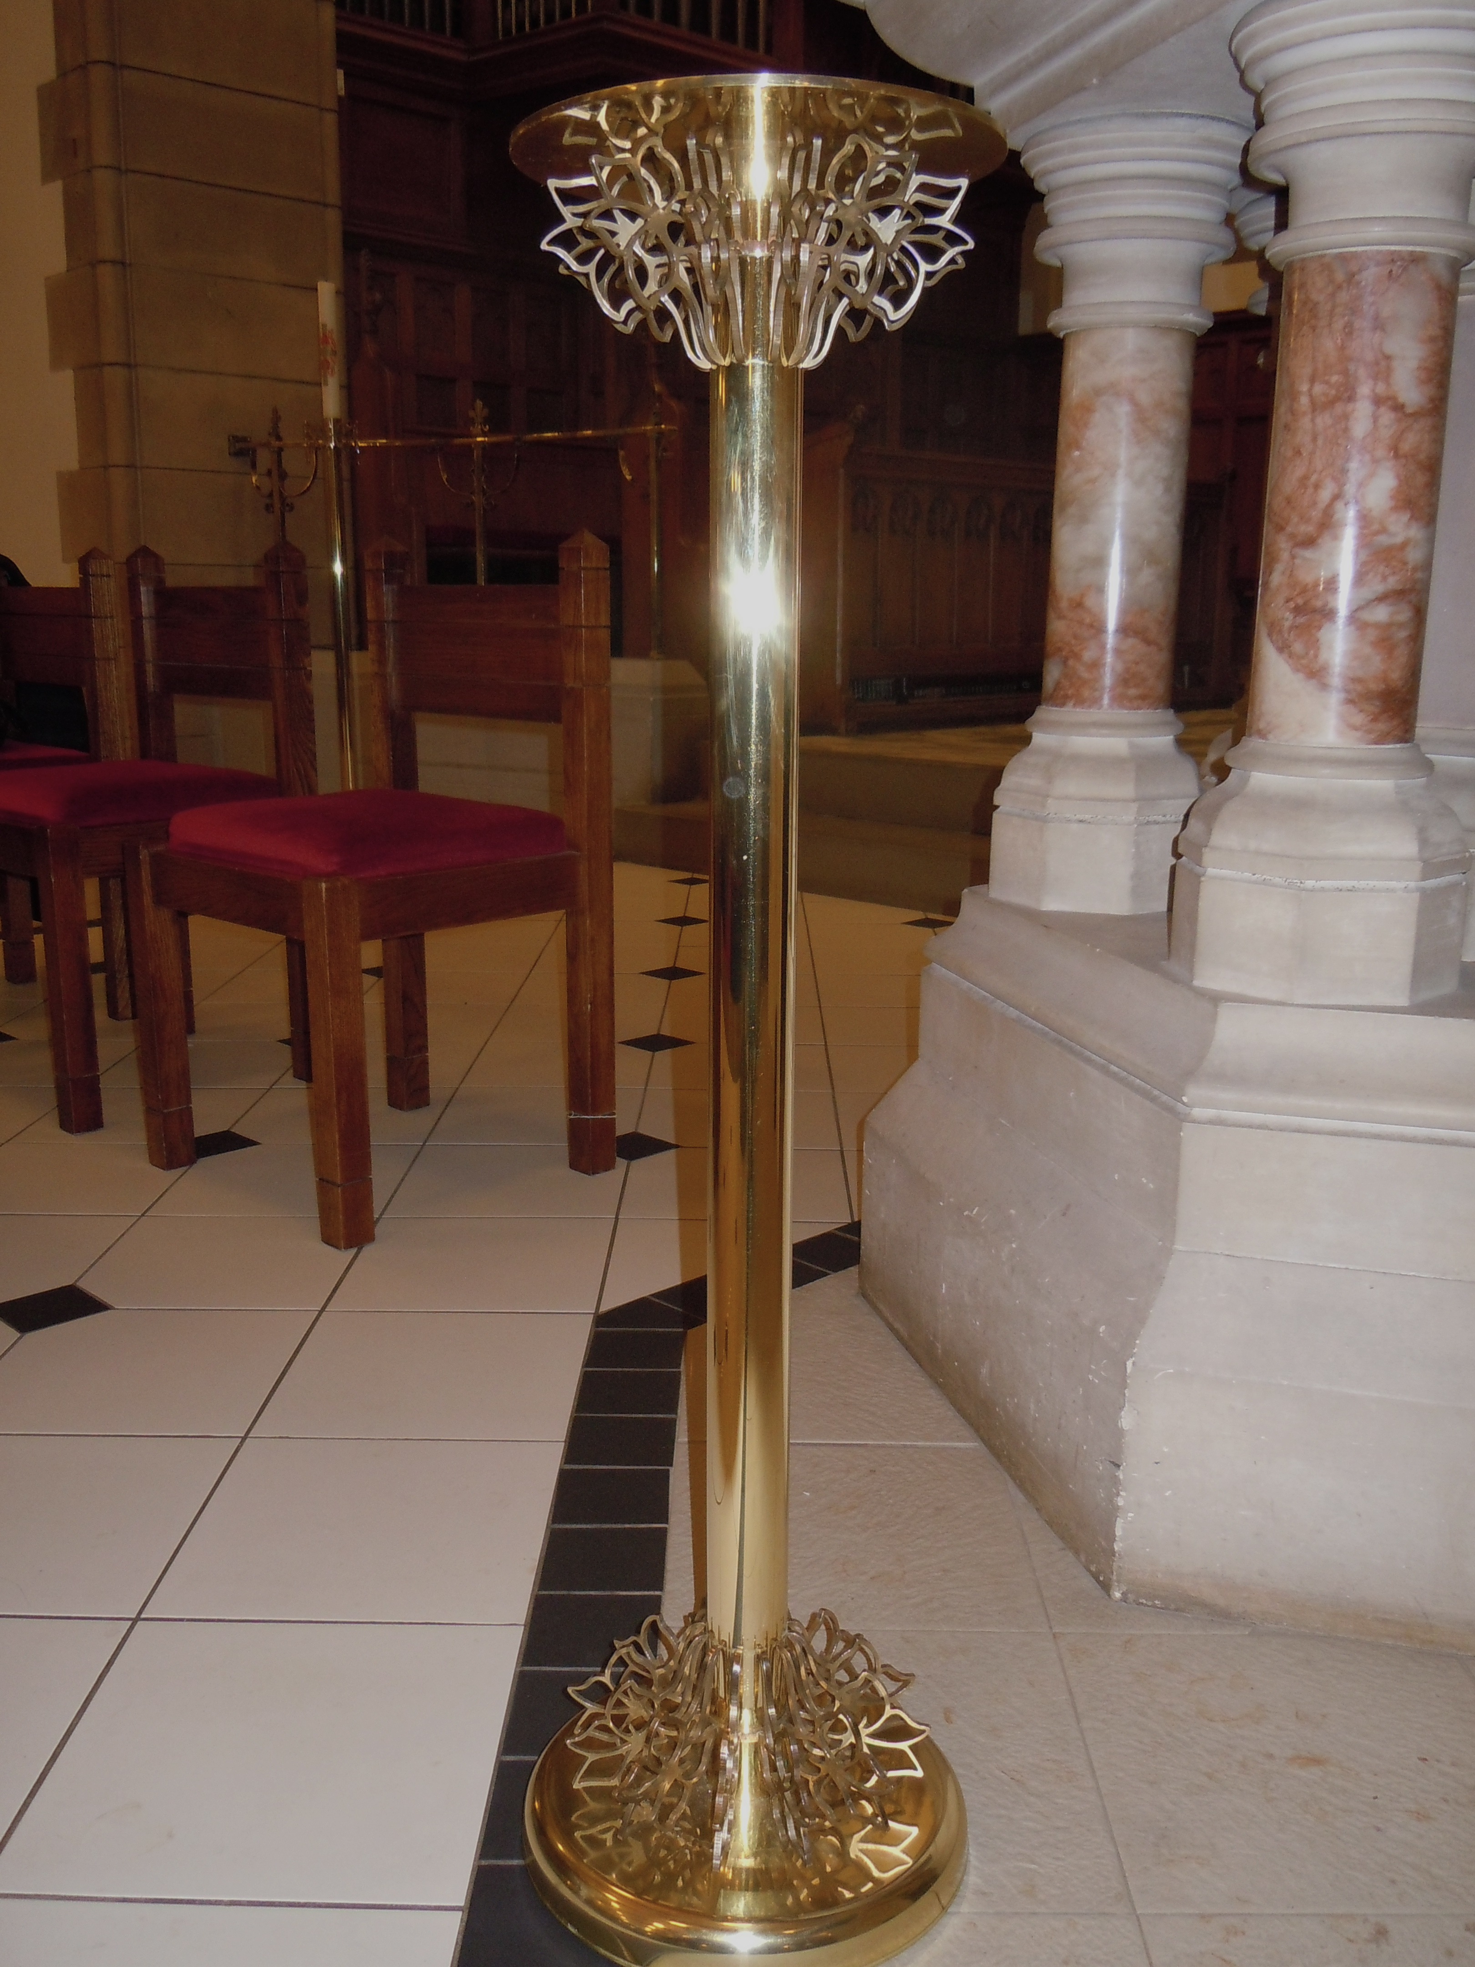
brass flower pedestal

Slide 18
The structure created as a component in the brassware was demanding to be developed into a complete piece of work. The opportunity came with another CBS exhibition, Fit for Purpose a collection of work forming part of the V&A’s Britain Design Season complementing its major spring exhibition British Design 1948-2012:
The Candlesticks I produced described their purpose both practically and conceptually through the medium of silver. The leaf form I developed for the design created a three dimensional shape when repeated and included the means by which the candle was held. The silver elements were produced by the same method as the brass shapes in the previous commission and then simply soldered to two rings, the stems of the leaves grip the candle.

Slide 19
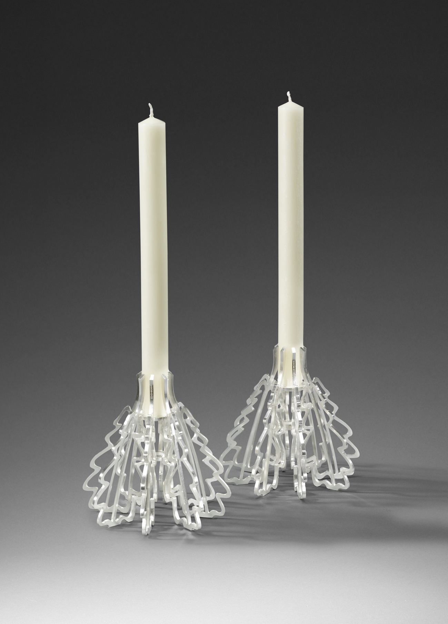
fit for purpose

Slide 20
The development of the three outcomes described demonstrates how a change in working practice as technology offers new possibilities has produced work that would otherwise have been impossible using traditional methods alone. The most interesting work being produced by contemporary silversmiths is when they experiment technically whilst retaining a strong approach to design. The following silversmiths; Lucian Taylor, Pete Musson and Chris Knight I consider to be top of their field, they are all producing work of a very high quality using new technology to drive creativity.

Slide 21
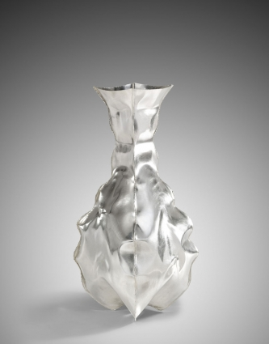
lucian taylor

Slide 22
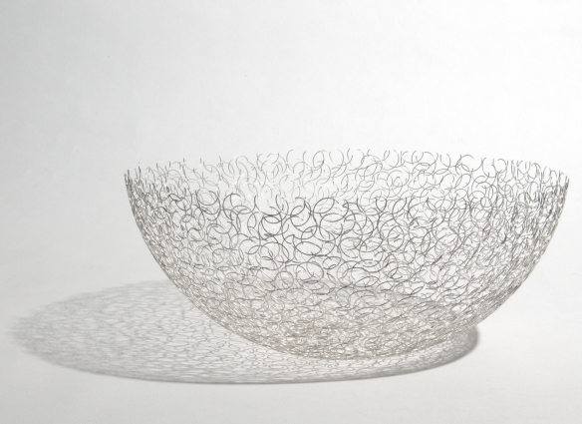

Slide 23
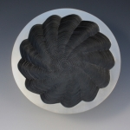
pete musson

Slide 24
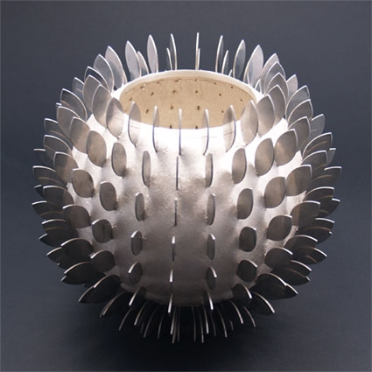
chris knight

