Slide 1

Curious Arts - No. 3
Site-specific installation at Hospitalfield House, Abroath (2010 to date)
Semi-permanent commission for the Library of Hospitalfield House produced in collaboration with Jim Harold. This historic library forms the focus for research and apprehension of the world through the artists' complex interpretation of the relationship between rational bodies of knowledge and the poetic space of imagining.
Vinyl text on painted walls.
Submitted by Susan Brind
Output No. 1

Slide 2

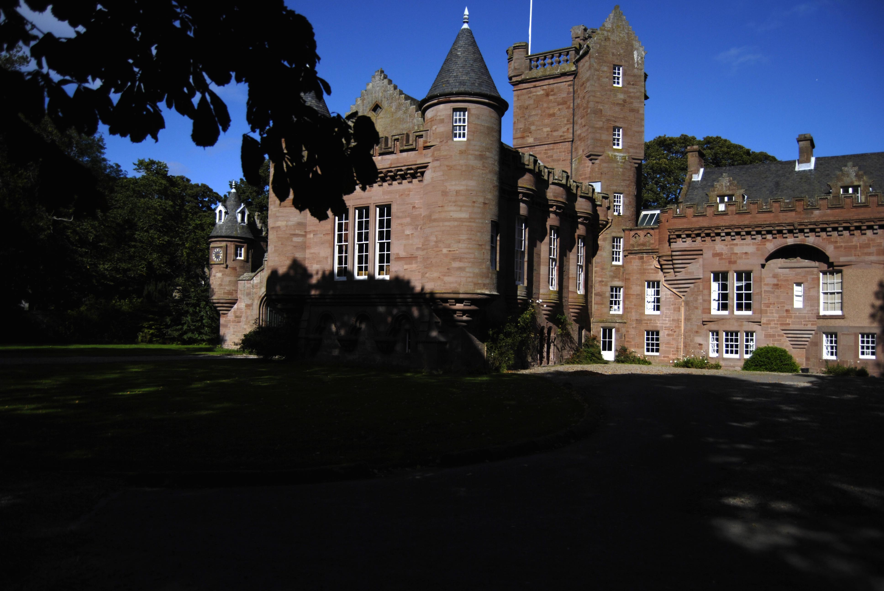
Hospitalfield House,
Arbroath
Research Question:
How might one make a site-specific installation that draws on the particular holdings of Hospitalfield House Library in particular, whilst addressing more generally the nature of libraries, the acquisition and ordering of knowledge, and the overarching desire to understand the world around us?
Image one & a description of what we are looking at in the context of the project.

Slide 3

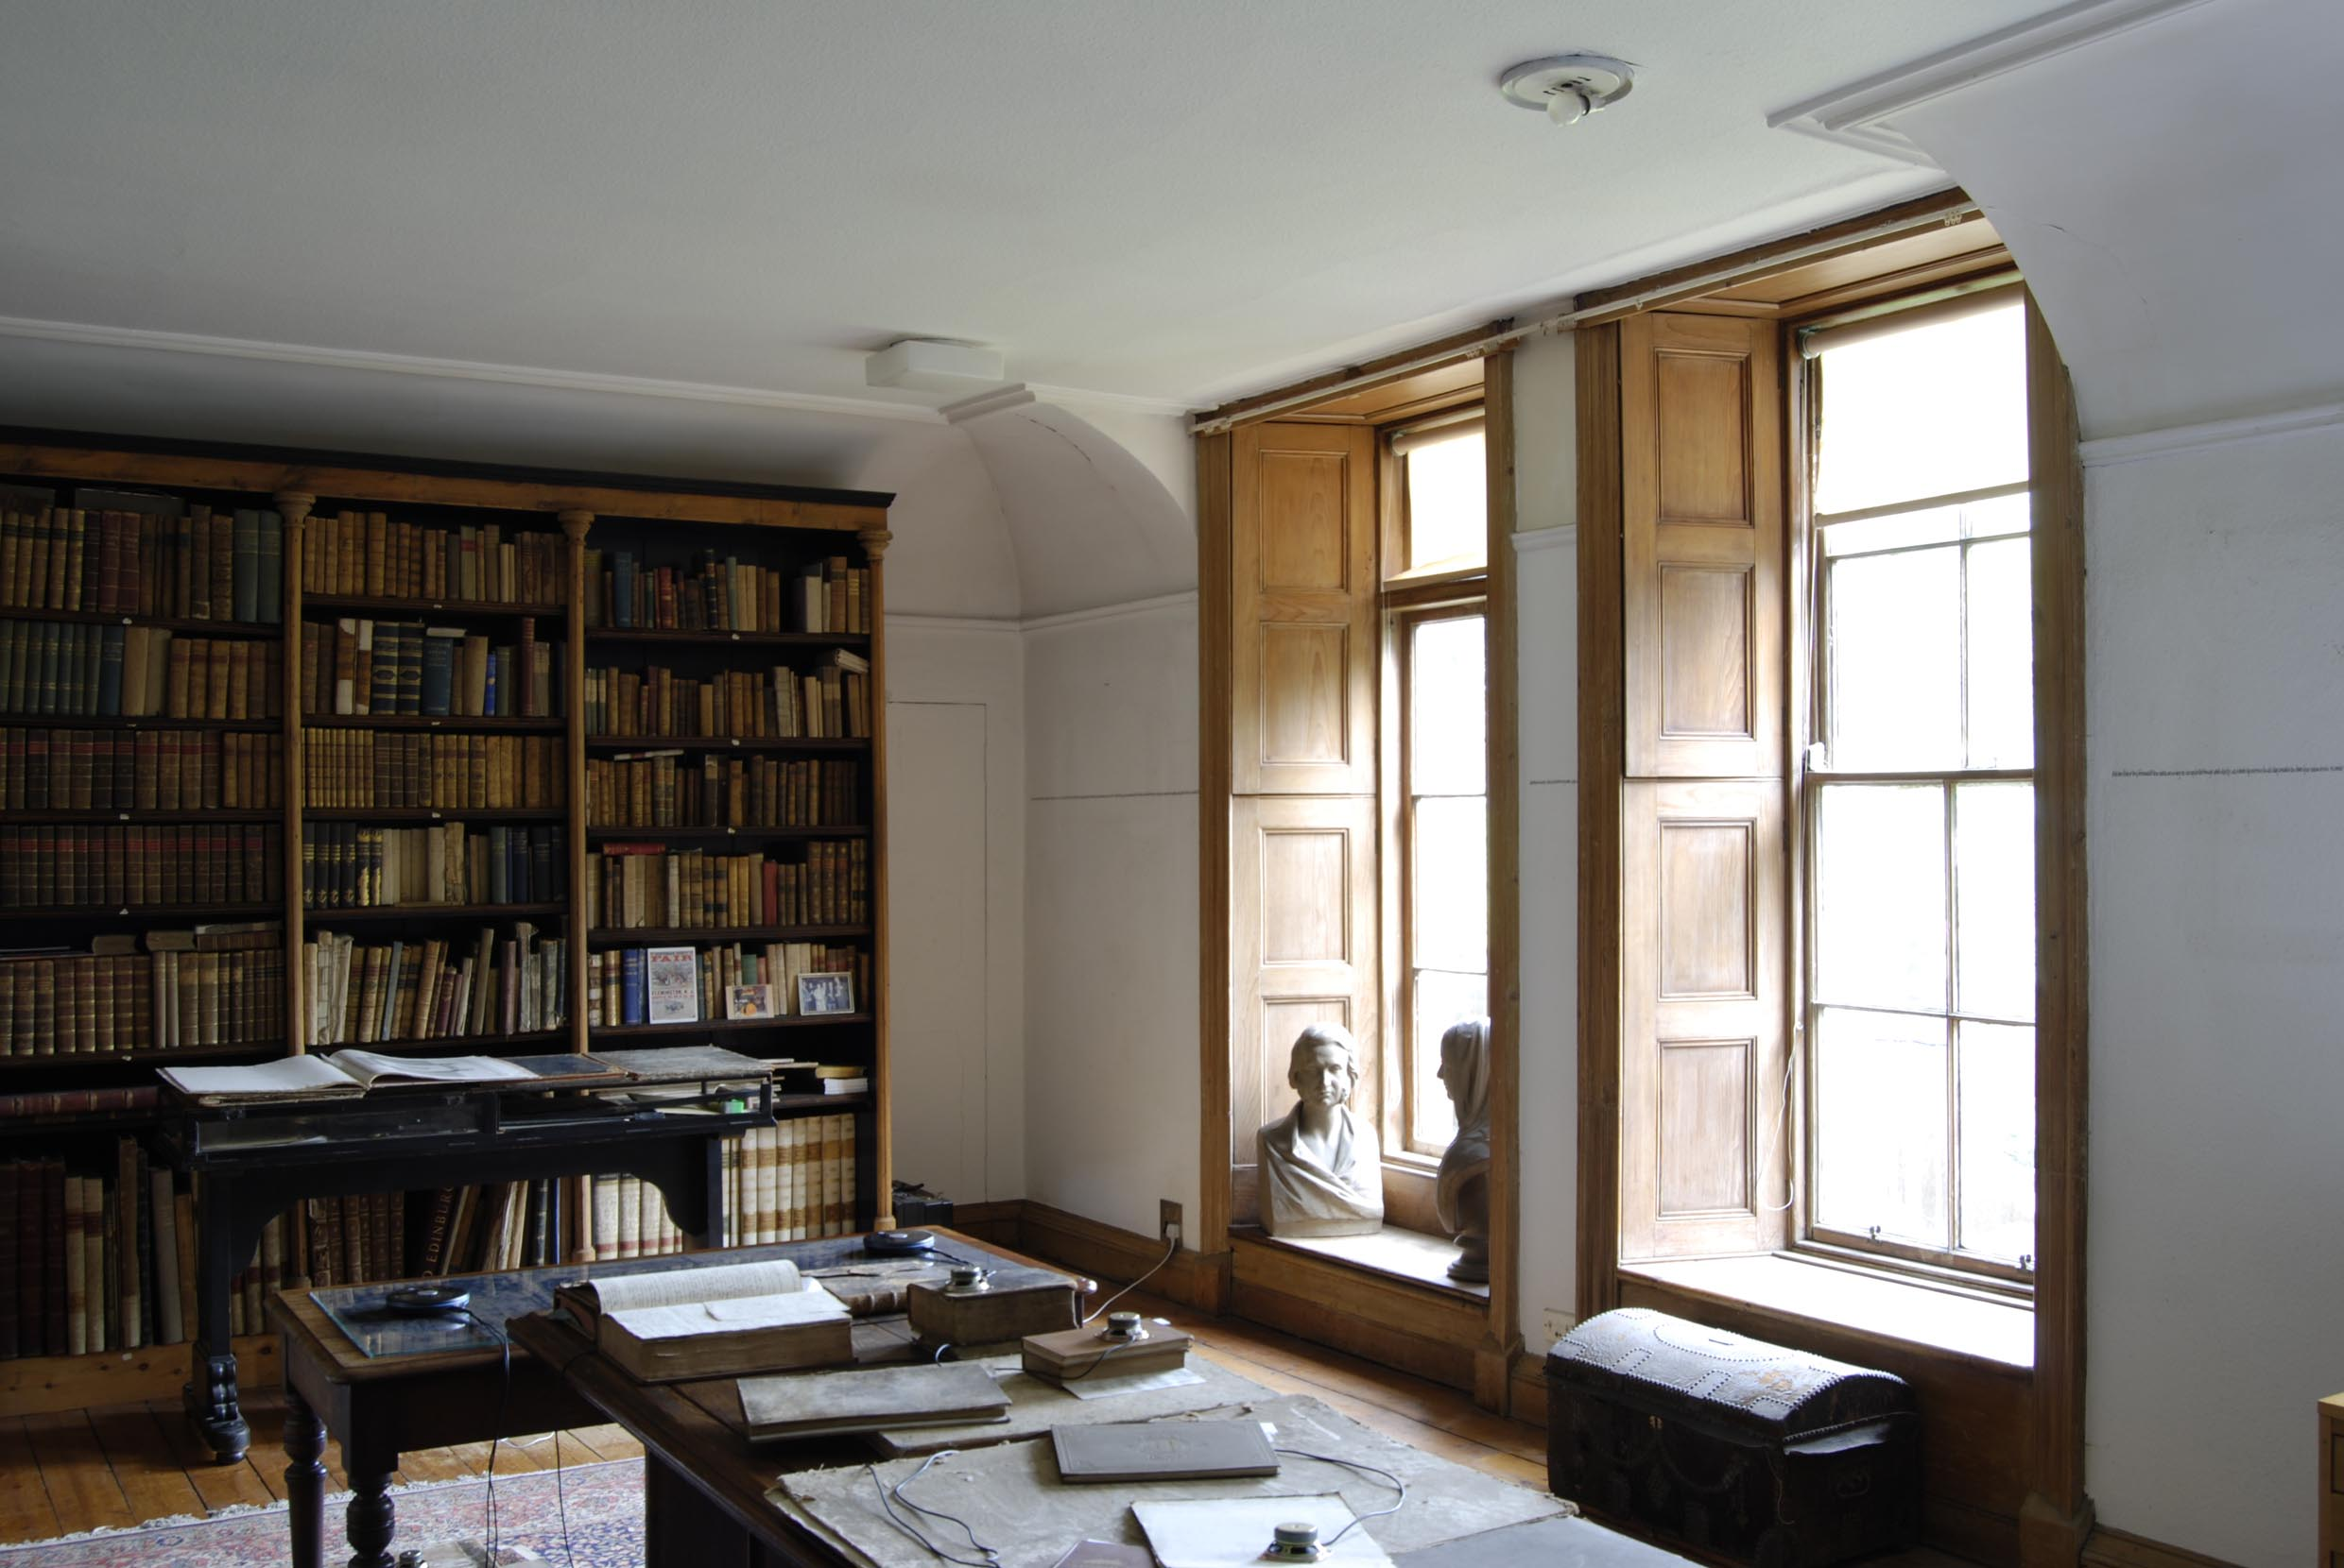
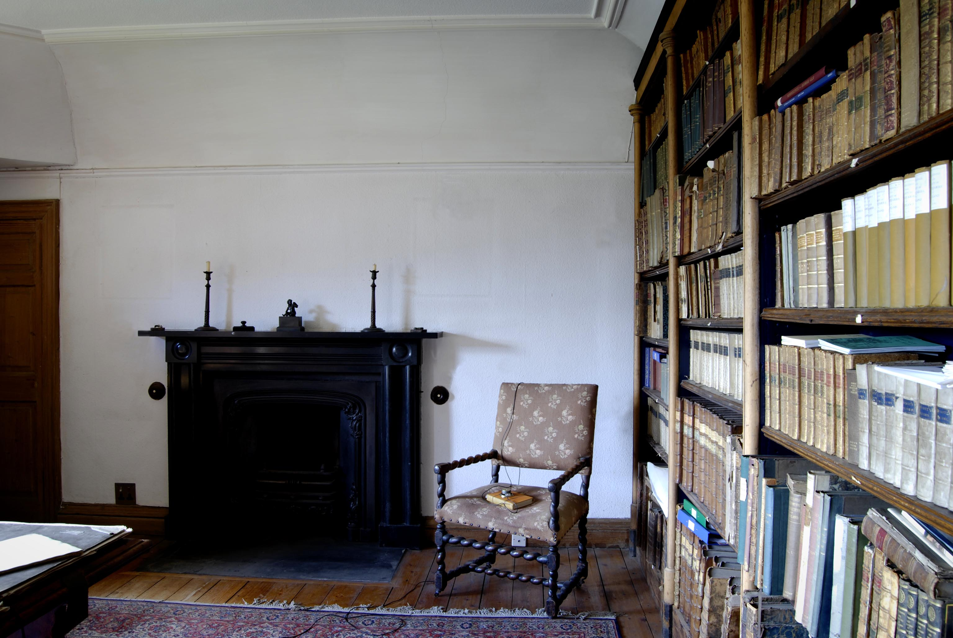
Hospitalfield Library
during the artists’ research residency
and before the making of
Curious Arts - No. 3
The invitation to Susan Brind & Jim Harold to make a semi-permanent installation for Hospitalfield Library in 2010 resulted from a collaborative research residency that the artists undertook at Hospitalfield House in 2007, funded by the Royal Society of Arts and Hospitalfield House Trust. During the period of their residency the library (seen here) - filled with books but otherwise, at the time, a neglected space - became both a research resource and a space in which emerging ideas were explored and tested out through: textual research, drawing, writing, photography, sound recording and material investigation.
Image one & a description of what we are looking at in the context of the project.

Slide 4
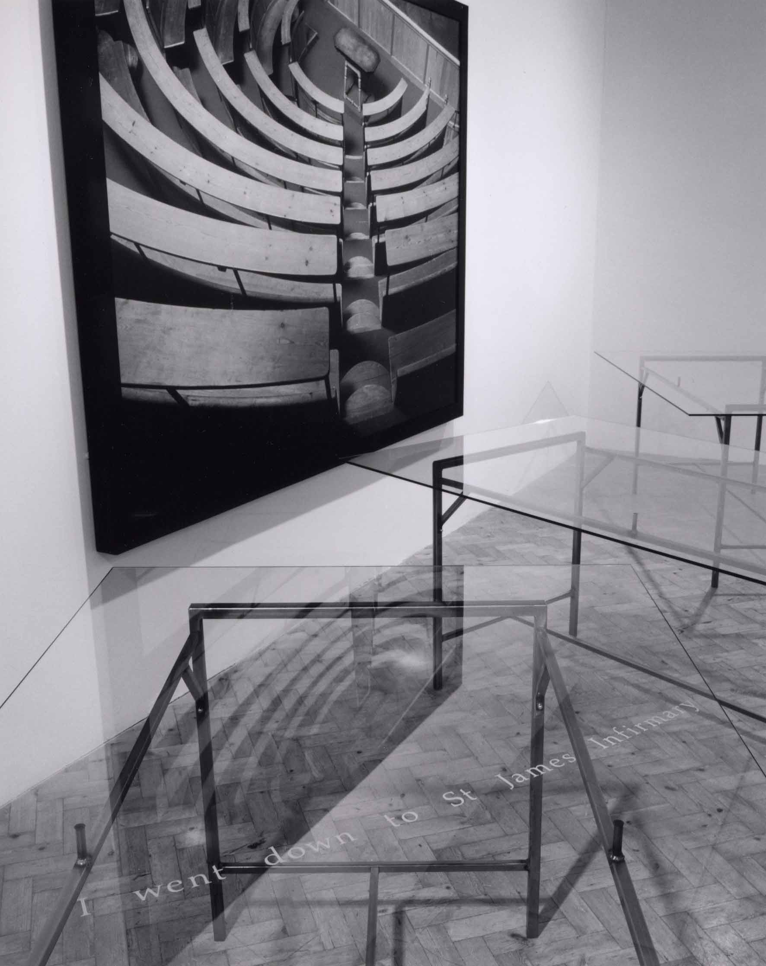
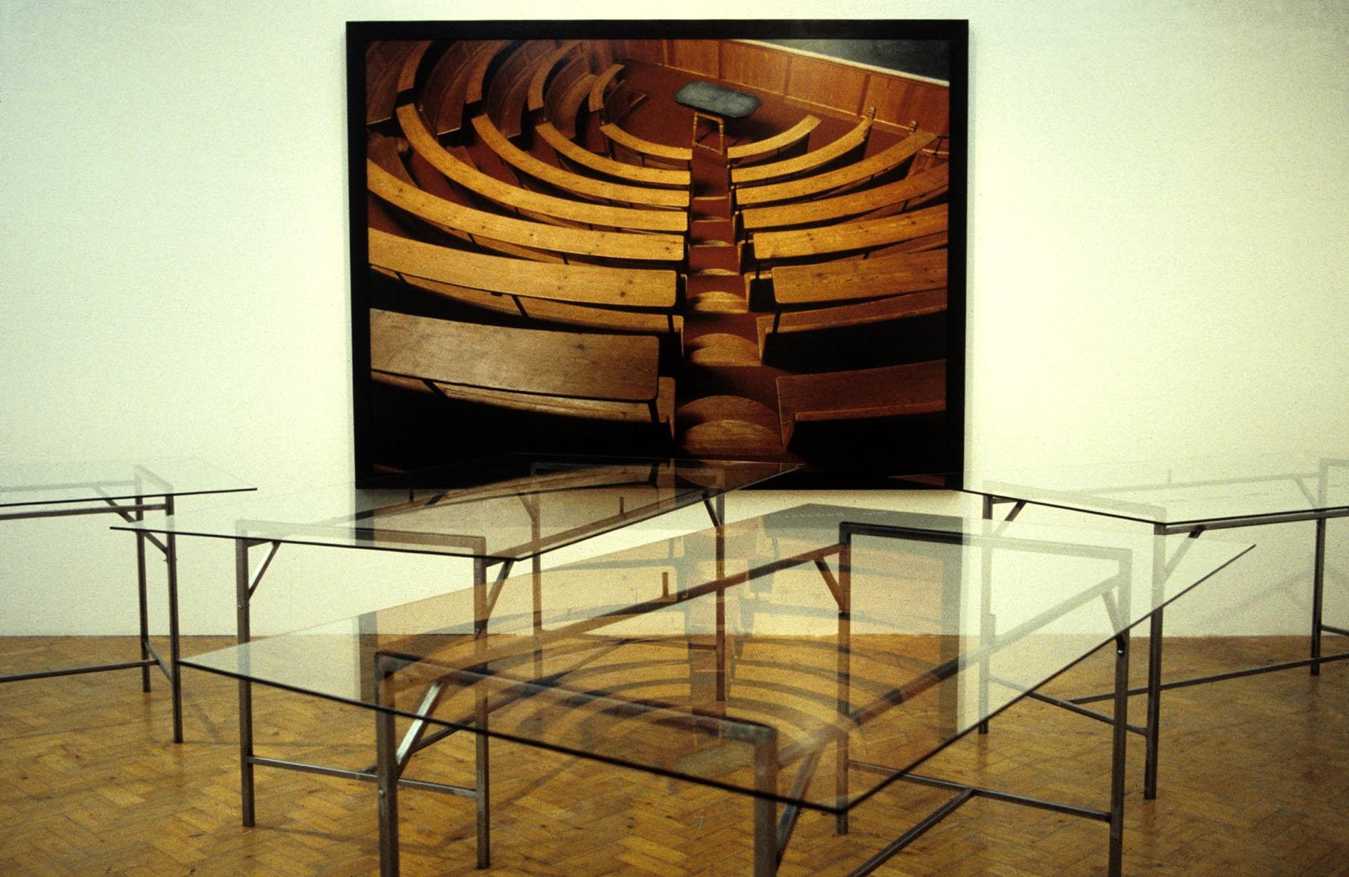
Mysteries of the heart (detail and view)
Commission from Book Works, London
for the exhibition ‘The Reading Room’
at Camden Arts Centre, London, 1994
Since the late 1980s the artist-partners Brind & Harold have worked in collaboration at points when their specific research interests have coalesced. Both artists work across a range of media, including sculpture, installation, text, sound and photography, and site is frequently an integral element within artworks. Their shared concern is how a poetic space of imagining might allow new insights into historical knowledge through contemporary re-interpretation. A notable early example of their collaborative work would be Mysteries of the heart (shown here) which looked at how the subjective body was interpreted by the medical gaze.
During the period 2007-2013, Brind & Harold have worked exclusively as collaborators on a series of works entitled Curious Arts - each with a numerical suffix - which have been developed out of the Hospitalfield residency, the artists being equally involved in the research and generation of ideas, as well as the production of artefacts, exhibitions and related written material.
Image one & a description of what we are looking at in the context of the project.

Slide 5
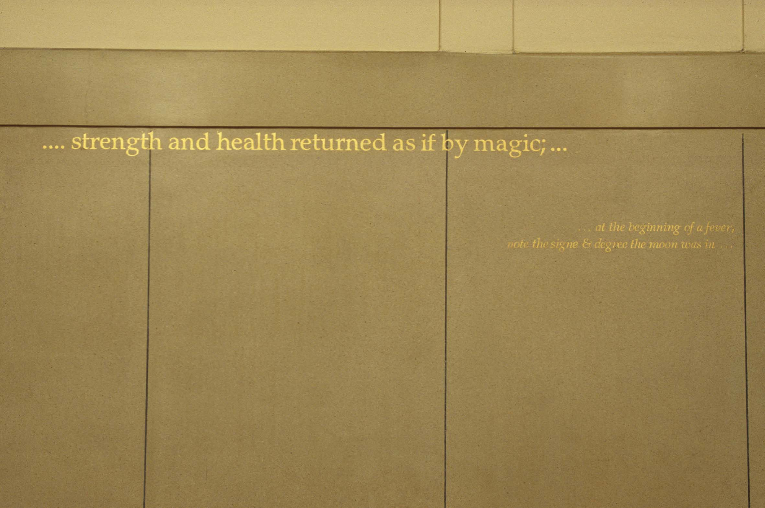
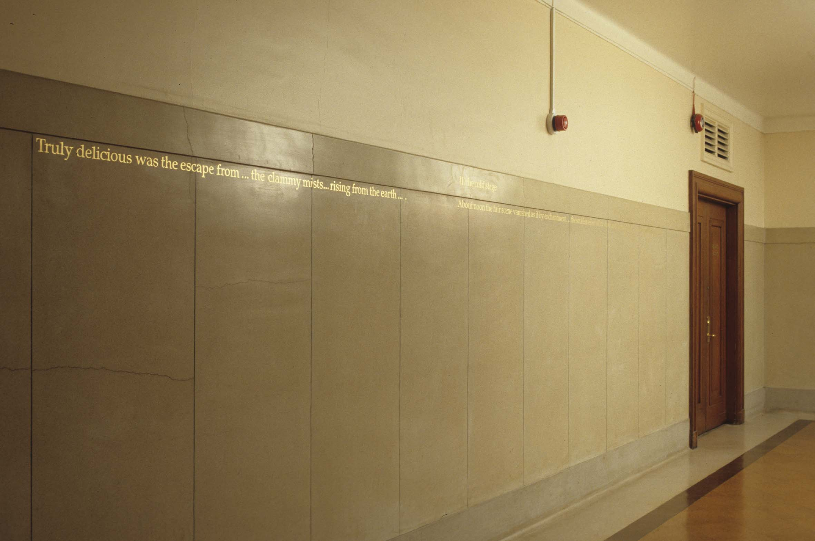
Bad Air [mal’aria], (detail and partial view)
London School of Hygiene & Tropical Medicine
Hand rendered gold leaf on terrazzo walls, 2001
In 2008 the then Director of Hospitalfield House Trust commissioned Brind & Harold to make Curious Arts - No. 3 specifically for the Library. The method used for this project – utilising texts as material presented in architectural space - created a dynamic space of connected ideas and embodied experience. It is a further development of the approach, including use of library and archive material, taken by Brind in the research and presentation of the commission, bad air [mal'aria] for London School of Hygiene & Tropical Medicine.
Image one & a description of what we are looking at in the context of the project.

Slide 6

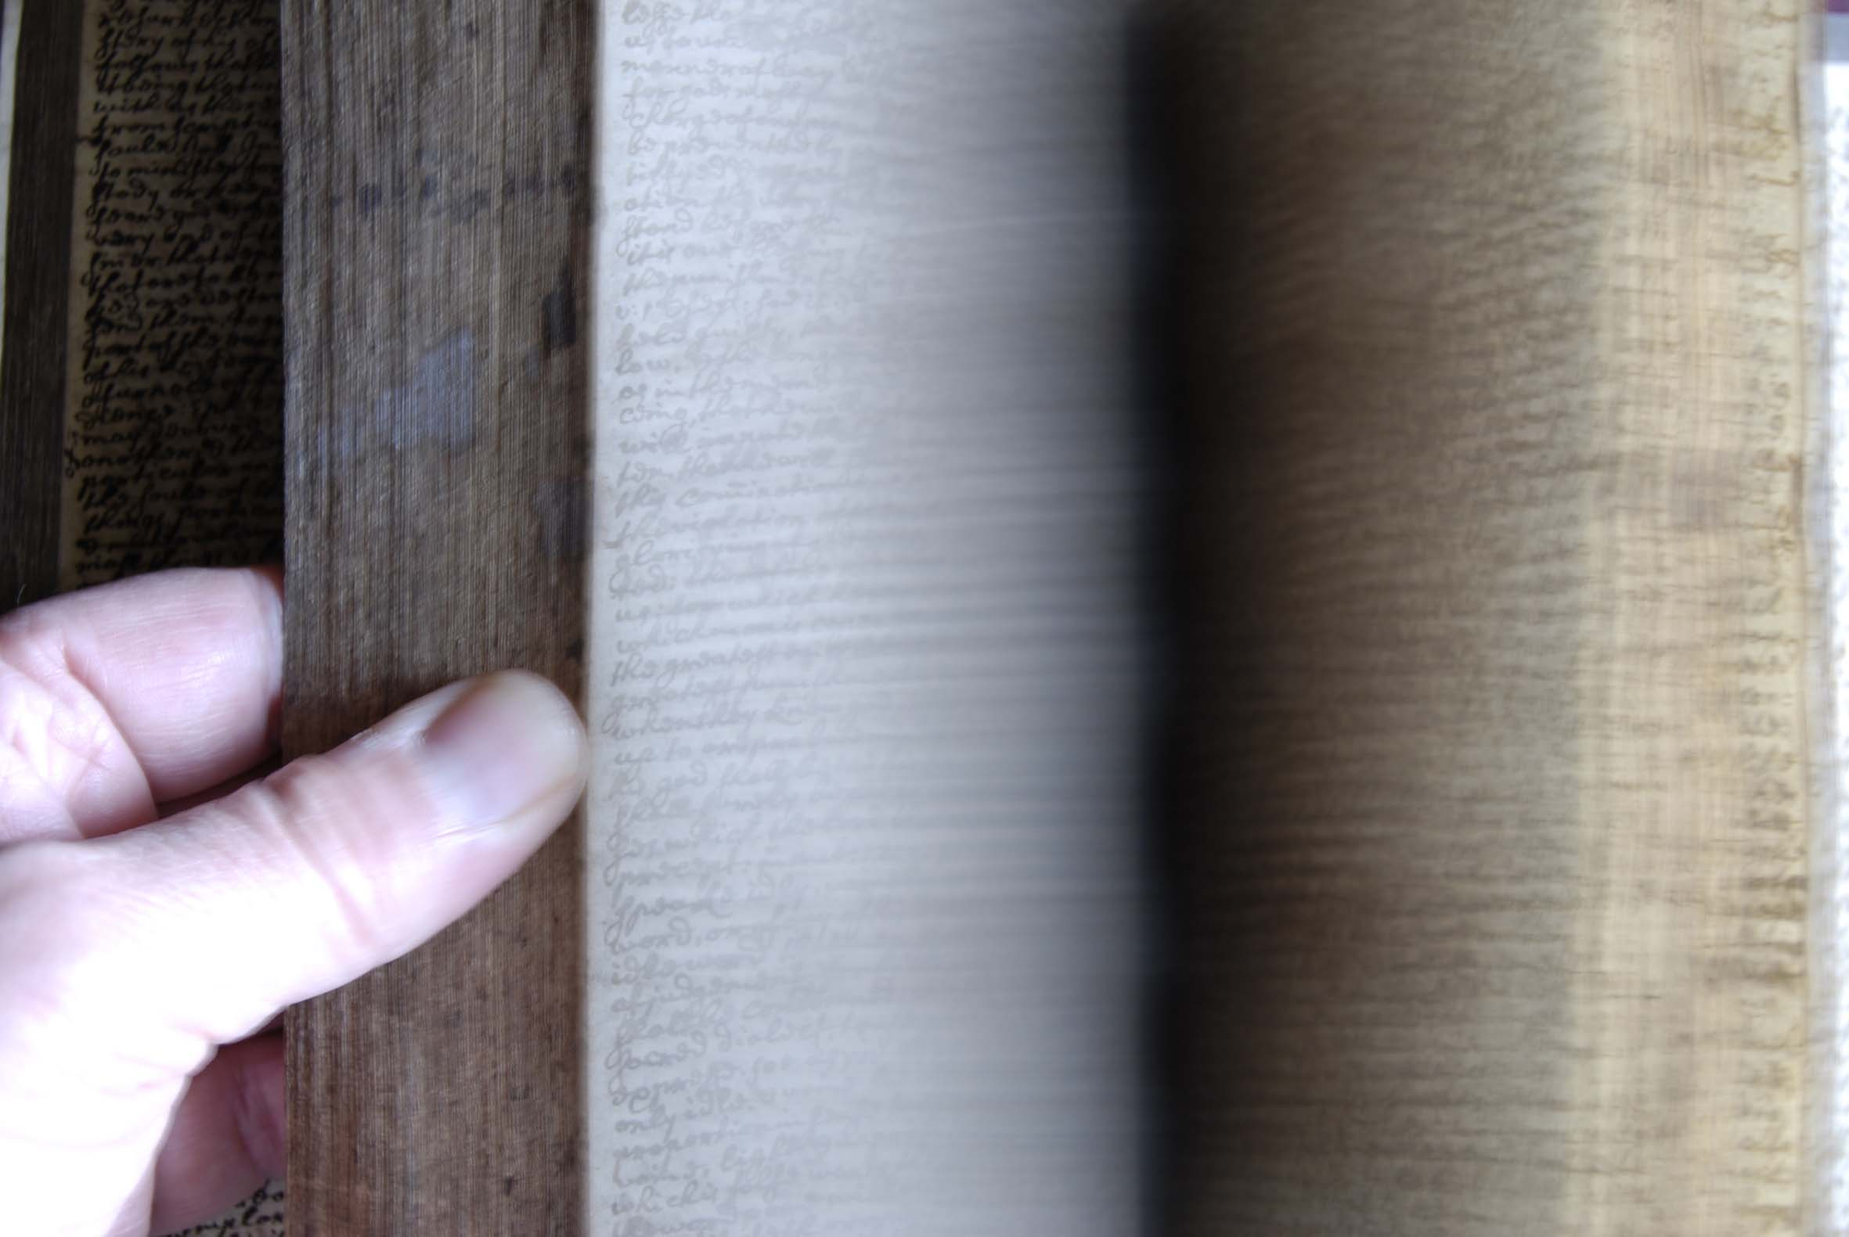
The journal of Christopher Wright, C18th
Hospitalfield House Library.
Method:
Curious Arts – No. 3, which incorporated the refurbishing of the Library of Hospitalfield House, takes the form of a series of related wall and ceiling texts on a rich and warm coloured ground. The chosen texts re-introduce to the Library history and ideas discovered by the artists during the collaborative residency in the house in 2007, and during subsequent research visits in 2008 and 2009.
Close readings of historic journals and comparative textual and visual analysis of books, both held in the library, revealed a consistent attempt to understand and order knowledge. A pattern of thinking emerged which revealed a curiosity in the relatedness of all things.
Image one & a description of what we are looking at in the context of the project.

Slide 7
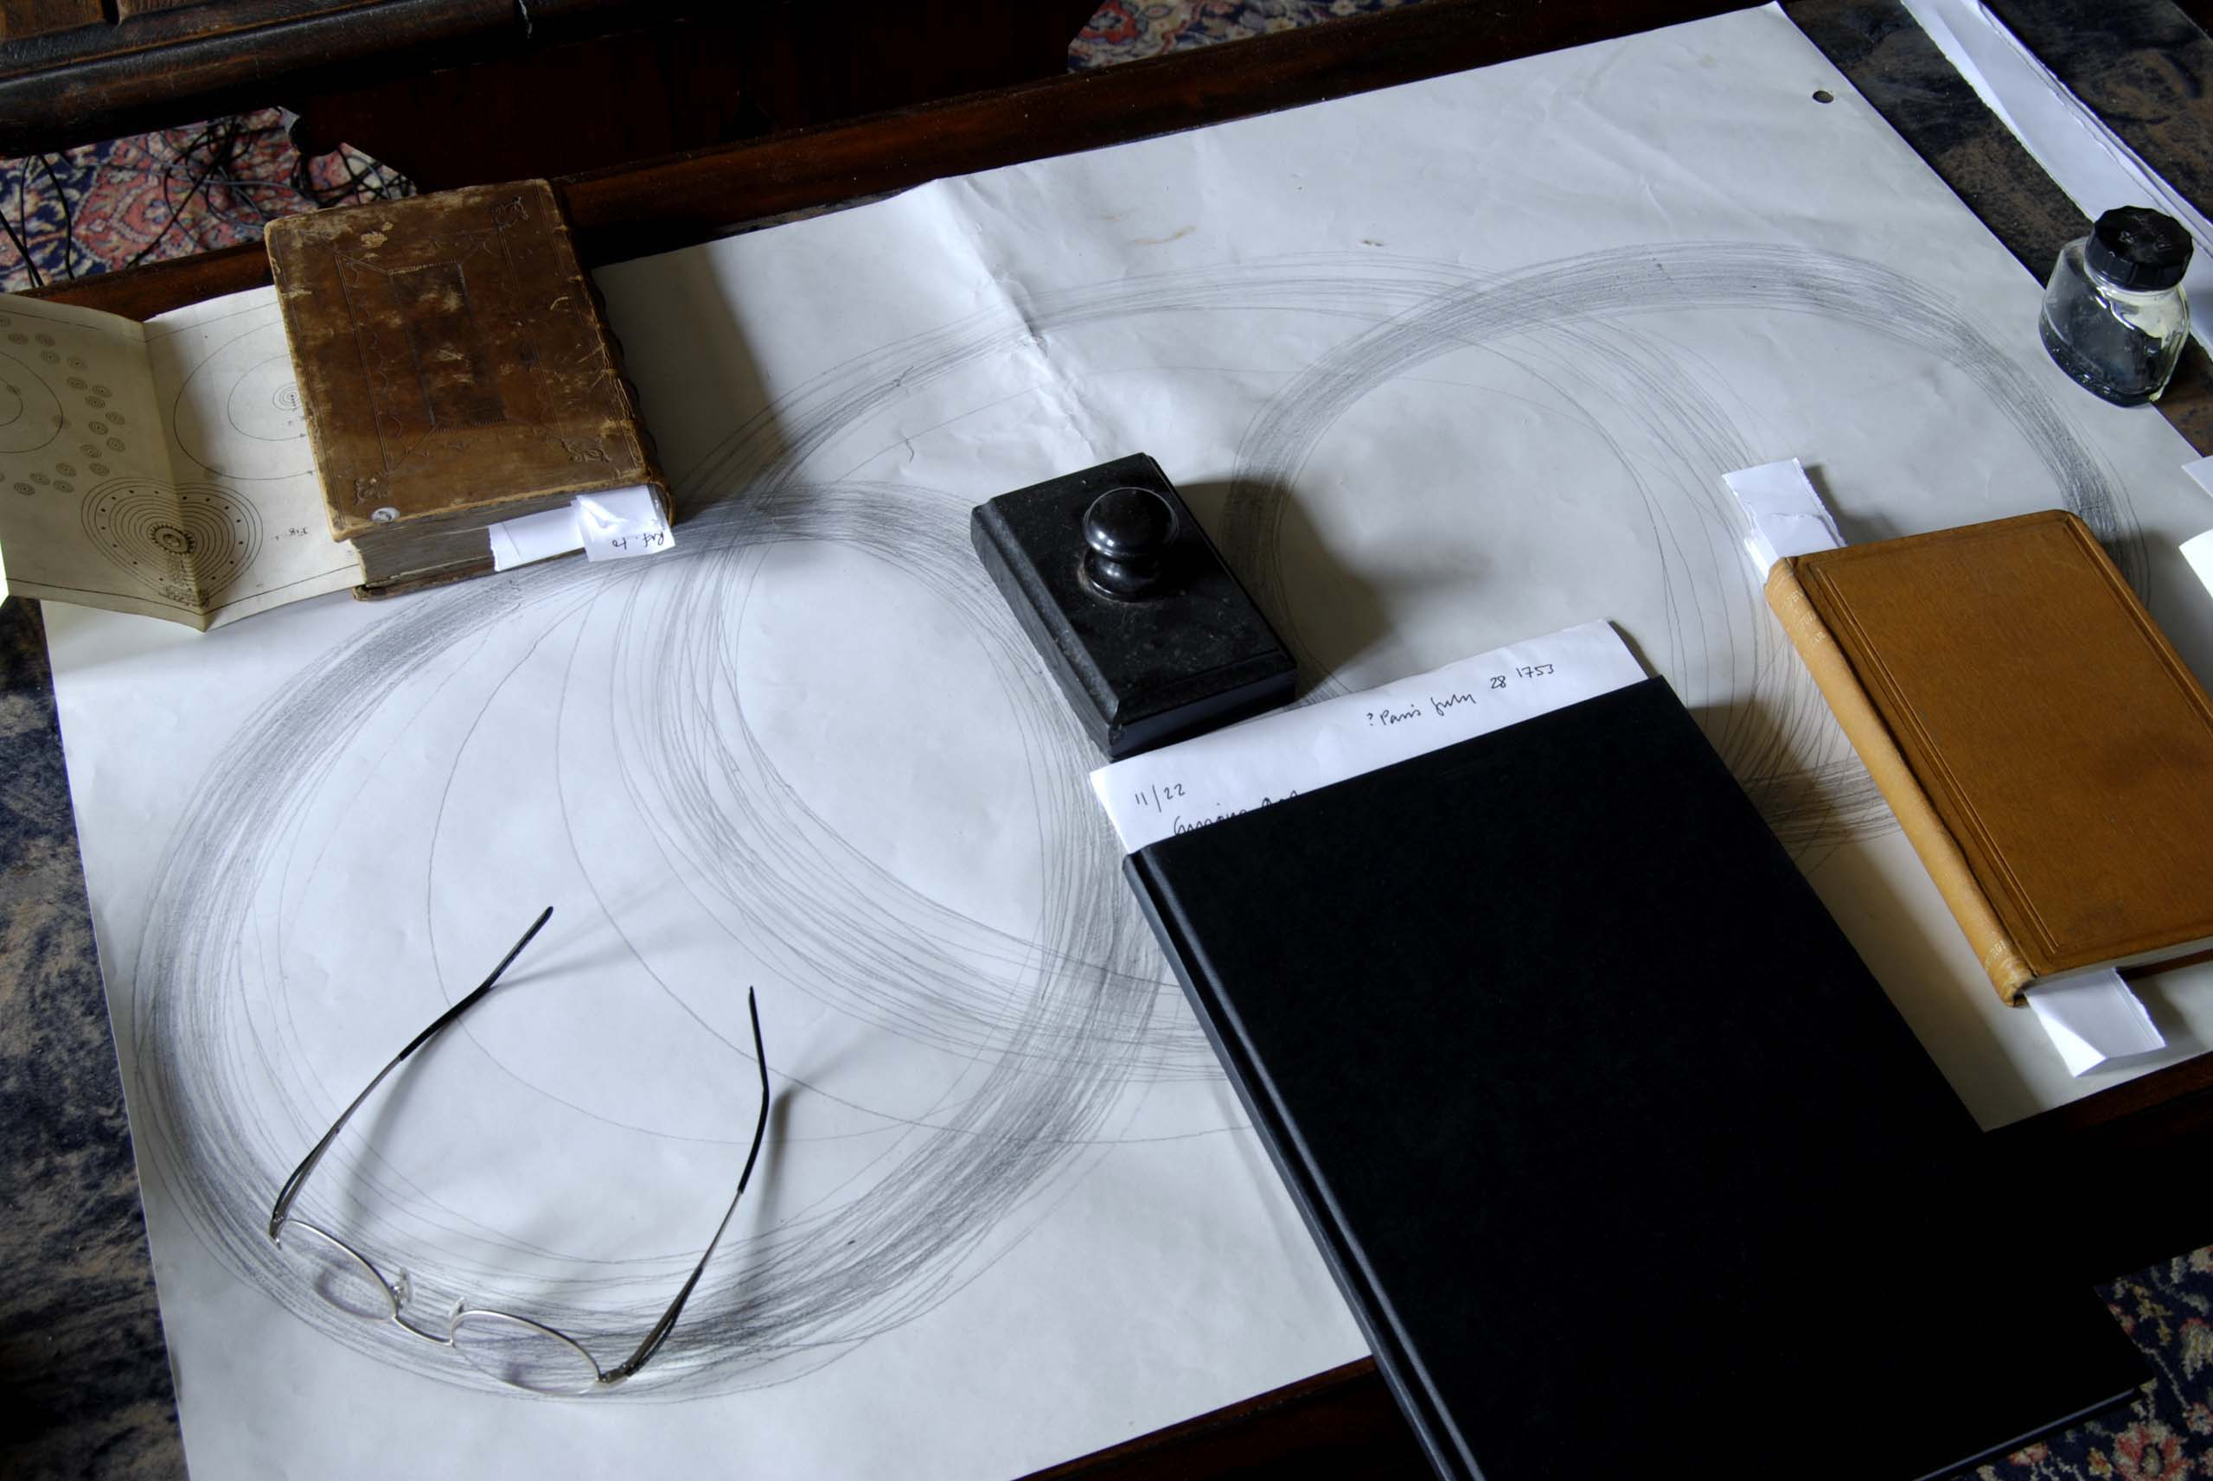
Curious Arts - No. 3 focused on tracing connections between what might appear to be diverse and disconnected ideas. The intention was to find a way of making such ideas more physically apparent within the room, and to transform the Library into a space that was equally about the user’s experience of it and about the ideas contained within the holdings. The following books became key influences in the research:
Three leather bound journals belonging to Richard Parrot and Christopher Wright;
Patrick Allan Fraser’s Notebook containing circle drawings relating to celestial orbits;
Bouffon’s ‘Oeuvres: Histoire des Animaux – Oiseaux 19’ - the volume with the Hoopoe in it
‘Birth of Chemistry’, G F Rodwell, Macmillan & Co, 1874
‘The Power of Form: Applied to Geometric Tracery’, R W Billings, Wm Blackwood & Sons, Edinburgh & London, 1851
‘Philosophy of the Beautiful’, John G MacVicar, Edmonston and Douglas, MDCCCLV
‘Astro-Theology: or a demonstration of the Being and Attributes of God from a survey of the Heavens’, W Derham, Rector of Upminster in Essex, W Innys, Prince’s Arms, St Paul’s MDCCXV.
Image one & a description of what we are looking at in the context of the project.

Slide 8
Curious Arts - No. 3
Background Research

Slide 9

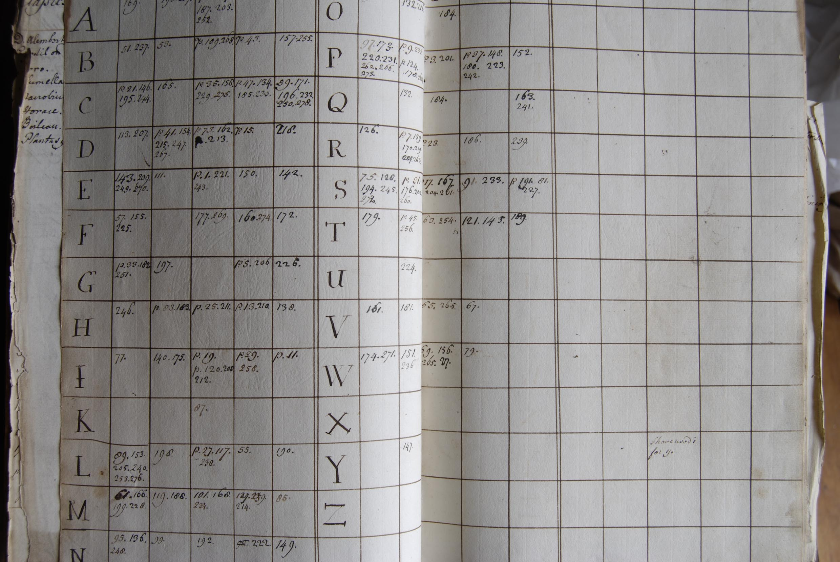
Hospitalfield Library
Index for one of the journals of Richard Parrott
compiled, 1740-1762
The site of Hospitalfield House dates from the C13th and its architectural style reflects the cultural values of its C19th owners, Elizabeth and Patrick Allan Fraser. The library holdings and the archive reflect the body of knowledge acquired by them and their forebears, and the history of the development of rational and scientific thought through the period of the Enlightenment. The writings of one man in particular, Richard Parrott, an ancestor of Mrs Fraser, became an increasing influence upon the artists. His journals, and most of the books in the Library, reveal a reading of the world informed by a study of astronomy, cosmology, theology, philosophy, ethics, aesthetics, the natural sciences and Classical antiquity.
Image one & a description of what we are looking at in the context of the project.

Slide 10
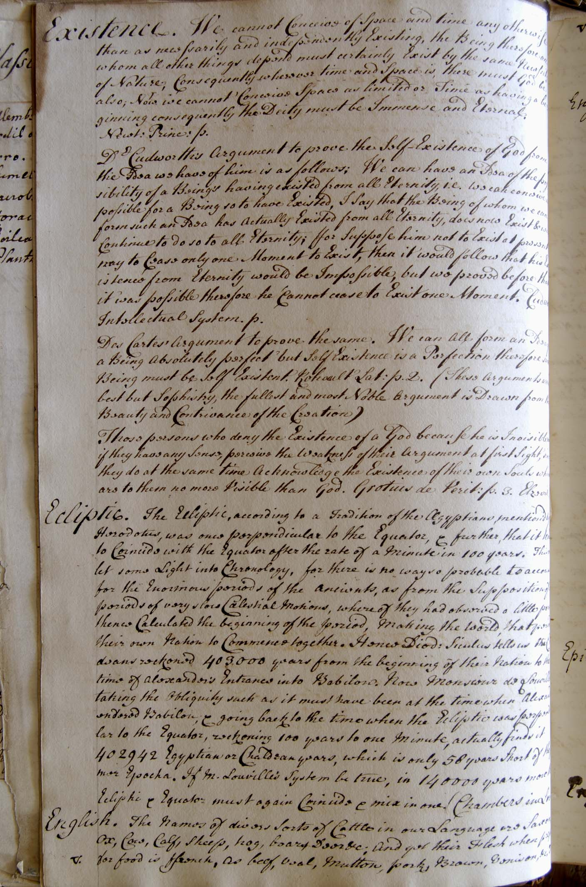
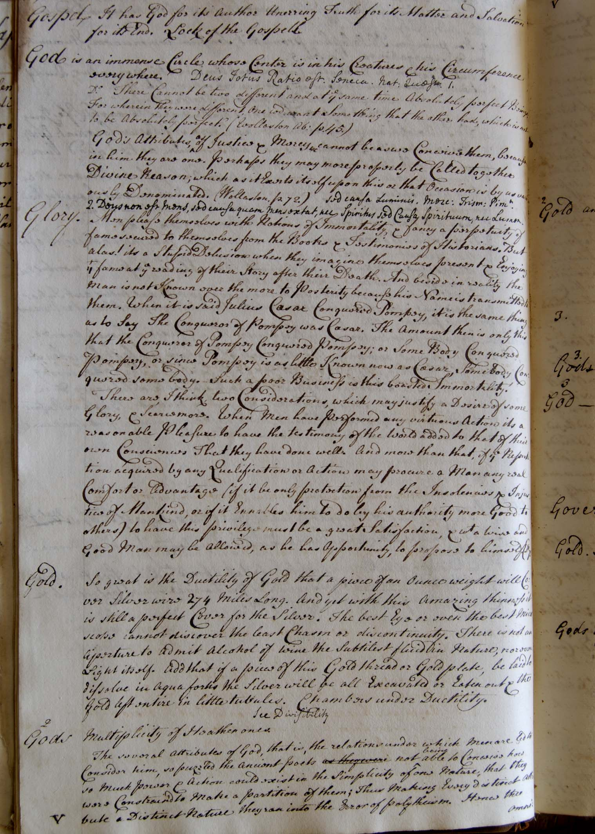
Hospitalfield Library
Pages from the journals of Richard Parrott
written, 1740-1762
Image one & a description of what we are looking at in the context of the project.

Slide 11
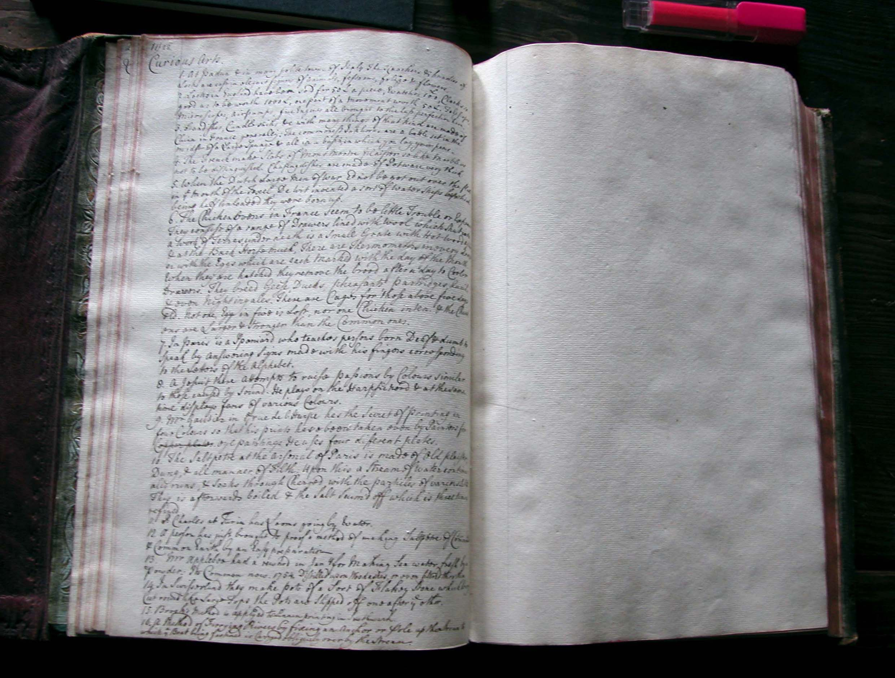
The journals of Richard Parrott
written, 1740-1762. ‘Curious Arts’ is the title he gives topics that he cannot easily categorise.
Hospitalfield Library
Image one & a description of what we are looking at in the context of the project.

Slide 12
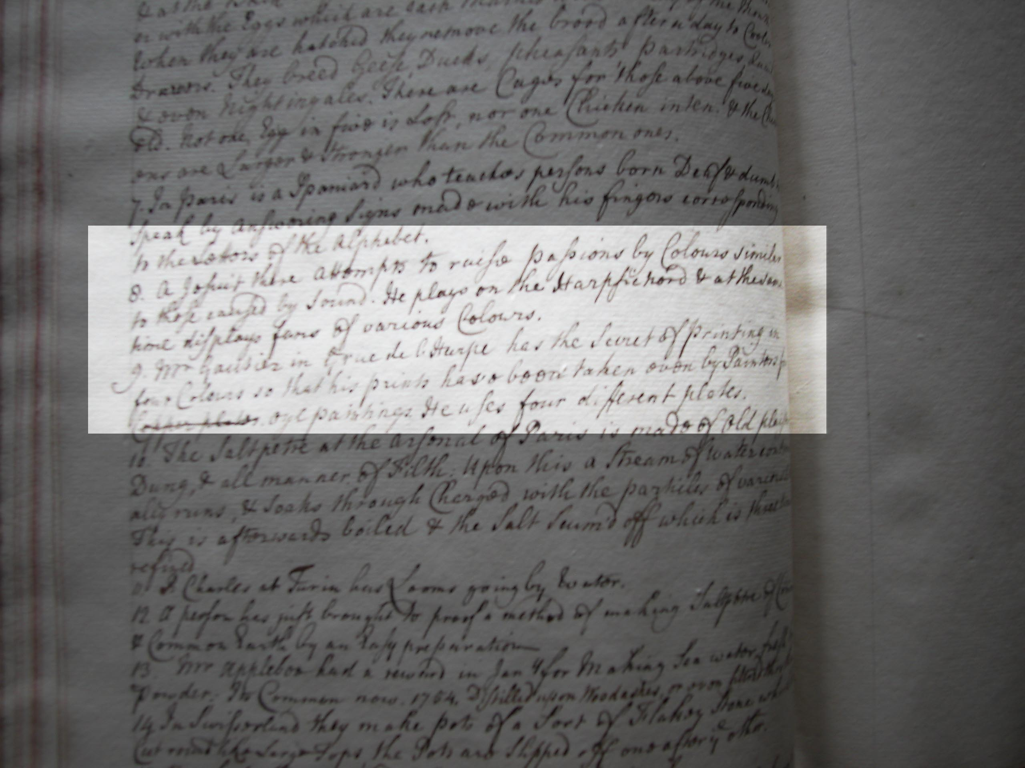
The journal of Richard Parrott (example of one entry under one of the headings ‘Curious Arts’).
This highlighted entry relates to Parrott’s experience of the Grand Tour and an event he encountered in Paris:
“8. A Jesuit there attempts to raise passions by colours similar to those raised by sound. He plays on the harpsichord and at the same time displays fans of various colours.”
This account - of what we now understand as an early experiment in synaesthesia - is verified in Goethe’s writings on ‘Theory of Colours’. Goethe attributes these experiments to the Jesuit, Louis Bertrand Castel.
Image one & a description of what we are looking at in the context of the project.

Slide 13
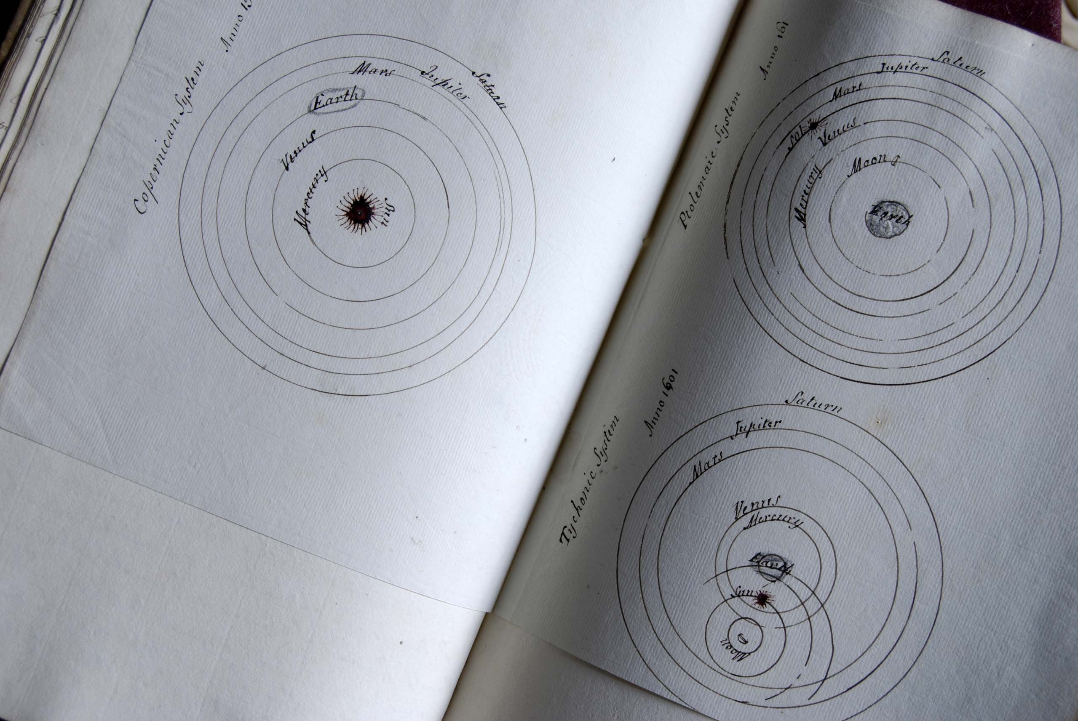
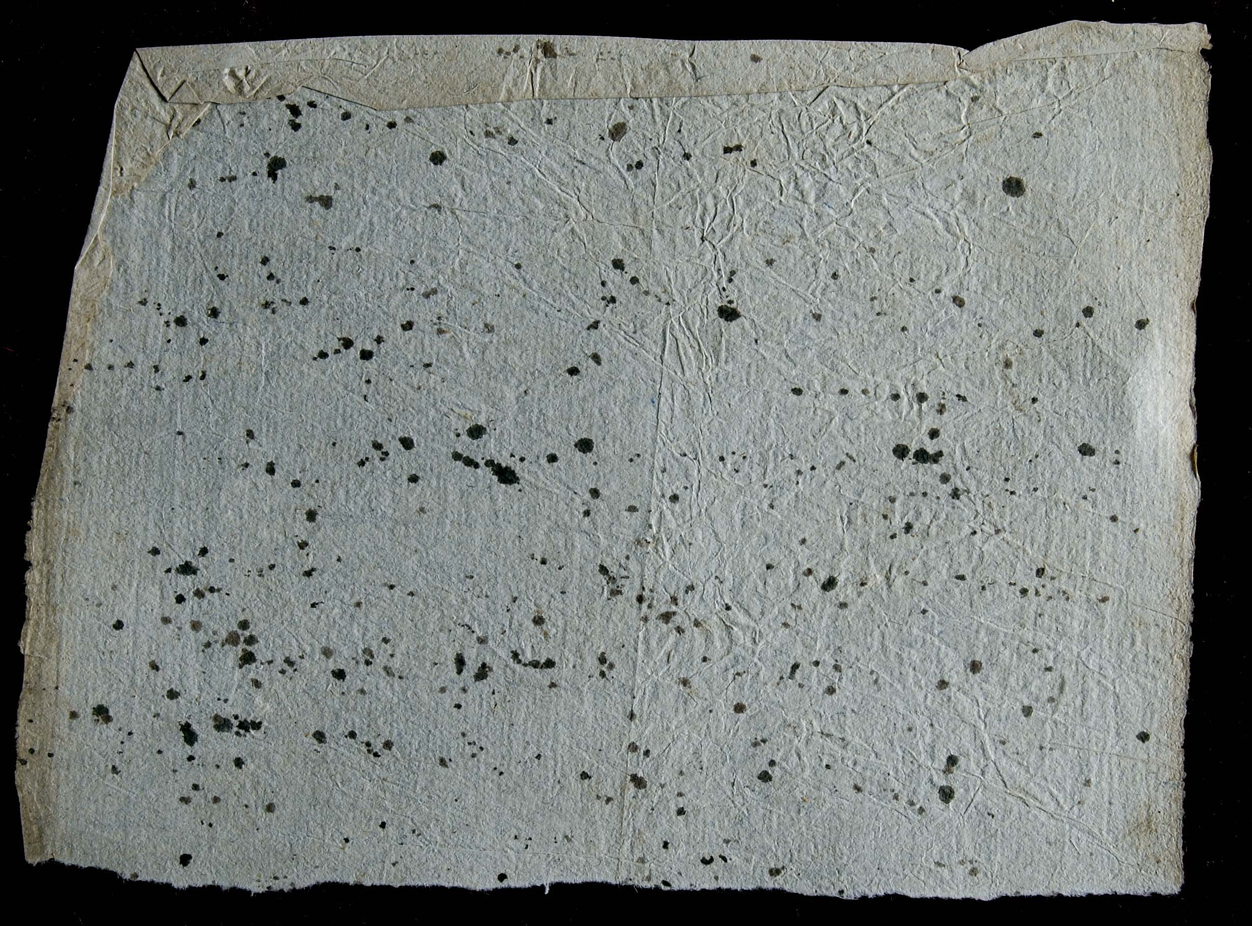
Planetary Systems drawn by Richard Parrott in one of his journals between 1740-1762
and a page of his blotting paper.
Hospitalfield House Library, Arbroath
Image one & a description of what we are looking at in the context of the project.

Slide 14
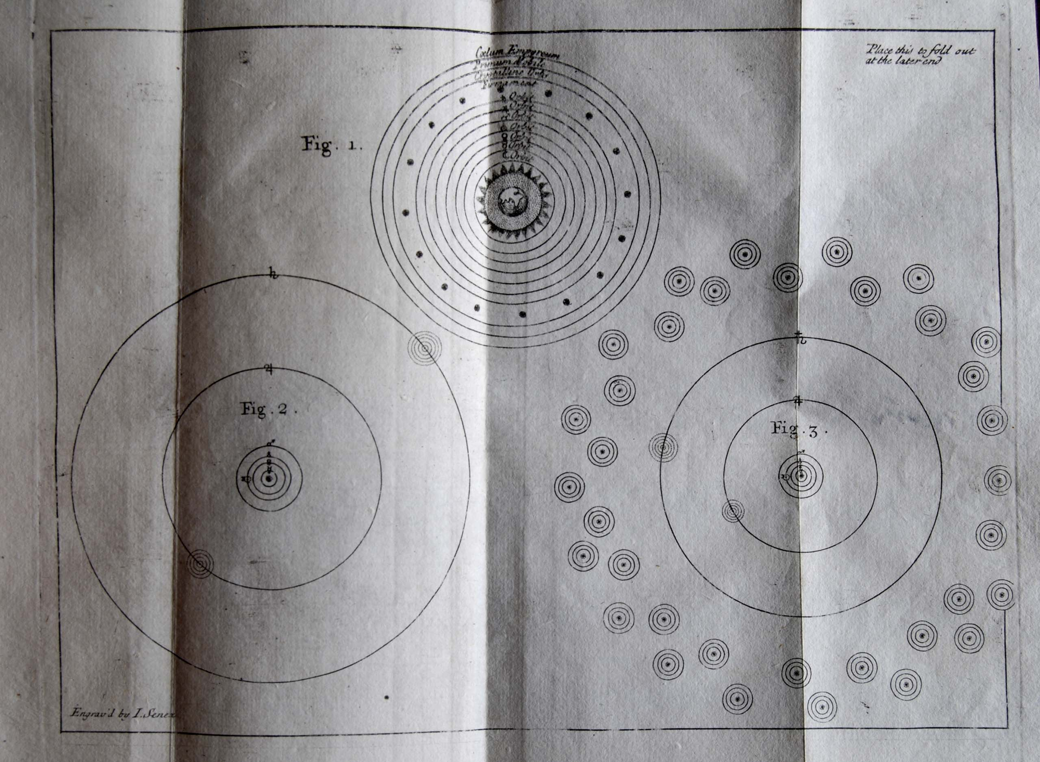
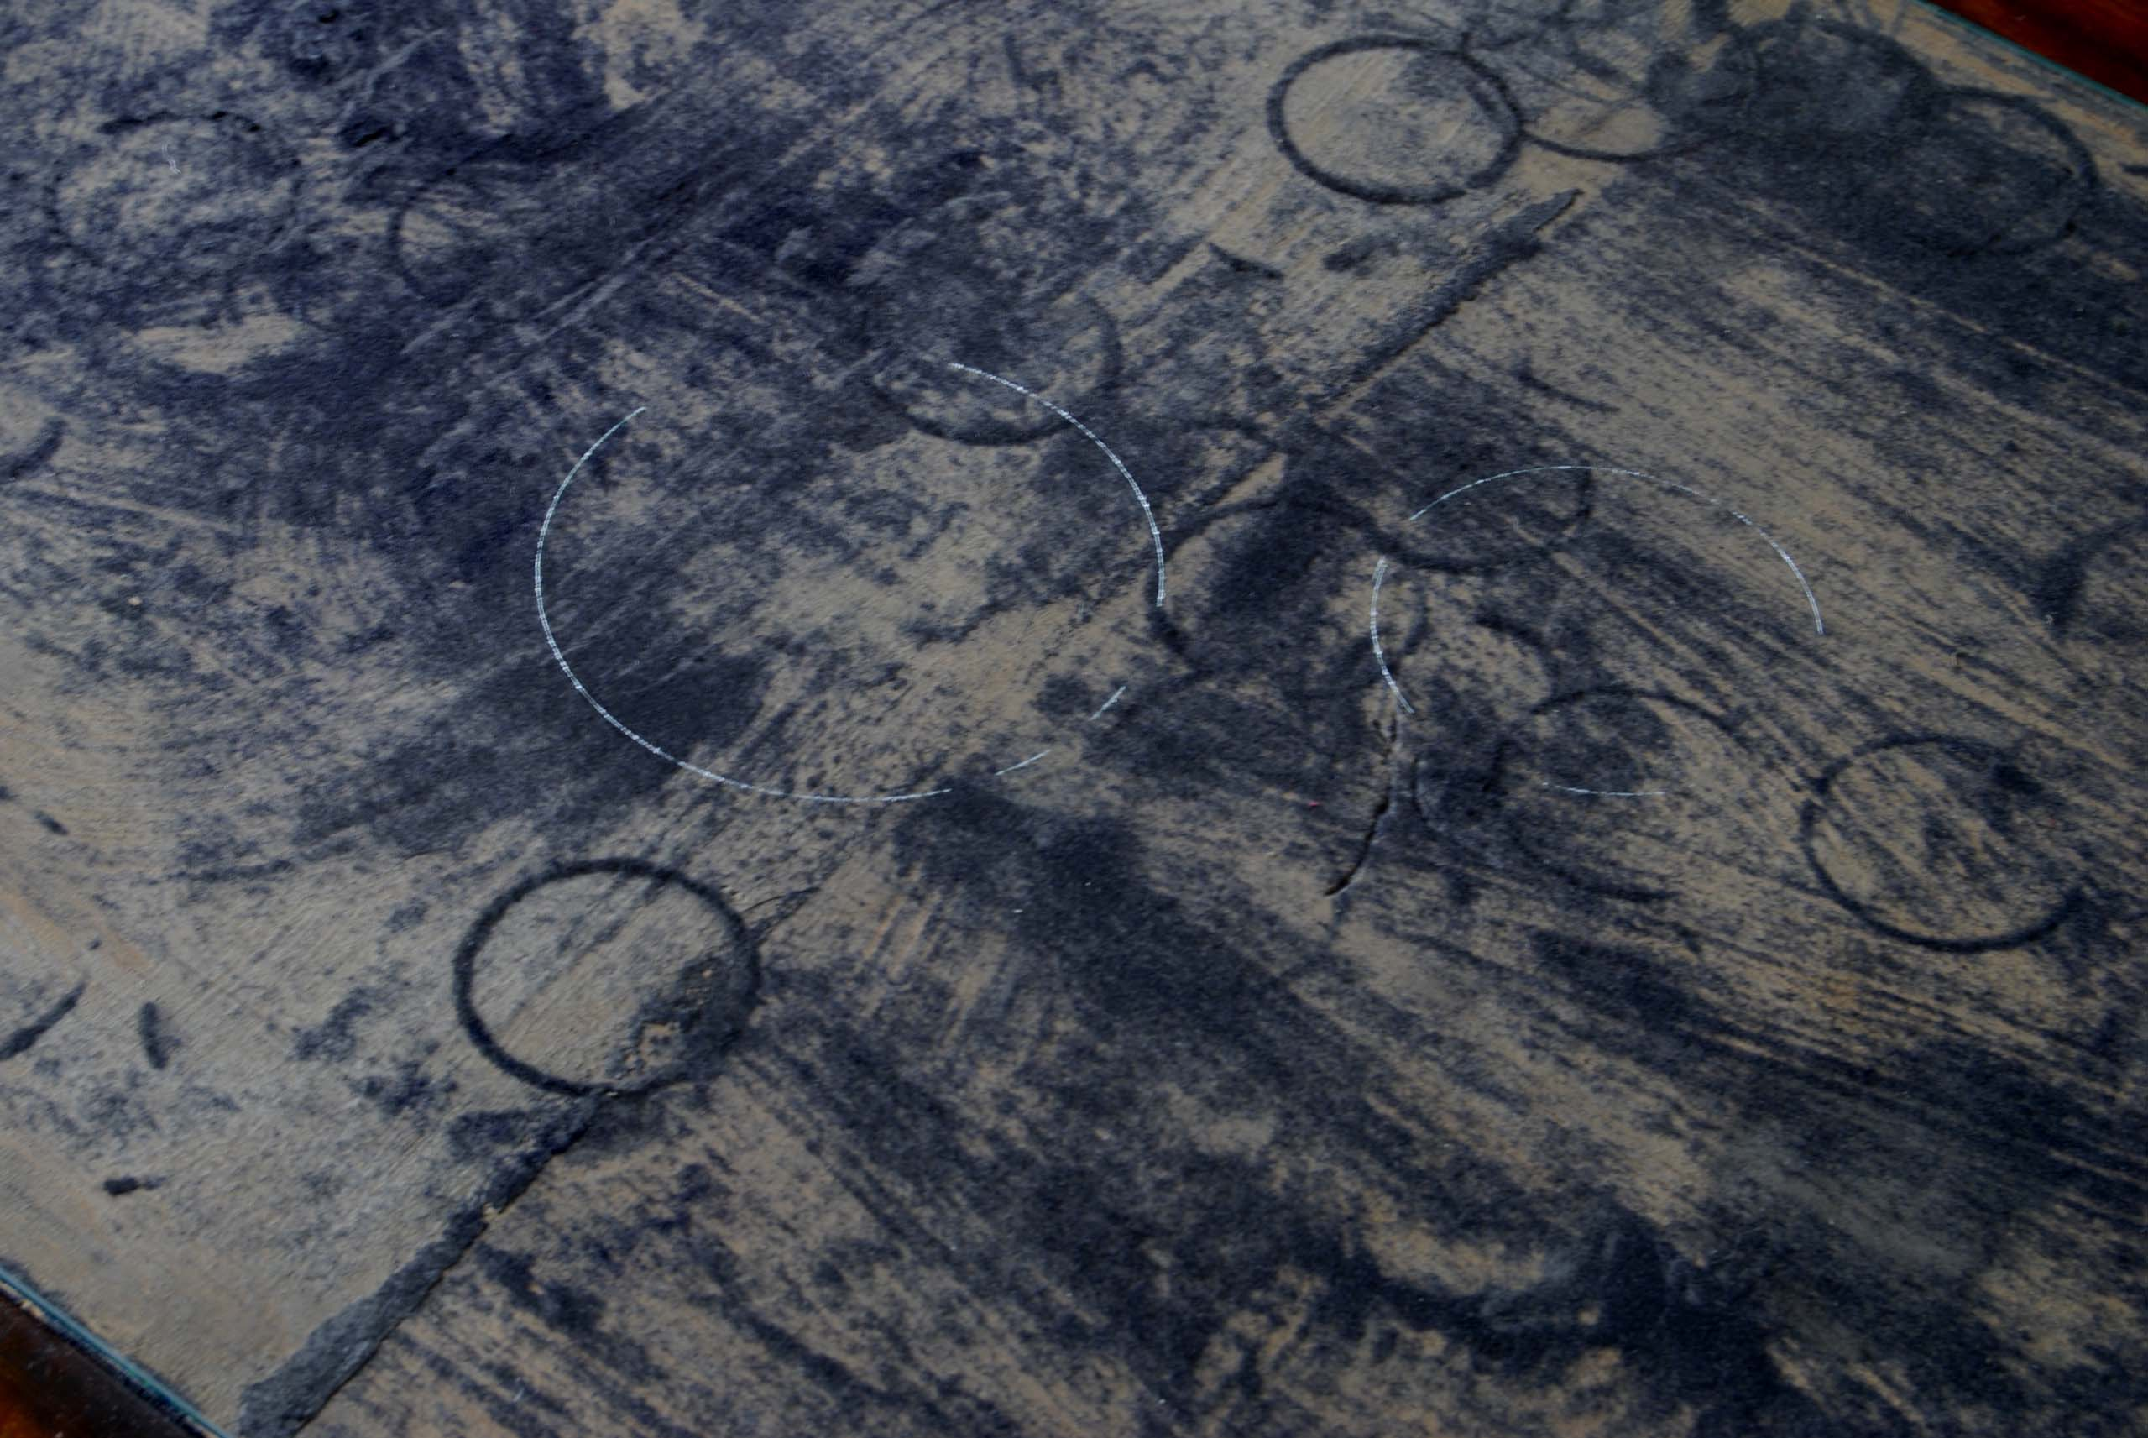
A page from
‘Astro-Theology: or a demonstration of the Being and Attributes of God from a survey of the Heavens’,
W Derham, Rector of Upminster in Essex, W Innys, Prince’s Arms, St Paul’s MDCCXV.
and the surface of a an antique writing desk
Hospitalfield House Library, Arbroath
Image one & a description of what we are looking at in the context of the project.

Slide 15
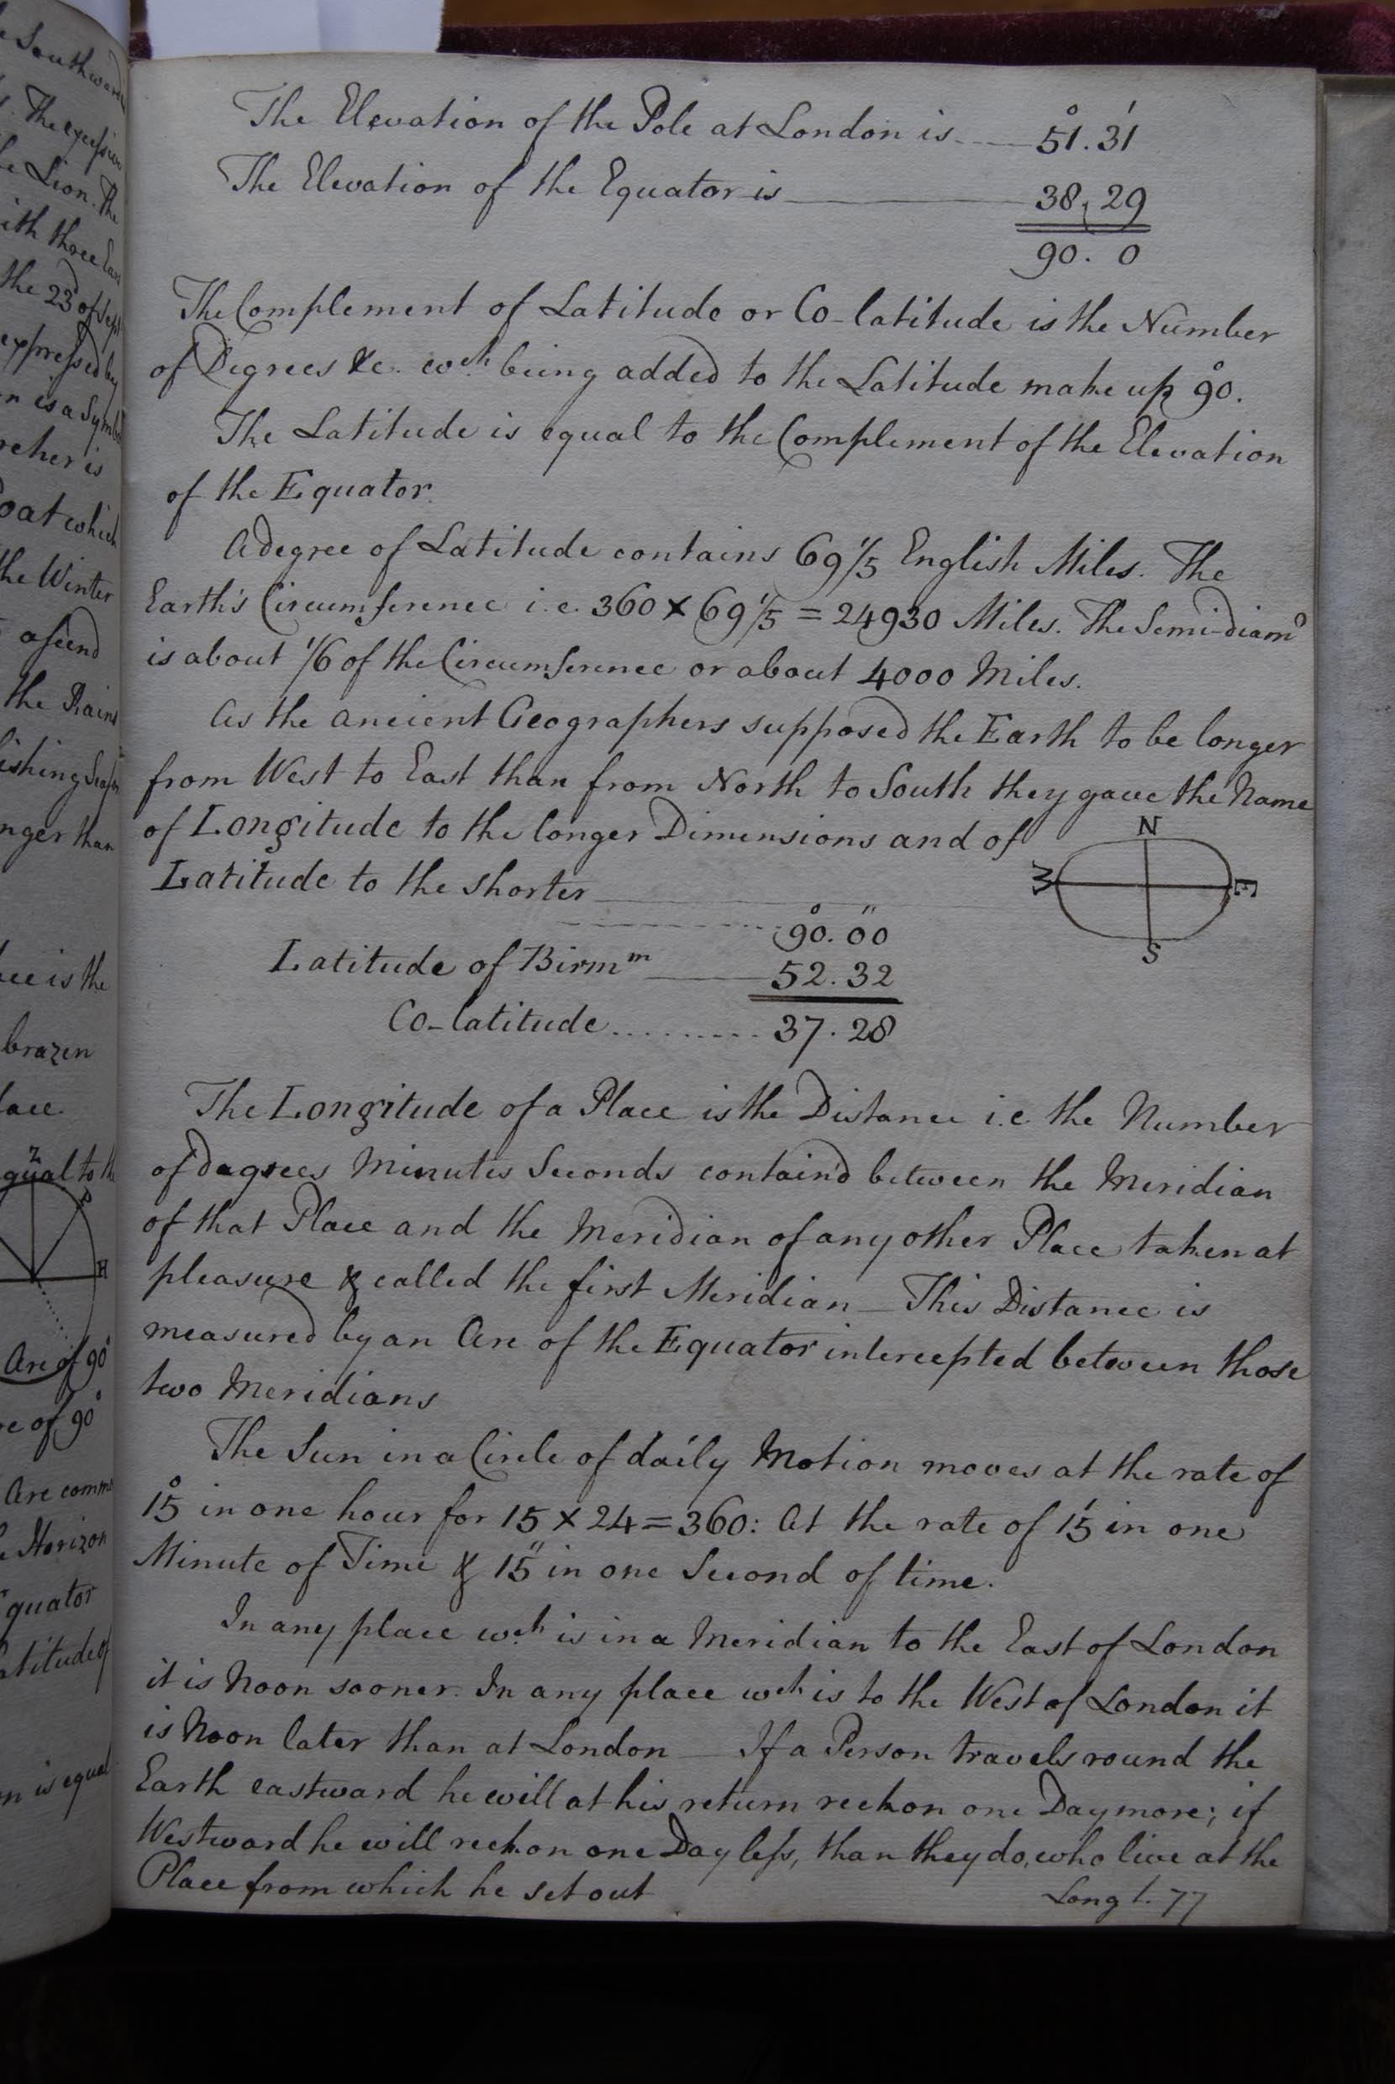
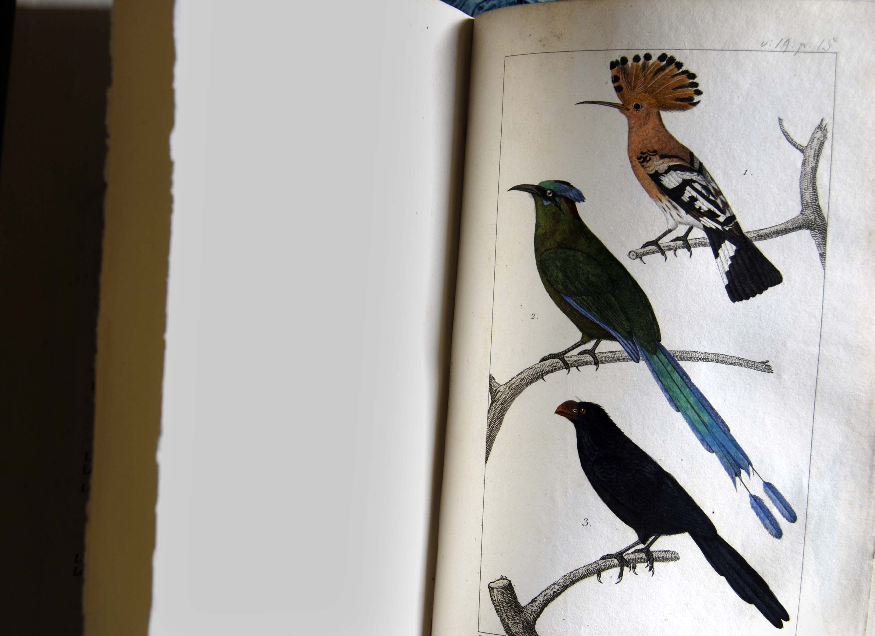
A page from one of Richard Parrot’s journals on his research
into longitude and latitude
and
Bouffon’s ‘Oeuvres: Histoire des Animaux – Oiseaux 19’
Hospitalfield House Library, Arbroath
In addition to his research into the rational world, Parrott is fascinated by mythology and history. He writes in his journal about King Solomon and his love for Sheba. The Hoopoe is the bird that carried messages between them. During our research we discovered that at 8.56 am on 8th April 2004 a Hoopoe was reported on the Arbroath cliffs, north of the town, by the path half a mile from Whiting Ness, having been blown off its migratory route.
[www.birdforumarchive accessed 20/9/2007].
Image one & a description of what we are looking at in the context of the project.

Slide 16
One particular journal, hand-written and compiled by Parrott between 1740 and 1762, is indexed alphabetically; encyclopaedic topics appear on the pages, however, in an apparently random order under subject headings (extract below). Strange and poetic connections are made as ideas on the pages seem to grow out of each other like rhizomes. In the semi-permanent installation Curious Arts - No. 3, a selection of these texts is distributed around the walls of the library, the coloured ground upon which they sit being sampled from the breast and crest of Bouffon’s illustration of the Hoopoe.
…. Instinct animals Brutes Burning glass Burial Christianity China Cicero Christina 2 of Sweden Revolutions Revolution of Ye Heavenly Bodies round their axes Refinement Remedies Frost Fortifications Floating Fortune Fossils v Deluge Stones Vapours Vanity Divisibility of Matter Diagonal Dissections Digestion Diseases Divorces Questions in Physics o Natural Philosophy Quakers Ancient Architecture Ancients Ancients Air Cements Chemistry Creation – God’s design and Ends in Creation Creed Mathematics Magnet Maxims Scripture Spirits Spirits Mistakes of Authors Microscopes Analogy Arabians Attraction of Cohesion Academies Remedies Reason Retirement Repartee Curious Arts of Receipts Cruelty Fruits Fluid Bodies Futuro Strato Paradoxes Planets Pasquil Plane Prayer Plautus Parrott Water Watch Water War v Cannons Incredible Insects v Generation Species Swearing Smell Seneca Friction Fire Fish Friendship Figures Tastes Tallard Translators Trade Tradition Travelling Vegetables Venice v Italy Vehicles Glands Granaries Gaming Gain Gardening v Vegetables Hearing Hermathene Heat v Burning Glass Hebrew Oysters Ophir Oyl Colours Constancy and Resolution Content Cromwell’s son Coal Company of Good Men Commonplace Books Contompt Coral Royal Society Romances Rome Agriculture Ancient Arts Ancient Writers Animals Mechanical Improvements Meals Memory Meridian Melancholy Thunder Tun Turkey Luxury of the Ancients Lufus Nature Surprize Sugar Suicide Sugar Superstition Study v Learning Arteries Amber Alexander Afbofness Salts Salos Antique Shakespeare Slavery v Liberty Sabbath Spain Changes in Ye Earth Charles 1 Cannon Characters Curious Arts& Receipts Cruelty Generation Greek Germany Magnificence Massacre Manna of Ye Children of Israel Man v Life Marriage v Woman Seneca Senate Sleep Strength Philosophy Printing Amusements Authors v Books Ancient Arts Ancient Architecture v Magnificence Italy Spirits Ships Sympathy Siege Similes Latin Latin Poetry Lamps Laws God Government Politics English England Drama Instincts Brutes Animals Inscription East Indies Engraving England v Policy Government Laws Parliament Toleration English Honour Holland v Liberty Hypothesis History Highways Imitations Drinking Dyeing v Colours Curious Arts Diamonds Discount Diseases Mountains Money Motto Morality Ancient Derivations Denmark Deluge Debt Obscene Expressions v Whore Eunuch Castration Marriage Writing Witnesses Writers Duols v punishment Dumb Duties Religion Revolutions Papists Patriot Parliament Parrott Epitaphs Normans North Poisons Productions Protestants Poland Portugal v Customs Policy Utrecht France Fancy Guiscard Superstition Maxims Marriage Criticisms Climate v Cold Copperas Cold Coals Papists Painting Parliament v Prerogative Customs v Titles Curious Receipts Stones Sound Sound Soul Mistakes Prettyness Peter the Great Prerogative Weather Web Bravery Bastard Baptism Barbarism Lifes Liberty Russia Laws Language Latin Quakers Questions Prophecy Providence Proverbs Poisons v Vegetables Remedies Diseases Epitaphs Epithets v Metaphor Empires Characters Sales Antique Sabbath Hanover Designs or Devices v Motto Superstition Painting Dress v Customs Derivations Names England Curious Arts & Receipts Gardening Agriculture Animals v Brutes Instinct Languages Latin Tide Tythes Titles Brutes v Animal Instincts Bulk Trees America Inconsistencies v Mistakes Impositions Inclosing Money Moral Moral Evil Senses v Sleep Soul Innate Shellfish Scripture Parliament Reformation Remedies Prerogative Wife Whimsical Inventions Vicissitudes of Fortunes Virtue Prayer Derivations Birds v Animals Fish England Water Salt Papists Fossiles Frost Climate Latin Curious Arts & Receipts

Slide 17
Parrott’s elliptical approach to the recording of knowledge not only provides one of the sources for the texts used in the installation, it also inspired the form of Curious Arts – No. 3 as a series of apparently disconnected ideas, which are juxtaposed with a quotation from the C19th that runs around the ceiling cornicing. The latter text (below) reflects the ordering of the world through scientific thought, quoted from G F Rodwell, ‘Birth of Chemistry’, Macmillan & Co, 1874. Combined, their ideas spin around the room attracted to each other by the context, thus creating a cycle of insight.
… there is a strong propensity, which dances through every atom … and attracts the minutest particle to some peculiar object … from its base to its summit … from fire to air … from water to earth … from all below the moon to all above the celestial spheres … the very point of the first thread in this apparently tangled skein … in heavenly or in terrestrial bodies … is a disposition to be attracted … which taught hard steel to rush from its place and rivet itself on the magnet … the same disposition … which impels the light straw to attach itself firmly to the amber … this quality … which gives every substance in nature a tendency towards another … an inclination forcibly directed towards a determinate point

Slide 18
Curious Arts - No. 3
Semi-permanent commission for the Library of Hospitalfield House, Arbroath, produced in collaboration with Jim Harold (2010 to date).
Vinyl text on painted walls.

Slide 19
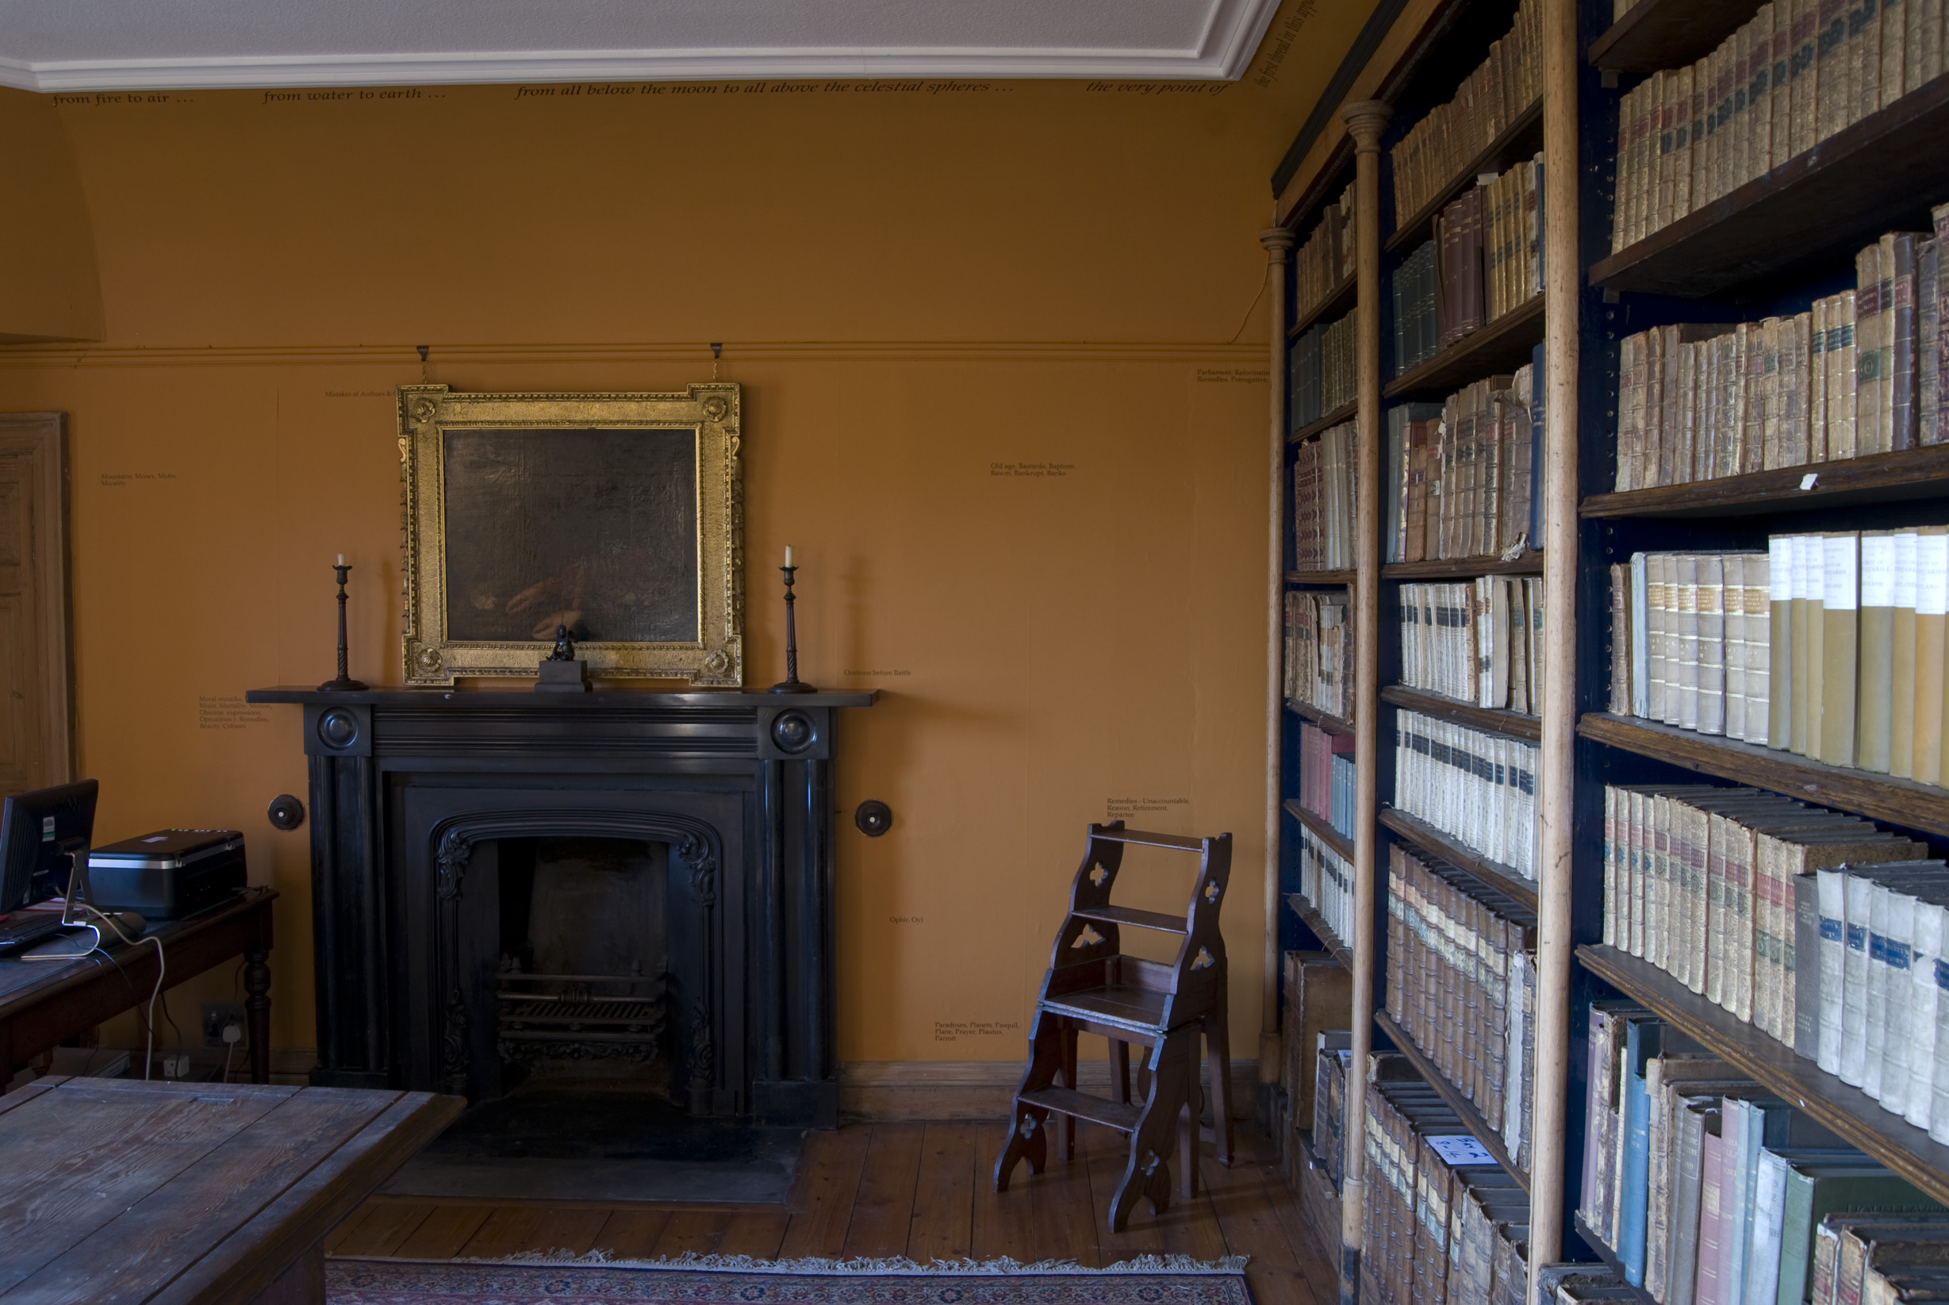

Slide 20
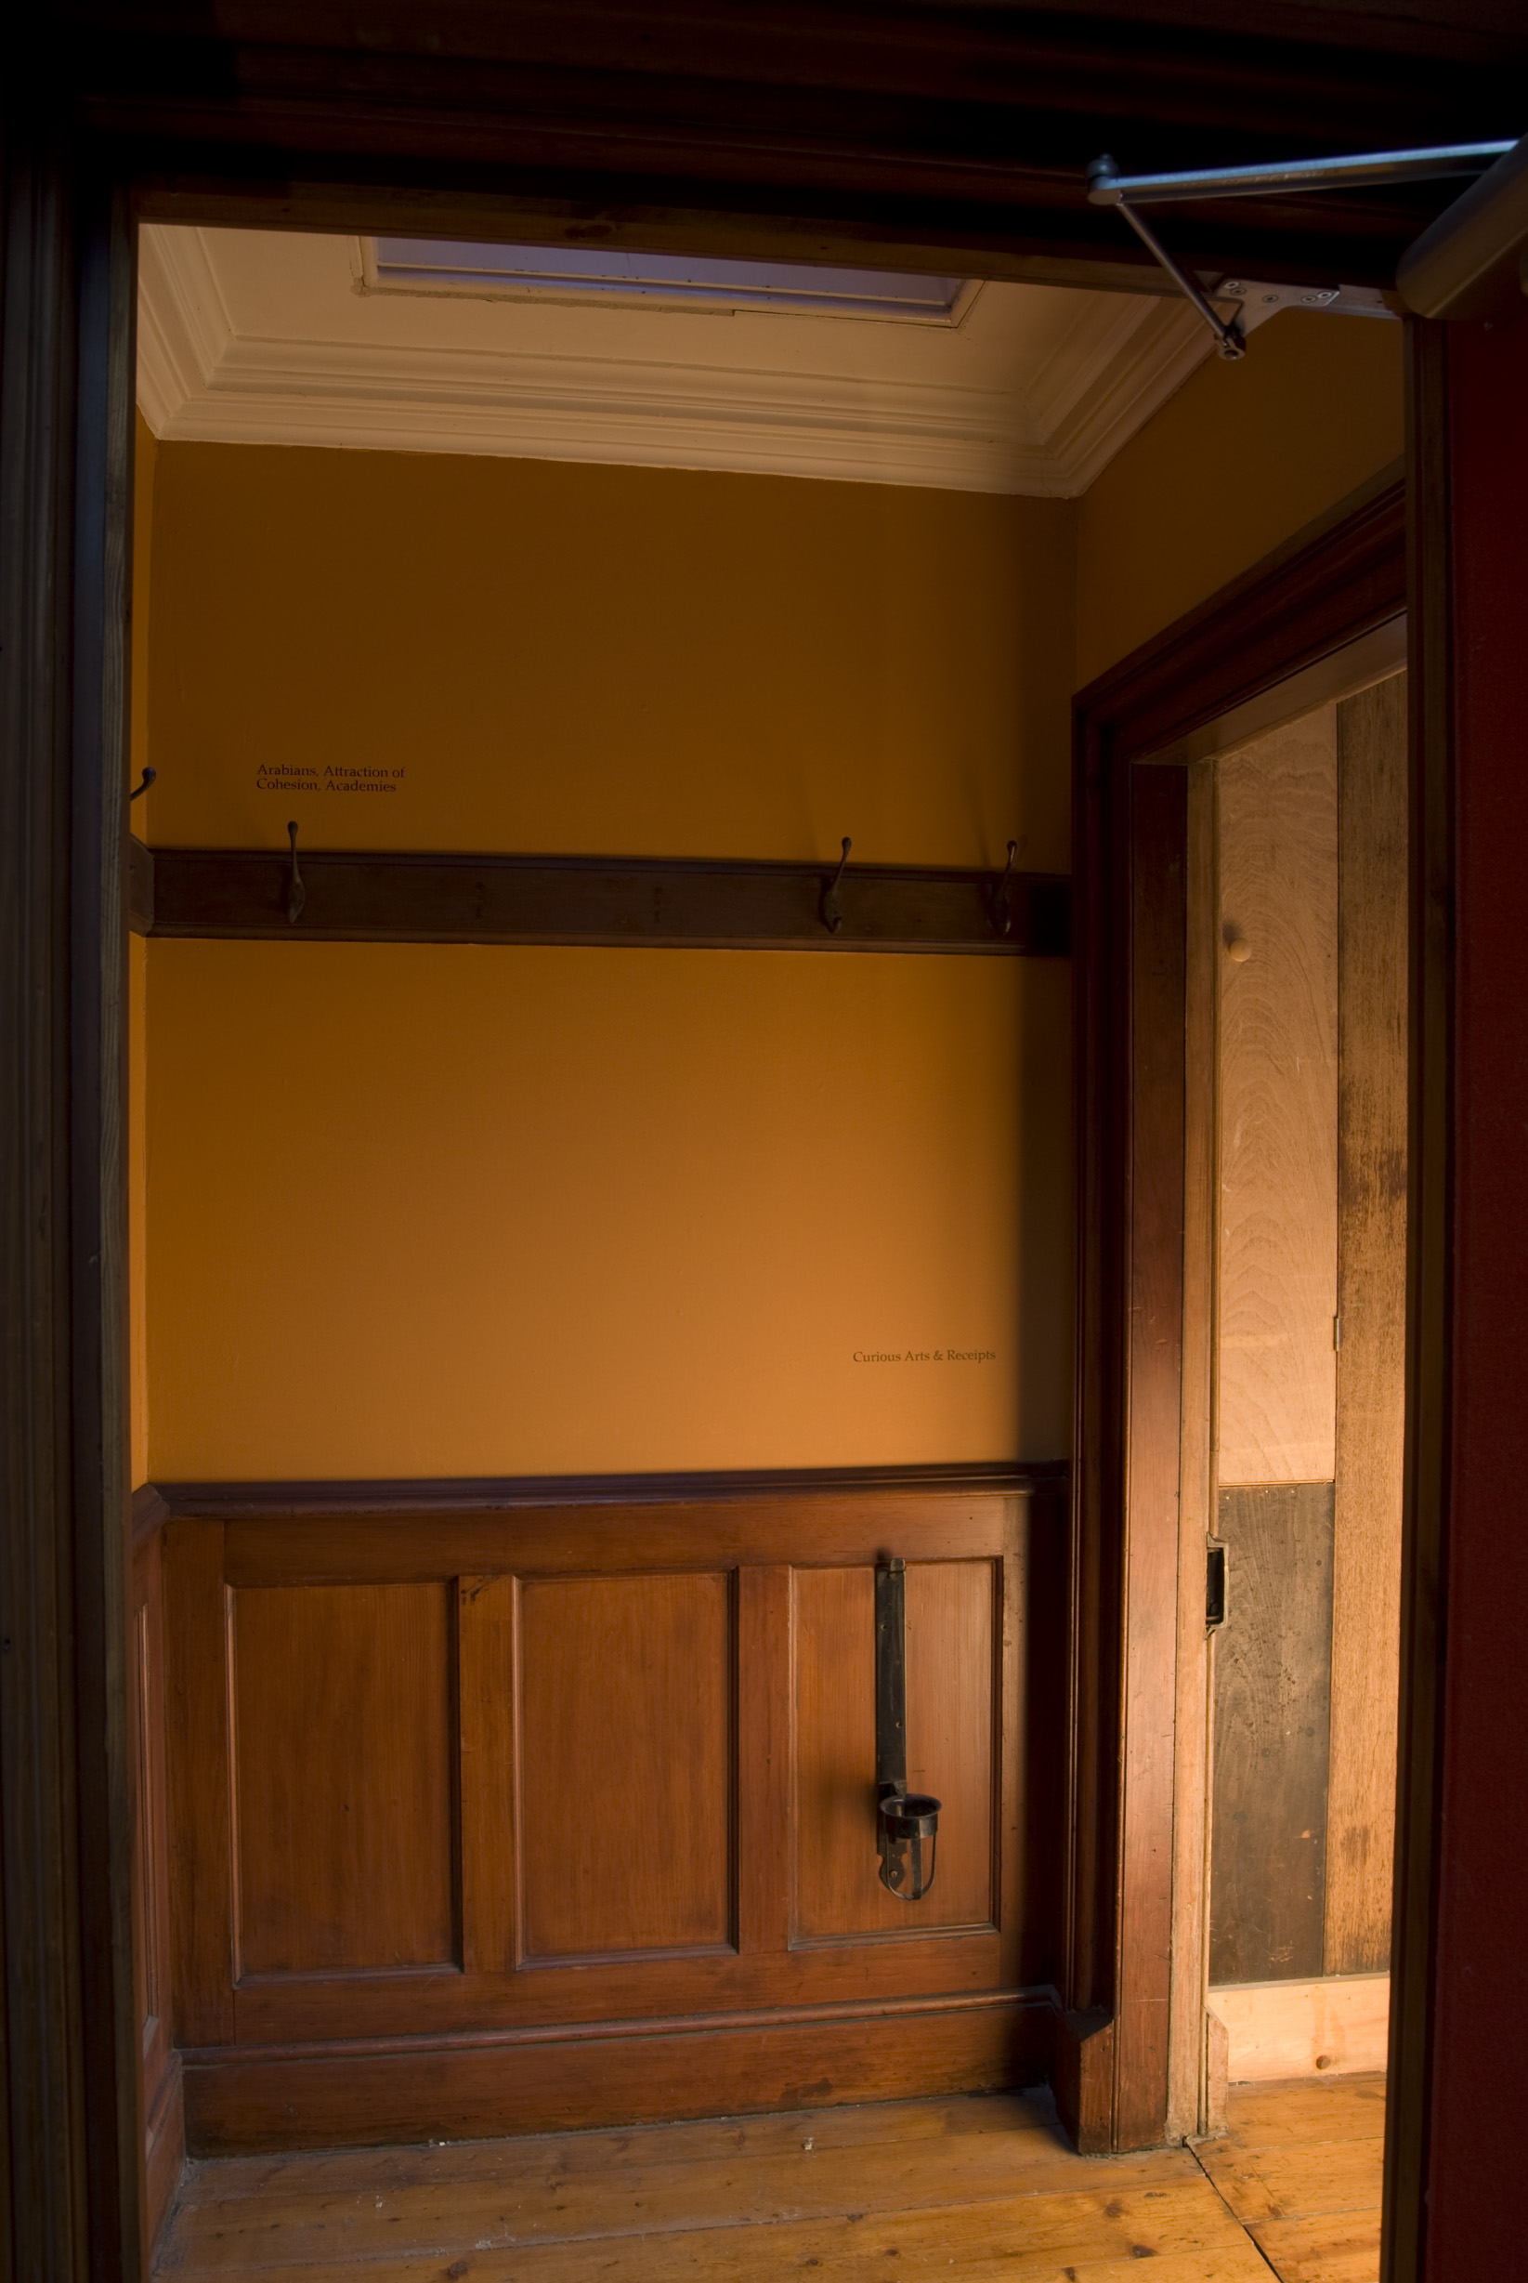

Slide 21
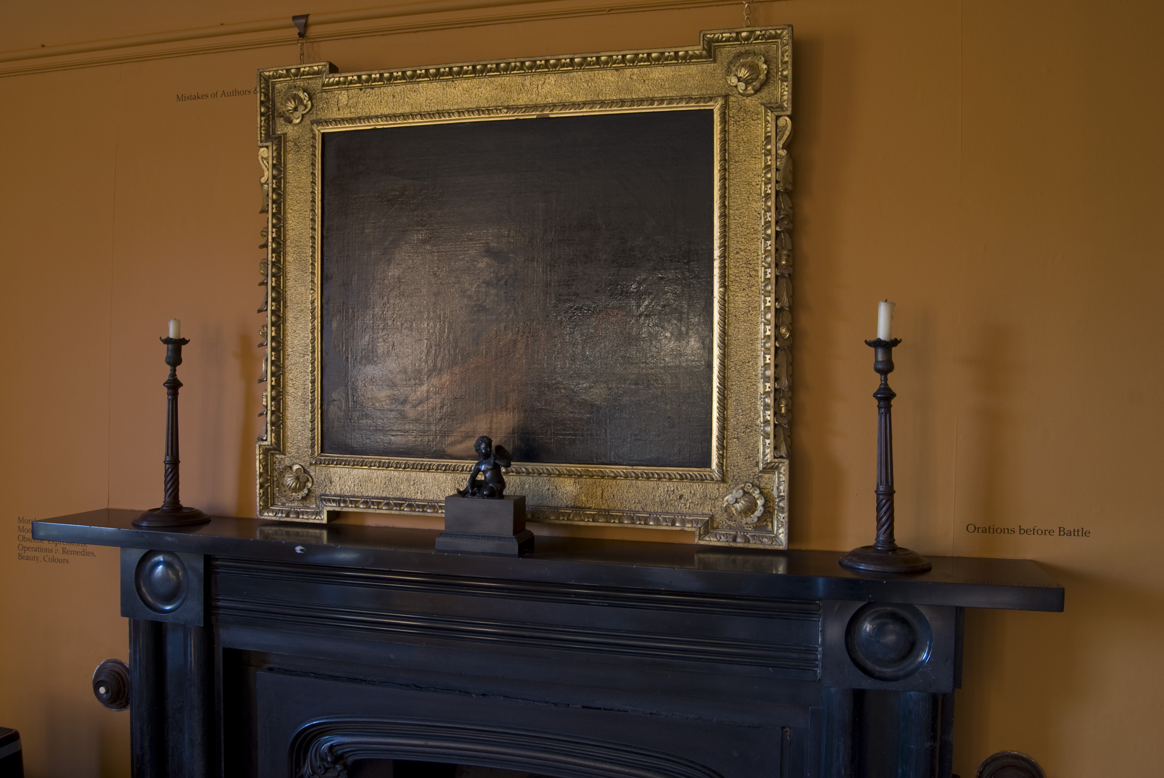

Slide 22
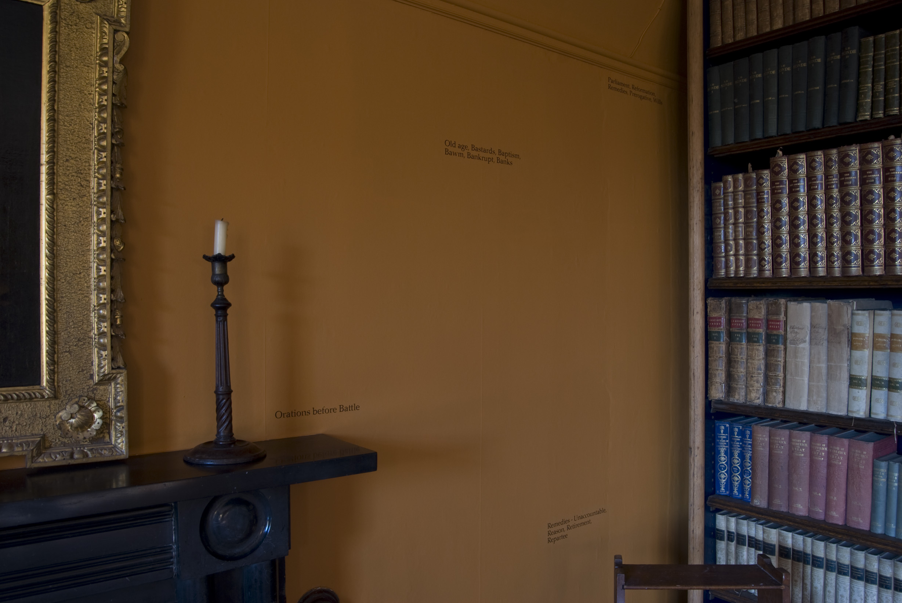

Slide 23
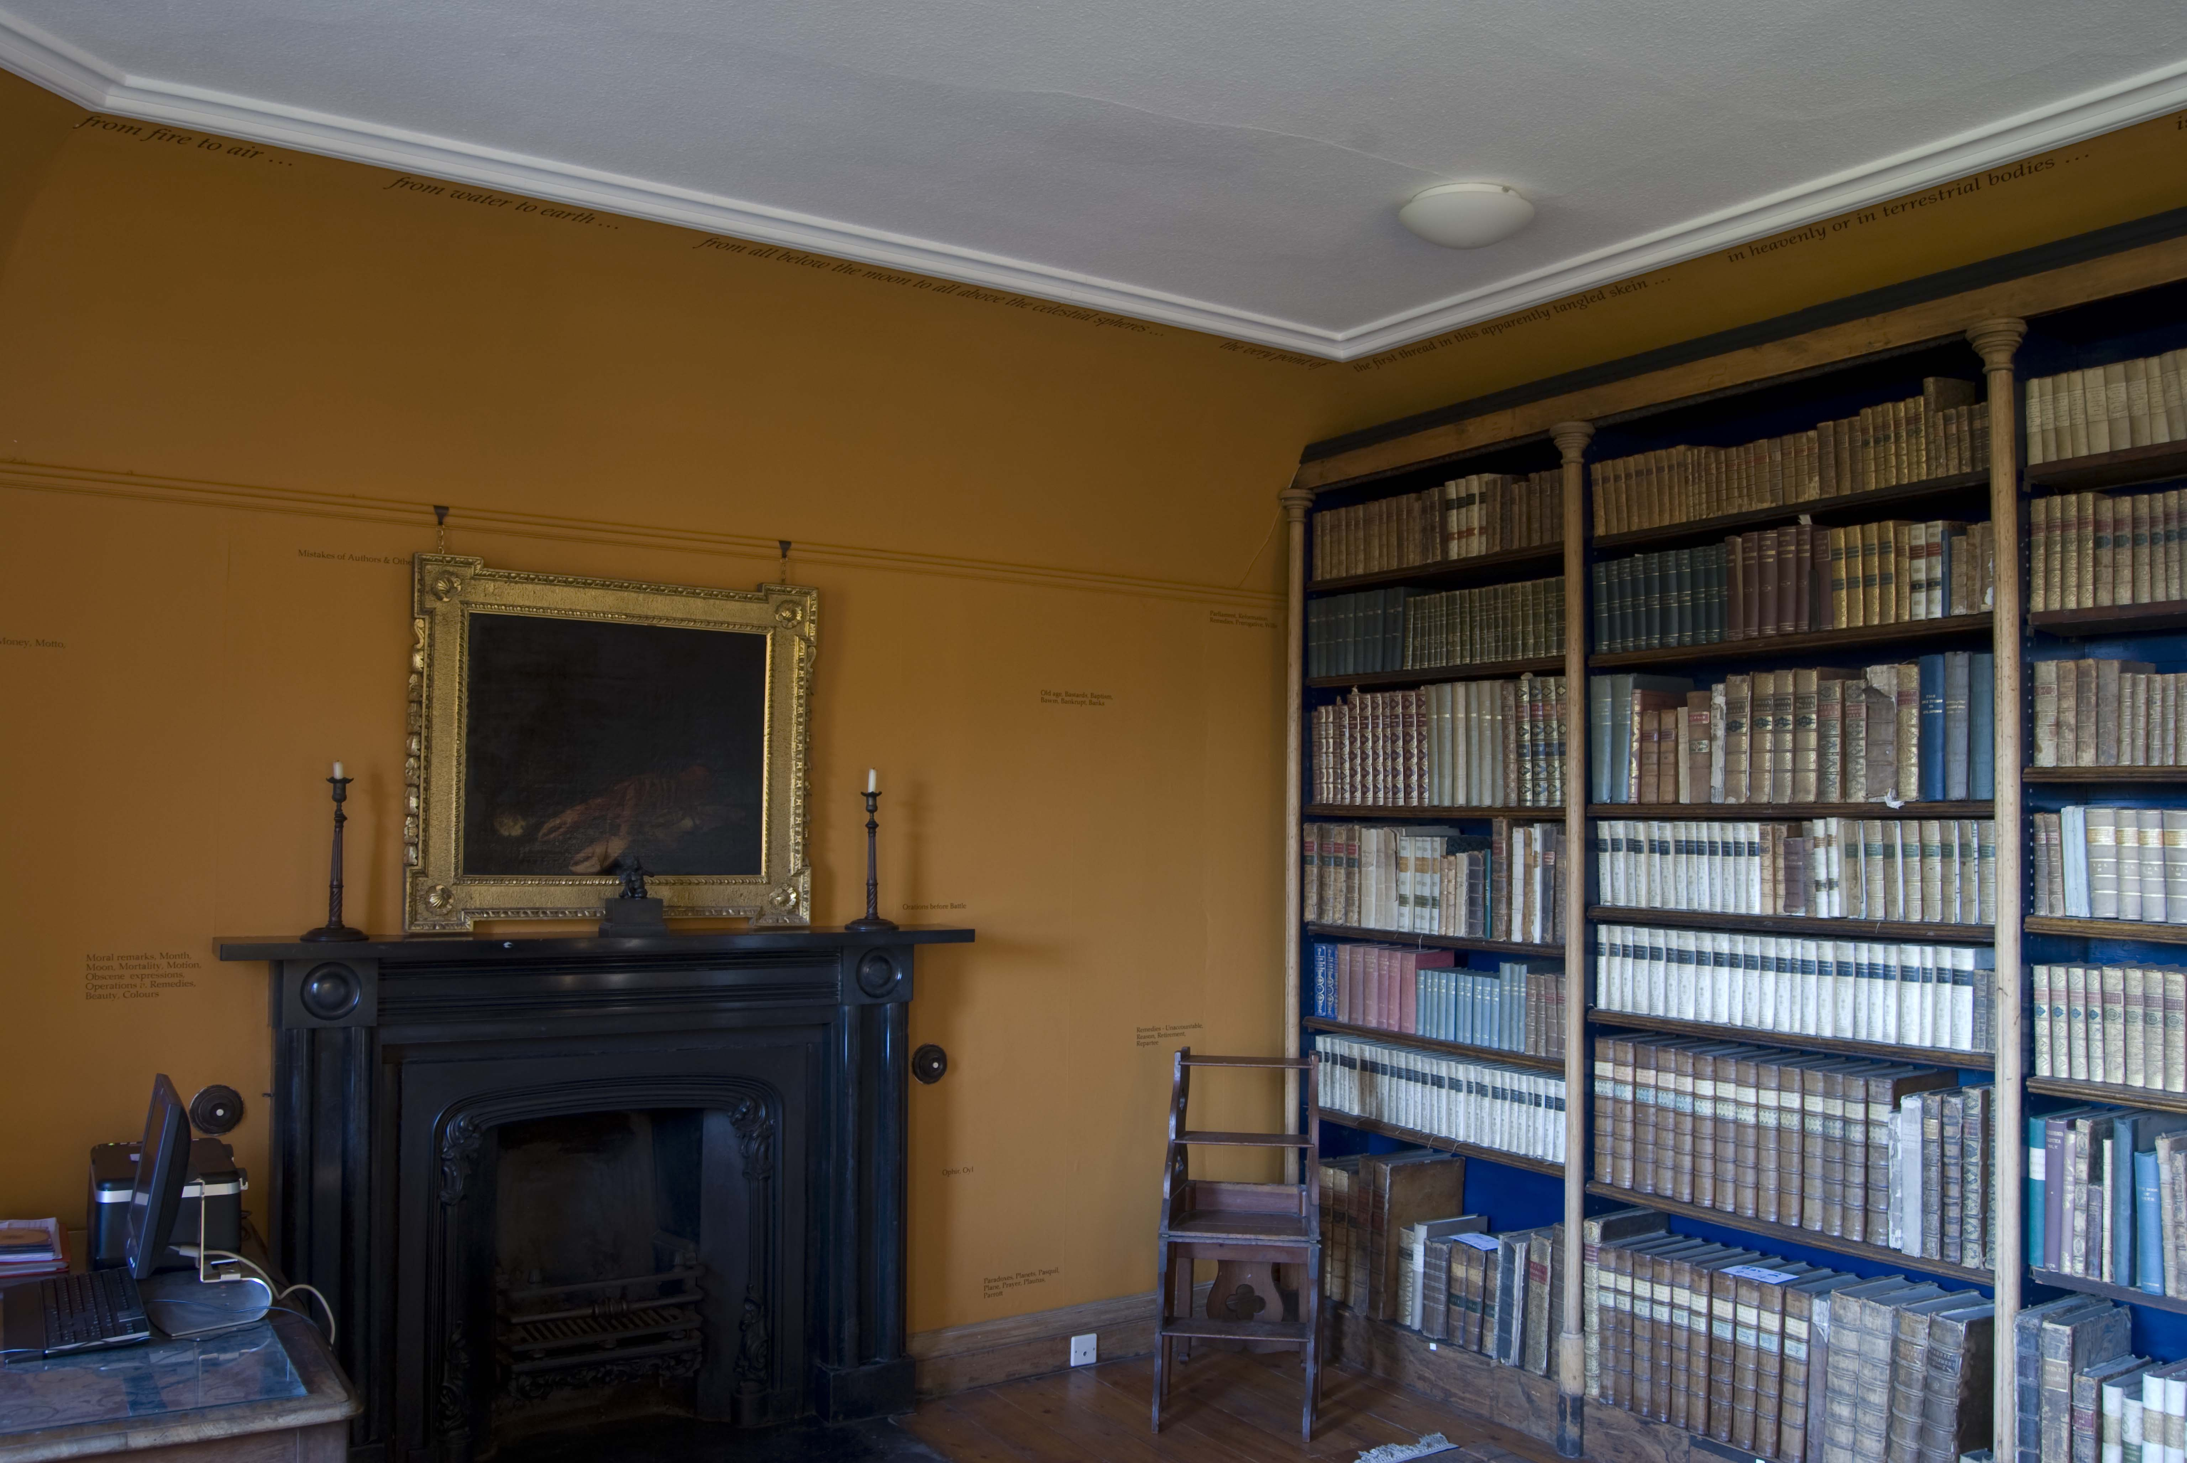

Slide 24
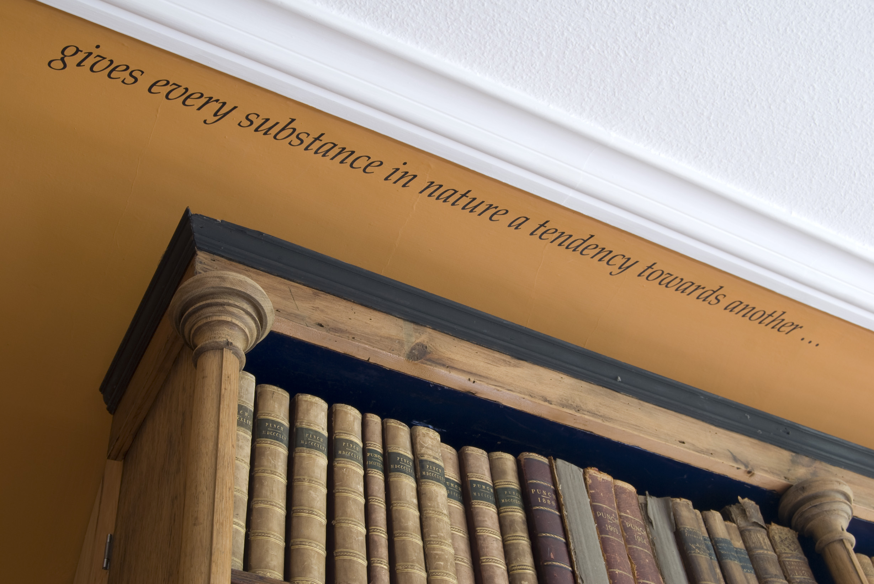

Slide 25
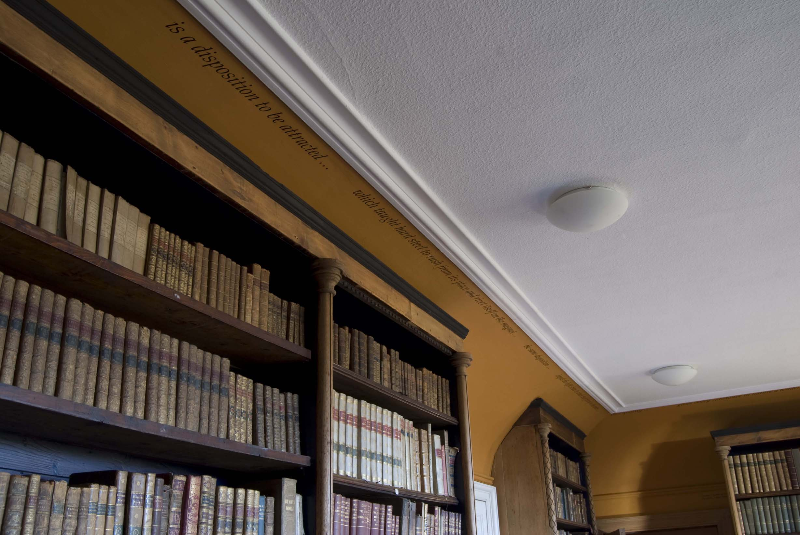

Slide 26
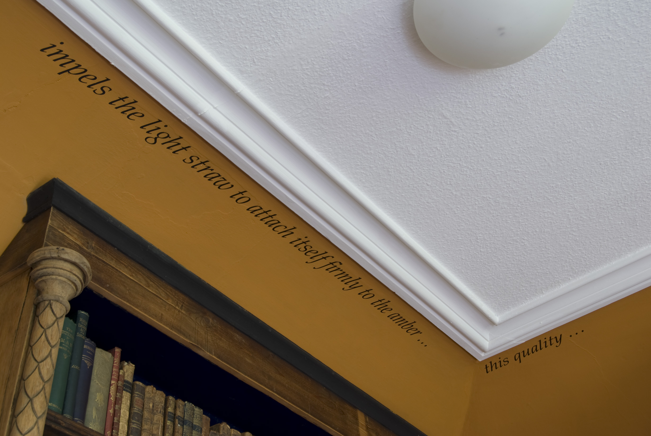

Slide 27
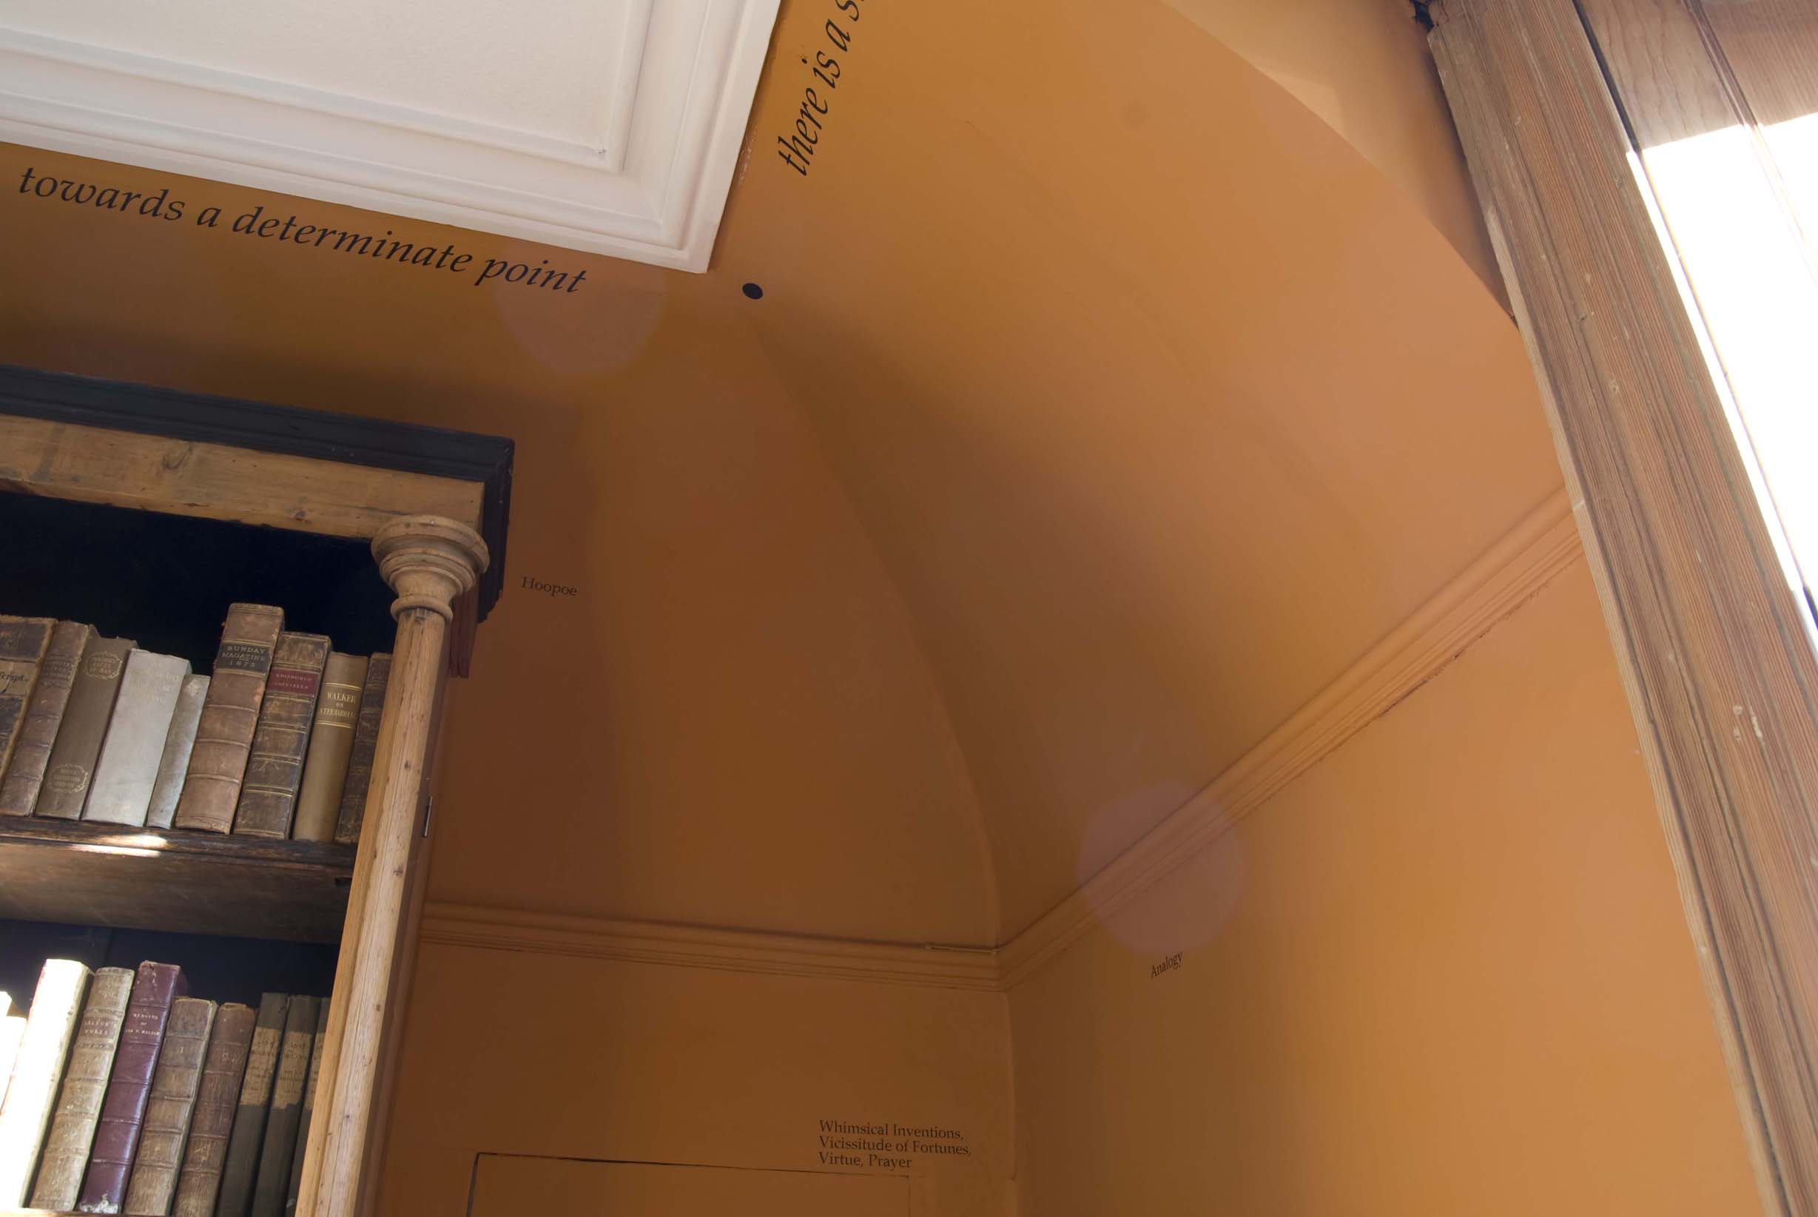

Slide 28
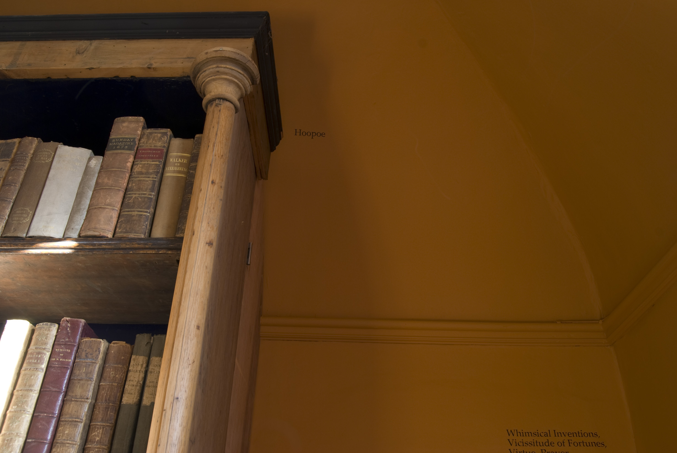

Slide 29
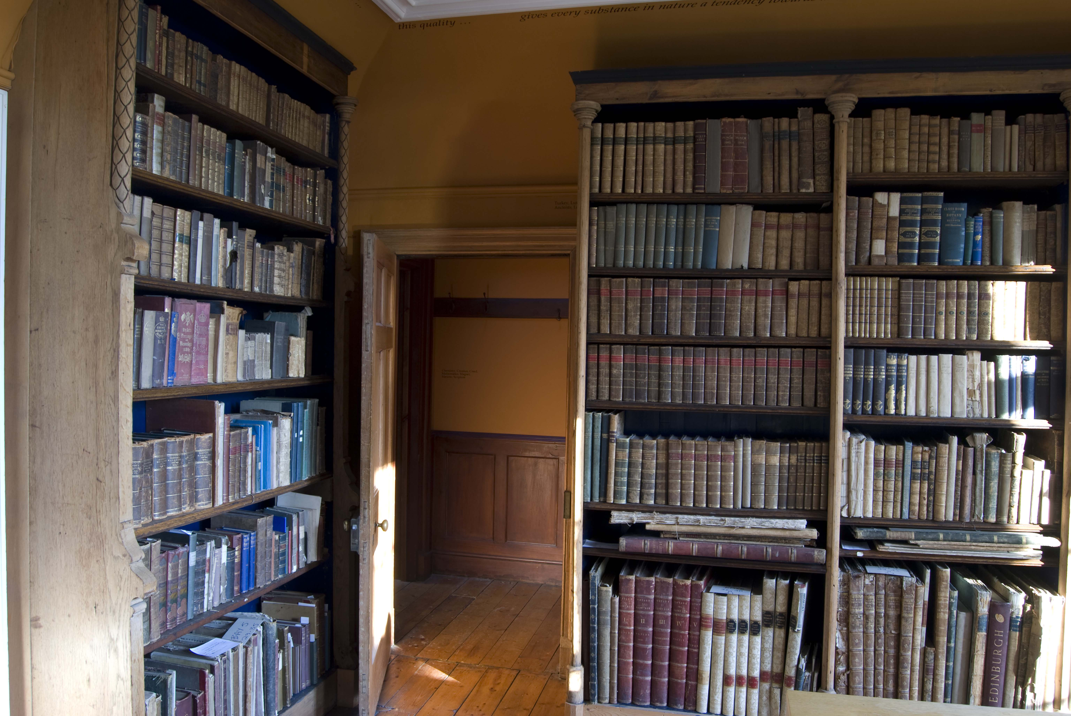

Slide 30
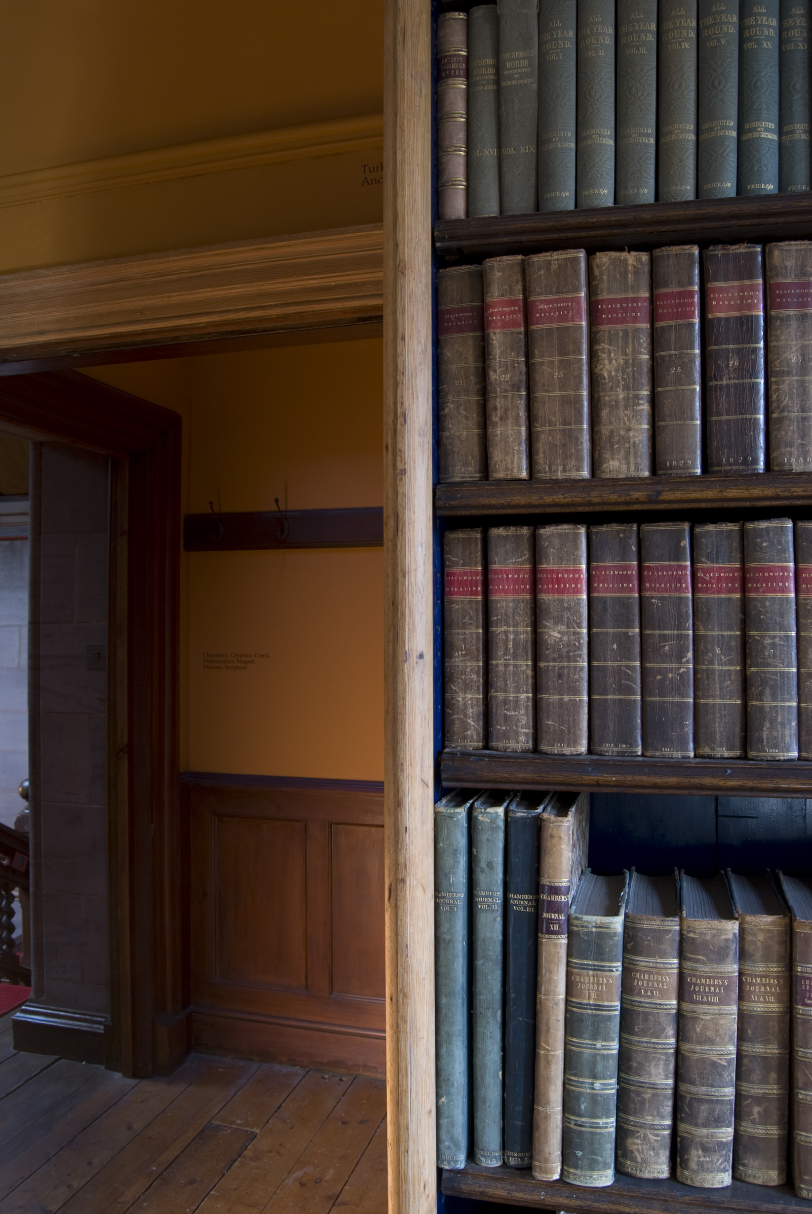

Slide 31
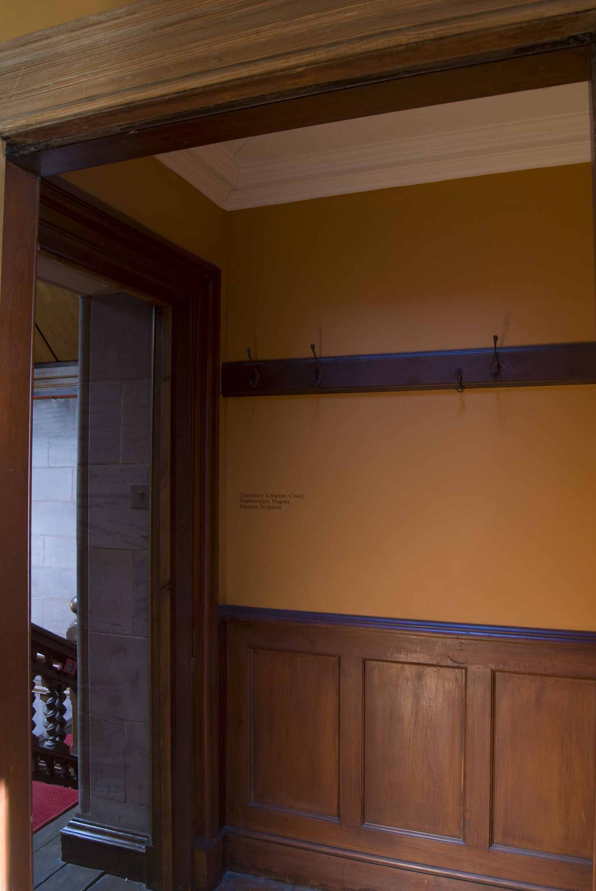

Slide 32

Context:
An interrogation of the relationship between rational forms of knowledge (Descartes and Locke) and embodied knowing (Valéry) underpins Brind & Harold’s thinking. In the Curious Arts series (Nos. 1-6), this has been focussed: Firstly, upon what can be collated and understood at the limits - or in the margins - of the archive (Foucault, Crimp and Stafford’s critiques of the structuring and ordering of knowledge is important here, as are the writings of Flaubert, the study of forms by Baltrusaitis, and the works of Mark Dion, Gabriel Orozco and James Welling); Secondly, upon the space where rational language falls short, and poetics and subjective imagining take over (reference to Lacan, Kristeva, Derrida, Lyotard and the work of Lothar Baumgarten, and Susan Hiller is significant here).
Curious Arts - No. 3 contributes to this artistic dialogue by questioning how we contend with that which can’t be categorised. It reinterprets historical knowledge and categorisation in order to open up an imaginative space that draws attention to the relatedness of things and unfolds new ways of thinking.
Brind & Harold’s work also contributes to a contemporary dialogue about collaborative practice and a critical questioning of individual authorship. Artist partnerships such as Smith/Stewart, Dalziel & Scullion, Thatham and O’Sullivan provide other similar models.
Curious Arts – No. 3 is a semi-permanent installation made for the Library of Hospitalfield House, Arbroath, commissioned by Hospitalfield House Trust. The work is available for viewing at times when the Hospitalfield House is open to the public or by appointment.
Image one & a description of what we are looking at in the context of the project.

