Slide 1

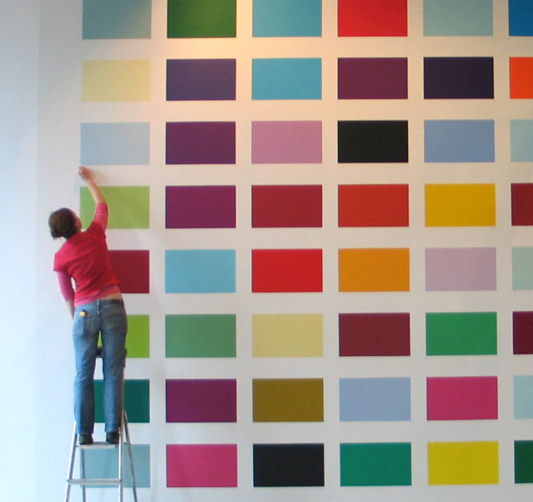
The Albert Drive Colour Chart
Commissioned by Glas(s) Performance and Tramway, the Albert Drive Colour Chart is the artwork produced as a result of a 6month residency and large scale participatory arts project working with people living in the Pollokshields area of Glasgow to explore the central question ‘Who is my neighbour? The project culminated in an exhibition, performance, shared meal and conference in Tramway, Glasgow.
Submitted by Shauna McMullan
Output No. 2

Slide 2

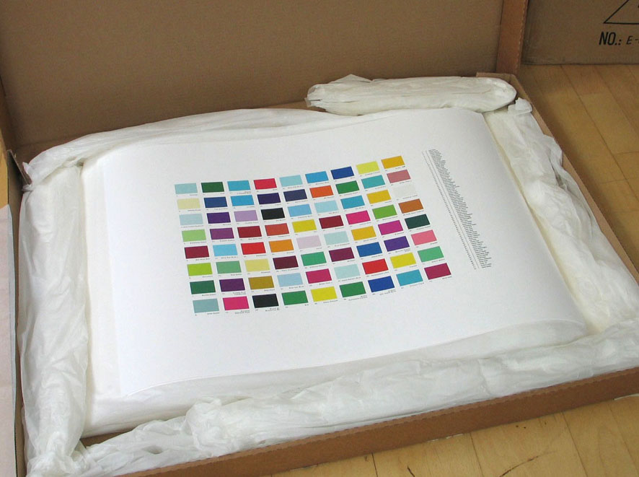
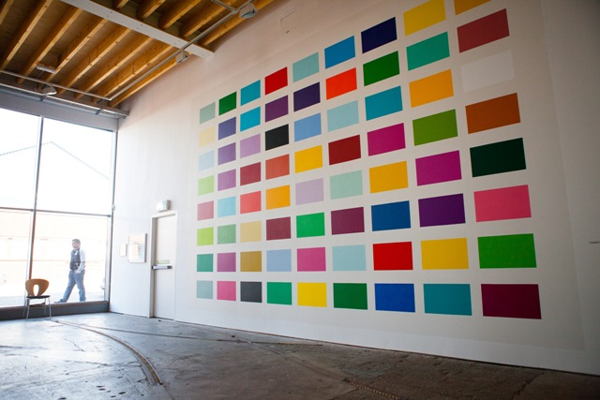
The Albert Drive Colour Chart
The Albert Drive Colour Chart, is a record of favourite/significant colours selected by 72 people who live, work on, or visit Albert Drive, (a 3 mile long street on the southside of Glasgow). Collected over a period of 6 months, each contributor to the project was invited by the person who went before them – a daisy chain of connections. The artwork exists in two parts. Firstly a temporary wall painting (6mts x 4.5mts) in gallery T5, Tramway, Glasgow, which brought together the complete collection of selected colours. (This existed for the duration of the exhibition only). The second part is a limited edition, digital fine art print on paper. This edition of 72 prints, the same number as there are contributors to the work, were gifted to each person involved in the project. The prints are now dispersed in and around the Albert Drive area in contributors homes, offices, allotments, shops, community halls and places of worship. Contributors to the work included church leaders, students, shop keepers, primary school teachers, community activists, local residents, gardeners, chefs and the Deputy First Minister of Scotland.
2
Shauna McMullan
Image 1, The Albert Drive Colour Chart , limited edition, fine art digital print (ed. of 72)
Image 2, Albert Drive Colour Chart, wall painting , Gallery T5, Tramway

Slide 3

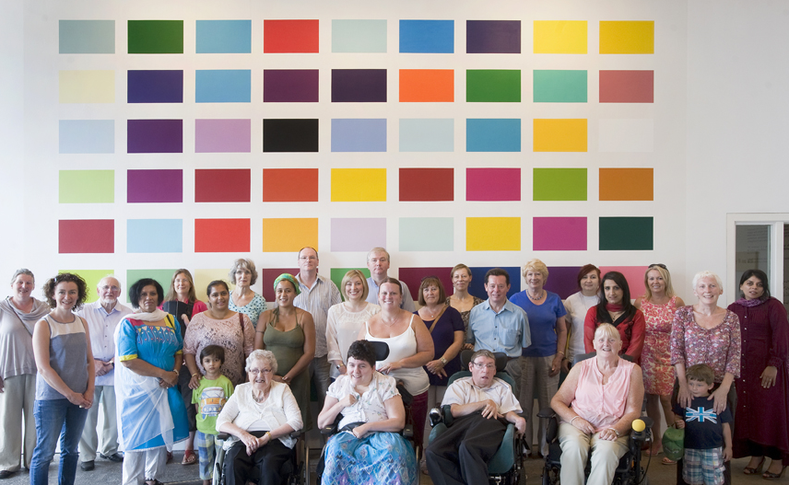
Following an international call to artists I was successful in being selected as one of 6 artists commissioned by Gla(s)s Performance and Tramway, to undertake a 6 month residency on Albert Drive, exploring the question “Who is my neighbour? The residency culminated in an exhibition, performance and shared meal in Tramway, Glasgow in July 2013. The six artists, Arpita Shah, Nic Green, Janice Parker, Bashrat Khan, Gla(s)s Performance, Edo Architecture and myself work across film, photography, installation, architecture, performance, dance and visual art.
Funded by Creative Scotland’s First In a Lifetime fund, the ALBERT DRIVE PROJECT, was a multidisciplinary enquiry into the dialogue surrounding creativity, social engagement and participation.
The central themes of the over arching project were:
to develop creative strategies to engage diverse communities into a central question; "who is my neighbour”
to explore the relationship between an arts venue and the community living alongside it and
to examine the aesthetics of participation.
The Albert Drive Colour Chart group photo, taken on Sat. 13th July, Tramway, Glasgow.

Slide 4

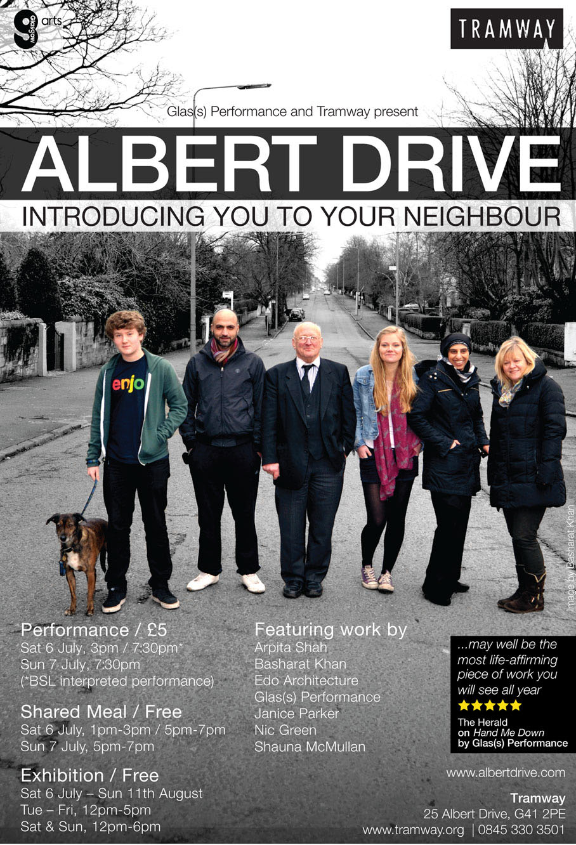
Chart as each selected colour is thickened with layers of reference. Ann Temkin talks about the perception of colour depending entirely on adjacencies – “that in fact, colour is the most relative medium in art”. Colour Shift, essay in Colour Chart, reinventing colour 1950 – To Today. At its core this artwork builds from this premise and explores how the most ‘relative medium in art’ can inform a relational approach to developing ideas.
Claire Bishop asks the question ‘how do we measure or compare the relationships developed as a consequence of a relational approach to making art?’. Antagonism and Relational Aesthetics, for October 110, Fall 2004. One of the primary focuses of the Albert Drive Colour Chart, and of the overarching Albert Drive Project, was to develop an understanding of what type of relationships were being produced, for whom these were being produced, and why? These questions were discussed throughout the residency at monthly artist check-in sessions and will be reflected on in depth in the Albert Drive Project Symposium in Oct.
Central to the Albert Drive Colour Chart is the idea of the ‘Gift’ (and the process of gifting), and its role in decentralising the position/location of the artwork. Lewis Hyde in his book ‘The Gift’, says that when gifts circulate their commerce leaves a series of “interconnected relationships in its wake and a kind of decentralized cohesiveness emerges”. I am interested in exploring this in relation to a socially engaged practice and how the gift might become an agent of social cohesion. The Albert Drive Colour Chart was the first time I put this into practice through the gifting of the limited edition print.
.
Like Travelling the Distance (2005), commissioned by the Scottish Parliament & Blue Spine Collection (2010) commissioned by Glasgow Women’s Library, the Albert Drive Colour Chart continues my ongoing interest in the collective and in finding innovative, visual ways of representing methods of inclusion and engagement with a diversity of individuals and groups. The Albert Drive Colour Chart explores the dialogue surrounding Grant Kester’s thoughts on the kind of knowledge that aesthetic experience is capable of producing and the role of a socially engaged practice in the field of contemporary Fine Art. Conversation Pieces, Community and Communication in Modern Art.
In working through this project, as with previous projects key questions were:
Is it possible to have a dialogical work that is also capable of giving visual gratification?
How do we understand the aesthetic significance of the collaborative process?
And, can an artwork show us that our perceptions and identities, are shifting, unstable and contingent?
Personal narratives as well as socio-political context is invoked in the Albert Drive Colour
Invitation and flyer for the Albert Drive Project, including exhibition, performance and shared meal.

Slide 5

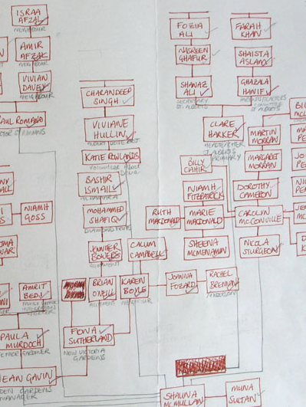
Exploring issues of positionality and situated knowledge, (relations between subjects, places and identities) the Albert Drive Colour Chart developed from ideas surrounding ‘modern Western thinking about place and its relationality, geography’. Terra Infirma, Geography’s Visual Culture, Irit Rogoff.
Maps and mapping have always been central to my practice and the Albert Drive Colour Chart, (as well as past projects such as The Blue Spine Collection & Travelling the Distance) extend this interest by creating artworks that although aren’t specifically about mapping the physical earth are instead concerned with charting mutual topographies and our relatedness and connectivity to each other.
My main method of research is conversation, and through it, ideas develop form, material and content. The materials I use, and the form the artwork takes, changes from project to project. These decisions grow out of a relationship with people and place and as a result no two works are the same. Context and conversation drive the making.
The social and ethnographic research for the Albert Drive Colour Chart, involved a 6 month journey along one street in Glasgow – Albert Drive, meeting with 72 people who live, work on, or visit the Drive, talking about colour. (‘Scotland’s most ethnically diverse street’ according to a review of the project by Chitra Ramaswamy in the Scotland on Sunday, 07th July 2013). http://www.scotsman.com/lifestyle/scotland-s-most-ethnically-diverse-street-1-2991437
Each contributor to the project was invited to tell me about their favourite colour (or a colour of significance) which would be added to the artwork along with a name they attributed to it. Each person directed me onwards to the next, in the chain of connections – not knowing where I would be sent next or with whom I would meet. This daisy chain approach of asking one person do lead me onto the next in the line of connections is a powerful way of getting to meet and engage with a diversity of people in the process of making the artwork.
Detail from the Albert Drive Colour Chart, map of connections. Ink on paper, A4.

Slide 6

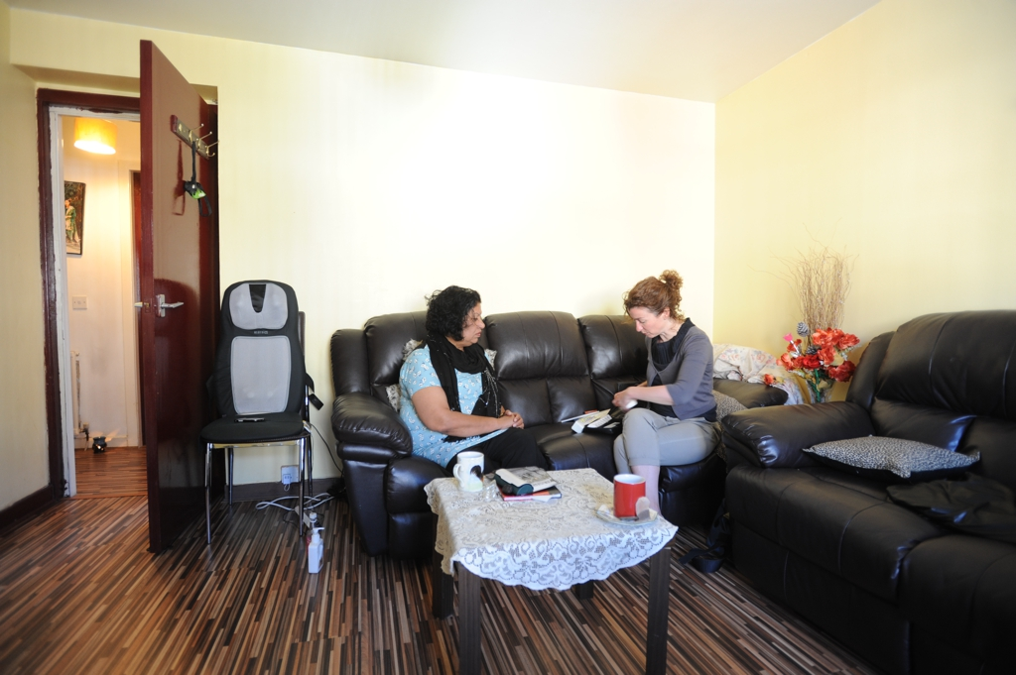
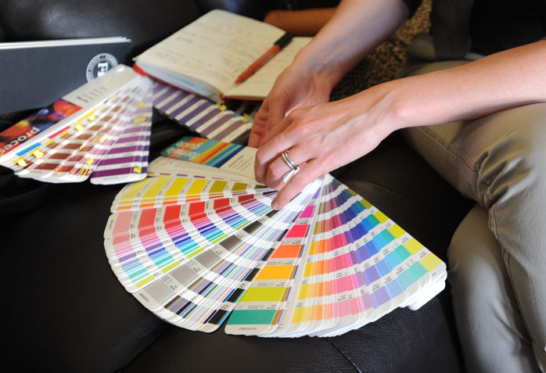
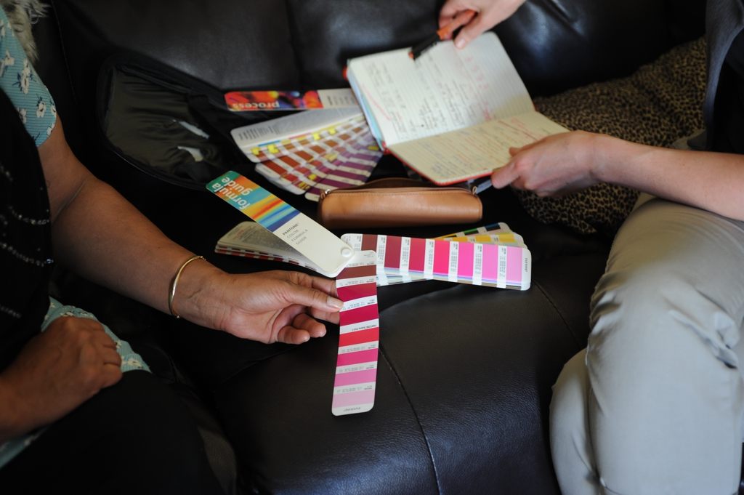
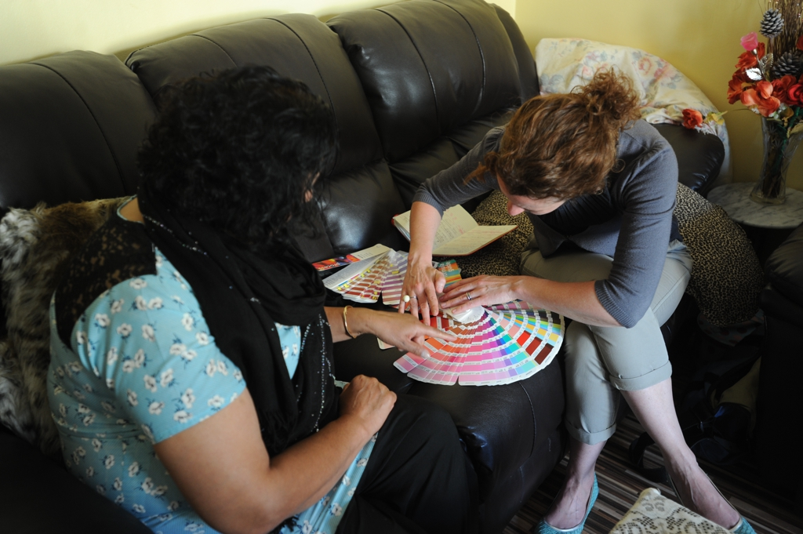
The 72 contributors came from a diversity of backgrounds and experiences for e.g. Fiona Sutherland is secretary for the Victoria Garden Allotments, Charandeep Singh is responsible for social media in the new Glasgow Gurdwara, Jack Norton is a high court judge who has lived on Albert Drive all his life, Father John Gannon is the local parish priest, Bashir Ismail the local butcher and Nicola Sturgeon the local MSP. Meetings and conversations took place in peoples homes, places of work and local cafes and usually lasted minimum an hour.
The exhibition opening was the first opportunity where everyone was invited to come together and this was followed by a group photograph and gifting of the print which happened a week later. There were 72 prints produced, each individually numbered and signed for each of the 72 contributors. This means that once the exhibition ends (11th Aug.) the artwork is dispersed in and around Albert Drive in the homes, places of work, and worship of those who contributed to the artwork.
Process - meeting Muna Sultan in her home to collect her chosen colour, Deep Rose.

Slide 7
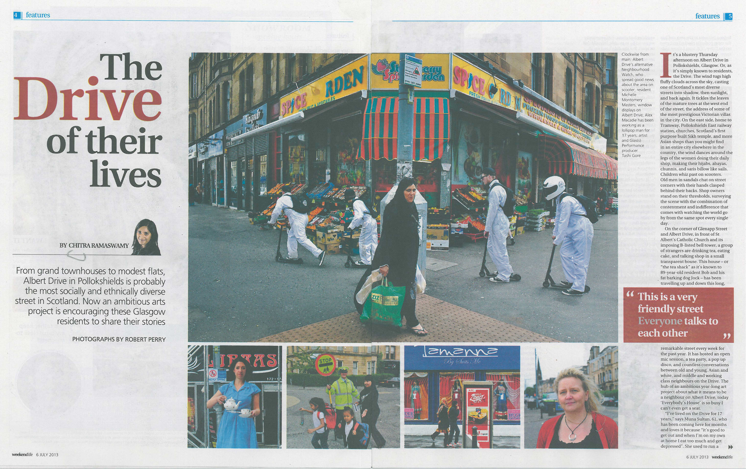
The process of making the Albert Drive Colour Chart involved the orchestration of 72 collaborative encounters and conversations that exist beyond the fixed location of the artwork.
In terms of direct local participation there were just over 2000 people (not including online participation) involved in the overarching Albert Drive Project. This included volunteers, local businesses, residents, families, individuals, communities and the artists.
Over the event weekend which included the opening of the exhibition, performance and shared meal, there were 2461 visitors. This was an unprecedented number of visitors for the Tramway and a major success in terms of bringing the local communities closer to the venue.
‘It’s a large-scale, sprawling, and ingenious endeavour, involving performance and visual artists, photographers, choreographers, filmmakers and, of course, dozens of members of the local community who will perform in a show at Tramway this weekend alongside various other celebrations and exhibitions. Many of them had never set foot in the internationally acclaimed arts venue before, let alone taken to its main stage’
Feature by Chitra Ramaswamy,
The Scotsman, ‘Weekend Life’ Magazine, 07/07/13
http://www.scotsman.com/lifestyle/scotland-s-most-ethnically-diverse-street-1-2991437
Four page review of the Albert Drive Project in the Scotsman ‘Weekend Life’ by Chitra Ramaswamy

Slide 8

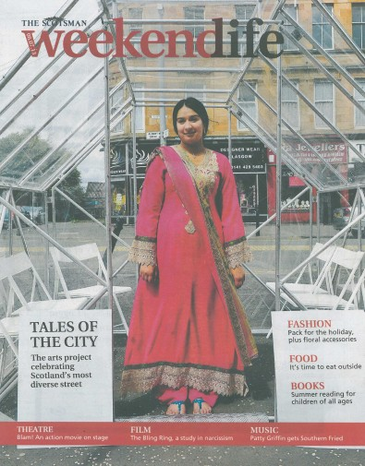
Tramway is an international art-space which commissions, produces and presents contemporary art projects to local, national and international audiences. It is one of the major exhibition spaces in Scotland and Britain and as such, a prestigious place to be commissioned to make art for and an important space in which to contextualise and raise my profile.
The Albert Drive Project website: http://www.albertdrive.com/project/
Has been an important space to share and articulate the development of the artworks from their initiation, through their development and finally as a showcase for the resolved works. Each of the commissioned artists had blogs that followed the development of their ideas and allowed for wider conversations to take place. (We are currently developing ideas for how to use the website to communicate the evaluation of the participant process and also to present the artworks online for audiences following the closing of the exhibition).
I have been asked to be one of the key speakers at the Albert Drive Project Symposium which is due to take place on 17th Oct. in Tramway. Designed for artists, students, producers, community leaders and arts professionals with an interest in the
dialogue surrounding creativity, social engagement and participation, the symposium aims to reflect on the results of the project; to share key moments of learning discovered along the way; and to contextualise it in relation to national and internationally socially engaged practices.
The project has been critically reviewed and discussed in the local and national press. For e.g.:
Feature by Shireen Nanjiani, BBC Radio Scotland, Culture Studio, 05/07/13
http://www.bbc.co.uk/programmes/b036tdqc
Mary Brennan, The Herald, 08/07/13
http://www.heraldscotland.com/arts-ents/stage/tramway-glasgow-albert-drive-project.21538114
Feature by Chitra Ramaswamy,
The Scotsman, ‘Weekend Life’ 07/07/13
http://www.scotsman.com/lifestyle/scotland-s-most-ethnically-diverse
Feature by Eric Karoulla
The Skinny, 02/07/13
http://www.theskinny.co.uk/theatre/previews/305048-albert_drive_who_your_neighbour
http://news.stv.tv/west-central/articles/230347-albert-drive-project-culminates-in-performances-at-the-tramway/
Front cover of the Scotsman “Weekend Life’ , 07/07/13

Slide 9

