Slide 1

Curious Arts - No. 4
Text work / Artists’ pages
2011
A text work designed in collaboration with Jim Harold to be translated into a form appropriate for production as a set of artists' pages: firstly, reproduced in 2HB, Volume 10, published by CCA, Glasgow (2011) and subsequently included in an exhibition of printed matter at MoMA, New York (2012).
Submitted by Susan Brind
Output No. 2

Slide 2

Focussing on the artists' use of text and their interest in how the gaps between different knowledge structures generate the emergence of other ideas, ‘Curious Arts - No. 4’ posed the question: How does a viewer/reader understand and reflect upon the contemporary world through subjects as apparently diverse as time, nature, history, mathematics, politics, theology, astronomy, mysticism and specifically through a journey of thought as reflected in the writings of Richard Parrot (1740-1762); found in the library of Patrick Allan Fraser of Hospitalfield House, Arbroath?
Image one & a description of what we are looking at in the context of the project.

Slide 3

Method: 'Curious Arts - No. 4' is a text work that comprises an index of subject headings drawn from the journal of Richard Parrot, transcribed as one continuous list in an attempt to encapsulate his whole body of knowledge. Parrott compiled his journal between 1740 and 1762. It is indexed alphabetically; encyclopaedic topics appearing in an apparently random order under subject headings.
Strange, poetic and potent connections are made as subjects flow from one to another: Old age, Bastards, Baptism, Bawm, Bankrupt, Banks, …, Diamonds, Discount, Diseases, Mountains, Money, Motto, Morality, … .
Image one & a description of what we are looking at in the context of the project.

Slide 4

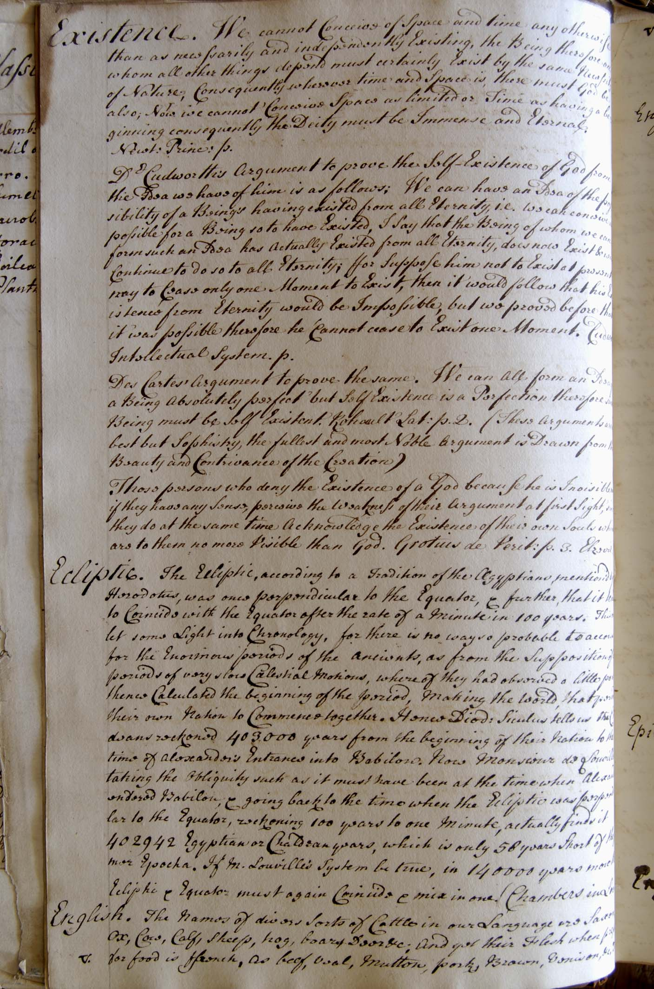
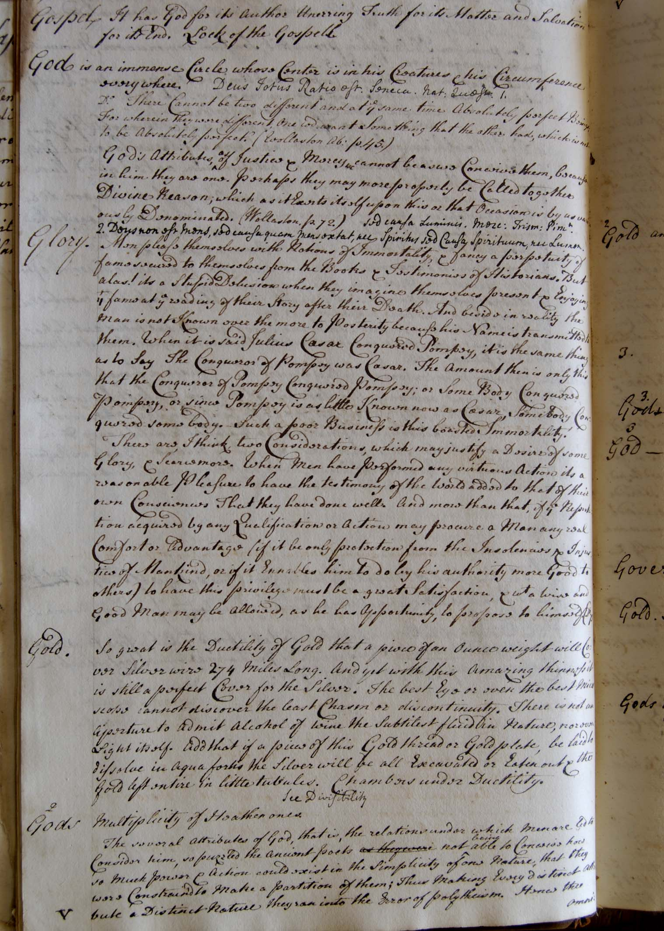
Hospitalfield Library, 2007
The journals of Richard Parrott
written, 1740-1762
Image one & a description of what we are looking at in the context of the project.

Slide 5
'Curious Arts - No. 4' makes manifest the impossibility of ever completely archiving and ordering knowledge, at the same time as acknowledging the significance of history as manifested in libraries and archives.
When facts are recorded that cannot easily be categorised they appear under the heading ‘Curious Arts’, the title adopted for this text work and the extended series of works that have emerged from this body of research.
Image one & a description of what we are looking at in the context of the project.

Slide 6
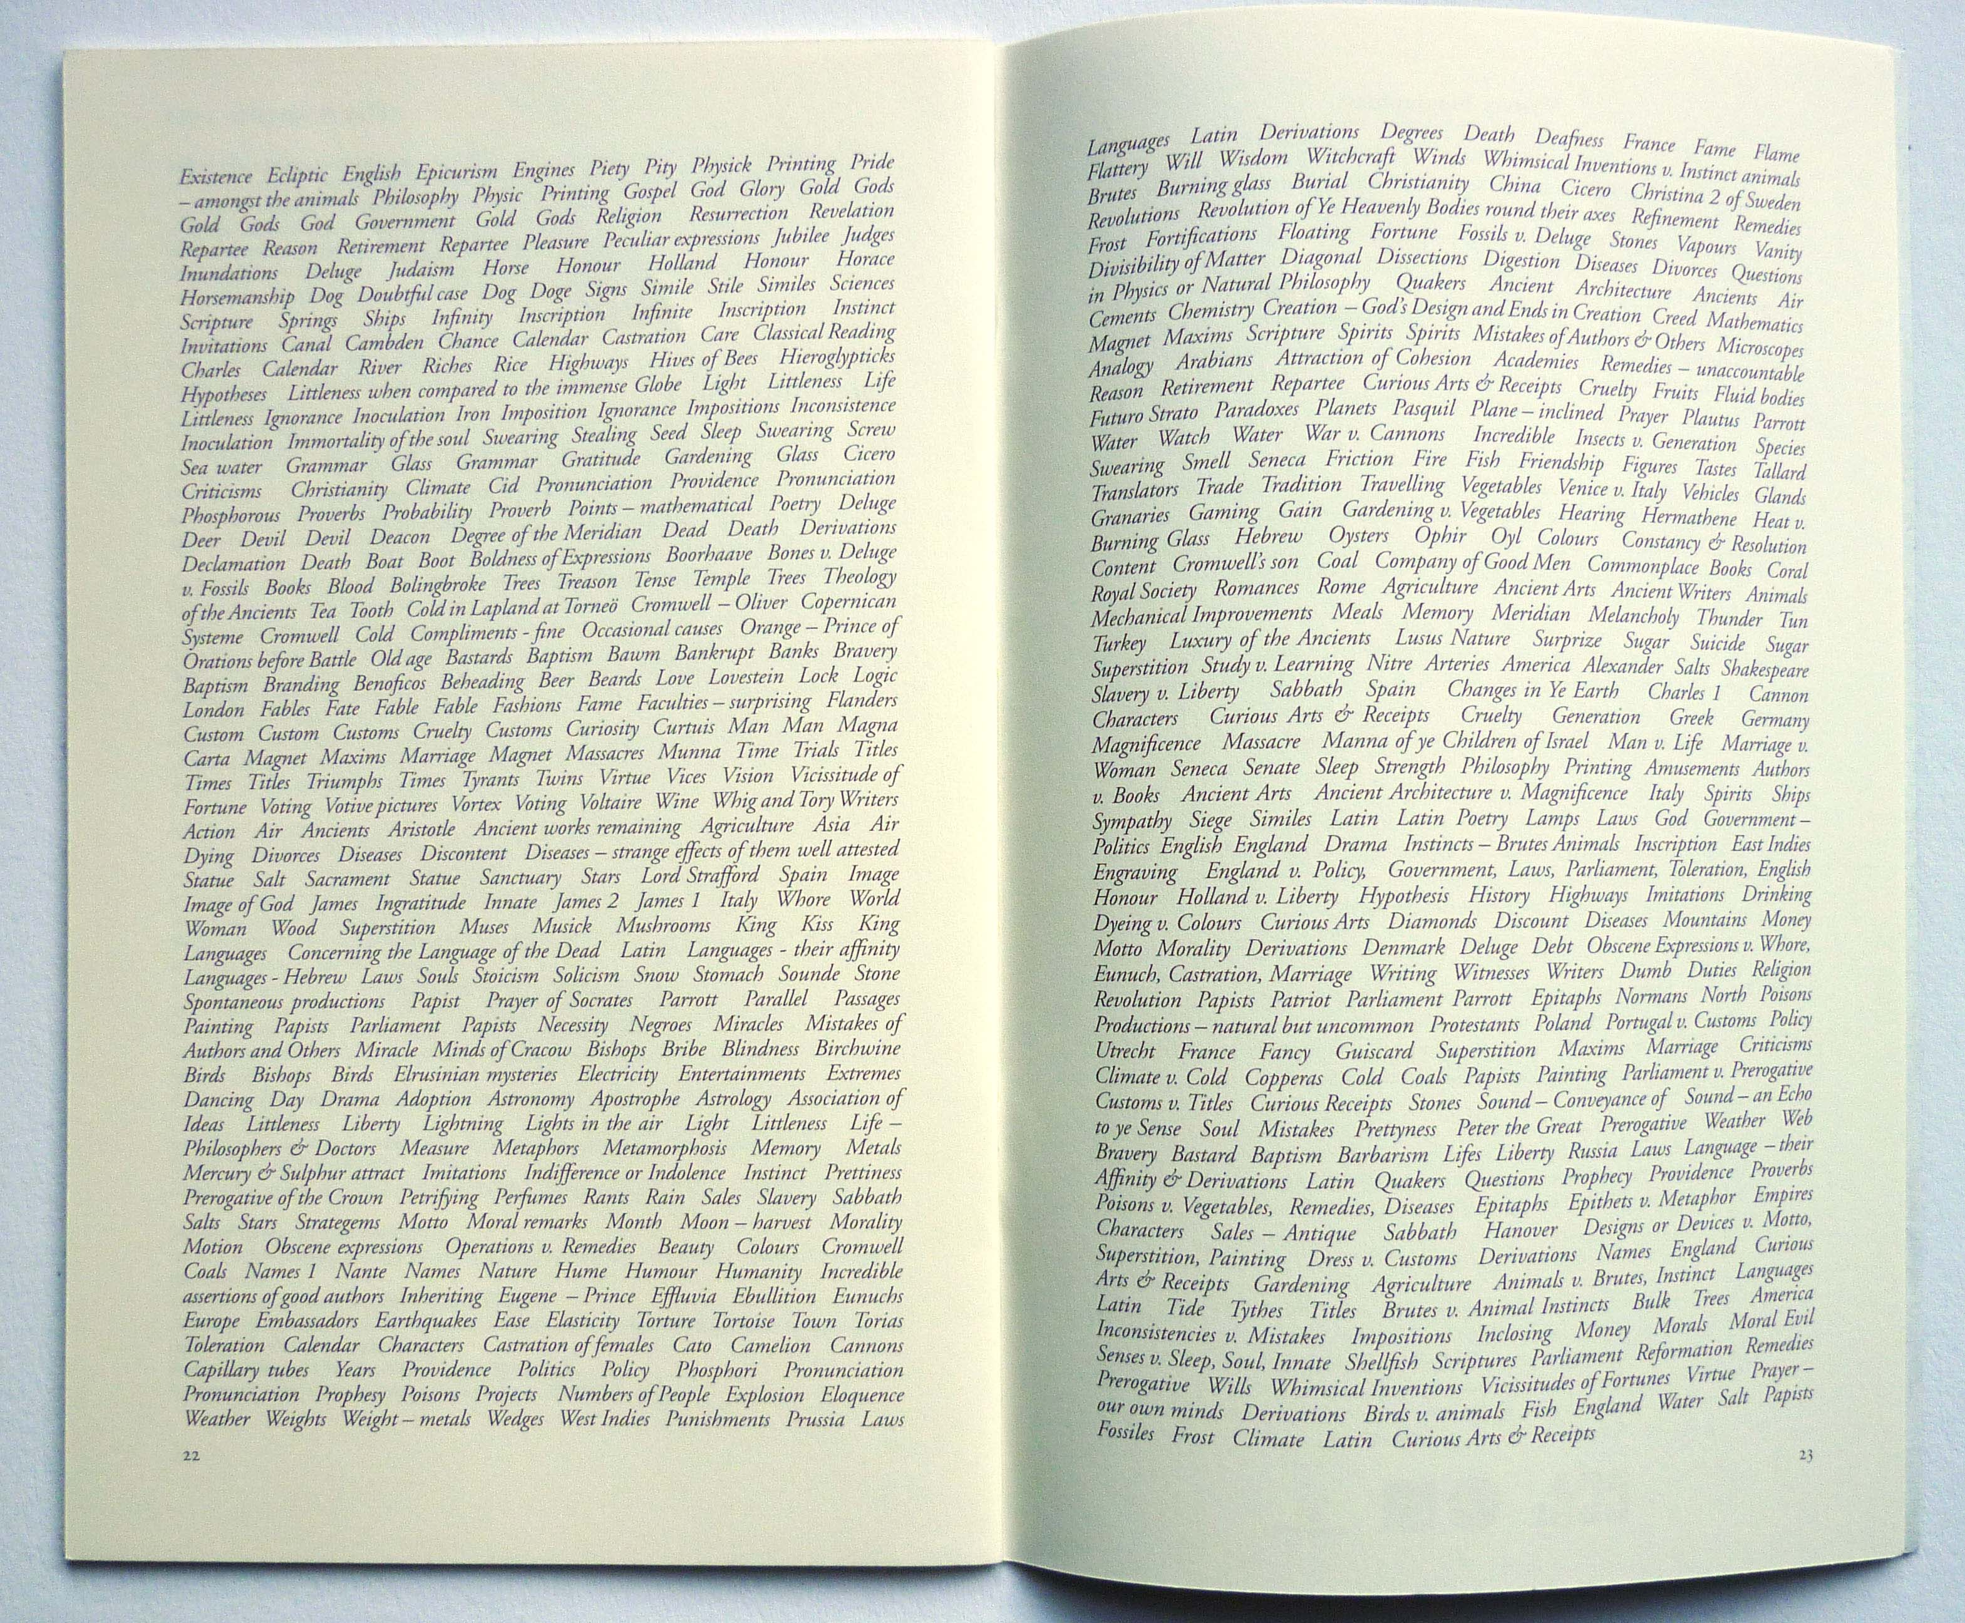

Slide 7
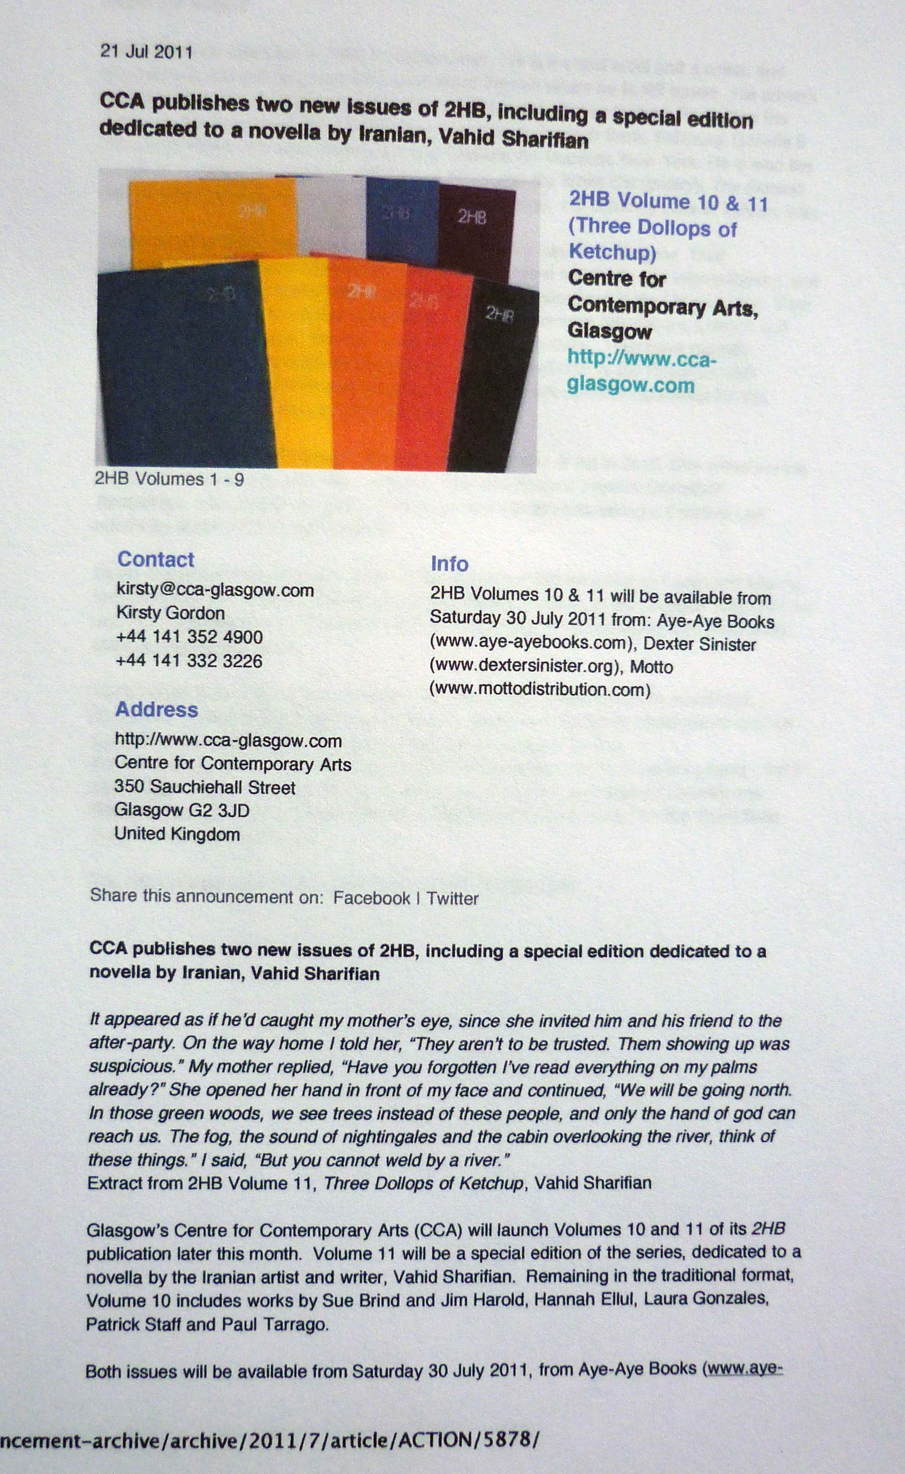
The text work was published in the '2HB: Volume 10'. 2HB is a quarterly publication of creative writing / text works, edited by Louise Shelly and Francis McKee, published by CCA, Glasgow. Volume 10 was published in 2011.

Slide 8

In this form, the work itself could be critically considered in the context of a range of artists working with text and installation, and with the book as a context for work. Other contributors to the volume include: Laura Gonzales, Paul Tarrago, Patrick Staff and Hannah Ellul, although the critical framework might be extended by reviewing the contributors to the 2HB series as a whole.
Image one & a description of what we are looking at in the context of the project.

Slide 9
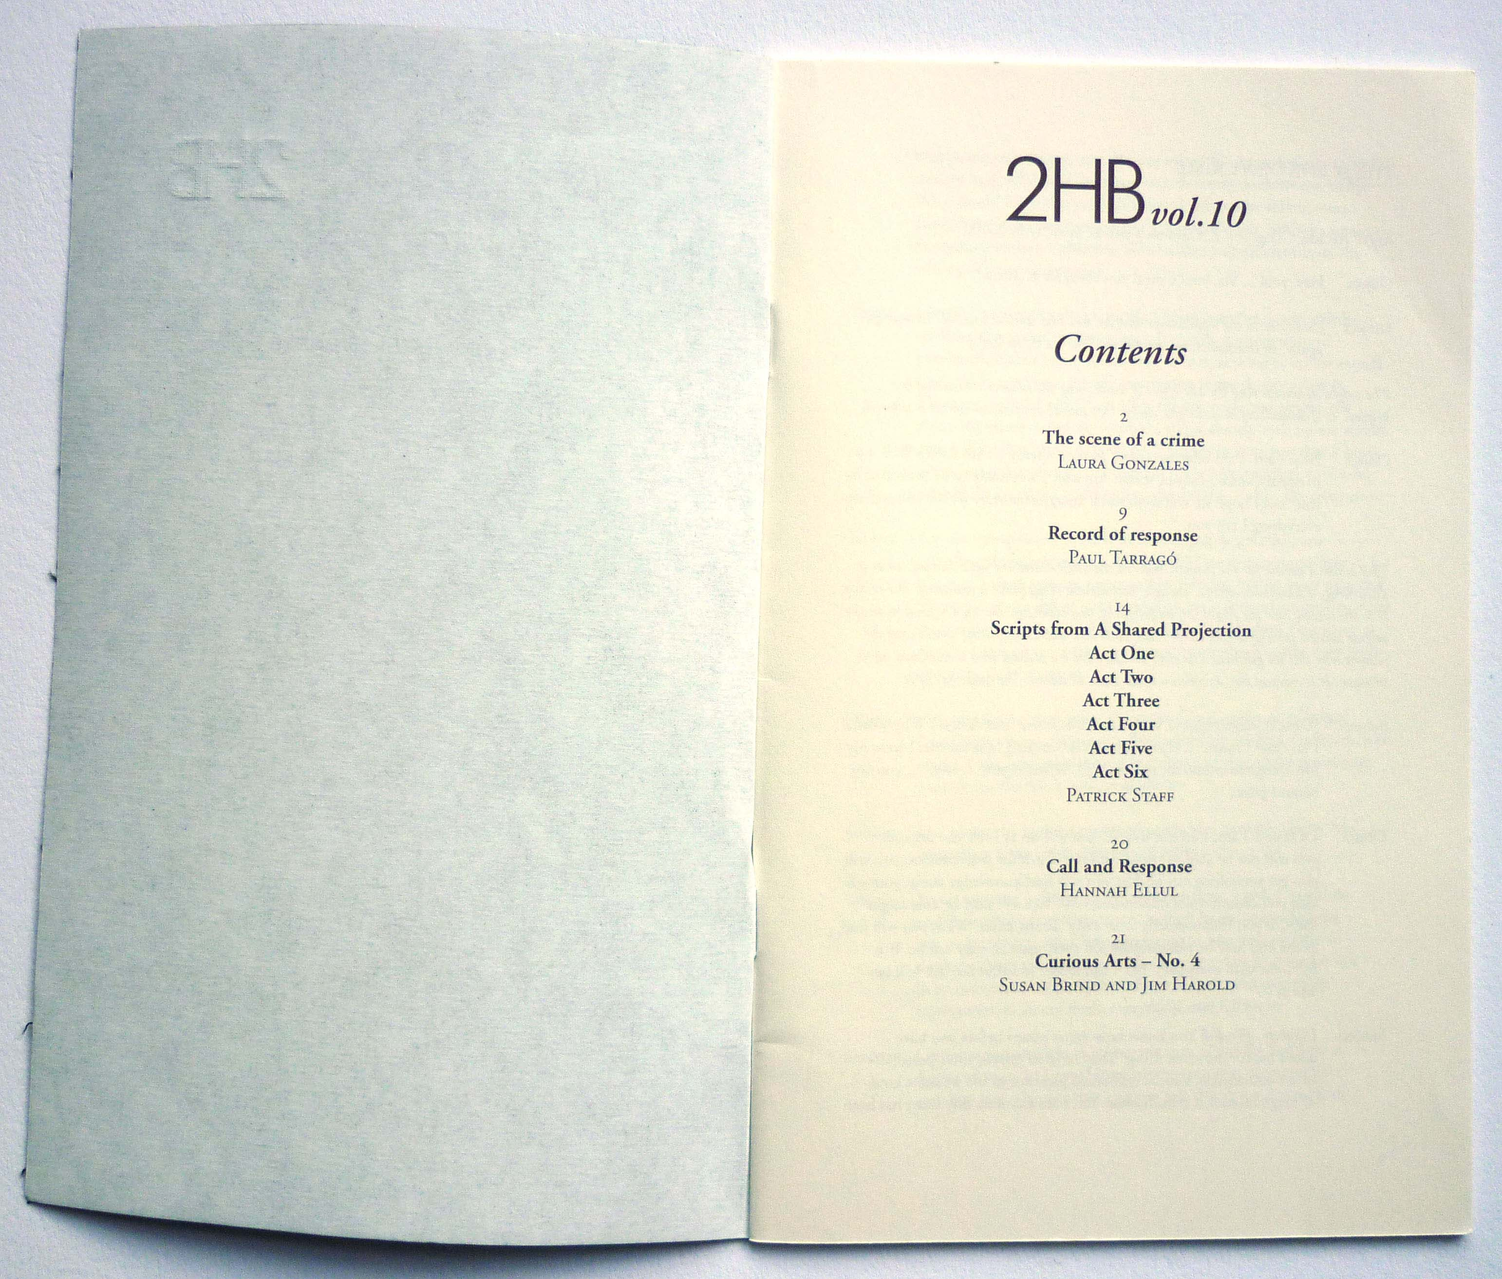

Slide 10
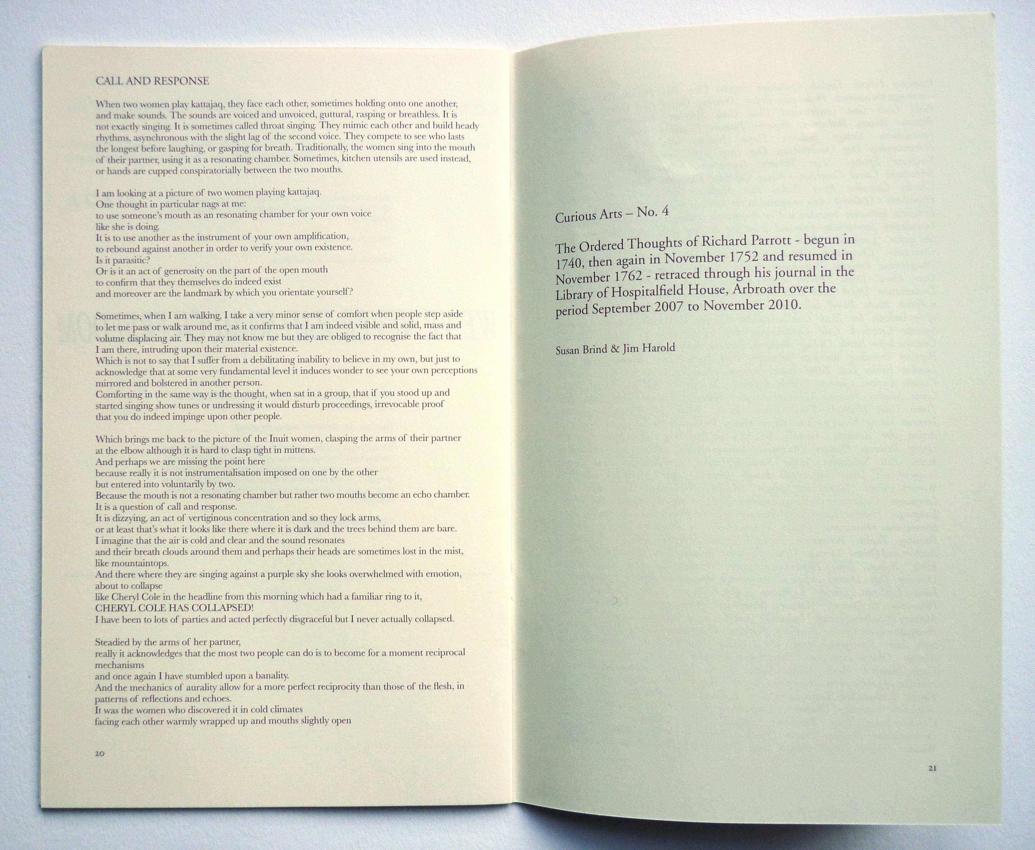

Slide 11
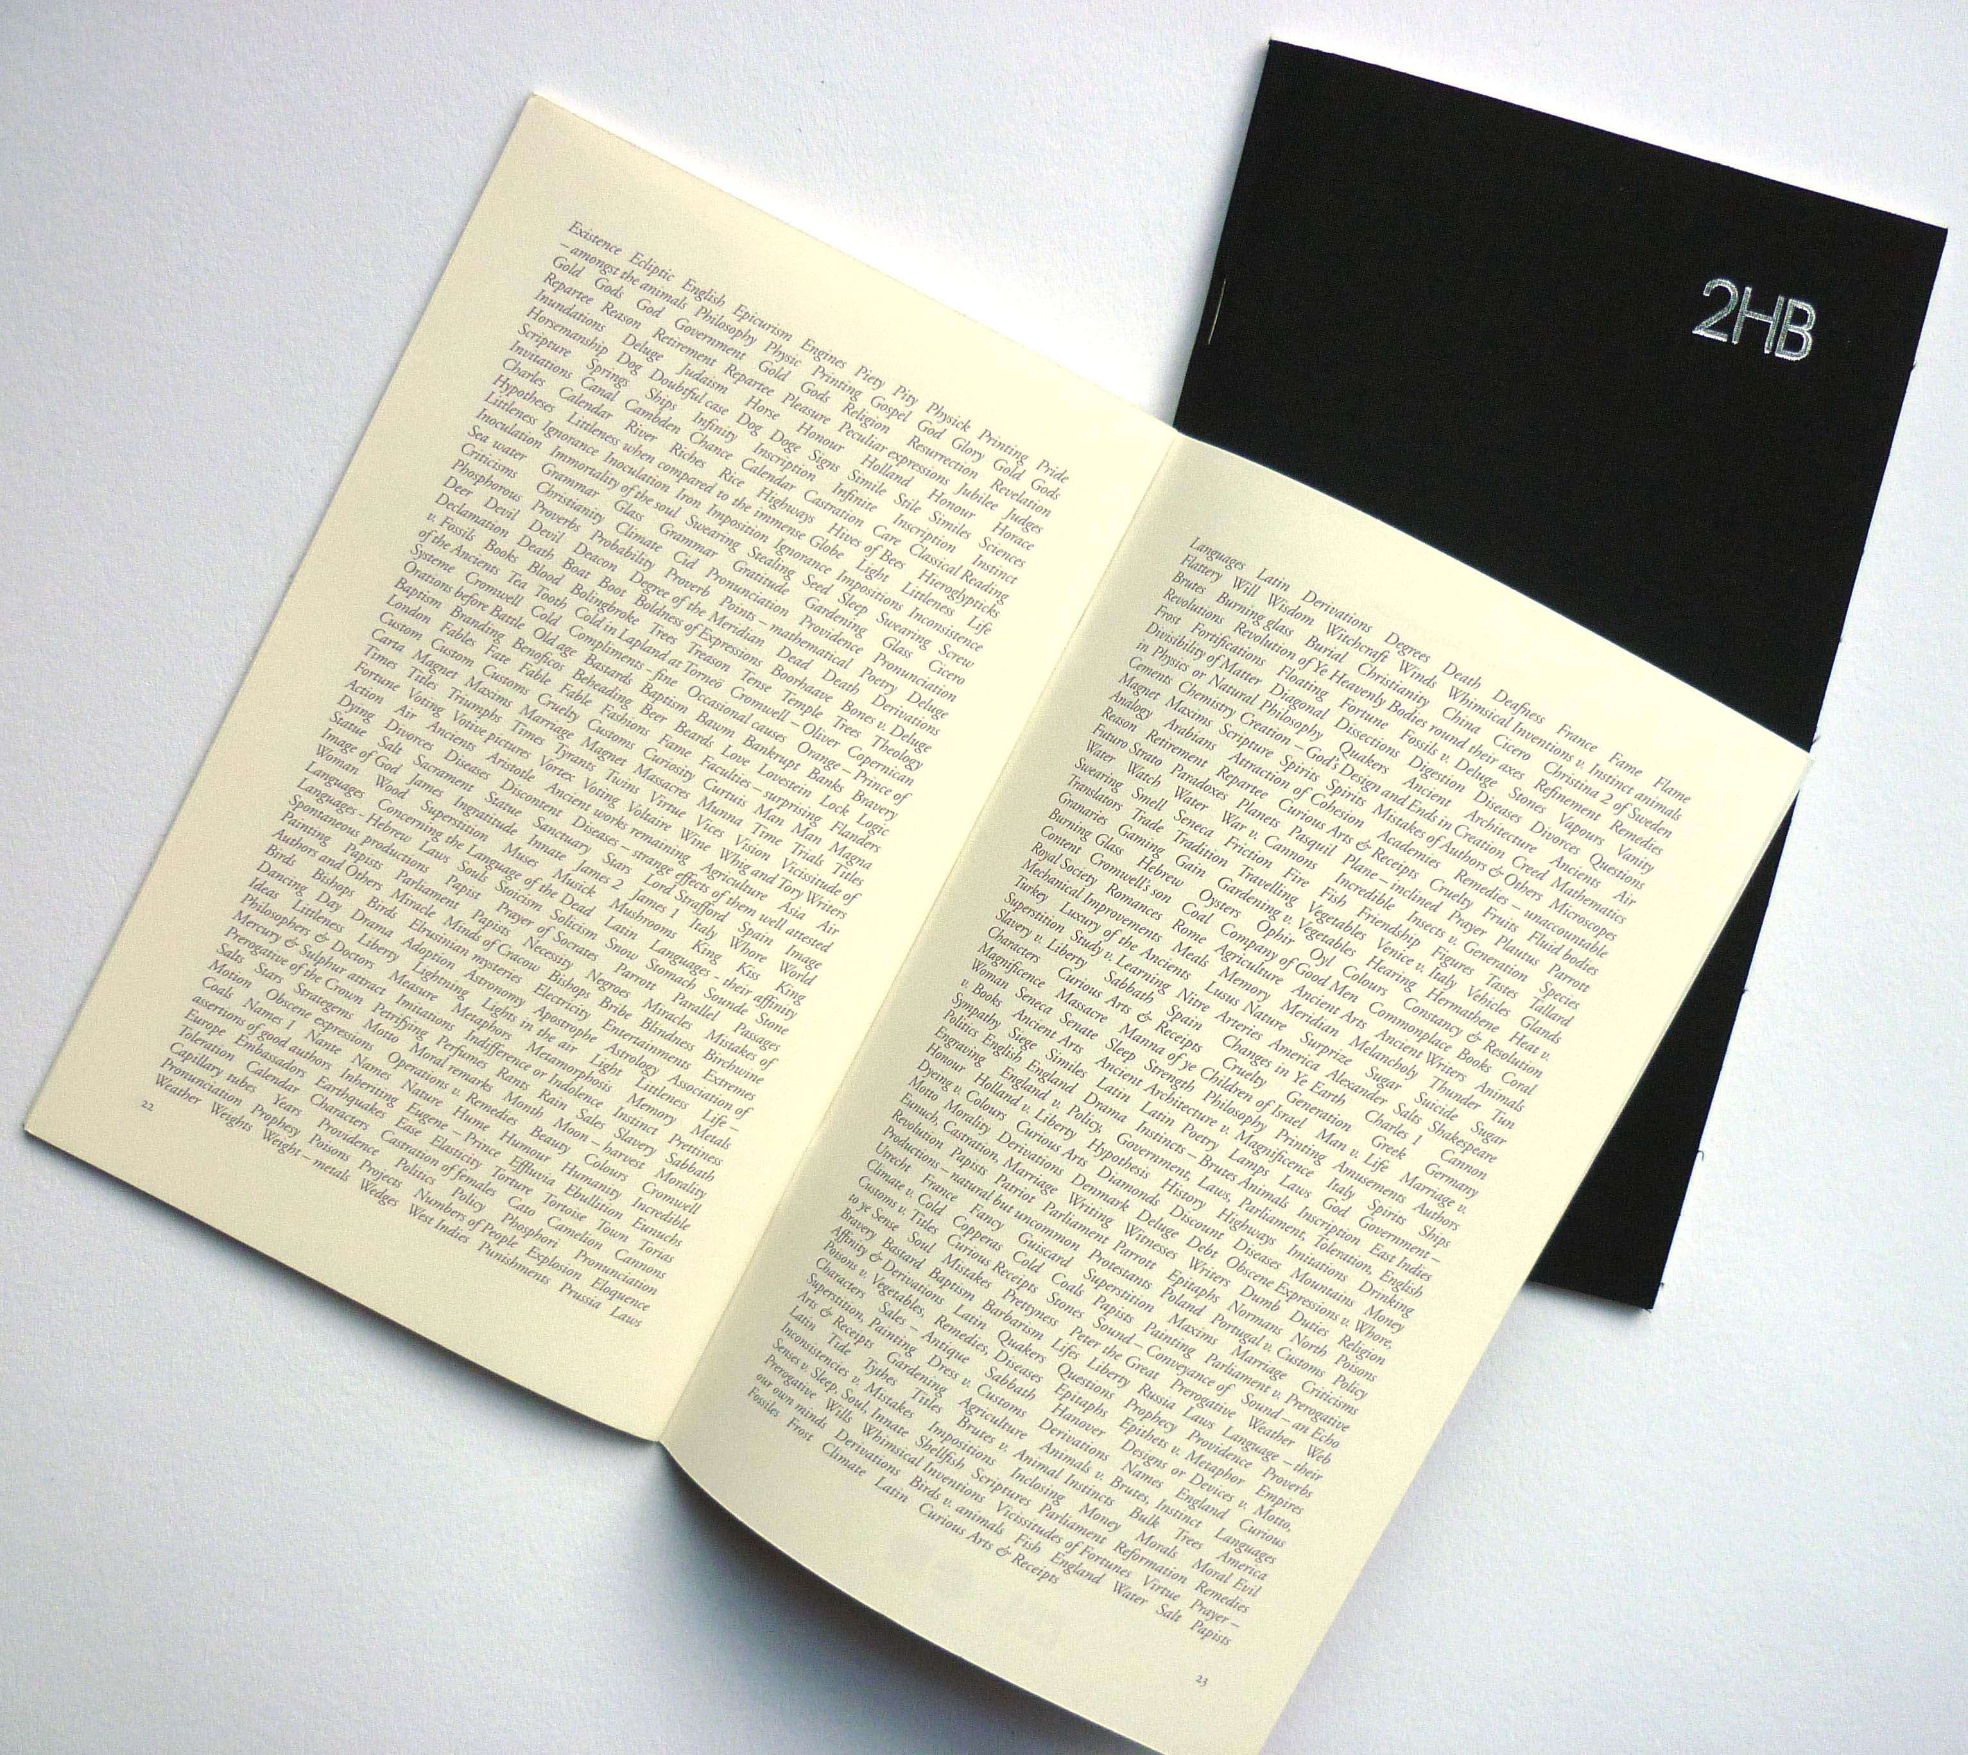

Slide 12
The work subsequently became incorporated into an exhibition, 'Millenium Magazines', curated by Rachael Morrison and David Senior, drawn from the holdings of the Museum of Modern Art Library, New York. The exhibition, which ran from 20 February to 14 May 2012, was "intended to provide a firsthand view of the latest practices in art and design in print", since 2000, and "to represent MoMA Library's sustained effort to document and collect work originated in this medium."
Quotes from 'Millennium Magazines' webpage – accessed 9/7/12.)
The curators selected the whole series of 2HB publications to be included in the exhibition and, post-exhibition, they remain in the MoMA archive as a research resource.
"The range of publications included in the MoMA exhibition and archive provide the most immediate context. A sample of which include such publications as: '0-100; 2-UP; A3 Series; A Prior; An Architektur; aTree zine; ALBUM; Apartamento, Bad Day, Bidoun;...; Zug".
Image one & a description of what we are looking at in the context of the project.

Slide 13
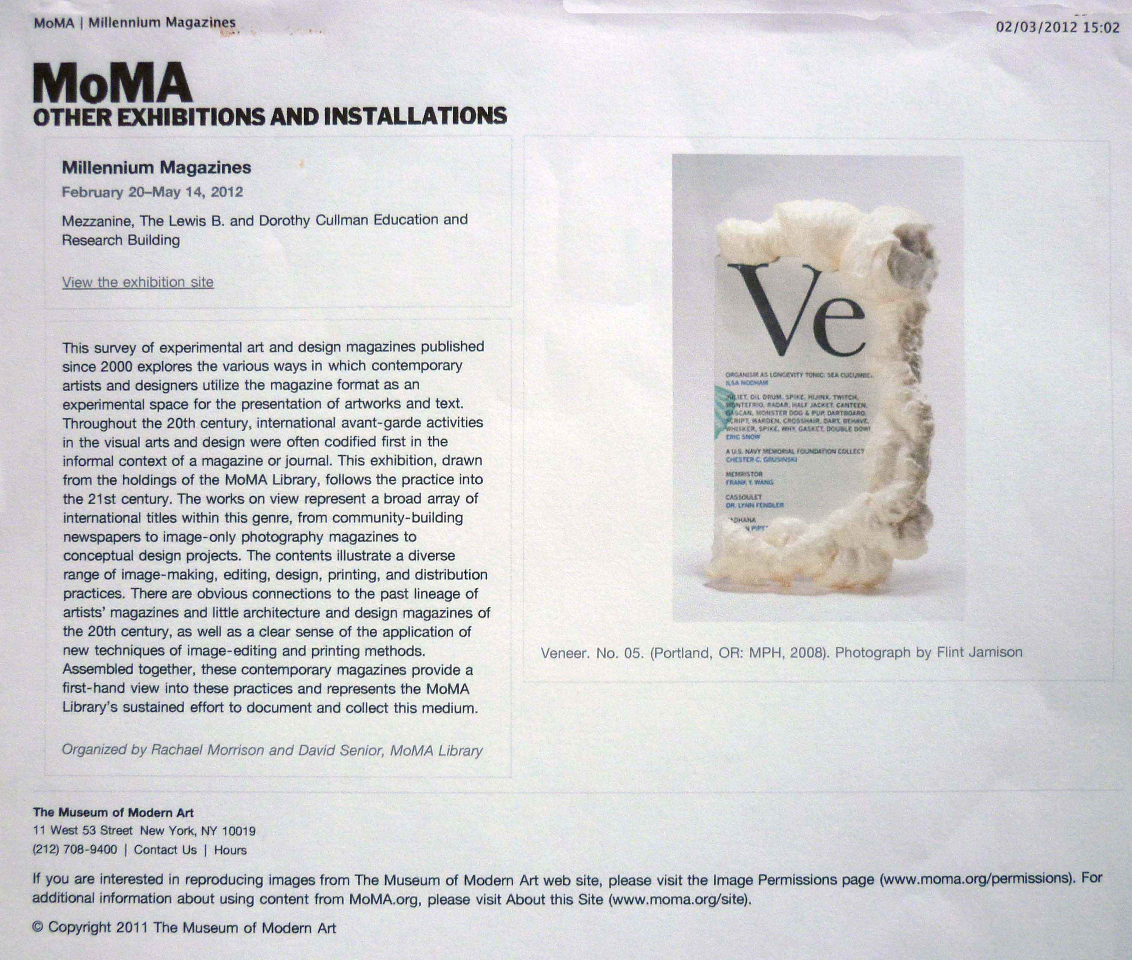

Slide 14
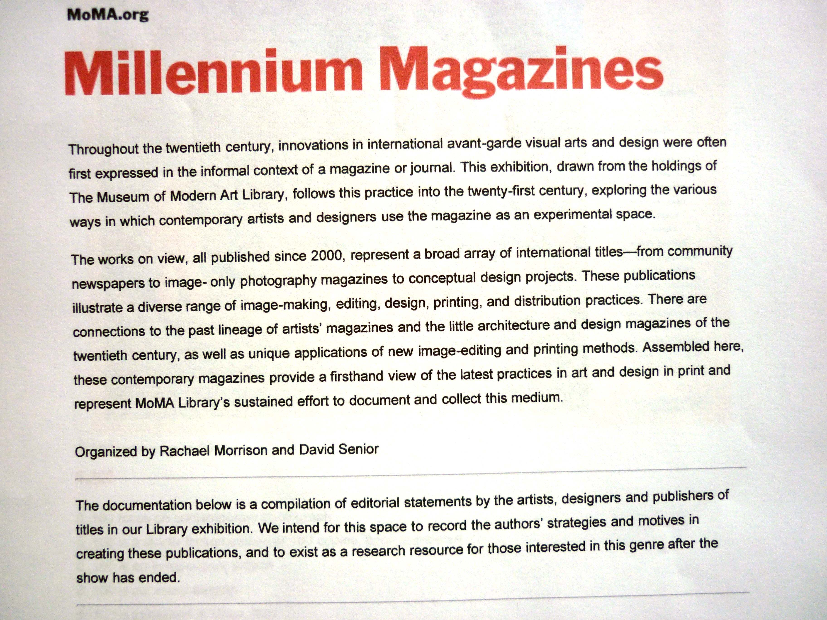

Slide 15
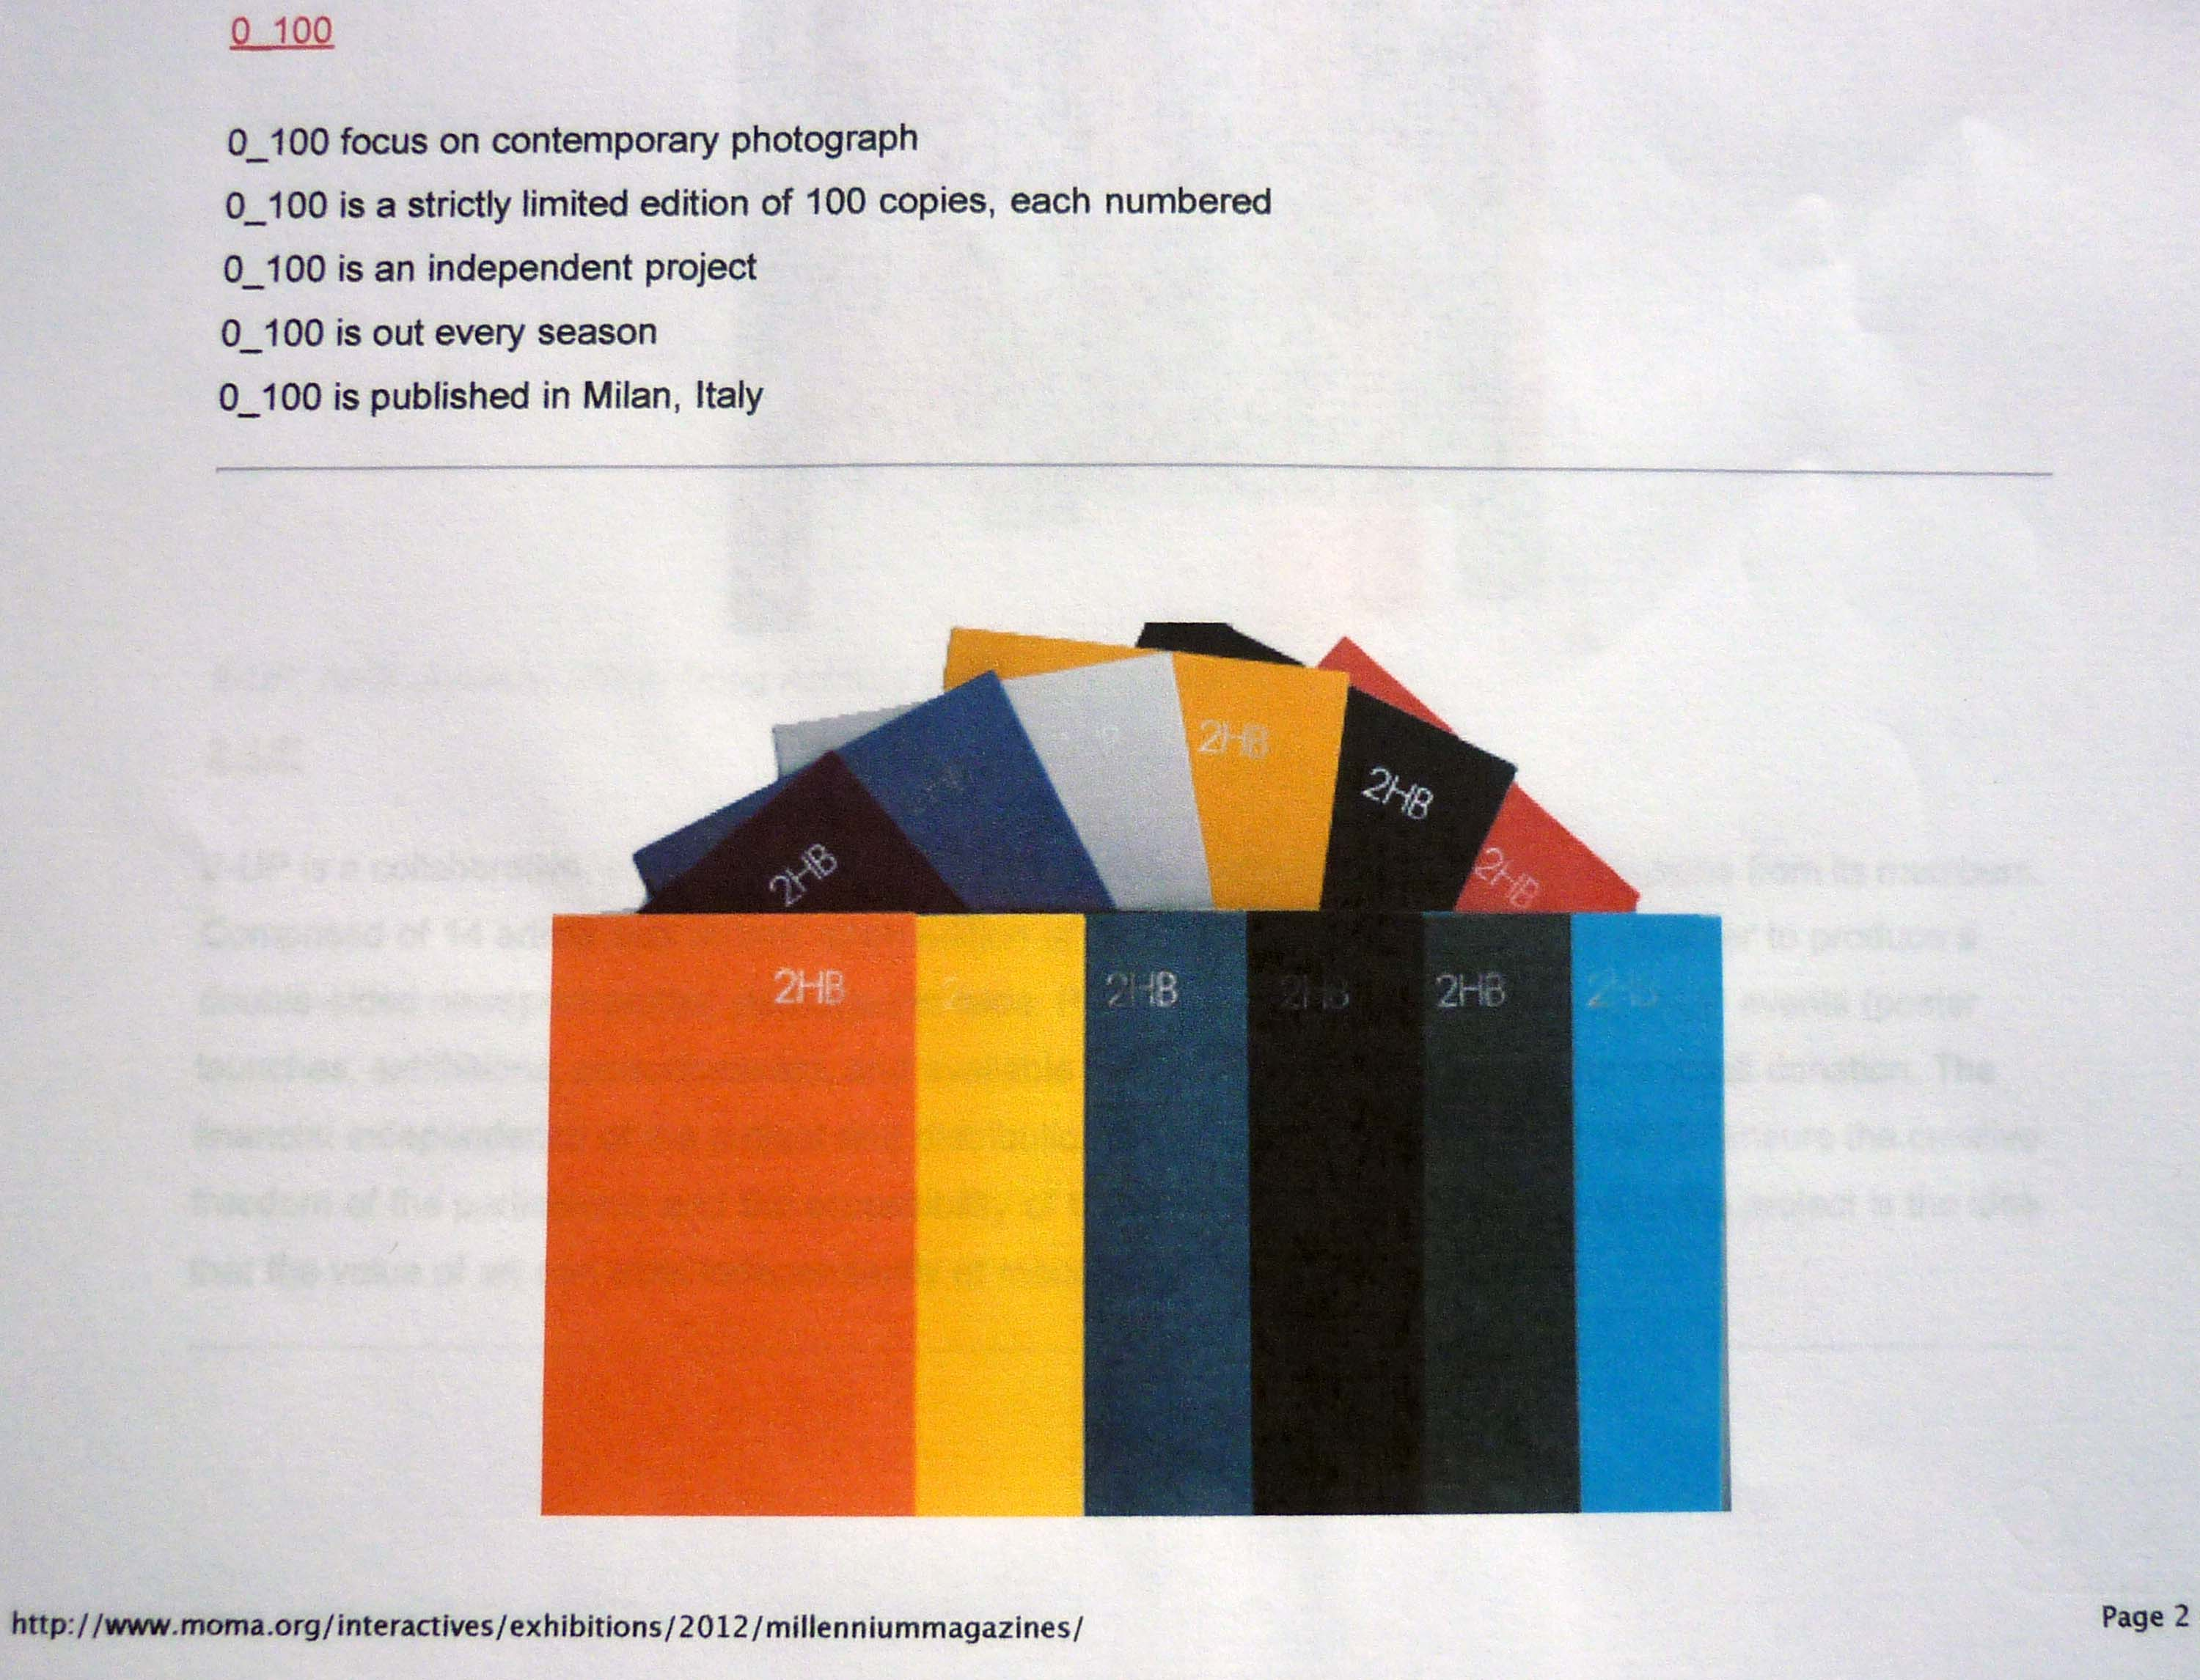
2HB web page (detail)
‘Millenium Magazines’’
Exhibition at MoMA, New York, 2012
Image one & a description of what we are looking at in the context of the project.

Slide 16
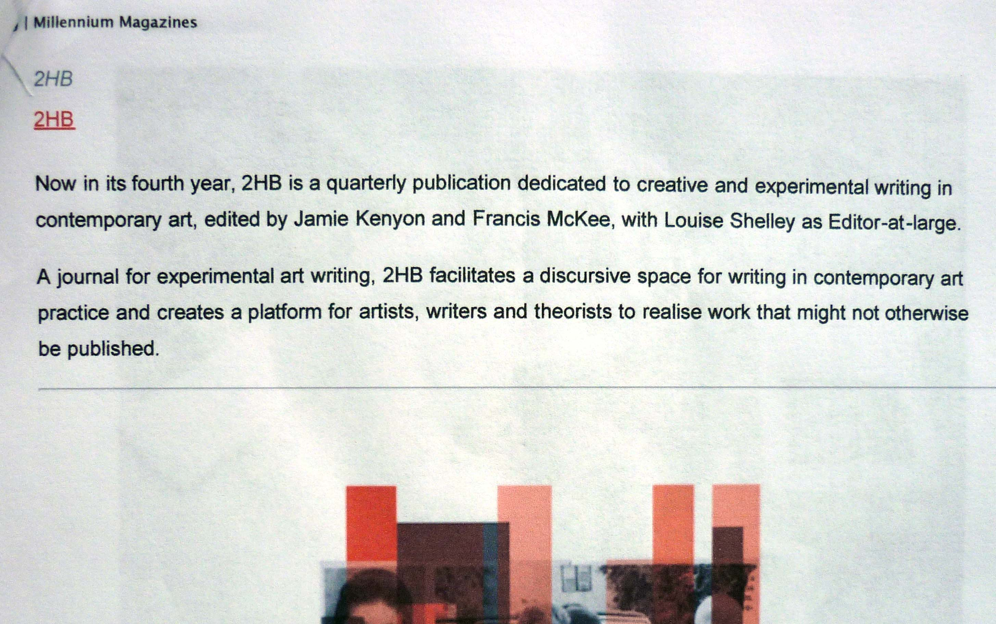
2HB web page (detail)
‘Millenium Magazines’’
Exhibition at MoMA, New York, 2012
Image one & a description of what we are looking at in the context of the project.

Slide 17
Preliminary written and photographic research for the work was undertaken in the Library of Hospitalfield House in during a research residency in 2007 (funded by the RSA, Edinburgh and Hospitalfield House Trust), and extended with further research visits in 2008 and 2009.
The textual material was brought forth from the journals of Richard Parrot (1740-1762), an ancestor of Patrick Allan Fraser, the last owner of Hospitalfield House.
Images from this wider body of research are included in the ‘What we make with words’ catalogue for 'Curious Arts – No. 5' (2011); and extracts from the list of subject headings are included in the site-specific installation 'Curious Arts - No. 3' (2010 to date). See REF Outputs 1 and 3 respectively.
Image one & a description of what we are looking at in the context of the project.

Slide 18
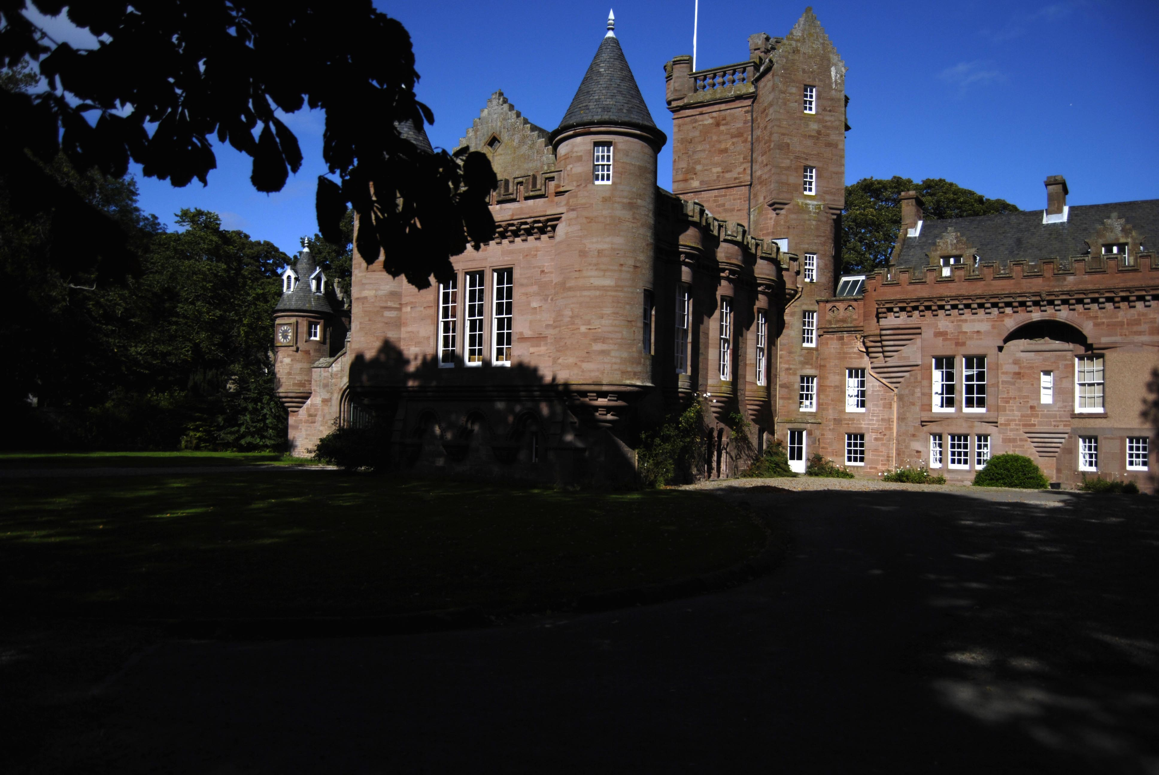
Hospitalfield House
Arbroath
Image one & a description of what we are looking at in the context of the project.

