Slide 1

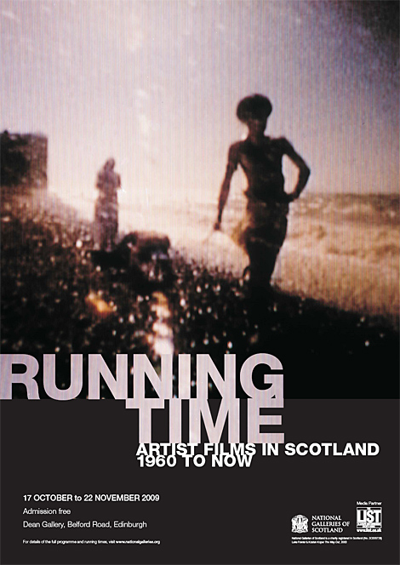
Running Time: Artist films in Scotland from 1960 to now.
A survey exhibition, dedicated to Scottish artist films, featuring selection of over one hundred film and video works by over sixty artists, created in the past fifty years. Three of my collaborative video works, made with John Beagles, were included in this exhibition that took place at the Dean Gallery, Scottish National Gallery of Modern Art, Edinburgh.
Graham Ramsay

Slide 2

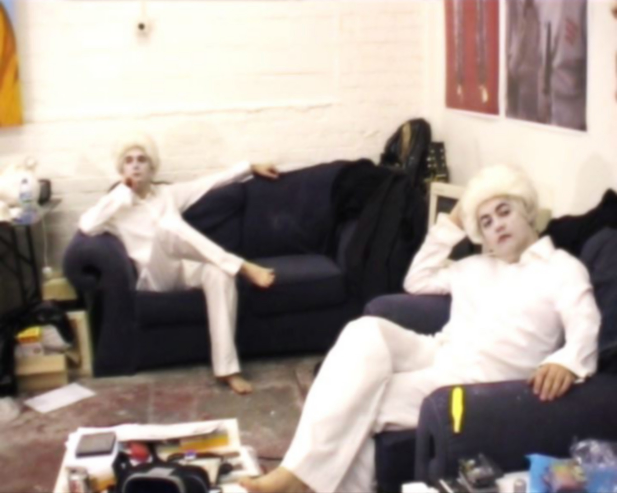
Running Time: Artist film in Scotland from 1960 to now
2274
Graham Ramsay & John Beagles
This comprehensive survey exhibition featured a selection of over one hundred film and video works by over sixty artists, including Douglas Gordon, Margaret Tait, Boyle Family, Eduardo Paolozzi, David Shrigley and Luke Fowler.
Three of my collaborative video works, made with John Beagles, were included in this exhibition. These works were "Two Fine Examples of British Dentistry' (2009), "Trilogy" (2003) and "We Are The People" (2000).
‘Two Fine Examples of British Dentistry’ (2009) Video still

Slide 3

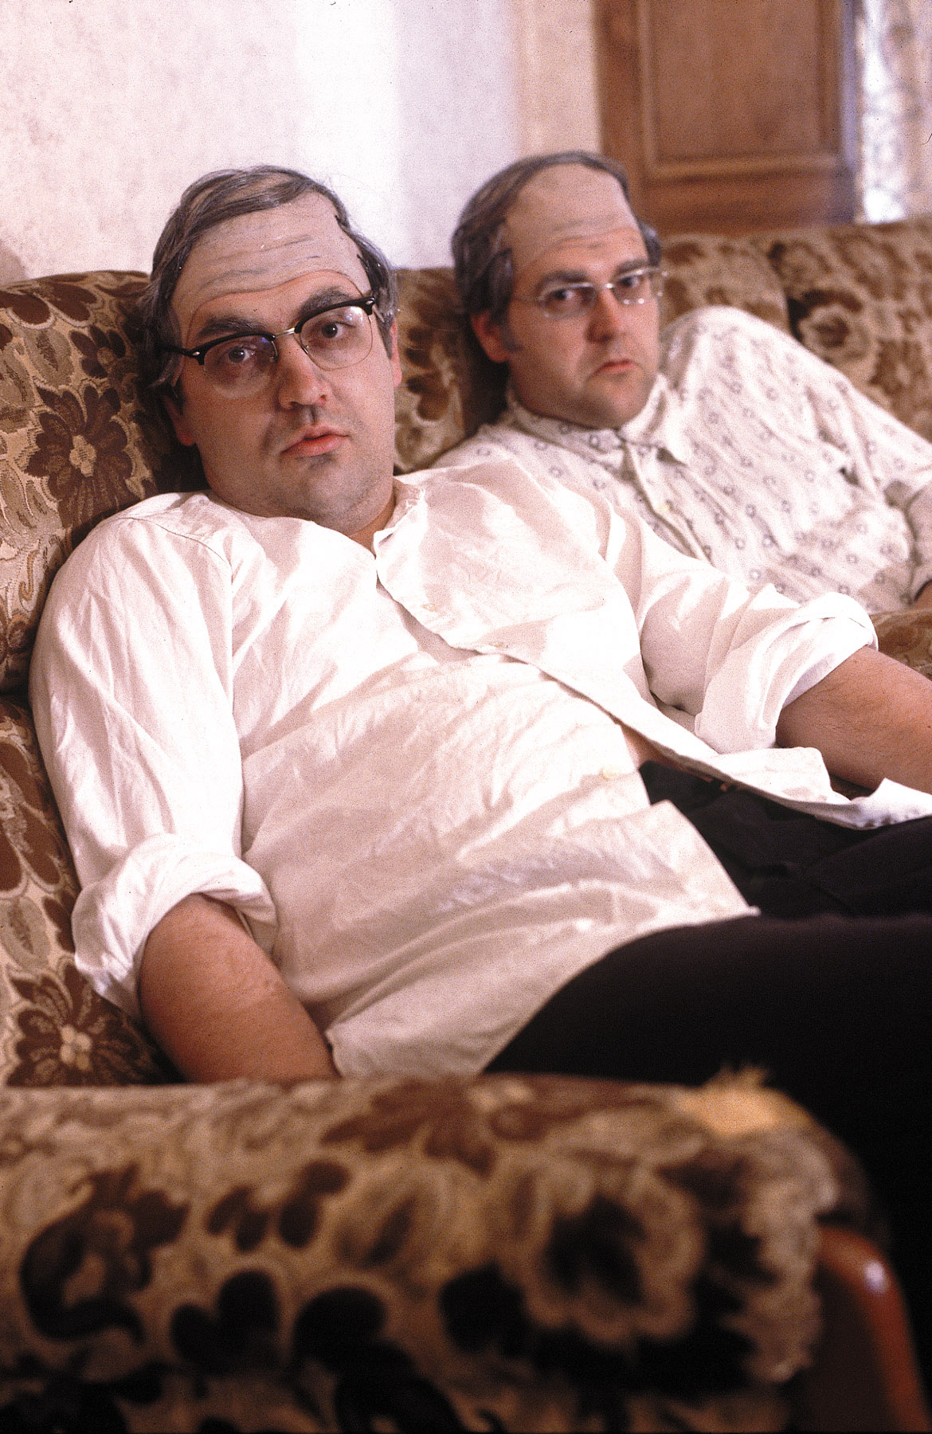
“Drama and Suspense brings together a group of film, video and animation works which suggest the macabre and subvert the cinematic conventions of narrative to create a state of tension in the viewer.”
“Portraits in Action explores an ongoing concern with performance in Scottish film since the 1970s.”
National Galleries of Scotland 2009
Being including in a significant and unique survey exhibition of Scottish artists film and video marked an important point in my career and allowed my work to be understood and framed within a wider historical context.
In particular this meant that my work was curated into two thematic strands within the overall exhibition that focused upon ‘Drama and Suspense’ and ‘Portraits in Action’.
These thematic strands were clearly connected to my longstanding research interests and particularly relevant to the three works that were selected for the exhibition.
Image one & a description of what we are looking at in the context of the project.
‘Trilogy’ 2000. Production still

Slide 4

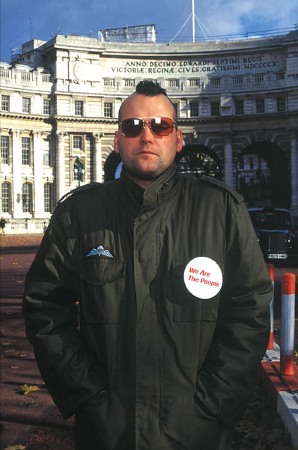
The exhibition was developed by curator and writer Rosie Lesso.
Prior to the exhibition we met for a studio visit in June 2009, and the works were selected through discussion at this meeting. This offered an open and productive means to develop a mutual understanding both of the thematic strands and also the conceptual framing of my work within the exhibition through dialogue with the curator.
The other artists included in each thematic strand were chosen because of their interest in how video or film can be used to explore cinematic narrative conventions and performance to camera. This resulted in an exhibition that featured a diverse range of approaches, techniques and content, thus allowing for a fresh perspective on my own collaborative work when viewed within such a context.
“We Are The People’
Production still 2000

Slide 5

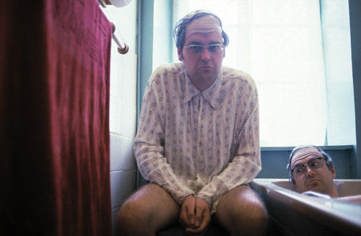
The exhibition took place at the Dean Gallery, Scottish National Gallery of Modern Art, Edinburgh, from 16 October - 22 November 2009 (http://www.nationalgalleries.org/whatson/exhibitions/running-time )
The exhibition had very high visitor numbers due to its location in one of Scotland’s major national institutions and was also reviewed in the following publications: The Herald newspaper, 12th October 2009 (http://www.heraldscotland.com/arts-ents/stage-visual-arts/rewinding-50-years-of-scottish-video-art-1.925779 ), The Scotsman newspaper 19th October 2009, Laura Cumming (http://www.theguardian.com/artanddesign/2009/nov/08/running-time-dean-gallery-review) , The Observer newspaper 8th November 2009 Giles Sutherland, The Times newspaper, 13th November 2009, Liz Shannon, The List, October 2009 (http://www.list.co.uk/article/21281-running-time-artist-films-in-scotland/)
‘Trilogy’ 2000
Video still

