Slide 1

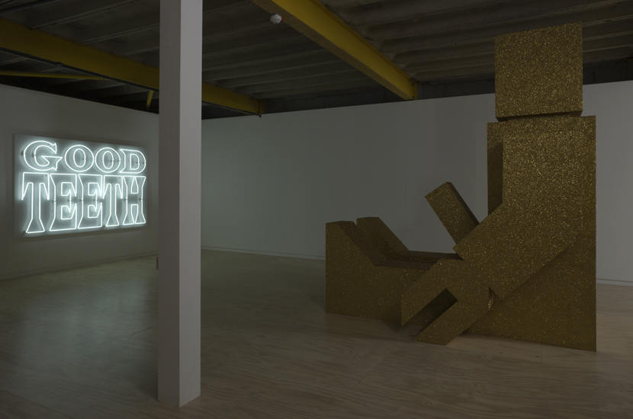
Good Teeth
A production residency and solo exhibition of newly commissioned work at Glasgow Sculpture Studios.
Submitted by Graham Ramsay
Output No. 3135

Slide 2
Installation view at Glasgow Sculpture Studios

Slide 3

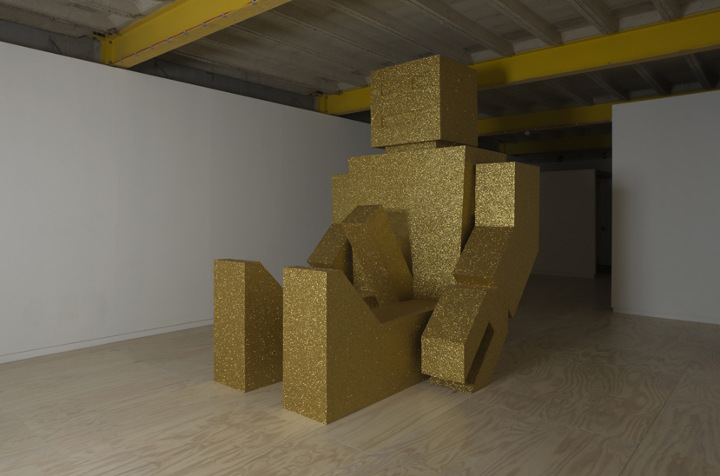
Good Teeth
The project ‘Good Teeth’ (2008-2009) involved a funded period of new research (£7,000), a production residency and a solo exhibition at the Glasgow Sculpture Studios. (GSS)
The new body of work that was produced explored the iconography of the automaton, the stimulation of desire within digital culture, ideas relating to feedback (positive and negative) and the pathologies produced by consumerism.
3135
Graham Ramsay and John Beagles
Installation view at Glasgow Sculpture Studios

Slide 4
Installation view at Glasgow Sculpture Studios

Slide 5

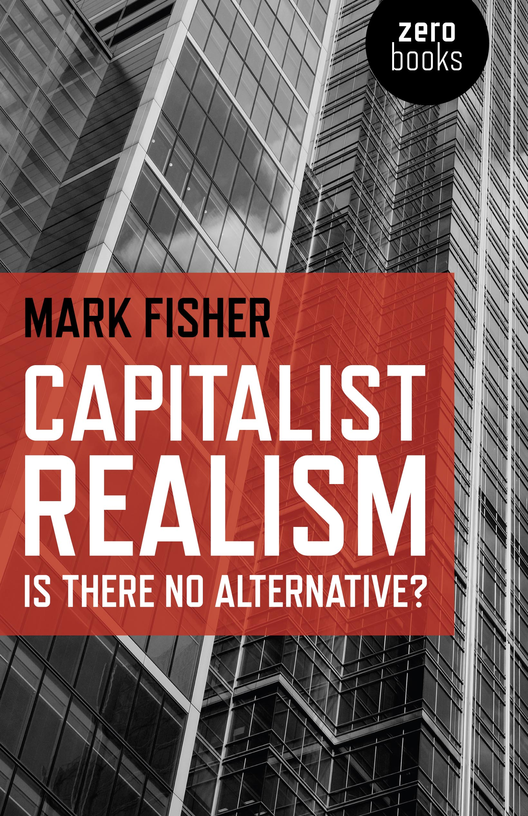
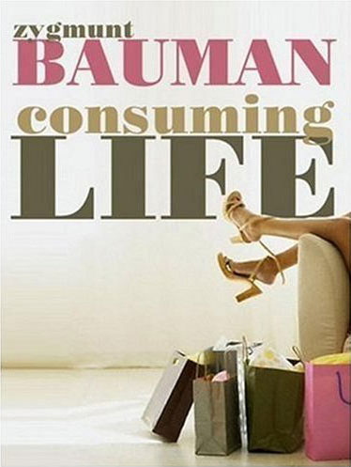
The development of new work arises for me out of both practical studio based collaboration with John Beagles, and more theoretical and research based activity. The lengthy development of ‘Good Teeth’ was no different.
The primary source for the works theoretical research was sociologist Zygmunt Bauman’s ‘Consuming Life’(2007) and his notion of the ‘blase’ disposition, and the writings of the then blogger K-Punk ( Mark Fisher) and his ideas of ‘reflexive impotence’, later published in his first book ‘Capitalist Realism’ (2009).
This research also fed into the writing of two related essays by John Beagles, ‘The Blase Zombie’ (catalogue essay for ‘Warehouse of Horrors’, SWG3, Glasgow 2009) and ‘In a class of their own’ (Variant magazine, 2010).
Key texts by Mark Fisher and Zygmunt Bauman

Slide 6

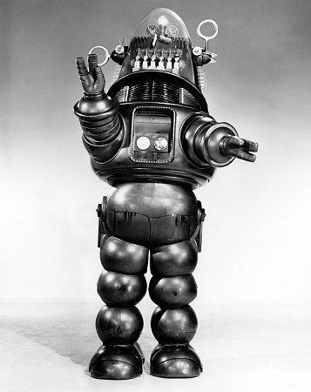
The conjunction of this theoretical grounding with a desire on our part to further develop the use of allegorical motifs necessitated a significant shift in our working practices. During the one-year prior to the final production of the gallery work, we developed multiple bodies of work that sought to develop suitable carrier motifs. While we have always utilised reoccurring motifs within the work (the island, the desert, etc.), this was an intense period of experimentation, and yet another period of trying to reinvent our practice
The final form of the totemic, priapic vintage robot drew upon popular cultural reference points such as early 1950’s Japanese toy robots and iconic film references (‘Forbidden Planet’ 1956 and ‘Demon Seed’ 1977). Our artistic reference points were artists such as Warhol and General Idea, whose reconfigurations of pop culture motifs and advertising slogans were of particular interest.
Robbie the Robot, Forbidden Planet 1956

Slide 7

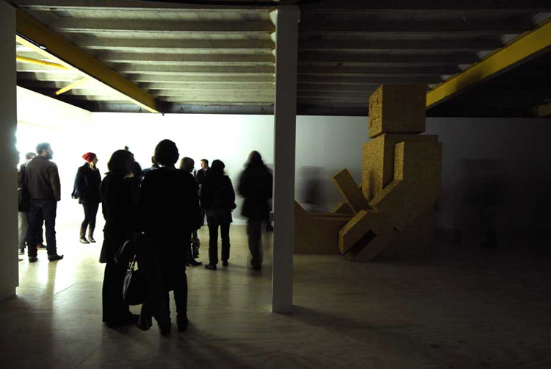
After initial studio visits by GSS curator Amy Sales in early 2008, we were formally offered a period of funded research to develop new work.
This production residency took place over three months, (including a large studio and access to workshops) with a commission to produce a new body of sculptural work to coincide with the reopening of GSS in their new premises. We also had access to the gallery for several weeks before the opening of the show.
Being able to work in the gallery over a protracted period of time meant that we were able to develop the pieces with particular sensitivity to how they would affect the viewer in the space. In the gallery the sedentary passive behemoth (the robot was approximately 4m x 5m), was sat before a neon sign spelling out the words Good Teeth.
Caught in a feedback loop; indifferent, blasé, numbed but permanently stimulated the beglittered robot was positioned before the neon text in a symbiotic relationship of mutual dependence.
The creation of an ascetic, chapel like silence, coupled with the cold neon glow of the sign and the reflected light from imposing body and glitter surface of the robot created an immersive space where an ‘affective fugue state’ predominated.
What was fundamental to the creation of the sculptures in the space was the position and role of the viewer in interjecting into the feedback loop between the priapic glitter robot and the neon sign. The material body of the viewer was a potential glitch, in this loop of eternal arousal, repetition and indifference.
Opening of the exhibition

Slide 8

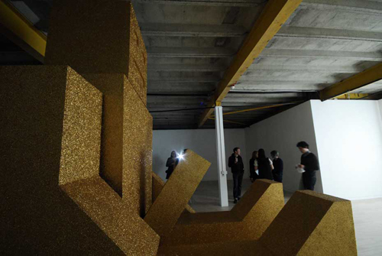
On one level ‘Good Teeth’restated and developed longstanding interests in our collaborative practice, namely an allegorical form of self-portraiture (‘Sanguis Gratia Artis’ 2004 P.S.1. MoMA, New York), ‘Glitter Island’ Tramway, Glasgow 2006), the grotesque body (‘New Meat’, Chapter Arts Centre 2004)) the pathologies of consumerism (‘Burgerheaven’, YYZ Toronto 2001) and the use of humour as a mode of critical engagement (‘New Meat’, Migros Museum, Zurich 2005). However the significant development in ‘Good Teeth’ was the shift away from the literal, visible presence of ourselves in the work (for example our doppelganger selves in ‘Glitter Island’) towards the use of other motifs and forms. Previous bodies of work (‘Glitter Island’ and ‘Glitter Desert’) had utilised the allegorical potential of cheap domestic glitter, but had still been reliant on our doppelganger presence in the work as dandyish fops. For‘Good Teeth’we intended to further explore the potential of gold glitter but develop a more ‘abstract’or ‘ refracted’ presence in the work. While the focus of research remained the pathologies of consumerism and their ‘blocs of affect’ (Deleuze and Guattari), we increasingly became interested in the dynamics of manufactured desire generated by digital technologies.
The opening of the exhibition at GSS

Slide 9

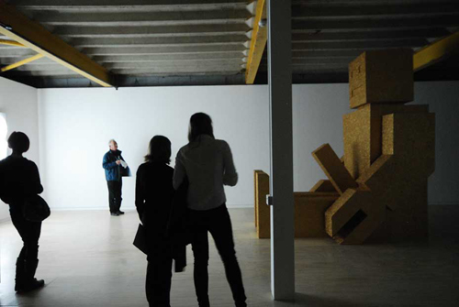
The new body of work was exhibited at Glasgow Sculpture Studios from October 30th 2008 - February 28th 2009.
The exhibition was reviewed by Lauren Dyer Amazeen in Artforum, February 2009, and also by Dean Kenning in Artmonthly, December 2008.
There were also a number of reviews in national newspapers including Metro, November 2008, The Herald, October 2008 and The Scotsman, October 2008.
I gave two public lectures at GSS as part of a programme of events related to the exhibition. The lectures featured archival film, TV and news footage to develop a framework within which the audience could understand this new work within broader cultural and political contexts.
Installation view at Glasgow Sculpture Studios

Slide 10


