Slide 1
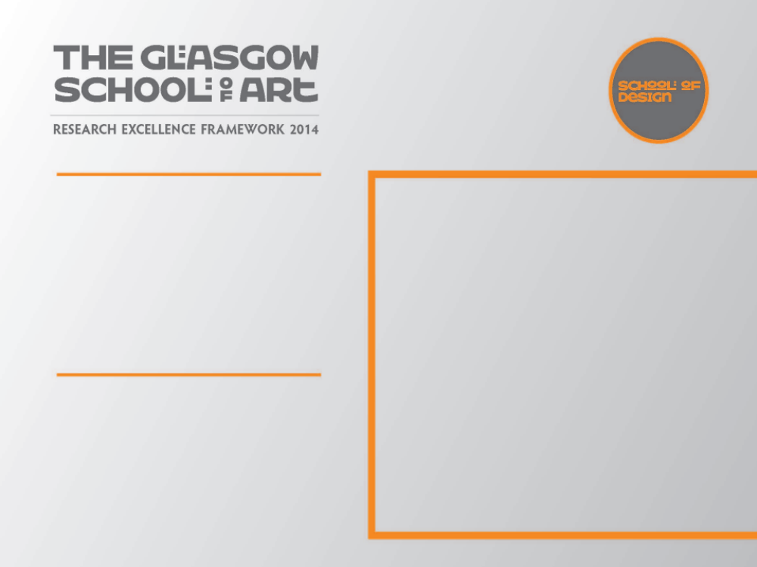
OAK LEAF BREAD BASKET
As a designer maker a deep understanding of my chosen materials, techniques and engagement with new technologies is essential in the development of ideas and working practice
I am also inspired by the designer craftsmen I work alongside who employ cutting edge technology; computer aided design, laser cutting, rapid prototyping and casting. I wanted to incorporate some of these techniques alongside the traditional skills that to me are so familiar

Slide 2

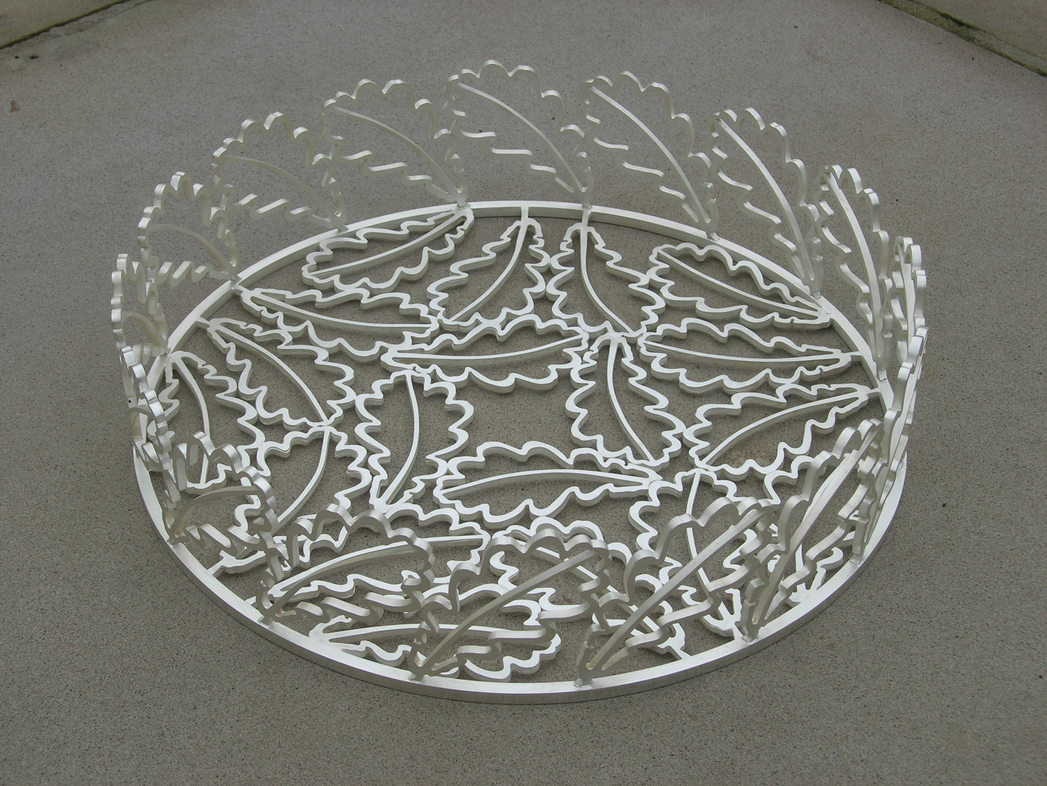
Silver oak leaf bread basket
In 2009 I was invited to participate in an exhibition with the Contemporary British Silversmiths titled SidexSide Edge-Edge the silver for which was sponsored by a Finnish bullion company. It provided a collaboration with our Finnish counterparts to be held in Hame Castle Finland.
This was an opportunity to create a piece of work exploring new possibilities.
1
Helen Marriott
Image one & a description of what we are looking at in the context of the project.

Slide 3
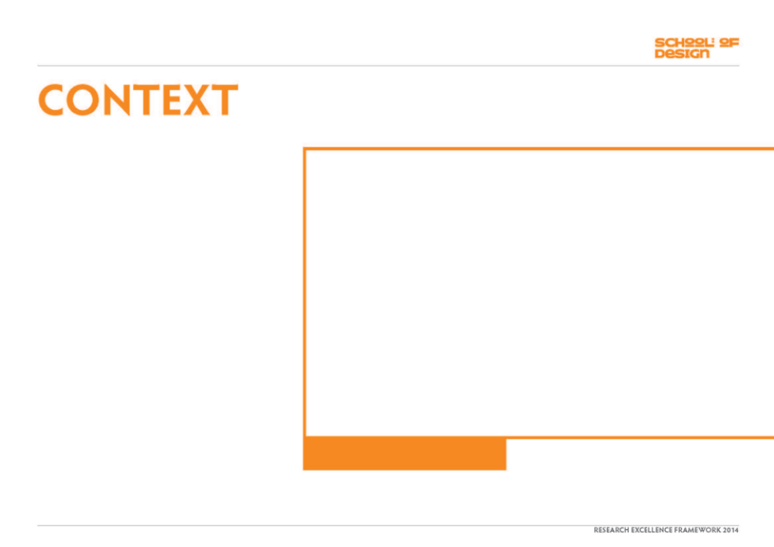
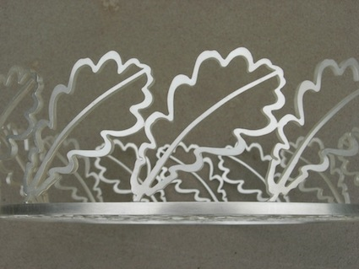
A bumper crop of acorns in 2008 on an oak tree in my garden provided me with a new source for my work. I was fascinated by the acorns, collected them at all stages of growth and cast them in silver.
When considering this project I was keen to include the produce from my oak tree in developing a new direction for my work.
Image one & a description of what we are looking at in the context of the project.

Slide 4
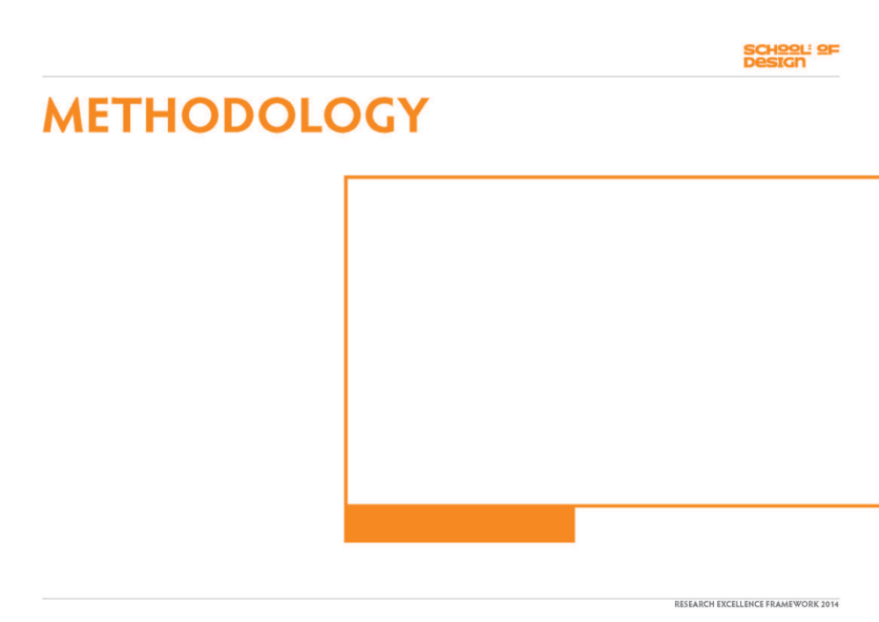
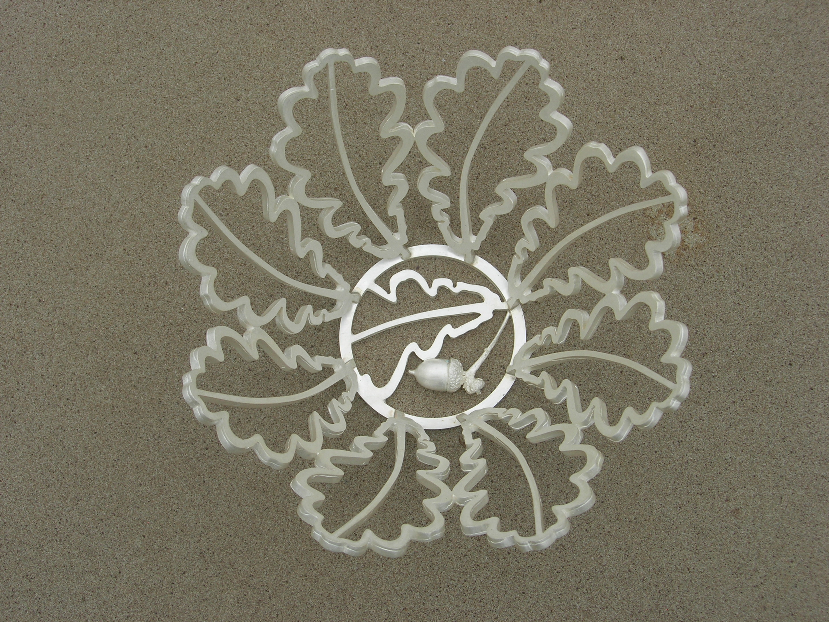
The silver acorns were fascinating but limited, the leaves had more potential. It was interesting that after the leaves fell from the tree they did not curl like most other leaves but remained flat, I gathered a selection and drew them. I used the shapes to create an outline which I developed to fit together and by placing them side x side and edge to edge ideas for bowls emerged.
Placing the leaves together in different ways produced a number of outcomes, the resulting design was in part dictated by the amount of silver the bullion dealer was providing.
Image one & a description of what we are looking at in the context of the project.

Slide 5
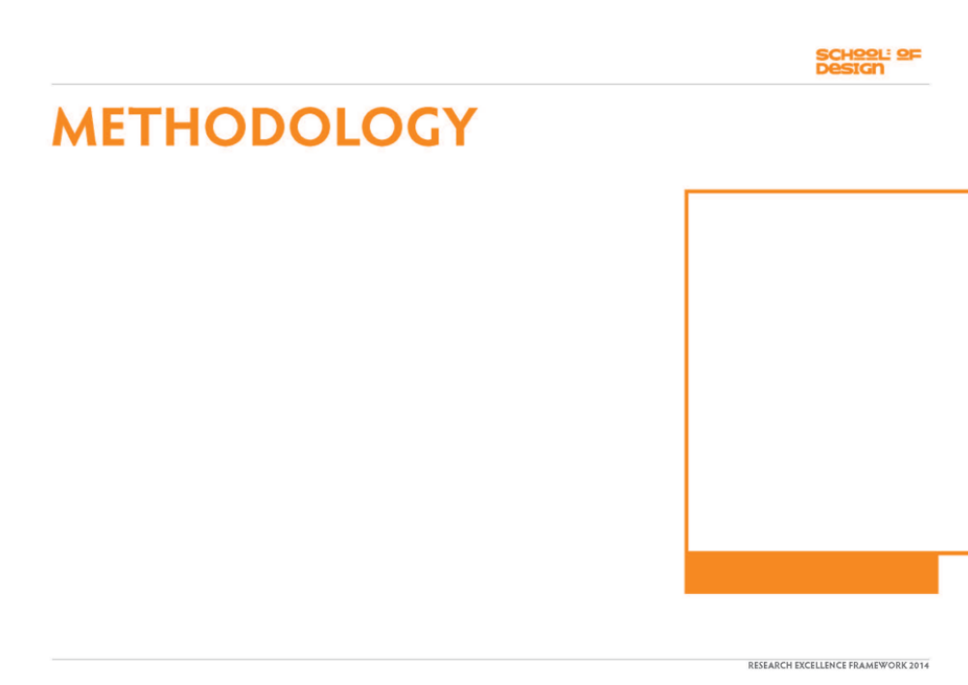
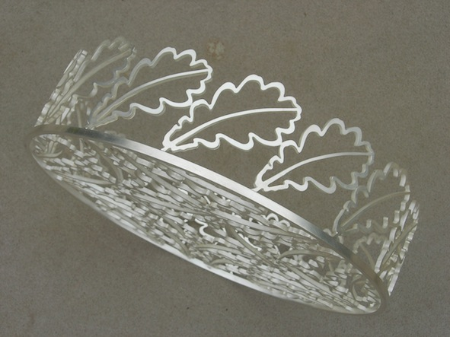
The bread basket evolved and was made by casting in silver separate units and soldering them together. This is the most exciting part of designing, making it work.
The development of the technique introduced a new direction for my work from mainly flat and hollow ware using traditional techniques to three dimensional objects made from identical elements joined together. I was increasingly interested in the different forms I could achieve.
Image one & a description of what we are looking at in the context of the project.

Slide 6
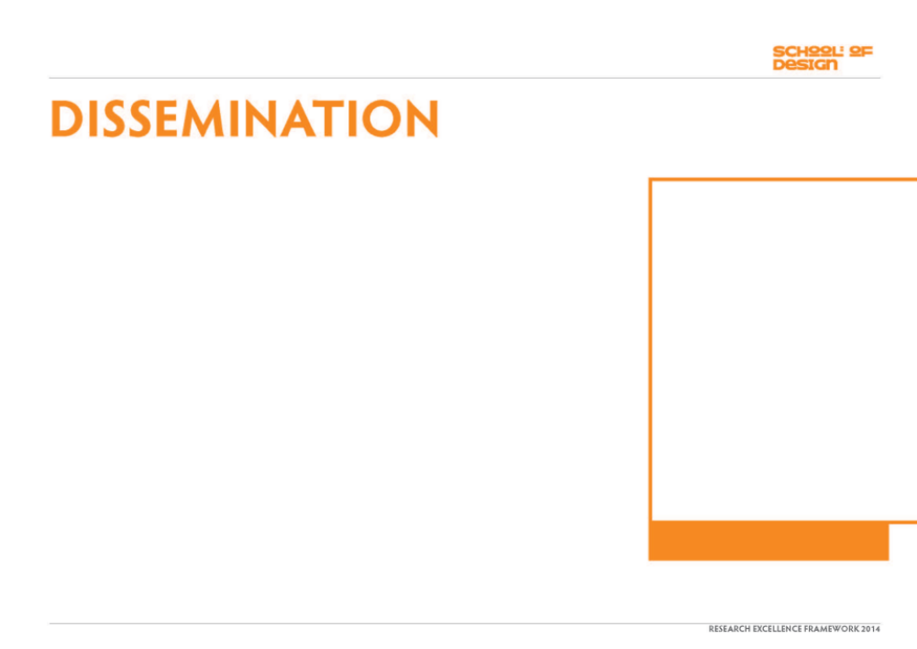
The exhibition was opened in Finland 2009. It was then shown in the Royal Cornwall Museum September 2010 and the Capstone, Liverpool Hope University May 2011.
A catalogue was produced to accompany the collection.
Image one & a description of what we are looking at in the context of the project.

