Slide 1
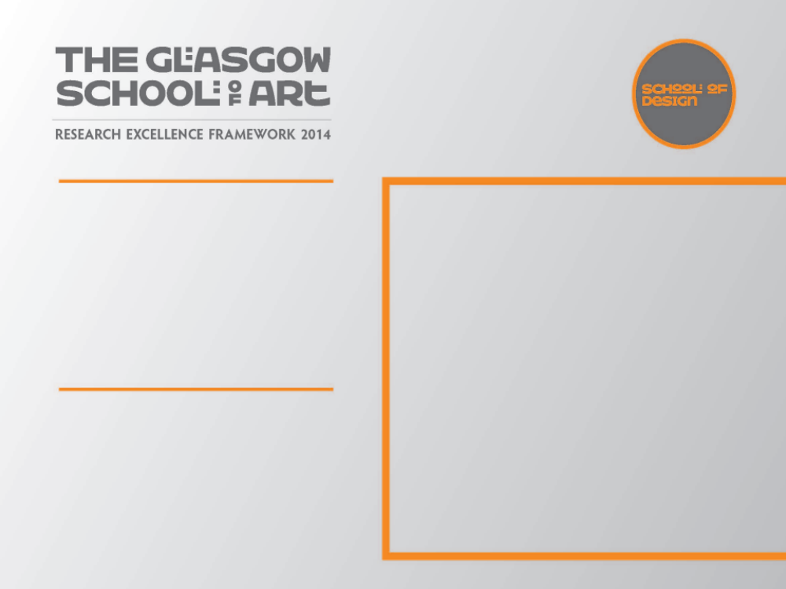
Floor standing candlestick &
flowerstand
As a designer maker a deep understanding of my chosen materials, techniques and engagement with new technologies is essential in the development of ideas and working practice
I am also inspired by the designer craftsmen I work alongside who employ cutting edge technology; computer aided design, laser cutting, rapid prototyping and casting. I wanted to incorporate some of these techniques alongside the traditional skills that to me are so familiar

Slide 2

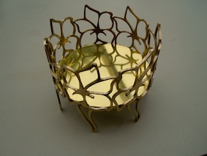
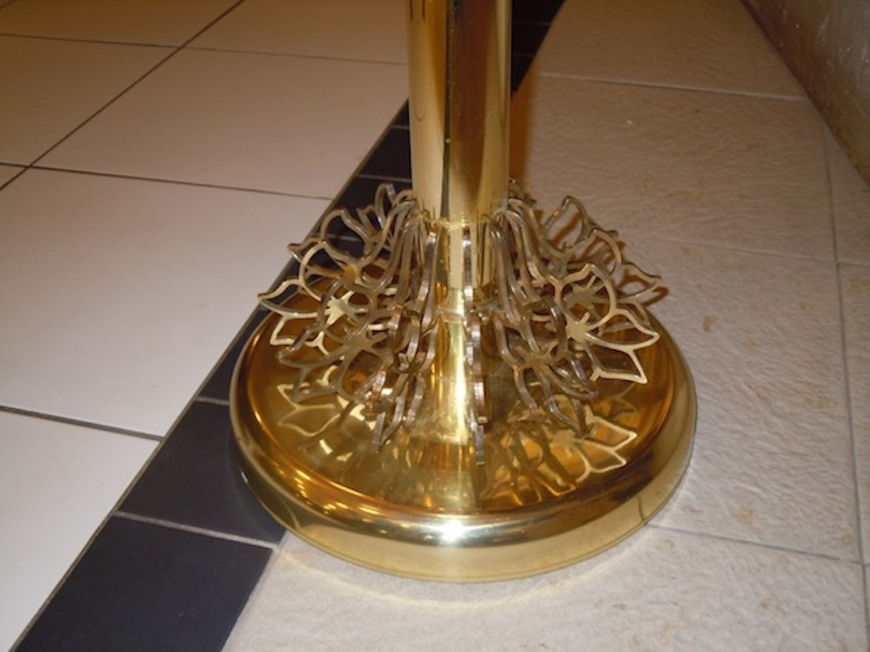
Floor standing candlestick & flowerstand
Floor standing flower pedestal and candlestick both one metre high.
In a previous piece of work I developed an interesting idea of making identical linear elements and then joining them in different ways. I explored this further through these two
objects
2
Helen Marriott
Image one & a description of what we are looking at in the context of the project.

Slide 3
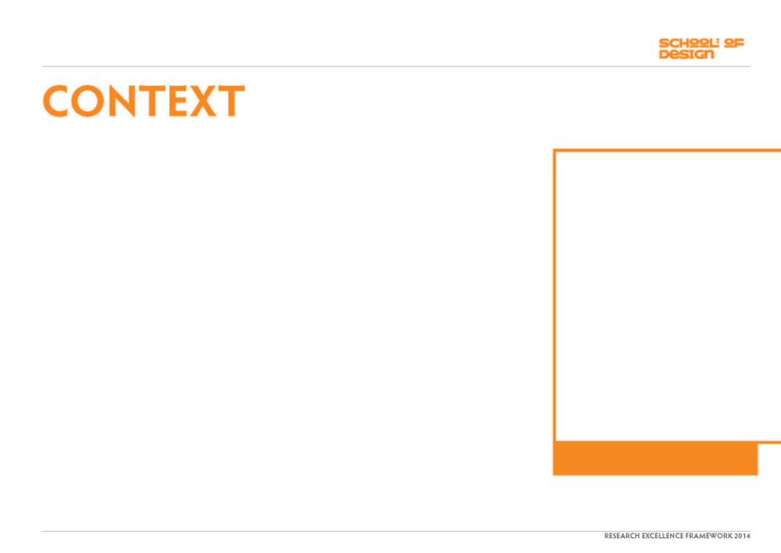
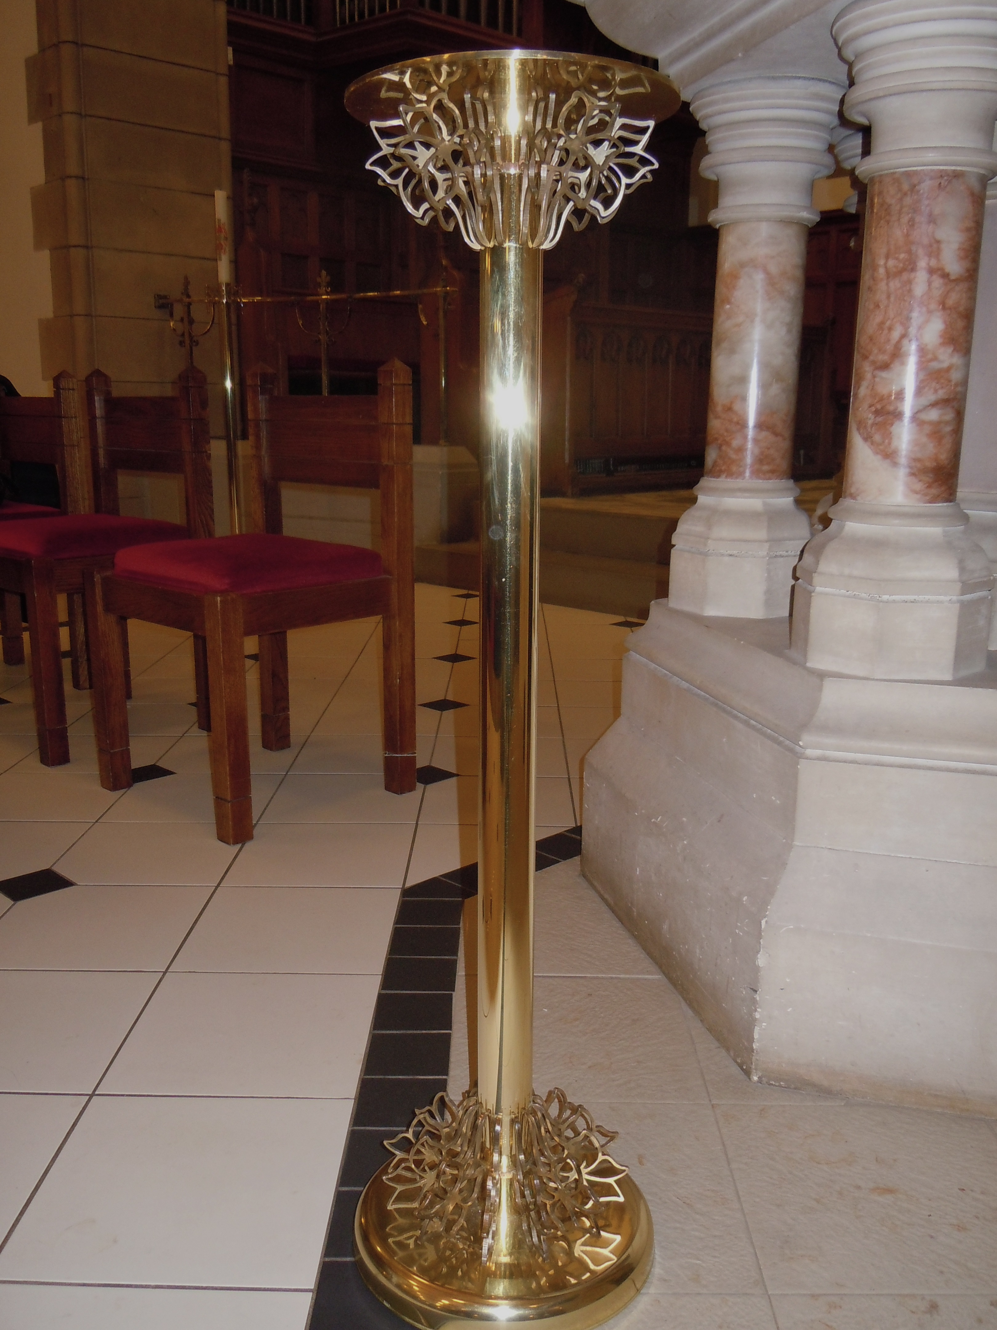
An approach from a client wishing to commission large brassware for a church in memory of a member offered me an opportunity to work in a scale that I had never previously worked.
I developed designs for a floor standing flower pedestal and candlestick both one metre high
The scale of this commission, constraints of my workshop and transportation of the work required the pieces to be easiy constructed and dismantled.
Image one & a description of what we are looking at in the context of the project.

Slide 4
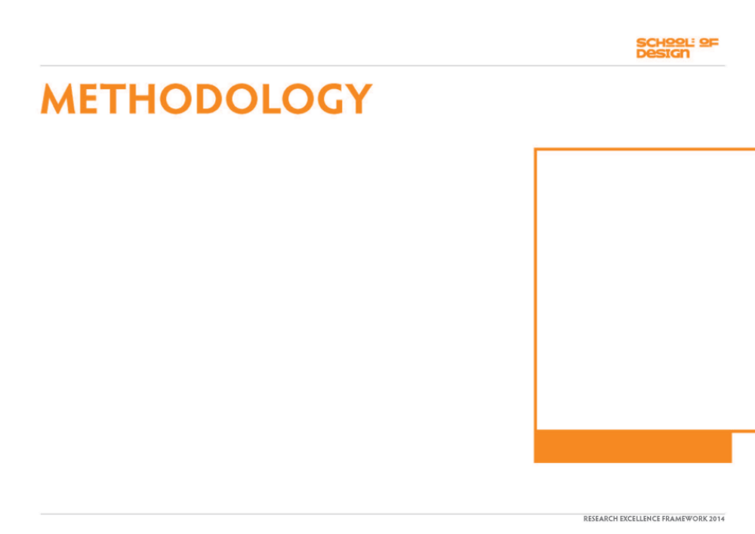
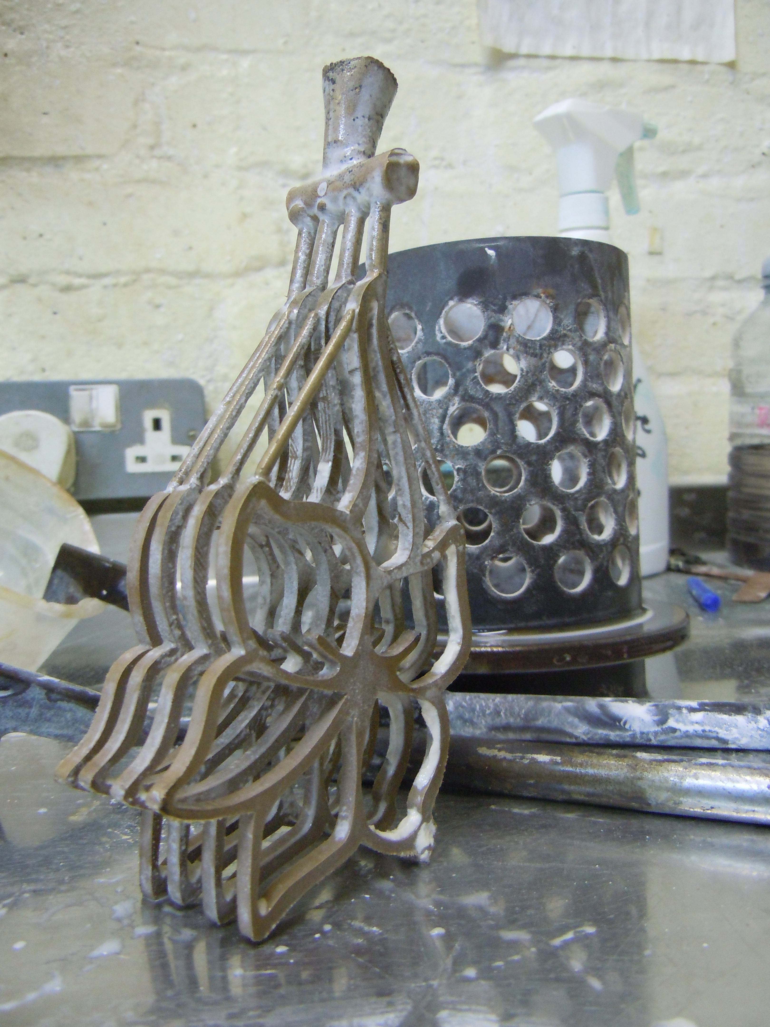
The design of these outline shapes came from delphinium flowers which I drew extensively as they were relevant to the client.
The traditional method used to produce multiples of an element is to make the object in metal, make a rubber mold, inject hot wax into it thus generating identical waxes for casting. When considering the manufacture of the delphinium outlines which were too large to produce using a rubber mold I scanned the drawing on to a computer and laser cut the shapes in acrylic. The acrylic shapes were then mounted in the traditional way onto a wax sprue, invested in plaster and cast in bronze.
Image one & a description of what we are looking at in the context of the project.

Slide 5
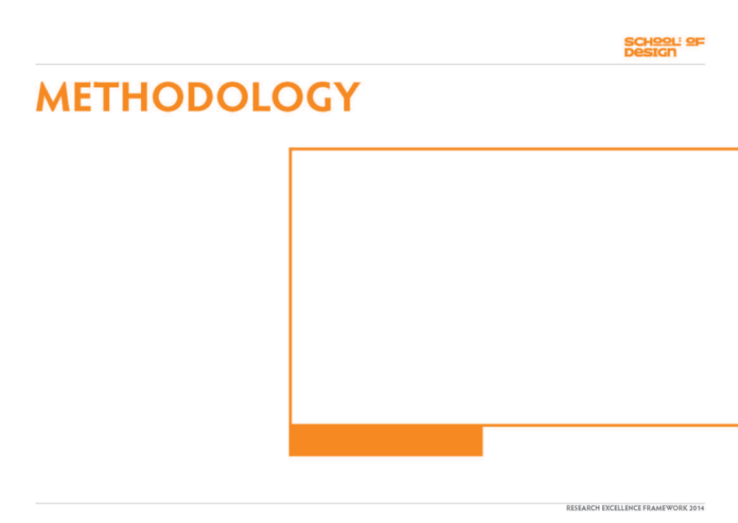
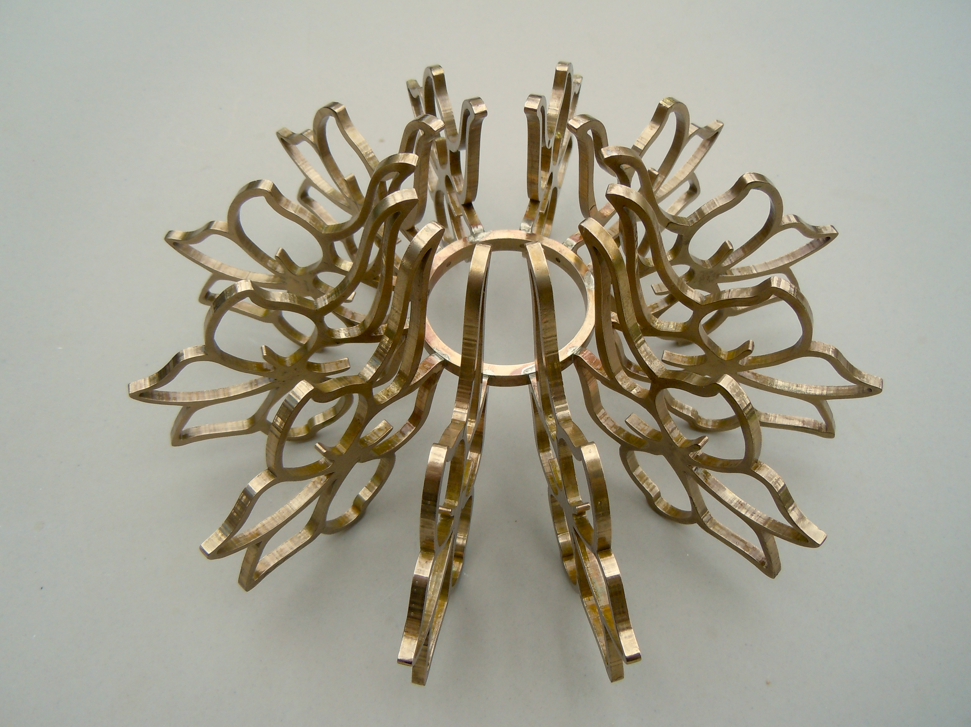
When soldered together the three dimensional shapes created were more interesting than I had imagined, I was really excited by the outcome. These forms introduced a delicacy to very large brass objects.
Image one & a description of what we are looking at in the context of the project.

Slide 6
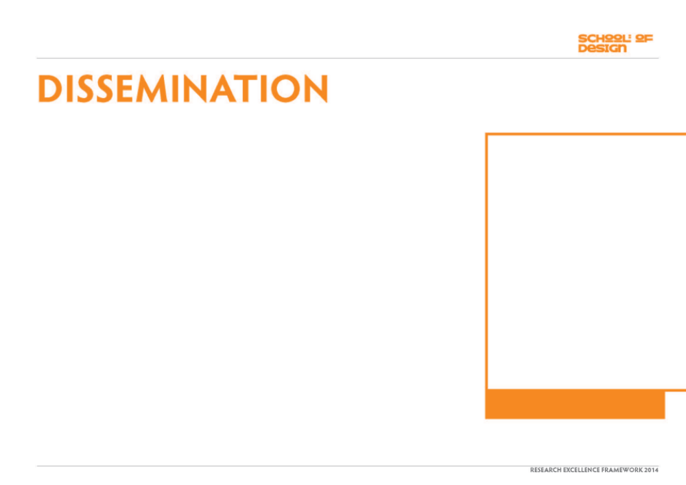
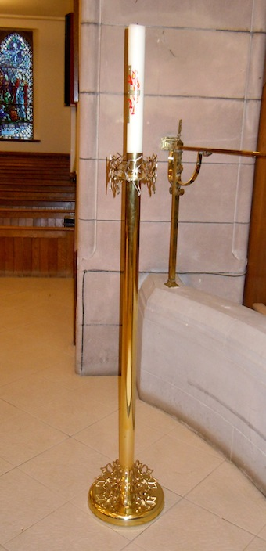
I put together a presentation explaining the designing and making of the brassware for delivery to the church congregation .
Image one & a description of what we are looking at in the context of the project.

