Slide 1
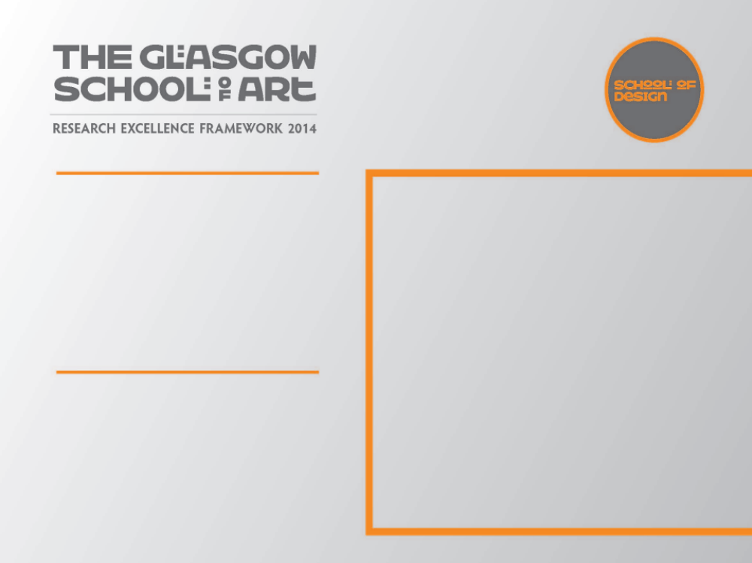
Pair of candlesticks
As a designer maker a deep understanding of my chosen materials, techniques and engagement with new technologies is essential in the development of ideas and working practice
I am also inspired by the designer craftsmen I work alongside who employ cutting edge technology; computer aided design, laser cutting, rapid prototyping and casting. I wanted to incorporate some of these techniques alongside the traditional skills that to me are so familiar

Slide 2

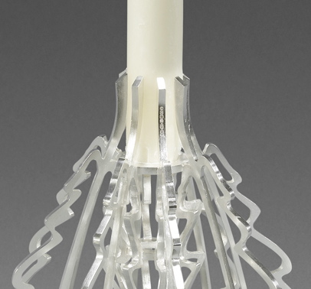
Pair of Silver candlesticks
In 2012 I was invited to participate in an exhibition with the Contemporary British Silversmiths titled Fit for purpose. A collection of work to be shown in the V&A forming part of the Britain Design Season complementing its major spring exhibition British Design 1948-2012.
I produced a pair of silver candlesticks, their purpose to light a tabletop
3
Helen Marriott
Image one & a description of what we are looking at in the context of the project.

Slide 3
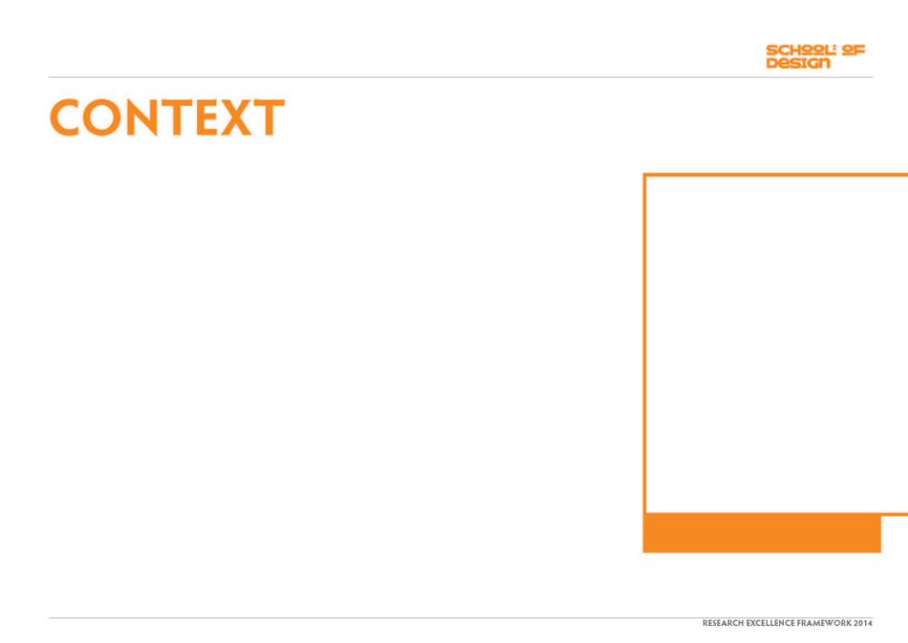
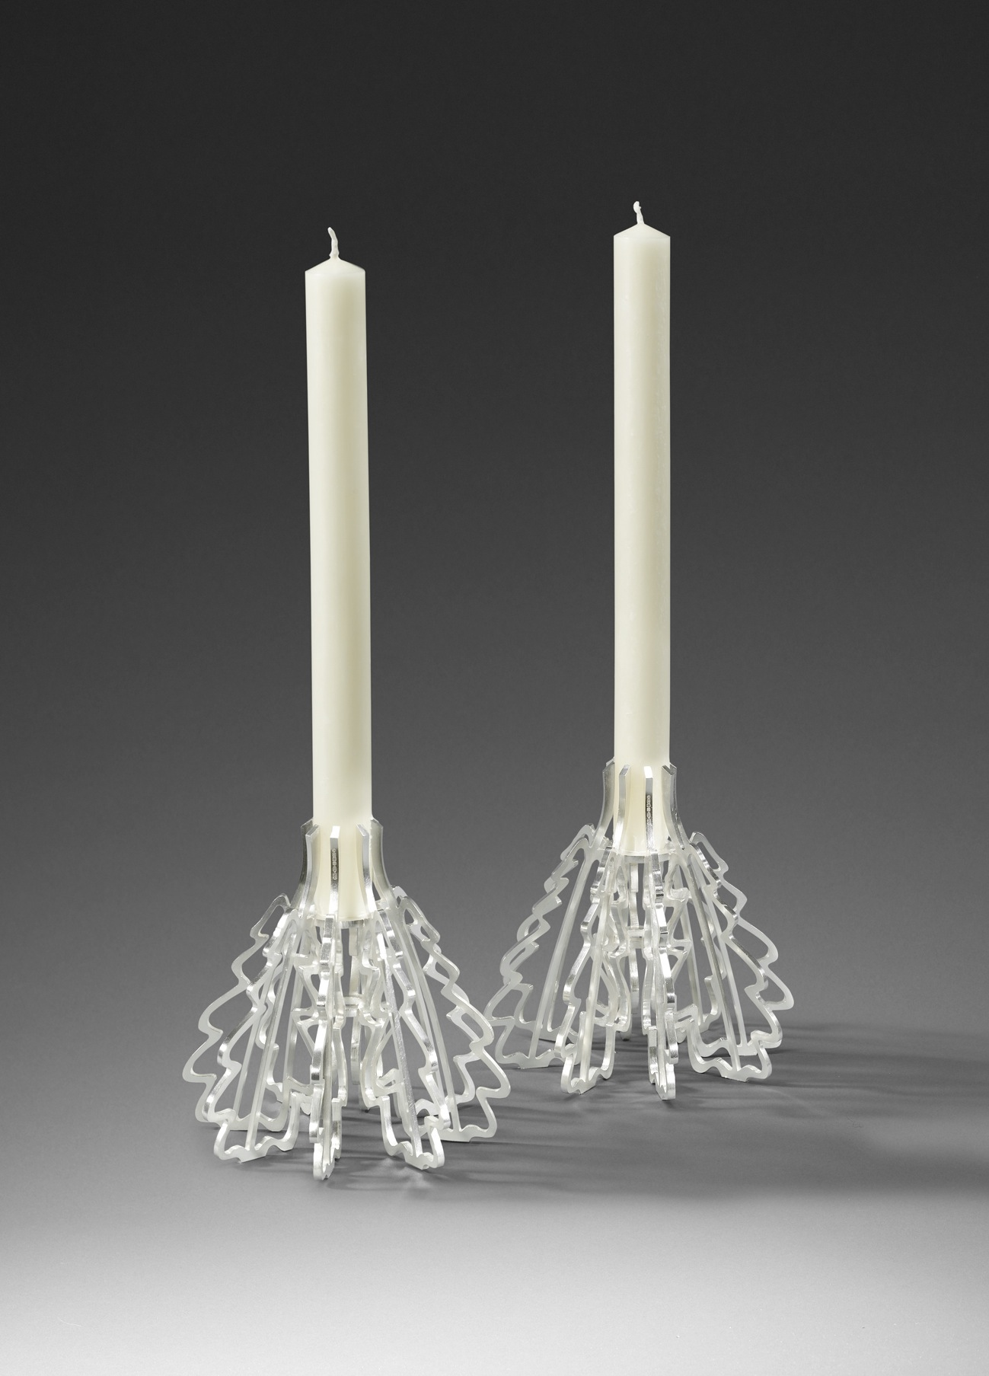
In The development of my recent work I have changed my working practice. I have embraced new technology offering new possibilities which has allowed me to produce work that would otherwise have been impossible using traditional methods alone.
Image one & a description of what we are looking at in the context of the project.

Slide 4
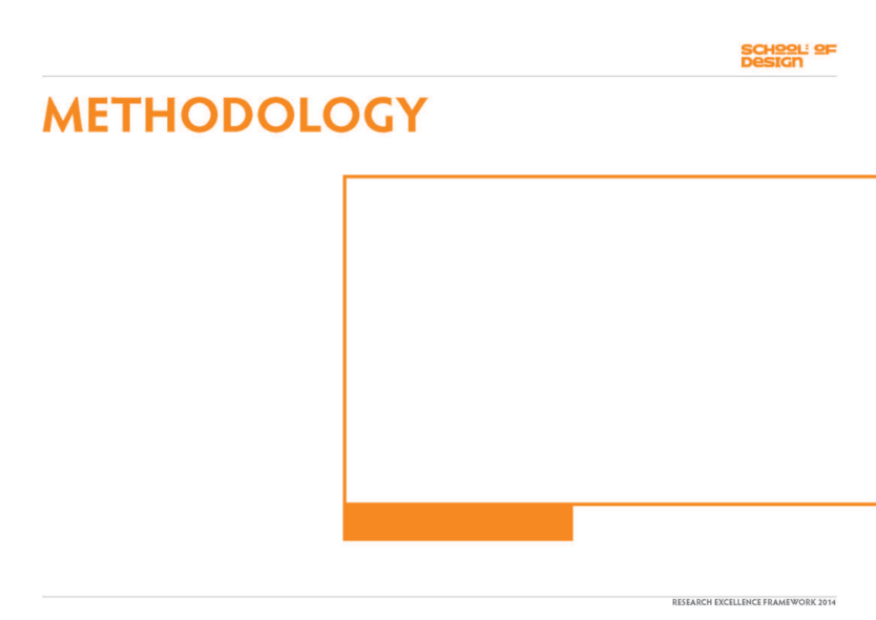
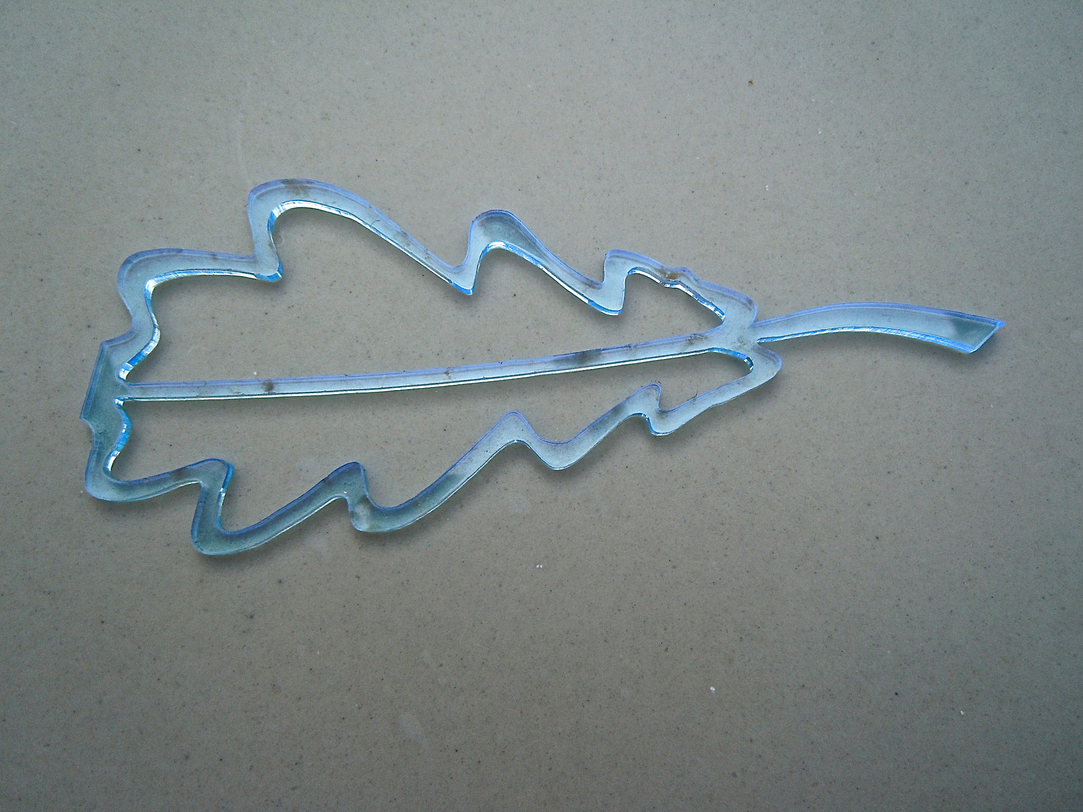
The source of these outline shapes came from oak leaves that I had used in a previous design
The traditional method used to produce multiples of an element is to make the object in metal, make a rubber mold, inject hot wax into it thus generating identical waxes for casting. When considering the manufacture of the leaves for this piece which were too large to produce using a rubber mold I scanned the drawing on to a computer and laser cut the shapes in acrylic. The acrylic shapes were then mounted in the traditional way onto a wax sprue, invested in plaster and cast in silver
Image one & a description of what we are looking at in the context of the project.

Slide 5
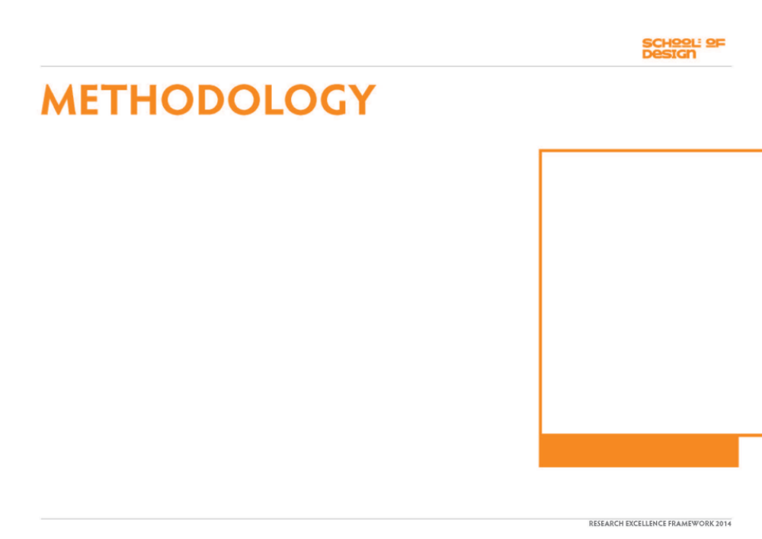
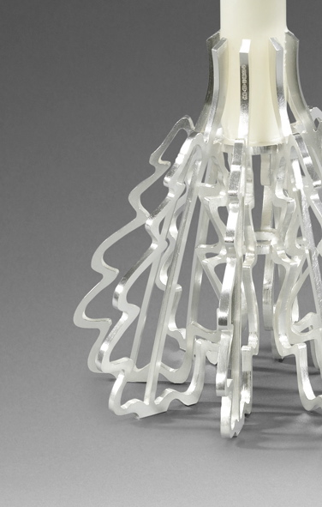
The Candlesticks I produced described their purpose both practically and conceptually through the medium of silver. The leaf form I developed for the design created a three dimensional shape when repeated and included the means by which the candle was held. The silver elements were produced and then simply soldered to two rings, the stems of the leaves grip the candle.
Image one & a description of what we are looking at in the context of the project.

Slide 6
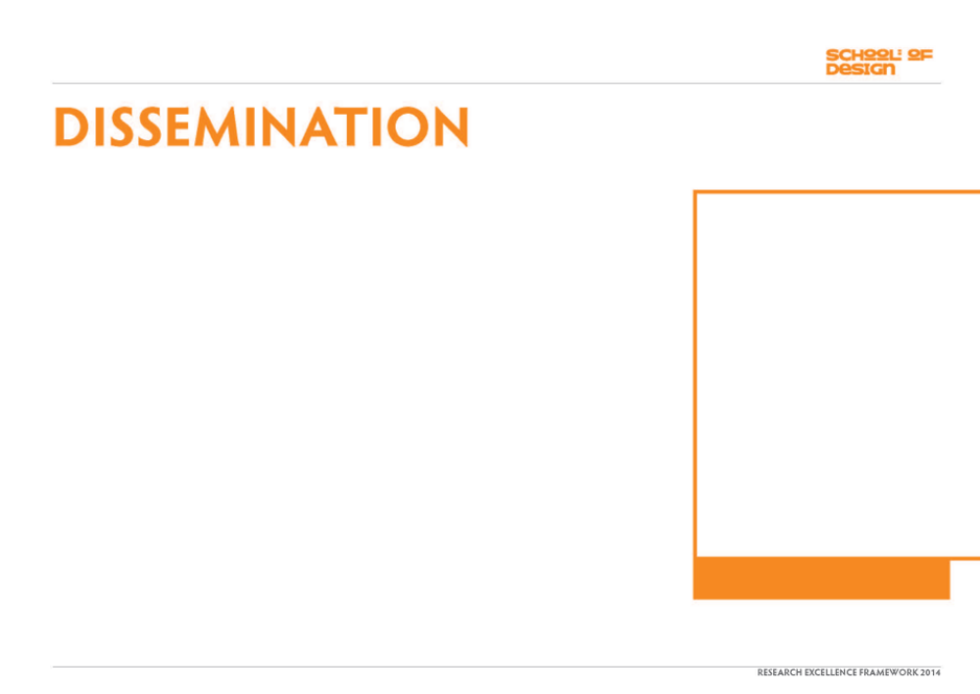
Fit for Purpose a collection of fifty two pieces was shown in the V&A in the summer of 2012 for two months
A catalogue was produced to accompany the collection.
Image one & a description of what we are looking at in the context of the project.

