Slide 1

DEVELOPING AN OER IN INFORMATION SKILLS
FOR THE ART AND DESIGN COMMUNITY
Duncan Chappell
Academic Liaison Librarian
Glasgow School of Art
Notes:
This presentation will discuss InfosmART, the Glasgow School of Art Library’s award-winning portfolio of online interactive modules in information and research skills.
Firstly I will look at the context, both generic and GSA0-specific, that encouraged us to develop InfomsART in the first place.
I’ll then outline some key findings from the evidence-base that informed our development work
Before taking you through each of the 5 modules one-by-one to outline what each module contains
We’ll look at the pedagogies upon which InfosmART is scaffolded
And analyse the impact it has had on our students and in the sector to date
Finally, I’ll briefly touch on how we intend to develop InfosmART still further in the short to medium term

Slide 2

Notes:
For those of you who haven’t encountered InfosmART before, some background and context on the project…
It is a series of online modules in information and research skills, freely available to all via our website.
All these modules are self-directed, so learners can follow each module through from start to finish, or dip in and out when they need specific information.
All InfosmART content is written in easy-to-understand language and is designed for learners to work through at their own pace.
It can help students to develop and improve their own research capabilities independently and to take charge of their learning.
It is for any creative practitioner who wants to develop, improve or enhance their information skills.
InfosmART was developed in-house by the Library team at Glasgow School of Art, using relatively inexpensive tools and platforms and the skills and knowledge of our own staff.

Slide 3
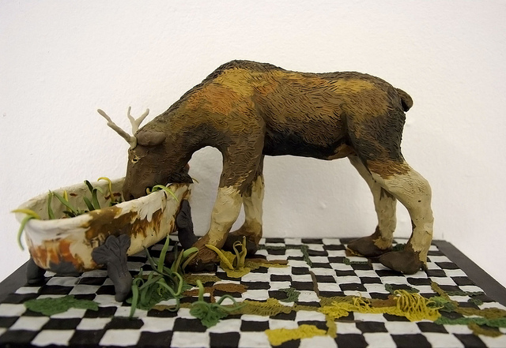
Tori Drost (2011) ‘Faux natural history: bathtub moose 2', plasticine, 33 x 18.5x 14.5cm
Notes:
The Glasgow School of Art is internationally recognised as one of Europe's foremost higher education institutions for creative education and research in fine art, design and architecture.
We were founded in 1845 as one of the first Government Schools of Design, and today our community numbers about 2,000 individuals.
We are 1 of only 2 remaining Small Specialist Institutions within Scotland, with undergraduate, taught postgraduate, and research programmes delivered across architecture, fine art, design, digital design, and historical and critical studies.
We are 1 of the few remaining independent art schools in the UK.
Since 2005, 30% of nominees for the prestigious Turner Prize, and two winners, have graduated from the Glasgow School of Art.

Slide 4

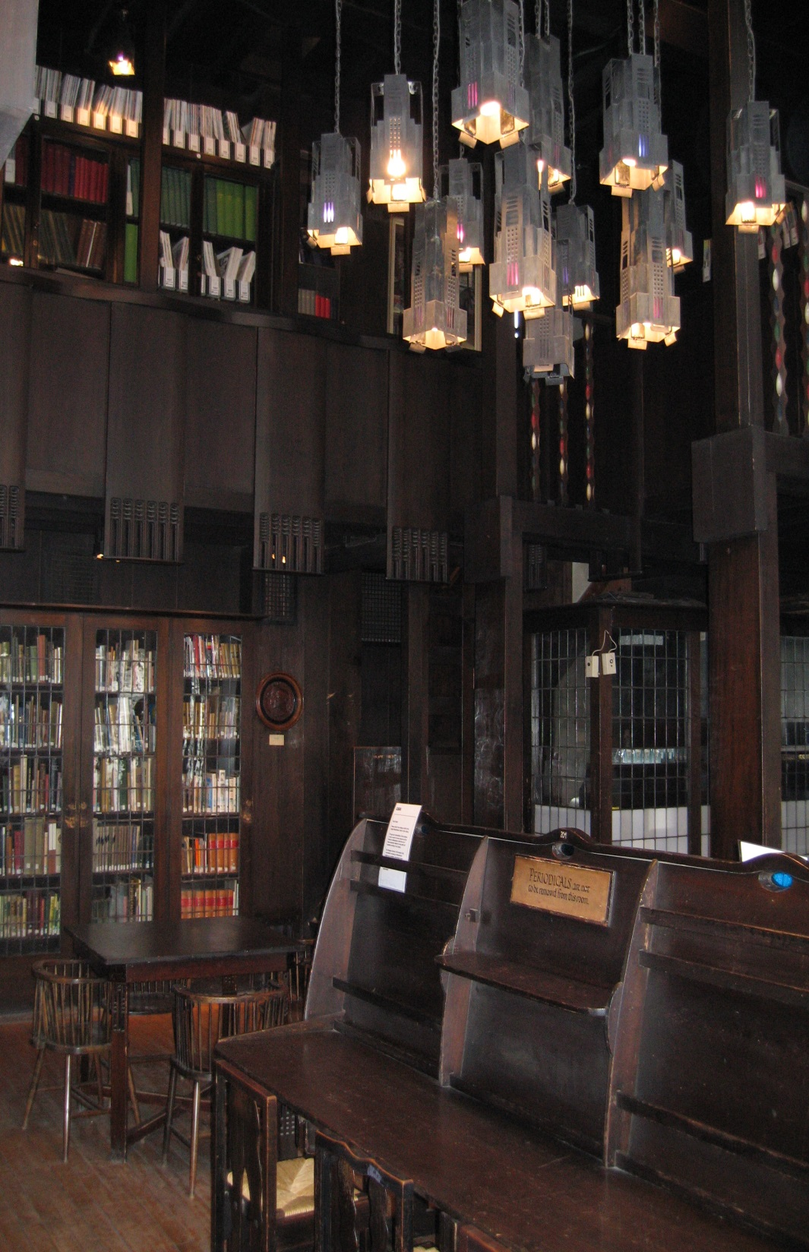
Notes:
The famous Glasgow School of Art building designed by Charles Rennie Mackintosh is an icon of late 19th and early 20th century architecture.
It is an A-listed building of international significance, and viewed as one of the most beautiful interiors in the world.
The masterwork within the masterpiece is Mackintosh’s original library, which is still used as a library today and houses our older reference materials and journals.

Slide 5
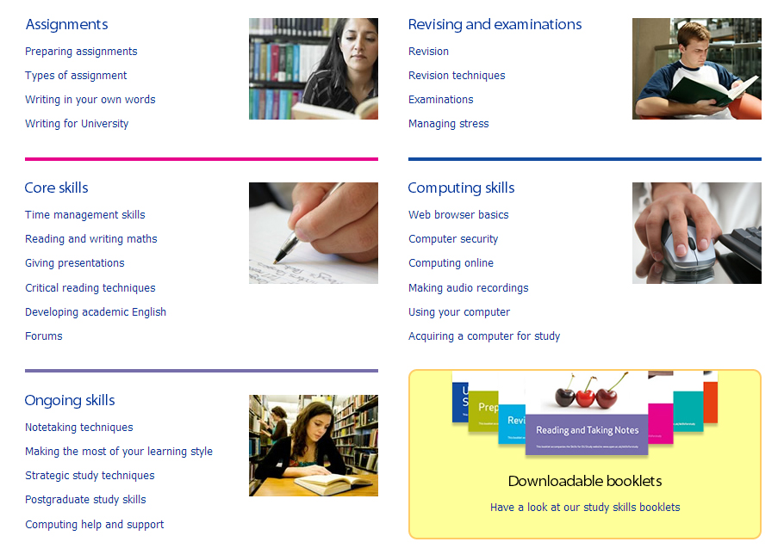
Notes:
Of primary importance to most of your today, will be that InfosmART has been specifically designed for learning, teaching and research communities in art, design and architecture.
We had originally explored online courses in information and study skills developed by other institutions, including those developed by institutions such as the Open University.
In effect, we were concerned to not reinvent the wheel.
During out research we discovered a wealth of fantastically put-together and useful resources
But none that were specifically aimed at our own target audience of art and design practitioners.
We felt that pre-existing resources did not offer the granularity or the subject-specificity that our students required, or were written in a very dry academic mode, or were very text-heavy.
All of this made us certain that we needed to think about developing our own approach to information literacy at GSA.

Slide 6
Cobbledick, S. (1996)
‘The information-seeking behaviour of artists: exploratory interviews’,
Library Quarterly, 66(4), pp.343-372.
Cowan, S. and Branigan, T. (2004)
‘Informing visual poetry: information needs and sources of artists’,
Art Documentation, 23(2), pp.14-20.
Frank, p. (1999)
‘Student artists in the library: an investigation of how they use general academic libraries for their creative needs’,
Journal of Academic Librarianship, 25(6), pp.445-455.
Notes:
I’m sure I don’t have to convince many of you that for many art and design students information skills and processes do not come as second nature.
Whereas other subject disciplines may assume certain core competencies, this cannot be assumed for art and design students who often employ non-linear modes of thinking and find academic writing problematic.
Many of our students exist and operate within visual arenas, and find text-based worlds alien and intimidating.
Cobbledick (1996) has written that artists’ information needs are interdisciplinary, undefined and circuitous.
Frank (1999) reveals that browsing, as differentiated from search, remains uniquely key to the artist’s information-seeking.
Cowan and Branigan (2004) conclude that the artist’s information needs are markedly different from many other disciplines.
A full literature review on the unique information-seeking of creative practitioners is available on the InfosmART website

Slide 7
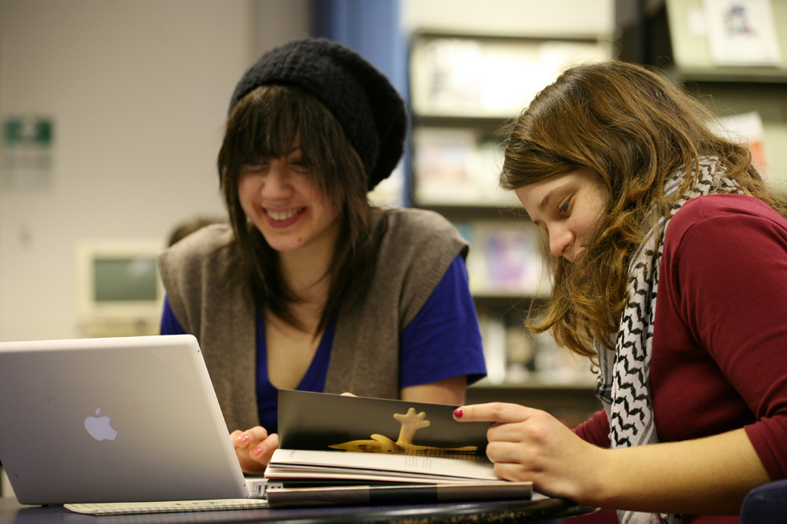
Notes:
InfosmART was developed through learner feedback in direct response to the challenges identified by these writers.
Experience within the Library had demonstrated that in general GSA students experience difficulty in searching for information effectively, evaluating it critically, and then using it legally.
This seemed to be true across all levels of study, from undergraduate right up to research degrees.
Feedback from academic staff confirmed that they too had witnessed this difficulty, and that there was a genuine need for information skills training within the student body.
We also recognised that there was often a deficit in information skills in students joining us from FE foundation courses.

Slide 8

Notes:
In the very early stages of the InfosmART project, a focus group was held entitled “Assessing the information literacy needs for FE to HE transitions within the creative disciplines”
Its purpose was to establish an evidence-base for how creative practitioners find, assimilate and use information.
We wanted, in effect, to ensure our development work was evidence-based and responded to real-world needs.
In particular, the study sought to find answers to the following questions:
Do creative practitioners look for information in ways that are unique to their creative disciplines?
What techniques do creative practitioners typically employ when looking for information?
What aspects of information-seeking do creative practitioners find particularly problematic or challenging?
What support do creative practitioners require when searching for information?

Slide 9
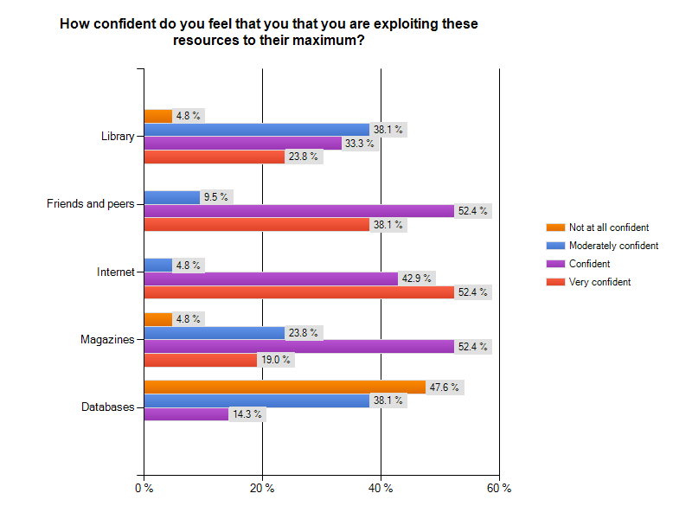
Notes:
Traditional feeder colleges to Glasgow School of Art were targeted, and the study concentrated on students in the creative disciplines.
Wherever possible, a broad range of participants were invited, to reflect different backgrounds, opinions and viewpoints
Full results and methodology from the focus group are available on the InfosmART website.
Some feedback included…
“I always find loads of information, but it's not always relevant and I don't know how to concentrate on the good stuff.”
“You can pick magazines and books off the shelves and see what you're getting, but when stuff is out there online and you need a login to access it, it's hard to know what to expect.”
“I can never remember what I'm meant to be using and for what task or project.”
“You have to seem to jump through hoops to use some resources, and it really confuses me.”
“I just don't know where to begin. I know I'm not finding everything I should be, but I don't know what it is or how to get it.”
“I get too confused about where to go and for what.”
In this graph we can see how a lack of confidence, relatively low in most areas, increases hugely when applied to database searching.

Slide 10
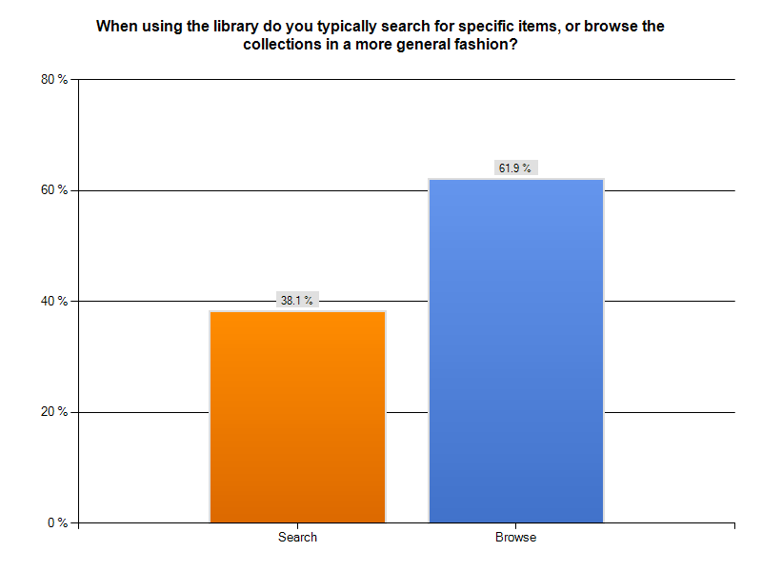
Notes:
Other results demonstrated the continued importance of browsing for the art and design student, and need to serendipitously stumble across useful images or resources.
This confirms Frank’s research from the last 1990s.
Many participants noted the importance of unknown-item searching within their research practice, and how poorly traditional databases systems serve these kinds of search

Slide 11
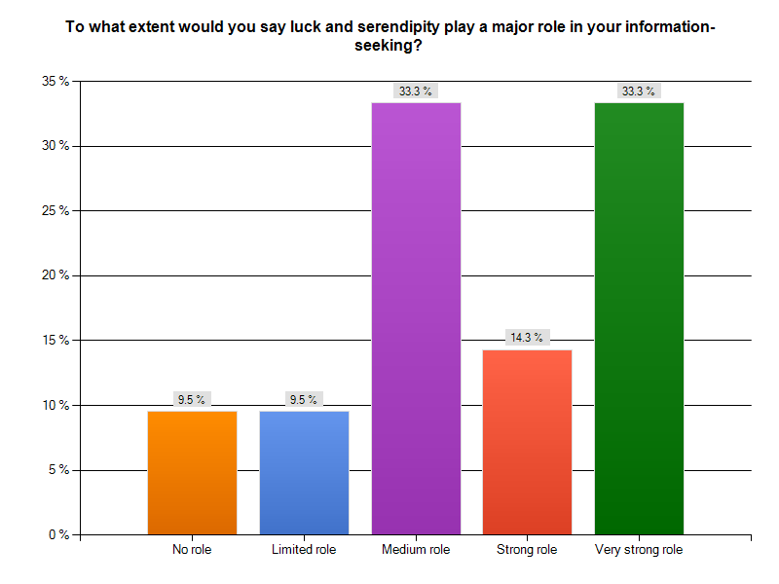

Slide 12
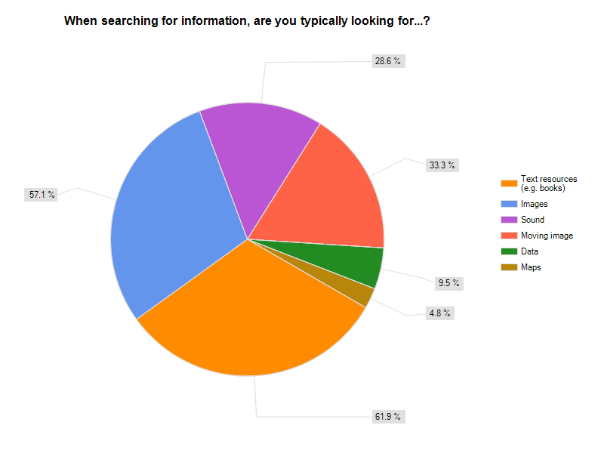

Slide 13
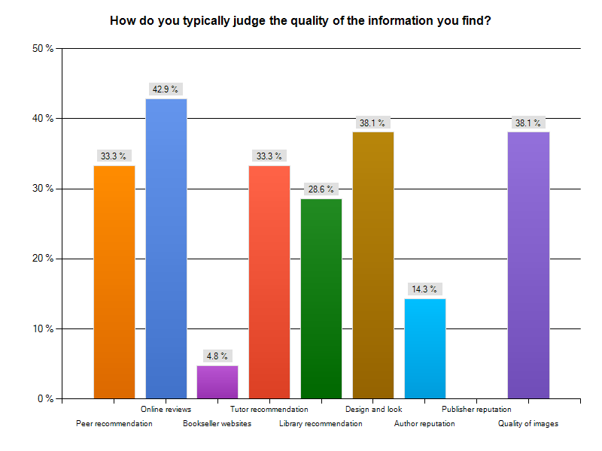

Slide 14

Notes:
One of InfosmART’s explicit aims is to equip creative practitioners with the cross-transferable information skills that are attractive to employers.
The ability to undertake self-directed research is an increasingly important skill in the knowledge economy.
How to search for and evaluate quality information in a crowded information landscape are skills that are sought after by employers.
A large proportion of GSA graduates are self-employed, where an ability to apply one’s own information skills is key.
The Creative Graduates Creative Futures longitudinal survey found that 48% of creative graduates pursued portfolio careers, combining employment, self-employment, study and creative practice.
The study looked at the career patterns of graduates from UK courses in art, design, crafts and media subjects between 2008-9, and involved more than 23,000 first degree and foundation degree UK and international graduates up to six years after graduation.
It was published 2010 by the Institute for Employment Studies.

Slide 15
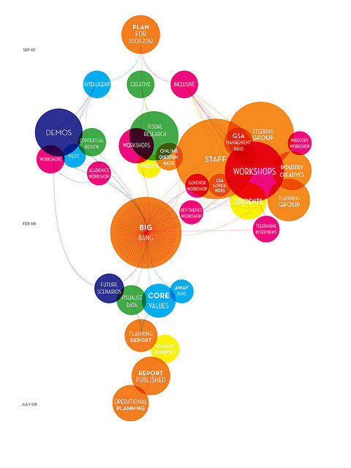

Notes:
Institutionally, there are drives to increase our intake of students from non-traditional backgrounds as historically these have been under-represented within the student body.
These learners may be compromised still further in academic or research skills.
GSA is also actively striving to develop its research activity and outputs.
GSA Future plan has a strategic emphasis on increasing its numbers of researchers and on building a research culture and infrastructure to support them.
The GSA is committed to increasing the number of postgraduate students to 20% of the student body by 2014.

Slide 16
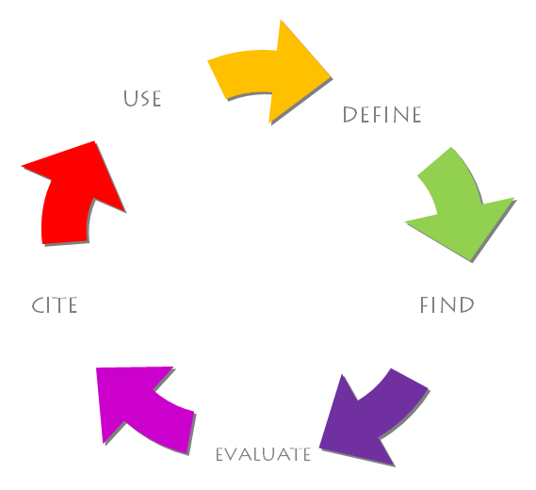
Notes:
InfosmART is modular in approach and comprises an easy-to-follow 5-step programme.
Learners can follow the programme through in its entirety from Module 1 to Module 5, or can concentrate on discrete modules in response to specific identified needs.
Linkages and interrelations will begin to emerge across all the modules for learners.

Slide 17
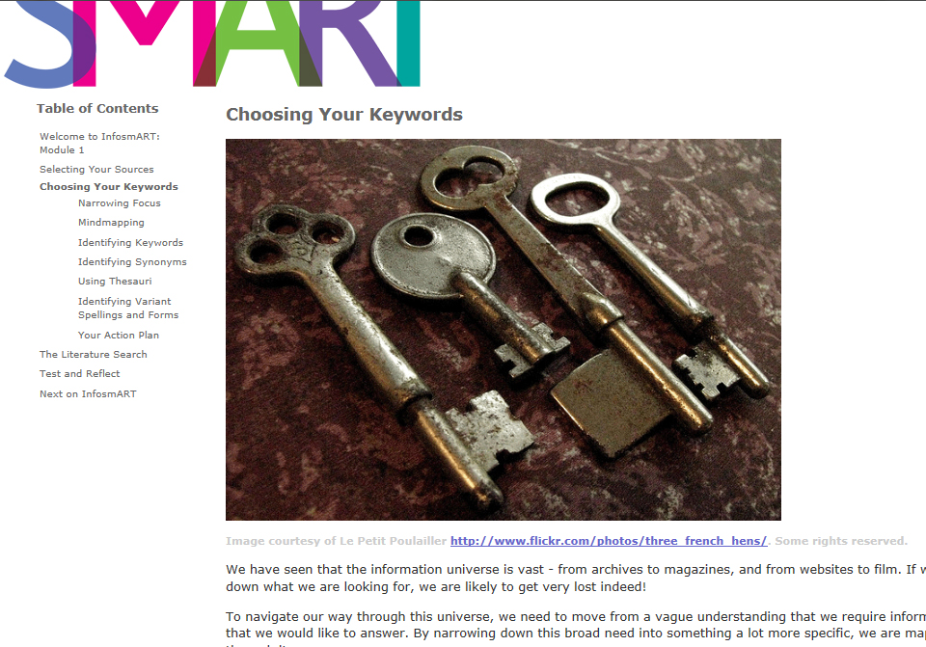
Notes:
DEFINE
This module encourages learners to recognise their specific information needs, and provides them with the techniques they need to describe this need and select sources to satisfy it.
We look at selecting sources, maintaining a balanced resource mix, print vs online, primary information vs secondary information, mindmapping, selecting keywords whilst being aware of synonyms and alternative forms, running a literature search, the relative merits of search vs browse, and field searching.

Slide 18
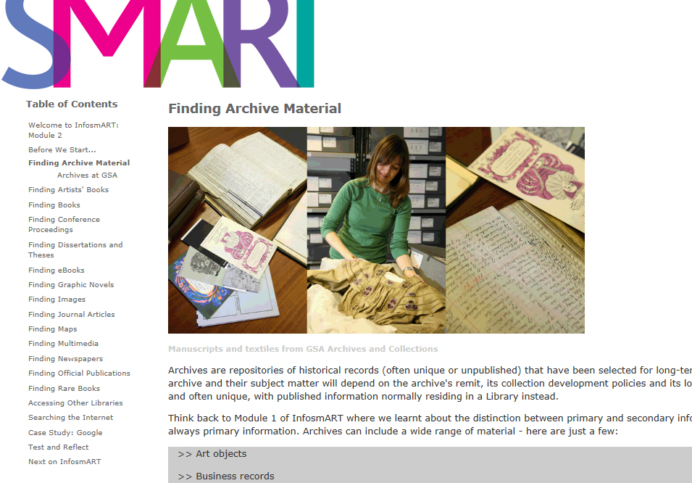
Notes:
FIND
This module teaches students how to search the sources they have identified in Module 1 both quickly and effectively.
We cover the whole gamut of information sources, from books to journals, archives to images, and newspapers to rare books.
This module concludes with a comprehensive case study on effective Google searching.
Short demonstration movies for the catalogues, databases and platforms to which we subscribe were created using Adobe Captivate.
The ability to view actual click paths through a resource, rather than a text description of the activity, is ideal for our visual thinkers.
This approach is now being adopted by GSA’s Learning Support unit as best practice for international students whose first language is not English.

Slide 19
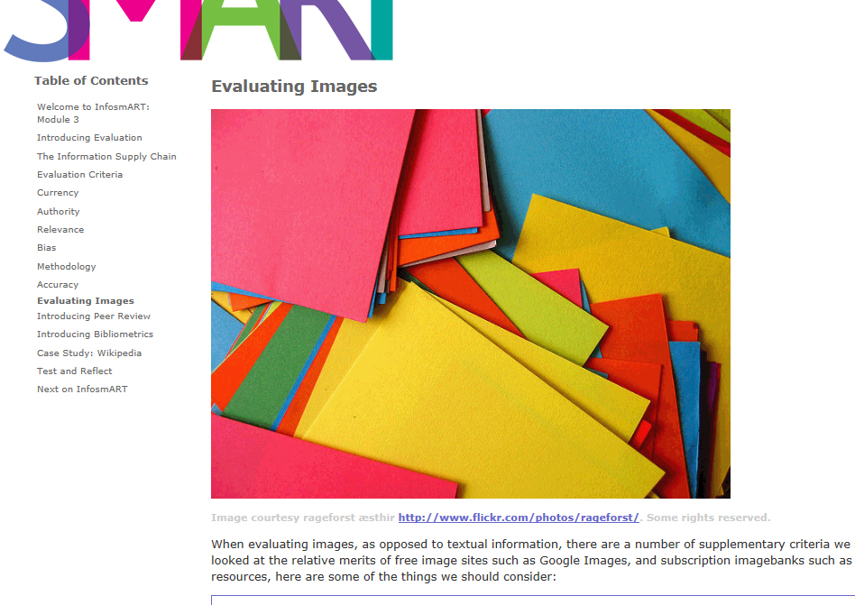
Notes:
EVALUATE
This module introduces the techniques of critical judgement to learners, and encourages them to evaluate the information they found in Module 2 for authority, currency, relevance, accuracy, objectivity and bias, and methodology.
We look at information journeys, and how information is edited, packaged, distributed, and consumed.
We also cover the processes and benefits of peer review, before covering the basics of bibliometrics.
This module concludes with a comprehensive case study on the advantages and disadvantages of Wikipedia as a research tool.
It is interesting to note that GSA does not ban the use of Wikipedia within written work. Rather, because of its potential disadvantages, we see Wikipedia as an ideal opportunity for students to engage with the text and to test their critical thinking skills.

Slide 20
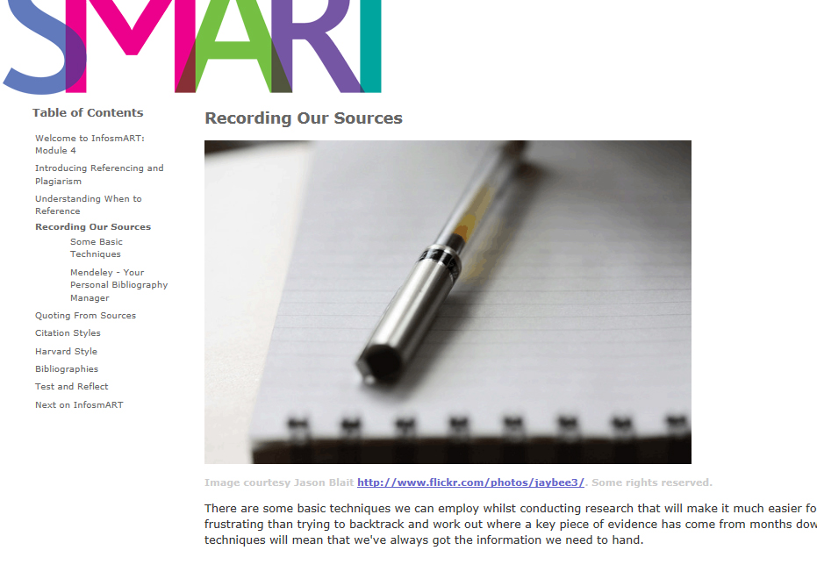
Notes:
CITE
This module introduces the techniques and ethics of academic writing, and instructs learners in how to cite their sources in footnotes, endnotes and bibliographies using MHRA (the School’s preferred citation style)
We explain how to record information from sources, and the importance of doing so.
And we introduce the concepts of plagiarism, and of research ethics.

Slide 21
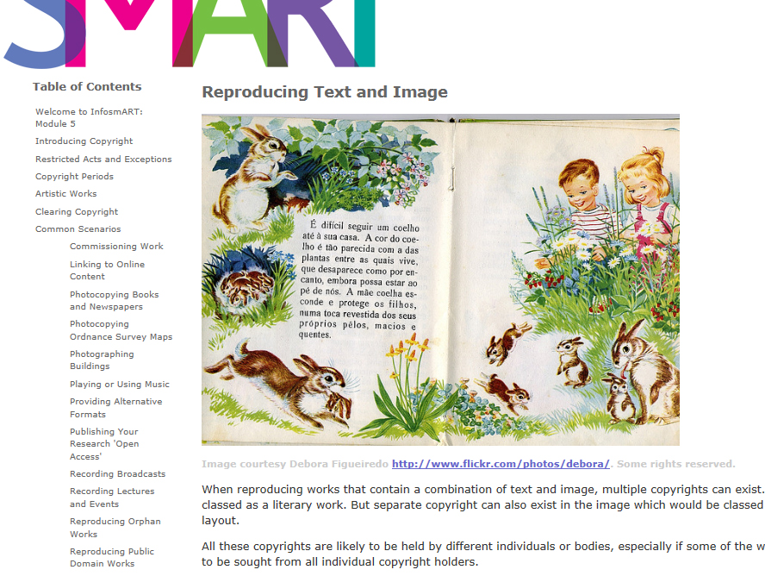
Notes:
USE
This module provides learners with the skills they need to use information legally, ethically and professionally, taking into account legislation such as copyright.
In particular, it looks at the sometimes problematic relationship between appropriation and theft, and the grey areas of copyright that art and design often occupy.
We include a number of typical copyright scenarios, drawing on the experience of our enquiry staff.

Slide 22

Notes:
A clean, consistent and elegant interface is presented throughout InfosmART, key for such a design-literate target audience.
The branding was developed in-house at GSA by our colleagues in the School of Design.
Text is kept clear and non-technical, without being patronising.
Navigation is through directional back and forward arrows, or collapsible subject trees to the side.
Wherever possible, images are used to represent ideas or concepts, whether literally or metaphorically.
This is because our audience are most comfortable explaining complex ideas through image, rather than text.
GSA Library has a policy of not using text in any workshop or induction presentations, unless absolutely necessary.

Slide 23
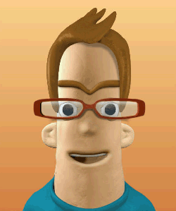
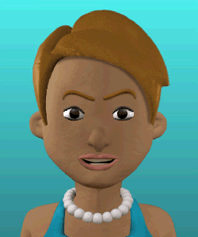
Notes:
During the course of each module, InfosmART’s helpful avatars Iain and Iona point out useful facts that learners might not have known before, and introduce thinking exercises to help them engage with what they have just learnt.
InfosmART is designed to provide both useful facts and instruction (surface learning) and a deeper engagement with issues and concepts (deep learning).

Slide 24
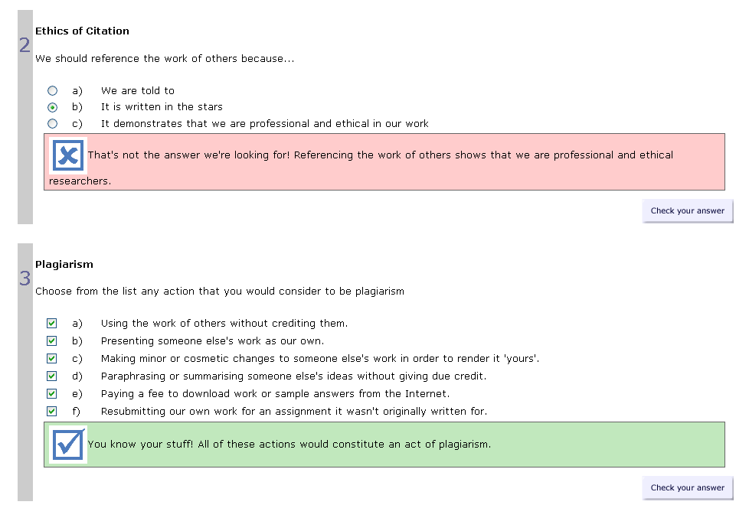
Notes:
At the end of each module students have the opportunity to test their new skills through a short series of games, multiple choice, yes/no, true/false and word-fill exercises.
The results of their responses is fed back on-the-fly in real-time. Any response, even to a wrong answer, aims to encourage the learner.
InfosmART will tell learners what they have got right, and what they could look at again. This is done in a supportive, non-threatening manner.
InfosmART is not formally assessed, but testing helps to reinforce what has been learnt during the course of the module.
And InfosmART has been future-proofed so that it can be easily integrated into credit-bearing courses if a decision if made to do so at a later date.

Slide 25
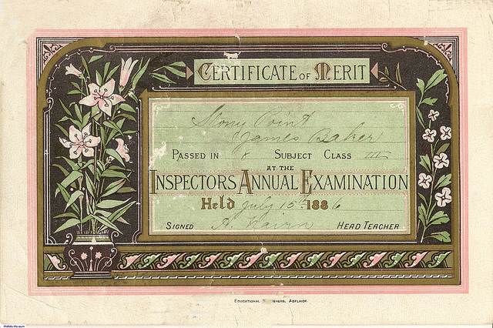
Notes:
Once learners are confident in their new skills, InfosmART provides space for them to reflect on their learning and to identify what they are now confident in and what could be developed further.
They can then download a Certificate of Learning which outlines what they have learnt
This can be included in personal professional development journals or sketchbooks.
We have ideas to re-engineer this component in the near future, which I’ll discuss presently

Slide 26
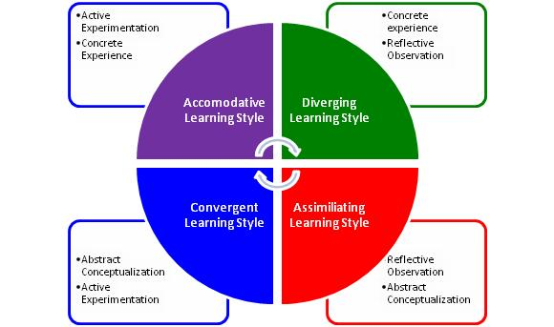
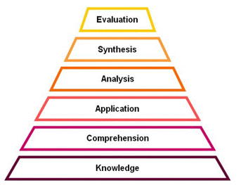
Notes:
InfosmART presents tasks that are contextualised and situational, with real-world applications.
A defined set of learner attributes presents the skills, knowledge and abilities beyond disciplinary knowledge that InfosmART can provide, applicable to a range of contexts.
Its learning and teaching pedagogy aims to create autonomous learners able to take responsibility for their own experiential and reflective learning.
This pedagogy is informed by Bloom’s 1956 taxonomy of the cognitive domain in Taxonomy of educational objectives
Bloom's Taxonomy divides educational objectives into three domains: cognitive, affective, and psychomotor (sometimes loosely described as head, heart and hands respectively).
Within the domains, learning at the higher levels is dependent on having attained prerequisite knowledge and skills at lower levels.
A goal of Bloom's Taxonomy is to motivate educators to focus on all three domains, creating a more holistic form of education.
InfosmART is also informed by Kolb’s 1984 4-type definition of learning styles, namely converger, accommodator, assimilator and diverger, outlined in Experiential learning
Converger (active experimentation-abstract conceptualisation), accommodator (active experimentation-concrete experience), assimilator (reflective observation-abstract conceptualization), and diverger (reflective observation-concrete experience).

Slide 27
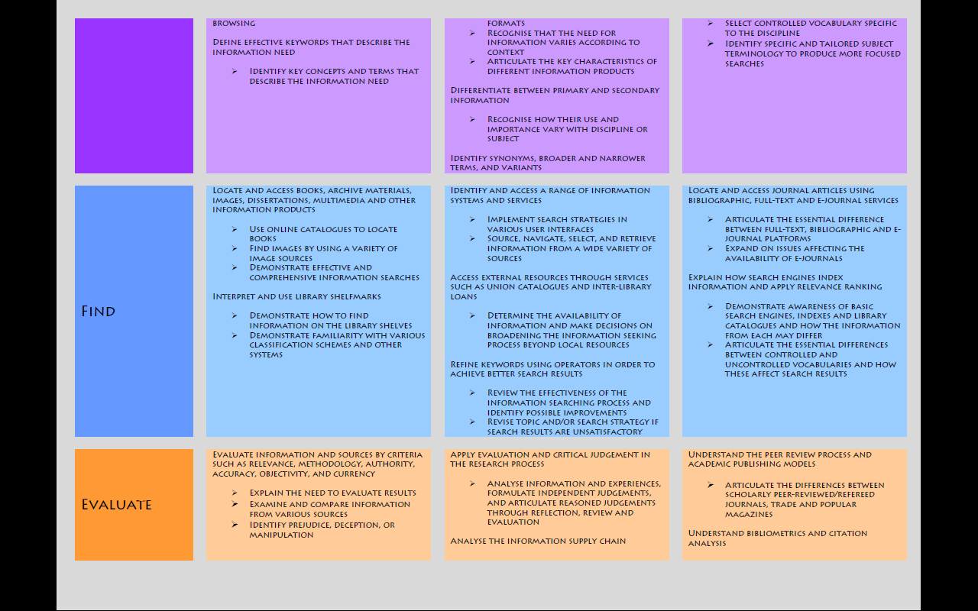
Notes:
Every InfosmART module has ascribed Intended Learning Outcomes that seek to develop and stretch learners.
All InfosmART ILOs are specifically measurable
This ensures that learners remain motivated, confident that what they are learning has real-world realistic applications.
InfosmART ILOs and content are tiered at 3 levels: undergraduate, postgraduate and research.
This approach makes clear to both the learner and tutor which specific skills are expected at each academic level.
Content can be included in programmes of study based on the academic level of the learners in question.
The full set of ILOs is available on the InfosmART homepage.

Slide 28
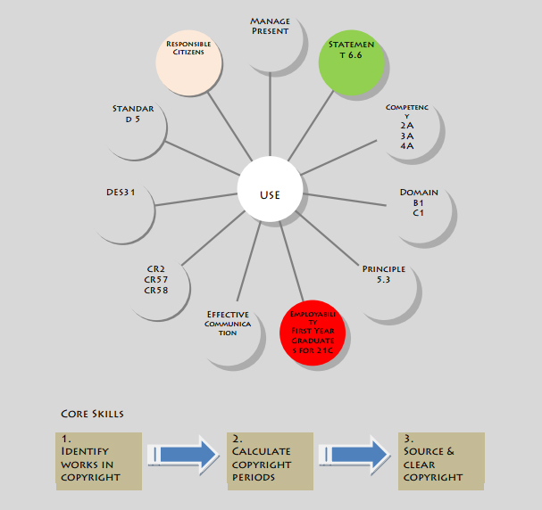
Notes:
All content and learning outcomes are mapped to externally-validated frameworks
This mapping demonstrates to academic staff and the wider institution that InfosmART content is explicitly tied to the pedagogical frameworks and standards they employ in their teaching and course design
The mappings are available as 4 lens: learning and teaching, vocational, information literacy, and research
This is an example of the mapping of the Use module in the learning and teaching lens.
All content is mapped to:
QAA Subject Benchmark for Art and Design
SQA National Units in Information Handling
ARLIS/NA competencies for design students
Futurelab digital literacy model
SCONUL 7 pillars
Vitae Researcher Development Framework
National Occupational Standards

Slide 29

James McGarvey (2013) ‘New species cell structure’, cut pearlescent vinyl
Notes:
In the QAA Enhancement-Led Institutional Review of Glasgow School of Art in 2010, InfosmART was highlighted as an excellent example of responsive services developed directly out of student feedback.
Enhancement-Led Institutional Review is one component of the Quality Enhancement Framework, an approach to quality assurance and enhancement in higher education introduced in Scotland in 2003.
ELIR reviews are carried out by a team of six reviewers: one student reviewer, one international reviewer, three senior UK-based academic reviewers and one coordinating reviewer.

Slide 30

Notes:
In recognition of its innovative work on InfosmART, the GSA Library won Outstanding Library Team of the Year at the Times Higher Education Leadership and Management Awards in 2010
Joanna Newman, Head of Higher Education at the British Library said:
"We were impressed with the winning entry's innovative use of technology, tailoring information research literacy into personalised learning to help students realise their potential and broaden their research horizons."

Slide 31
“I showed it to a group of Year 3 Fine Art students a couple of weeks ago and we went through a bit of the multiple choice part regarding correct ways to reference. You'd be amazed at how many times they guessed wrongly and I think they were too. They loved it though and it worked very well in a group situation because it's fun and they enjoyed shouting out 'send her to jail!'”
Sarah Smith, Lecturer in Forum of Critical Inquiry, Glasgow School of Art
Notes:
And our academics are now actively using InfosmART content to achieve real results in their classes

Slide 32
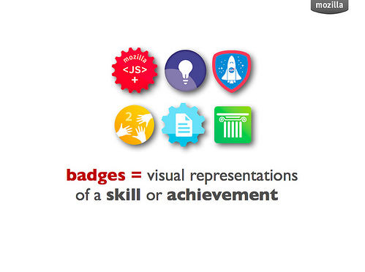
Notes:
We are now actively looking at how to continue developing InfosmART for the future
Currently we are considering whether Open Badges can be integrated to allow learners to earn badges for specific skills learnt in InfosmART
Open Badges is an initiative of the Mozilla Foundation, and allows students to build up digital portfolios (or ‘backpacks’) of badges that can be taken with them from college to work and elsewhere.
They have been enthusiastically taken up by the FE community.
We are still in the very early days of exploring this avenue.

Slide 33


Notes:
We’re also looking at how we can further integrate InfosmART into our other content development activities, such as our Discovery Guides
We are developing a series of workshops that integrates with InfosmART, as part of the Library’s Twilight Classes portfolio

Slide 34
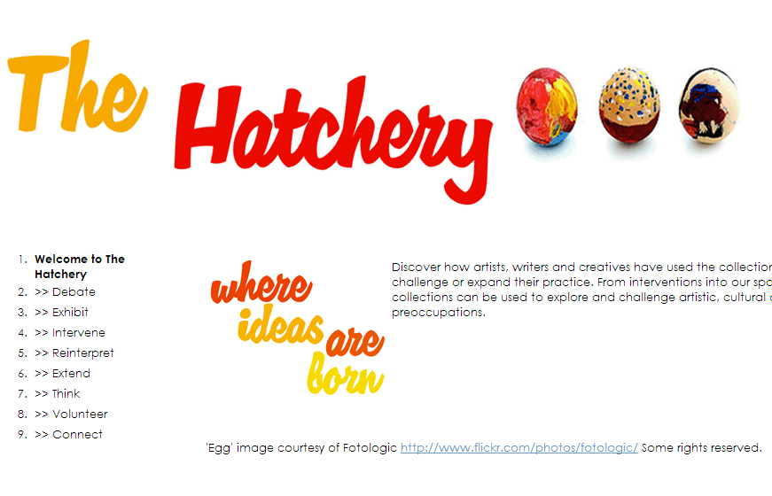
Notes:
And, inspired by the Library as Incubator Project in America, we’ve recently developed a new OER called The Hatchery
The Hatchery allows our students to discover how artists, writers and creatives have used our collections of to inspire, challenge or expand their practice.
From interventions into our spaces, to installations amongst our shelves, or from re-interpretations of our historical objects to using them in exhibitions.
We’ll be looking to make linkages from InfosmART to The Hatchery as the latter develops.

Slide 35


Notes:
InfosmART has received Innovation and Development Funding from the Scottish Library and Information Council.
It is now available as an Open Educational Resource, licensed under a Creative Commons Attribution-NonCommercial-ShareAlike 2.5 UK: Scotland License.
This means you can adapt InfosmART for your own learners, as long as you:
>> Credit ‘Learning Resources, Glasgow School of Art’ wherever you use our content.
>> Only use our content for non-commercial purposes.
>> Make any work you create that includes our content freely available to others through Creative Commons

Slide 36

http://www2.gsa.ac.uk/library/infosmart

Slide 37




@GSALibrary
Glasgow School of Art
Glasgow School of Art Library
Glasgow School of Art Archives & Library
Duncan Chappell
Academic Liaison Librarian
Glasgow School of Art
d.chappell@gsa.ac.uk

