Slide 1


Slide 2

Pedagogical Approaches to the Teaching of Information and Research Skills to Creative Practitioners
Duncan Chappell
Academic Liaison Librarian
Glasgow School of Art

Slide 3
WHAT
Notes:
When I was preparing this presentation I was pondering how best to structure it to better convey the InfosmART approach to information skills provision.
Eventually I settled on exploring with you the What? How? And Why? of the project.

Slide 4

Notes:
InfosmART is the Glasgow School of Art Library’s portfolio of online interactive modules in information and research skills.
It can help students to develop and improve their own research capabilities independently and to take charge of their learning.
But of primary importance to most of you I’m guessing, is that InfosmART has been specifically designed for learning, teaching and research communities in art, design and architecture.
It is for any creative practitioner who wants to develop, improve or enhance their information skills.

Slide 5
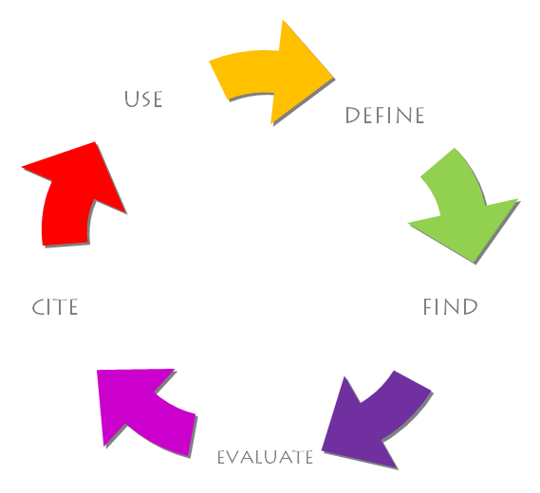
Notes:
InfosmART is modular in approach and comprises an easy-to-follow 5-step programme.
Learners can follow the programme through in its entirety from Module 1 to Module 5, or can concentrate on discrete modules in response to specific identified needs.
Linkages and interrelations will begin to emerge across all the modules for learners.
DEFINE
This module encourages learners to recognise their specific information needs, and provides them with the techniques they need to describe this need and select sources to satisfy it.
FIND
This module teaches students how to search the sources they have identified in Module 1 both quickly and effectively.
This module also includes a comprehensive case study on effective Google searching.
EVALUATE
This module introduces the techniques of critical judgement to learners, and encourages them to evaluate the information they found in Module 2 for authority, currency, relevance, accuracy, objectivity and bias, and methodology.
This module also includes a comprehensive case study on the advantages and disadvantages of Wikipedia as a research tool.
CITE
This module introduces the techniques and ethics of academic writing, and instructs learners in how to cite their sources in footnotes, endnotes and bibliographies.
USE
This module provides learners with the skills they need to use information legally, ethically and professionally, taking into account legislation such as copyright.

Slide 6
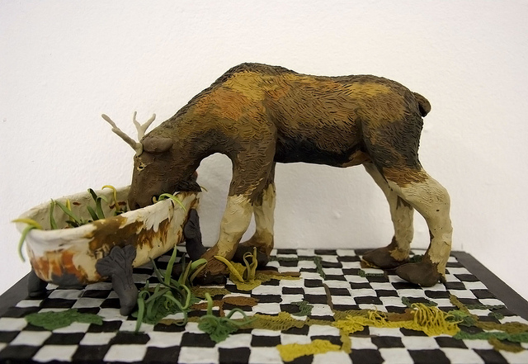
Tori Drost 'Bathtub Moose', plasticine, 33 x 18.5x 14.5cm
Notes:
InfosmART was developed in-house by the Library, Glasgow School of Art
The Glasgow School of Art is internationally recognised as one of Europe's foremost higher education institutions for creative education and research in fine art, design and architecture.
It is one of only three Small Specialist Institutions within Scotland, with undergraduate, taught postgraduate, and research programmes delivered across architecture, fine art, design, digital design, and historical and critical studies.
One of the few remaining independent art schools in the UK.
Since 2005, 30% of nominees for the prestigious Turner Prize, and two winners, have graduated from the Glasgow School of Art
The Library forms part of Learning Resources, which also includes e-learning, archives, and collections.

Slide 7
WHY

Slide 8
Cobbledick, S. (1996)
‘The information-seeking behaviour of artists: exploratory interviews’,
Library Quarterly, 66(4), pp.343-372.
Cowan, S. and Branigan, T. (2004)
‘Informing visual poetry: information needs and sources of artists’,
Art Documentation, 23(2), pp.14-20.
Frank, p. (1999)
‘Student artists in the library: an investigation of how they use general academic libraries for their creative needs’,
Journal of Academic Librarianship, 25(6), pp.445-455.
Notes:
I’m sure I don’t have to convince many of you that for many art and design students information skills and processes do not come as second nature.
Whereas other subject disciplines may assume certain core competencies, this cannot be assumed for art and design students who often employ non-linear modes of thinking and find academic writing problematic.
Many GSA students exist and operate within visual arenas, and find text-based worlds alien and intimidating.
Cobbledick (1996) has written that artists’ information needs are interdisciplinary, undefined and circuitous.
Frank (1999) reveals that browsing, as differentiated from search, remains uniquely key to the artist’s information-seeking.
Cowan and Branigan (2004) conclude that the artist’s information needs are markedly different from many other disciplines.
A full literature review on the information-seeking of creative practitioners is available on the InfosmART website, the URL of which I’ll provide later.

Slide 9

Notes:
InfosmART was developed through learner feedback in direct response to these challenges.
Experience within the Library had demonstrated that in general GSA students at all levels experience difficulty in searching for information effectively, evaluating it critically, and then using it legally.
Feedback from academic staff has confirmed that this is often the case and that there is a need for information skills training within the student body.
One of its explicit aims is to equip creative practitioners with the cross-transferable information skills that are attractive to employers.
The ability to undertake self-directed research is an increasingly important skill in the knowledge economy.
How to search for and evaluate quality information in a crowded information landscape are skills that are sought after by employers.

Slide 10

Notes:
A large proportion of GSA graduates are self-employed, where an ability to apply one’s own information skills is key.
The Creative Graduates Creative Futures longitudinal survey found that 48% of creative graduates pursued portfolio careers, combining employment, self-employment, study and creative practice.
It is study of the career patterns of graduates from UK courses in art, design, crafts and media subjects, being undertaken in 2008-9, involving more than 23,000 first degree and foundation degree UK and international graduates up to six years after graduation.
Published 2010 by Institute for Employment Studies.

Slide 11
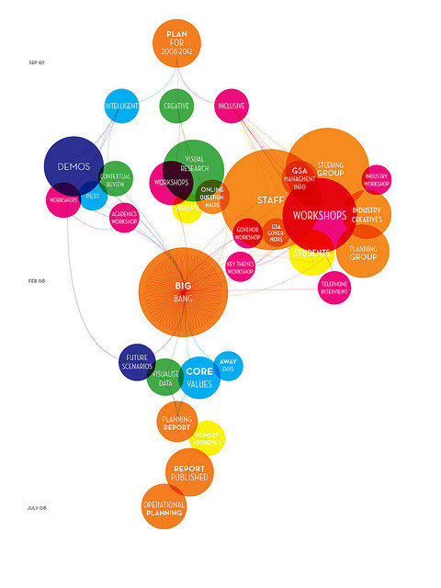

Notes:
Institutionally, there are drives to increase our intake of students from non-traditional backgrounds as historically these have been under-represented within the student body.
These learners may be compromised still further in academic or research skills.
GSA is also actively striving to develop its research activity and outputs.
GSA Future plan has a strategic emphasis on increasing its numbers of researchers and on building a research culture and infrastructure to support them.
The GSA is committed to increasing the number of postgraduate students to 20% of the student body by 2014.

Slide 12
HOW

Slide 13
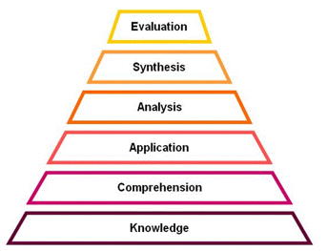
Notes:
InfosmART is modular in approach and presents tasks that are contextualised and situational, with real-world applications.
A defined set of learner attributes presents the skills, knowledge and abilities beyond disciplinary knowledge that InfosmART can provide, applicable to a range of contexts.
Its learning and teaching pedagogy aims to create autonomous learners able to take responsibility for their own experiential and reflective learning.
This pedagogy is informed by Bloom’s taxonomy of the cognitive domain: Bloom, B. (1956) Taxonomy of educational objectives, handbook I: the cognitive domain. New York: David McKay.

Slide 14
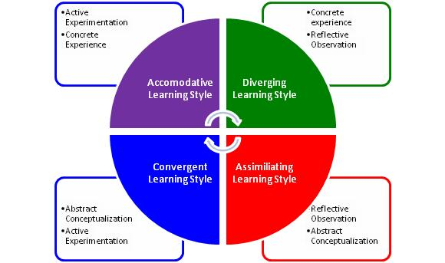
Notes:
And Kolb’s 4-type definition of learning styles, namely converger, accommodator, assimilator and diverger: Kolb, D. A. (1984) Experiential learning. Englewood Cliffs, NJ.: Prentice Hall.

Slide 15
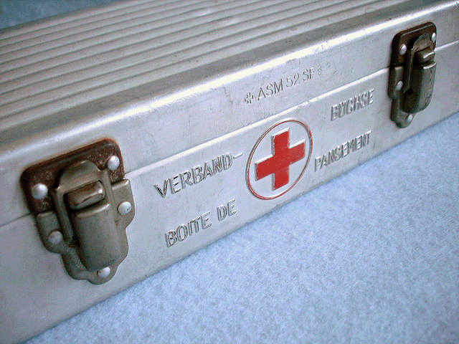
Notes:
When the learner first accesses InfosmART, the homepage presents a quick ‘first-aid’ assessment, where learners can acquire a personal InfosmART prescription by rating themselves against a scale.
InfosmART indicates the content they should concentrate on.
The learner can then choose to follow the course through across all 5 modules, or to concentrate on those discrete modules that best address their particular needs.

Slide 16
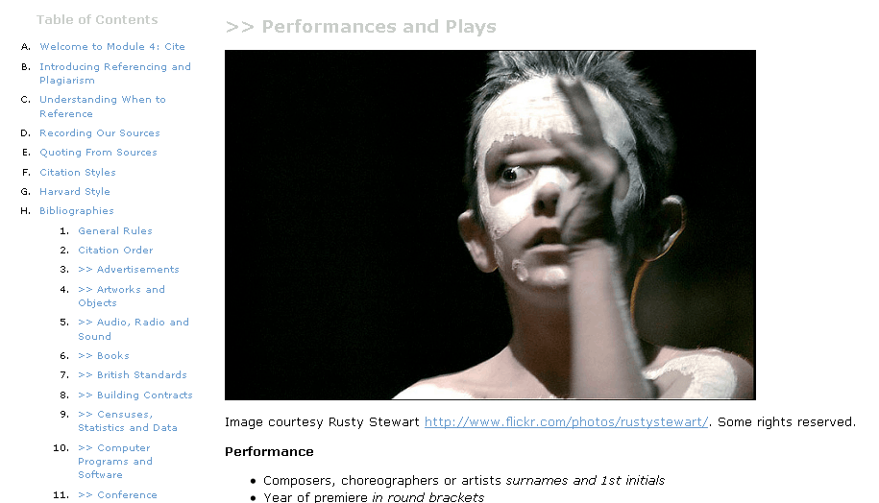
Notes:
A clean, consistent and elegant interface is presented throughout, key for such a design-literate target audience.
Text is kept clear and non-technical, without being patronising.
Navigation is through directional back and forward arrows, or collapsible subject trees to the side.
Wherever possible, images are used to represent ideas or concepts, whether literally or metaphorically.
This is because our audience are most comfortable explaining complex ideas through image, rather than text.
You’ll have noticed that this presentation itself consists mostly of images.
Short demonstration movies for catalogues, databases and platforms were created using Adobe Captivate.
The ability to view actual clickpaths through a resource, rather than a text description of the activity, is ideal for our visual thinkers.
This approach is now being adopted by GSA’s Learning Support unit as best practice for international students whose first language is not English.

Slide 17
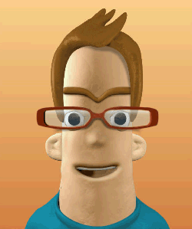
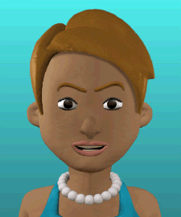
Notes:
During the course of each module, InfosmART’s helpful avatars Iain and Iona point out useful facts that learners might not have known before, and introduce thinking exercises to help them engage with what they have just learnt.
InfosmART is designed to provide both useful facts and instruction (surface learning) and a deeper engagement with issues and concepts (deep learning).

Slide 18
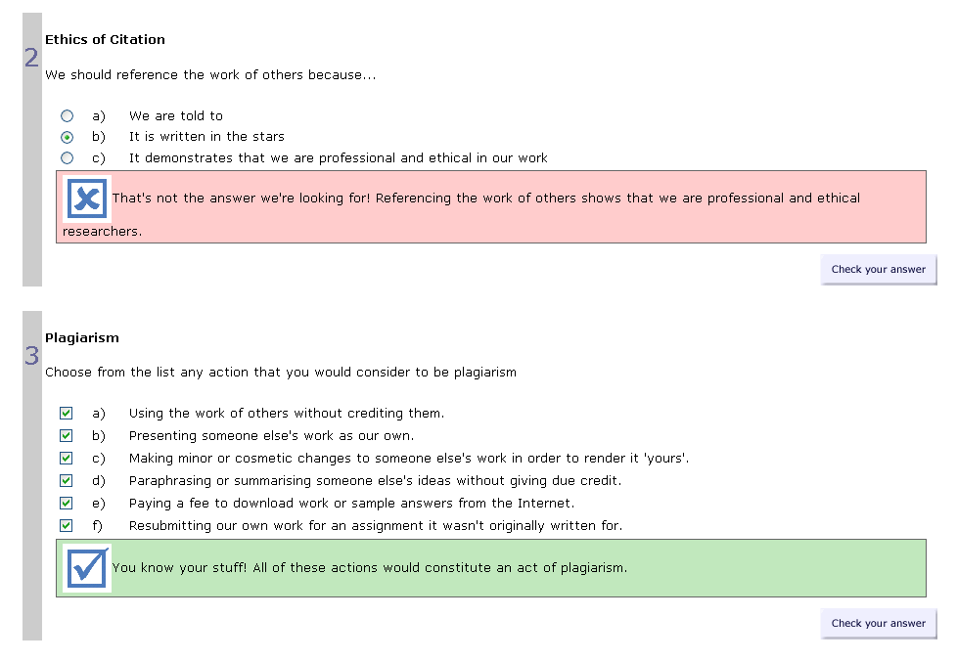
Notes:
At the end of each module students have the opportunity to test their new skills through a short series of games, multiple choice, yes/no, true/false and word-fill exercises.
InfosmART is not formally assessed, but testing helps to reinforce what has been learnt during the course of the module.
InfosmART will tell learners what they have got right, and what they could look at again.
And InfosmART has been future-proofed so that it can be easily integrated into credit-bearing courses if a decision if made to do so at a later date.

Slide 19

Notes:
Once learners are confident in their new skills, InfosmART provides space for them to reflect on their learning and to identify what they are now confident in and what could be developed further.
They can then download a Certificate of Learning which outlines what they have learnt
This can be included in personal professional development journals or sketchbooks.

Slide 20
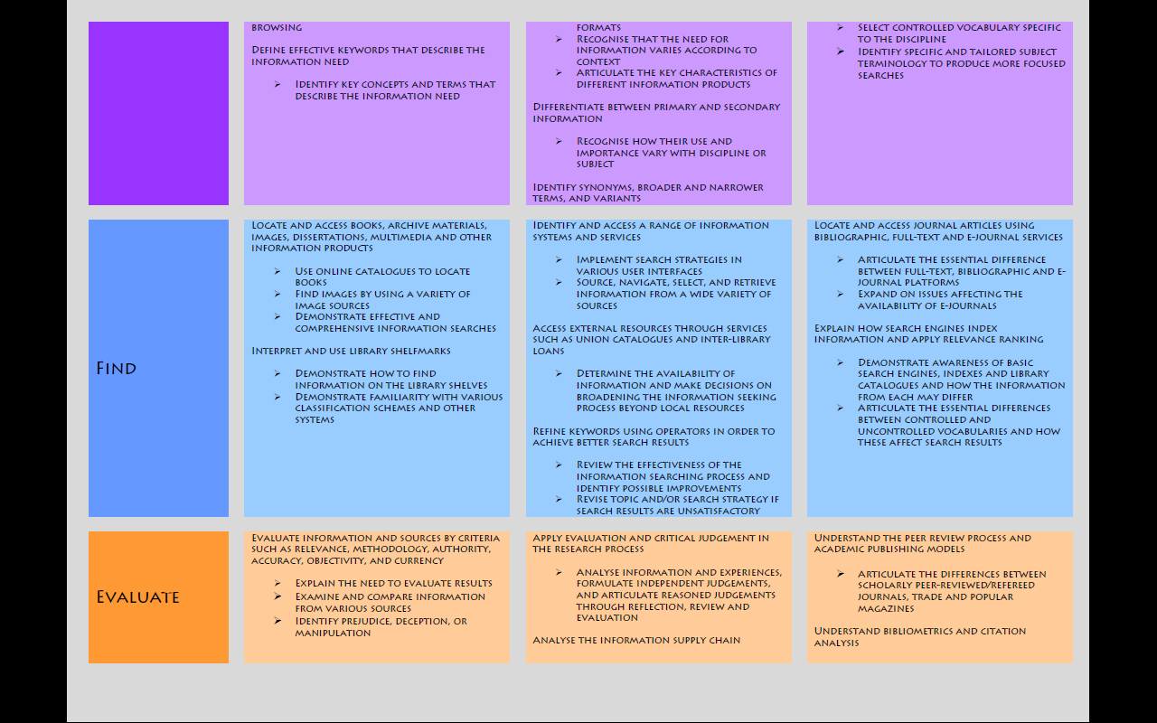
Notes:
Every InfosmART module has ascribed intended learning outcomes that seek to develop and stretch learners.
All InfosmART ILOs are specifically measurable
This ensures that learners remain motivated, confident that what they are learning has real-world realistic applications.
InfosmART ILOs and content are tiered at 3 levels: undergraduate, postgraduate and research.
This approach makes clear to both the learner and tutor which specific skills are expected at each academic level.
Content can be included in programmes of study based on the academic level of the learners in question.
The full set of ILOs is available on the InfosmART homepage.

Slide 21
 | QAA Subject Benchmark Statement for Higher Education: art and design
 | SQA National Unit Specification: information handling skills
 | ARLIS/NA information competencies for students in design disciplines
 | Futurelab digital literacy model
 | SCONUL seven pillars of information literacy
 | Vitae researcher development framework
 | Concordat to support the career development of researchers
 | SHEEC enhancement themes
 | National Occupational Standard for Design
 | National Occupational Standard for craft
 | ALA Information Literacy Competency standards for HE
Notes:
All content and learning outcomes are mapped to externally-validated subject, research and IL.
This mapping demonstrates to academic staff that InfosmART content is explicitly tied to the pedagogical frameworks and standards they employ in their teaching and course design.

Slide 22
Notes:
This is an example of the mapping schematic for the 2nd InfosmART module.
The full mapping document can be downloaded from the InfosmART homepage

Slide 23
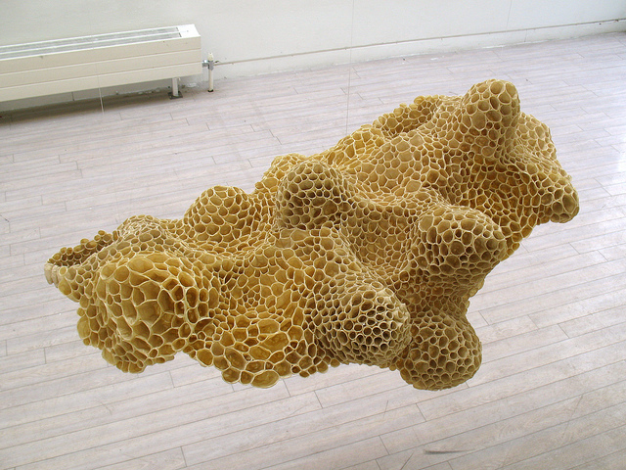
Notes:
How has InfosmART been received?
In the QAA Enhancement-Led Institutional Review of GSA (2010) InfosmART was highlighted as an excellent example of responsive services developed directly out of student feedback.
Enhancement-Led Institutional Review is one component of the Quality Enhancement Framework, an approach to quality assurance and enhancement in higher education introduced in Scotland in 2003.
ELIR reviews are carried out by a team of six reviewers: one student reviewer, one international reviewer, three senior UK-based academic reviewers and one coordinating reviewer.

Slide 24

Notes:
In recognition of its innovative work on InfosmART, the GSA Library won Outstanding Library Team of the Year at the Times Higher Education Leadership and Management Awards 2010
Joanna Newman, Head of Higher Education at the British Library said:
"We were impressed with the winning entry's innovative use of technology, tailoring information research literacy into personalised learning to help students realise their potential and broaden their research horizons."

Slide 25


Notes:
InfosmART has received Innovation and Development Funding from the Scottish Library and Information Council.
It is now available as an Open Educational Resource, licensed under a Creative Commons Attribution-NonCommercial-ShareAlike 2.5 UK: Scotland License.
This means you can adapt InfosmART for your own learners, as long as you:
>> Credit ‘Learning Resources, Glasgow School of Art’ wherever you use our content.
>> Only use our content for non-commercial purposes.
>> Make any work you create that includes our content freely available to others through Creative Commons

Slide 26

http://www2.gsa.ac.uk/library/infosmart

Slide 27


Slide 28



 | @gsalibrary
 | flickr.com/gsalib
 | vimeo.com/gsofa
Duncan Chappell
Academic Liaison Librarian
Glasgow School of Art
d.chappell@gsa.ac.uk

