Slide 1

Understanding and Improving Research Data Management in the Visual Arts:
Case Study of the KAPTUR Project
Dr Robin Burgess
r.burgess@gsa.ac.uk
Open Repositories Conference 2013
Notes:
Title slide giving my contact details

Slide 2
Context
To raise awareness of the complexity of research data management in the visual arts
Determining the current state of management of research data
Through describing the KAPTUR project, illustrate approaches to help data management in the visual arts
Give examples and recommendations based on GSAs findings
Notes:
Briefly describe the context of the presentation

Slide 3
Research Data
“What is arts research data? What does it mean to you? Research, art, design, architecture, I’m going to tell you. What is arts research data? We tried to find out. We asked various researchers, and this is what we found…”
Valuable resource for learning, teaching, research, knowledge transfer and consultancy
Little is known in the visual arts on RDM
Requirement for policies and procedures
Pressure coming from various bodies for higher education institutes to manage their data
Requirement for data transparency
Accessibility to data
Long term use
Notes:
The importance of research data, particularly in the visual arts

Slide 4
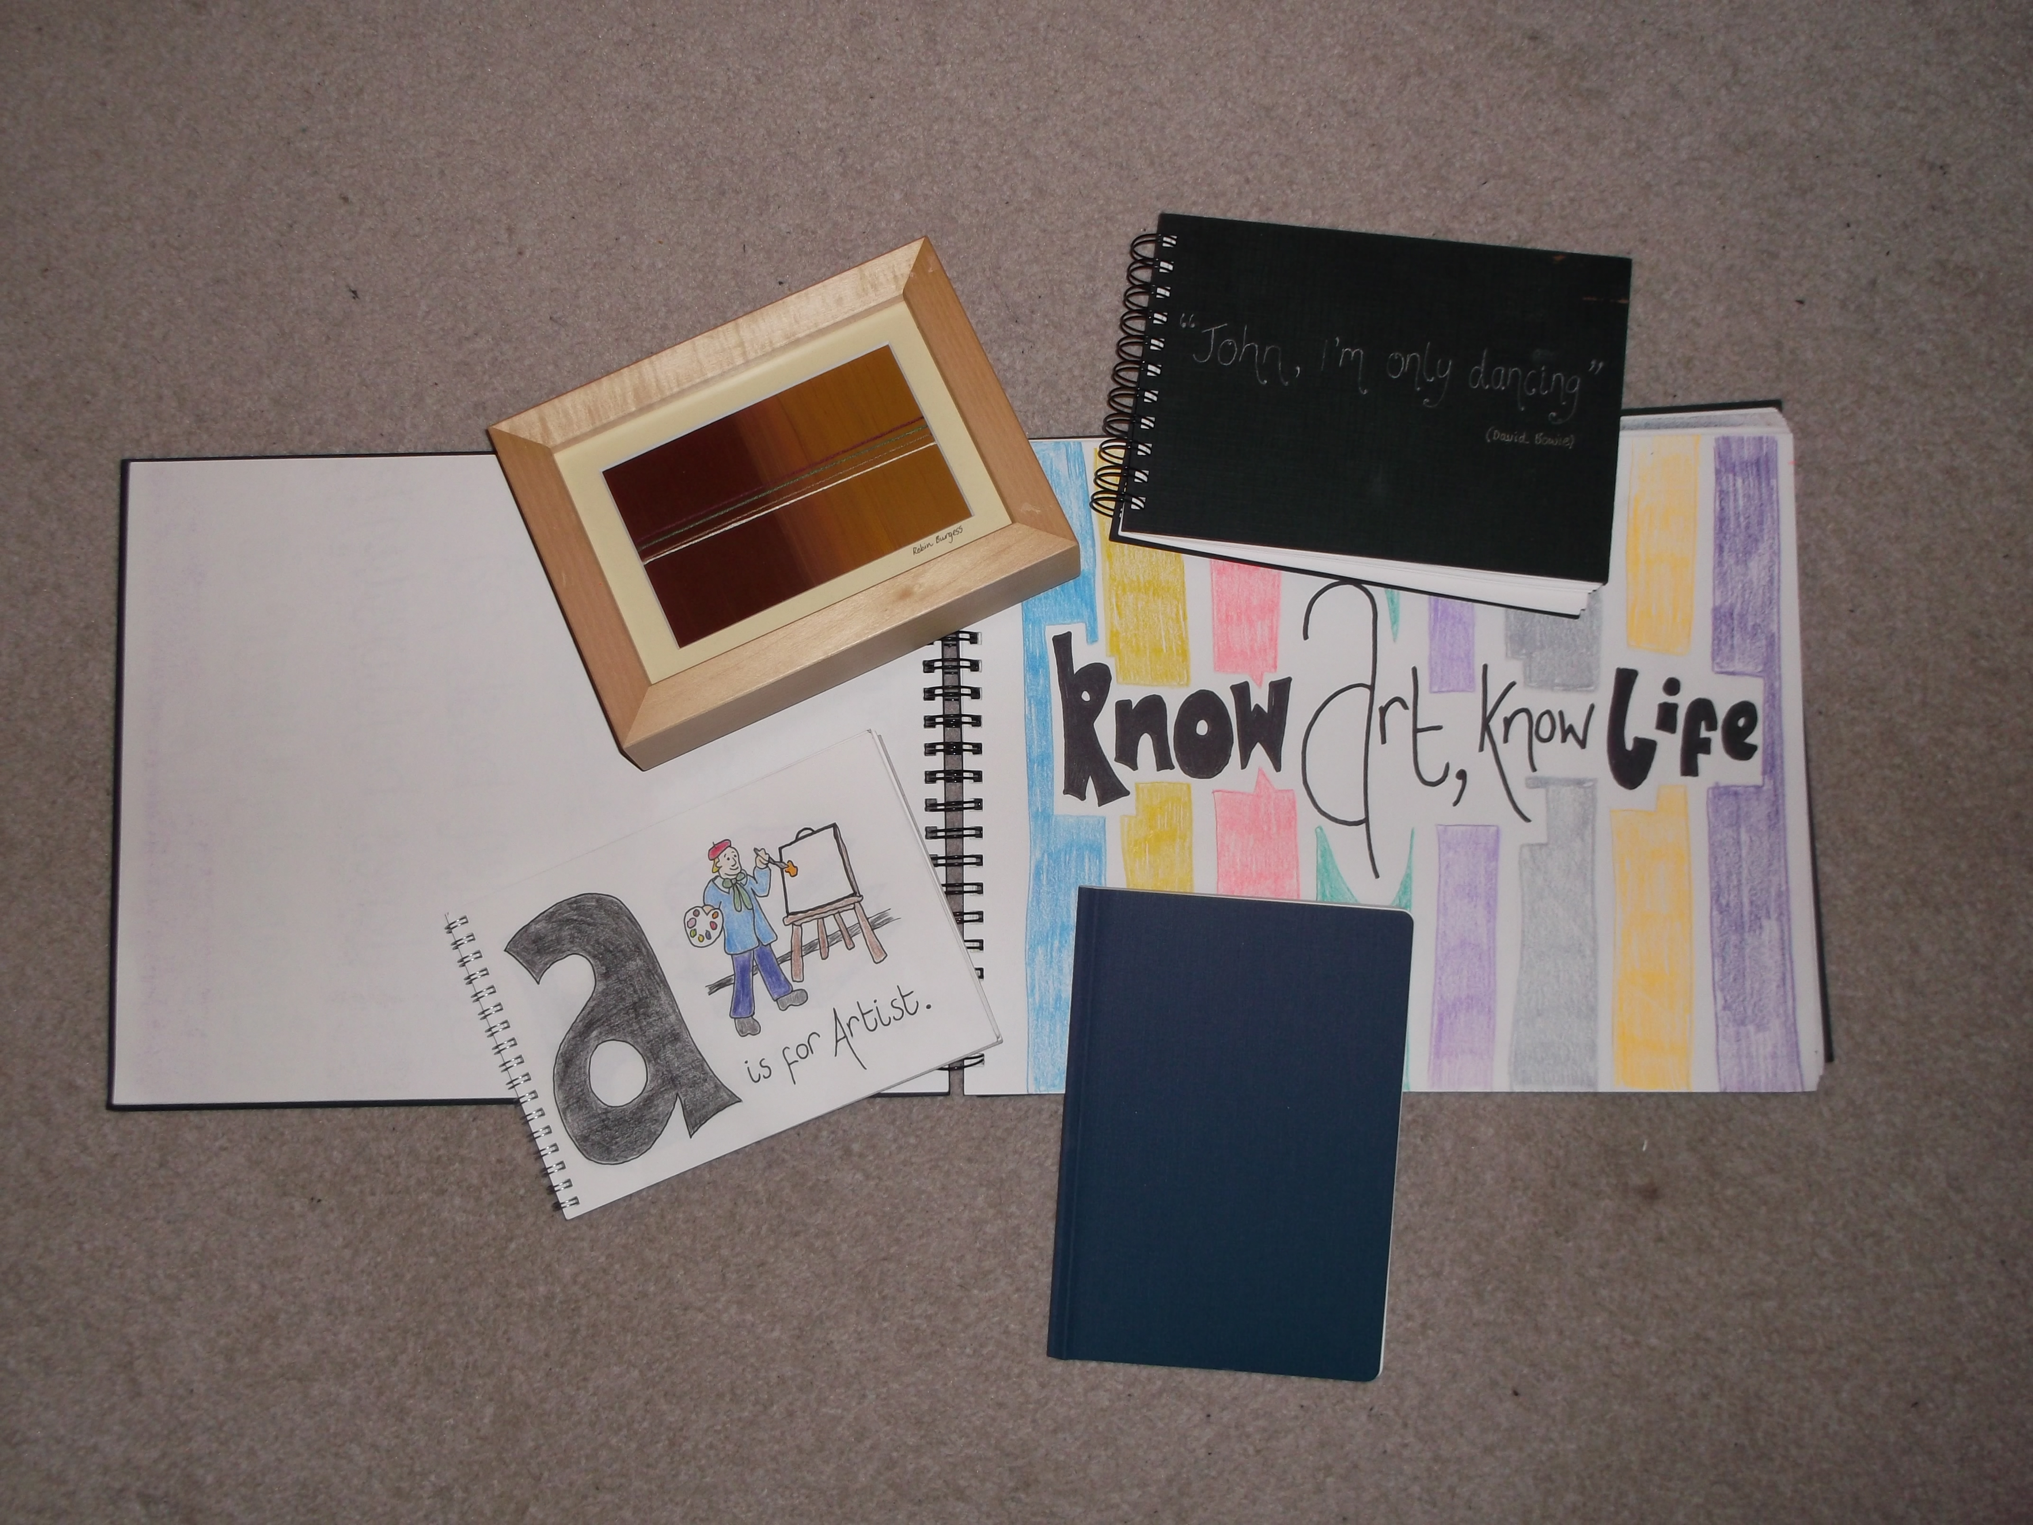
Complexity
Research in the Arts is highly complex and varied
Many formats
Varying terminology and methods
Physical nature
Risks from data loss, deterioration
Data protocols
Notes:
Describe the complex nature of arts data, the issues faced

Slide 5
Importance of
Data Management
“not only desirable, but essential”
Satisfies funding requirements
Open Access
Helps explain methods and outputs
Production of research data is time consuming and costly
Significant application and future value
Helps other researchers
Improved re-use and sharing of data
Improved tracking of information
Helps the development of new tools and systems
Increase collaborative opportunities
Notes:
Why arts institutes are being asked to manage their data

Slide 6




KAPTUR
To investigate the nature of research data in the visual arts
To consider the application of technology to support collection, discoverability, usage, and preservation of research data in the arts
To review appropriate policies, procedures and systems
To develop case studies and showcase good practice to a wider audience
Notes:
Moving onto the development of the KAPTUR project. Give a bit of history behind it and comment on the partners and funders of the project

Slide 7
Expectations
To develop and implement the RDM policy throughout the school
Raise awareness of staff
Understand what research data is
Understand further what funders are expecting of HEIs
Notes:
A brief comment on what GSA expected to get from contributing to KAPTUR

Slide 8
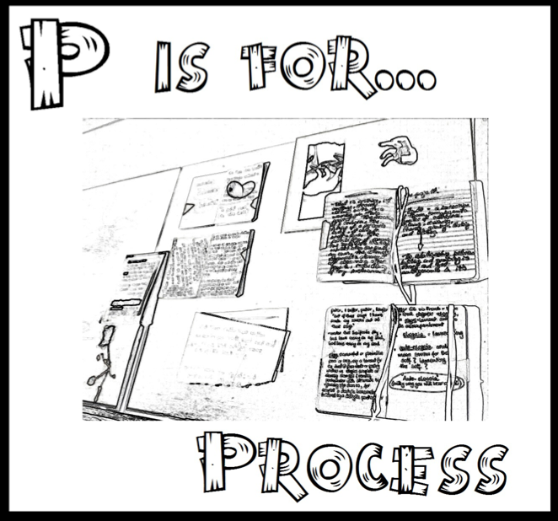
Process
Environmental Assessment
User Requirements, systems evaluation and piloting
Policy formation
Capacity building
Sustainability
Dissemination
Notes:
How was KAPTUR implemented, the important areas of the project

Slide 9
Environmental Assessment
Discover, Create and pilot a sectoral model of best practice in the management of research data in the arts
What is research data in the arts?
How can visual arts data be managed appropriately
4 researchers from each institute chosen, from a broad range of disciplines
Areas discussed
Terminology
Role of the visual arts researcher
Creation of visual arts research data
Use/re-use of visual arts data
Visual arts data in the longer term
Notes:
Two key areas are the environmental assessment and the technical requirements. Environmental assessment will be reviewed first, detailing the approach and findings

Slide 10
Interview Findings
The term ‘research data’ was not helpful
Researchers undertake multiple roles
Creation of data altered
Awareness of use and re-use present
Importance of archiving raised
Little consensus in the visual arts on what research data is
Described as tangible, intangible, digital, and physical
Visual arts data is heterogeneous and infinite,
complex and complicated
Notes:
Findings from the process

Slide 11

Quote from a researcher:
“… I am not sure what constitutes research data… What is data? I mean, I talk to you about my data as a researcher, but for the institution, what does it consider data? Would it be conference proceedings, would a performance be data even if it was not recorded, sometimes I don’t record my performances…”
Notes:
Comment on what researchers were saying, illustrating the complexity of data management again

Slide 12
Definition
“Research data means data in the form of facts, observations, images, computer program results, recordings, measurement or experiences on which a research output is based. Data maybe numerical, descriptive, visual or tactile. It may be raw, cleaned or processed, and may be held in any format or media. Research data in the arts mirrors the complexity of the outputs, taking many forms including logbooks, journals, workbooks, sample libraries, sketchbooks, sets of images, video recordings, trials, prototypes, ceramic glaze recipes, found objects, and correspondence. Provenance information about the data might also be included: the how, when, where it was collected and with what. This metadata facilitates later interpretation and re-use of data"
Notes:
A generic definition that was developed

Slide 13

A-Z of Arts Research Data
http://www.youtube.com/watch?v=tbG1Tg9_0l8
Notes:
Further output from the environmental analysis. The A-Z and song for arts research data

Slide 14
Technical Development
Two elements of interest:
Determine user and technological requirements to support the effective management of research data in the visual arts
Identify and recommend a technical solution to support the effective management of research data in the visual arts
Notes:
Moving onto the technical development. Key areas tackled

Slide 15
Requirements Gathering
Types of data collected
Management of the data
Disk space
Shared drives
Servers and remote servers
The Cloud
Authentication methods
Tracking of research data
Back up procedures
Required support
Technical needs
System preferences
Notes:
Discuss the method in which requirements were gathered through testing of systems, and questionnaires. Meetings held to formulate these requirements

Slide 16
Options Investigated
Testing Involved:
Interface design
Usability
Inputting of data
Extrapolation of data
Sharing and re-use
Functionality and ability to link to other systems
Costs and application
Systems tried and tested:
Dataflow
DSpace
Fedora
Figshare
CKAN
EPrints
Notes:
Go into detail about the options that were investigated. Brief comments on good and bad points of each, and mention how they were tested against each other etc

Slide 17

Current Solution
Partner institutes all running EPrints repositories
Tried and tested solution
Limited need for support/training
Can accommodate different workflows
Good editing function
Storage of content wide ranging
EPrints Bazaar
Notes:
The main option chosen by the team

Slide 18
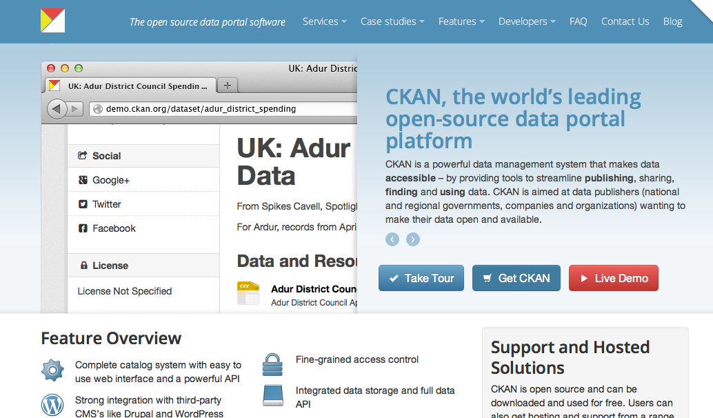
But…
EPrints is not the only option
CKAN is being further investigated by VADS
CKAN tested by partners
Options and approaches will vary for institutions, One size does not necessarily fit all
Notes:
Work is however continuing, looking at CKAN

Slide 19
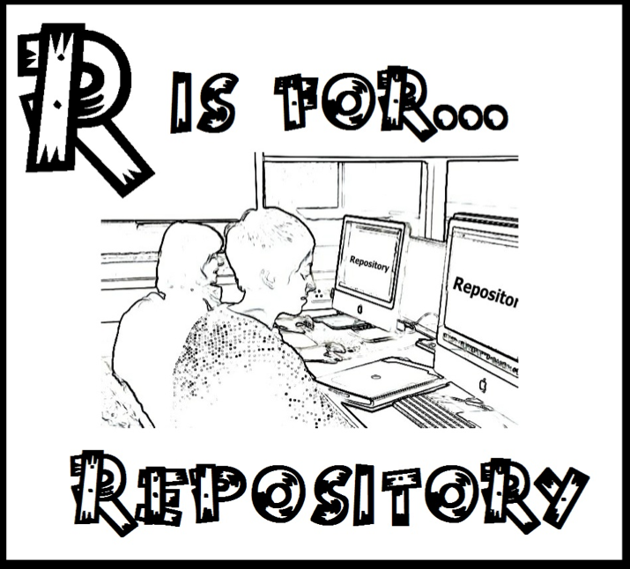
Current Status
EPrints has been tested amongst the partner institutes
Investigation being undertaken with regard to embedding RDM within RADAR (GSAs research repository)
Development of RDM policies
Notes:
Where we are at with our developments

Slide 20
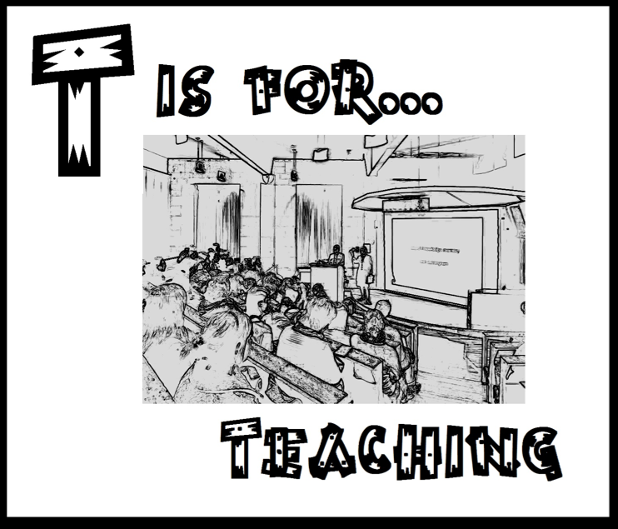
Work in Progress
Implementation of policies
Changes being made to RADAR
Teaching, training of staff and students
VADS4R
Notes:
The work in progress, focus on the teaching element and introduction of VADS4R

Slide 21
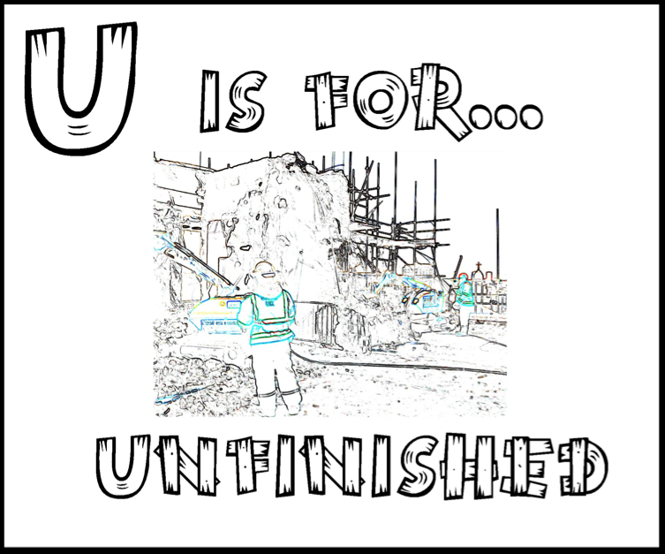
Concluding Remarks
Challenges have been faced in understanding what Visual Arts Data is and how it can be managed
Systems, policies and procedure allow for improved management
Communication with staff
The issue of RDM is open, continuing and unfinished
Notes:
A few comments to reiterate the work and the complexity of working with arts related data and management tools

Slide 22

Acknowledgements
The team at VADS (Leigh Garrett and Marie-Therese Gramstadt)
The Project Partners working on KAPTUR
The DCC for their input on policies
EPrints – developers and users
JISC – funding body
GSA Research Office and Learning Resources
The researchers at GSA
Images courtesy of Burgess&Bear (http://www.facebook.com/BurgessBear)
Notes:
Those who have helped out

Slide 23
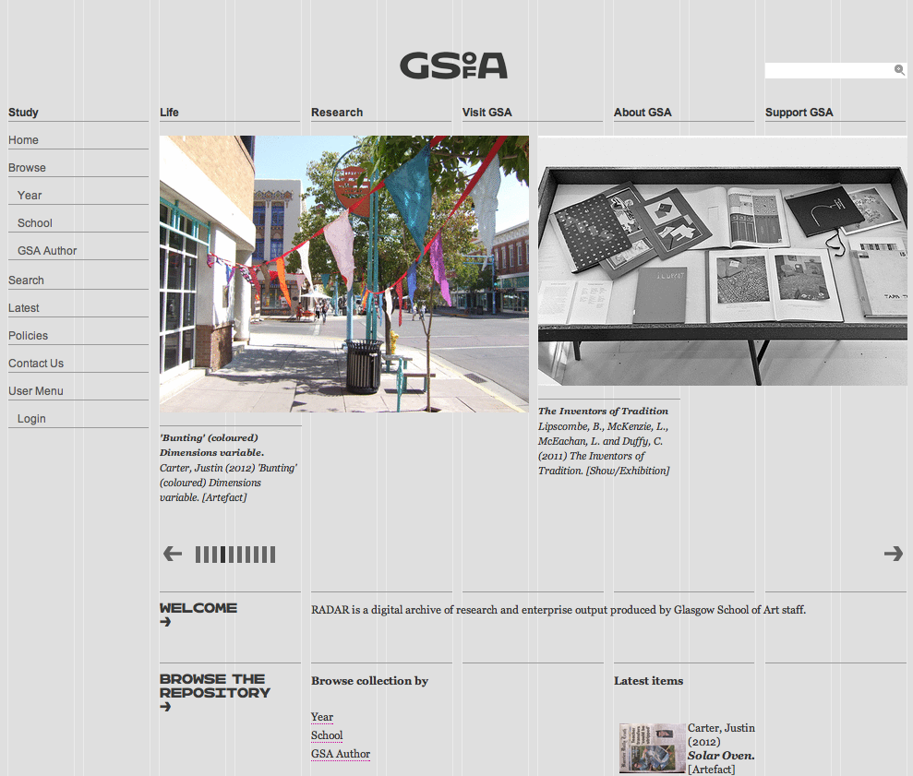
Thankyou
http://www.vads.ac.uk/kaptur/
http://radar.gsa.ac.uk/
Notes:
Link to the repository and the KAPTUR website

