Slide 1

The Sharing and Re-Use of Research Data and Outputs via the Application of RADAR
Dr Robin Burgess
R.Burgess@gsa.ac.uk
Open Repositories Conference 2013
Notes:
The title of the presentation based on the title of the paper I submitted. My contact email address is also given.

Slide 2
Context
To describe the development of RADAR, Glasgow School of Art’s research repository
Demonstrate how RADAR has been implemented for the management of research outputs
Demonstrate aspects of re-use and sharing of data through RADAR
Describe future developments to RADAR
Notes:
Overview of what will be covered

Slide 3
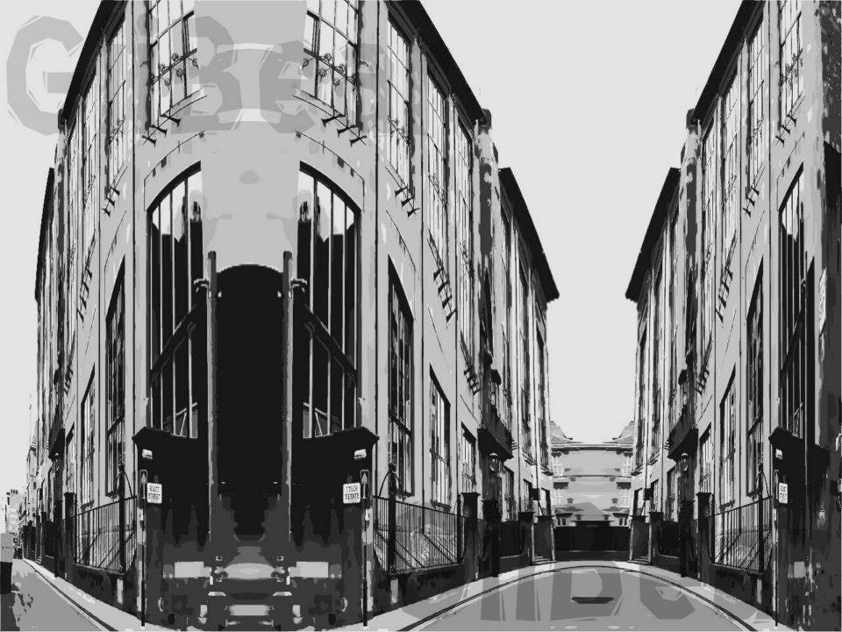
Background - GSA
A creative hothouse
At the heart of one of Europe’s most influential creative artistic communities
Producers of mature and confident graduates in fine art, design and architecture
Researchers that influence world culture and generate new knowledge
Notes:
Brief background on GSA and it being a research led institute

Slide 4
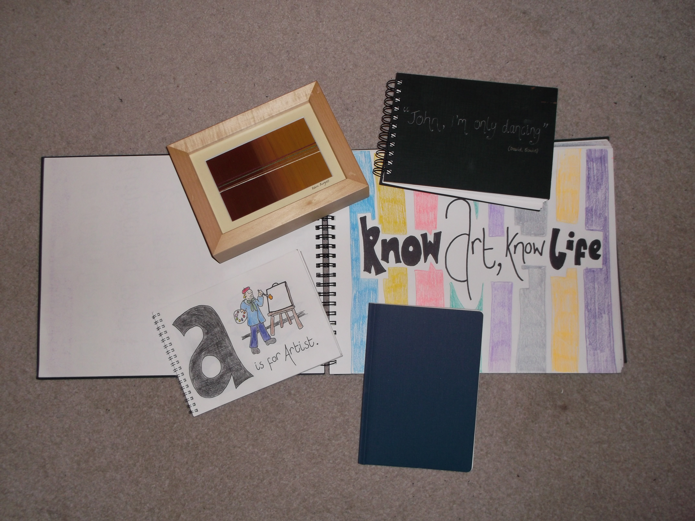
Background – Arts Data
Complex
Complicated
Hard to define
Appropriate management systems required
Valuable resource
Notes:
Discuss the complexity of arts research data (this will have also been covered in the talk I’m giving about KAPTUR)

Slide 5
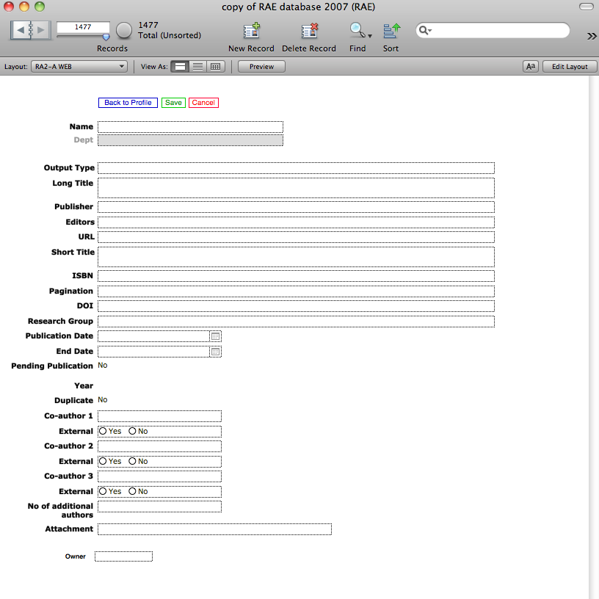
Background - RADAR
Outputs recorded in a Filemaker database
Poorly embedded
Limited access
Lack of re-use and sharing of information
Complicated system
Notes:
Give the history of the development of RADAR, detailing the previous system and the need for an improved system. Highlight the considerations made and decisions made in relation to which software was chosen etc

Slide 6
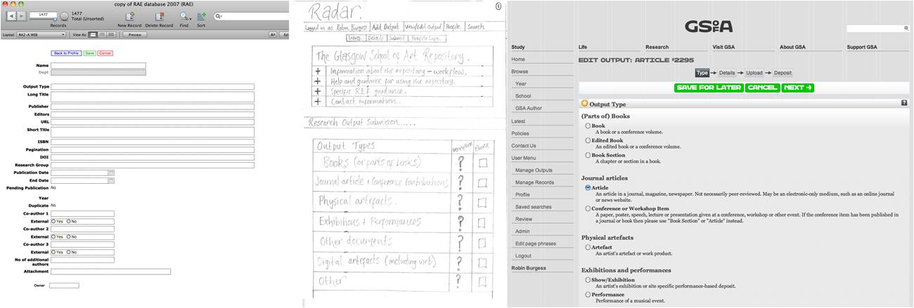
RADAR Development
Research Art Design Architecture Repository
JISC Funding acquired
Engagement with EPrints
Liaison with ScreenMedia
RADAR developed
Notes:
Talk through the developmental process, engagement with EPrints and Screenmedia. Illustrate design process and the standard approach to repository development

Slide 7
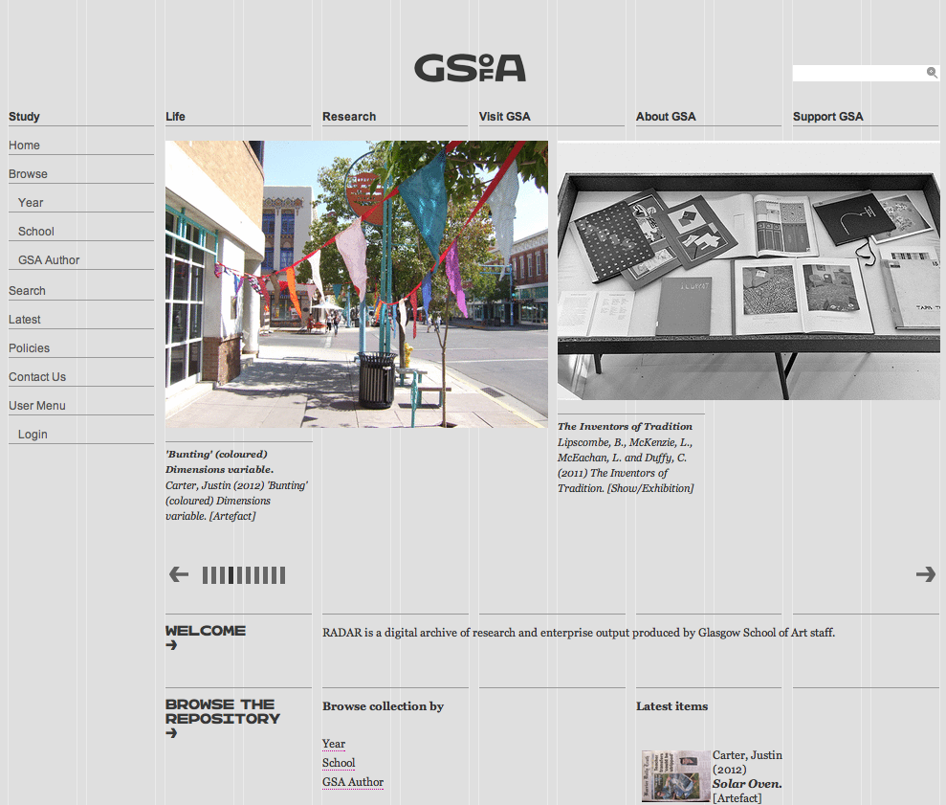
RADAR – External View
Notes:
Comment on the external face of RADAR – what a member of the public will see

Slide 8
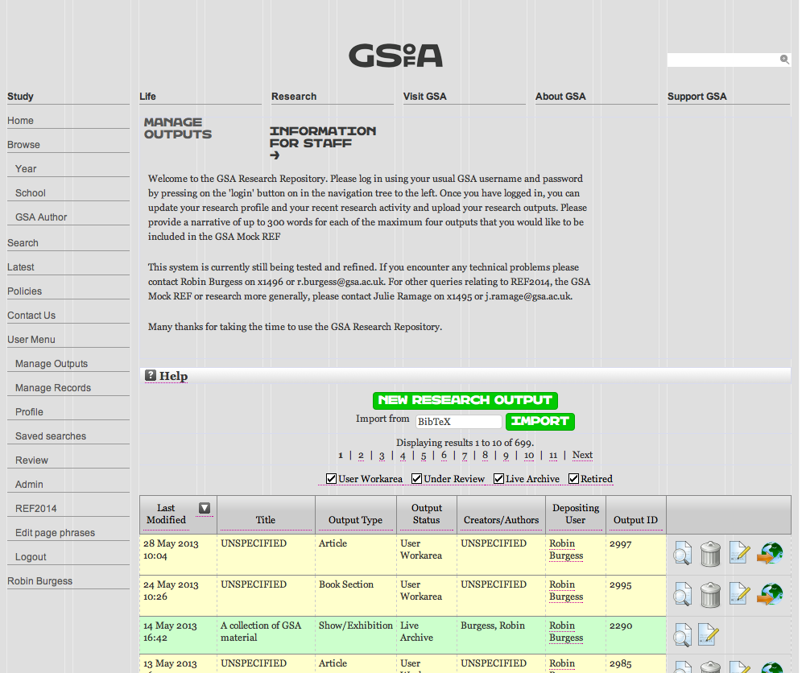
RADAR – Internal View
Notes:
Comment on the internal view seen by GSA researchers, standard EPrints set up

Slide 9
Application of RADAR
Internal:
Uploading research outputs
Enhancement of staff profiles
Showcasing work at GSA
Management of research data
External:
Sharing the research undertaken at GSA
Enhancing links with other institutes
Linking with funding bodies
Open access
Notes:
Illustrate the internal and external uses for RADAR, expand on these in discussion

Slide 10
RADAR Functions
Data Management:
Uploading of research outputs
Enhancing staff profiles
Storage facility
Publications record
Data Extrapolation:
Research Excellence Framework
Funding body issues
Open access to information
Research showcase
Notes:
Highlight the main functions of RADAR in relation to data management and sharing of information. This is stipulated in the paper I wrote

Slide 11
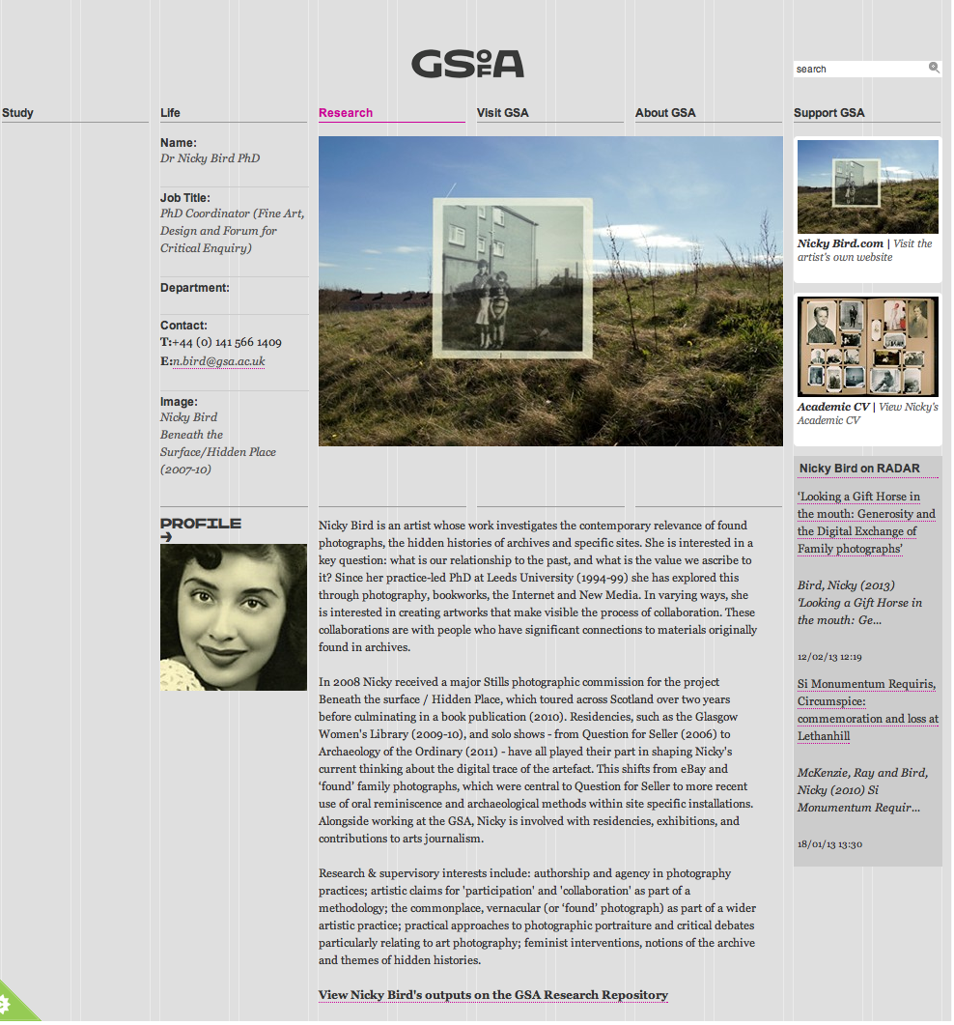
Sharing and Re-Use
Staff Profiles:
Developed to enable staff to share their research practice
Embedded links with RADAR
Key research highlighted
Dynamically managed
Notes:
Go into depth about staff profiles and their link to RADAR and showcasing work at GSA

Slide 12
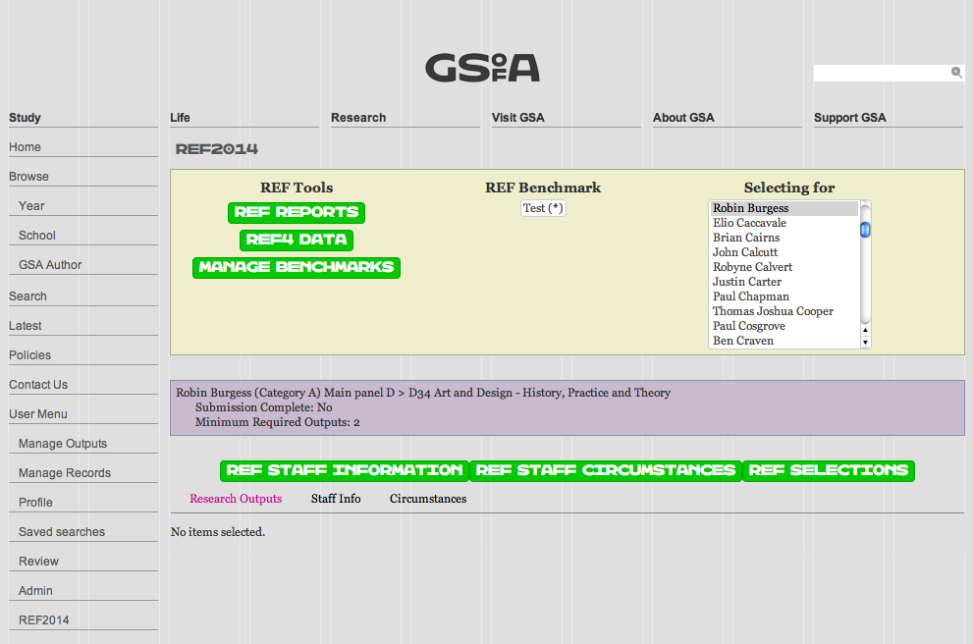
Sharing and Re-Use
REF:
REF2013 module produced by EPrints
Enables staff to choose REFable outputs
Reports can be generated
Links with HEFCE
Notes:
Fundamental aspect of the talk and the paper I wrote is in relation to the application of the REF module for extrapolating and sharing information on research outputs. This is a specific function and has a specific purpose.

Slide 13
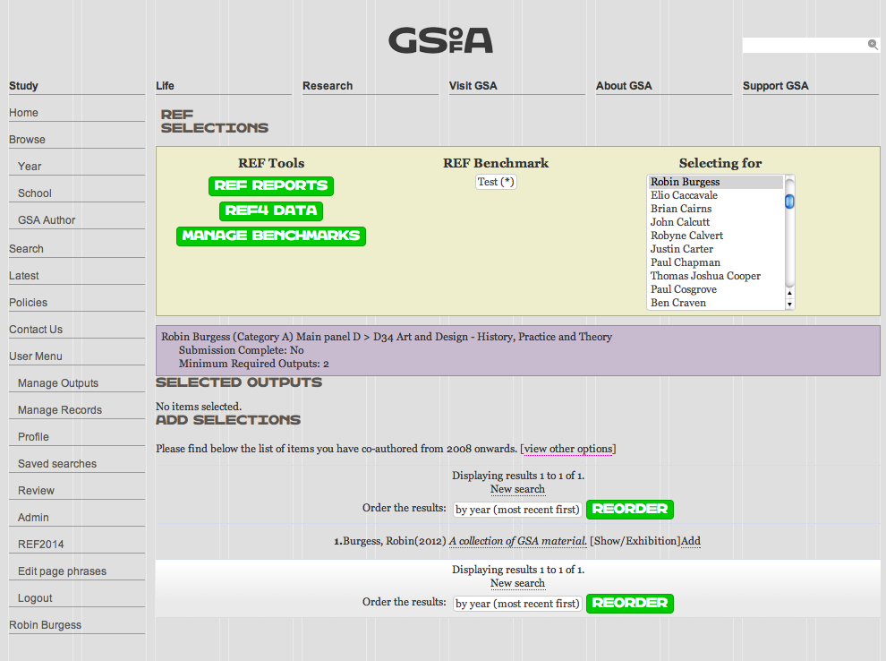
REF - Continued
REF2013 Module:
Assign UoA
Assign Champions
Select Outputs
Rate and qualify
View and generate reports
Export data for further use
Notes:
Further details about the module that EPrints embedded in the repository

Slide 14
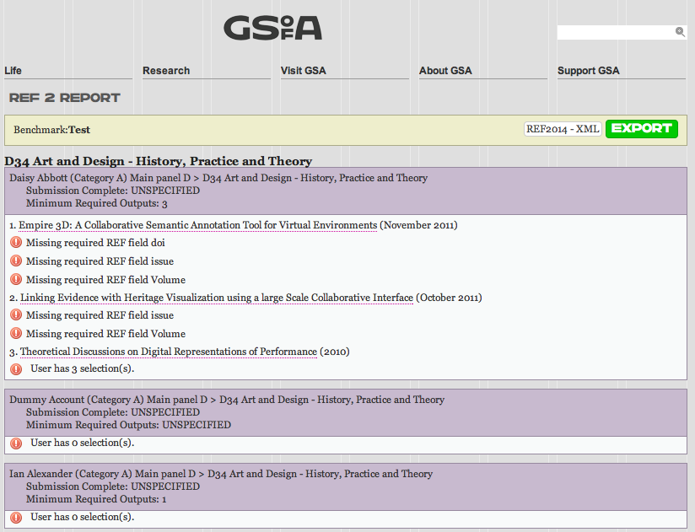
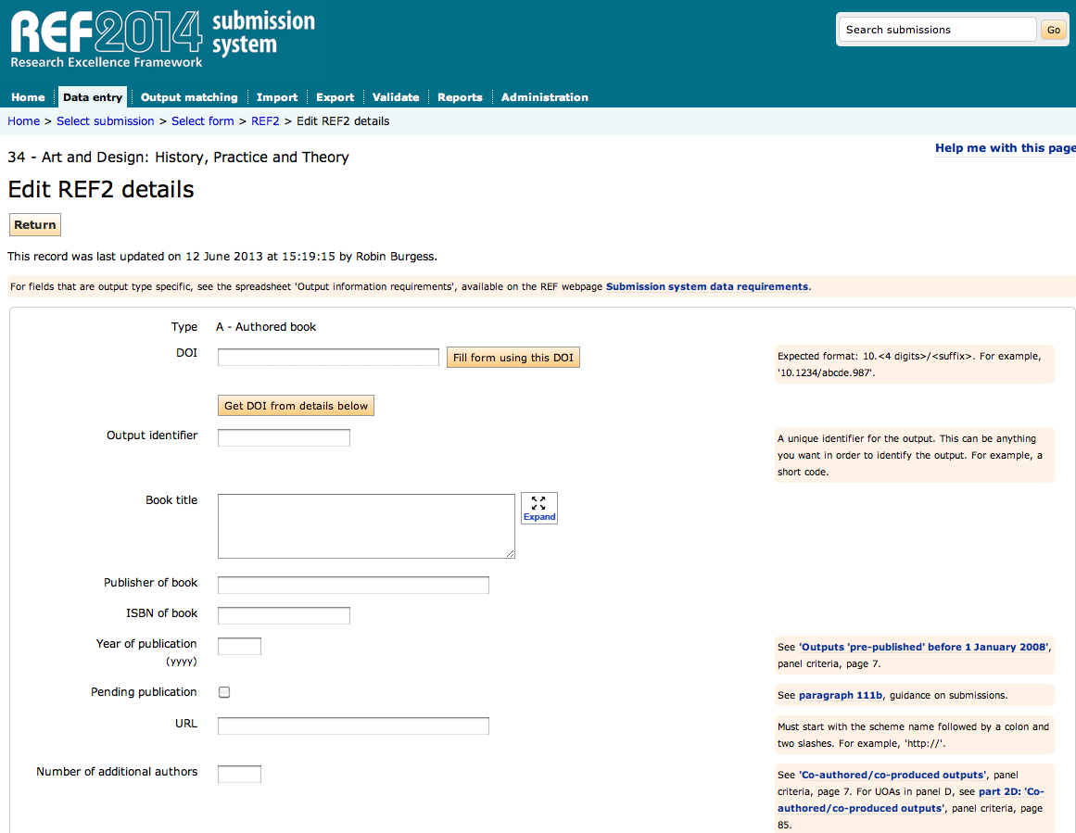
REF Data - Outputs
Reports run from the REF module in RADAR
Correspond with the HEFCE system
Notes:
Comments on the reporting and output submission methods, both in RADAR and the HEFCE system. Describe the compatibility of the systems and the importance of their use

Slide 15
Staff Engagement
Increased awareness of the importance of uploading quality outputs
Full metadata deposits
Increased knowledge of data management
Better web presence for staff
Awareness of the complexity of arts research data
Inclusion of physical evidence with outputs
Notes:
Comment on the engagement received from staff during the process, look at this from the point of view of repository inception – people not being fully engaged and unsure – to present day and people being fully engaged

Slide 16
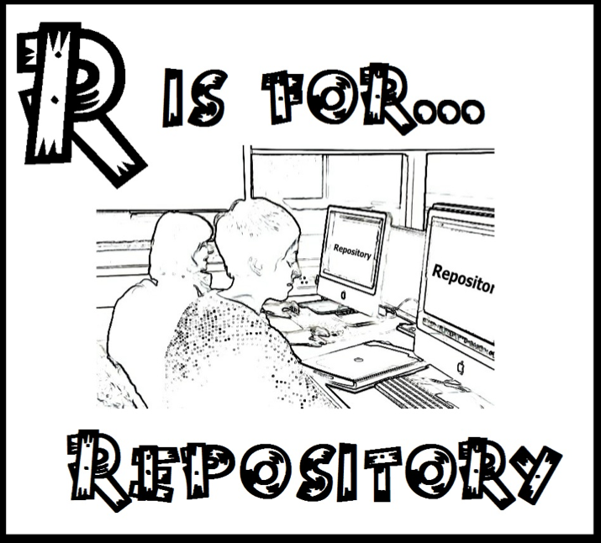
Future Enhancements
Research Data Management (KAPTUR Project)
Research Pipeline system
Postgraduate record keeping
Additional deposit types - theses
Notes:
Discuss the future potential that RADAR has, utilising the skill set of EPrints

Slide 17





Support for Development
Notes:
The probably people/groups who will support these developments

Slide 18

Concluding Remarks
Iterative process for the development of RADAR
Continued engagement with research staff
Buy-in for enhancements
Forward planning with regard to changes in policy/procedures
Notes:
Give a few concluding remarks about the work, advice, feedback, support and recommendations

Slide 19
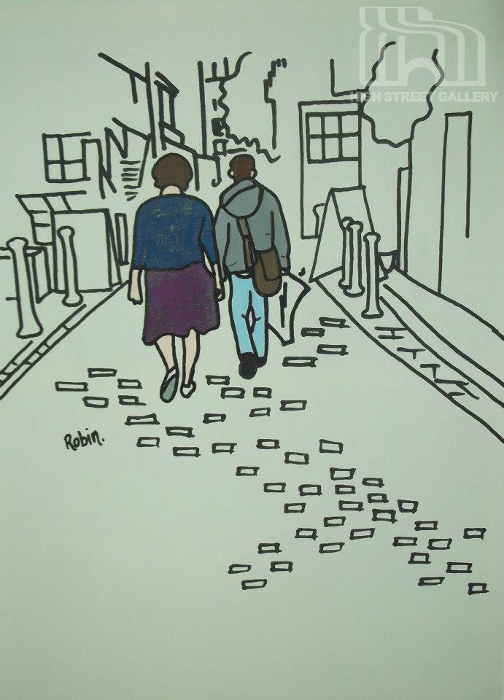
Acknowledgements
The team at EPrints (Justin Bradley and Tim Miles-Board)
ScreenMedia
William Nixon (Glasgow University)
VADS
GSA Research Office and Learning Resources
The researchers at GSA
Images courtesy of Burgess&Bear (http://www.facebook.com/BurgessBear)
Notes:
Those who have helped out

Slide 20
Thankyou
http://radar.gsa.ac.uk/
Notes:
Link to the repository…

