Slide 1
The Early History of GSA Library
Duncan Chappell
Glasgow School of Art

Slide 2
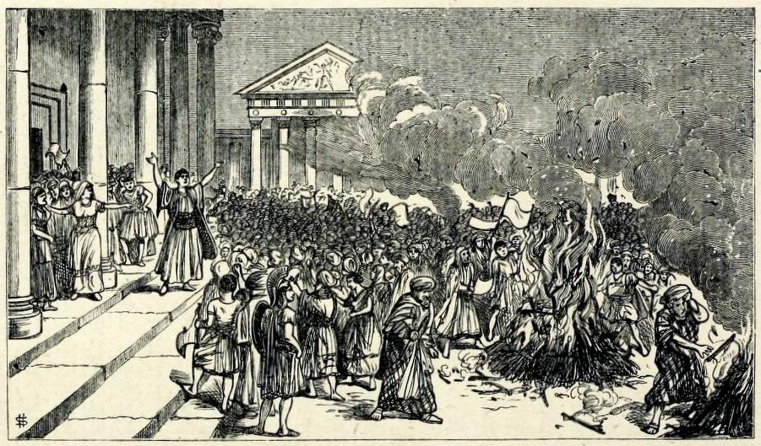
Notes:
Plate II. The destruction of Books of Magic at Ephesus.
Blades, William The Enemies of Books
In his treatise The Enemy of Books, first published in 1880 (by whom?), William Blades, the well-known collector of the works of William Caxton, documents his outrage at the mistreatment suffered by books at the hands of biblioclasts, both human and non-human
His text enumerates and discusses threats to the survival of books, with dedicated chapters on water, gas and heat, dust and neglect, ignorance and bigotry, bookworms, other vermins, bookbinders, collectors, and servants and children
His chapter on fire begins:
“There are many of the forces of Nature which tend to injure Books; but among them all not one has been half so destructive as Fire.”
“It would be tedious to write out a bare list only of the numerous libraries and bibliographical treasures which, in one way or another, have been seized by the Fire-king as his own.”

Slide 3
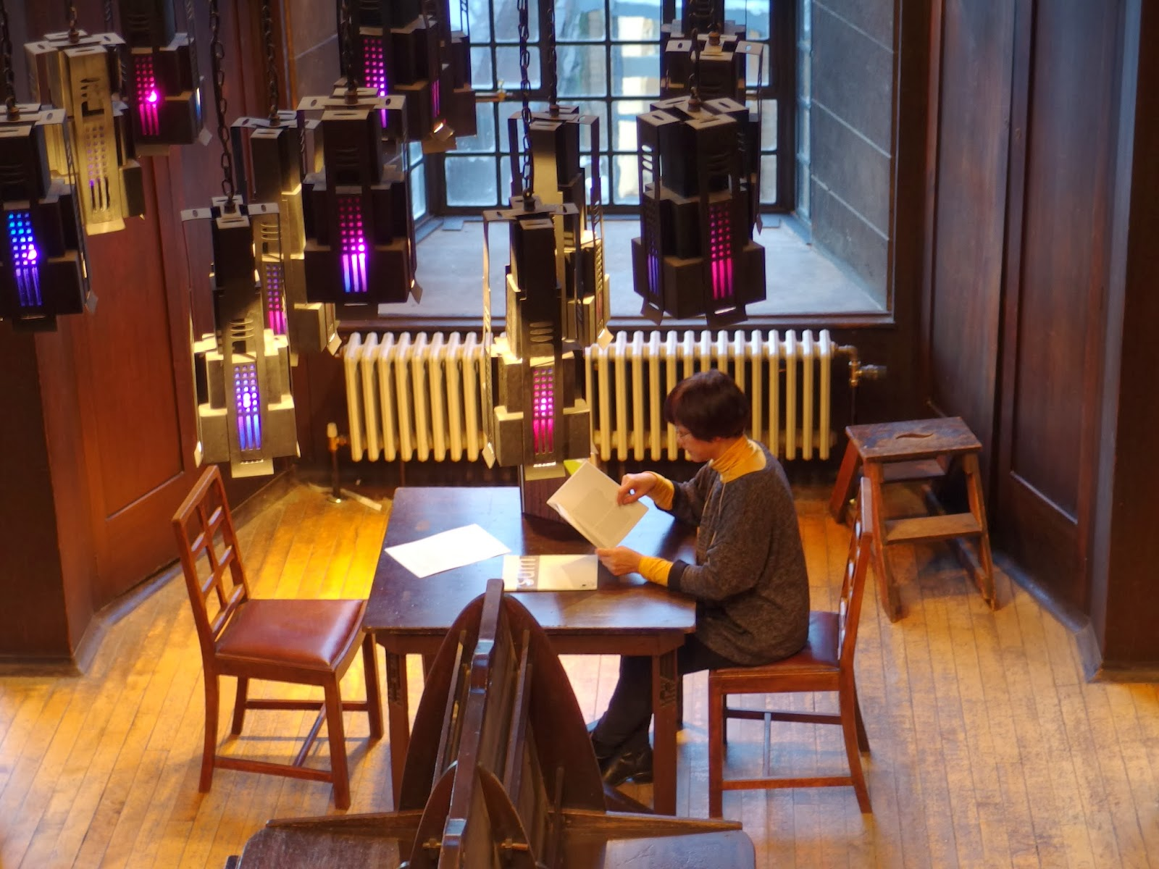
Notes:
Many of you will be aware that on the 23rd of May 2014, a devastating fire at the Glasgow School of Art totally destroyed the world-famous Mackintosh Library and its important historical collections.
One of the most important and widely recognised library spaces in the world, it was designed by Charles Rennie Mackintosh between 1907 and 1909 as part of the second phase of the Art School building.
It was generally accepted as one of the finest Art Nouveau interiors internationally, and any visitor to the space could not help but be moved by its architectural and aesthetic beauty…
…From its hand-painted balusters to its pierced wooden pendants, and from its coloured-glass hanging lamps, to its original tables, Windsor chairs and periodicals desk.

Slide 4
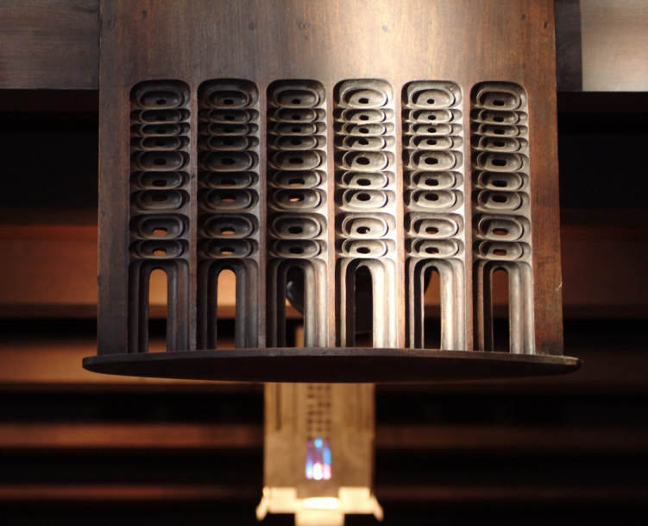
Notes:
Balcony pendant

Slide 5
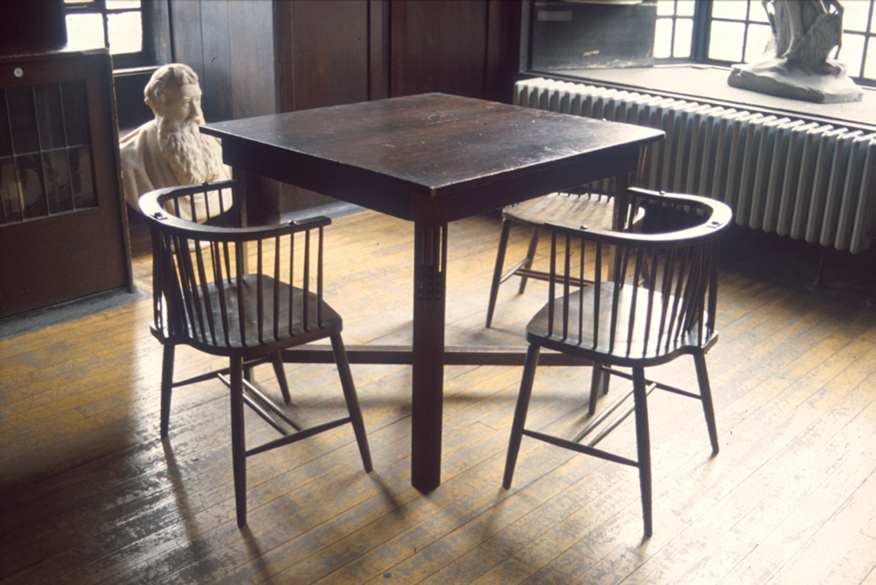
Notes:
Original Windsor chairs with table, the latter with pendants to reflect those above at balcony level.

Slide 6
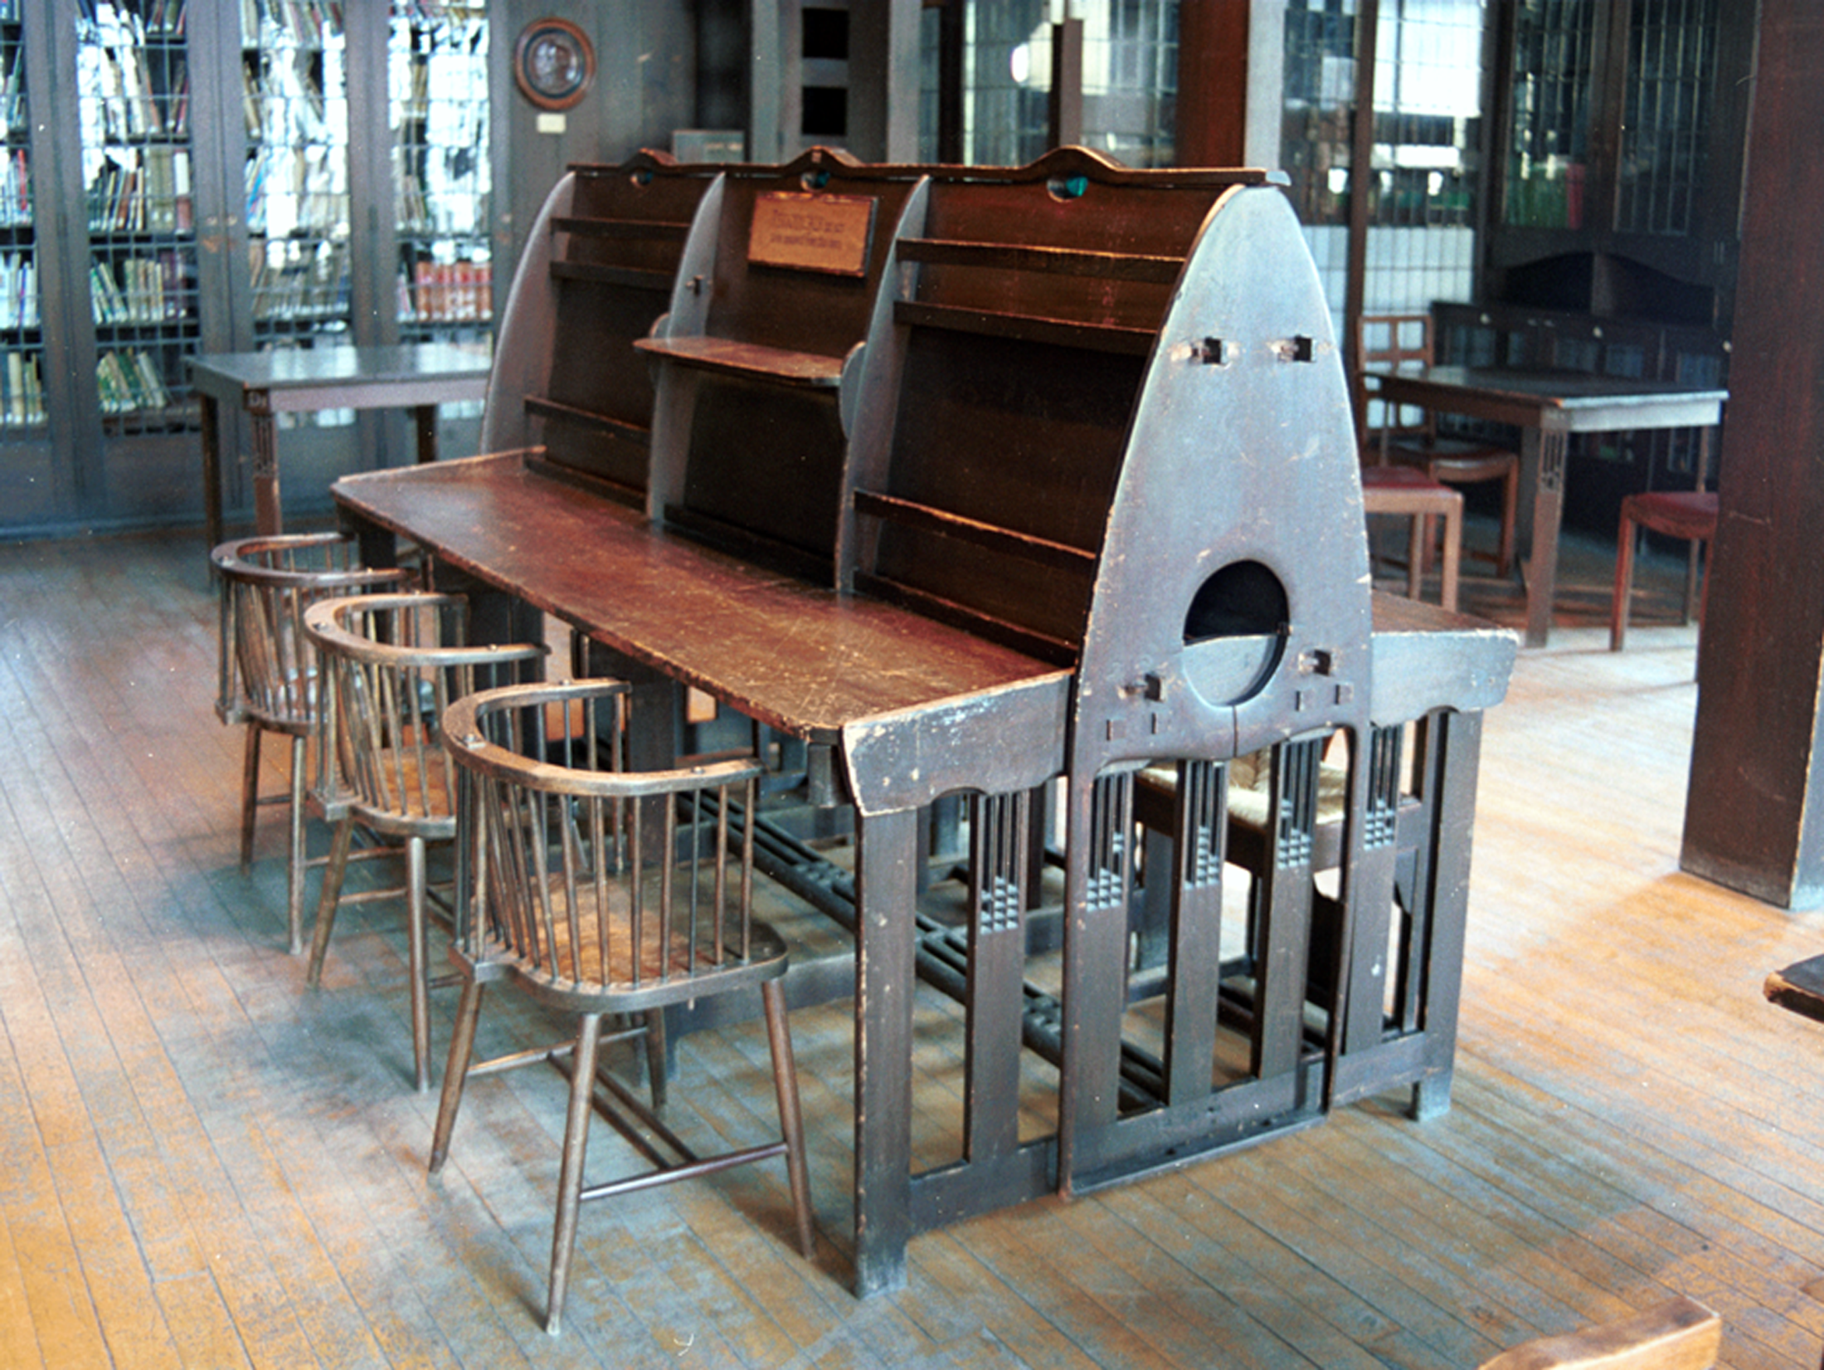
Notes:
Periodicals desk and chairs

Slide 7
Notes:
An early image of the library soon after completion from our Archives

Slide 8
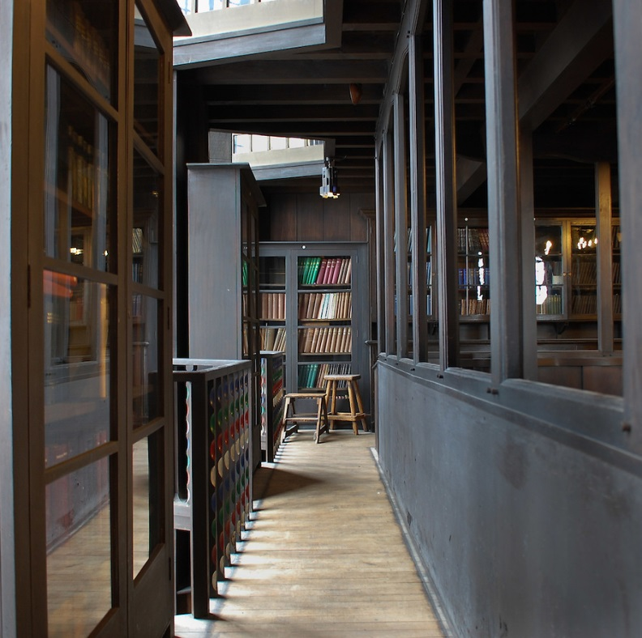
Notes:
Writing on the symbolic allusions of Mackintosh’s design, James Macaulay, in his authoritative 1993 Phaidon account of the building , states “…the library of the Glasgow School of Art is not only an aesthetic experience but the translation of philosophical thought into three dimensions.”
(what books are there on the architecture of the space)
The building as a whole has been described by Sir Christopher Frayling, Rector of the Royal College of Art, as “the only art school in the world where the building is worthy of the subject...this is a work of art in which to make works of art”.
As an architectural space, the Library was built across 3 levels, comprising a ground floor, a mezzanine balcony (which can be seen here) running along all four sides, and a bookstore above (latterly used as a furniture store).
Nearly all the wood employed in the design is oak.
Mackintosh employed some innovative and unusual engineering solutions when constructing these spaces.
The bottom levels were hung from two large cast-iron cross-beams in the store, with hangers dropped through subsequent levels and encased in oak to form dummy columns.
The columns themselves were therefore non-supportive, with all load-bearing undertaken by the cross-beams and hangers.
At ground floor level the dummy columns formed a nave-and-aisle plan, though the space itself was square rather than rectangular.

Slide 9
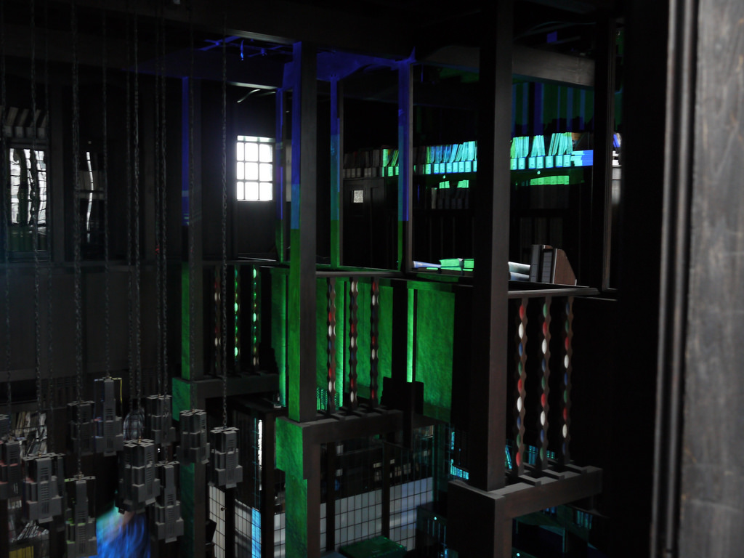
Notes:
You can perhaps gain a better sense of this interrelation of levels in this photo, which shows digital light interventions staged by our Digital Culture students earlier this year.

Slide 10
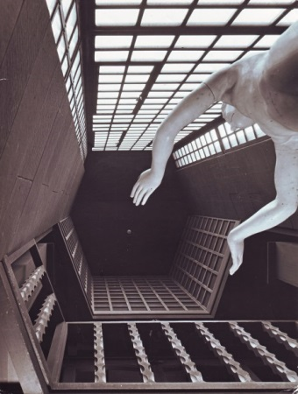
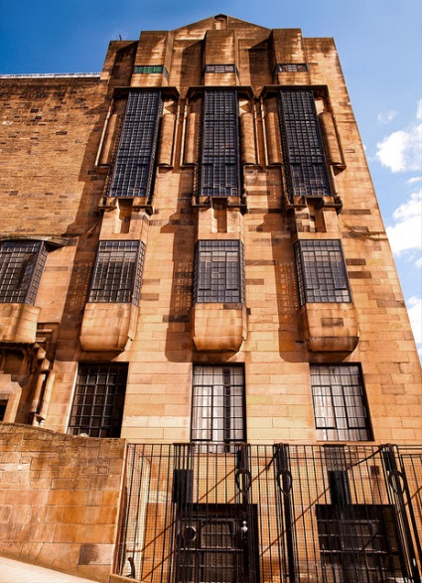
Notes:
Meanwhile, on the west façade, hexagonal voids allowed massive glazed windows to rise up through all three levels, increasing the light available to the space.
Macaulay has compared these vast windows to those at York Minster

Slide 11
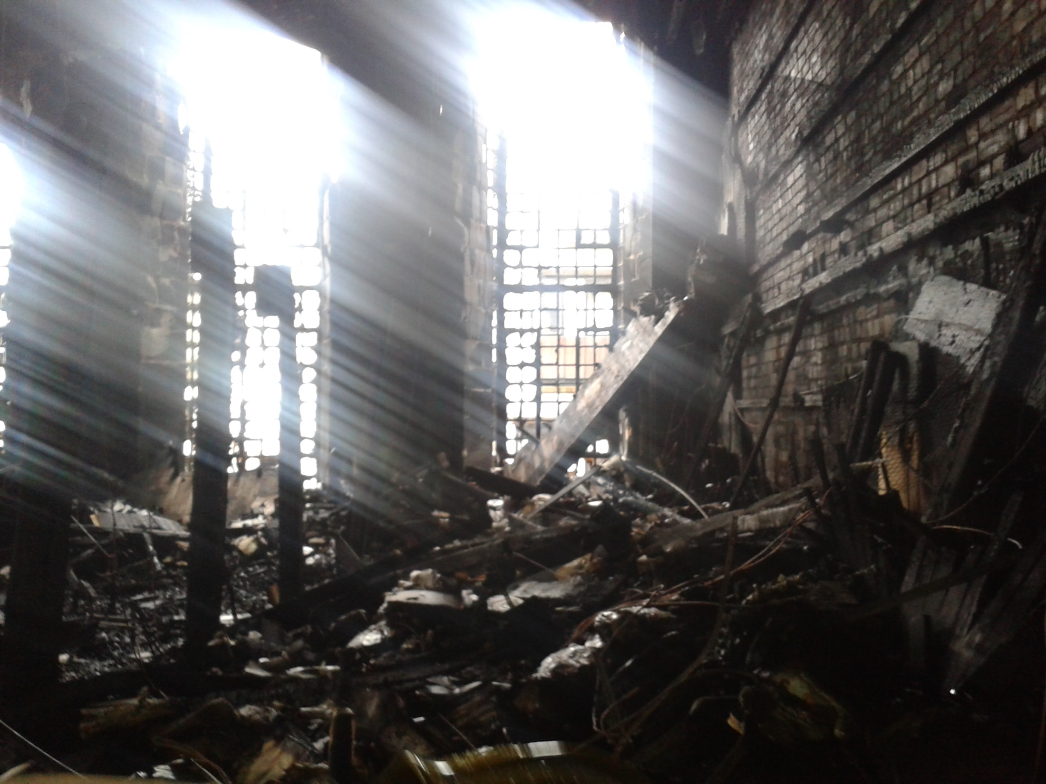
Notes:
Unhappily, On 23 May 2014 all these spaces were destroyed by fire.
These photographs of the destroyed library spaces were taken two days after that fire.
They were taken with a camera phone, so the resolution is very low, but it will give you a good indication of the extent of the devastation.
The remains of the dummy columns can be seen on the left
To the right, the ferocity of the fire is evidenced by how the wood facing has been completely stripped back to bare brick

Slide 12
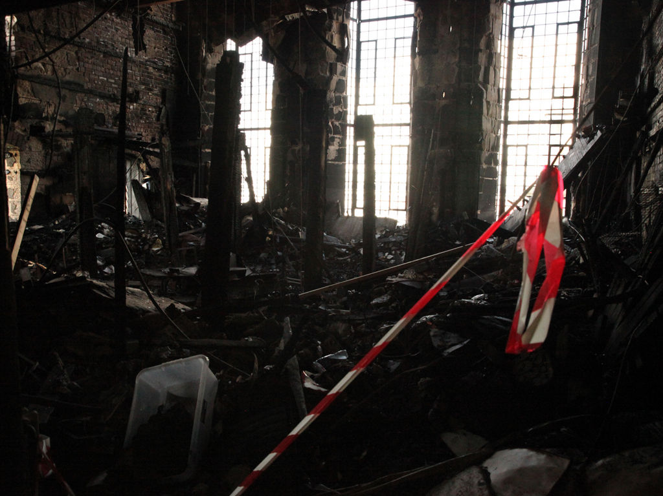
Notes:
Another view of the devastation, looking towards the west windows.
You can see that the former mezzanine level has completely collapsed down onto the ground floor.

Slide 13
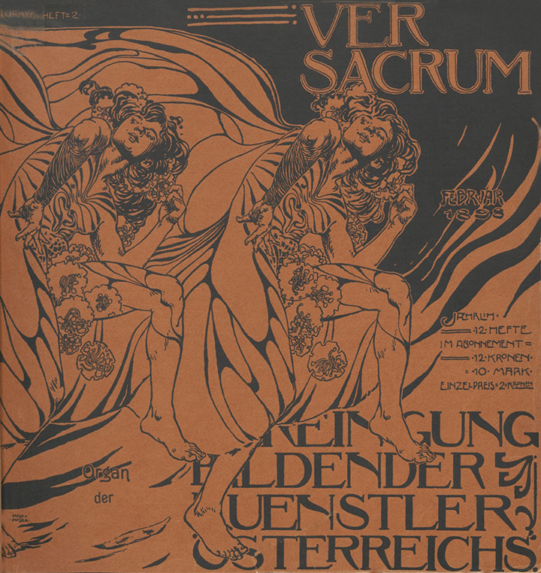
Notes:
But of course any historic library is more than just an architectural space.
We also lost many treasured irreplaceable collections in the fire, including books dating to the 16th century and 19th century illustrated books by our former staff and alumni
Ver Sacrum was the official magazine of the Vienna Secession and means 'Sacred Spring‘
It featured drawings and designs in the Jugendstil style by artists such as Josef Hoffmann and and Koloman Moser, along with literary contributions from distinguished writers from across Europe
The Vienna Secession was formed in 1897 by a group of painters, sculptors and architects, with its first president as Gustav Klimt.
These artists objected to the prevailing conservatism of officially-sanctioned art at the time, with its emphasis on historicism. Instead they invited artists such as the Impressionists to exhibit.

Slide 14
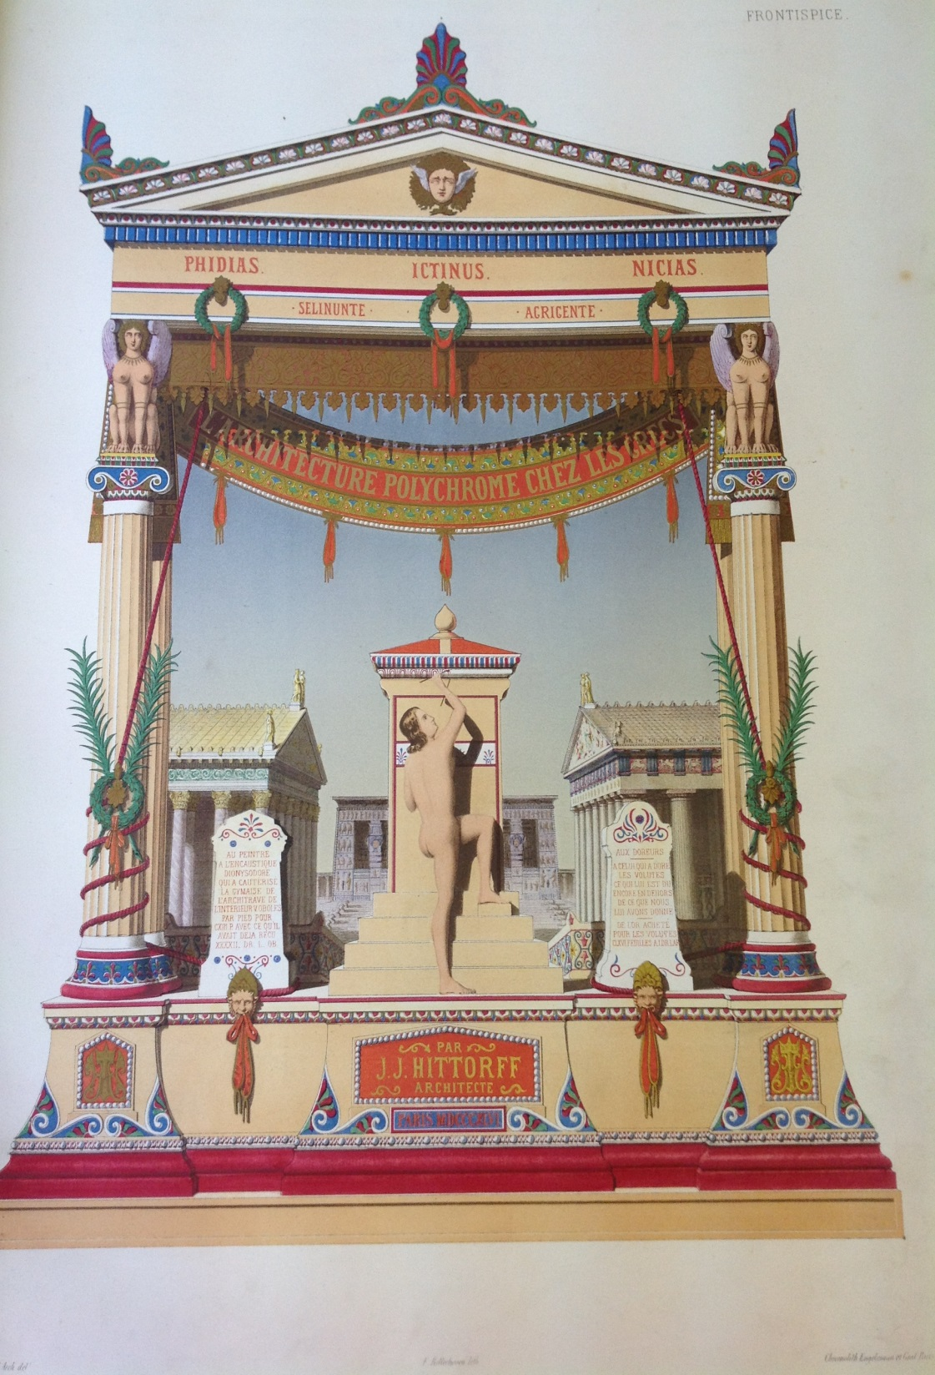
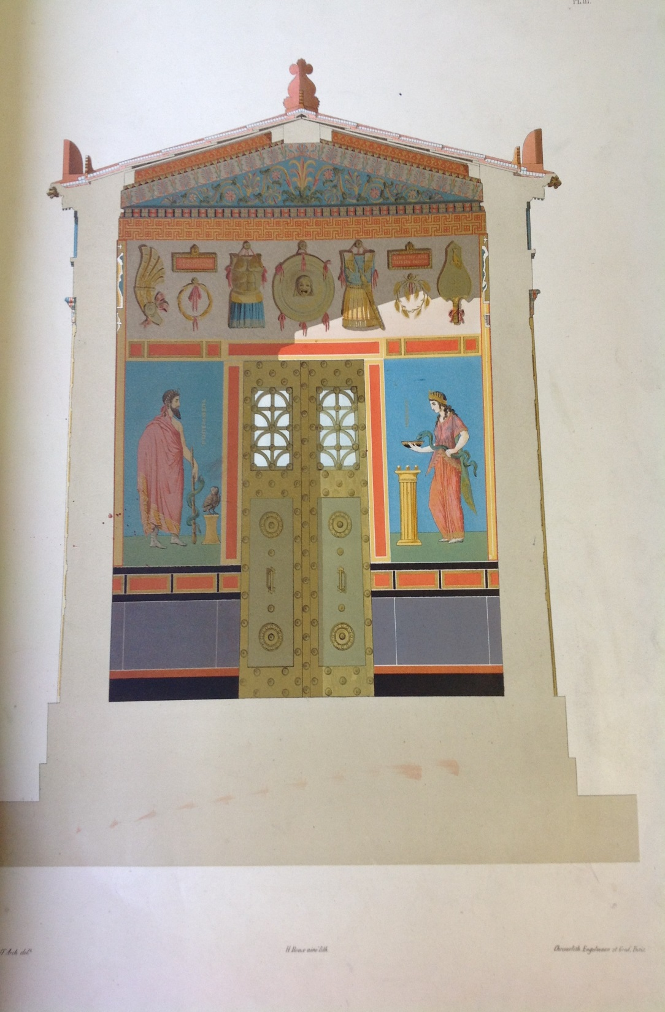
Notes:
Restitution du temple d'Empedocle a Selinonte, ou, l'Architecture polychrome chez les Grecs by Jacques Ignace Hittorff, Paris, 1851
Hittorff was a German-born architect who combined advanced structural use of new materials, notably cast iron, with a conservative Beaux-Arts classicism
One of his important discoveries was that colour had been employed in ancient Greek architecture, a subject that he discusses in this volume.
In accordance with the Greek doctrine he often made colour an important feature in many of his architectural designs.
He was also a member of the committee formed in 1836 to determine whether the Elgin Marbles and other Greek statuary in the British Museum had originally been coloured.
Their conclusions were published in Transactions of the Royal Institute of British Architects, 1842

Slide 15
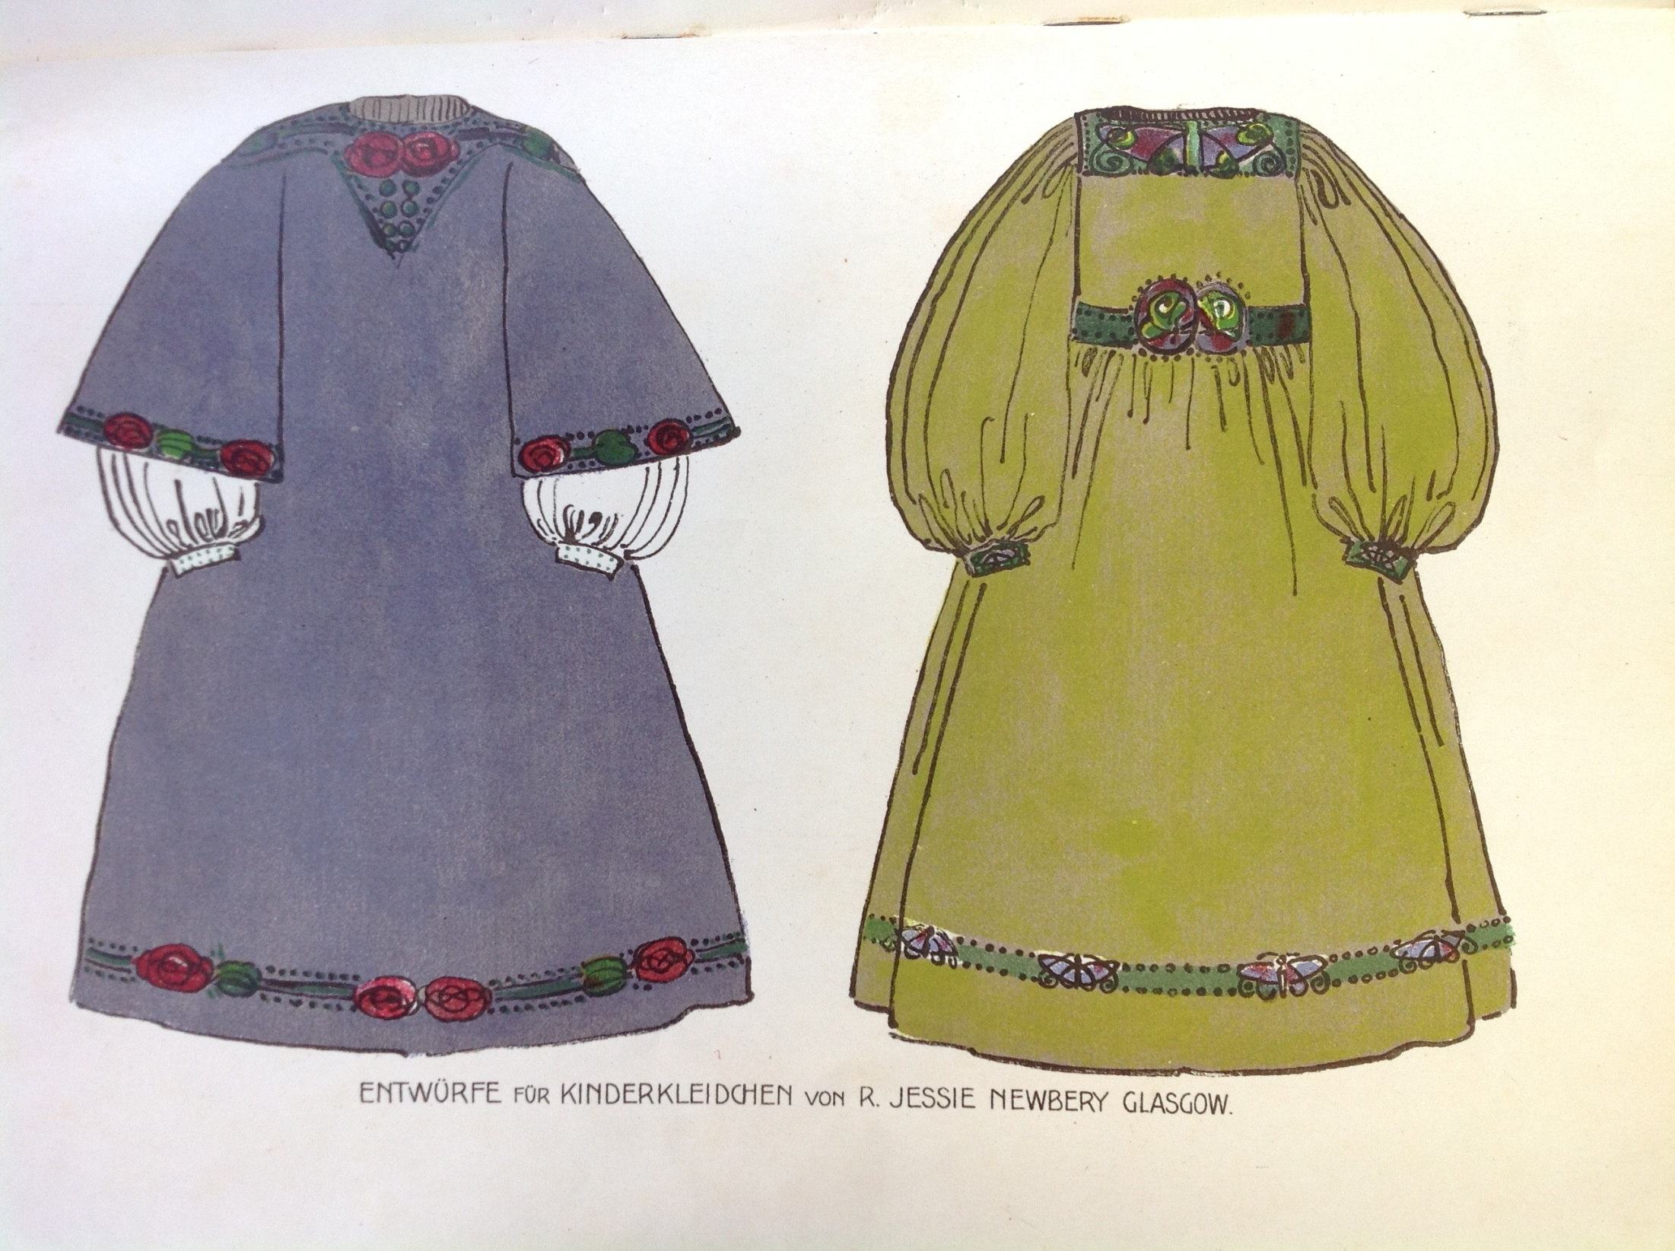
Notes:
Moderne Stickereien (19--), Darmstadt, Alexander Koch
Smocks by Jessie Newbery in the Artistic Dress style
Artistic Dress describes clothing that was produced for everyday use, designed in accordance with contemporary art principles, intended to challenge fashion, and considered a work of art in and of itself.
Emphasis was placed on the rejection of the heavy, restrictive Victorian fashions of the day.
The movement was also political in its aims and part of wider societal moves to liberate women in the public and private spheres.
Muthesius herself encouraged women to design their own clothing so that “every woman clothes herself as her particular personal style requires.
The resulting dress will be an artistic reform of women’s attire.”
Jessie Rowat Newbery was born in 1864 to a Paisley shawl manufacturer who subscribed to radical politics and who fully supported education for women.
She attended Glasgow School of Art from 1884-1888, marrying its Headmaster Francis Newbery in 1889.
She later taught at the School, establishing embroidery classes in 1894.
Her avant-garde milieu, textiles training and radical politics meant that she found a perfect outlet in the artistic dress movement.
Our copy of this book came from Newbery’s own collection at Corfe Castle.

Slide 16
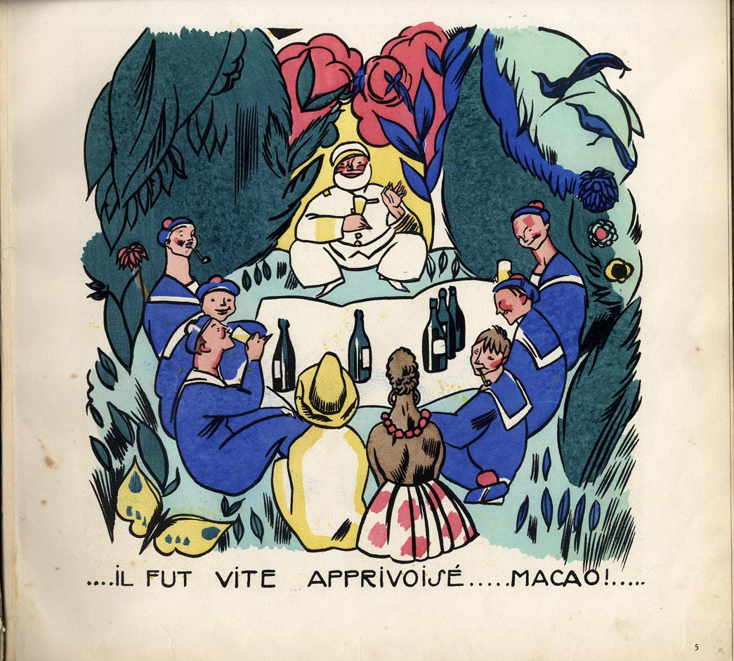
Notes:
Macao et Cosmage: ou l'experience du Bonheur by Edy-Legrand (1892-1970), Paris, Nouvelle Revue Francaise, 1919
Illustrations in full-colour pochoir, reflecting the influence of Fauvism and jazz.
Completed when the artist was just 18.
Edy-Legrand was born near Bourdeaux.
After finishing his studies at the École des Beaux Artes in Paris and the Art Academy in Munich, Edy-Legrand lived and worked primarily as an illustrator for the Tolmer publishing house in Paris.
Starting in 1933, he travelled extensively throughout Europe and North Africa, and several longer stays in Morocco strongly influenced the motifs in his works

Slide 17
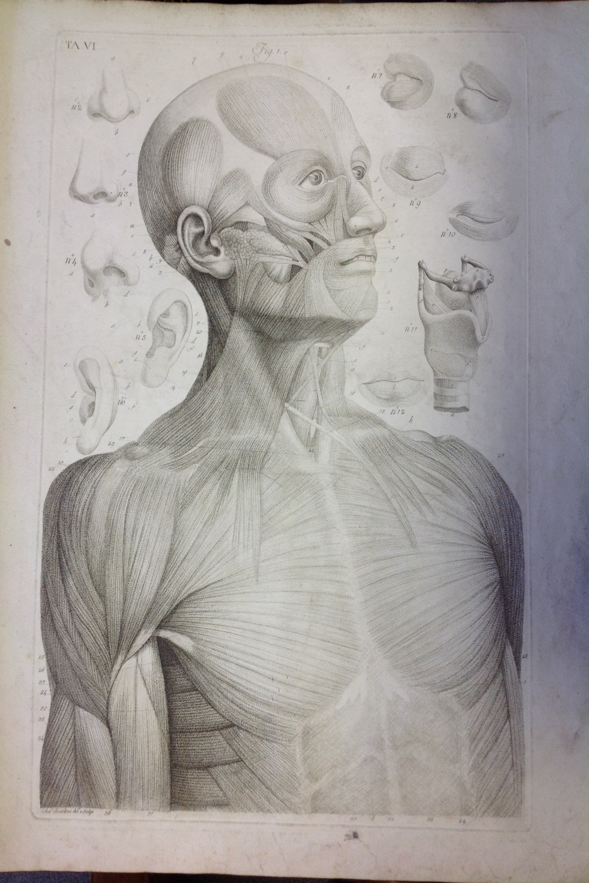
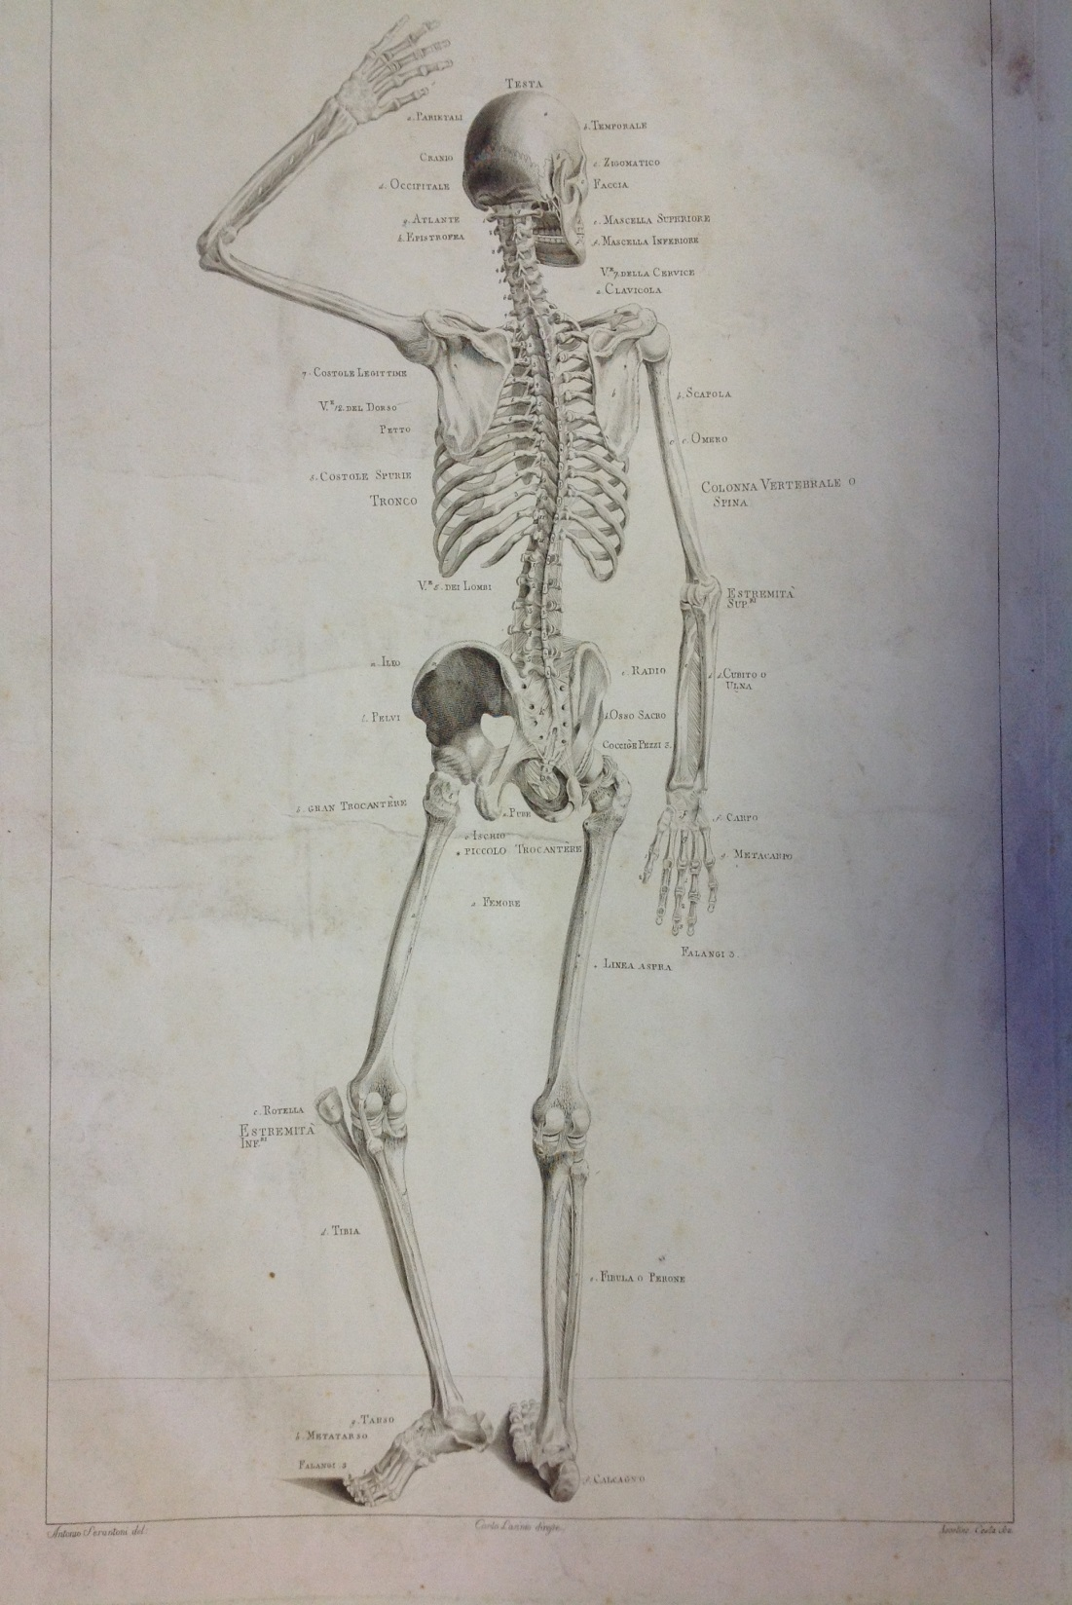
Notes:
The Library held an 1816 copy of Paolo Mascagni’s Anatomia per uso degli studiosi di scultura e pittura, published in Florence a year after the author’s death and dedicated to Ferdinand III, Grand Duke of Tuscany.
The volumes features 15 engraved plates of the human body and its anatomy, and was designed to be used by students of painting and sculpture.
It was only the 19th book to be purchased for the library collections, appearing in the original inventory of the library.
Mascagni studied anatomy in Siena before graduating in 1778.
In 1780 he became assistant to his anatomy master Tabarrini before being elected to the Royal Swedish Academy in 1796.
In 1801 he was appointed Professor of Anatomy at the University of Pisa by the King, before subsequently moving to the University of Florence.
Throughout his studies he employed artists to make wax models of his discoveries.
He died in 1815 and today a statue of him stands in the courtyard of the Uffizi, Florence.

Slide 18
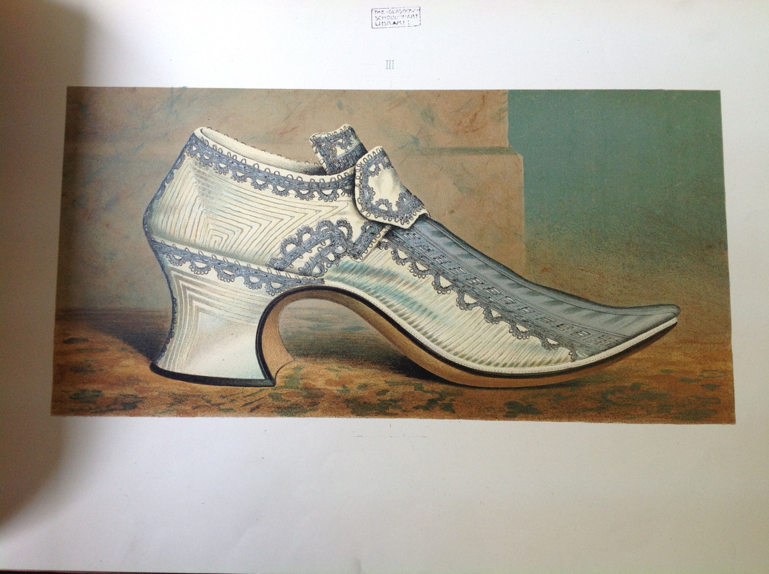
Notes:
Ladies' old-fashioned shoes by Thomas Watson Greig (d.1912) of Glencarse, Edinburgh, David Douglas, 1885

Slide 19
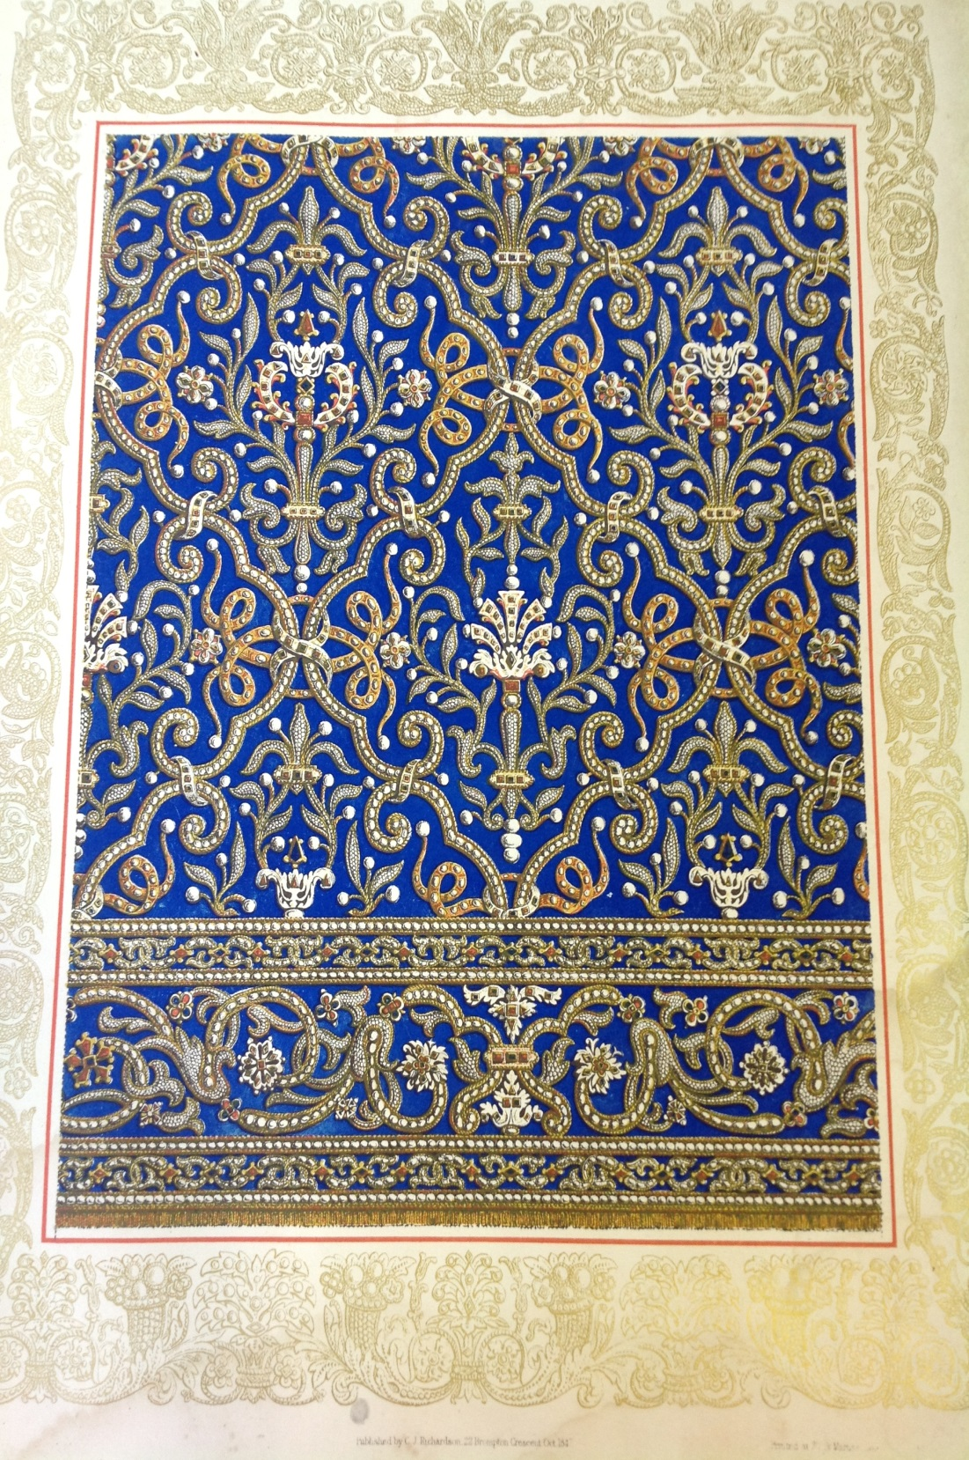
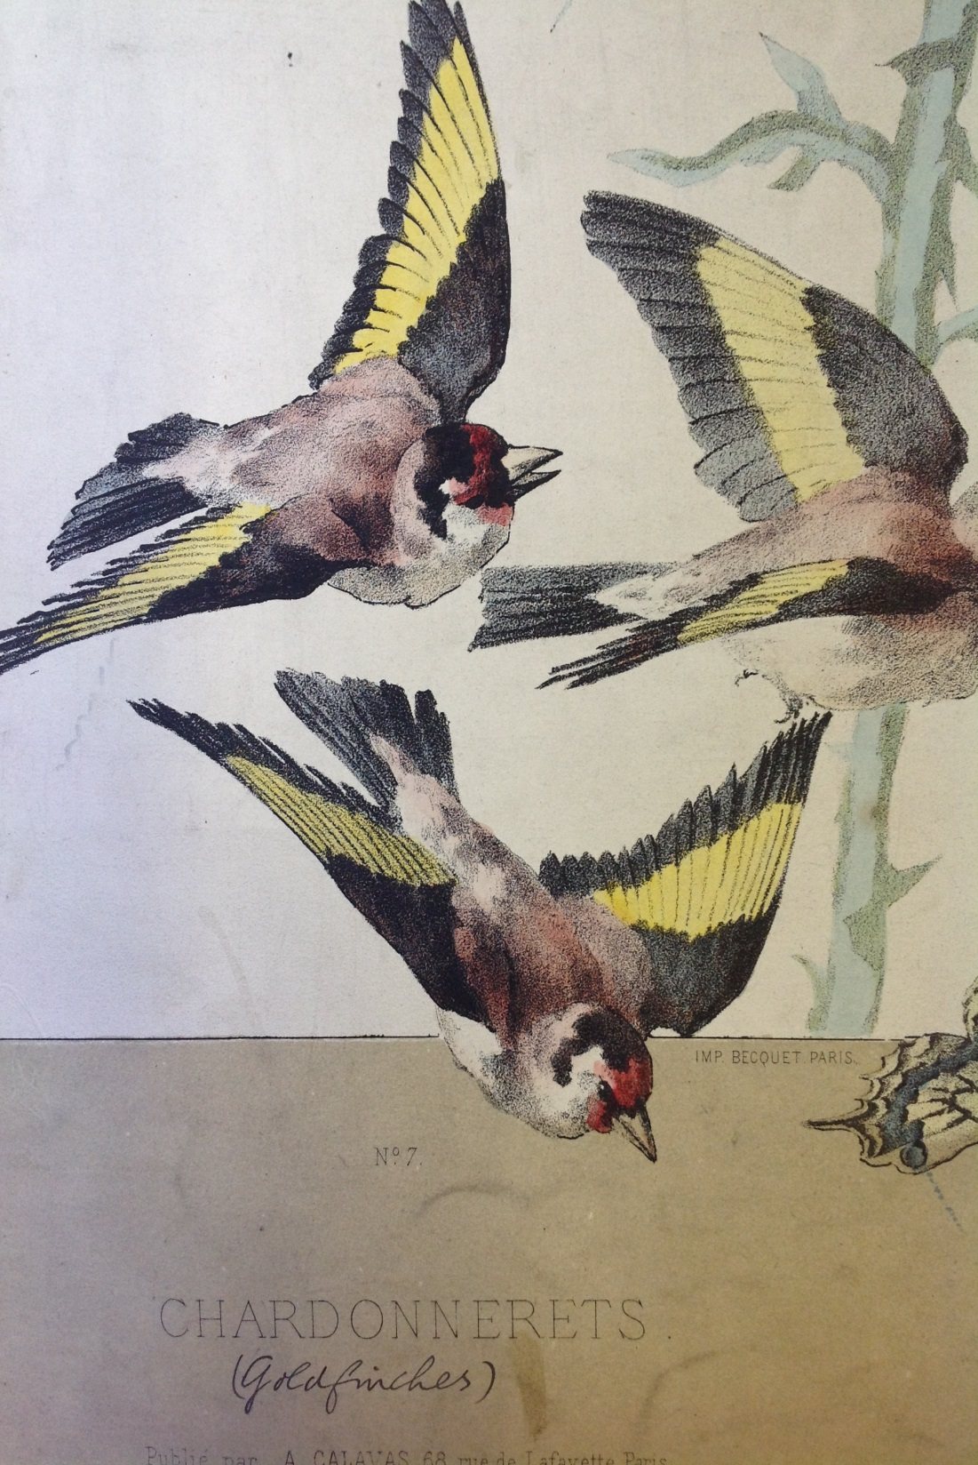
Notes:
Studies of Ornamental Design by Charles James Richardson (1806-1871), London, John Weale, 1851
Richardson was an architect and pupil of Soane, who worked across an eclectic number of styles and is nowadays often dismissed as derivative
Les Oiseaux by Joseph Carl Paul Schuller (ca.1880-1920), Paris, A. Calavas, 1880

Slide 20
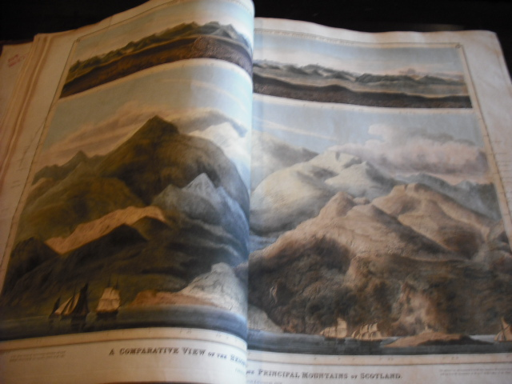
Notes:
John Thomson’s Atlas of Scotland, or County Atlas, Edinburgh, 1831
Thomson, an Edinburgh booksellers had already produced a series of travel guides before he launched a subscription service for the maps in his Atlas in 1818
It was published in parts and finally collated in 1831
His atlas consists of maps of all the counties of Scotland on a very large double-folio scale, compiled from actual surveys on the ground and “forming the most complete series of county maps ever published”.
Thomson was particularly proud that “the accuracy of each county in attested by at least four respectable names.”
Our copy, with a dedication to the Earl of Hopetoun, was published in 1831 by the Trustees of Thomson’s estate.
It includes 29 colour plates, some double-fold. To the front are two spectacular colour plates showing the comparative heights of mountains and lengths of rivers.
Such was the cost of his endeavour, that Thomson was declared bankrupt twice

Slide 21
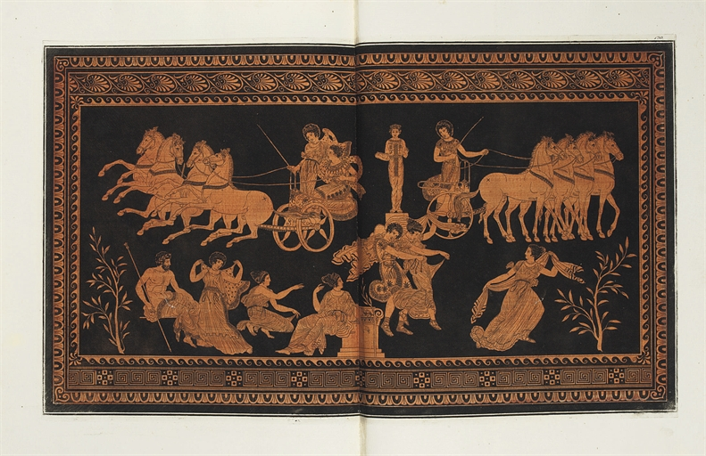
Notes:
Collection of Etruscan, Greek, and Roman antiquities from the cabinet of the Honorable Wm Hamilton, his Britannick Majesty’s envoy extraordinary and plenipotentiary at the court of Naples, Naples, 1766 and 1767.
These impressive volumes contain engraved frontispieces with terracotta washes and silvered hand-colouring
Most engravings are unsigned, but some of those in volume 2 are signed respectively G. Bracci, Edmondo Beaulieu, C. Pignatari, Ant. Cardon, and Car. Nolli.
The text is by Pierre d’Hancarville.
An amateur art dealer, d’Hancarville introduced William Hamilton, British Ambassador at Naples, to the Porcinari family, whose collection of antiquities Hamilton bought, and subsequently sold to the British Museum in London.
The antiquities shown and discussed in these volumes are nearly all ancient Greek vases, collected from Herculaneum, Pompeii and other parts of south Italy and Greece.
Hamilton intended this collection of vases not only to provide models for contemporary designers but also, because of their great number, to help in tracing the historic development of the ‘stiles of the different periods in the Art of the Ancients’.

Slide 22
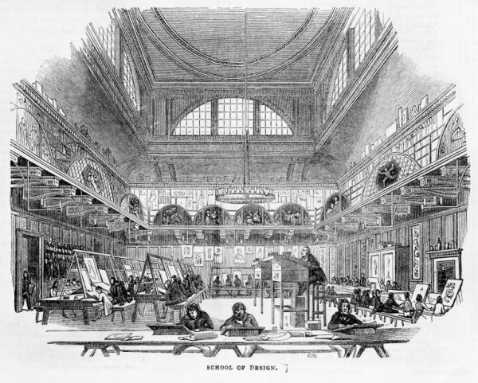
Notes:
Many of these lost volumes were from the School's Foundation Collections, which came to us from the then South Kensington Museum under the South Kensington system of arts education
In 1835 the Select Committee on Arts and Manufactures reported on why Britain’s commercial and industrial products were failing to compete with foreign imports and, in turn, not finding foreign markets of their own.
Their final Report recommended, amongst other things, that the country should seek “the best means of extending knowledge of the arts and the principles of design among the people (especially the manufacturing population of the country)”.
In reaching their recommendations the Committee had taken evidence from Dr Gustav Friedrich Waagen (1794-1868), then Director of Berlin’s Royal Museum, who had spoken of the Prussian Kunstgewerbeschule, founded in the city in 1821, which provided drawings classes, workshops, plaster casts and (notably) a library to educate the future designer-craftsman.
The Select Committee hence recommended that a UK-wide network of Government Schools of Design be established.
The first such School, in London, was established in 1837 in Somerset House on the Strand.
Henceforth the number of Schools increased exponentially; in 1843 six were in existence, but by 1869 one hundred and seven has been established.
A Government School of Design in Glasgow is first proposed by the Board of Trade in 1841.
The Glasgow School of Art opens 6 Jan 1845 as one of these Government Schools of Design.
It was originally managed, as were the other Government Schools, by the Board of Trade and a Committee of Management representing local subscribers.
Then, in 1852, the Government Schools of Design were taken over by the Department of Practical Art, which had benefited substantially from the Great Exhibition of 1851, part of the profits of which were distributed by the Commissioners of the Great Exhibition for educational purposes.
This Department was renamed the Department of Science and Art in 1853 and was located in South Kensington, London
Its first Superintendent was Henry Cole, and it supported not just science but also "practical arts" i.e. technology and design.
In 1856 the Science and Art Department was absorbed by a new Education Department, but retained considerable autonomy in promoting artistic and scientific higher education, especially for teacher training

Slide 23
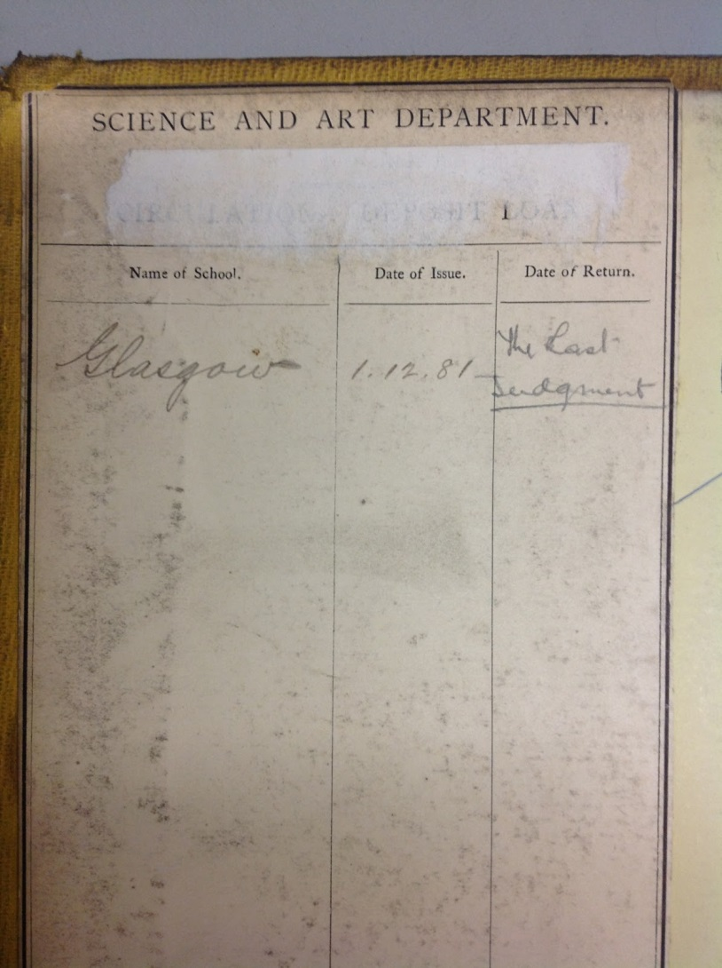
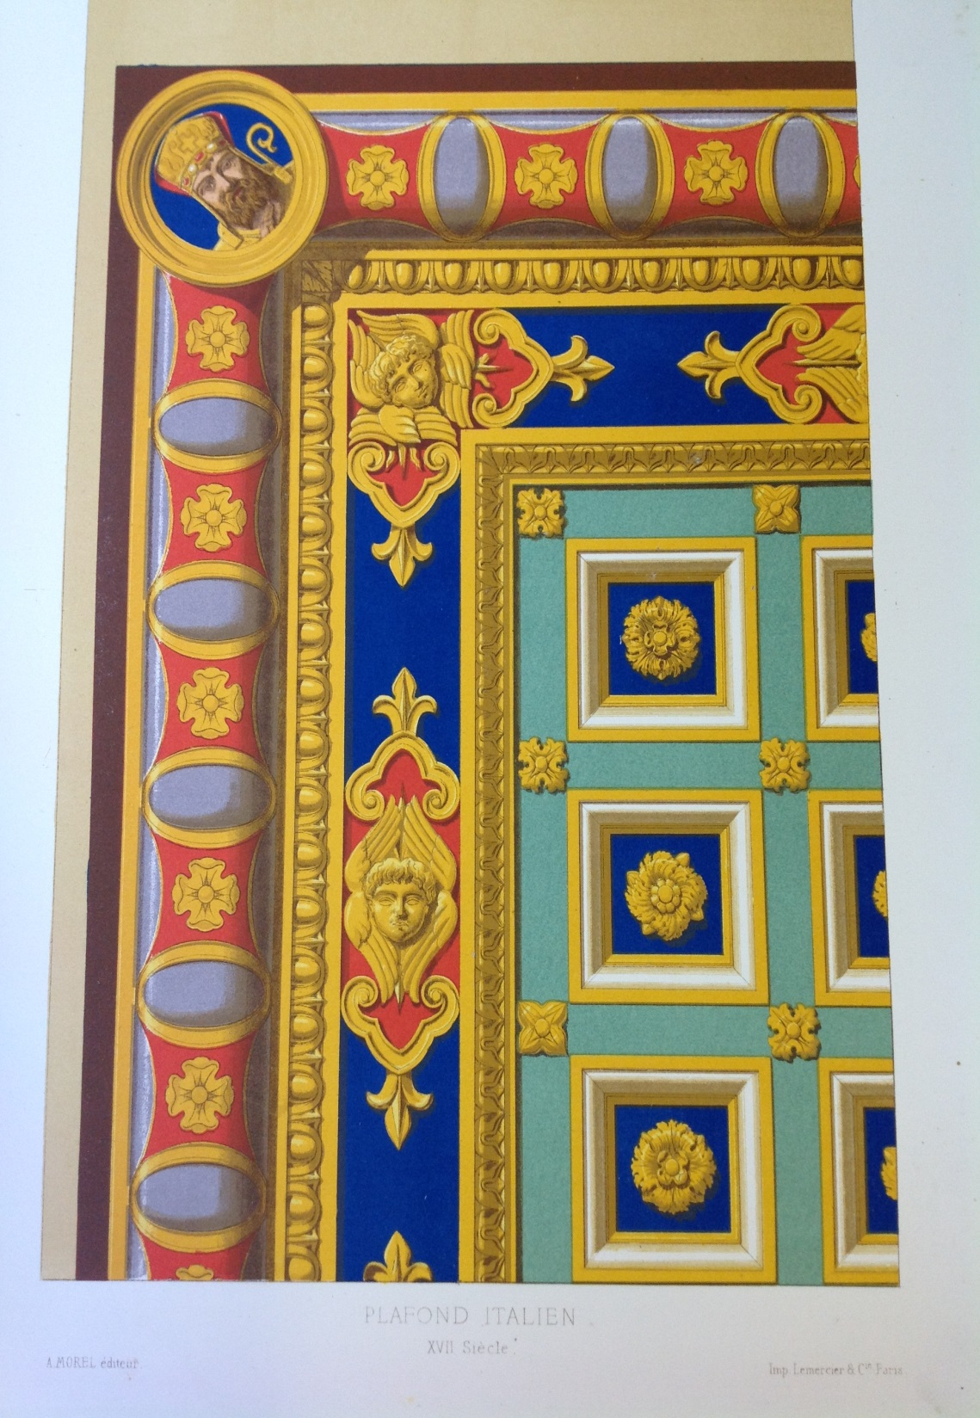
Notes:
Up until 1900, Glasgow School of Art followed the National Course of Instruction laid down by South Kensington system.
This system prescribed 23 stages, including linear drawing, freehand drawing, flat pattern, anatomy, painting of ornament, painting from nature, modelling, and applied design
Students progressed slowly from freehand outline from the flat copy, and subsequently three-dimensional object to shading from the flat and then the round – all using examples of historic ornament – until in the latter stages the student was allowed to work from life or nature.
South Kensington centrally distributed many of the resources required by the Schools under its charge, including books
Thus many of the older and rarer books in GSA Library contain bookplates from the Department of Science and Art, noting the deposit of these books with the Glasgow School of Art.
In stating the date of deposit they provide us with useful information on when individual titles entered our collections, and can therefore shed light on the curriculum of the time and the subjects being taught
Most of these volumes retained their original circulation plates, noting when they were deposited at the Glasgow School, and when they were due for return to London
In reality, most volumes were lodged in perpetuity
Motifs de decoration: cinquante planches inprimees en couleur extraites du journal-manuel de peintures, Paris: A. Morel, [18--]

Slide 24
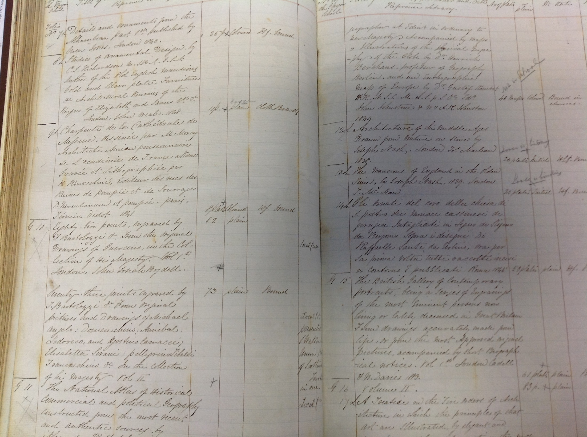
Notes:
Most of the volumes from these Foundation Collections are recorded in our very first catalogue, now held in our Archives and Collections, bound with other inventories in a single volume
The catalogue contains two library inventories, one for a reference library and one for a lending library (the 1849 AR mentions both these)
Many of the earlier entries appear to be in the hand of headmaster Charles Heath Wilson, with CHW appearing alongside the entries.
Later entries in the catalogue are in other hands, and generally lack the detail of Wilson's entries.
Charles Heath Wilson (1809–1882) was an Anglo-Scottish art teacher and author
He was the eldest son of Andrew Wilson, the landscape-painter and studied art under his father, and in 1826 accompanied him to Italy.
After seven years, Wilson returned to Edinburgh, where he practised as an architect, and was for some time teacher of ornament and design in the school of art.
In 1835 he was elected Associate of the Royal Scottish Academy
Charles Heath Wilson was appointed headmaster in November 1848 and commenced work in January 1849
In 1869 Wilson and his family left Scotland and settled at Florence, where he was involved with a large literary and artistic circle
For services to art, the cross of the Corona d'Italia was conferred upon him by Victor Emmanuel II of Italy

Slide 25
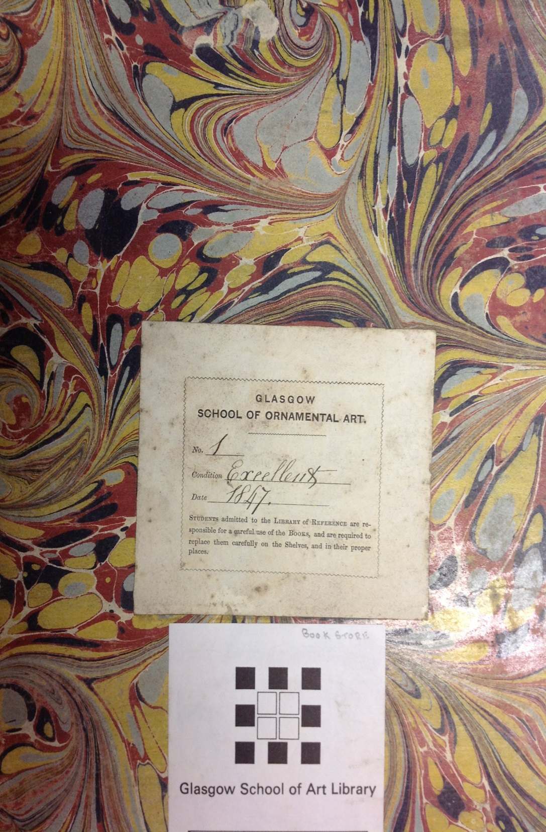
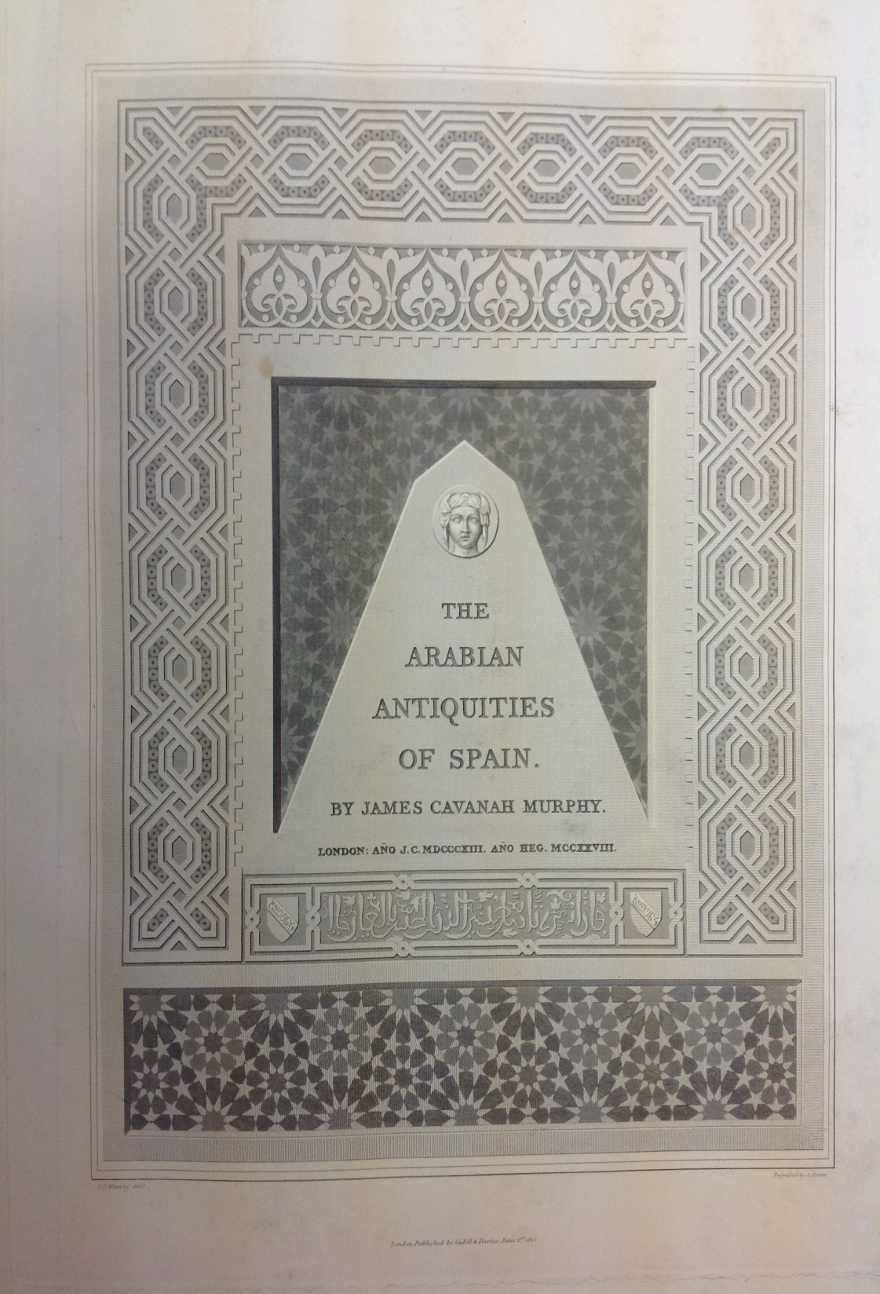
Notes:
Each volume is assigned an accession number in the inventory, and these numbers often still appear in manuscript towards the front of the physical volumes.
Entries in the inventory are undated, but the first book to be accessioned into the catalogue is still held by the Library and continues to bear its original bookplate with an 1847 date of deposit.
It is the Arabian antiquities of Spain by James Cavanah Murphy, London, 1813
Murphy was born in Cork and was originally a bricklayer.
He made his way to Dublin to study, and his name appeared in a list of the pupils of the drawing school of the Dublin Society about 1775, as working in miniature, chalk, and crayons
In 1802, he went to Cadiz, where he remained for seven years studying Moorish architecture, with some diplomatic duties.
Settling again in England in 1809, he spent his time preparing his notes on Moorish architecture for the press, but died on 12 September 1814 when only part of his major book had been published.
^{The} survival of this book is particularly miraculous:
It was in fact housed in the Mackintosh Library, but had been temporarily moved to the Librarian’s Office just a few days before the fire for recataloguing

Slide 26
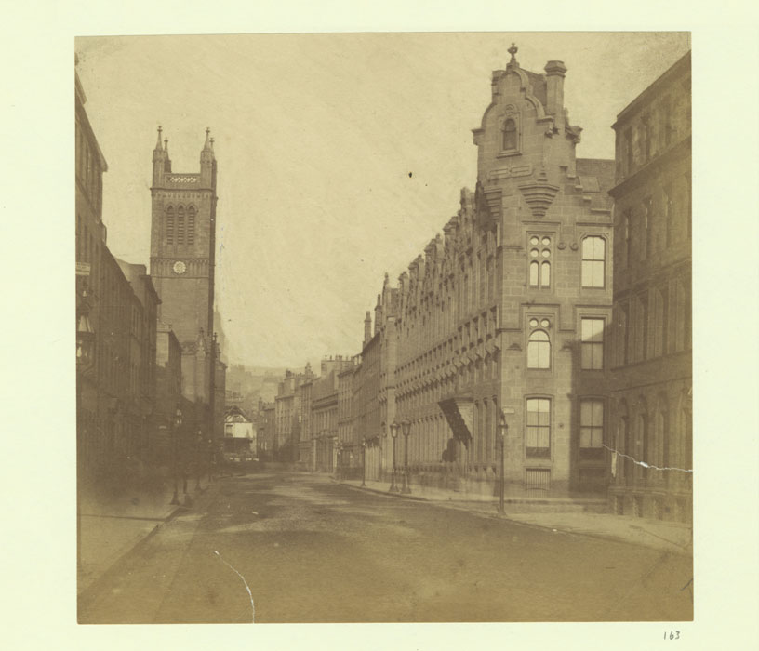
Notes:
The 1849 Annual Report mentions a library for the first time - 4 years after School was founded
"Arrangements have also been made for making the valuable Works in the Library of Reference accessible to Designers, for whom a commodious apartment, comfortably furnished, has been appropriated, where they may study four days in the week, from 7 to 9a.m., and from 6 to 10 p.m. from the Books of Engravings contained in the Library."
The following year the Annual Report mentions the library again: ""The students are encouraged to study in the lending Library, and also in that of reference, for which sixty-three tickets have been issued to well-conducted and deserving students, and Designers who are not students.“
A charge was probably levied. No membership ledgers or visitors books remain.
At this time, the School was housed in premises at 16 Ingram Street, at corner of Montrose Street
The building was constructed around 1805 for commercial use and was designed by architect David Hamilton
The view of Ingram Street dates to 1858 and was photographed by Duncan Brown (GSA Archives)
After these early years, the library seems to have suffered from a sustained period of benign neglect.
Indeed, the next mention of the library does not occur until the Governors’ Minutes of 1885, when the School was housed in McLellan Galleries
At this point the Governors seem keen to rectify the situation
They are keen that the collections should be formally catalogued, with books only given out under supervision of a Librarian who would be responsible for proper conduct
(In fact a Librarian is not appointed until 1894)
The library had by this time reached a certain critical mass: by 1887 the library housed 600 volumes and included “many valuable works received either as gifts or on permanent deposit loans from the Science and Art Department, or earlier yet from the Board of Trade”
It is open during set houses, with the Ladies Luncheon Room (where would this have been in McLellan?) doubling up as a Reading Room
Primarily a reference resource, a small lending library had been established (presumably the previous lending library had been stopped) for which a small fee was levied
By 1888 it had recently been “thoroughly overhauled, arranged and catalogued” (by whom is not recorded) and consideration was being given to producing a printed catalogue (this seems not to have occurred)
In 1890 it was valued by Mr Forrester of Queen Street (who is this) at £1500 insurance (how much is this) and the Governors are keen that values are added to the catalogue

Slide 27
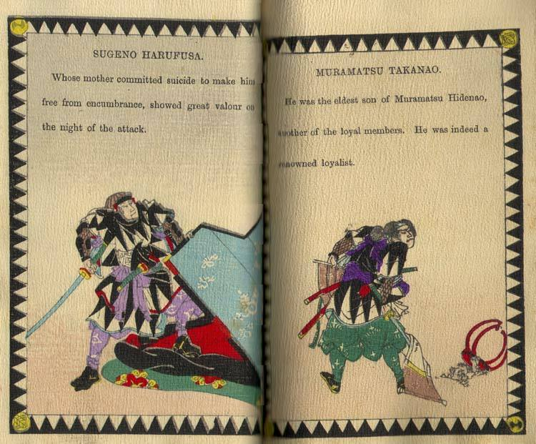
Notes:
During these early years, with no Librarian in post, the Governors and particularly the Headmaster played a key role in soliciting donations and gifts, and ultimately deciding what would be purchased
In 1885 Newbery (he became Director in this year) was presenting requests to the Governors to sanction the purchase of specific titles on design costing £10.2
In 1891, perhaps surprisingly for someone in his position, he is calling attention to the fact that “several valuable books in the Library require binding” and was asked by the Governors to make a thorough examination and get estimates for repairs
Also in 1891 the Governors grant him permission to purchase a few monthly art publications for use in the classes (do we know from inventory what these were)
Of particular note was the purchase in 1887 of a “series of books on Japanese art and design” to “give added value to the collection”
Newbery’s influence is clear
Much has been written on the influence of Japanese art and design on Mackintosh, who was enrolled as an evening class student from 1883-1894 (what in? what records do we have?)
Provide readings
Although the individual titles that were purchased at that time are not recorded, it is notable that we have particularly strong holdings of Japanese books of the period
The book, portraits of the forty-seven Ronins, was published in Yokohama the previous year
Might this decision to purchase these books at this period have proved particularly fateful for the future trajectory of Mackintosh’s career?

Slide 28
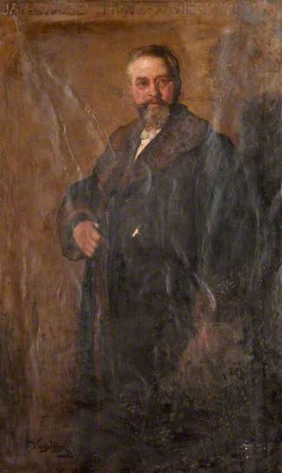
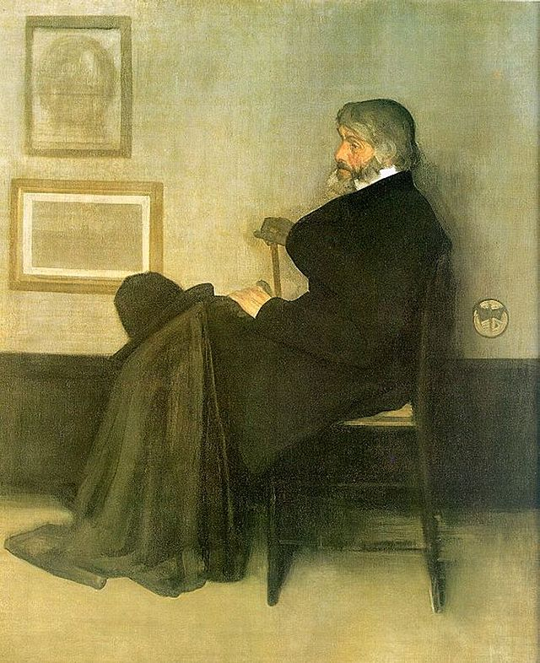
Notes:
The early 1890s signalled a new professionalisation of the library.
In 1893 Mr Salmon (William Forest? Was he a Governor at this time) was submitting plans to the Governors for a new reading room to replace that in the Ladies Luncheon Room
This seems to have been in preparation for the appointment of the School’s first librarian in 1894, 49 years after the foundation of the School and 9 years after Governors first discuss possibility (there is evidence of King being paid for library work ad hoc in 1893)
James Joseph Francis Xavier King (1855–1933) by David Forrester Wilson (Oil on Canvas, 1907, Hunterian)
Artist active between 1885 and 1891.
Exhibited two landscapes at the Glasgow Institute of the Fine Arts in 1885.
Among those who in 1891 appended their names to a list requesting that the Corporation of Glasgow buy JW's Arrangement in Grey and Black, No. 2: Portrait of Thomas Carlyle
He was also a noted entomologist and wrote several taxonomies of Neuroptera
Where are his archives kept
This was not a full-time role as we would understand it, and King’s qualifications for the role are suspect
His library duties were in on top of his teaching duties (he is noted as a “regular teacher in the ornament classes” and lecturer on geometry, perspective and plant form, GM 19 May 1902)
The Governors are clear that although they will grant him a one-off payment of £20 for work so far completed, his salary as it existed would cover his library work (they later back down)
This commences a whole series of toing and froing over a number of years with King calling for payment
After his appointment the library stock is overhauled, augmented and repaired, and a dedicated room set aside (in McLellan), with bookcases and tables
All this activity signals a marked reorientation of its purpose
It is no longer a kind of cabinet of curios for the diletanti, but is now very deliberately a resource to aid students in their particular studies
A new catalogue is thus prepared by King (assisted by John Dunlop, GM 21 Mar 1894) (no longer extant) to allow for recall and access
The following year in 1895 it is noted:
“The advantage of having a reading room in connection with the valuable library belonging to the School… has been very noticeable during the present and past sessions. The current Architectural and Art magazines are supplied (can we identify); new works are constantly being added”
To assist King, an assistant was also employed in 1894
Miss Jessie Mitchell (biog) was paid 1/6 a week for “serving out and taking in books and attending to the preservation of the library property”
In 1899 an Emily Russell (biog) was receiving 5 a week as an assistant and for “any office work required when not otherwise employed”
By 1900 the Governors were recommending that the library’s ‘girl assistant’ might be “utilised in working a type-writing machine and thus so far relieve the pressure of office work”
Her salary was raised to 7/6 a week in recognition
By 1909 the library assistant was also acting as a typist for the architectural department (this joined GSA in 1903) and for lectures. Paid 10/ a week (GM 7 July 1909)
In contrast, King’s role is defined (in 1902 GM) as comprising the “care of books, preparation of catalogue, binding books, delivering and reception of books to and from students, and any other relevant and incumbent duties” the whole to be done “in association and under the direction of the Head Master”
In Feb 1914 a Miss Minns is listed as Assistant

Slide 29
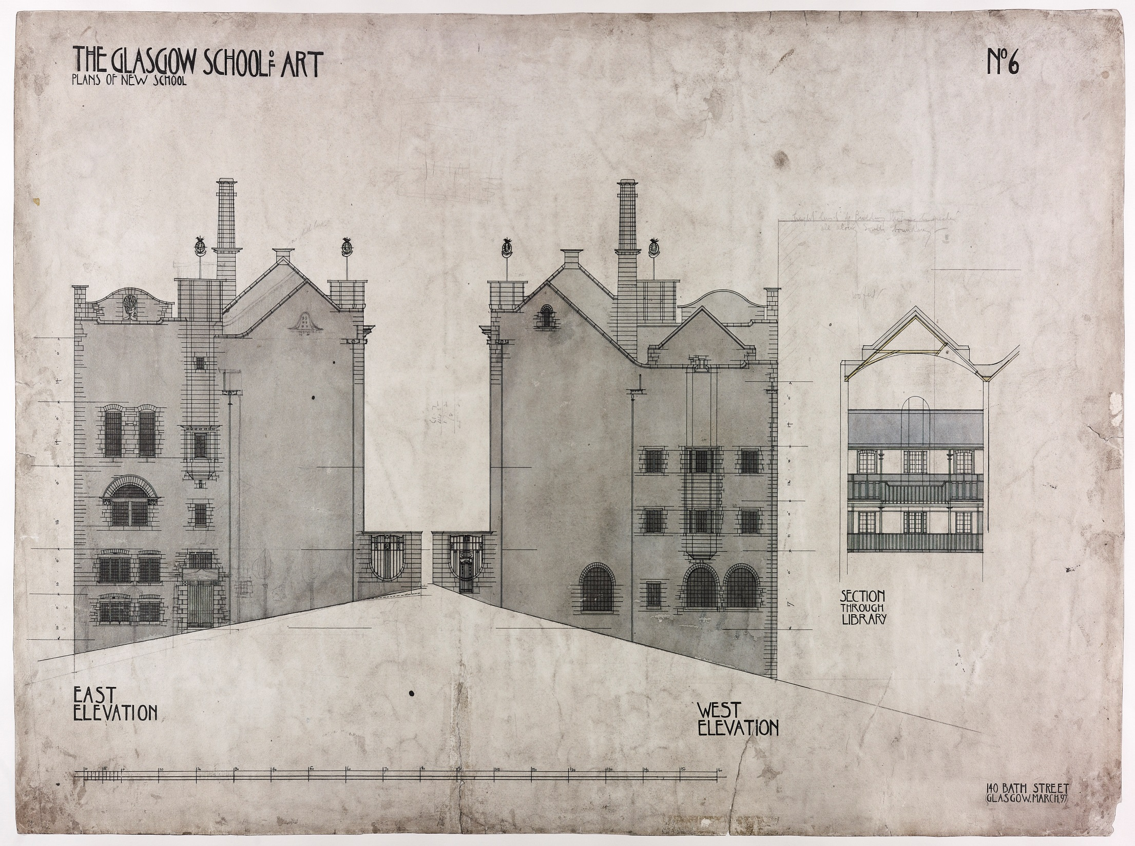
Notes:
By 1897 the “value of this adjunct to the School work is becoming more and more recognised by the students”
This increasing recognition of the value and need for a library came just as the first stage of the construction of Mackintosh’s purpose-built accommodation was commencing (though it is important to remember that Mackntosh’s design for the 2nd stage had not been finalised so the Governors would not have known a library was in the offing???)
In 1909 the second stage of the Mackintosh Building opened, including Mackintosh’s library
The annual reports note “The Library has, for the first time in the history of the School, a room specially devoted to it. It is well lighted by those long windows that make a striking feature on the west elevation. The arrangements are as complete as possible and quietness and seclusion are secured”
Where are the discussions about the library space and what was needed? Estates minutes? Architecture books?
Cases are moved in in Sept (29 1909). Books are moved in by degrees, with location changes marked in the catalogue
Popular books are to be on the ground floor, with less widely used books on the balcony.
Already, some concern is expressed regarded Mackintosh’s bookcases, and the lack of ventilation they provide
A librarians office is suggested for the south-east corner, with architects instructed accordingly
In Dec the Governors are reporting to architects that the library is insufficiently heated and could cause damage to books. 3 radiators are requested as students were unable to stay during the last bout of cold weather.
This suggests library was open to students before official building opening of Jan (?) 1910
In May 1915 leaded glass is still being added to those cases not yet done (check this, ambiguous wording. Do they mean they cases that were not yet installed) and in Sept that year an estimate was requested for 2 further bookcases
Mr Buchanan’s estimate for £11.15.0 (the lowest) was accepted

Slide 30
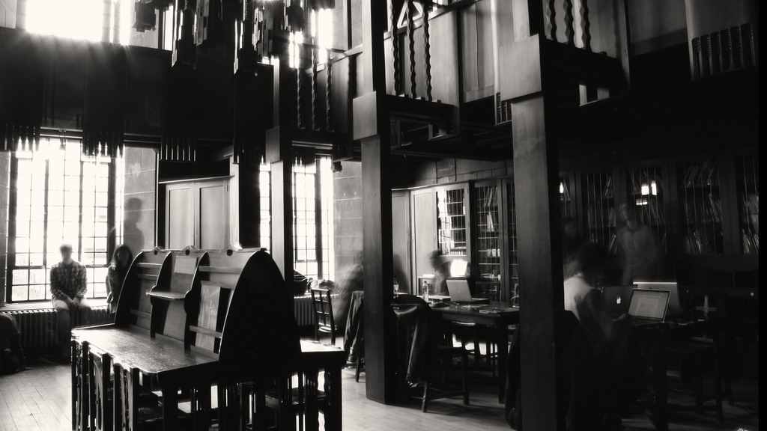
Notes:
In 1909 King is conscious of the extra demands the new library will bring
On 26 May 1909 he writes to the Governors
“Beginning with next Session there will be a new Library and in order to make it of greater use to the Students, the School should be able to demand the whole time and services of the Librarian. For the last few years owing to the want of proper accommodation and the multiplicity of duties imposed upon the Librarian, it has not been possible for him to give to it the time necessary for its proper administration; in fact the large collection of photographs, prints etc. have not been available to the general student, and in the case where a special demand is made for any of this material, the Librarian had to neglect other duties so as to allow of his looking out of the desired material.”
I would suggest that instead of my time being broken up by outside teaching (which I must do for money) that my time be wholly taken up by the School, which would mean that I give up this paying outside work, and that my salary be increased to £250 to allow of this; at the same time I would ask you to remind the Governors that I have been in the employ of the School for over 35 years, and that during this time, the average increase in my salary has been somewhat less than £1 per annum.
“It would be well that the Governors be also reminded that my duties are not only Librarian, but Conservator which entails the looking after of all the School properties, the safe-keeping of the students’ works, the preparing of these for exhibition purposes, the arranging of these for the inspection of the Director and Masters as well as for bursaries competitions etc. I have also to see after the engaging of models, a very important duty in the School and one taking up a considerable time; and I am often called upon to visit various people outside the School on School business.
All the above duties will not be any less under the new conditions and I can easily see that the increase of these will be very considerable owing to the greatly expanded premises. I well remember when I was appointed Librarian your saying that you did not see how you were going to fill up my time. I fancy that you have not found this a difficult matter owing to the development of the work in the various departments. Trusting that when you bring this under the notice of the Governors, they will see to my getting fair consideration in the matter.
“After discussion it was agreed to recommend that the Librarian be asked to give his full time to the work of the School and it was suggested that his salary be at the rate of £200 per annum.
In Feb 1910 a new 4 volume catalogue is being bound in linen (no longer extant) and the magazine table (without its top part) is installesd
When did top part arrive
Confronted with this new dedicated library space, the School also looks externally for advice on how best to manage its resource
F. T. Barrett, the City Librarian (biog) was invited to audit and assess the library and its facilities in March
He finds that the “the general working to be on good lines” but suggests that “a good accession catalogue by obtained, with columns for date of accession, author’s name, title, vendor’s name, price, number of volumes, imprint (place and date)
He advocated the adoption of a card catalogue, in place of King’s ledger, as “it lends itself to indefinite extension in a manner which no ordinary catalogue can do, as the latter is apt to get congested under certain heads”
By March 1913 King is recommending that the 1/ sub to use lending coll be dropped, as only 8 students have taken advantage in the session
Governors agreed, though a deposit of 2/6 was still required to borrow
Governors expressly forbid the transfer of books from ref to lending collections, unless dupes

Slide 31
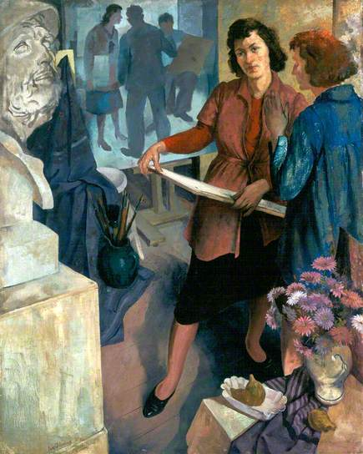
Notes:
In 1909 (29 Sept) Governors are including cost of proposed book acquisitions in grant-in-aid application to South Kensington
From 1913 this is supplemented by an annual grant of £200 from the Carnegie Trust for purchase of books and casts
The Governors first apply in March 1913:
“The importance of a library is apparent especially in view of the lack of art books in university and public libraries. Books are a daily necessity and the institution of lectures on the history of art and of social and intellectual history (Liberal Studies dept??) makes a supply of books a matter of urgent need”
Amended to:
“There is a noticeable dearth of works on art and cognate subjects in the city libraries and in the library of the University. Books are a vital necessity in an institution of this kind. Art students during the period of their studies should acquire a knowledge of the works of the schools and artists of the past in all mediums and manifestations, and should be kept in touch with present movements and productions at home and abroad. The Governors have recently instituted parallel sets of lectures on the history of art and on social and intellectual history and the lecturers are much hampered in their work by the absence of the necessary authorities for reference and for books to recommend to their students.”
Apart from donations and small gifts, this seems to have been the main source of funding the continued development of the library for the next 15 years (it cease in Oct 1930)
By August 1918 the Governors are concerned at King’s health, but retain him in post due to his length of service
He retires in 1920
James P Halcrow, temp assistant in the office, is appointed assistant secretary and given responsibility for library
A girl assistant at £50 a year is appointed
By Nov 1934 a Miss Wyper is mentioned as ‘Librarian’– she is noted as earning £8 a week, having commenced GSA employ in 1925)
She is mentioned again in Jan 1935 where it is accepted that although Halcrow was officially in charge in face she had done much for the work
In June 1925 Governors are recommending that important books remain in Mack Library but that “the new library” in the “school extension” be used as a reading room and study (where would this have been?)
By 1934 it is being noted that “The Library has for some years suffered from lack of funds. At one time it received £200 per annum (from Carnegie)… but this has been discontinued since 1930 and apparently cannot be renewed”
The Governors seem to accept that the Library has, for a number of years, suffered from benign neglect
In Jan 1935 they note that not many new books have been added or journal subscribed to due to lack of money, but that it was “of great importance that the library should be kept up-to-date by the addition of new publications”
Book purchases are now funded from general funds, which have many calls upon them
In 1935 The Director and Chairman seek to reinvigorate the committee (which had become “somewhat inactive”) by co-opting new members
The Director at this time tells that Committee that the post of Librarian “was one which [is] peculiarly fitted for an artist member of staff” Committee concurs
In 1934 they appoint Ian Fleming (1906-1994) as Librarian
They note “Mr Ian Fleming has been appointed Honorary Librarian, and is taking energetic steps to put the Library back on its feet again, and it is hoped that renewed interest will be taken in this most important part of the School of Art”
From 1924 to 1929 he studied drawing and painting at Glasgow School of Art, where he also began printmaking.
3 years earlier, in 1931, he had been appointed assistant lecturer at Glasgow School of Art, where he taught life drawing, painting, and art history
Ian Fleming (1906-1994) Art Students Preparing a Still-Life, 1940, Aberdeen Art Gallery
By 1936 Fleming had instigated the reorganisation of the library, and its classifying by Dewey “to enable readier reference… and to bring the library into line with other libraries in the country.”
By this point also “A considerable number of additional books were purchased during the session, and the number of periodicals, both British and foreign, retained in the Library, was increased to ensure that students would have available as much information as possible regarding modern development in all branches of Art throughout the world.” (can we identify these?)

Slide 32
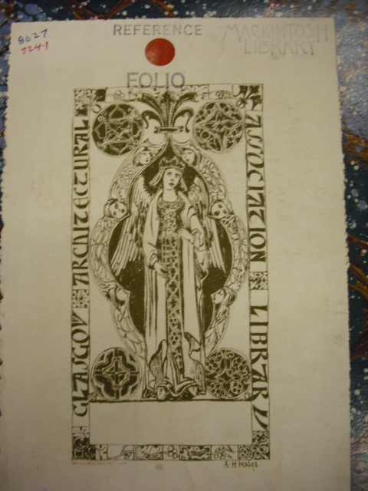
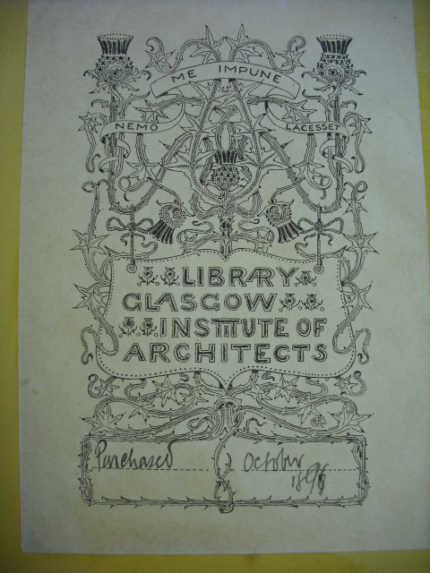
Notes:
By 1938 the ability to purchase new materials for the library was once again restricted, due to wartime economy.
From 1939 to 1944 the Governors allowed certain rooms in annexe premises (where?) to be used by the Glasgow Institute of Architects as a Library and Reading Rooms and for meetings
This was first mooted in Feb 1930
Originally the Glasgow Architectural Society, its members first met in Alexander Thomson's Scottish Exhibition Rooms in Bath Street on 14 January 1858
For over ten years the Glasgow Architectural Society maintained an active presence in the city, before becoming a part of the Philosophical Society of Glasgow in 1869.
General meetings, where members presented papers on a variety of topics, were held at regular intervals and recorded in the local press.
Competitions were staged for the apprentice architects of the city
An architectural library was built up for the use of members
On 18 September 1868, a new Institute promoted by the architect-only members of the original Society was incorporated.
Links with the Royal Institute of British Architects were established as early as 1870, while a permanent association with the School of Art was also formed.
In 1875, the death of Alexander Thomson saw the creation of a triennial Travelling Studentship to promote the study of Classical Architecture, which the Institute continues to award in his honour today.
Winner of this scholarship in 1890 was Charles Rennie Mackintosh
To this day, our collections include many volumes from the GAA and GIA, which may indeed have entered our collections around this time

Slide 33
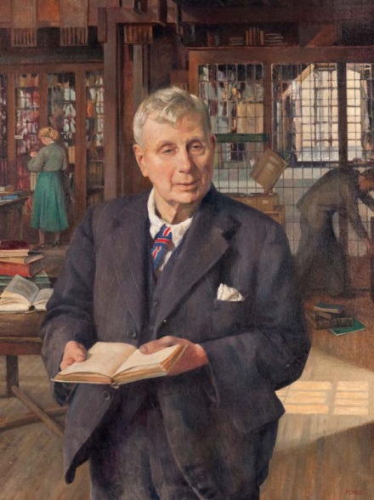
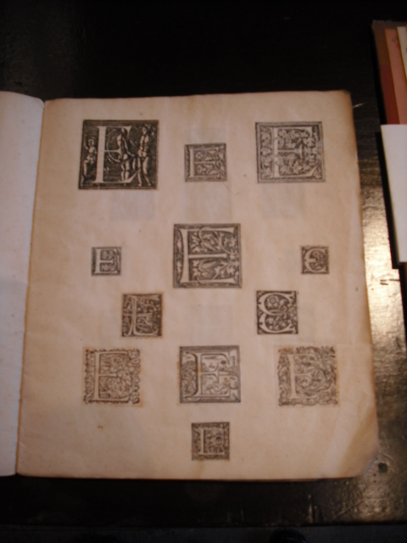
Notes:
In 1944 Adam Luke Gowans (1871-1958) was appointed Librarian
A Glasgow Bookman by Phyllis Dodd, 1951, GSA
Gowans graduated with an MA from the University of Glasgow in 1895 before entering publishing and establishing the firm of Gowans and Gray, known for their small pocket books of repertory plays
In the first year of his tenure exhibitions of rare manuscripts and books from Edward N. Marshall and Sir John Stirling-Maxwell were staged in the library
See SM provenance files
This scrapbook was probably used to compile examples of historiated initials and letters that could be used as the basis for those in his published works.
By 1945 the Carnegie Trust was once more providing a grant to the library, of £100 per annum
It now numbered some 5500 volumes
By 1948 the Governors note that “on several occasions the accommodation [is] being fully taxed”
Further grants are secured from the Trades House and Merchants House during this time
Gowans was succeeded as Librarian by Basil Chisholm Skinner in 1951
During Skinner’s tenure the library was open to students 6 hours a day, and received some 30 periodicals through regular subscription (can we identify?)
By 1953 it numbered some 10300 volumes
Of note for the art historical reception of Mackintosh, a file was being maintained and updating of press cuttings relating to him and his work (does this conflict with official perceptions of when CRM became known)
Three years later Skinner was made Assistant Keeper of the Scottish National Portrait Gallery at the unprecedented age of 31.
The Governors note that his loss is “a genuine grief to us all”
Much of the prestige of the gallery can be traced to Skinner's innovative work and energetic imagination.
Skinner's greatest contributions were perhaps the series of spectacularly successful exhibitions.
Among the highlights were "Scots in Italy in the 18th Century", in 1963; "Shakespeare in Scottish Art", 1964; and the Sir Walter Scott Bicentenary Exhibition, held in Parliament Hall, Edinburgh, in 1971

Slide 34
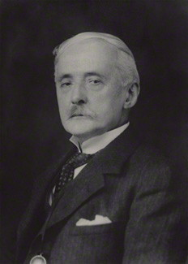
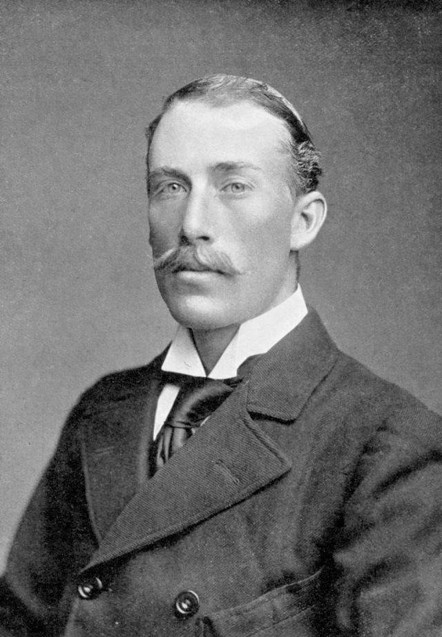
Notes:
From September 1909 , after the opening of Mackintosh’s library, the activities of the Library were overseen internally by the Library and Materials Committee, to which the Librarian would report (GM 17 Sept 1909)
Its minutes were formally recorded and incorporated upwards into the Governors’ Minutes
In effect, the Librarian had little autonomy, and needed to seek sanction for his actions from the Committee, to which he would defer
29 Septe 1909 includes book purchase proposal form pasted-in, with spaces for remarks from Librarian, head of requesting dept, Director and Committee
Books, presented by booksellers, are being left with Director and Convenor to assess
In Dec 1912 the Director is requesting powers to purchase from trade catalogues without permission, if the item is likely to be sold before decision can be granted
Oct 1913
That the work of this Committee be to select and decide upon books and museum material
That lists of books and museum material suggested for purchase be presented by the Director on the official forms now in use (or on other forms as may be found necessary), that each item be fully described, be initialed by the Head of the section asking for the purchase, and counter-signed by the Director, and that the separate prices by clearly stated.
That the selections when finally approved of, be sent forward to the Finance Committee for consideration
That the action of the Finance Committee upon any list sent forward be purely monetary and provided that the demand of the Library and Museum Committee do not exceed balances that no qualification be had by the Finance Committee upon the choice of books and material.
That the books and material selected for purchase be such as to be aids to study to be used by students in the ordinary day’s work, in any one of the School Sections
That nothing purchased be of such value as to make its use prohibitive under ordinary circumstances
That unique, precious or valuable books be not purchased. Any such books or objects may be recommended for purchase by the Corporation to be placed in their libraries and museums
That as a rule, the purchase of books and objects of small monetary value be not put upon the [Carnegie] Trust money, but if required, be entered under the ordinary estimates annually asked for.
The Committee itself included a number of distinguished individuals
Sir John James Burnet (1857-1938) entered his father's office at the age of fifteen, and attended classes whilst he practised his profession
He subsequently went to Paris, and attended the Ecole des Beaux arts from 1874 until 1877
He is now known for buildings such as the Glasgow Athenaeum and the British Museum extensions
He sat on the Library Committee from 1908-1924
Sir John Stirling Maxwell (1866-1956) was the son of the learned Spanish historian, William Stirling of Keir, and in 1878 he inherited the Maxwell estate of Pollok
He was made private secretary to Lord Knutsford, Colonial Secretary in Lord Salisbury's Government from 1887 till 1892
Losing his own seat in 1906, he subsequently involved himself in many philanthropic and charitable causes
He was Chairman of the Royal Fine Art Commission for Scotland, a Trustee of the National Galleries of Scotland, and Chairman of Ancient Monuments Board
He was a founder member of the National Trust for Scotland in 1931
He sat on the Library Committee from 1908-1947
In 1914 he had invited the Director and Bourdon to visit his library at Pollok House and had agreed to making it available for consultation by GSA students

Slide 35
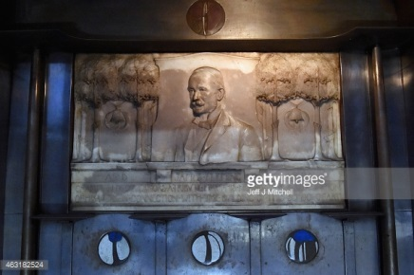
Notes:
Sir James Fleming (1831-) was Chairman of the Glasgow School of Art and born at Rutherglen, 3rd August, 1831
He began business life in a Glasgow lawyer's office, but after a year or two migrated to the office of the Britannia Pottery, St. Rollox, and in course of time became a partner in the firm, Messrs. Cochran & Fleming.
At the same time he had taken a strong interest in artistic matters, having studied as a lad at the Glasgow School of Art.
For two periods he acted as a member of Glasgow School Board, in which he was chairman of the Science and Art Classes Committee
He has also been for many years a governor of Glasgow and West of Scotland Technical College.
At Glasgow International Exhibition in 1901 he was convener of the section of applied and industrial art, and in November, 1906, his services to the artistic interests of the community were recognized by the King conferring upon him the dignity of knighthood
He sat on the Library Committee from 1908-1913
This memorial to him from GSA dates to 1901

Slide 36
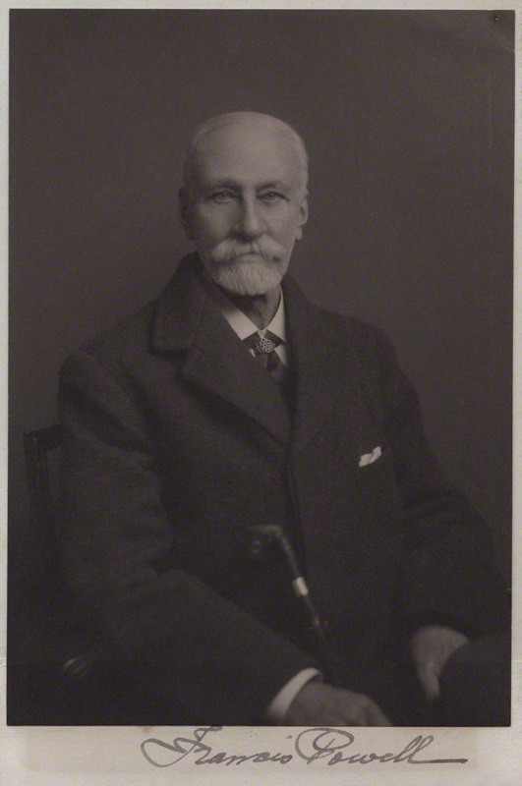
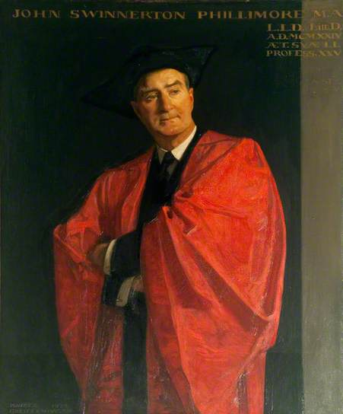
Notes:
Sir Francis Powell (1833-1914) was President of the Royal Scottish Water-Colour Society
He was born at Pendleton, near Manchester, 1833, and entered Manchester School of Art at the age of seventeen
After gaining the medals for figure drawing and for painting he went to London. There for four years he studied at Lee's Academy, and at the same time exhibited at the Royal Academy both water-colours and oil paintings
In 1860 he became one of the founders of the Scottish Society of Painters in Water-Colours, on the lines of the older London Society, and was elected its first President.
It was made a Royal Society in 1888, and in 1893 its President received the honour of knighthood.
Meanwhile, among other public offices, he had been elected to represent the Haldane Trust as one of the Governors of the Glasgow School of Art, he was President of the Glasgow Art Club from 1887 to 1891, and at the Glasgow International Exhibitions of 1888 and 1901 he was Joint-Chairman of the Art Section
He sat on the Library Committee from 1908-1912
John Swinnerton Phillimore (1873-1926) was FOURTH son of the late Admiral Sir Augustus Phillimore
He was born 26th February, 1873, and was educated at Westminster and at Christ Church, Oxford
A noted classicist, in 1907 he became Chair of Humanity in Glasgow University
He sat on the Library Committee from 1909-1926

Slide 37
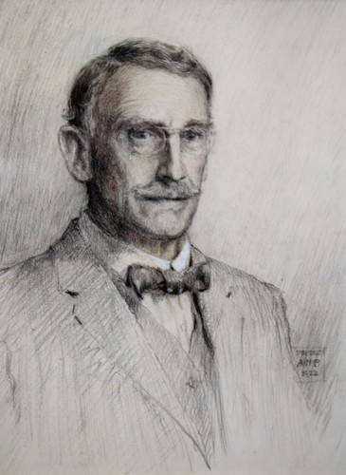
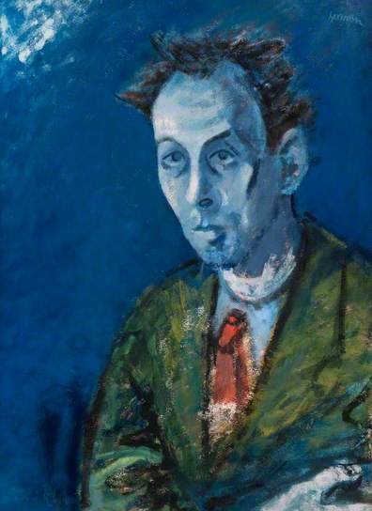
Notes:
Alexander Nisbet Paterson (1862-1947) was born in 1862 and was educated at the Western Academy, Glasgow Academy, and Glasgow University
He took his degree in arts in 1882
From 1883 to 1886, at the Ecole des Beaux Arts in Paris, he studied architecture and decoration
This was followed by office training as a draughtsman with John Burnett & Son, Glasgow, and Sir Aston Webb, London
From 1892 to 1903 he carried on practice on his own account in Glasgow and produced a number of notable buildings
He was a member of the Royal Institute of British Architects, vice-president of the Glasgow Institute of Architects, and a member of Glasgow Art Club
He sat on the Library Committee from 1909-1941
Alan M Boase (1902-1982) was Marshall Professor of French at Glasgow University
He sat on the Library Committee from 1946 to at least 1952

Slide 38
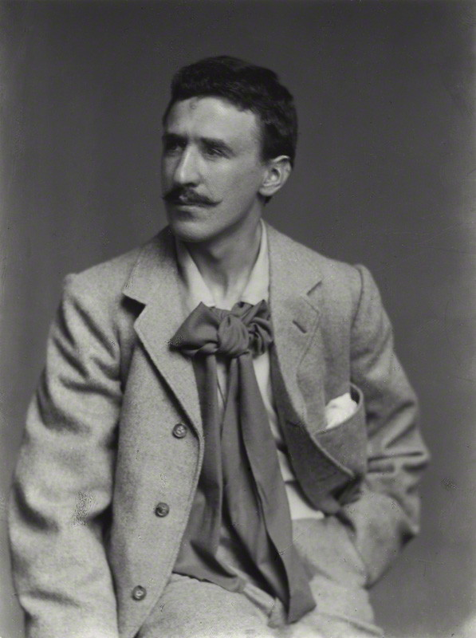
Notes:
Perhaps the most notable member of the Committee was Charles Rennie Mackintosh himself
He sat on the Library Committee immediately after his library had opened in 1909, and continued to serve until 1915
This is intriguing, as it means his hand was undoubtedly present in the development of the library collections in the early 1900s, though he have no way of identifying the particular volumes he selected for acquisition
Do minutes note his as present or absent?

Slide 39
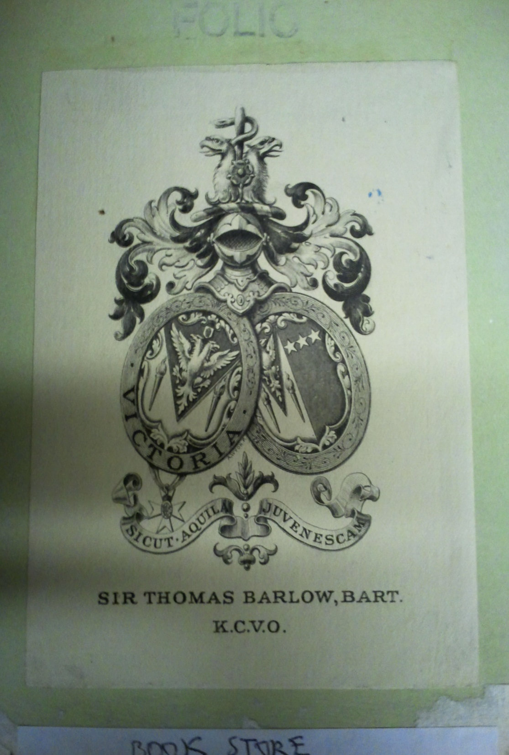
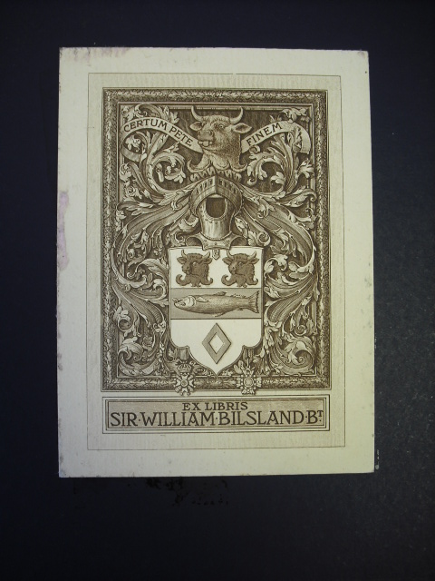
Notes:
From the late 1840s the School's Annual Reports, now held in Archives and Collections, sometimes note the purchase or donation of specific titles.
Similarly, donations and purchases are often noted in the Governors' Minutes, which include the minutes of the Library and Materials Sub-Committee.
All relevant information from these sources has now been transcribed up until the 1950s, and provenances added to catalogue records.
Barlow, Sir Thomas, 1st Baronet (1845-1945)
Royal Physician to Queen Victoria, King Edward VII and King George V. Pioneer researcher on infantile scurvy.
Arms of fired torches and a double-headed eagle.
Crested by double eagle heads and a staff with serpent entwined.
Motto 'sicut aquilla juvenescam', 'I shall grow up as the eagle'
Bilsland, Sir William (1847-1921)
Bread and biscuit manufacturer. Governor of GSA 1893, 1896-1908. Lord Provost of Glasgow 1905-1908. Created baronet in 1907, awarded an honorary LLD from Glasgow University, and made a member of several foreign orders.

Slide 40


Notes:
Stirling-Maxwells

Slide 41


Notes:
Campbell, Hugh, 3rd Earl of Loudoun (ca.1673-1731)
Parliamentarian. Enters Parliament 1696. Member of Privy Council 1697. 1702- 1704 Commissioner of the Scottish Treasury. 1704 joint Secretary of State. 1706 Scottish Commissioner for the Union, and Order of the Thistle.
motto 'byde my time'
Capell, Algernon, 2nd Earl of Essex (1670-1710)
English nobleman, soldier and courtier. Gentleman of the Bedchamber to King William III between 1691 and 1702
Arms a lion rampart between 3 crosslets, crested and supported by lions.
Motto 'fide et fortitudine', 'By faith and courage'

Slide 42


Notes:
Hague, Bernard (1893-1960)
Electrical engineer. James Watt chair of electrical engineering at University of Glasgow 1946.
Accomplished oboist and musician.
Heron-Allen, Edward (1861-1943)
motto Diligenter et Fidelis, 'careful and true'
Author and associate of Oscar Wilde.
Wrote The Cheetah Girl under pseudonym Christopher Blayre, which was suppressed for its explorations of unconventional sexualities.
Expert violin-maker and asparagus grower.
Practised palmistry and early member of Society of Psychical Research.
President of Microscopical Society.
Fellow of Royal Society 1919.
Persian scholar and translator of the Rubaiyat.

Slide 43


Notes:
Hohler, Sir Thomas Beaumont (1871-1946)
Bookplate to front bearing motto "Grata carpentis thyma per laborem", taken from Horace's Odes part IV
During World War I, he was head of the British delegation to Mexico and was involved in the interception of the German Zimmermann Telegram that was used to promote the entry of the United States into the war.
Although acting anonymously at the time, he later identified himself as the mysterious "Mr. H" responsible for intercepting the telegram.
Hewer, Humphrey Robert (1903-1974)
Naturalist.
Assistant professor and reader in zoology at Imperial College London 1926-64;
Professor, University of London from 1964.
Early work on colour change in salamanders and fish, and variation in burnet moths.
Innovative teacher, introducing biological films to classes, including a famous pioneer film on gannets, made with Julian Huxley

Slide 44

Notes:
Polymetis, London, 1774
Accession no. 24 in early accessions register, now held in GSA Archives and Collections. "This copy was once in the possession of Josiah Wedgwood"

Slide 45


Notes:
The donations we have received over the year have also given us many examples of artist-designed bookplates
Bookplate of William Maxwell by printmaker John Farleigh
Bookplate of Rainforth Armitage Walker by James Guthrie
Walker, Rainforth Armitage (1886-1967) was an Art historian and expert on Beardsley and Gill.

Slide 46


Notes:
Ex libris of A[lice] and T[alwin] Morris, showing pastoral scene with obelisk, river, setting sun, and female reader and cat to foreground.
Heart motifs around letters.
Bears motto "There lyeth more in ye telling than in ye tale".
Cinamon attributes the inspiration for the bookplate to the couple's recent move to Dunglass Castle on the Clyde.
Donated to the Library by Alice Talwin Morris from the library of her husband Talwin Morris. Governors' Minutes of 29 May 1911
Bookplate of John Keppie by CRM

Slide 47


Notes:
School's Annual Reports also note the awarding of prize books to individual students, some of which remain in the Library's collections with their prize certificates.
All relevant information from these sources has now been transcribed up until the 1950s, and added to catalogue records.
John Henderson (1883)
Henderson was a landscape and portrait painter.
In 1906-18 he was a GSA Governor, before becoming Director between 1918-24 during which time he steered the introduction of courses in architecture.
James Black Fulton (1895)
Fulton was an architect who attended GSA and West of Scotland Technical College 1890-1895.
Thereafter he worked with Honeyman & Keppie for two years
He was subsequently appointed Director of Studies at the Glasgow School of Architecture, and Professor of Architectural Design at Glasgow School of Art in 1920.

Slide 48


Notes:
Charles Rennie Mackintosh (1887)
John Ruskin’s Art of England

Slide 49

http://gsalibrarytreasures.wordpress.com
Notes:
Soon after the fire, we used our relationships and social media channels to record people’s memories of the destroyed library for posterity
We wanted to initiate this project pretty quickly after the fire, as we were conscious of not losing the momentum that the disaster provided
We therefore held interviews via email and in person with students, graduates and academics who had used the library, to record their first impressions of the space, their favourite items in the collection, and ways in which they had used the library in their learning and teaching
In the immediate aftermath of any disaster, the temptation, understandably, is to concentrate on immediate requirements
But we were determined that the fire, though tragic, would leave some kind of lasting legacy
Our suite of Mackintosh Memories, which can be read on our blog will eventually be deposited into the School’s archives, along with all the other documentation we have produced since the fire

Slide 50

Notes:
Since the fire we have received significant offers of donations to our library to replace the lost volumes
We are keen to capitalise on this good will, recognising that it provided an opportunity for us to begin to rebuild our lost collections very quickly
We are also keenly aware however that we had lost a significant proportion of our storage space, and that any rebuild needed to be highly focused
We therefore decided to pursue a targeted rebuild, tightly aligned to both the illustrious history and future direction of the Glasgow School of Art.
At the time of speaking, we are clear in only seeking very specific titles that hold particular relevance to our history, our alumni, and our learning, teaching and research activities
We have published a wants list of about 700 titles on our website

Slide 51


Notes:
We have also worked closely with our colleagues in the Press Office, to publicise our collections rebuild campaign and to mark successful milestones
This article appeared in The Herald on 15 September 2014 to celebrate our receiving 22% of our priority volumes in just 3 months.
The book is my hand is a rare Gregynog Press volume by Agnes Miller Parker, kindly donated to us by Blackwell’s Rare Books
And this is my colleague Jennifer accepting a donation of a rare Glasgow Style binding my former GSA Head of Embroidery Ann Macbeth, kindly donated by the Antiquarian Booksellers’ Association in March this year

Slide 52

Notes:
We even had some miraculous survivors from the fire, such as this 19th century photographic volume of topographical views of Japan, complete in its original silk covers

Slide 53

Notes:
Discussions are ongoing both within the School and with the wider public concerning the future of all the Mackintosh building spaces, particularly the library
There has obviously been a lot of debate and speculation about this
The School itself has organised a number of events at which stakeholders can share ideas and discuss the potential future of these spaces
There has also been much debate about the ethics of restoration, the relationship between the original and the replica, and the avoidance of a Mockintosh aesthetic
These debates are lively, stimulating and ongoing
What is clear is that the School has committed to restoring the space to Mackintosh’s design as a working library and we are actively involved in planning for this
It is likely that the restoration of this space will form the last tranche of the wider building restoration, as it is the most complex area

Slide 54
Duncan Chappell
Librarian
d.chappell@gsa.ac.uk
@duncanchappell

