Slide 1
Fear and Loathing in Glasvegas: Contemporary approaches to the copyright clearance headache
Michelle Kaye
Collections Development Officer
Archives and Collections
The Glasgow School of Art
Victoria Stobo
Postgraduate Researcher: Archives, Digitisation and Copyright
CREATe, School of Law
The University of Glasgow

Slide 2
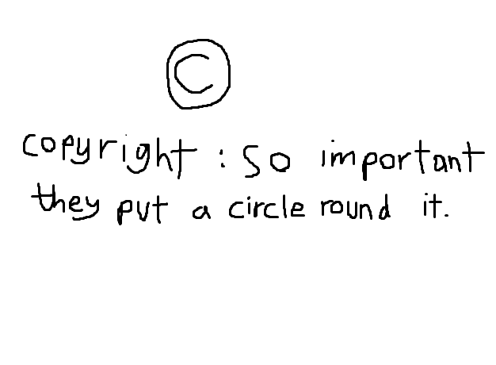
© Alex Singerman, GSA Archives and Collections Volunteer, July 2015

Slide 3
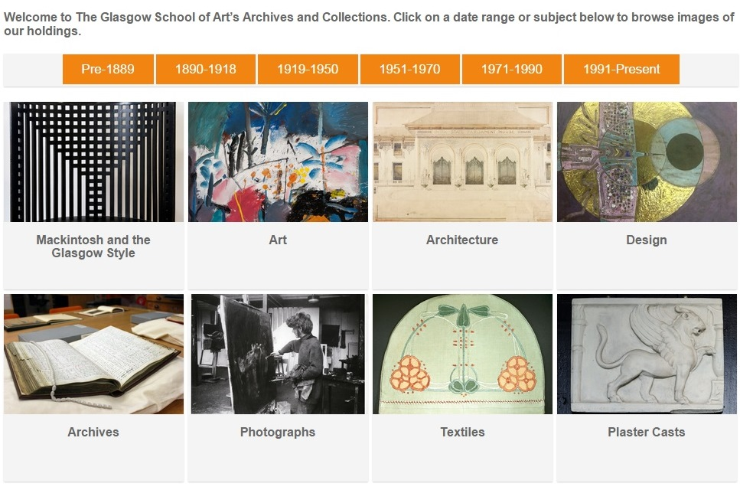
Archives and Collections online catalogue

Slide 4
User feedback
“It's great to have so many images up. I think your decision to put images up and allow people to download them for research is good”.
“The browse feature broken down into collections, images etc. is really useful and not something I've actually found with many other online catalogues… useful that it's alphabetical for looking for what you know you want but even better is the 'view all' so you can browse the list!”
“Would it be possible to link from a large gallery of images back to the catalogue records, so a user could browse visually?”
“the more digital content the better!”

Slide 5
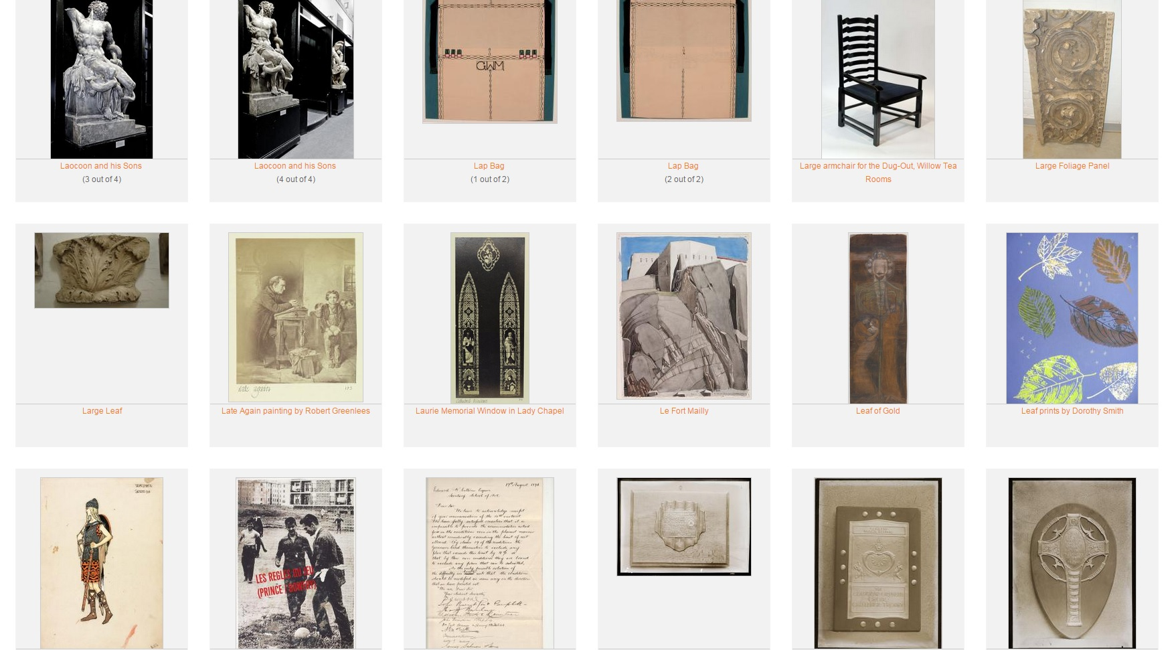
Opening up a treasure trove of images

Slide 6
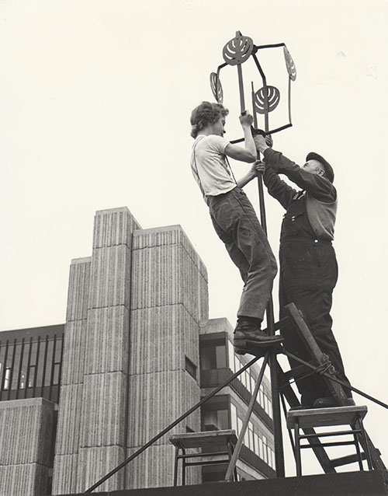
Risky business

Slide 7
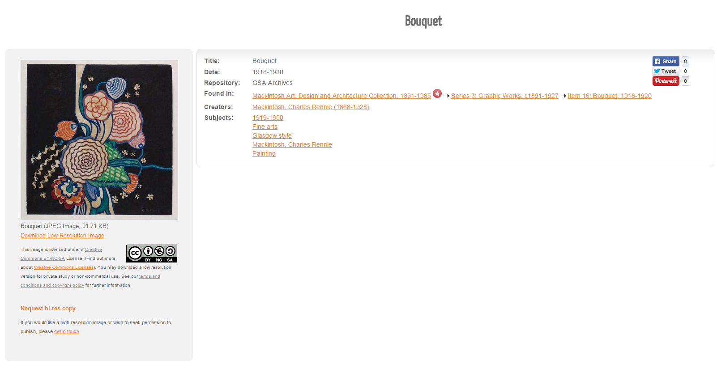

Slide 8
Copyright clearance process
Internal accessions documentation was our starting point
An alumni/staff database held by the School’s alumni relations officer has also been of use
Artists tend to publicise themselves well so that was helpful
The internet
Word of mouth – the art world is a small world
Local knowledge is often key too
The WATCH file (http://norman.hrc.utexas.edu/watch/)
Who’s Who, Dictionary of National Biography

Slide 9
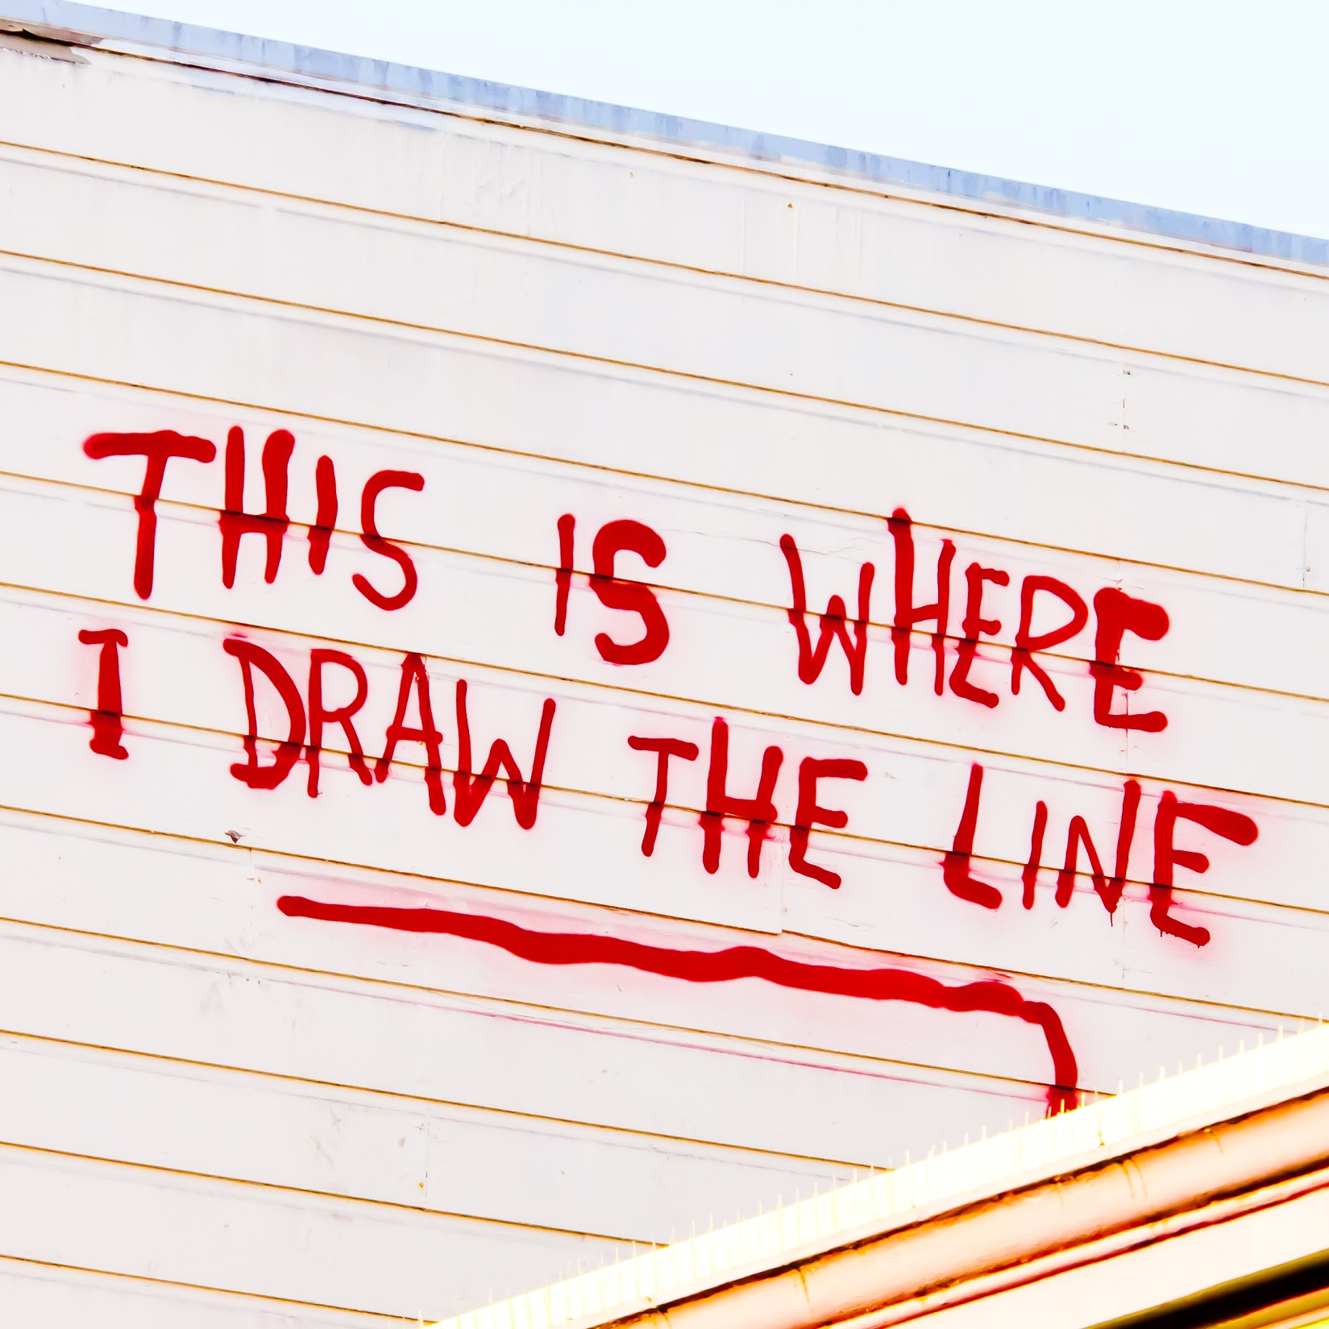
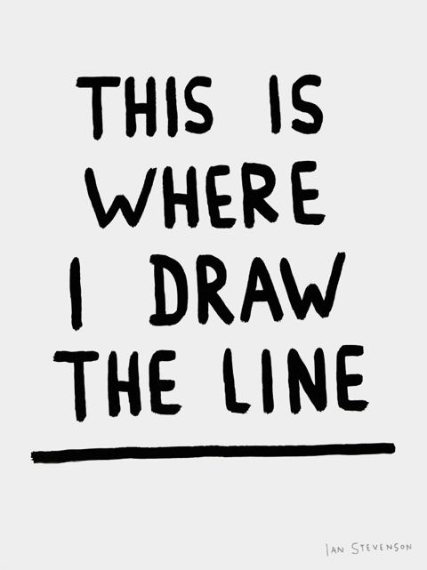

© Banksy, photo credit: Thomas Hawk, Flickr

Slide 10
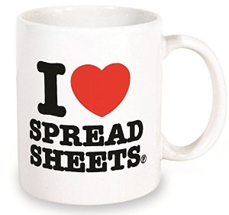
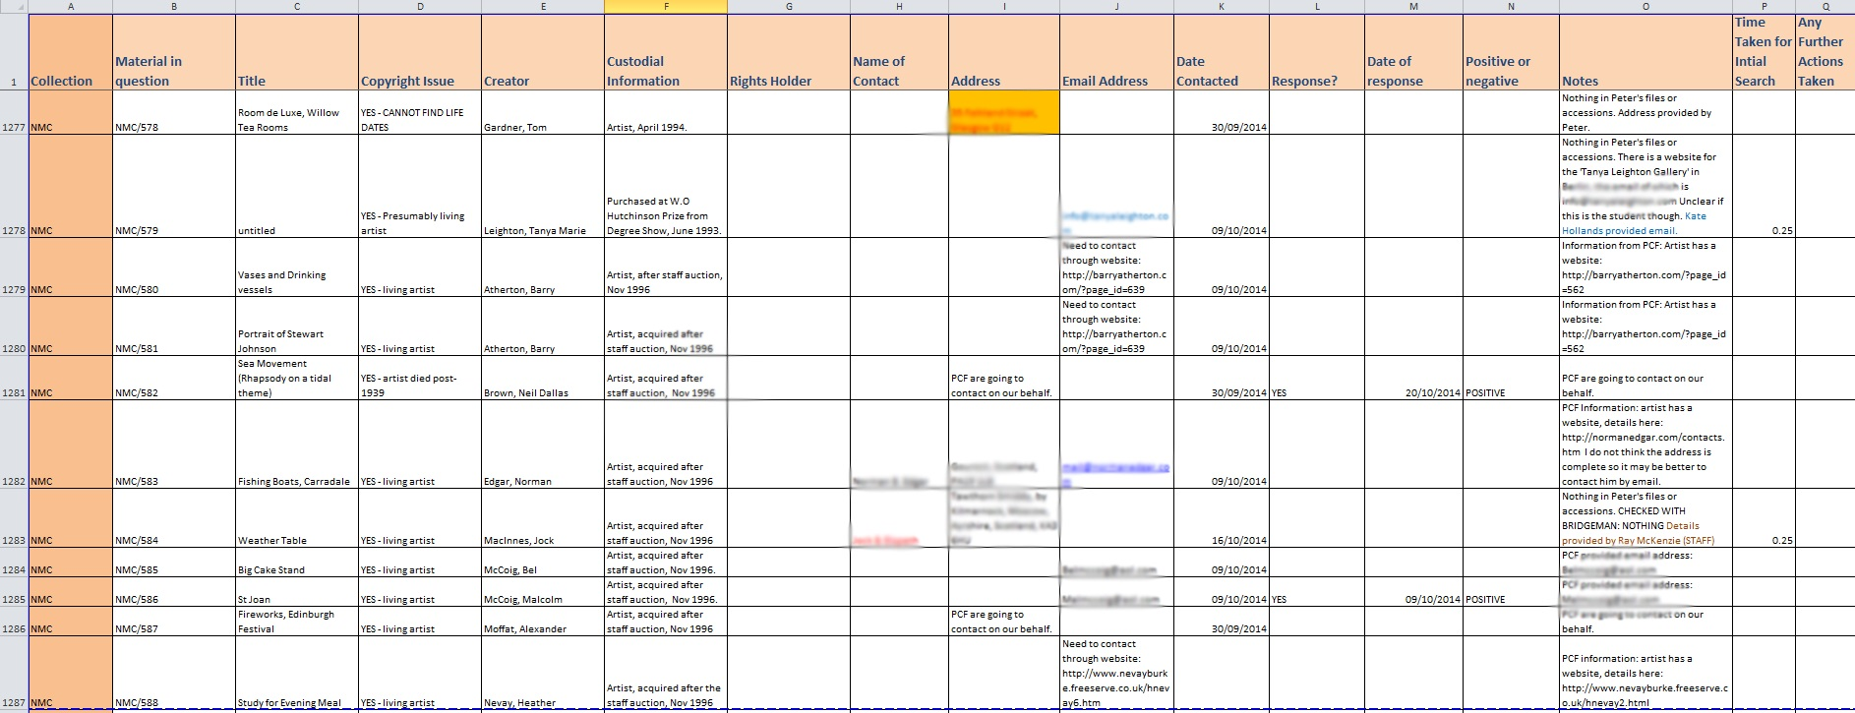
Recording process and results

Slide 11
Rights clearance: results of diligent search
Number of creators identified within framework | 401
Number of creators within framework with copyright issues | 281 | 70% of creators within framework
Total permission requests sent (relating to 235 creators) | 253 | 84% of those identified
Contact details found: emails sent | 85 | 34% of those contacted
Contact details found: letters sent | 168 | 66% of those contacted
Contact made via the PCF | 16 | 6% of those contacted
Total replies | 97 | 38% of those contacted
Permission granted | 97 | 100% of respondents
Permission refused | 0 | 0% of respondents
Did not respond | 156 | 62% of those contacted
Number of creators where no rights holders or contact details were found | 46 | 17% of those identified

Slide 12

Speculative Analysis of results – NEED IMAGE!!!!!

Slide 13
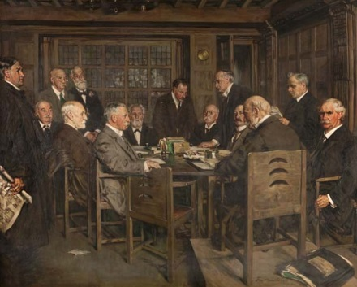
Ongoing considerations

Slide 14
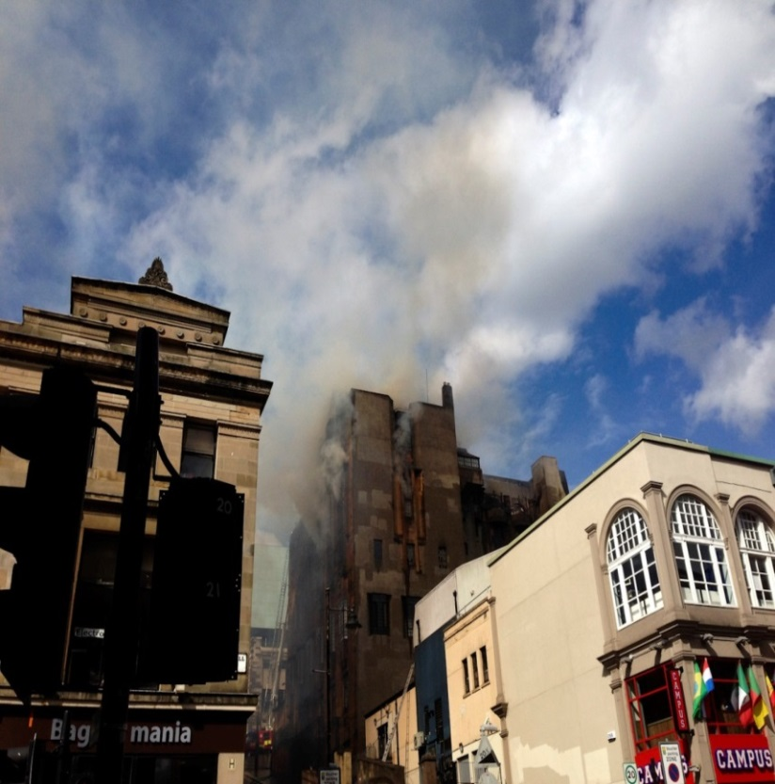
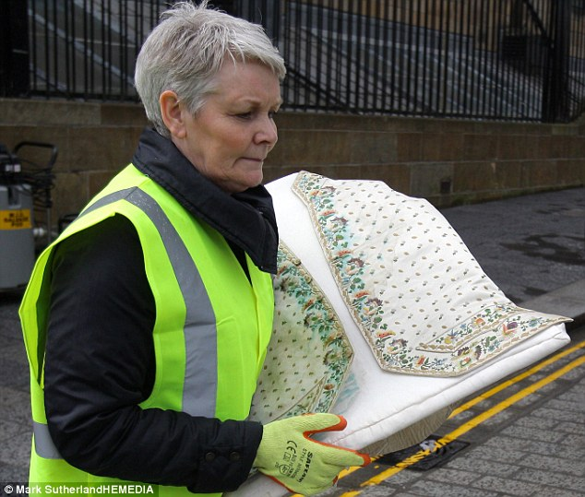
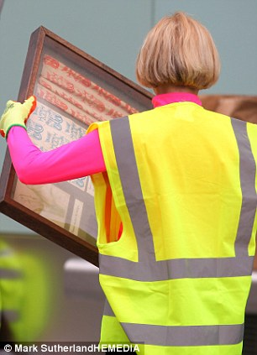
Recovering from the fire

Slide 15
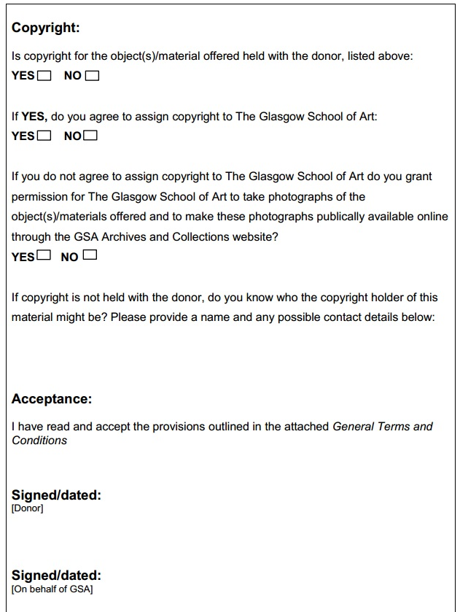
Going forward

Slide 16

A positive experience

Slide 17
Top Tips
Keep calm and carry on
Learn to love spreadsheets
Education, education, education
Pass things up the chain
Think positive
Talk to people
Listen to people
Keep it simple
Remember why you’re doing all this in the first place

Slide 18
MANAGING RISK: SOME MORE EXAMPLES
Copyright clearance is about managing risk, always …
Christy Henshaw
Digitisation Programme Manager, Wellcome Library
[D]ecisions about copyright clearance, when to do it, how to do it and how much to do, are always considerations based in the end on a vision of risk, and of risk tolerance in a particular institution …
Peter Jazsi
Washington College of Law

Slide 19
COPYRIGHT AND RISK
SCOPING THE WELLCOME DIGITAL LIBRARY
Mass-digitisation pilot project at the Wellcome Library, covering the 20th cent. history of genetics
5 third party archives joined as partners:
King’s College London, Cold Spring Harbour, University College London, University of Glasgow and Churchill Archives Centre
20 collections; 5 million + images available online
With thousands of potential rightsholders to contact, the Wellcome Library decided to adopt a risk based approach to copyright compliance

Slide 20
WELLCOME LIBRARY RISK MANAGEMENT STRATEGY
In-copyright material
Risk criteria for identifying rightsholders likely to object to publication
Diligent search methods to trace and contact those rightsholders
Sensitive material
Wellcome Library follows Access to Archives policy to determine access to sensitive personal data within collections
Takedown Policy
Applies to ALL material published on the Wellcome Library website

Slide 21
RISK CRITERIA
CODEBREAKERS
HIGH RISK |  | MEDIUM RISK
Author is a well-known literary figure, broadcaster, artist |  | Author has (or had) a high public profile
The author/estate/publisher is known to actively defend their copyright |  | Author is alive and known to have a literary estate as recorded in the WATCH file
The relationship between the institution and the author/estate/publisher is awkward |  | The material appears to have been published or broadcast and/or prepared for commercial gain rather than to advance academic knowledge or in a not-for-profit context

Slide 22
RISK-MANAGED RIGHTS CLEARANCE
CODEBREAKERS: THE RESULTS
NAMES IN COPYRIGHT DATABASE | 160
Reliable contact details: total letters sent | 134 | 84% of all rightsholders
Total replies | 103 | 77% of those contacted
Permission granted | 101 | 98% of respondents
Permission refused | 2 | 2% of respondents
Did not respond | 26 | 19% of those contacted
Low risk: put online after suitable delay | 23 | 89% of non-respondents
High risk: do not put online | 3 | 11% of non-respondents
Orphan Works | 22 | 14% of those identified
In Progress | 4 | 4% of those identified

Slide 23
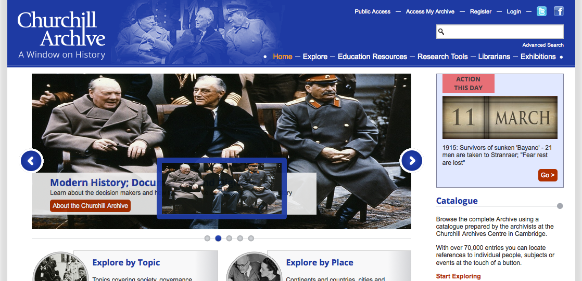
CHURCHILL PAPERS
COMMERCIAL DIGITISATION

Slide 24
RIGHTS CLEARANCE
CHURCHILL: MICROFILM & ONLINE
NAMES IN COPYRIGHT DATABASE | 20,482 | 2000-2005
Contact details: Letters Sent | 12,573 | 61% of those identified
Total replies | 4209 | 33% of those contacted
Permission granted | 4195 | 99.7% of respondents
Permission refused | 14 | 0.3% of respondents
Did not respond | 8364 | 67% of those contacted
Orphan Works | 7909 | 39% of those identified
NAMES IN COPYRIGHT DATABASE | 20,482 | 2010 <1 Year
Contact details: Letters Sent | 10,537 | 51% of those identified
Total replies | 2104 | 20% of those contacted
Permission granted | 2035 | 97% of respondents
Permission refused | 69 | 3% of respondents
Did not respond | 8433 | 80% of those contacted
Orphan Works | 9945 | 49% of those identified

Slide 25
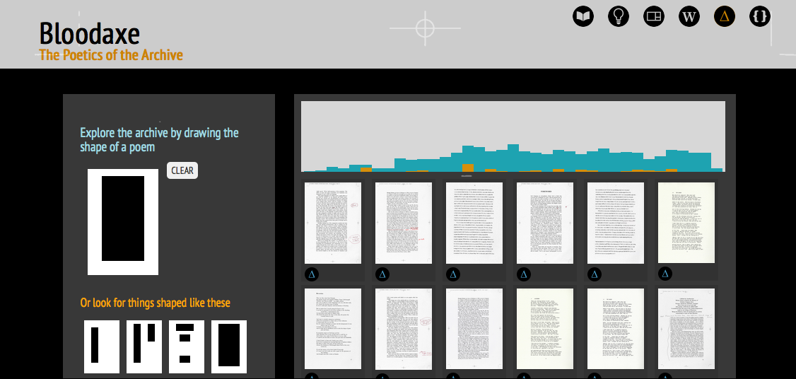
BLOODAXE BOOKS

Slide 26
RIGHTS CLEARANCE
BLOODAXE: THE RESULTS SO FAR
NAMES IN COPYRIGHT DATABASE | 360
Reliable contact details: total letters sent | 327 | 91% of all rightsholders
Total replies | 173 | 53% of those contacted
Permission granted | 125 | 72% of respondents
Permission refused | 23 | 13% of respondents
Did not respond | 154 | 47% of those contacted
Orphan Works | 33 | 9% of those identified
In Progress | 25 | 15% of those identified

Slide 27
SOME LESSONS LEARNED?
RESPONDENTS TEND TO GRANT PERMISSION
Codebreakers: 98% of respondents
GSA: 100% of respondents
Churchill: 97% of respondents
AND THEY OFTEN DO SO WITHOUT SEEKING A FEE
Codebreakers: 1 respondent requested a charitable donation be made, but this related to library not archival material
GSA and Bloodaxe: No respondents have asked for a fee

Slide 28
RIGHTSHOLDER CONCERNS
    Not always about copyright
    Content and sensitivity of material is important
    Age of material: particularly for artists/writers/creators
    Type of material; some writers are uncomfortable with drafts being made available
    Take this into consideration when you contact rightsholders
    Give detailed descriptions of the material you want to digitise; and be prepared for follow-up enquiries
    Explain why you want to digitise their material
    Offer them extra acknowledgement; a link to their website or a description of their current work to make them feel comfortable

Slide 29
POSITIVES of rights clearance
    Many archivists appreciate the chance to get back in touch with depositors
    Some depositors have become involved in outreach and fundraising as a result of contact
    Asking users and/or depositors for information about collections can lead to increased engagement
    Copyright doesn’t always need to be assigned to the archive at deposit; acting as a gatekeeper or broker between users and depositors can help to establish trust
    Advertising the fact that you are looking for rights holders in a collection can boost external coverage of your project

Slide 30
WHY IS RISK MANAGEMENT RELEVANT?
Take Peter Hirtle’s advice –
  Explain: why is your project important and why should rightsholders give permission? Articulate your aims clearly.
  Solicit: Ask for information about rightsholders from a variety of sources; you don’t have to search for them by yourself
  Document: Record as much of your due diligence as possible
  Avoid Commercial Use?

Slide 31
Thank you
Michelle Kaye
Collections Development Officer
Archives and Collections
The Glasgow School of Art
m.kaye@gsa.ac.uk
Victoria Stobo
Postgraduate Researcher: Archives, Digitisation and Copyright
CREATe, School of Law
The University of Glasgow
Victoria.Stobo@glasgow.ac.uk

