Slide 1
Rescuing Rennie Mackintosh
Duncan Chappell
Glasgow School of Art

Slide 2
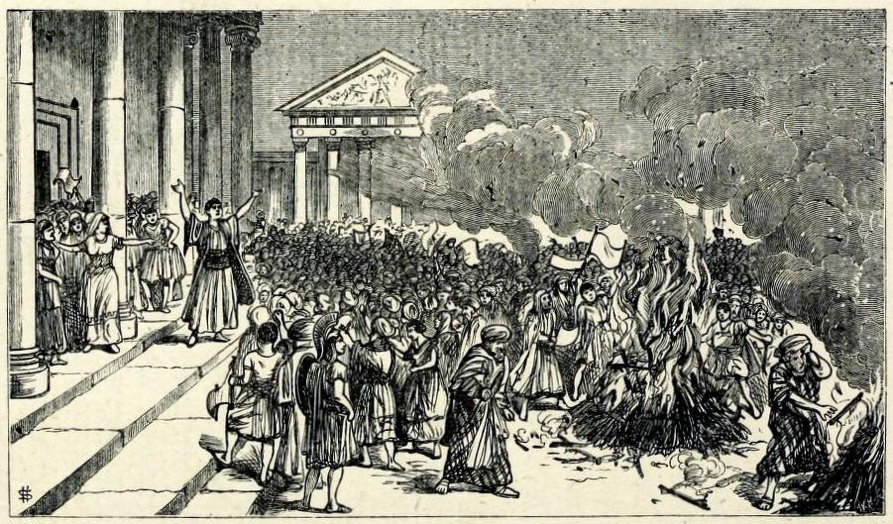
Notes:
Plate II. The destruction of Books of Magic at Ephesus.
Blades, William The Enemies of Books
In his treatise The Enemy of Books, first published in 1880 (by whom?), William Blades, the well-known collector of the works of William Caxton, documents his outrage at the mistreatment suffered by books at the hands of biblioclasts, both human and non-human
His text enumerates and discusses threats to the survival of books, with dedicated chapters on water, gas and heat, dust and neglect, ignorance and bigotry, bookworms, other vermins, bookbinders, collectors, and servants and children
His chapter on fire begins:
“There are many of the forces of Nature which tend to injure Books; but among them all not one has been half so destructive as Fire.”
“It would be tedious to write out a bare list only of the numerous libraries and bibliographical treasures which, in one way or another, have been seized by the Fire-king as his own.”

Slide 3
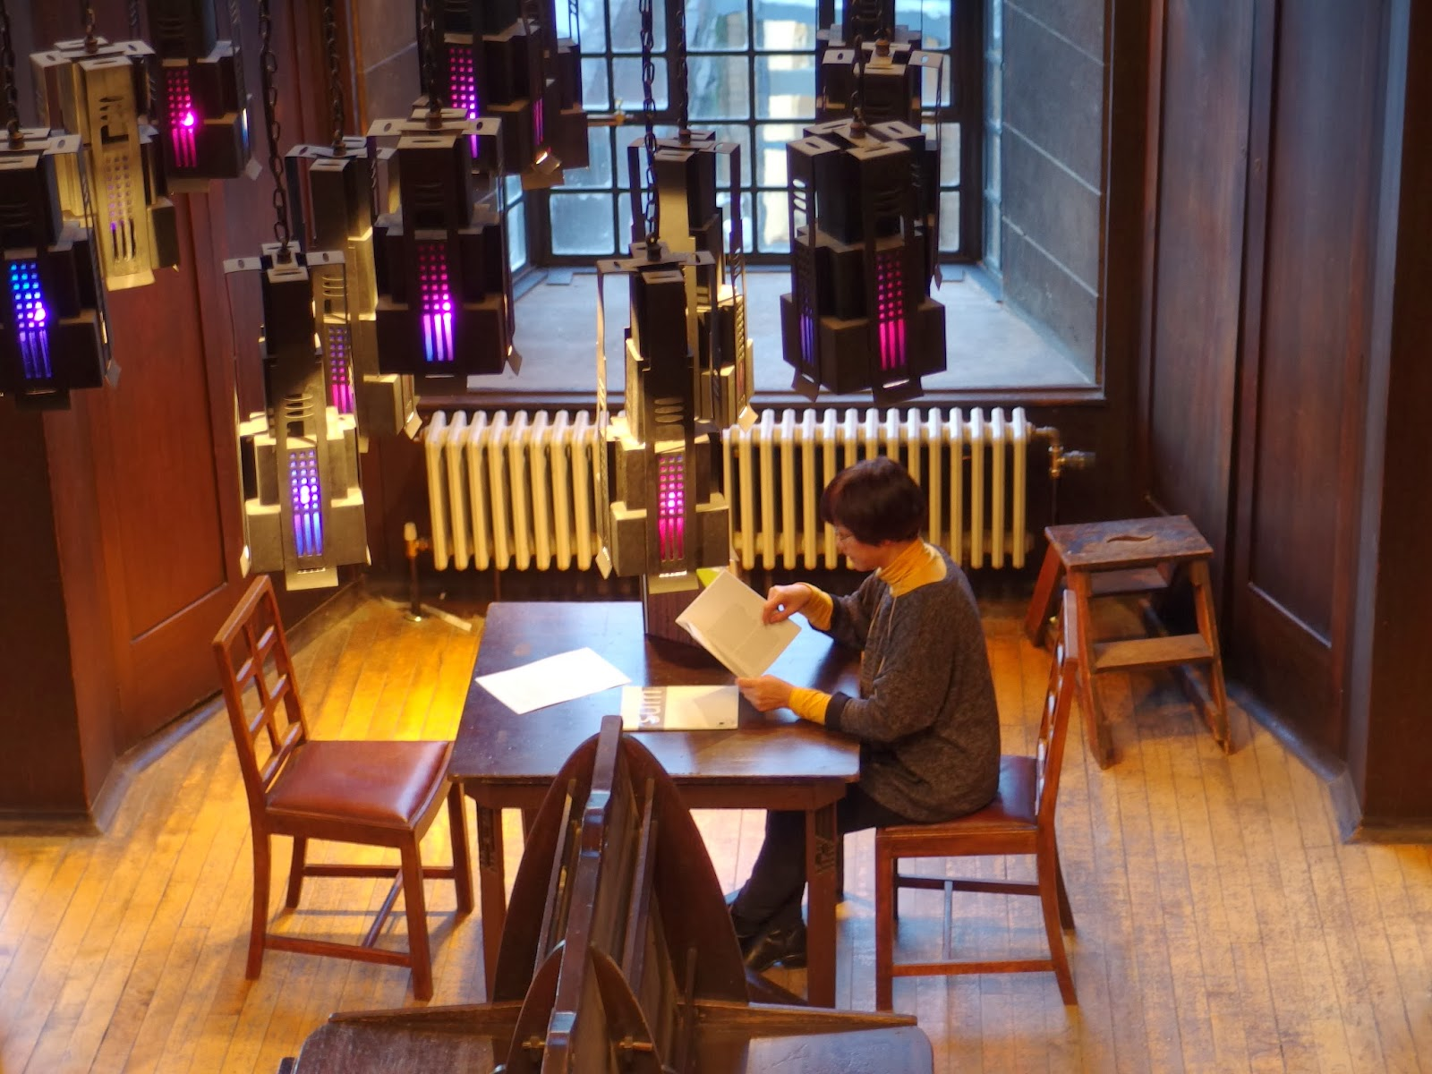
Notes:
Many of you will be aware that on the 23rd of May 2014, a devastating fire at the Glasgow School of Art totally destroyed the world-famous Mackintosh Library and its important historical collections.
One of the most important and widely recognised library spaces in the world, it was designed by Charles Rennie Mackintosh between 1907 and 1909 as part of the second phase of the Art School building.
It was generally accepted as one of the finest Art Nouveau interiors internationally, and any visitor to the space could not help but be moved by its architectural and aesthetic beauty…
…From its hand-painted balusters to its pierced wooden pendants, and from its coloured-glass hanging lamps, to its original tables, Windsor chairs and periodicals desk.

Slide 4
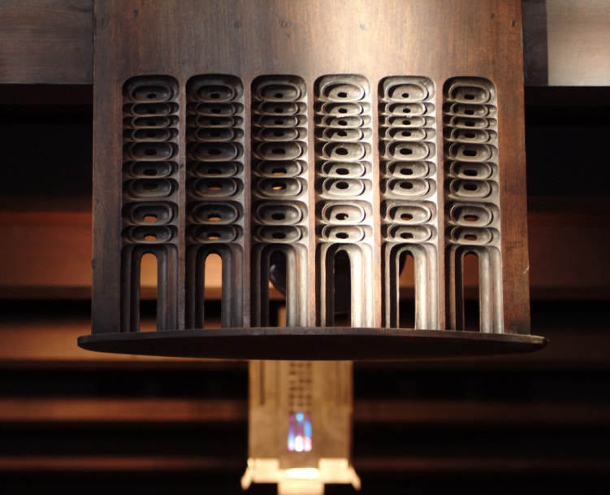
Notes:
Balcony pendant

Slide 5
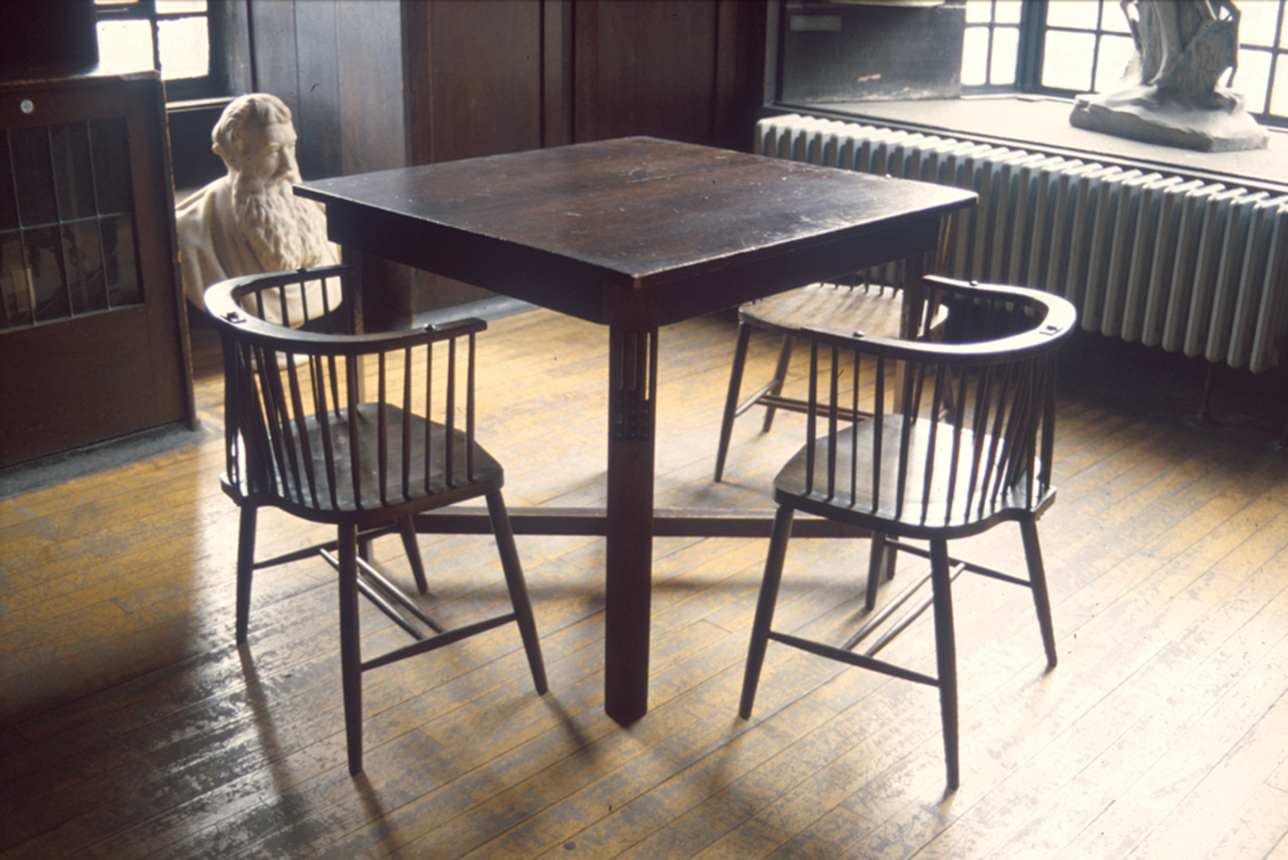
Notes:
Original Windsor chairs with table, the latter with pendants to reflect those above at balcony level.

Slide 6
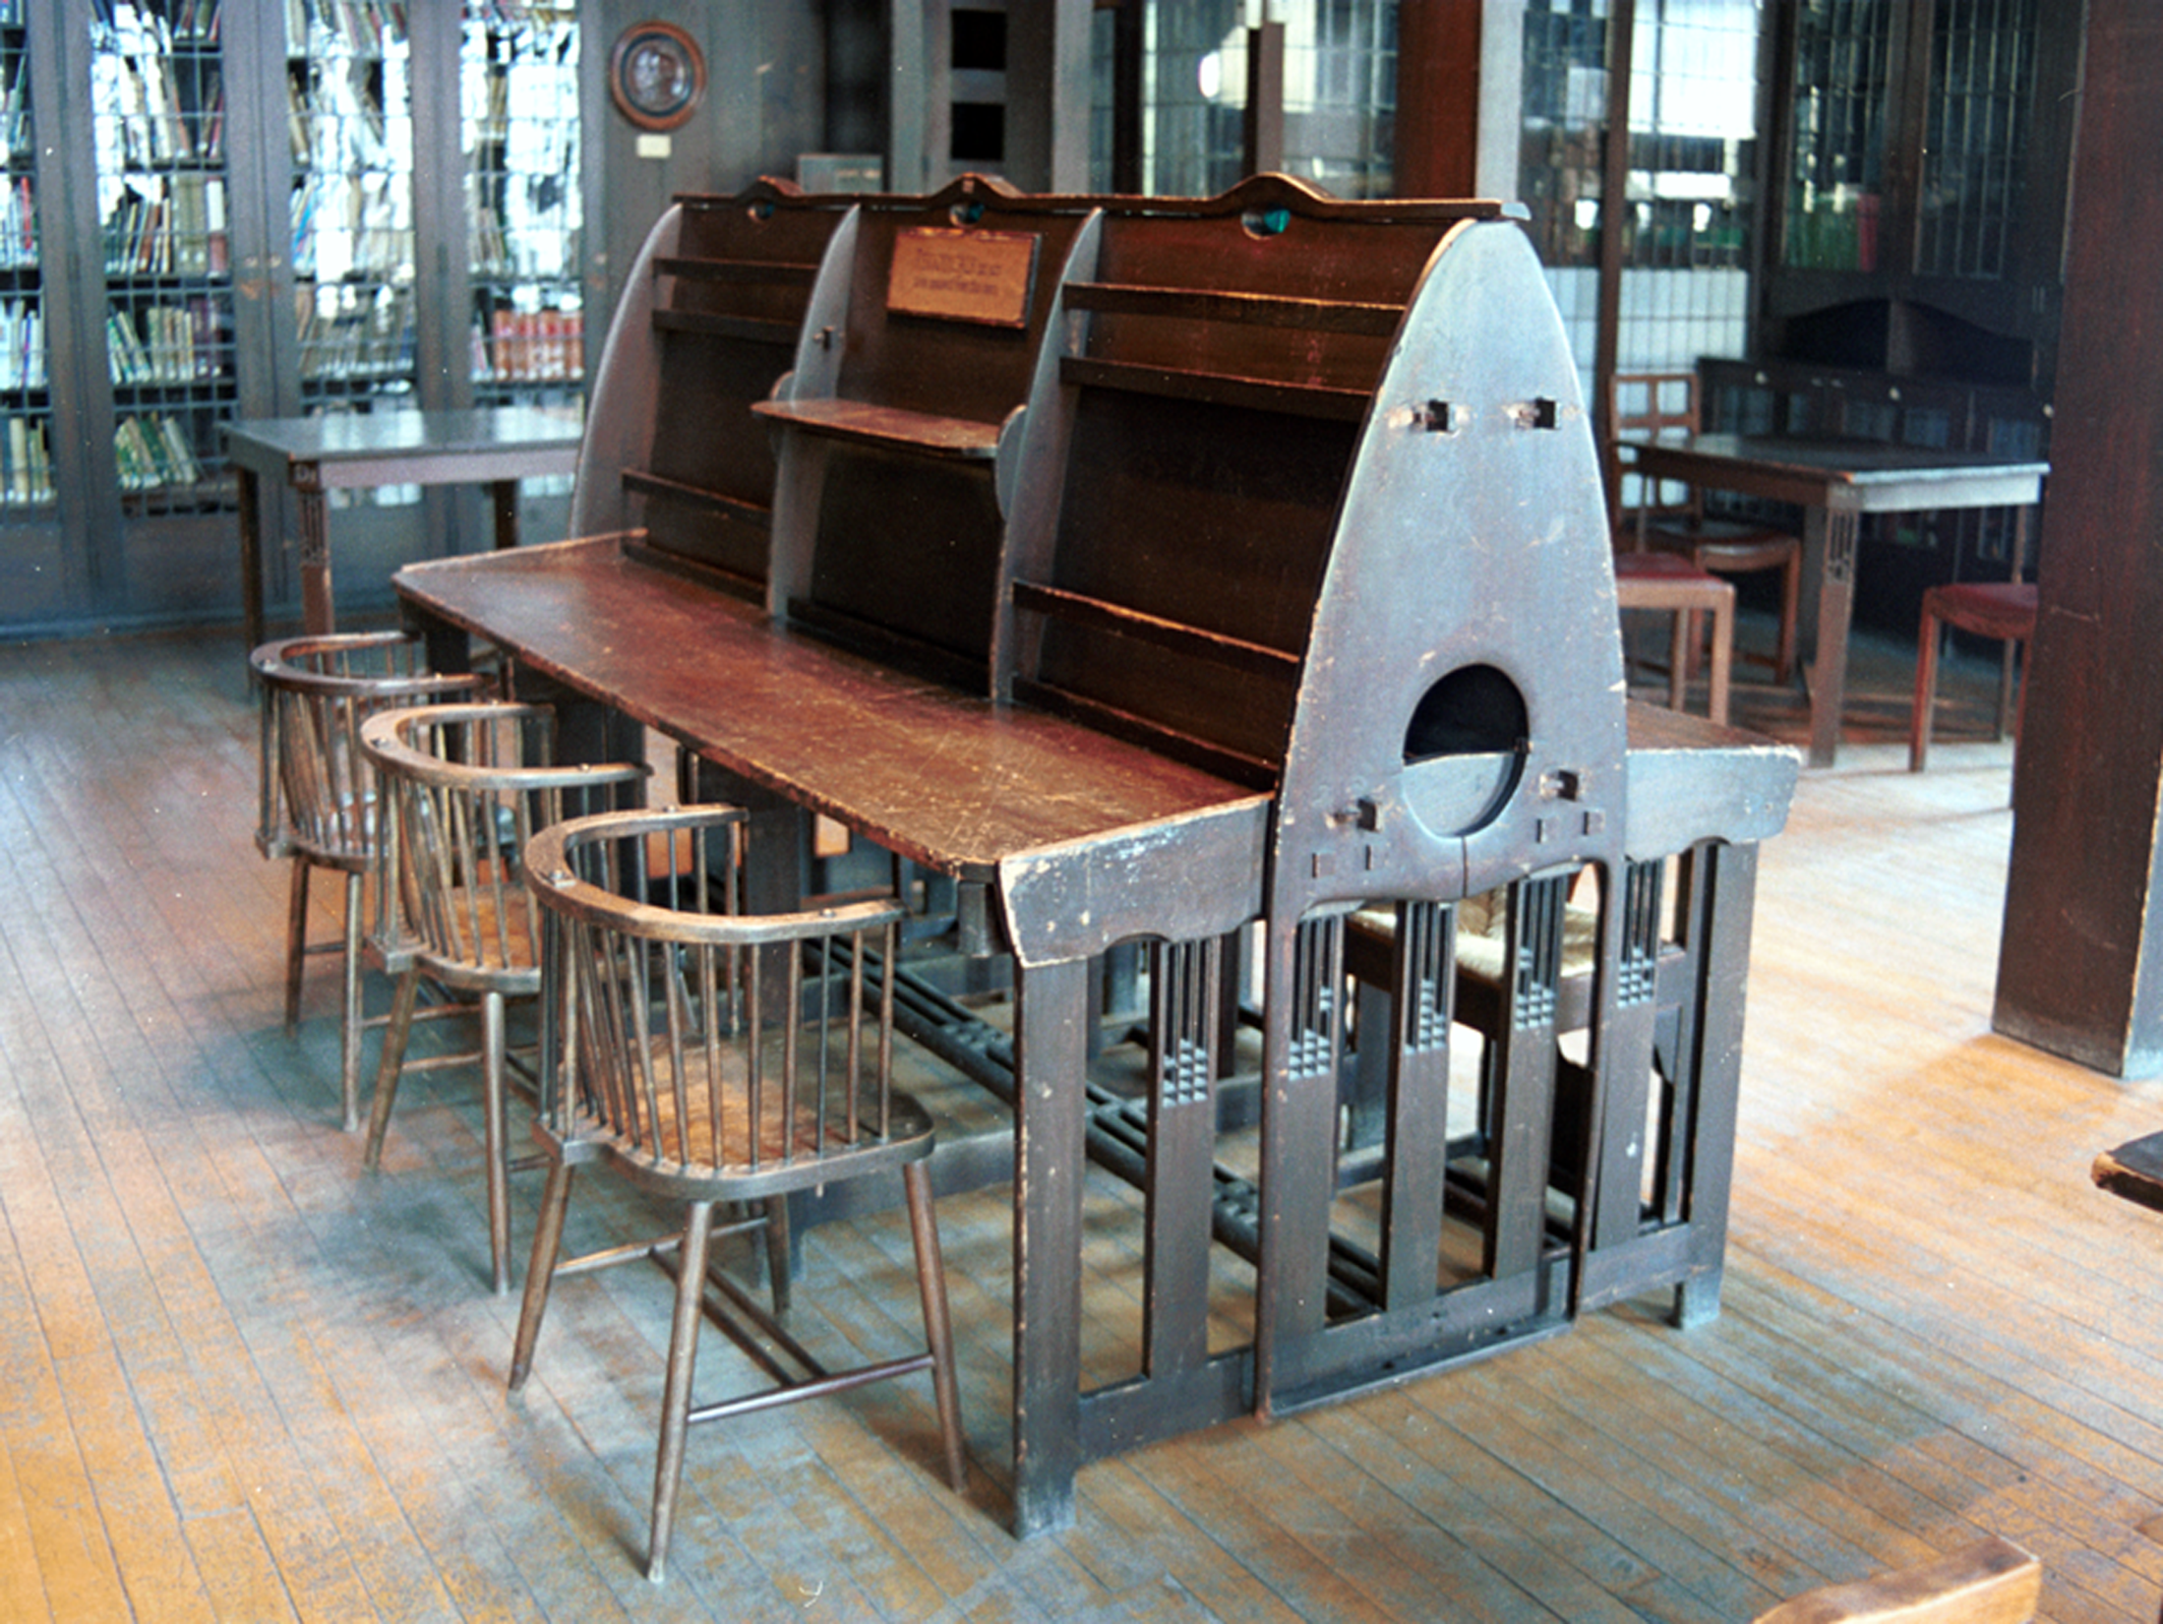
Notes:
Periodicals desk and chairs

Slide 7
Notes:
An early image of the library soon after completion from our Archives

Slide 8
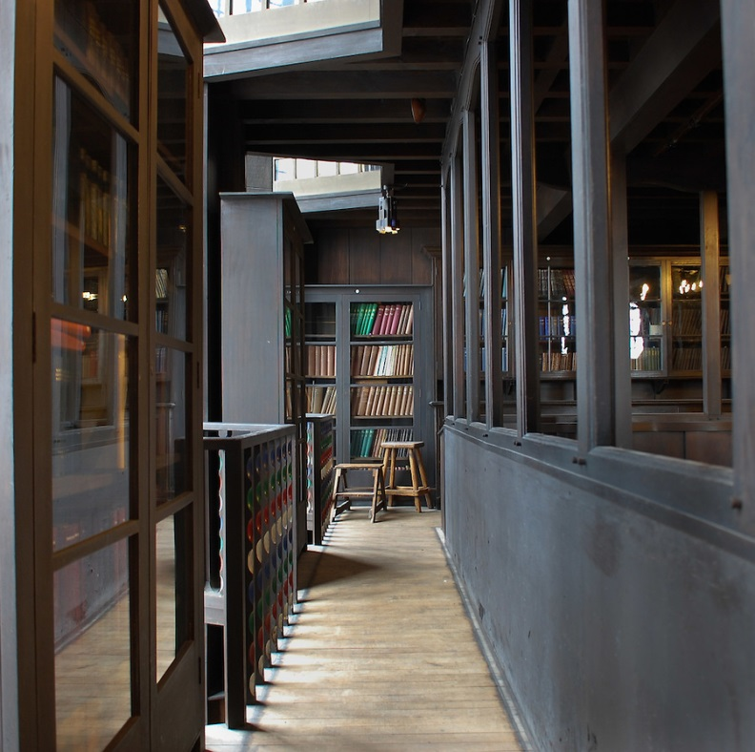
Notes:
Writing on the symbolic allusions of Mackintosh’s design, James Macaulay, in his authoritative 1993 Phaidon account of the building , states “…the library of the Glasgow School of Art is not only an aesthetic experience but the translation of philosophical thought into three dimensions.”
The building as a whole has been described by Sir Christopher Frayling, Rector of the Royal College of Art, as “the only art school in the world where the building is worthy of the subject...this is a work of art in which to make works of art”.
The particular ways in which the Library was constructed had marked implications for how the fire spread:
As an architectural space, the Library was built across 3 levels, comprising a ground floor, a mezzanine balcony (which can be seen here) running along all four sides, and a bookstore above (latterly used as a furniture store).
Nearly all the wood employed in the design is oak.
Mackintosh employed some innovative and unusual engineering solutions when constructing these spaces.
The bottom levels were hung from two large cast-iron cross-beams in the store, with hangers dropped through subsequent levels and encased in oak to form dummy columns.
The columns themselves were therefore non-supportive, with all load-bearing undertaken by the cross-beams and hangers.
At ground floor level the dummy columns formed a nave-and-aisle plan, though the space itself was square rather than rectangular.

Slide 9
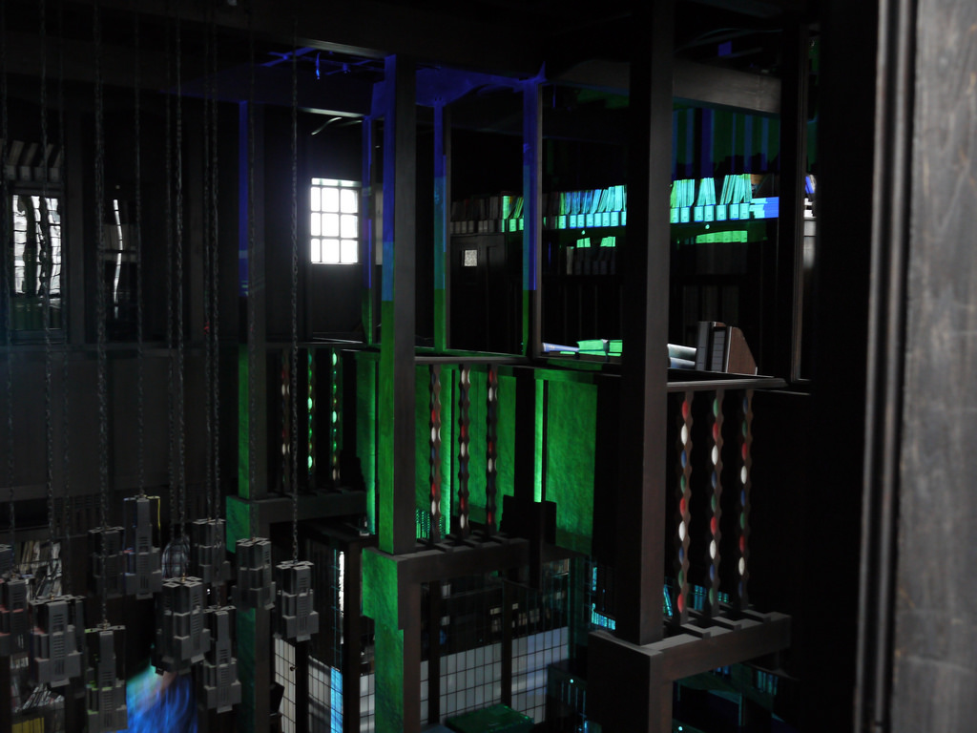
Notes:
You can perhaps gain a better sense of this interrelation of levels in this photo, which shows digital light interventions staged by our Digital Culture students earlier this year.

Slide 10
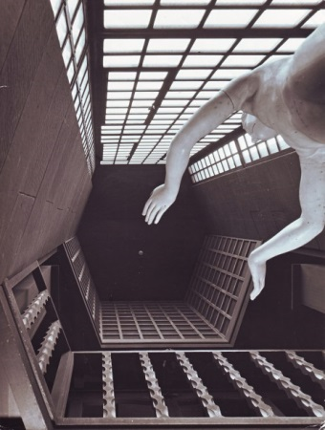
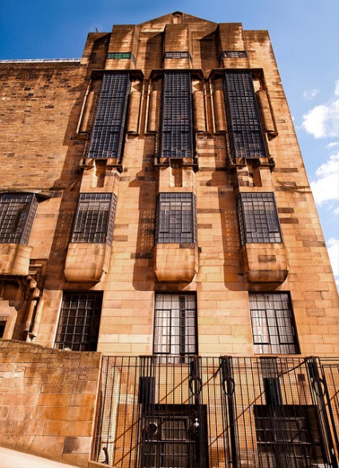
Notes:
Meanwhile, on the west façade, hexagonal voids allowed massive glazed windows to rise up through all three levels, increasing the light available to the space.
Macaulay has compared these vast windows to those at York Minster

Slide 11
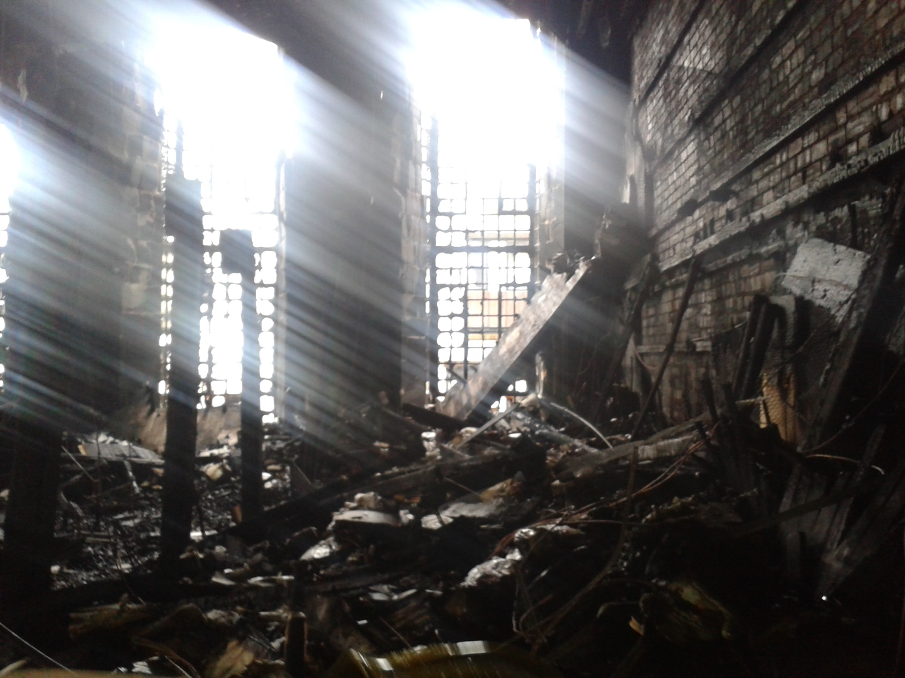
Notes:
Unhappily, On 23 May 2014 all these spaces were destroyed by fire.
These photographs of the destroyed library spaces were taken two days after that fire.
They were taken with a camera phone, so the resolution is very low, but it will give you a good indication of the extent of the devastation.
The remains of the dummy columns can be seen on the left
To the right, the ferocity of the fire is evidenced by how the wood facing has been completely stripped back to bare brick
Throughout the building hidden voids has been inserted to carry building services such as heating, ventilation and plant
Many of these voids were actually unknown to us and our Estates people until the fire laid them bare
Indeed the official report into the fire from the Fire Brigade noted that these voids acted as the principal route for the fire once it had taken hold
This meant that the route of the fire was mainly vertical, rather than lateral

Slide 12
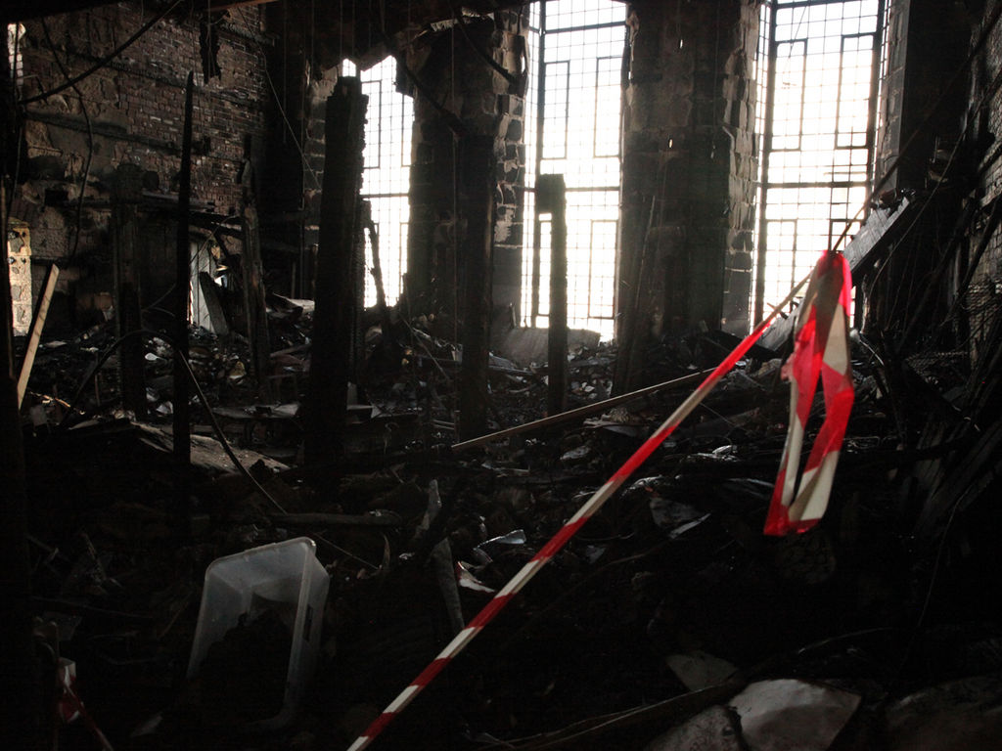
Notes:
Another view of the devastation, looking towards the west windows.
You can see that the former mezzanine level has completely collapsed down onto the ground floor.

Slide 13
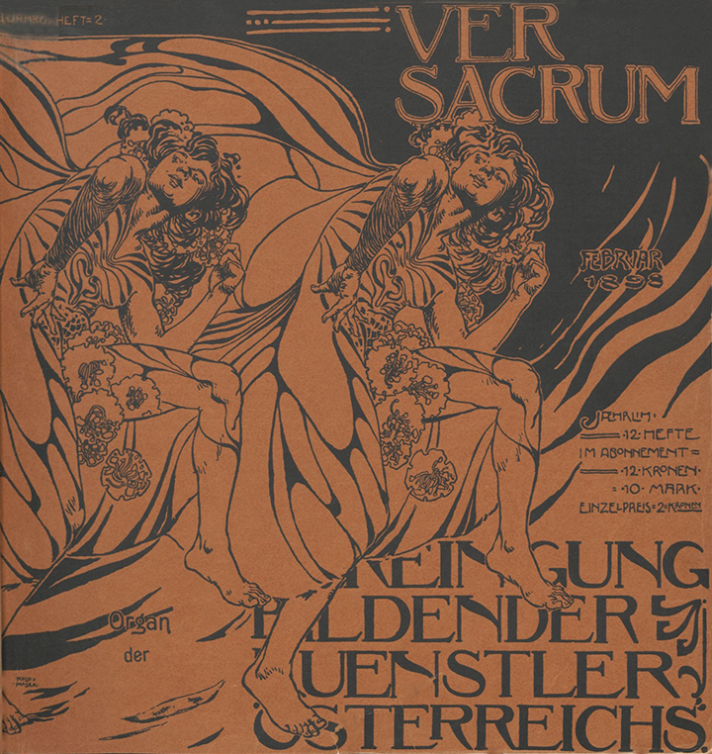
Notes:
But of course any historic library is more than just an architectural space.
We also lost many treasured irreplaceable collections in the fire, including books dating to the 16th century, rare avant-garde journals (such as Ver Sacrum – the journal of the Vienna Secession - that you see here) and 19th century illustrated books by our former staff and alumni

Slide 14
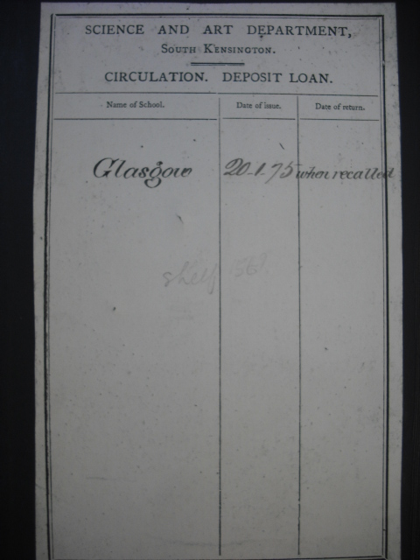
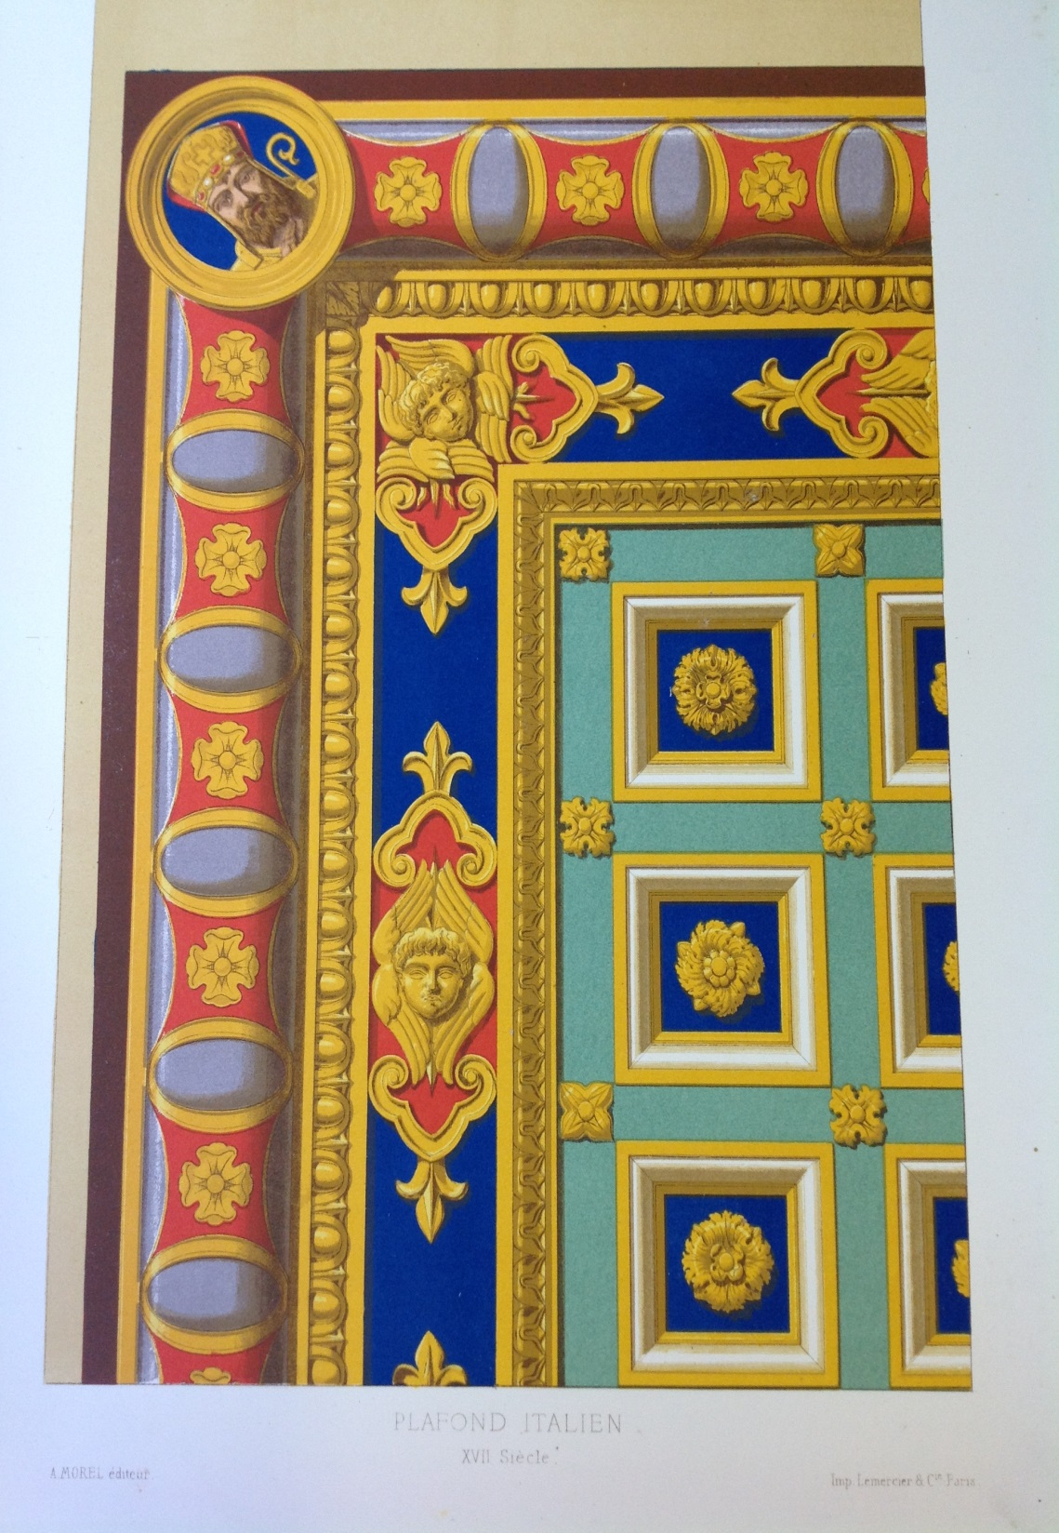
Notes:
We also lost a significant proportion of the School's Foundation Collections, which came to us from the then South Kensington Museum under the South Kensington system of arts education…
This obviously constitutes a great loss to the School’s institutional history

Slide 15
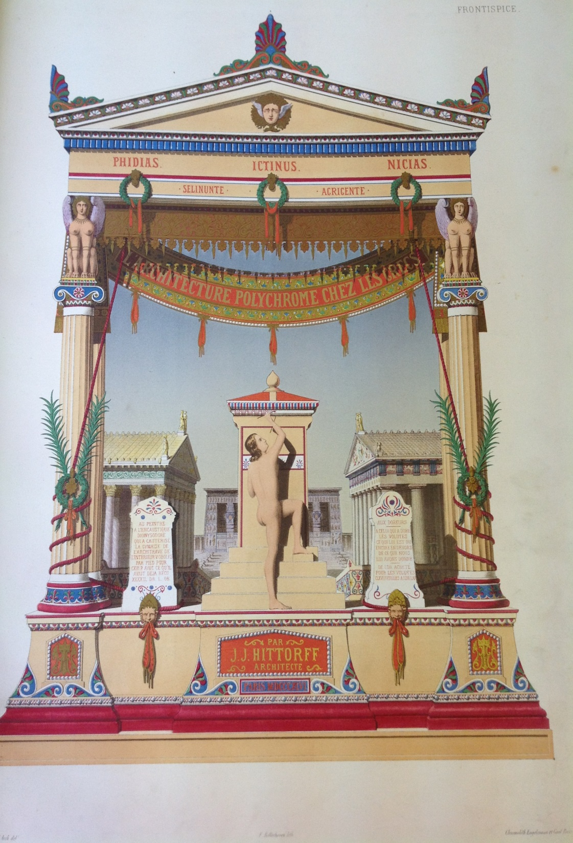
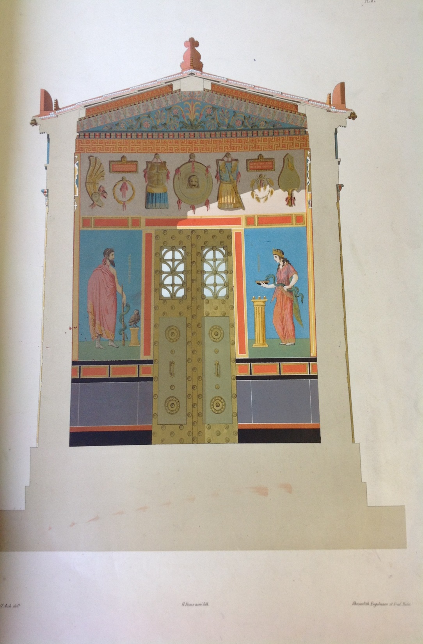
Notes:
Lost volume

Slide 16
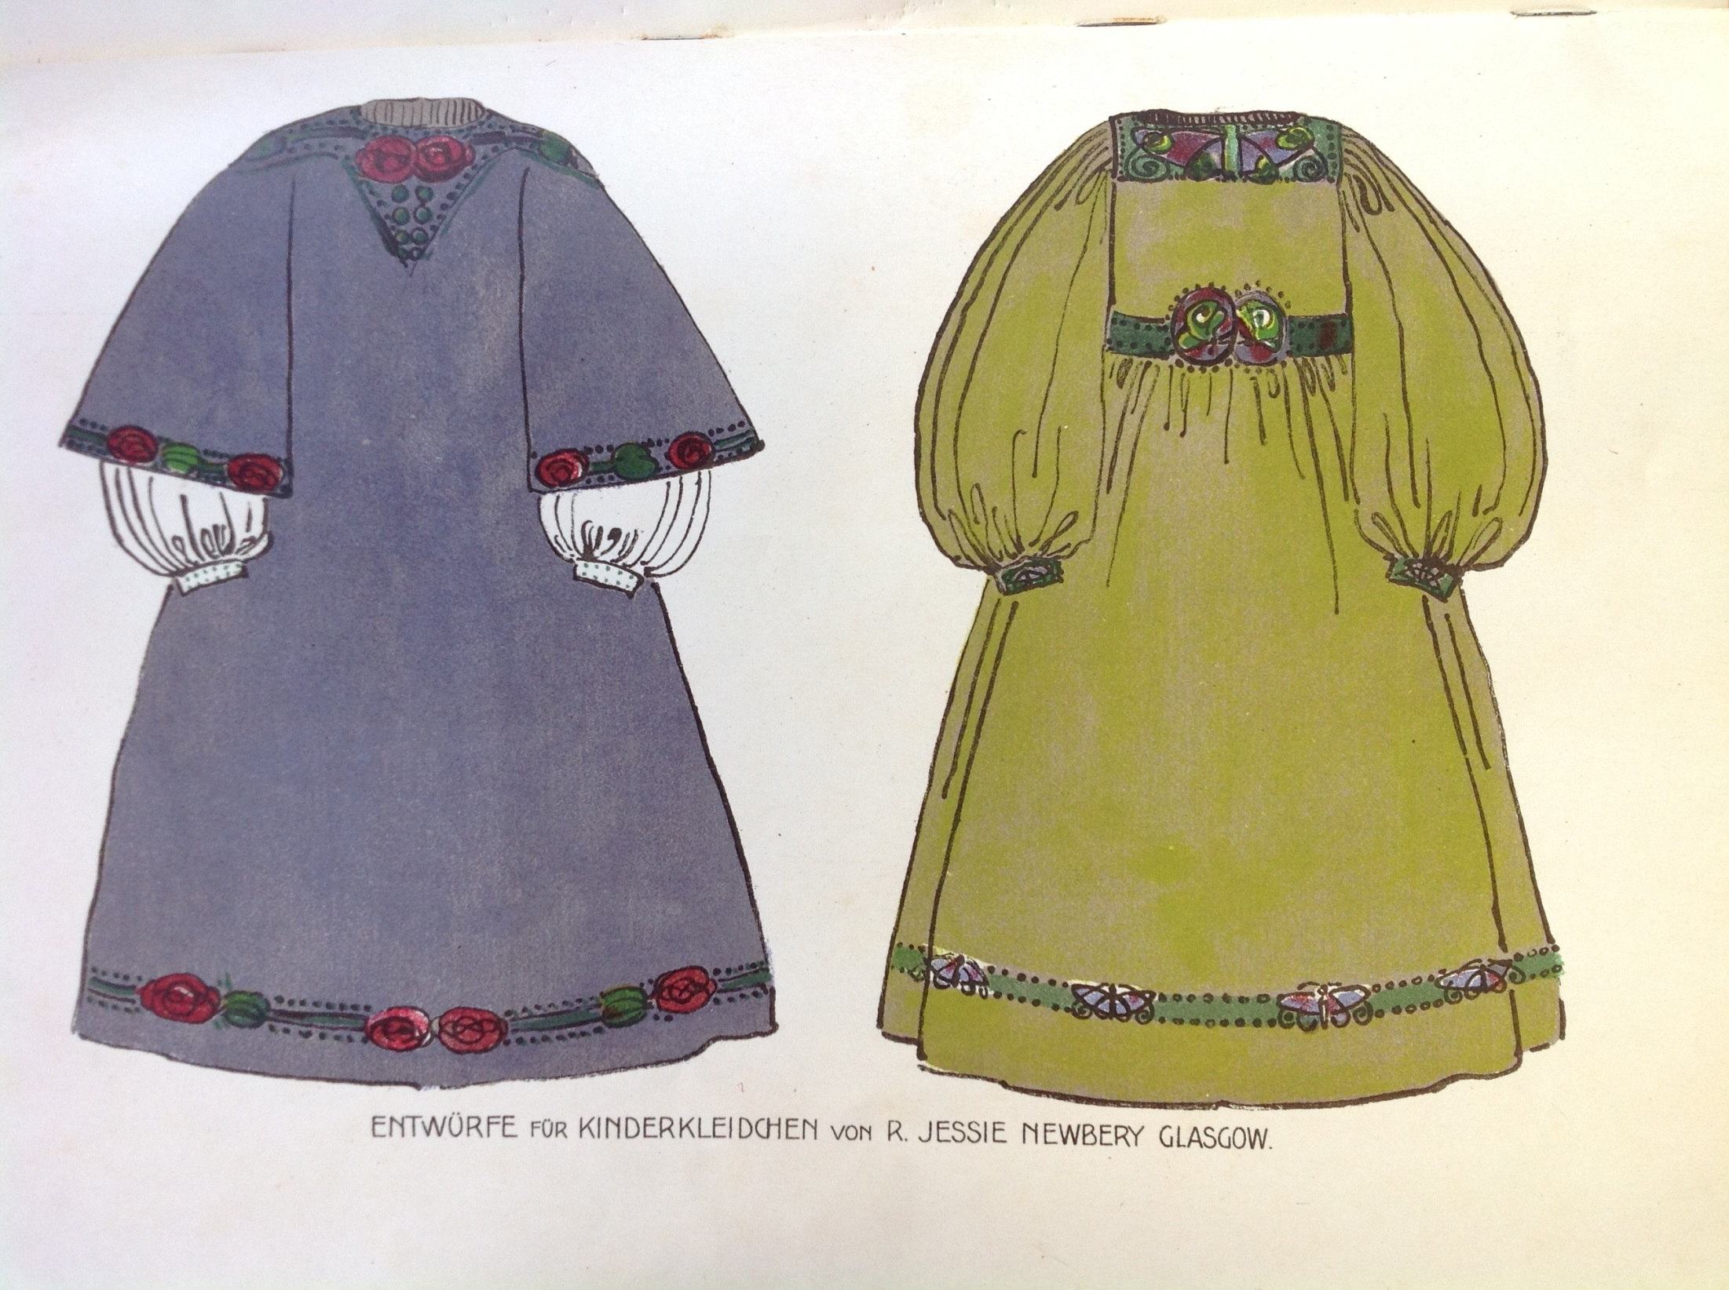
Notes:
Lost volume

Slide 17
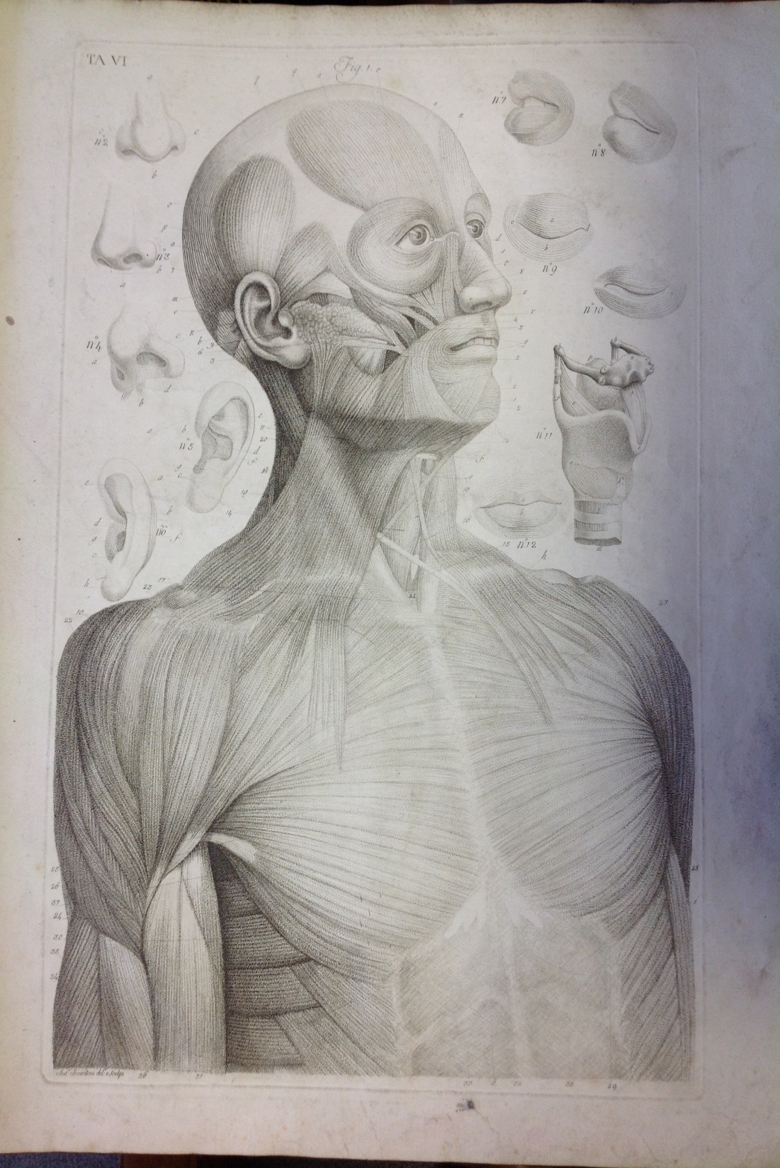
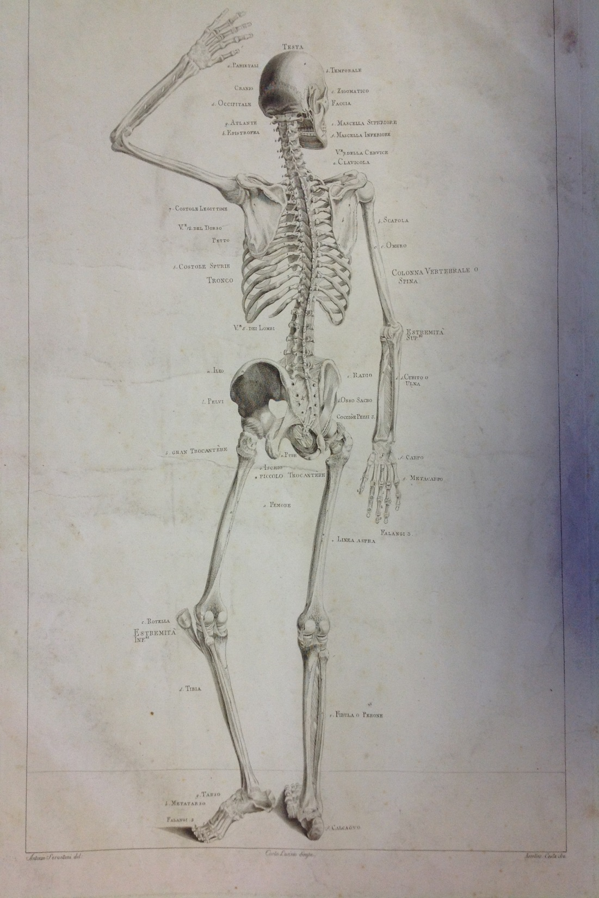
Notes:
Lost volume

Slide 18
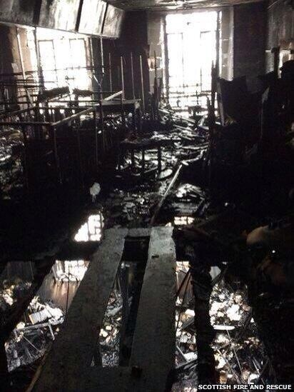
Notes:
Several items from our Mackintosh and non-Mackintosh collections were stored in the former bookstore above the Library, and so were also lost.
This includes the majority of our oil paintings on canvas and items of original Mackintosh furniture not then on display in our public furniture gallery.
The photo shows the former library bookstore (latterly the furniture store) looking down through the rafters into the library below.
You can make out the metal skeletons of the former painting racks.

Slide 19
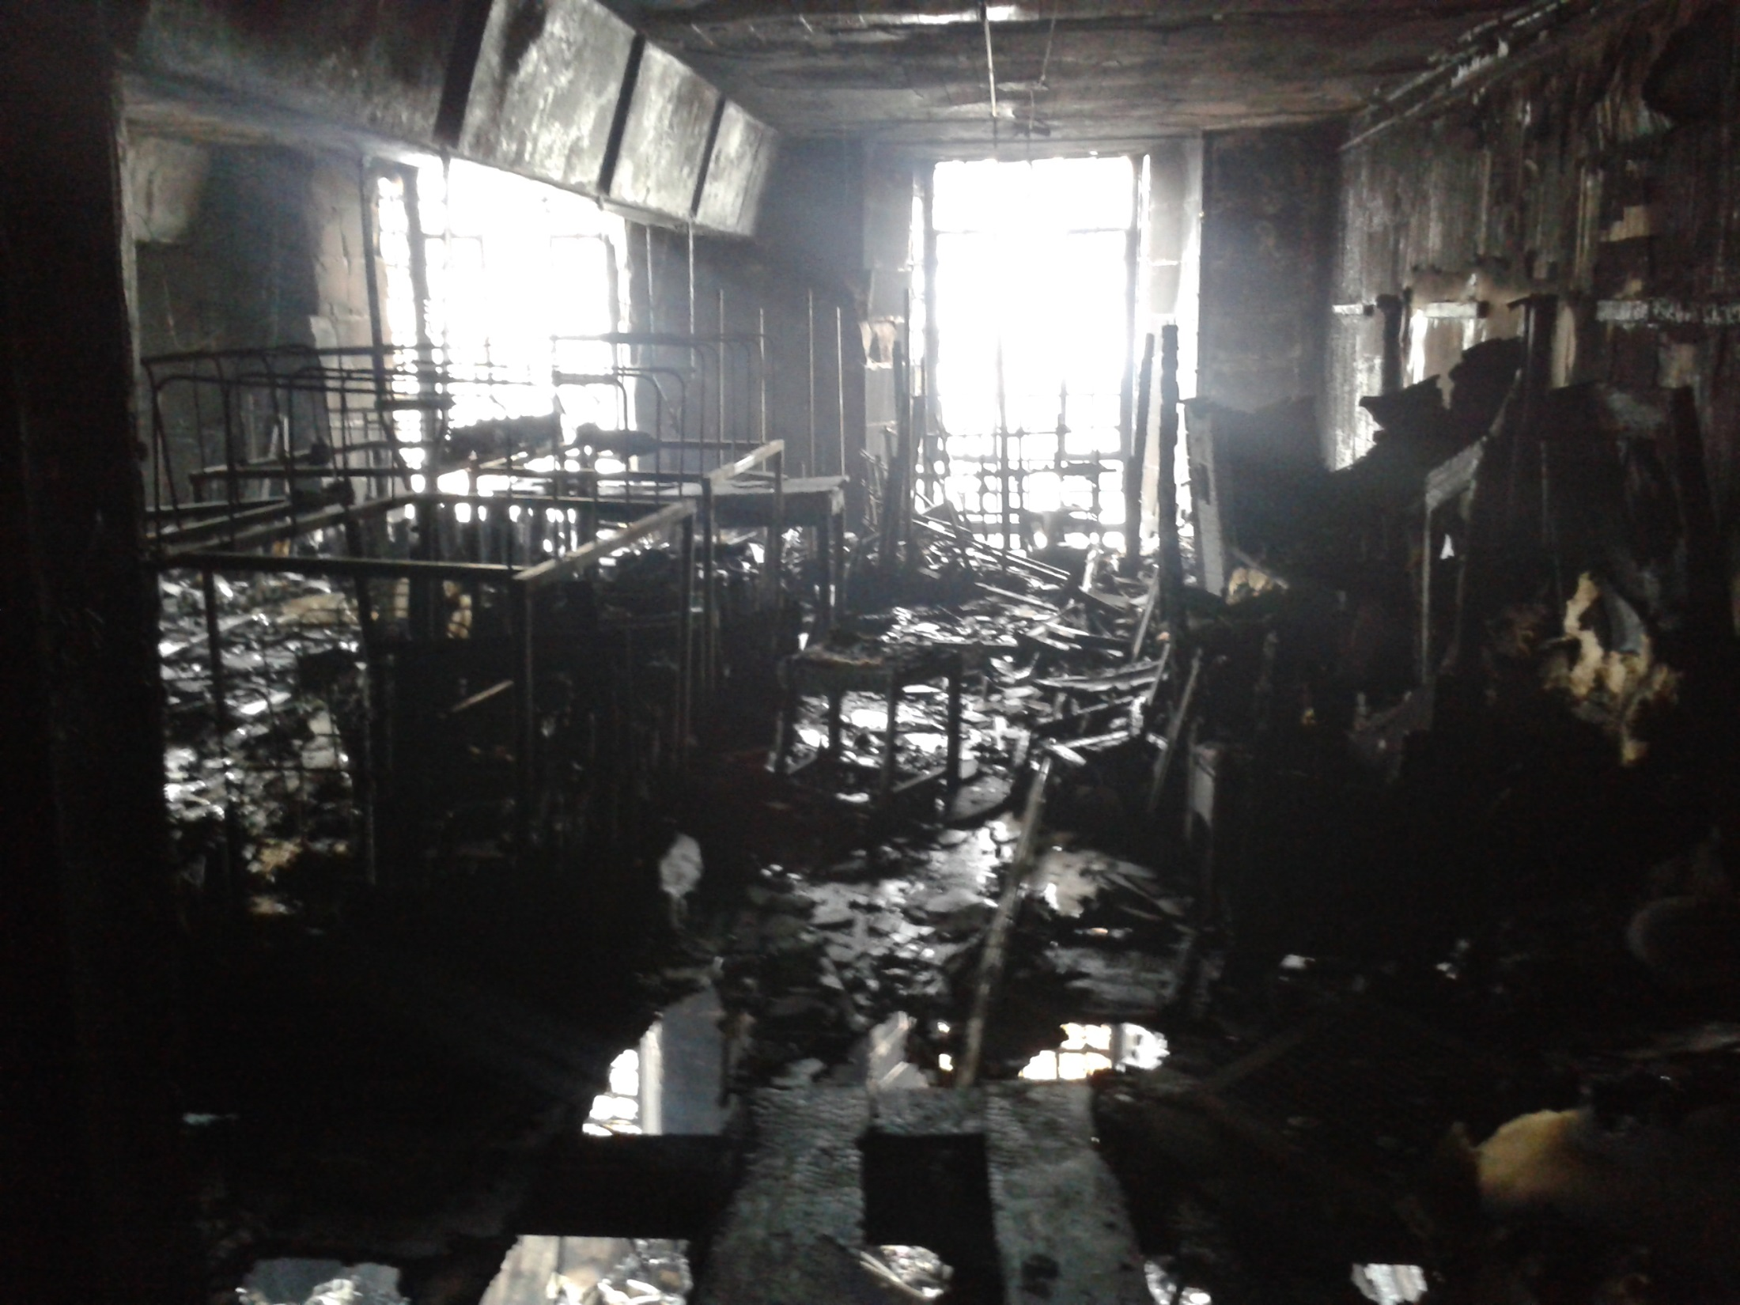
Notes:
You can perhaps get a better view in this image

Slide 20
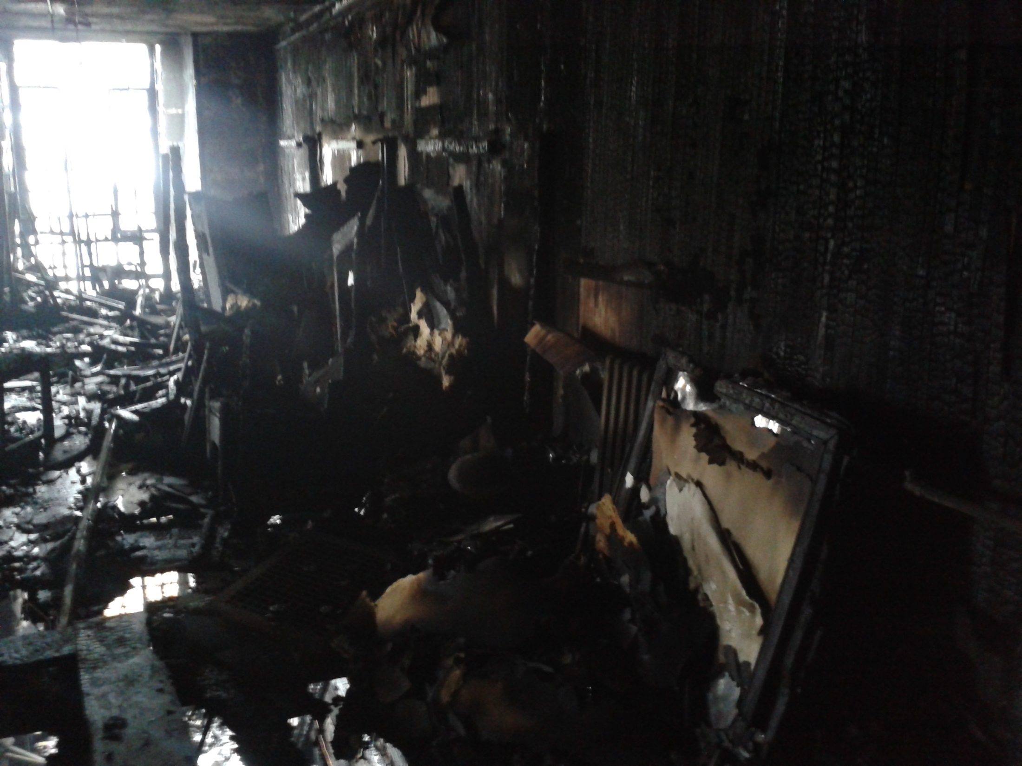
Notes:
And another view of the store with some of the destroyed canvases to the right

Slide 21
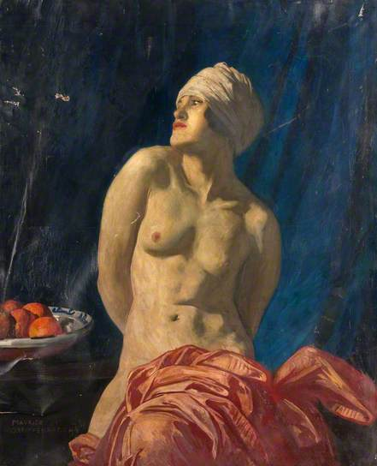
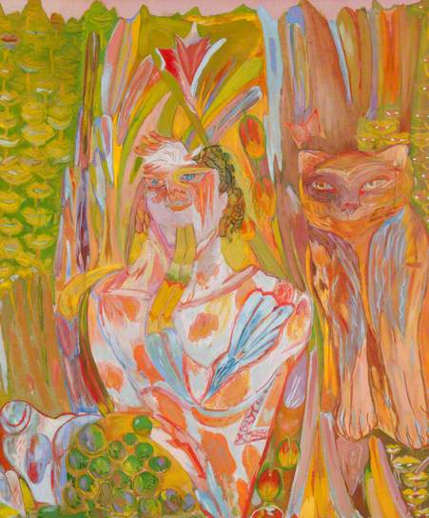
Notes:
Two of our destroyed paintings: Nude with a wrap by Maurice Greiffenhagen (1924), a former Head of Painting; Pan by Carole Gibbons (1970), a GSA graduate
In total, the majority of our oil paintings were destroyed: some 92 canvases from a total collection of 122.
The remaining collection now numbers just 30 or so canvases
They mainly represented the work of former students and staff of the School
The lost paintings can still be viewed on our Archives and Collections catalogue, but with the destroyed status noted
They continue to appear on the BBC Your Paintings website and we expect their status to be annotated by July this year

Slide 22
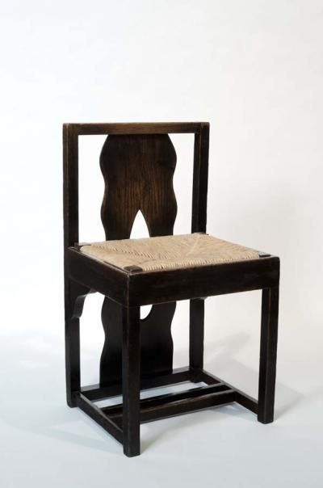
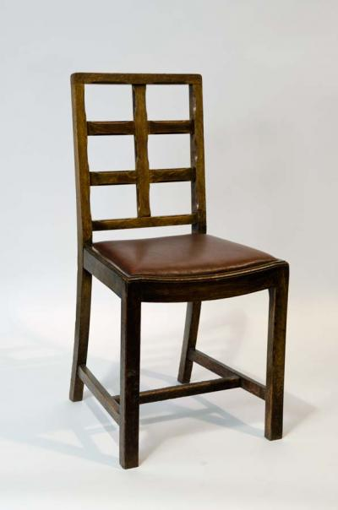
Notes:
In total some 139 pieces of original Mackintosh furniture were also lost
Most of these pieces were duplicates of pieces on display in our public Furniture Gallery, which was unaffected by the fire
But a small number of pieces were unique

Slide 23
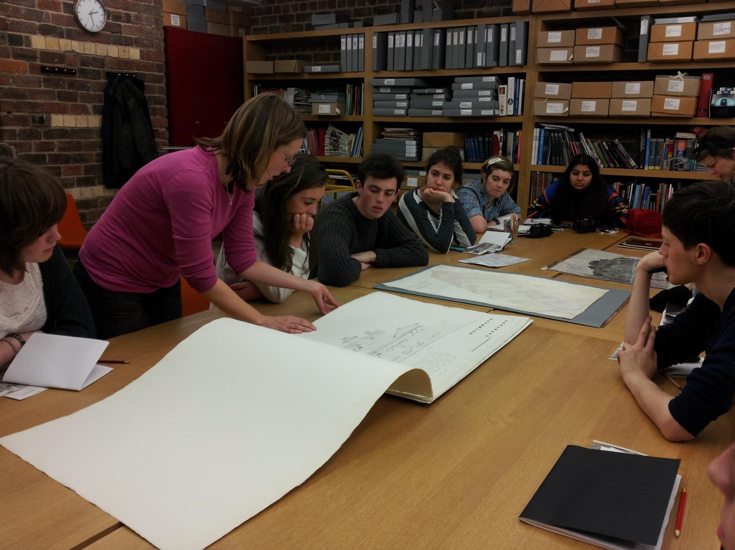
Notes:
The School’s Archives miraculously escaped the fire, despite the fact they were housed in the basement level right next door to the studio from which the fire originated.
Since 2008 they have been housed in environmentally-controlled stores close to a public reading room.
These were created as part of an HLF-funded Mackintosh Conservation and Access Project which aimed to conserve the fabric of the building and its archive and museum collections, and to enable enhanced access to our heritage assets.
The total project cost in the region of £8.6 million.
Subsequent to the fire, these facilities are now closed for the foreseeable future, and Archives and Collections staff are maintaining a limited access and enquiry service from rooms in the School’s main library

Slide 24
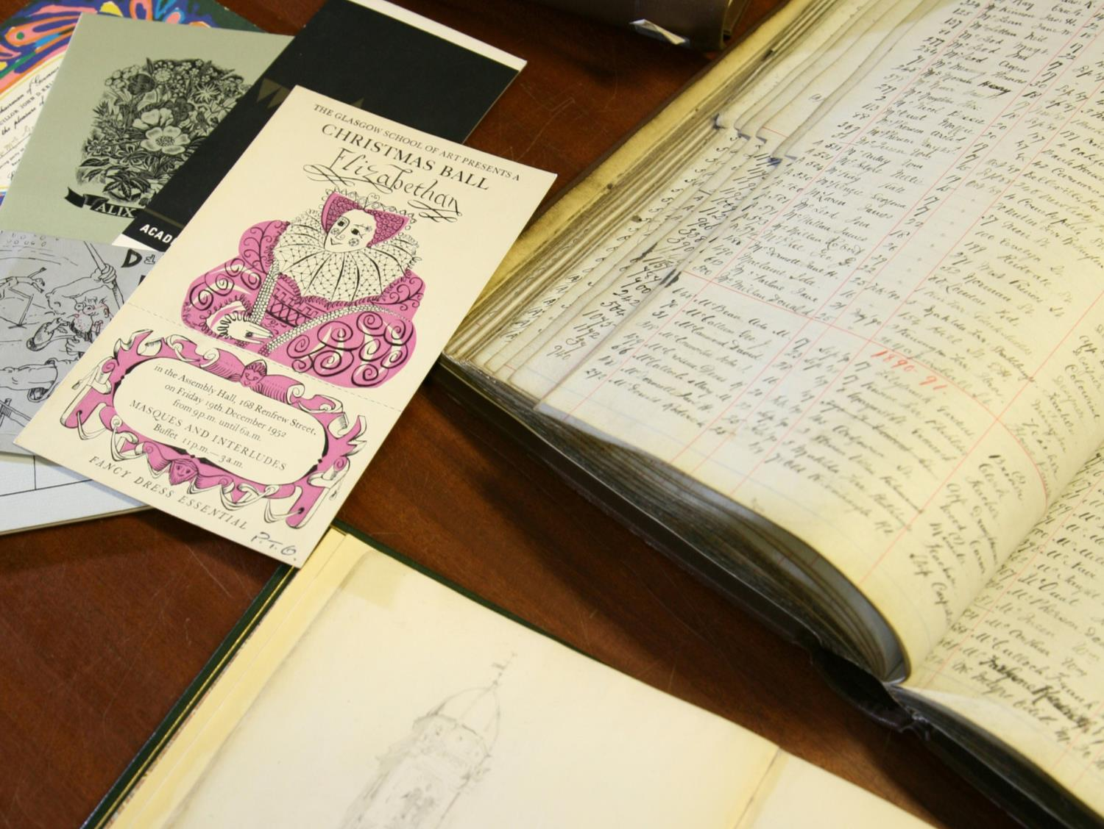
Notes:
These archive collections include a wide range of material relating to GSA’s history, activities, buildings, staff and students.
Material ranges from paper archives, photographs, sketch books, textiles, architectural designs, and posters.
The sheer variety of artefact obviously complicates subsequent salvage and conservation efforts
We are having to deal with multiple media and artefact types, which means that conservators from across specialisms will ultimately need to be engaged

Slide 25
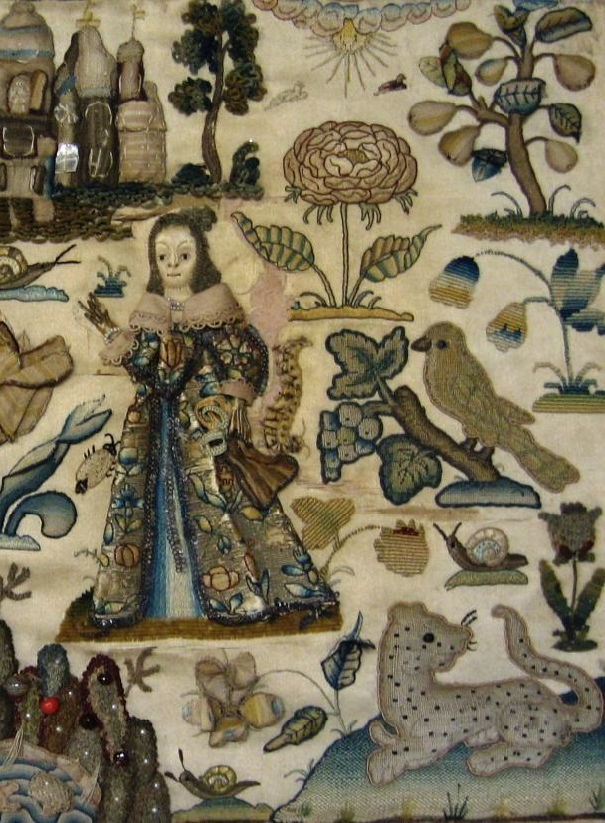
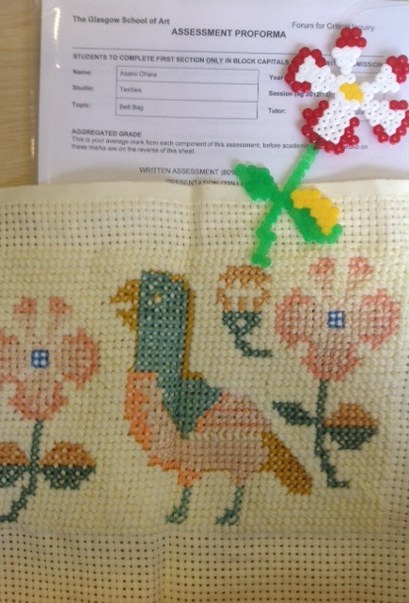
Notes:
Traditionally, Archives have placed a large emphasis on using these artefacts to stimulate and inspire current practice in our students
This is an example of course work created by a second year student in response to a piece of 1652 stumpwork held in our Archives

Slide 26
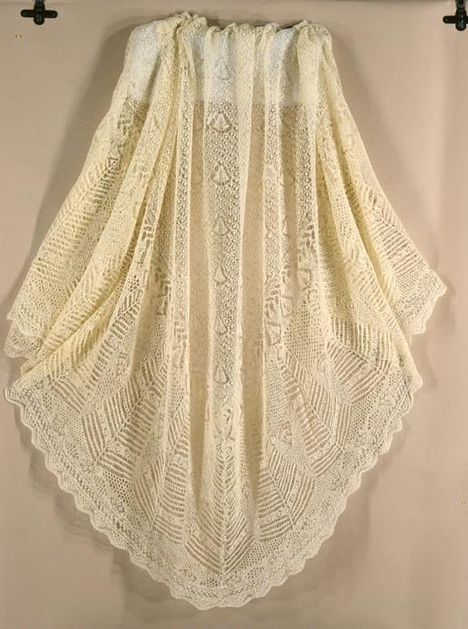
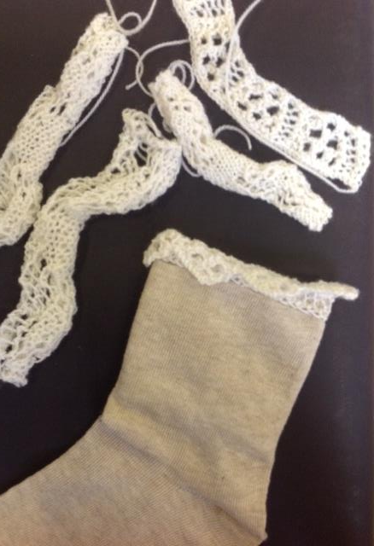
Notes:
And another example of student work, this time in response to a 19th c Shetland lace shawl
Our planning for the long-term conservation and access to these displaced collections therefore has to take into account continued student access
So that the collections can continue to play an active role in the learning and teaching activities of the School
Archives staff are obviously keen to maintain the relative high profile of their collections within the life of the School, whilst wrestling with the inevitable limitations placed upon them by such circumstances

Slide 27
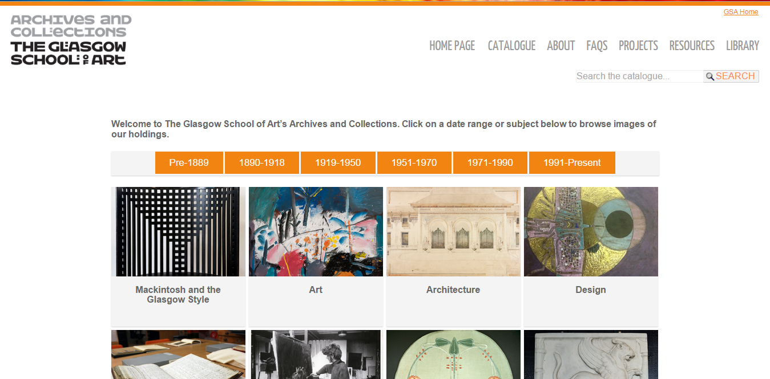
Notes:
Luckily, prior to the fire we had already initiated a project to migrate our archive and collections metadata and images to a new catalogue using the ARCHON system
And work to complete this was already underway
Subsequent to the fire, MGS very kindly gave us a further 3 month extension to our project grant to enable this work to complete
This has meant that access to our collections can be increased and expanded, if only in the digital realm

Slide 28
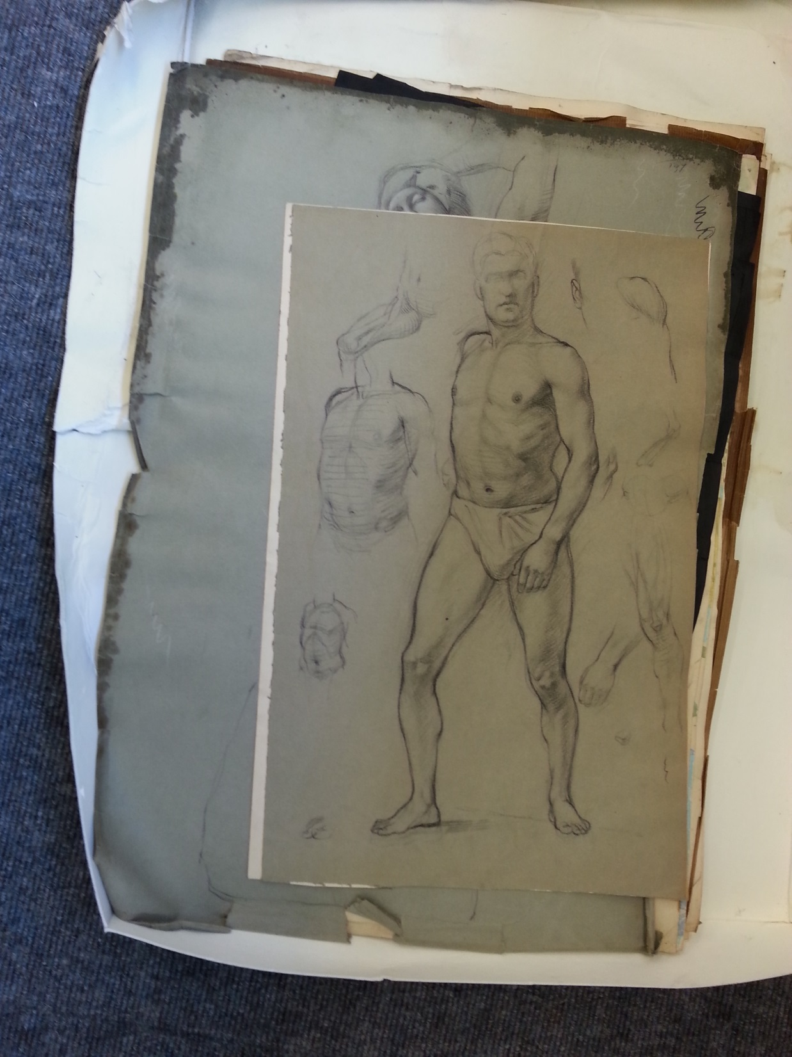
Notes:
Our archives, although safe, did suffer significant water and smoke damage during the fire and subsequent fire-fighting
One of our sub-basement stores and also the Archives reading room suffered water ingress.
These areas held the majority of the paper archives, textiles, and some plaster casts
Luckily 2 other stores did not suffer any ingress
In the immediate aftermath of the fire, with the loss of the library and much of our collections, our main priority quickly became the salvage of these damaged archives and textiles from the Mackintosh Building
These are life studies by a student from the 1940s, Gerard Murphy.
At the time of the fire they were a recent addition, and had not formally been accessioned or catalogued

Slide 29
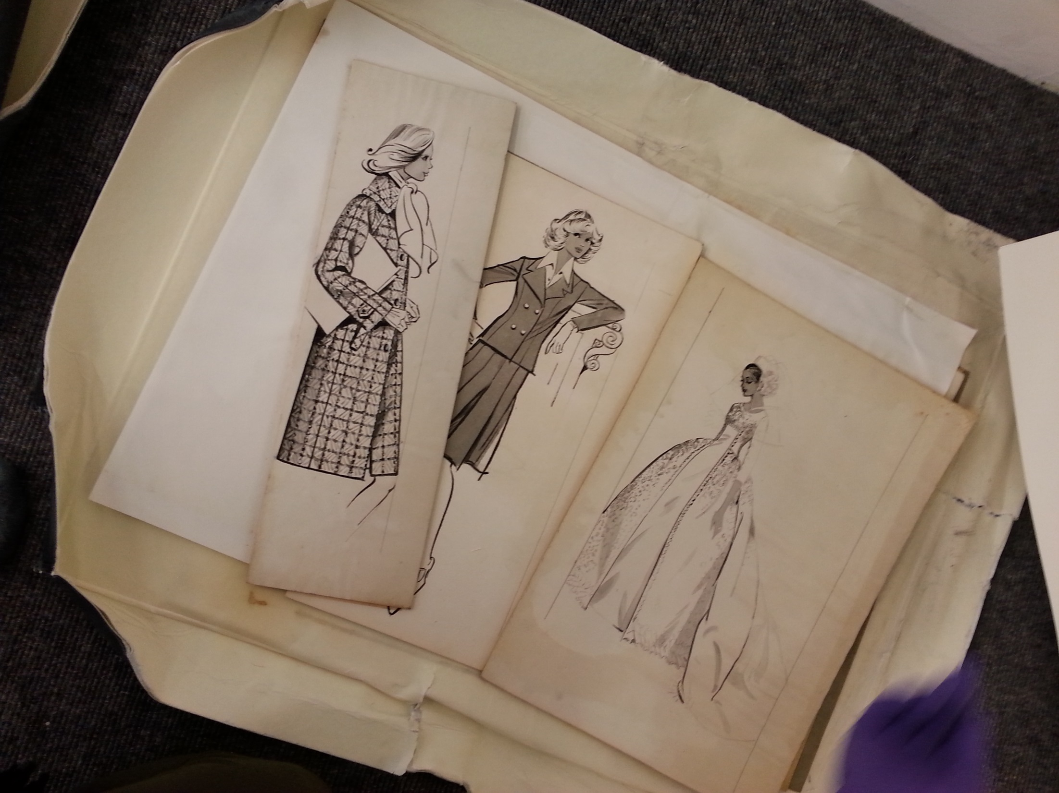
Notes:
Fashion plates by Garcia Hunter from the 1930s-1950s
Our bespoke conservation boxes did an excellent job in minimising the water damage inflicted on these collections

Slide 30
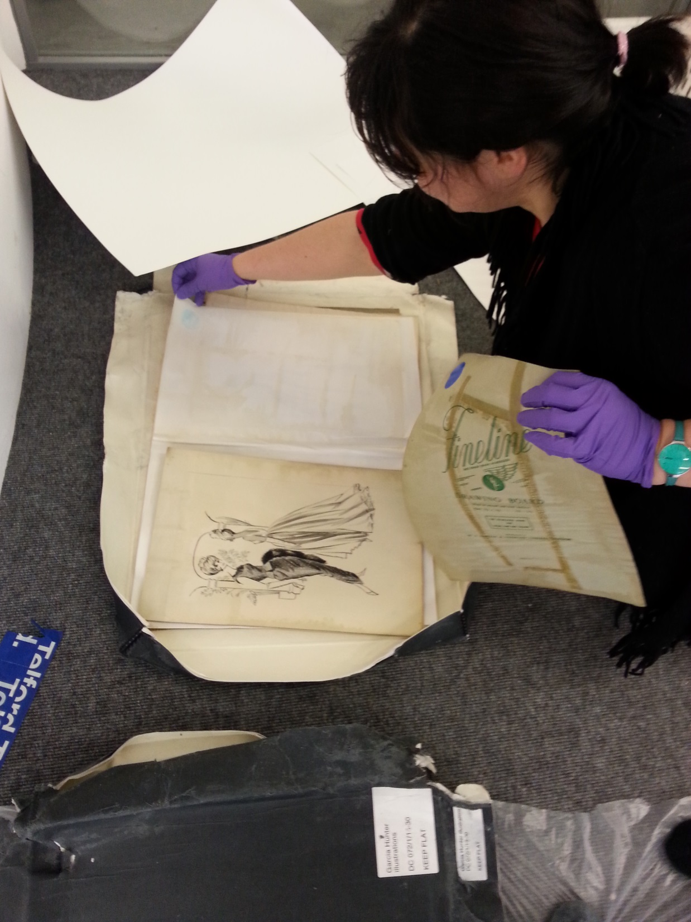
Notes:
We were aided in this salvage by many volunteers – including some academics – who willingly volunteered their time to help us
We were very humbled by the good will shown to us during this time, and by the generosity of all those who gave their time and support
It became apparent incredibly quickly how important it is to maintain a good roster of volunteers who are able to help at these times
And the importance of the close relationships we had built up with our teaching colleagues over a number of years became obvious

Slide 31
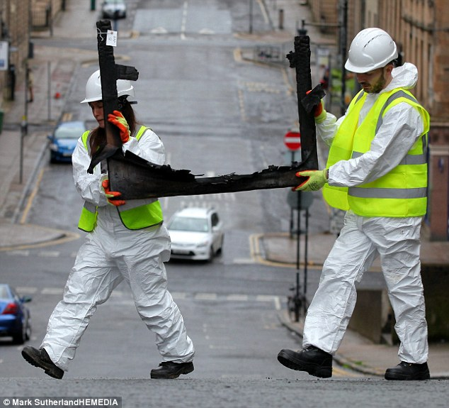
Notes:
For at least 3 days, it was all hands to the pump as we formed human chains to remove the damaged artefacts.
On the advice of conservators and the many other institutions who offered us their guidance, we salvaged almost anything that looked as if it could potentially be of interest
No retention or discard decisions were made at this point
In fact, we probably salvaged items that ultimately are of no use or value, but at this stage we were, to an extent, working blind
It is important to remember that at this point the building had no electricity, and many of the stores we were salvaging from had no sources or natural light or ventilation
The Mackintosh Building is an A-listed structure, so almost immediately after the fire, our colleagues from Historic Scotland were on site
They remained keen to salvage even small details that might later fill in blanks over the construction of the space

Slide 32
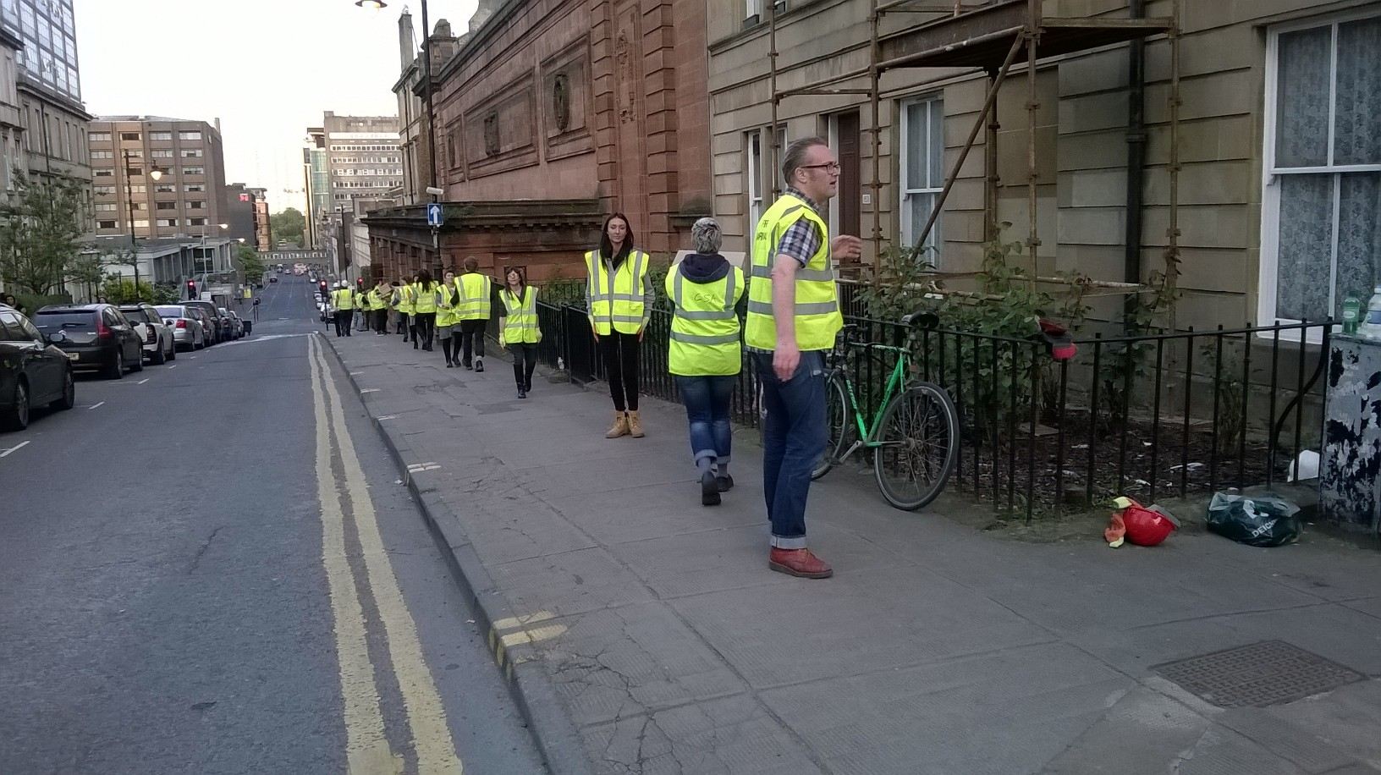
Notes:
Luckily we were able to lease the nearby McLellan Galleries very quickly from Glasgow City Council, in order to store, sort and triage their salvaged remains

Slide 33
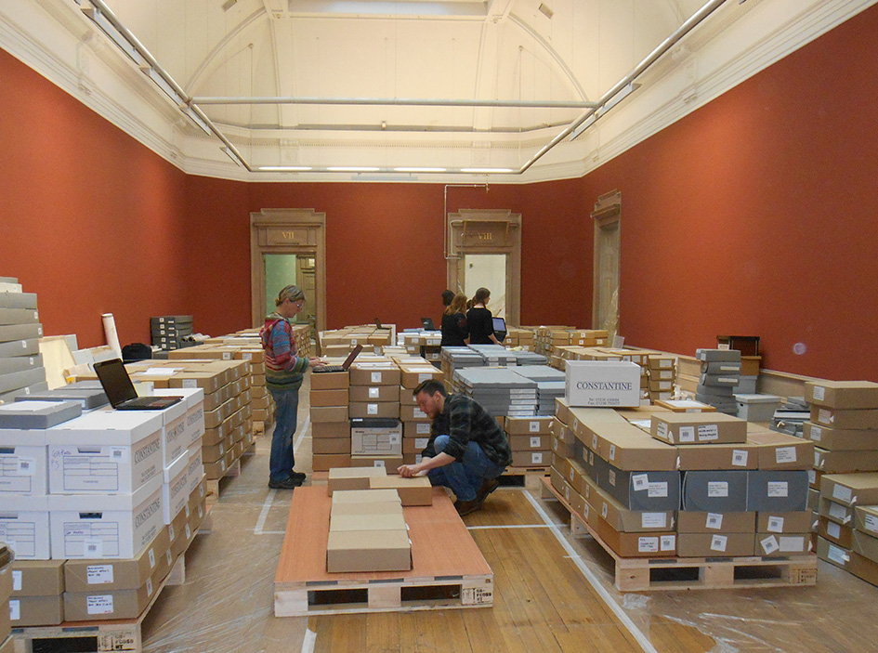
Notes:
A view of the interior of the McLellan Galleries, with some of our undamaged institutional records from the basement of the Mackintosh building

Slide 34
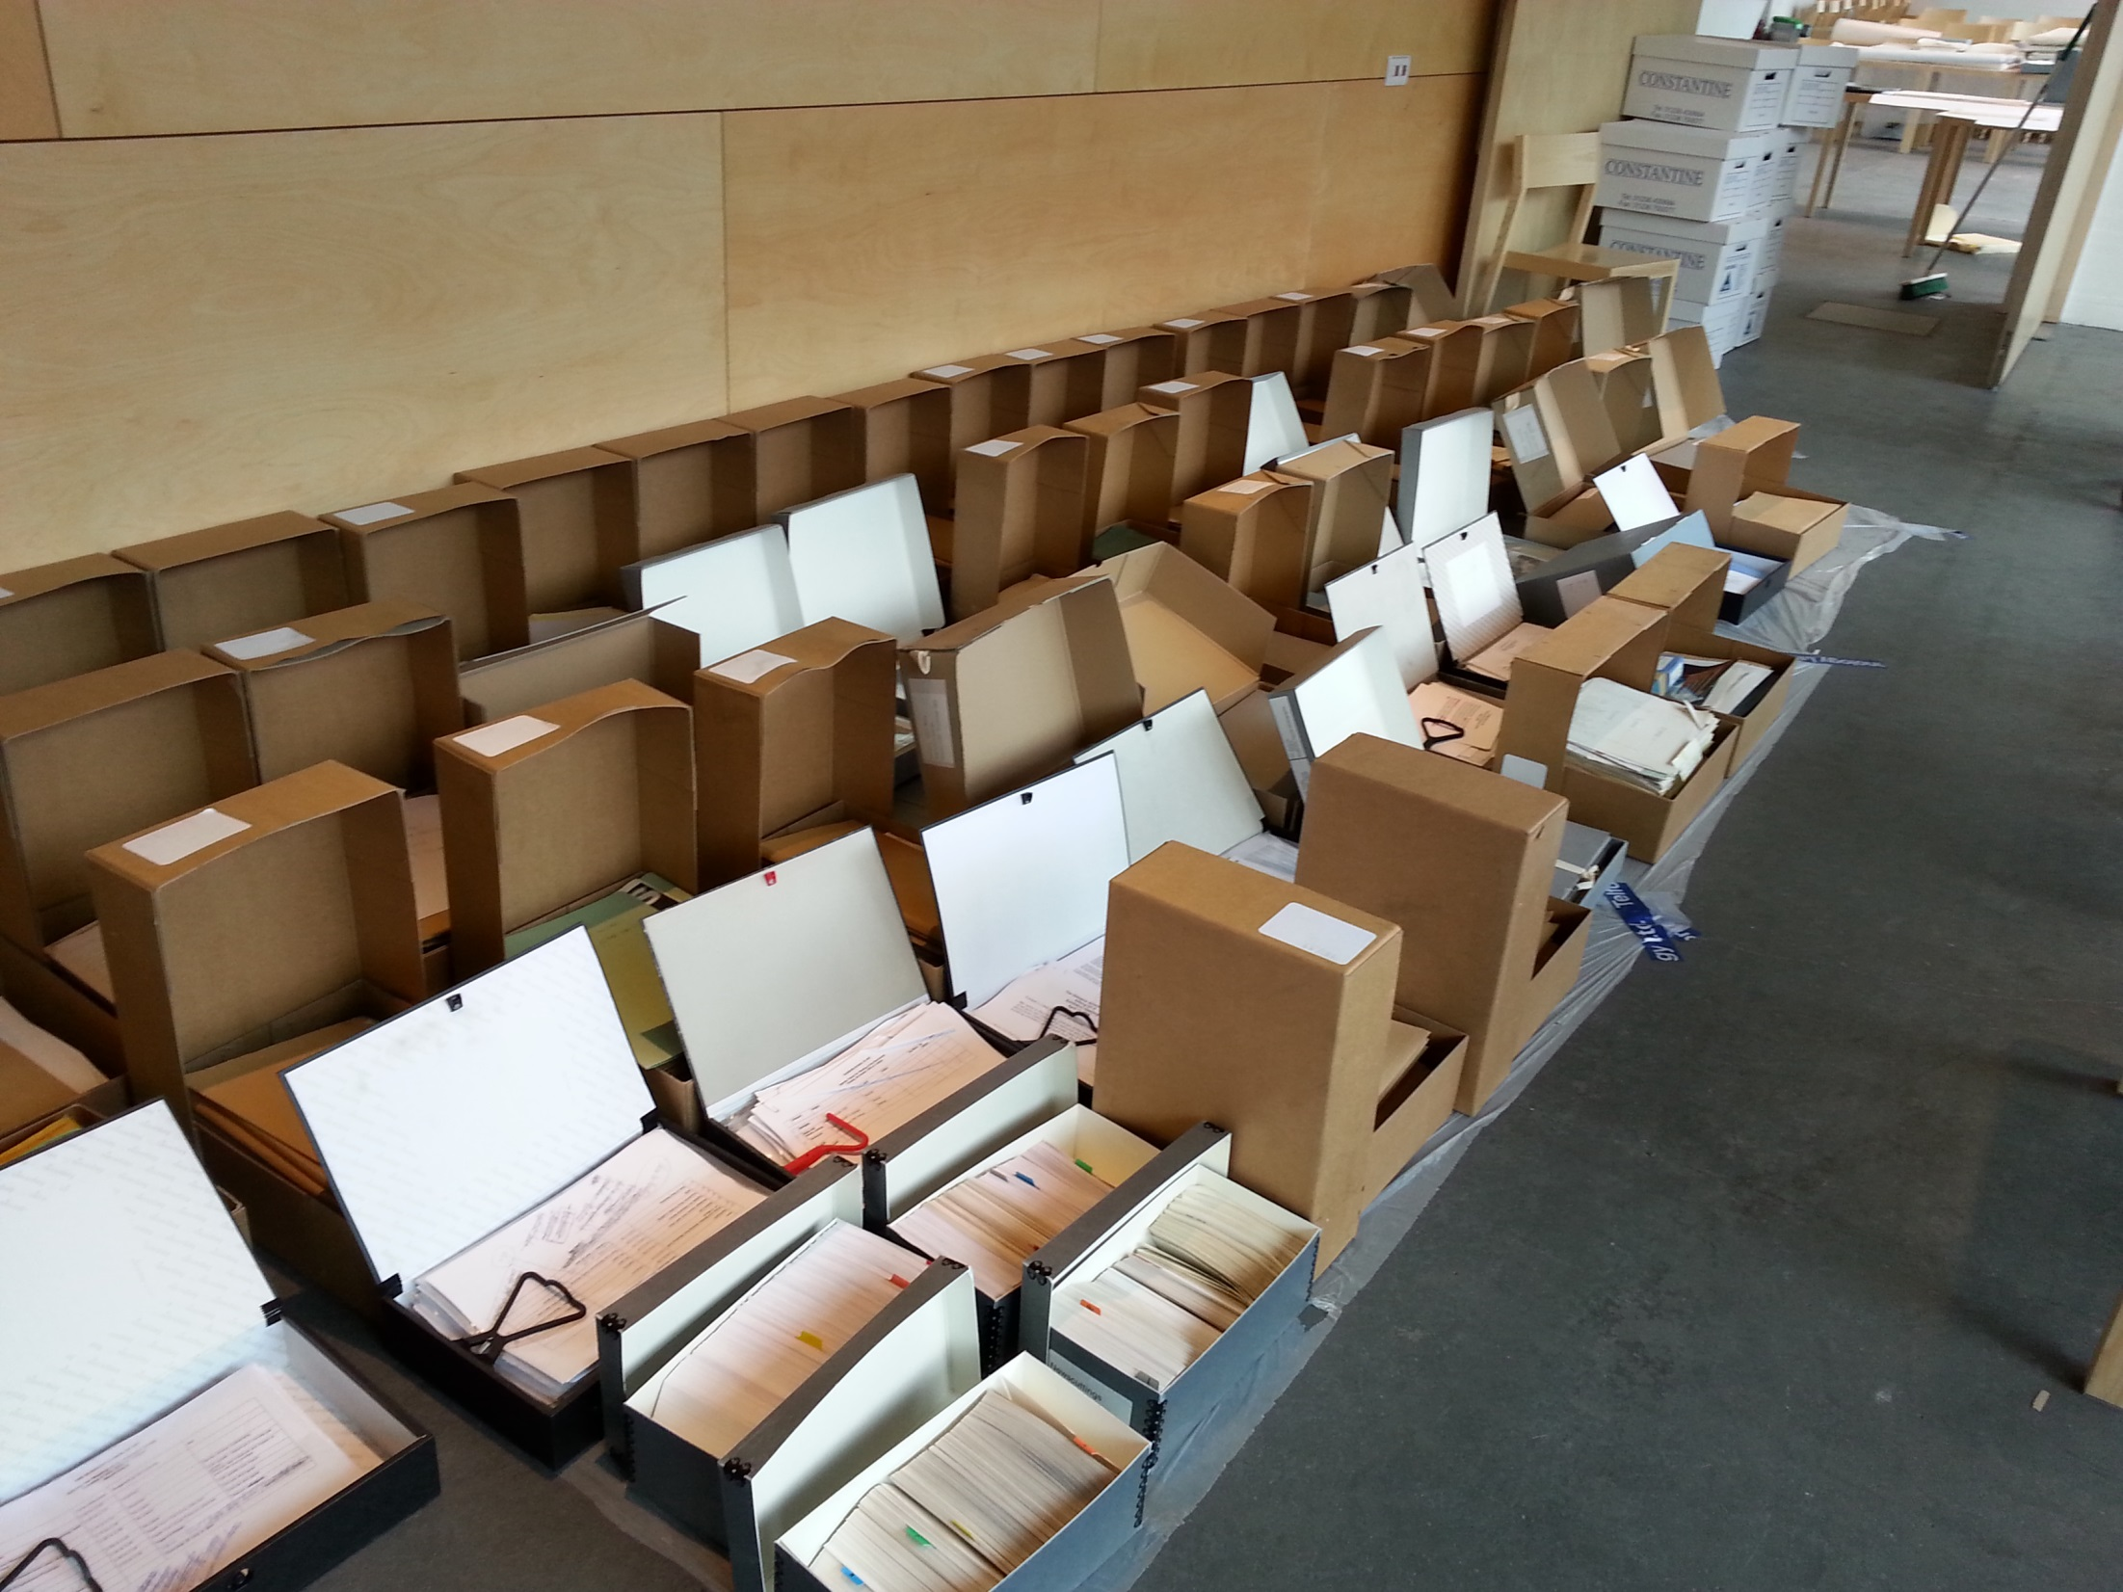
Notes:
We were also lucky to have sizable areas in which to sort and rest our damaged archives and textiles
Phase 1 of our campus redevelopment had just been completed with the opening of our new Reid Building, located directly across the road from the Mackintosh Building.
This meant that we had large areas of floorspace, the canteen, and a number of seminar rooms, that we could purloin
The fire occurred in May, towards the end of our academic year.
Had it occurred earlier in the year during core teaching weeks, we may not have been able to requisition so much space so quickly.
The Executive had also made the decision very quickly to close all School buildings for a week to enable staff to concentrate on the salvage process

Slide 35
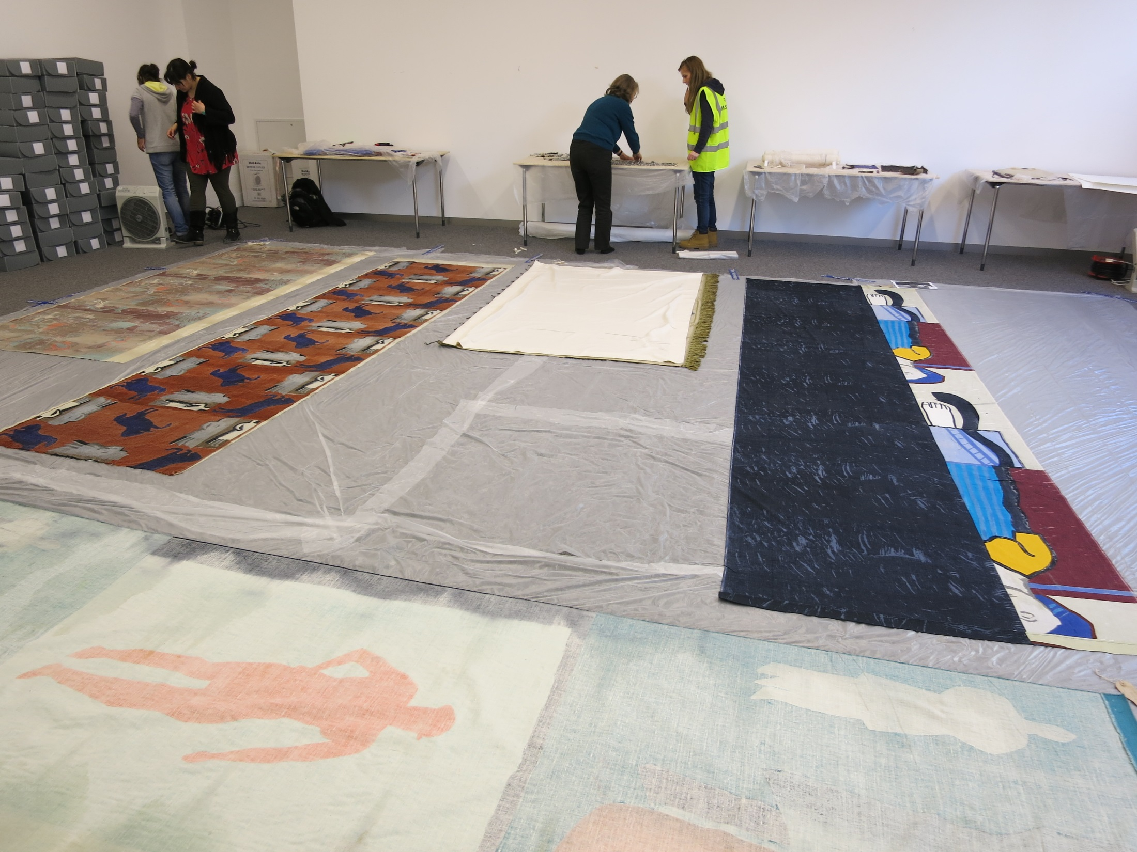
Notes:
We were aided in our salvage efforts by the Glasgow Area Disaster Planning Network
This group was initiated in 2004 by the Scottish Screen Archive and holds regular meetings, organises training events, and offers help to its members should a disaster occur.
Each member organisation is asked to sign an operational agreement and to submit their disaster plans
We were able to draw upon the expertise and skills of many experts across Scotland because of our membership.
This proved particularly important for a small organisation like ours, which does not normally retain conservators on its payroll.
Of most benefit to us were the organisational and logistical roles that could be assumed by others, such as phoning external companies, responding to enquiries, and planning rotas

Slide 36
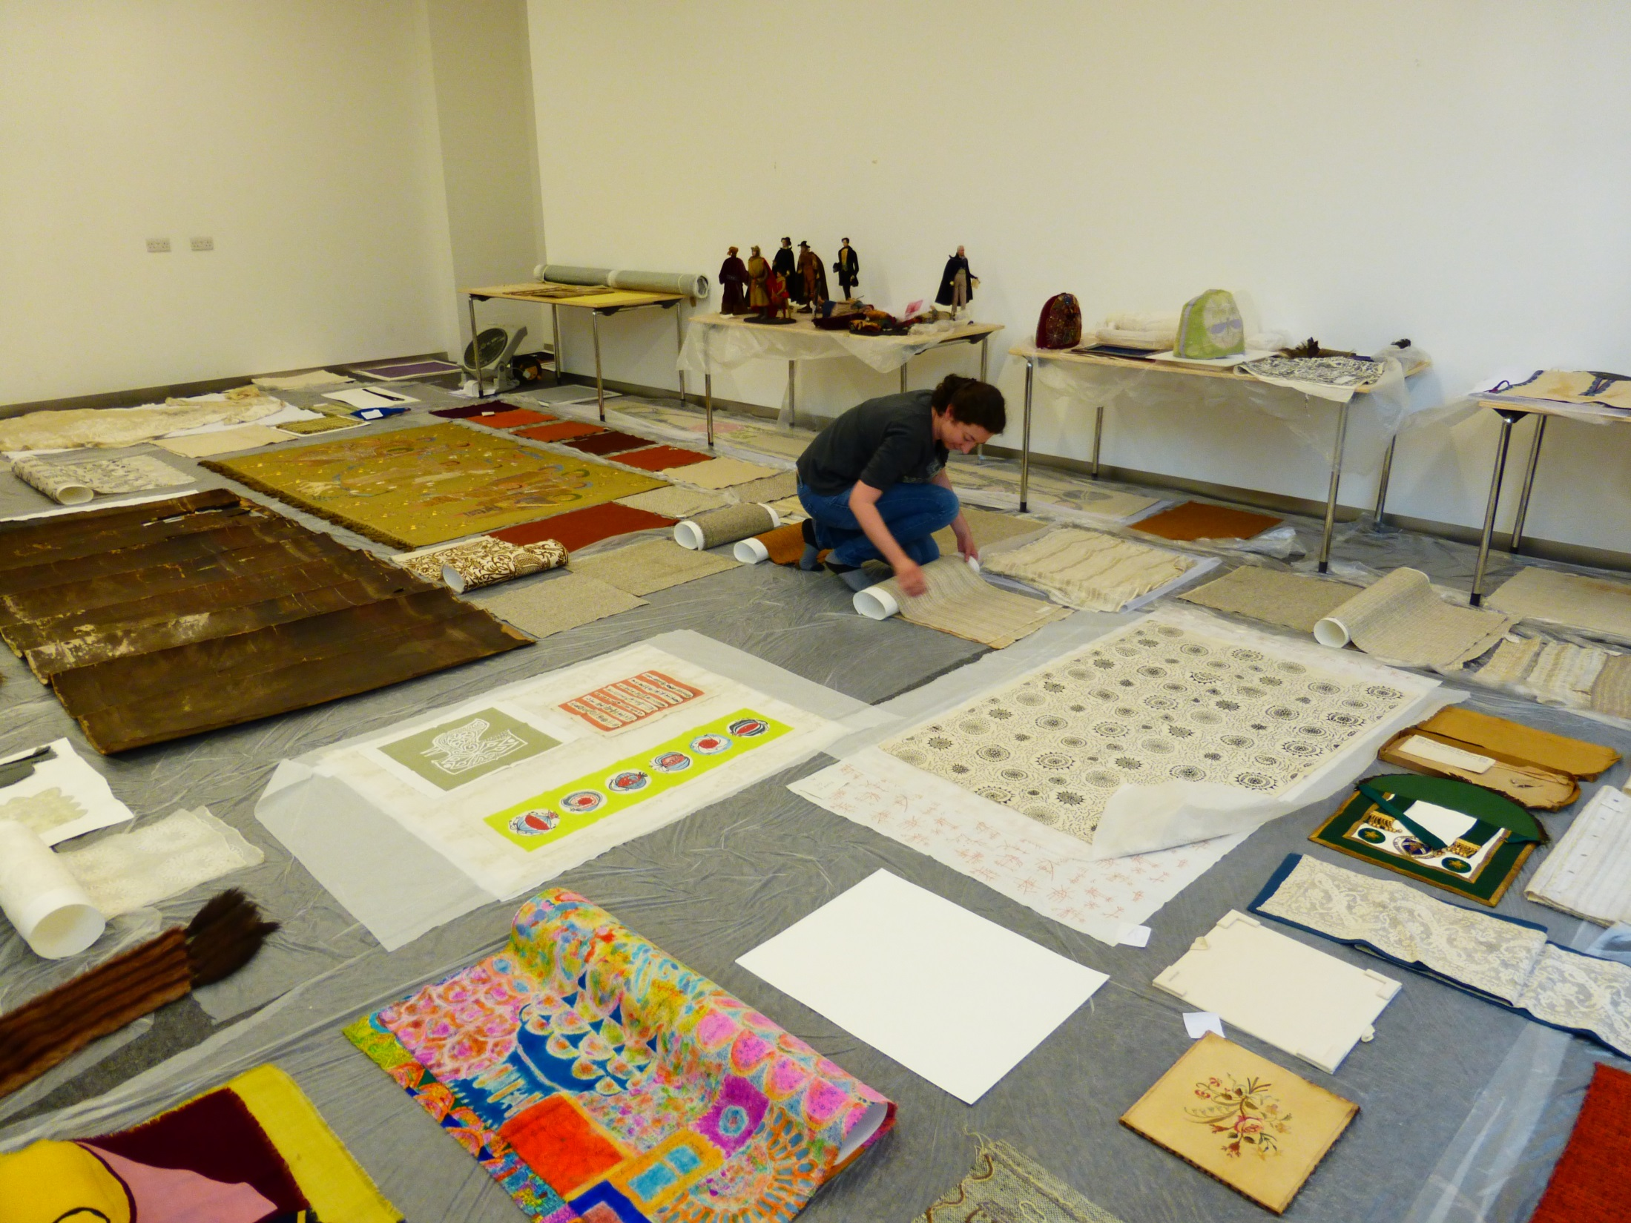
Notes:
The initial salvage priority quickly became the paper and textile archives, as these were most vulnerable to long-term water damage
Here you can see some textiles from our archives being laid out to dry after their wet packaging was removed
Once materials were salvaged, sorted, dried as far as possible, and recorded they were packed for transportation, where suitable, to Constantine’s just outside Glasgow
Some items that required freezing were sent to Harwell’s in Oxfordshire
We were added in this process by specialist textile conservator Frances Lennard from GU and, for paper records, by Linda Ramsay and her team from NRS
At the time of speaking these collections remain with Constantine’s and Harwell’s until a longer term solution for storage and access is found
At present therefore we cannot offer a retrieval service to researchers or students

Slide 37
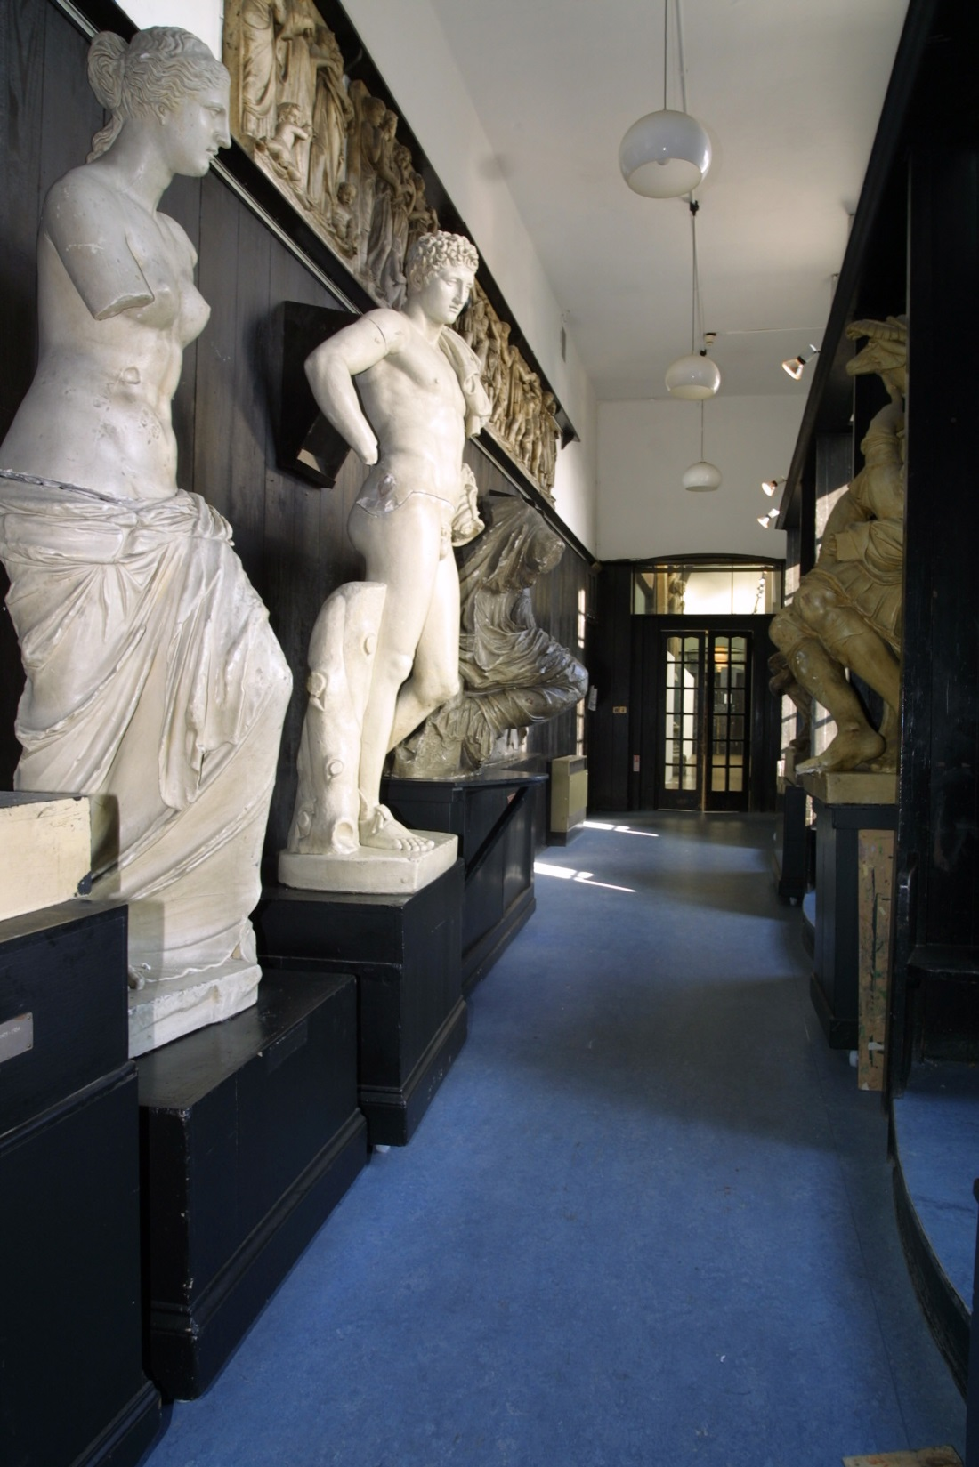
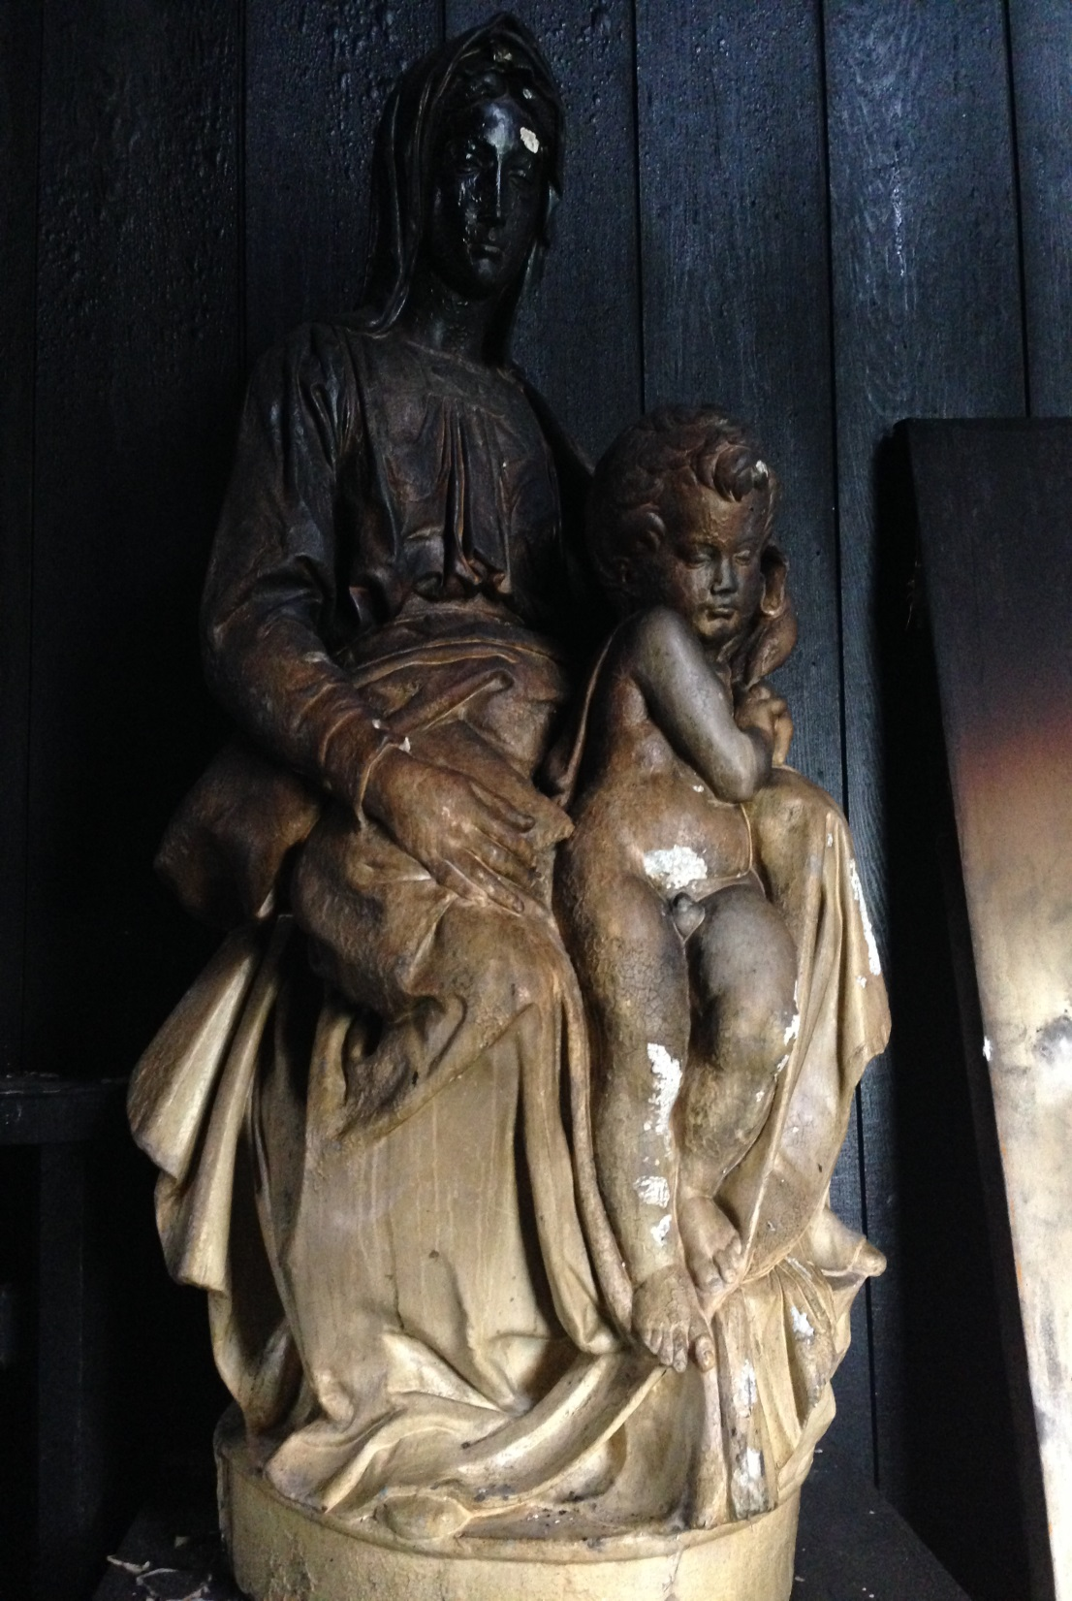
Notes:
The School also possesses a sizable collection of plaster casts of classical and medieval sculptures, purchased in the 19th century for students to draw from
These are much like the casts you will see in the Cast Courts of the V&A and were a common pedagogical tool in art schools of the time
Some of the smaller casts were removed from the building by Belfor and Kerr, and are now housed off-site at their premises
But the larger casts were too big to move out of the building, and are currently still in situ
Advice from the V&A is that to move them might cause more damage than they suffered in the fire
Only 1 plaster cast was lost entirely, and this had been housed in the Mackintosh library

Slide 38
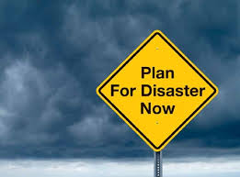
Notes:
Immediately after the fire, and certainly during our salvage operations, our departmental disaster plans provided us with an important overarching framework to guide our activities
Traditionally we have operated two disaster plans: one for the library, and one for archives and collections
But both follow best practice and employ the same consistent format
In common with most disaster plans, they outlined for us how to respond initially to the disaster, how to salvage different types of material, how to prioritise between artefacts, and, perhaps most importantly, how to designate the different team roles that are necessary for successful salvage
Many of you here will be much more acquainted with the drafting and operationalising of disaster plans than me
It is probably fair to say that these documents were not consulted frequently, and were perhaps of limited use on the ground when events take on a dynamic of their own
But formulating the plans in the first place probably did help to crystalise decision-making processes in our heads, and this knowledge was put to use during the initial salvage
Of particular use were the building and floorplans, which helped us to explain to authorities and volunteers alike where particular collections were housed

Slide 39
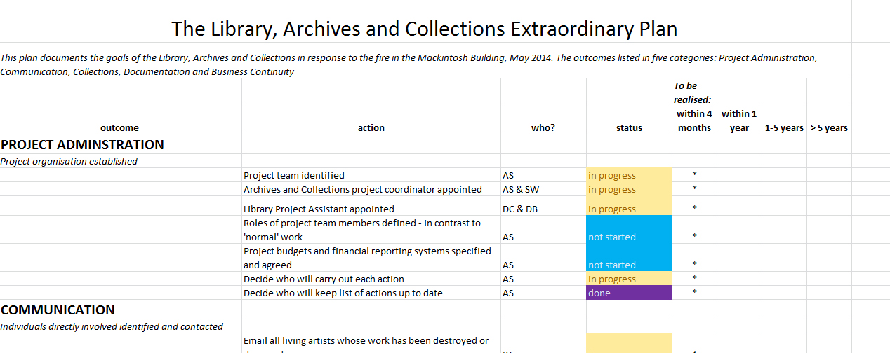
Notes:
Once the initial salvage operation was complete (which took about 1 week), our Head of Learning Resources convened an extraordinary working group, to take a long-term strategic approach to the disaster
This group now meets fortnightly, and considers issues such as long-term storage, relocation of services, insurance and costs, communications, and business continuity
It has proved invaluable as a way of keeping everyone up to date with developments
The School has also funded a number of additional posts to allow us to manage conservation and relocation works whilst continuing to perform our normal day-to-day roles.
Assistant Librarian
Collection Development Officer for Archives and Collections
Project Lead for recovery project

Slide 40
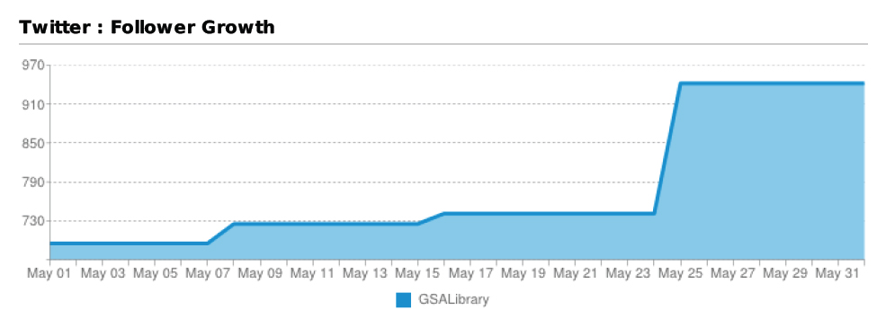
Notes:
One of the areas our disaster plans failed to touch on was social media
In the immediate aftermath of the fire, we were particularly struck by the importance and pressures of these communication channels
It is telling perhaps, that most disaster planning documents fail to mention the extent to which your staff may be inundated with offers of support, guidance from others, or questions from the public via Twitter, Facebook and the other social media your institution may employ
In our experience, it is really important to think now about who you would designate to this role, particularly if your institution is high-profile
This person will need an understanding of the subtle etiquettes of social media and press relations, as you will need to be able to trust them to fly solo
They can be used to record offers of help or materials in a spreadsheet, that can be revisited once the initial salvage winds down
In our experience, the relationships you are able to cultivate over social media at this point will pay huge dividends for you later on

Slide 41
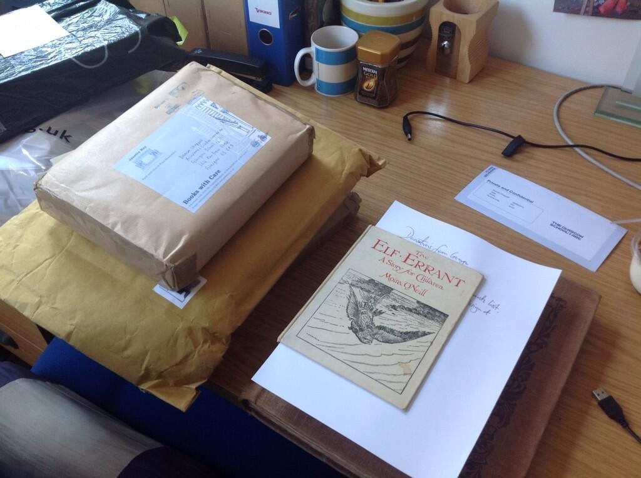
Notes:
Through social media we received significant offers of donations to our library
We were keen to capitalise on this good will, recognising that it provided an opportunity for us to begin to rebuild our lost collections very quickly
We were also keenly aware however that we had lost a significant proportion of our storage space, and that any rebuild needed to be highly focused
We therefore decided to pursue a targeted rebuild, tightly aligned to both the illustrious history and future direction of the Glasgow School of Art.
At the time of speaking, we are clear in only seeking very specific titles that hold particular relevance to our history, our alumni, and our learning, teaching and research activities
You will find that you receive many offers of books, even whole libraries, that you just cannot accept, and will need to employ tact and diplomacy in rejecting these offers
It is imperative to understand where you strategic objectives lie, both as an institution and a department
This strategising can in fact be done now, so that you are prepared if a disaster were to strike.

Slide 42
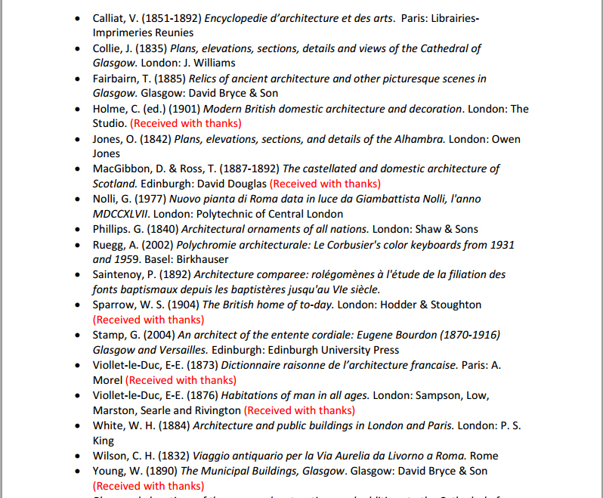
Notes:
We decided to publish wants list of about 700 titles on our website, and publicised this list widely to academic mailing lists, library communities, and other institutions
We could then refer potential donors to this list and solicit only those donations that were key to us
To date, this approach has proved very successful, and we were able to replace 22% of our priority volumes in the first 3 months after the fire
Key to our ability to do this was that our library catalogue was complete – we had excellent computer-readable records for every single item we held
Our task would have been infinitely more difficult had we not possessed the ability to interrogate our catalogue so completely and had we not had such in-depth knowledge of our collection as a totality
Within just a few days of the fire we had a complete list of every single item that was lost from the library
One of the lessons we have taken from our experience, is that in fact this list of priority replacements could have been prepared in advance of a disaster occurring, as part of our general preparedness

Slide 43
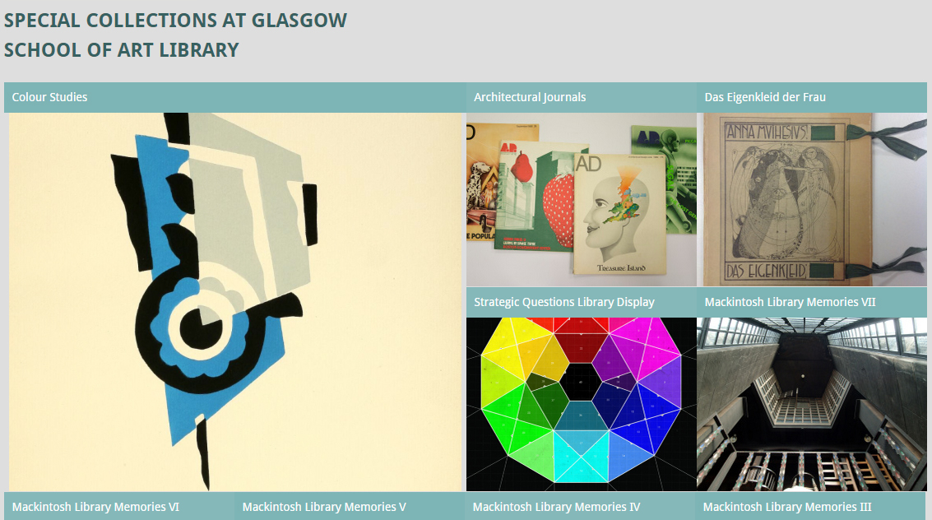
http://gsalibrarytreasures.wordpress.com
#macklibmemories
Notes:
We were also keen to use our relationships and social media channels to record people’s memories of the destroyed library for posterity
We wanted to initiate this project pretty quickly after the fire, as we were conscious of not losing the momentum that the disaster provided
We therefore held interviews via email and in person with students, graduates and academics who had used the library, to record their first impressions of the space, their favourite items in the collection, and ways in which they had used the library in their learning and teaching
In the immediate aftermath of any disaster, the temptation, understandably, is to concentrate on immediate requirements
But we were determined that the fire, though tragic, would leave some kind of lasting legacy
Our suite of Mackintosh Memories, which can be read on our blog and via our Twitter hashtag, will eventually be deposited into the School’s archives, along with all the other documentation we have produced since the fire
Our Archivist too has recently sent questionnaires to the volunteers involved in the salvage, to capture their memories or events

Slide 44

Notes:
We have also worked closely with our colleagues in the Press Office, to publicise our collections rebuild campaign and to mark successful milestones
This article appeared in The Herald on 15 September 2014 to celebrate our receiving 22% of our priority volumes in just 3 months.
The book is my hand is a rare Gregynog Press volume by Agnes Miller Parker, kindly donated to us by Blackwell’s Rare Books
We’ve also enjoyed coverage in The Times, The Metro, BBC News, Telegraph, Design Week, and The Guardian

Slide 45

Notes:
And this is my colleague Jennifer accepting a donation of a rare Glasgow Style binding my former GSA Head of Embroidery Ann Macbeth, kindly donated by the Antiquarian Booksellers’ Association in March this year

Slide 46

Notes:
After the fire, a major milestone for us came with the excavation of the library interior
The School, under the advice of Historic Scotland, has employed a team from Kirkdale Archaeology supported by object specialists from AOC to undertake this work
They undertook a systematic excavation based on 1m2 grids, excavating down in columns at 25cm increments
Each layer was fully photographed and recorded
Any salvaged artefacts were recorded following established methodologies, before removal for treatment or freezing
All processes and findings will be archived for posterity

Slide 47

Notes:
Excavation in progress

Slide 48


Notes:
Excavation in progress

Slide 49

Notes:
We fomulated decision trees to help us decide which salvaged materials we should keep, and which we should dispose of.
Separate trees were developed for each media: paper and books, metalwork, glass, etc
Those relating to collection elements were sent to MGS for their guidance and approval

Slide 50

Notes:
Some materials survived better than others, depending on where they were situated in the room, the amount of oxygen available to the fire, whether they were tightly or loosely packed on the shelves, and whether debris fell on top of them from above
81 rare books in total were salvaged from the library space, including many that you see here
They are now in deep freeze with Harwell’s
Although the books themselves are sometimes difficult to identify immediately, our barcodes (which we use as distinguishing marks) are nearly always complete, which has enabled us very quickly to put a title to each volume
We are currently undertaking a cost/benefit analysis for each volume, taking into account replacement costs on the open market, to decide which books to conserve and which to buy anew

Slide 51

Notes:
We even had some miraculous survivors, such as this 19th century photographic volume of topographical views of Japan, complete in its original silk covers.
All salvaged materials are now with Harwells, many in deep freeze, and await conservation works in the near future.

Slide 52

Notes:
Discussions are ongoing both within the School and with the wider public concerning the future of all the Mackintosh building spaces, particularly the library
There has obviously been a lot of debate and speculation about this
The School itself has organised a number of events at which stakeholders can share ideas and discuss the potential future of these spaces
There has also been much debate about the ethics of restoration, the relationship between the original and the replica, and the avoidance of a Mockintosh aesthetic
These debates are lively, stimulating and ongoing
What is clear is that the School has committed to restoring the space to Mackintosh’s design as a working library and we are actively involved in planning for this
It is likely that the restoration of this space will form the last tranche of the wider building restoration, as it is the most complex area
Our Archives and Collections are also planning for the future
They are currently offering a limited service from temporary accommodation within our main library
But are exploring options for a more permanent home for the next 3-5 years
During this time, our collections will be stabilised and conserved
It is also providing an opportunity for staff to revisit our collections management
To assess for example whether, and how, to barcode all our holdings, or to RFID archive materials
Many of the objects we salvaged had become separated from their original packaging and identifiers, making them hard to identify by volunteers and non-Archives staff
Unlike the library collections, many items were also uncatalogued
Although some items were easy to identify (we only have 1 blue ceramic rabbit for example) others proved more difficult (we have lots of bronze heads of men)

Slide 53
Duncan Chappell
Librarian
d.chappell@gsa.ac.uk
@duncanchappell
@gsalibrary

