Slide 1

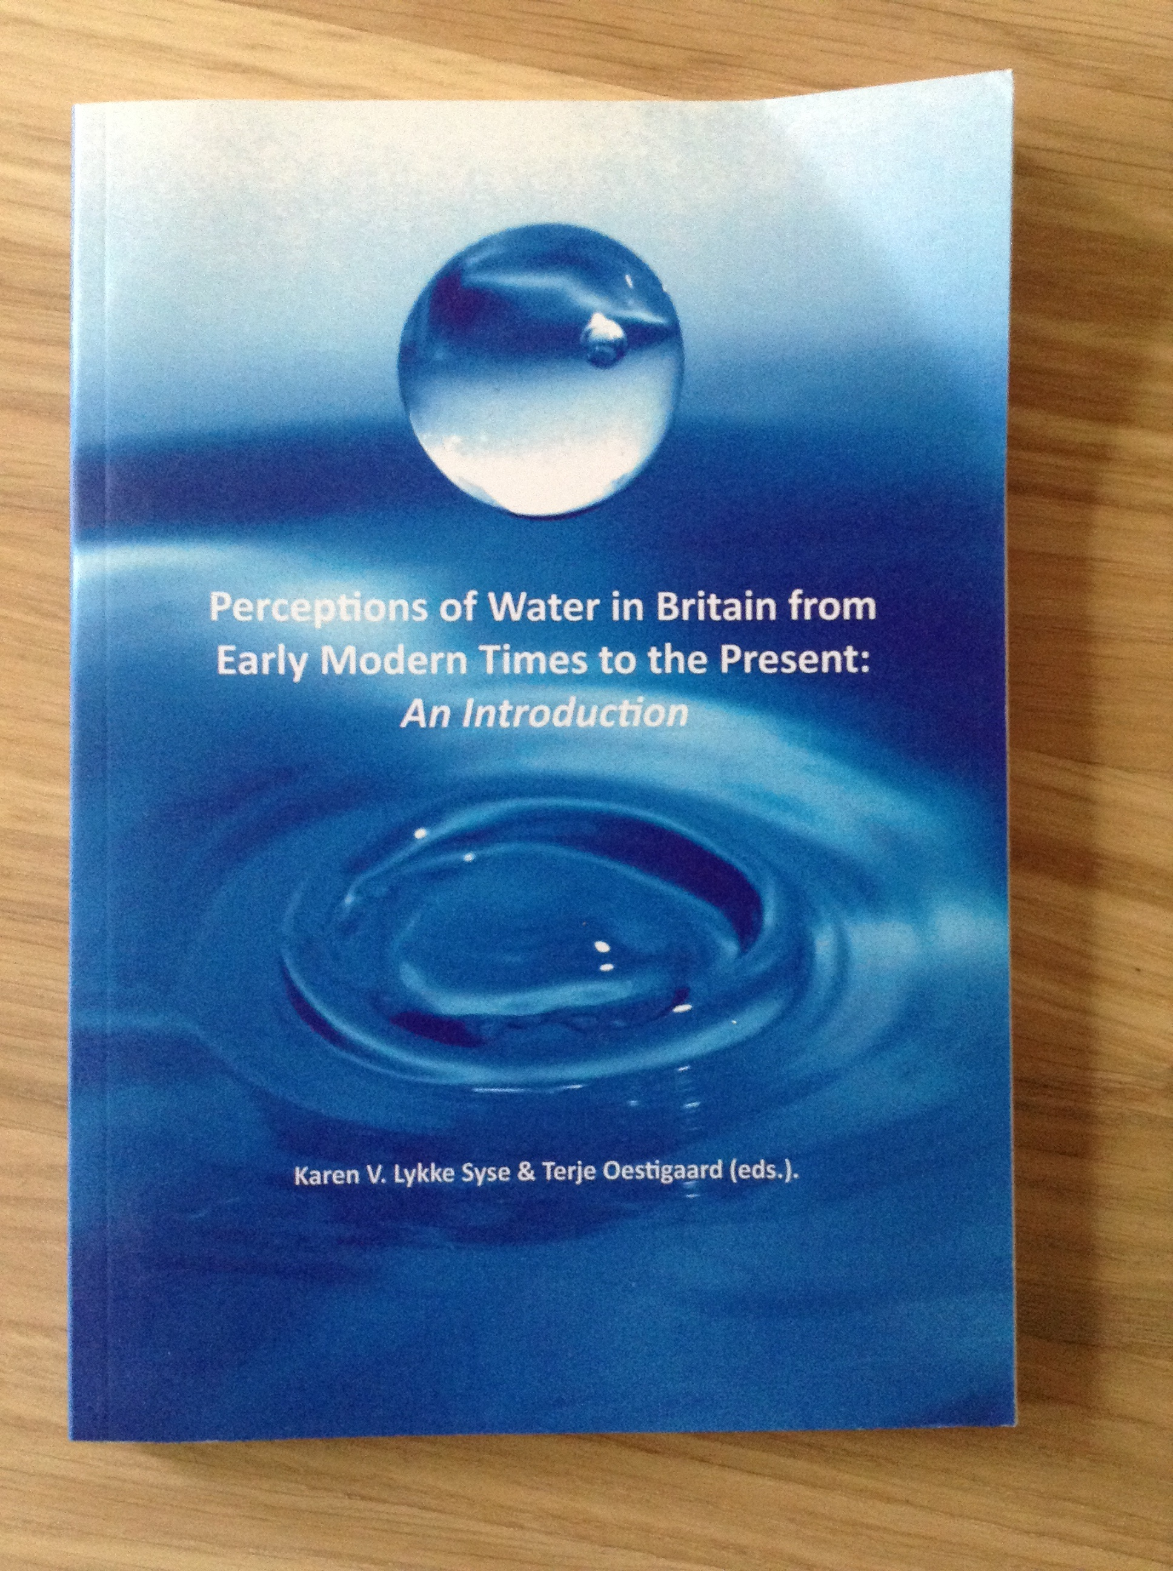
Searching For The Molendinar – Unearthing Glasgows Hidden Past.
Book chapter exploring the significance of Glasgows most iconic subterranean stream - the Molendinar. This research draws on a range of primary and secondary sources (in addition to practice based approaches) in order to consider a more integrated strategy for urban water management.
Submitted by Justin Carter

Slide 2

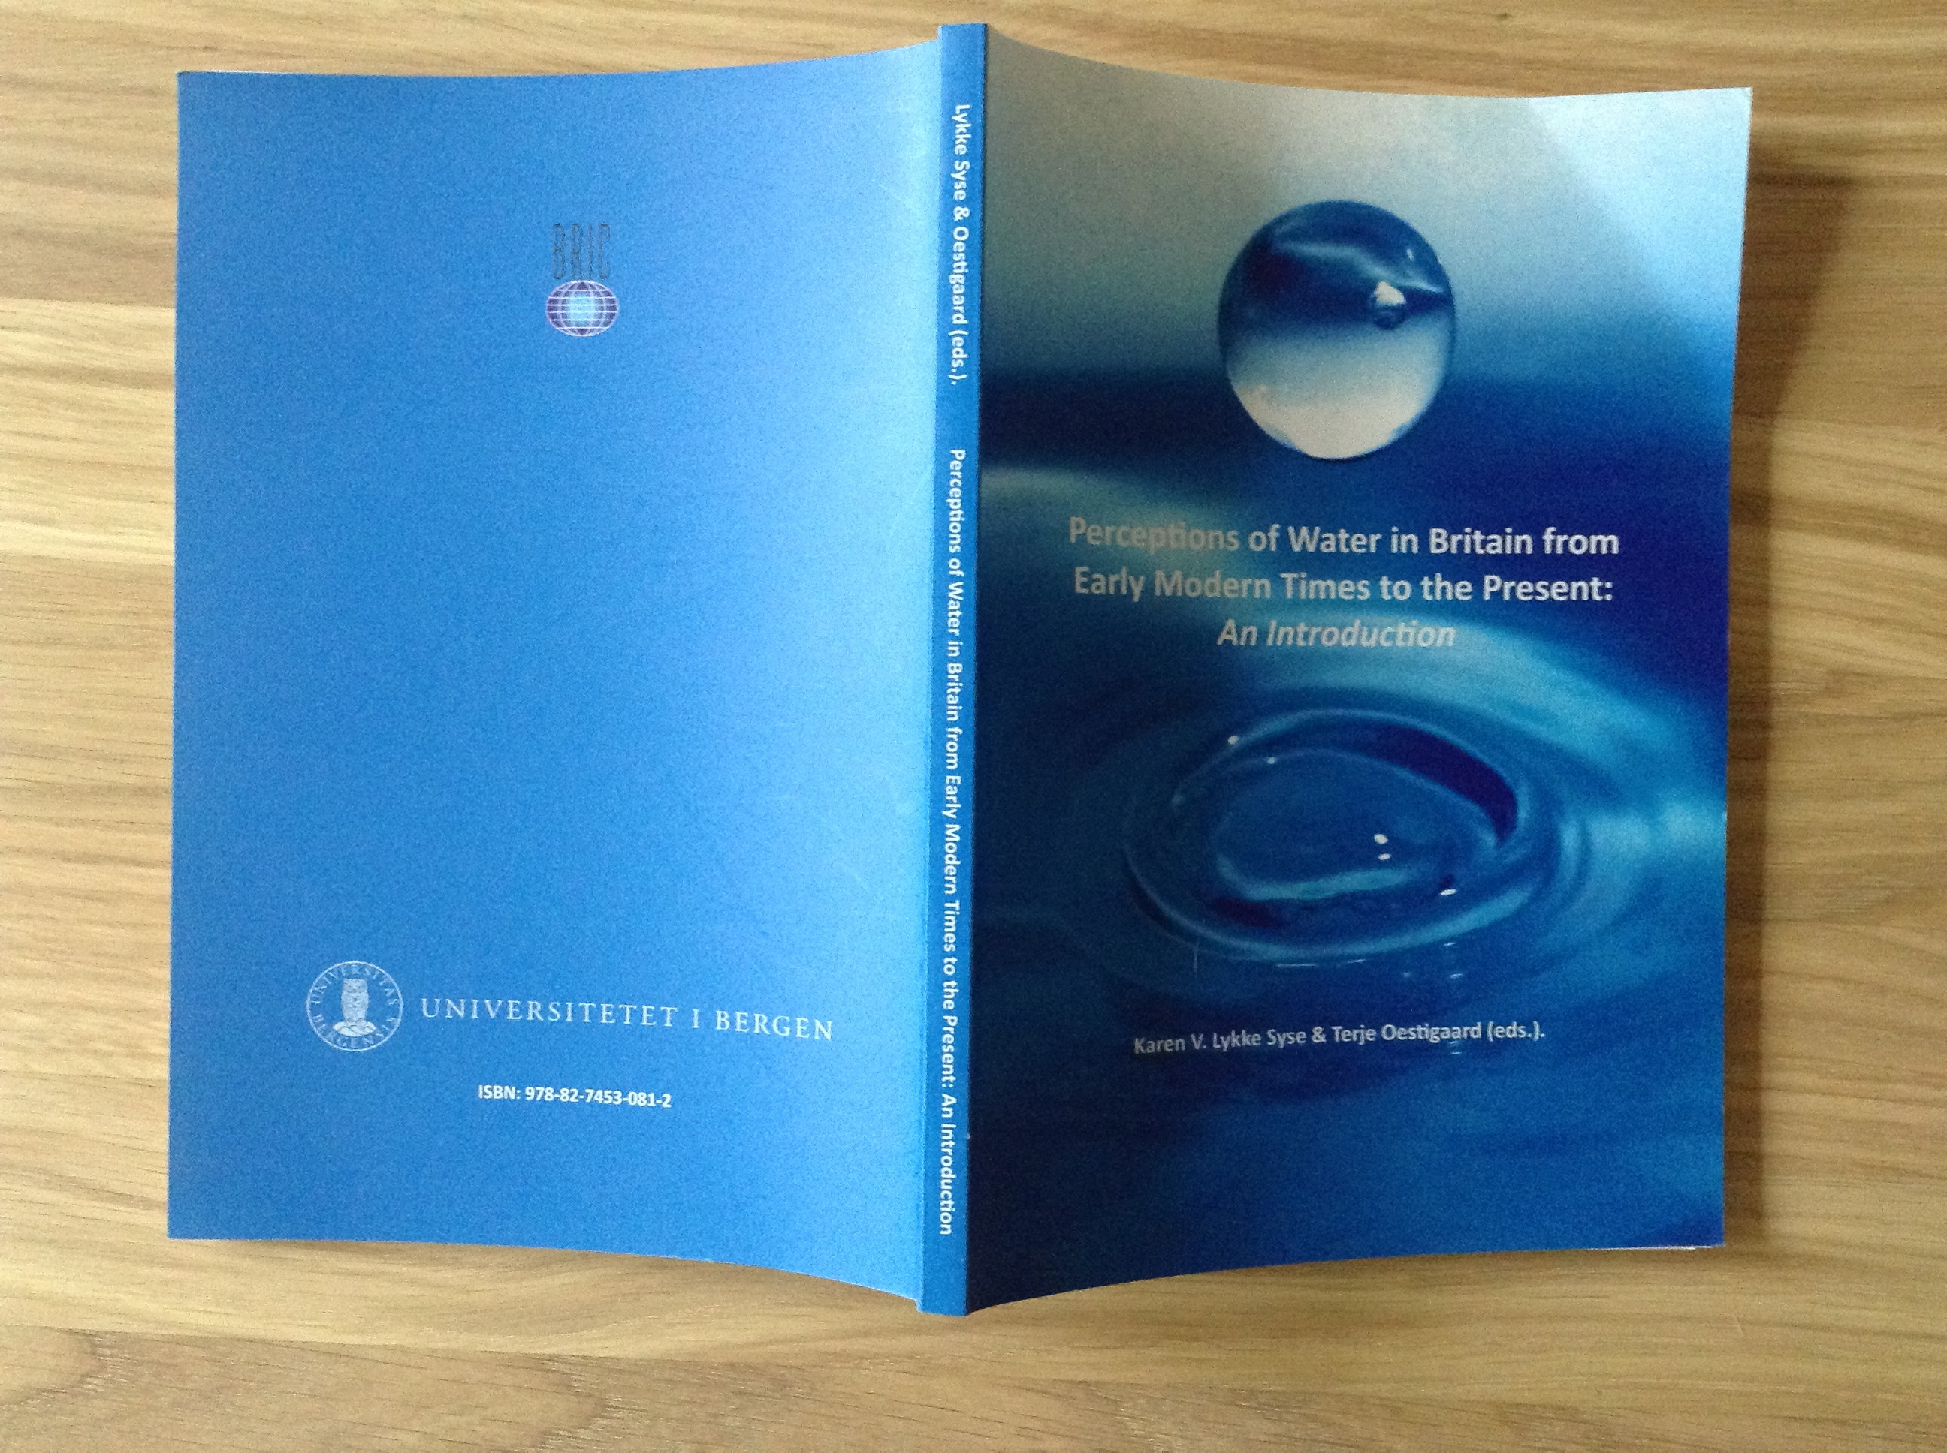
Searching For The Molendinar – Unearthing Glasgows Hidden Past
Book Chapter – (chapter 4) from ‘Perceptions of Water in Britain from Early Modern Times to the Present: An Introduction. (eds. Syse & Terje Oestigaard, Karen V.)
Publisher - BRIC Press, University of Bergen
Year Publication - 2010
Pages - pp. 82-115
ISBN – 978-82-7453-081-2
http://folk.uib.no/gsuto/ArtiklerWeb/LykkeSyse_Oestigaard/LykkeSyse_Oestigaard.pdf
What does it mean when a stream so central to a city’s history becomes almost entirely culverted? What impact does this physical change have on a place and its people? The Molendinar Project set out to investigate the disappearance of a stream at the heart of Glasgow’s medieval past. How and why has the burn almost completely vanished, and what physical and psychological residue remains? This chapter explores the relationship between city and stream revealing changing attitudes to water and different notions of ‘progress’. How and why should we remember the Molendinar, and what role can art play in this process?
2
Justin Carter
Image of the book – front and back covers.

Slide 3

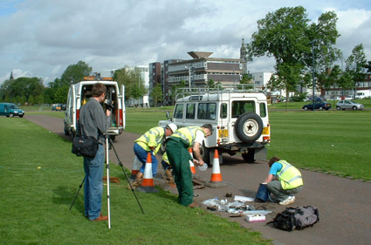
Background:
In 2001 I was invited by curator Tomomi Iguchi to participate in a group exhibition considering Art and Ecology through the lens of water. The show which took place at Mile End Gallery in Lonon coincided with a conference hosted by the Whitechapel Gallery*. I used this whole opportunity to research the disappearance of the Molendinar Burn in Glasgow, a stream that was originally settled in medieval times, and which is at the heart of Glasgows story. I physically traced the course of the burn using historical maps, legal records and newspaper articles kept at the Mitchell Library. I then decided to interview local residents, Glasgow Humane Society, The National Geological Survey, Glasgow City Council and Scottish Water in an attempt to uncover the social, economic and environmental impact of the streams historical shift to underground culvert. The video installation made for the show at Mile End also included maps, photography and newspaper articles.
(*Watershed: ‘Environmental Art – En- gendering a Community of Change’, held at the Whitechapel Art Gallery on Saturday 11th October, 2003. The Conference coincided with the exhibition Crossovers 2003 at the Pavillion in Mile End Park,London.)
Fieldwork by The National Geolgical Survey, being filmed at Glasgow Green.

Slide 4

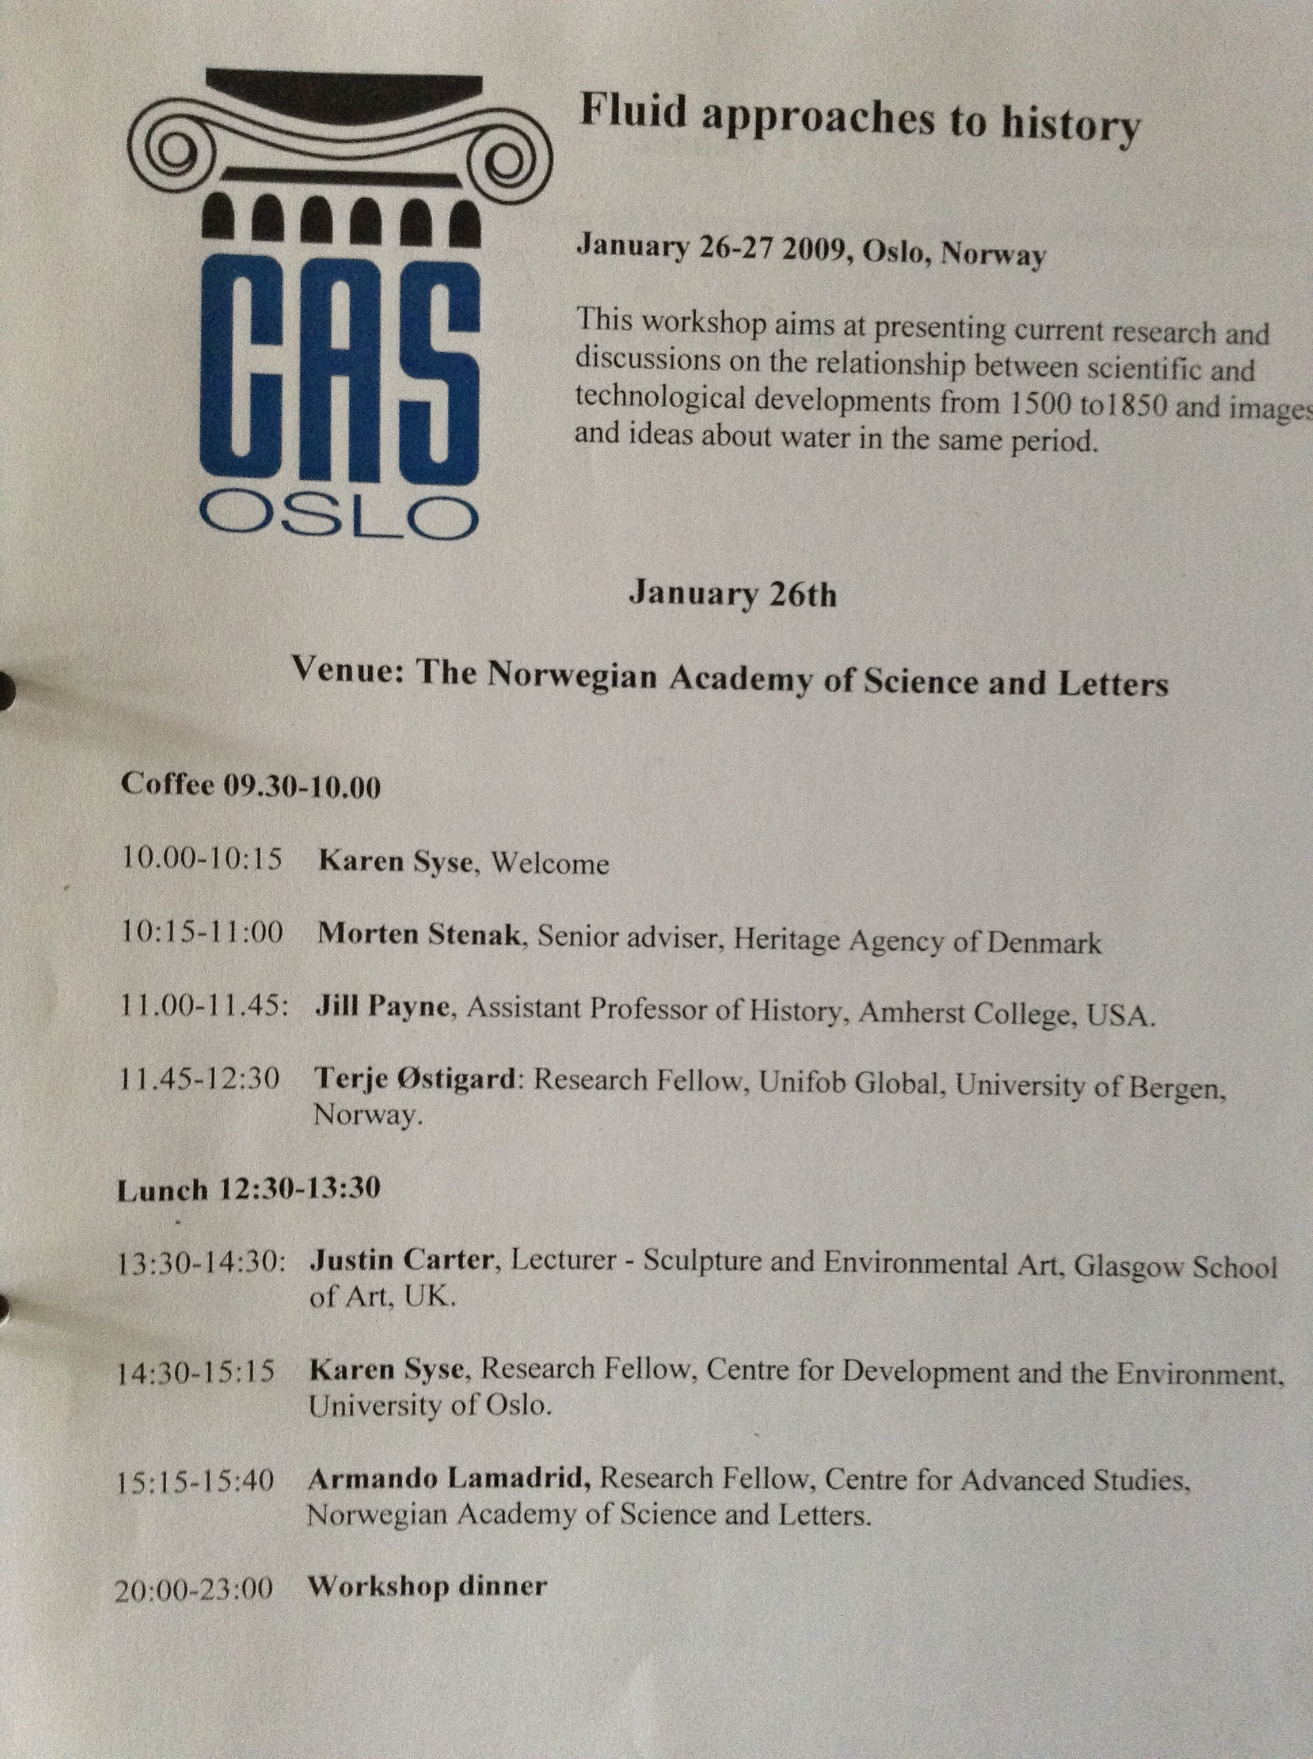
The opportunity to further develop and write up this body of research in textual form came after an Invitation from Karen Syse (Research Fellow, Centre for Advanced Studies – CAS) to speak at a symposium entitled: Fluid Approaches to History (26–27.1.2009) at the Norwegian Academy of Arts and Letters, Oslo. This came under a larger umbrella of research led by Terje Tvedt entitled ‘Understanding the role of water in history and development’.
My presentation formed part of a cross-disciplinary workshop looking at “current research and discussions on the relationship between scientific and technological developments from 1500 to1850 and images and ideas about water in the same period”.
Pre-Industrial and post-Industrial Britain were explored through the lens of ‘The Molendinar Project’. Issues of riparian ownership and the new European Water Framework Directive were brought sharply into focus.
The symposium was considered a success as it brought different disciplines and perspectives together. A publication would allow this material to be extended and considered by a widerresearch community.
In terms of references and influences, Theodore Brotchies ‘Glasgow Rivers and Streams, Their Legend and Lore’ (1914) was a key starting point, partly for it’s informative content, but also for it’s romantic and poetic style. It contains a whole chapter dedicated to Glasgows buried streams and there are many poignant references to the Molendinar Burn.
In terms of Fine Art practice based, interdisciplinary and collaborative approaches - I was informed by artists and writers such as Platform, Lucy Lippard, David Haley, and the Harrisons.
The schedule of presentations at CAS in Oslo, from which the book emerged.

Slide 5

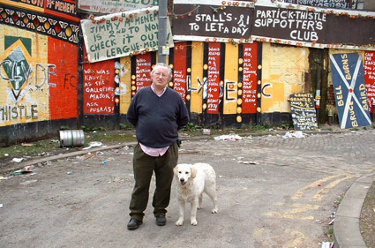
The research included the referencing of many primary and secondary sources, as well as an attempt to integrate practice based methodologies – walking, video, photography and drawing. These were assimilated not from the expert position of historian, geographer, sociologist or ecologist, but from the viewpoint of an artist working between these disciplines.
By locating maps and images of the Molendinar a visual picture of Glasgow was constructed over time – from rural retreat to urban sprawl. This led to site visits and walks, re‐ mapping the course of the burn, and occasionally catching glimpses of the hidden stream.
Semi‐structured interviews were also conducted with a number of individuals and representatives from a range of associated groups including local residents, the Glasgow Humane Society, the National Geological Survey, Glasgow City Council (GCC), the Scottish Environmental Protection Agency (SEPA) and Scottish Water (SW). These interviews attempted to uncover the social, economic and environmental impact of the stream’s historical shift from open waterway to underground culvert.
Speaking to local residents and conducting semi-structured interviews was vital.

Slide 6

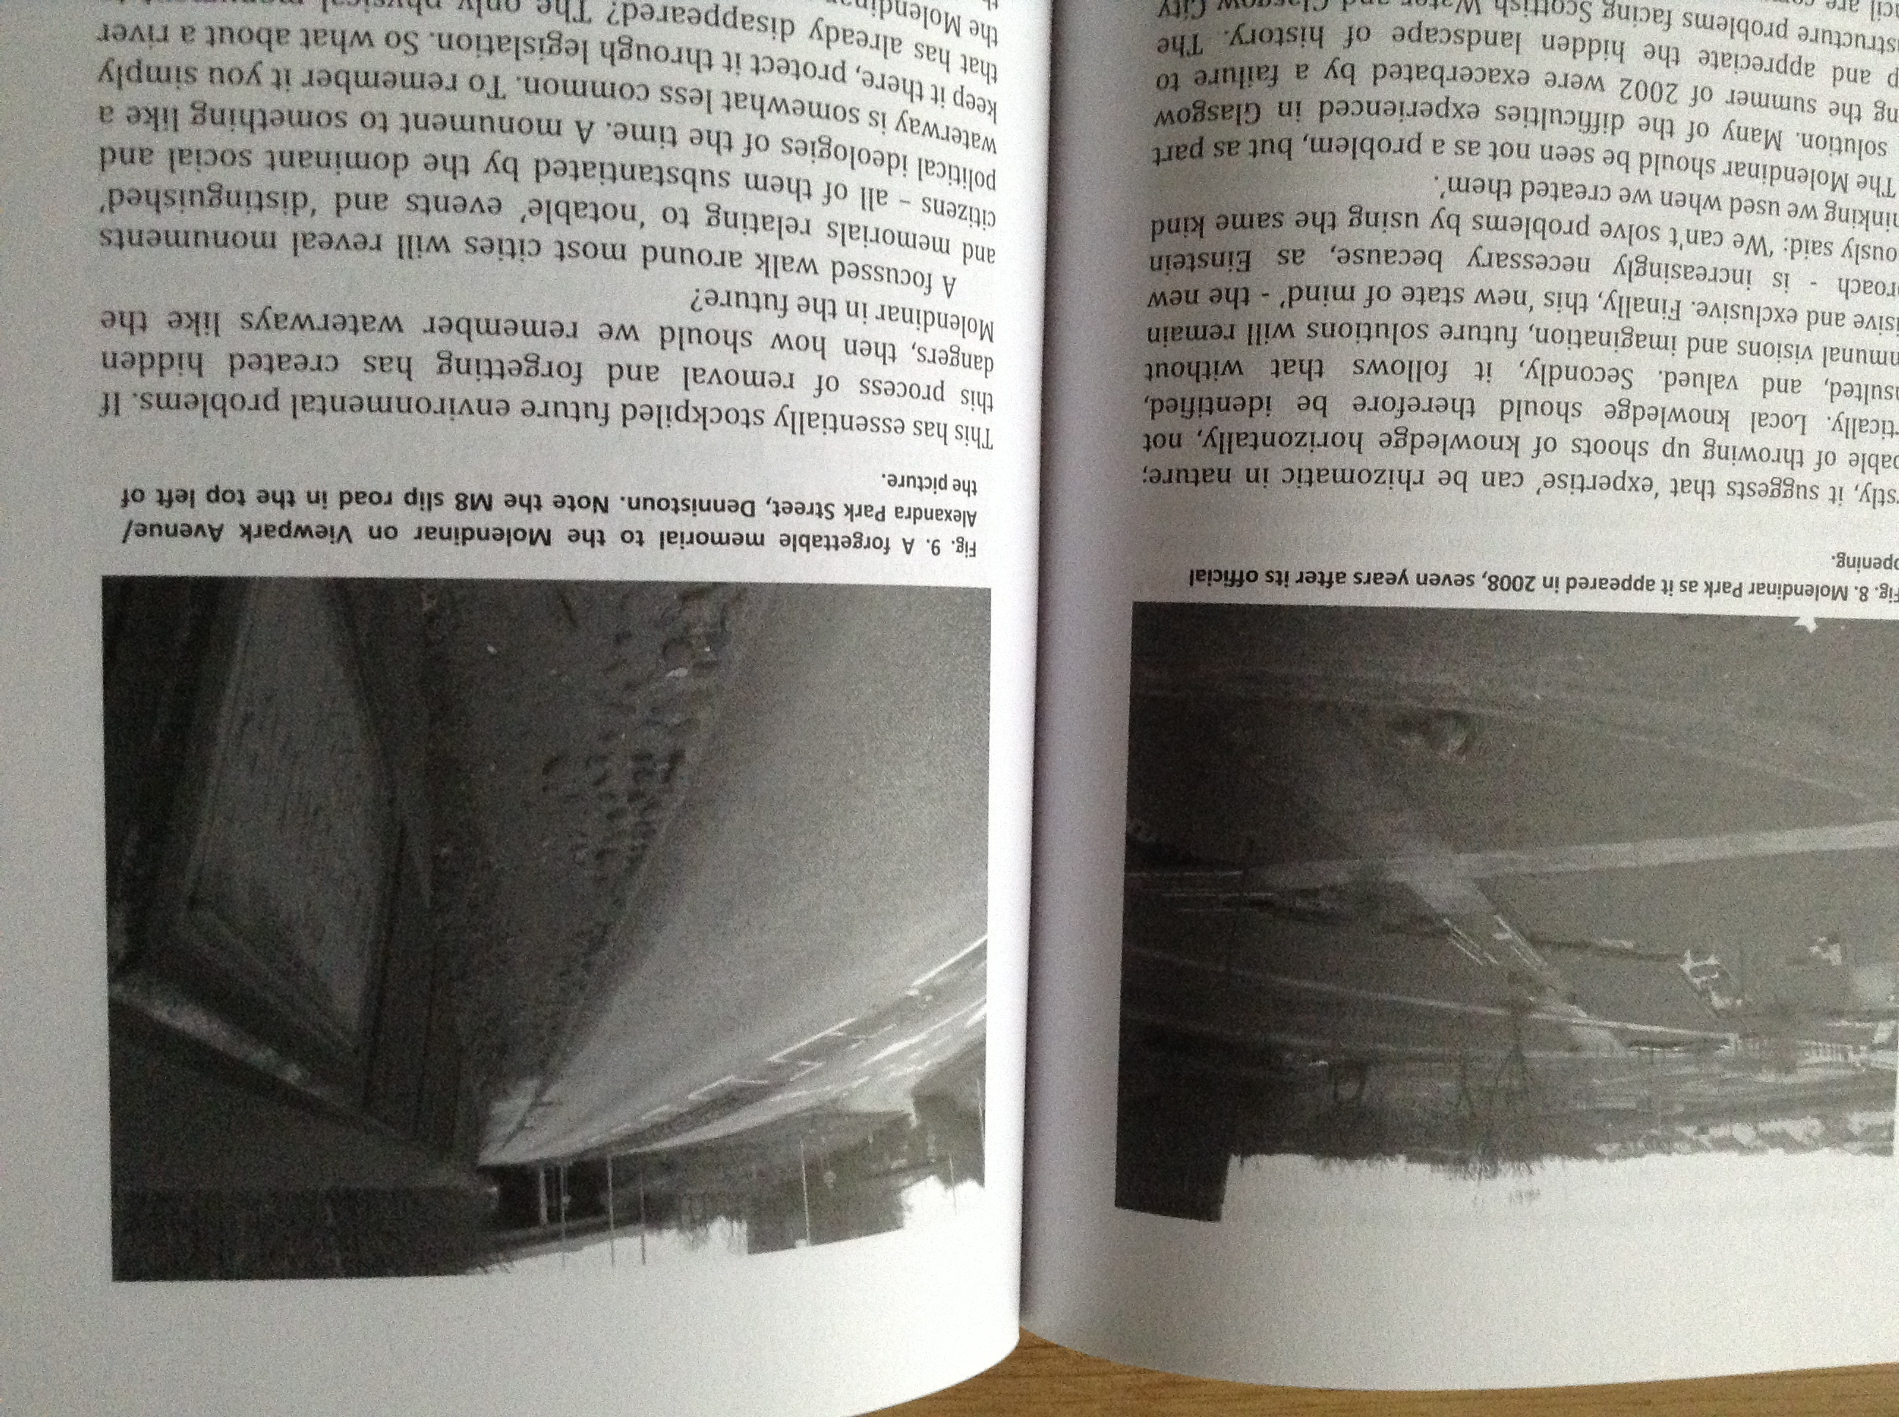
“The problem of polluted watercourses is considered in depth by Justin Carter, who presents the aims and results of the Molendinar Project in Glasgow, Scotland. Unlike rivers that have been revitalised in the post‐industrial age, the Molendinar continues to flow in murky darkness. The Molendinar Project set out to investigate the disappearance of a river at the heart of Glasgow’s early medieval history. It was an attempt to discover how and why the burn had almost completely vanished. More importantly, it was an attempt to assess the impact this loss might have had on the city and its population in the context of yet further urban development”.
(Extract from the Introduction to ‘Perceptions of Water in Britain’, written by Karen Syse & Terje Oestigaard.)
Details of original photographs taken by the researcher, included in the body of text.

Slide 7

A copy of this book is now held at the Mitchell Library and several other libraries and institutions around he World.
The text is also available online at:
http://folk.uib.no/gsuto/ArtiklerWeb/LykkeSyse_Oestigaard/LykkeSyse_Oestigaard.pdf
Front and back cover of the book.

Slide 8

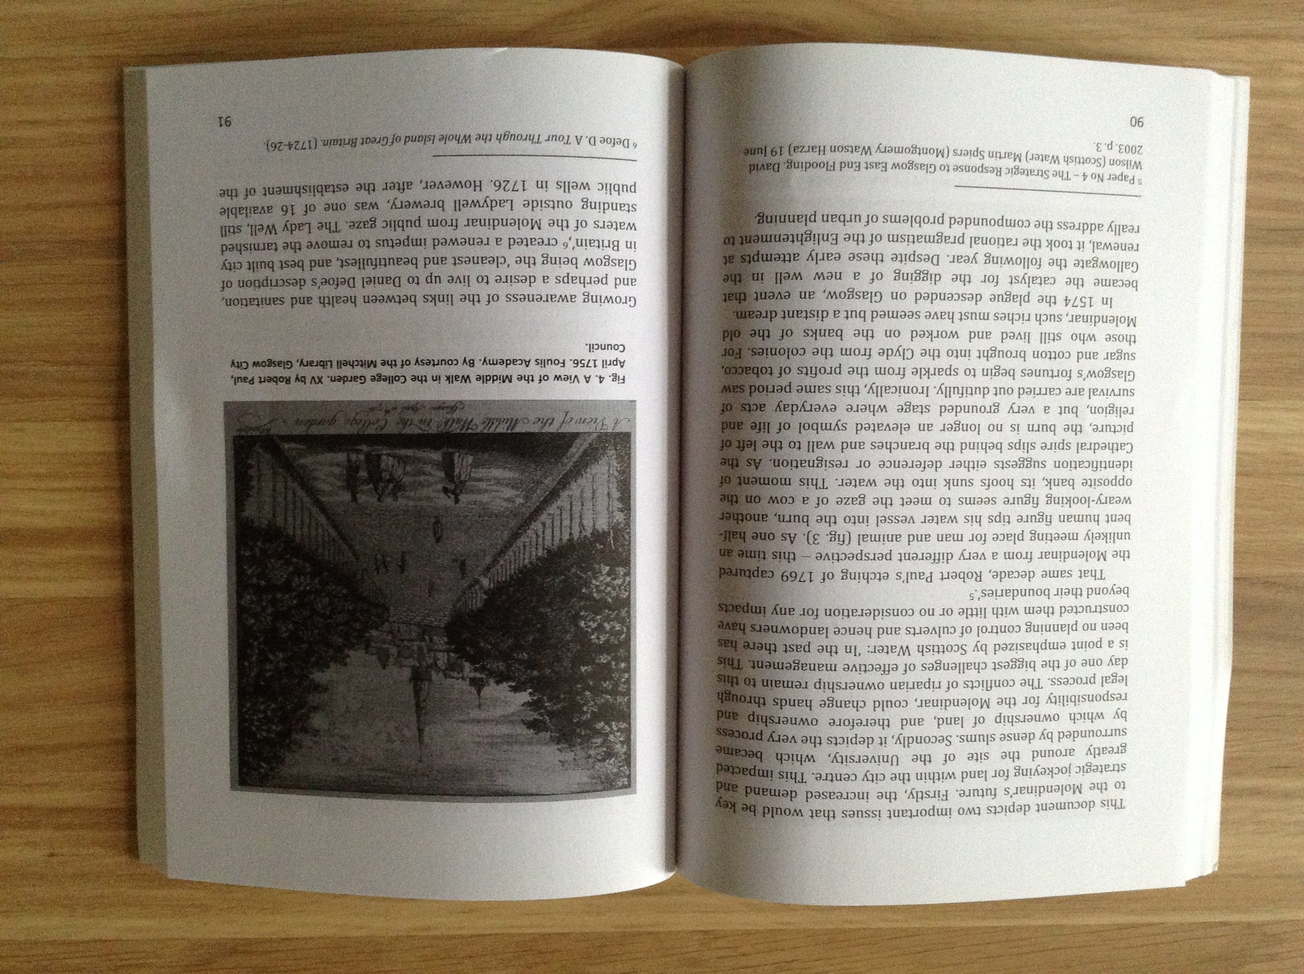
There are also various links to the research group and it’s work at:
www.cas.uio.no
http://www.cas.uio.no/research/0809water/workshop_jan09.pdf
I am aware that this research has been looked at because I have received emails from PhD students based in the Geography Department at Glasgow University.
The book contains many images and maps brought together for the first time.

Slide 9
Special thanks go to Karen Syse for inviting me to talk at CAS in Oslo and for encouraging me to produce a chapter for the book, to SEPA for helping me to access the Molendinar both physically and scientifically, and to George Parsonage (Glasgow Humane Society) the real expert when it comes to Glasgows waterways. This project could not have happened without the help of everyone I spoke to and interviewed.

