Slide 1

Pedal Power for Bybrua (City Bridge)
A Temporary Public Art Work (human powered light intervention) Commissioned by Rogaland Kunstsenter for Stavanger 2008 (Port Capital of Culture)
Submitted by Justin Carter
Output No. 1

Slide 2

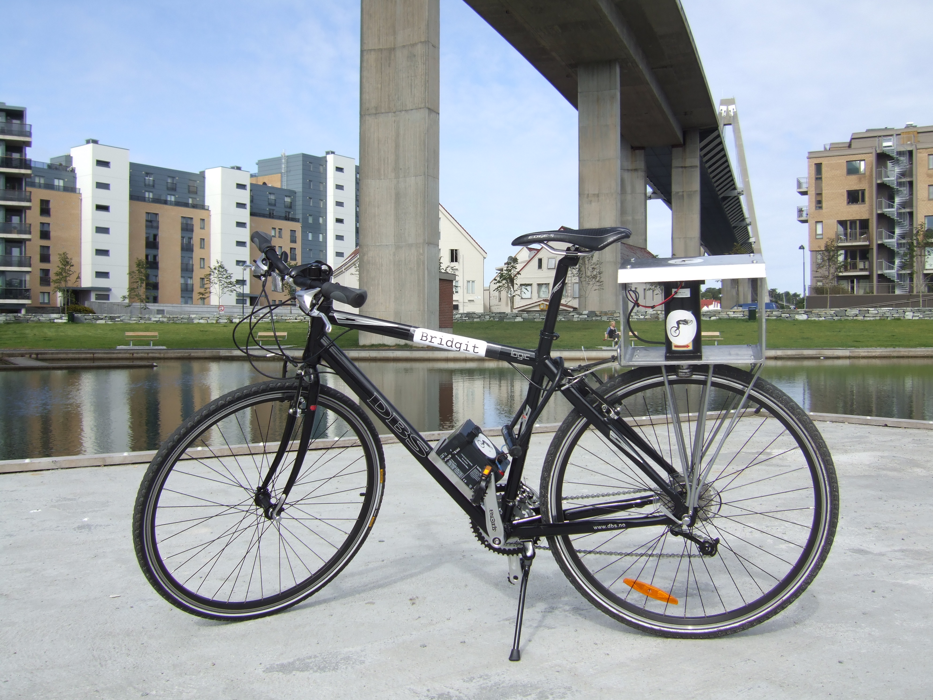
Pedal Power for Bybrua (Pedal Power for City Bridge)
The practical and technical aim of this project was see if a lighting system could be designed and installed for an outdoor public space, reliant solely on ‘gifted’ human energy (pedal power). The latest LED technology was linked to a 12v battery storage system. However, the deeper, underlying aim of the project was to encourage community dialogue about alternative energy within an urban context. This debate had special significance in Norway, a country with enormous oil wealth. The physical effort to keep the lighting system going attempted to revive the spirit of Dognad, a Norwegian tradition of individuals coming together to make improvements in the local community. Previous lighting systems in this area had been vandalized, so one of the questions opened up through this research concerned whether this lighting system would engender a greater sense of communal ownership?
1
Justin Carter
‘Brigit’ the bike generator designed for pedestrian transit, seen beneath Bybrua.

Slide 3

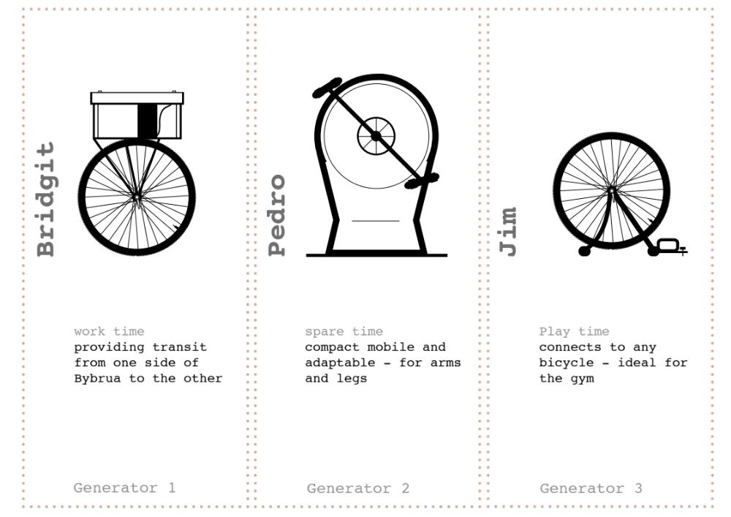
This commissioned work followed an International Art & Ecology workshop I was invited to lead at Gallery KIT in Trondheim, Norway in 2005 at the invitation of Hilde Hemming (British Council).
Hilde Hemming promoted my work and I was subsequently invited by Torunn Larsen (Curator, Stavanger Kunstsenter) to visit Stavanger to develop ideas for a Public Art Work to be located somewhere in the city during Stavanger 2008 cultural festivities.
Much of the initial research for this project was undertaken with support from an Arts Council England funded Bright Sparks Award ‘Renewable Devices for Art and Ecology’ – the report from which can be found at:
http://www.haringwoods.com/userfiles/Bright%20Sparks/JCarterBS2FinalRepor1.pdf
The three types of pedal powered generators.

Slide 4

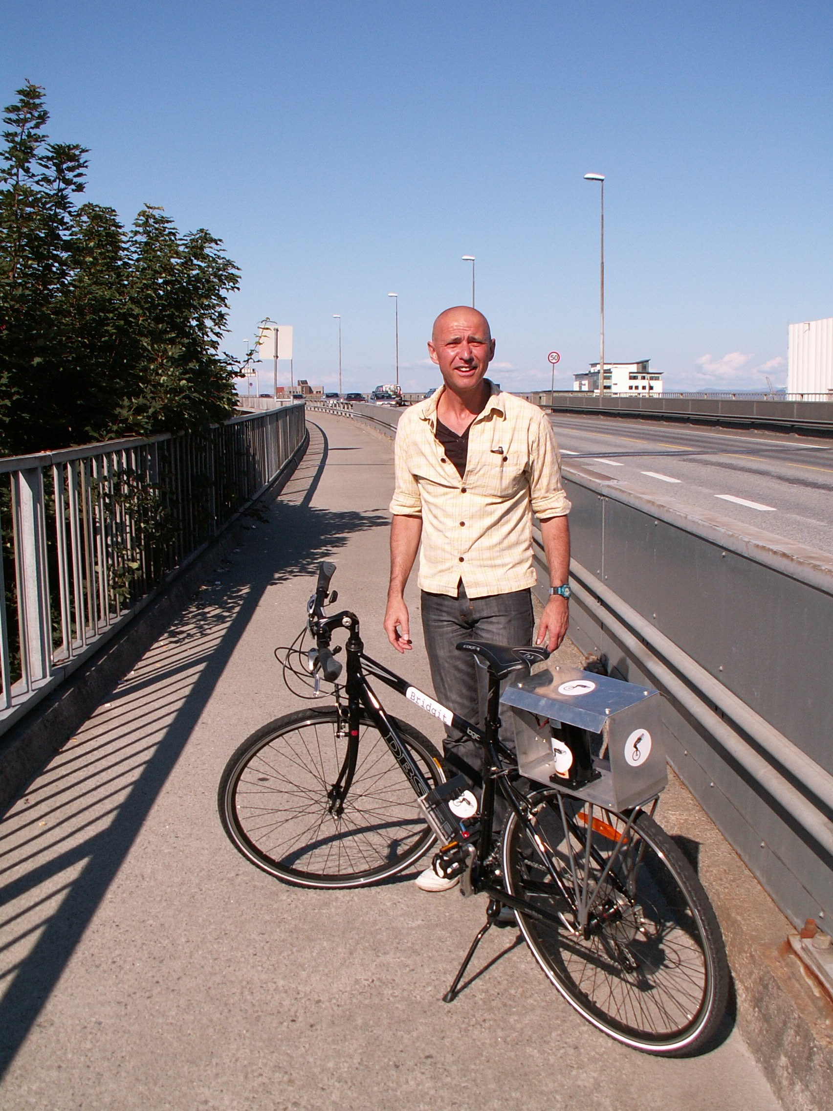
This project is an art/design hybrid in the spirit of Krzysztof Wodiczko, Michael Rakovitz and Marjetika Potrc – artists designing objects as functional prototypes. As an ‘artefact’ (or series of artefacts) the work has a clear function – that is to enable user mobility (or exercise) in order to sustain an environmentally friendly public lighting system. However, people not technology are at the centre of this research. It’s about attitudes and ideas about technology, not technology in itself. Social engagement is made manifest neither as ‘event’ nor ‘performance’, but as an exchange of energy and ideas. These are what string together the technological aspects of the work.
The research is critically informed by leading academics and theorists such as Claire Bishop who have tried to untangle the complexities of participatory art. Two other thinkers heavily influenced the project; Henri Lefebvres book ‘Rhythmnanalysis’ which opens up new thinking about time and space, and Ivan Illichs ‘Energy and Equity’ which deals provocatively with issues of power and ownership. In terms of my own work, this research follows previous explorations of temporality, mobility and energy explored within the Public Domain.
Participant ‘Vic’ who became the first pedestrian to become a ‘repeat user’.

Slide 5

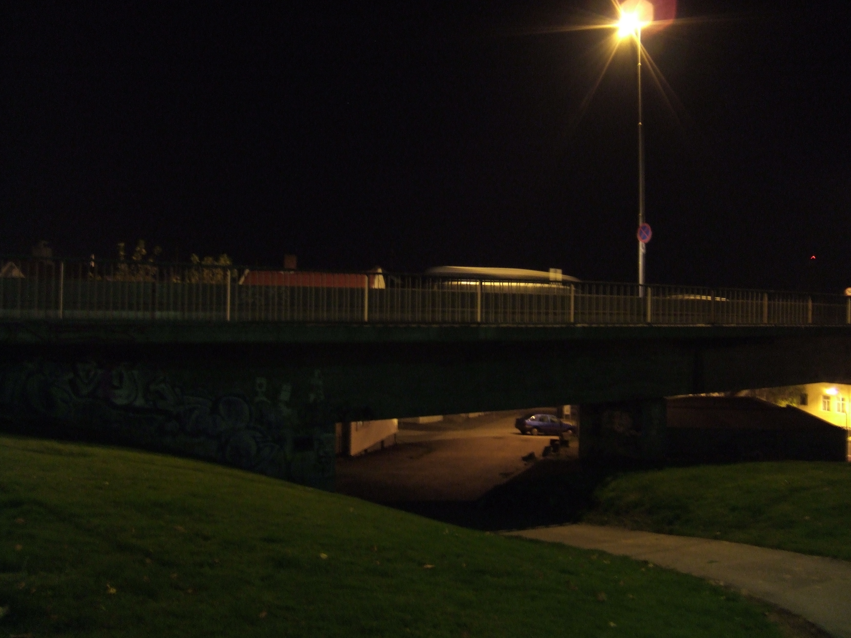
Following a series of extended site visits (including a public consultation) a battery powered lighting system (topped up by three pedal powered generators) was designed and constructed with assistance from lighting designer Nich Smith (Glasgow) Mike Stoane Lighting (Edinburgh) and Scott Associates (Glasgow). The system was installed beneath Bybrua in order to illuminate the dark pedestrian underpass leading from Johannes Park to Nedre Dalgate.
For a period of ten days these pedal powered generators toured various schools, streets, gymnasiums, parks, cafes, museums and cultural centers harvesting human energy from those willing to gift it. By-passers were asked if they had a minute of their time to spare. One generator ‘Brigit’ offered pedestrians free bicycle transit across the bridge. At the end of each day the various batteries were harvested and re-connected to the lighting system, powering the lights during hours of darkness.
“During several research trips I became increasingly interested in a site beneath the main city road bridge ‘Bybrua’. The bridge itself was built in the early 1970’s when Norway discovered ‘black gold’ in the North Sea. Essentially this was a fairly nondescript pedestrian walkway situated between a park and a residential street. However, what made this space unusual - certainly when compared to the rest of the city - was its problematic ‘feel’ evidenced by graffiti, intravenous syringes, household rubbish and the omnipresent stench of urine. What had been designed as a crossroads linking several different paths now seemed to be a place of conflict. Territorial claims were evident and yet the space felt abandoned and disowned despite its close proximity to neighbouring houses (which were themselves well-kept). “
(extracts from: Carter, J. ‘Sculptural Intervention as Action Research’ The Permanent European Conference for the Study of the Rural Landscape (PECSRL) 23rd session – Landscapes, Identities and Development (2008) Special Session A10: Emerging Energies, Emerging Landscape)
The ‘problem’ site beneath city bridge, dark and dingy.

Slide 6

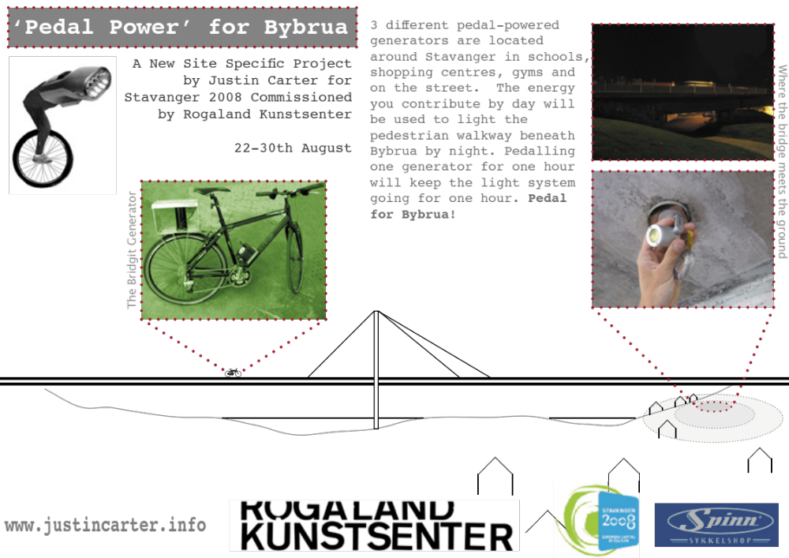
“My original proposal was simply to create a new lighting system for the underpass powered by wind turbines and photovoltaic panels installed on top of the bridge. Conceptually this intervention would give back the light, taken away through the bridges construction. It would also use the elevated concrete structure itself as a parasitic ‘host’. On reflection however, and through discussion with locals, I eventually moved away from this idea realising that conventional renewables might be perceived and experienced as too passive. A stronger intervention was required – one that involved people more directly. Remembering that the road bridge had originally been established as a toll bridge, I decided to turn this idea on its head: What about a toll system for pedestrians where the ‘profits’ could be shared locally? Would people be willing to invest in a scheme that sought to tackle this ‘problem space’? After much discussion I decided that this new toll system – situated in an oil-rich economy - should be based not on money, but on time and energy - thereby creating a more effective glass ceiling on consumption.” (extract from PECSRL paper)
Image of publicity used to promote and explain the project to residents.

Slide 7
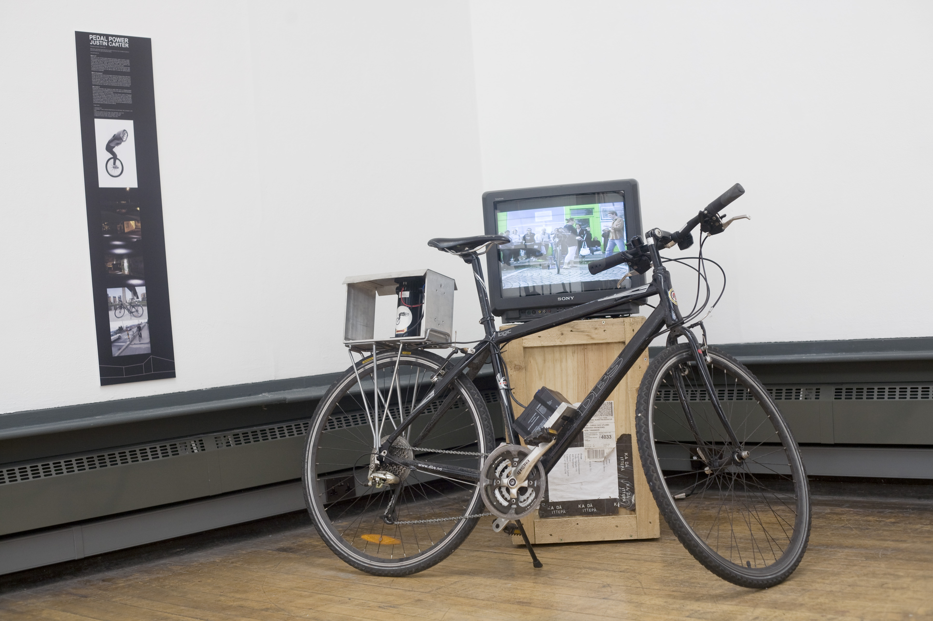
A daily project blog published during the event:
http://justincarterbrightsparks.blogspot.com/search/label/%27Pedal%20Power%20for%20Bybrua%27
Various websites have archived documentation of the project:
http://www.justincarter.info/
http://vimeo.com/29915625
http://www.rogalandkunstsenter.no
An upcoming Rogaland Kunstsenter book publication which includes the project
(expected June 2013)
Conference Papers:
‘Sculptural Intervention as Action Research; Pedal Power for Bybrua’ presented at conference; The Permanent European Conference for the Study of the Rural Landscape (PECSRL) 23rd session – Landscapes, Identities and Development, Lisbon and Obidos, Portugal, 1st-5th September 2008, as part of Special Session A10: Emerging Energies, Emerging Landscapes.
http://tercud.ulusofona.pt/publicacoes/2008/SCULPTURAL.pdf
Installation view, ‘Mobile Solutions’ exhibition, Mackintosh Museum, GSA curated by Jenny Brownrigg (7/10/11 – 17/12/11)

Slide 8

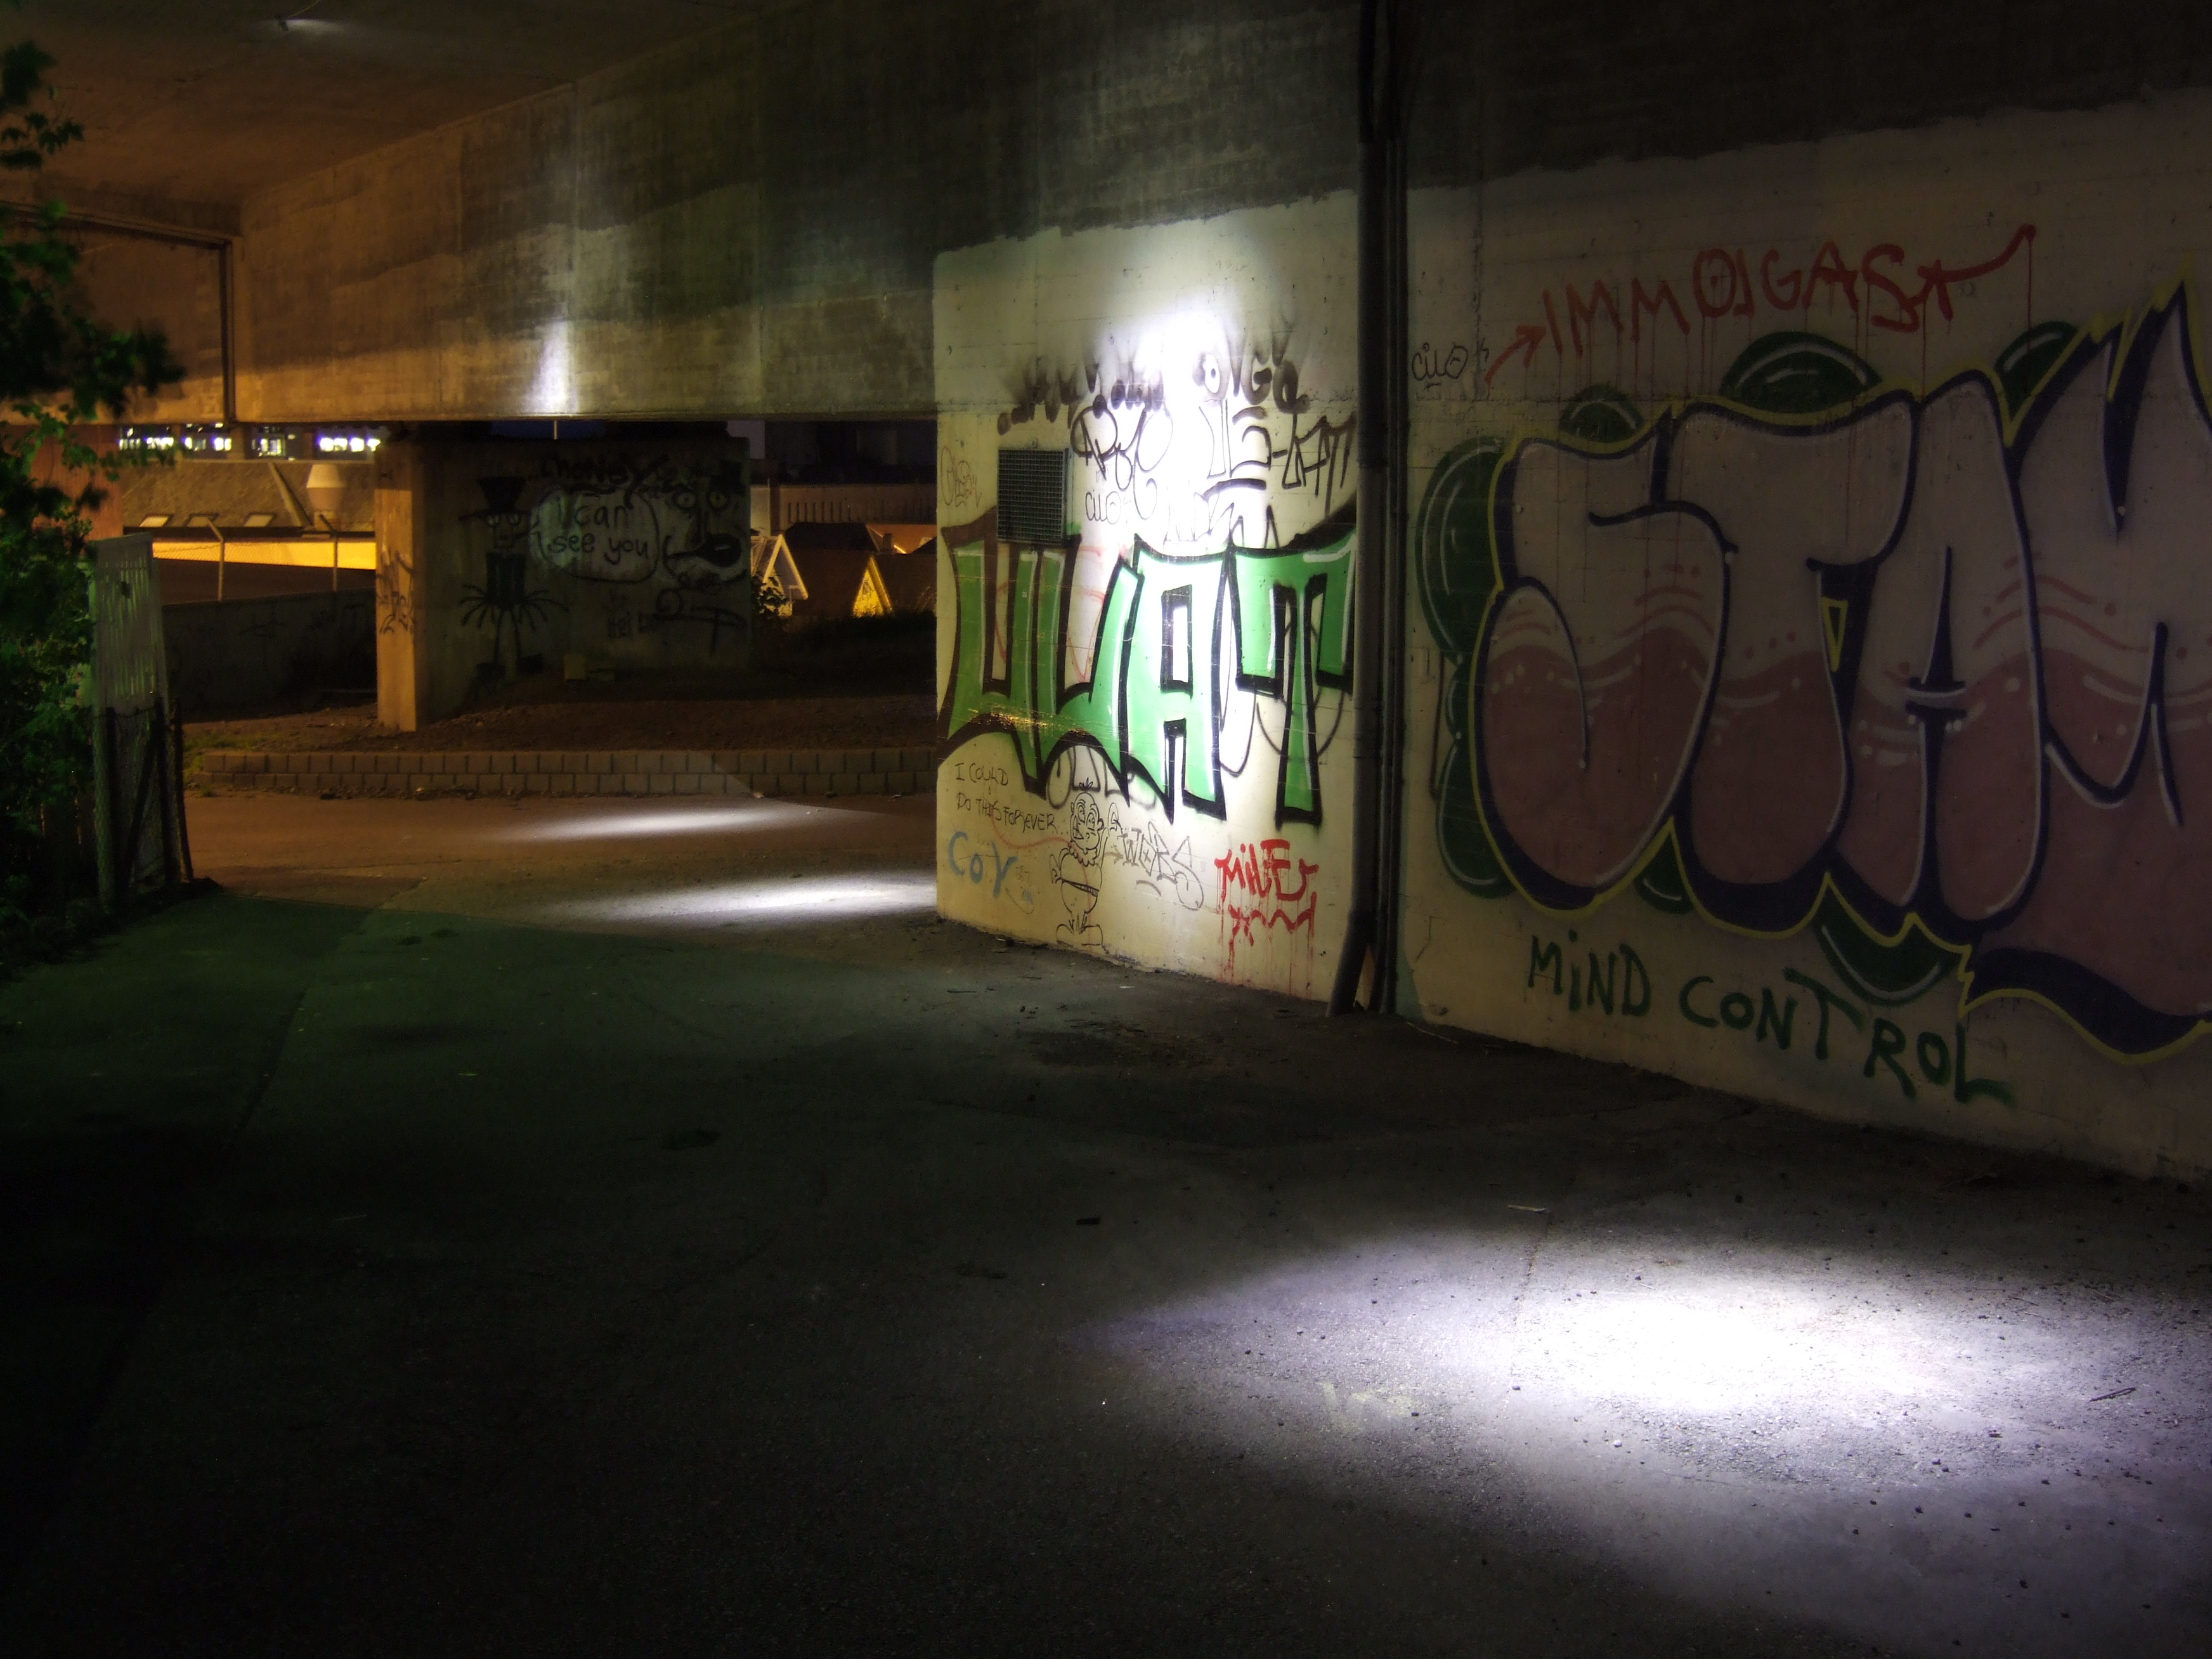
Paper ‘As Functional Prototype – Pedal Powered Light Intervention at City Bridge, Stavanger’ presented as part of Design Connexity conference, 8th European Academy Of Design Conference (EAD) - 1st, 2nd & 3rd April 2009, The Robert Gordon University, Aberdeen, Scotland
(ed. Julian Malins)
ISBN 978-1-901085-97-6
http://ead09.rgu.ac.uk/Papers/084.pdf
Paper ‘Generating Mobility and Power through Art’ presented at ‘Machine Wilderness’ ISEA 2012, Albuquerque New Mexico. 19-24 September.
http://www.isea2012.org/sites/default/files/ISEA2012_confproceedings_WEB.pdf
ISBN - 147935080X (Ed. Andrea Polli)
Articles:
Norwegian radio feature: http://nrk.no/programmer/radio/nitimen/1.6196534
‘Appliance of Science’ article, Sunday Herald 14/6/09 p.15
Project sited by Sam Clarke in Contemporary ‘Art and Environmental Aesthetics’
in Environmental Values 19 (2010): 351–371. 2010 The White Horse Press doi: 10.3197/096327110X519871
http://www.samanthaclark.net/images/content/07_Clark-2.pdf
Also see book chapter 'Pedalkraft Til Bybrua' in 'Art City Population, Rogaland Kunstsenter 2003-2013. ISBN: 978-82-999281-0-6 (ed. Torunn Larsen) published 2013
Subsequent Exhibitions:
‘Where tomorrow begins: Reflections on Scottish Innovation’. Universities Scotland. Exhibition launched Scottish Parliament (touring). www.wheretomorrowbegins.co.uk (2009)
Related book 128 pages, Published by Universities Scotland (2 June 2009) ISBN-10: 0956270506 ISBN-13 : 978-0956270504 Paperback: 128 pages
Texts by Hugh McDiarmid, Alexander Hutchison, Edwin Morgan and Henry Cockburn
‘Mobile Solutions’ exhibition, Mackintosh Museum, GSA curated by Jenny Brownrigg (7/10/11 – 17/12/11)
Image of the underpass space with the lighting system in operation.

Slide 9

Thanks to Torunn Larsen (Rogaland Kunstsenter) Will Foster, Hilde Hemming (British Council) Spinn Cycle shop, Stavanger 2008, and the hundreds of people who pedalled for Bybrua.

