Slide 1


Towards an Entrepreneurial State: Finding the Courage to Fail
10th Regional Innovation Policies Conference Karlsruhe, 14-15 October 2015
Mari Jose Aranguren (Orkestra) Joseph Lockwood (GSA) Madeline Smith (GSA) James R. Wilson (Orkestra)

Slide 2

Motivation
Recent debates on territorial development have emphasized more entrepreneurial approaches to public policy
Renewed interest in industrial policy (Rodrik, 2004; Mazzucato, 2013; Warwick, 2013)
Smart specialisation strategies (European Commission, 2012; Foray, 2014; Morgan, 2015)
Research on innovation in a private sector context suggests benefits (but also costs) from open approaches engaging a range of stakeholders
Open innovation paradigm (Chesbrough, 2003; von Hippel, 2005; Dahlander and Gann, 2010)
Challenge: Seeking to translate the positive aspects of private sector innovation to the public sector has proven difficult
Notes:
Rodrik (2004) argues that the right way of thinking about industrial policy is as a discovery process – one where firms and the government learn about underlying costs and opportunities and engage in strategic coordination
This discovery process is a cornerstone of the smart specialisation approach, which Morgan (2015) argues makes unprecedented demands on public sector bodies to nurture more collaborative forms of economic search and craft more inclusive forms of regional governance
Mazzucato (2013) talks about the State playing a role in actively shaping and creating markets
RODRIK: The right way of thinking about industrial policy is as a doscovery process – one where firms and the government learn about underlying cossts and opportunities and engage in strategic coordination.
MAZZUCATO: State has always been entrepreneurial. Role of State in fostering long-run innovation-led growth – seeks to take apart myths around the public & private sector. Has led to debates around the appropriation of the results of research & scale of future investment in research & development
Morgan: work on nurturing novelty

Slide 3
Realising the demand
There is a clear demand: many governments realise they need to do something different
A key question then is what capabilities does the State require to do these things (and what can be learned from experience with private sector innovation management)
Open to new ideas, new voices – bottom up expertise not just top down implementation
System approach is needed – not siloed
But mixed evidence on open innovation and emerging acknowledgment of balance between openness and closedness (& different governance requirements)
E.g. Dahlander & Gann (2010); Felin & Zenger (2014)

Slide 4
Approach
Reflection on a series of action research processes, where research teams at Orkestra and GSA have worked with public sector agents to innovate the process by which they do policy
Processes began from a desire to innovate in policy and an understanding that change was needed
Action research processes seek to generate reflective cycles & double-loop learning (safe space to explore)
Proven success in private sector contexts – testing with public sector
The processes have generated some success, but not the extent and legacy of change hoped for (at least not yet – Still WIP)
Learning from difference (is there difference between private/public sector and across territorial different contexts, and if so why) as an approach that aims to enhance our understanding of the barriers to deeper change in policy-making practice

Slide 5
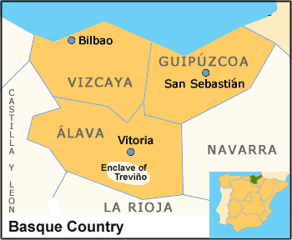
Basque Country: Three Cases in Territorial Strategy
RIS3 (Basque Country Regional Government)
Aim: Advise regional government on development of RIS3
3 phases (3 years): Learning space with Economic Development and Competitiveness Department / Strategy document development with Presidency / Implementation phase with Presidency
Bizkaia Competitiva (Bizkaia Provincial Government):
Aim: Analysis the competitiveness of Bizkaia to set in motion strategic processes
2 phases (3 years): Holistic diagnosis of competitiveness / Working with stakeholders on two strategic challenges (territorial cohesion & diversification towards higher value activities)
Gipuzkoa Sarean (Gipuzkoa Provincial Government):
Aim: development of a new governance model in Gìpuzkoa
Phases (6 years project): Reinforcement of social capital in Gipuzkoa / Construction of a new governance model (HOW) / Currently redefining the project with the new government

Slide 6
Basque Country: Territorial Strategy Learnings
RIS3:
Usual Government organization does not facilitate transversal learning and collaboration that are critical in new innovation policies, so the strategy has to be leaded at the highest governmental level.
Governmental strategy building experience is based on a planning (design, implementation, evaluation) approach and to change to an entrepreneurial and process based approach they have to see first the need (the lack of evaluation is a barrier to see the need).
The change to an entrepreneurial approach asks also to assume risks: you do not know the results that it could generate (political cost), other actors expect to see a clear plan (generates uncertainty) and government need to be brave.
Gipuzkoa Sarean:
The development of new governance modes requires also an internal organizational change (creation of a transversal department on Territorial development). Easier to create a new unit than to change the existent ones?
Creation of new capabilities (facilitators(relational leaders…) is critical for the development of new governance modes.
The creation of a safe spaces helps in the development of co-generation of knowledge and learning for researchers and policy-makers.
Bizkaia Competitiva:
The need to have tangible results in the short term (a document in one year). There were elections (political cycle). Tensions in the research and political tempus.
Prevalence of control vs trust: the diagnosis as a internal document (save space, without risks), and control based mindset for the development of the territorial cohesion challenge.
Language barriers: mutual misunderstanding period (Orkestra as a consultant or as researcher).

Slide 7
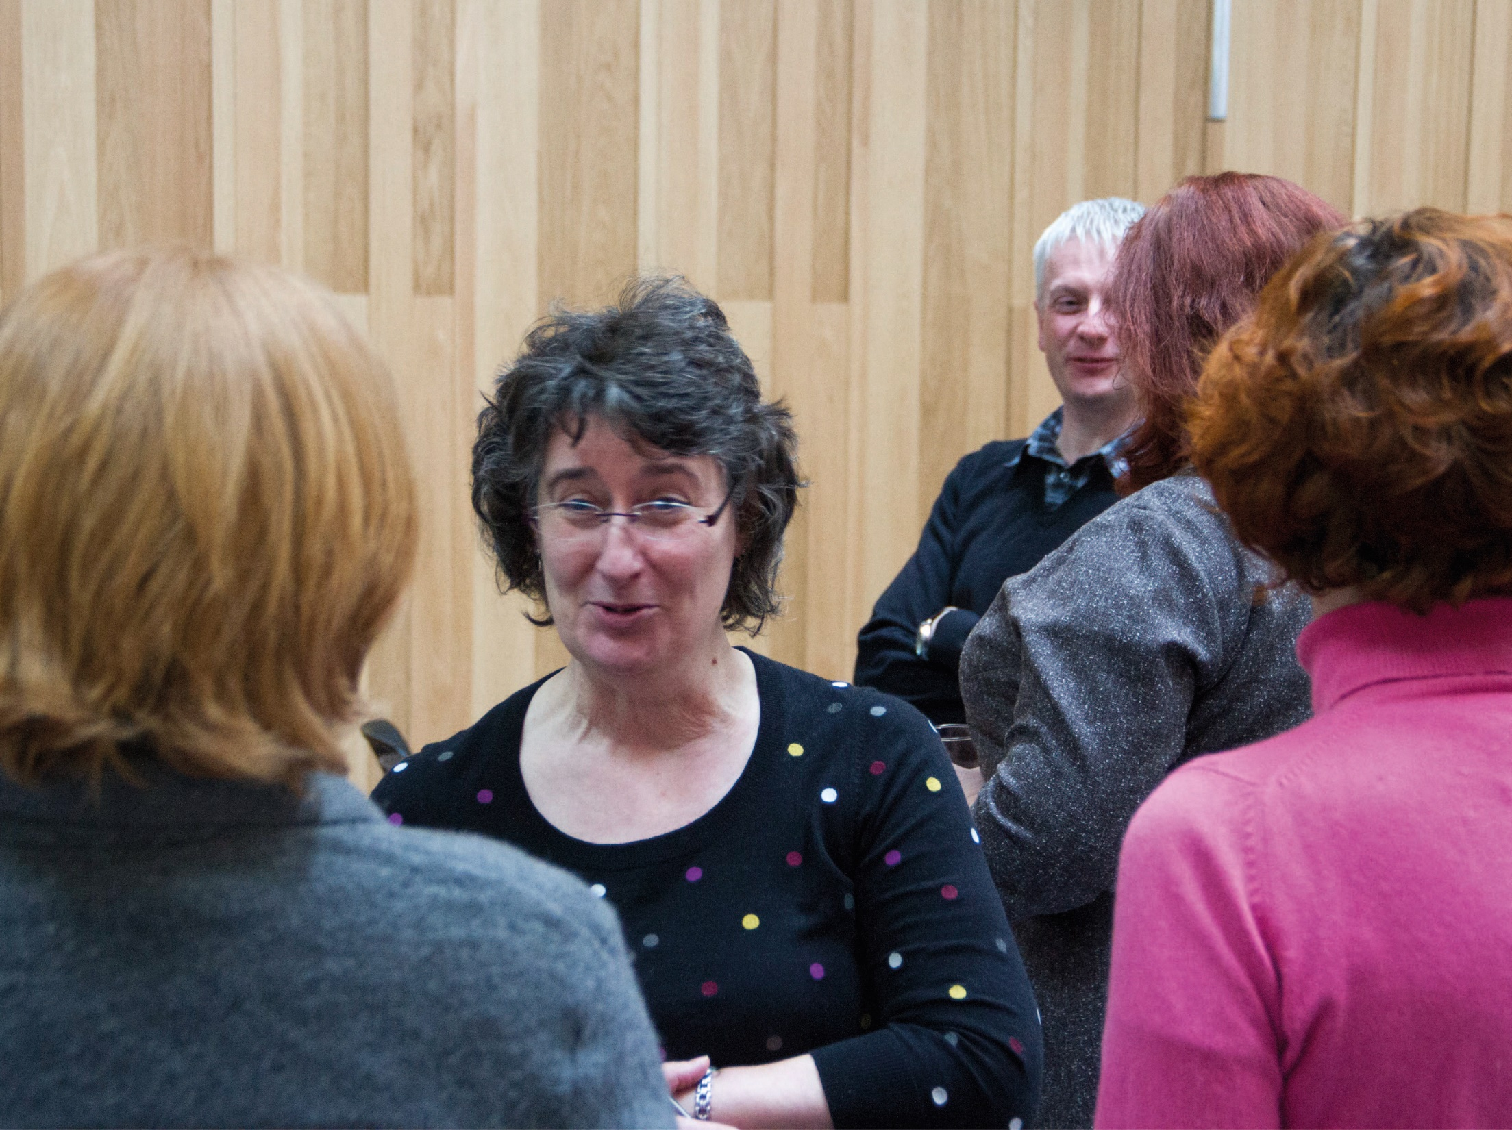
Scottish Government
Notes:
GRANTON ON SPEY – NHS & GOV WORKING ON PHYSICAL ACTIVITY

Slide 8

Cultures of Innovation
Design Innovation Approach
Can design act as a vehicle to enhance and embed sustainable innovation capability in organisations
Successful examples in private sector – testing in public sector
Diverse cross organization group/challenge way of looking at problems/safe space to iterate/ripple out to embed behaviours
“Significantly, the intervention has left a legacy of on going development activity, with the innovation team at Scott & Fyfe becoming permanently embedded within its everyday practice.”
Jonathan Payne SKOPE

Slide 9
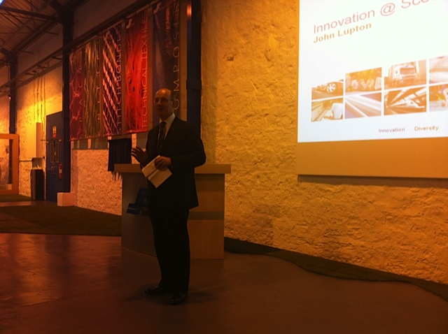
Scottish Government Innovative approaches to Policy Making in Scotland
Innovation for Public Health in Scotland

Slide 10
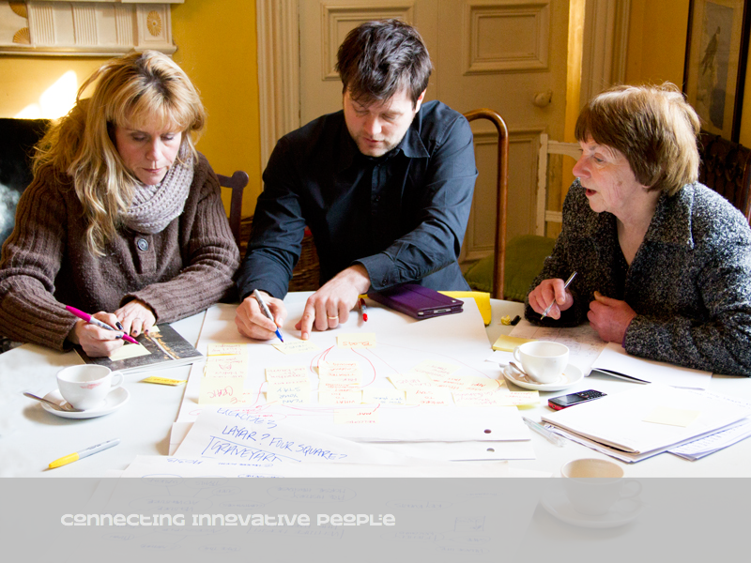
Cross section of departments and external partners - Champions

Slide 11
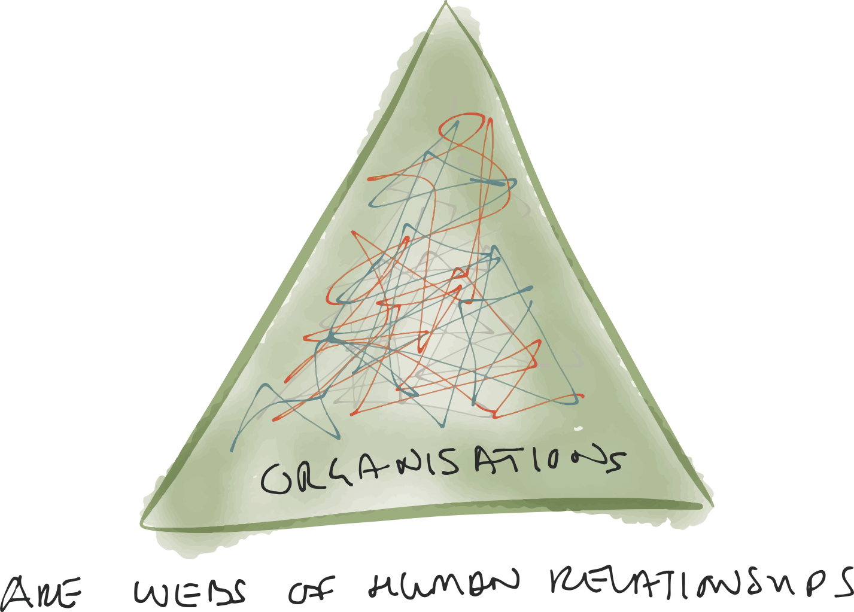
Scottish Government Learning
Immediate result very positive
“Permission to be Creative”
New collaborations tackling real challenges
Follow up results:
Time taken to make progress
Longer term commitment
Leadership commitment for implementation
Right people in the room? Influence?
Understanding context
Ongoing appetite

Slide 12

Understanding context
Risk and risk appetite
Contrast with entrepreneurial private sector – maximise maximum gain vs minimise maximum loss
Fear of failure (media and political consequences, and need to not upset anyone just before an election – and change upsets)

Slide 13

Challenges around the need for change
Realisation of need for change is not widespread: institutional inertia
Lack of & pace of feedback loops: Loss of sales give immediate feedback in private sector
Size and structure effects
Buy-in that institutional change is important (government sector compartmentalized)
Language barriers
Also some positives
Often strongly motivated to produce improved results
(Can be) Passionate about the need for change

Slide 14
Conclusions & Next Steps
The notion of a ‘safe space’ is useful, but there are challenges in connecting this to wider processes: Limits in design of processes
Need for widespread organizational support and commitment (similar to in the private sector)
Need to fully understand context and plan actions to help address them during “ripple”
Resistance to change shouldn’t be underestimated (partly this comes back to political agendas, and what society expects from politicians – media responsibility, citizen responsibility)
Need to have a sensible conversation about failure
Learning from failure as a positive issue requires a culture change (people, recruitment, structures, reward)
Risk of sanction if wrong predominant “reward” model
Need for further research: continuing to engage in these sorts of projects with government
These were projects that happened because the government approaches us
There is a desire to innovate and do things differently and therefore an opportunity to capatilise on this demand

Slide 15
10th Regional Innovation Policies Conference Karlsruhe, 14-15 October 2015
Madeline Smith (GSA) : m.smith@gsa.ac.uk James R. Wilson (Orkestra): jwilson@orchestra.deusto.es

