Slide 2
Rules:
Not to hang or exhibit or permit or suffer to be hung or exhibited outside the structure any goods, articles or things for sale.
Not to play music by whatever means either in or outside the structure at a level that causes a nuisance to either the Landlord or their agents or the general public.
Not to use or permit or suffer to be used in or outside the structure any radio, electric or electronic equipment in such manner or condition as to cause electrical, electronic or other forms of interference to adjoining or neighbouring subjects or equipment operated therein.
No overnight accommodation will be permitted in the building. No residential or holiday use of the building will be permitted.
No services, will be permitted on or to be connected to the building.
No tents, camper vans or caravans will be permitted at any time.
No barbecues or fires will be permitted.
No commercial activities may be carried out, with the exception of commissioning of works by artists using the studio.
Please do not litter or toilet in the environs (if you find litter outside the building please remove if possible).
Please do not leave anything behind either in the studio or in the environs (this includes natural or collected materials) If you have used natural materials to construct something please disperse in the environment or remove completely from site.

Slide 3
OUTLANDIA proposal
This residency interests me because it offers a short but intense period of time in a relatively remote location. I’m drawn to mountains and the possibility of somehow building a relationship with Ben Nevis: I’ve been reading about mountains in Scotland and the North on England through the work of Nan Shepherd, Richard Askwith and Robert MacFarlane. This material has provided me with many fertile ideas for creative development.
My work often references the history of landscape and wrestles with the idea of nature. I’m interested in place, site and location. Specifically, I’m interested in the disruptions and conflicts that exist in landscape through human interaction and I have previously made work in response to strong military presence in remote areas, (Cove Park) and issues around tourism and conservation (Grizedale). Most recently I was commissioned by Trust New Art Bristol (2013) to respond to Leigh Woods. The subsequent work, ‘Autumn’, incorporated aspects of walking, performance and camouflage; attempting to disrupt conventional binaries of urban/rural, art/life and nature/culture.
For this residency I plan to respond to the Ben Nevis Hill Race which takes place annually in September. This year the race is scheduled for 5th September, so I propose a stay from 31st August until 6th September. What shape and form the work will take I‘m not yet sure, but I’m interested in finding a language that can describe physical risk and endeavor, and the sense of fulfillment that this affords. Although the methods and materials are ‘open’ at this stage, I do plan to disseminate the results of this residency at the PECSRL conference (2016) where there will be a strong thematic focus on Mountain landscapes. In this way I’m also interested in understanding my residency as an experimental space that tests the inevitable conflicts between academic rigor and the uncertainties of the creative process.

Slide 4


Slide 5
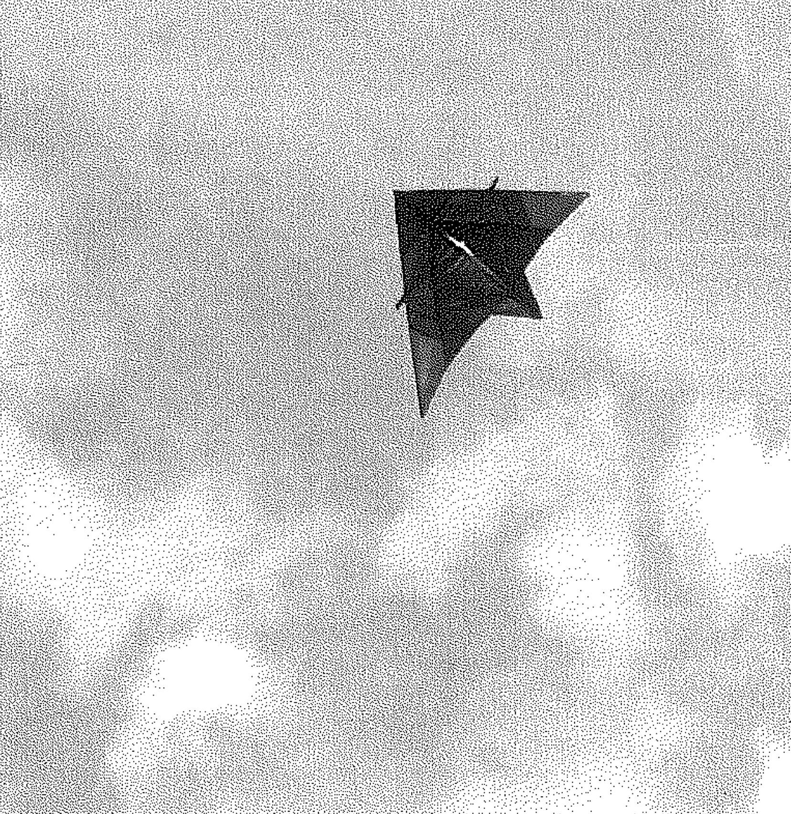

Slide 9
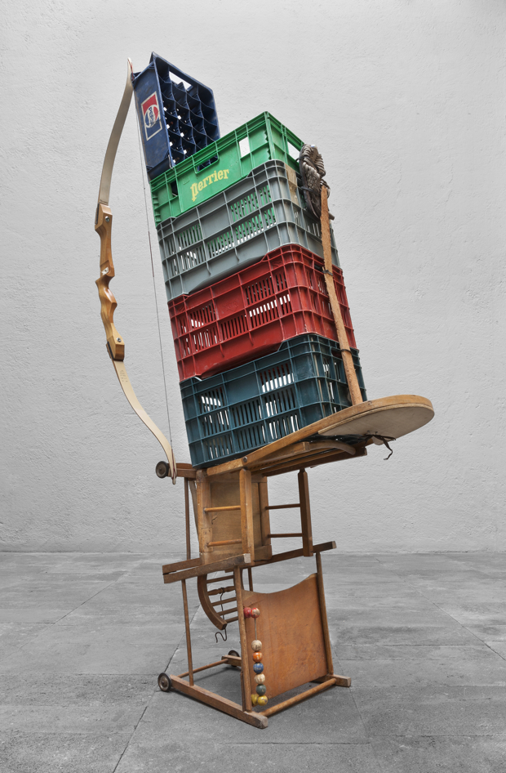
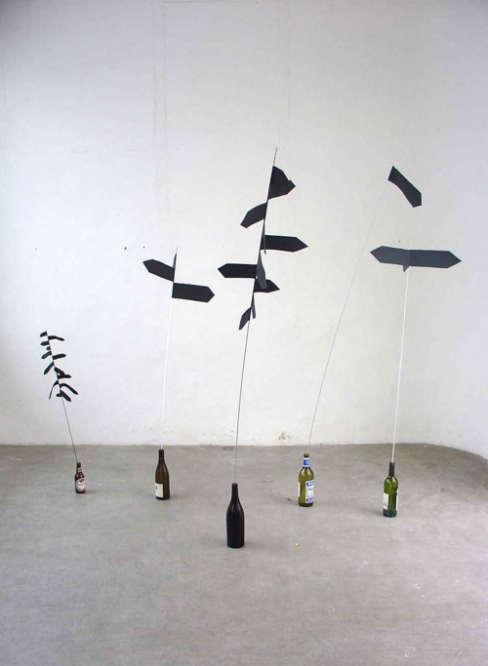

Slide 10
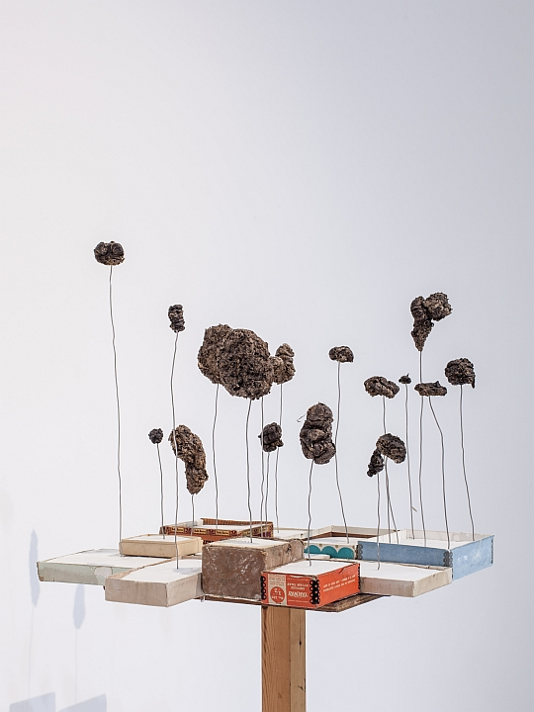
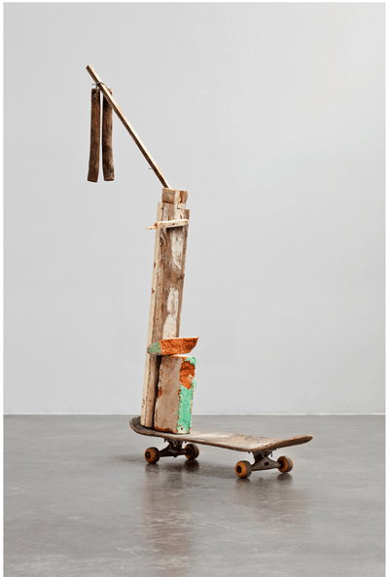

Slide 11
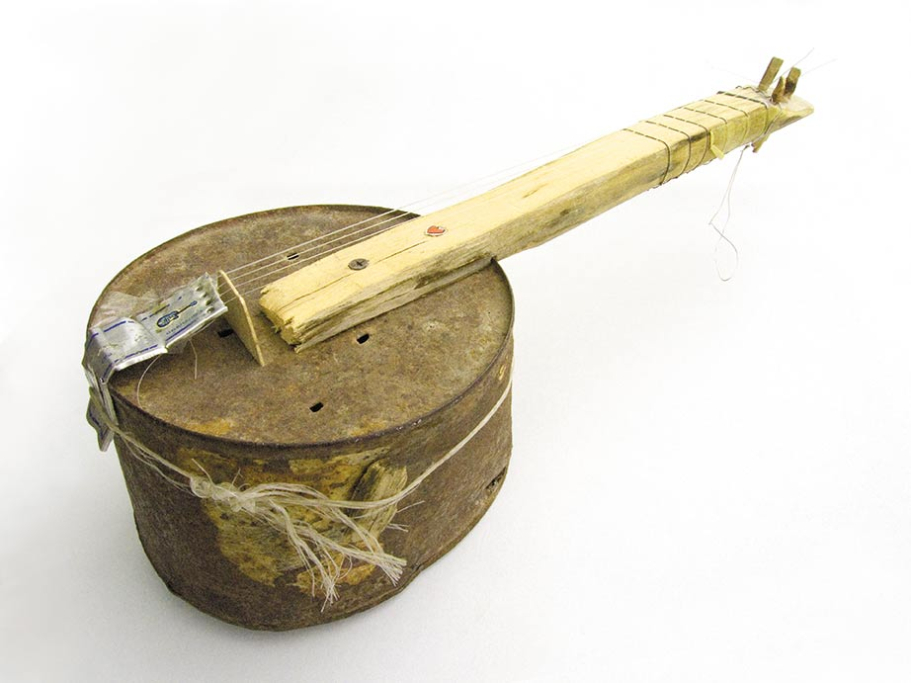

Slide 12
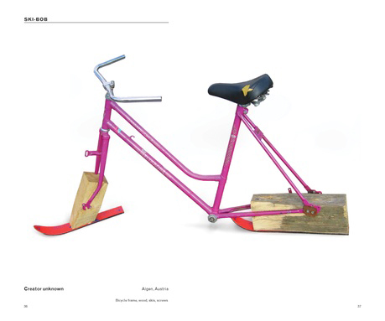

Slide 13
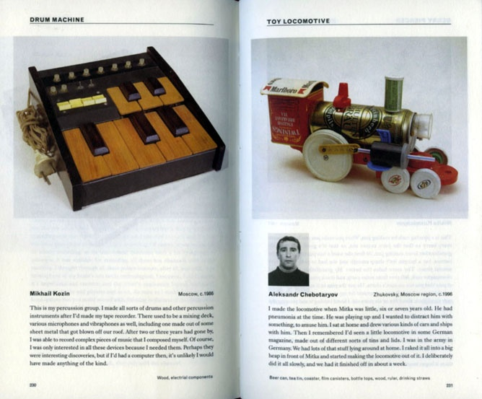

Slide 14
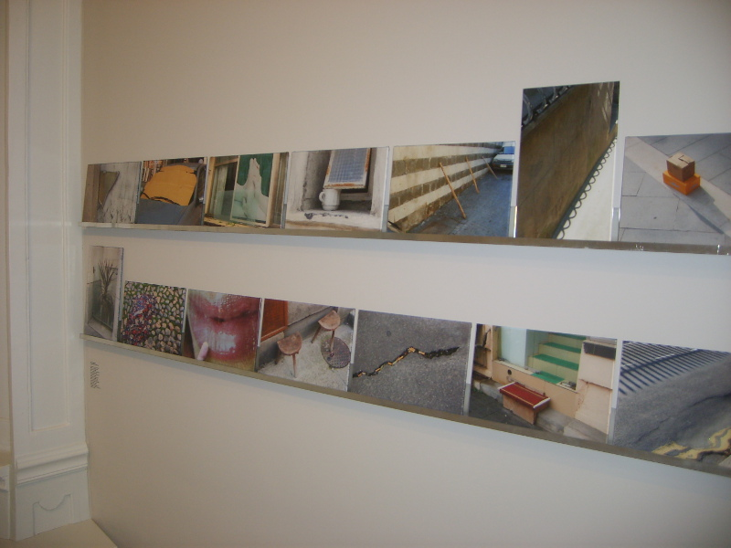

Slide 15
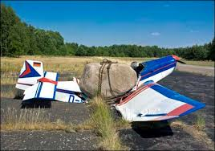
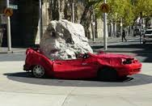
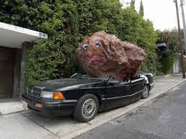

Slide 16
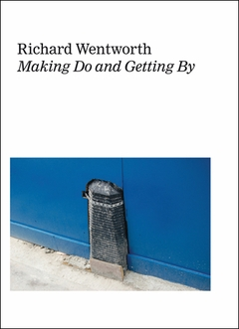

Slide 17
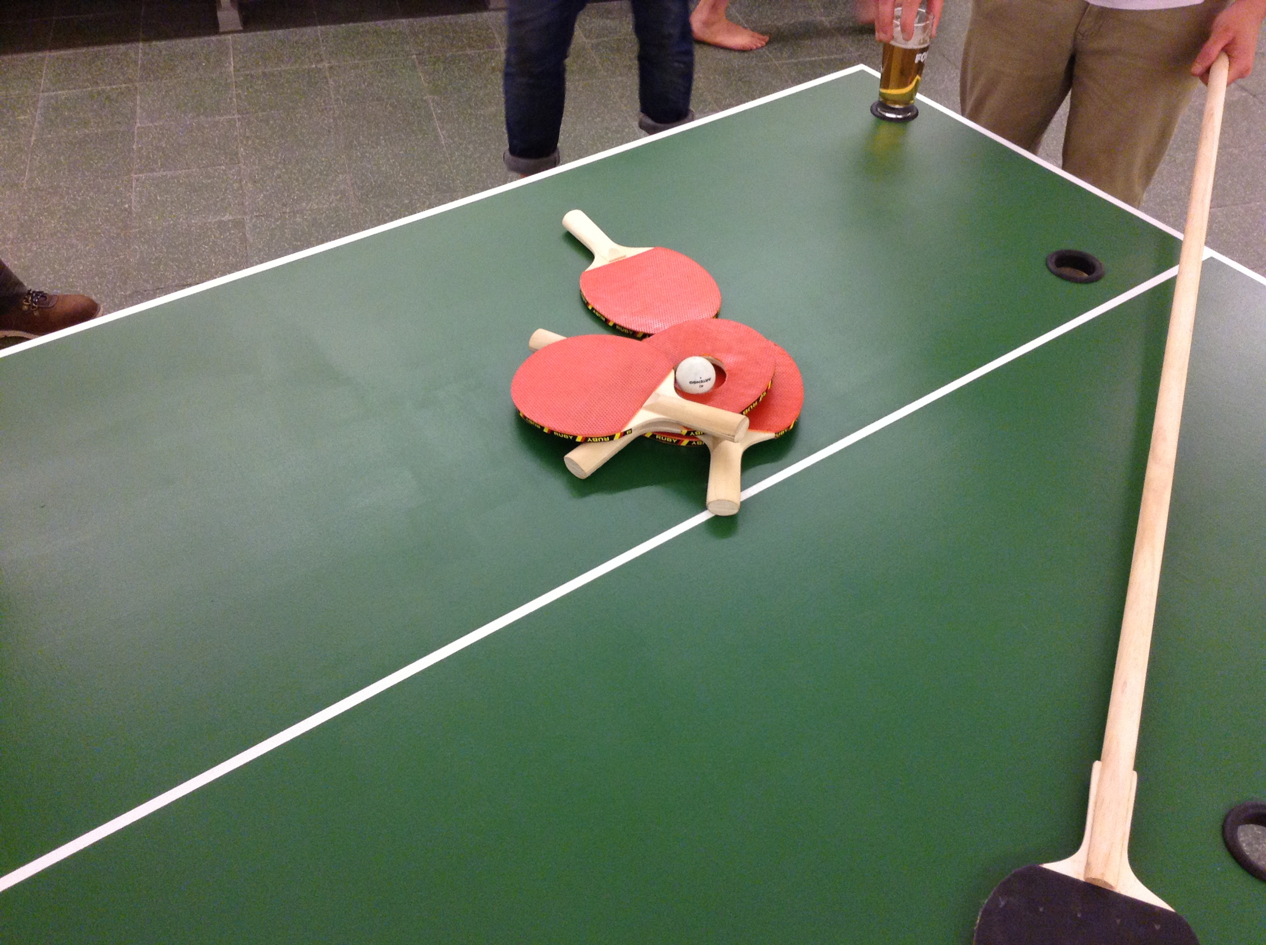

Slide 18
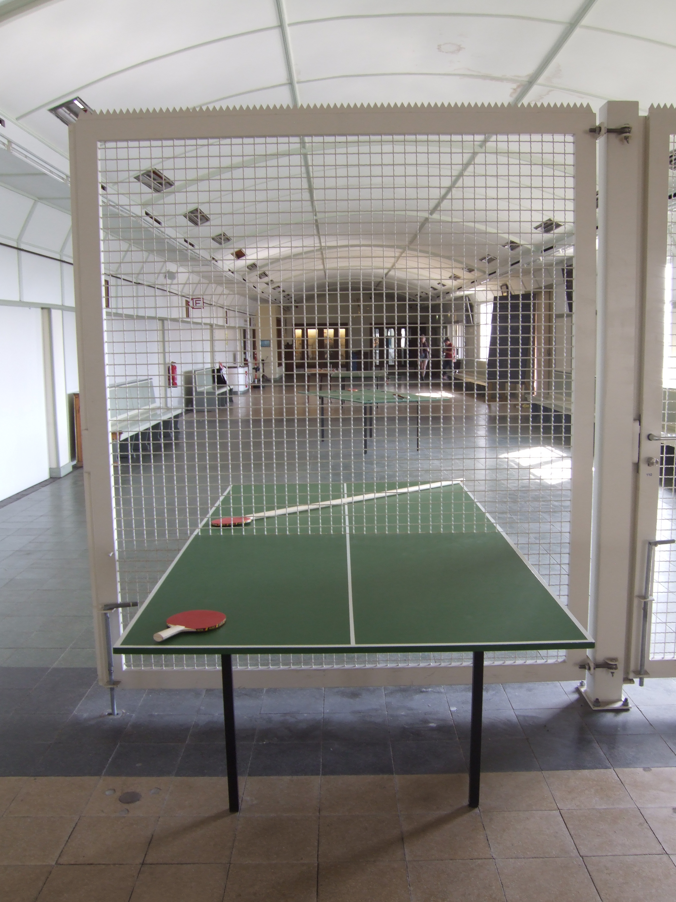

Slide 23
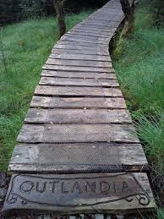
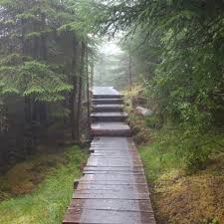

Slide 24
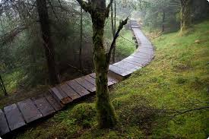

Slide 25
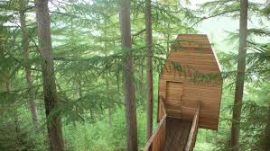
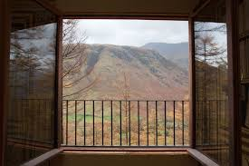

Slide 26
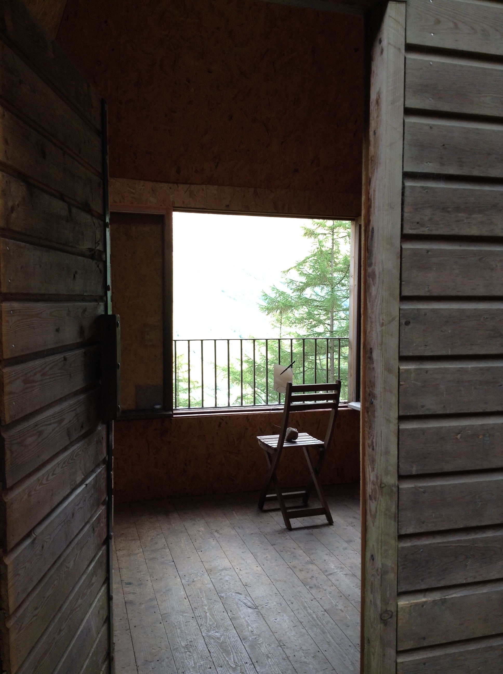

Slide 28
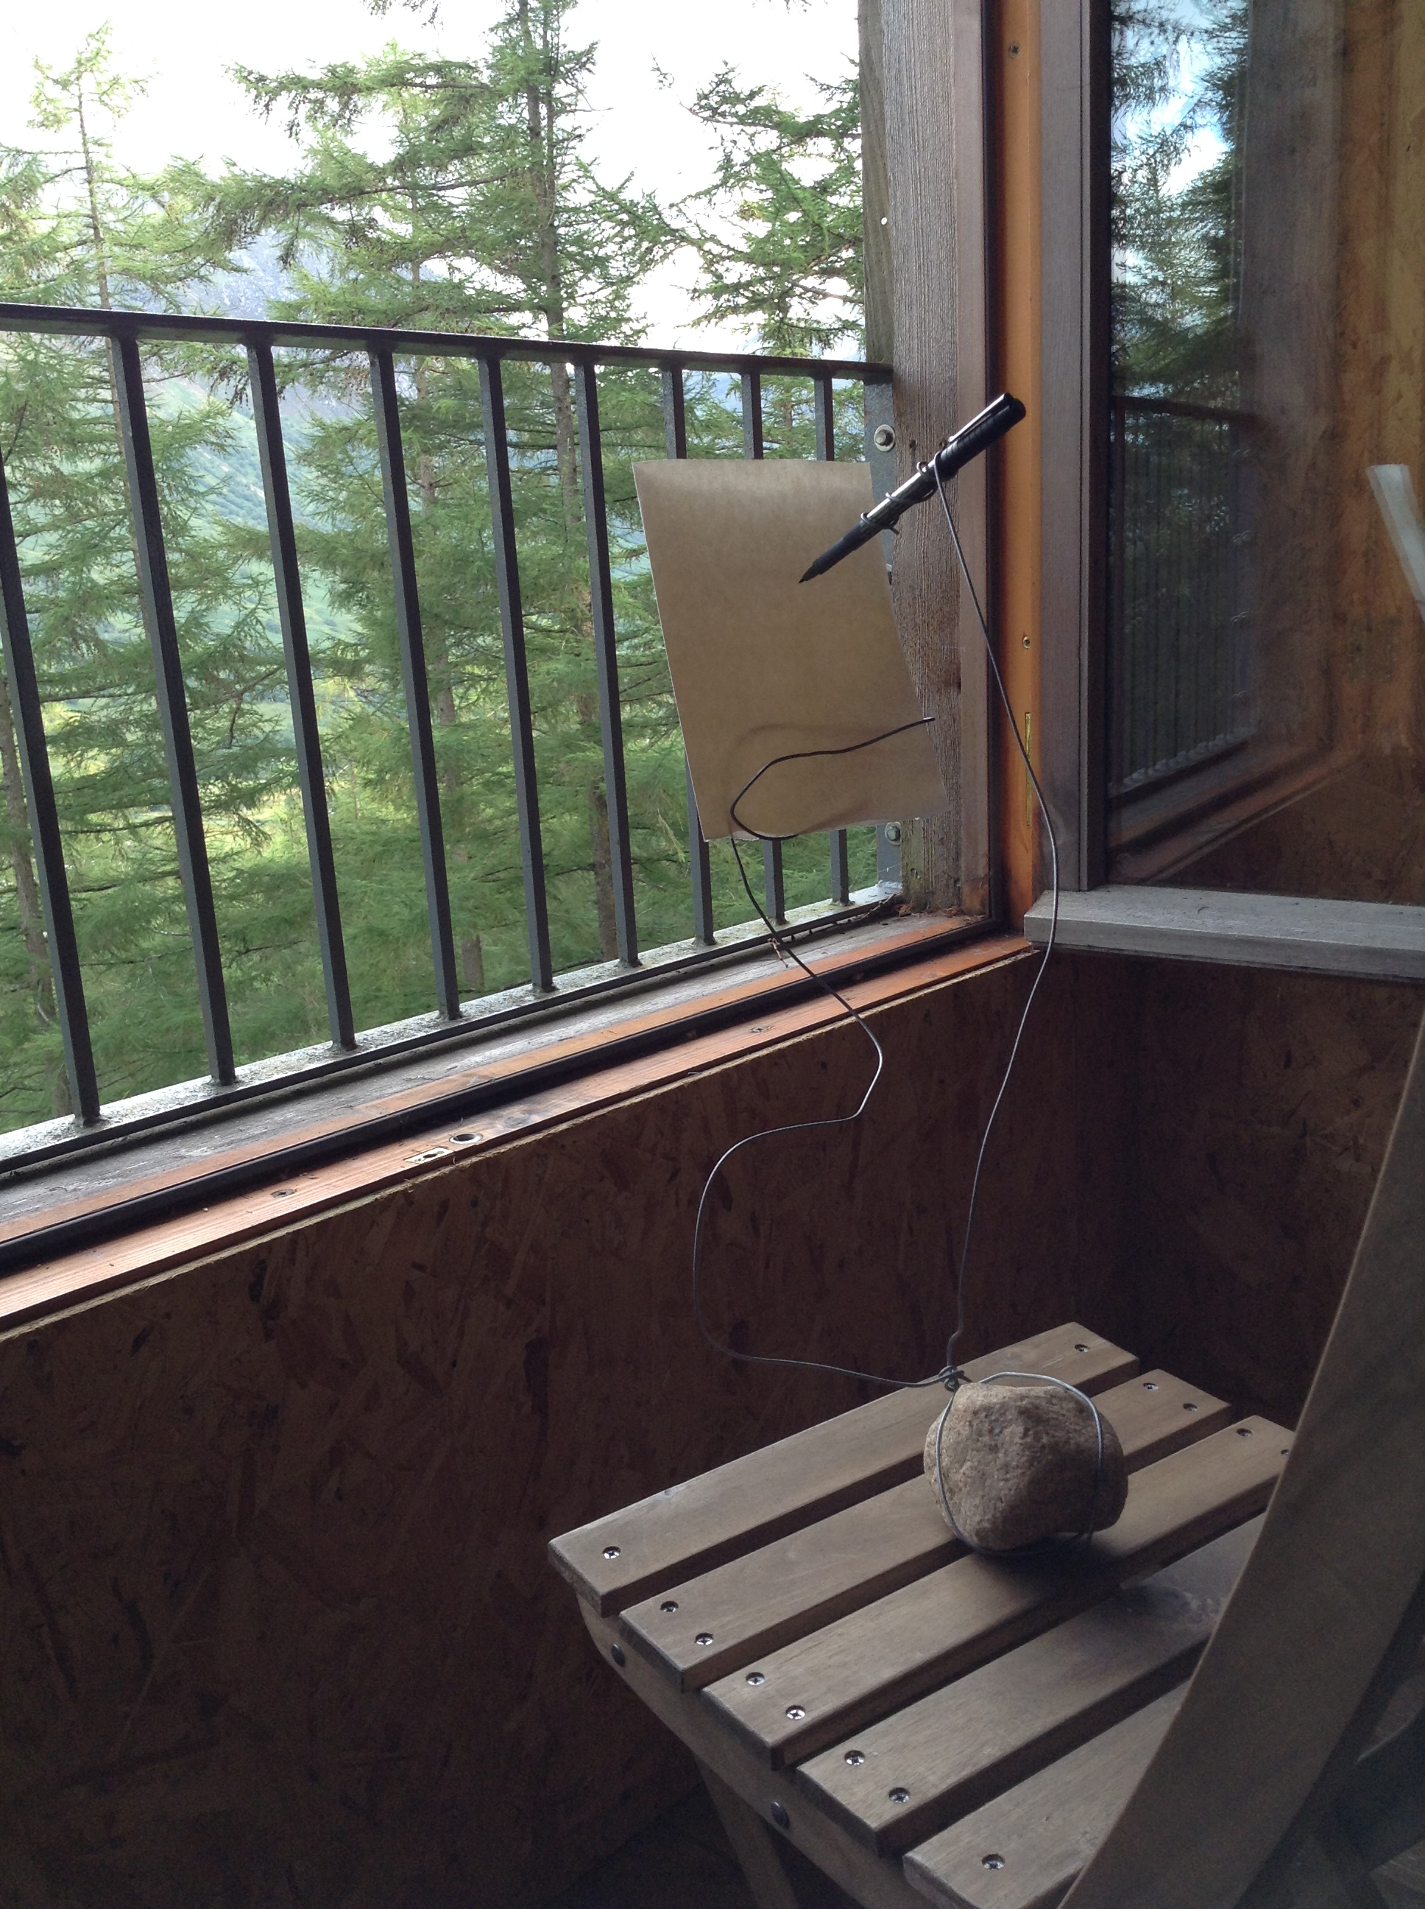

Slide 29
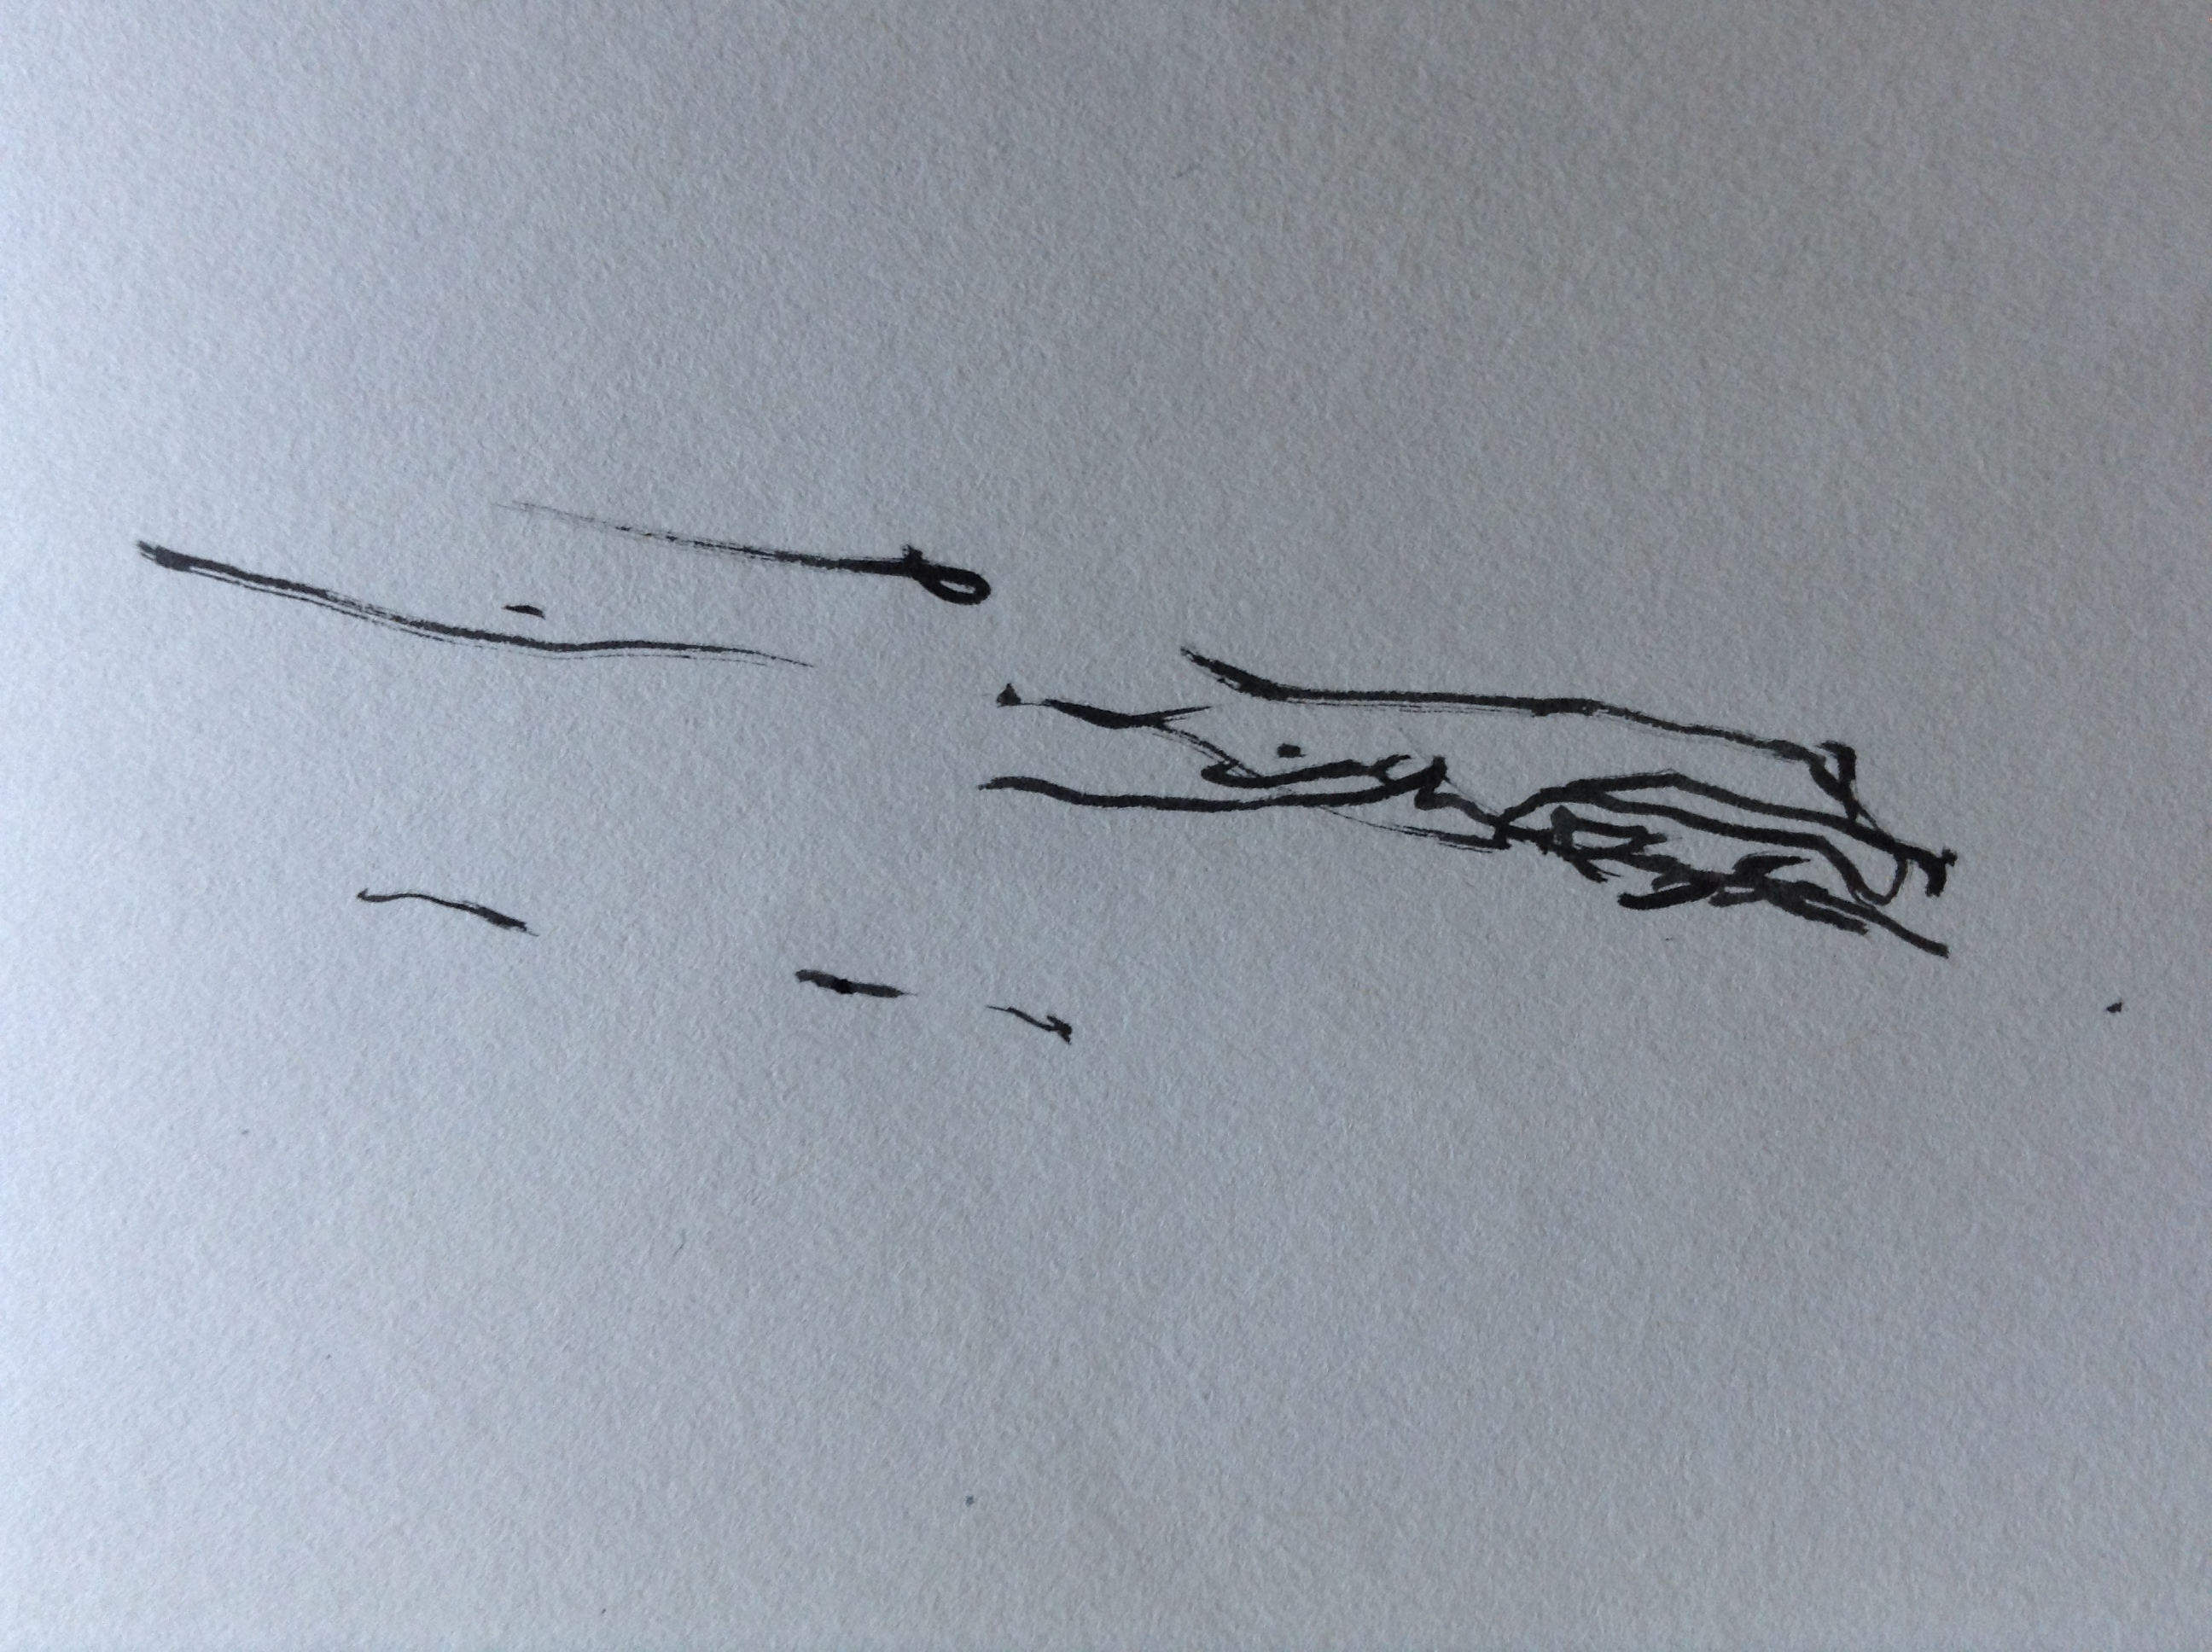

Slide 30
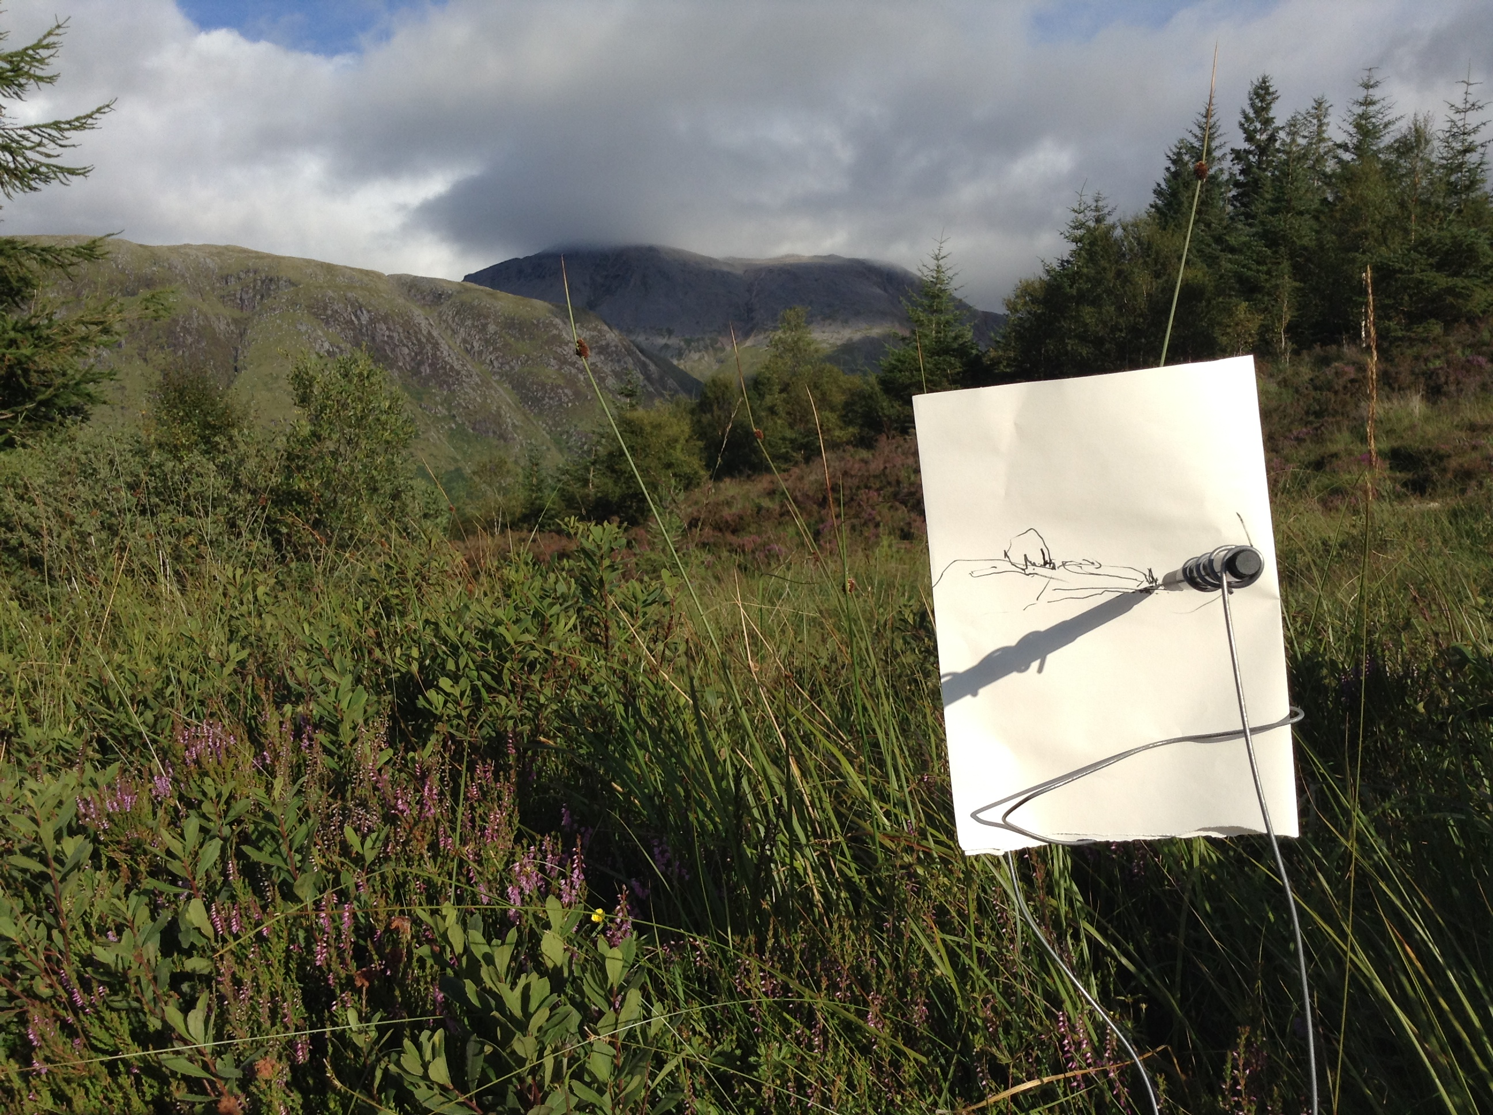

Slide 31
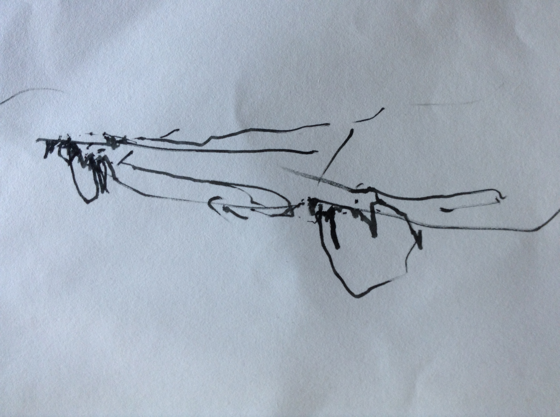

Slide 32
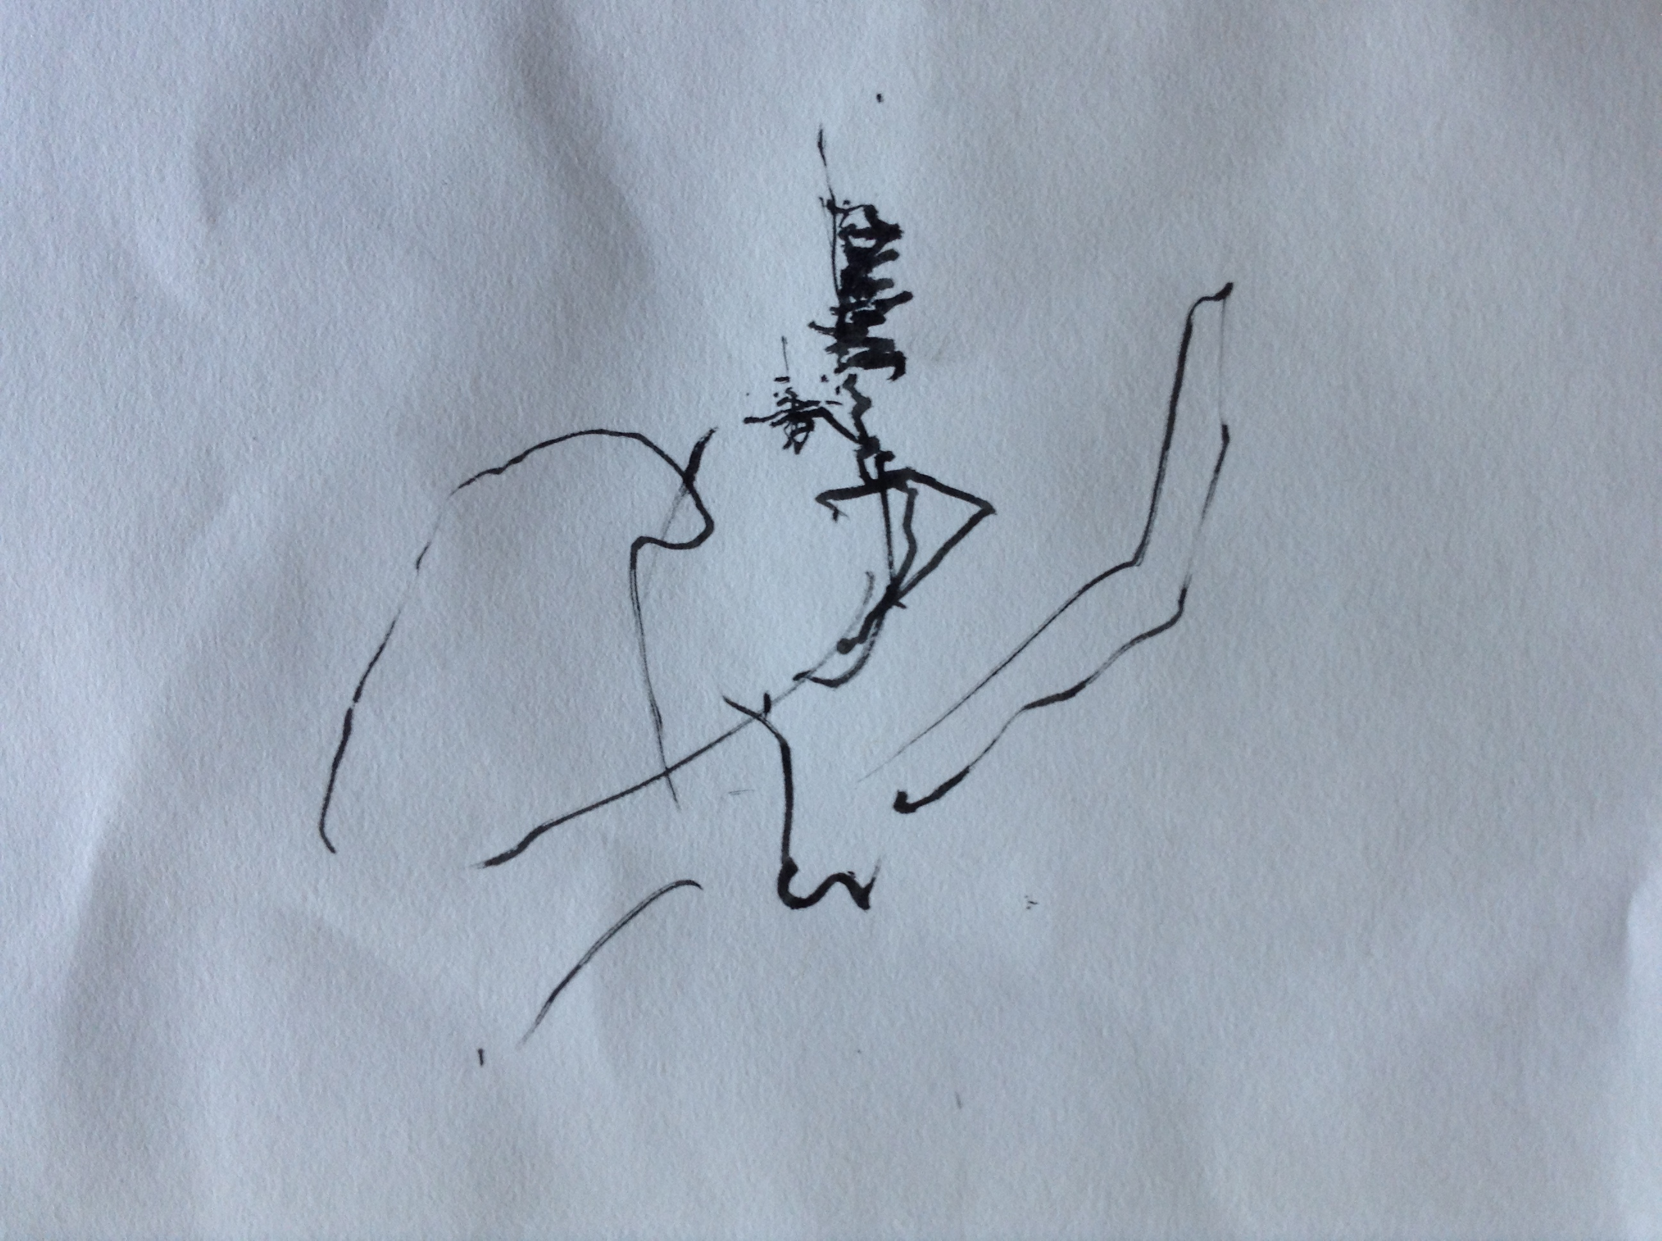

Slide 33
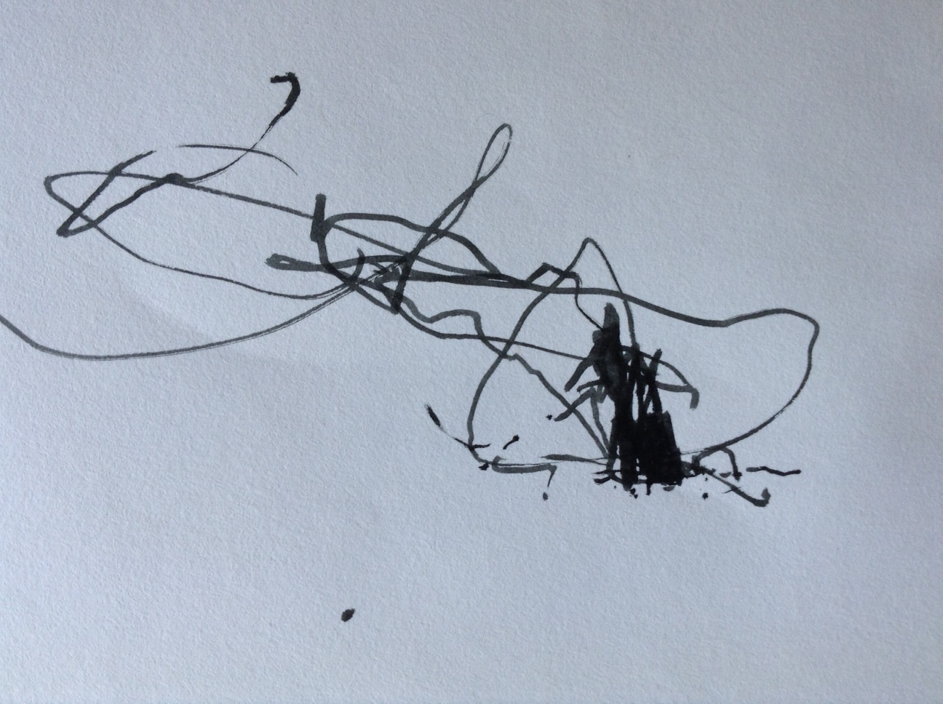

Slide 34
https://vimeo.com/143245169

Slide 35
http://www.outlandia.com/2015/09/justin-carterair-september-2015.html

