Slide 1
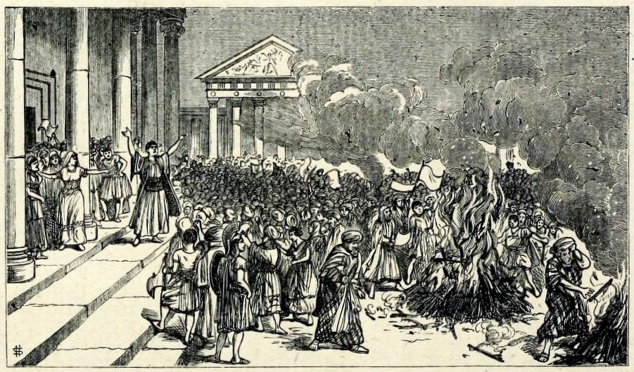
Notes:
In his treatise The Enemy of Books, the printer and bibliophile William Blades enumerates the varied mistreatments that books can suffer at the hands of agents such as water, heat, dust and neglect, ignorance and bigotry, bookworms, and even servants and children.
His chapter on fire begins: “There are many of the forces of Nature which tend to injure Books; but among them all not one has been half so destructive as Fire… It would be tedious to write out a bare list only of the numerous libraries and bibliographical treasures which, in one way or another, have been seized by the Fire-king as his own.”
(He illustrates his point with an engraving of the destruction of books on magic at the library of Ephesus.)
We stand of course some two years and more from the 23rd of May 2014, when the Fire-king seized our much-loved Mackintosh library here at Glasgow School of Art and the important art historical collections it contained.

Slide 2
Research
Restore
Rebuild
Reclaim
Notes:
Now much has been written on the importance of the design of Mackintosh’s library, and my colleagues here (and indeed many of you) are infinitely more qualified to talk on that subject than I.
So it is not the intention of this talk to add further to this architectural discourse.
Rather, it adopts the premise that any historical library is more than an architectural space alone; the collections it contains also form an intrinsic part of its history of both use and reception.
In the case of Mackintosh’s library, the innovative aesthetic has tended to overshadow the collections that it held
In tonight’s talk I aim to address this, and provide a short overview of the post-fire activities that relate specifically to the important collections held within Mackintosh’s space
We will start with the historical research that has been conducted into the early library collections at GSA

Slide 3
Notes:
Mackintosh’s space is now so synonymous with the GSA library, that it is often overlooked that a collection had existed within the School for many years.
The fire provided us with an opportunity to reconsider primary documents that remain in the School’s archives (such as the Minutes of the Library and Materials Sub-Committee of Governors) in order to construct, for the first time, an evidenced narrative of the history of the library and the strategies that were employed to develop its collections.
Here, I will provide a rather potted version of the history we have uncovered:
We now know, for example, that a library is first mentioned in 1847 when the Governors ‘request their fellow citizens to assist them in making additions to the lending library, which is far from being sufficient for the wants of the school; and, as the use of the library is valued highly by the students, it is desirable to extend it as much as possible.’
The date of 1847 is perhaps significant, for it comes just 2 years after the Glasgow School first opened its doors, and it is clear that within a very short period of time following its foundation the School was actively constructing a library for its students.
After these formative years, the next mention of the library does not occur for another 35 years, in 1885 when the School was housed in the McLellan Galleries
The 1887 Annual Report observes that though the library had been ‘thoroughly overhauled, arranged and catalogued’ and was open during set hours, it had become necessary to use the ladies luncheon room as a reading room.

Slide 4
James Joseph Francis Xavier King (1907)
by David Forrester Wilson © The Hunterian, University of Glasgow
Notes:
In 20 March 1893 William Forrest Salmon submitted a plan to alleviate the situation with a new library space within the Corporation Buildings that would release the ladies’ luncheon room for its original intended use.
The following year the Annual Report noted that ‘a special room has been set aside…, suitably provided with book-cases and tables, where students can consult the books which may aid them in their particular study.’
No plans of Salmon’s scheme survive.
This new space seems to have acted as the catalyst for the appointment of the School’s very first librarian in 1894, the artist James Joseph Francis Xavier King, shown here in a portrait by David Forrester Wilson

Slide 5
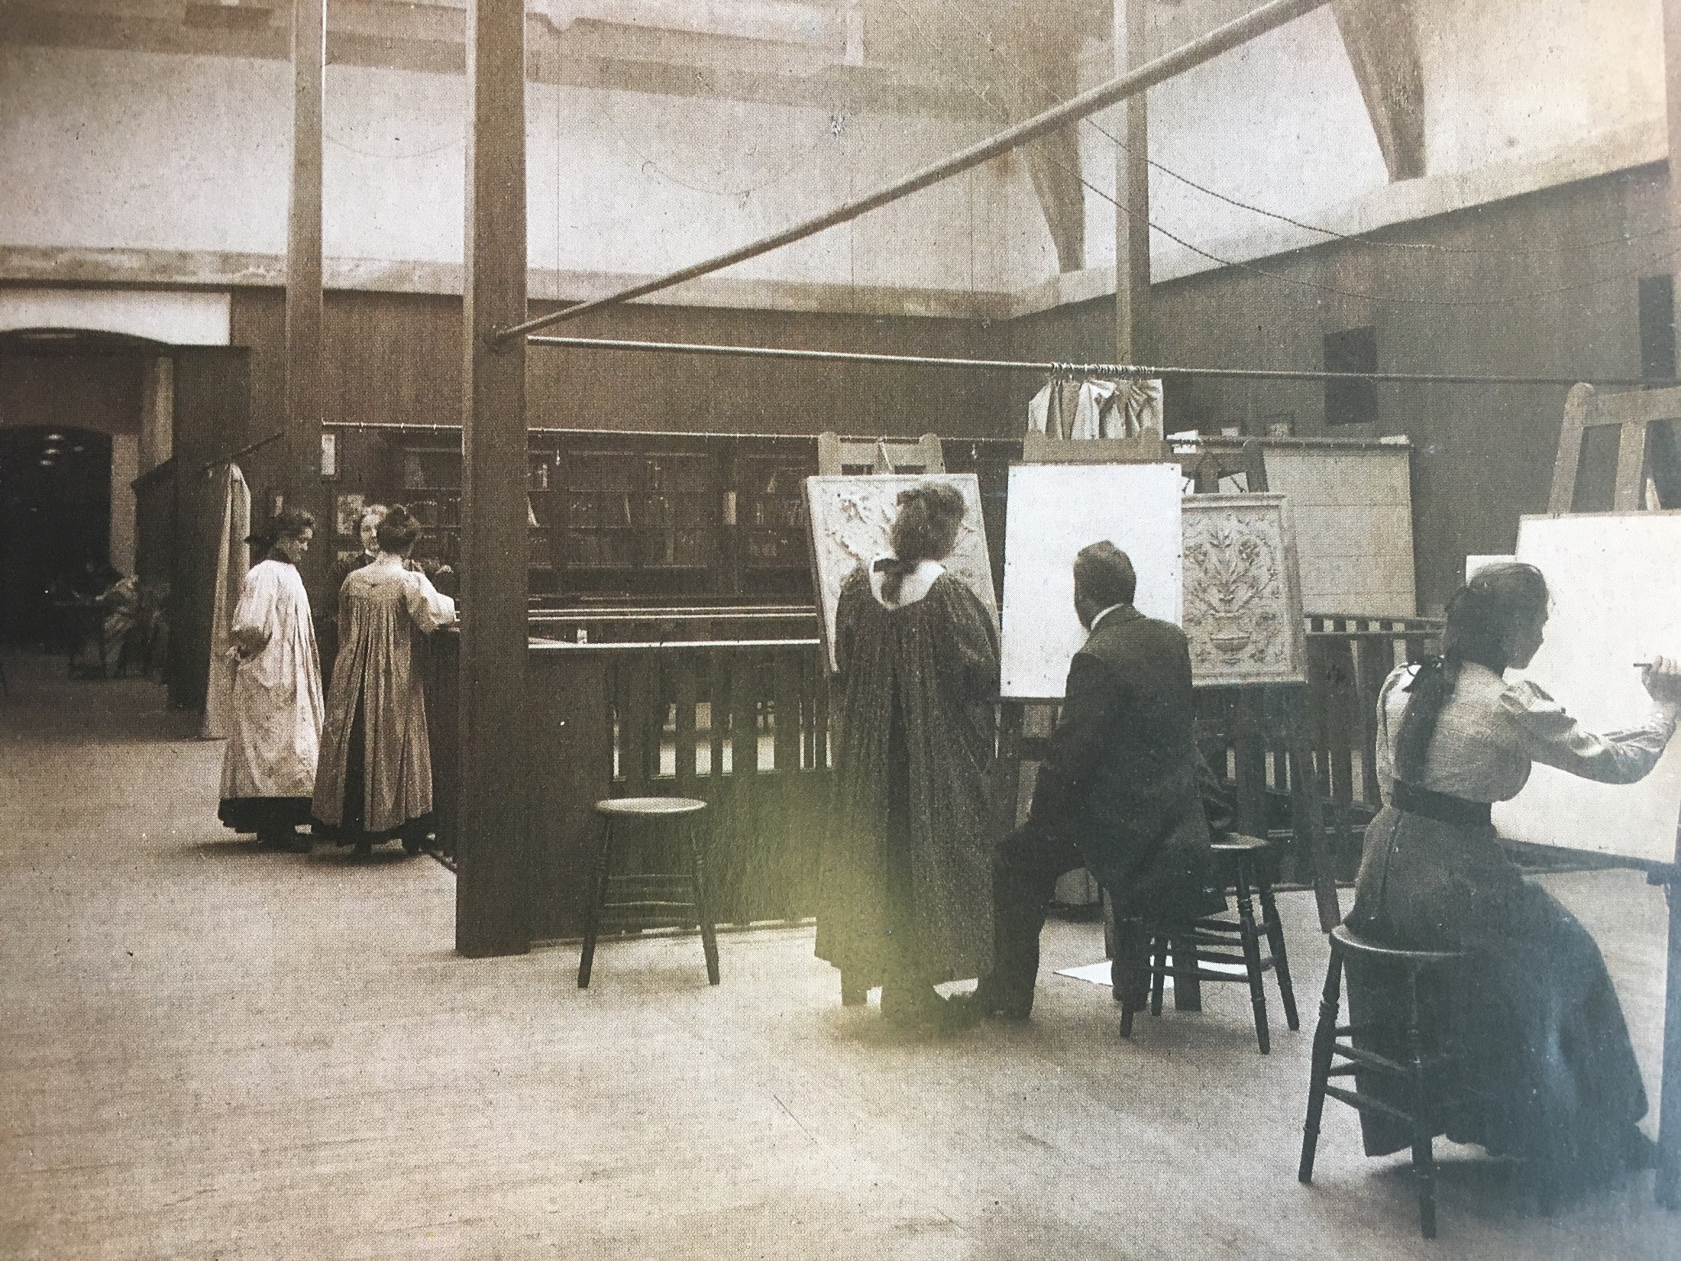
Notes:
1899 saw the completion of the first stage of Mackintosh’s new accommodation for the School, and the library moved into the first floor museum space, where it was to reside for the next ten years.
An undated but contemporary photograph taken by T. & R. Annan shows an antique drawing class taking place against the backdrop of library bookcases extending along the east wall.
It was only with the subsequent opening of the second stage of Mackintosh’s building that the Governors were finally able to observe: “The library has, for the first time in the history of the school, a room specially devoted to it. It is well lighted by those long windows that make a striking feature on the west elevation. The arrangements are as complete as possible and quietness and seclusion are secured.”

Slide 6
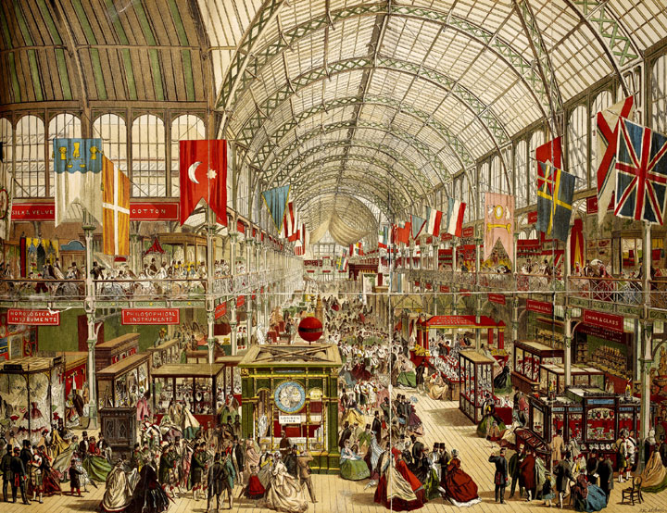
Notes:
Following its move to Mackintosh’s space, the library’s arrangement and classification were significantly formalised.
By 29 September, the collections had been transferred to their new cases by degrees and renumbered, with titles in heavy demand placed on the ground floor, and lesser-used stock and the portfolios of prints and drawings housed in the gallery.
We do not know categorically how the volumes were arranged for access during this time, but we do know that in many other areas the library took its cue from the library of the London School at South Kensington which, tantilisingly, were arranged “as nearly as practicable according to the classification of arts and trades adopted in the Great Exhibition of 1851”

Slide 7
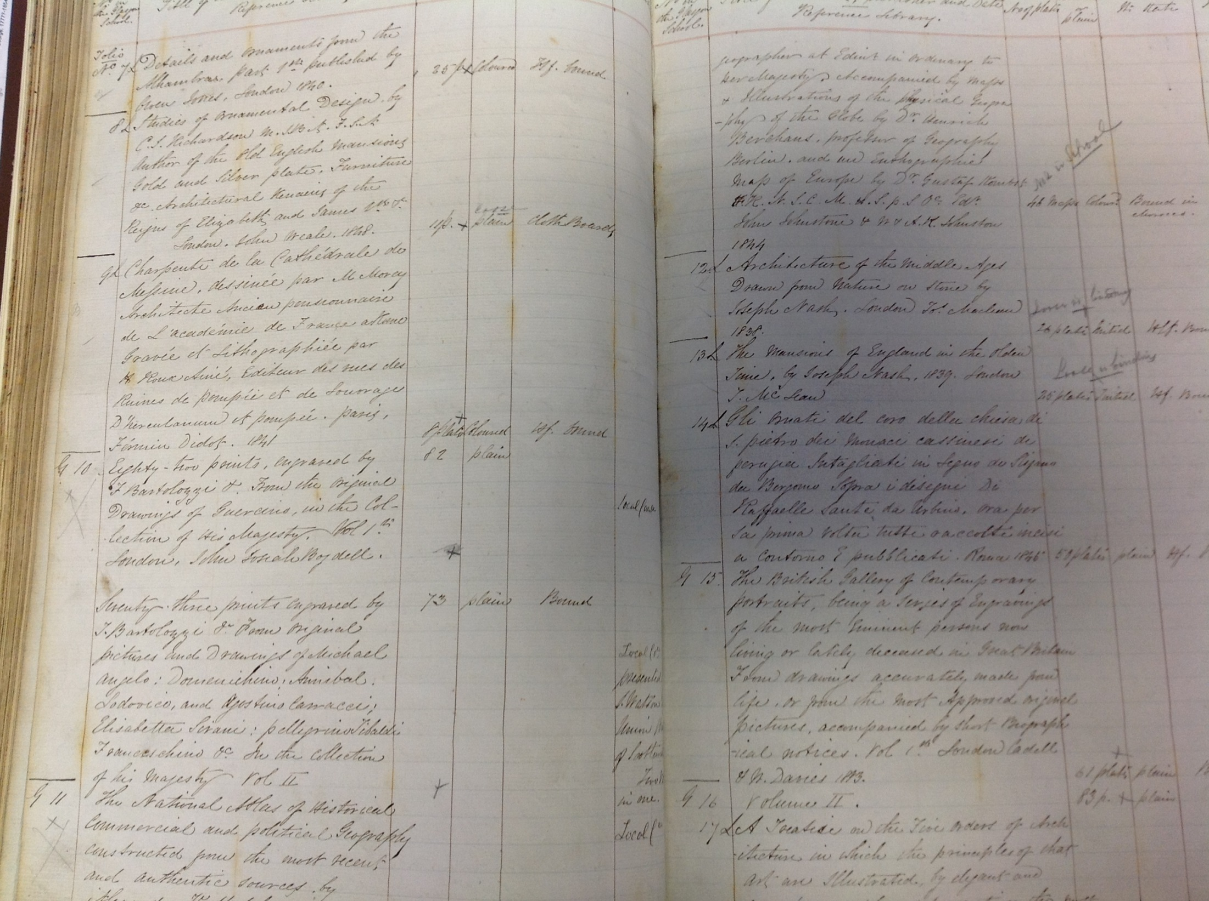
Notes:
The fire has also presented us with the opportunity of reconstructing the collections that would have been present in Mackintosh’s space in those early days
We now refer to these volumes as our Foundation Collections.
We know exactly what they were for they are recorded in our very first catalogue, rediscovered since the fire in the School’s Archives bound-in with other inventories.
Many of the earlier entries appear to be in the hand of then headmaster Charles Heath Wilson. Later entries in the catalogue are in other hands, and generally lack the detail of Wilson's entries
We have now transcribed the catalogue and sourced digital surrogates in libraries worldwide, in order to reconstruct the foundation collections virtually
These collections can now be interrogated and browsed online via the library’s website.

Slide 8
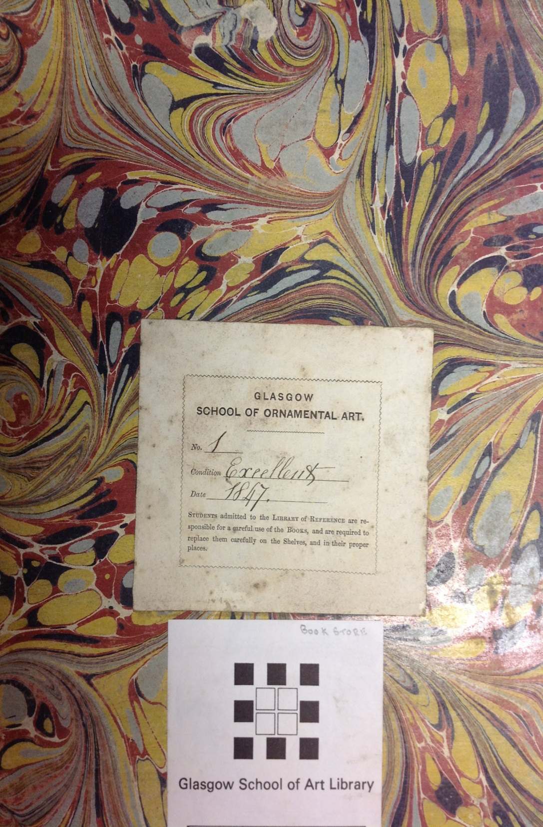
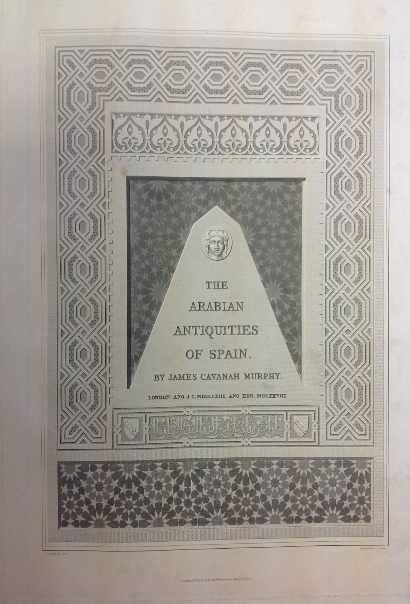
Notes:
Although individual catalogue entries are undated the first book to be accessioned, James Cavanah Murphy’s Arabian Antiquities of Spain (1813), is a miraculous survivor and bears a bookplate with the accession number 1 and an 1847 date of deposit
From this and other physical evidence, it is clear that it was standard practice at this time to assign each book an accession number in the catalogue, and then to inscribe this number, along with a date of deposit, towards the front of the book in question
The survival of this book is particularly miraculous: it was in fact kept in the Mackintosh Library, but had been temporarily moved to the Librarian’s Office just a few days before the fire for re-cataloguing
And we are beginning to discuss some suitably anarchic plans with our Exhibitions colleagues to mark the re-entry of this volume into the restored Mackintosh Library in 2019

Slide 9
Chappell, D. (2016) ‘The Early History and Collections of Glasgow School of Art Library 1845-1945’, Library and Information History, 32(3), pp.161-178
Notes:
Full a full discussion of the research we have conducted, post-fire, into the early library collections and how they relate to currents in late 19th and early 20th century design education, a research paper has just been published

Slide 10
Restore
Research
Rebuild
Reclaim
Notes:
We now turn to our restoration efforts as they relate to library collections

Slide 11
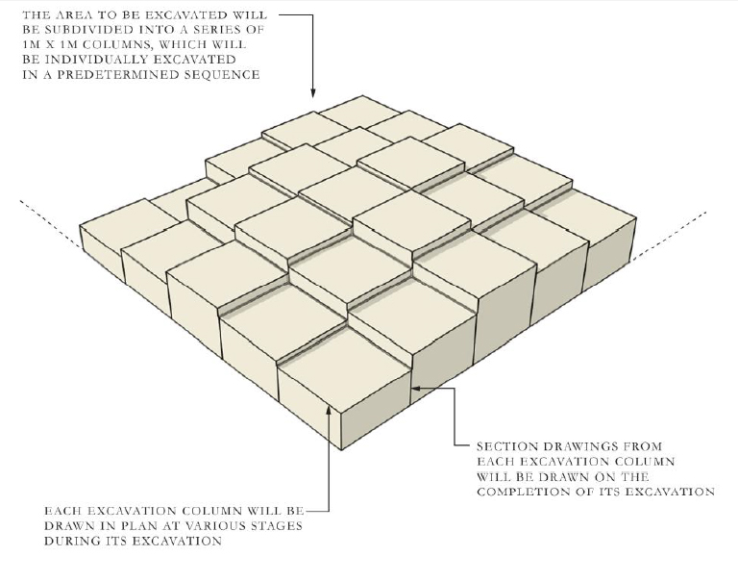
Notes:
Post-fire, it was somewhat miraculous to discover that the Fire-King had left a few choice volumes unclaimed
As archaeologists dug down into the detritus of the burnt library in 1 metre2 grids, they encountered some salvageable remnants of our foundation collections
These remnants were then assessed by myself and my colleagues for possible retention and conservation

Slide 12
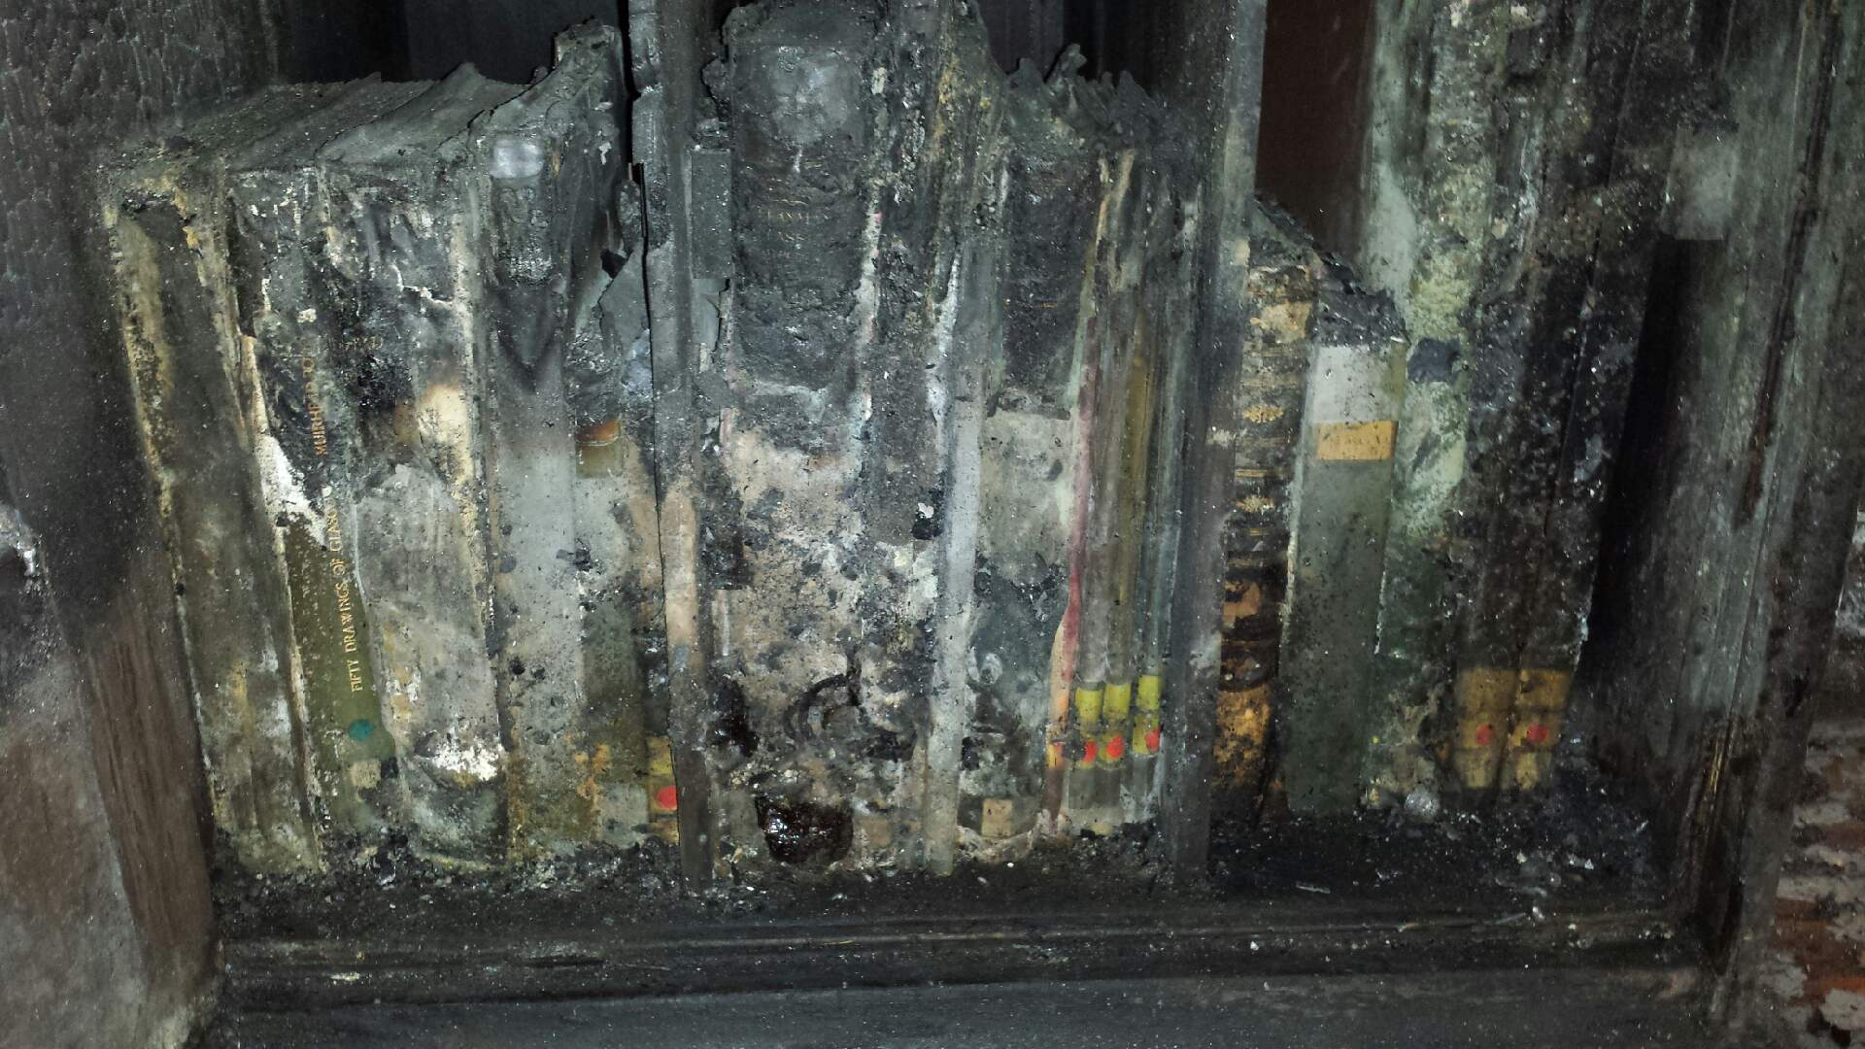
Notes:
Some materials survived better than others, depending on where they were situated in the room, the amount of oxygen available to the fire, whether they were tightly or loosely packed on the shelves, and whether debris fell on top of them from above

Slide 13
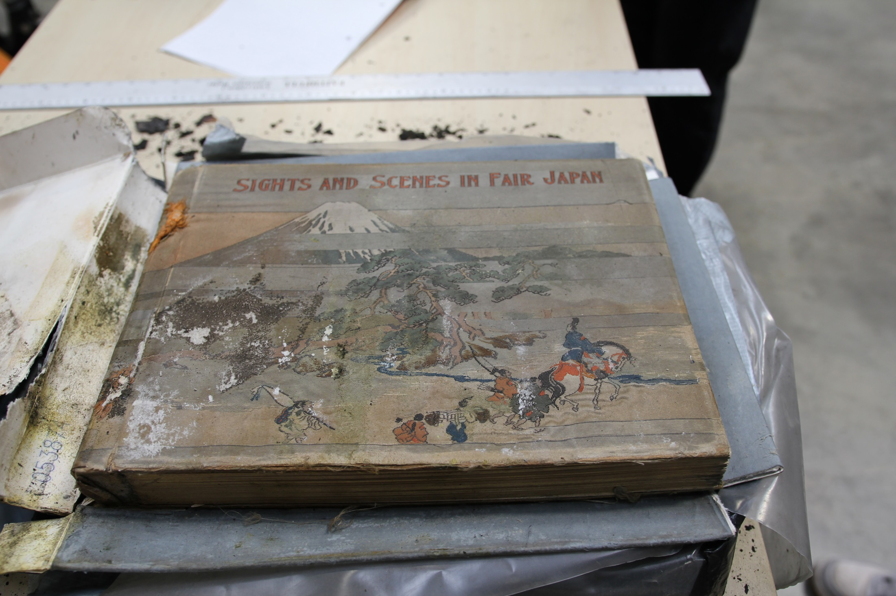
Notes:
81 rare books in total were salvaged from the library, of which 14 were able to be cost-effectively conserved by our restorers
Volumes such as this 19th century photographic volume for example, containing topographical views of Japan complete in their original silk covers.
Here you see the volume before conservation

Slide 14
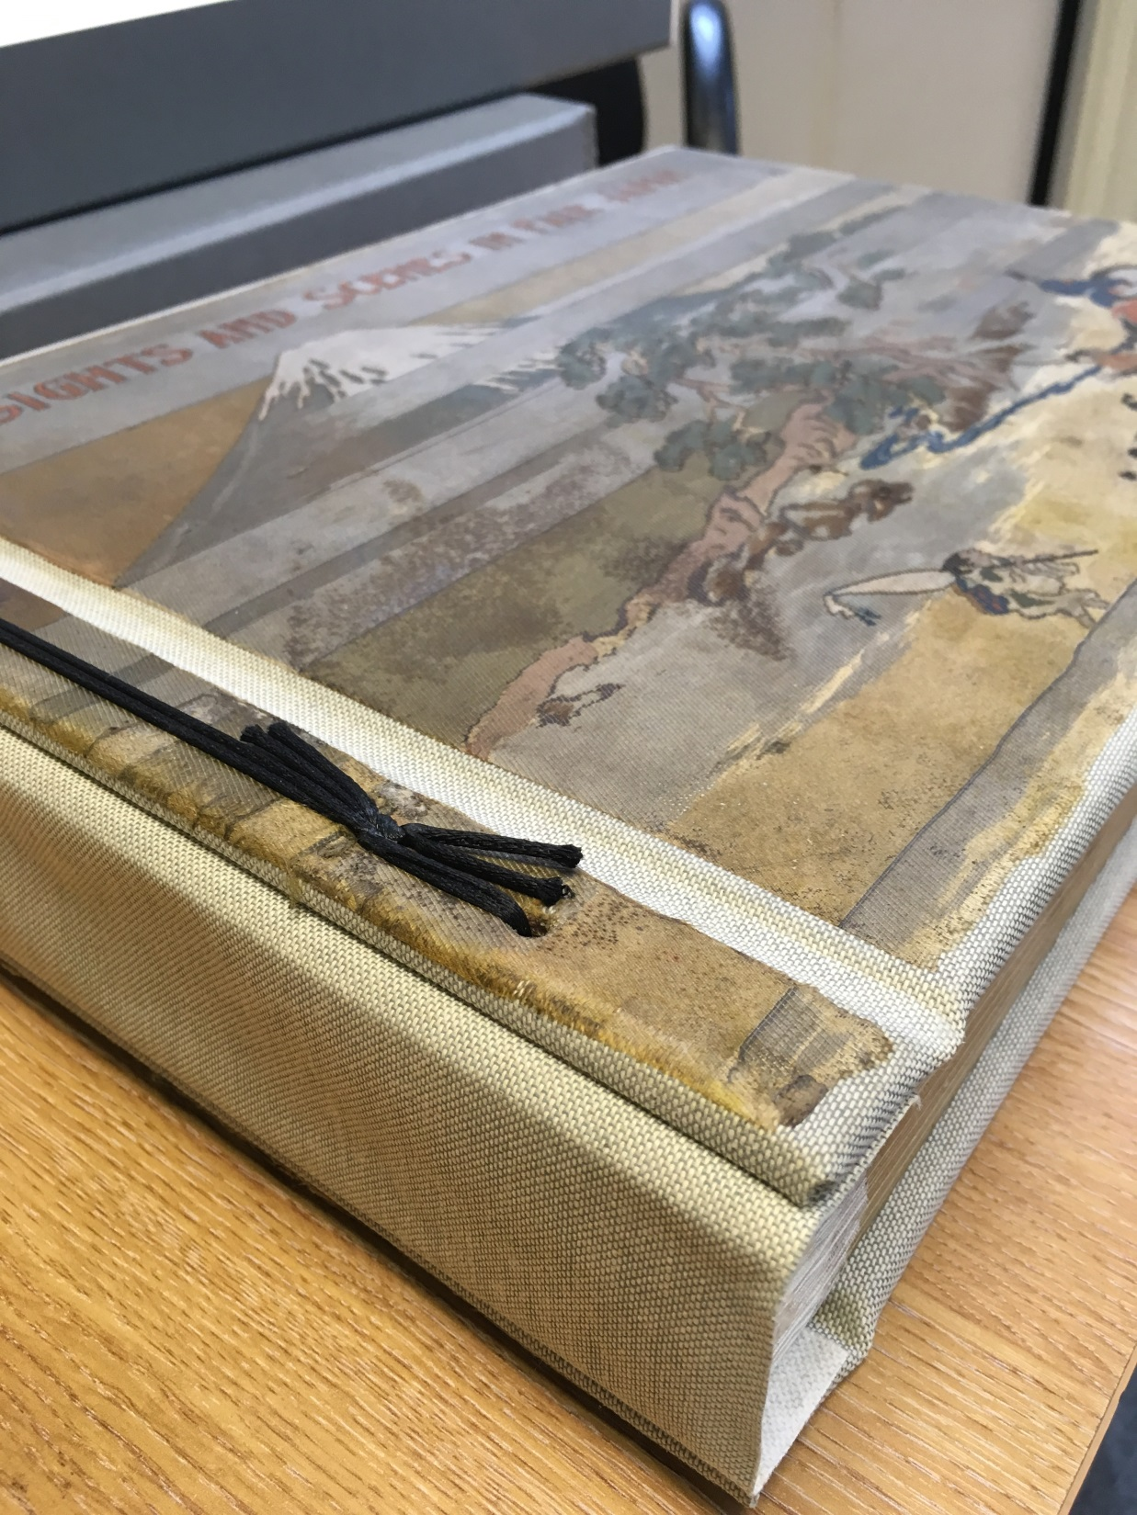
Notes:
And post-conservation when it returned to the School just a month or so ago
These survivors will, no doubt, be showcased somehow within the restored Library and its outlying spaces

Slide 15
Rebuild
Restore
Research
Reclaim
Notes:
But as well as looking back, we look forward
Immediately after the fire, we were touched by the many offers of donations we received, and indeed we continue to receive many offers of donations from individuals and institutions, for which we are very grateful
This has enabled us to begin the process of rebuilding, in part, our lost collections

Slide 16
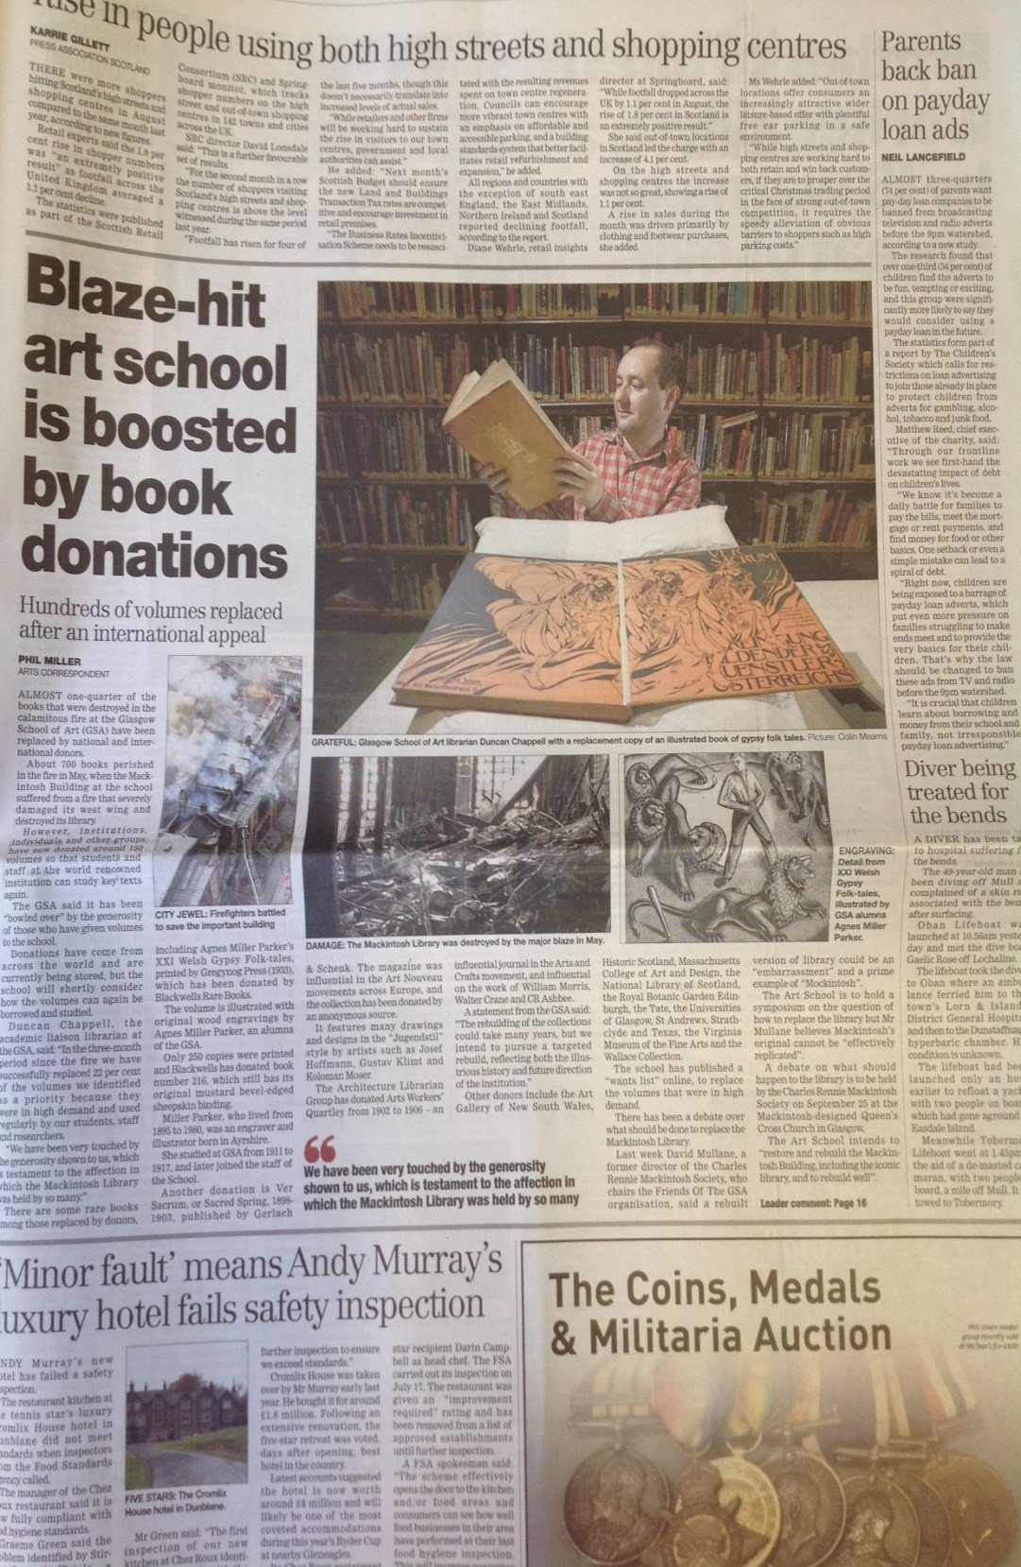
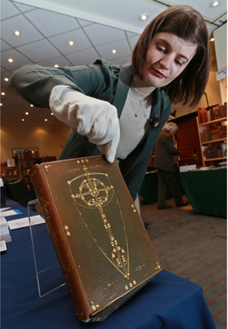
Notes:
The loss of these collections however has provided us with an opportunity to re-orientate the Mackintosh Library so that its collections are more tightly aligned to both the illustrious history and future direction of the Glasgow School of Art
This raises a series of ethical and professional questions: how do we ensure that collections built today remain relevant for 100 years hence, or collections built 100 years ago relevant for today?
So we will not be replacing like for like, but will instead build collections that add value to the learning and research experiences of our students.
At the time of speaking, we are clear in only seeking very specific titles that hold particular relevance to our history, our alumni, and our learning, teaching and research activities
Our current Wants List of about 700 titles is available on our website
To date, this approach has proved very successful, and we were able to replace 22% of our priority volumes in the first 3 months after the fire
Some notable works have been received. The book in my hand in this Herald article is a rare Gregynog Press volume by GSA alumnus Agnes Miller Parker, kindly donated by Blackwell’s Rare Books
And you can also see my then colleague Jennifer accepting a donation of a rare Glasgow Style binding by former GSA Head of Embroidery Ann Macbeth, kindly donated by the Antiquarian Booksellers’ Association

Slide 17
Reclaim
Restore
Rebuild
Research
Notes:
Much as the fire has provided us with an opportunity to re-evaluate and re-orientate the library’s collections, it has also opened up possibilities in use and access that hitherto were not available
The particular rarity and value of the furniture and art housed in that space had meant that our learners were unable to access its unique materials, or enjoy its experiential qualities, when they wished or required to do so
But of course, a restored building will present a new reality which, as both a space and service, the library must respond to

Slide 18
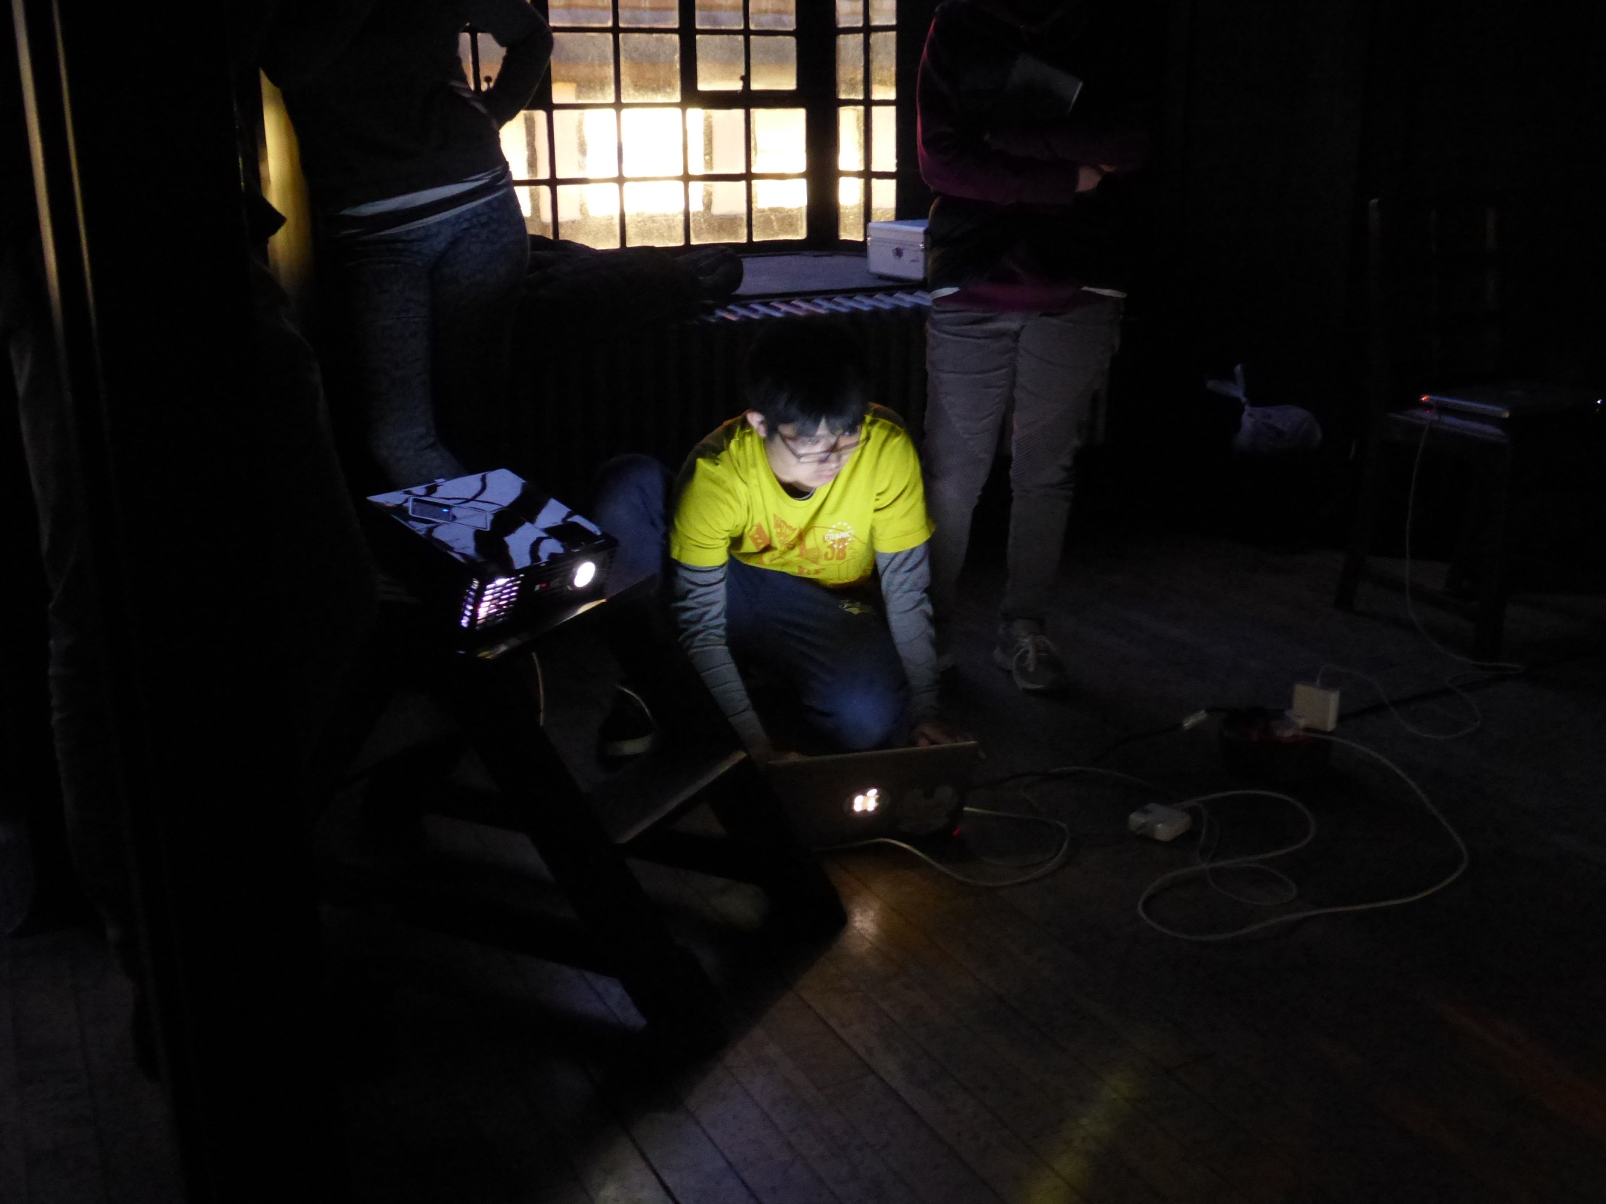
Notes:
The original Book Store above the library, too small and restricted for studio use, will become a dedicated store and reading room for our unique and distinctive collections.
This will open up these collections for the first time to both our own students and researchers, and those from other institutions and the general public.
Central to our plans for the reoccupation and use of the main space is the question of how we engage with it in ways that are learner-, rather than system-centred
A learner-centred space of course requires us to open up our spaces to people both physically and psychologically
Physical access is, in reality, the easiest of these to address, but psychological barriers are more deeply ingrained
How can we begin the process of unchaining those rare and distinctive collections we hold that can add so much both qualitatively and experientially to the learning experience
We envisage a space that is not shut away, as in previous years, but is opened up for learning and teaching, whilst respecting the needs of the public
Here you see students on our Interaction Design programme who enjoyed a week-long residency in the Mackintosh Library in early 2014, during which time they designed and developed digital interventions into the space

Slide 19
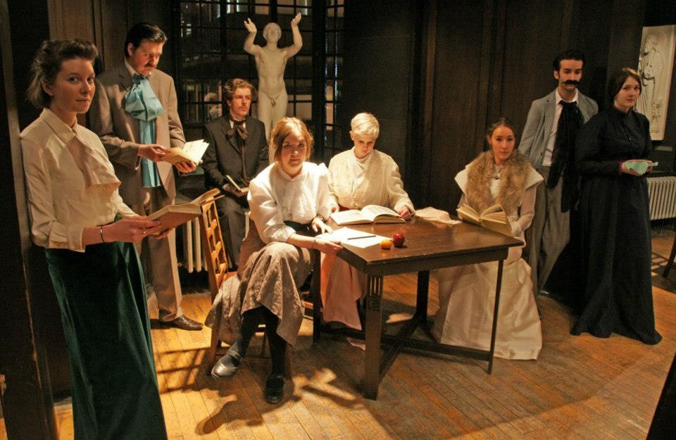
Notes:
And here you see a tableau vivant staged by students within the library as part of Robyne’s artistic dress elective.
This new vision for the library sees it reclaiming its centrality in the student experience and in the life of the restored Mackintosh Building.

Slide 20
Duncan Chappell
Librarian
Glasgow School of Art
d.chappell@gsa.ac.uk

