Slide 1
Adopting Game Technology for Heritage Information Modelling
Calum Sinclair¹, Brian Loranger², Daniel Livingstone²
¹ WSP UK, www.wsp-pb.com/en/WSP-UK/
² School of Simulation & Visualisation,
The Glasgow School of Art, www.gsa.ac.uk/simvis
@dlivingstone @gsofasimvis

Slide 2
Building Information Modelling
BIM – huge impact, esp. in construction
Integration of data from building components to complete projects
Data rich models support planning, construction & maintenance of new building
Notes:
BIM is a data led approach to the development and maintenance of buildings that has had huge impact over recent years, particularly in construction

Slide 3
hBIM
Recent interest in use of BIM software in Heritage related areas
Includes support for visualisation
Recording of conservation and building management data

Slide 4
Limitations of BIM for Heritage
BIM relies on parts libraries, developed by vendors
These do not exist for heritage buildings, and challenging to develop as parts (e.g. lintels) would be hand made with high degree of individuality and uniqueness in the component parts
BIM ideal for workflow of constructing a building from known parts – workflow of reconstructing a digital model from an existing building considerably different
  Some solutions/methods do exist – c.f. Scan-to-BIM
‘hBIM’

Slide 5
Heritage Information Modelling
HIM: A different approach to hBIM
Accurate 3D modelling (from scan, or other sources)
Pull information from range of relevant sources
Support upload of additional data in range of media formats
  Extend data beyond physical representation

Slide 6
An Unreal Based HIM
Prototype of approach based on needs of heritage projects
Expert interviews identified use-cases not supported in current generation BIM software solutions:
Community engagement & Co-production
Software design for non-expert users
Improved support for non-technical data
Heritage material libraries
Aspects of BIM need replicated:
Linking model to data
Model data to online repositories
Prototype developed using Unreal Engine

Slide 7
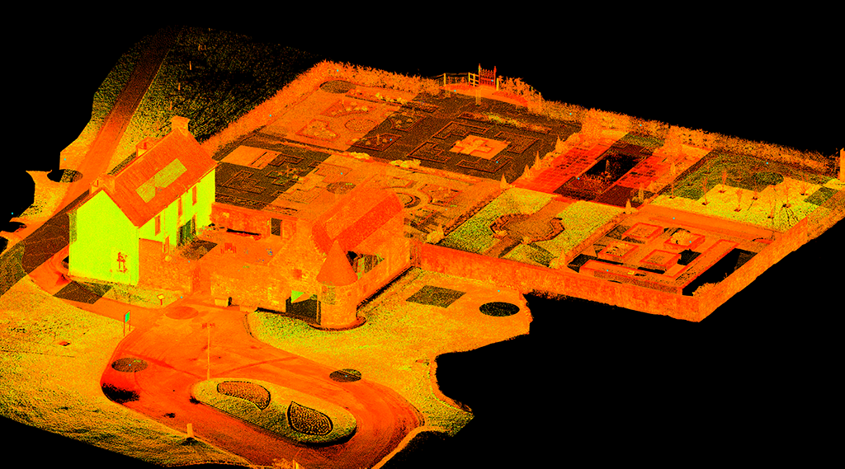
Provan Hall, Glasgow
Scanned by MSc Heritage Visualisation, class of 2016

Slide 8
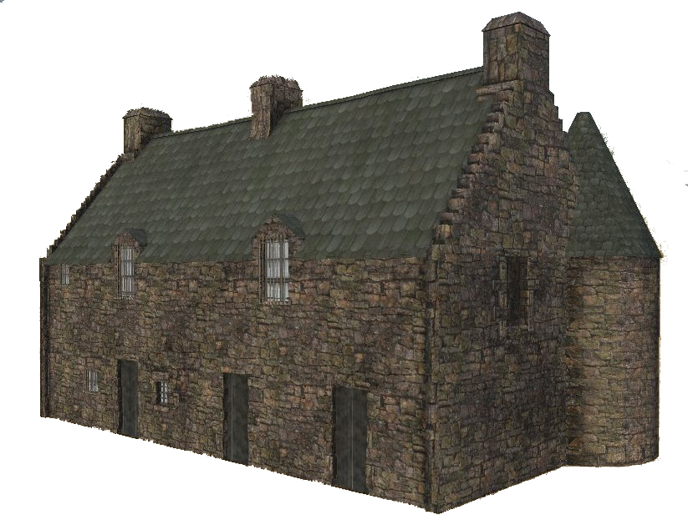
Scan Data
Laser scanning & phototexturing can provide photo-realistic 3D models that also provide highly accurate 3D
representation of building-as-is
Sub-cm accuracy
Additional processing
to prepare photo-
real model
Not always possible
or affordable
c.f. reconstruction
of lost sites with limited
photographic evidence

Slide 9


Slide 10
Discussion & Further Work
Significant work underway around the world in re-purposing BIM for heritage use-cases
But BIM solutions fundamentally designed from ground up for a different type of use-case and are non-ideal fit for many heritage applications
Balancing the costs and benefits:
  Imperfect adaptation (hBIM)
  vs Developing a novel HIM platform

