Slide 1
State of the Art:
Glasgow’s Government School of Design and its Library
1845-1900
Duncan Chappell
Notes:
This paper will present the findings of archival research into the early history and collections of Glasgow School of Art Library, covering the period 1845-1900.
Specific themes will include: the role of the Select Committee on Arts and Manufactures in mandating early design libraries; networks of exchange and patronage between the library of the central School of Design in London and its provincial satellites; the role of the 1851 Great Exhibition in early design library classifications and arrangements; and the role of the artist-librarian in 19th century design libraries.

Slide 2
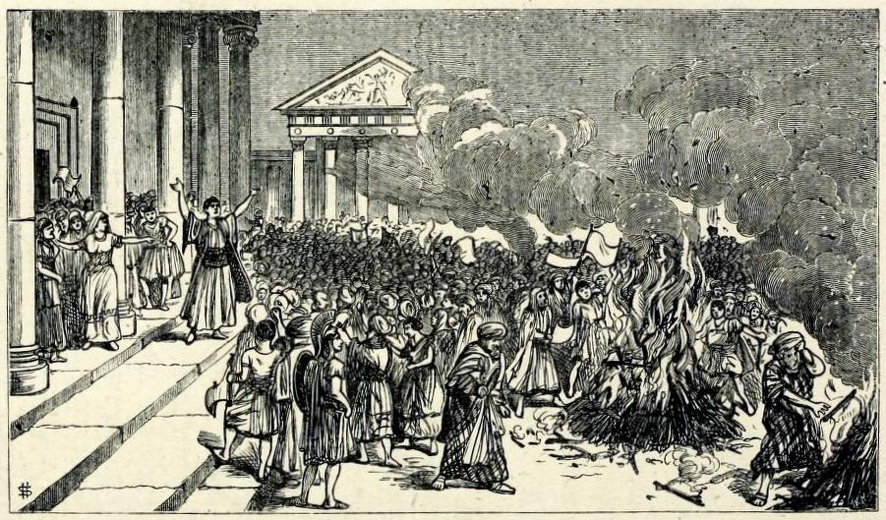
Notes:
In his treatise The Enemies of Books, first published in 1880 by Trubner & Co., William Blades, the well-known collector of the works of William Caxton, documents his outrage at the mistreatment suffered by books at the hands of biblioclasts, both human and non-human
His text enumerates and discusses threats to the survival of books, with dedicated chapters on water, gas and heat, dust and neglect, ignorance and bigotry, bookworms, other vermin, bookbinders, collectors, servants, and children
His chapter on fire begins:
“There are many of the forces of Nature which tend to injure Books; but among them all not one has been half so destructive as Fire.”
“It would be tedious to write out a bare list only of the numerous libraries and bibliographical treasures which, in one way or another, have been seized by the Fire-king as his own.”
This engraved illustration, taken from Blades’ text, depicts the destruction of books of magic at Ephesus

Slide 3
Notes:
On the 23rd of May 2014, the Fire-king seized the world-famous Mackintosh library at the Glasgow School of Art and the important art historical collections it contained.
The devastating fire was widely reported and discussed at the time, and continues to feature prominently as the School moves from a period of rescue and salvage to a period of rebirth and reconstruction.
One of Scotland’s most important and widely recognised library spaces, it was designed by Charles Rennie Mackintosh between 1907 and 1909 as part of the second phase of the Art School building he had first designed in 1896
It was generally accepted as one of the finest Art Nouveau interiors internationally, and any visitor to the space could not help but be moved by its architectural and aesthetic beauty, from its hand-painted balusters to its pierced wooden pendants, and from its coloured-glass hanging lamps, to its original tables, Windsor chairs and periodicals desk.
This postcard view of the library by an unknown photographer dates to soon after completion in 1909, and is taken from the School’s Archives

Slide 4
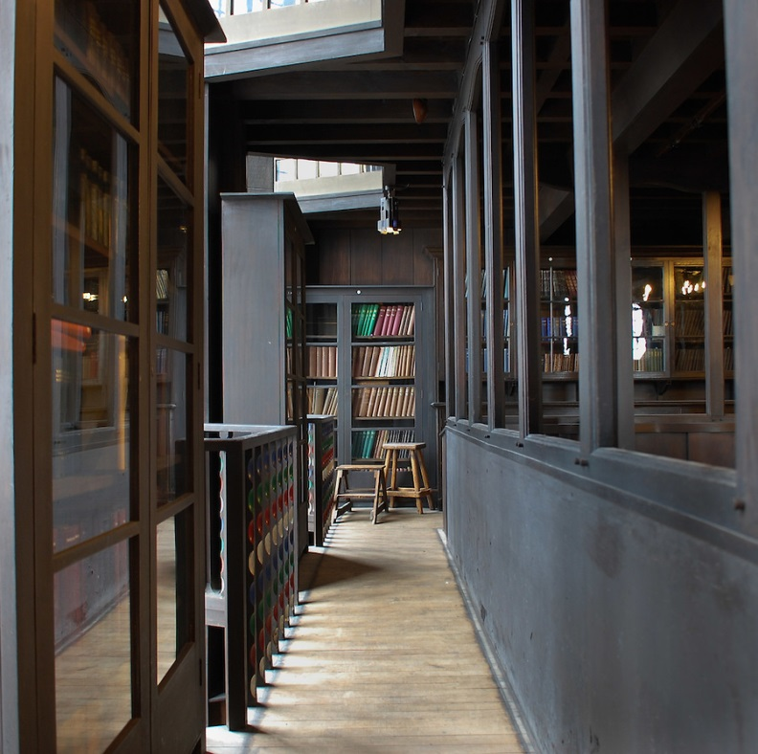
Notes:
But this paper adopts the premise that any historical library is more than an architectural space alone; the collections it contains also form an intrinsic part of its history of both use and reception.
In the case of Mackintosh’s library, the innovative aesthetic has tended to overshadow the collections that it held: until recently, no research had been conducted into the early library collections at GSA, and how their development related to wider currents within nineteenth and early twentieth century British art and design education.
But primary documents in the School’s archives have helped us to understand the particular history of the library and the strategies that were employed to develop its collections, and this in turn has shed light on the contemporaneous development of libraries within wider 19th century UK networks of design.

Slide 5
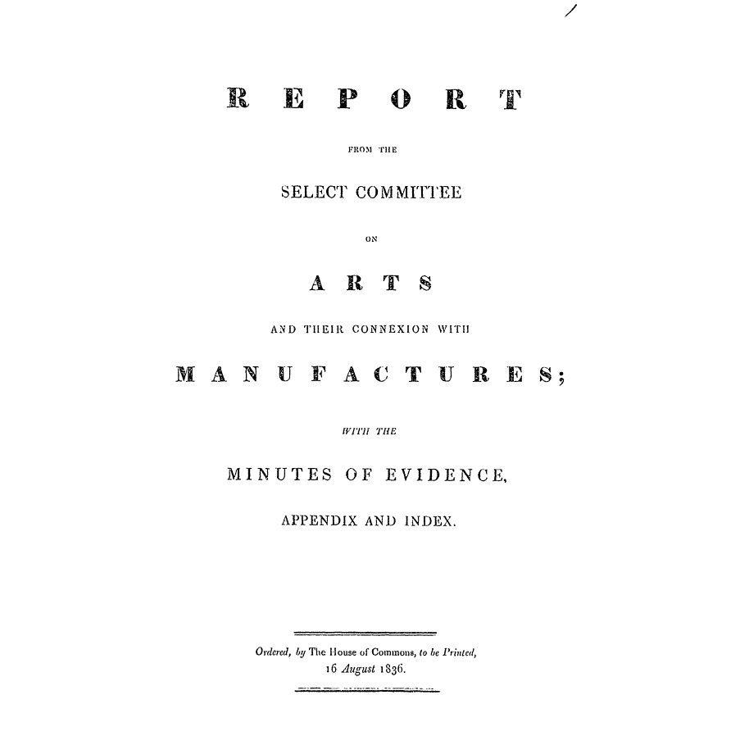
Notes:
To understand the history of the GSA library, one must first locate it within a particularly British system of arts education.
In 1835 the UK Government had established a Select Committee on Arts and Manufactures to report on why Britain’s commercial and industrial products were failing to compete with foreign imports in the domestic market, and struggling to gain footholds in markets abroad.
Originally proposed by William Ewart, the then Member of Parliament for Liverpool, the Committee was to ‘inquire into the best means of extending a knowledge of the Fine Arts, and the principles of Design among the people - especially among the manufacturing population of the country.’
Ewart’s parliamentary motion reflects insecurities that were widely felt at the time by both the ruling and commercial classes: that the standard of Britain’s manufactured output was falling behind in terms of design and execution, particularly when compared to her Continental rivals.
The Select Committee was thus positioned squarely within wider moves to create a national infrastructure that would educate both the manufacturing classes and their employers in good design, but also the wider general public, whose unreformed tastes were felt to create damaging consumer demands.
Sproll notes that the French in particular were observed to have ‘succeeded in creating an informed public by establishing nationwide teaching programmes and granting public access to art exhibitions’, producing ‘both informed producers and consumers.’

Slide 6
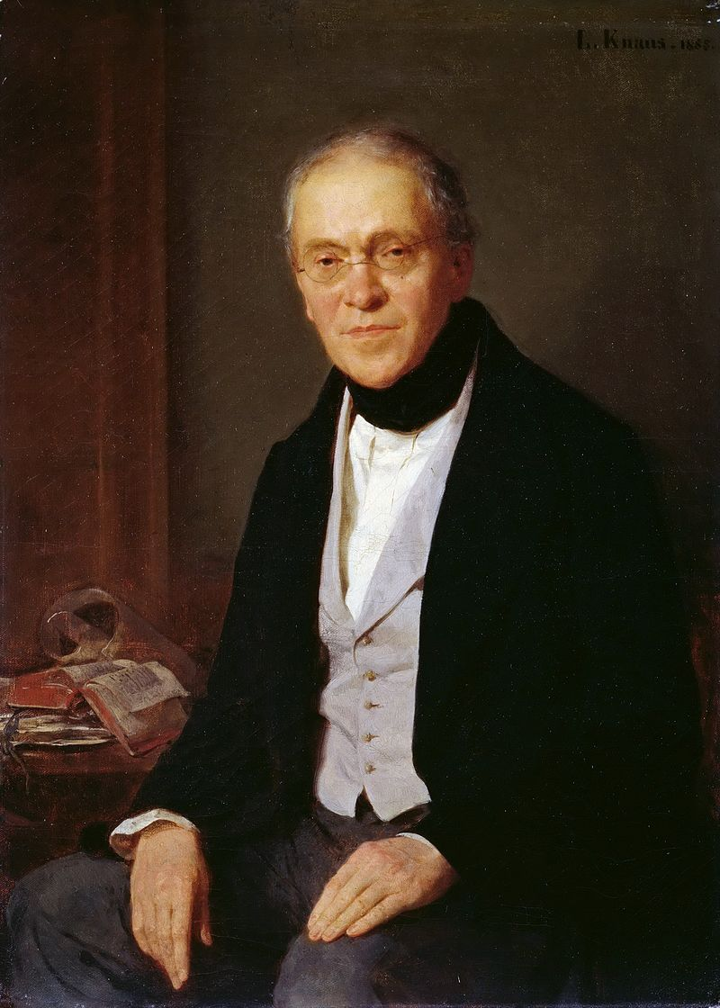
Notes:
During its hearings, the Select Committee took evidence from witnesses representing a variety of interests: from academia, retail, manufacture, design and fine art.
But the testimony of one witness in particular proved highly influential.
Dr Gustav Friedrich Waagen, then Director of Berlin’s Museum of Decorative Arts, spoke of the Prussian Kunstgewerbeschule (founded in 1821) which provided drawing classes, workshops, and a collection of plaster casts for its students.
His observations on the comparative state of art and design education in England were widely circulated and read when first published a couple of years later in 1838.
Waagen presented a model of ‘a central school controlling regional affiliates’, and this provided a blueprint for the British system of design education that was to follow.
This portrait of Waagen dates to 1855 and is by Ludwig Knaus. It now resides in the Alte Nationalgalerie in Berlin.

Slide 7
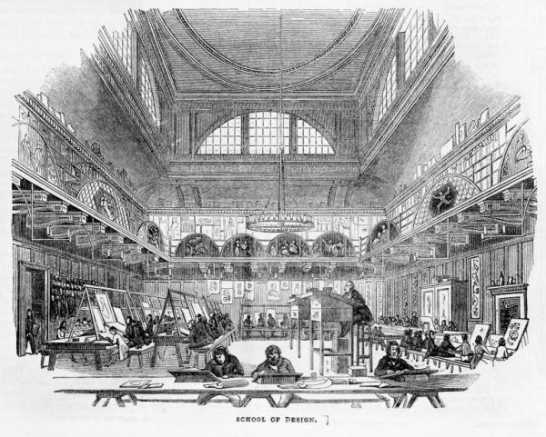
Notes:
When the Select Committee published its final report, one of its principal recommendations was that Britain should immediately seek to establish a network of Government Schools of Design in order to address the deficit to her Continental neighbours.
The Committee proposed a central school, supplemented by networked provincial schools that would each respond to their own particular civic and economic locales.
The central school was henceforth established with speed at Somerset House on the Strand just one year after the Select Committee’s report, its home the top-floor galleries recently vacated by the Royal Academy.
The number of provincial satellites then increased exponentially; by 1843, six had been founded (in Manchester, York, Birmingham, Sheffield, Newcastle and Spitalfields), but by 1869 some 107 were in existence.
Originally managed by the Board of Trade and committees of local subscribers, from 1852 all such schools were brought under the jurisdiction of a new Department of Practical Art superintended by Henry Cole, and this was renamed the Department of Science and Art the following year.
The provincial Government Schools generally offered a curriculum set down centrally by South Kensington.
Lessons included elementary drawing, shading from the flat, shading from casts, chiaroscuro painting, colouring, figure drawing from the flat, figure drawing from the round, painting the figure, geometrical drawing, perspective, and modelling.
And by 1853 this pattern of courses was standardised at 23 stages, which, as the National Course of Instruction, became the established curriculum that all Government Schools of Design were expected to follow.

Slide 8
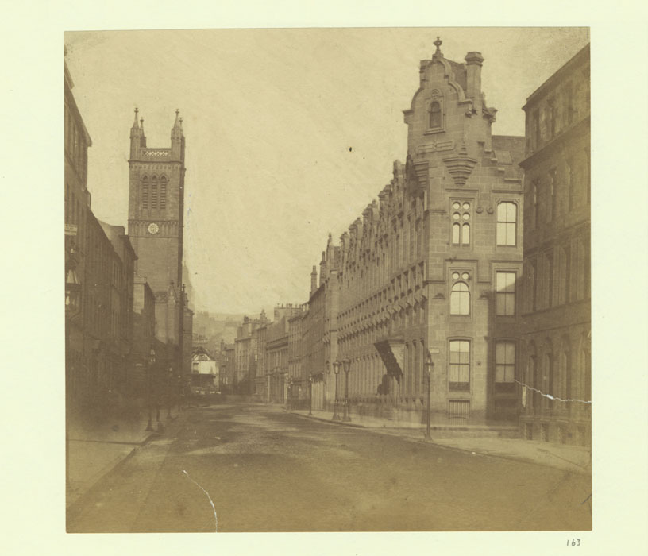
Notes:
The Glasgow School first opened its doors on 6 January 1845, in commercial premises constructed some 40 years previously at 12 Ingram Street. Additional accommodation was subsequently purchased in the adjacent premises at no. 16.
In 1853, the year of the National Course of Instruction, the institution was renamed the Glasgow School of Art, later adding the epithet Haldane Academy (after the engraver James Haldane who had placed some monies in trust).
This view of Ingram Street dates to 1858 and was taken by Duncan Brown, then GSA janitor
Then in 1869, the School subsequently moved to occupy the east end of the Corporation Buildings, which had been erected on Sauchiehall Street in 1855 and contained the McLellan Galleries.

Slide 9
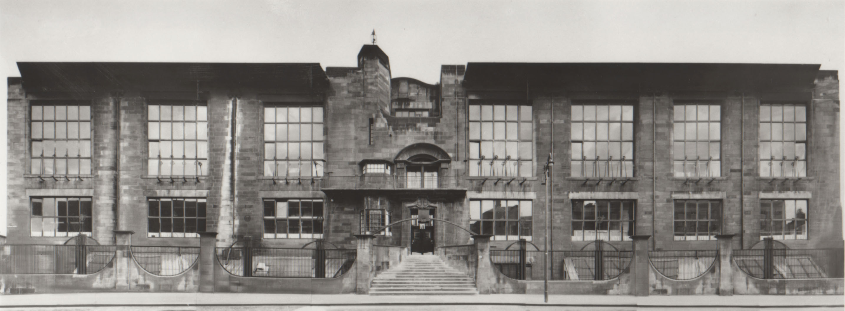
Notes:
Despite the obvious constraints of these accommodations, the reputation and standing of the School continued to grow, until, in 1897, work finally started on new purpose-built accommodation on an adjacent site on Renfrew Street.
It is this building, designed by Mackintosh and completed in two stages in 1899 and 1909, for which the School is now so justly famous.
The Mackintosh library would sit in the west wing of the second stage of construction.

Slide 10
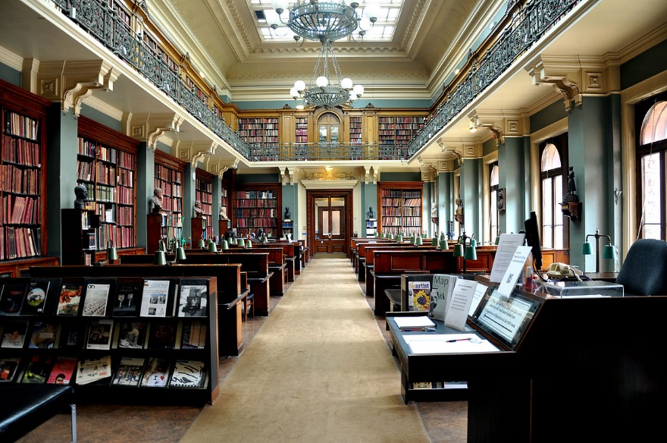
Notes:
Mackintosh’s space is now so synonymous with the GSA library, that it is often overlooked that a collection had existed within the School for many years.
Indeed, a library is first mentioned in 1847 when the Governors ‘request their fellow citizens to assist them in making additions to the lending library, which is far from being sufficient for the wants of the school; and, as the use of the library is valued highly by the students, it is desirable to extend it as much as possible.’
The date of 1847 is significant, for it comes just 2 years after the Glasgow School first opened its doors, and it is clear that within a very short period of time following its foundation the School was actively constructing a library for its students.
Was this activity uniquely local, or did it arise from wider, more systemic motivations?
It certainly seems that the presence of a rounded working library was viewed as a key requirement for a successful design education.
Waagen’s evidence to the Select Committee is particularly notable here, for he had observed that the Prussian Kunstgewerbeschule had invested in a library ‘of general literature, and of all works relating to the objects of the institution.’
Hence, from its own foundation in 1837, the Central School in London had also possessed a library containing a wide range of books, with the aim of ensuring that the craftsperson’s intellectual and aesthetic sensibilities were advanced alongside his practical skills.
By 1846 for example, Walter Ruding Deverell, then secretary of the London School, reported that it now held a total of eight hundred and fifty books ‘conducive to mental elevation and refinement’ and covering subjects as wide as fine art, architecture, geometry, optics, perspective, anatomy, design, aesthetics, biography and poetry.
This view is of the now National Art Library in London, though the architecture and layout dates to the later Victorian period.
Unfortunately for us, after 1847 the next mention of the Glasgow library does not occur for another 38 years.
The Governors instructed in the Minute Book of 13 April 1885 that the library’s collections should be properly catalogued, and books given out only under the supervision of a librarian who should be responsible for proper conduct.
They may have been particularly daunted by the scale of the collections that now presented themselves: by 1887 the Annual Report notes that the library had grown to around 600 volumes.
A collection of this scale presented a not inconsiderable management burden to the Governors, given the constraints of the School’s accommodation in the Corporation Buildings at the time.
Yet, it is noticeable that the 600 books amassed by Glasgow over this 40 year period remains small when compared to the 850 volumes that Deverell reports as accrued by the London School in just nine years.
This likely reflects a very real difference in status and budget between the central school in London and its provincial satellites.

Slide 11
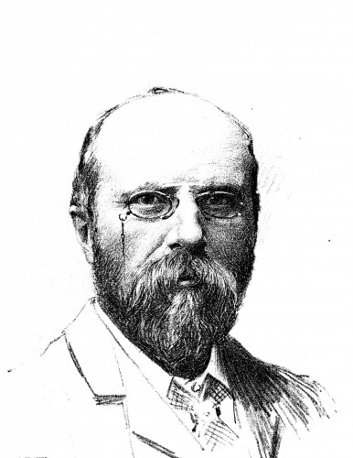
Notes:
What is clear from the archival evidence, is that the accommodation of the library and its growing collections began to impress upon the Governors during this period.
The 1887 Annual Report observes that though the library had been ‘thoroughly overhauled, arranged and catalogued’ and was open during set hours, it had become necessary to use the ladies luncheon room as a reading room.
Consequently, the final years of the nineteenth century signal a marked shift in the attention given to both the library and its collections.
By 20 March 1893 a Mr Salmon had submitted a draft plan to the Governors for a new library space within the Corporation Buildings that would release the ladies’ luncheon room for its original intended use, and by 1894 the Annual Report noted that ‘a special room has been set aside…, suitably provided with book-cases and tables, where students can consult the books which may aid them in their particular study.’
It was undoubtedly architect William Forrest Salmon who produced these plans, for a few years later in 1909-1910 he is recorded as sitting on the Library and Materials Sub-Committee.
This image of him is taken from the periodical Quiz in July 1893

Slide 12
Notes:
Salmon’s new space seems to have acted as a catalyst for the employment of the School’s first Librarian in that same year
James Joseph Francis Xavier King, was an artist and lecturer at the School who had exhibited with the Glasgow Institute of the Fine Arts between 1885 and 1891
This portrait of King by David Forrester Wilson dates to 1907 and sits in the Hunterian in Glasgow
When appointing William Henry James Weale librarian at the London School in 1890, it was his background as an art historian, rather than a librarian, that qualified him for the position.
Taking its cue from London, the role of librarian at the GSA was similarly assigned; indeed, a qualification from the then Library Association became a prerequisite from November 1950 only, following the insistence of the Scottish Education Department.
Up until then the role of librarian was most often occupied by an artist or designer.
During this early period, the role was not well formalised, and the librarian would be expected to perform other duties within the School, sometimes of an administrative nature, but often within the teaching staff.
King is first mentioned in connection with the library on 21 September 1893, and by 1894 the Annual Report observed that the library ‘has been put into good order’ under his superintendence.
In 1902, the Governors took the opportunity to formalise his role as the ‘care of books, preparation of catalogue, binding books, delivering and reception of books to and from students, and any other relevant and incumbent duties’, the whole to be done ‘in association and under the direction of the Head Master’ (the titular role was rebadged Director from 1904 onwards).
King appears to have enjoyed his library work, and even to have preferred it to his other duties, which included looking after the School property, safe-keeping student work, preparing works for exhibition and inspection by the Masters, and engaging life models.

Slide 13
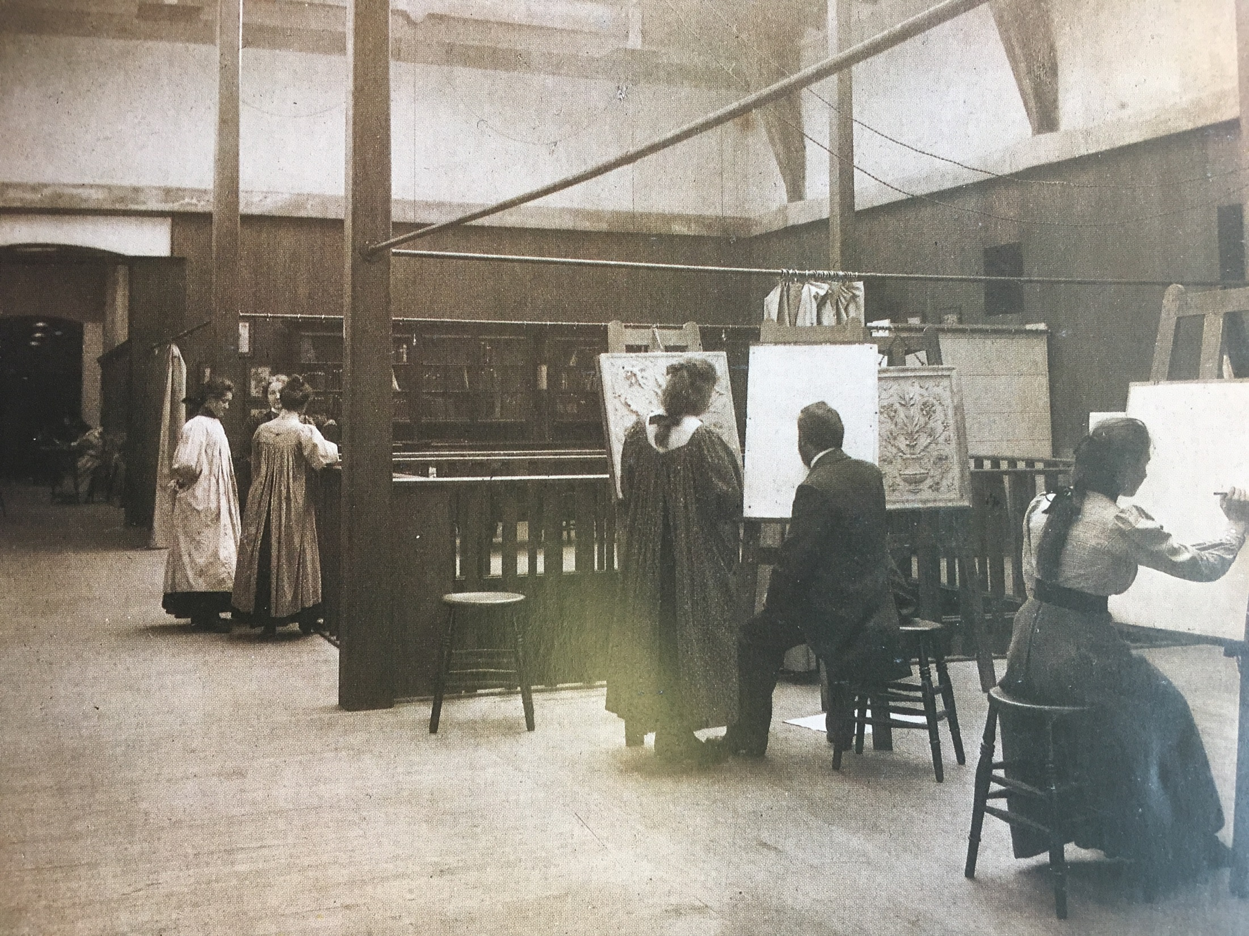
Notes:
1899 saw the completion of the first stage of Mackintosh’s new accommodation for the School, and the library, under King’s superintendence, moved into the first-floor where it was to reside for the next ten years whilst the west extension was completed
An undated but contemporary photograph taken by T. & R. Annan shows an antique drawing class taking place against the backdrop of library bookcases extending along the east wall.
Probably the same cases designed by Salmon for the Corporation Buildings, they were subsequently recorded on 29 September 1909 as moving to Mackintosh’s newly opened library where they likely occupied the north gallery.
Mackintosh himself had not designed cases for these walls in his plans, and their origin had been unclear.

Slide 14
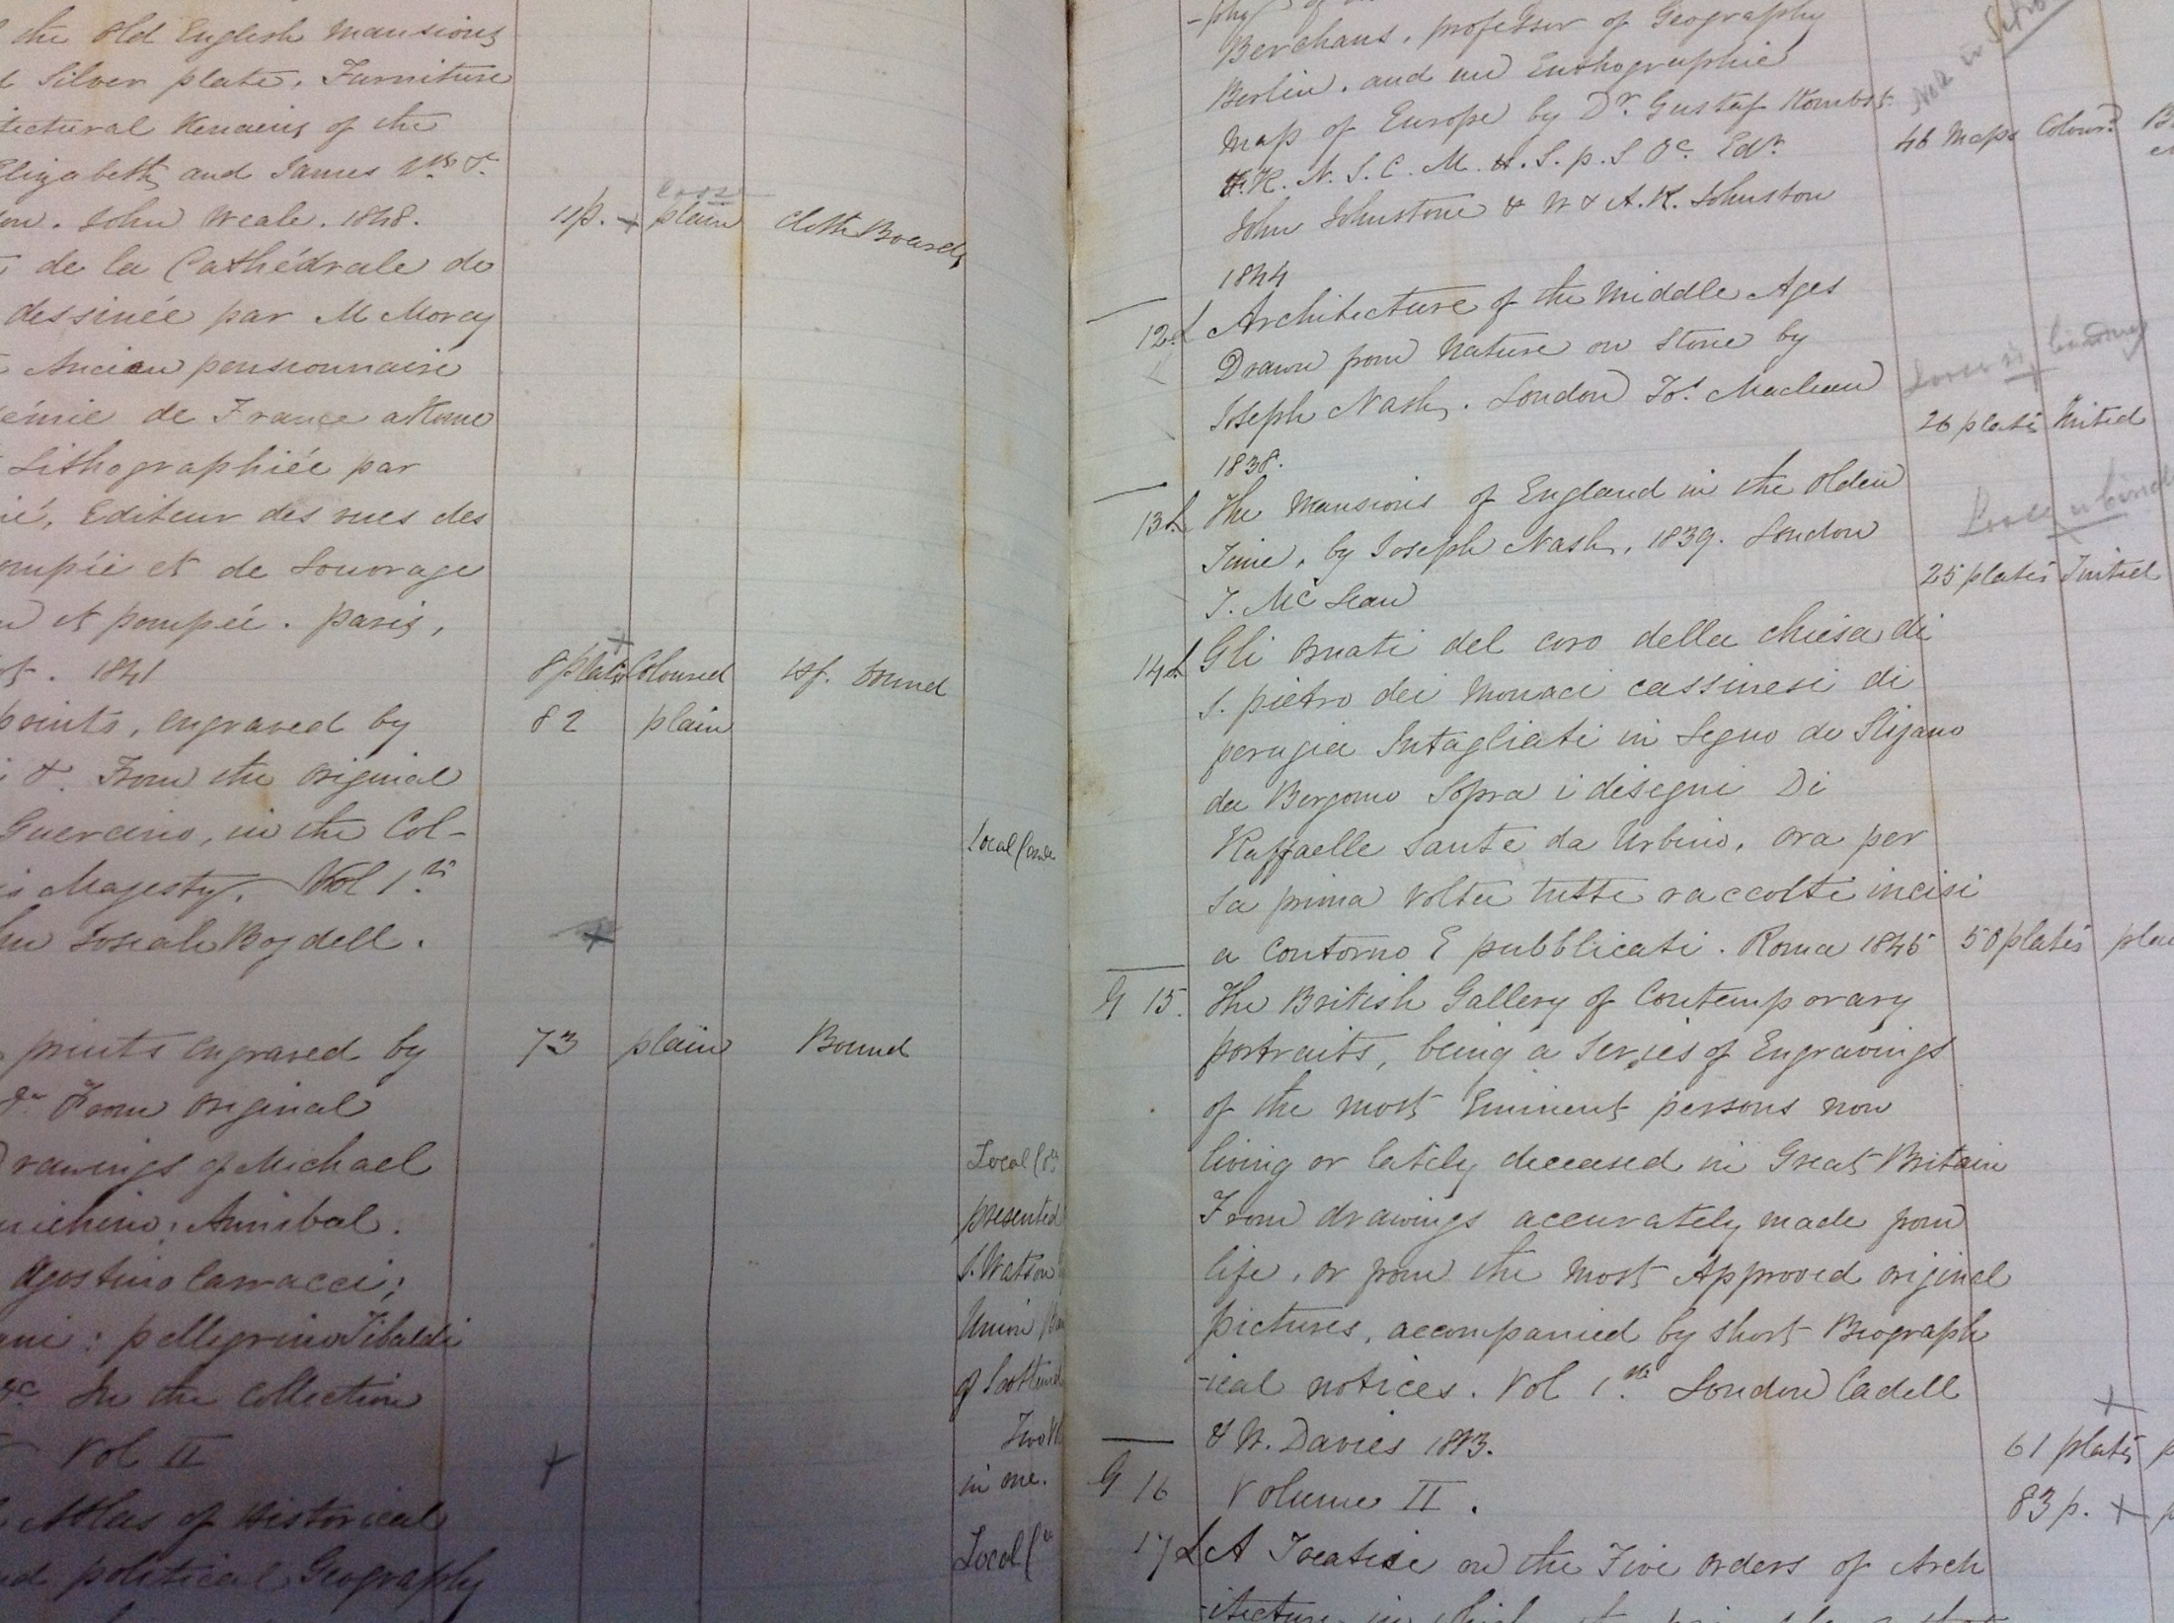
Notes:
Until the rediscovery of the library’s first manuscript catalogue in the School’s Archives in recent years, we had little or no knowledge of the volumes that were housed in these cabinets and that subsequently moved into Mackintosh’s space.
The entries in this catalogue appear to be in the hand of the first Headmaster, Charles Heath Wilson, and are organised in two distinct sections, one for reference, and one for lending.
There is little to differentiate the volumes however, and it is not now possible to discern the criteria used to assign the volumes to these respective sections.
The Annual Report for 1850 notes that ‘students are encouraged to study in the lending library, and also in that of reference, for which sixty-three tickets have been issued to well-conducted and deserving students, and designers who are not students.’
The fact that the library’s collections were open to non-matriculated designers and craftsmen reflects the industrial and social advancement role ascribed to the Government Schools at this time, and apes the vision for the library of the London School laid down by its then librarian Ralph Nicholson Wornum: to be an ‘art manufactures library’ with ‘the attention of manufacturers and skilled workmen… particularly invited to it.’
Though it was standard practice to levy a charge on both students and the wider public for use of the design school libraries, this was generally small and designed as a ‘guarantee of the earnest nature of the studies carried on.’
Fees would be paid for single visits (6d for the library of the London School in 1855) or through monthly or annual subscription (1/6 or a half guinea respectively).
The levying of a small charge was certainly standard practice in GSA library up until the early twentieth century: it was only on 6 March 1913 that the decision was taken to open the lending collections to students free of charge, albeit with a guarantor’s deposit of half a crown.

Slide 15
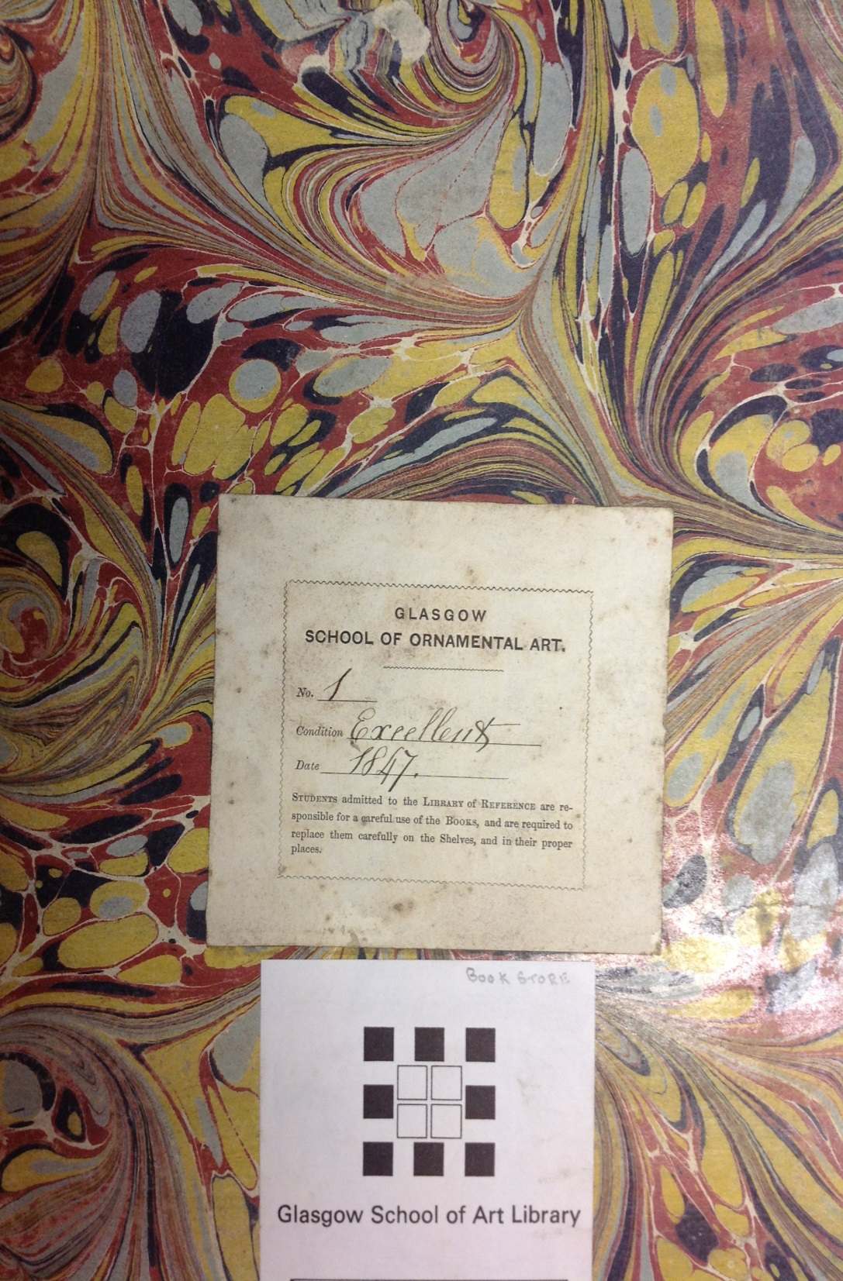
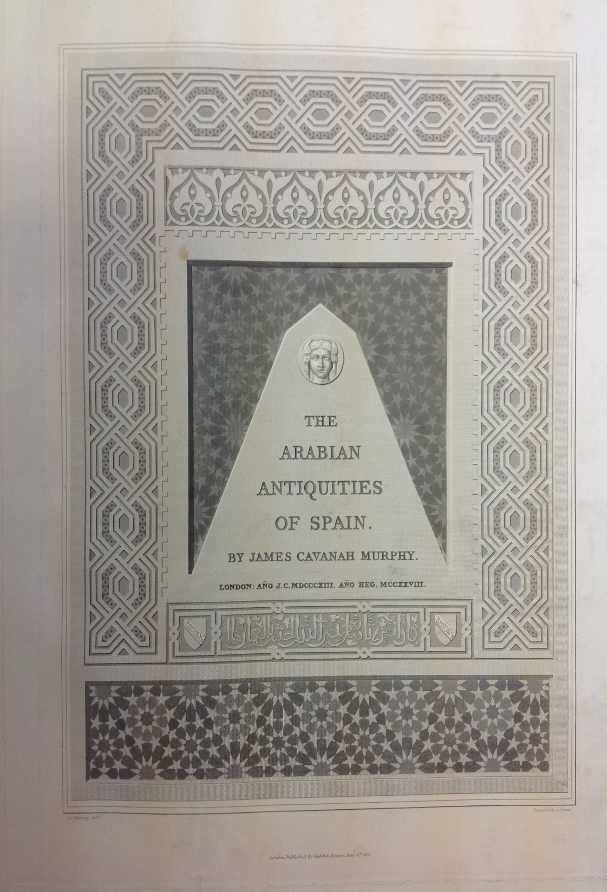
Notes:
Although the manuscript catalogue is sadly undated, the first book to be accessioned, James Cavanah Murphy’s Arabian Antiquities of Spain of 1813, is still held in the library and bears a bookplate with an 1847 date of deposit.
From this and other physical evidence, it is clear that it was standard practice at the time to assign each book an accession number in the catalogue, and then to inscribe this number, along with a date of deposit, towards the front of the book in question.

Slide 16
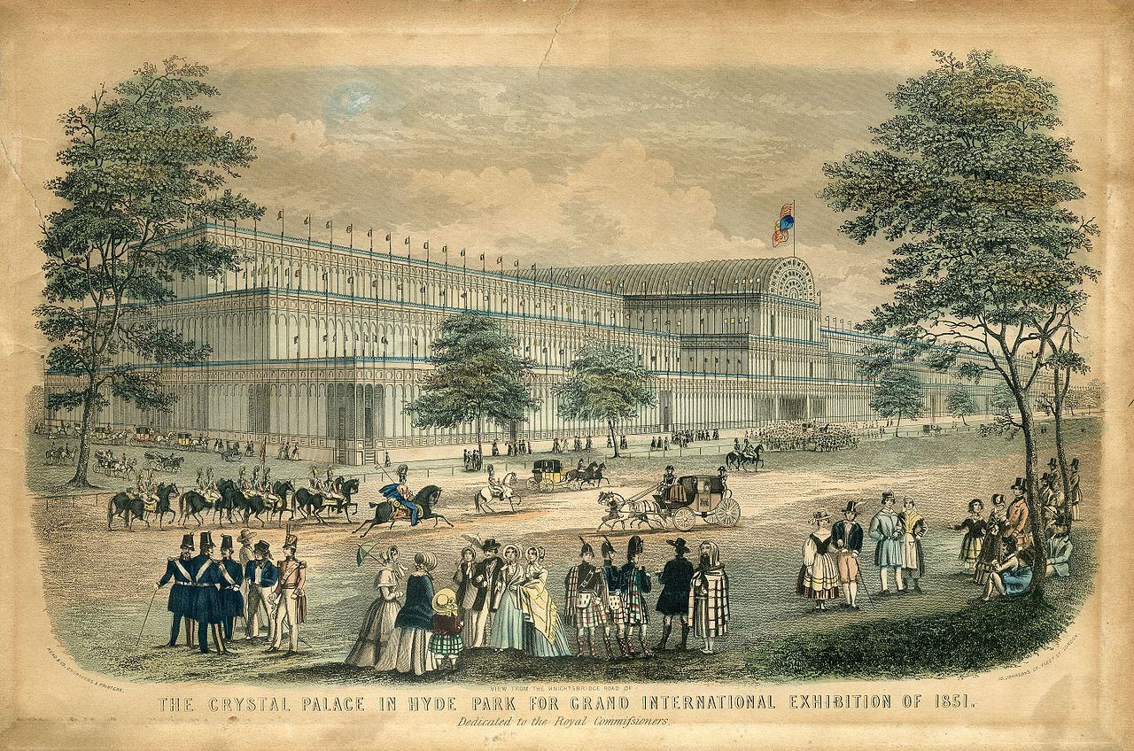
Notes:
We can only now speculate how these volumes were arranged at the time, but it is clear that broad subject headings were preferred within the arts libraries of the period
The first printed catalogue of the London School for example had been published by Ralph Nicholson Wornum in 1856, followed by subsequent enlargements
Wornum’s library was notably ‘arranged as nearly as practicable according to the classification of arts and trades adopted in the Great Exhibition of 1851,’ an arrangement that was designed to enable the serendipitous exposure of the craftsperson to good design from outside his own orbit
The Great Exhibition of the Works of Industry of All Nations was an international exhibition that took place in a purpose-built temporary pavilion, Joseph Paxton’s Crystal Palace, in Hyde Park from 1 May to 15 October 1851.
It was the first in a series of subsequent World's Fairs, which became pervasive in the 19th century
Organised by Henry Cole and Prince Albert, it provided a platform upon which competing countries could display their design and cultural productions.
The link between the Great Exhibition and the subsequent Government Schools of Design were manifold: they were overseen by the Department of Practical Art, which was itself funded from the profits of 1851, and the Department was of course headed by Henry Cole himself.
Wornum was acutely aware that this arrangement by Great Exhibition classes enabled browsing; he compared his library to that of the British Museum for example, noting that in the latter the craftsman ‘must know exactly what he wants, and look for it… it is the necessity of knowing the precise work he wants.’
It is not now possible to evidence whether the GSA library was similarly arranged during this period, and locational inscriptions within the extant volumes are sadly lacking.
A large-scale reclassification was later instigated however, with the 1936-1937 Annual Report noting that the library was being ‘re-catalogued under the Dewey system to enable readier reference... and to bring the library into line with other libraries in the country’.
This reclassification was left unfinished after a change in Librarian, and did not recommence until 15 May 1951

Slide 17
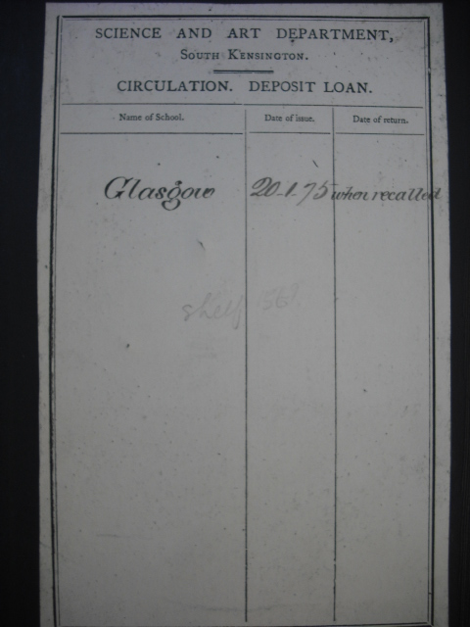
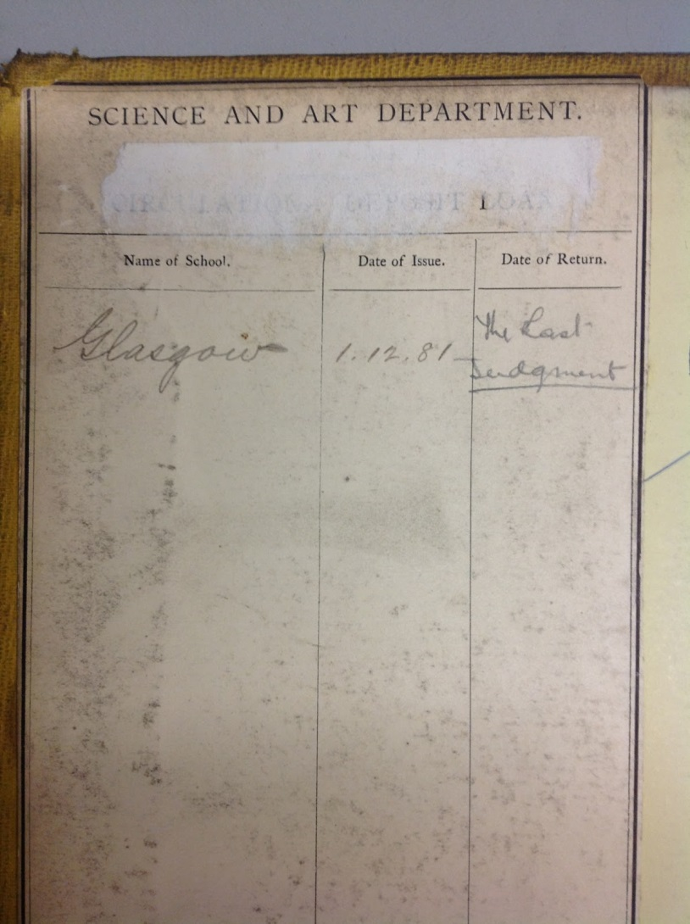
Notes:
Now fully transcribed, the 1847 manuscript catalogue has shed valuable light onto the Glasgow library’s foundation collections.
Around 18% of the listed volumes remain physically extant in the collections, with the other volumes lost either to general wastage over the intervening years or to the 2014 fire.
Where the physical volumes do not survive, surrogates are generally locatable within digital libraries.
This activity has allowed for the recreation virtually of much of the library’s first catalogue, which can now be interrogated for evidence of particular collecting histories and strategies
South Kensington centrally distributed many of the resources required by the schools under its charge, and books were no exception.
Bryant asserts that the library of the London School was ‘crucial to Henry Cole’s nationwide ambitions, and lent books, prints, drawings and photographs to the new regional art schools.’
By 1862, the London librarian John Charles Robinson had published an alphabetical catalogue for the use of both students of the library and ‘the provincial schools which have the privilege of obtaining books on loan.’
Certainly, many of the volumes from the early years of GSA library were loaned from South Kensington, though in reality nearly all were lodged in perpetuity.
To this day, some 135 extant volumes retain their bookplates from the Department of Practical Art and its successor, the Department of Science and Art, and are often inscribed with their original date of deposit.
There are noticeable correlations between the volumes acquired by GSA during this period and those acquired by the London School as evidenced in Wornum’s 1855 catalogue.
Examples include Owen Jones’s Alhambra and John Flaxman’s Anatomical Studies.
Around 37% of the accessions listed in the first catalogue relate to fine art, 12% to architecture and engineering, 5% to ornament and decoration and art techniques respectively, 3% to aesthetics, 2% to anatomy and physiology, and 1% to costume and textiles.
However, the diffuse remit of GSA library at that time is reflected in the 40% of volumes that focus on more general topics such as literature, history, economics and politics.
An equally important contributor of volumes however was the Local Committee which oversaw the work of the School.
In total, this committee provided some 48% of the volumes listed under the reference library in the first catalogue.
Volumes were also individually gifted, and from 1850 onwards these are generally recorded in the Annual Reports or Minute Books as a courtesy to the donors.
They include a number of volumes from noted individuals such as art historian Sir Isidore Spielmann, architect John James Burnet, and industrialist Sir William Bilsland.
A 1774 edition of Polymetis is listed in the first catalogue as ‘once in the possession of Josiah Wedgwood’.

Slide 18
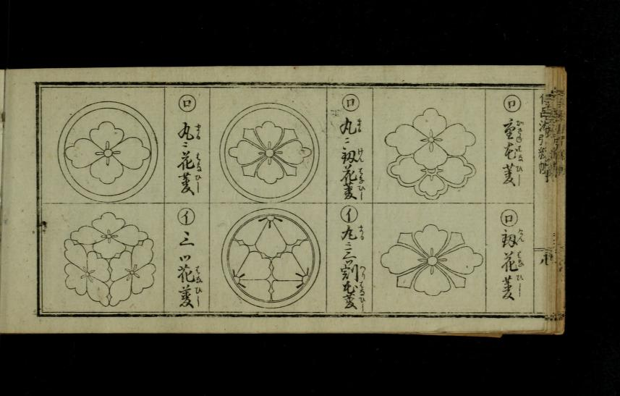
Notes:
Of particular note in 1887 was the purchase of ‘a series of books on Japanese art and design’, an acquisition in which the hand of the then Headmaster Francis Newbery is perhaps clear.
Although individual titles are not recorded, presumably due to the language barrier, the GSA library holds to this day a number of Japanese books published in the 1880s.
Much has been written on the influence of Japanese art and design on the young Mackintosh, who was enrolled as an evening class student at the School from 1883-1894, and it is tempting to conjecture that Mackintosh may have enjoyed a formative exposure to the arts of Japan with the arrival of these volumes into the GSA library during his studies.
This photo is of Iroha-biki Moncho and dates to the 14th year of the Meiji period. It shows Japanese heraldic devices, or ‘mon’, used to show familial allegiances.

Slide 19
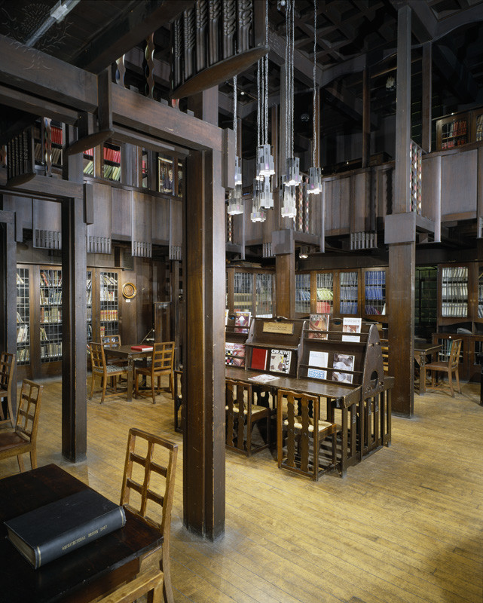
Notes:
The histories of both the library at Glasgow School of Art and its foundation collections are intrinsically bound to the development of a particular design reform agenda in mid-nineteenth century Britain.
Born from the recommendations of the Select Committee on Arts and Manufactures, the Government-sanctioned and funded Schools of Design that were to proliferate across the country were charged, in part, with both educating the artisan and re-educating the wider public in good design.
The Glasgow School, which opened in 1845, was no exception and provides a useful case study for the development of these institutions.
The development and cultivation of a good, rounded library in the arts and manufactures were viewed as central to their mission, and notably both the London school and the Prussian Kunstgewerbeschule placed great stock in the importance of their libraries.
We have seen that GSA library is first documented in 1847, just two years after the school’s foundation.
It is observable that from these beginnings the library developed in a rather piecemeal fashion, due to sparse financing or a lack of professional oversight, and it was only in the preparations made for the occupation of Mackintosh’s custom-built library that a step change in approach is noticeable.
Although the collecting strategy of the library has seen particular foci at different points in its history, its central concern has always remained the need to educate students not only in practical design, but also in wider taste, aesthetics, theory and culture.

Slide 20
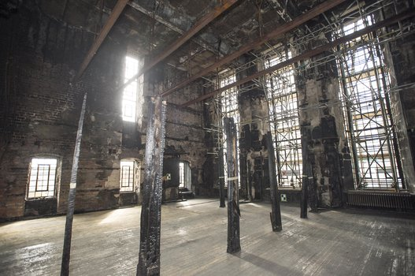
Notes:
As the library moves forward into a period of post-fire reconstruction, it is a history of adaptation and evolution that will continue in the years to come.

Slide 21
Chappell, D. (2016) ‘The early history and collections of Glasgow School of Art library 1845–1945’, Library and Information History, vol. 32, no. 3, pp.161-174, Available http://dx.doi.org/10.1080/17583489.2016.1186479 (subscription required)
Duncan Chappell
Glasgow School of Art
d.chappell@gsa.ac.uk

