Slide 1
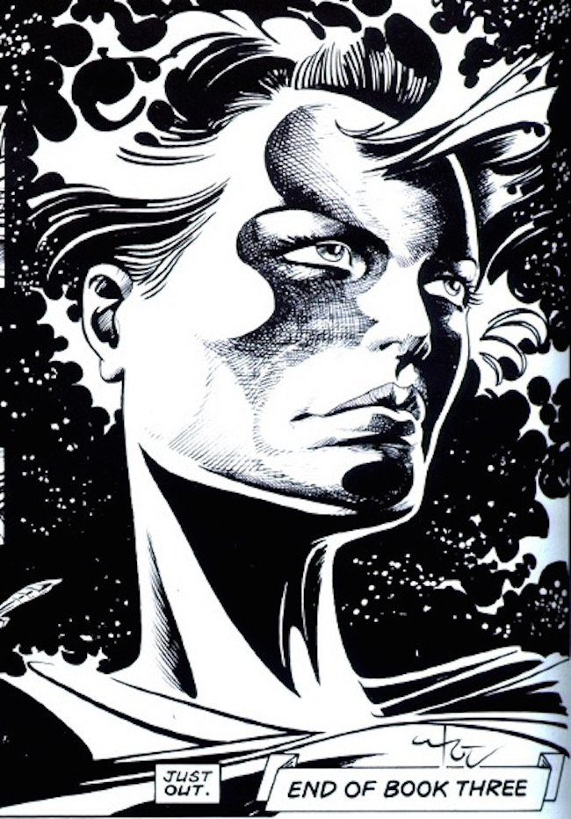
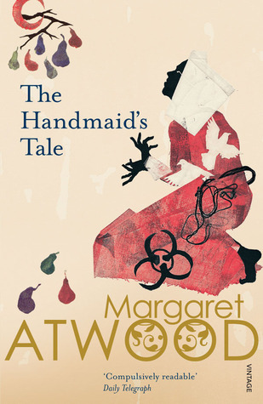
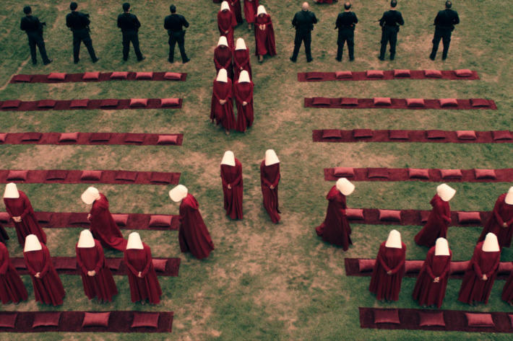
“I wish this story were different. I wish it were more civilized.” A Comparative Analysis of The Handmaid’s Tale and Halo Jones. Dr David Sweeney, Design History and Theory, The Glasgow School of Art

Slide 2
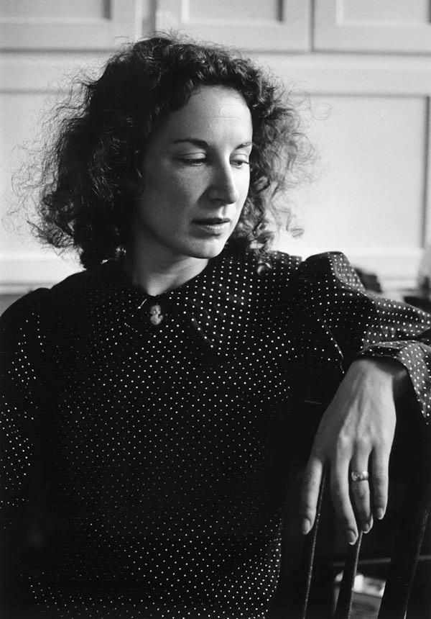

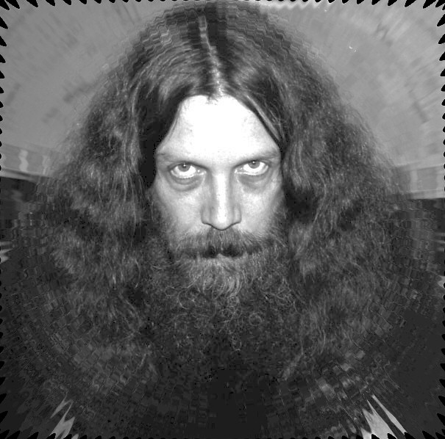
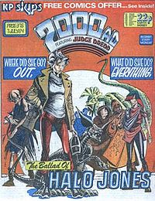
A
H
I
E
R
A
R
C
H
Y
O
F
T
E
X
T
S
I I
I I
I I

Slide 3
'The Handmaid's Tale won the very first Arthur C Clarke award in 1987. [Margaret Atwood has] been trying to live this down ever since.’
David Langford (Science Fiction author, editor, and critic)
'Science fiction has monsters and spaceships; speculative fiction could really happen.'
Margaret Atwood
'If you were working-class you had comics. It was like rickets.'
Alan Moore

Slide 4
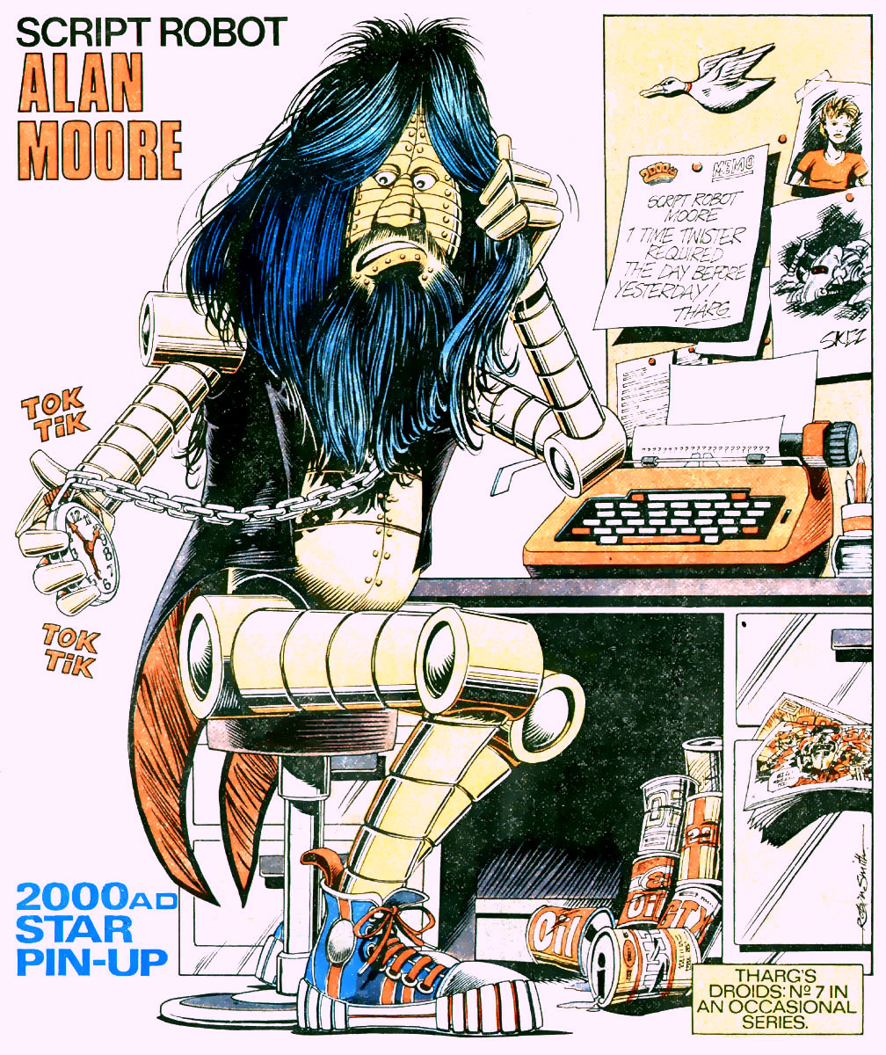
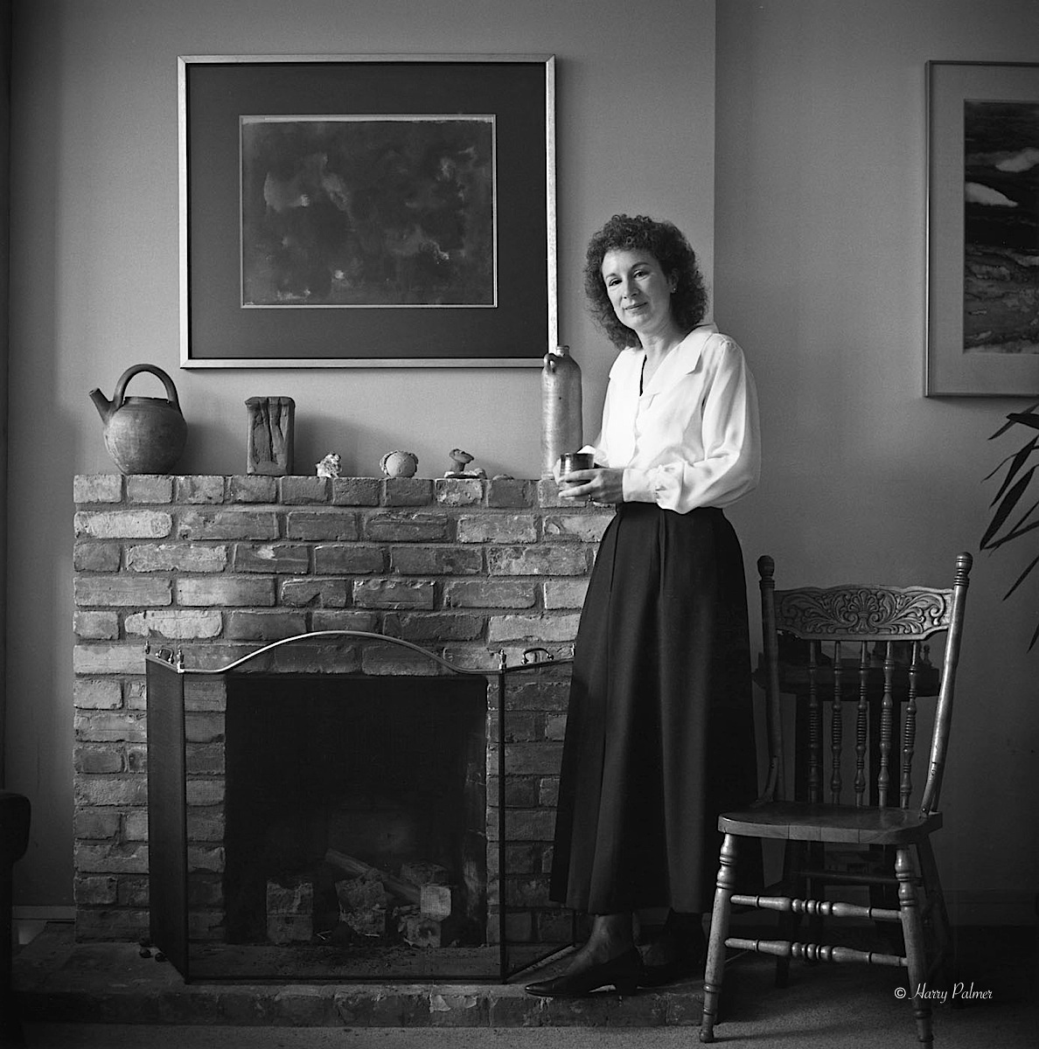
The Conditions of Authorial Production

Slide 5
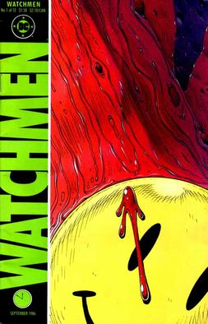
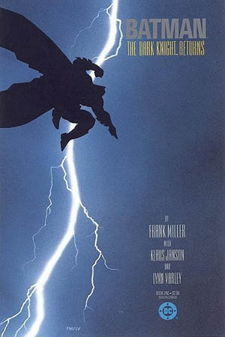

The ‘80s and the Rise of the Graphic Novel
“Bam! Pow! Zap! Comics aren’t just for kids any more!” [A typical media cliché of the time]

Slide 6
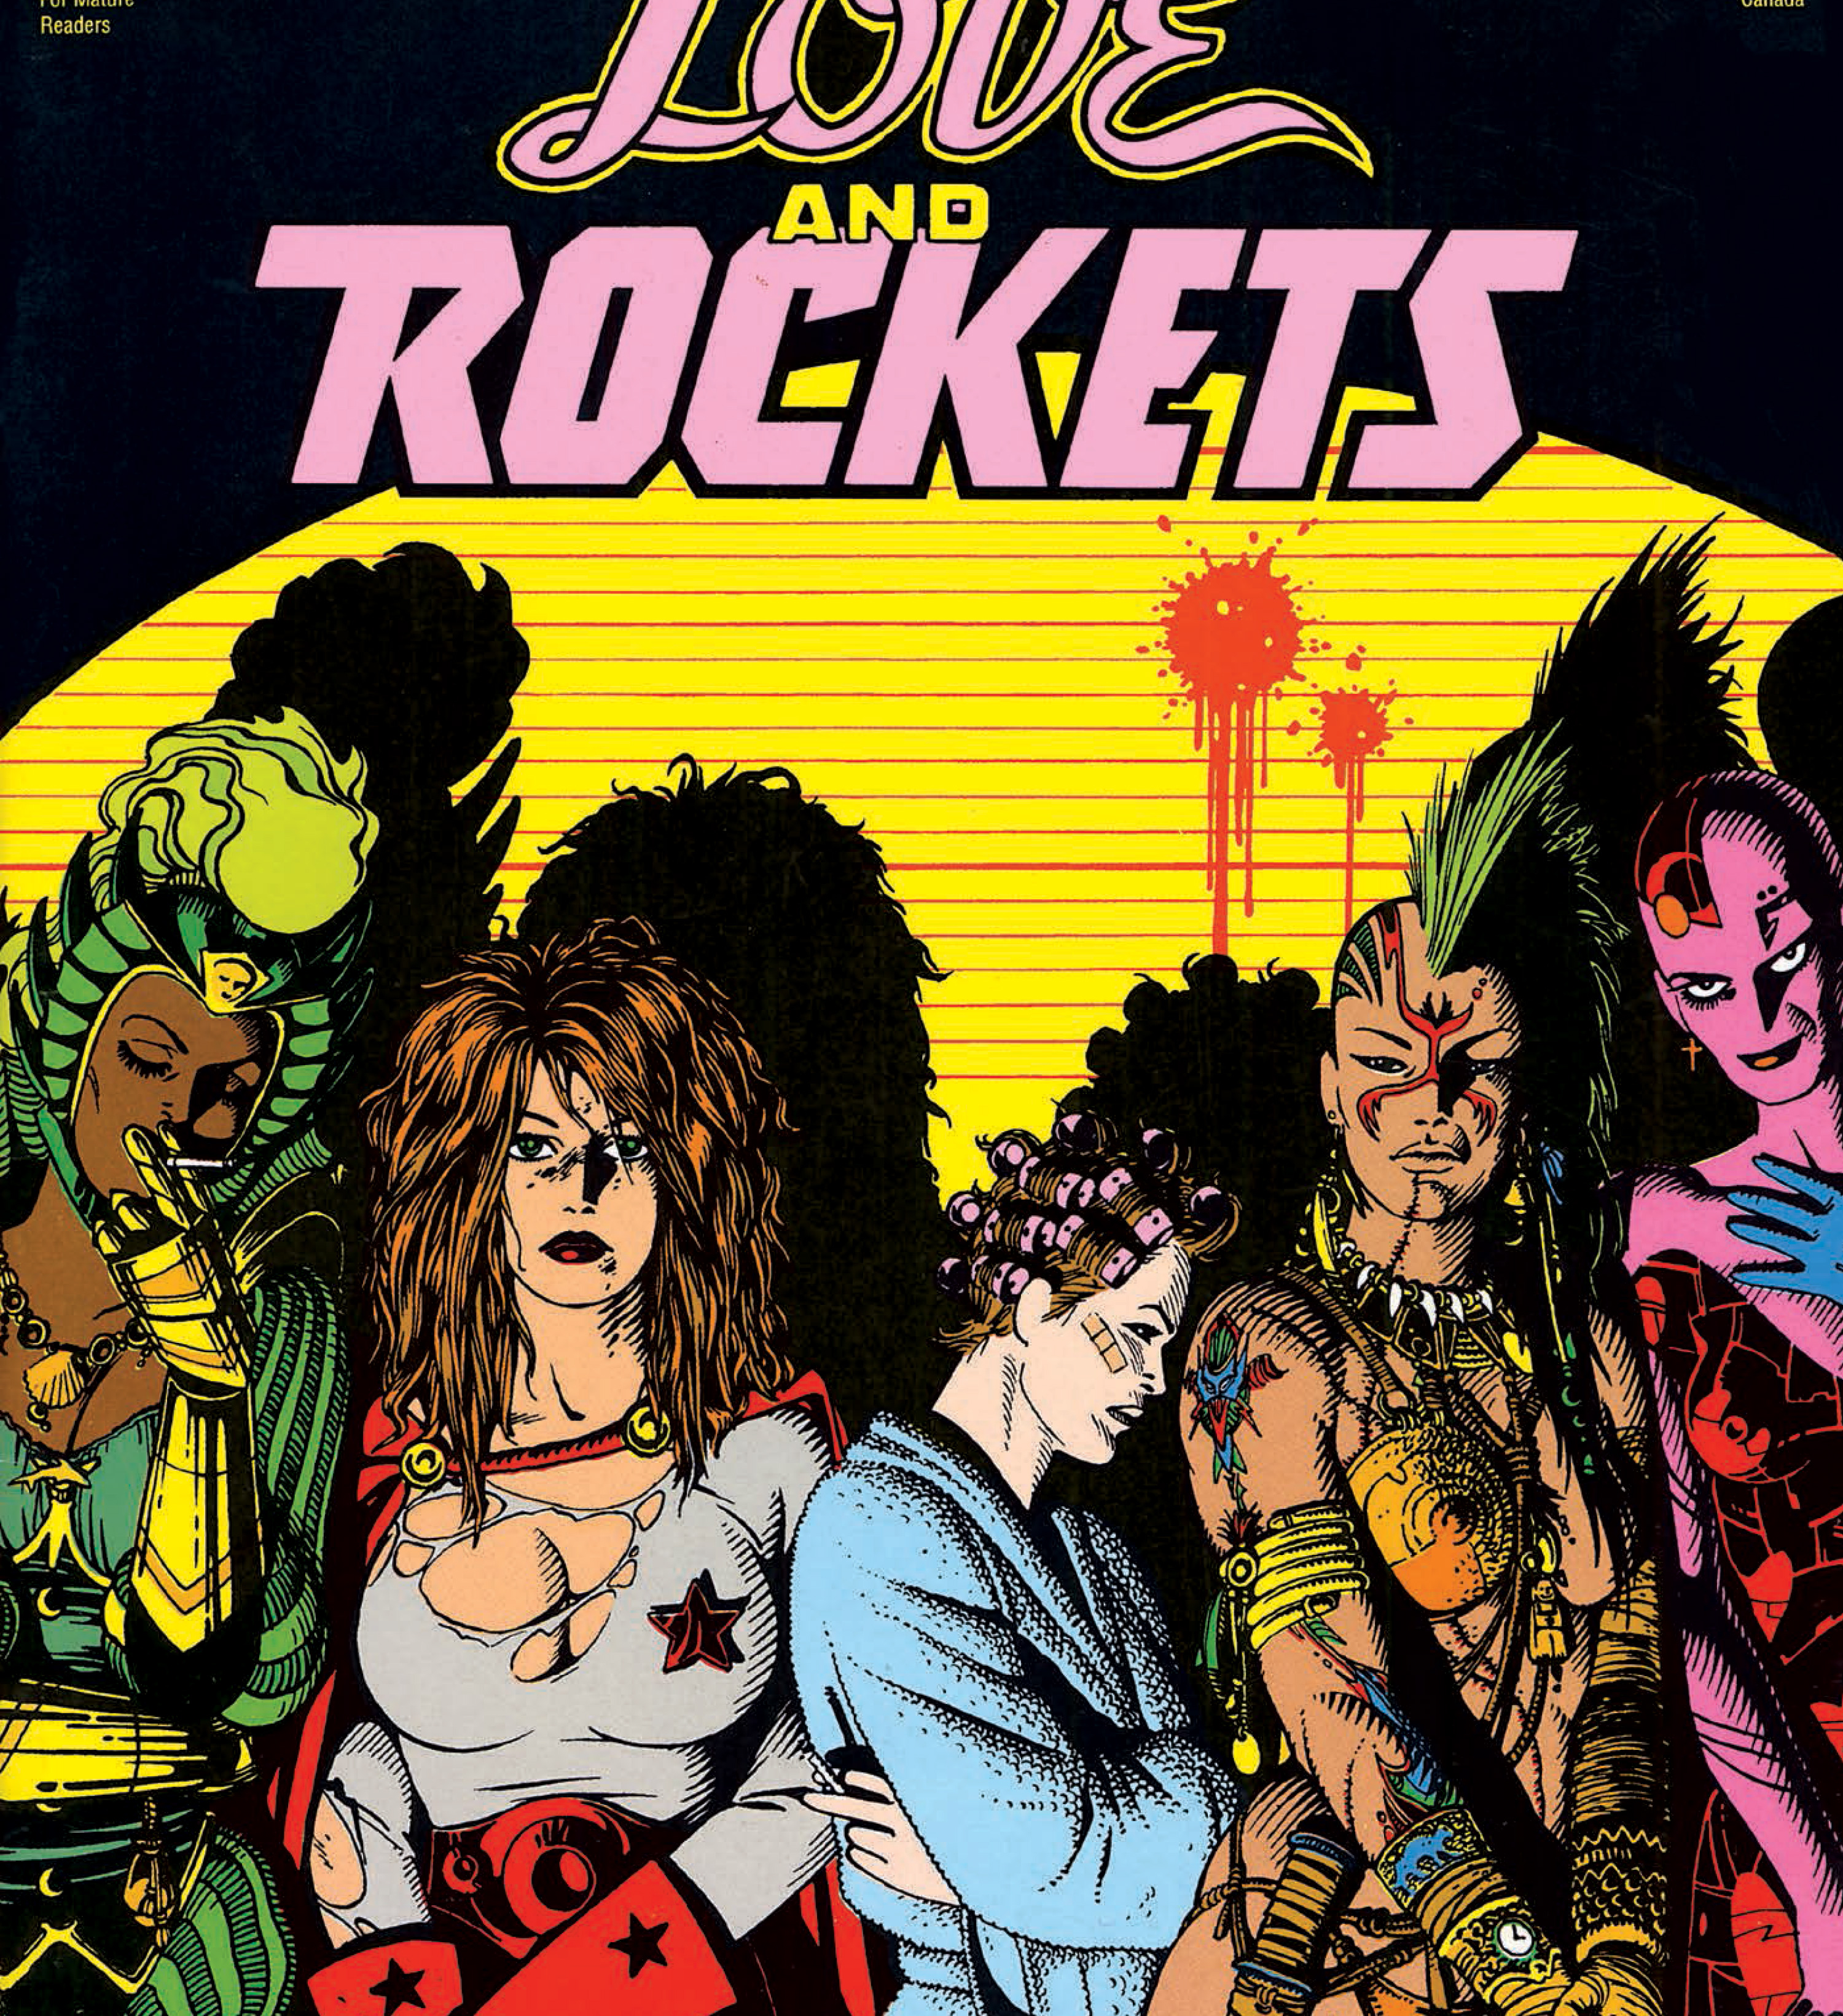
GENRE Love and Rockets (1982 -)

Slide 7
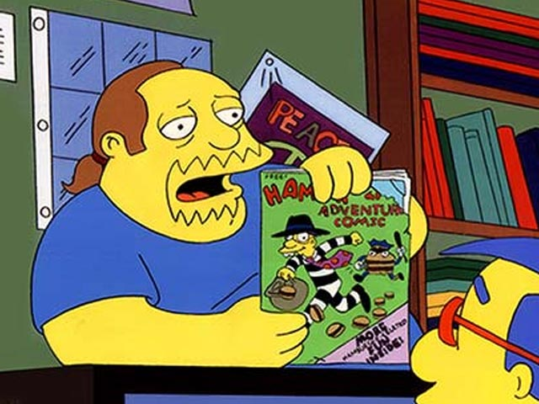
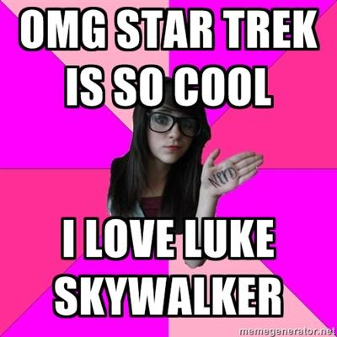
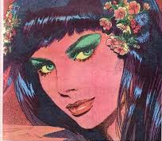
Genre and Gender

Slide 8
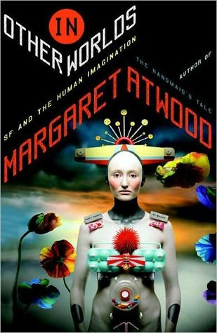
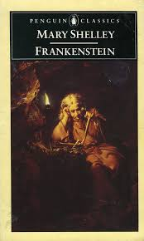
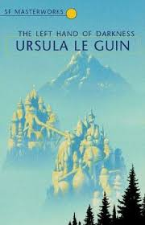

Gender and Genre

Slide 9
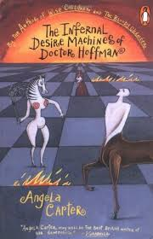

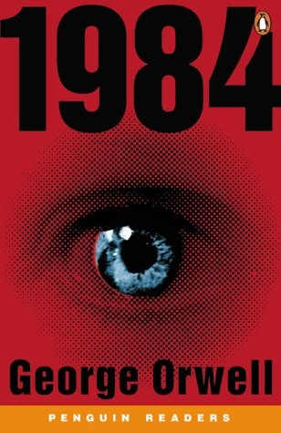
“Literary” Science Fiction

Slide 10
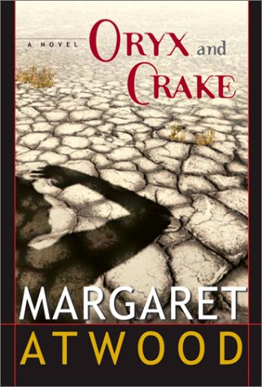
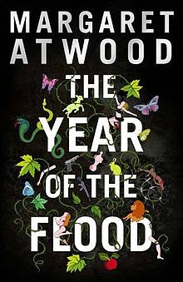
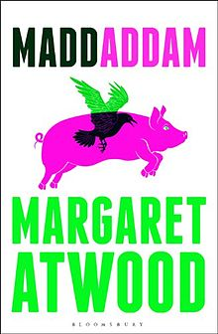
More Speculative Fiction by Atwood
(2003)
2009
2013

Slide 11
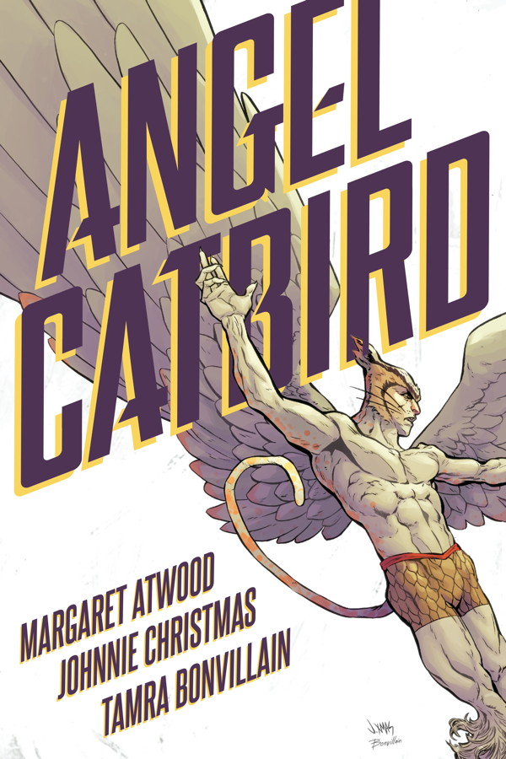
Atwood as Graphic Novelist

Slide 12
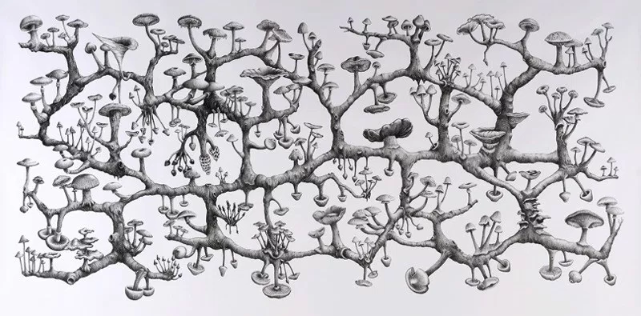
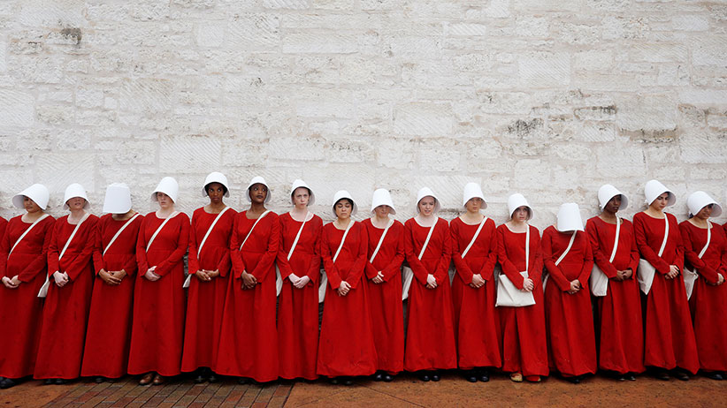
‘Tree Logic’ v ‘Rhizomatics’
‘The tree is filiation, but the rhizome is alliance, uniquely alliance.’
A Thousand Plateaus, Gilles Deleuze and Felix Guattari (1980)

Slide 13



Popular Feminism

Slide 14



Adaptation

Slide 15
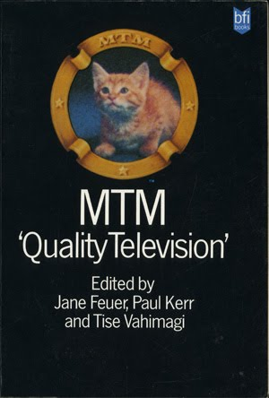
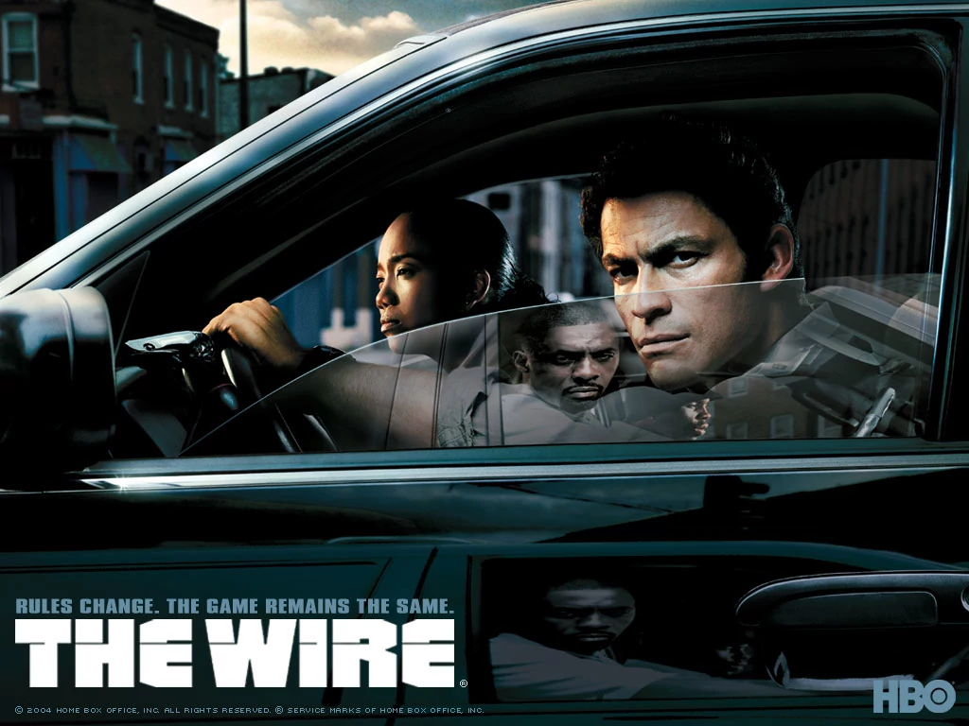
The ‘Golden Age’ of Television

Slide 16
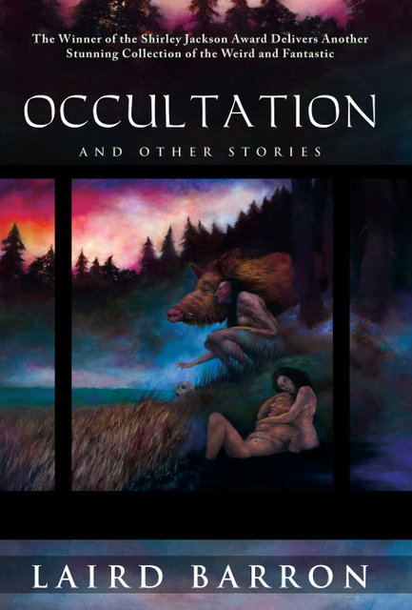
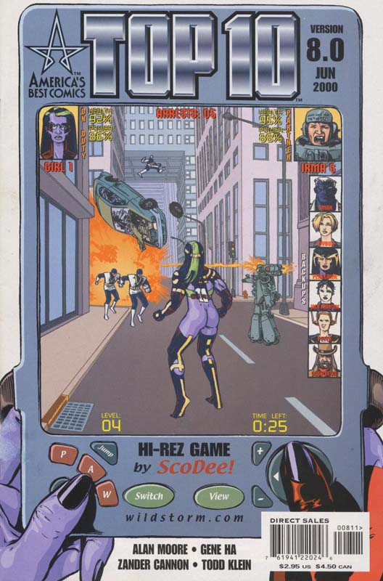

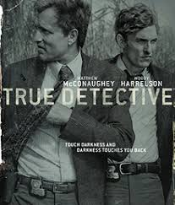
The ‘Golden Age’ of Televison

Slide 17


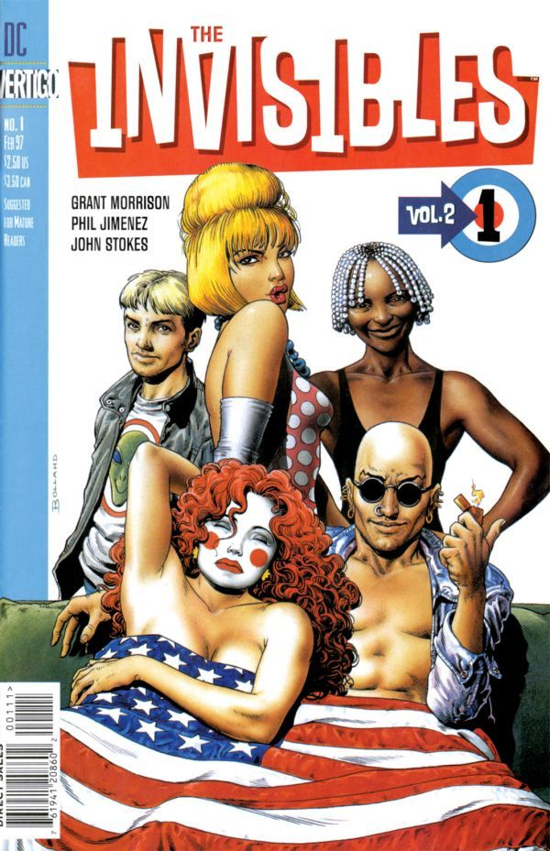
The ‘Golden Age’ of Televison

Slide 18
“It’s a trap, this matter of definition, and I can’t think of a more boring academic subject.’ Novelist Stephen King on genre. ‘Like the best fiction, it’s important because it’s true.’ Novelist Lauren Beukes on The Ballad of Halo Jones

Slide 19
“It’s a trap, this matter of definition, and I can’t think of a more boring academic subject.” Novelist Stephen King on genre. “Like the best fiction it’s important because it’s true.” Novelist Lauren Beukes on Halo Jones.

