Slide 1
BRITISH AND GUARANTEED
Nicholas Oddy
n.oddy@gsa.ac.uk

Slide 2
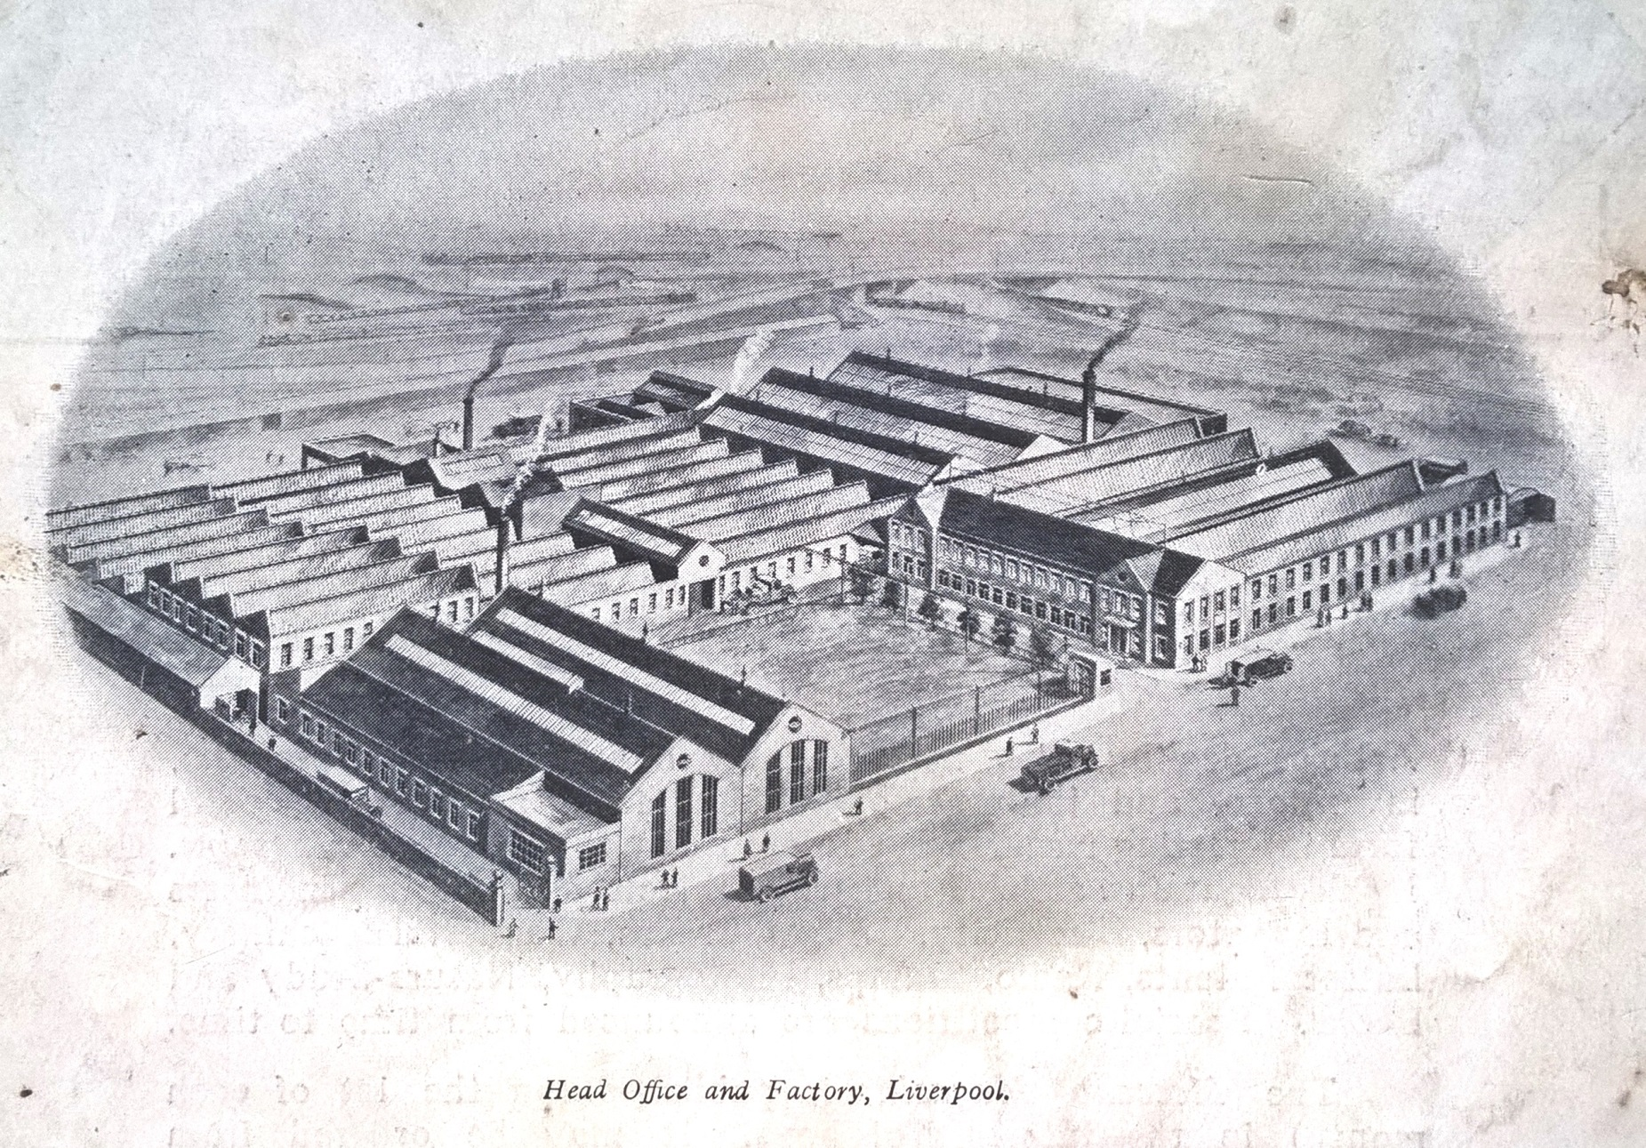
Vignette of Meccano Ltd, Binns Road From the rear cover of The Hornby Book of Trains, 1925 (1st edn)

Slide 3
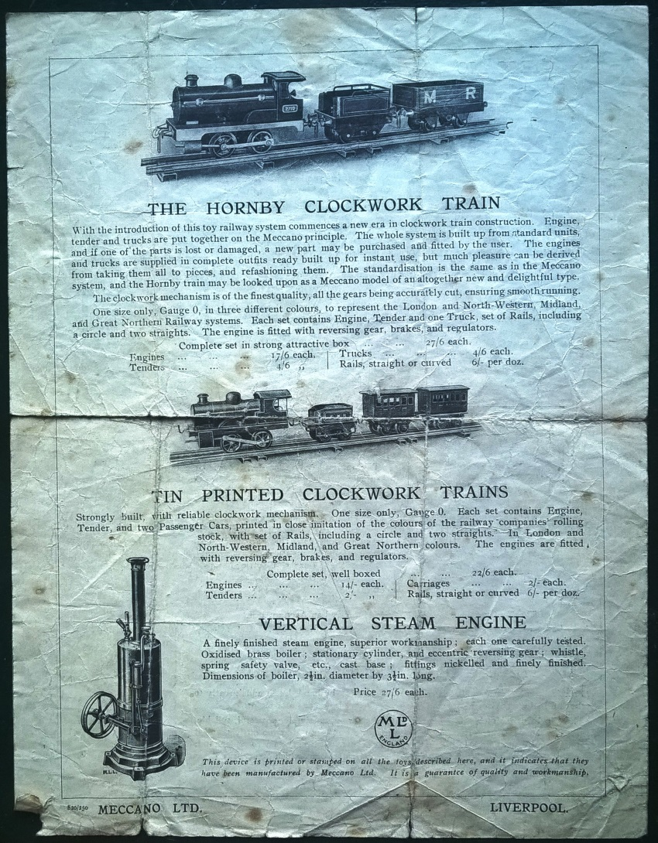
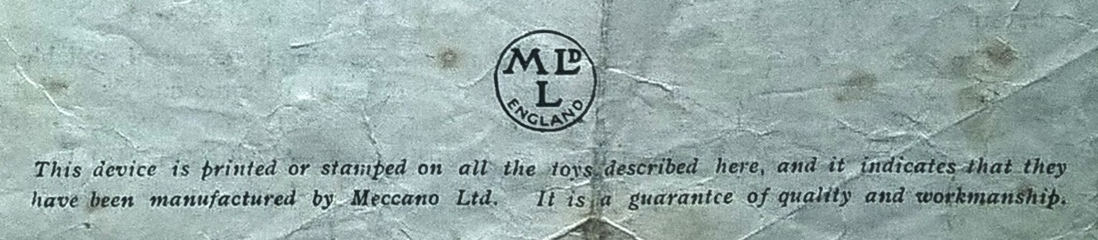
Left: Early advertising flyer dated 8 20 with implied guarantee below. The price of the Tin Printed Train was deliberately inflated to make the Hornby Train the better option. Its ‘proper’ retail price was 12/6 using Hornby’s own costings in 1921-2 given as evidence to The Safeguarding of Industries Committee on Toys (National Archives BT/55/80)

Slide 4
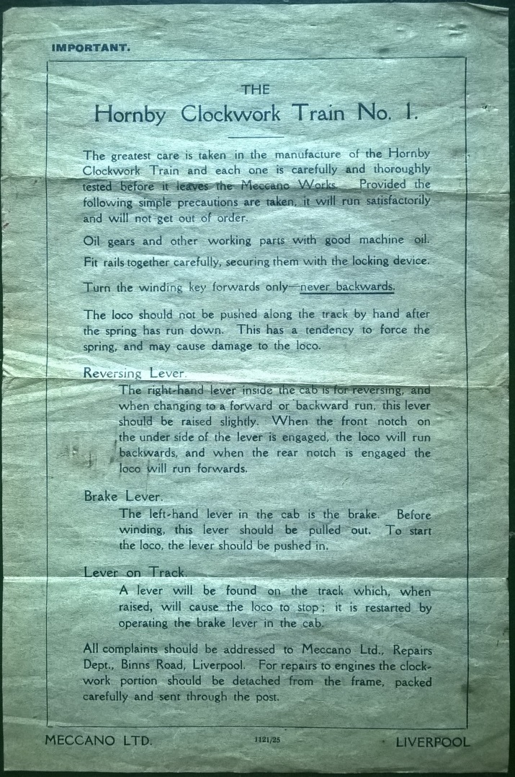
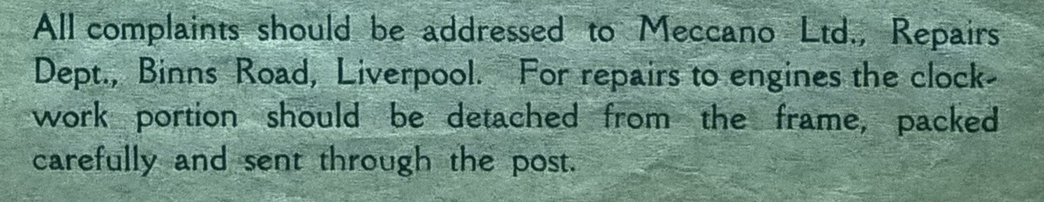
Left: Instructions for revised ‘No1’ locomotive dated 11 21 with mention of the ‘Repairs Dept.’ below.

Slide 5
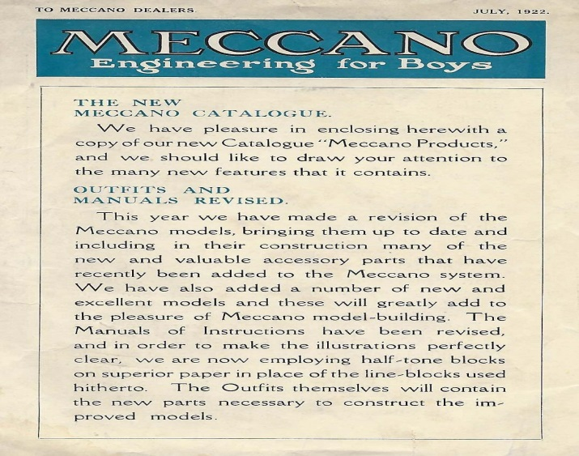
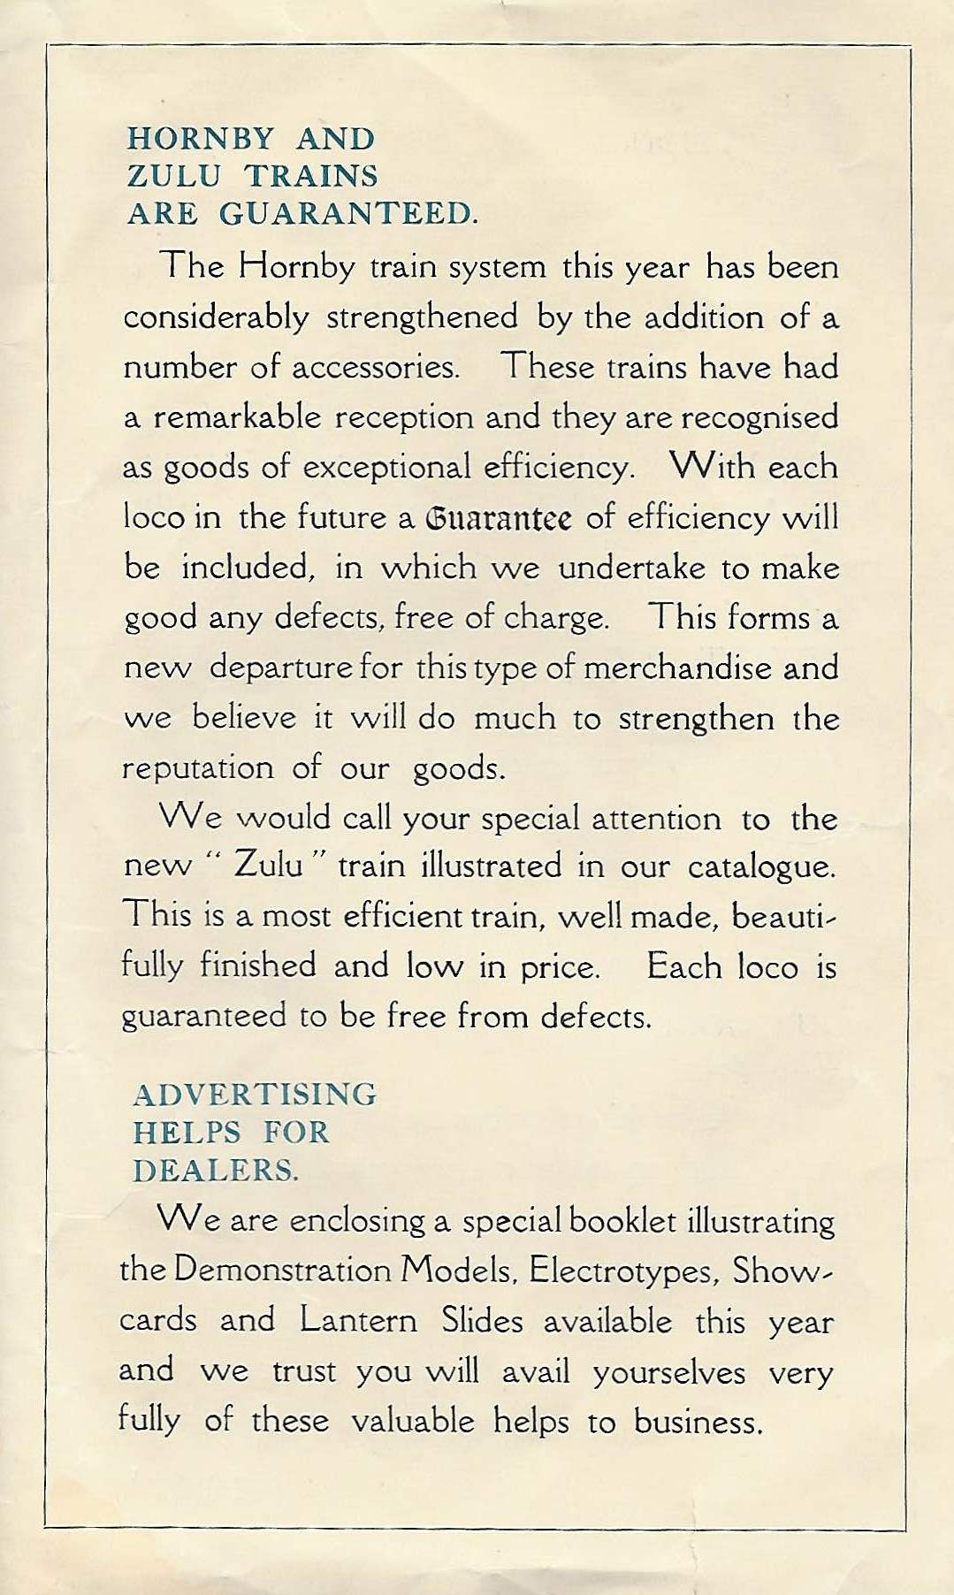
To Meccano Dealers July 1922 announcing the guarantee to ‘strengthen the reputation of our goods’

Slide 6
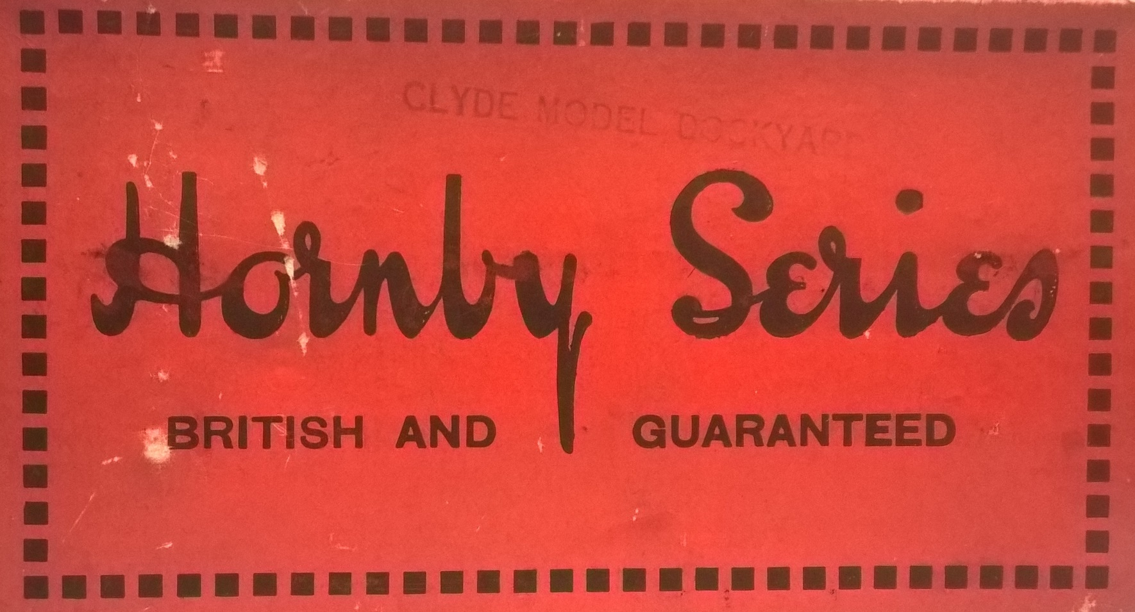
Standard package design, 1925-1942 (with minor variations )

Slide 7
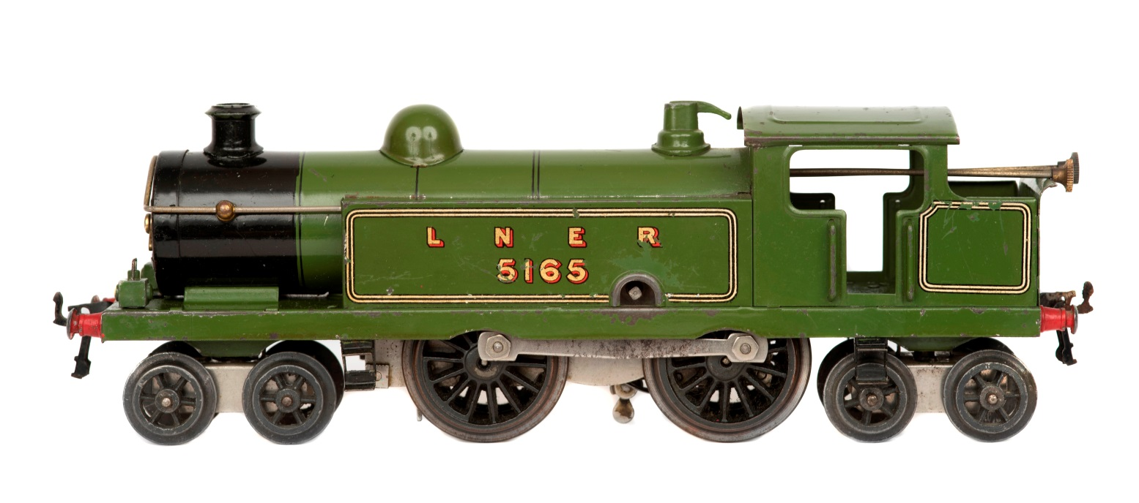
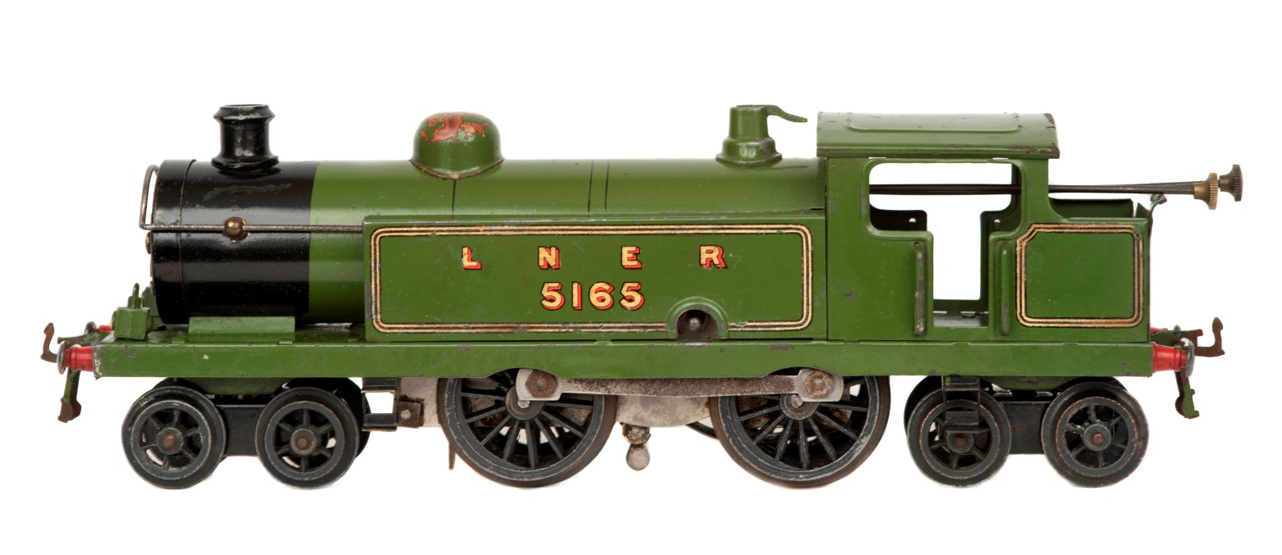
Top: Final production No2 Tank Loco, 1929 Bottom: Service Department replacement No2 Tank Loco, c1931 supplied until c1935

Slide 8
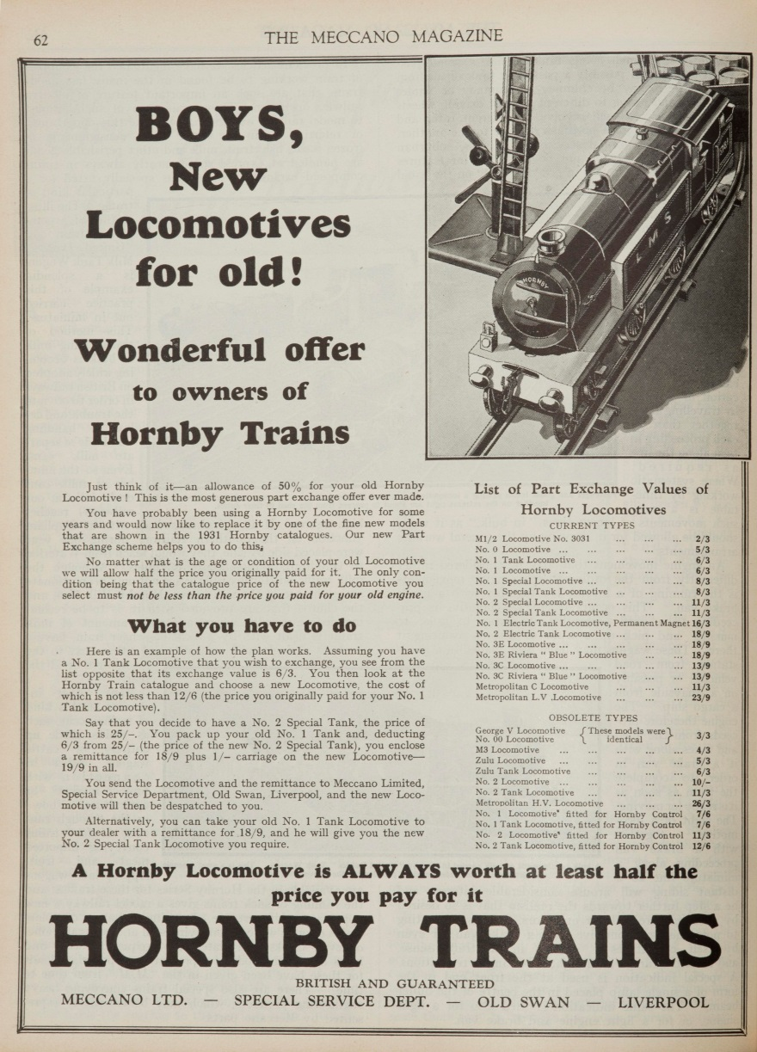
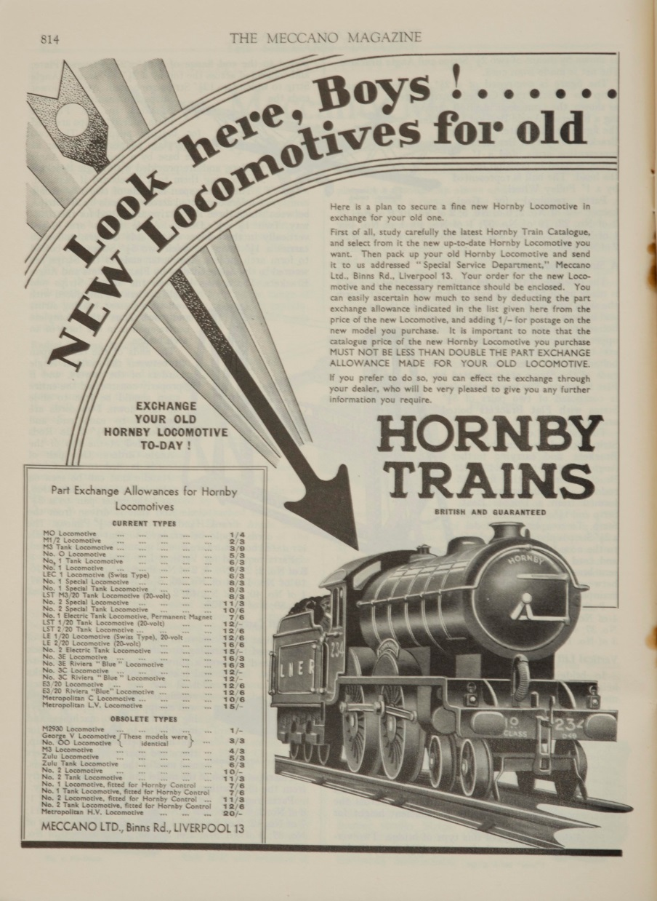
Meccano Magazine. Left: January 1931. Right: October 1934.
By 1934 the scheme had been adjusted to favour the return of older products and the strap-line ‘ALWAYS worth at least half the price you pay for it’ had been dropped

Slide 9
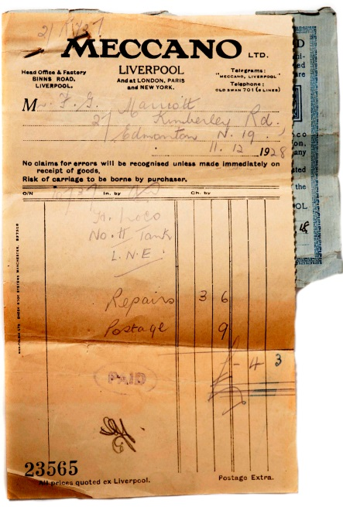
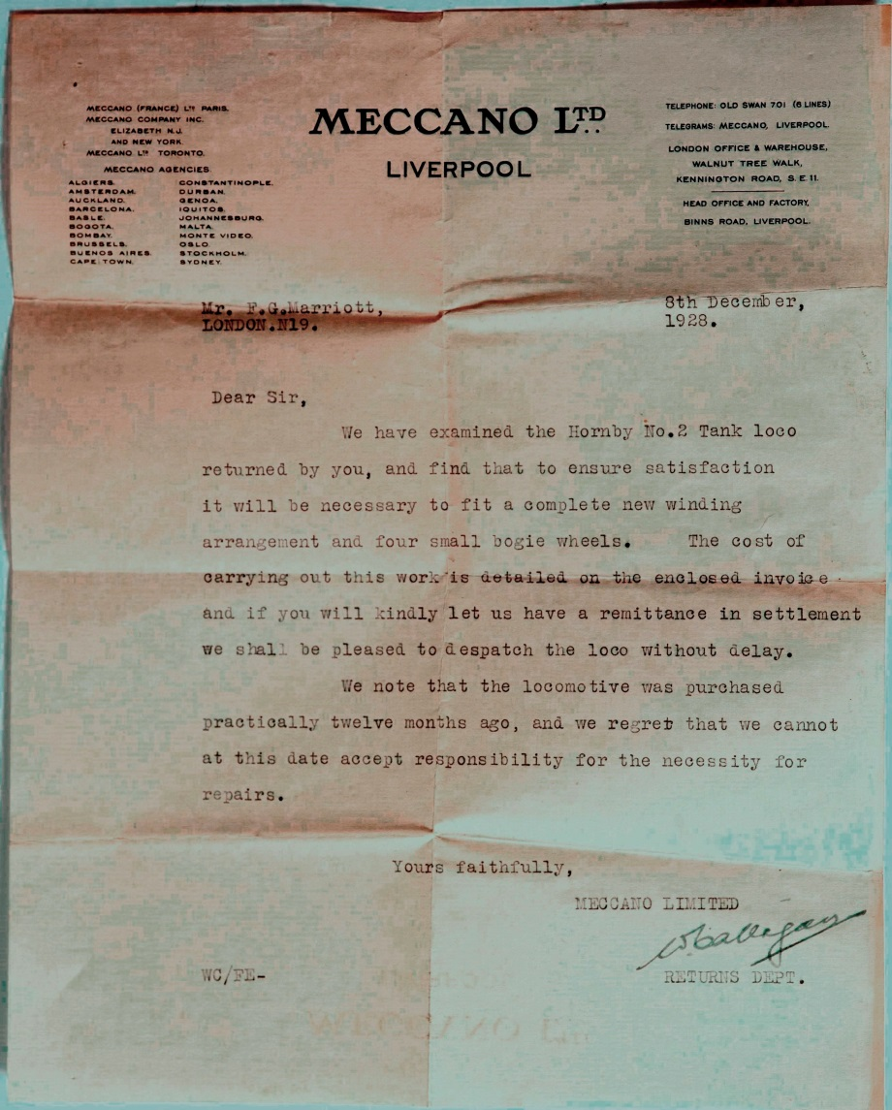
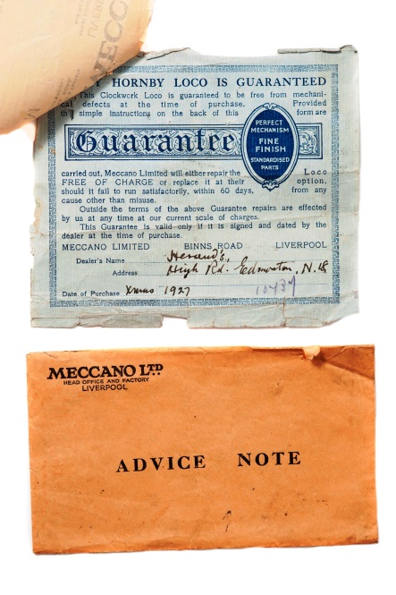
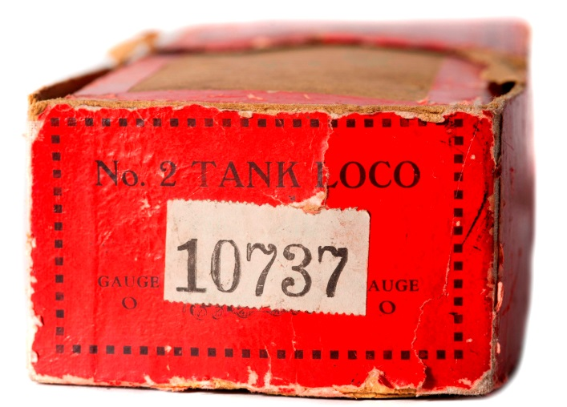
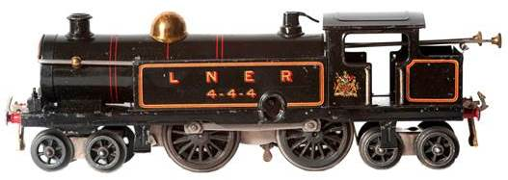
Throughput can be established through the prominent numbering system used by the Service Department. Note this loco was sent back a year after purchase on the misunderstanding that it was still under guarantee. Its failure was entirely due to deficient design and materials.

Slide 10
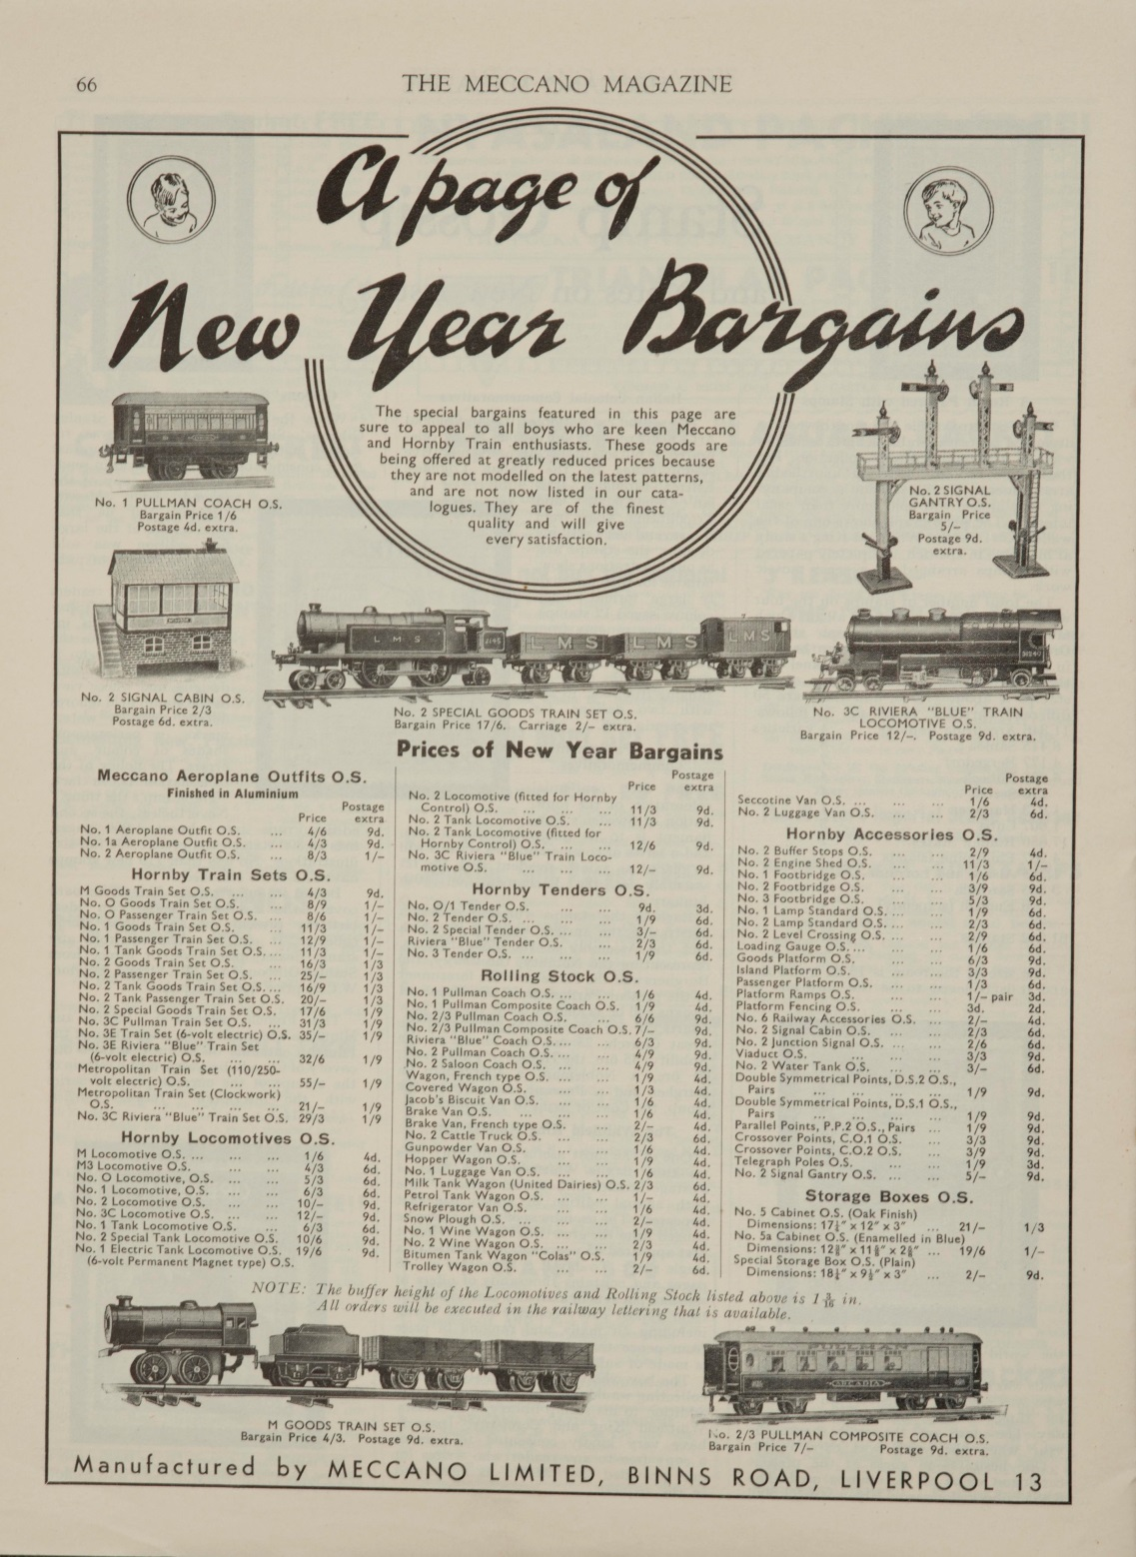

Meccano Magazine, January 1935
The inset above shows entries for the No2 Tank Loco that the Service Department had gone to considerable effort to remanufacture between 1930 and 1935

Slide 11
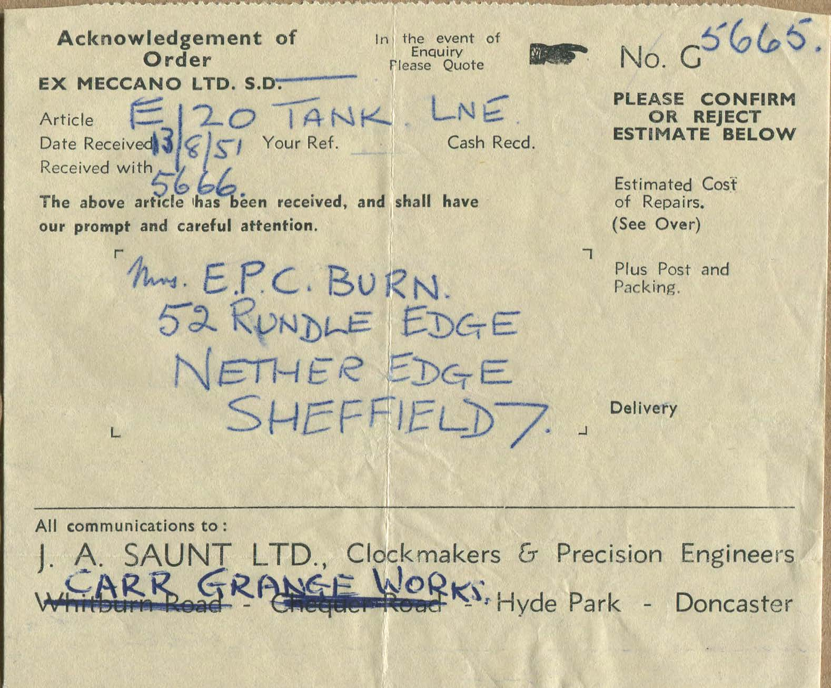
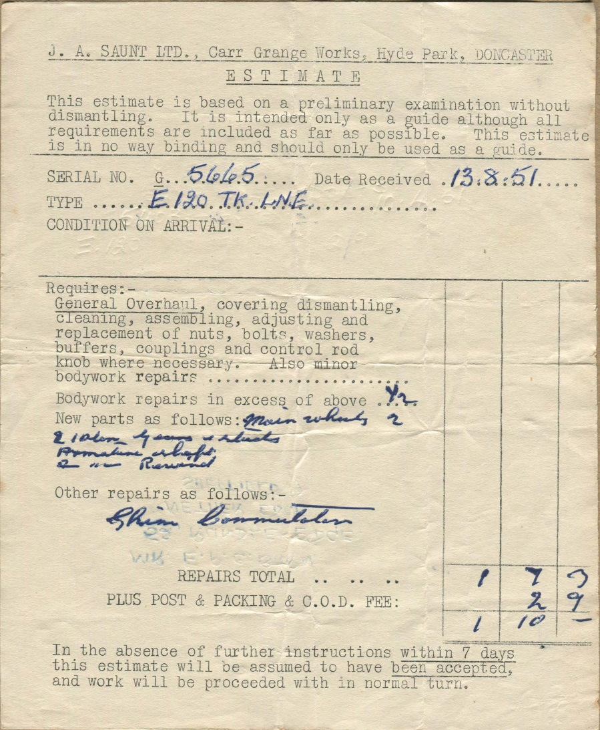
J A Saunt paperwork , August 1951, for a pre-war, obsolete , 0 gauge electric loco, not made since 1941.

Slide 12
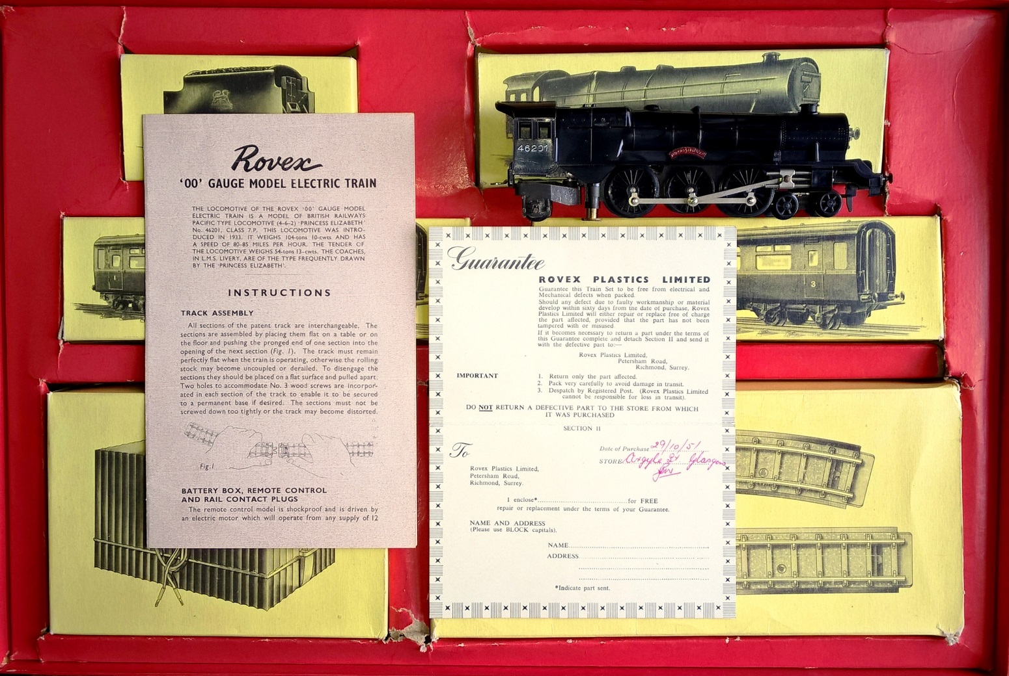
Rovex train set from the time of the Tri-ang take over with its guarantee filled out. Sold at Marks & Spencer, Argyle Street, Glasgow October 1951.

Slide 13
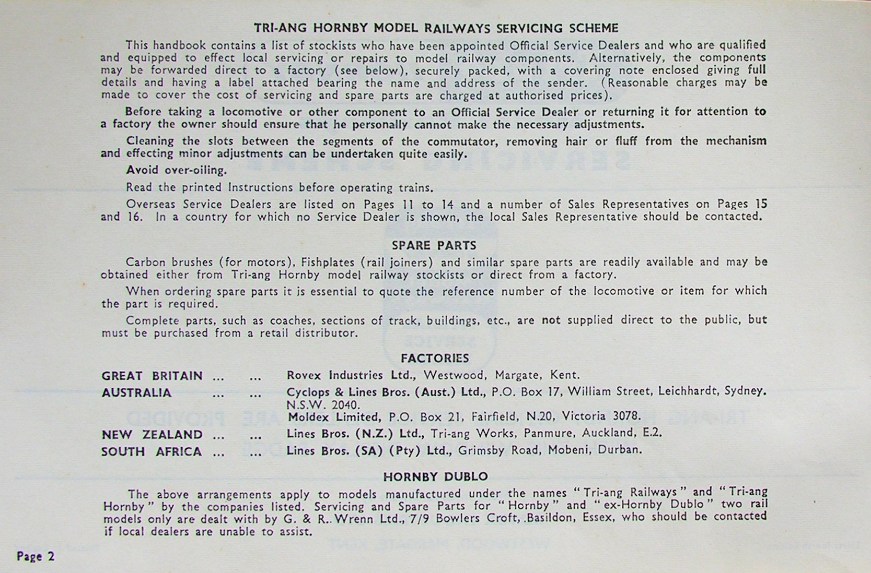
Preface of Tri-ang Model Railways Servicing Scheme 1968. Four years after Tri-ang bought Meccano, this was the first edition where the Service Department was not mentioned. It survived another year.

Slide 14
THE END

