Slide 1
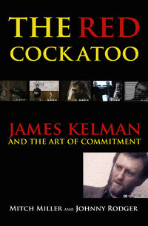
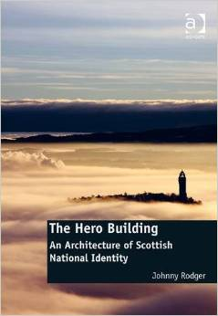
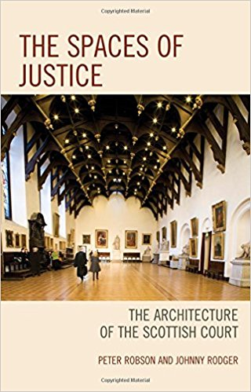
Publishing a Book
Project
Choice of Publisher
Refereed/Readers?
Text
Images
Finance
Launch/Distribution
Review

Slide 2
Project & choice of publisher
1/ Commercial literary publisher – research and writing (no field work) -complete text submitted
2/ Commercial Academic publisher – field work &research and writing –proposal & sample chapter submitted (project piggy-backed on funding from RSE for below)
3/ University press publisher (USA) – field work & research and writing -complete text submitted (projected funded by RSE)

Slide 3
Text & Referee/Readers
1/ Commercial literary publisher – proof reading okay –not so great –book accepted after crits by publisher’s Readers
2/ Commercial Academic publisher – best proofing –very thorough, many suggested changes. Book accepted after reading and crit by two academic referees from the field (good suggestions made)
3/ University press publisher (USA) – Book submitted this publisher because of their expertise and name in the field. Crit by two international academic referees. Difficult style sheet and submission not accepted unless perfect form. We hired an editor to do this. Good proofing, not very good layout of text (too dry looking)

Slide 4
Images
1/ Commercial literary publisher – best images -graphs , photos, sketches etc–colour, money no object
2/ Commercial Academic publisher – images mixed, some not so good (use of images from GSA library and out of copyright mags where restrictions on photo taking) Unfortunately B&W only.
3/ University press publisher (USA) – Because of type of publisher, they have very little experience of using images. We had to pay a ‘subvention’ to get them to reproduce –very expensive, only B7w , poor quality.

Slide 5
Finance
1/ Commercial literary publisher – costs –nothing to us .royalties –regular at first and reasonable
2/ Commercial Academic publisher – costs –if you wanted colour images then pay. Royalties –good payout after worldwide uni libraries buy
3/ University press publisher (USA) – costs we had to pay for images and also an editor to make the ms conform to style sheet. Royalties –not sure thus far –we were asked to fill out a US tax exemption form –proved so difficult as to be impossible so probably no payout

Slide 6
Launch/Distribution
1/ Commercial literary publisher – good launch important for market. Book relatively cheap (£15) sold lots of copies in the shop
2/ Commercial Academic publisher – launch good for morale –sells few copies in shops because expensive (£55). Wrldwide sales to Uni libraries (over 100 at £60 a shot …)
3/ University press publisher (USA) – academic event rather than launch, involving many of the professions, agencies, scholars in the field. Very few in shops as very expensive ($90)

Slide 7
Review
1/ Commercial literary publisher – reviews in newspapers (ie half page in The Scotsman) and literary magazines etc. Much discussion on social media and invitations to speak at radical book festivals etc all to encourage book and amazon sales.
2/ Commercial Academic publisher – Good reviews in scholarly professional and refereed journals – eg AJ, Jounral of Scottish Historical Studies (EdinUni), college deFrance review, LSE Review etc. no newspaper reviews
3/ University press publisher (USA) – preview in The Herald (we rather than publisher got that), and dcited in one other book so far –we await reviews –sometimes these take years as with Hero Building

