Slide 1
Crestfallen to Phoenix Risen
Coping with Disaster and Recovery at Glasgow School of Art
Duncan Chappell

Slide 2
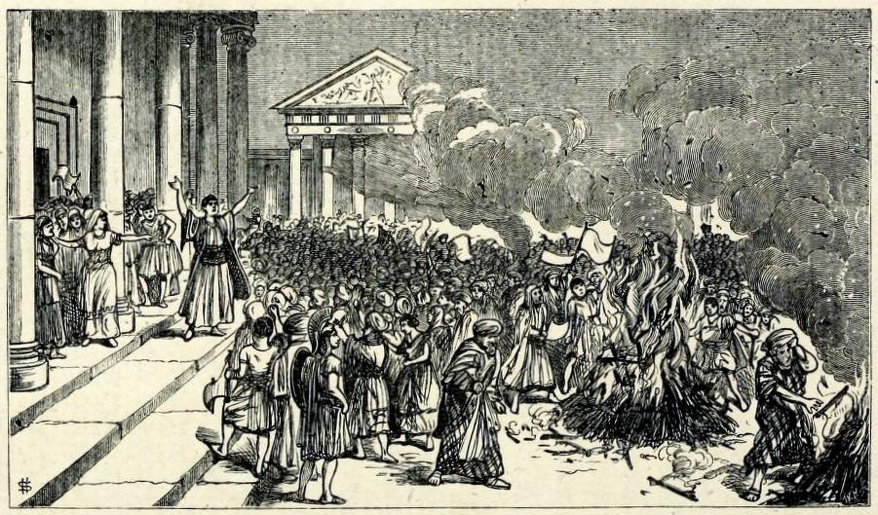
Notes:
In his treatise The Enemies of Books, first published in 1880 by Trubner & Co., William Blades, the well-known collector of the works of William Caxton, documents his outrage at the mistreatment suffered by books at the hands of biblioclasts, both human and non-human
His text enumerates and discusses threats to the survival of books, with dedicated chapters on water, gas and heat, dust and neglect, ignorance and bigotry, bookworms, other vermin, bookbinders, collectors, servants, and even children
His chapter on fire begins:
“There are many of the forces of Nature which tend to injure Books; but among them all not one has been half so destructive as Fire.”
He goes on: “It would be tedious to write out a bare list only of the numerous libraries and bibliographical treasures which, in one way or another, have been seized by the Fire-king as his own.”
This engraved illustration, taken from Blades’ text, depicts the destruction of books of magic at Ephesus

Slide 3
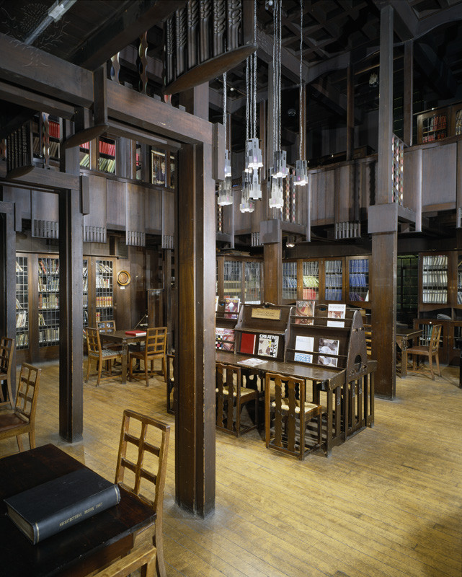
Notes:
On the 23rd of May 2014, the Fire-King struck the Glasgow School of Art and totally destroyed the world-famous Mackintosh Library and its important historical collections.
The devastating fire was widely reported and discussed at the time, and continues to feature prominently as the School moves from a period of rescue and salvage to a period of rebirth and reconstruction
For those of you who never had the opportunity to visit the library in person, or who know of it only fleetingly, I will try to describe its significance
The library was generally accepted as one of the finest Art Nouveau interiors internationally, and any visitor to the space could not help but be moved by its architectural and aesthetic beauty...

Slide 4
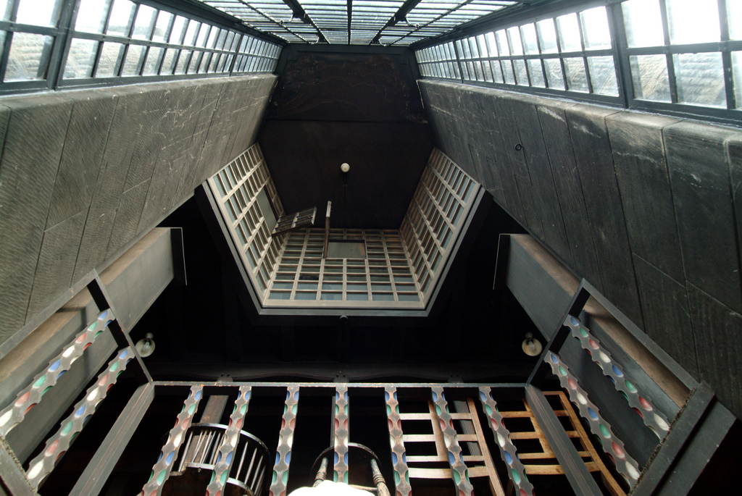
Notes:
...from its hand-painted balusters...

Slide 5
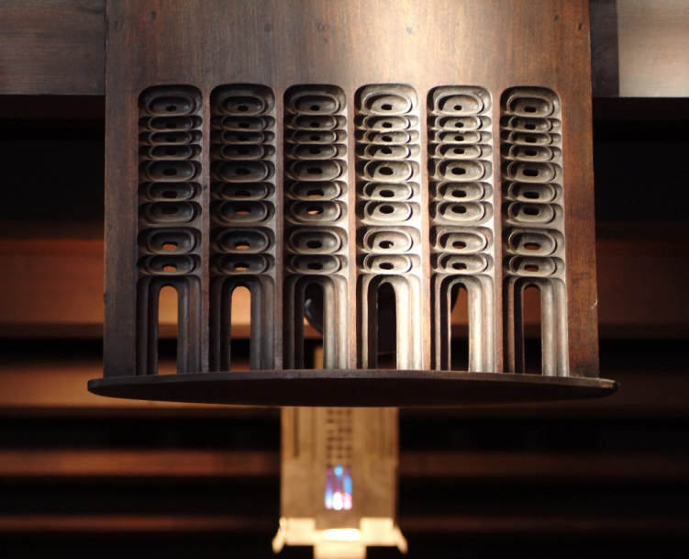
Notes:
...to its pierced wooden pendants...

Slide 6
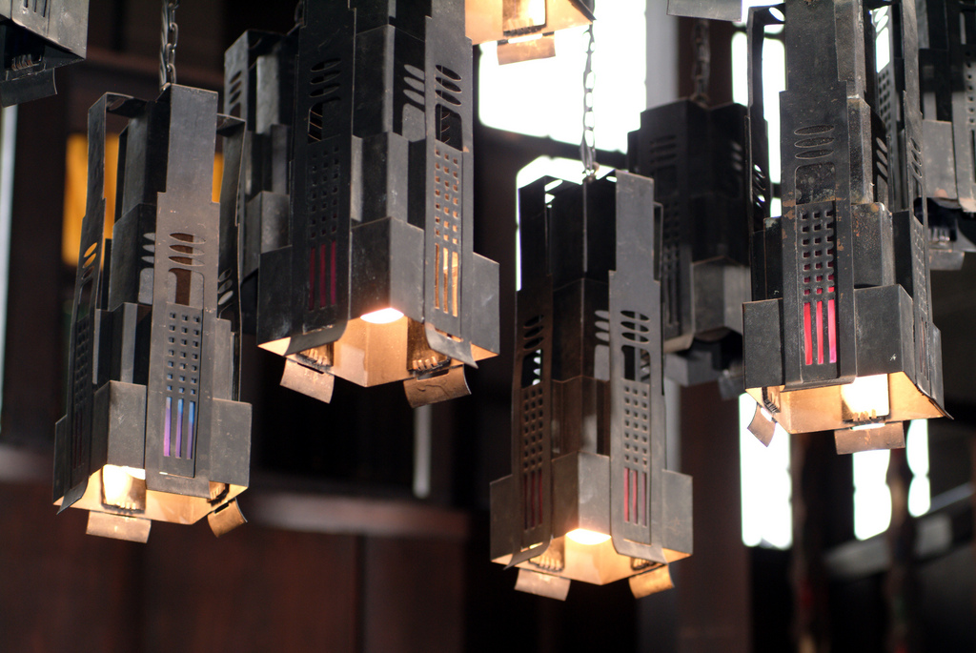
Notes:
...and from its coloured-glass handing lamps...

Slide 7
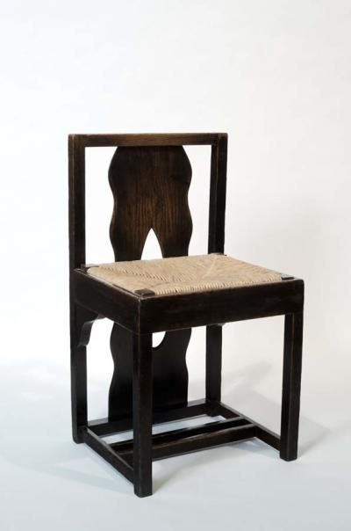
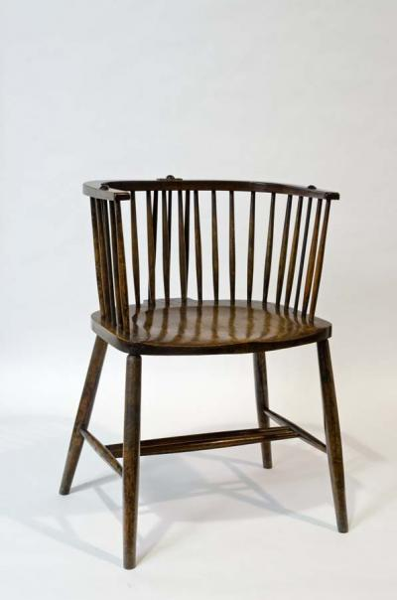
Notes:
...to its original tables and Windsor chairs...

Slide 8
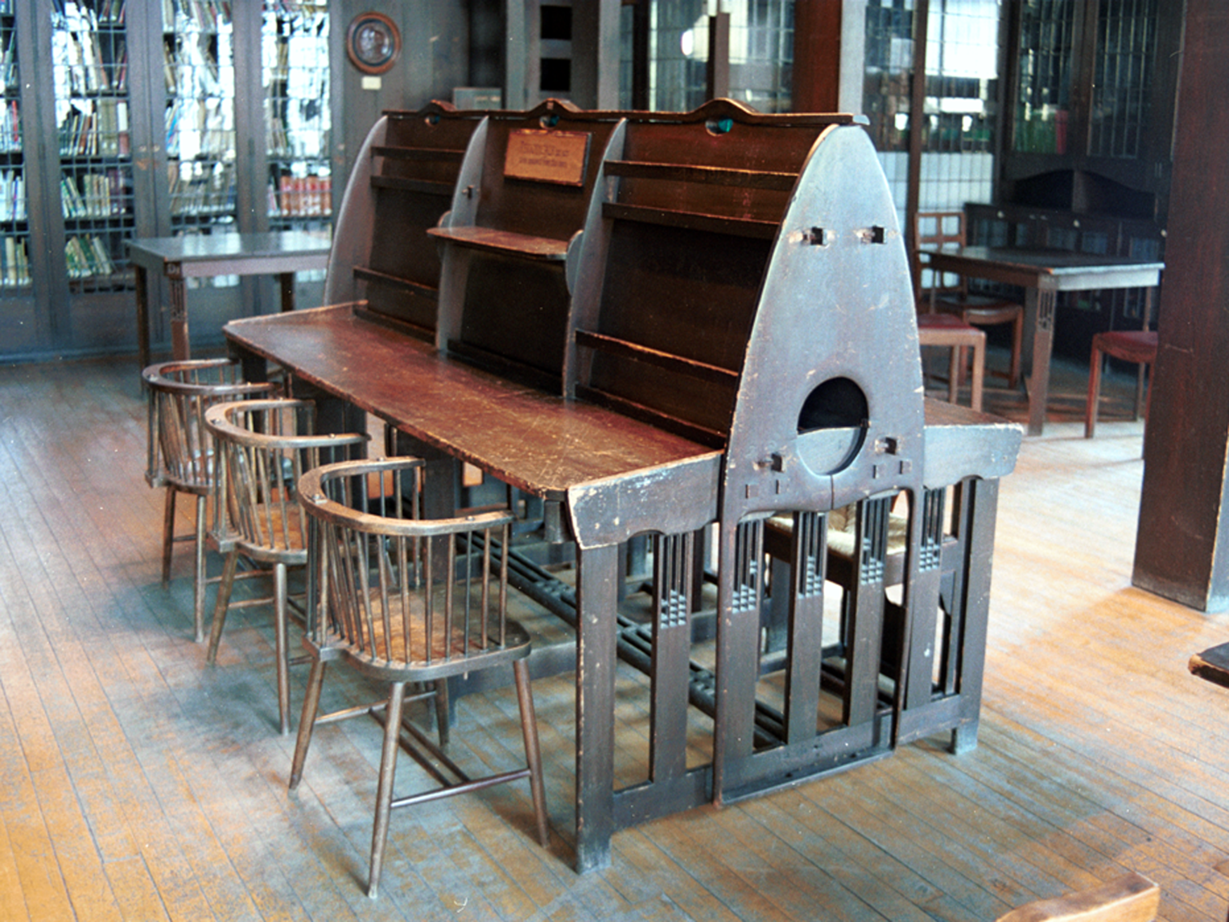
Notes:
...and periodicals desk, which formed such an arresting motif in the centre on the library

Slide 9
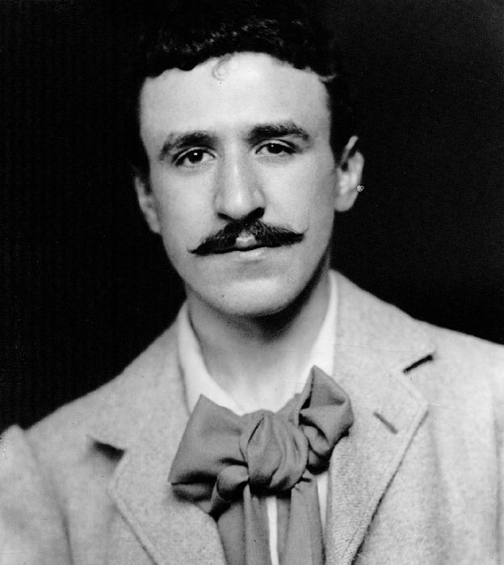
Notes:
The library was designed by architect and former student of the school Charles Rennie Mackintosh between 1907 and 1909, as part of the second phase of the Art School building he had first designed in 1896

Slide 10
Notes:
This postcard view of the library by an unknown photographer dates to soon after completion in 1909, and is taken from the School’s Archives

Slide 11
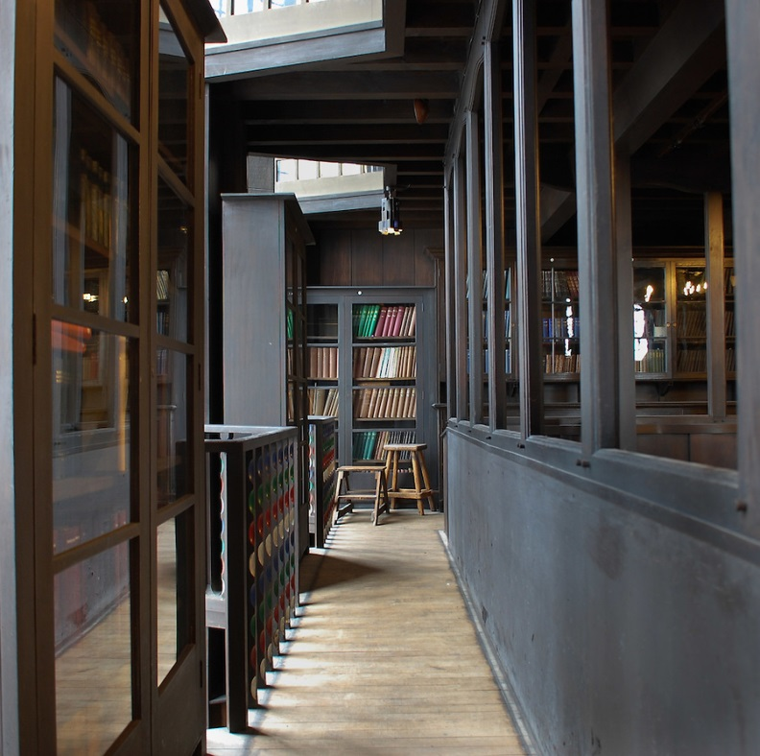
Notes:
Writing on the symbolic allusions of Mackintosh’s design, James Macaulay, in his authoritative 1993 Phaidon account of the building , states “…the library of the Glasgow School of Art is not only an aesthetic experience but the translation of philosophical thought into three dimensions.”
The building as a whole has been described by Sir Christopher Frayling, Rector of the Royal College of Art in London, as “the only art school in the world where the building is worthy of the subject...this is a work of art in which to make works of art”.

Slide 12
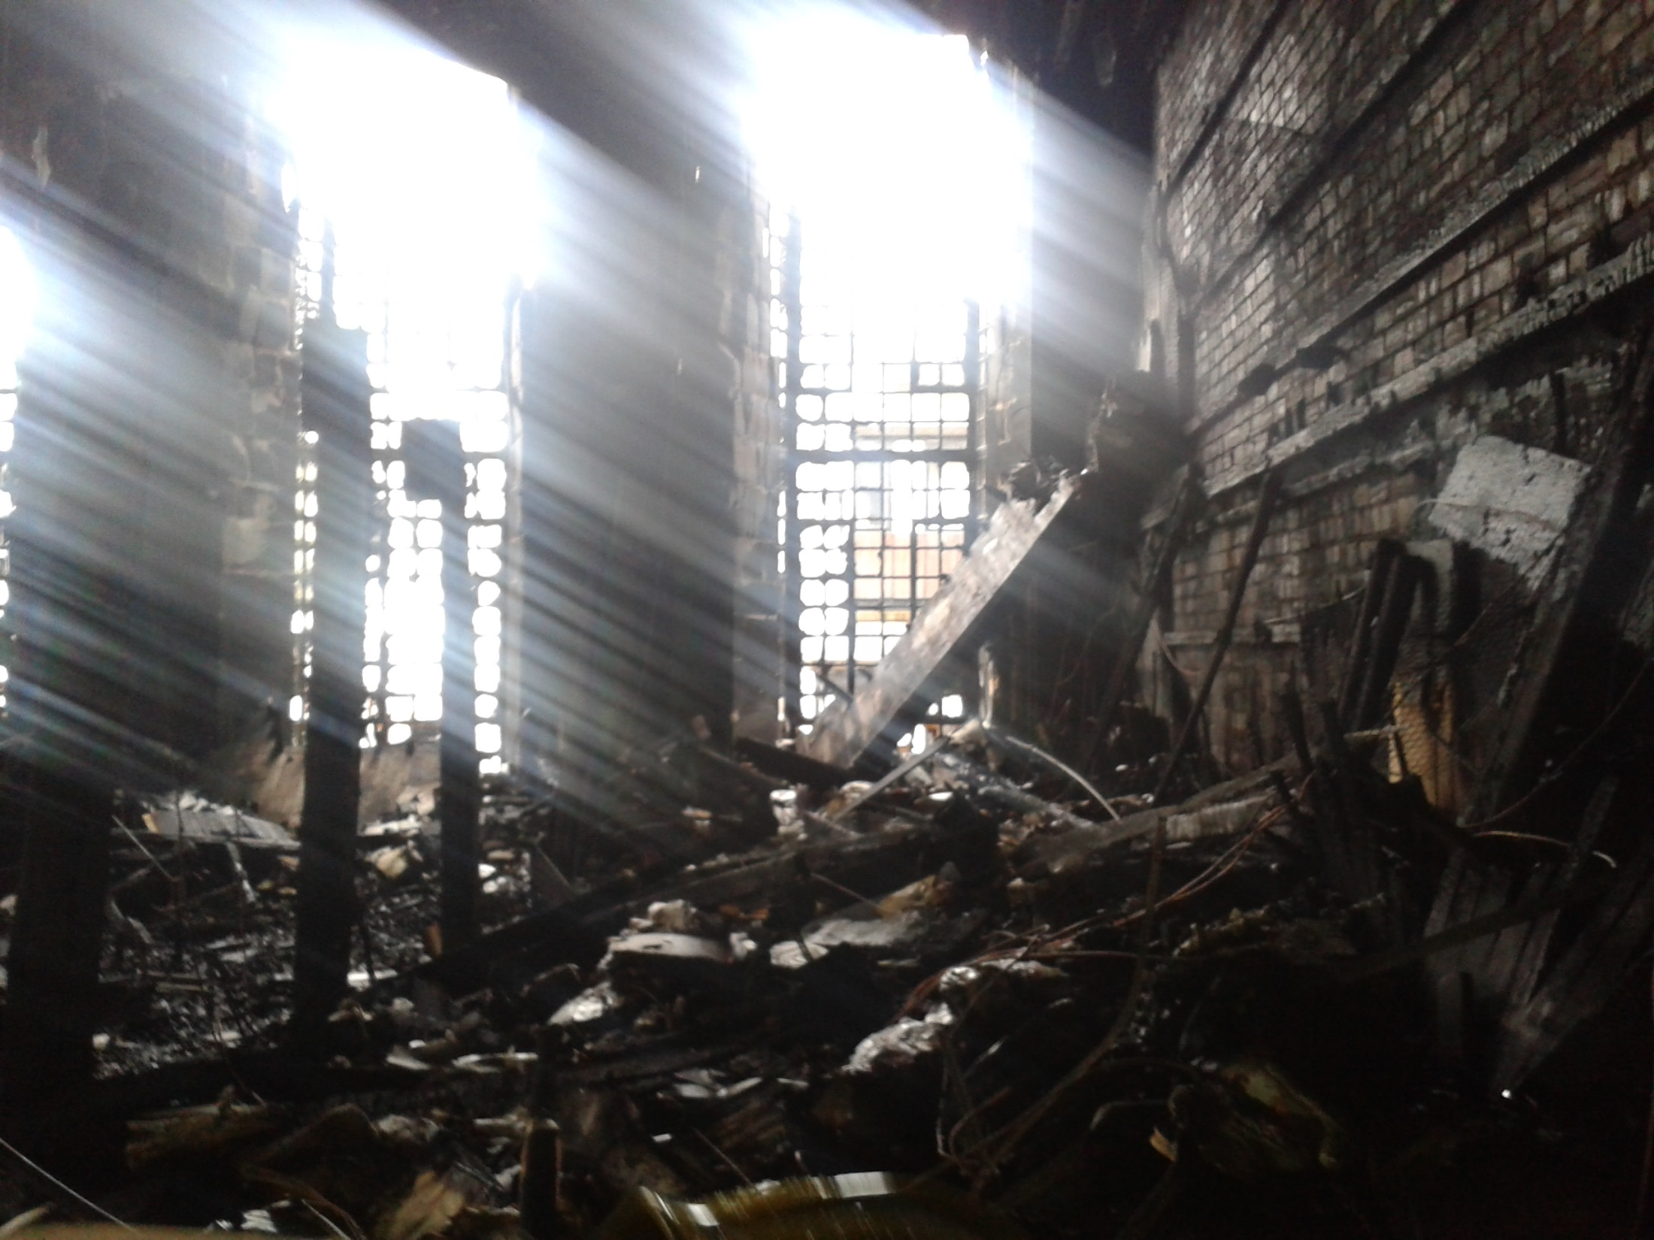
Notes:
Unhappily, On 23 May 2014 all these unique and beautiful spaces were totally destroyed by fire.
These photographs of the destroyed library were taken two days after that fire.
They were taken with a camera phone, so the resolution is very low, but it will give you a good indication of the extent of the devastation.
The remains of the columns leading to the mezzanine level of the library can be seen still standing on the left
To the right, the ferocity of the fire is evidenced by how the wood facing has been completely stripped back to bare brick
But of course everyone gathered here today knows that any historic library is more than just an architectural space.
We also lost many treasured irreplaceable collections in the fire, including books dating to the 16th century, rare avant-garde journals, and 19th century illustrated books by our former staff and alumni

Slide 13
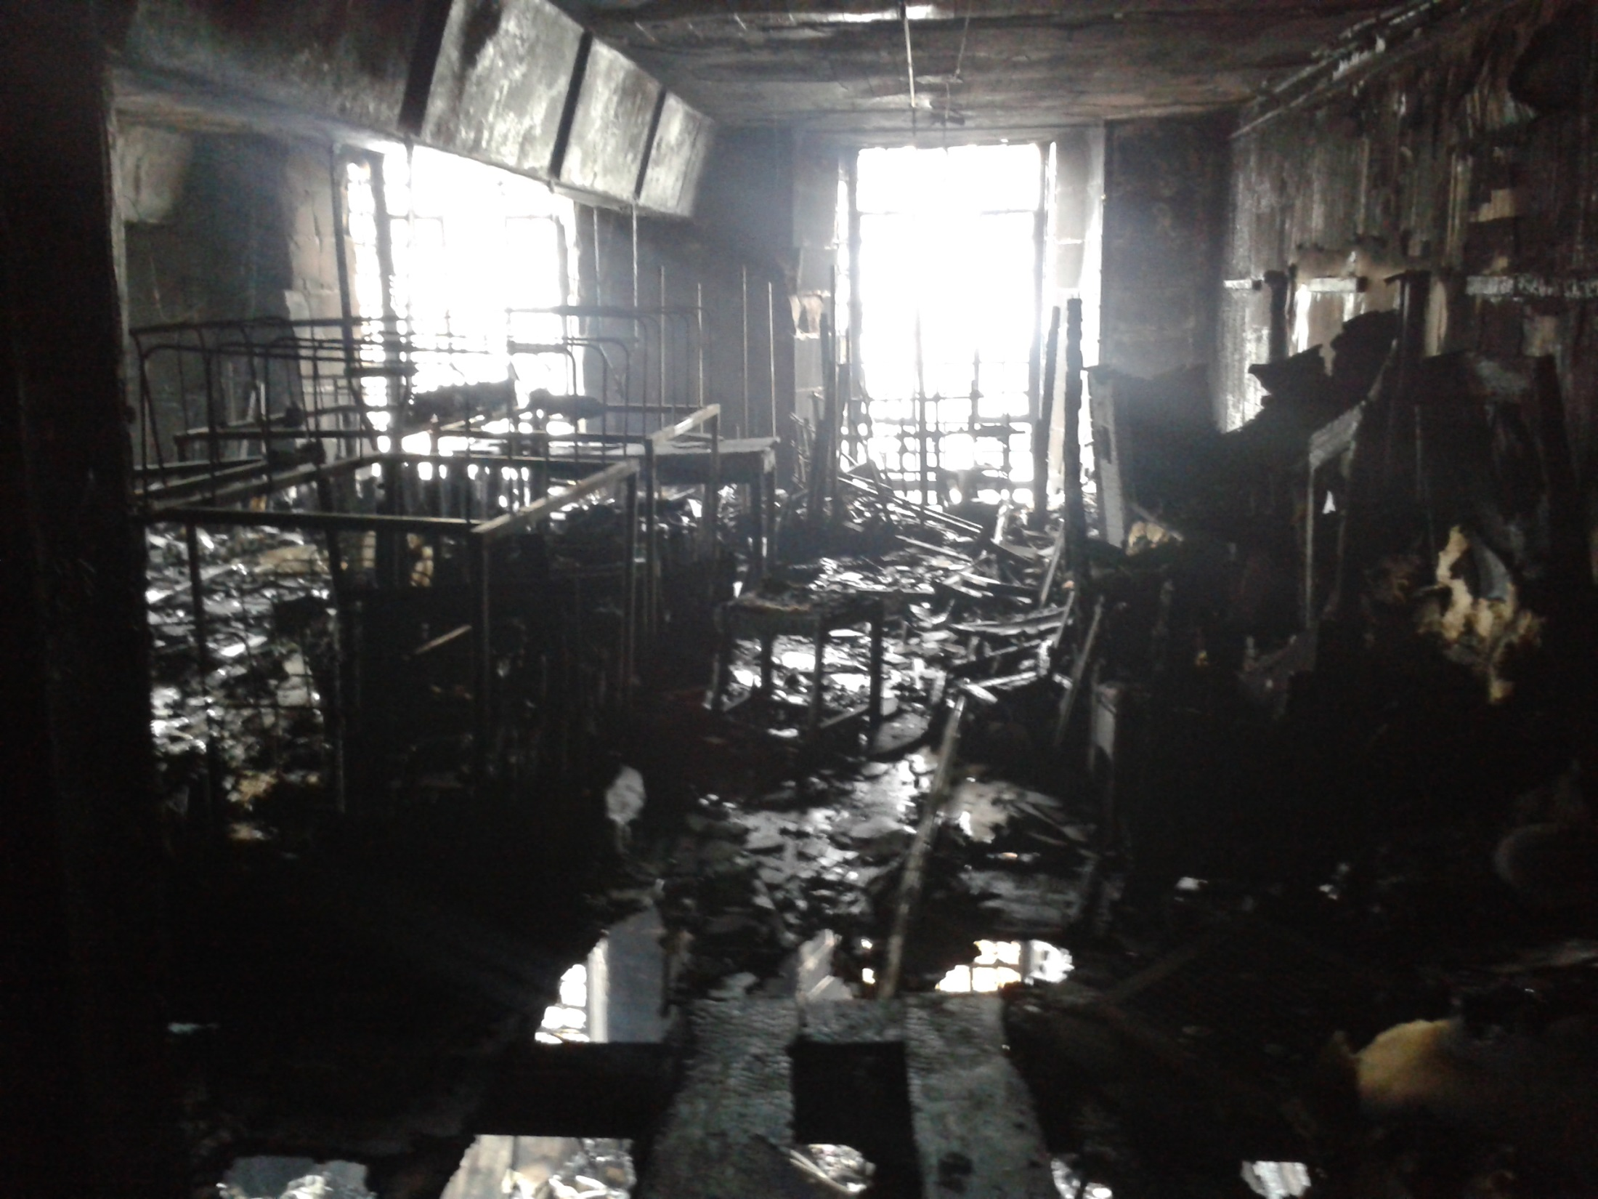
Notes:
This view shows the former library bookstore (latterly the furniture store) looking down through the rafters into the library below
Sadly, much of the School’s art collections were stored in this space, and so were irretrievably lost.
This included the vast majority of our paintings, some decorative arts, and items of Mackintosh furniture not then on display in our public furniture gallery.
Here, you can make out the metal skeletons of the former painting racks

Slide 14
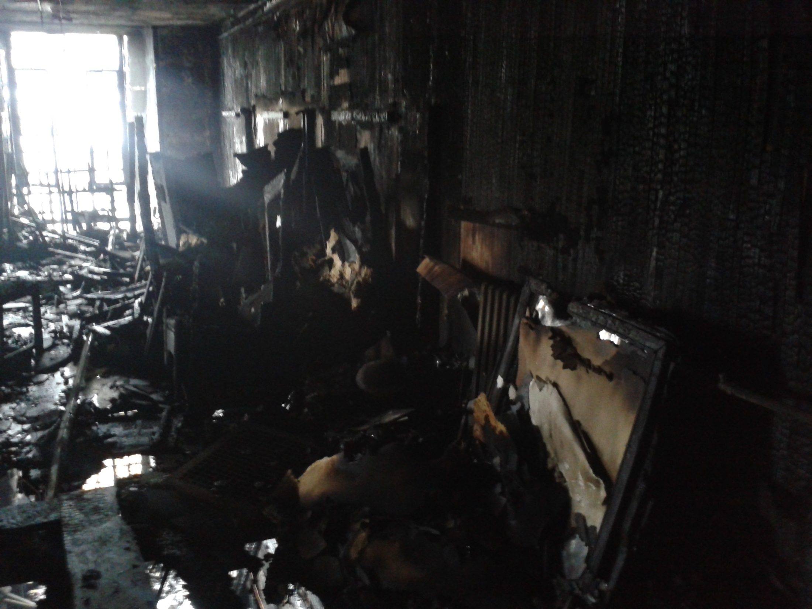
Notes:
And another view of the store with some of the destroyed canvases to the right

Slide 15
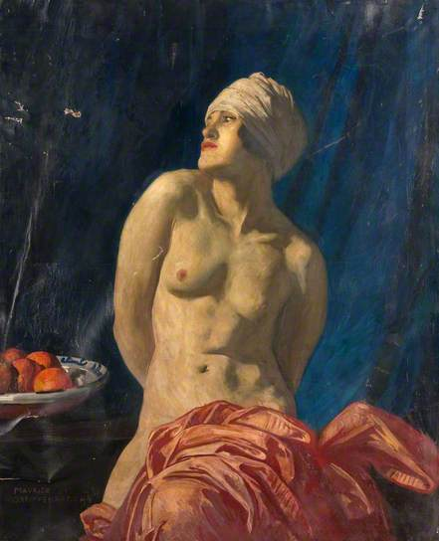
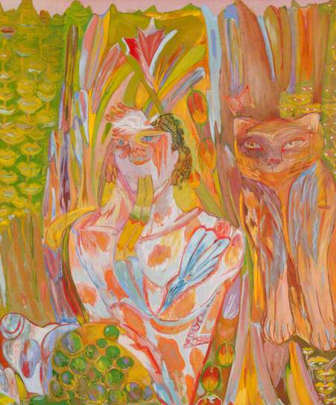
Notes:
In total, the majority of these canvases were totally destroyed: some 92 canvases from a total collection of 122.
Many represented the work of former students and staff of the School
Two of our destroyed paintings: Nude with a wrap by Maurice Greiffenhagen (1924), a former Head of Painting; Pan by Carole Gibbons (1970), a GSA graduate
The lost paintings can still be viewed on our Archives and Collections catalogue, but with their destroyed status noted
They continue to appear on the Art UK website, an online catalogue of the entire art holdings of UK public institutions
The paintings that did survive only did so by virtue of being hung in other buildings at the time
In hindsight, the storing of an entire collection in a single vulnerable location was problematic, but most of you will understand the compromises that become necessary when working in historical legacy buildings, where space is at a premium and is always contested

Slide 16
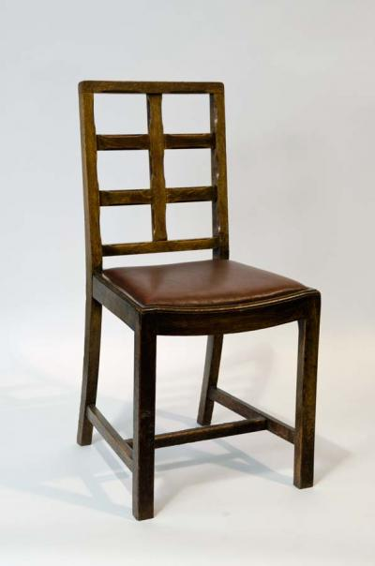
Notes:
In total some 139 pieces of original Mackintosh furniture were also lost
Most of these pieces were duplicates of pieces on display in our public Furniture Gallery, which was largely unaffected by the fire
But a small number of pieces were unique and so forever lost

Slide 17
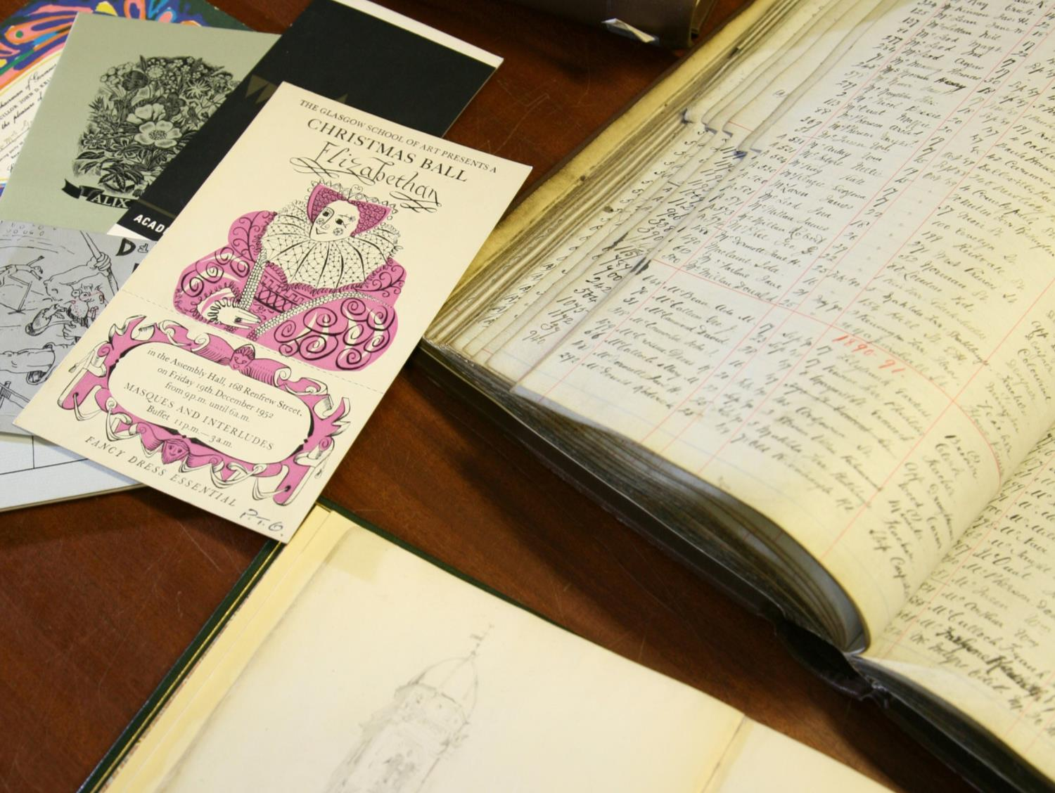
Notes:
The School’s historical archives miraculously escaped the fire, despite the fact they were housed in the basement level where the fire originated
Throughout the building hidden voids has been inserted to carry building services such as heating, ventilation and plant
Many of these voids were actually unknown to us and our Estates people until the fire laid them bare so evidently
Indeed the official report into the fire from the Fire Brigade noted that these voids acted as the principal route for the fire once it had taken hold
This meant that the route of the fire was mainly vertical, rather than lateral
This was to the benefit of our Archives, but to the detriment of the Mackintosh Library

Slide 18
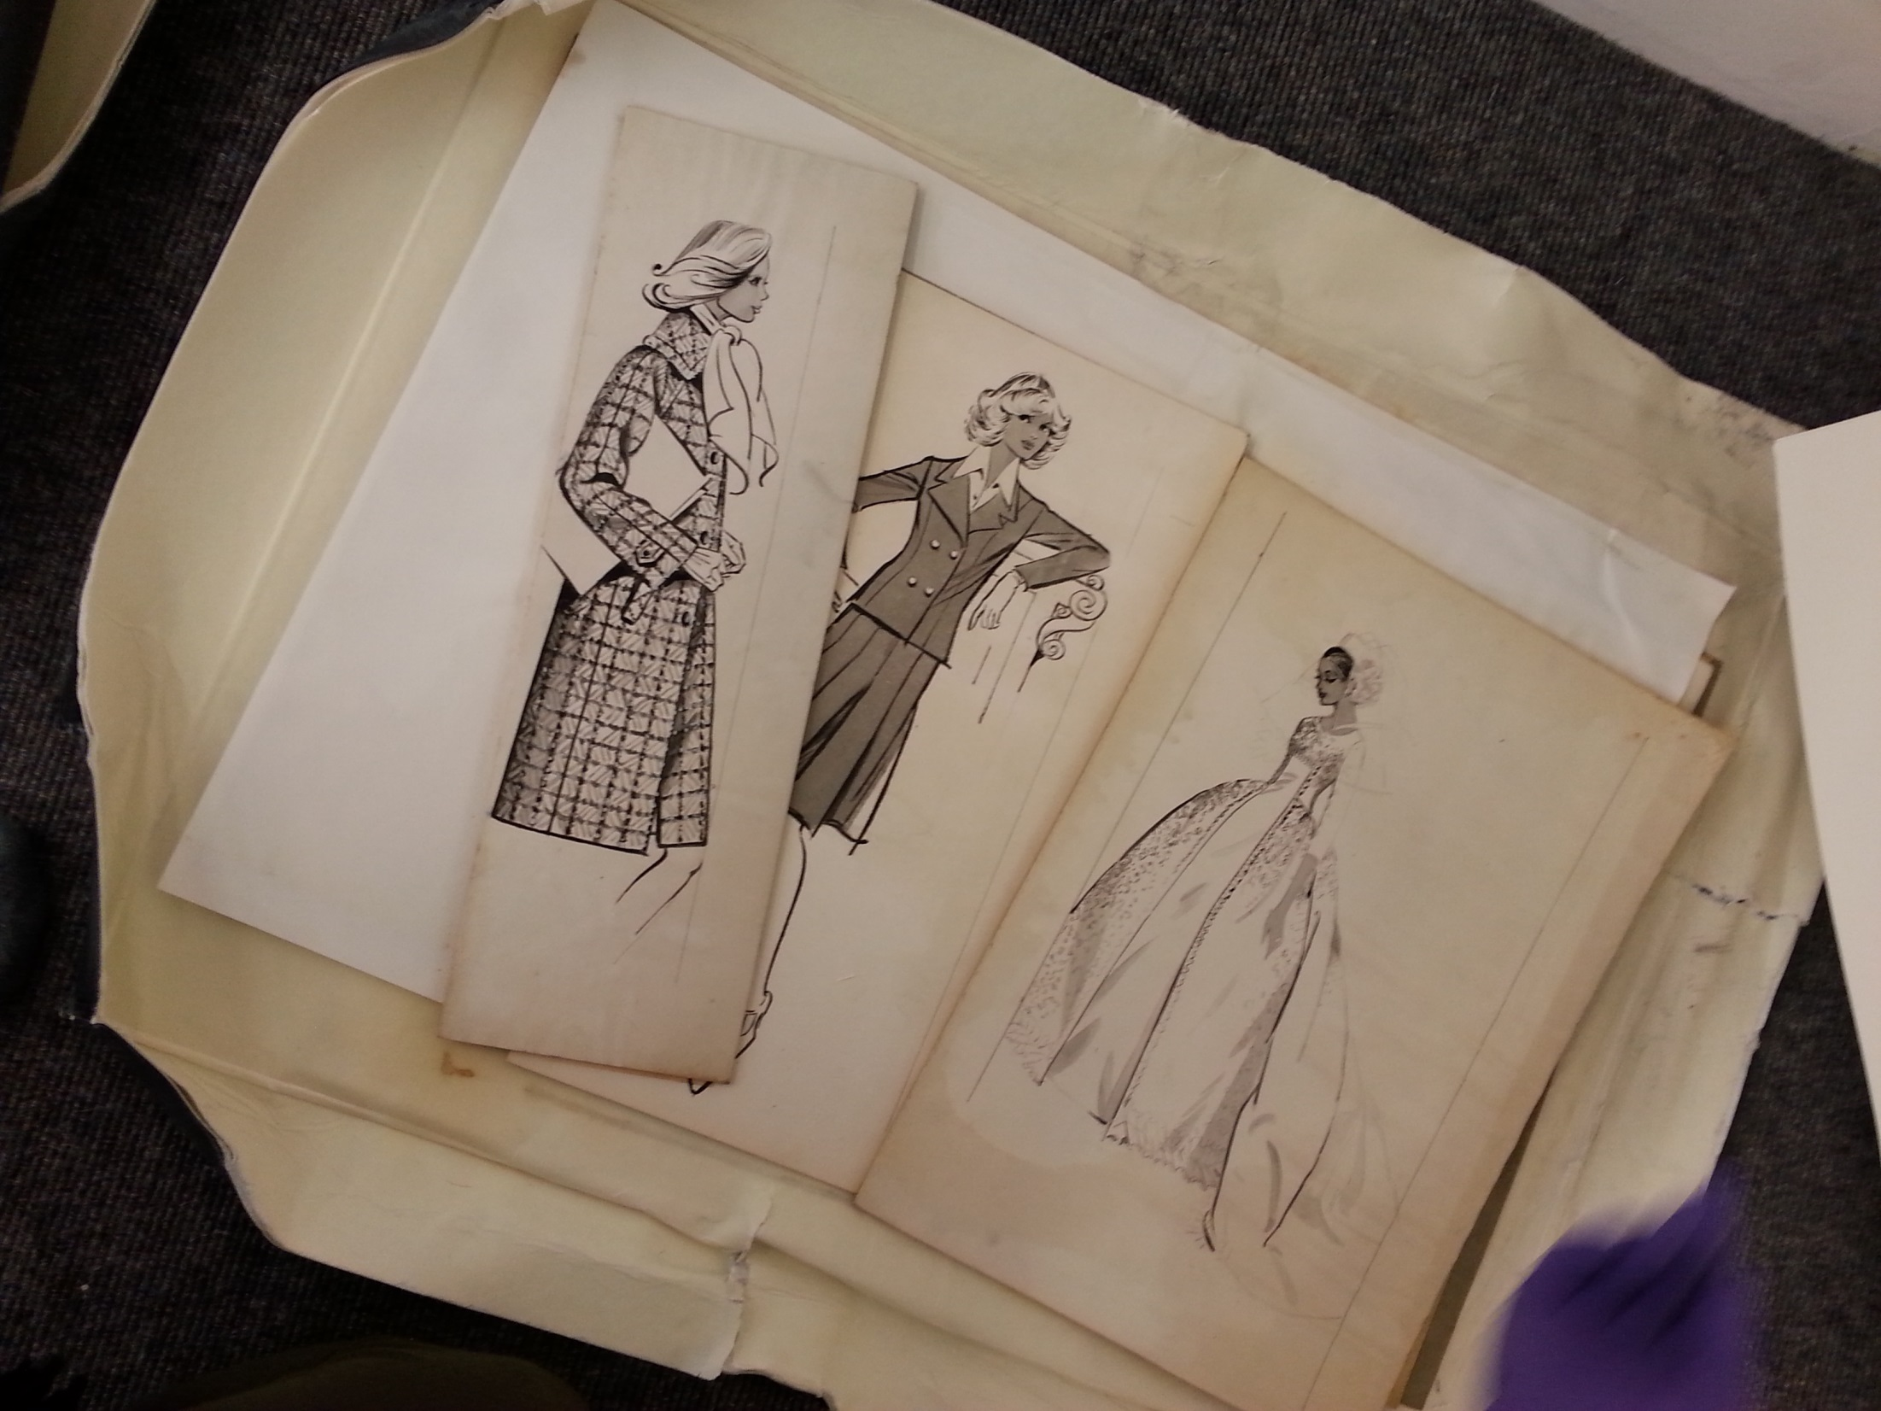
Notes:
Our archives include a wide range of material relating to GSA’s history, activities, buildings, staff and students
Material ranges from paper archives, photographs, sketch books, textiles, architectural designs, and posters
The sheer variety of artefact and media obviously complicated subsequent salvage and conservation efforts
We were faced with multiple media and artefact types, which means that conservators from across specialisms needed to be engaged
Our archives, although safe, did suffer significant water and smoke damage during the subsequent fire-fighting
It was surprising however, the extent to which our bespoke conservation boxes minimised the water damage suffered by these collections
Many of you will recognise these inexpensive cardboard boxes from your own collections

Slide 19
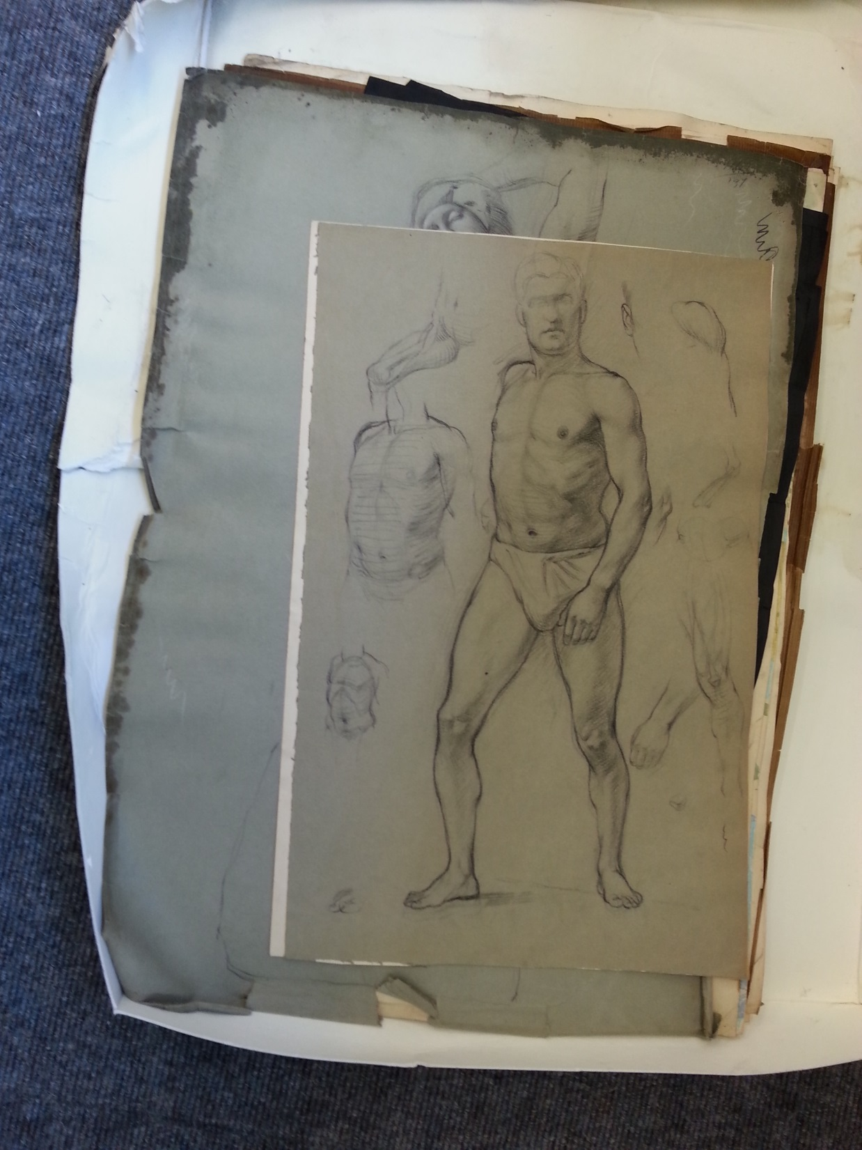
Notes:
With the total loss of the library all too apparent, our main priority quickly became the salvage of these damaged archives
Our departmental disaster plan provided us with an important overarching framework to guide our activities
It outlined for us how to respond initially to the disaster, how to salvage different types of material, how to prioritise between artefacts, and, perhaps most importantly, how to designate the different team roles that are necessary for successful salvage
It is probably fair to say that documents such as these are perhaps of limited use on the ground where events tend to take on a dynamic of their own
But formulating the plans in the first place probably did help to crystalise decision-making processes in our heads
Of particular use were the building and floorplans, which helped us to explain to authorities and volunteers alike where particular collections were housed

Slide 20
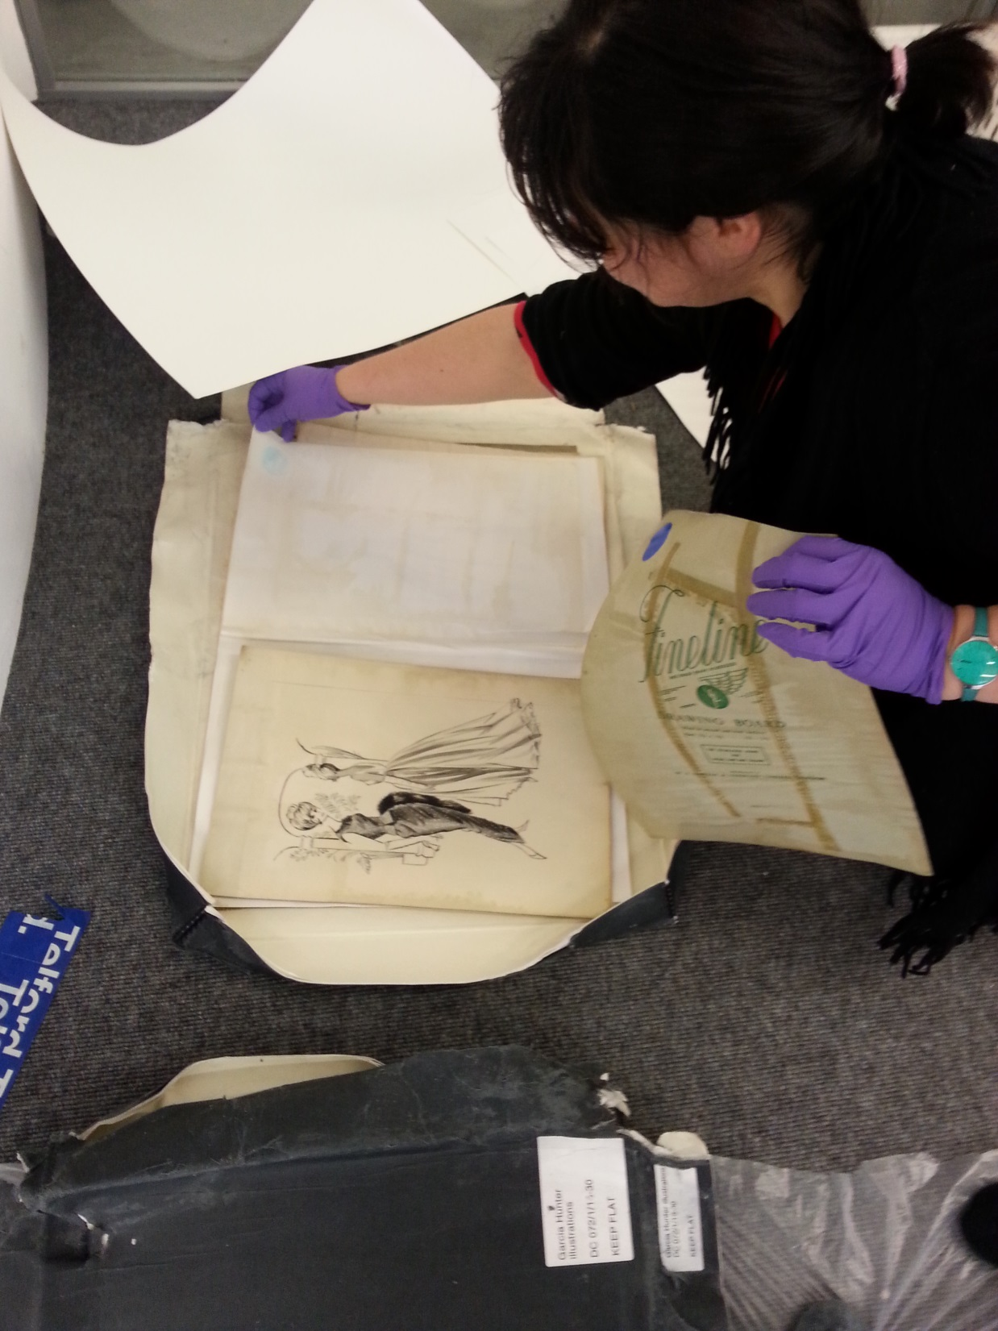
Notes:
We were aided in our salvage efforts by many volunteers – including some academics – who willingly volunteered their time to help us
We were very humbled by the good will shown to us during this time, and by the generosity of all those who gave their time and support
It became apparent incredibly quickly how important it is to maintain a good roster of volunteers who are able to help at these times
And the importance of the close relationships we had built up with our teaching colleagues over a number of years became obvious
The GSA is a very small, close-knit organisation of around 2000 students and staff, so we were able to draw upon the many close relationships, indeed friendships, we had cultivated over the years

Slide 21
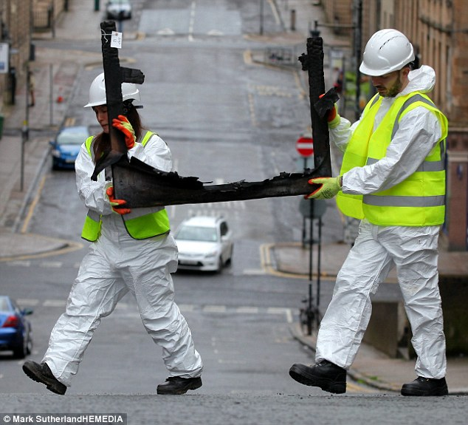
Notes:
For at least 3 days, it was all hands to the pump as we formed human chains to remove the damaged artefacts.
On the advice of conservators and the many other institutions who offered us their guidance, we salvaged almost anything that looked as if it could potentially be of interest
No retention or discard decisions were made at this point
In fact, we probably salvaged items that ultimately were of no use or value, but at this stage we were, to an extent, working blind
It is important to remember that at this point the building had no electricity, and many of the basement stores we were salvaging from had no sources or natural light or ventilation
The Mackintosh Building is an A-listed structure, so almost immediately after the fire, our colleagues from Historic Environment Scotland were on site
They remained keen to salvage even small details, such as nails or wires, that might later fill in blanks over the construction of the space

Slide 22
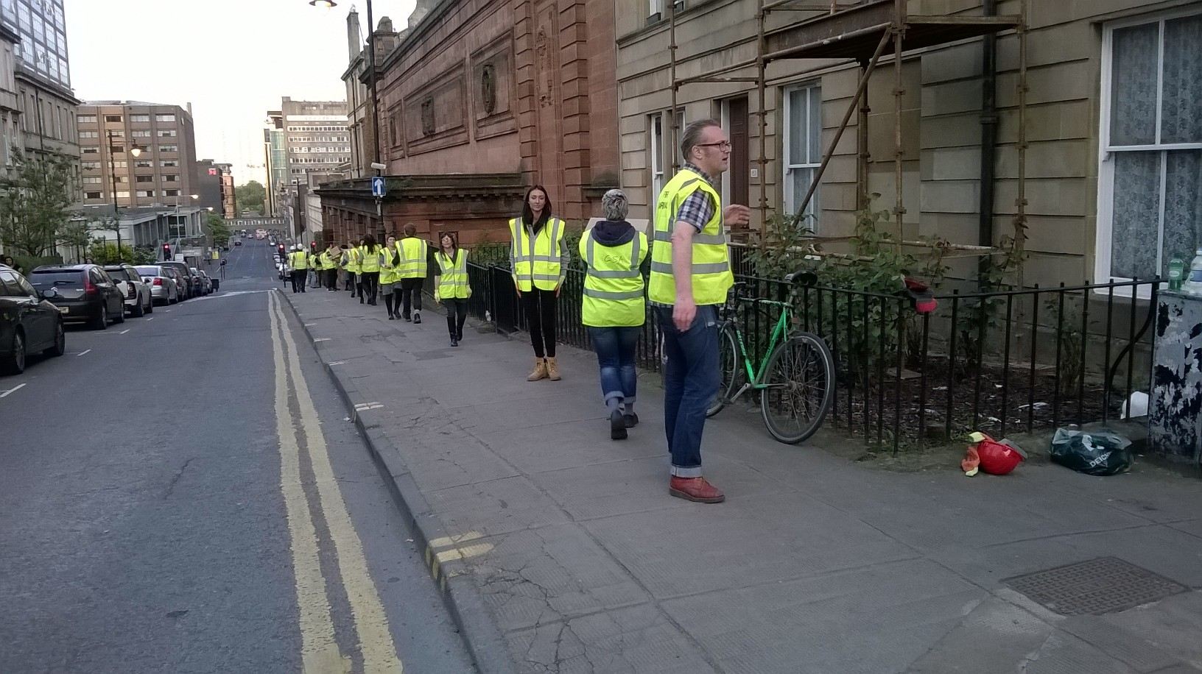

Slide 23
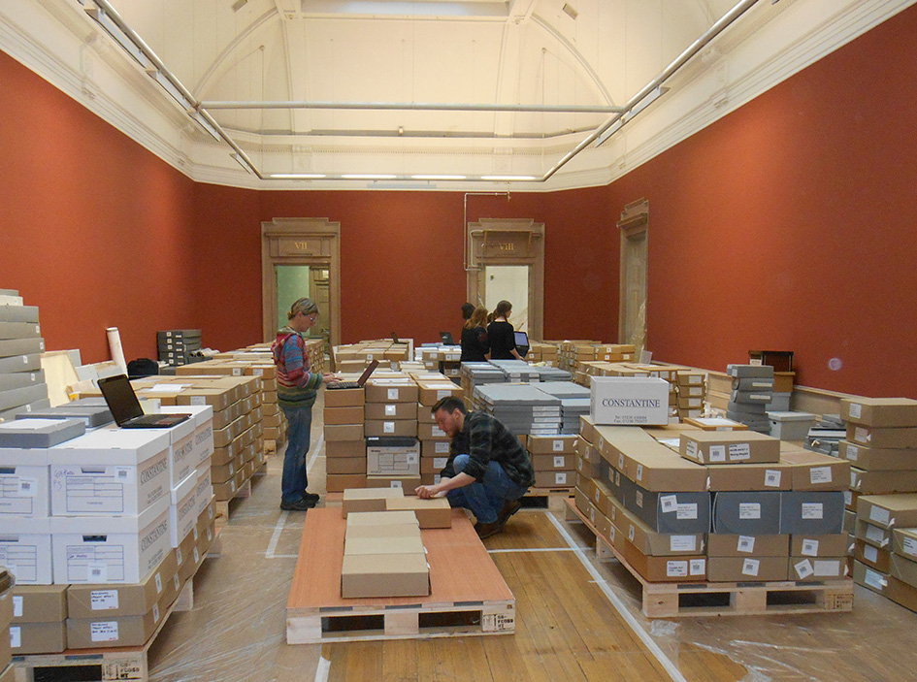
Notes:
Luckily we were able to lease the nearby vacant McLellan Galleries very quickly from Glasgow City Council, in order to store the salvaged remains
The galleries are a suite of Victorian exhibition rooms that, at the time, were closed to the public and not in use
This is a view of the interior of the Galleries, with some of our institutional records from the basement of the Mackintosh building

Slide 24
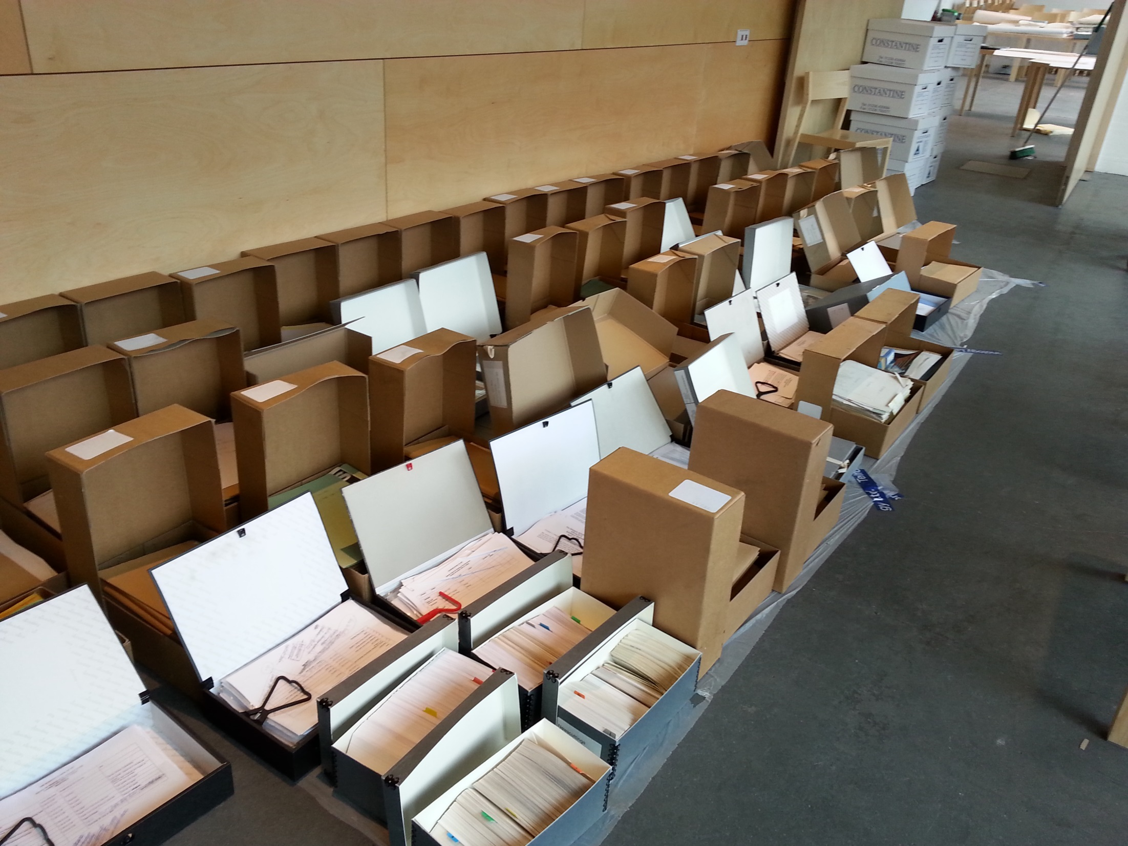
Notes:
The Executive had made the decision very quickly to close all School buildings for a week to enable staff to concentrate on the salvage process
We were lucky to have sizable areas on-site in which to sort and rest our damaged archives.
Phase 1 of our campus redevelopment had just been completed with the opening of our new Reid Building, located directly across the road from the Mackintosh Building.
This meant that we had large areas of floorspace, and a number of seminar rooms, that we could use
The fire occurred in May, towards the end of our academic year.
Had it occurred earlier in the year during core teaching weeks, we may not have been able to requisition so much space so quickly

Slide 25
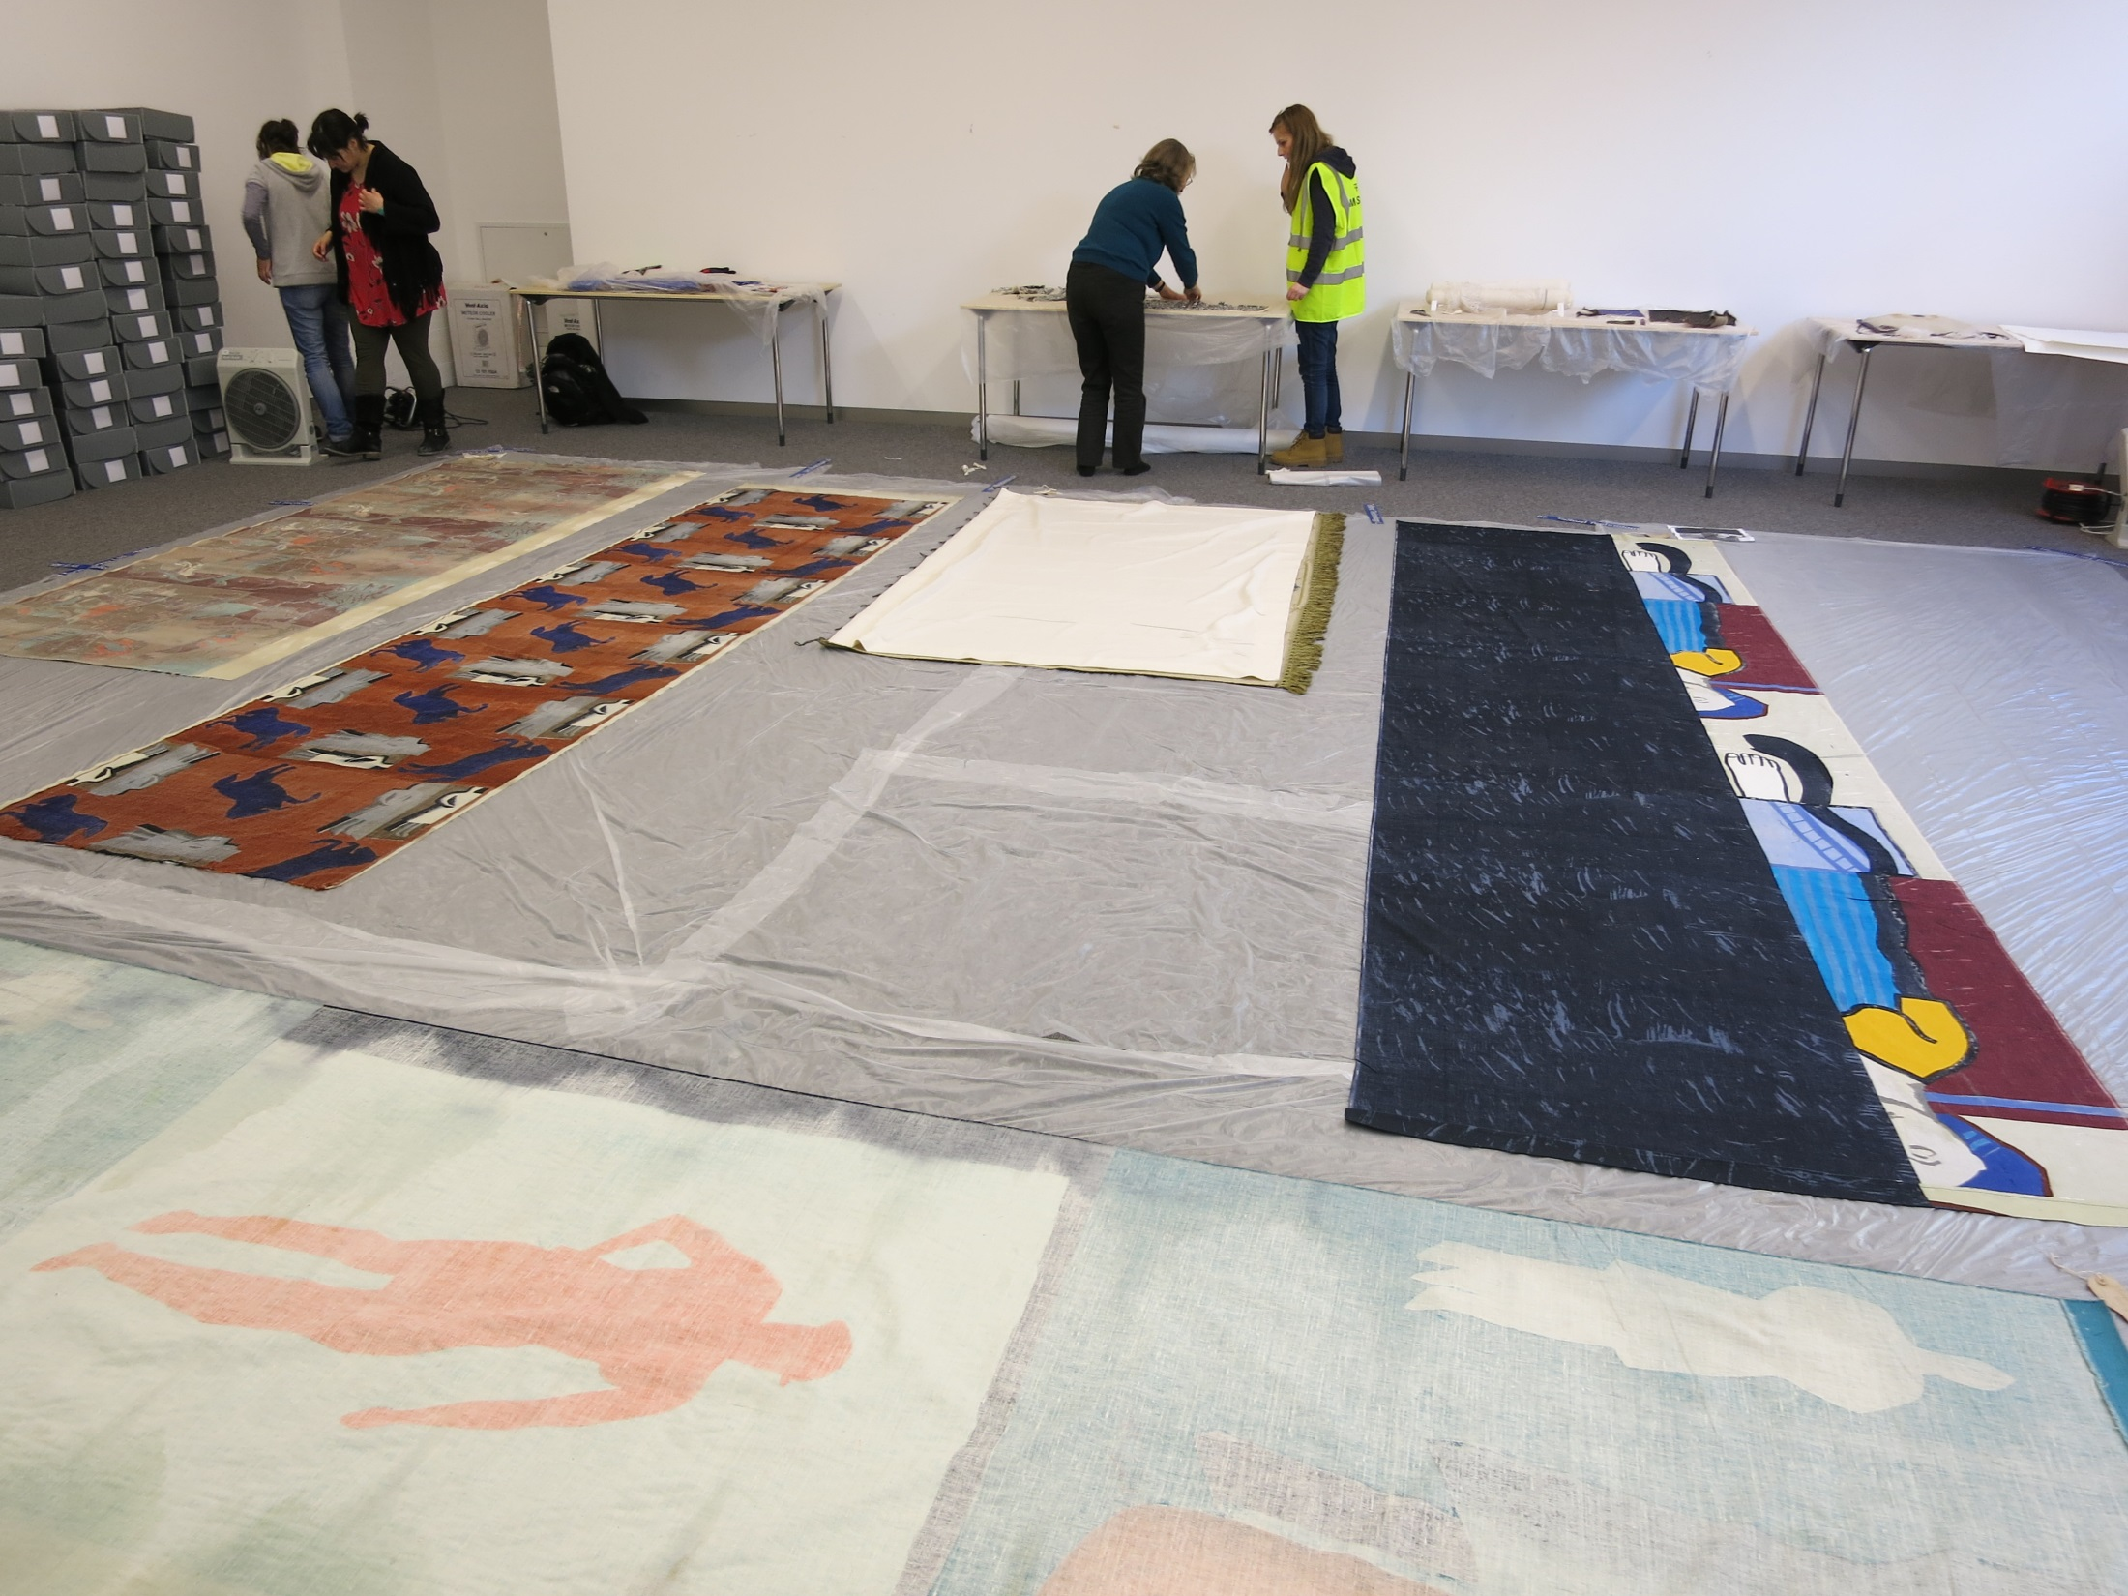
Notes:
We were aided in our salvage efforts by the Glasgow Area Disaster Planning Network
This group was initiated in 2004 and holds regular meetings, organises training events, and offers help to its members should a disaster occur.
Each member organisation is asked to sign an operational agreement and to submit their disaster plans
We were able to draw upon the expertise and skills of many experts across Scotland because of our membership.
This proved particularly important for a small organisation like ours, which does not normally retain conservators on its payroll
Scotland, like Ireland, is a small country with a concentrated population and we all draw heavily upon our formal and informal networks
Of most benefit to us were the organisational and logistical roles that could be assumed by others, such as phoning external companies, responding to enquiries, and planning rotas

Slide 26
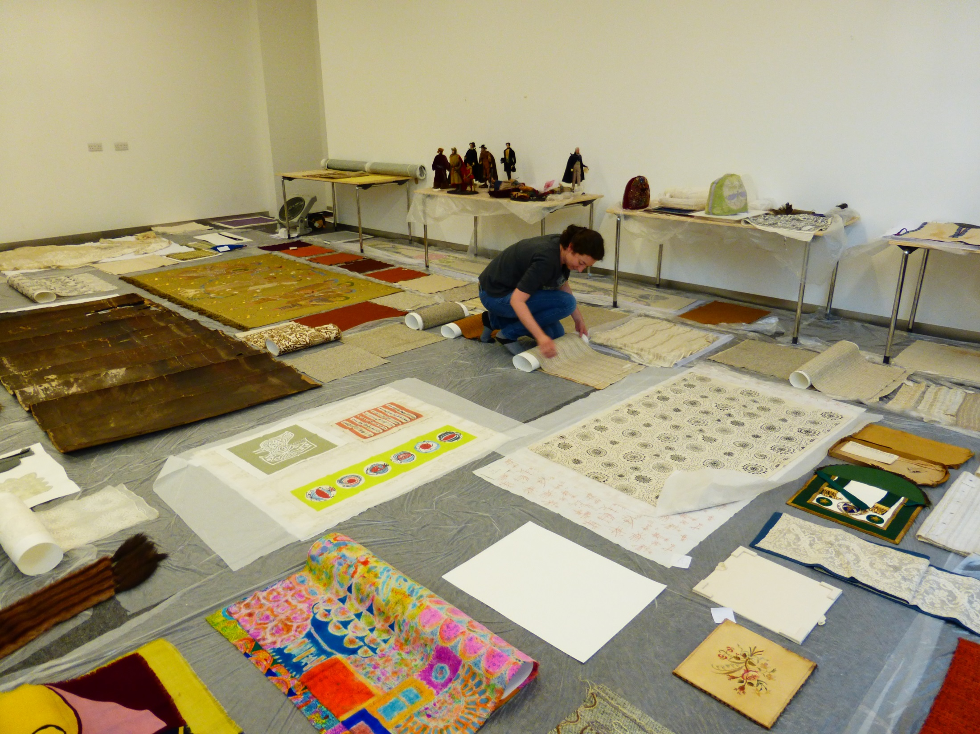
Notes:
The initial salvage priority quickly became the paper and textile archives, as evidently these were most vulnerable to long-term water damage
Here you can see some textiles from our archives being laid out to dry
Once materials were salvaged, sorted, dried as far as possible, and recorded they were packed for transportation to temporary storage with Constantine’s just outside Glasgow
The items that required freezing were sent to Harwell’s in Oxfordshire
We were added in this process by specialist textile conservator from GU and, for paper records, by the NRS
Happily today all our textiles are fully dry and back on site, and are awaiting repackaging

Slide 27
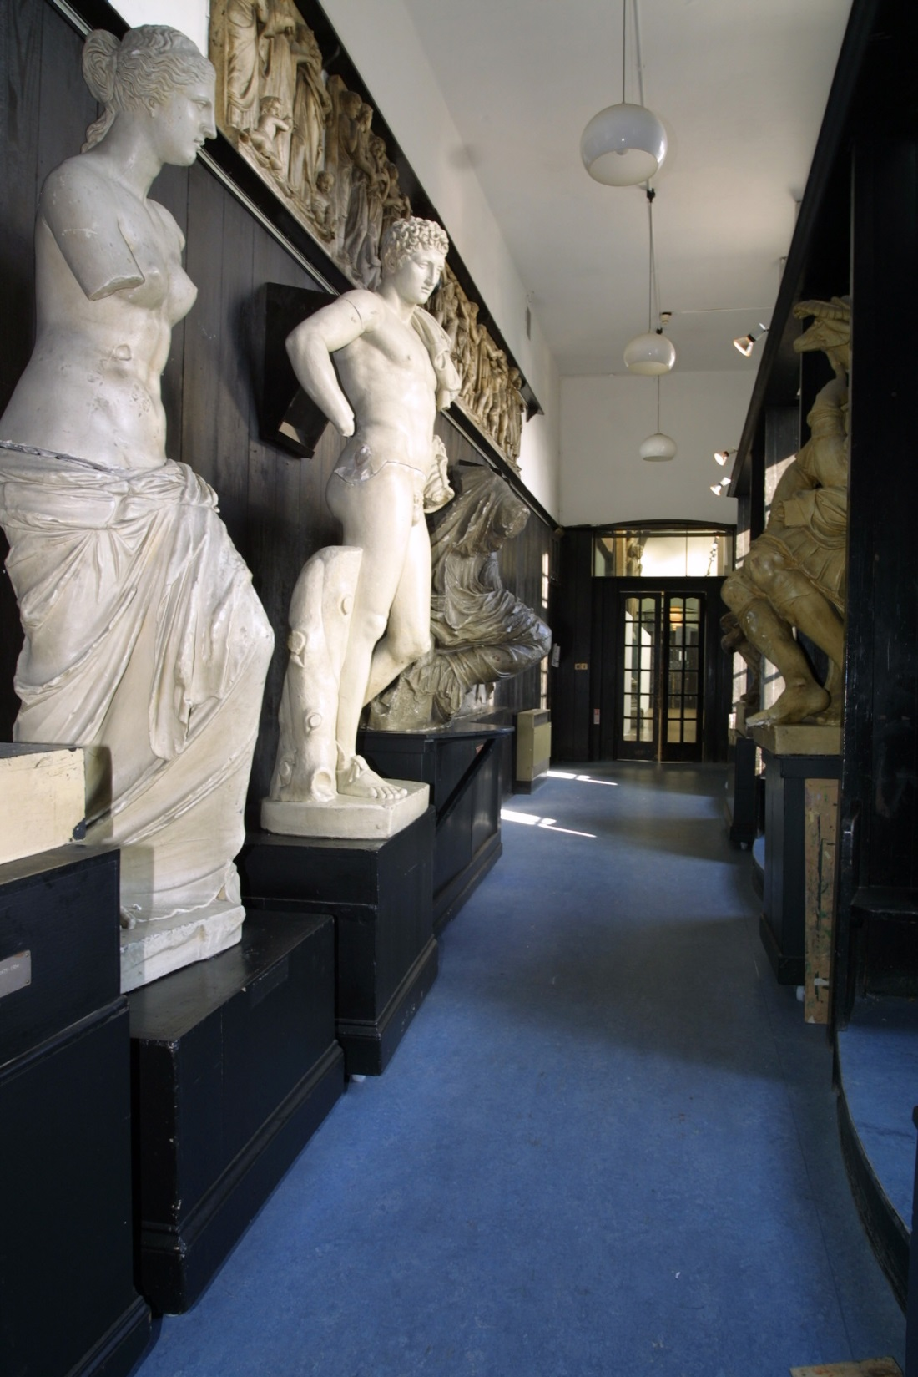
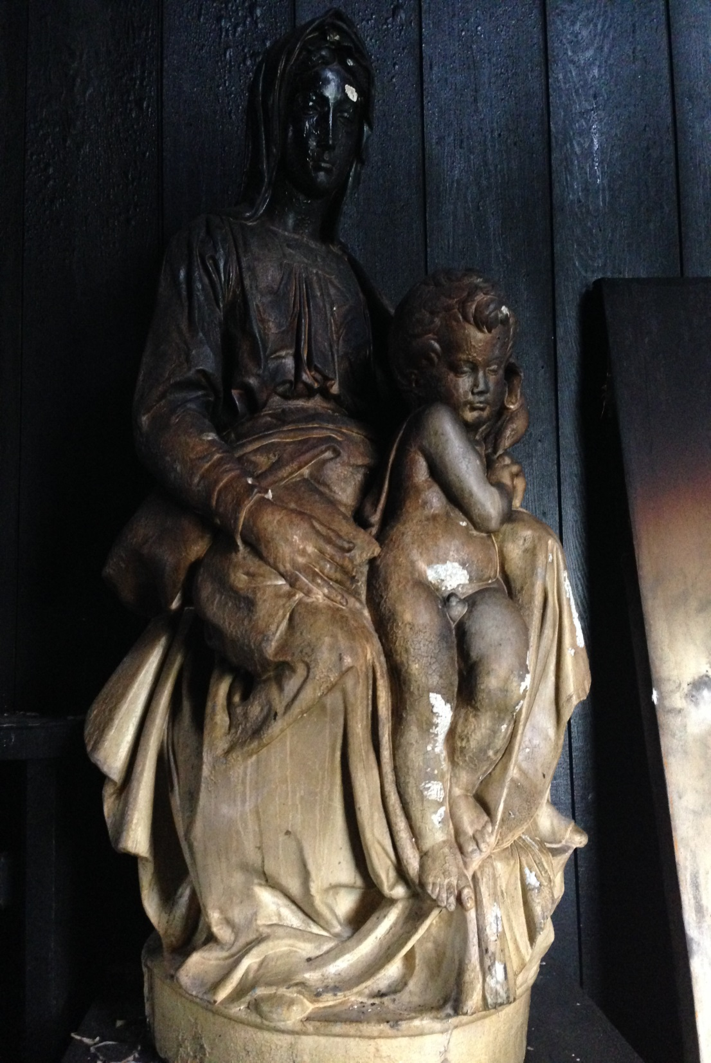
Notes:
The School also possesses a sizable collection of plaster casts of classical and medieval sculptures, purchased in the 19th century for students to draw from
These are much like the casts you will see in the Cast Courts of the Victoria & Albert Museum in London and were a common pedagogical tool in art schools of the time
Many were cracked and blackened by the fire
Some of the smaller casts were removed from the building by Belfor and Kerr, and are now housed off-site at their premises
But the larger casts were too big to move out of the building, and are currently still boxed in situ whilst the building undergoes restoration
Advice from the V&A was that to move them might cause more damage than they suffered in the fire
Only 1 plaster cast was lost entirely, and this had been housed in the Mackintosh library

Slide 28
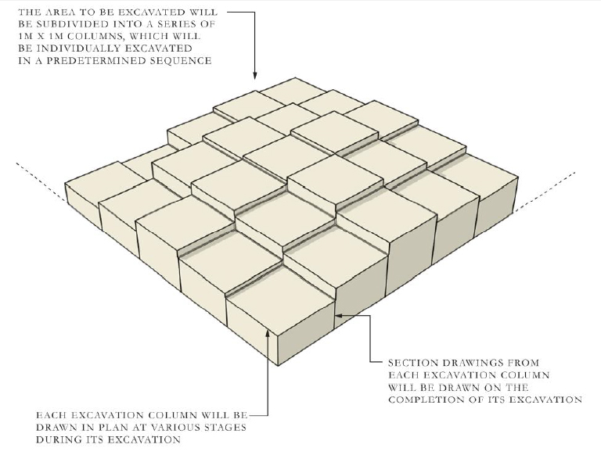
Notes:
A major milestone came with the excavation of the library interior
Due to the art historical importance of the library, Historic Environment Scotland required a full archaeological investigation, and the School employed the services of Kirkdale Archaeology
They undertook a painstaking and systematic excavation based on 1m2 grids, excavating down in columns at 25cm increments
Each stratum was photographed and recorded
Any salvaged artefacts were recorded following established methodologies, before removal for treatment or conservation

Slide 29
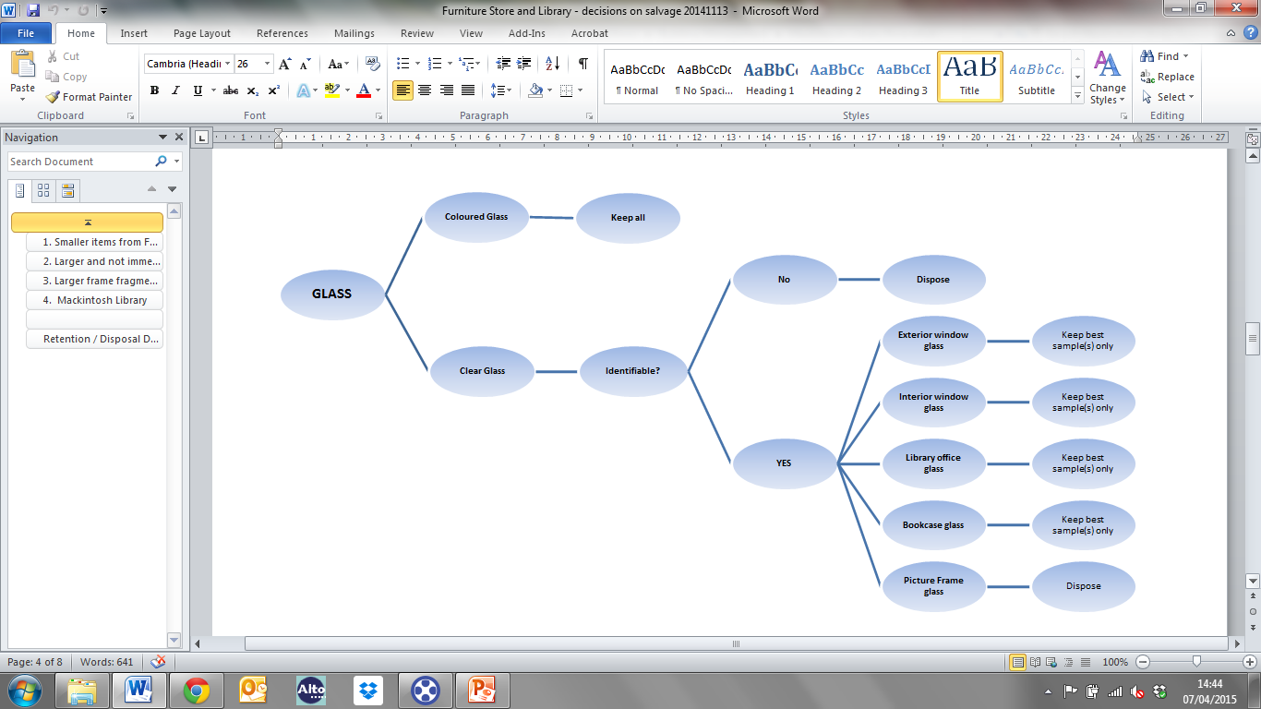
Notes:
We formulated decision trees to help us decide which salvaged materials we should keep, and which we could dispose of.
Separate trees were developed for each media: paper and books, metalwork, glass, etc
These trees were reviewed and approved by colleagues Museums and Galleries Scotland
Having these guidelines meant that our decisions were consistent across individuals, but also totally transparent and accountable

Slide 30
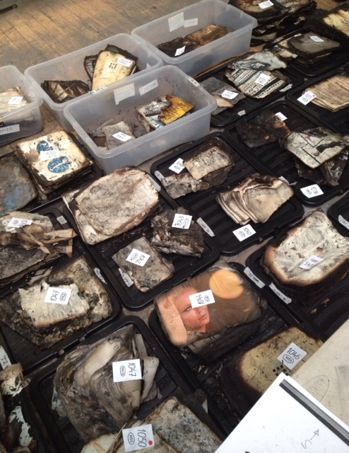
Notes:
Here you can see just a small percentage of the 10,000 books that were hitherto housed in the library, awaiting disposal/retention assessment

Slide 31
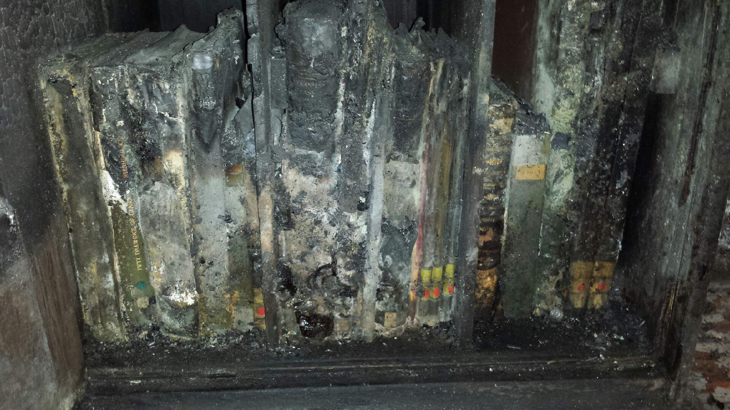
Notes:
Perhaps surprisingly some books survived better than others, depending on where they were situated, the amount of oxygen available to the fire, whether they were tightly or loosely packed on the shelves, and whether debris fell on top of them from above
81 rare books, from a pre-fire collection of 10,000, were salvaged and subsequently sent for deep freeze with Harwell’s
Although the books themselves were sometimes difficult to identify immediately, our barcodes (which we use as distinguishing marks) were nearly always complete, which enabled us very quickly to put a title to each volume
In subsequent months we undertook a cost/benefit analysis for each volume, taking into account replacement costs on the open market, to decide which books to conserve and which to source anew

Slide 32
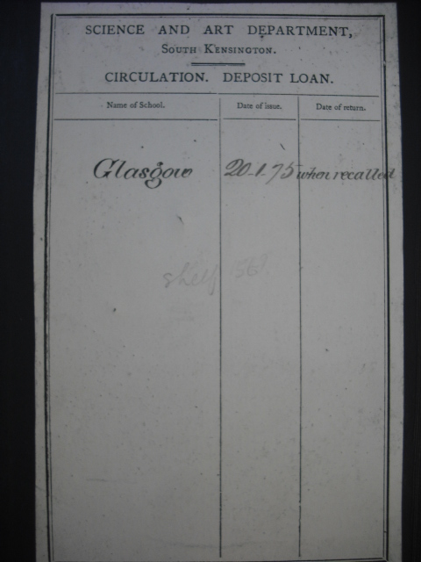
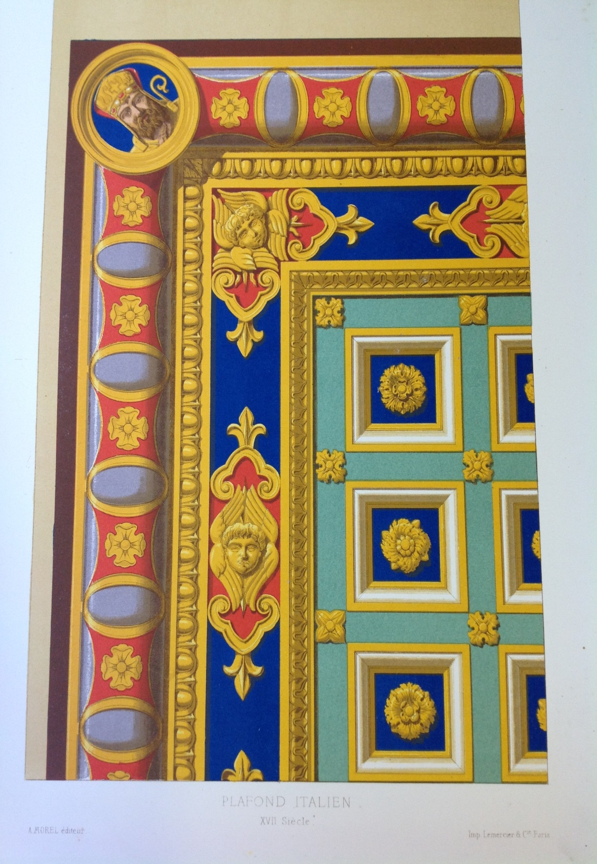
Notes:
It is undeniable however that we lost a significant proportion of the School's Foundation Collections, which came to us from the then South Kensington Museum under the South Kensington system of arts education…
This obviously constitutes a great loss to the School’s institutional history

Slide 33
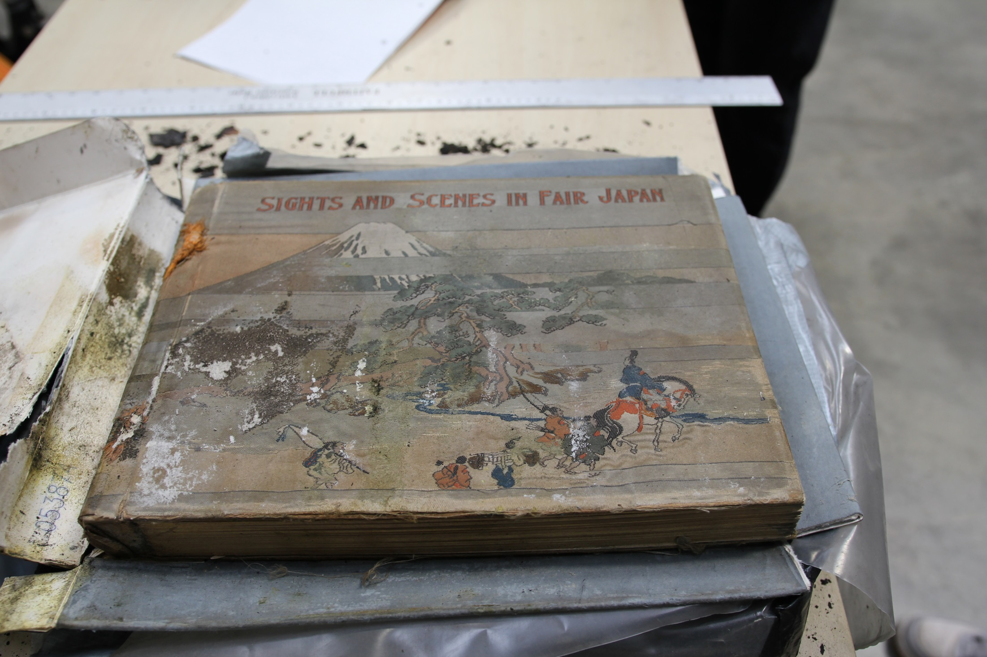
Notes:
We did however have some miraculous survivors, such as this 19th century photographic volume of topographical views of Japan, complete in its original silk covers.
Our conservation approach has been to stabilise but retain evidence of the fire and its damage, viewing this as an important part of a volume’s history
This reflects the teaching and research methodologies of the School, in which emphasis is placed upon object analysis and materiality
Indeed, one of our PhD candidates has now chosen to base her thesis on the phenomenological qualities of these salvaged volumes and how they can act as a crucible for new artistic responses

Slide 34



Notes:
One of the areas our disaster plans failed to touch upon adequately was social media
In the immediate aftermath of the fire, we were particularly struck by the importance and pressures of these communication channels
It is telling perhaps, that most disaster planning documents fail to mention the extent to which your staff may be inundated with offers of support, guidance from others, or questions from the public via Twitter, Facebook and the other social media your institution may employ
In our experience, it is really important to think now about who you would designate to this role, particularly if your institution is high-profile
This person will need an understanding of the subtle etiquettes of social media and press relations, as you will need to be able to trust them to fly solo
The relationships you are able to cultivate over social media at this point will pay huge dividends for you later on

Slide 35
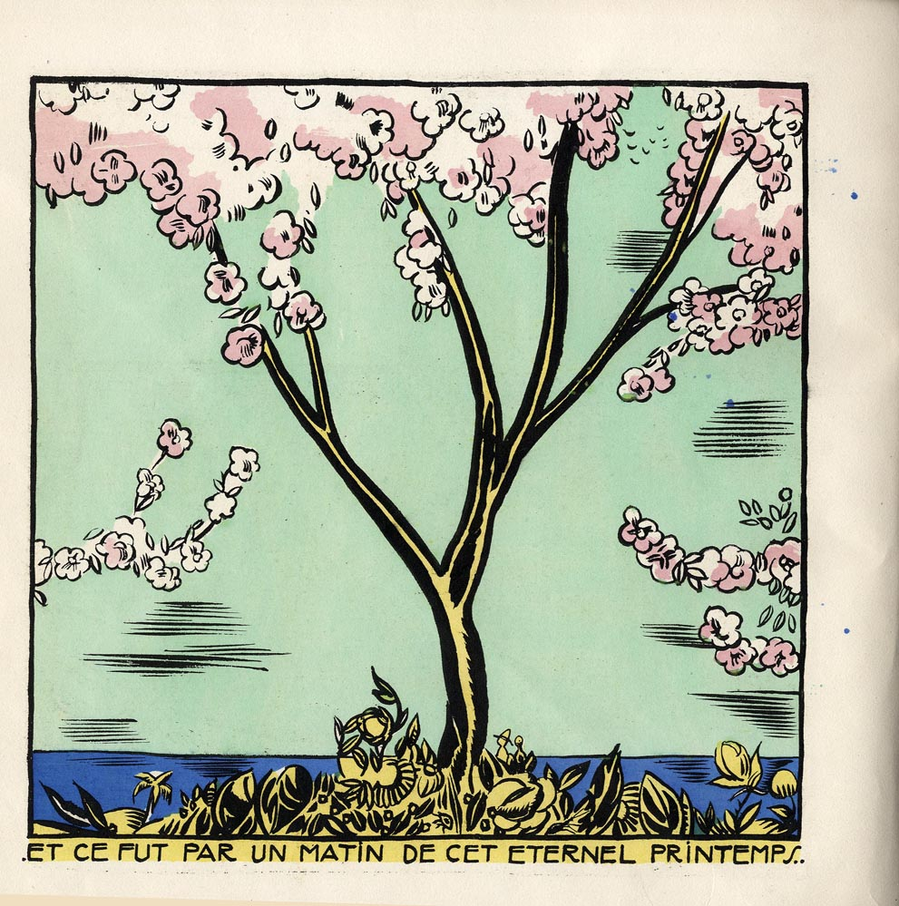
Notes:
We received significant offers of donations to our library and, keen to capitalise on this good will, we recognised that it provided an opportunity for us to begin to rebuild our lost collections very quickly
We were also aware however that we had lost a significant proportion of our storage space, and that any rebuild needed to be highly focused
We therefore decided to pursue a targeted rebuild, tightly aligned to both the illustrious history and future direction of the Glasgow School of Art.
You will find that you receive many offers of books, even whole libraries, that you just cannot accept, and will need to employ tact and diplomacy in rejecting these offers
It is imperative to understand where your strategic objectives lie, both as an institution and a department
This strategising can in fact be done now, so that you are prepared if a disaster were to strike.
Once we were clear in only seeking very specific titles that hold particular relevance to our history, our alumni, and our learning, teaching and research activities...
We published a wants list of about 700 titles on our website, and publicised this list widely to academic mailing lists, library communities, and other institutions
We could then refer potential donors to this list and solicit only those donations that were key to us
To date, this approach has proved very successful, and we were able to replace 22% of our priority volumes in the first 3 months after the fire
Key to our ability to do this was that our library catalogue was complete – we had excellent computer-readable records for every single item we held
Our task would have been infinitely more difficult had we not possessed the ability to interrogate our catalogue so completely and had we not had such in-depth knowledge of our collection as a totality
Within just a few days of the fire we had a complete list of every single item that was lost from the library
One of the lessons we have taken from our experience, is that in fact this list of priority replacements could have been prepared in advance of a disaster occurring, as part of our general preparedness

Slide 36
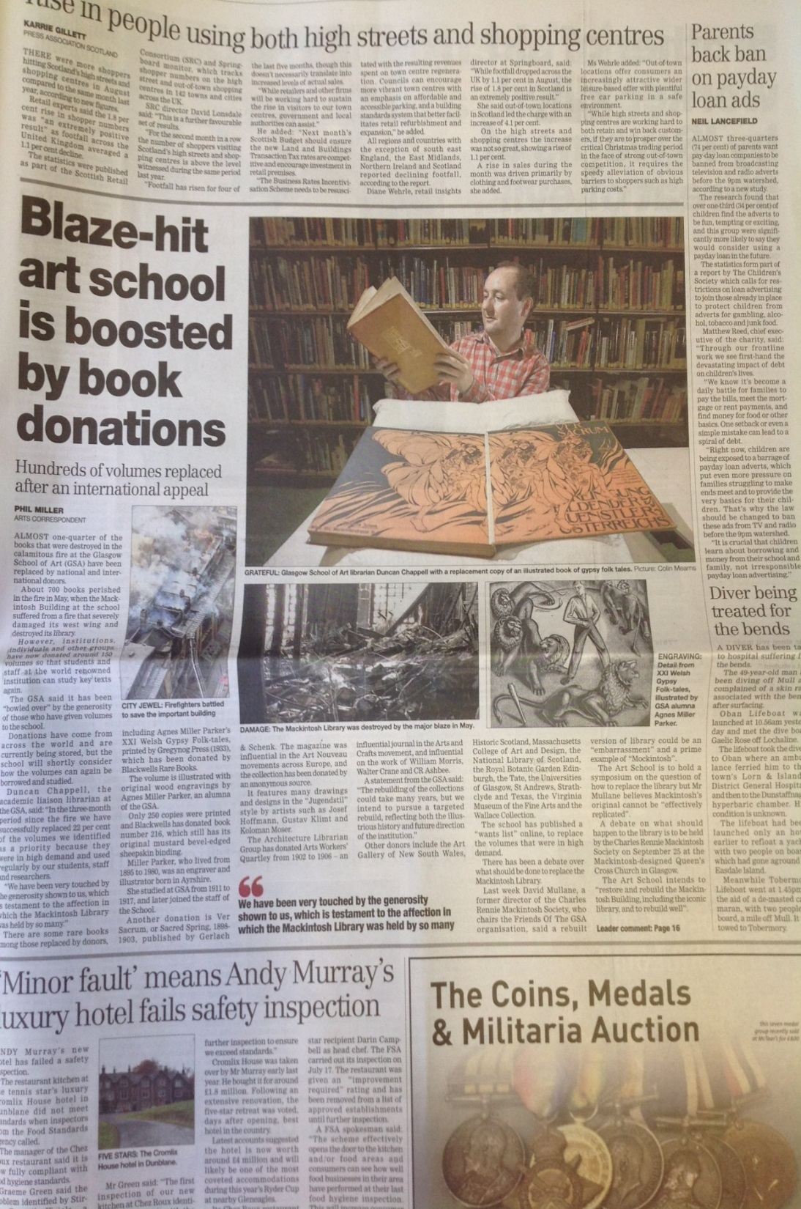
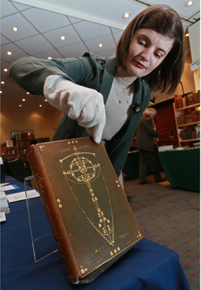
Notes:
We have also worked closely with our colleagues in the Press Office, to publicise our collections-rebuild campaign and to mark successful milestones
This article on the left appeared in The Herald on 15 September 2014 to celebrate our receiving 22% of our priority volumes in just 3 months
We’ve also enjoyed coverage in The Times BBC News, Telegraph, Design Week, and The Guardian
To the right is my then colleague Jennifer accepting a donation of a rare Glasgow Style binding by former GSA Head of Embroidery Ann Macbeth, kindly purchased on our behalf by the Antiquarian Booksellers’ Association
This, I hasten to add, was achieved at zero cost to the institution, and demonstrates I think what can be achieved through collaboration, outreach and sector engagement.

Slide 37
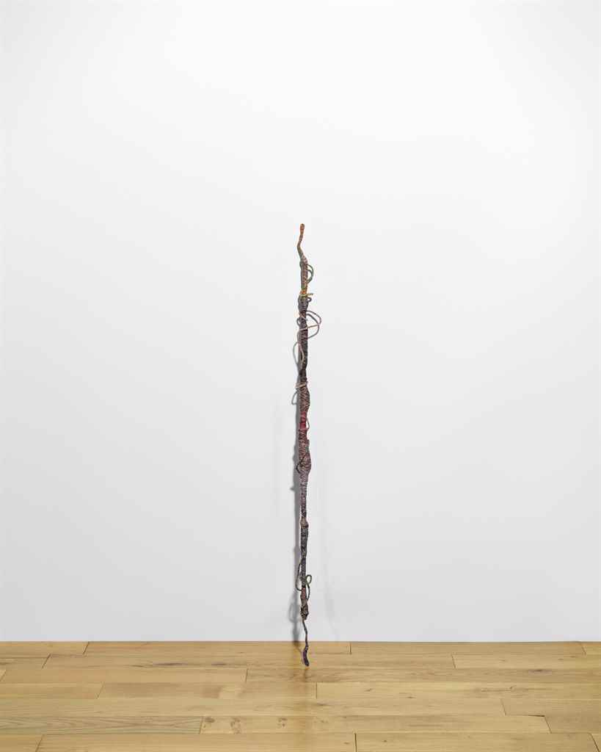
Notes:
As befits an art school, responses to the fire have been fearless, experimental and doggedly forward-looking
And we have delighted in facilitating many artistic responses to the fire
Jim Lambie’s Psychedelic Soul Stick #79 incorporates charcoal extracted from the Mackintosh Library’s burnt collections, including remnants of Muirhead Bone’s Fifty Drawings of Glasgow (1911) which poignantly includes etchings of the Mackintosh Library’s construction in 1909

Slide 38
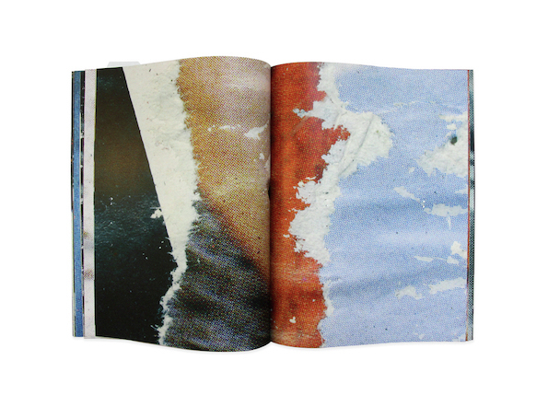
Notes:
The bookwork 51170 by Erin Scott and Kate Loudon references the original library accession number of a volume that was damaged by the fire and disposed of.
Its images are collected from a men's fashion magazine published in the 1970's, that was stored in the library's mezzanine. The pages had suffered from both fire and water damage.

Slide 39
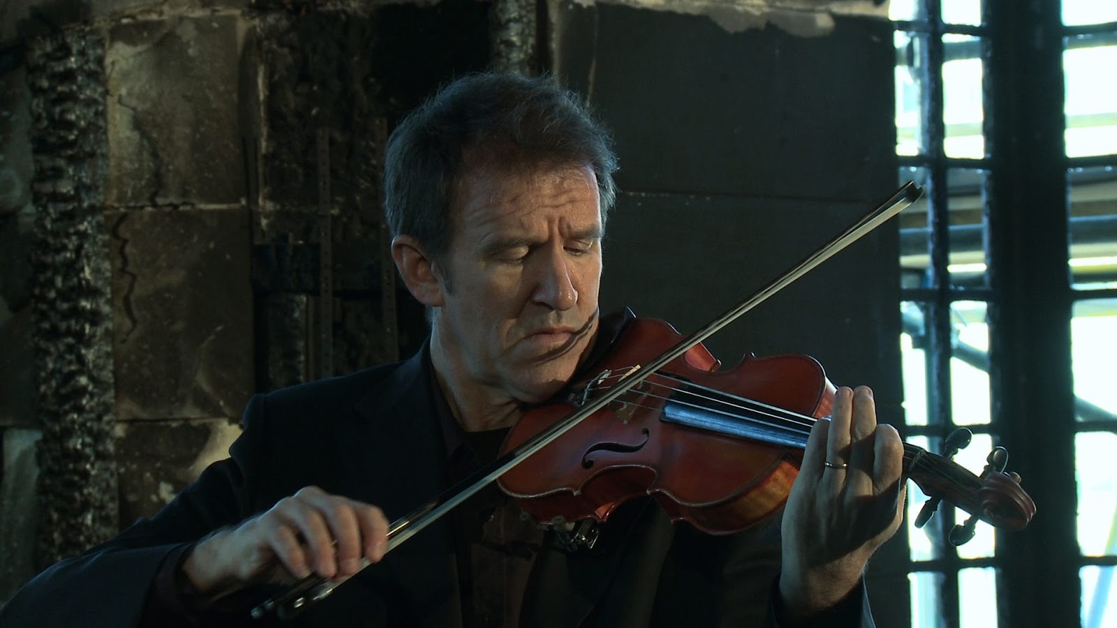
Notes:
In Ross Birrell’s A Beautiful Living Thing, a single musician sits within the shell of the damaged library and plays a specially written lament
Bill Chandler of the RSNO performed the score in late December 2014/early January 2015 inside the ruined library.
At that time, the fire’s debris was still in situ and this provided a unique temporary acoustic within the space
The film of the performance begins in silence in the first floor corridor in the west wing, and takes the viewer slowly into the library, revealing an unworldly landscape of burnt fittings and fixture as well as badly charred books and furniture.
Here the lament begins
Finally, the viewer is finally taken up to the loggia, and at this point the lament builds to a more hopeful tone, where views of the city are revealed in the last light of the day.

Slide 40
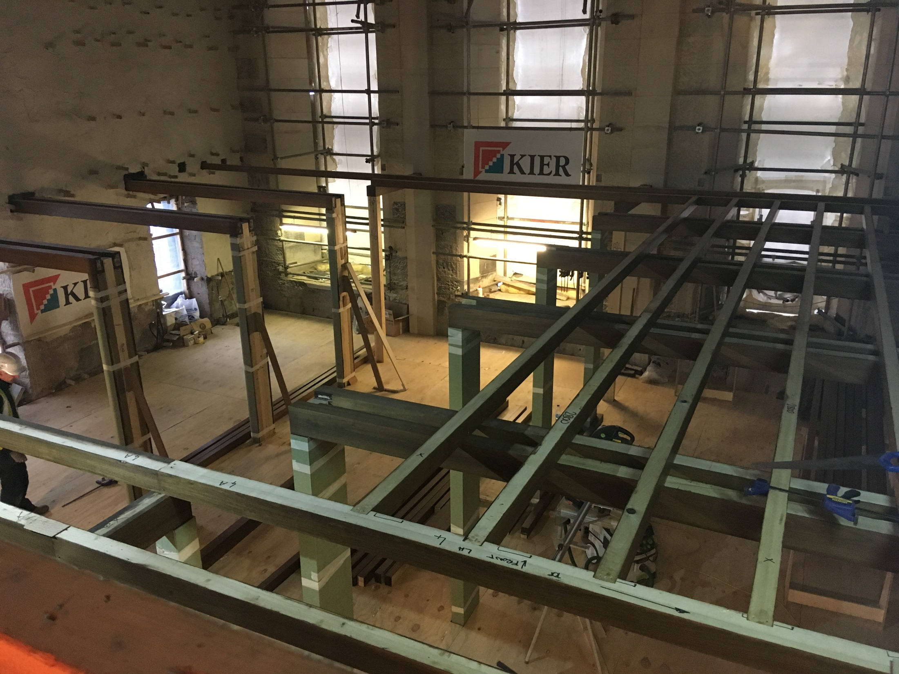
Notes:
Immediately after the fire there was wide public debate about the future of the Mackintosh building and its spaces
What is clear though is that the School committed very early to restoring the space to Mackintosh’s design as a working library
This has concerned the ethics of restoration, the relationship between the original and the replica, and the avoidance of a ‘Mockintosh’ aesthetic
The debates were lively and stimulating

Slide 41
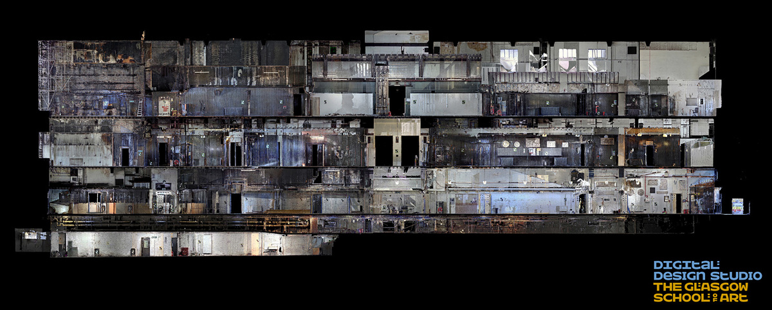
Notes:
The restoration of the building as whole, and the library in particular, is now fully in train
The process has been aided by full LIDAR scanning and digital modelling undertaken by our own in-house experts
This enables the restoration architects Page & Park to study the building’s construction in intricate detail
Much work has also been undertaken by our Mackintosh Research Fellow, Dr Robyne Calvert, into Mackintosh’s working methods, materials and aesthetics, using primary documents in the School’s archives and other repositories

Slide 42
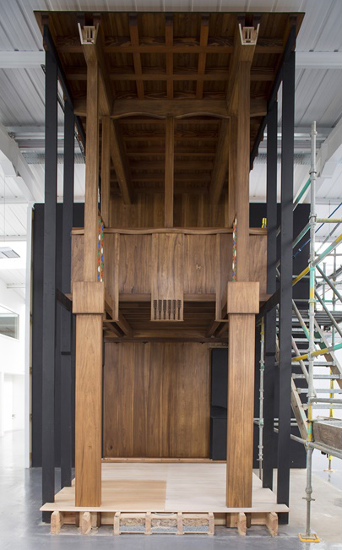
Notes:
The restoration ethos is to return the building as much as possible to how Mackintosh’s design would have appeared in 1909, without the modifications and over-paintings that had occurred across a century
Recently a life-size mock-up of one of the six library bays was unveiled by our woodworkers Laurence McIntosh of Edinburgh
This has enabled them to test out different materials and finishes
We now know for example that the wood used was tulipwood and that the 1909 colouration would have been significantly lighter than was latterly the case
For the painted scalloped balustrades multiple jigs were created until exactly the right finish was attained

Slide 43
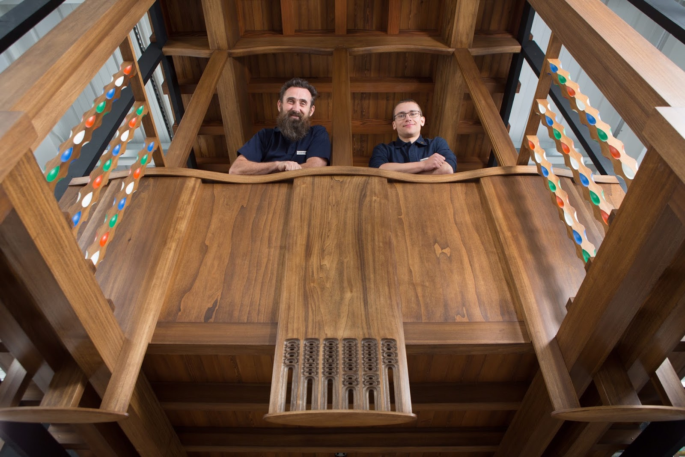
Notes:
Much of this process has require the rekindling of traditional skills that are now not as prevalent as in Mackintosh’s day
Mackintosh has his pick of skilled fitters, carpenters and joiners, mostly purloined from the nearby shipyards
Today we need to look much further for the skills we require
To the right stands Martins Cirulis from Latvia, who was the only person with the right skills to carved the wooden pendants you see below

Slide 44
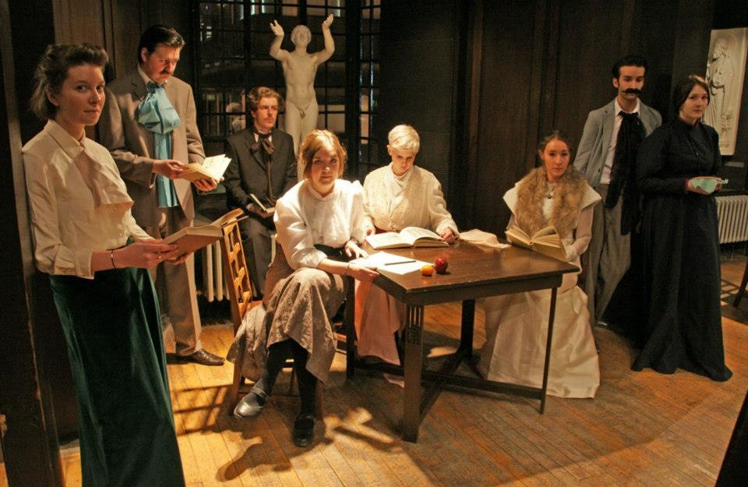
Notes:
Understanding anew the early history of the Mackintosh Library and its collections allow us, today, to reconceptualise the function of that space as we prepare for reoccupation in 2019
For the first time, all of the library’s special and rare collections will be relocated to this single space, where they will be significantly more visible and accessible to students and researchers
The former bookstore above the library will become a dedicated reading room, where students can request and view items from collections as diverse as artists’ books, 19th century design folios, and illustrated books
Central to the vision for the new library is that is acts as an incubator for new creative practice through exposure to exquisite and unusual collections

Slide 45
Duncan Chappell
Glasgow School of Art
d.chappell@gsa.ac.uk
https://lib.gsa.ac.uk/special-collections

