Slide 1
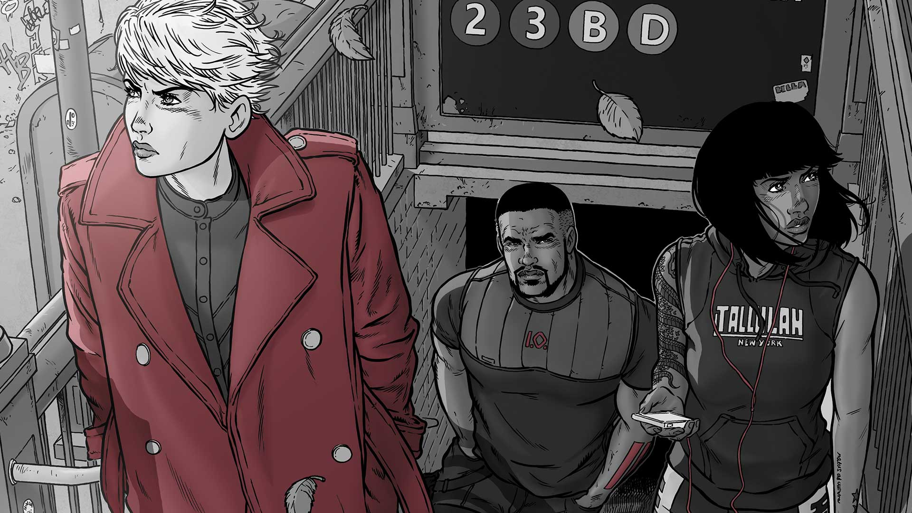
Perverting Suits: Superhero Costume in the WildStorm Comics of Warren Ellis Dr David Sweeney The Glasgow School of Art NeMLA 2018 d.sweeney@gsa.ac.uk

Slide 2
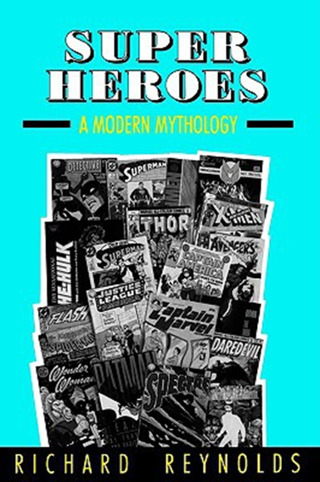
Superheroes: A Modern Mythology Richard Reynolds (1992)
‘’Costume functions as the crucial sign of super-heroism.’
‘The conventions of superhero costume constitute a system of langue and parole – to use the terms first introduced by Saussure. The langue (or language) is the structure of costume conventions, the rules that dictate the kind of costumes characters may wear. An individual costume is an example of parole – a specific utterance within this language of signs.’
‘The appearance of a costumed character in a story will generate a specific set of expectations – a state of affairs which the writer and artist can work with or against, but which cannot be left wholly out of account.’
(All quotations: p.26)

Slide 3
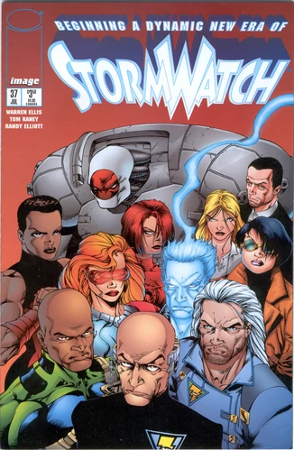
Ellis infiltrates Stormwatch
Note the three characters circled
L-R: Jenny Sparks, Jack Hawksmoor; Swift aka Shen Li-Min..
Stormwatch #37, written by Warren Ellis, Cover art by Tom Raney & Randy Elliott
Published by Image Comics, of which WildStorm was an imprint
WildStorm was founded by Jim Lee (1992)

Slide 4
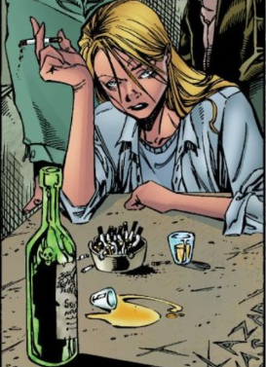
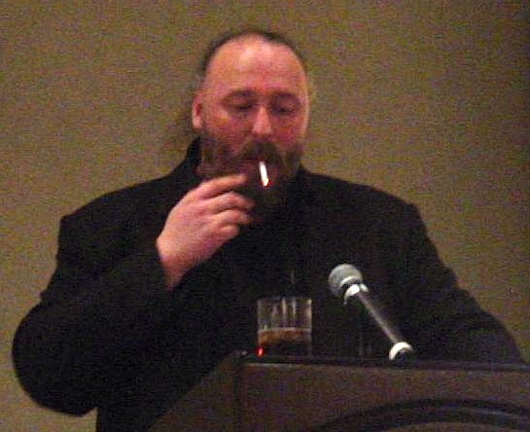
Ellis’s Avatar: Jenny Sparks
L: Jenny Sparks (b. London, 1900); R: Warren Ellis (b. Essex, 1968)
Ellis created Jenny for Stormwatch

Slide 5
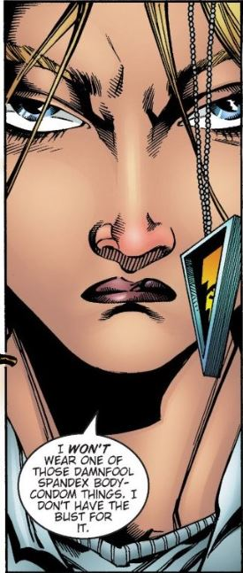
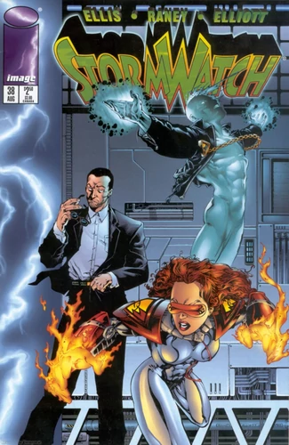
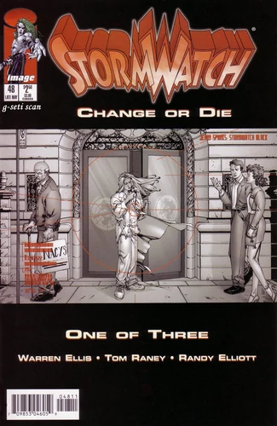
Statements of Intent
“I won't wear one of those damnfool spandex body-condom things. I don't have the bust for it.”
Jenny Sparks in her debut appearance, Stormwatch #37, (July, 1996)
Stormwatch # 38 (August, 1996)
Cover art by Tom Raney & Randy Elliott
Note cover presence of Jack Hawksmoor, who also debuted in #37 and was created by Ellis
Stormwatch #48 (May, 1997)
Cover art by Tom Raney and Randy Elliott.
Note cover presence of Jenny Sparks and title, ‘Change or Die’ circled.

Slide 6
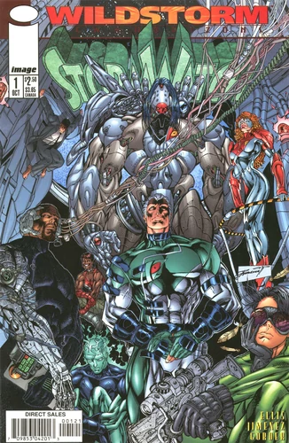
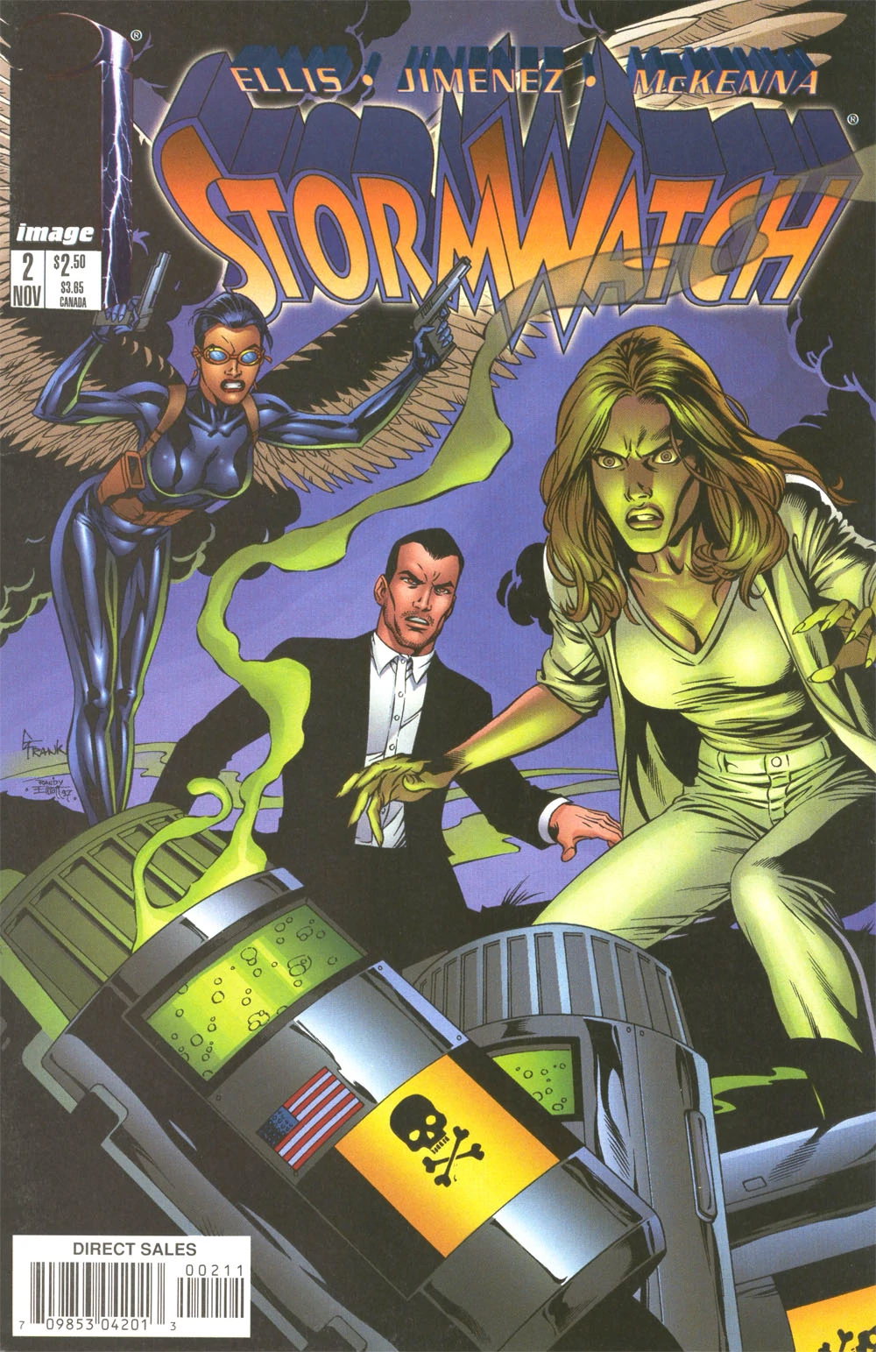
Stormwatch Vol. 2
Stormwatch Vol 2, #1
(October, 1997)
Cover art by Richard Bennett & Travis Charest
Note absence of Jenny Sparks.
Stormwatch Vol 2, #2
(November, 1997)
Art by Oscar Jimenez
Note Swift, circled.
Swift was not created by Warren Ellis.
Jenny, Jack and Swift form a covert team called Stormwatch Black.
Note Jenny’s resemblance to Gillian Anderson of The X-Files here.

Slide 7
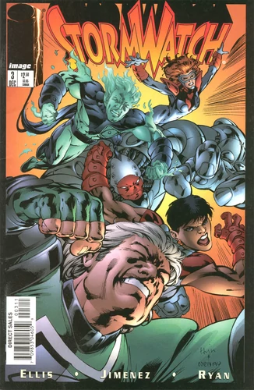
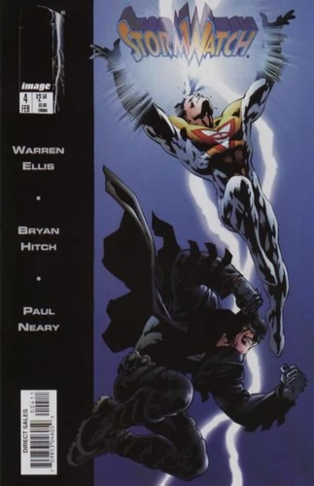
Stormwatch Vol. 2
Stormwatch Vol 2, #3
(January, 1998)
Cover art by Gary Frank & Randy Elliott
Stormwatch Vol 2, #4
(February, 1998)
Cover art by Bryan Hitch & Paul Neary
Hitch & Neary also did the interior art.
This issue is the debut of Apollo and The Midnighter, shown, both co-created by Ellis & Hitch.

Slide 8
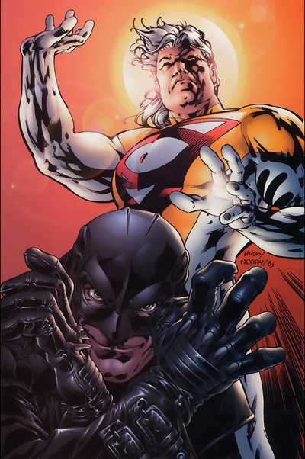
Apollo & The Midnighter
Appear in Stormwatch ## 4-6 but do not join the team
The duo are analogues of Superman and Batman respectively
‘The discourse implicit in superhero comics is far from being an arbitrary set of conventions’ (Reynolds, p.26)
‘Costume creates a community between its wearers’ (Reynolds, p.37)
And with readers. We recognise Apollo and Midnighter for who/what they represent.

Slide 9
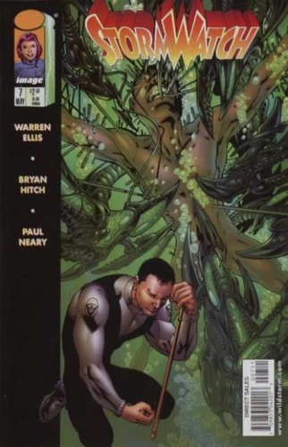
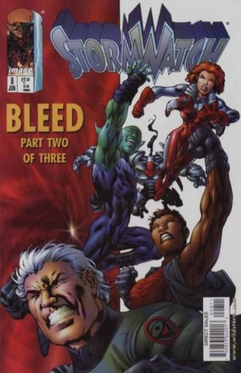
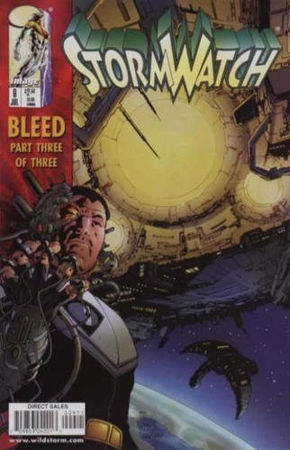
Stormwatch Vol. 2
Stormwatch Vol 2, # 7
(May, 1998)
Cover art by Bryan Hitch and Paul Neary
Beginning of the story-arc ‘Bleed’ set in a parallel universe. Cover shows this universe’s version of Jack Hawksoor who is undergoing surgery to no longer be a superhero, just as Ellis is ‘operating’ on Stormwatch to make it a science fiction comic.
Stormwatch Vol 2, #8 (June, 1998)
Shows members of the team who pre-date Ellis’s run on the book.
Stormwatch Vol 2, #9 (July, 1998)
Show only a cyber-enhanced parallel universe Jack Hawksmoor.

Slide 10
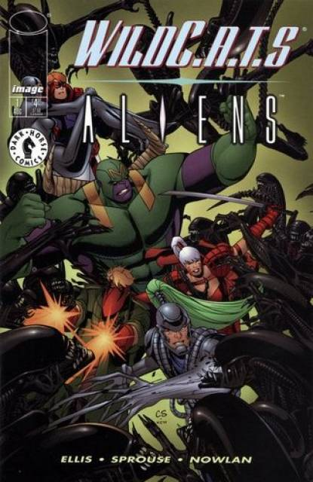
WildC.A.T.S/Aliens
WildC.A.T.S/Aliens (August, 1998)
Written by Ellis, co-published by Image and Dark Horse Comics
A one-shot crossover with the Aliens franchise
Stormwatch also feature
Most of them are killed, but Jenny Sparks and Jack Hawksmoor survive, as does Swift.

Slide 11
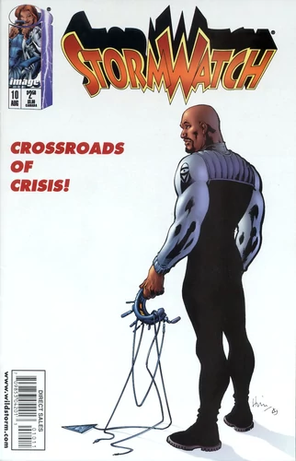
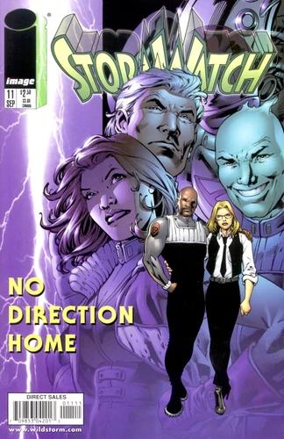
Stormwatch Vol. 2
Stormwatch Vol 2, # 10
(August, 1998)
Cover art by Bryan Hitch and Paul Neary
Shows only Jackson King aka Battalion, who was not created by Ellis.
The parallel universe version of Hawksmoor performed an equivalent role to King as ‘Weatherman’ of Stormwatch in the main WildStorm Universe.
Stormwatch Vol 2, #11 (September, 1998)
Cover art by Bryan Hitch and Paul Neary.
None of these characters were created by Ellis. All the characters in the background are dead.
This is the final issue of Stormwatch published by WildStorm.
Although not created by Ellis the two in the foreground survive and feature as minor characters in his next project.

Slide 12
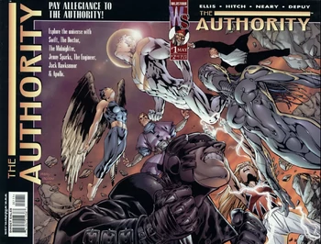
The Authority
The Authority #1 (May, 1999) written by Ellis, art by Bryan Hitch & Paul Neary
A new superteam born out of Stormwatch created by Ellis & Hitch
Members are Jenny Sparks, Jack Hawksmoor, Swift, Apollo, The Midnighter, The Engineer and the Doctor
All created by Ellis & Hitch except Swift

Slide 13
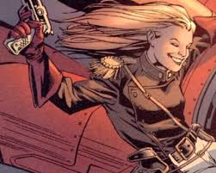
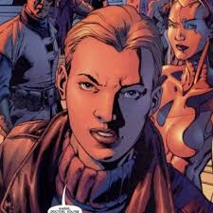
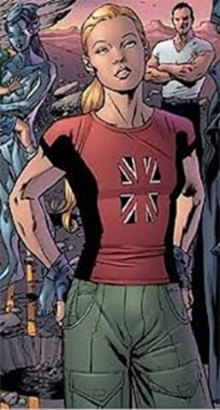
Colonel Jennifer Sparks of the British Space Group
We learn about Jenny’s military past which is represented sartorially in her occasional wearing of fatigues rather than her white suit.

Slide 14
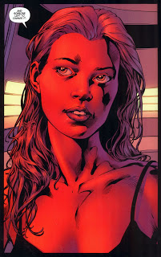

Brit Jenny
Jenny regularly wore a Union Jack T-shirt and Hitch often used British supermodel and Britpop icon Kate Moss as the model for her.

Slide 15
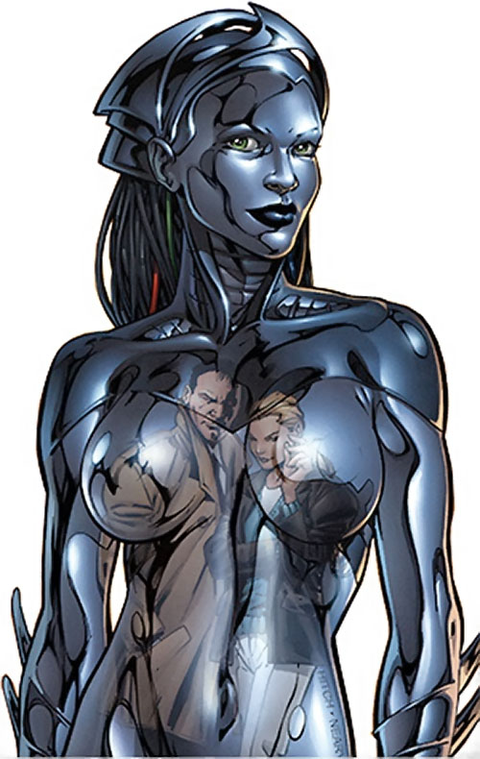
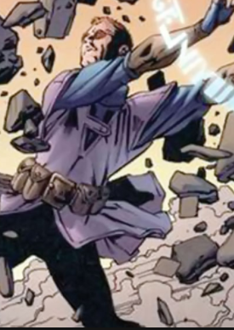
The Engineer and The Doctor

Slide 16
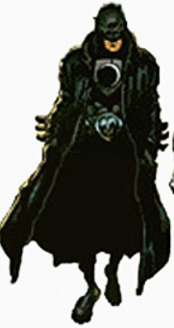
The Midnighter
Although The Midnighter does resemble a traditional superhero – specifically Batman – all of his outfit could easily be purchased in real life
“If a guy walked into a pub dressed like Batman you’d p*ss yourself. But if a guy walked in dressed like Midnighter you’d sh*t yourself”
Mark Millar, writer on The Authority after Ellis left in 2000 (personal interview, August 8th, 2000)

Slide 17
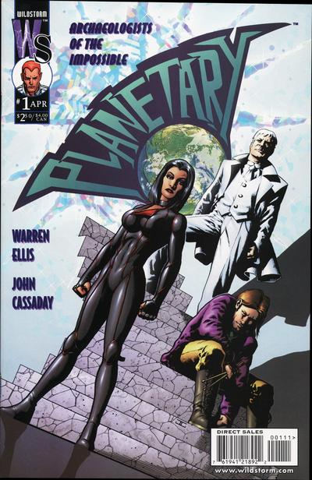
Planetary
Planetary #1 (April, 1999) an entirely new team created by Ellis and artist John Cassady
Sister title to The Authority
Members are L-R: Jakita Wagner, Elijah Snow, The Drummer
All have powers, but of the three Jakita most resembles a traditional superhero
‘Planetary shows comic book history as a battle with an earlier version of itself –pulp novel characters struggling with the golden age superheroes, silver age heroes killing off golden age icons.’
How to Read Superhero Comics and Why
Geoff Klock (2002)
P.154

Slide 18
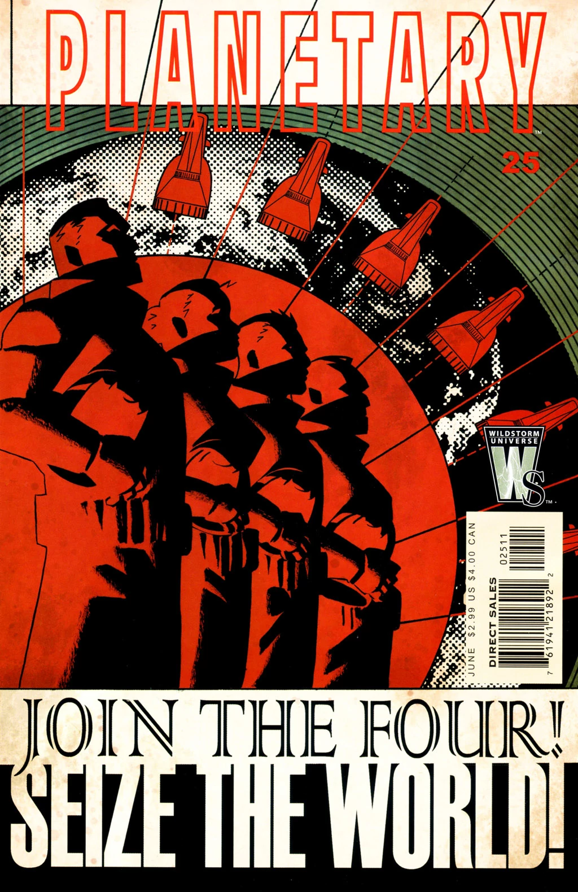
Antagonism/The Agon
‘Planetary culminates this lineage and places the revisionary superhero narrative in its proper context, with an antagonism between the four man Planetary team and their most present imaginative debt: the royalty of the Silver Age, the Fantastic Four.’
(p.154)
Klock is influenced by Harold Bloom’s concept of the agon.
Planetary #25 (June, 2006)
Cover art by John Cassady and Laura Martin
Planetary’s arch enemies, the Four, are based on the Fantastic Four, who were part of the US space programme, which incorporated Nazi scientists like Wernher von Braun. Consequently, Ellis imagines the Four as fascists.

Slide 19
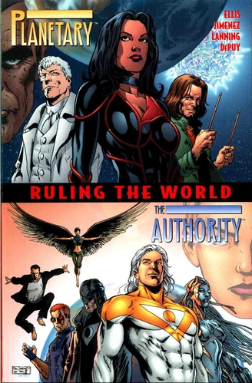
Planetary/The Authority: Ruling The World (June, 2000)

Slide 20
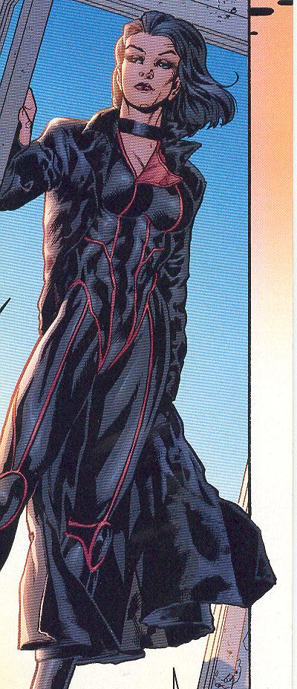
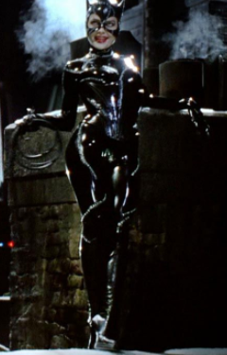
Jakita Wagner
Reynolds makes reference to the 'fetishism implicit in the design of most superhero costumes’ (p.30).
If Wonder Woman was conceived as ‘a frank appeal to male fantasies of sexual domination’ as Reynolds puts it (p.34) then Jakita, in her dominatrix leather, appeals to masochistic fantasies
Her costume recalls Michelle Pfeiffer’s Catwoman in Batman (Tim Burton, 1992) as well as that of The Midnighter

Slide 21
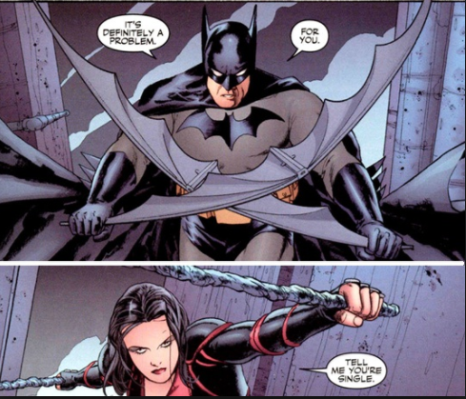
Planetary/Batman: Night on Earth (August, 2003)

Slide 22
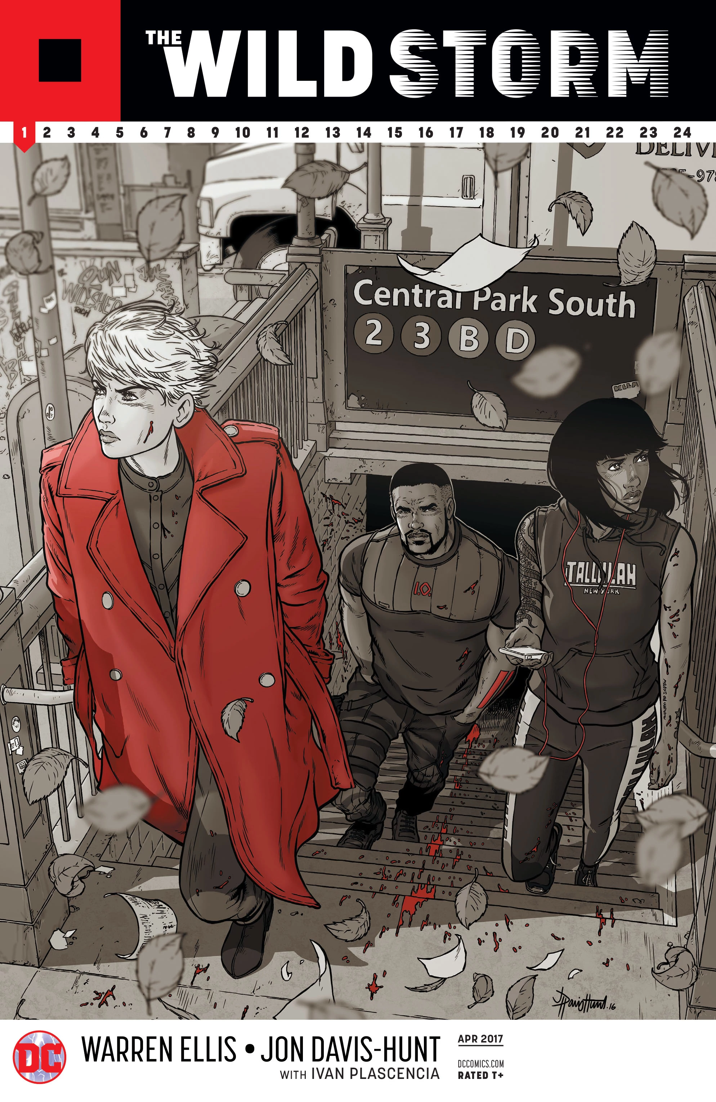
The Wild Storm (2016 - )
A complete re-imagining of the WildStorm Universe.
Ellis describes it as “an alternative-reality story on a parallel earth”.
One of the main influences is Game of Thrones but “instead of house sigils we have mission patches, corporate logos and mystery symbols “.
The cover to the first issue (April, 2017) shows new iterations of the characters (L-R) Zealot, Deathblow and Voodoo.
Zealot and Voodoo were members of WildC.A.T.S; Deathblow was the WildStorm Universe’s equivalent of The Punisher
In the series Zealot is the character’s code name; Voodoo is a stage name; Deathblow is not used at all so far.

Slide 23
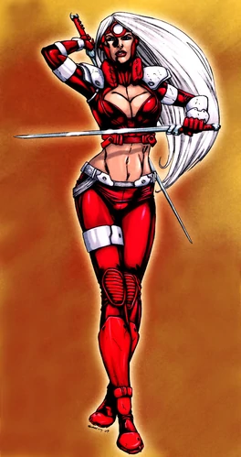
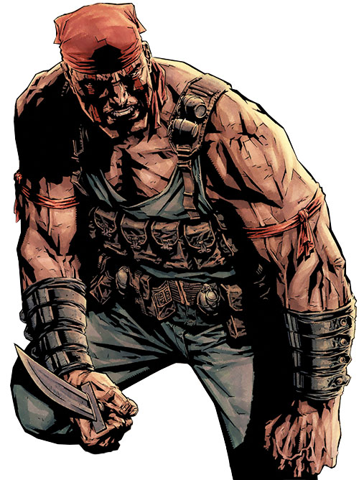
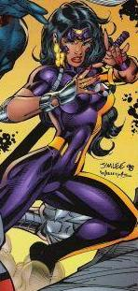
The Original Versions
L-R: Zealot; Deathblow; Voodoo

Slide 24
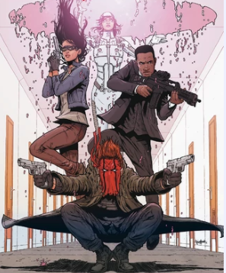
The Wild C.A.T
Clockwise from left: Kenesha; Adrianna Tereshkova; John Colt, Cole Cash

Slide 25
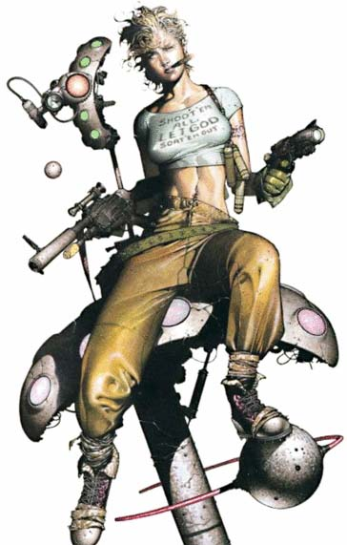
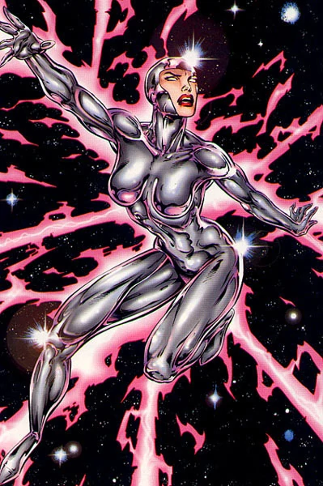
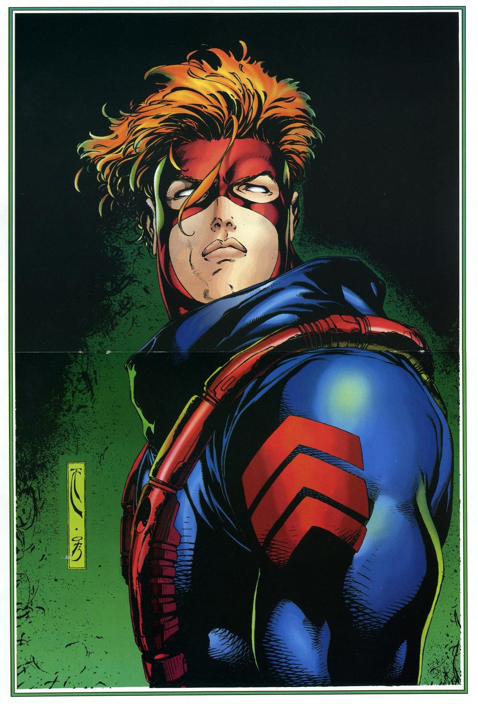
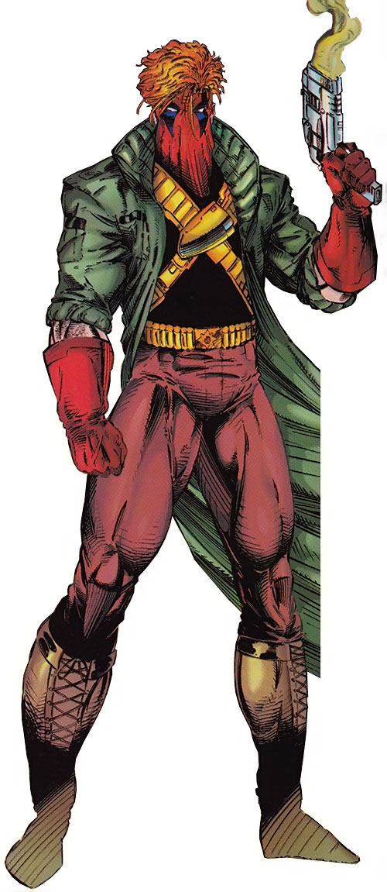
The Original Versions
L-R: Savant; Void Spartan; Grifter

Slide 26
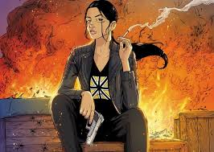
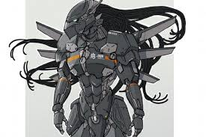
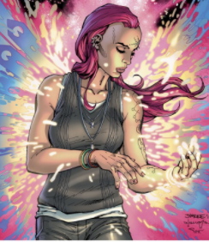
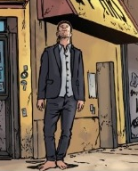
Characters from The Authority
Clockwise from top left:
Jenny Mei Sparks; Angela Spica (The Engineer); “The Mayor” (Jack Hawksmoor); Shin Lei-Men (a fusion of The Doctor and Swift)

Slide 27
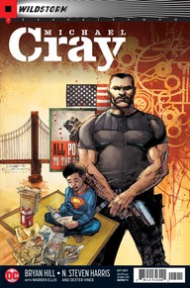
Michael Cray (2017 -)
The first spin-off from The Wild Storm not only has a character in fatigues on its cover it also has his given name as the title.

Slide 28
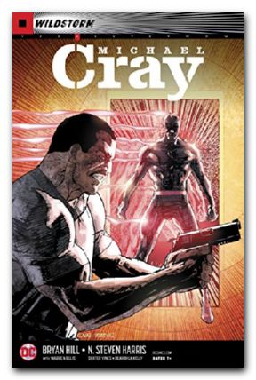
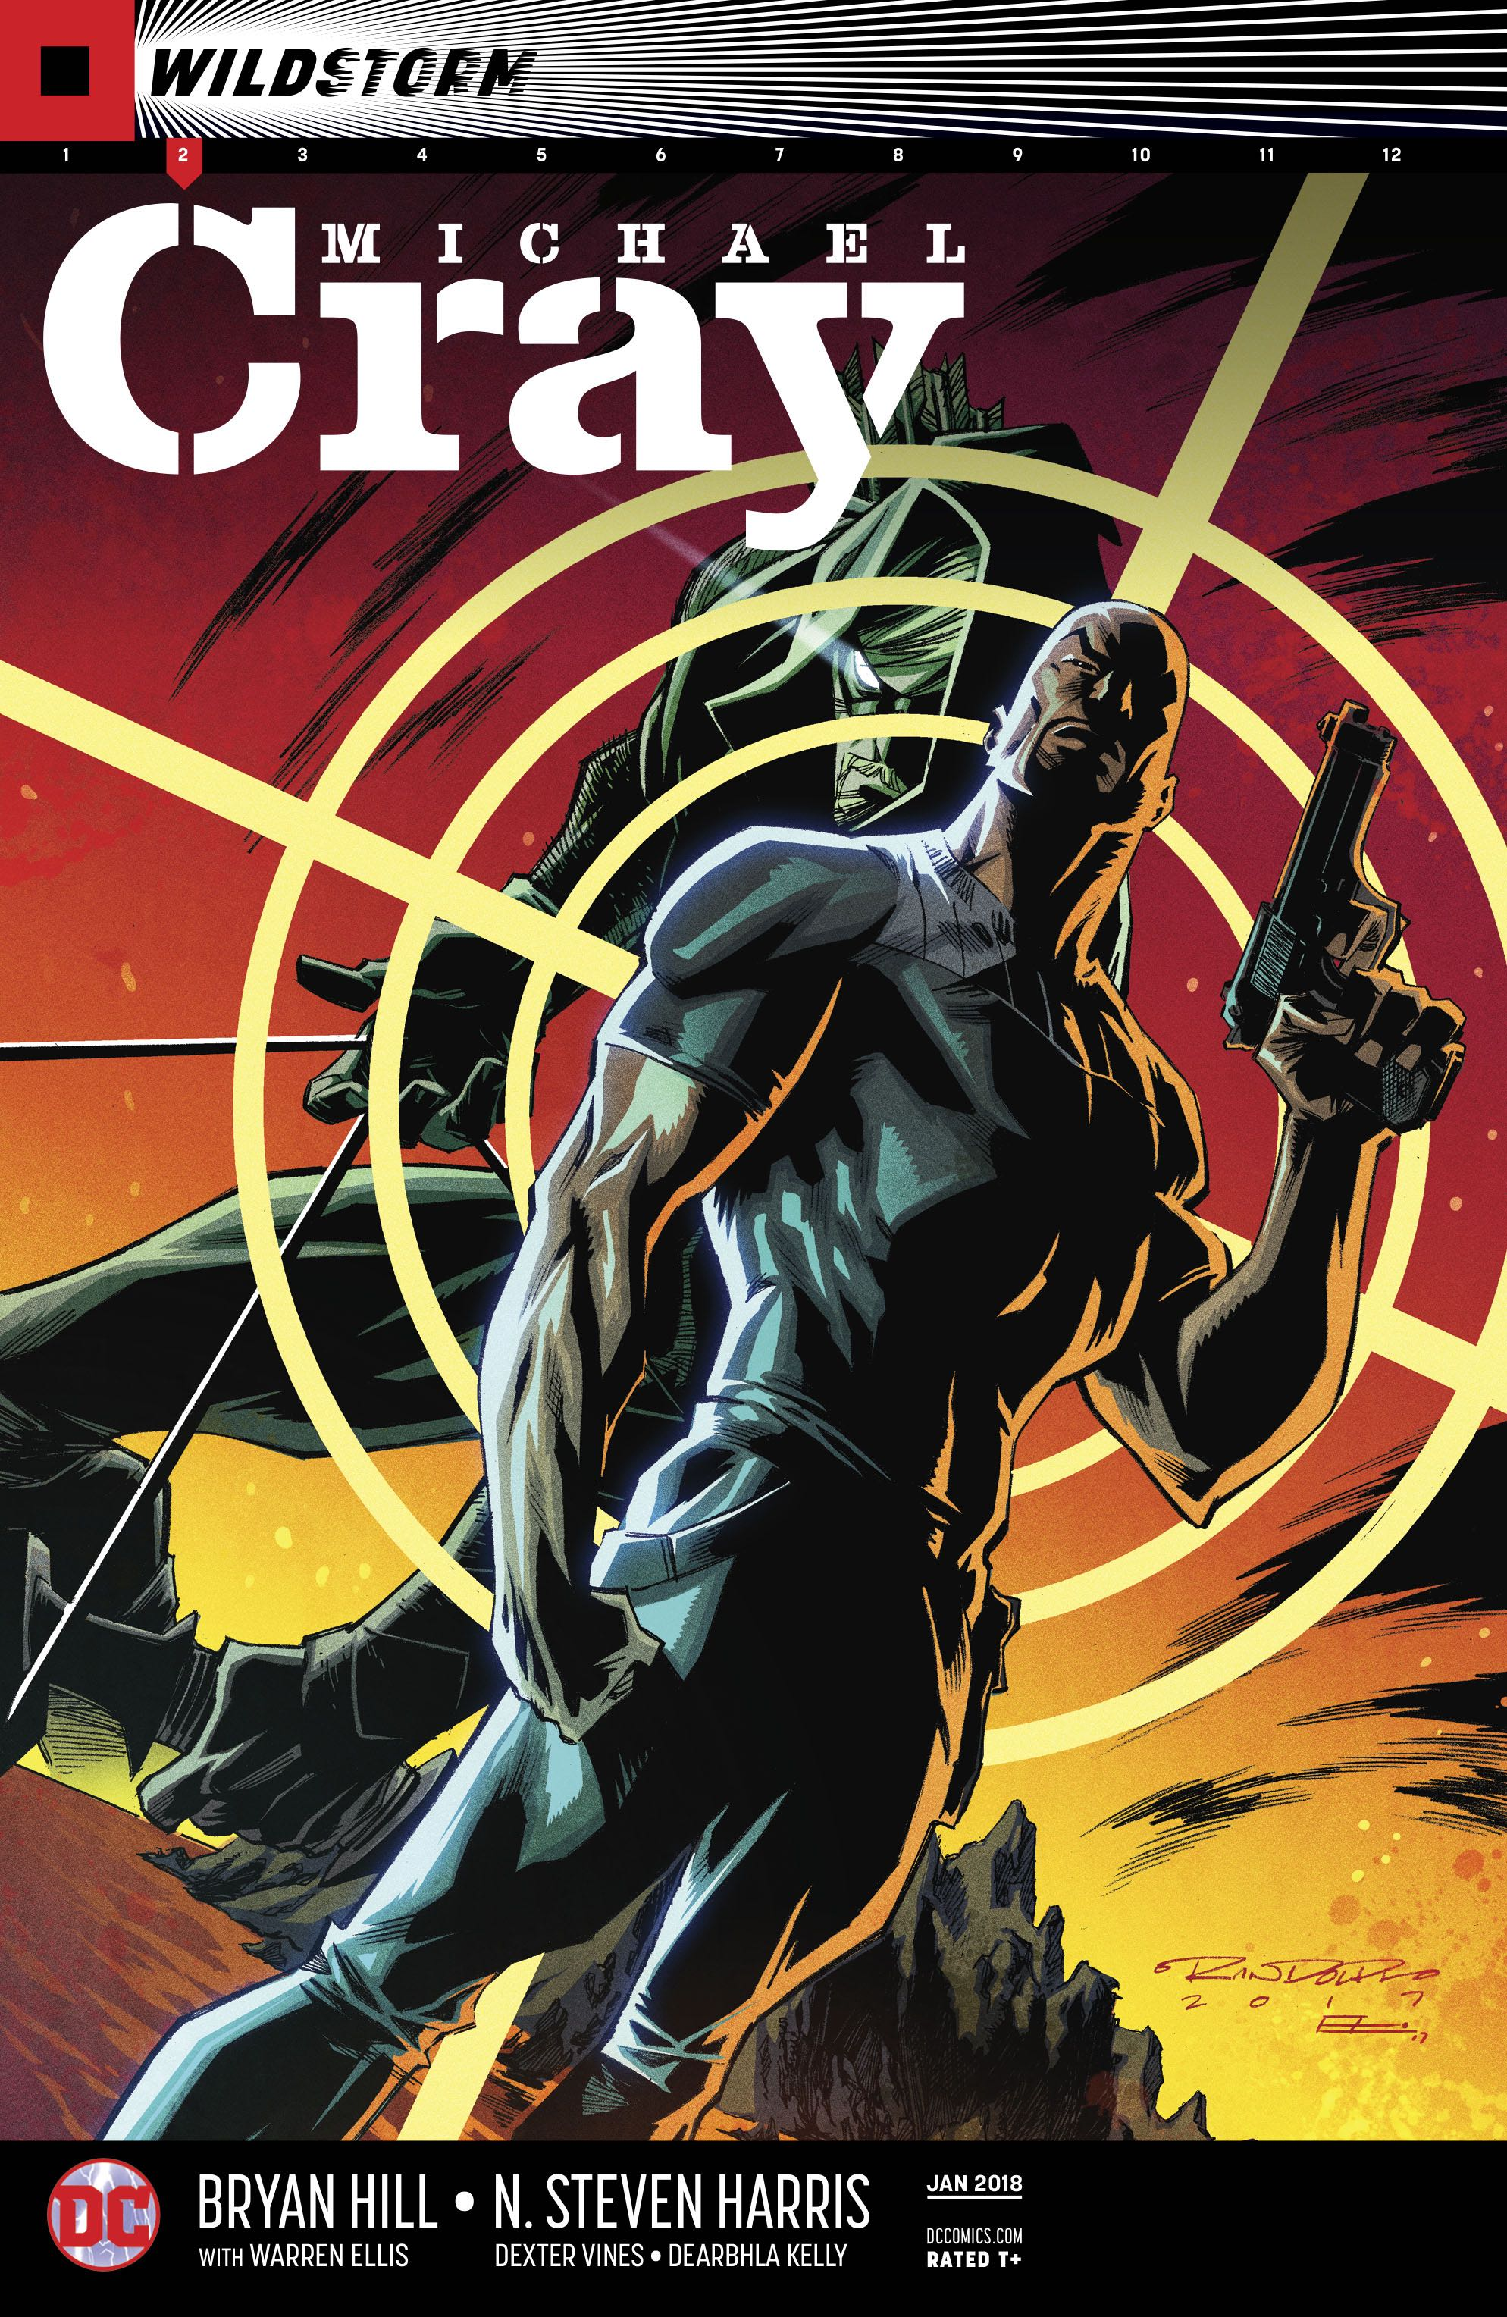
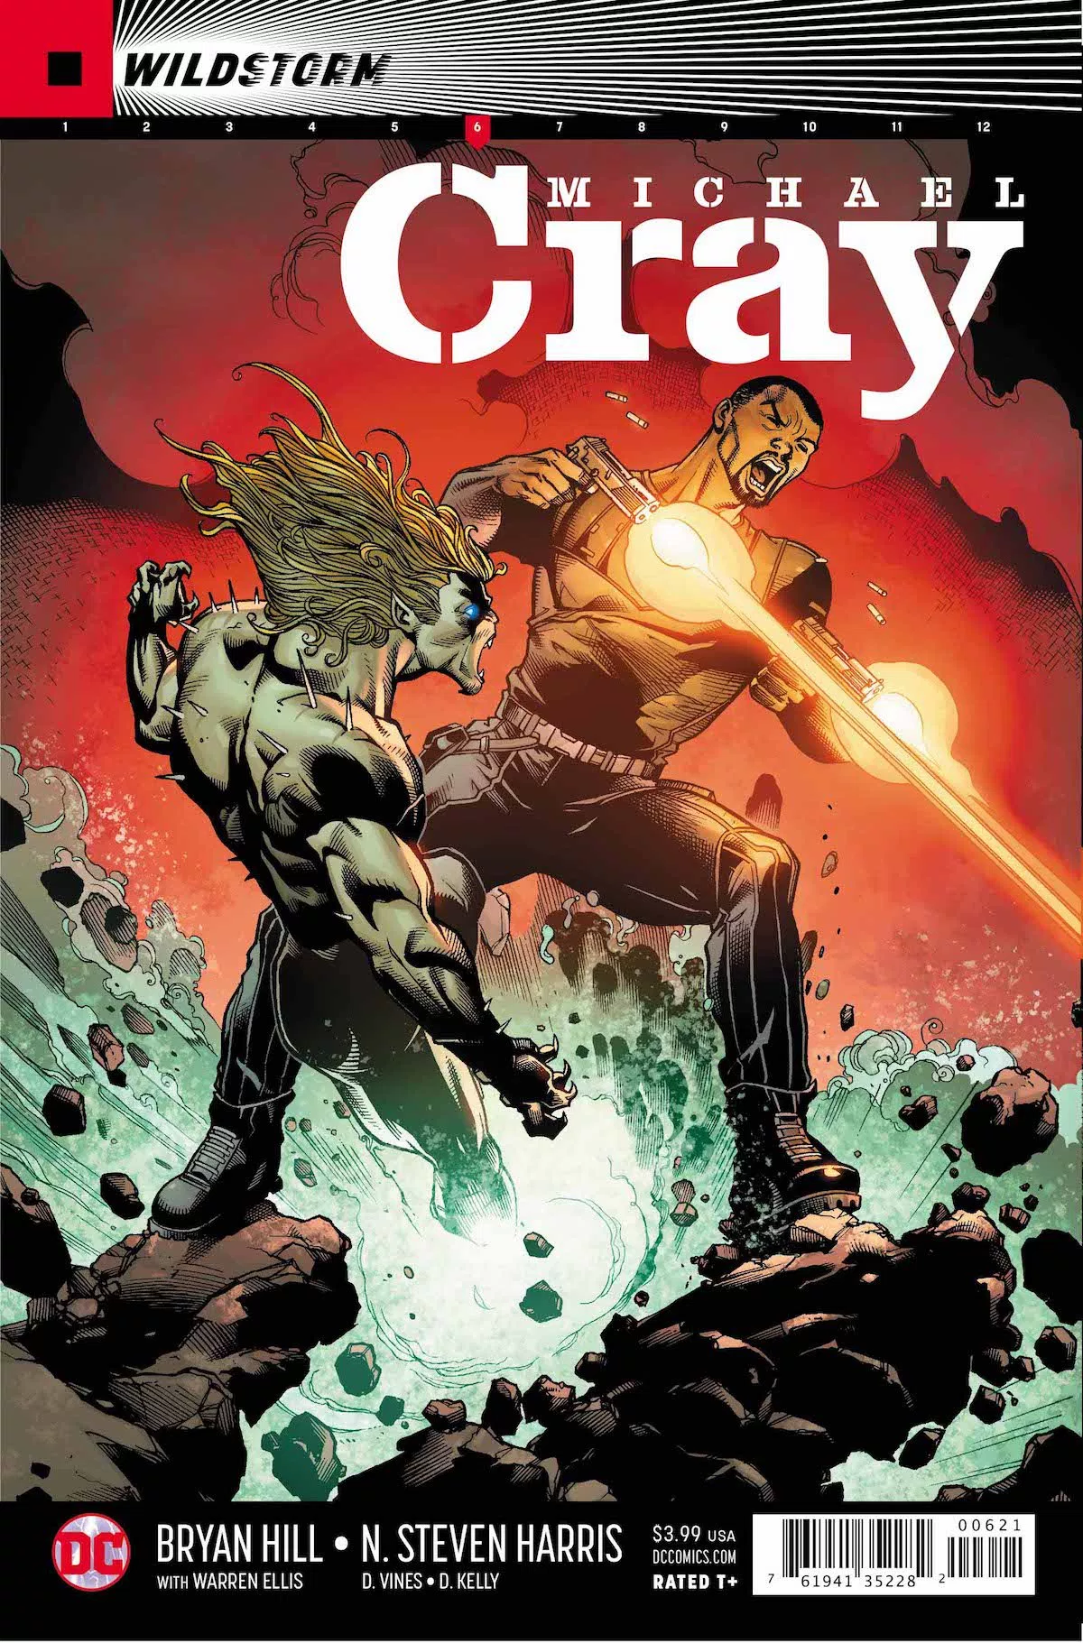
Michael Cray Kills the DC Universe

Slide 29
Conclusion
Ellis doesn’t just want to refashion the superhero.
He wants to destroy it.
d.sweeney@gsa.ac.uk

